Slide 1
Λ14 Διαδικτυακά Κοινωνικά Δίκτυα και Μέσα
Positive and Negative Relationships
Chapter 5, from D. Easley and J. Kleinberg book

Slide 2
Structural Balance
What about negative edges?
Initially, a complete graph (or clique): every edge either + or -
  Let us first look at individual triangles
  Lets look at 3 people => 4 Cases
  See if all are equally possible (local property)

Slide 3
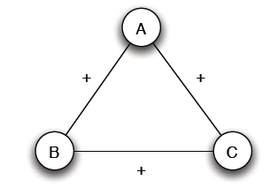
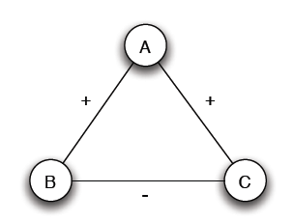
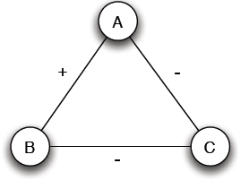
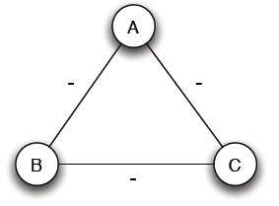
Structural Balance
Case (a): 3 +
Case (b): 2 +, 1 -
Mutual friends
A is friend with B and C, but B and C do not get well together
Case (c): 1 +, 2 -
Case (d): 3 -
Mutual enemies
A and B are friends with a mutual enemy

Slide 4
Structural Balance
Case (a): 3 +
Case (b): 2 +, 1 -
Stable or balanced
Unstable
Mutual friends
A is friend with B and C, but B and C do not get well together
Implicit force to make B and C friends (- => +) or turn one of the + to -
Case (c): 1 +, 2 -
Case (d): 3 -
Stable or balanced
Unstable
Mutual enemies
Forces to team up against the third (turn 1 – to +)
A and B are friends with a mutual enemy

Slide 5
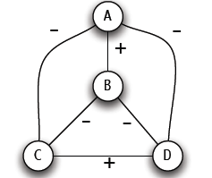
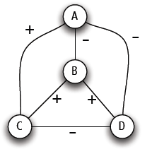
Structural Balance
  Let us now define structural balance for the network
A labeled complete graph is balanced if every one of its triangles is balanced
Structural Balance Property: For every set of three nodes, if we consider the three edges connecting them, either all three of these are labeled +, or else exactly one of them is labeled -

Slide 6
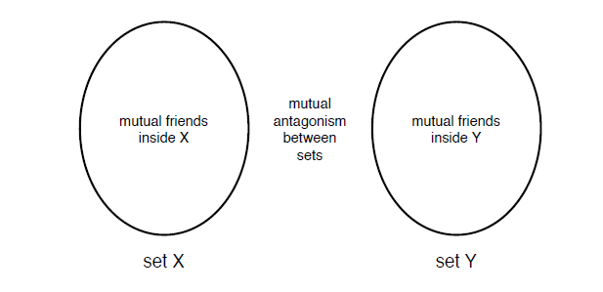
The Structure of Balanced Networks
What does a balanced network look like?
Is this balanced?

Slide 7
The Structure of Balanced Networks
Balance Theorem: If a labeled complete graph is balanced,
all pairs of nodes are friends or,
the nodes can be divided into two groups X and Y, such that every pair of nodes in X like each other, every pair of nodes in Y like each other, and every one in X is the enemy of every one in Y.
Proof ...

Slide 8
Applications of Structural Balance
International relationships (I)
The conflict of Bangladesh’s separation from Pakistan in 1972 (1)
₋
USSR
N. Vietnam
USA
Pakistan
-
-
-
₊
Bangladesh
China
-
India
USA support to Pakistan?
China?

Slide 9
Applications of Structural Balance
International relationships (I)
The conflict of Bangladesh’s separation from Pakistan in 1972 (II)
₊
₋
USSR
N. Vietnam
USA
Pakistan
-
-
₊
-
Bangladesh
China
-
India
USA support to Pakistan?
China?

Slide 10
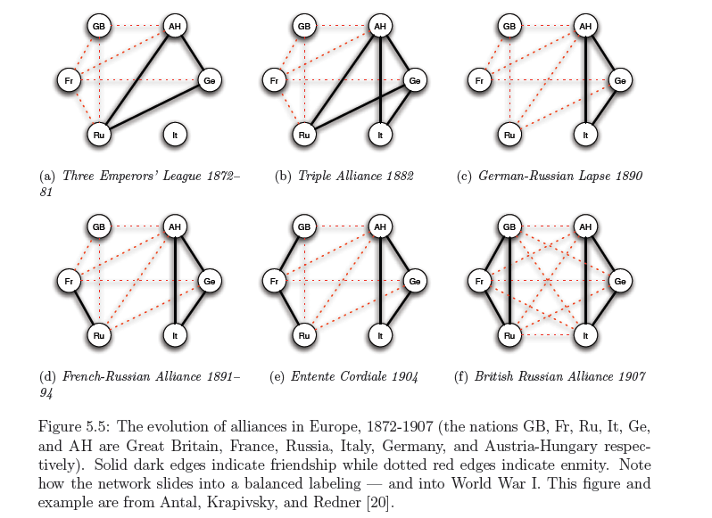
Applications of Structural Balance
International relationships (II)

Slide 11
Applications of Structural Balance
Trust, Distrust and Online Rating
Evaluation of products and trust/distrust of other users
Directed Graphs
A
A
C
C
+
-
+
-
B
B
A trusts B, B trusts C, A ? C
A distrusts B, B distrusts C, A ? C
If distrust enemy relation, +
A distrusts means A is better than B, -
Depends on the application
Rating political books or
Consumer electronics products

Slide 12
A Weaker Form of Structural Balance
Allow this
Weak Structural Balance Property: There is no set of three nodes such that the edges among them consist of exactly two positive edges and one negative edge

Slide 13
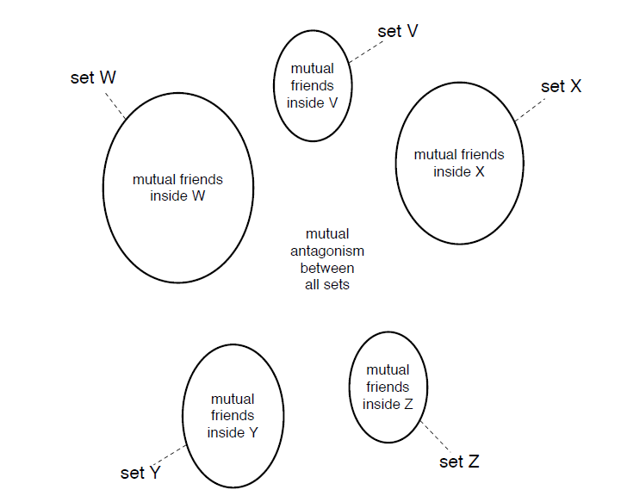
A Weaker Form of Structural Balance
Weakly Balance Theorem: If a labeled complete graph is weakly balanced, its nodes can be divided into groups in such a way that every two nodes belonging to the same group are friends, and every two nodes belonging to different groups are enemies
Proof …

Slide 14
A Weaker Form of Structural Balance
Two enemies of A can be either friends or enemies of each other

Slide 15
Generalizing
Non-complete graphs
Instead of all triangles, “most” triangles, approximately divide the graph
We shall use the original (“non-weak” definition of structural balance)

Slide 16
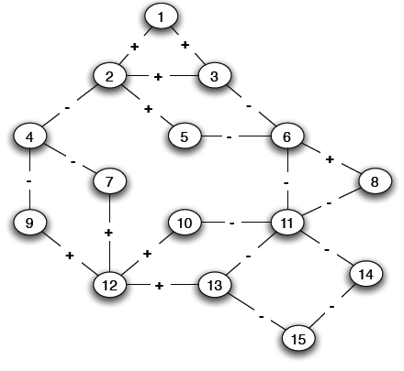
Structural Balance in Arbitrary Graphs
Positive edge
Negative edge
Absence of an edge

Slide 17
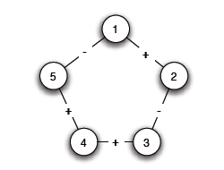
Balance Definition for General Graphs
Based on triangles (local view)
Division of the network (global view)
A (non-complete) graph is balanced if it can be completed by adding edges to form a signed complete graph that is balanced
-
+

Slide 18
Balance Definition for General Graphs
+

Slide 19
Balance Definition for General Graphs
Based on triangles (local view)
Division of the network (global view)
A (non-complete) graph is balanced if it possible to divide the nodes into two sets X and Y, such that any edge with both ends inside X or both ends inside Y is positive and any edge with one end in X and one end in Y is negative
The two definition are equivalent:
An arbitrary signed graph is balanced under the first definition, if and only if, it is balanced under the second definitions

Slide 20
Balance Definition for General Graphs
Algorithm?

Slide 21
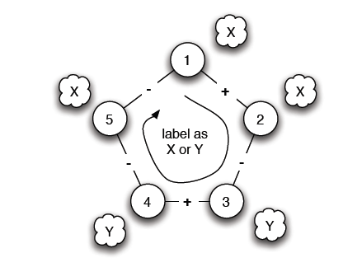
Balance Characterization
Start from a node (1) and place nodes in X or Y
Every time we cross a negative edge, change the set
Cycle with odd number of negative edges

Slide 22
Balance Definition for General Graphs
Is there such a cycle?

Slide 23
Balance Characterization
Claim: A signed graph is balanced, if and only if, it contains no cycles with an odd number of negative edges
(proof by construction)
Find a balanced division: partition into sets X and Y, all edges in X and Y positive, crossing edges negative
Either succeeds or Stops with a cycle containing an odd number of -
Two steps:
Convert the graph into a reduced one with only negative edges
Solve the problem in the reduced graph

Slide 24
Balance Characterization
Step 1:
1. Find connected components by considering only positive edges, called supernodes
2. Supernodes contain a negative edge between any pair:
          yes, odd cycle (1 negative)
          no, each supernode either X or Y
3. Reduced problem: a node for each supernode, an edge between two supernodes if an edge in the original

Slide 25
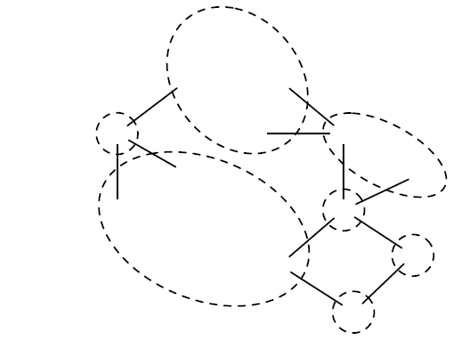
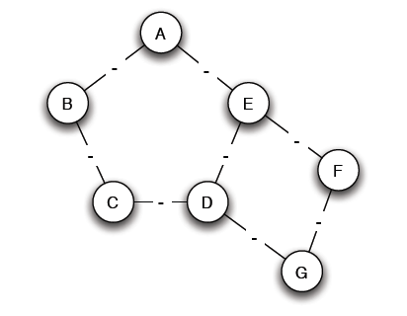
Balance Characterization

Slide 26
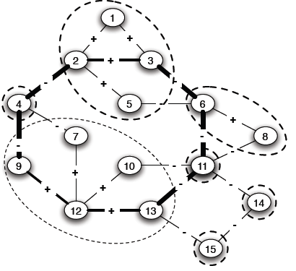
Balance Characterization
Step 2:
Note: Only negative edges among supernodes
Start labeling by either X and Y
If successful, then label the nodes of the supernode correspondingly
A cycle with an odd number, corresponds to a (possibly larger) odd cycle in the original

Slide 27
Balance Characterization
Step 2:
Determining whether the graph is bipartite
Use Breadth-First-Search (BFS)
Start the search at any node and give alternating labels to the vertices visited during the search. That is, give label X to the starting node, Y to all its neighbors, X to those neighbors' neighbors, and so on.
If at any step a node has (visited) neighbors with the same label as itself, then the graph is not bipartite (cross-level edge)
If the search ends without such a situation occurring, then the graph is bipartite.
Why is this an “odd” cycle?

Slide 28
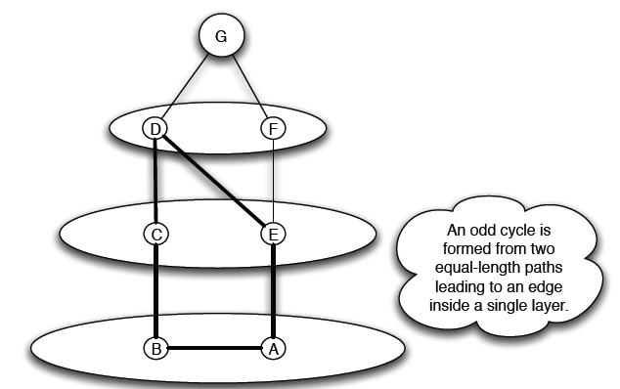
Balance Characterization

Slide 29
Generalizing
Non-complete graphs
Instead of all triangles, “most” triangles, approximately divide the graph

Slide 30
Approximately Balance Networks
a complete graph (or clique): every edge either + or -
Claim: If all triangles in a labeled complete graph are balanced, than either
all pairs of nodes are friends or,
the nodes can be divided into two groups X and Y, such that
  every pair of nodes in X like each other,
  every pair of nodes in Y like each other, and
  every one in X is the enemy of every one in Y.
Not all, but most, triangles are balanced
Claim: If at least 99.9% of all triangles in a labeled compete graph are balanced, then either,
There is a set consisting of at least 90% of the nodes in which at least 90% of all pairs are friends, or,
the nodes can be divided into two groups X and Y, such that
  at least 90% of the pairs in X like each other,
  at least 90% of the pairs in Y like each other, and
  at least 90% of the pairs with one end in X and one in Y are enemies

Slide 31
Approximately Balance Networks
Claim: If at least 99.9% of all triangles in a labeled complete graph are balanced, then either,
There is a set consisting of at least 90% of the nodes in which at least 90% of all pairs are friends, or,
the nodes can be divided into two groups X and Y, such that
  at least 90% of the pairs in X like each other,
  at least 90% of the pairs in Y like each other, and
  at least 90% of the pairs with one end in X and one in Y are enemies
Claim: Let ε be any number, such that 0 ≤ ε < 1/8, If at least 1 – ε in a labeled complete graph are balanced, then either
There is a set consisting of at least 1-δ of the nodes in which at least 1-δ of all pairs are friends, or,
the nodes can be divided into two groups X and Y, such that
  at least 1-δ of the pairs in X like each other,
  at least 1-δ of the pairs in Y like each other, and
  at least 1-δ of the pairs with one end in X and one in Y are enemies

Slide 32
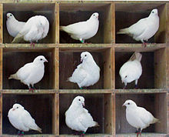
Approximately Balance Networks
Basic idea – find a “good” node A (s.t., it does not belong to too many unbalanced triangles) to partition into X and Y
Pigeonhole principle: if n items are put into m pigeonholes with n > m, then at least one pigeonhole must contain more than one item
Counting argument based on pigeonhole: compute the average value of a set of objects and then argue that there must be at least one node that is equal to the average or below (or equal and above)

Slide 33
Approximately Balance Networks
Let a graph with N nodes
Number of edges? Number of triangles?
Weight of a node -> how many unbalanced triangles it is part of
Total weight? Average weight per node?
Choose a node whose weight is <= average

Slide 34
Approximately Balance Networks
Cases based on the relative size of X and Y
If X and Y too large -> case (a) else case (b)

Slide 35
End of Chapter 5
Balanced networks in the case of both positive and negative edges

