Slide 1
Online Social Networks and Media
Navigation in a small world

Slide 2
Small world phenomena
Small worlds: networks with short paths
Stanley Milgram (1933-1984): “The man who shocked the world”
Obedience to authority (1963)
Small world experiment (1967)

Slide 3
Small world experiment
Letters were handed out to people in Nebraska to be sent to a target in Boston
People were instructed to pass on the letters to someone they knew on first-name basis
The letters that reached the destination followed paths of length around 6
Six degrees of separation: (play of John Guare)

Slide 4
Milgram’s experiment revisited
What did Milgram’s experiment show?
(a) There are short paths in large networks that connect individuals
(b) People are able to find these short paths using a simple, greedy, decentralized algorithm

Slide 5
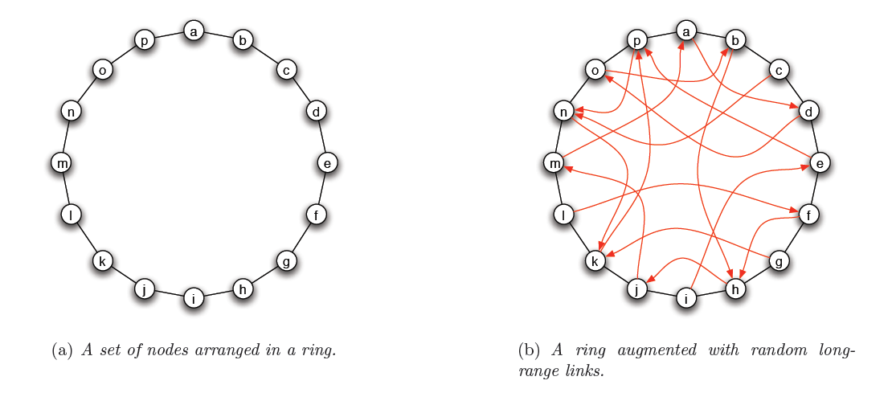
Small worlds
We can construct graphs with short paths
E.g., the Watts-Strogatz model

Slide 6
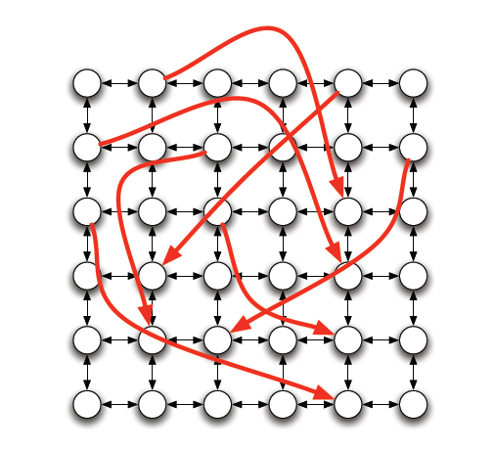
Small worlds
Same idea to different graphs

Slide 7
Navigation in a small world
Kleinberg: Many random graphs contain short paths, but how can we find them in a decentralized way?
In Milgram’s experiment every recipient acted without knowledge of the global structure of the social graph, using only
information about geography
their own social connections

Slide 8
Kleinberg’s navigation model
Assume a graph similar (but not the same!) to that of Watts-Strogatz
There is some underlying “geography”: ring, grid, hierarchy
Defines the local contacts of a node
Enables to navigate towards a node
There are also shortcuts added between nodes
The long-range contacts of a node
Similar to WS model – creates short paths

Slide 9
Kleinberg’s navigational model
Given a source node s, and a navigation target t we want to reach, we assume
No centralized coordination
Each node makes decisions on their own
Each node knows the “geography” of the graph
They can always move closer to the target node
Nodes make decisions based only on their own contacts (local and long-range)
They do not have access to other nodes’ contacts
Greedy (myopic) decisions
Always move to the node that is closest to the target.

Slide 10
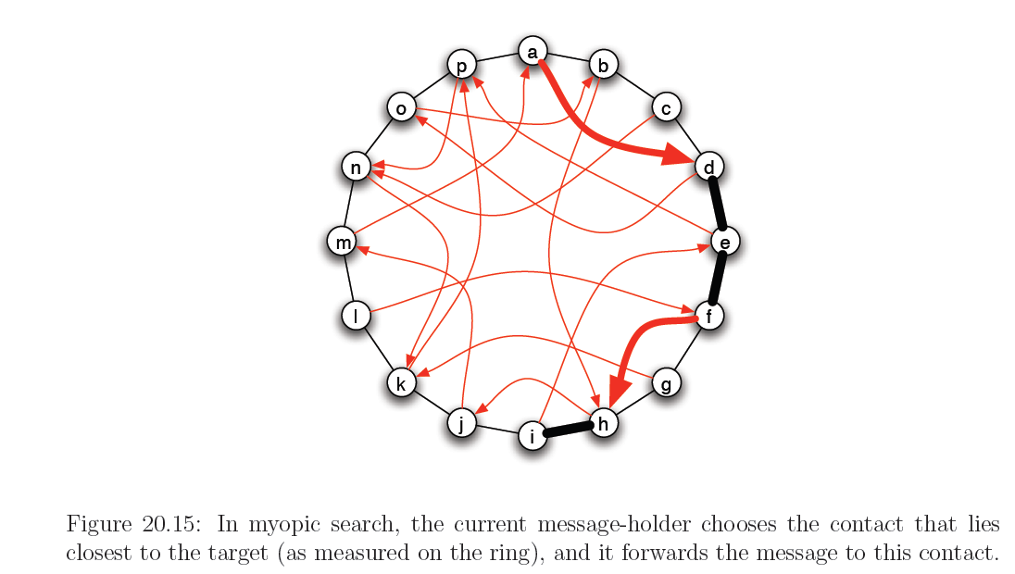
Example

Slide 11
Long-range contacts
If long-range contacts are created uniformly at random they do not help in navigation/search.
Proven theoretically
We create contacts with probability that decreases with the distance to the endpoint
$$P\left(x→y\right)\sim d{\left(x,y\right)}^{−q}$$
q: clustering exponent
Nodes more likely to connect closer to them (follows also intuitively)
The (clustering) exponent q depends on the geography:
If the underlying topology is a 1-dimensional ring, q = 1
If the underlying topology is a 2-dimensional grid, q = 2
If a 3-dimensional cube… etc

Slide 12
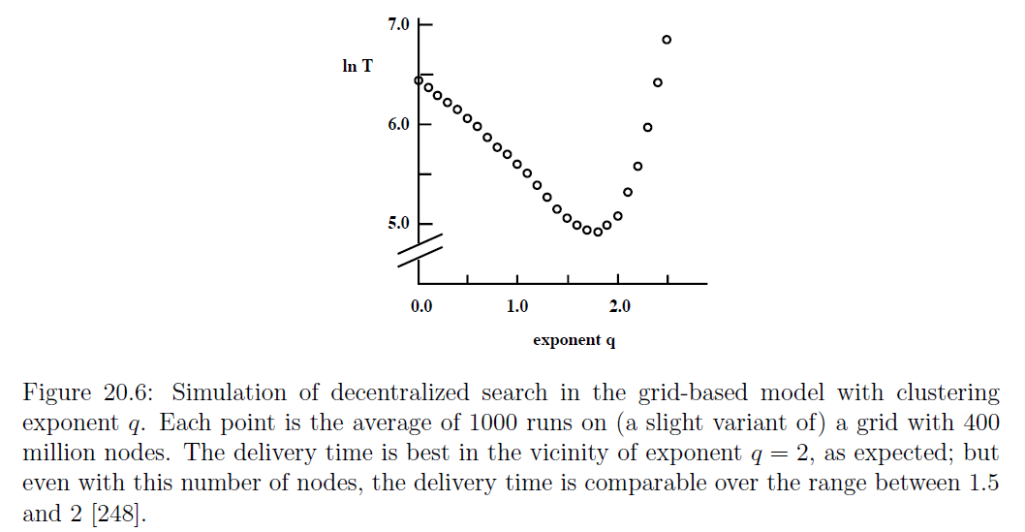
Clustering exponent
This exponent is the only one for which we can obtain “short” (polylogarithmic length) paths

Slide 13
Theoretical results
Proven for an underlying grid:
If the underlying topology is a 2-dimensional grid, and the clustering exponent is $q =$2, then the search time is $O(\log^{2}{n})$. If $q≠2$, then the search time is $O(n^{c})$ for some c > 0.
Exact same theorem for q = 1 for the ring.
If the underlying topology is a 1-dimensional ring, and the clustering exponent is $q =1$, then the search time is $O(\log^{2}{n})$. If $q≠1$, then the search time is $O(n^{c})$ for some c > 0.
Extends to any dimension d
We obtain $O(\log^{2}{n})$ search time when q=d, the exponent is equal to the dimension of the underlying graph

Slide 14
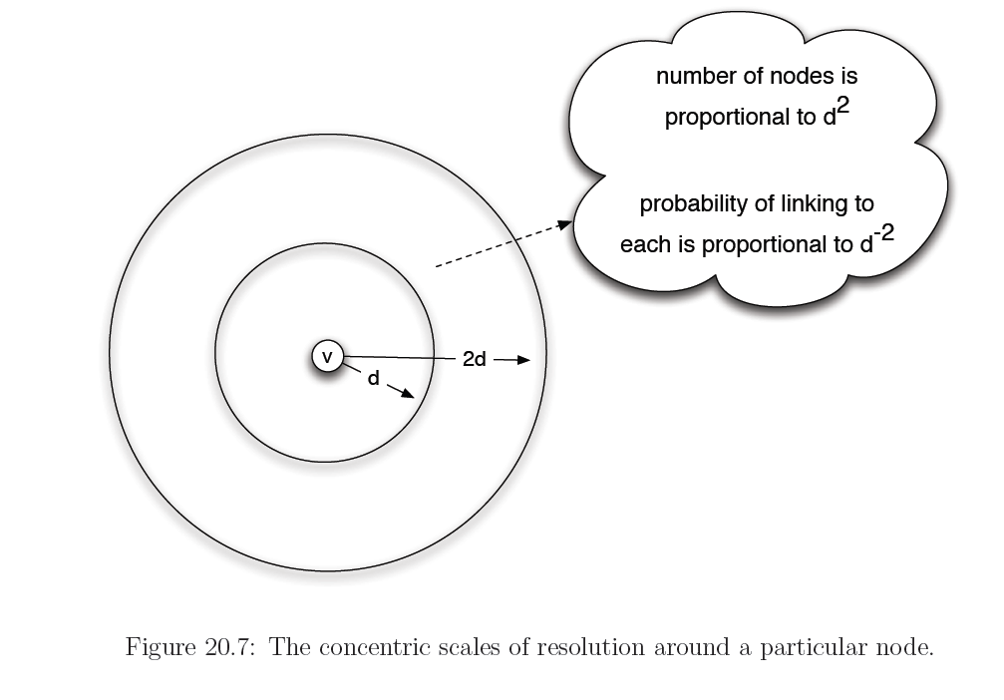
Proof Intuition
The algorithm has the same probability to link to any scale of resolution
logn scales, logn steps in expectation to change scale

Slide 15
Proof intuition
The algorithm is able to replicate what happens in the Milgram experiment

Slide 16
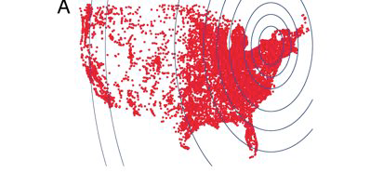
Long range links in the real world
Is it the case that people link to each other with probability $P\left(x→y\right)\sim d{\left(x,y\right)}^{−2}$
Live Journal data
Connections between friends
Postal codes for locations
Problem: non-uniform density of points

Slide 17
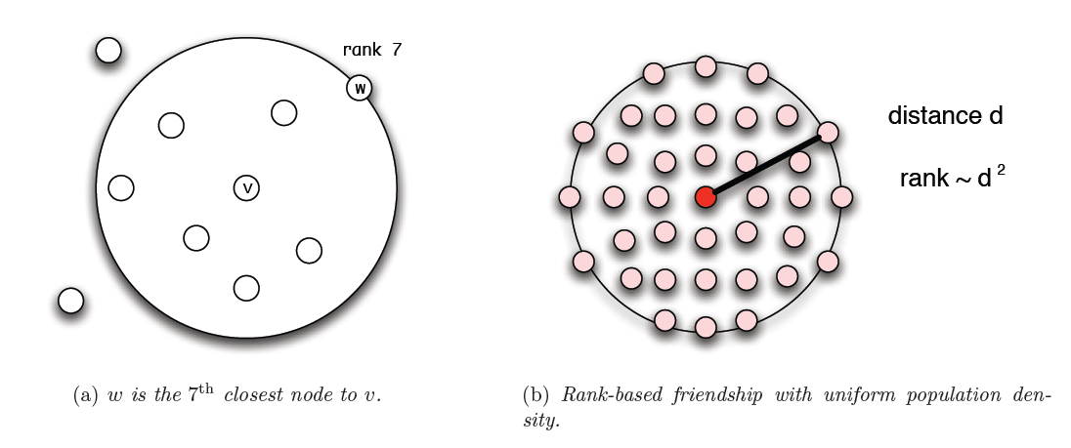
Linking by rank
Link to the r-th closest neighbor with probability $P\left(x→y\right)\sim r^{−1}$
In the case of uniform distribution, $P\left(x→y\right)\sim d^{−2}$

Slide 18
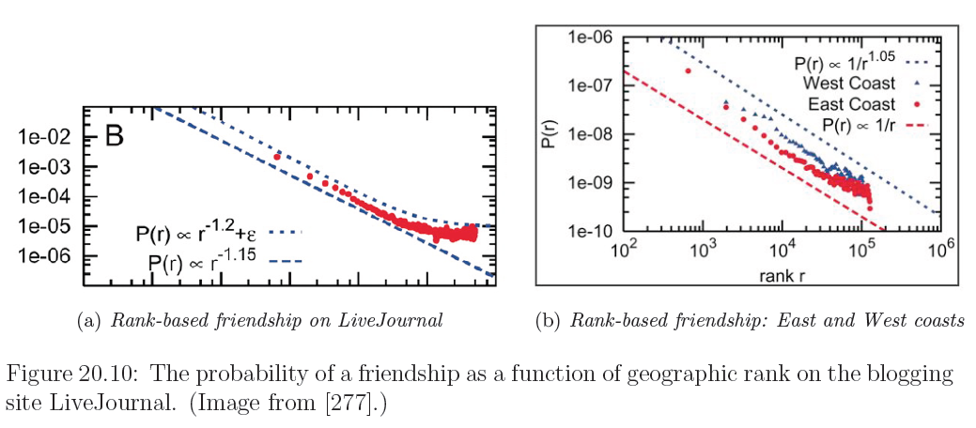
Live Journal measurements
Replicated for other networks as well (FB)
Is there a mechanism that drives this behavior?

Slide 19
Other models
Lattice captures geographic distance. How do we capture social distance (e.g. occupation)?
Hierarchical organization of groups
distance h(i,j) = height of Least Common Ancestor

Slide 20
Other models
Generate links between leaves with probability
$$P\left(x→y\right)\sim b^{−αh(x,y)}$$
b=2 the branching factor

Slide 21
Other models
Theorem: For α=1 there is a polylogarithimic search algorithm. For α≠1 there is no decentralized algorithm with poly-log time
note that α=1 and the exponential dependency results in uniform probability of linking to the subtrees

Slide 22
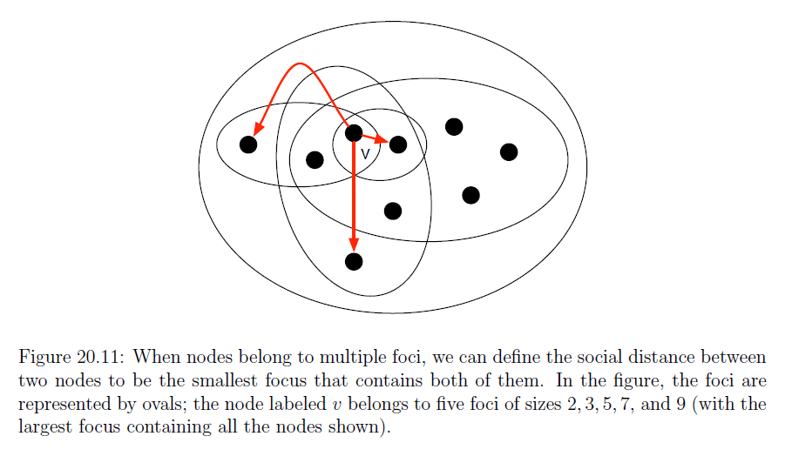
Generalization
$P\left(x→y\right)\sim d^{−1}$

Slide 23
Doubling dimension
A point set X has doubling dimension λ if any set of points in X that are covered by a ball of radius r can be covered by $2^{λ}$ balls of radius r/2 .
Practically, for any point $x,$ if $N(x,r)$ is the number of points within distance $r$ of $x$, then $N\left(x,2r\right)=2^{λ}N(x,r)$

Slide 24
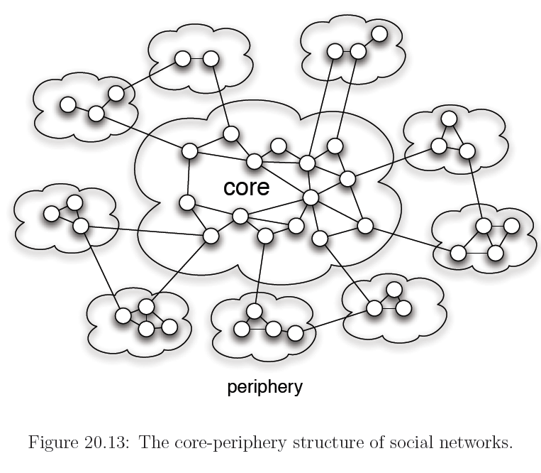
Small worlds with nodes of different status

Slide 25
Application: P2P search -- Symphony
Map the nodes and keys to the ring
Link every node with its successor and predecessor
Add k random links with probability proportional to 1/(dlogn), where d is the distance on the ring
Lookup time O(log²n)
If k = logn lookup time O(logn)
Easy to insert and remove nodes (perform periodical refreshes for the links)

Slide 26
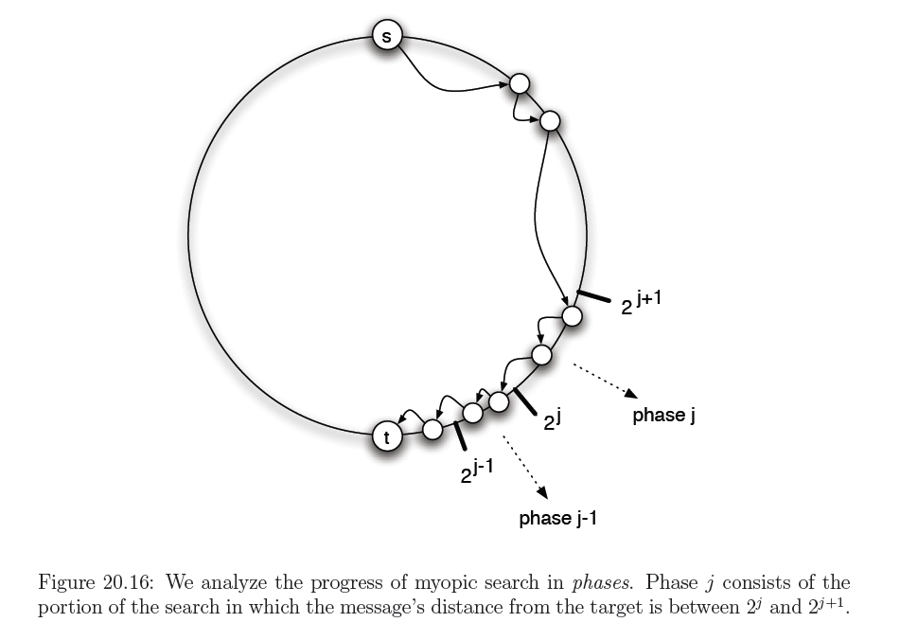
Proof of Kleinberg’s theorem
Game plan:
Break the path from s to t into phases:
In phase $i$ we are at distance $(2^{i},2^{i+1}]$from t
When transitioning between phases we cut the remaining distance from s to t in half
There are $\log{n}$ phases
Show that the expected time spent in each phase is $O(\log{n})$
Total time: $O(\log^{2}n)$

Slide 27
Normalization constant
$$Z=\sum_{y}{d{\left(x,y\right)}^{−1}=2\left(1+\frac{1}{2}+⋯+\frac{1}{n/2}\right)}≤2\left(1+\ln{\frac{n}{2}}\right)≤2(1+log{n/2)=2log{n}}$$

Slide 28
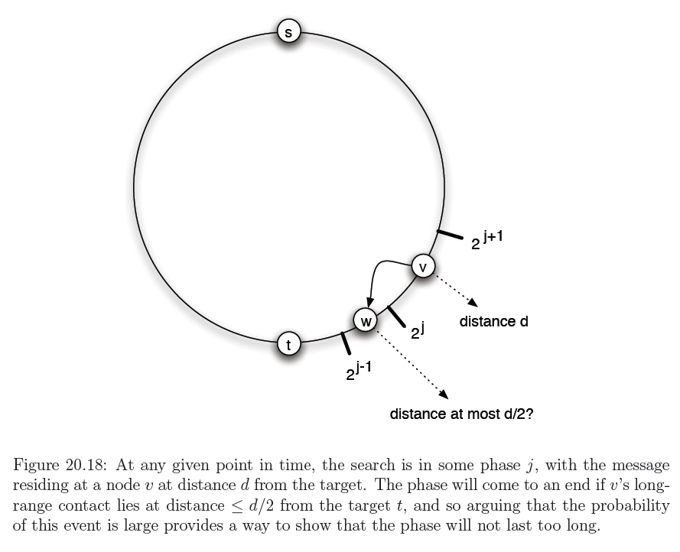

Slide 29
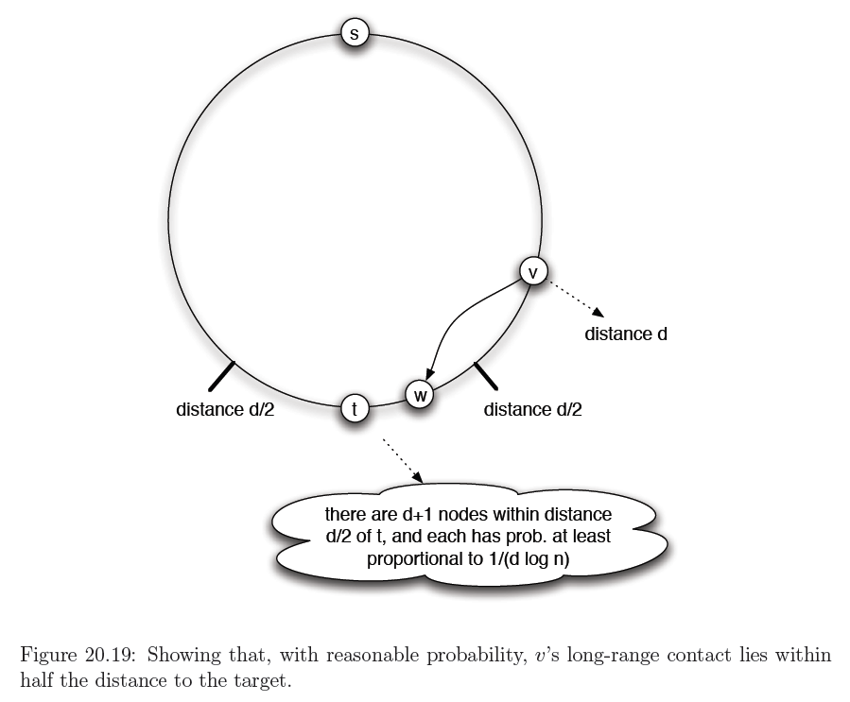

Slide 30
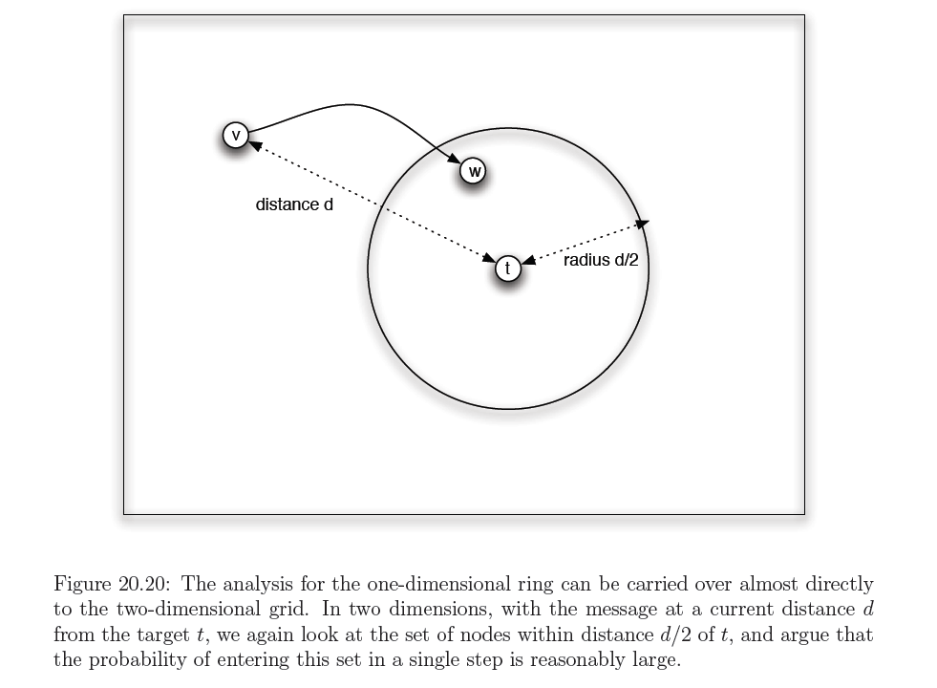

Slide 31
