Slide 1
Λ14 Διαδικτυακά Κοινωνικά Δίκτυα και Μέσα
Networks and Surrounding Contexts
Chapter 4, from D. Easley and J. Kleinberg book

Slide 2
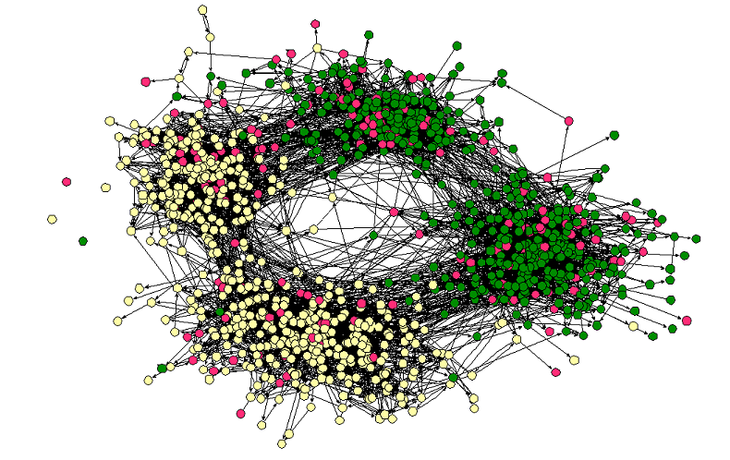
Homophily
Middle – High School
Race

Slide 3
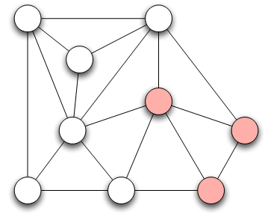
Measuring Homophily
If the fraction of cross-gender edges is significantly less than expected, then there is evidence for homophily
gender male with probability p
gender female with probability q
Probability of cross-gender edge?

Slide 4
Measuring Homophily
“significantly” less than
Inverse homophily
Characteristics with more than two values:
Number of heterogeneous edges (edge between two nodes that are different

Slide 5
Mechanisms Underlying Homophily: Selection and Social Influence
Selection: tendency of people to form friendships with others who are like then
Socialization or Social Influence: the existing social connections in a network are influencing the individual characteristics of the individuals
Social Influence as the inverse of Selection
Mutable & immutable characteristics

Slide 6
The Interplay of Selection and Social Influence
Longitudinal studies in which the social connections and the behaviors within a group are tracked over a period of time
Why?
- Study teenagers, scholastic achievements/drug use (peer pressure and selection)
- Effect of possible interventions (example, drug use)

Slide 7
The Interplay of Selection and Social Influence
Christakis and Fowler on obesity, 12,000 people over a period of 32-years
Why?
(i) Because of selection effects, choose friends of similar obesity status,
(ii) Because of confounding effects of homophily according to other characteristics
(iii) Because changes in the obesity status of person’s friends was exerting an influence that affected her
(iii) As well -> “contagion” in a social sense

Slide 8
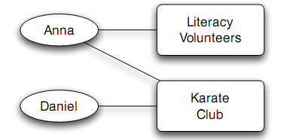
Affiliation
A larger network that contains both people and context as nodes
foci
Affiliation network
Bipartite graph
A node for each person and a node for each focus
An edge between a person A and focus X, if A participates in X

Slide 9
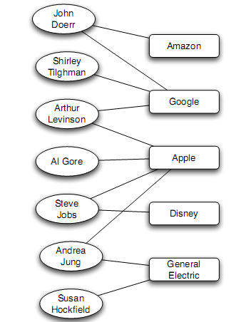
Affiliation
Example:
Board of directors

Slide 10
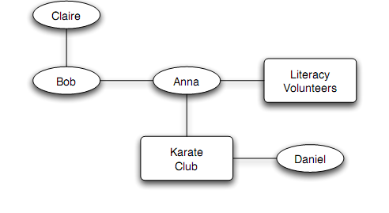
Co-evolution of Social and Affiliation Networks
Social Affiliation Network
Two type of edges:
Friendship: between two people
Participation: between a person and a focus

Slide 11
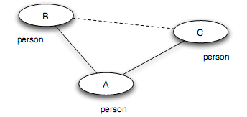
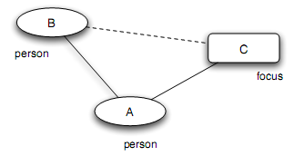
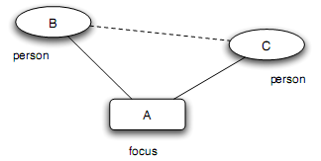
Co-evaluation of Social and Affiliation Networks: Closure process
Triadic closure: (two people with a friend in common - A introduces B to C)
Membership closure (social influence): (a person joining a focus that a friend is already involved in A introduces focus C to B)
Focal closure: (two people with a focus in common - focus A introduces B to C)

Slide 12
Co-evaluation of Social and Affiliation Networks

Slide 13
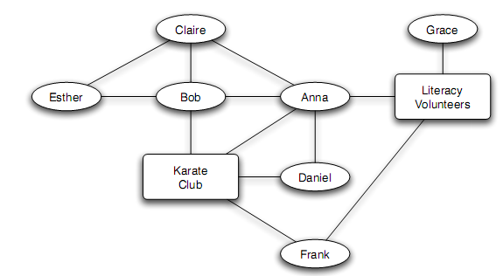
Tracking Link Formation in Online Data: triadic closure
Triadic closure:
How much likely is a link to form between two people
How much more likely a link to form between two people if they multiple friends in common?

Slide 14
Tracking Link Formation in Online Data: triadic closure
We take two snapshots of the network at different times
For each k, identify all pairs of nodes that have exactly k friends in common in the first snapshot, but who are not directly connected
Define T(k) to be the fraction of these pairs that have formed an edge by the time of the second snapshot
Plot(k) as a function of k
T(0): does not close any triangle
T(k): the rate at which link formation happens when it does close a triangle

Slide 15
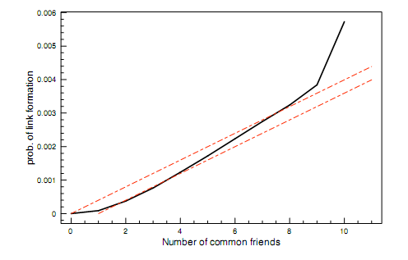
Tracking Link Formation in Online Data: triadic closure
E-mail (“who-talks-to-whom” dataset type)
Among 22,000 undergraduates and graduate students (large US universty)
For 1-year
Network evolving over time
At each instance (snapshot), join two people if they have exchanged e-mail in each direction at some point in the past 60 days
Multiple pairs of snapshots ->
Built a curve for T(k) on each pair, then average all the curves
Snapshots – one day apart
From 0 to 1 to 2 friends
From 8 to 9 to 10 friend (but on a much smaller population)
Having two common friends produces significantly more than twice the effect compared to a single common friend

Slide 16
Tracking Link Formation in Online Data: triadic closure
Assume triadic closure:
Each common friend two people have gives them an independent probability p of forming a link each day
For two people with k friend in common,
probability not forming a link on any given day
(1-p)^{k}
probability forming a link on any given day
T_{baseline}(k) = 1 - (1-p)^{k}
Given the absolute effect of the first common friend in the data
T_{baseline}(k) = 1 - (1-p)^{k-1}
Qualitative similar, but no independent assumption

Slide 17
Tracking Link Formation in Online Data: focal and membership closure
Focal closure: what is the probability that two people form a link as a function of the number of foci that are jointly affiliated with
Membership closure: what is the probability that a person becomes involved with a particular focus as a function of the number of friends who are already involved in it?

Slide 18
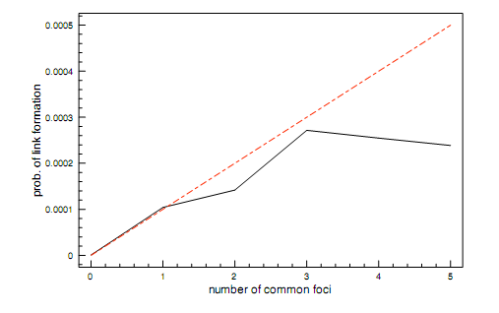
Tracking Link Formation in Online Data: focal and membership closure
For focal closure
E-mail (“who-talks-to-whom” dataset type)
Use the class schedule of each student
Focus: class (common focus – a class together)
Subsequent shared classes after the first produce a diminishing effect

Slide 19
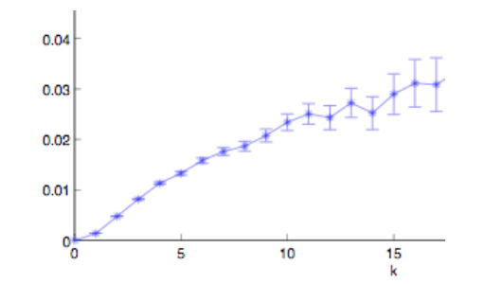
Tracking Link Formation in Online Data: focal and membership closure
For membership closure
Wikipedia
Node: Wikipedia editor who maintains a use account and user talk page
Link: if they have communicated with one writing on the user talk page of the other
Focus: Wikipedia article
Association to focus: edited the article
An initial increasing effect: the probability of editing a Wikipedia article is more than twice as great when you have two connections into the focus than one
Also, multiple effects can operate simultaneously

Slide 20
Tracking Link Formation in Online Data: interplay between selection and social influence
Underlying social network
Measure for behavioral similarity
Wikipedia
Node: Wikipedia editor who maintains a use account and user talk page
Link: if they have communicated with one writing on the user talk page of the other
Editor’s behavior: set of articles she has edited
Neighborhood overlap in the bipartite affiliation network of editors and articles consisting only of edges between editors and the articles they have edited
Wikipedia editors who have communicated are significantly more similar in their behavior than pairs of Wikipedia editors who have not (homomphily)
Selection (editors form connections with those have edited the same articles) vs Social Influence (led to the articles of people they talk to)

Slide 21
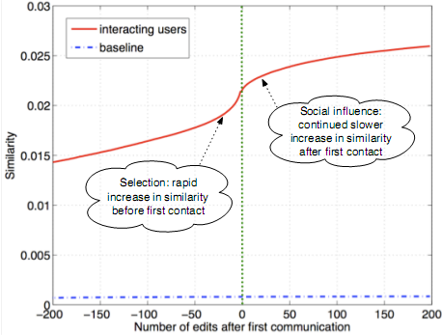
Tracking Link Formation in Online Data: interplay between selection and social influence
Actions in Wikipedia are timestamped
For each pair of editors A and B who have ever communicated record their similarity over time
Time moves in discrete units, advancing by one “tick” whenever either A or B performs an action on Wikipedia
Time 0 when they first communicated
Similarity is clearly increasing both before and after the moment of first interaction
(both selection and social influence)
Not symmetric around time 0 (particular role on similarity)
Significant increase before they meet
Blue line shows similarity of a random pair (non-interacting)

Slide 22
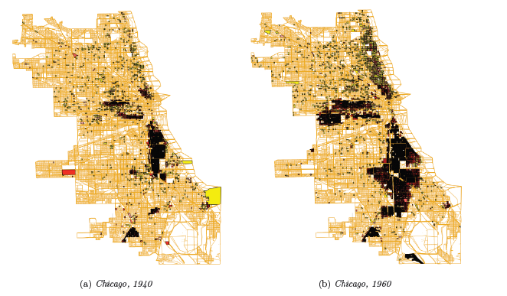
A Spatial Model of Segregation

Slide 23
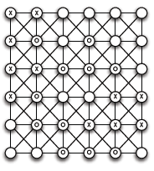
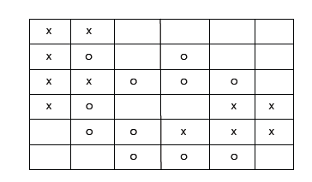
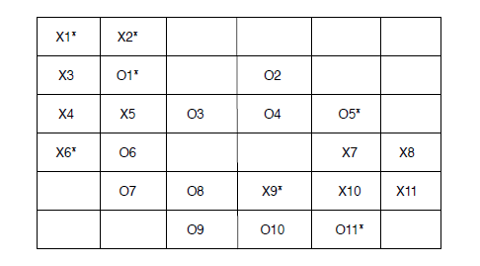
A Spatial Model of Segregation: The Schelling Model
Neighbors (including diagonal)
A threshold t: if an agent discovers that fewer than t of its neighbors are of the same type of itself, then it has an interest to move to a new cell
Unsatisfied
t = 3

Slide 24
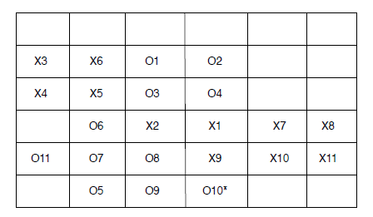
A Spatial Model of Segregation: The Schelling Model
Agents move in rounds: consider unsatisfied agents at some order
How to move? (in a random order, downwards?) what if no empty position?

Slide 25
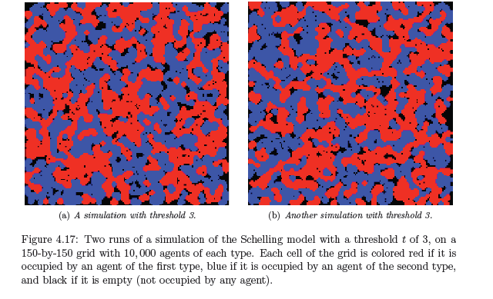
A Spatial Model of Segregation: The Schelling Model

Slide 26
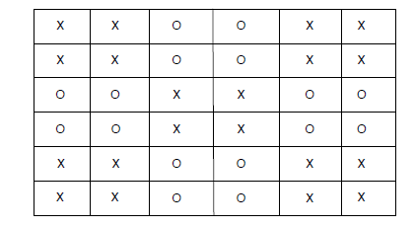
A Spatial Model of Segregation: The Schelling Model
Satisfied even in the minority among its neighbors
Requirements not globally incompatible
If we start from a random configuration, attach to clusters

Slide 27
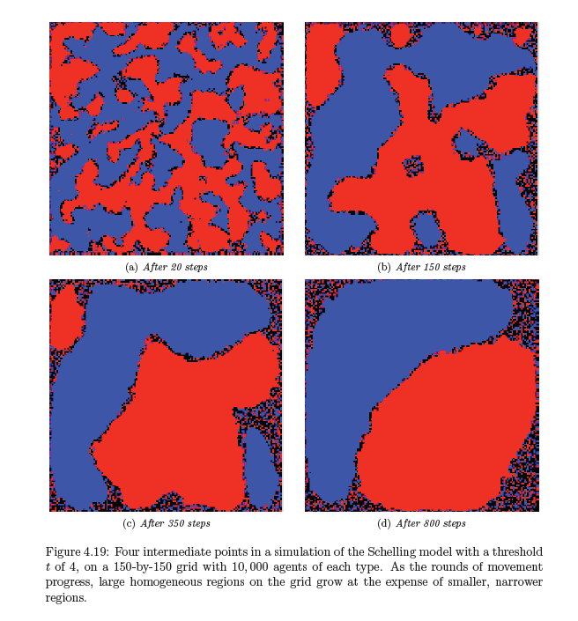
A Spatial Model of Segregation: The Schelling Model

