Slide 1
Λ14 Διαδικτυακά Κοινωνικά Δίκτυα και Μέσα
Strong and Weak Ties
Chapter 3, from D. Easley and J. Kleinberg book

Slide 2
Issues
How simple processes at the level of individual nodes and links can have complex effects at the whole population
How information flows within the network
How different nodes play structurally distinct roles

Slide 3
The Strength of Weak Ties Hypothesis
Mark Granovetter, in the late 1960s
Many people learned information leading to their current job through personal contacts, often described as acquaintances rather than closed friends
Two aspects
Structural
Local (interpersonal)

Slide 4
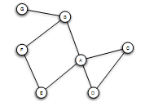
Triadic Closure
If two people in a social network have a friend in common, then there is an increased likelihood that they will become friends themselves at some point in the future
Triangle

Slide 5
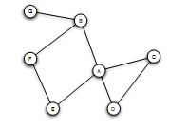
Triadic Closure
Snapshots over time:

Slide 6
Clustering Coefficient
(Local) clustering coefficient for a node is the probability that two randomly selected friends of a node are friends with each other
Fraction of the friends of a node that are friends with each other (i.e., connected)

Slide 7
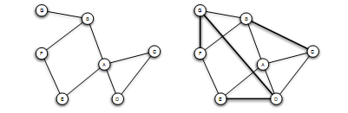
Clustering Coefficient
1/6
1/2
Ranges from 0 to 1

Slide 8
Triadic Closure
If A knows B and C, B and C are likely to become friend, but WHY?
B
A
C
Opportunity
Trust
Incentive of A (latent stress for A, if B and C are not friends, dating back to social psychology)

Slide 9
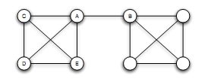
Bridges and Local Bridges
Bridge
(aka cut-edge)
An edge between A and B is a bridge if deleting that edge would cause A and B to lie in two different components
AB the only “route” between A and B
extremely rare in social networks

Slide 10
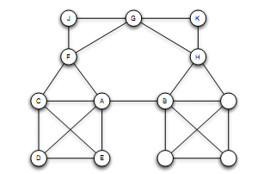
Bridges and Local Bridges
Local Bridge
An edge between A and B is a local bridge if deleting that edge would increase the distance between A and B to a value strictly more than 2
Span of a local bridge: distance of the its endpoints if the edge is deleted

Slide 11
Bridges and Local Bridges
An edge is a local bridge, if an only if, it does not form a side of any triangle in the graph

Slide 12
Back to job seeking:
If you are going to get truly new information, it may come from a friend connected by a local bridge
But why distant acquaintances?

Slide 13
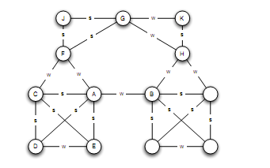
The Strong Triadic Closure Property
Levels of strength of a link
Strong and weak ties
Vary across different time and situations
Annotated graph

Slide 14
The Strong Triadic Closure Property
If a node A has edges to nodes B and C, then the B-C edge is especially likely to form if both A-B and A-C are strong ties
A node A violates the Strong Triadic Closure Property, if
it has strong ties to two other nodes B and C, and there is no edge (strong or weak tie) between B and C.
A node A satisfies the Strong Triadic Property if it does not violate it
B
S
A
X
S
C

Slide 15
The Strong Triadic Closure Property

Slide 16
Local Bridges and Weak Ties
Local distinction: weak and strong ties
Global structural distinction: local bridges or not
Claim:
If a node A in a network satisfies the Strong Triadic Closure and is involved in at least two strong ties, then any local bridge it is involved in must be a weak tie
Proof: by contradiction
Relation to job seeking?

Slide 17
The role of simplifying assumptions:
Useful when they lead to statements robust in practice, making sense as qualitative conclusions that hold in approximate forms even when the assumptions are relaxed
Stated precisely, so possible to test them in real-world data
A framework to explain surprising facts

Slide 18
Tie Strength and Network Structure in Large-Scale Data
How to test these prediction on large social networks?

Slide 19
Tie Strength and Network Structure in Large-Scale Data
Communication network: “who-talks-to-whom”
Strength of the tie: time spent talking during an observation period
Cell-phone study [Omnela et. al., 2007]
“who-talks-to-whom network”, covering 20% of the national population
Nodes: cell phone users
Edge: if they make phone calls to each other in both directions over 18-week observation periods
Is it a “social network”?
Cells generally used for personal communication + no central directory, thus cell-phone mummers exchanged among people who already know each other
Broad structural features of large social networks (giant component, 84% of nodes)

Slide 20
Generalizing Weak Ties and Local Bridges
Either weak or strong
Local bridge or not
Tie Strength
From weak and strong -> Numerical quantity (= number of min spent on the phone)
Quantify “local bridges”, how?

Slide 21
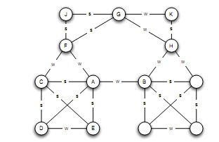
Generalizing Weak Ties and Local Bridges
Bridges
“almost” local bridges
Neighborhood overlap of an edge e_{ij}
(*) In the denominator we do not count A or B themselves
A: B, E, D, C
F: C, J, G
1/6
When is this value 0?

Slide 22
Generalizing Weak Ties and Local Bridges
= 0: edge is a local bridge
Small value: “almost” local bridges
1/6
?

Slide 23
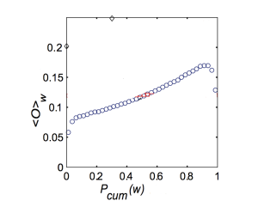
Generalizing Weak Ties and Local Bridges: Empirical Results
How the neighborhood overlap of an edge depends on its strength
(Hypothesis: the strength of weak ties predicts that neighborhood overlap should grow as tie strength grows)
(*) Some deviation at the right-hand edge of the plot
sort the edges -> for each edge at which percentile
Strength of connection (function of the percentile in the sorted order)
Local level -?-> global level: weak ties serve to link different tightly-knit communities that each contain a large number of stronger ties – How would you test this?

Slide 24
Generalizing Weak Ties and Local Bridges: Empirical Results
Hypothesis: weak ties serve to link different tightly-knit communities that each contain a large number of stronger ties
Delete edges from the network one at a time
Starting with the strongest ties and working downwards in order of tie strength
  giant component shrank steadily
Starting with the weakest ties and upwards in order of tie strength
  giant component shrank more rapidly, broke apart abruptly as a critical number of weak ties were removed

Slide 25
Social Media and Passive Engagement
People maintain large explicit lists of friends
Test:
How online activity is distributed across links of different strengths

Slide 26
Tie Strength on Facebook
Cameron Marlow, et al, 2009
At what extent each link was used for social interactions
Reciprocal (mutual) communication: both send and received messages to friends at the other end of the link
One-way communication: the user send one or more message to the friend at the other end of the link
Maintained relationship: the user followed information about the friend at the other end of the link (click on content via News feed or visit the friend profile more than once)

Slide 27
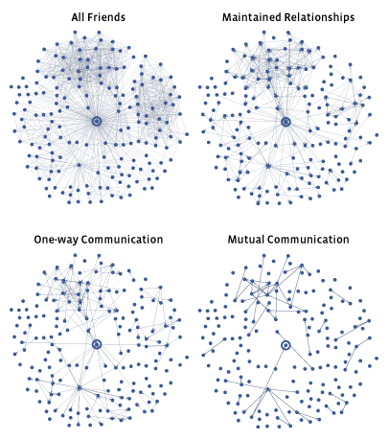
Tie Strength on Facebook
Two distinct regions

Slide 28
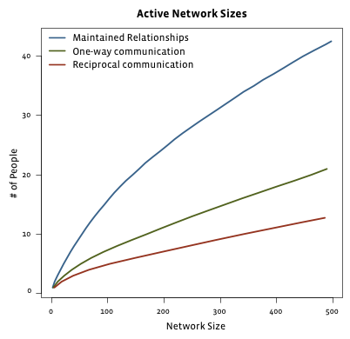
Tie Strength on Facebook
Even for users with very large number of friends
actually communicate : 10-20
number of friends follow even passively <50
Passive engagement (keep up with friends by reading about them even in the absence of communication)
Passive as a network middle ground
Total number of friends

Slide 29
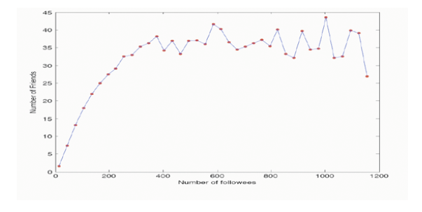
Tie Strength on Twitter
Huberman, Romero and Wu, 2009
Two kinds of links
Follow
Strong ties (friends): users to whom the user has directed at least two messages over the course if the observation period

Slide 30
Social Media and Passive Engagement
Strong ties require continuous investment of time and effort to maintain (as opposed to weak ties)
Network of strong ties still remain sparse
How different links are used to convey information

Slide 31
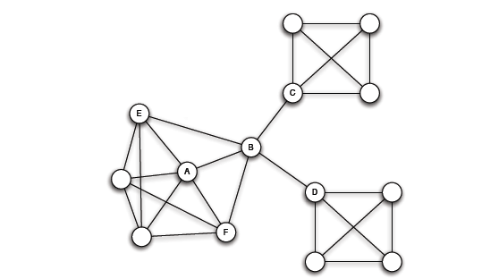
Closure, Structural Holes and Social Capital
Different roles that nodes play in this structure
Access to edges that span different groups is not equally distributed across all nodes

Slide 32
Embeddedness
Large clustering coefficient
Embeddedness of an edge: number of common neighbors of its endpoints (neighborhood overlap, local bridge if 0)
A all its edges have significant embeddedness
3
2
3
(sociology) if two individuals are connected by an embedded edge => trust
  “Put the interactions between two people on display”

Slide 33
Structural Holes
(sociology) B-C, B-D much riskier, also, possible contradictory constraints
Success in a large cooperation correlated to access to local bridges
B “spans a structural hole”
  B has access to information originating in multiple, non interacting parts of the network
  An amplifier for creativity
  Source of power as a social “gate-keeping”
Will a triangle be formed?

Slide 34
Closure and Bridging as Forms of Social Capital
Social capital: benefits from membership in social networks and other social structures

Slide 35
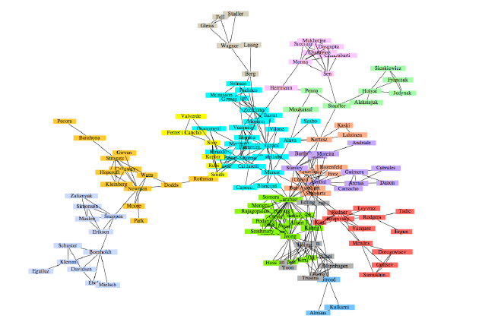
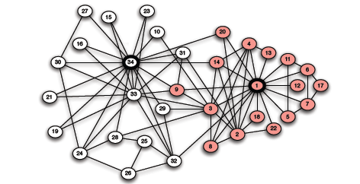
Betweenness and Graph Partitioning
Graph partitioning
Given a network dataset, how to identity densely connected groups of nodes within it
Co-authorship network of physicists and applied mathematicians
Karate club

Slide 36
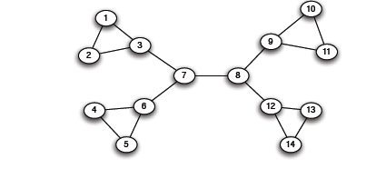
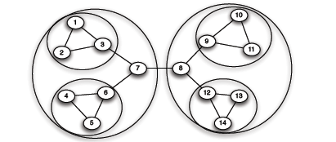
Betweenness and Graph Partitioning
Divisive methods: try to identify and remove the “spanning links” between densely-connected regions
Agglomerative methods: Find nodes that are likely to belong to the same region and merge them together (bottom-up)

Slide 37
Girvan and Newman
Divisive method
Finding bridges and local bridges?
Which one to choose?

Slide 38
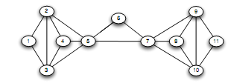
Girvan and Newman
There is no local bridge

Slide 39
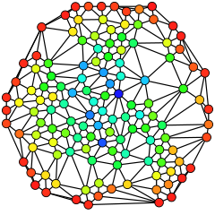
Girvan and Newman: Betweenness
vertices that have a high probability to occur on a randomly chosen shortest path between two randomly chosen nodes have a high betweenness.
Traffic (unit of flow)
Betweenness of an edge (a, b): number of pairs of nodes x and y such that the edge (a, b) lies on the shortest path between x and y.
Since there can be several shortest paths between x and y, edge (a, b) is credited with the fraction of those shortest paths that include the edge (a, b).
Similar notion exists for nodes
Blue (max)
Red (0)

Slide 40
Girvan and Newman: Betweenness
3
x
11
Carries the flow from 1 to every other node but 2
7
x
7

Slide 41
Girvan and Newman
1. Find the highest betweenness or multiple betweenness, if there is a tie – remove these from the graph. If this separates the graph -> partition.
2. The betweenness of all edges affected by the removal is recalculated.
Steps 2 and 3 are repeated until no edges remain.

Slide 42
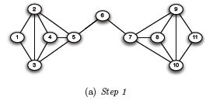
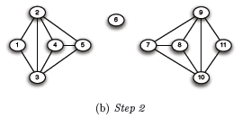
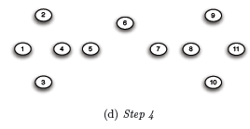
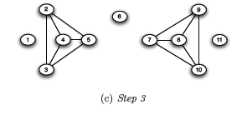
Girvan and Newman
Need to recompute

Slide 43
Computing Betweenness
Perform a BFS starting from A
Determine the shortest path from A to each other node
Based on these numbers, determine the amount of flow from A to all other nodes that uses each edge

Slide 44
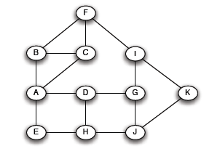
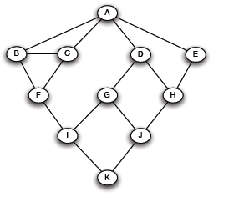
Computing Betweenness
Initial network
BFS on A

Slide 45
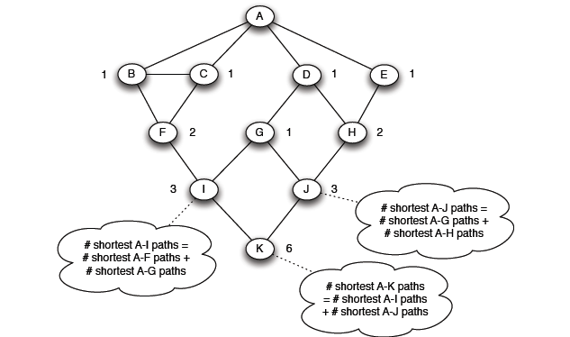
Computing Betweenness
Count how many shortest paths from A to a specific node
Level 1
Level 2
Level 3
Level 4
Top-down

Slide 46
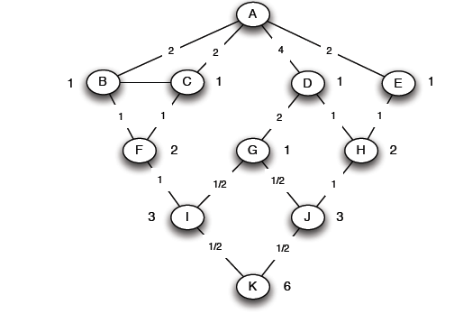
Computing Betweenness
Compute the flow
calculate for each edge e the sum over all nodes
Y of the fraction of shortest paths from the root X to Y that go through e.
for each edge e: the sum over all nodes Y of the fraction of shortest paths from the root A to Y that go through e.
Each edge participates in the shortest-paths from the root to nodes (at levels) below it
Each node other than the root is given a credit of 1, representing the shortest path to that node.
This credit may be divided among nodes and edges above, since there could be several different shortest paths to the node.
e

Slide 47
Computing Betweenness
Count the flow through each link
Portion of the shortest paths to I that go through (F, I) = 2/3 +
Portion of the shortest paths to K that go through (F, I)
(1/2)(2/3) = 1/3
= 1
1/3+(1/3)1/2 = 1/2
Portion of the shortest paths to K that go through (I, K) = 3/6 = 1/2

Slide 48
Computing Betweenness
(X, Y)
p_{X}
X
Y
p_{Y}
.. .
Y₁
Y_{m}

Slide 49
Computing Betweenness
Final for A
Sum over all BFSs

Slide 50
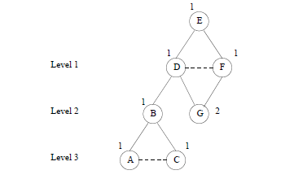
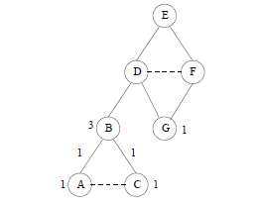
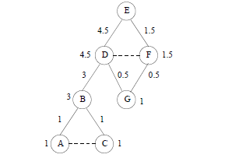
Computing Betweenness

Slide 51
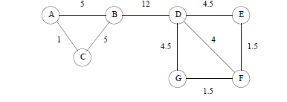
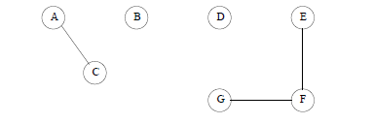
Computing Betweenness

Slide 52
Computing Betweenness
Issues
Test for connectivity?
Re-compute all paths, or only those affected
Parallel computation
“Sampling

Slide 53
Girvan and Newman
34 president
1 instructor
Correct but node 9 (attached it to 34) – why? 3 weeks away from getting a black belt
Minimum cut approach – the same outcome

