Slide 1
Λ14 Διαδικτυακά Κοινωνικά Δίκτυα και Μέσα
Strong and Weak Ties
Chapter 3, from D. Easley and J. Kleinberg book

Slide 2
Issues
How simple processes at the level of individual nodes and links can have complex effects at the whole population
How information flows within the network
How different nodes play structurally distinct roles

Slide 3
The Strength of Weak Ties Hypothesis
Mark Granovetter, in the late 1960s
Many people learned information leading to their current job through personal contacts , often described as acquaintances rather than closed friends
Two aspects
Structural
Local (interpersonal)

Slide 4
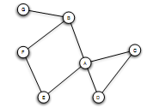
Triadic Closure
If two people in a social network have a friend in common, then there is an increased likelihood that they will become friends themselves at some point in the future
Triangle

Slide 5
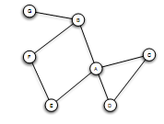
Triadic Closure
Snapshots over time:

Slide 6
Clustering Coefficient
(Local) clustering coefficient for a node is the probability that two randomly selected friends of a node are friends with each other
Fraction of the friends of a node that are friends with each other (i.e., connected)

Slide 7
Clustering Coefficient
1/6
1/2
Ranges from 0 to 1

Slide 8
Triadic Closure
If A knows B and C, B and C are likely to become friend, but WHY?
Opportunity
Trust
Incentive of A (dating back to social psychology)

Slide 9
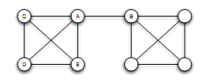
Bridges and Local Bridges
Bridge
(aka cut-edge)
An edge between A and B is a bridge if deleting that edge would cause A and B to lie in two different components
extremely rare in social networks

Slide 10
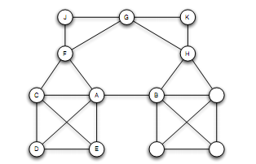
Bridges and Local Bridges
Local Bridge
An edge between A and B is a local bridge if deleting that edge would increase the distance between A and B to a value strictly more than 2
Span of a local bridge: distance of the its endpoints if the edge is deleted

Slide 11
Bridges and Local Bridges
An edge is a local bridge, if an only if, it does not form a side of any triangle in the graph

Slide 12
Back to job seeking:
If you are going to get truly new information, it may come from a friend connected by a local bridge
But why distant acquaintances?

Slide 13
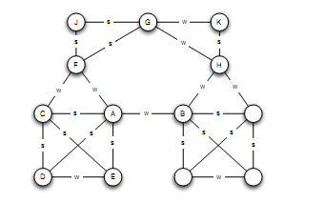
The Strong Triadic Closure Property
Levels of strength of a link
Strong and weak ties
Vary across different time and situations
Annotated graph

Slide 14
The Strong Triadic Closure Property
If a node A has edge to nodes B and C, then the B-C edge is especially likely to form if both A-B and A-C are strong ties
A node A violates the Strong Triadic Closure Property, if
It has strong ties to two other nodes B and C, and there is no edge (strong or weak tie) between B and C.
A node A satisfies the Strong Triadic Property if it does not violate it

Slide 15
The Strong Triadic Closure Property

Slide 16
Local Bridges and Weak Ties
Local distinction: weak and strong ties
Global structural distinction: local bridges or not
Claim:
If a node A in a network satisfies the Strong Triadic Closure and is involved in at least two strong ties, then any local bridge it is involved in must be a weak tie
Proof: by contradiction
Relation to job seeking?

Slide 17
The role of simplifying assumptions:
Useful when they lead to statements robust in practice, making sense as qualitative conclusions that hold in approximate forms even when the assumptions are relaxed
Possible to test them in real-world data
A framework to explain surprising facts

Slide 18
Tie Strength and Network Structure in Large-Scale Data
How to test these prediction on large social networks?
Communication network: “who-talks-to-whom”
Strength of the tie: time spent talking during an observation period
Cell-phone study [Omnela et. al., 2007]
“who-talks-to-whom network”, covering 20% of the national population
Nodes: cell phones
Edge: if they make phone calls to each other in both directions over 18-week observation periods
Is it a “social network”?
Cells generally used for personal communication, no central directory, thus cell-phone mummers exchanged among people who already know each other
Broad structural features of large social networks (giant component, 84% of nodes)

Slide 19
Generalizing Weak Ties and Local Bridges
Tie Strength
From weak and strong -> Numerical quantity (= number of min spent on the phone)
Also sort the edges -> for each edge at which percentile

Slide 20
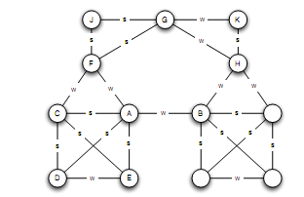
Generalizing Weak Ties and Local Bridges
Bridges
“almost” local bridges
Neighborhood overlap of an edge e_{ij}
(*) In the denominator we do not count A or B themselves
A: B, E, D, C
F: C, J, G
1/6
When is this value 0?

Slide 21
Generalizing Weak Ties and Local Bridges
= 0 : edge is a local bridge
Small value: “almost” local bridges
1/6
?

Slide 22
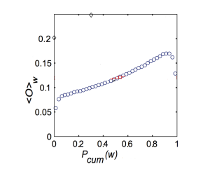
Generalizing Weak Ties and Local Bridges: Empirical Results
How the neighborhood overlap of an edge depends on its strength
(the strength of weak ties predicts that neighborhood overlap should grow as tie strength grows)
(*) Some deviation at the right-hand edge of the plot
Strength of connection (function of the percentile in the sorted order)
Local level -?-> global level: weak ties serve to link different tightly-knit communities that each contain a large number of stronger ties – How would you test this?

Slide 23
Generalizing Weak Ties and Local Bridges: Empirical Results
Hypothesis: weak ties serve to link different tightly-knit communities that each contain a large number of stronger ties
Delete edges from the network one at a time
Starting with the strongest ties and working downwards in order of tie strength
giant component shrank steadily
Starting with the weakest ties and upwards in order of tie strength
giant component shrank more rapidly, broke apart abruptly as a critical number of weak ties were removed

Slide 24
Social Media and Passive Engagement
People maintain large explicit lists of friends
How online activity is distributed across links of different strengths

Slide 25
Tie Strength on Facebook
Cameron Marlow, et al, 2009
At what extent each link was used for social interactions
Reciprocal (mutual) communication: both send and received messages to friends at the other end of the link
One-way communication: the user send one or more message to the friend at the other end of the link
Maintained relationship: the user

Slide 26
References
M. E. J. Newman, The structure and function of complex networks, SIAM Reviews, 45(2): 167-256, 2003

