Slide 1
Λ14 Διαδικτυακά Κοινωνικά Δίκτυα και Μέσα
Privacy

Slide 2
Privacy in Social Networks:
Introduction

Slide 3
Introduction: Anonymized data publishing
Digital traces in a wide variety of on-line settings
Provide rich sources of data for large-scale studies of social networks
Some made based on publicly crawlable social networking sites
Goal: Permit useful analysis yet avoid disclosing sensitive information

Slide 4
Introduction
The Players
The user (whose privacy we want to protect)
The publisher or data owner (role: anonymize data before publication) G -> anonymized G*
The attacker or adversary
The analyst

Slide 5
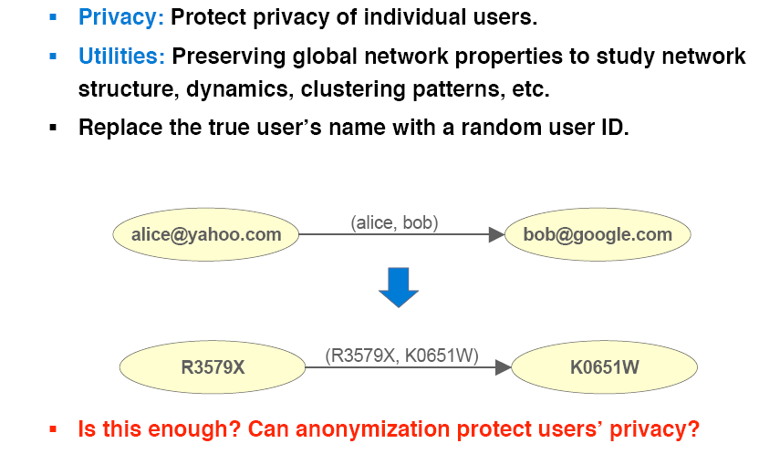
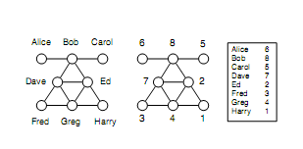
Introduction
Pseudo- or Naive anonymization: replace identifying attributes with synthetic (encrypting) identifiers
NAÏVE ANONYMIZATION
Is this enough?

Slide 6
Introduction
  Basic Elements
  Models of Privacy
    what pieces of information, we want to protect – usually, information is classified as sensitive (i.e., private) and not sensitive
  Background Knowledge
    what an adversary may know
  Models of Utility
    Use of the published data

Slide 7
Introduction: Privacy Model
Privacy classified into
identity disclosure: the identity of an individual who is associated with a node is revealed (or, just whether an individual participates or not)
link disclosure: the sensitive relationship between individuals is disclosed, and
content disclosure: the sensitive data associated with each node or edge is compromised, for example, the email message sent and/or received, the label (e.g., age, political beliefs, etc) associated with a node, properties such as the degree of a node, and general graph properties, etc

Slide 8
Introduction: the attacker
1. Background Knowledge (what the attacker knows besides the released network)
e.g., the age of the victim, the number of her friends, etc
also, combine from participation in many networks
2. Acquired through malicious actions of the adversary called attacks
active: an adversary tries to compromise privacy by strategically creating new user accounts and links before the anonymized network is released
passive: try to learn the identities of nodes only after the anonymized network has been released
a closed world adversary, in which case, external information is complete and absent facts are considered false,
an open world adversary, in which case, external information may be incomplete and absent facts are simply unknown

Slide 9
Introduction: utility models
aka information loss or anonymization quality
      Preserve general graph properties (diameter, distribution of node degrees, number of nodes/edges, average path length, clustering coefficient, etc)
Quality of the results of queries. E.g., Aggregate network queries: compute the aggregate on some path or subgraph that satisfies some given condition
Example: the average distance from a medical doctor vertex to a teacher vertex
Useful in many applications, such as customer relationship management

Slide 10
Introduction: anonymization methods
Initial Graph G -> Anonymized Graph G*
Clustering-based approaches: clusters nodes and edges into groups and replaces a sub-graph with a super-node (Generalization)
Graph modification approaches: modifies (inserts or deletes) edges and nodes in the graph (Add noise or “perturb” the graph)

Slide 11
Introduction: definitions
Mappings that preserve the graph structure
A graph homomorphism f from a graph G = (V, E) to a graph G' = (V', E'), is a mapping f: G → G’, from the vertex set of G to the vertex set of G’ such that
(u, u’) ∈ G ⇒ (f(u), f(u’)) ∈ G’
If the homomorphism is a bijection whose inverse function is also a graph homomorphism, then f is a graph isomorphism [(u, u’) ∈ G ⇔ (f(u), f(u’)) ∈ G’]

Slide 12
Introduction
the naive anonymization produces an isomorphic graph
Data owner (publisher)
Data Analyst
NAÏVE ANONYMIZATION
Good utility: Published graph isomorphic to input graph
The general graph isomorphic problem which determines whether two graphs are isomorphic is NP-hard

Slide 13
Other issues
Beside privacy-aware publishing (non-interactive) mechanisms
Interactive mechanism
a question is posed, the exact answer is computed by the curator, and then a noisy (anomymized) version of the true answer is returned to the user
Beside publishing:
private attributes
access control
Location privacy

Slide 14
Outline
An example of an active attack
General “structural” k-anonymity
An example of combining information from more than one network
(besides data publishing) How to infer private attributes

Slide 15
Active and Passive Attacks
Lars Backstrom, Cynthia Dwork and Jon Kleinberg, Whrefore art thou r3579x?: anonymized social networks, hidden patterns, and structural steganography, Proceedings of the 16th International Conferences on World Wide Web (WWW), 2007

Slide 16
Problem
Focus of the paper:
Identify type of attacks that even from a single anonymized copy of a social network, it is possible for an adversary to learn whether edges exist or not between specific targeted pair of nodes
Note that the adversary may be a user of the system being anomymized

Slide 17
Passive and Active Attacks
Passive Attacks
Learn the identities of the nodes after the anonymized network has been released
How?
Users find themselves in the released network and from this discover the existence of edges among users to whom they are linked
Based on the observation that:
most nodes in real social networks already belong to a small subgraph, thus if a user can collude with a coalition of k-1 friends after the release, he/she is able to identify additional nodes that are connected to this coalition

Slide 18
Passive and Active Attacks
Active Attacks
compromise privacy by strategically creating new user accounts and links before the anonymized network is released
Chooses an arbitrary set of users whose privacy it wishes to violate,
Creates a small number of new user accounts with edges to those targeted users, and
Creates patterns of links amongst the new accounts to make it identifiable in the anomymized graph structure

Slide 19
Passive and Active Attacks
Active work in with high probability in any network – passive rely on the chance that a use can uniquely find themselves after the network is released
Passive attacks can compromise the privacy only of users linked to the attacker
Passive attacks no observable wrong doing

Slide 20
Active Attack: overview
Anonymized network G of n-k nodes
Attacker
  Choose b targeted users
  Create a sub-graph H containing k nodes
  Attach H to the targeted nodes
How to create the sub-graph H

Slide 21
Active Attack: overview
After the anonymized network is released:
  Find the sub-graph H in the graph G
  Follow edges from H to locate the b target nodes and their true location in G
  Determine all edges among these b nodes (privacy breach)
How to locate the sub-graph H

Slide 22
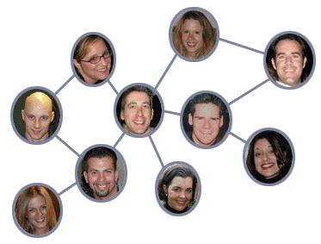
The Walk-Based Attack – Simplified Version
Construction:
  Pick target users W = {w₁,…,w_{k}}
  Create new users X = {x₁,…,x_{k}} and random subgraph G[X] = H
  Add edges (x_{i}, w_{i})
Recovery
  Find H in G ↔ No subgraph of G isomorphic to H
  Label H as x₁,…,x_{k} ↔ No automorphisms
  Find w₁,…,w_{k}
W₁
W₂
X₂
X₁
Notes:
Standard results in random graph theory (see e.g. [9]) imply that with high probability, the graph H has no non-trivial automorphisms.

Slide 23
Active Attack
What is a good H?
With high probability, H must be:
Uniquely identifiable in G
  For any G, there is no S ≠ X such that G[S] and G[X] are isomorphic (if we found a copy of H, this is the correct one)
Efficiently locatable in G
  Tractable instance of sub-graph isomorphism
Subgraph H has non trivial automorphism
  H has no non trivial automorphism (isomorphism to itself (relabeling of the nodes)]
But undetectable
  From the point of view of the data curator

Slide 24
Active Attacks - Approaches
Basic idea: H is randomly generated
  Start with k nodes, add edges independently at random
Two variants:
  k = Θ(logn) de-anonymizes Θ(log²n) users
  k = Θ(√logn) de-anonymizes Θ(√ logn) users
    H needs to be “more unique”
    Achieved by “thin” attachment of H to G
The “Walk-based” attack
– better in practice
The “Cut-based” attack –
matches theoretical bound
Notes:
Harder to detect, more efficient recovery

Slide 25
The Walk-Based Attack –
Construction of H
Construction:
  Pick target users W = {w₁,…,w_{b}}
  Create new users X = {x₁,…,x_{k}} and H
  Connect w_{i} to a unique subset N_{i} of X
  Between H and G – H
    Add Δ_{i} edges from x_{i}
    where d₀ ≤ Δ_{i} ≤ d₁=O(logn)
  Inside H, add edges (x_{i}, x_{i+1})
To help find H
X₁
X₂
X₃
Notes:
Unique – wi is the only node in G-H attached to Ni

Slide 26
The Walk-Based Attack – Construction of H
G
N₁
w₂
x₂
w₄
x₁
w₁
w₃
x₃
Δ₃
(2+δ)logn
O(log²n)
Total degree of x_{i} is Δ'_{i}
Notes:
Choose k = (2 + δ)logn,
Choose b = O(logn), connect wj to distinct subgroups Nj of size <= c without violating Δi
Add arbitrary edges from H to G – H to meet Δi without violating wj Nj
Edges in H Δ’i

Slide 27
The Walk-Based Attack – Recovering H
Search G based on:
  Degrees Δ'_{i}
  Internal structure of H
root
α₁
v
f (α_{l})
f (α₁)
α_{l}
β
G
Search tree T
Notes:
A rooted tree T represents the progress of the search
Node a in T is f(a) in G
Path a,….al <-> path f(a1,) in G same degs and internal struct
At each step add new leaves
If unique rooted length-k path -> H

Slide 28
The Walk-Based Attack – Analysis
Theorem 1 [Correctness]:
With high probability, H is unique in G. Formally:
  H is a random subgraph
  G is arbitrary
  Edges between H and G – H are arbitrary
  There are edges (x_{i}, x_{i+1})
  Then WHP no subgraph of G is isomorphic to H.
Theorem 2 [Efficiency]:
Search tree T does not grow too large. Formally:
  For every ε, WHP the size of T is O(n^{1+ε})

Slide 29

Experiments
Data: Network of friends on LiveJournal
  4.4∙10⁶ nodes, 77∙10⁶ edges
Uniqueness: With 7 nodes, an average of 70 nodes can be de-anonymized
  Although log(4.4∙10⁶) ≈ 15
Efficiency: |T| is typically ~9∙10⁴
Detectability:
  Only 7 nodes
  Many subgraphs of 7 nodes in G are dense and well-connected

Slide 30
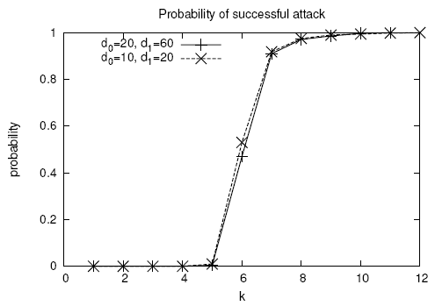
Experiments
Attack an average of 34 to 70 nodes

Slide 31
k-structural Anonymity

Slide 32
A number of approaches based on k-anonymity: at least k elements satisfy a constraint
Hide the private information with these k elements
Methods based on “structural” k-anonymity (the attacker knowledge concerns the structure of the graph)
  k-candidate
  k-degree
  k-neighborhood

Slide 33
k-candidate Anonymity
M Hay et al, Resisting Structural Re-identification in Anonymized Social Networks VLDB 2008

Slide 34
Introduction
G_{a} the naive anonymization of G through an anonymization mapping f
An individual x ∈ V called the target has a candidate set, denoted cand(x) which consists of the nodes of G_{a} that could possibly correspond to x
Given an uninformed adversary, each individual has the same risk of re-identification, cand(x) = V_{a}
In practice, some knowledge, examples:
Bob has three or more neighbors, cand(Bob) =?
Greg is connected to at least two nodes, each with degree 2, cand(Greg) =?

Slide 35
Introduction
Target x ∈ V
cand(x) nodes of G_{a} that could possibly correspond to x
Topic of this work:
Definition of the problem: size of cand(x) (at least size k)
Model background knowledge
Study both real (experimentally) and synthetic (analytically) graphs in terms of the size of cand(x)

Slide 36
Introduction
(background knowledge) structural re-identification where the information of the adversary is about graph structure
(utility) analysis about structural properties: finding communities, fitting power-law graph models, enumerating motifs, measuring diffusion, accessing resiliency
Two important factors
descriptive power of the external information
structural similarity of nodes

Slide 37

Automorphic Structural Similarity
A strong form of structural similarity.
[automorphic equivalence]. Two nodes x, y ∈ V are automorphically equivalent (denoted x ≡ y) if there exists an isomorphism from the graph onto itself that maps x to y.
Example: Fred and Harry, but not Bob and Ed

Slide 38
Automorphic Structural Similarity
Automorphic equivalence induces a partitioning on V into sets whose members have identical structural properties.
Size of each partition at least k
An adversary —even with exhaustive knowledge of the structural position of a target node — cannot identify an individual beyond the set of entities to which it is automorphically equivalent.
Some special graphs have large automorphic equivalence classes.
  E.g., complete graph, a ring
In general, an extremely strong notion of structural similarity.

Slide 39
Model of Adversary Knowledge
An adversary access a source that provides answers to a
restricted knowledge query Q evaluated for a single target node of the original graph G.
knowledge gathered by the adversary is accurate.
For target x, use Q(x) to refine the candidate set.
[CANDIDATE SET UNDER Q]. For a query Q over a graph, the candidate set of x w.r.t Q is candQ(x) = {y ∈V_{a} | Q(x) = Q(y)}.

Slide 40
Model of Adversary Knowledge
Adversary knowledge about a targeted individual tends to be local to the targeted node
Three Types of Queries
Vertex Refinement Queries
Subgraph Queries
Hub Fingerprint Queries

Slide 41
Vertex Refinement
A class of queries of increasing power which report on the local structure of the graph around a node.
H₀, simply returns the label of the node.
H₁(x) returns the degree of x,
H₂(x) returns the multiset of each neighbors’ degree,
H_{i}(x) returns the multiset of values which are the result of evaluating H_{i-1} on the nodes adjacent to x
H* Iterative computation of H until no new vertices are distinguished.

Slide 42
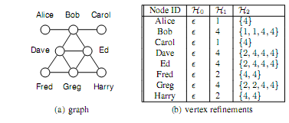
Vertex Refinement
Unlabeled graph, H₀ = {ε}
H* = H₂

Slide 43
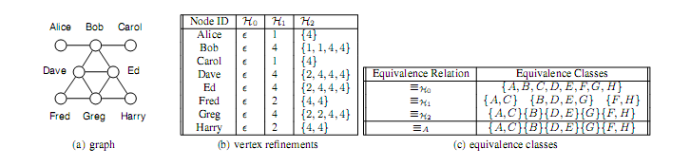
Vertex Refinement
DEFINITION 2 (RELATIVE EQUIVALENCE). Two nodes x, y in a graph are equivalent relative to H_{i}, denoted x ≡ _{Hi} y, if and only if H_{i}(x) = H_{i}(y).
Proposition: Let x, x' ∈ V, if x ≡ _{Hi} x', then cand_{Hi}(x) = cand_{Hi}(x')
To an adversary limited to knowledge query H_{i}, nodes equivalent with respect to H_{i} are indistinguishable.
Equivalence under H* is very likely to coincide with automorphic equivalence.

Slide 44
Subgraph Queries
Limitation of vertex refinement:
always provide complete information about the nodes adjacent to the target (closed-world).
arbitrarily large subgraphs around a node if that node is highly connected
E.g., if H₁(x) = 100 vs H₁(y) = 2
Class of queries about the existence of a subgraph around the target node.
Measure their descriptive power by counting edge facts (# edges in the subgraph).

Slide 45
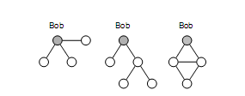
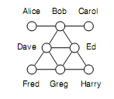
Subgraph Queries
Example: Three subgraph queries centered around Bob with 3, 4 and 5 edge facts
may correspond to different strategies of knowledge acquisition by the adversary.
including breadth-first exploration, induced subgraphs of radius 1 and 2. etc -- For a given number of edge facts, some queries are more effective at distinguishing individuals.
may be incomplete (open-world)

Slide 46
Hub Fingerprint
Hub: a node with high degree and high betweenness centrality (the proportion of shortest paths in the network that include the node)
  are often outliers, making it difﬁcult to protect their identity through anonymization.
Hub fingerprint for a target node x: a description of the connections of x to a set of designated hubs in the network.
F_{i}(x) hub fingerprint of x to a set of designated hubs, where i limit on the maximum distance

Slide 47
Hub Fingerprint
Hubs: Dave and Ed
F₁(Fred) = (1; 0)
F₂(Fred) = (1; 2)
both an open and a closed world.
Example:
open world, if the adversary knows F₁(Fred) = (1; 0) then nodes in the anonymized graph with F₁ ﬁngerprints of (1; 0) or (1; 1) are both candidates for Fred.

Slide 48
Disclosure in Real Networks
Study three networked data sets, from diverse domains.
For each data set,
Consider each node in turn as a target.
Assume the adversary computes a vertex refinement, a subgraph, or a hub fingerprint query on that node, and compute the corresponding candidate set for that node.
Report the distribution of candidate set sizes across the population of nodes to characterize how many nodes are protected and how many are identifiable.

Slide 49
Disclosure in Real Networks
Hep-Th database: papers and authors in theoretical high-energy physics, from the arXiv archive, linked if at least two papers together.
Enron dataset: from a corpus of email sent to and from managers at Enron Corporation -- Two individuals connected if they corresponded at least 5 times.
Net-trace dataset: from an IP-level network trace collected at a major university. monitors traffic at the gateway; a bipartite graph between IP addresses internal to the institution, and external IP addresses.
187 internal addresses from a single campus department and the 4026 external addresses to which at least 20 packets were sent on port 80 (http traffic).
undirected edges, self-loops removed, eliminated a small percentage of disconnected nodes.

Slide 50
Disclosure in Real Networks: Vertex refinement
very low percentage of high-risk nodes under a reasonable assumption about adversary knowledge.
Two datasets meet that requirement for H1 (Hep-Th and Net-trace), but no datasets meet that requirement for H2.
signiﬁcant variance across different datasets in their vulnerability to different adversary knowledge.
the most signiﬁcant change in re-identiﬁcation is from H1 to H2
Re-identiﬁcation tends to stabilize after H3 — more information in the form of H4 does not lead to an observable increase in re-identiﬁcation
a substantial number of nodes are not uniquely identified even with H4

Slide 51
Disclosure in Real Networks: Subgraph queries
disclosure is substantially lower than for vertex reﬁnement queries.
To select candidate sets of size less than 10 requires a subgraph query of size 24 for Hep-Th, size 12 for Enron, and size 32 for Net-trace.
The smallest subgraph query resulting in a unique disclosure was size 36 for Hep-Th and 20 for Enron. The smallest candidate set witnessed for Net-trace was size 2, which resulted from a query consisting of 88 edge facts.
Breadth-ﬁrst exploration led to selective queries across all three datasets.
  asserts lower bounds on the degree of nodes.
  In Enron, the most selective subgraph queries witnessed;
  for Hep-Th and Net-trace, the more selective subgraph queries asserted the existence of two nodes with a large set of common neighbors.

Slide 52
Disclosure in Real Networks: Hub fingerprints
disclosure is low using hub fingerprints.
At distance 1, 54% of the nodes in Enron were not connected to any hub and therefore hub fingerprints provide no information.
This was 90% for Hepth and 28% for Net-trace.
connectivity to hubs was fairly uniform across individuals.
For example, the space of possible fingerprints at distance 1 for Hepth and Net-trace is 2¹⁰= 1024.
Of these, only 23 distinct fingerprints were observed for Hepth and only 46 for Net-trace.
hubs themselves stand out, but have high-degrees, thus connections to a hub are shared by many.

Slide 53
Re-identification in Random Graphs
Erdos-Renyi (RE) random graphs
n nodes by sampling each edge independently with probability p
How p scales with n
sparce p = c/n, dense = clogn/n, super-dense p = c (c is a constant)
c>1,
include a giant connected component of size Θ(n), and a collection of smaller components (sparse)
completed connected (dense)

Slide 54


Re-identification in Random Graphs
For dense, nodes cannot be identified for H₁ for any c>0, but all nodes are re-identifiable for H₂ for any c>1

Slide 55

Re-identification in Random Graphs
ω(G) the number of nodes in the largest clique
Any subgraph query matching fewer than ω(G) nodes, will match any node in the clique

Slide 56

Anonymization Algorithm
Partition/Cluster the nodes of Ga into disjoint sets
In the generalized graph,
supernodes: subsets of Va
edges with labels that report the density (including self-loops)
Analyst: sample a single random graph
Partitions of size at least k
Extreme cases: a singe super-node with self-loop, Ga
Again: Privacy vs Utility

Slide 57

Anonymization Algorithm
Find a partition that best fits the input graph
Estimate fitness via a maximum likelihood approach
Uniform distribution over all possible worlds
(different ways to take distances in each cluster and among clusters)
Searches all possible partitions using simulated annealing
Each valid partitions (minimum partition of at least k nodes) is a valid state
Starting with a single partition with all nodes, propose a change of state:
  split a partition
  merge two partitions, or
  move a node to a different partition
Always accept the change if it improves the likelihood, accept with some probability if it does not
Stop when fewer than 10% of the proposals are accepted

Slide 58
k-degree Anonymity
K. Liu and E. Terzi, Towards Identity Anonymization on Graphs, SIGMOD 2008

Slide 59
k-degree Anonymity
Assume that adversary A knows that B has 327 connections in a social network! (background knowledge)
If the graph is released by removing the identity of the nodes
  A can find all nodes that have degree 327
  If there is only one node with degree 327, A can identify this node as being B.
Notes:
59

Slide 60
k-degree Anonymity
k-degree anonymity A graph G(V, E) is k-degree anonymous if every node in V has the same degree as k-1 other nodes in V.
A (2)
B (2)
E (2)
2-degree anonymous
C (1)
D (1)
Prop 1: If G is k1-degree anonymous, then it is also k2-degree anonymous, for every k2 ≤ k1
  [Properties] It prevents the re-identification of individuals by adversaries with a priori knowledge of the degree of certain nodes.

Slide 61
k-degree Anonymity: Anonymization problem
Given a graph G(V, E) and an integer k,
modify G via a set of edge addition or deletion operations
to construct a new graph k-degree anonymous graph G’ in which every node u has the same degree with at least k-1 other nodes
Why not simply transform G to the complete graph?

Slide 62
k-degree Anonymity: Anonymization problem
Given a graph G(V, E) and an integer k, modify G via a minimal set of edge addition or deletion operations to construct a new graph G’(V’, E’) such that
1) G’ is k-degree anonymous;
2) V’ = V;
3) (utility) The symmetric difference of G and G’ is as small as possible
Symmetric difference between graphs G(V,E) and G’(V,E’) :
Assumption: G: undirected, unlabeled, no self-loops or multiple-edges
Only edge additions -- SymDiff(G’, G) = |E’| - |E|

Slide 63
k-degree Anonymity
A (2)
A (2)
B (1)
E (1)
B (2)
E (2)
anonymization
C (1)
D (1)
C (1)
D (1)

Slide 64
k-degree Anonymity: degree sequence
[k-anonymous sequence] A sequence of integers d is k-anonymous if every distinct element value in d appears at least k times.
[100,100, 100, 98, 98,15,15,15]
A graph G(V, E) is k-degree anonymous if its degree sequence is k-anonymous

Slide 65
k-degree Anonymity: degree sequence anonymization
Increase/decrease of degrees correspond to additions/deletions of edges
[degree-sequence anonymization] Given degree sequence d, and integer k, construct a k-anonymous sequence d’ such that ||d’-d|| (i.e., L₁(d’ – d)) is minimized
|E’| - |E| = ½ L₁(d’ – d)
Relax graph anonymization: E’ not a supergraph of E

Slide 66
k-degree Anonymity: algorithm
Two steps
Input: Graph G with degree sequence d, integer k Output: k-degree anonymous graph G’
[STEP 1: Degree Sequence Anonymization]: Construct an (optimal) k-anonymous degree sequence d’ from the original degree sequence d [STEP 2: Graph Construction]: [Construct]: Given degree sequence d', construct a new graph G⁰(V, E⁰) such that the degree sequence of G⁰ is d‘ [Transform]: Transform G⁰(V, E⁰) to G’(V, E’) so that SymDiff(G’,G) is minimized.

Slide 67
k-degree Anonymity Algorithm: degree sequence
Degree sequence anonymization
d (1) ≥ d (2) ≥… ≥ d (i) ≥… ≥ d (n) : original degree sequence.
d’(1) ≥ d’(2) ≥…≥ d’(i) ≥… ≥ d’ (n) : k-anonymized degree sequence.
If we only add edges, d’(i) ≥ d(i)
Observation 1, if d’(i) = d’(j) with i < j, then d’(i) = d’(i+1) = .. . d’(j-1) = d(j)
I(i, j): anonymization cost when all nodes i, i+1, …, j are put in the same anonymized group

Slide 68
k-degree Anonymity Algorithm: degree sequence
Example
6 6 5 5 4 4 4 4 4 (k=3)
6 6 6
Merge with previous group: 6 6 6 6, or
Start new group: 6 6 6 5
Greedy
Form a group with the first k, for the k+1, consider
C_{merge} = (d(1) – d(k+1)) + I(d(k+2, 2k+1)) C_{new}= I(d(k+1, 2k)

Slide 69
k-degree Anonymity Algorithm: degree sequence
DA(1, j): the optimal degree anonymization of subsequence d(1, j)
DA(1, n): the optimal degree-sequence anonymization cost
I(i, j): anonymization cost when all nodes i, i+1, …, j are put in the same anonymized group
For i < 2k (impossible to construct 2 different groups of size k)
For i ≥ 2k

Slide 70
k-degree Anonymity Algorithm: degree sequence
Can be improved, no anonymous groups should be of size larger than 2k-1
We do not have to consider all the combinations of I(i, j) pairs, but for every i, only j’s such that k ≤ j – i + 1 ≤ 2k-1
O(n²) -> (Onk)
Additional bookkeeping -> Dynamic Programming with O(nk)

Slide 71
k-degree Anonymity Algorithm: graph construction
A degree sequence d is realizable if there exists a simple undirected graph with nodes having degree sequence d.
Are all degree sequences realizable?
Not all vectors of integers are realizable degree sequences
  d = {4, 2, 2, 2, 1} ?
How can we decide?

Slide 72
k-degree Anonymity Algorithm: graph construction
[Erdös and Gallai] A degree sequence d with d(1) ≥ d(2) ≥… ≥ d(i) ≥… ≥ d(n) and Σd(i) even, is realizable if and only if
For each subset of the l highest degree nodes, the degrees of these nodes can be “absorbed” within the nodes and the outside degrees

Slide 73
k-degree Anonymity Algorithm: graph construction
Input: Degree sequence d’
Output: Graph G⁰(V, E⁰) with degree sequence d’ or NO!
General algorithm, create a graph with degree sequence d’
In each iteration,
pick an arbitrary node u
add edges from u to d(u) nodes of highest residual degree, where d(u) is the residual degree of u
Is an oracle
We also need G’ such that E’ ⊇ E
Thus, we start with the edges of E already in
Is not an oracle

Slide 74
k-degree Anonymity Algorithm: graph construction
Input: Degree sequence d’
Output: Graph G⁰(V, E⁰) with degree sequence d’ or NO!
→If the degree sequence d’ is NOT realizable?
  Convert it into a realizable and k-anonymous degree sequence
Slightly increase some of the entries in d via the addition of uniform noise
In the implementation, examine the nodes in increasing order of their degrees, and slightly increase the degrees of a single node at each iteration (in real graph, few high degree nodes – rarely any two of these exactly the same degree)

Slide 75
k-degree Anonymity Algorithm: graph transformation
GreedySwap transforms G⁰ = (V, E⁰) into G’(V, E’) with the same degree sequence d’, and min symmetric difference SymDiff(G’,G) .
GreedySwap is a greedy heuristic with several iterations.
At each step, GreedySwap swaps a pair of edges to make the graph more similar to the original graph G, while leaving the nodes’ degrees intact.
Notes:
75
Overall process dp-erdosgallai-transform the graph into something close to the original graph

Slide 76
Valid swappable pairs of edges
k-degree Anonymity Algorithm: graph construction
A swap is valid if the resulting graph is simple

Slide 77
Experiments
Datasets:
  Co-authors (7995 authors of papers in db and theory conference),
  Enron emails (151 users, edge if at least 5 times),
  powergrid (generators, transformers and substations in a powergrid network, edges represent high-voltage transmission lines between them),
  Erdos-Renyi (random graphs with nodes randomly connected to each other with probability p),
  small-world large clustering coefficient (average fraction of pair of neighbors of a node that are also neighbors) and small average path length (average length of the shortest path between all pairs of reachable nodes),
  power-law or scale graphs (the probability that a node has degree d is proportional to d^{-γ}, γ = 2, 3)
Goal (Utility): degree-anonymization does not destroy the structure of the graph
  Average path length
  Clustering coefficient
  Exponent of power-law distribution

Slide 78
Experiments: Clustering coefficient and Avg Path Length
Co-author dataset
APL and CC do not change dramatically even for large values of k

Slide 79
Experiments: Edge intersections
Edge intersection achieved by the GreedySwap algorithm for different datasets.
Parenthesis value indicates the original value of edge intersection
Synthetic datasets
Small world graphs* | 0.99 (0.01)
Random graphs | 0.99 (0.01)
Power law graphs** | 0.93 (0.04)
Real datasets
Enron | 0.95 (0.16)
Powergrid | 0.97 (0.01)
Co-authors | 0.91(0.01)

Slide 80
Experiments: Exponent of power law distributions
Original | 2.07
k=10 | 2.45
k=15 | 2.33
k=20 | 2.28
k=25 | 2.25
k=50 | 2.05
k=100 | 1.92
Co-author dataset
Exponent of the power-law distribution as a function of k

Slide 81
k-neighborhood Anonymity
B. Zhou and J. Pei, Preserving Privacy in Social Networks Against Neighborhood Attacks, ICDE 2008

Slide 82
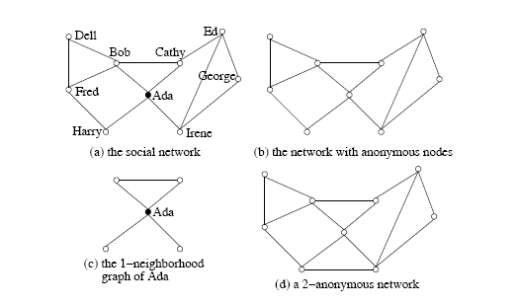
Introduction
The neighborhood of u ∈ V(G) is the induced subgraph of the neighbors of u, denoted by Neighbor_{G}(U) = G(N_{u}) where N_{u} = {v | (u,v) ∈ E(G)}.
1-neighborhood attacks
For example, the adversary knows that:
Ada has 2 friends who know each other and another two friends who do not know each other (1-neighborhood graph – induced subgraph)
Bob can also be identified from its 1-neighborhood graph

Slide 83
Graph Model
Graph G= (V, E, L, F),
V a set of nodes,
E ⊆ Vx V set of edges,
L is a set of labels, and
F a labeling function F: V →L assigns each node a label.
edges do not carry labels
Items in L form a hierarchy.
E.g., if occupations as labels, L contains not only the specific occupations [such as dentist, general physician, optometrist, high school teacher, primary school teacher, etc] but also general categories [such as, medical doctor, teacher, and professional}.
* ∈ L -> most general category generalizing all labels.

Slide 84
Graph Model
Given a graph = (V_{H}, E_{H}, L, F ) and a social network G = (V, E, L, L), an instance of H in G is a tuple (H', f) where H' = (V_{H’} ,E_{H’} ,L, F) is a subgraph in G and f: V_{H} →V_{H’}, is a bijection function such that
(1) for any u ∈ V_{H}, F(f(u)) ≤ F(u), /* the corresponding labels in H’ are more general */ and
(2) (u, v) ∈ E_{H} if and only if (f (u), f(v)) ∈ E_{H’}.

Slide 85
k-neighborhood anonymity
G -> G’ through a bijection (isomorphism) A
[k-neighborhood anonymity] A vertex u ∈ V (G), u is k anonymous in G’ if there are at least (k − 1) other vertices u₁, . . . , u_{k−1} ∈ V (G) such that Neighbor_{G′}(A(u)), Neighbor_{G′}(A(u₁)), . . ., Neighbor_{G′}(A(u_{k−1})) are isomorphic.
G′ is k-anonymous if every vertex in G′ is k-anonymous.
Property 1 (k-anonymity) Let G be a social network and G′ an anonymization of G.
If G′ is k-anonymous, then with the neighborhood background knowledge, any vertex in G cannot be re-identified in G′ with confidence larger than 1/k .

Slide 86
k-neighborhood anonymity
Given a social network G, the k-anonymity problem is to compute an anonymization G′ such that
(1) G′ is k-anonymous;
(2) each node in G is anonymized to a node in G′ and G′ does not contain any fake nodes; (no node addition)
(3) every edge in G is retained in G′; (no edge deletion); and
(4) the number of edges to be added is minimized.

Slide 87
k-neighborhood anonymity
Utility
Aggregate queries:
compute the aggregate on some paths or subsgraphs satisfying some given conditions
E.g., Average distance from a medical doctor to a teacher
Heuristically, when the number of edges added is as small as possible, G′ can be used to answer aggregate network queries accurately

Slide 88
k-neighborhood anonymization method
Two steps:
STEP 1
Extract the neighborhoods of all nodes in the network
Encode the neighborhood of each node (to facilitate the comparison between neigborhoods)
STEP 2
Greedily, organize nodes into groups and anonymize the neighborhoods of nodes in the same group

Slide 89
k-neighborhood anonymization method
Step 1: Neighborhood Extraction and Coding
General problem of determining whether two graphs are isomorphic is NP-complete
Goal: Find a coding technique for neighborhood subgraphs so that whether two neighborhoods are isomorphic can be determined by the corresponding encodings

Slide 90
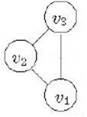
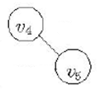

k-neighborhood anonymization method
Step 1: Neighborhood Extraction and Coding
A subgraph C of G is a neighborhood component of u ∈ V (G), if C is a maximal connected subgraph in Neighbor_{G}(u).
Neighborhood components of u
Divide the neighborhood of v into neighborhood components
To code the whole neighborhood, first code each component.

Slide 91
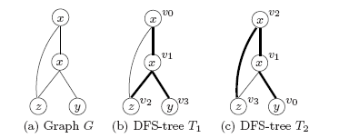
k-neighborhood anonymization method
Step 1: Neighborhood Extraction and Coding
Encode the edges and vertices in a graph based on its depth-first search tree (DFS-tree).
All the vertices in G can be encoded in the pre-order of T .
Thick edges are those in the DFS-trees (forward edges),
Thin edges are those not in the DFS-trees (backward edges)
vertices encoded u0 to u3 according to the pre-order of the corresponding DFS-trees.
The DFS-tree is generally not unique for a graph -> minimum DFS code (based on an ordering of edges) – select the lexically minimum DFS code – DFS(G)
Two graphs G and G’ are isomorphic, if and only if, DFS(G) = DFS(G’)

Slide 92
k-neighborhood anonymization method
Step 2: Social Network Anonymization
Each node must be grouped with a least (k-1) other nodes such their anonymized neighborhoods are isomorphic
Vary few nodes have high degrees, process them first to keep information loss for them low
Many vertices of low degree, easier to anonymize

Slide 93
k-neighborhood anonymization method
Step 2: Anonymizing 2 neighborhoods
First, find all perfect matches of neighborhood components (perfectly match=same minimum DFS code)
For unmatched, try to pair “similar” components and anonymize them
How: greedily, starting with two nodes with the same degree and label in the two components to be matched (if ties, start from the one with the highest degree - If there are no such nodes: choose the one with minimum cost)
Then a BFS to match nodes one by one, if we need to add a node, consider nodes in V(G)

Slide 94
k-neighborhood anonymization method
Co-authorship data from KDD Cup 2003 (from arXiv, high-energy physics)
Edge – co-authored at least one paper in the data set.
57,448 vertices
120,640 edges
average number of vertex degrees about 4.

Slide 95
k-Automorphism
L. Zhu, L. Chen and M. Tamer Ozsu, k-automorphism: a general framework for privacy preserving network publication, PVLDB 2009

Slide 96
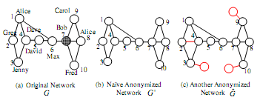
K-Automorphism
Considers any subgraph query - any structural attack
At least k symmetric vertices no structural differences

Slide 97

K-Automorphism
any k-1 automorphic functions?

Slide 98
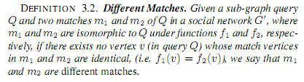

K-Automorphism

Slide 99

K-Automorphism: Cost

Slide 100
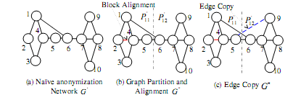
K-Match (KM) Algorithm
Step 1: Partition the original network into blocks
Step 2: Align the blocks to attain isomorphic blocks (add edge (2,4))
Step 3: Apply the "edge-copy" technique to handle matches that cross the two blocks

Slide 101
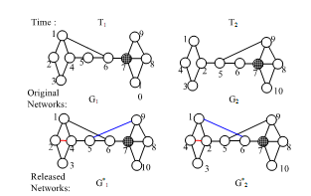

Dynamic Releases
Example:
Individually satisfy 2-automorphism
Assume that an adversary knows that sub-graph Q4 exists around target Bob at both time T1 and T2.
At time T1, an adversary knows that there are two candidates vertices (2, 7)
Similarly, at time T2, there are still two candidates (4, 7)
Since Bob exists at both T1 and T2, vertex 7 corresponds to Bob

Slide 102
Evaluation
Prefuse (129 nodes, 161 edges)
Co-author graph (7995 authors in database and theory, 10055 edges)
Synthetic
Erdos Renyi, 1000 nodes
Scale free, 2 < γ < 3
All k = 10 degree anonymous, but no sub-graph anonymous

Slide 103
Privacy of Private Profiles
E. Zheleva and L. Getoor, To Join or not to Join: The illusion of privacy in social networks with mixed private and public profiles. WWW 2009

Slide 104
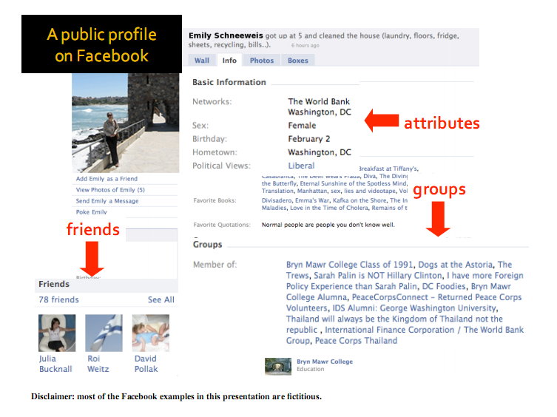
Motivation

Slide 105
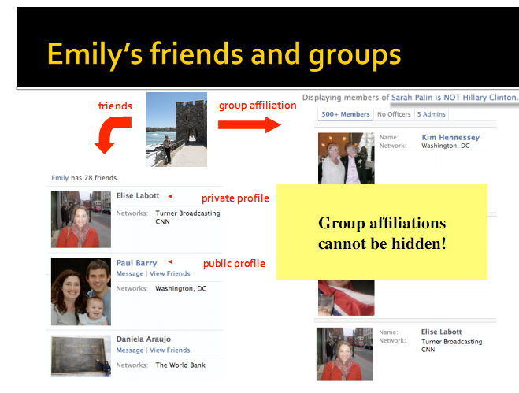
Motivation

Slide 106
Problem Definition
sensitive attribute inference in social networks
Inferring the private information of users given a social network in which some proﬁles and all links and group memberships are public
Different Problem than Anonymized Publishing:
Goal is not to release anonymized data but to illustrate how social network data can be exploited to predict hidden information

Slide 107
Problem Definition
Identity disclosure
  E.g., Elise Labbort refers to the CNN reporter Elise Labbort --
Attribute disclosure
  E.g., Elise Labbort is 30
Link/relationship disclosure
  E.g., Elise Labbort is friends with Emily
Group membership disclosure
  E.g., Elise Labbort is a member of the group "Sarah Palin is NOT Hillary Clinton"

Slide 108
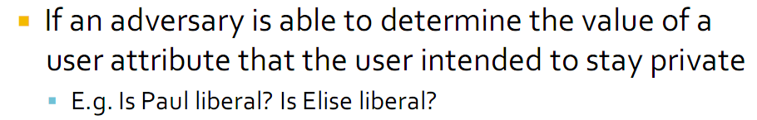
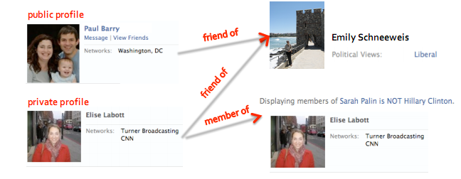
Problem Definition

Slide 109
Model
A social network as a graph G = (V, E, H),
V is a set of n nodes of the same type,
E is a set of (directed) edges (the friendship links), and
H is a set of groups
A group as a hyper-edge h ∈ H among all the nodes who belong to that group
h.U set of users who are connected through hyper-edge h and
v.H the groups that node v belongs to
v.F is the set of nodes that v has connected to (friends)
A group can have a set of properties h.T.

Slide 110
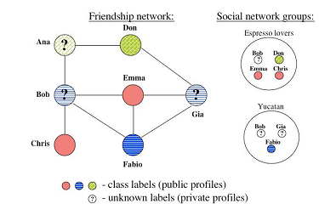
Example

Slide 111
Approach
The sensitive attribute value of an individual is modeled as a random variable.
The distribution of this random variable can depend
on the overall network’s attribute distribution,
the friendship network’s attribute distribution and/or [LINK]
the attribute distribution of each group the user joins. [GROUP]
The problem of sensitive attribute inference is to infer the hidden sensitive values, Vs.A, conditioned on the observed sensitive values, links and group membership in graph G.

Slide 112




Approach
Based on overall network distribution
BASIC
Based on friendship links
AGG, CC, BLOCK, LINK
Based on social groups
CLIQUE, GROUP, GROUP*
Based on both links and groups
LINK-GROUP

Slide 113

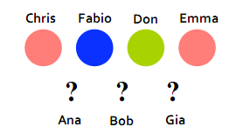
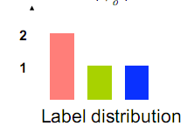
Approach: Baseline
Model based on overall network distribution
In the absense of links and groups, BASIC assigns majority label
at least as good as a random guess

Slide 114

Approach: Friends
Take advantage of autocorrelation, the property that the attribute values of linked objects are correlated
There is a random variable associated with each sensitive attribute v.a, and the sensitive attributes of linked nodes are correlated.
Friends-Aggregate Model (AGG): looks at the attribute's distribution among the friends
The adversary picks the most probable attribute value (i.e., the mode of the friends’ attribute distribution).

Slide 115
Approach: Friends
Bob, same as Emma and Chris, Ana? Gia?

Slide 116
Approach:
Collective Classification Model (CC): learning and inferring class labels of linked objects together
Instead of each instance being classified independently, use also the inferred attributes for connected private profiles
Various Implementations -
ICA (Iterative Classification)
ﬁrst assigns a label to each private proﬁle based on the labels of the friends with public proﬁles, then
it iteratively re-assigns labels considering the labels of both public and private-proﬁle friends.

Slide 117
Approach: Friends
Flat-link model (LINK): ”Flatten” the data by considering the adjacency matrix of the graph.
Each row (user) a list of binary features of the size of the network: value 1 if the user is a friend with the person who corresponds to this feature, and 0 otherwise.
The user instance also has a class label known if the user’s proﬁle is public
The instances with public proﬁles are the training data which can be fed to any traditional classiﬁer, such as Naive Bayes, logistic regression or SVM.
The learned model can then be applied to predict the private proﬁle labels.

Slide 118

Approach: Friends
Blockmodeling attack (BLOCK)
Basic idea: users form natural clusters or blocks, and their interactions can be explained by the blocks they belong to.
Block Bi the set of public profiles with value ai
λi,j the probability that a link exists between users in block Bi and users in block Bj
λi is the vector of all link probabilities between block Bi and each block B1, ...,Bm.
For user v, λ(v)j the probability of a link between a single user v and a block Bj
λ(v) the vector of link probabilities between v and each block.
sim (any similarity, minimum L2 norm), Z a normalization factor

Slide 119
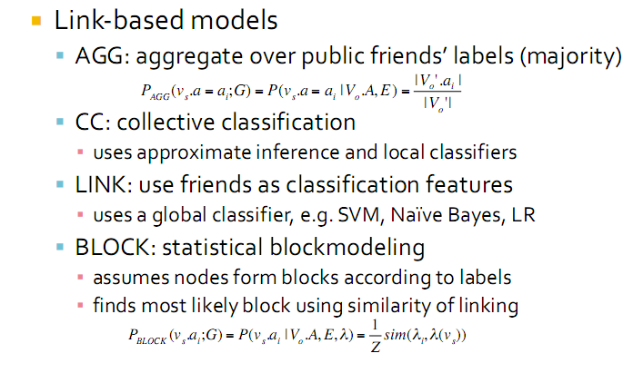
Approach: Friends

Slide 120
Approach: Groups
Groupmate-link model (CLIQUE)
Each group is a clique of friends: a friendship link between users who belong to at least one group together.
apply any of the link-based models
(+) simpliﬁes the problem to a link-based classiﬁcation problem
(-) doesn’t account for the strength of the relationship between two people, e.g. number of common groups

Slide 121
Approach: Groups
Group-based Classification (GROUP): each group as a feature in a classifier
Three steps
Step 1: identify which groups are likely to be predictive -- apply feature selection (small groups, homogeneous, etc)
Step 2: learn a global function f, (e.g., train a classiﬁer, that takes the relevant groups of a node as features and returns the sensitive attribute value).
Uses only the nodes from the observed set whose sensitive attributes are known.
Each node v as a binary vector where each dimension corresponds to a unique group: {groupId : isMember}, v.a. Only memberships to relevant groups and v.a is the class coming from a multinomial distribution which denotes the sensitive attribute value.
Step 3: return the predicted sensitive attribute for each private proﬁle.

Slide 122
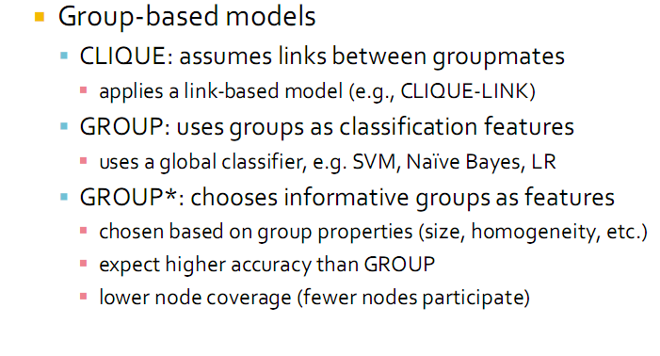
Approach: Groups

Slide 123
Approach: Friends + Groups
a method which uses both links and groups to predict the sensitive attributes of users
a simple method which combines the ﬂat-link and the group-based classiﬁcation models into one:
LINK-GROUP: uses all links and groups as features.

Slide 124
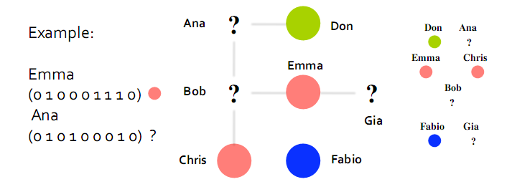
Approach: Friends + Groups

Slide 125
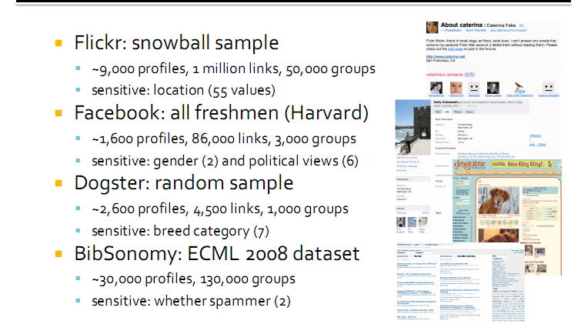
Evaluation

Slide 126
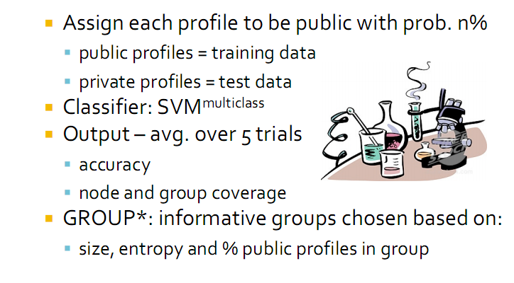
Evaluation
succesful attack?

Slide 127
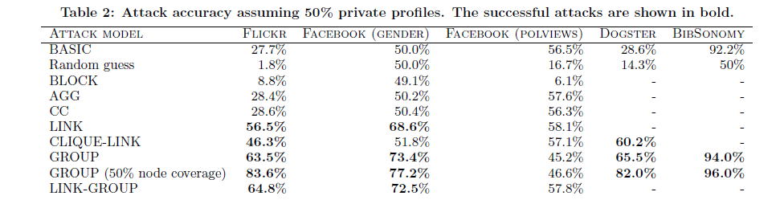
Evaluation
Countries 6 labels 8 breeds spam or not

Slide 128
De-anonymization
A. Narayanan, V. Shmatikov, De-anonymizing Social Networks. International Symposium on Security and Privacy, 2009

Slide 129


Introduction: new type of passive attack
Bob
Bob has accounts in both facebook and myspace
Background knowledge: another social network with partially overlapping membership

Slide 130
Introduction: goal
Given the auxiliary information, (nodes, edges) about one social network (auxiliary network) and a small number of members of target network, the attacker wants to learn sensitive information about other members of target network.

Slide 131
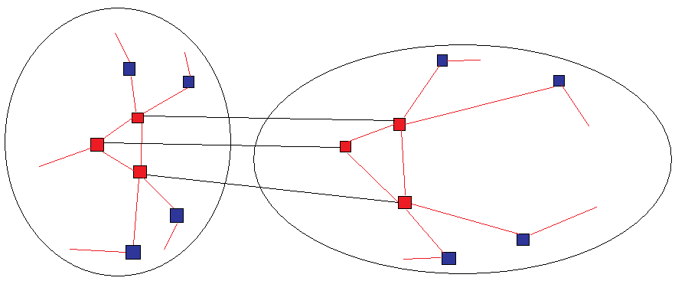
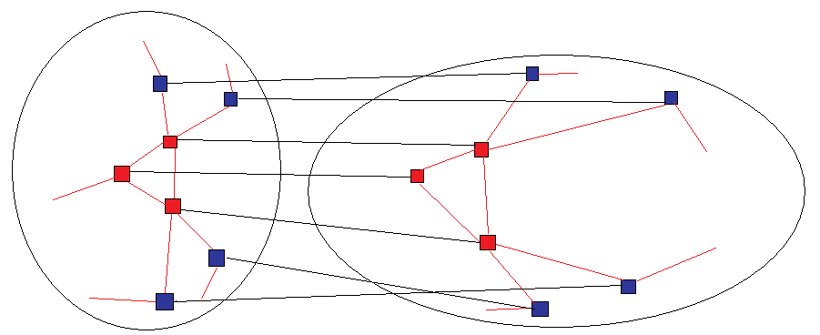
Introduction: goal
Facebook graph (auxiliary)
Myspace graph (target)
Initial mapping (seed)
Final mapping

Slide 132
Algorithm
2 stages
1. Seed identification
2. Propagation

Slide 133
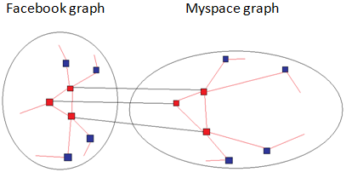
Algorithm: Seed identification
Identify a small number of seed nodes in both target graph and auxiliary graph, and map them to each other
assumes a clique of k nodes in both graphs
suffices to know the degree of each node and the number of common neighbors for each pair

Slide 134
Algorithm: Seed identification
Input:
1. the target graph
2. k seed nodes in the auxiliary graph
3. k nodes’ information, such as, degree values and pairs of common-neighbor counts
4. Error parameter ε
Method
Search the target graph for a unique k-clique with matching (within a factor of 1 ± ε) nodes degrees and common-neighbor counts
Output
If found, it maps the nodes in the clique to the corresponding nodes in the auxiliary graph

Slide 135
Algorithm: Seed identification
does not guarantee a unique k-clique in target graph.
the running time is exponential in k.
  Once we find a matched clique in target graph, stop searching

Slide 136
Algorithm: Propagation
Input
1. G1(V1, E1)
2. G2(V2, E2)
3. A partial “seed” mapping between the two.
No distinction which is the auxiliary graph or the target graph
Output
mapping μ, focus on deterministic

Slide 137
Algorithm: Propagation
Finds new mappings using the topological structure of the network and the feedback from previously constructed mappings.
At each iteration,
start with the list of mapped pairs between V1 and V2.
Pick an arbitrary unmapped node u in V1 and computes a score for each unmapped node v in V2, equal to the number of neighbors of u that have been mapped to neighbors of v.
If the strength of the match is above a threshold,
the mapping between u and v is added to the list, and the next iteration starts.

Slide 138
Algorithm: Propagation
G1
G2
B
Y
A
X
Z
C
E
D
W
Mapping list={(B,Y), (C, Z),(D, W)}
Score(A, X) = 2, Score(E, Z) = 0

Slide 139

Algorithm: Propagation
Lots of scores. Which mapping should we keep?
Additional details
1. Edge directionality. Score = incoming edge score + outgoing edge score.
2. Node degrees. (to compensate for the bias towards high degree nodes)
Score(u, v_{i})=score(u, v_{i})/√degree of v_{i}
3. Eccentricity. It measures how much an item in a set X “stands out” from the rest.
where max and max2 denote the highest and second highest values, respectively, and σ denotes the standard deviation.
If > θ, keep the mapping; otherwise, it is rejected, where θ is a parameter.

Slide 140
Algorithm: Propagation
4. Does not matter whether G1 is the target and G2 is the auxiliary, each time u is mapped to v, switch the input graph, if v gets mapped back to u, the mapping is retained; otherwise, it is rejected.
5. Revisiting nodes. As the number of mapped nodes increases, we need to revisit already mapped nodes.
6. Do the iteration until convergence.

Slide 141
Algorithm: Propagation
Complexity
O((|E1|+|E2|)*d1*d2) where d1 is a bound on the degree of nodes in G1. D2 is a bound on the degree of nodes in G2.
Without revisiting nodes and reverse matches
O(|E1|*d2)
Without reverse matches
O(|E1|*d1*d2)

Slide 142
Propagation
Auxiliary graph: Flickr. Target graph: Twitter
ground truth (matches based on username, name, location)
27,000 mappings
Seed mapping consists of 150 pairs of nodes with the constraints that the degree of each node in auxiliary graph is at least 80.

Slide 143
Result of accuracy
30.8% of mappings(27,000) were re-identified correctly, 12.1% were identified incorrectly, and 57% were not identified.
41% of the incorrectly identified mappings were mapped to nodes which are at a distance 1 from the true mapping.
55% of the incorrectly identified mappings were mapped to the nodes where the same location was reported.
The above two categories overlap; only 27% of incorrect mappings are completely erroneous.

Slide 144
Result of accuracy
30.8% of mappings(27,000) were re-identified correctly, 12.1% were identified incorrectly, and 57% were not identified.
41% of the incorrectly identified mappings were mapped to nodes which are at a distance 1 from the true mapping.
55% of the incorrectly identified mappings were mapped to the nodes where the same location was reported.
The above two categories overlap; only 27% of incorrect mappings are completely erroneous.

