Slide 1
Λ14 Διαδικτυακά Κοινωνικά Δίκτυα και Μέσα
Link Prediction

Slide 2
Motivation
Recommending new friends in online social networks.
Predicting the participants of actors in events
Suggesting interactions between the members of a company/organization that are external to the hierarchical structure of the organization itself.
Predicting connections between members of terrorist organizations who have not been directly observed to work together.
Suggesting collaborations between researchers based on co-authorship.

Slide 3
Liben-Nowell, D. and Kleinberg, J. The link-prediction problem for social networks. Journal of the American Society for Information Science and Technology, 58(7) 1019–1031 (2007)

Slide 4
Problem Definition
Link prediction problem: Given the links in a social network at time t, predict the edges that will be added to the network during the time interval from time t to a given future time t’
Based solely on the topology of the network (social proximity) (the more general problem also considers attributes of the nodes and links)
Different from the problem of inferring missing (hidden) links (there is a temporal aspect)
  To save experimental effort in the laboratory or in the field

Slide 5
Problem Formulation
Consider a social network G = (V, E) where each edge e = <y, v> ∈ E represents an interaction between u and v that took place at a particular time t(e)
(multiple interactions between two nodes as parallel edges with different timestamps)
For two times, t < t′, let G[t, t′] denote subgraph of G consisting of all edges with a timestamp between t and t′
For four times, t₀ < t′₀ < t₁ < t′₁, given G[t₀, t′₀], we wish to output a list of edges not in G[t₀, t′ ₀] that are predicted to appear in G[t₁, t′₁]
[t₀, t′₀] training interval
[t₁, t′₁] test interval
What about new nodes?
Two parameters: κ_{training} and κ_{test}
Core: all nodes that are incident to at least κ_{training} edges in G[t₀, t′₀], and at least κ_{test} edges in G[t₁, t′₁]
Predict new edges between the nodes in Core

Slide 6
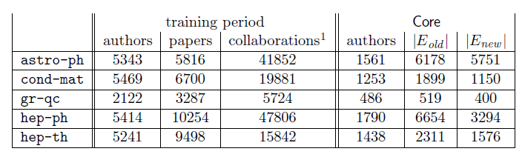
Example Dataset: co-authorship
t₀ = 1994, t′₀ = 1996: training interval -> [1994, 1996]
t₁ = 1997, t′₁ = 1999: test interval -> [1997, 1999]
- G_{collab} = <A, E_{old}> = G[1994, 1996]
- E_{new}: authors in A that co-author a paper during the test interval but not during the training interval
κ_{training} = 3, κ_{test} = 3: Core consists of all authors who have written at least 3 papers during the training period and at least 3 papers during the test period
Predict E_{new}

Slide 7
How to Evaluate the Prediction
Each link predictor p outputs a ranked list L_{p} of pairs in A × A − E_{old} : predicted new collaborations in decreasing order of confidence
In this paper, focus on Core, thus define
E∗_{new} = E_{new} ∩ (Core × Core), n = |E∗_{new}|
Evaluation method: Size of the intersection of
  the first n edge predictions from L_{p} that are in Core × Core, and
  the set E∗_{new}
How many of the (relevant) top-n predictions are correct (precision?)

Slide 8
Methods for Link Prediction
Assign a connection weight score(x, y) to pairs of nodes <x, y> based on the input graph (G_{collab}) and produce a ranked list of decreasing order of score
How to assign the score between two nodes x and y?
Some form of similarity or node proximity

Slide 9
Methods for Link Prediction: Shortest Path
For x, y ∈ A × A − E_{old},
score(x, y) = (negated) length of shortest path between x and y
If there are more than n pairs of nodes tied for the shortest path length, order them at random.

Slide 10


Methods for Link Prediction: Neighborhood-based
The “larger” the overlap of the neighbors of two nodes, the more likely to be linked in the future
Let Γ(x) denote the set of neighbors of x in G_{collab}
Common neighbors:
A adjacency matrix -> A_{x,y}²
Number of different paths of length 2
Jaccard coefficient:
The probability that both x and y have a feature f, for a randomly selected feature that either x or y has

Slide 11

Methods for Link Prediction: Neighborhood-based
Adamic/Adar:
Assigns large weights to common neighbors z of x and y which themselves have few neighbors
(weight rare features more heavily)

Slide 12
Methods for Link Prediction: Neighborhood-based
Preferential attachment:
Based on the premise that the probability that a new edge has node x as its endpoint is proportional to |Γ(x)|, i.e., nodes like to form ties with ‘popular’ nodes
Researchers found empirical evidence to suggest that co-authorship is correlated with the product of the neighborhood sizes
This depends on the degrees of the nodes not on their neighbors per se

Slide 13
Methods for Link Prediction: based on the ensemble of all paths
Not just the shortest, but all paths between two nodes

Slide 14



Methods for Link Prediction: based on the ensemble of all paths
Katz_{β} measure:
Sum over all paths of length l, β > 0 is a parameter of the predictor, exponentially damped to count short paths more heavily
Small β predictions much like common neighbors
Unweighted version, in which path_{x,y}⁽¹⁾ = 1, if x and y have collaborated, 0 otherwise
Weighted version, in which path_{x,y}⁽¹⁾ = #times x and y have collaborated

Slide 15
Methods for Link Prediction: based on the ensemble of all paths
Consider a random walk on G_{collab} that starts at x and iteratively moves to a neighbor of x chosen uniformly at random from Γ(x).
The Hitting Time H_{x,y} from x to y is the expected number of steps it takes for the random walk starting at x to reach y.
score(x, y) = −H_{x,y}
The Commute Time C_{x,y} from x to y is the expected number of steps to travel from x to y and from y to x
score(x, y) = − (H_{x,y} + H_{y,x})
Can also consider stationary-normed versions:
score(x, y) = − H_{x,y} π_{y}
score(x, y) = −(H_{x,y} π_{y} + H_{y,x} π_{x})

Slide 16
Methods for Link Prediction: based on the ensemble of all paths
The hitting time and commute time measures are sensitive to parts of the graph far away from x and y -> periodically reset the walk
Random walk on G_{collab} that starts at x and has a probability of α of returning to x at each step.
Rooted Page Rank: Starts from x, with probability (1 – a) moves to a random neighbor and with probability a returns to x
score(x, y) = stationary probability of y in a rooted PageRank

Slide 17

Methods for Link Prediction: based on the ensemble of all paths
SimRank
score(x, y) = similarity(x, y)
The expected value of γ^{l} where l is a random variable giving the time at which random walks started from x and y first meet

Slide 18
Methods for Link Prediction: High-level approaches
Low rank approximations
M adjacency matrix
Apply SVD (singular value decomposition)
The rank-k matrix that best approximates M

Slide 19


Methods for Link Prediction: High-level approaches
Unseen Bigrams
Unseen bigrams: pairs of word that co-occur in a test corpus, but not in the corresponding training corpus
Not just score(x, y) but score(z, y) for nodes z that are similar to x
S_{x}^{(δ)} the δ nodes most related to x

Slide 20
Methods for Link Prediction: High-level approaches
Clustering
Compute score(x, y) for al edges in E_{old}
Delete the (1-p) fraction of these edges for which the score is lowest, for some parameter p
Recompute score(x, y) for all pairs in the subgraph

Slide 21
Evaluation: baseline
Baseline: random predictor
Randomly select pairs of authors who did not collaborate in the training interval
Probability that a random prediction is correct:
In the datasets, from 0.15% (cond-mat) to 0.48% (astro-ph)

Slide 22
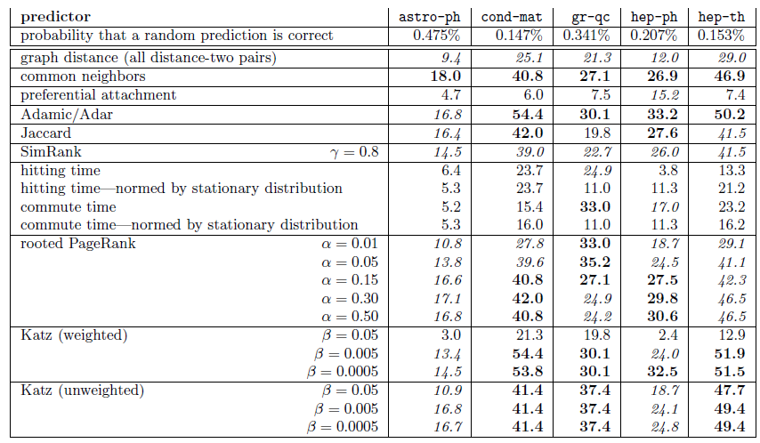
Evaluation: Factor improvement over random

Slide 23
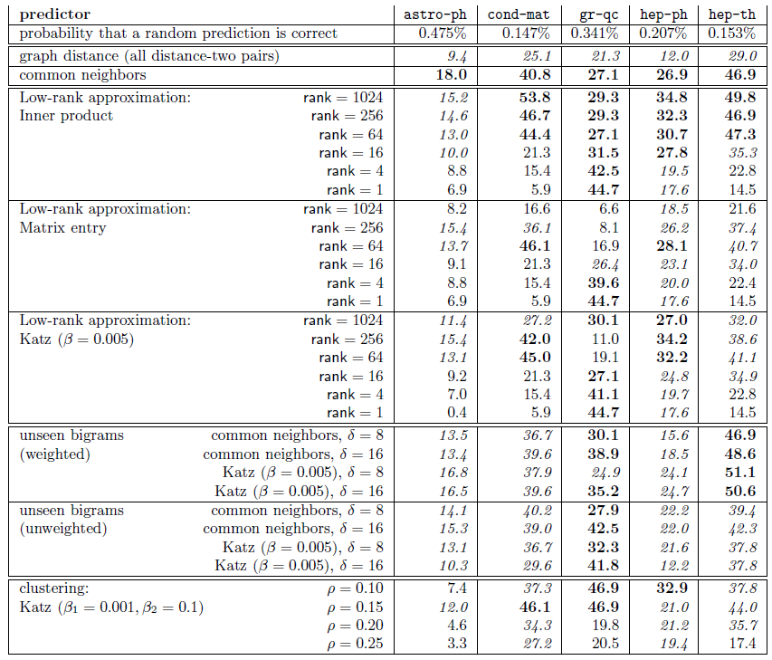
Evaluation: Factor improvement over random

Slide 24
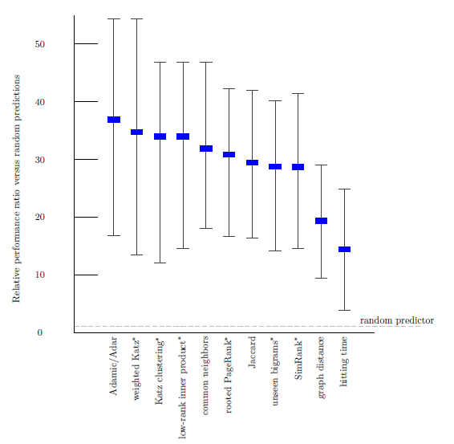
Evaluation: Average relevance performance (random)
average ratio over the five datasets of the given predictor's performance versus a baseline predictor's performance.
The error bars indicate the minimum and maximum of this ratio over the five datasets.
The parameters for the starred predictors are as follows: (1) for weighted Katz, β= 0.005; (2) for Katz clustering, β1 = 0.001; ρ = 0.15; β2 = 0.1; (3) for low-rank inner product, rank = 256; (4) for rooted Pagerank, α = 0.15; (5) for unseen bigrams, unweighted
common neighbors with δ = 8; and (6) for SimRank, γ = 0.8.

Slide 25
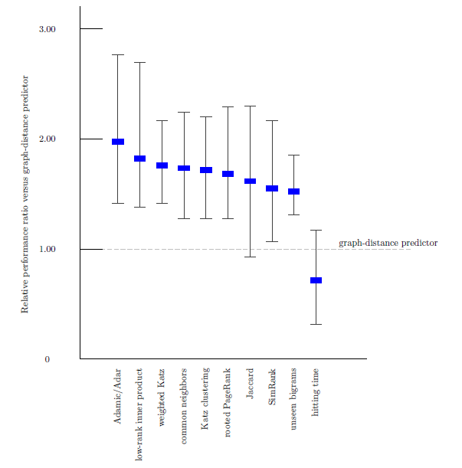
Evaluation: Average relevance performance (distance)

Slide 26
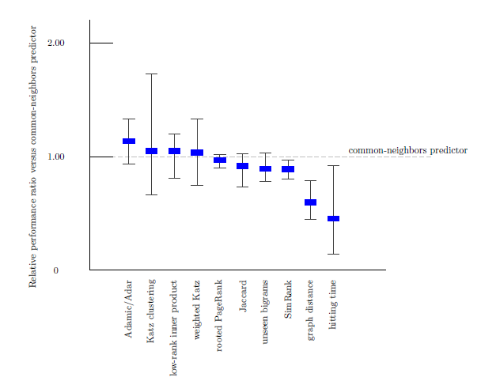
Evaluation: Average relevance performance (neighbors)

Slide 27
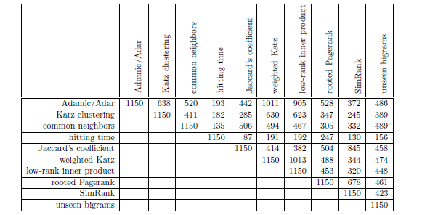
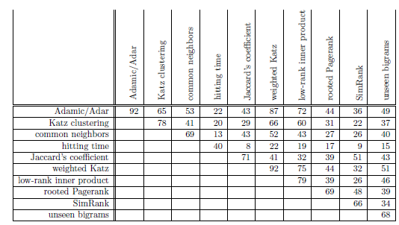
Evaluation: prediction overlap
How much similar are the predictions made by the different methods?
Why?
correct

Slide 28
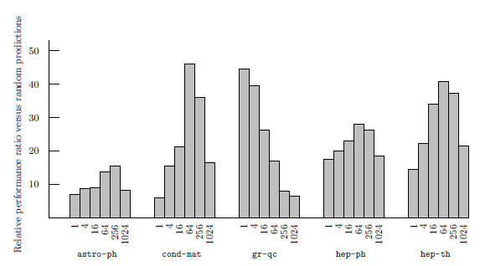
Evaluation: datasets
How much does the performance of the different methods depends on the dataset?
(rank) On 4 of the 5 datasets best at an intermediate rank
On qr-qc, best at rank 1, does it have a “simpler” structure”?
On hep-ph, preferential attachment the best
Why is astro-ph “difficult”?
The culture of physicists and physics collaboration

Slide 29
Evaluation: small world
The shortest path even in unrelated disciplines is often very short

Slide 30
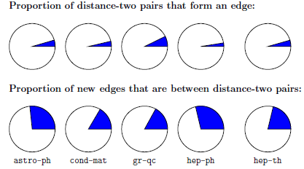
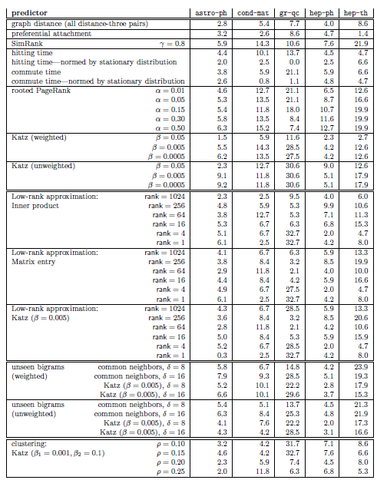

Evaluation: restricting to distance three
Many pairs of authors separated by a graph distance of 2 who will not collaborate and many pairs who collaborate at distance greater than 2
Disregard all distance 2 pairs

Slide 31
Evaluation: the breadth of data
Three additional datasets
Proceedings of STOC and FOCS
Papers for Citeseer
All five of the arXiv sections
Common neighbors vs Random

Slide 32
Future Directions
Improve performance. Even the best (Katz clustering on gr-qc) correct on only about 16% of its prediction
Improve efficiency on very large networks (approximation of distances)
Treat more recent collaborations as more important
Additional information (paper titles, author institutions, etc)
To some extent latently present in the graph

Slide 33


Future Directions
Consider bipartite graph (e.g., some form of an affiliation network)
author
paper
Coauthor graph
Apply classification techniques from machine learning
  A simple binary classification problem: given two nodes x and y predict whether <x, y> is 1 or 0

Slide 34
Aaron Clauset, Cristopher Moore & M. E. J. Newman. Hierarchical structure and the prediction of missing links in network, 453, 98-101 (2008)

Slide 35
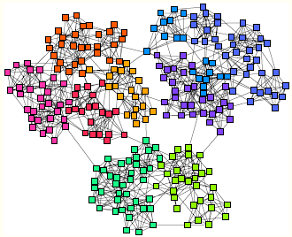
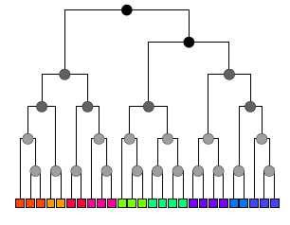
Hierarchical Random Graphs
Dendrogram D a binary tree with n leaves
Each internal node corresponds to the group of nodes that descend from it
Graph G with n nodes
Each internal node r of the dendrogram is associated with a probability p_{r} that a pair of vertices in the left and right subtrees of that node are connected
Given two nodes i and j of G the probability p_{ij} that they are connected by an edge is equal to p_{r} where r is their lowest common ancestor

Slide 36
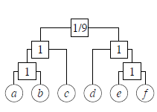

Hierarchical Random Graphs
Example
graph
Possible dendrogram
Assortaitivity (dense connections within groups of nodes and sparse between them) -> probabilities p_{r} decrease as we move up the tree
Given D and the probabilities p_{r}, we can generate a graph, called a hierarchical random graph
D: topological structure and parameters {p_{r}}

Slide 37
Hierarchical Random Graphs
Use to predict missing interactions in the network
Given an observed but incomplete network, generate a set of hierarchical random graphs (i.e., a dendrogam and the associated probabilities) that fit the network (using statistical inference)
Then look for pair of nodes that have a high probability of connection
Is this better than link prediction?
Experiments show that link prediction works well for strongly assortative networks (e.g, collaboration, citation) but not for networks that exhibit more general structure (e.g., food webs)

Slide 38

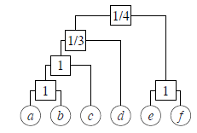

A rough idea of how to generate the model
r a node in dendrogram D
E_{r} the number of edges in G whose endpoints have r as their lowest common ancestor in D,
L_{r} and R_{r} the numbers of leaves in the left and right subtrees rooted at r
Then the likelihood of the hierarchical random graph is
L(D1) = (1/9)(8/9)⁸ = 0.0433..
If we fix the dendrogram D, it is easy to find the probabilities {p_{r}} that maximize L(D, {p_{r}}). For each r, they are given by the fraction of potential edges between the two subtrees of r that actually appear in the graph G.
L(D2) = (1/3)(2/3)²(1/4)²(3/4)⁶ = 0.0165 ..

Slide 39
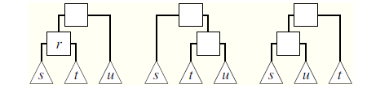
A rough idea of how to generate the model
Sample dendrograms D with probability proportional to their likelihood
Choose an internal node uniformly at random and consider one of the two ways to reshuffle
Always accept the transition if it increases the likelihood else accept with some probability

Slide 40

How to Evaluate the Prediction (other)
An undirected network G(V, E)
Predict Missing links (links not in E)
To test, randomly divide E into a training set E^{T} and a probe (test) set E^{P}
Apply standard techniques (k-fold cross validation)
Each time we randomly pick a missing link and a nonexistent link to compare their scores
If among n independent comparisons, there are n′ times the missing link having a higher score and n′′ times they have the same score, the AUC value is
the probability that a randomly chosen missing link is given a higher score than a randomly chosen nonexistent link
If all the scores are generated from an independent and identical distribution, the AUC value should be about 0.5.

Slide 41
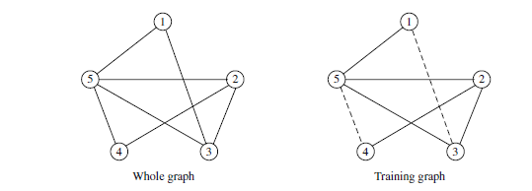
How to Evaluate the Prediction (other)
Algorithm assigns scores of all non-observed links as
s12 = 0.4, s13 = 0.5, s14 = 0.6, s34 = 0.5 and s45 = 0.6.
To calculate AUC, compare the scores of a probe (missing) link and a nonexistent link.
(n=) 6 pairs: s13 > s12, s13 < s14, s13 = s34, s45 > s12, s45 = s14, s45 > s34.
AUC = (3 × 1 + 2 × 0.5)/6 ≈ 0.67.

