Slide 1

Master Thesis Defense
A Method to Establish Taxa of Schema Evolution
Presenter: Georgios Theodoros Kalampokis
Advisor: Panos Vassiliadis
July 2021

Slide 2

Outline of Presentation (1)
Introduction
  What is schema evolution?
  Related Work
  An overview of the taxa presented in [Vass21]
  Research questions of this study
Profiling and evaluating of the existing taxonomy
  Data and Statistics extraction from “HeraclitusFire”
  Correlations of the attributes – Most important attributes
  Behaviors and patterns per taxon
  Centroids per taxon
  Assessment of the existing taxonomy by using validity metrics from the area of clustering
  Findings concerning the existing taxonomy

Slide 3

Outline of Presentation (2)
The possibility of deriving super taxa
  Relationship between super taxa and schema measurements:
    Heartbeat
    Activity
    Table-Level Activity
    Duration
  Centroid per super taxon
  Findings regarding super taxa
Future Work

Slide 4
Introduction

Slide 5
What is schema evolution?
Schema evolution refers to the change of the internal structure of the database.
  Table additions/removals
  Foreign key additions/removals
  Attribute additions/removals/updates
When schema evolves, the software must adapt to the changes of the schema, so that it continues to be viable.
For this reason, it is important to examine how schemata evolve over time, as well as which are the patterns that accompany this evolution.

Slide 6
Related Work
Gap between 1993 and 2008 due to the absence of datasets.
The availability of open-source projects allowed researchers to:
  Study more extensively how schemata evolve
  Suggest ways to avoid software and system failures
  Observe patterns of evolution
Sjoberg
IST 93’
Curino +
ICEIS 08’
Neamtiu +
IWPSE 09’
ICDEW 11’
Qu, Li, Su
FSE 13’
Cleve+
SCP 15’
Un. Ioannina
CAiSE 17’
ER 17’
Un. Ioannina
CAiSE 14’
ER 15’
P. Vassiliadis
ICDE 21’
~…~
…
1993
2008
2009
2011
2013
2014
2015
2017
2021

Slide 7
Research questions of (P. Vassiliadis – ICDE 21’)
Is schema evolution extensively present?
Can we extract families, (“taxa” as in biology) of schemata, with respect to the way they evolve over time?
What are the quantitative characteristics of schema evolution and how do they perform for different taxa?

Slide 8
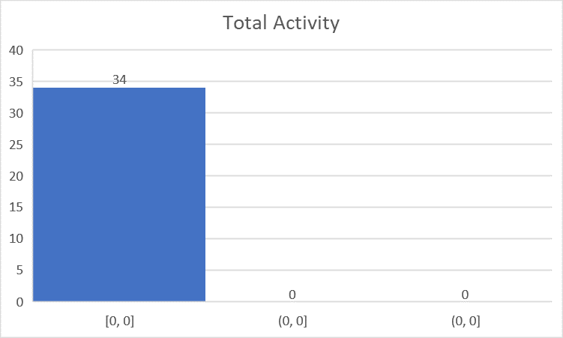
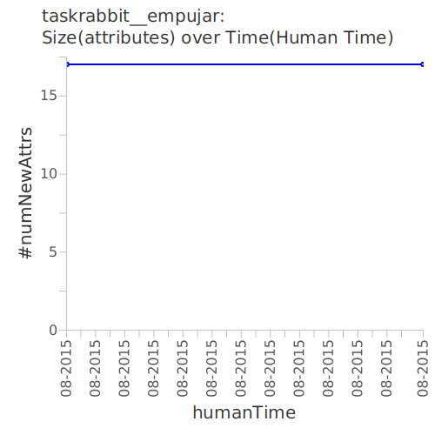
Frozen Taxon
Projects with completely frozen schema histories and with zero change at the logical level. (totalActivity = 0)
34 projects out of 195 belong to the Frozen taxon.
These projects have project updates but just zero evolution to their schema
Panos Vassiliadis. Profiles of Schema Evolution in Free Open Source Software Projects.37th IEEE International Conference on Data Engineering (ICDE '21), Chania, Crete, Greece, 19-22 April 2021.

Slide 9
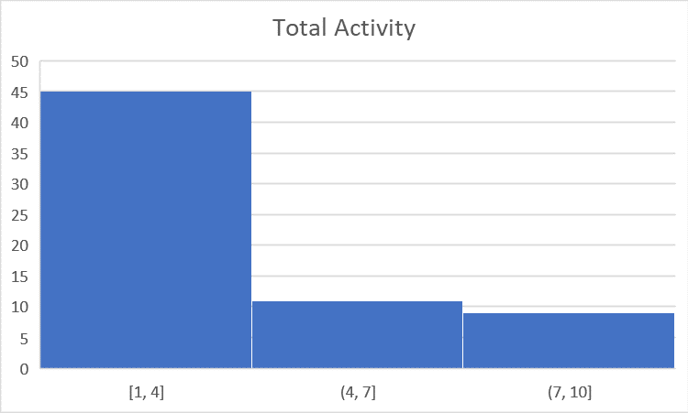
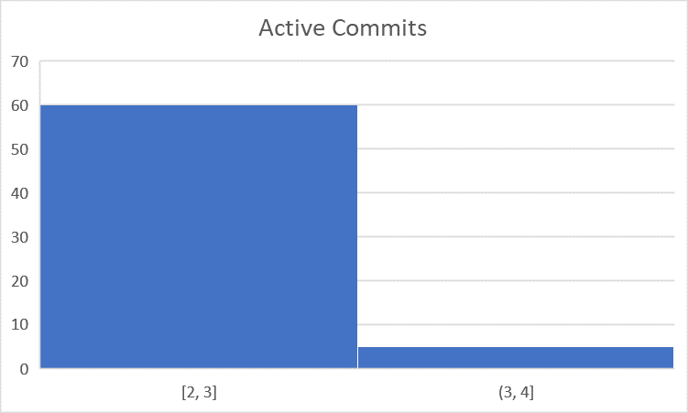
Almost Frozen Taxon
Projects with histories of very small change, typically with few intra-table attribute modifications. (At most 4 active commits, totalActivity <= 10 updated attributes).
65 projects out of 195 belong to the Almost Frozen taxon.
Panos Vassiliadis. Profiles of Schema Evolution in Free Open Source Software Projects.37th IEEE International Conference on Data Engineering (ICDE '21), Chania, Crete, Greece, 19-22 April 2021.

Slide 10
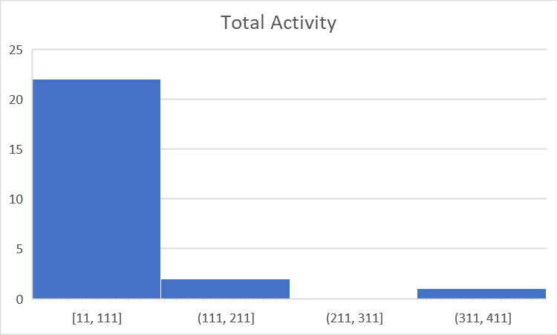
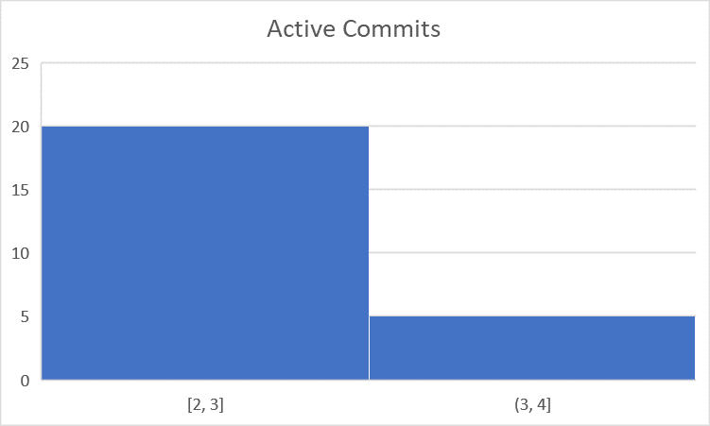
FocusedShot_n_FROZEN Taxon
Projects with almost frozen histories but with a single spike of change (not necessarily small) and almost no other change (At most 4 active commits, totalActivity > 10 updated attributes).
25 projects out of 195 projects are based around one or two schema modifying transitions
  In 36% of them, just attr. injections
  In 52% of them, just a single step-up the schema line
Panos Vassiliadis. Profiles of Schema Evolution in Free Open Source Software Projects.37th IEEE International Conference on Data Engineering (ICDE '21), Chania, Crete, Greece, 19-22 April 2021.

Slide 11
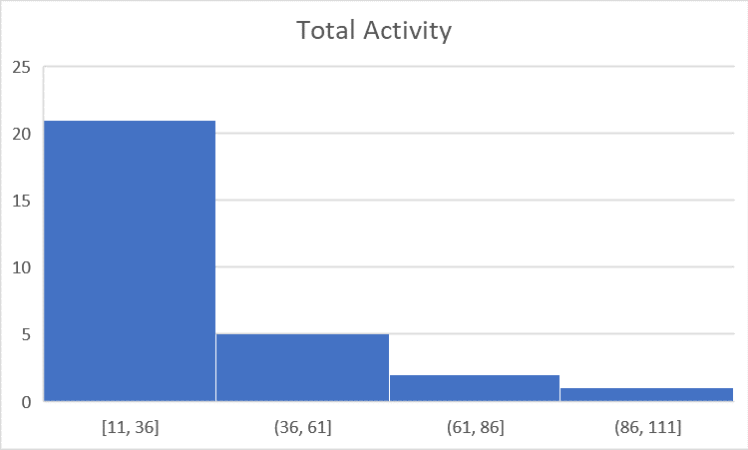
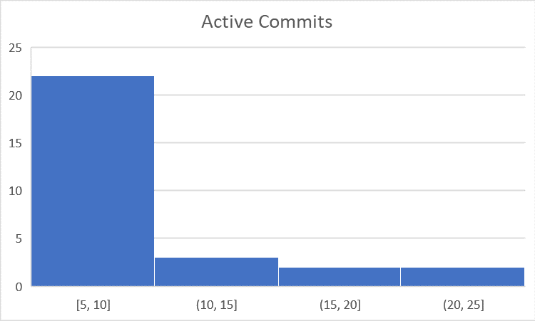
MODERATE Taxon
Projects with histories of moderate evolution, without spectacular changes.
29 projects out of 195 belong to the Moderate taxon.
This taxon is characterized by activity spread over time, in small volumes of change.
Panos Vassiliadis. Profiles of Schema Evolution in Free Open Source Software Projects.37th IEEE International Conference on Data Engineering (ICDE '21), Chania, Crete, Greece, 19-22 April 2021.

Slide 12
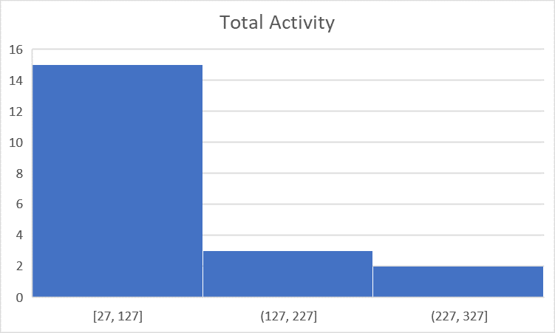
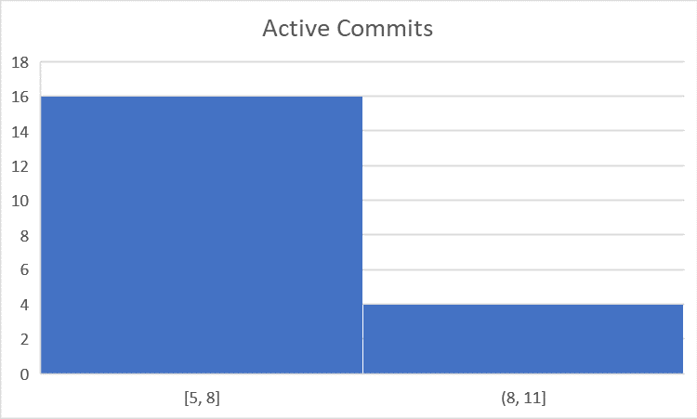
FocusedShot_n_LOW Taxon
Projects with evolution similar to the moderate one but also with a pair of spikes on their activity.
20 projects out of 195 belong to the FocusedShot_n_LOW taxon.
Small number of active commits but medium to high total activity.
Panos Vassiliadis. Profiles of Schema Evolution in Free Open Source Software Projects.37th IEEE International Conference on Data Engineering (ICDE '21), Chania, Crete, Greece, 19-22 April 2021.

Slide 13
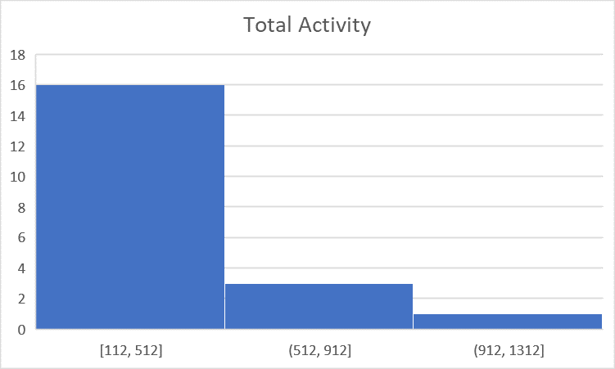
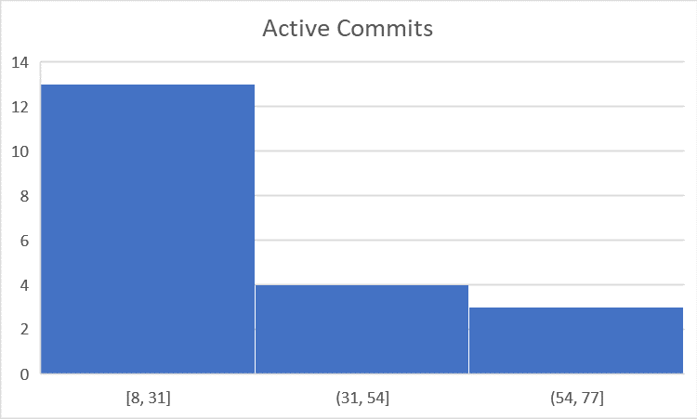
ACTIVE Taxon
Projects with a significant amount of change both as intra-table change and in terms of table generation and eviction.
22 out of 195 projects belong to the ACTIVE taxon.
Panos Vassiliadis. Profiles of Schema Evolution in Free Open Source Software Projects.37th IEEE International Conference on Data Engineering (ICDE '21), Chania, Crete, Greece, 19-22 April 2021.

Slide 14

Research questions of this study
If given a taxon, can we tell any specific information about its values as well as its characteristics?”
Can we give a “centroid” characteristic project of each taxon?
Can we do better than the existing taxonomy?

Slide 15
Profiling and evaluating of the existing taxonomy

Slide 16
Atomic Schema Attributes
  Active: A commit is called active if its total activity is greater than 0.
  Turf: A commit is called turf if it is active, and its total activity is less than 15.
  Reed: A commit is called reed if its total activity is greater or equal than 15.

Slide 17
Monthly Schema Attributes
Active - measurements
  activeCommits
  activeCommitRatio
Turf - measurements
  turfs
  activityDueToTurfs
  turfRatioAComm
  turfRatioTComm
Reed - measurements
  reeds
  activityDueToReeds
  reedRatioAComm
  reedRatioTComm

Slide 18
Summary Schema Attributes
Active - measurements
  activeCommits
  activeCommitRatio
  activeCommitRatePerMonth
  +
  commitRatePerMonth
Turf - measurements
  turfs
  turfsPostV0
  activityDueToTurf
  activityDueToTurfPostV0
  turfRatioAComm
  turfRatioTComm
Reed - measurements
  reeds
  reedsPostV0
  activityDueToReeds
  activityDueToReedsPostV0
  reedRatioAComm
  reedRatioTComm

Slide 19
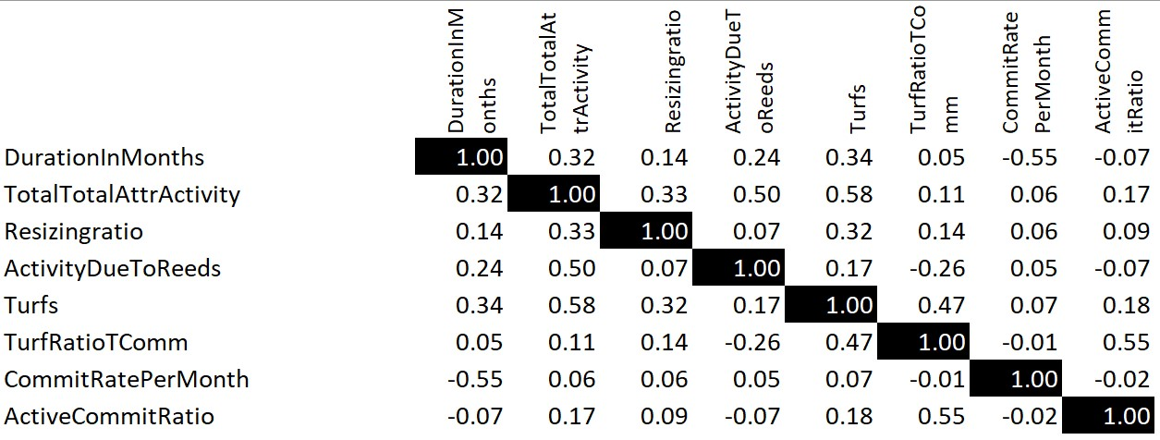
Most Important attributes

Slide 20
Behaviors and patterns per taxon

Slide 21
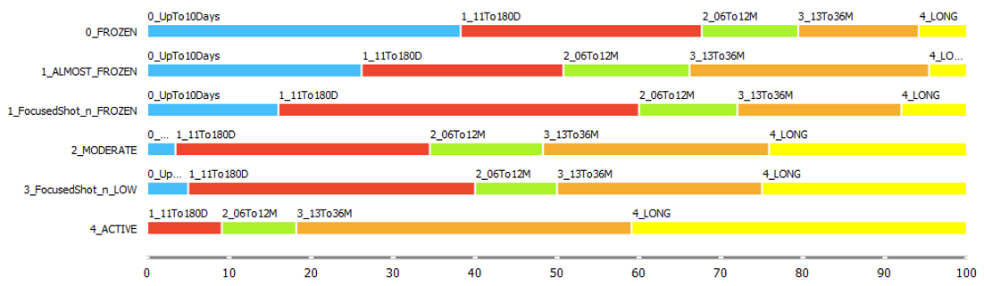
Schema Line Update Period
• 0_UpTo10Days: Projects with schema update period in the range [0 – 10] days.
• 1_11To180D: Projects with schema update period in the range [11 – 180] days.
• 2_06To12M: Projects with schema update period in the range [181 – 365] days.
• 3_13To36M: Projects with schema update period in the range [366 – 1095] days.
• 4_LONG: Projects with schema update period greater than 1095 days (3 years).

Slide 22
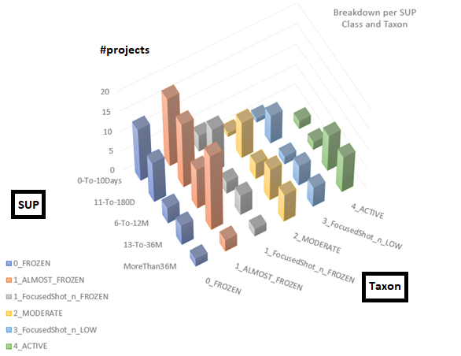
Schema Update Period
Active taxon is biased towards longer Schema Update Periods.
Moderate and FS-Low are mostly biased towards medium SUP ranges.
The frozen land is mostly oriented to small SUP periods (with the prominent exception of some Al-most Frozen projects, that have almost frozen SUPs between 1 and 3 years.

Slide 23
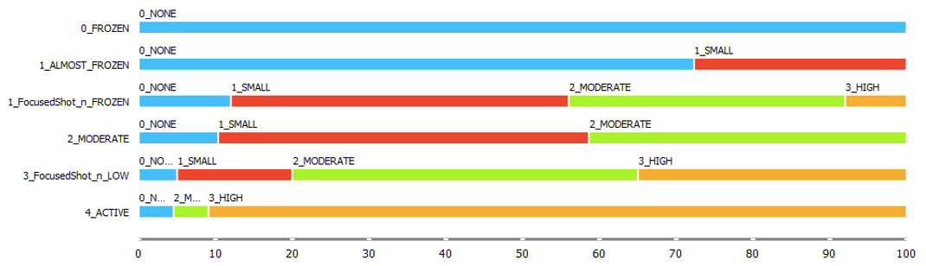
Schema Line Volume of Change
BD = tableInsertions + tableDeletions
• 0_NONE: BD = 0
• 1_SMALL: BD in the range [1 – 2]
• 2_MODERATE: BD in the range [3 - 10]
• 3_HIGH: BD ≥ 11

Slide 24
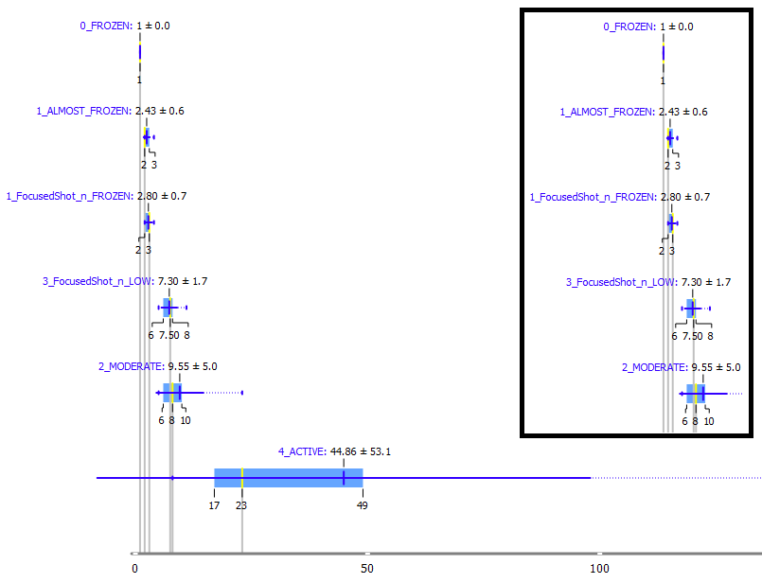
Active Commits - BoxPlot
The active commits separate well the taxa.
Exception: the medium activity classes that are not only separated by the active commits, but also by the amount and concentration of change.
The range of the active commits, increases, as we move from the frozen to the active class.

Slide 25
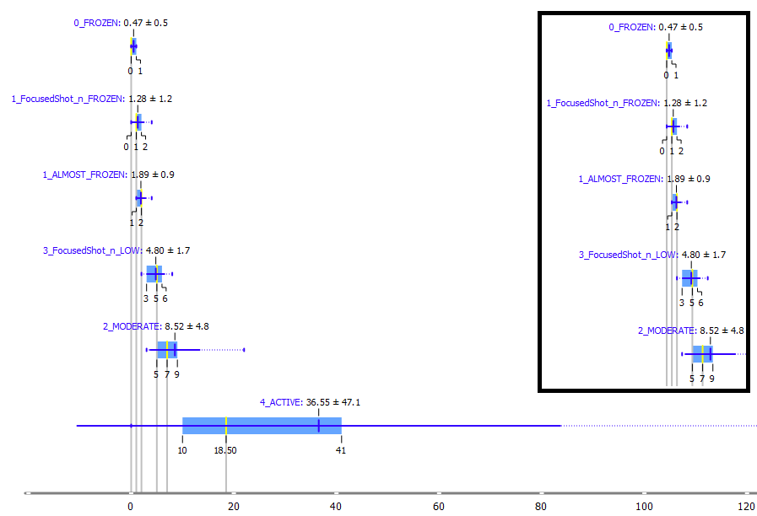
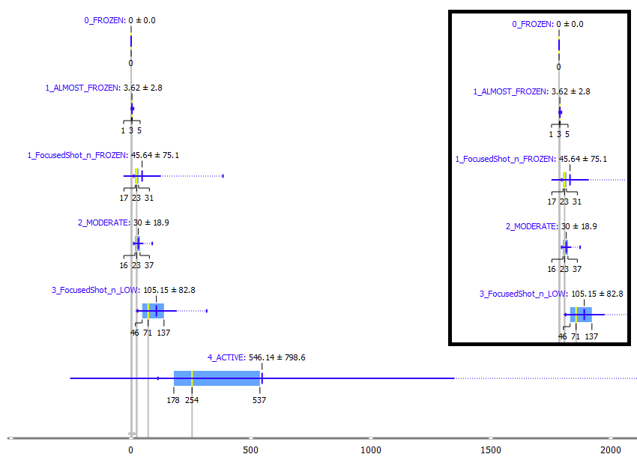
Turfs – Total Activity (BoxPlots)
Both turfs and total activity are increasing while moving from the frozen towards the active class.
The taxa are distinct to each other.

Slide 26
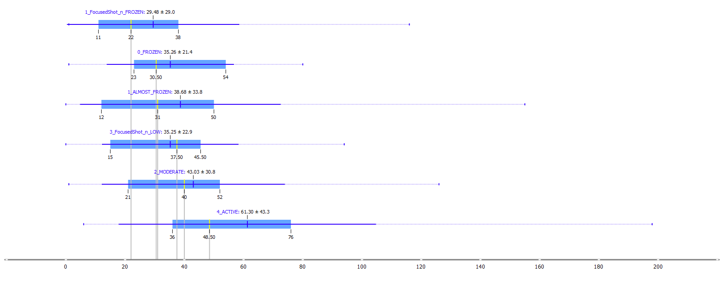
Project Update Period – Months (BoxPlot)
The update periods of the projects of all families, except for the active class, seem to be big and very similar.
None of the families of the projects is inactive. They simply just have different schema evolution profiles.

Slide 27
Patterns of Schema Evolution per taxon
• 0_FLAT : Zero schema evolution
• Single Rise : A single step of evolution, upwards
• Multi-Step Rise : Several upward steps, like a staircase
• Drop : Drop of the number of tables over time.
• Turbulent & DoUndo : Mix of Up’s and Down’s and DoUndo commits

Slide 28
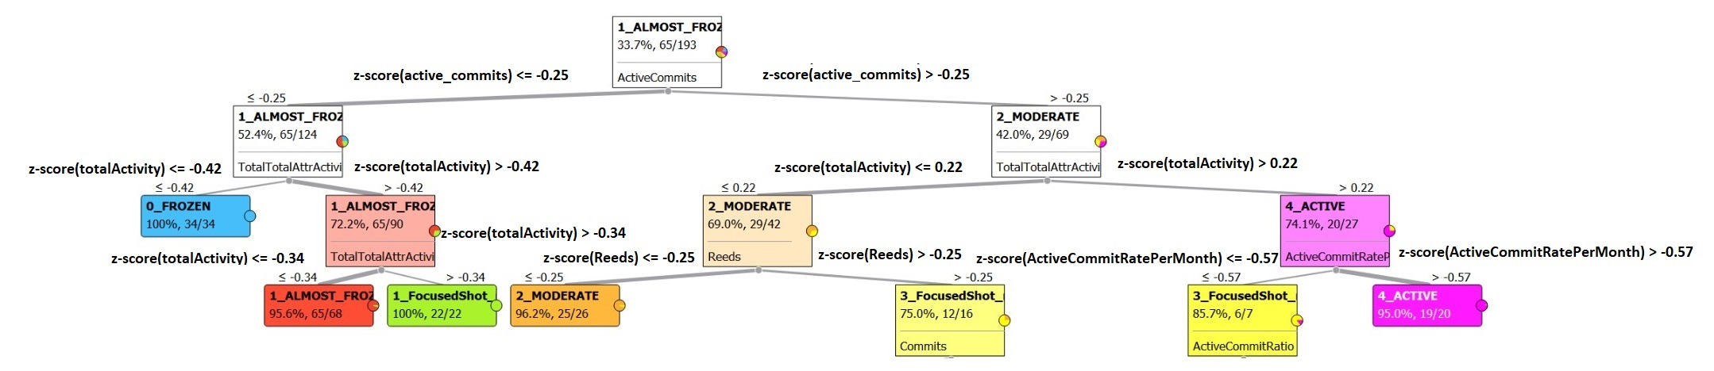
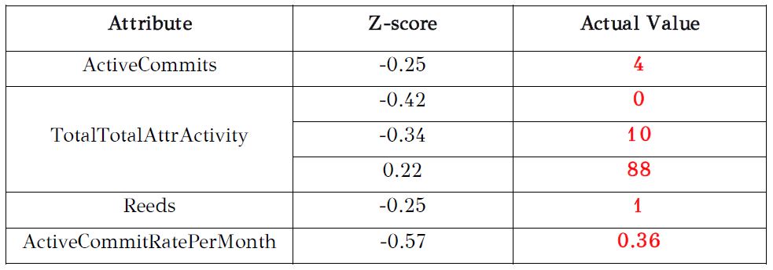
Decision Tree produced by Orange Software

Slide 29
Centroids per taxon

Slide 30
How were centroids defined?
For each taxon, we calculate the average value for all the measurements of interest.
For each project we calculate the distances between every such measurement and its average.
We sum up all the distances, that we calculated on the previous step, per project.
Finally, we find the smallest of the sums of the previous step. The smallest sum represents the sum of the distances of the project, whose measures are closer to the average measures of the respective taxon.
* We used the normalized values instead of the actual values*

Slide 31
Centroids per taxon with stats (1)
Frozen Taxon Characteristics (Centroid-Project: damnpoet__yiicart)
• Zero total activity
- totalActivity(damnpoet__yiicart) = 0
• Just one active commit (Either a reed or a turf)
- activeCommits(damnpoet__yiicart) = 1
Almost Frozen Taxon Characteristics (Centroid-Project: RubyMoney__money-rails)
• Small total activity (less than 10 updated attributes)
- totalActivity(RubyMoney__money-rails) = 3
• At most 4 active commits (Mix of turfs and reeds)
- activeCommits(RubyMoney__money-rails) = 3

Slide 32
Centroids per taxon with stats (2)
FocusedShot_n_FROZEN Taxon Characteristics (Centroid-Project: accgit__acl)
• Medium to high total activity (More than 10 updated attributes and less than 383 updated attributes)
- totalActivity(accgit__acl) = 31
• At most 4 active commits (Mix of turfs and reeds)
- activeCommits(accgit__acl) = 3
Moderate Taxon Characteristics (Centroid-Project: mapbox__osm-comments-parser)
• Medium total activity (More than 10 and less than 88 updated attributes)
- totalActivity(mapbox__osm-comments-parser) = 34
• More than 4 active commits (Mix of turfs and reeds)
- activeCommits(mapbox__osm-comments-parser) = 10

Slide 33
Centroids per taxon with stats (3)
FocusedShot_n_LOW Taxon Characteristics (Centroid-Project: anchorcms__anchor-cms)
• High total activity (more than 27 and less than 315 updated attributes)
- totalActivity(anchorcms__anchor-cms) = 125
• More than 4 active commits (Mix of turfs and reeds)
- activeCommits(anchorcms__anchor-cms) = 8
Active Taxon Characteristics (Centroid-Project: pods-framework__pods)
• Very high total activity (more than 111 and less than 1268 updated attributes)
- totalActivity(pods-framework__pods) = 352
• More than 7 active commits (Mix of turfs and reeds)
- activeCommits(pods-framework__pods) = 30

Slide 34
Assessment of the existing taxonomy via validity metrics

Slide 35
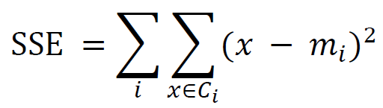
Cohesion (SSE)
It measures how closely related are the objects within the same cluster.
A lower within-cluster variation is an indicator of good compactness, which means that the lower the cohesion is, the better the clustering is.
Can be computed by the following formula:
        where:
        x∈ 𝐶𝑖 : Every element in 𝐶𝑖 cluster.
        𝑚𝑖 : Centroid of i cluster.

Slide 36
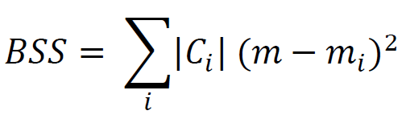
Separation (BSS)
It measures how distinct or well-separated a cluster is from other clusters.
The bigger the separation is the better the clustering is, because it means that the clusters have fewer common characteristics.
Can be computed by the following formula:
        where:
        𝐶𝑖 : Number of elements of i cluster.
        m : Mean value of the whole dataset.
        𝑚𝑖 : Mean value of i cluster.

Slide 37
Groups of attributes - Results
Compared Groups
Group A: TotalTotalAttrActivity, ResizingRatio, DurationInMonths.
Group B: TotalTotalAttrActivity, Turfs, ActivityDueToReeds.
Group C: TotalTotalAttrActivity, Turfs.
Group D: TotalTotalAttrActivity, Turfs, ActiveCommits.
Observations and Results
Resizing ratio
Duration in months
Activity due to reeds
Total Activity
Active Commits
The SSE in the “4_ACTIVE” class seems to remain high in all groups.
In all groups, the values of the metric separation are not that high.
Increase sum of squared errors.
Decrease sum of squared errors.

Slide 38
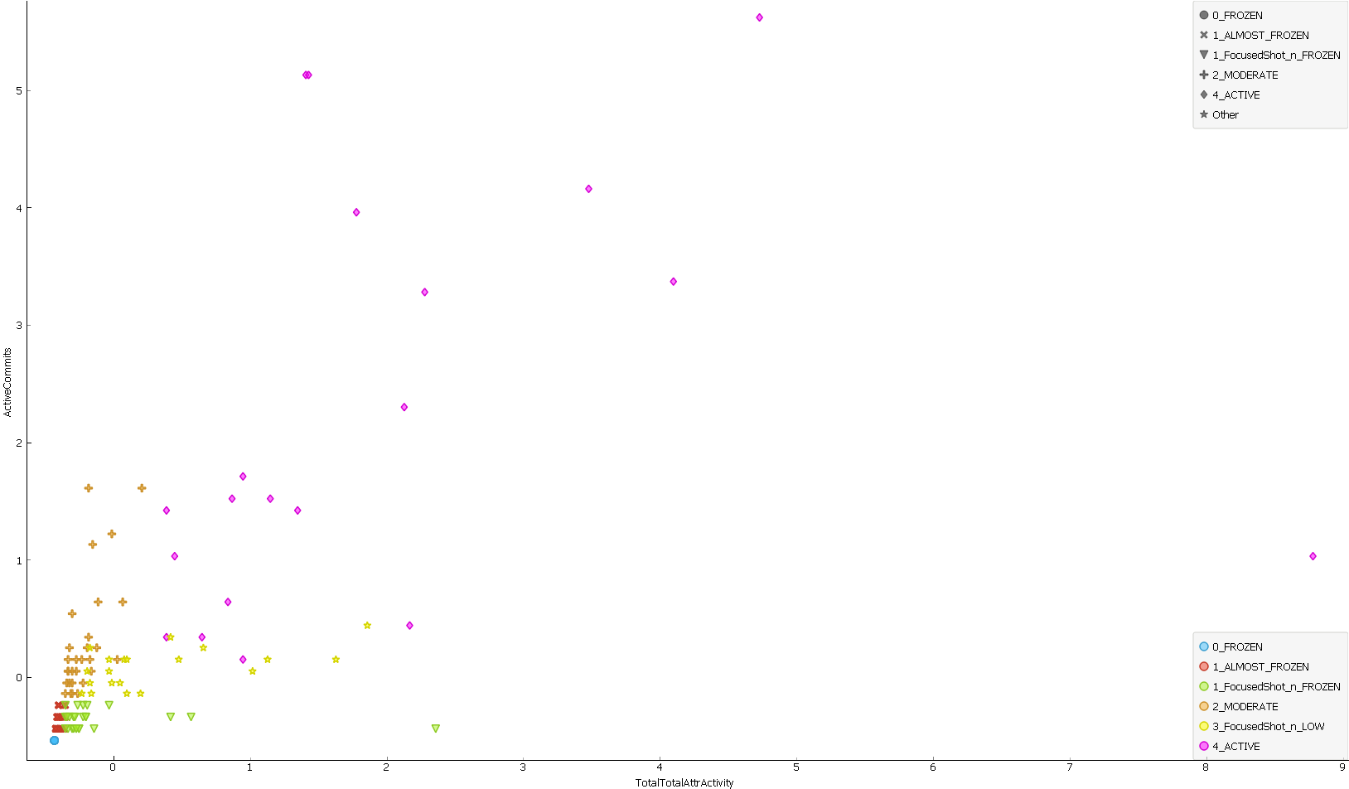
ScatterPlot: TotalTotalActivity - ActiveCommits

Slide 39

Silhouette Coefficient
It is a measure of how similar an object is to its cluster (cohesion) compared to other clusters (separation).
The silhouette ranges from −1 to +1, where a high value indicates that the object is well matched to its cluster and poorly matched to neighboring clusters.
Can be computed by the following formula:
      where:
        a : The average distance between each point within a cluster.
        b : The average distance between all clusters.

Slide 40
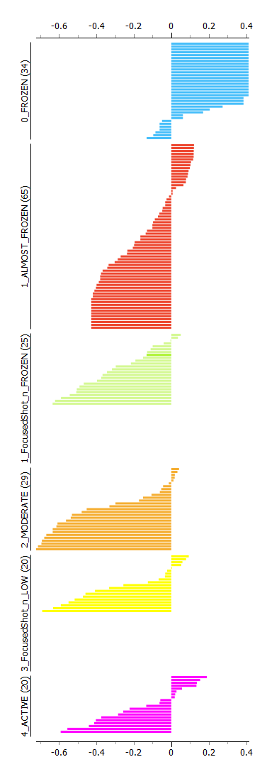
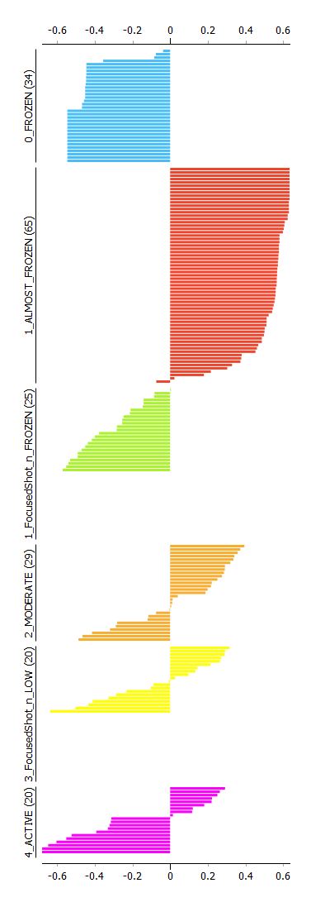
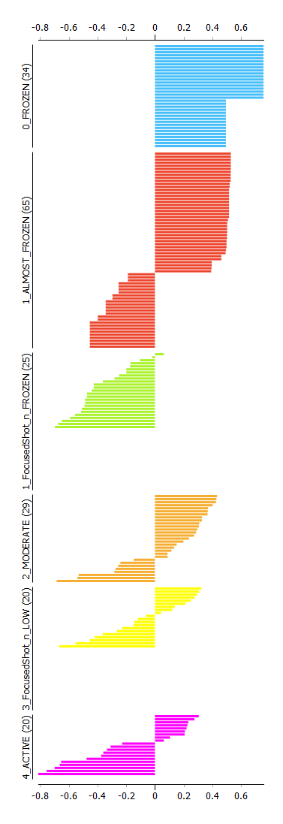
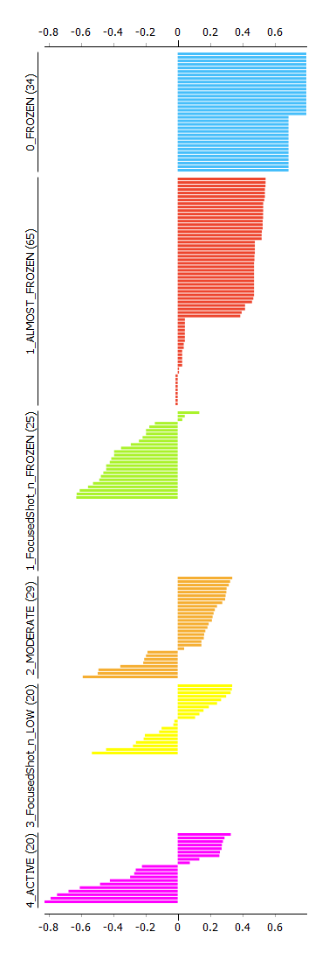
Silhouette Plots per Group
Group A
Group B
Group C
Group D

Slide 41
Findings concerning the existing taxonomy (1)
Regarding the schema update period, every taxon seems to have projects with both short and big periods of updates.
The more active a taxon is, the bigger the percentage of the high volume of changes in the schema line and the smaller the percentage of the low volume of changes is.
The active commits separate well the taxa, except for the medium activity classes that are not only separated by the active commits, but also by the amount and concentration of change.
Turfs and total activity are good taxon discriminators and proportional to the active-ness of the taxon.

Slide 42
Findings concerning the existing taxonomy (2)
The update periods of the projects of all families, except for the active class, seem to be big and very similar.
Considering the values of the centroid-projects and especially the total activity and the active commits, the taxa are distinguished from one another.
The validity metrics were better for groups consisting of attributes related to the heartbeat and the activity of the projects.

Slide 43
The possibility of deriving super taxa

Slide 44
Super taxa
Super-taxon | Taxa | Super-Taxon Characteristics
Cold | 0_FROZEN 1_ALMOST_FROZEN 1_FocusedShot_n_FROZEN | Low total activity in average. At most 4 active commits.
Mild | 2_MODERATE 3_FocusedShot_n_LOW | More than 4 active commits. The majority of projects have less or equal than 3 reeds.
Hot | 4_ACTIVE | More than 4 active commits. Most of the projects have more than 3 reeds.

Slide 45
Super taxa - Heartbeat

Slide 46
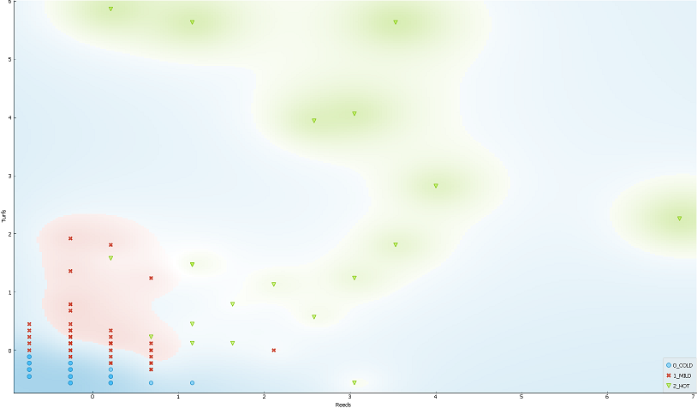
Turfs – Reeds

Slide 47
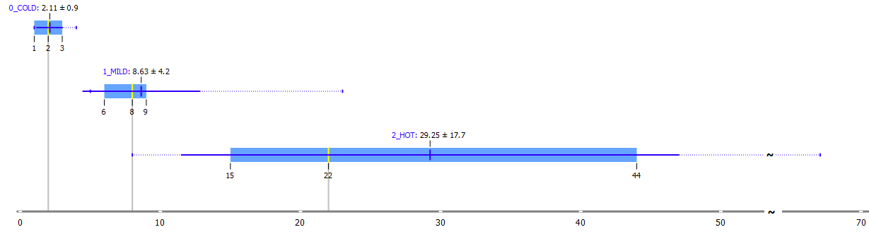
Active Commits
The number of active commits increases while moving from the 0_COLD class to the 2_HOT class, as expected.
Concerning the active commits, the super taxa are well separated.

Slide 48
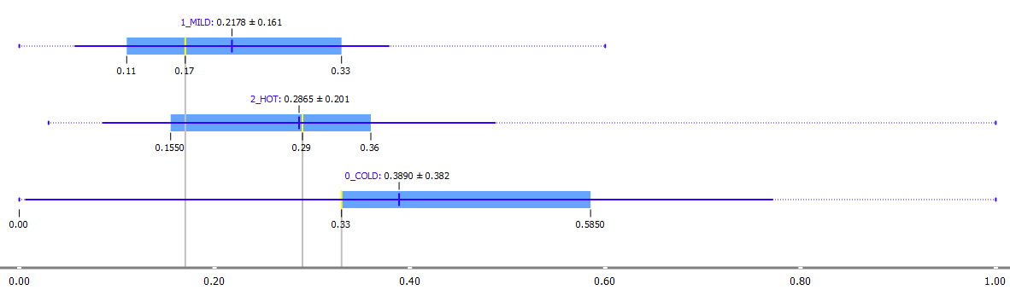
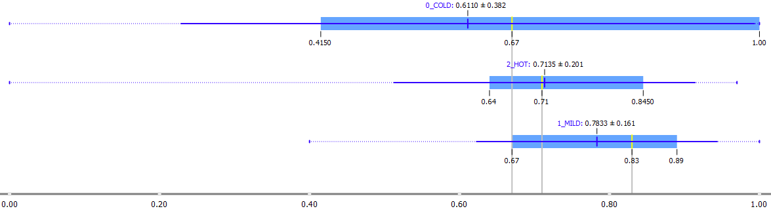
Reed – Turf (Ratios)
ReedRatioAComm
TurfRatioAComm
We surprisingly observe that the 0_COLD taxon has the biggest ratio of reeds to active commits.
This can be explained by the small number of active commits that the 0_COLD taxon has, which makes its reeds ratio seem high.
Regarding the ratio of turfs to active commits, the 1_MILD taxon has the highest ratio of turfs to active commits.

Slide 49
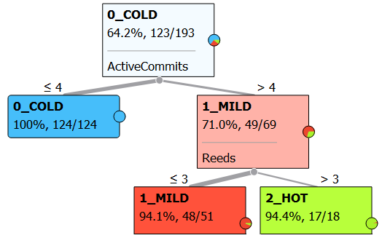
Decision Tree – Heartbeat
We can clearly conclude that the super taxa are highly related to the heartbeat of the projects.
4 misclassified projects out of 193, meaning 2%.

Slide 50
Super taxa - Activity

Slide 51
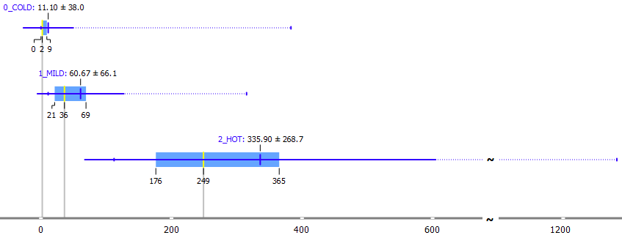
Total Activity
The concentration of the values at each taxon shows that, moving from the 0_COLD to the 2_HOT class the total activity increases.
However, there are a few outliers at the 0_COLD class with high total activity.
These outliers in the original taxonomy belonged to the 1_FocusedShot_n_FROZEN taxon, which contained projects with a small number of active commits (less than 4) and total activity greater than 10.

Slide 52
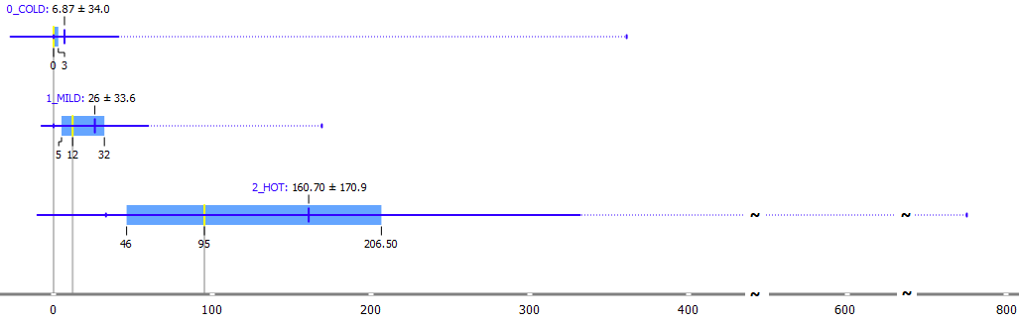
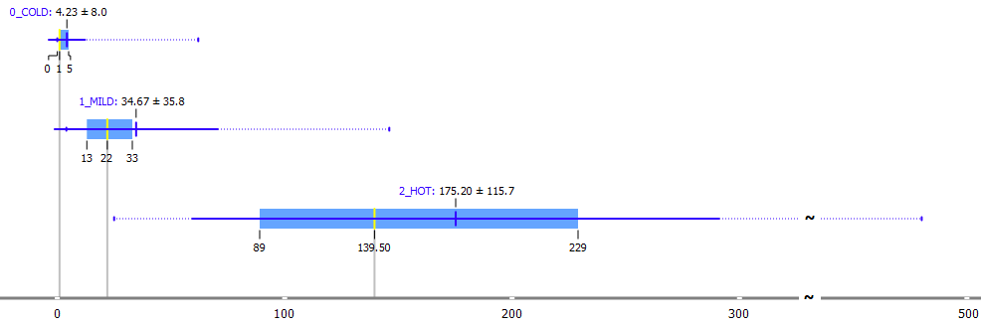
Total Maintenance – Total Expansion
Total Maintenance
Total Expansion
Observe that the more active the class is, the more maintenance it goes through.
Super taxa are very distinct to each other.
Good super taxon discriminator

Slide 53
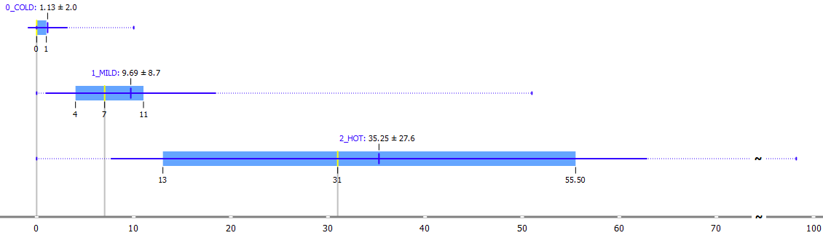
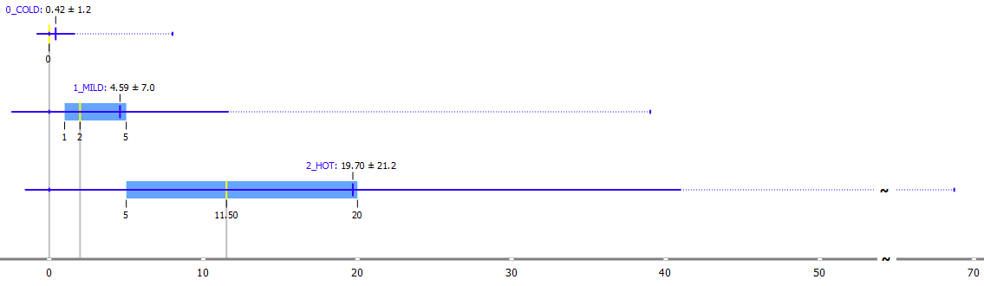
TotalAttrInjected – TotalAttrEjected
TotalAttrInjected
TotalAttrEjected
The number of injections is increasing while moving from the 0_COLD to the 2_HOT taxon.
Proportional to the activeness of the taxon.
The super taxa are distinct to each other.
The number of ejections is increasing while moving from the 0_COLD to the 2_HOT taxon.
The super taxa are less distinct to each other than in the injections case.

Slide 54
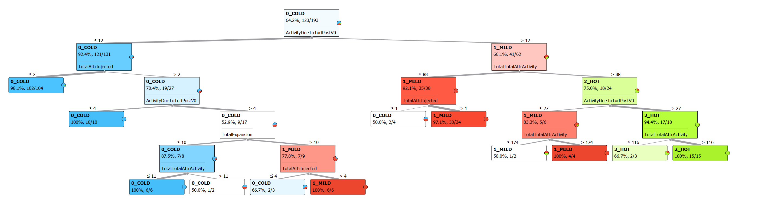
Decision Tree – Activity
20 misclassified projects out of 193, meaning 10%.
Most of the misclassified, meaning 7%, are projects that belong to the 1_MILD class and have been misclassified either to the 0_COLD class or to the 2_HOT class).

Slide 55
Super taxa - Table-Level Activity

Slide 56
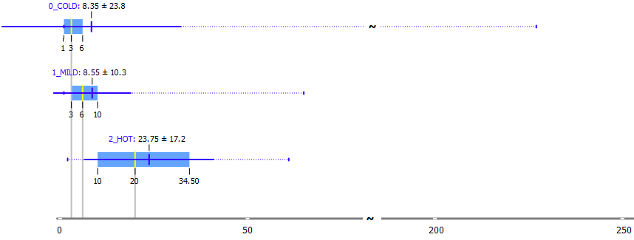
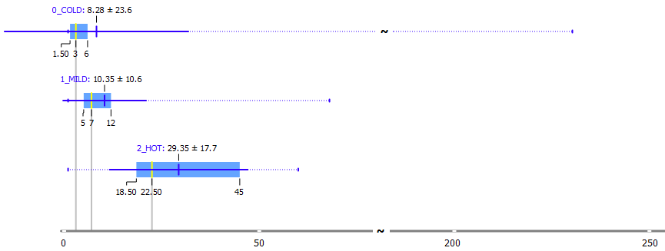
Tables@Start – Tables@End
Tables@Start
Tables@End
Tables@Start and Tables@End are not necessarily proportional to the activeness of the taxon.
The super taxa are kind of distinct, but these metrics cannot discriminate the super taxa, alone.

Slide 57
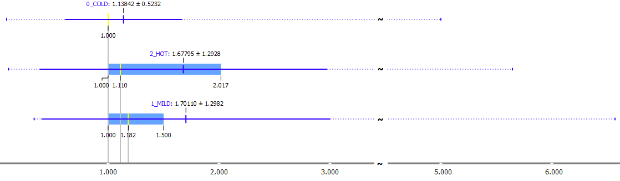
Resizing Ratio
The resizing ratio of the projects neither discretizes the super taxa nor is much related to the evolution of the projects.

Slide 58
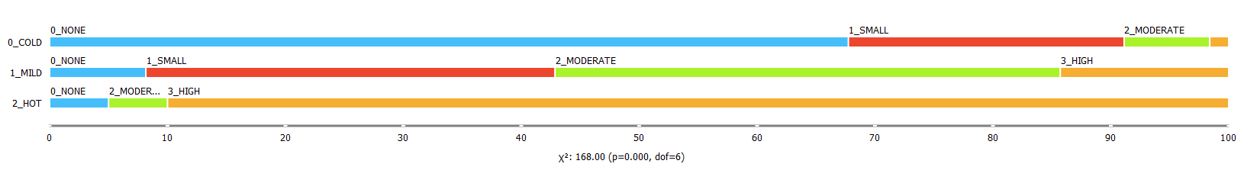
BD = TotalTableInsertions + TotalTableDeletions
0_NONE: BD = 0
1_SMALL: BD in the range [1 – 2]
2_MODERATE: BD in the range [3 - 10]
3_HIGH: BD ≥ 11
The more active a taxon is, the bigger the percentage of the high volume of changes and the smaller the percentage of the low volume of changes, is.

Slide 59
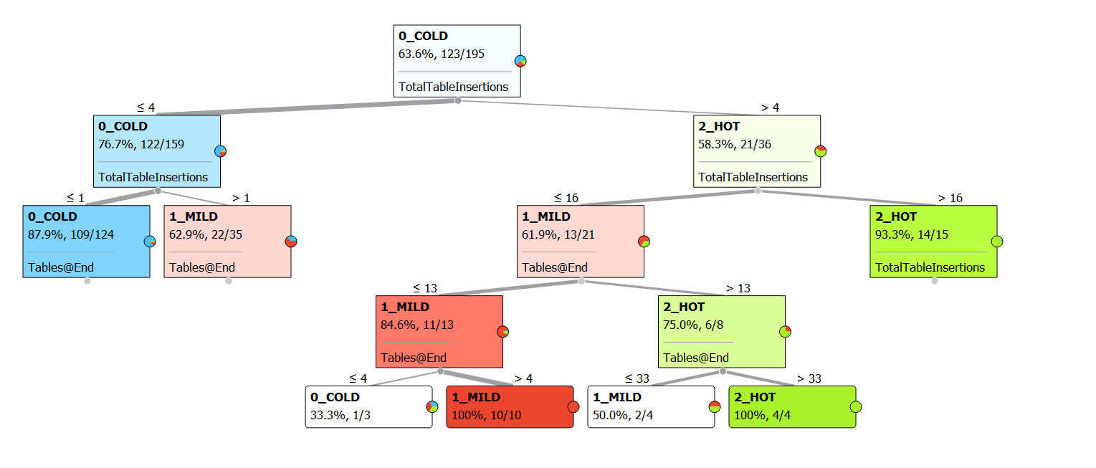
Decision Tree – Table-Level Activity
44 misclassified projects out of 193, meaning 22%.
Most of the misclassified, meaning 18%, are projects that belong to the 1_MILD class and have been misclassified either to the 0_COLD class or to the 2_HOT class.

Slide 60
Super taxa - Durations

Slide 61
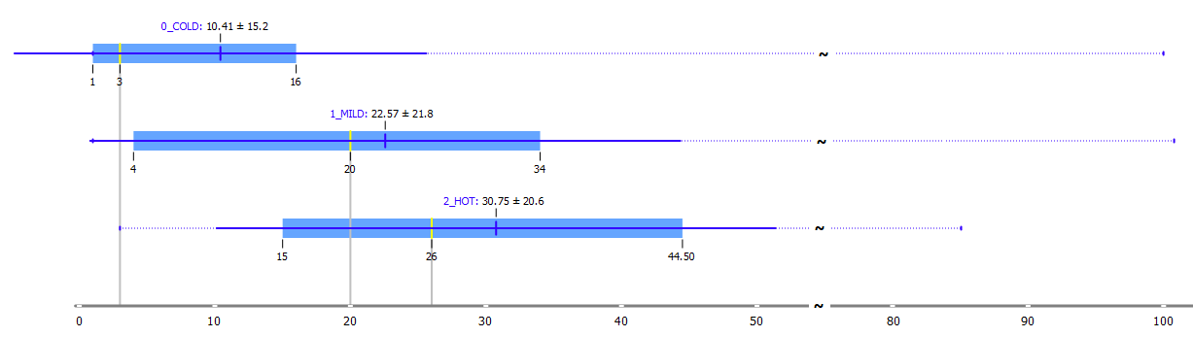
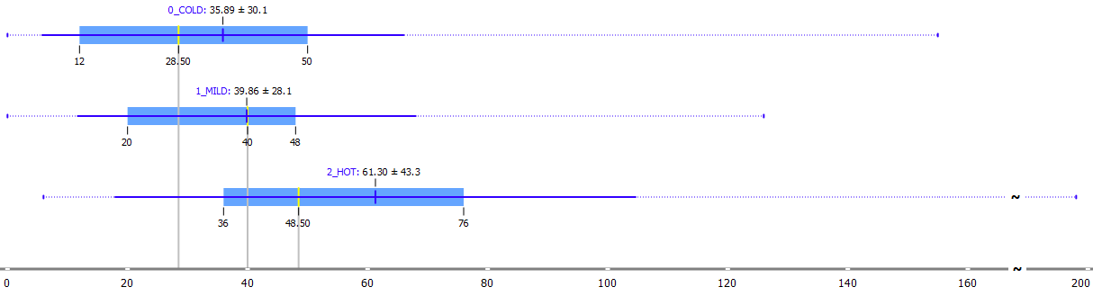
SUP - PUP
Schema Update Period
Project Update Period
The concentration of the values is similar for all the super taxa.
The 1_MILD class overlaps both the 0_COLD and the 2_HOT class, which shows that the activity is due to the nature of the project.
The project update period is not necessarily proportional to the activity of the projects.
All classes seem to have similar project update periods.

Slide 62
Centroid per super taxon
Taxon | Centroid- Project | Total Activity | Reeds | Turfs | Active Commits
Cold | yiier__forum | 7 (-0.37) | 1 (-0.25) | 1 (-0.46) | 2 (-0.45)
Mild | jasdel__harvester | 55 (-0.02) | 2 (0.22) | 6 (0.11) | 8 (0.14)
Hot | pods-framework__pods | 352 (2.14) | 9 (3.54) | 21 (1.80) | 30 (2.29)
Considering the values of the centroid-projects the super taxa are clearly distinguished from each other. Moving from the cold to the hot taxon, both the total activity and the number of active commits noteworthy increase.

Slide 63
Findings regarding super taxa (1)
Reeds, Turfs, and Active Commits distinguish the super taxa well.
The super taxa can be discriminated easily on grounds of a decision tree which is defined only by using the attributes Active Commits and Reeds.
The more active a super taxon is, the bigger the number of the active commits, reeds and turfs it has. On the other hand, all ratios seem to be close for the different super taxa.
All the activity measures and especially totalActivity, totalExpansion, and totalAt-trsInjected are good super taxon discriminators.

Slide 64
Findings regarding super taxa (2)
In the decision tree that was produced by activity measurements, the areas of each super taxon are distinct.
The resizing ratio is not an indicator of how active a taxon is.
Regarding the schema update period, the activity is due to the nature of the projects.
Project update period is not related to the activity.

Slide 65
Future Work
It is possible to explore which percentage of the projects per taxon abides by patterns like progressive reduction of activity, intense spikes of activity, commits of massive maintenance, commits of zero maintenance, etc, and see if the taxa can predict the patterns.
Also, one could define for each pattern, the property values that each project needs to fulfill, and then could check if intersections of these properties can be used as discriminators to create taxa and observe which taxa are created after applying them.

Slide 66
Thank you for your attention !!!

