Slide 1
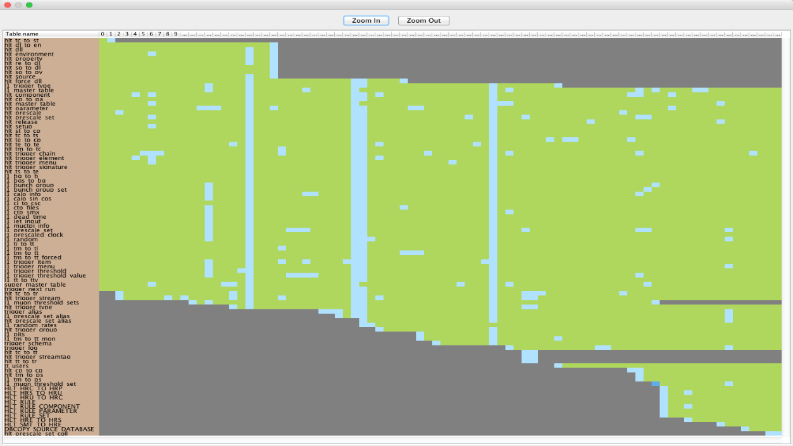
Biography synopses for evolving relational database schemata
Theofanis Giachos
Supervisor: Panos Vassiliadis

Slide 2
Structure
Introduction
Problem Specification
Creating an overview of the history of a schema
Plutarch’s Parallel Lives Results
Conclusions and Open Issues

Slide 3
Structure
Introduction
Problem Specification
Creating an overview of the history of a schema
Plutarch’s Parallel Lives Results
Conclusions and Open Issues

Slide 4
General Facts
Studying the evolution of database schemata is of great importance.
A change in the schema of the database can impact the entire ecosystem of applications that are built on top of the database.
The study of schema evolution entails extracting schema versions and their delta changes from software repositories, subsequently leading to the extraction of patterns and regularities.
The history of a typical database can consist of hundreds of transitions and includes a potentially large number of tables.

Slide 5
Visual Inspection
One of the main tools to study schema evolution is the visual inspection of the history of the schema.
This can allow the scientists to construct research hypotheses as well as to drill into the details of inspected phenomena and try to understand what has happened at particular points in time.
Such a representation is targeted for a two-dimensional representation target in a computer screen or a printed paper.
The space available in these representation media is simply too small for encompassing the hundreds of transitions from one version to another and the hundreds of tables involved in such a history.

Slide 6
Our Solution
The main idea is the creation of a synopsis of the history of the schema evolution.
The number of transitions is abstracted by a limited set of phases and the number of tables is represented by a limited number of table clusters.
Then, we can represent this synopsis as a 2D diagram, with the details of change in the contents of this 2D space.

Slide 7
How we achieve our solution (1/2)
Phase Extraction
We introduce a hierarchical agglomerative clustering algorithm that merges the most similar transitions.
As a result we can have a desired number of phases, each of which encompasses subsequent and similar transitions.
Cluster Extraction
We introduce another hierarchical agglomerative clustering algorithm that creates a desired number of clusters.
Within each cluster, the desideratum is to maximize the similarity of the contained tables.

Slide 8
How we achieve our solution (2/2)
Plutarch’s Parallel Lives tool
Plutarch’s Parallel Lives (in short, PPL) tool combines our abovementioned contribution and allows an interactive exploration of the history of schema.
Functionalities:
Production of a detailed visualization of the life of the database, called Parallel Lives Diagram
Production of an overview for this visualization, which has the extracted phases in its x-axis and the extracted clusters in its y-axis
Zooming into specific points
Filters according to specific criteria
Details on demand

Slide 9
Terminology (1/2)
Schema Version, or simply, Version: A snapshot of the database schema, committed to the public repository that hosts the different versions of the system
Dataset: A sequence of versions, respecting the order by which they appear in the repository that hosts the project to which the database belongs
Transition: The fact that the database schema has been migrated from version vi to version vj, i < j
Revision: A transition between two sequential versions, i.e., from version vi to version vi+1
History of a database schema: A sequence of revisions

Slide 10
Terminology (2/2)
For each transition, for each relation, we can identify the following data:
Old Attributes: The set of attributes of the relation at the source, old version of the transition
New Attributes: The set of attributes of the relation at the target, new version of the transition
Attributes Inserted: The set of attribute names inserted in the relation in the new version of the transition
Attributes Deleted: The set of attribute names deleted from the relation during the transition from the old to the new version
Attributes with Type Alternations: The set of attributes whose data type changed during a transition.
Attributes involved in Key Alternations: The set of attributes that reversed their status concerning their participation to the primary key of the relation between the old and the new version of the transition

Slide 11
Visual representation of a history of a database (1/3)
Parallel (Table) Lives Diagram of a database schema: a two dimensional rectilinear grid having all the revisions of the schema’s history as columns and all the relations of the diachronic schema as its rows
Each cell PLD[i,j] represents the changes undergone and the status of the relation at row i during the revision j.

Slide 12
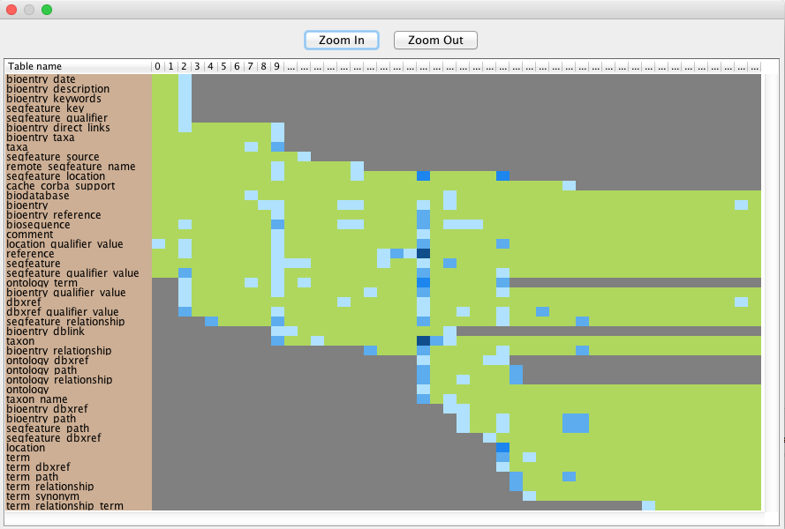
Visual representation of a history of a database (2/3)
The blue cells correspond to transitions where some form of change occurred to the respective table.
Dark cells denote that the table was not part of the database at that time.
Green solid cells denote zero change.

Slide 13
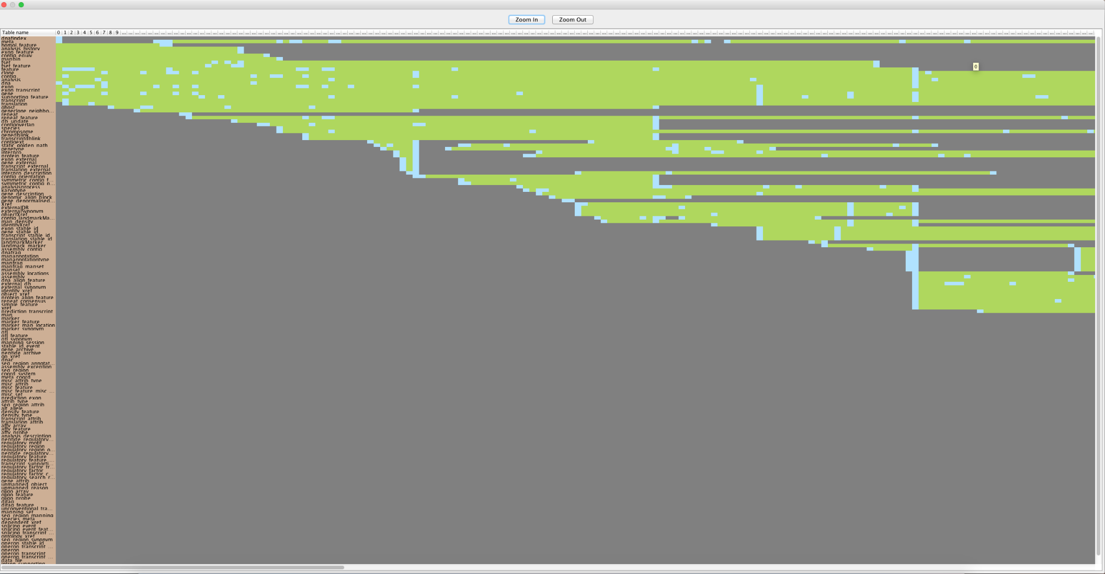
Visual representation of a history of a database (3/3)

Slide 14
Structure
Introduction
Problem Specification
Creating an overview of the history of a schema
Plutarch’s Parallel Lives Results
Conclusions and Open Issues

Slide 15
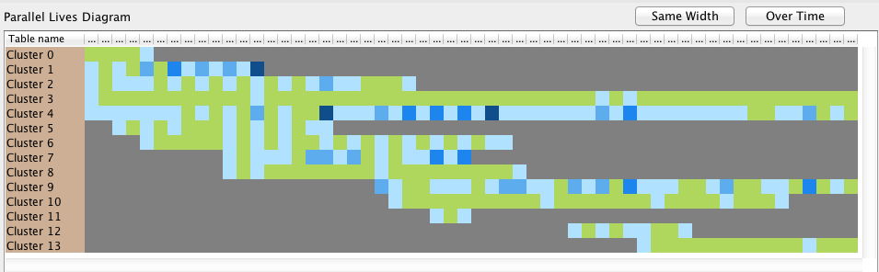

Intuition on the problem
The idea came from the mantra that Shneiderman underlines in his article at 1996 [Shne96], which is
Overview first, zoom and filter, details on demand.
Construct an overview
instead of a
non-fitting diagram

Slide 16
Segmentation of the history into phases
The idea is that we want to zoom-out on the time/version axis.
We need to group transitions to phases, i.e., partition the set of transitions to disjoint groups of consecutive transitions, such that each phases is “homogeneous” internally
The formulation of the problem is as follows:
Given the evolution history of a database schema,
group transitions into phases
such that the transitions of each phase share similar

Slide 17
Clustering of tables into groups
The idea is that we want to zoom-out on the vertical axis with the tables (in case the relations are too many).
We partition the set of relations into disjoint subsets or else clusters. Each cluster has relations with similar lives i.e., lives with similar start, death and heartbeat of changes.
The formulation of the problem is as follows:
Given the evolution history of a database schema,
group relations into groups of relations with similar lives
such that the relations of each group share similar

Slide 18
Zoom, filter and details on demand
Zoom into a specific point of the overview: if we have a matrix in which the x-axis contains the phases and the y-axis contains the tables of the database or the clusters how we could zoom into a specific cell of this table?
Filter the overview: often there is the desire to isolate a component of an overview including its elements to compare for example how similar are the elements from which it consists of.
Details on demand: if the PLD contains in its x-axis the phases and the clusters in its y-axis what details we could get about a cell of PLD?

Slide 19
Structure
Introduction
Problem Specification
Creating an overview of the history of a schema
Plutarch’s Parallel Lives Results
Conclusions and Open Issues

Slide 20
Creating an overview of the history of the database
Creation of an overview of the history of the database consists of two parts:
Computing a segmentation of the history into phases
  Phase extraction algorithm (on the basis of a parameterized distance function)
  Assessment of the quality of result & parameter tuning
Grouping tables into table clusters
  Table clustering algorithm (on the basis of a parameterized distance function)
  Assessment of the quality of result & parameter tuning

Slide 21
Computing a segmentation of the history into phases: The Algorithm
Algorithm: The Phasic Extractor algorithm
Input: A list of schema transitions H = { t_{s}, t_{s+1}, …, t_{e-1}, t_{e}}, the desired number of phases k, the weight to assign to time w_{t}, the desired weight to assign to changes w_{c} , the choice if we want the data to be preprocessed according to the time preProcessingTime, the choice if we want the data to be preprocessed according to the changes preProcessingChanges.
Output: A partition of H, P = {p₁...p_{k}}
variable numPhases=e, counter of the number of phases.
Begin
P={p₁,…p_{e}} s.t. p_{i}={t_{i}} i s…e
while(numPhases>k){
  for each pair of phases ph_{i}, ph_{i+1},
    compute δ(ph_{i}, ph_{i+1})
  Merge the most similar phases, p_{a} and p_{a+1} into a new phase p’
  P = {p1,…, p_{a-1}, p, p_{a+1}, …, p_{m}}
  numPhases --
}
Return P;
End

Slide 22
Computing a segmentation of the history into phases: Parameters
Desired number of segments (k): refers to the number of phases that we would like to be extracted.
Pre-Processing Changes (PPC): refers to the preprocessing of the data from the aspect of changes (ON if the data has been preprocessed, OFF otherwise).
Pre-Processing Time (PPT): refers to the preprocessing of the data from the aspect of time (ON if the data has been preprocessed, OFF otherwise).
Weight Change (WC): refers to the weight of changes (0.5 normal weight, 0 if changes is not taken into account).
Weight Time (WT): refers to the weight of time (0.5 normal weight, 0 if time is not taken into account).

Slide 23

Computing a segmentation of the history into phases: Distance Function
$$δ\left(p_{i}, p_{i+1}\right)=w^{T}×δ^{T}\left(p_{i},p_{i+1}\right)+w^{C}×δ^{C}(p_{i}, p_{i+1})$$

Slide 24

Computing a segmentation of the history into phases: Assessment via divergence from the mean (1/3)
$$E_{pn}={\left(\sum_{∀phase ph_{i}}{\sum_{∀event e_{j} ∈ph_{i}}{{\left|μ_{i}−e_{j}\right|}^{p}}}\right)}^{1/p}$$
μ_{i} is the average number of changes of each phase
e_{j} is the number of changes of each phase’s event
Typically p is equal to one or two

Slide 25
Computing a segmentation of the history into phases: Assessment via divergence from the mean (2/3)
Datasets that were used by Phasic Extractor
Atlas
bioSQL
Coppermine
Ensembl
mediaWiki
Opencart
phpBB
typo3

Slide 26
Computing a segmentation of the history into phases: Assessment via divergence from the mean (3/3)
 | PPC: OFF PPT: OFF | PPC: ON PPT: OFF | PPC: OFF PPT: ON | PPC: ON PPT: ON
WC = 0.0 WT = 1.0 | - | - | - | -
WC = 0.5 WT = 0.5 | - | - | 1 | 1
WC = 1.0 WT = 0.0 | 5 | 3 | - | 1

Slide 27
Computing a segmentation of the history into phases: Assessment via spread in the time x change space (1/2)
The second assessment method can be described as follows:
For each pair of phases ph_{i} and ph_{i+1} :
compute the term δ^{time}
compute is the term δ_{change}
When these two terms have been computed for the whole set of pairs we can represent our results with the scatter plot format.

Slide 28
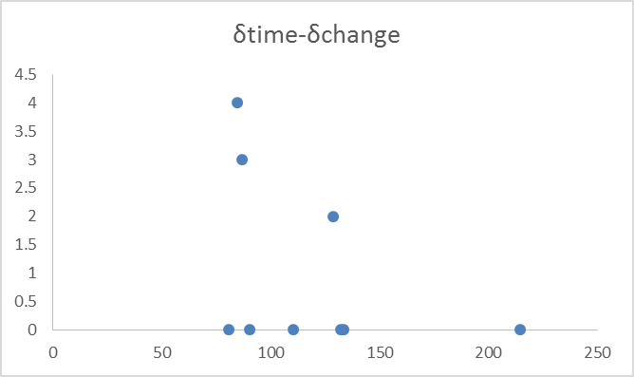
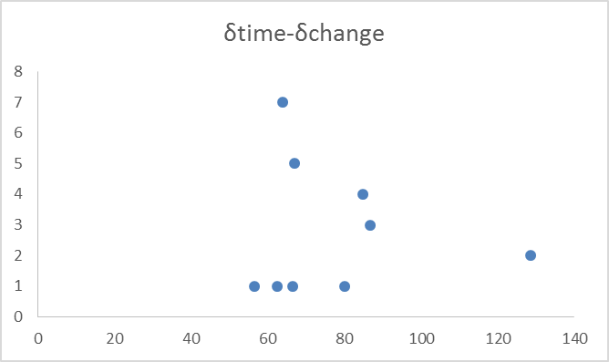
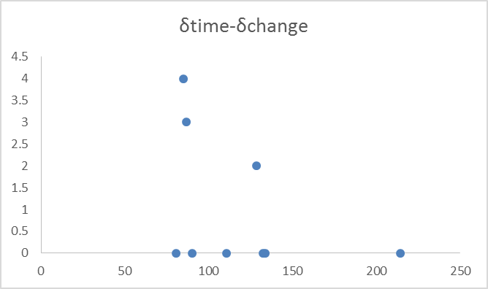
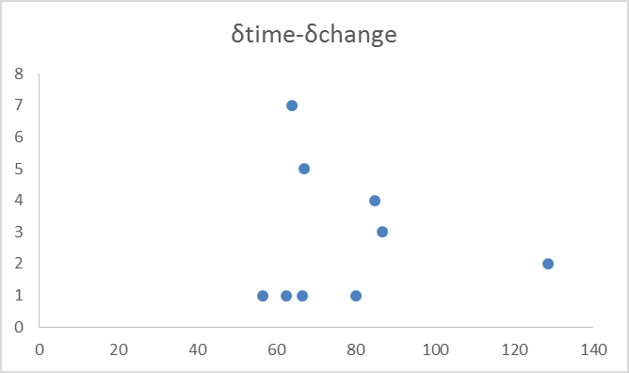
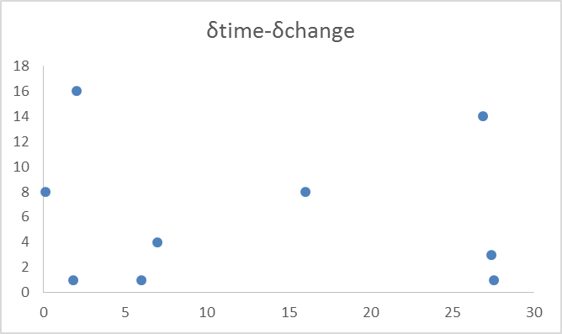
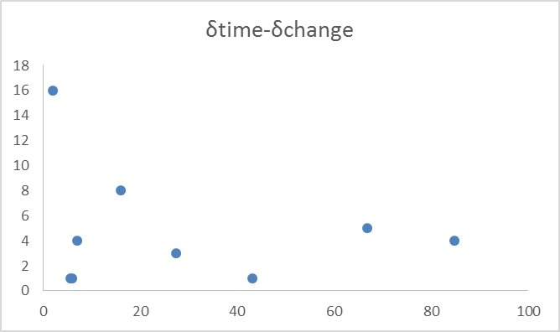
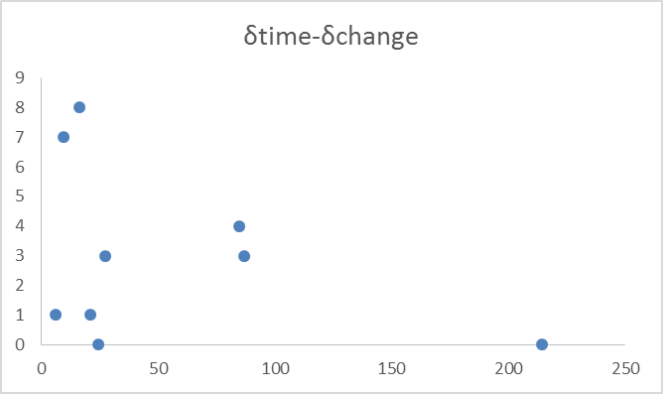
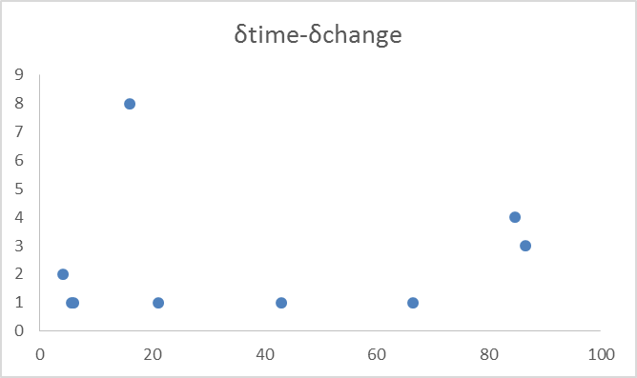
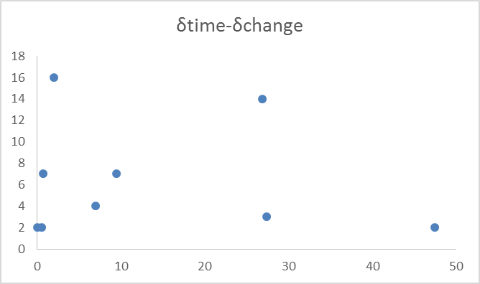
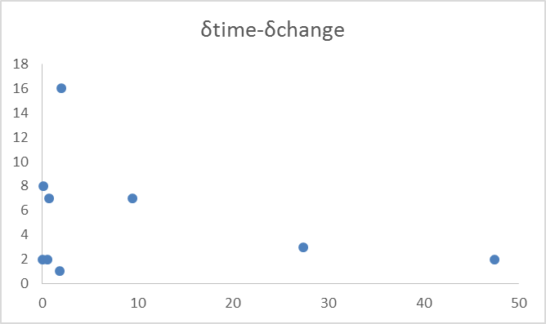
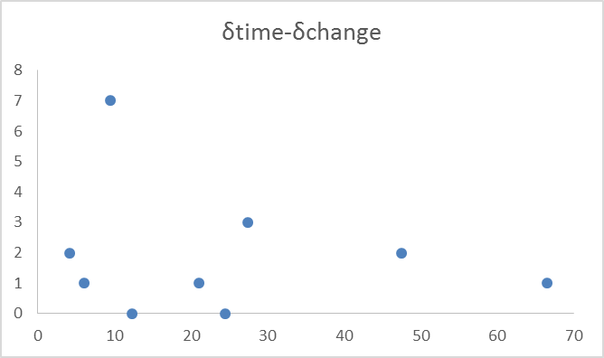
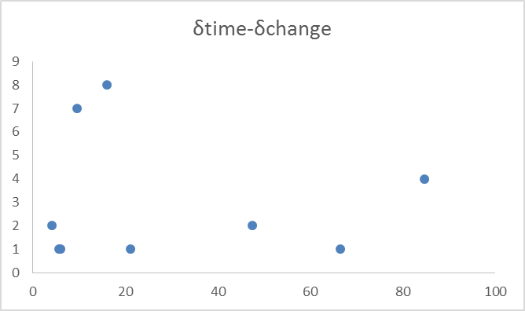
Computing a segmentation of the history into phases: Assessment via spread in the time x change space (2/2)
WC:0.0 WT:1.0 PPC:OFF PPT:OFF
WC:0.0
WT:1.0
PPC:ON PPT:OFF
WC:0.0
WT:1.0
PPC:OFF PPT:ON
WC:0.0
WT:1.0
PPC:ON PPT:ON
WC:0.5
WT:0.5
PPC:OFF PPT:OFF
WC:0.5
WT:0.5
PPC:ON PPT:OFF
WC:0.5
WT:0.5
PPC:OFF PPT:ON
WC:0.5
WT:0.5
PPC:ON PPT:ON
WC:1.0
WT:0.0
PPC:OFF PPT:OFF
WC:1.0
WT:0.0
PPC:ON PPT:OFF
WC:1.0
WT:0.0
PPC:OFF PPT:ON
WC:1.0
WT:0.0
PPC:ON PPT:ON

Slide 29
Grouping tables into clusters: The Algorithm
Algorithm: The Clustering Extractor algorithm
Input: The entire set of the database’s tables T {tab₁, ... , tab_{n}}, the desired number of clusters k, the weight to assign to birth date w_{b,} , the weight to assign to death date w_{d,} , the weight to assign to heartbeat of the changes date w_{c}
Output: A partition of T, C={c₁, … , c_{k}}
variable numClusters=n, counter of the number of clusters
Begin
C={c₁, … , c_{n}} s.t. c_{i} = {tab_{i}} i 1…n
while(numClusters>k){
  for each pair of clusters c_{i}, c_{i+1},
    compute the δ(c_{i},c_{i+1})
  Merge the most similar clusters, c_{a} and c_{a+1} into a new cluster c’
  C = {c₁,…, c_{a-1}, c, c_{a+1}, …, c_{m}}
  numClusters –-
}
Return C;
End

Slide 30
Grouping tables into clusters: Parameters
Desired number of clusters (k): refers to the number of clusters that we would like to be created.
Birth Weight (BW): refers to the weight of the distance between birth dates of compared clusters.
Death Weight (DW): refers to the weight of the distance between death dates of compared clusters.
Change Weight (CW): refers to the weight of the distance between the changes of compared clusters.

Slide 31
Grouping tables into clusters: Distance Function
$$δ\left(cluster_{A},cluster_{B}\right)=w_{b}∗\left|δ_{birth}\left(c_{A},c_{B}\right)\right|+w_{d}∗\left|δ_{death}\left(c_{A},c_{B}\right)\right|+w_{c}∗\left|δ_{change}(c_{A},c_{B})\right|$$

Slide 32
Grouping tables into clusters: Clustering Validity Techniques
There are two main categories for clustering validity:
Internal evaluation: refers to methods that do not need external knowledge and can measure the quality of the clusters only with the information that they keep and which was used from the clustering algorithm
External evaluation: needs external knowledge, i.e., data have to be classified before the evaluation process, by explicit tracing of human knowledge on the issue.

Slide 33
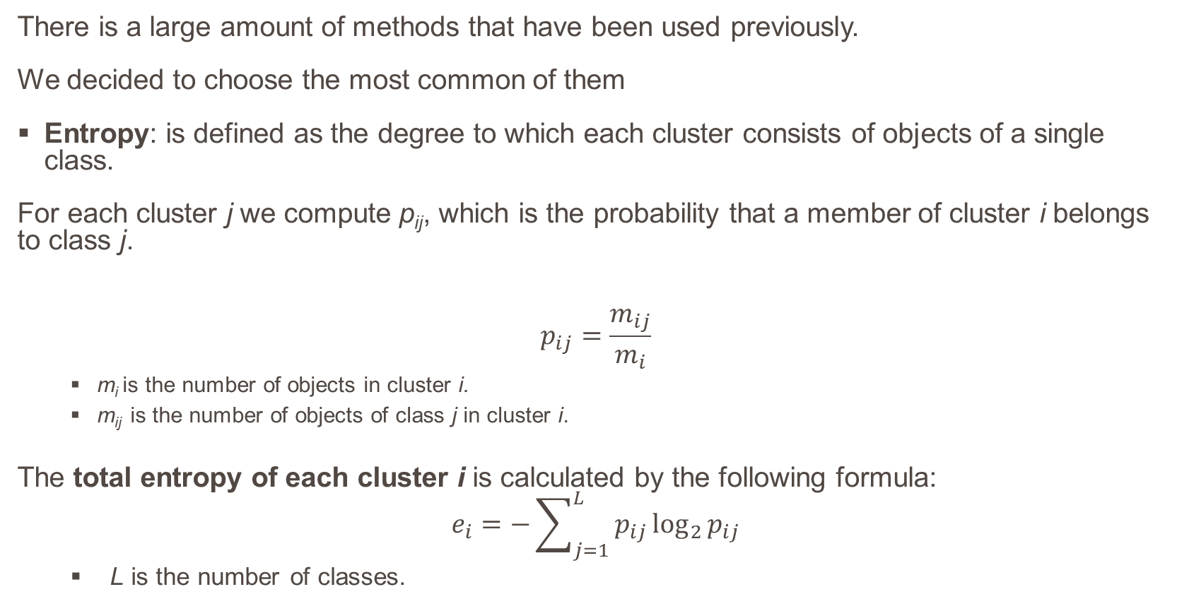
Grouping tables into clusters: Assessment via External evaluation - Metrics
There is a large amount of methods that have been used previously.
We decided to choose the most common of them
Entropy: is defined as the degree to which each cluster consists of objects of a single class.
For each cluster j we compute p_{ij}, which is the probability that a member of cluster i belongs to class j.
$$p_{ij}=\frac{m_{ij}}{m_{i}}$$
  m_{i} is the number of objects in cluster i.
  m_{ij} is the number of objects of class j in cluster i.
  The total entropy of each cluster i is calculated by the following formula:
  $$e_{i}=−\sum_{j=1}^{L}{p_{ij}\log_{2}{p_{ij}}}$$
    L is the number of classes.

Slide 34
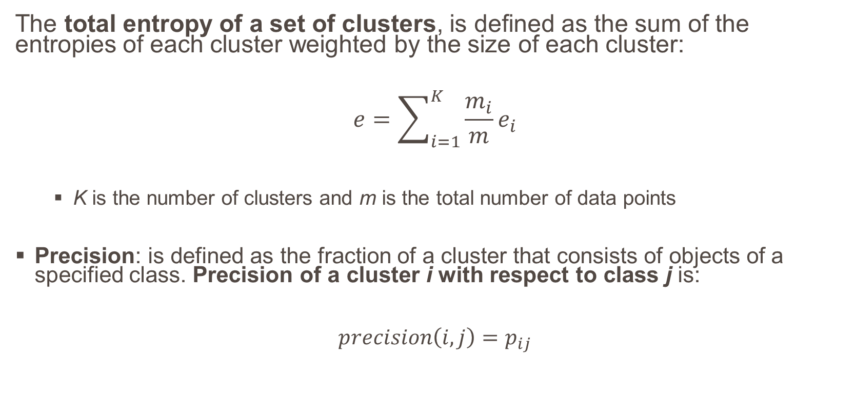
Grouping tables into clusters: Assessment via External evaluation – Metrics
The total entropy of a set of clusters, is defined as the sum of the entropies of each cluster weighted by the size of each cluster:
$$e=\sum_{i=1}^{K}{\frac{m_{i}}{m}e_{i}}$$
  K is the number of clusters and m is the total number of data points
Precision: is defined as the fraction of a cluster that consists of objects of a specified class. Precision of a cluster i with respect to class j is:
$$precision\left(i,j\right)=p_{ij}$$

Slide 35
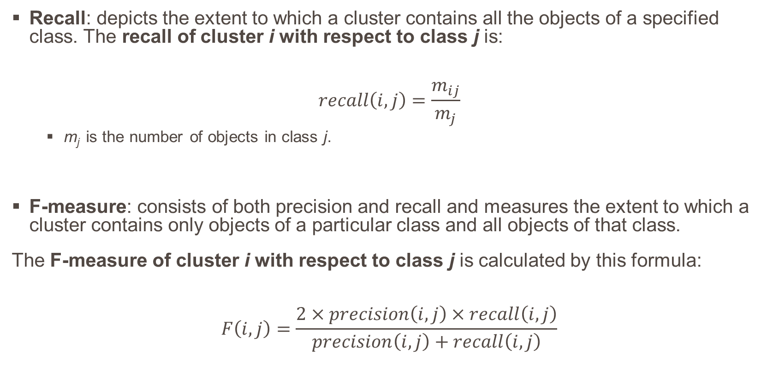
Grouping tables into clusters: Assessment via External evaluation - Metrics
Recall: depicts the extent to which a cluster contains all the objects of a specified class. The recall of cluster i with respect to class j is:
$$recall\left(i,j\right)=\frac{m_{ij}}{m_{j}}$$
  m_{j} is the number of objects in class j.
F-measure: consists of both precision and recall and measures the extent to which a cluster contains only objects of a particular class and all objects of that class.
The F-measure of cluster i with respect to class j is calculated by this formula:
$$F\left(i,j\right)=\frac{2×precision\left(i,j\right)×recall\left(i,j\right)}{precision\left(i,j\right)+recall\left(i,j\right)}$$

Slide 36
Grouping tables into clusters: Assessment via External evaluation – Classifying Method
Datasets
  Atlas
  bioSQL
  Coppermine
  phpBB
The source of our classification procedure was the PLD (Parallel Live Diagram).
The most obvious criteria of the PLD are when a table is born (birth date) and when a table died and not as much the count of changes of each table.

Slide 37
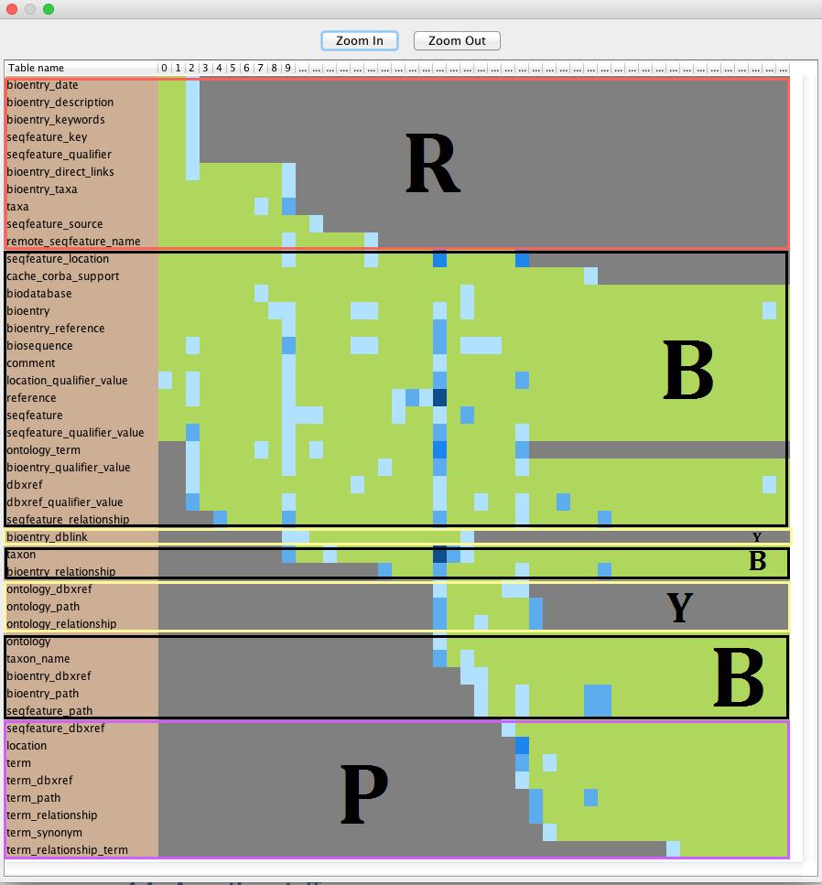
Grouping tables into clusters: Assessment via External evaluation – Classifying Method

Slide 38
Grouping tables into clusters: Assessment via External evaluation – Results
Average F-Measure
Entropies
Parameters Set wb-wd-wc | Average F-Measure
0.33 - 0.33 - 0.33 | 0.19
0.00 - 1.00 - 0.00 | 0.22
0.00 - 0.50 - 0.50 | 0.20
0.00 - 0.00 - 1.00 | 0.17
0.50 - 0.50 - 0.00 | 0.25
0.50 - 0.00 - 0.50 | 0.16
1.00 - 0.00 - 0.00 | 0.21
w_{b} | w_{d} | w_{c} | Entropy (e)
0.333 | 0.333 | 0.333 | 1.13
0 | 1 | 0 | 0.79
0 | 0.5 | 0.5 | 1.06
0 | 0 | 1 | 1.14
0.5 | 0.5 | 0 | 0.00
0.5 | 0 | 0.5 | 0.57
1 | 0 | 0 | 0.52

Slide 39
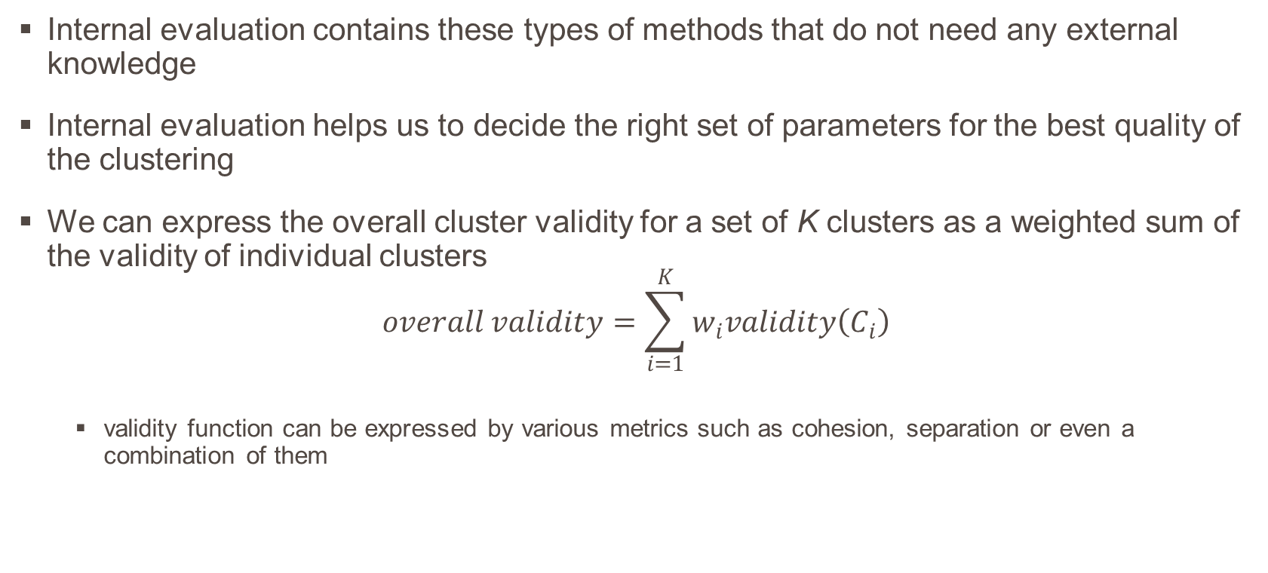
Grouping tables into clusters: Assessment via Internal evaluation - Metrics
Internal evaluation contains these types of methods that do not need any external knowledge
Internal evaluation helps us to decide the right set of parameters for the best quality of the clustering
We can express the overall cluster validity for a set of K clusters as a weighted sum of the validity of individual clusters
$$overall validity=\sum_{i=1}^{K}{w_{i}validity\left(C_{i}\right)}$$
  validity function can be expressed by various metrics such as cohesion, separation or even a combination of them

Slide 40
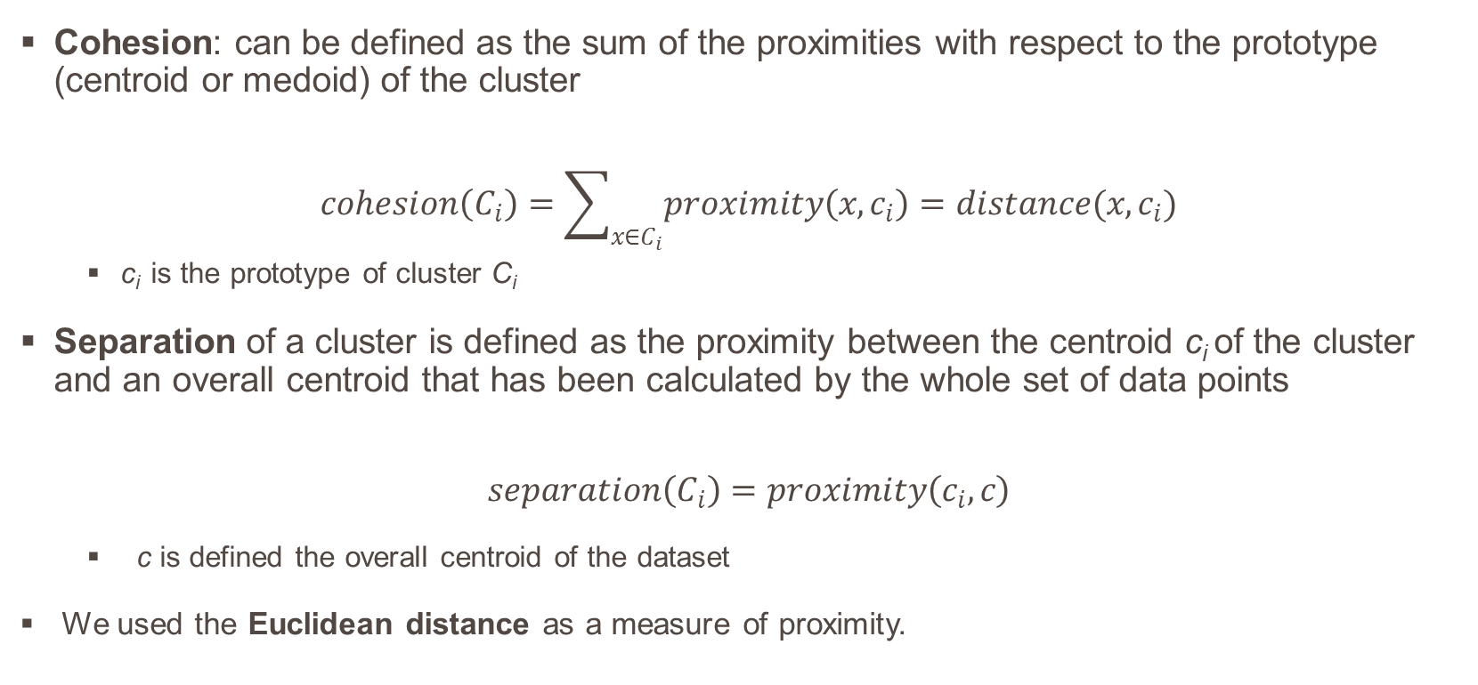
Grouping tables into clusters: Assessment via Internal evaluation - Metrics
Cohesion: can be defined as the sum of the proximities with respect to the prototype (centroid or medoid) of the cluster
$$cohesion\left(C_{i}\right)=\sum_{x∈C_{i}}{proximity\left(x,c_{i}\right)=distance(x,c_{i})}$$
  c_{i} is the prototype of cluster C_{i}
  Separation of a cluster is defined as the proximity between the centroid c_{i} of the cluster and an overall centroid that has been calculated by the whole set of data points
  $$separation\left(C_{i}\right)=proximity\left(c_{i},c\right)$$
    c is defined the overall centroid of the dataset
    We used the Euclidean distance as a measure of proximity.

Slide 41
Grouping tables into clusters: Assessment via Internal evaluation - Results
Wb | Wd | Wc | Cohesion
0.00 | 1.00 | 0.00 | 2
0.33 | 0.33 | 0.33 | 2
0.50 | 0.50 | 0.00 | -
0.50 | 0.00 | 0.50 | 4
1.00 | 0.00 | 0.00 | -
Wb | Wd | Wc | Separation
0.00 | 1.00 | 0.00 | 3
0.33 | 0.33 | 0.33 | 2
0.50 | 0.50 | 0.00 | -
0.50 | 0.00 | 0.50 | 3
1.00 | 0.00 | 0.00 | -

Slide 42
Structure
Introduction
Problem Specification
Creating an overview of the history of a schema
Plutarch’s Parallel Lives Results
Conclusions and Open Issues

Slide 43
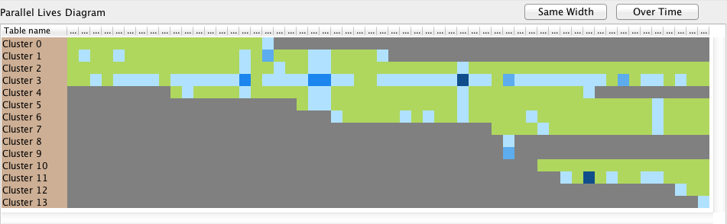

Overview vs PLD (Atlas)

Slide 44
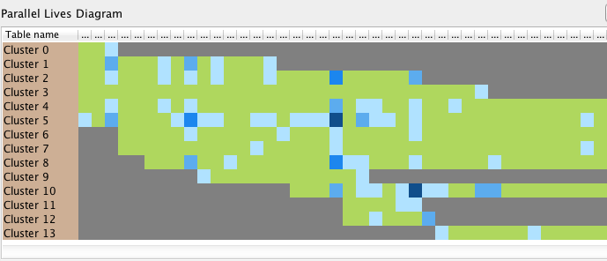
Overview vs PLD (bioSQL)

Slide 45

Overview vs PLD (Ensembl)

Slide 46
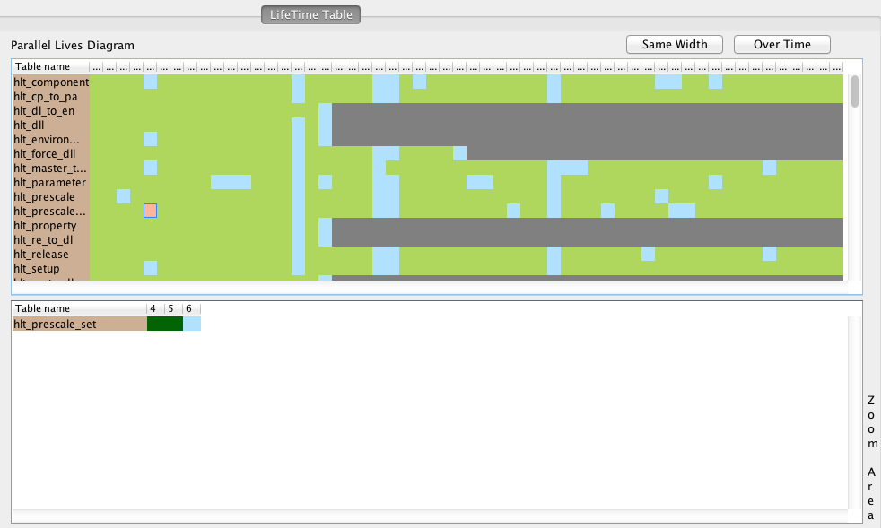
Zoom into a specific point of overview: PLD phases x tables

Slide 47
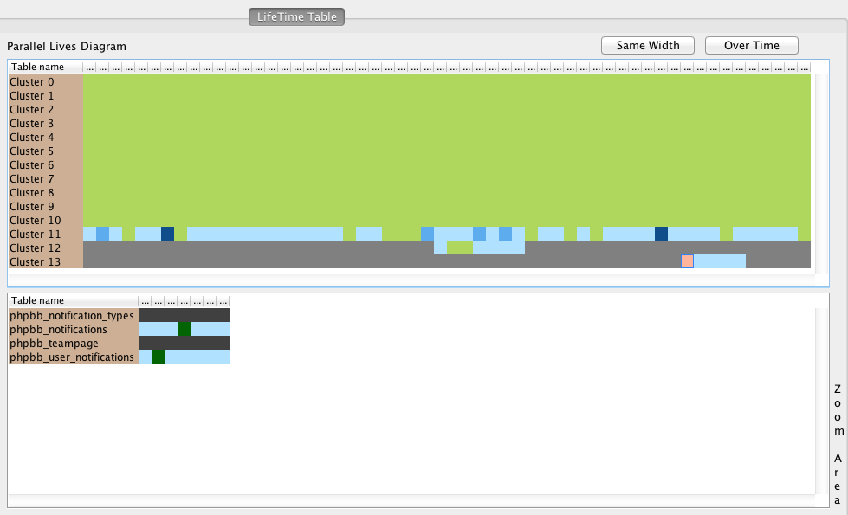
Zoom into a specific point of overview: PLD phases x clusters

Slide 48
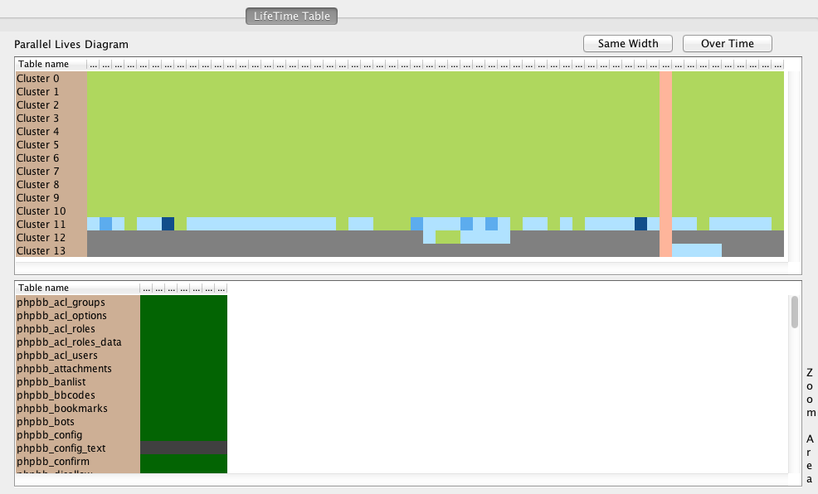
Filter the overview of the history: Filter by a specific phase

Slide 49
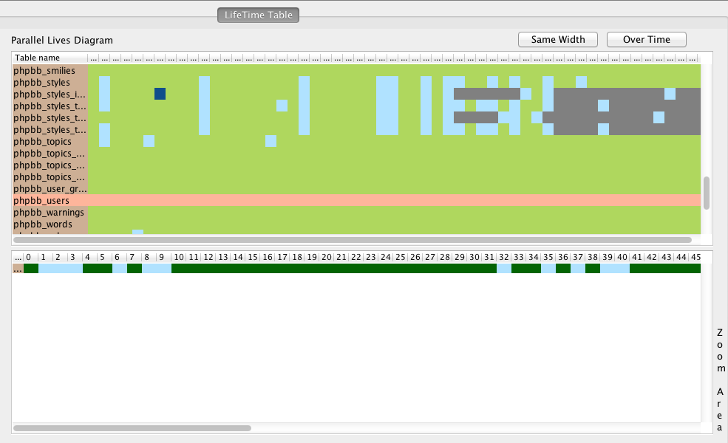
Filter the overview of the history: Filter by a specific table

Slide 50
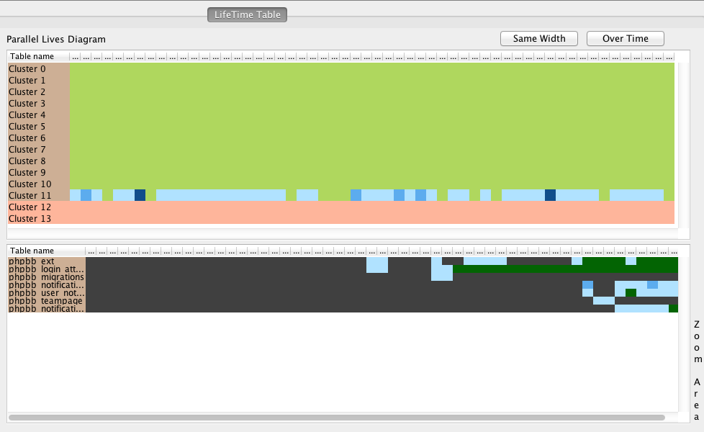
Filter the overview of the history: Filter by specific clusters

Slide 51
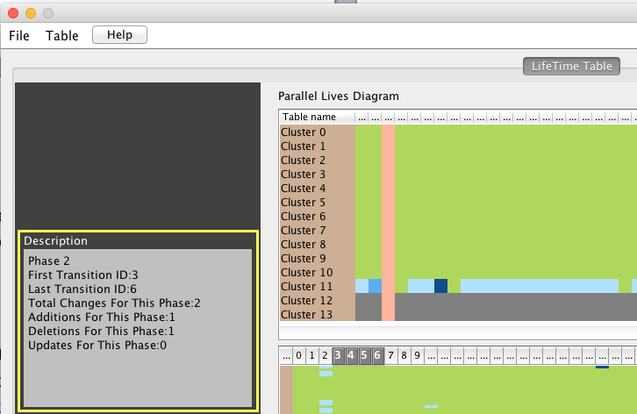
Details on demand for selected phase

Slide 52
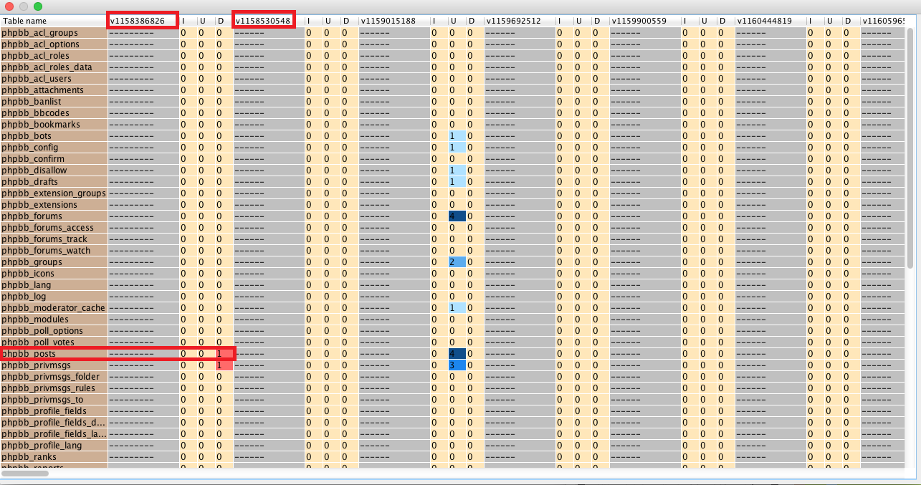
Details on demand with a full detailed PLD

Slide 53
Structure
Introduction
Problem Specification
Creating an overview of the history of a schema
Results
Conclusions and Open Issues

Slide 54
Conclusions
Conclusions:
Creation of an interactive overview from the entire life of a database
Phase Extraction Algorithm
Cluster Extraction Algorithm
Assessment of both of them
Plutarch’s Parallel Lives tool

Slide 55
Open Issues
Open Issues
Implementation of different distance metrics for phase extraction
Implementation of different distance metrics for cluster extraction
Enrichment of PPL with more features

Slide 56
Thank you!

Slide 57
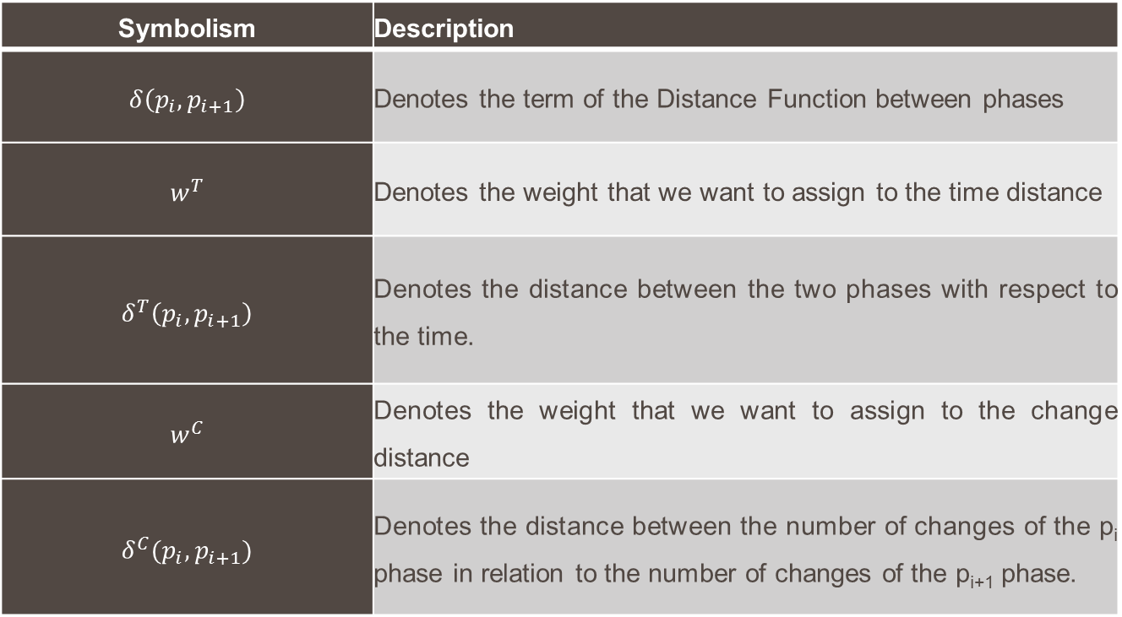
Phase Extraction Distance Function Notations

Slide 58
Computing a segmentation of the history into phases: Assessment via divergence from the mean (3/4)
Atlas Dataset
bioSQL Dataset
Coppermine Dataset
Ensembl Dataset

Slide 59
Computing a segmentation of the history into phases: Assessment via divergence from the mean (4/4)
mediaWiki Dataset
Opencart Dataset
phpBB Dataset
typo3 Dataset

Slide 60
Computing a segmentation of the history into phases: Assessment via spread in the time x change space (2/7)
WC:0.0, WT:1.0, PPC:OFF, PPT:OFF
WC:0.0, WT:1.0, PPC:ON, PPT:OFF

Slide 61
Computing a segmentation of the history into phases: Assessment via spread in the time x change space (3/7)
WC:0.0, WT:1.0, PPC:OFF, PPT:ON
WC:0.0, WT:1.0, PPC:ON, PPT:ON

Slide 62
Computing a segmentation of the history into phases: Assessment via spread in the time x change space (4/7)
WC:0.5, WT:0.5, PPC:OFF, PPT:OFF
WC:0.5, WT:0.5, PPC:ON, PPT:OFF

Slide 63
Computing a segmentation of the history into phases: Assessment via spread in the time x change space (5/7)
WC:0.5, WT:0.5, PPC:OFF, PPT:ON
WC:0.5, WT:0.5, PPC:ON, PPT:ON

Slide 64
Computing a segmentation of the history into phases: Assessment via spread in the time x change space (6/7)
WC:1.0, WT:0.0, PPC:OFF, PPT:OFF
WC:1.0, WT:0.0, PPC:ON, PPT:OFF

Slide 65
Computing a segmentation of the history into phases: Assessment via spread in the time x change space (7/7)
WC:1.0, WT:0.0, PPC:OFF, PPT:ON
WC:1.0, WT:0.0, PPC:ON, PPT:ON

Slide 66
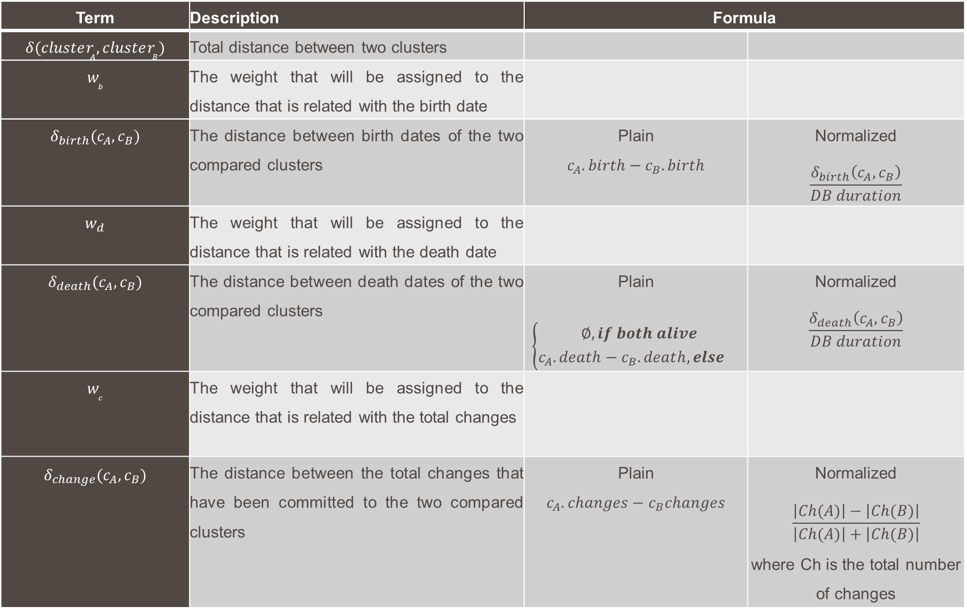
Term | Description | Formula
$$δ(cluster_{A},cluster_{B})$$ | Total distance between two clusters
$$w_{b}$$ | The weight that will be assigned to the distance that is related with the birth date
$$δ_{birth}(c_{A},c_{B})$$ | The distance between birth dates of the two compared clusters | Plain $$c_{A}.birth−c_{B}.birth$$ | Normalized $$\frac{δ_{birth}\left(c_{A},c_{B}\right)}{DB duration}$$
$$w_{d}$$ | The weight that will be assigned to the distance that is related with the death date
$$δ_{death}(c_{A},c_{B})$$ | The distance between death dates of the two compared clusters | Plain $$\left\{\begin{aligned}∅,if both alive \\ c_{A}.death−c_{B}.deat{h, else }^{}\end{aligned}\right.$$ | Normalized $$\frac{δ_{death}\left(c_{A},c_{B}\right)}{DB duration}$$
$$w_{c}$$ | The weight that will be assigned to the distance that is related with the total changes
$$δ_{change}(c_{A},c_{B})$$ | The distance between the total changes that have been committed to the two compared clusters | Plain $$c_{A}.changes−c_{B}changes$$ | Normalized $$\frac{\left|Ch(A)\right|−\left|Ch(B)\right|}{\left|Ch(A)\right|+\left|Ch(B)\right|}$$ where Ch is the total number of changes

Slide 67
Grouping tables into clusters: Assessment via External evaluation – Results
w_{b} | w_{d} | w_{c} | Entropy (e)
0.333 | 0.333 | 0.333 | 0.40
0 | 1 | 0 | 0.45
0 | 0.5 | 0.5 | 0.51
0 | 0 | 1 | 1.14
0.5 | 0.5 | 0 | 0.32
0.5 | 0 | 0.5 | 0.50
1 | 0 | 0 | 0.30
w_{b} | w_{d} | w_{c} | Entropy (e)
0.333 | 0.333 | 0.333 | 1.13
0 | 1 | 0 | 0.79
0 | 0.5 | 0.5 | 1.06
0 | 0 | 1 | 1.14
0.5 | 0.5 | 0 | 0.00
0.5 | 0 | 0.5 | 0.57
1 | 0 | 0 | 0.52
Atlas
bioSQL

Slide 68
Grouping tables into clusters: Assessment via External evaluation – Results
w_{b} | w_{d} | w_{c} | Entropy (e)
0.333 | 0.333 | 0.333 | 0.38
0 | 1 | 0 | 0.19
0 | 0.5 | 0.5 | 0.38
0 | 0 | 1 | 0.38
0.5 | 0.5 | 0 | 0.19
0.5 | 0 | 0.5 | 0.60
1 | 0 | 0 | 0.00
w_{b} | w_{d} | w_{c} | Entropy (e)
0.333 | 0.333 | 0.333 | 0.13
0 | 1 | 0 | 0.94
0 | 0.5 | 0.5 | 0.28
0 | 0 | 1 | 0.28
0.5 | 0.5 | 0 | 0.00
0.5 | 0 | 0.5 | 0.20
1 | 0 | 0 | 0.26
Coppermine
phpBB

Slide 69
Grouping tables into clusters: Assessment via Internal evaluation - Results
Atlas
Wb | Wd | Wc | Cohesion | Separation
0.00 | 1.00 | 0.00 | 1323.69 | 2115.12
0.33 | 0.33 | 0.33 | 650.45 | 2598.62
0.50 | 0.50 | 0.00 | 331.31 | 2797.45
0.50 | 0.00 | 0.50 | 1383.74 | 2049.81
1.00 | 0.00 | 0.00 | 1271.30 | 2314.82
Coppermine
Wb | Wd | Wc | Cohesion | Separation
0.00 | 1.00 | 0.00 | 211.33 | 362.10
0.33 | 0.33 | 0.33 | 35.62 | 421.41
0.50 | 0.50 | 0.00 | 40.16 | 418.65
0.50 | 0.00 | 0.50 | 35.62 | 421.41
1.00 | 0.00 | 0.00 | 40.16 | 418.65

Slide 70
Grouping tables into clusters: Assessment via Internal evaluation - Results
bioSQL
Wb | Wd | Wc | Cohesion | Separation
0.00 | 1.00 | 0.00 | 320.45 | 781.45
0.33 | 0.33 | 0.33 | 159.73 | 890.94
0.50 | 0.50 | 0.00 | 122.00 | 886.21
0.50 | 0.00 | 0.50 | 473.46 | 668.98
1.00 | 0.00 | 0.00 | 253.59 | 827.05
Ensembl
Wb | Wd | Wc | Cohesion | Separation
0.00 | 1.00 | 0.00 | 11167.50 | 30780.37
0.33 | 0.33 | 0.33 | 21301.49 | 21566.66
0.50 | 0.50 | 0.00 | 5289.72 | 33661.45
0.50 | 0.00 | 0.50 | 19684.44 | 24562.84
1.00 | 0.00 | 0.00 | 14182.14 | 27347.17

Slide 71
Grouping tables into clusters: Assessment via Internal evaluation - Results
mwiki
Wb | Wd | Wc | Cohesion | Separation
0.00 | 1.00 | 0.00 | 4653.55 | 6882.07
0.33 | 0.33 | 0.33 | 1752.76 | 9397.74
0.50 | 0.50 | 0.00 | 1033.57 | 9561.50
0.50 | 0.00 | 0.50 | 5349.92 | 7390.00
1.00 | 0.00 | 0.00 | 4775.46 | 7740.74
Opencart
Wb | Wd | Wc | Cohesion | Separation
0.00 | 1.00 | 0.00 | 3924.06 | 15890.54
0.33 | 0.33 | 0.33 | 3359.07 | 16089.72
0.50 | 0.50 | 0.00 | 2366.92 | 16189.32
0.50 | 0.00 | 0.50 | 7604.85 | 13317.76
1.00 | 0.00 | 0.00 | 3202.38 | 16068.17

Slide 72
Grouping tables into clusters: Assessment via Internal evaluation - Results
phpBB
Wb | Wd | Wc | Cohesion | Separation
0.00 | 1.00 | 0.00 | 766.54 | 2053.20
0.33 | 0.33 | 0.33 | 2243.29 | 512.37
0.50 | 0.50 | 0.00 | 506.25 | 2196.72
0.50 | 0.00 | 0.50 | 2104.33 | 565.81
1.00 | 0.00 | 0.00 | 506.25 | 2196.72
typo3
Wb | Wd | Wc | Cohesion | Separation
0.00 | 1.00 | 0.00 | 414.14 | 1096.70
0.33 | 0.33 | 0.33 | 192.07 | 1240.47
0.50 | 0.50 | 0.00 | 239.91 | 1213.34
0.50 | 0.00 | 0.50 | 208.57 | 1212.90
1.00 | 0.00 | 0.00 | 277.97 | 1200.29

Slide 73
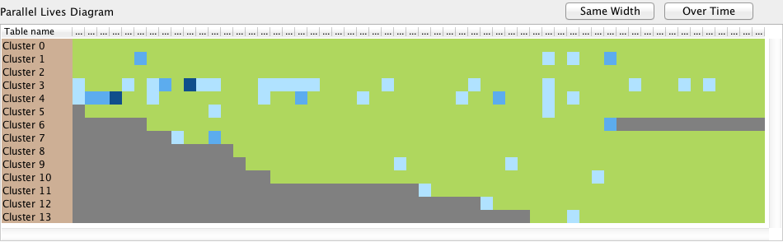
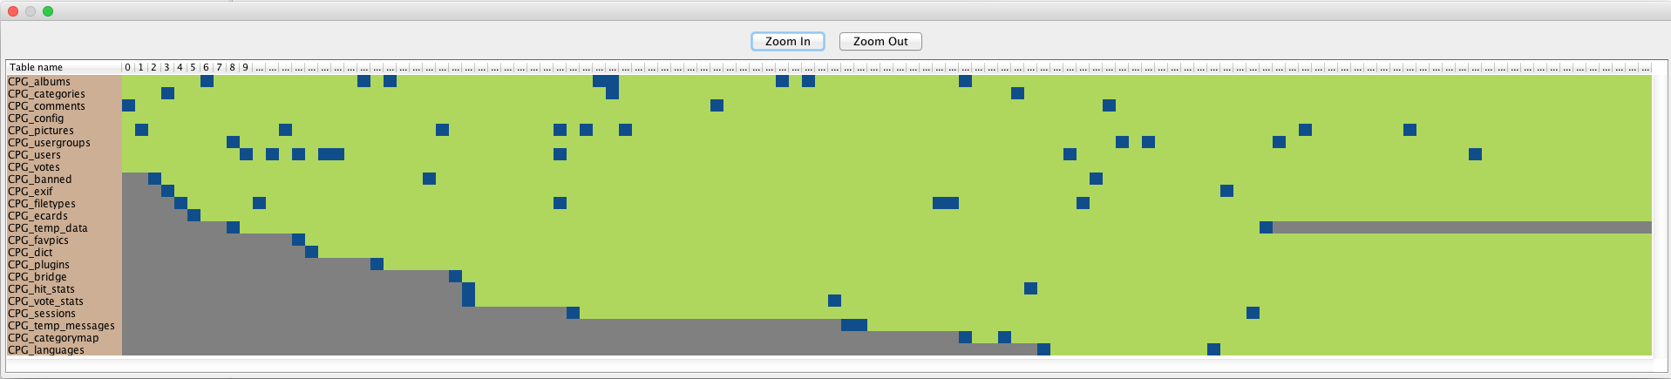
Overview vs PLD (Coppermine)

Slide 74
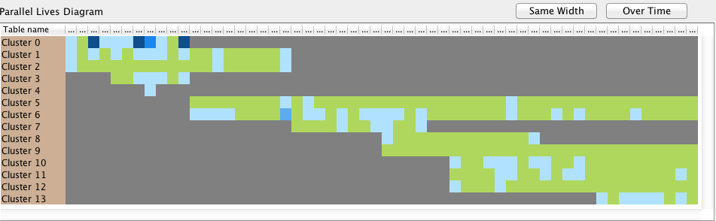
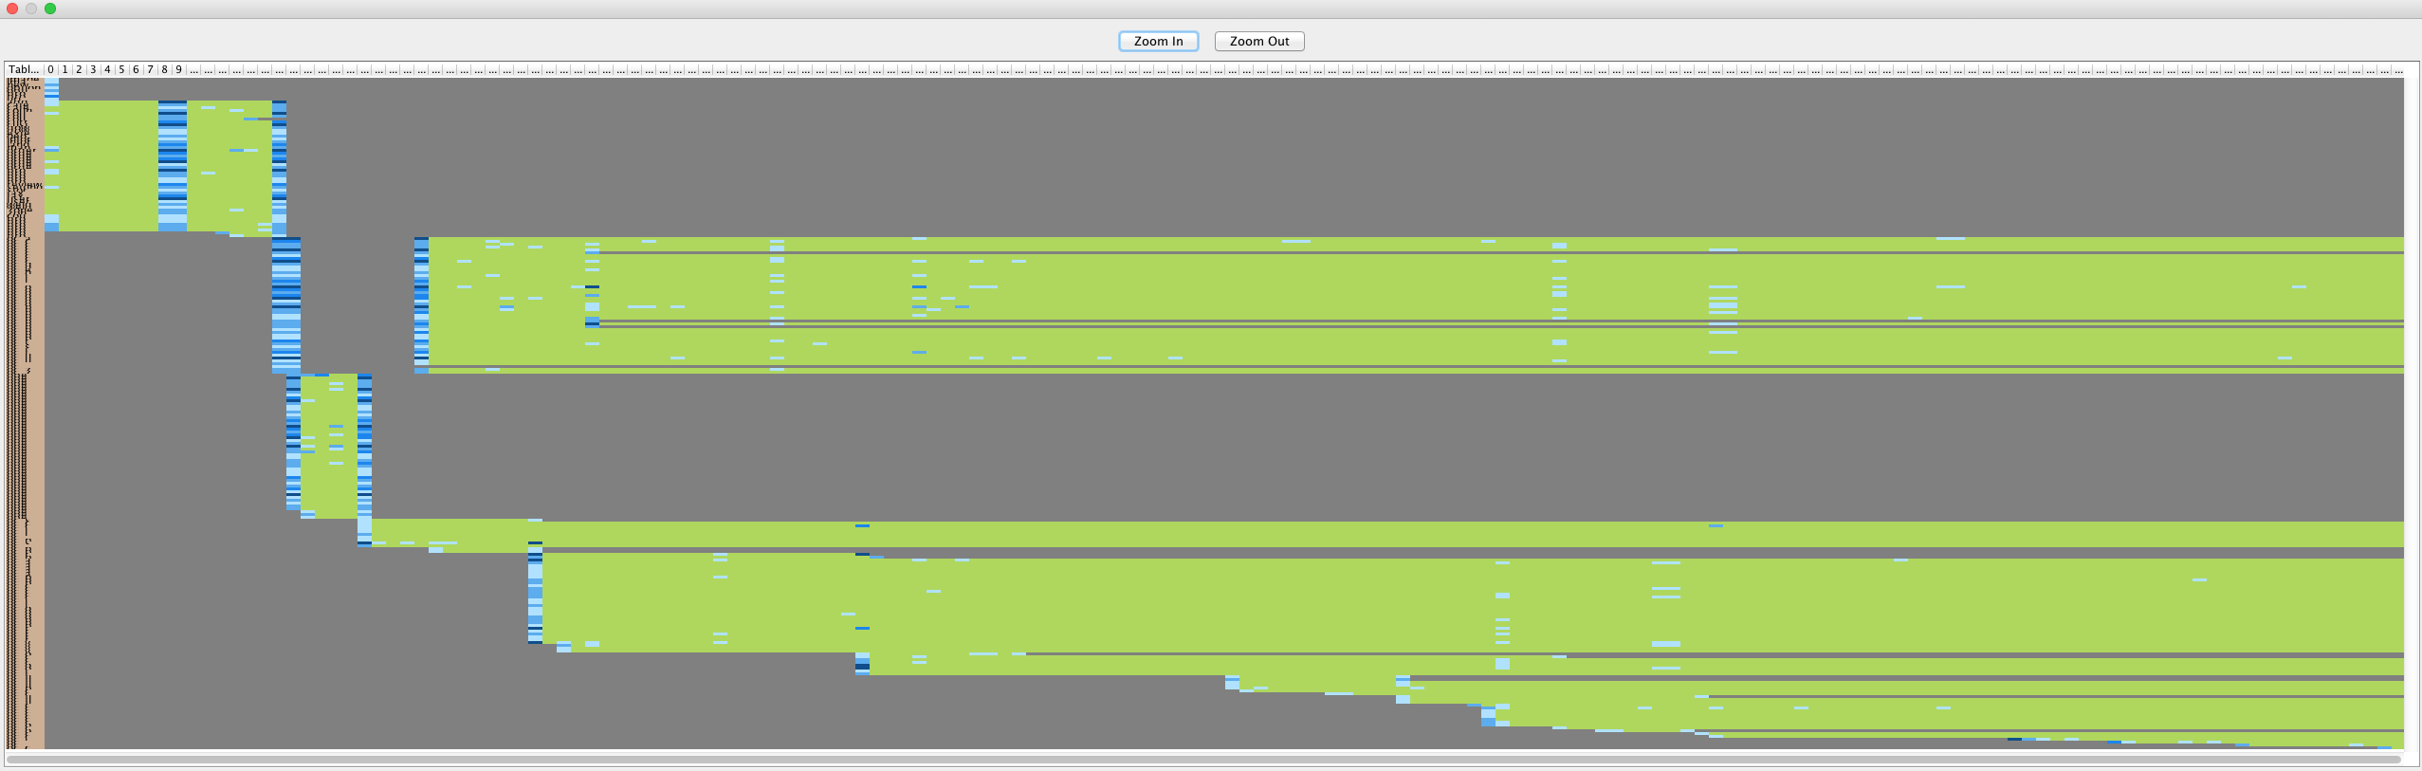
Overview vs PLD (Opencart)

Slide 75
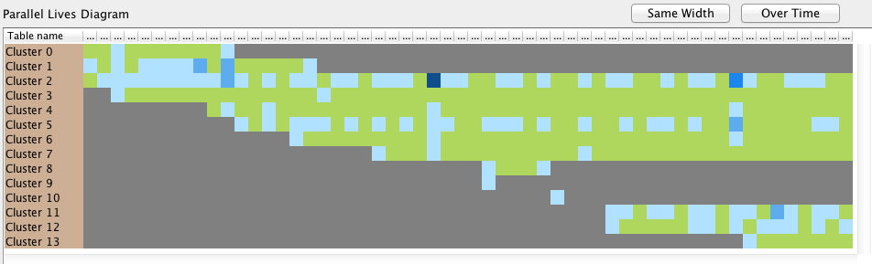
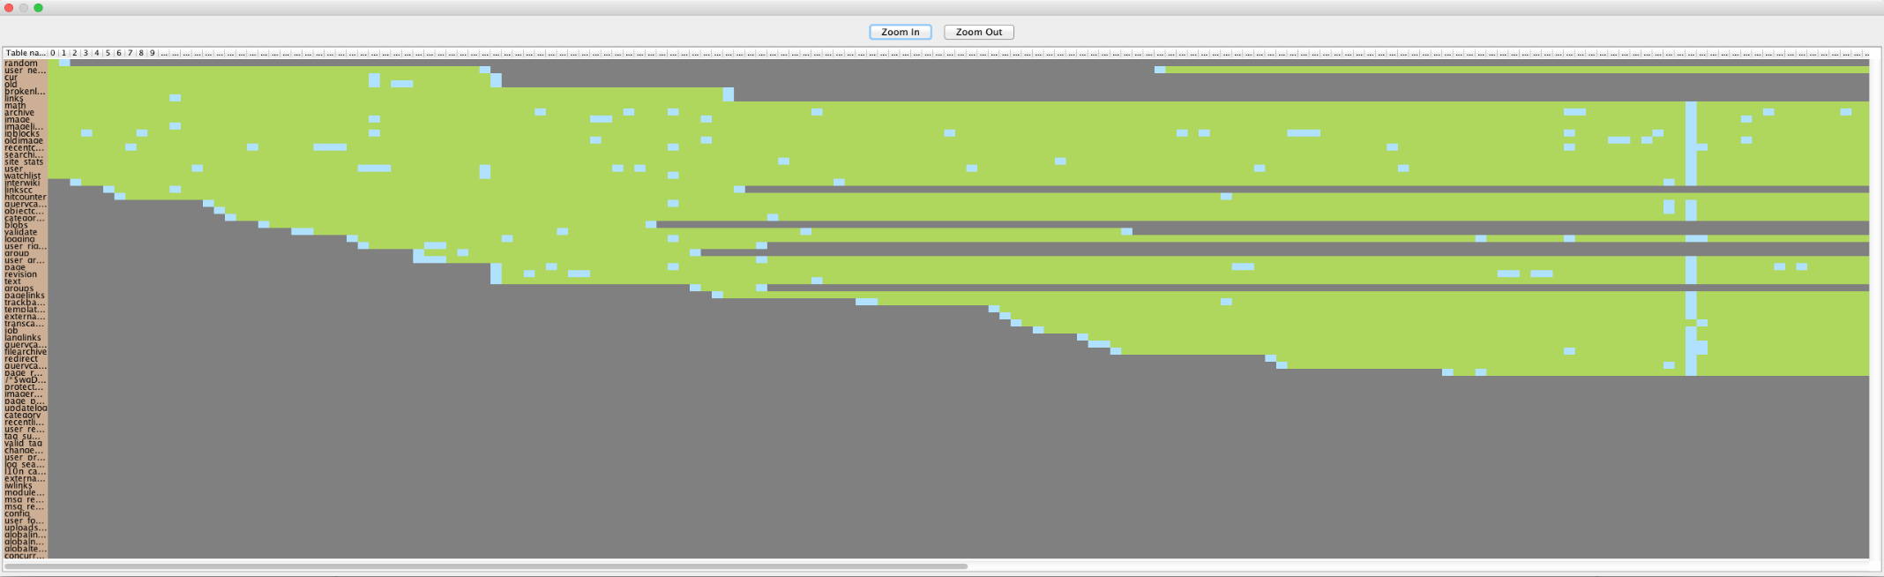
Overview vs PLD (mediaWiki)

Slide 76
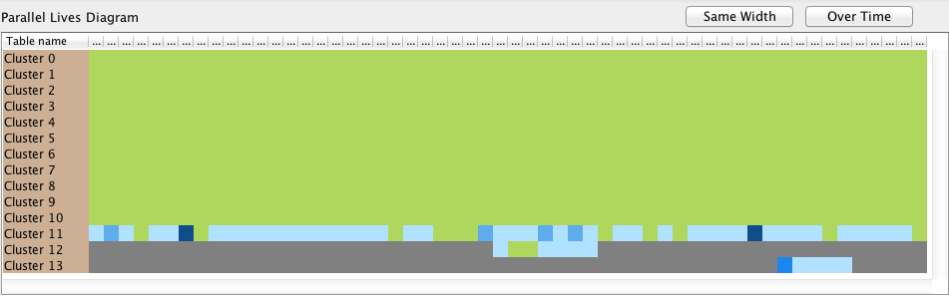
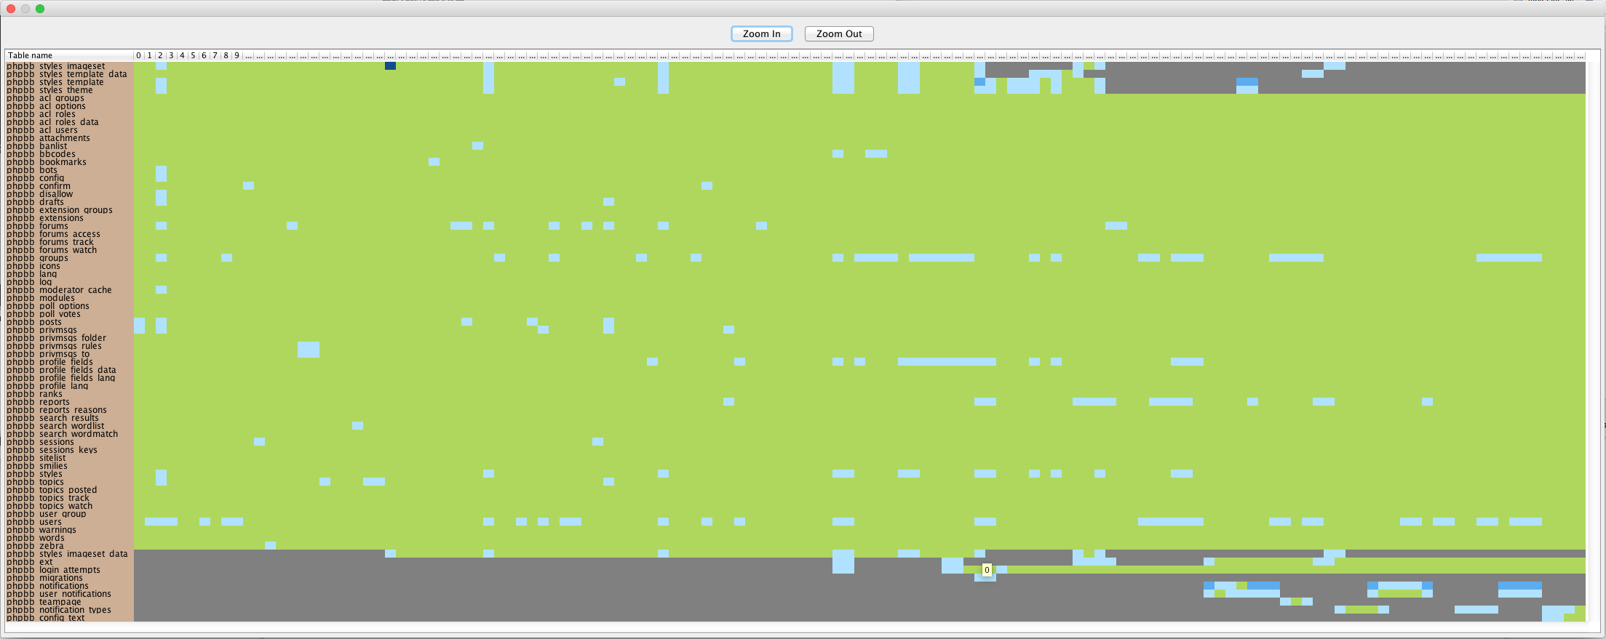
Overview vs PLD (phpBB)

Slide 77
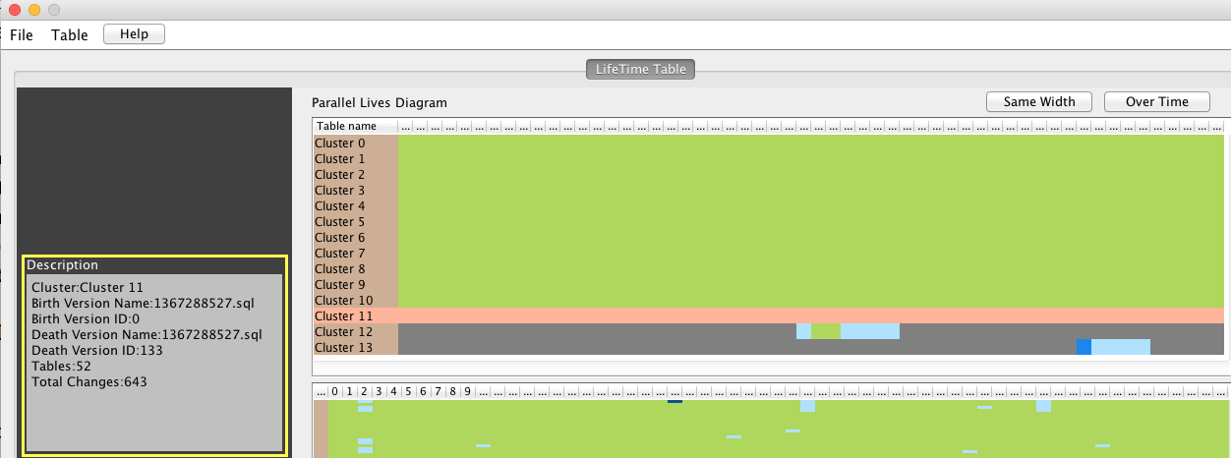
Details on demand for selected cluster

Slide 78
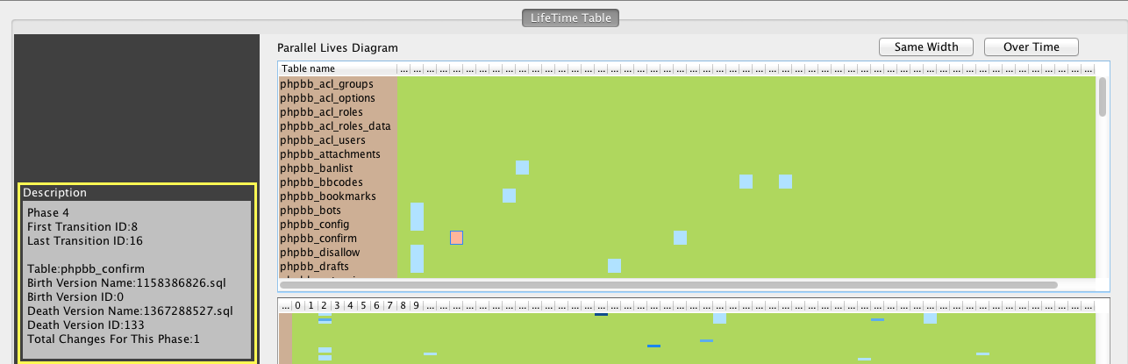
Details on demand for selected cell

Slide 79
References
[Ecli15] | Eclipse IDE. Available at https://eclipse.org/downloads/. Last accessed 2015-09-30.
[Heca15] | Hecate. Available at https://github.com/daintiness-group/hecate . Last accessed 2015-09-30.
[PPL15] | Plutarch’s Parallel Lives at https://github.com/daintiness-group/plutarch_parallel_lives. Last accessed 2015-09-30
[Shne96] | Shneiderman, Ben. "The eyes have it: A task by data type taxonomy for information visualizations." Visual Languages, 1996. Proceedings., IEEE Symposium on. IEEE, 1996.
[SkVZ14] | Skoulis, Ioannis, Panos Vassiliadis, and Apostolos Zarras. "Open-Source Databases: Within, Outside, or Beyond Lehman’s Laws of Software Evolution?."Advanced Information Systems Engineering. Springer International Publishing, 2014.
[TaSK05] | Pang-Ning Tan, Michael Steinbach and Vipin Kumar. Introduction to Data Mining. 1st ed. Pearson, 2005.
[TaTT06] | Mielikäinen, Taneli, Evimaria Terzi, and Panayiotis Tsaparas. "Aggregating time partitions." Proceedings of the 12th ACM SIGKDD international conference on Knowledge discovery and data mining. ACM, 2006.
[TeTs06] | Terzi, Evimaria, and Panayiotis Tsaparas. "Efficient Algorithms for Sequence Segmentation." SDM. 2006.
[ZhSt05] | Xing, Zhenchang, and Eleni Stroulia. "Analyzing the evolutionary history of the logical design of object-oriented software." Software Engineering, IEEE Transactions on 31.10 (2005): 850-868.

