Slide 1
Tool Support and Topological Study of Schema Evolution in terms of Foreign Keys
Konstantinos Dimolikas
Department of Computer Science and Engineering
University of Ioannina

Slide 2
Presentation Overview
Problem statement
Study the relationship between tables’ topology and evolution
Refactor the Parmenidian Truth tool
Create a web application that visualizes schema evolution
Main contributions-Open issues

Slide 3
Problem Statement
Broad Research Problem: How DB schemata evolve over time?
Here, a specific question on the problem:
How do tables evolve over time depending on their Foreign Keys?

Slide 4
What is Schema Evolution?
A change in the representation of a DB’s structure from an older to a newer version*
Types of changes
  Tables additions/removals
  Foreign keys additions/removals
  Attributes additions/removals/updates
  *: http://www.cse.uoi.gr/~pvassil/projects/schemaBiographies/info.html

Slide 5
Why Schemata Evolve?
Adjusting to constantly changing environments
  Surrounding applications offer new services
Dealing with design defects
  Changing the structure to favor extensibility
  Changing the structure to correct identified faults

Slide 6
Why Schema Evolution Matters?
Extend information capacity in an organized way
  Eliminate effects on the surrounding applications
Reduce time and effort for maintenance
  Actions taken, in advance, to avoid design complications

Slide 7
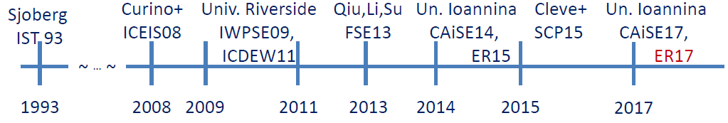
What Has Be Done So Far?
Limited number of works until 2008
  Unavailability of DBs’ schema histories
Available open-source projects
  Studying the evolution of the DBs’ schemata
  Identifying evolution-related commonalities
  Suggesting ways to reduce design complexity
  Source: P. Vassiliadis et al., Schema Evolution & Gravitation to Rigidity, MEDI 2017, Oct. 4-6, 2017-Barcelona

Slide 8
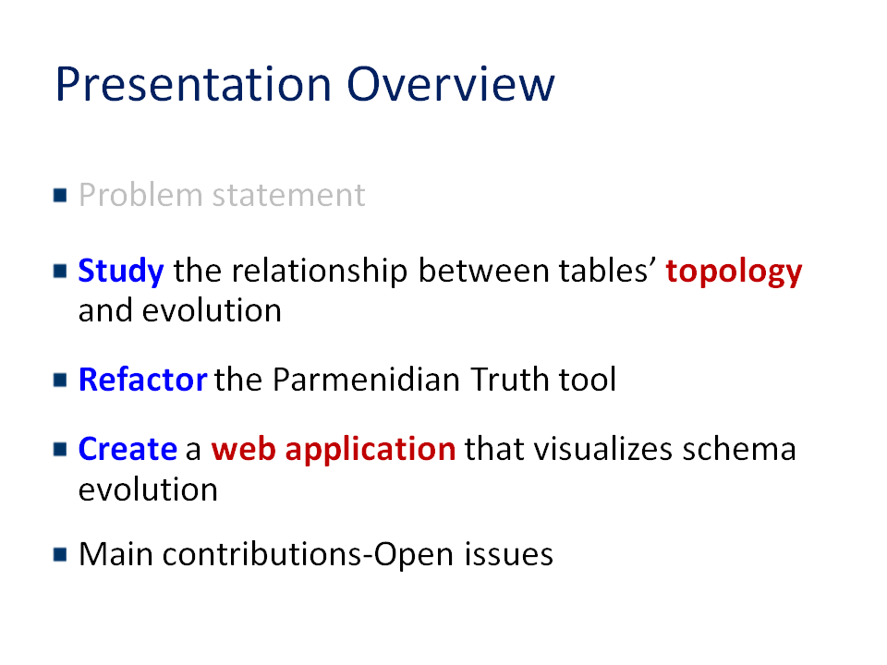
Our Approach on the Problem
Research Problem:
Study the relationship between tables’ topology and evolution
Engineering Actions:
Refactor the Parmenidian Truth tool
Create a web application that visualizes schema evolution

Slide 9
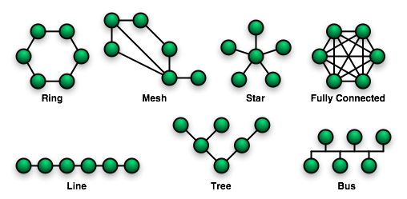
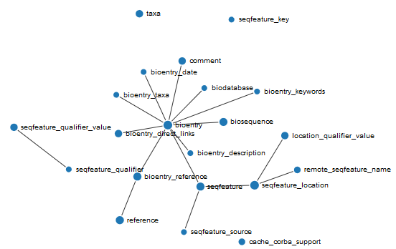
Definition of Topology
In network theory, topology is defined as the arrangement of a network’s nodes and links
In our work, a table’s (node’s) topology describes the pattern of edges (FKs) surrounding it
Source: https://commons.wikimedia.org/wiki/File:NetworkTopologies.png

Slide 10

Research Question
Is there a relationship between tables’ topological categories and their evolution?

Slide 11

How we Answer to this Question?
Collect the schema histories of 5 “open-source databases”
Preprocess schema histories to facilitate our work
Define topological categories
Classify tables into topological categories
Study schema evolution with respect to tables’ topological categories

Slide 12
Overview of Schemata
Derive from different domains (physics, biomedicine, CMSs)
Cover from 17 to 399 versions
Growth in number of tables from 19% to 220%
Growth in number of foreign keys with 2 exceptions

Slide 13
Preprocessing Schemata
Ignore periods where foreign keys are absent
In Slashcode, we limit the period considered in 74-260 versions
In Zabbix, we omit the period after 150th version

Slide 14
Topological Categories
Compute the distribution of the tables wrt their in- and out- degrees
Determine the different categories
Assign a label to each category

Slide 15
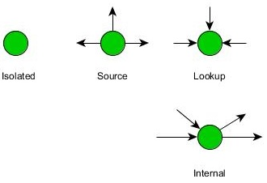
Tables Topological Categories
Define 4 topological categories
  Isolated tables with no inciting edges
  Source tables with only outgoing edges
  Lookup tables with only incoming edges
  Internal with at least 1 incoming and 1 outgoing edges

Slide 16
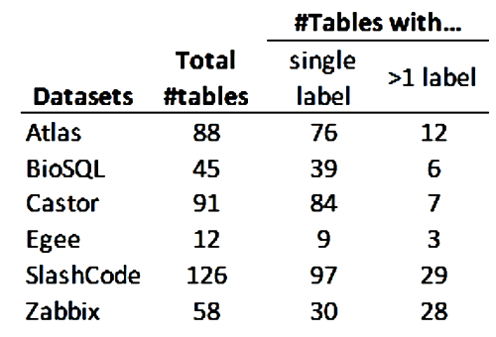
Classification of Tables
Classify tables into the topological categories
  Single label tables
  Multi-label tables
How to handle the change-of-category phenomenon?

Slide 17
Multi-label Tables-Why Bother?
A multi-labeling scheme is not helpful. Why?
We would like to associate topological categories with tables’ evolution

Slide 18
Multi-label Tables-How to Handle?
Inspect tables with change-of-category
Assign a single label to each of them
Small number of multi-label tables
  Minor loss of information

Slide 19
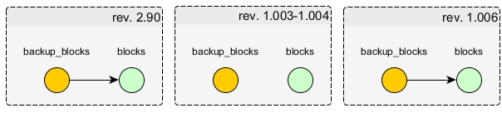
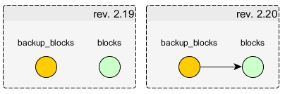
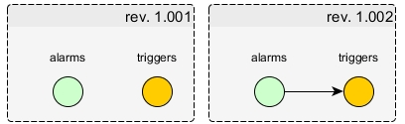
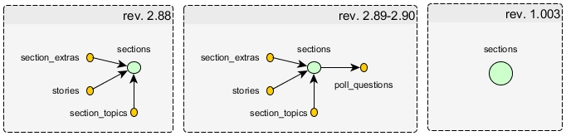
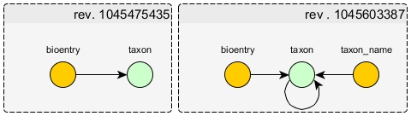
Multi-label Tables-Changes
Ephemeral transition to a different category and return to the former one
Change from the isolated category to another category
Change category soon after table’s birth
Changes leading to labels assigned for a short period
Changes caused by the presence of self-references

Slide 20
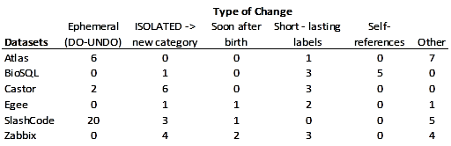
Multi-label Tables-Types of Changes
Occurrences of label changes per database
A table may experience more than one label changes
A change may belong to more than one types

Slide 21
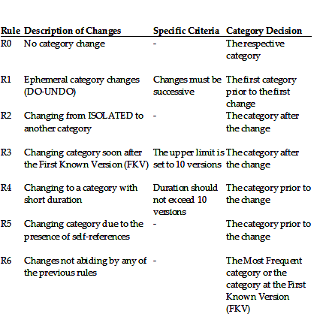
Label Assignment-Can we Automate it?
Define a process that remove or ignore confusing parts of a table’s history
The input is the list of labels of a table’s history
The output is a single label for the table

Slide 22
Classification of Tables
Isolated tables constitute the largest group in 4/6 datasets
Excluding isolated, source tables become the largest group in 4/6 datasets
Decreasing tendency for dependence
Topological Category | Datasets
 | Atlas | BioSQL | Castor | Egee | SlashCode | Zabbix
ISOLATED | 13% | 4% | 82% | 50% | 51% | 39%
SOURCE | 43% | 64% | 7% | 17% | 32% | 36%
LOOKUP | 36% | 18% | 10% | 8% | 10% | 20%
MINI-HUB | 7% | 13% | 1% | 0% | 6% | 4%
CHAIN LINK | 1% | 0% | 0% | 25% | 0% | 2%
Total | 88 | 45 | 91 | 12 | 68 | 56
Topological Category | Datasets
 | Atlas | BioSQL | Castor | Egee | SlashCode | Zabbix
SOURCE | 49% | 67% | 38% | 33% | 67% | 59%
LOOKUP | 42% | 19% | 56% | 17% | 21% | 32%
MINI-HUB | 8% | 14% | 6% | 0% | 12% | 6%
CHAIN LINK | 1% | 0% | 0% | 50% | 0% | 3%
Total | 77 | 43 | 16 | 6 | 33 | 34

Slide 23
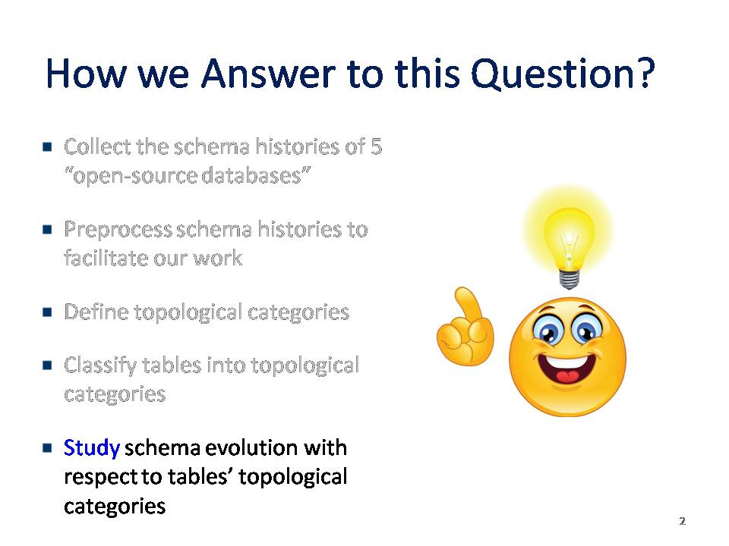
Tables Topology-Evolution
Is there a relationship between tables’ topological categories and
  Duration
  Survival
  Birth Version
  Update Activity
  Size Change

Slide 24
Tables Topology-Duration
Use the normalized duration* of the tables
Define 3 duration categories
  Short lived
  Medium lived
  Long lived
BREAKDOWN OF TABLES WRT NORMALIZED DURATION (PERCENTAGES OVER TOTAL #TABLES)
 | NORMALIZED DURATION CATEGORY
 | SHORT LIVED | MEDIUM LIVED | LONG LIVED | Total #Tables
Atlas | 32% | 14% | 55% | 88
BioSQL | 31% | 38% | 31% | 45
Castor | 24% | 16% | 59% | 91
SlashCode | 23% | 19% | 58% | 69
Zabbix | 32% | 28% | 40% | 57
  *: P. Vassiliadis, A. Zarras, I. Skoulis , How is Life for a Table in an Evolving Relational Schema? Birth, Death and Everything in Between, ER 2015, Dec. 2015

Slide 25
Tables Topology-Duration
Lookup and internal tend to lives of long duration
Source follow the aggregate duration in 3/5 datasets
Isolated avoid long lives
The statistical evidence are not adequate to suggest that there is correlation between topology and duration
PROBABILITY FOR A TABLE OF A TOPOLOGICAL CATEGORY TO BELONG TO A CERTAIN DURATION CATEGORY (PERCENTAGES OVER TOTAL #TABLES OF EACH TOPOLOGICAL CATEGORY)
 | TOPOLOGICAL CATEGORY
 | ISOLATED |  |  |  | SOURCE |  |  |  | LOOKUP |  |  |  | INTERNAL |  |  |  | Aggregate per Duration Category
 | Total #Tables | SHORT LIVED | MEDIUM LIVED | LONG LIVED | Total #Tables | SHORT LIVED | MEDIUM LIVED | LONG LIVED | Total #Tables | SHORT LIVED | MEDIUM LIVED | LONG LIVED | Total #Tables | SHORT LIVED | MEDIUM LIVED | LONG LIVED | Total #Tables | SHORT LIVED | MEDIUM LIVED | LONG LIVED
Atlas | 11 | 27% | 64% | 9% | 38 | 39% | 11% | 50% | 32 | 31% | 3% | 66% | 7 | 0% | 0% | 100% | 88 | 32% | 14% | 55%
BioSQL | 2 | 50% | 50% | 0% | 29 | 34% | 38% | 28% | 8 | 25% | 25% | 50% | 6 | 17% | 50% | 33% | 45 | 31% | 38% | 31%
Castor | 75 | 29% | 16% | 55% | 6 | 0% | 17% | 83% | 9 | 0% | 22% | 78% | 1 | 0% | 0% | 100% | 91 | 24% | 16% | 59%
SlashCode | 35 | 37% | 23% | 40% | 22 | 9% | 18% | 73% | 7 | 0% | 14% | 86% | 4 | 0% | 0% | 100% | 68 | 22% | 19% | 59%
Zabbix | 22 | 36% | 41% | 23% | 20 | 30% | 20% | 50% | 11 | 18% | 27% | 55% | 3 | 33% | 0% | 67% | 56 | 30% | 29% | 41%

Slide 26
Tables Topology-Survival
A table is survivor if exists in the last version studied
A decreasing sequence of percentages of survivors in 4/5 datasets
DISTRIBUTION OF SURVIVORS WITH AT LEAST ONE EDGE PER TOPOLOGICAL CATEGORY (PERCENTAGES OVER TOTAL #TABLES)
 |  | TOPOLOGICAL CATEGORY (FOR SURVIVORS) |  |  |  | Aggregate per Topological Category (ind. of survival)
 | Total #Tables | SOURCE | LOOKUP | INTERNAL | Aggregate %Survivors | SOURCE | LOOKUP | INTERNAL
Atlas | 77 | 39% | 34% | 9% | 82% | 49% | 42% | 9%
BioSQL | 43 | 44% | 12% | 9% | 65% | 67% | 19% | 14%
Castor | 16 | 31% | 44% | 6% | 81% | 38% | 56% | 6%
SlashCode | 33 | 64% | 21% | 12% | 97% | 67% | 21% | 12%
Zabbix | 34 | 53% | 24% | 6% | 85% | 59% | 32% | 9%

Slide 27
Tables Topology-Survival
Survival potential of source and lookup follow the aggregate distributions
The percentages of internal survivors exceed the aggregate ones
High survival potential (>=65%), irrespective of the topological categories
PROBABILITY OF SURVIVAL PER TOPOLOGICAL CATEGORY (PERCENTAGES OVER TOTAL #TABLES OF EACH TOPOLOGICAL CATEGORY)
 | TOPOLOGICAL CATEGORY |  |  |  |  |  |  |  |  | Aggregate Survival Probability
 | SOURCE |  |  | LOOKUP |  |  | INTERNAL
 | Total #Tables | #Survivors | %Survivors | Total #Tables | #Survivors | %Survivors | Total #Tables | #Survivors | %Survivors | Total #Tables | %Survivors
Atlas | 38 | 30 | 79% | 32 | 26 | 81% | 7 | 7 | 100% | 77 | 82%
BioSQL | 29 | 19 | 66% | 8 | 5 | 63% | 6 | 4 | 67% | 43 | 65%
Castor | 6 | 5 | 83% | 9 | 7 | 78% | 1 | 1 | 100% | 16 | 81%
SlashCode | 22 | 21 | 95% | 7 | 7 | 100% | 4 | 4 | 100% | 33 | 97%
Zabbix | 20 | 18 | 90% | 11 | 8 | 73% | 3 | 3 | 100% | 34 | 85%

Slide 28
Tables Topology-Birth Version
Focus on tables born in the first version
In 3/5 DBs, tables born in the first version exceed the 60%
Source tables born in the first version are the largest group in 3/5 DBs
DISTRIBUTION OF TABLES BORN @v0 PER TOPOLOGICAL CATEGORY (PERCENTAGES OVER TOTAL #TABLES)
 |  | TOPOLOGICAL CATEGORY
 | Total #Tables | ISOLATED | SOURCE | LOOKUP | INTERNAL | Total
Atlas | 88 | 1% | 26% | 28% | 8% | 64%
BioSQL | 45 | 4% | 24% | 9% | 9% | 47%
Castor | 91 | 53% | 5% | 9% | 1% | 68%
SlashCode | 68 | 22% | 24% | 9% | 6% | 60%
Zabbix | 56 | 4% | 11% | 9% | 4% | 27%

Slide 29
Tables Topology-Birth Version
Internal and lookup more likely to exist in the first version
Isolated and source tend to appear in later versions
Statistical tests confirm the correlation between topology and birth version
PROBABILITY TO BE BORN @v0 PER TOPOLOGICAL CATEGORY (PERCENTAGES OVER TOTAL #TABLES OF EACH TOPOLOGICAL CATEGORY)
 | TOPOLOGICAL CATEGORY |  |  |  |  |  |  |  | AGGREGATE BORN @v0
 | ISOLATED |  | SOURCE |  | LOOKUP |  | INTERNAL |  | TABLES WITH AT LEAST ONE EDGE |  | ALL TABLES
 | Total #Tables | Born @v0 | Total #Tables | Born @v0 | Total #Tables | Born @v0 | Total #Tables | Born @v0 | Total #Tables | Born @v0 | Total #Tables | Born @v0
Atlas | 11 | 9% | 38 | 61% | 32 | 78% | 7 | 100% | 77 | 71% | 88 | 64%
BioSQL | 2 | 100% | 29 | 38% | 8 | 50% | 6 | 67% | 43 | 44% | 45 | 47%
Castor | 75 | 64% | 6 | 83% | 9 | 89% | 1 | 100% | 16 | 88% | 91 | 68%
SlashCode | 35 | 43% | 22 | 73% | 7 | 86% | 4 | 100% | 33 | 79% | 68 | 60%
Zabbix | 22 | 9% | 20 | 30% | 11 | 45% | 3 | 67% | 34 | 38% | 56 | 27%

Slide 30
Tables Topology-Update Activity
Define 3 activity categories*
  Rigid
  Quiet
  Active
In 3/5 datasets, quiet tables are the largest group
BREAKDOWN OF ALL TABLES WRT ACTIVITY CLASS ( PERCENTAGES OVER TOTAL #TABLES)
 |  | Activity Class |  |  | Activity Class (%)
 | Total #Tables | RIGID | QUIET | ACTIVE | RIGID | QUIET | ACTIVE
Atlas | 88 | 18 | 43 | 27 | 20% | 49% | 31%
BioSQL | 45 | 16 | 13 | 16 | 36% | 29% | 36%
Castor | 91 | 57 | 31 | 3 | 63% | 34% | 3%
SlashCode | 68 | 15 | 38 | 15 | 22% | 56% | 22%
Zabbix | 56 | 23 | 30 | 3 | 41% | 54% | 5%
  *: P. Vassiliadis, A. Zarras, I. Skoulis , How is Life for a Table in an Evolving Relational Schema? Birth, Death and Everything in Between, ER 2015, Dec. 2015

Slide 31
Tables Topology-Update Activity
Internal are prone to many updates
Lookup undergo few or many updates
Isolated and source experience no or few updates
Tables with different topological categories experience different amounts of updates
PROBABILITY FOR A TABLE OF A TOPOLOGICAL CATEGORY TO DEVELOP A CERTAIN UPDATE ACTIVITY (PERCENTAGES OVER TOTAL #TABLES OF EACH TOPOLOGICAL CATEGORY)
 | TOPOLOGICAL CATEGORY
 | ISOLATED |  |  |  | SOURCE |  |  |  | LOOKUP |  |  |  | INTERNAL |  |  |  | Aggregate per Activity Class
 | Total #Tables | RIGID | QUIET | ACTIVE | Total #Tables | RIGID | QUIET | ACTIVE | Total #Tables | RIGID | QUIET | ACTIVE | Total #Tables | RIGID | QUIET | ACTIVE | Total #Tables | RIGID | QUIET | ACTIVE
Atlas | 11 | 27% | 55% | 18% | 38 | 29% | 58% | 13% | 32 | 13% | 47% | 41% | 7 | 0% | 0% | 100% | 88 | 20% | 49% | 31%
BioSQL | 2 | 100% | 0% | 0% | 29 | 34% | 31% | 34% | 8 | 25% | 38% | 38% | 6 | 33% | 17% | 50% | 45 | 36% | 29% | 36%
Castor | 75 | 67% | 32% | 1% | 6 | 67% | 17% | 17% | 9 | 33% | 56% | 11% | 1 | 0% | 100% | 0% | 91 | 63% | 34% | 3%
SlashCode | 35 | 34% | 54% | 11% | 22 | 14% | 68% | 18% | 7 | 0% | 43% | 57% | 4 | 0% | 25% | 75% | 68 | 22% | 56% | 22%
Zabbix | 22 | 55% | 41% | 5% | 20 | 35% | 65% | 0% | 11 | 27% | 73% | 0% | 3 | 33% | 0% | 67% | 56 | 41% | 54% | 5%

Slide 32
Tables Topology-Size Change
Define 3 size scale categories
  Scale down
  Steady
  Scale up
In all datasets, steady tables are the largest group
BREAKDOWN OF TABLES PER SIZE SCALE CATEGORY (PERCENTAGES OVER TOTAL #TABLES)
 |  | Size Scale Categories
 | Total #tables | <=0,99 | 1 | >1
Atlas | 88 | 6% | 69% | 25%
BioSQL | 45 | 7% | 53% | 40%
Castor | 91 | 3% | 67% | 30%
SlashCode | 68 | 3% | 50% | 47%
Zabbix | 56 | 2% | 55% | 43%

Slide 33
Tables Topology-Size Change
Internal and lookup tend to increase their size
Isolated and source remain steady
PROBABILITY FOR A TABLE OF A TOPOLOGICAL CATEGORY TO HAVE CERTAIN SIZE SCALE (PERCENTAGES OVER TOTAL #TABLES OF EACH TOPOLOGICAL CATEGORY)
 | TOPOLOGICAL CATEGORY
 | ISOLATED |  |  |  | SOURCE |  |  |  | LOOKUP |  |  |  | INTERNAL |  |  |  | Aggregate per Size Scale Category
 | Total #Tables | <=0,99 | 1 | >1 | Total #Tables | <=0,99 | 1 | >1 | Total #Tables | <=0,99 | 1 | >1 | Total #Tables | <=0,99 | 1 | >1 | Total #Tables | <=0,99 | 1 | >1
Atlas | 11 | 9% | 73% | 18% | 38 | 5% | 82% | 13% | 32 | 3% | 59% | 38% | 7 | 14% | 43% | 43% | 88 | 6% | 69% | 25%
BioSQL | 2 | 0% | 100% | 0% | 29 | 10% | 62% | 28% | 8 | 0% | 25% | 75% | 6 | 0% | 33% | 67% | 45 | 7% | 53% | 40%
Castor | 75 | 1% | 72% | 27% | 6 | 0% | 67% | 33% | 9 | 22% | 33% | 44% | 1 | 0% | 0% | 100% | 91 | 3% | 67% | 30%
SlashCode | 35 | 3% | 69% | 29% | 22 | 5% | 41% | 55% | 7 | 0% | 14% | 86% | 4 | 0% | 0% | 100% | 68 | 3% | 50% | 47%
Zabbix | 22 | 5% | 68% | 27% | 20 | 0% | 55% | 45% | 11 | 0% | 36% | 64% | 3 | 0% | 33% | 67% | 56 | 2% | 55% | 43%

Slide 34
Tables Topology-Main Findings
Relationship between tables’ topology and their probability to be “born” in the first version
  Topologically “complex” tables are more likely to be introduced in the first version
Relationship between tables’ topology and their update profile
  Isolated and source related to no or few updates
  Lookup associated with few or many updates
  Internal experience many updates

Slide 35
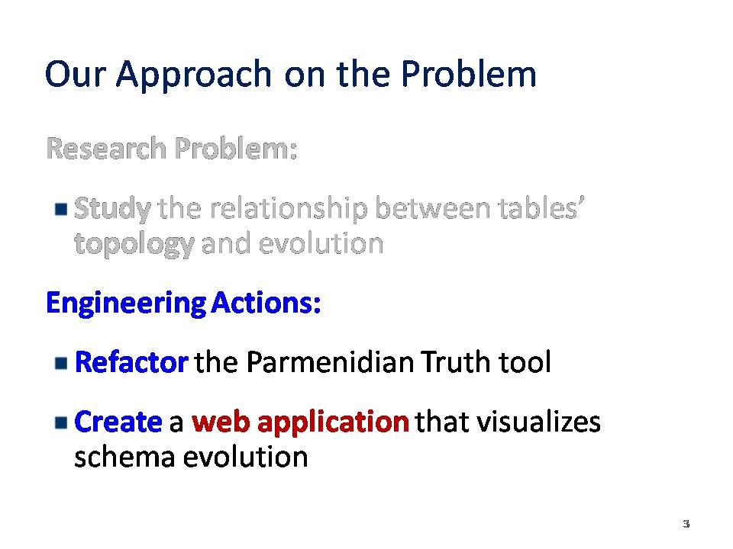
Refactoring-Definition and Aim
A change made in the internal structure of software to increase its extensibility and facilitate its maintenance
Applying a series of changes in Parmenidian Truth tool to improve its design
Aiming at utilizing its functionalities to create a web application

Slide 36
Refactoring-Our Approach
Identify design violations or lack of design principles*
Apply a series of changes to improve its design*
Verify via testing that the expected behavior has not been altered*
Evaluate the improvements of the refactoring process
  *: joint work with M. Zerva and I. Kouvatis in the context of the course “Software and Data Evolution”

Slide 37
Refactoring-Design Violations
Package level issues
God classes
Lack of APIs
Duplicated code
Misplaced methods
Redundant components
Convention violations

Slide 38
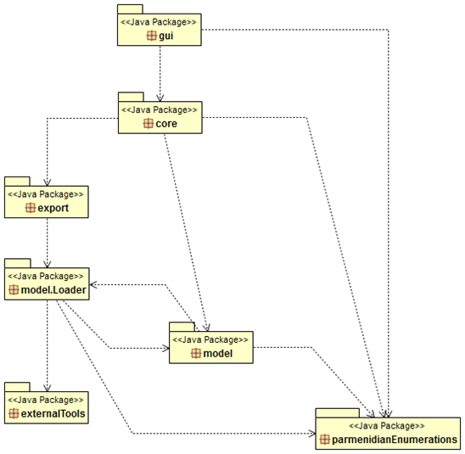
Refactoring-Package Level Issues
Cyclic dependency between the model.Loader and model
Tight coupling between the two packages
Identify the elements that create the cyclic dependency
Transfer them to a new package

Slide 39
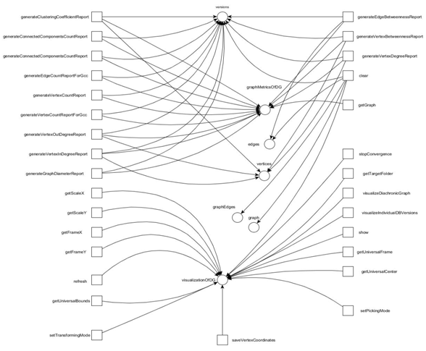
Refactoring-God Classes
Encompass more than one responsibilities
Violating the Single-Responsibility Principle
Each responsibility is a reason for change
Identify methods that serve different purposes
Extract methods to new classes

Slide 40
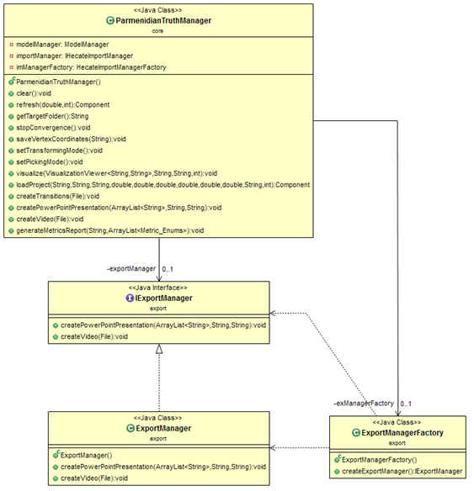
Refactoring-Lack of APIs
Absence of interfaces
Complicates tool’s reusability
Introduce interfaces between classes of different packages
“Clients” classes agnostic to implementation details

Slide 41
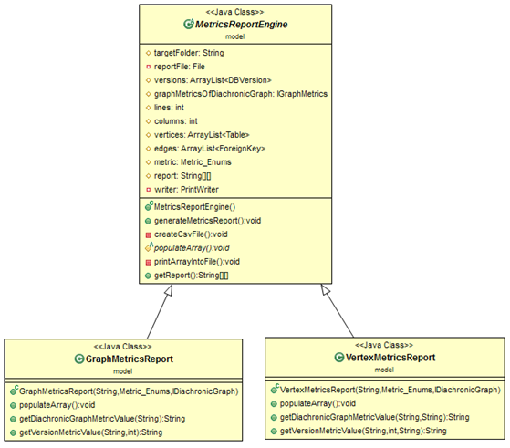
Refactoring-Duplicated Code
Re-using the same code structure to implement different methods
Complicates tool’s maintenance
Apply the Template Method Pattern

Slide 42
Refactoring-Design Defects
Misplaced methods
  Methods irrelevant to the functionalities provided
  Extract them to new classes
Redundant components
  Modules not being used by other packages
  Remove these modules to simplify tool’s design
Convention violations
  Identify violations related to names, method parameters and class size conventions

Slide 43
Refactoring-Testing
Verify that the modifications applied have not altered tool’s expected behavior
Utilize the unit testing framework, JUnit and the mocking framework Mockito
Create a test case for each class modified or added

Slide 44
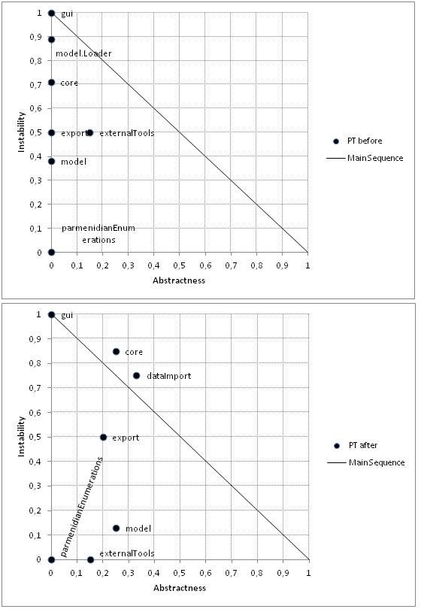
Refactoring-Evaluation
Assess the improvements achieved via the refactoring process
Utilize Abstractness-Instability graph
  Abstractness quantifies the number of abstractions wrt to the total number of classes
  Instability measures the degree of dependence of a module from other packages

Slide 45
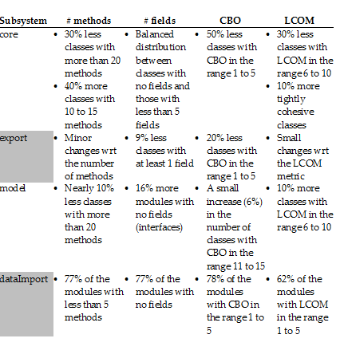
Refactoring-Evaluation
Utilize 4 class-level metrics
  Number of methods
  Number of attributes
  Coupling between objects
  Lack of Cohesion of Methods
Compare design quality before and after refactoring

Slide 46
Refactoring-Main Improvements
Abide by design principles
Increase tool’s expandability potential
Eliminate duplicated code
Increase methods’ cohesion
Comply with code conventions
Test our modifications

Slide 47
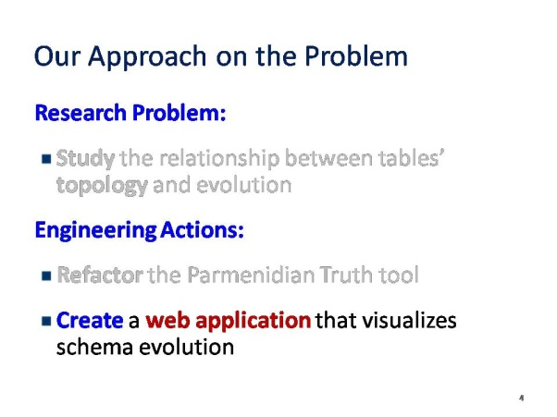
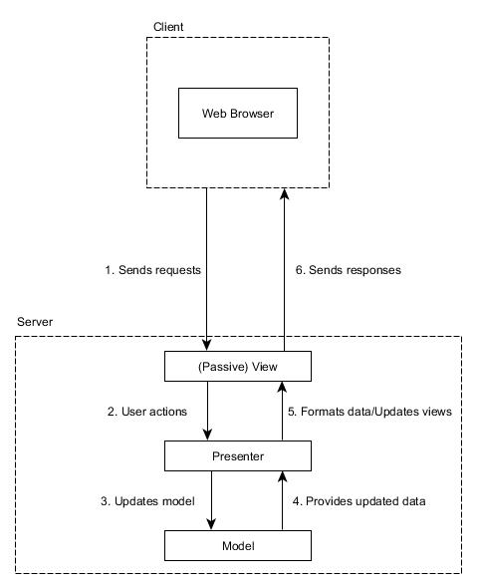
Web Application-Architecture
Utilize client/server model
Model-View-Presenter design pattern for server
MVP Pattern
  Model includes the data structures
  View contains the Graphical User Interfaces
  Presenter retrieves data from model and updates view

Slide 48
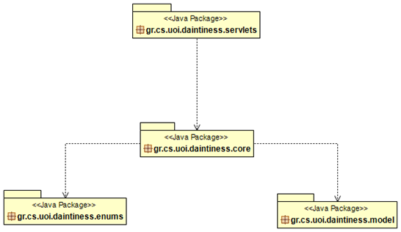
Web Application-Java Back End
Servlets module
  Receives clients’ requests
  Sends responses
Core module
  Defines/implements app’s main functionalities
Model module
  Includes the data structures of the application
Enums module
  Defines sets of predefined constants

Slide 49
Web Application-Functionalities
Upload DD files to create a new project
Load a project from the server
Visualize Diachronic Graph/versions
Visualize evolution-related patterns
Compute evolution-related statistics

Slide 50
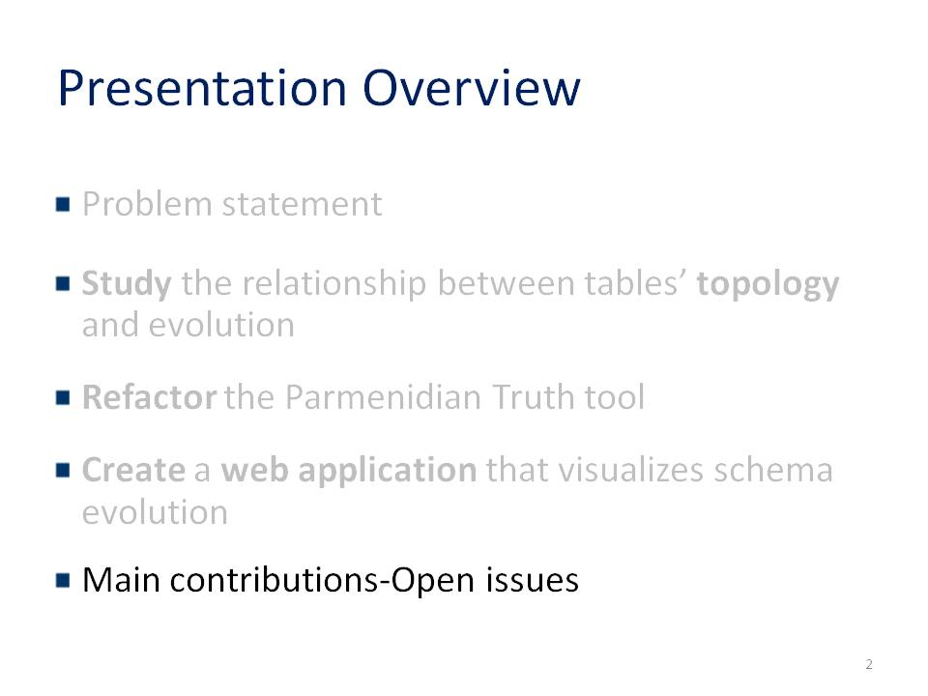
Main Contributions
A thorough study on the relationship between tables’ topology and their evolution
An extensive restructuring of Parmenidian Truth tool’s architecture
A web application that visualizes schemata evolution

Slide 51
Open Issues
A multi-label topological classification may lead to different conclusions
A “second-pass” classification step that takes into account topological labels of a table’s neighborhood

Slide 52
Thank you for your attention!!!

