Slide 1

Schema Evolution and Gravitation to Rigidity: a tale of calmness in the lives of structured data
Panos Vassiliadis
joint work with: Apostolos Zarras, Ioannis Skoulis, Petros Manousis, Fanis Giahos, Michael Kolozoff, Athanasios Pappas, Maria Zerva
Department of Computer Science and Engineering
University of Ioannina, Hellas
http://www.cs.uoi.gr/~pvassil/projects/schemaBiographies/

Slide 2

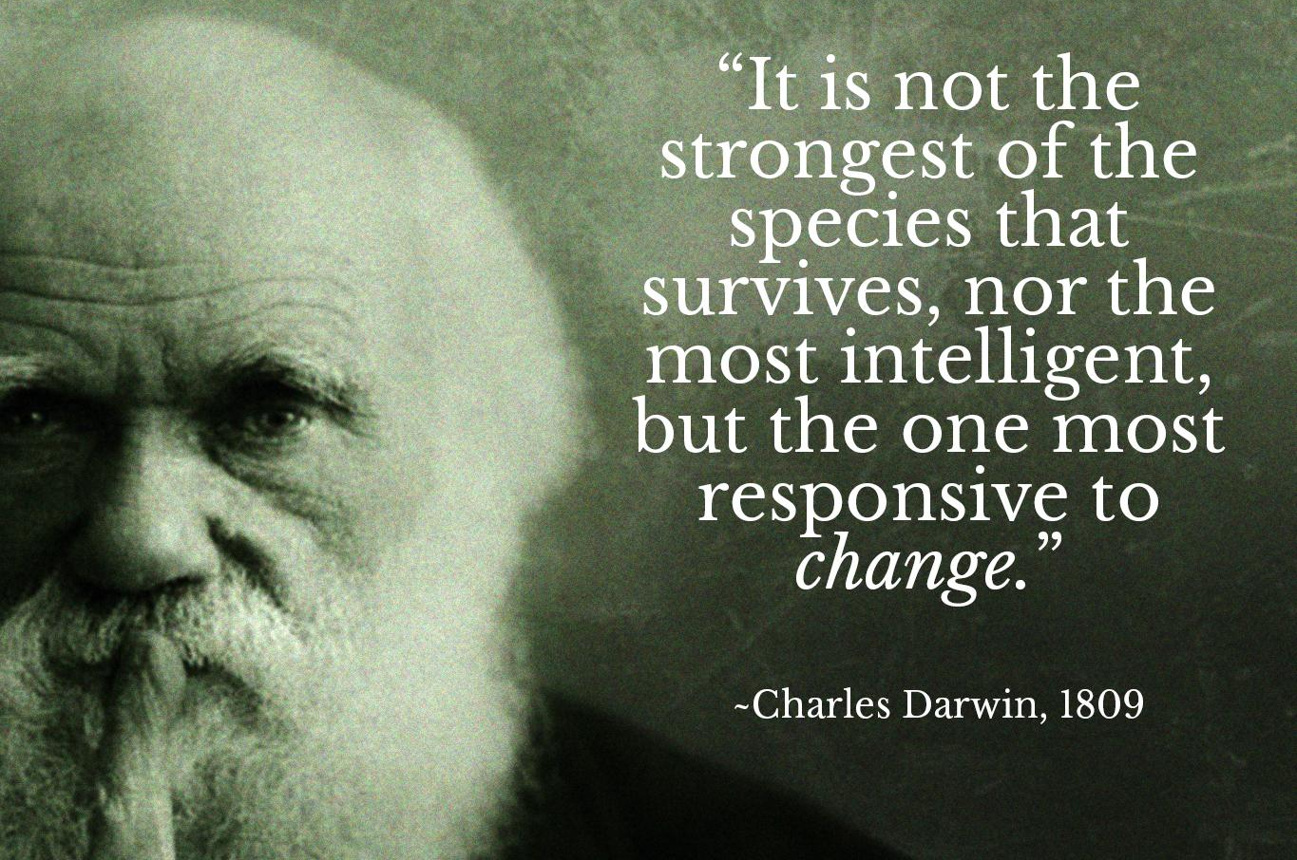
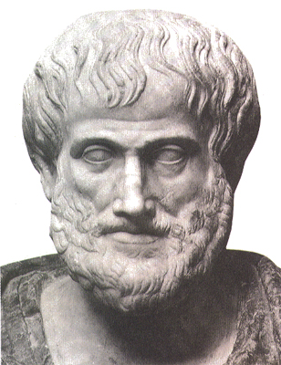
The nature that needs change is vicious; for it is not simple nor good…
Nicomachean Ethics, Book VII, Aristotle

Slide 3
SWEBOK Maintenance
 | Correction | Enhancement
Proactive | Preventive | Perfective
Reactive | Corrective | Adaptive
Preventive maintenance: modification of a software product after delivery to detect and correct latent faults in the software product before they become operational faults.
Corrective maintenance: reactive modification (or repairs) of a software product performed after delivery to correct discovered problems.
Perfective maintenance: modification of a software product after delivery to provide enhancements for users, improvement of program documentation, and recoding to improve software performance, maintainability, or other software attributes.
Adaptive maintenance: modification of a software product performed after delivery to keep a software product usable in a changed or changing environment.

Slide 4
Database Evolution: why and what
All software systems and, thus, both the databases themselves and applications built around databases are dynamic environments and can evolve due
  Changes of requirements
  Internal restructuring due to performance reasons
  migration to / integration with another system
  …
Database evolution further concerns
  changes in the operational environment of the database
  changes in the content (data) of the databases as time passes by
  changes in the internal structure, or schema, of the database

Slide 5
Why is (schema) evolution so important?
Software and DB maintenance makes up for at least 50% of all resources spent in a project.
Dependency magnets
  Databases are rarely stand-alone: typically, an entire ecosystem of applications is structured around them =>
  Typically, development waits till the “db backbone” is stable and applications are “safely” build on top of it, as…
  … changes in the schema can impact a large (typically, not traced) number of surrounding applications, without explicit identification of the impact & can cause several (parts of) different applications to crash, slow down, or miss data, causing the need for emergency repairing

Slide 6
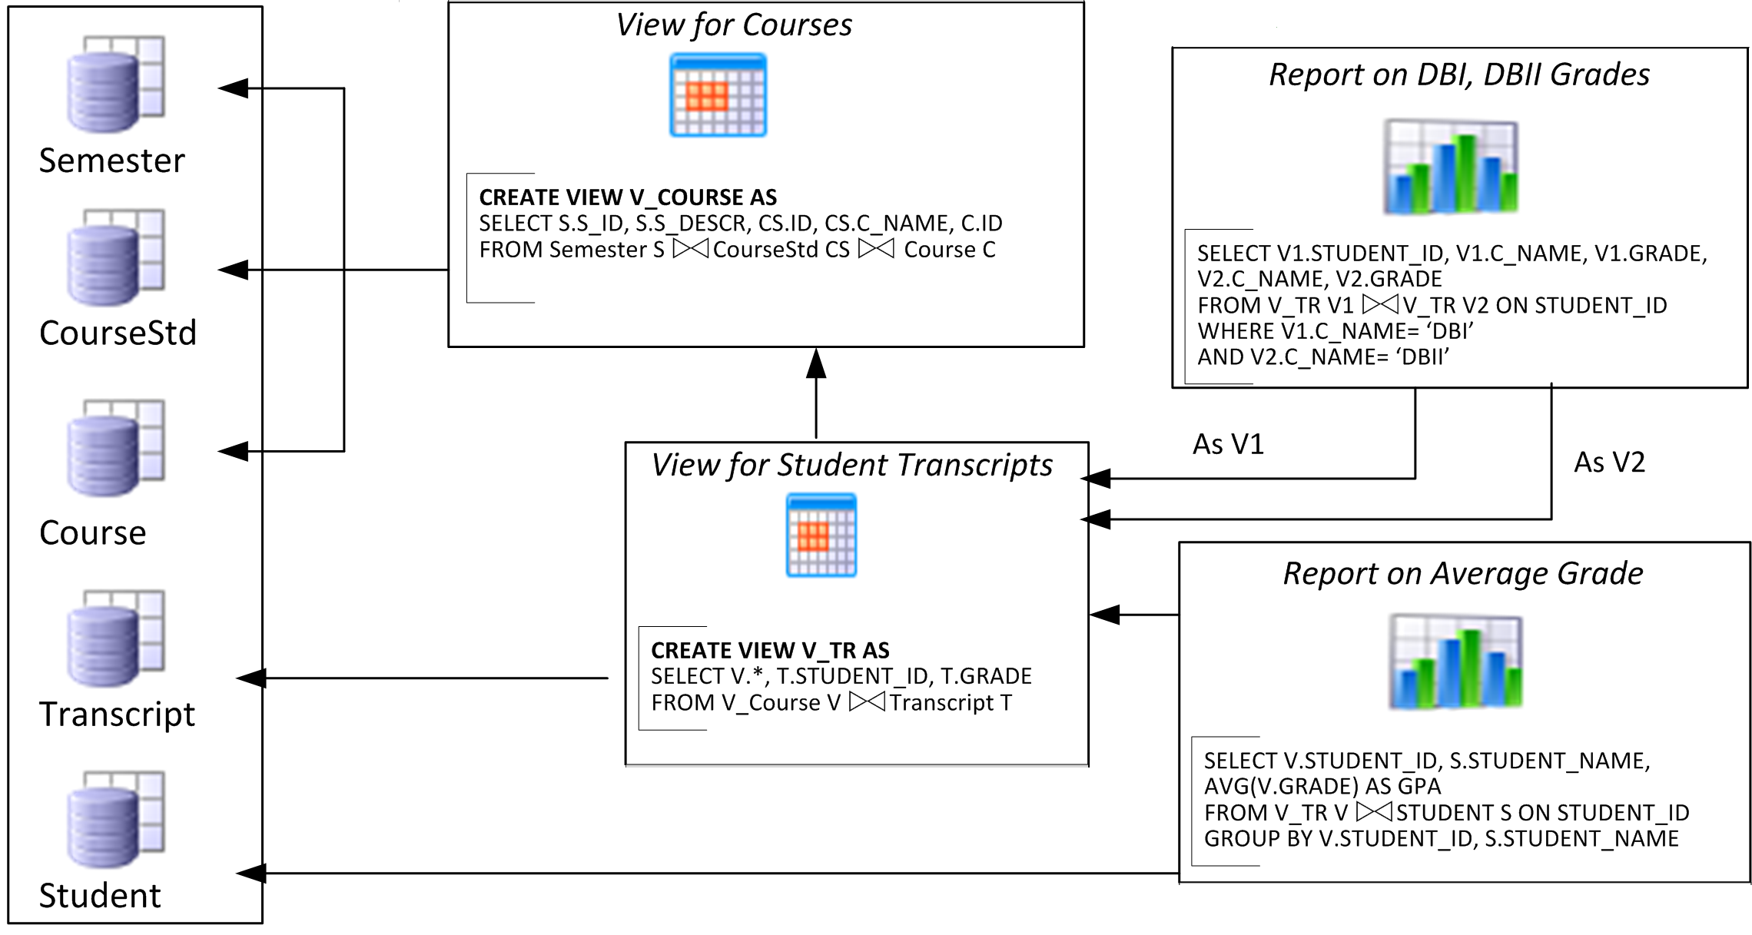
Evolving data-intensive ecosystem

Slide 7
Evolving data-intensive ecosystem
Remove CS.C_NAME
Syntactically invalid
Semantically unclear
Add exam year
The impact can be syntactical (causing crashes), semantic (causing info loss or inconsistencies) and related to the performance

Slide 8

The impact of evolution
Syntactic: scripts & reports simply crash
Semantic: views and applications can become inconsistent or information losing
Performance: can vary a lot

Slide 9
We would really love to…
Engineering goals
… “design for evolution” and minimize the impact of evolution to the surrounding applications by introducing appropriate mechanisms in our DBMS’s, applying design patterns & avoiding anti-patterns in both the db and the code in a way that insulates applications from unwanted schema change impacts
… plan in advance administration and perfective maintenance tasks and resources, instead of responding to emergencies
… (btw) detect & assess if there exist fundamental flaws in our Paradigms (like the relational model or the development of data-intensive applications)
… (with your permission) satisfy the scientific curiosity on gaining more knowledge on how things work
… but first, …
Scientific goals

Slide 10

What are the “laws” of database schema evolution?
… but, first, we must answer this:

Slide 11

Long term research goals
Are there any “invariant properties” (e.g., patterns of repeating behavior) on the way database schemata change?
Is there a theory / model to explain them?
Can we exploit findings to engineer data-intensive ecosystems that withstand change gracefully?
http://www.cs.uoi.gr/~pvassil/projects/schemaBiographies/

Slide 12
Do we know the mechanics of schema evolution?
Historically, nobody from the research community had access + the right to publish to version histories of database schemata
Open source tools internally hosting databases have changed this landscape, so…
… we are now presented with the opportunity to study the version histories of such “open source databases”
Mind the gap!
(15 years)
Sjoberg
IST 93
Curino+
ICEIS08
Univ. Riverside
IWPSE09,
ICDEW11
Qiu,Li,Su
FSE13
Un. Ioannina
CAiSE14,
ER15
Cleve+
SCP15
Un. Ioannina
CAiSE17,
ER17
~ … ~
1993
2008
2009
2011
2013
2014
2015
2017
Notes:
Sjoberg @ IST 93: 18 months study of a health system.
139% increase of #tables ; 274% increase of the #attributes
Changes in the code (on avg): (1) relation addition: 19 changes ; attribute additions: 2 changes, (2) relation deletion : 59.5 changes; attribute deletions: 3.25 changes
An inflating period during construction where almost all changes were additions, and a subsequent period where additions and deletions where balanced.
Curino+ @ ICEIS08: Mediawiki for 4.5 years
100% increase in the number of tables
142% in the number of attributes.
45% of changes do not affect the information capacity of the schema (but are rather index adjustments, documentation, etc)
IWPSE09: Mozilla and Monotone (a version control system). Many ways to be out of synch between code and evolving db schema
ICDEW11: Firefox, Monotone , Biblioteq (catalogue man.) , Vienna (RSS).Similar pct of changes with previous work
Frequency and timing analysis: db schemata tend to stabilize over time, as there is more change at the beginning of their history, but seem to converge to a relatively fixed structure later
Qiu,Li,Su@ FSE 2013: 10 (!) database schemata studied.
Change is focused both (a) with respect to time and (b) with respect to the tables who change.
Timing: 7 out of 10 databases reached 60% of their schema size within 20% of their early lifetime.
Change is frequent in the early stages of the databases, with inflationary characteristics; then, the schema evolution process calms down.
Tables that change: 40% of tables do not undergo any change at all, and 60%-90% of changes pertain to 20% of the tables (in other words, 80% of the tables live quiet lives). The most frequently modified tables attract 80% of the changes.
Code and db co-evolution, not always in synch.
Code and db changed in the same revision: 50.67% occasions
Code change was in a previous/subsequent version than the one where the database schema change: 16.22% of occasions
database changes not followed by code adaptation: 21.62% of occasions
11.49% of code changes were unrelated to the database evolution.
Each atomic change at the schema level is estimated to result in 10 -- 100 lines of application code been updated;
A valid db revision results in 100 -- 1000 lines of application code being updated

Slide 13

Our take on the problem
Collected version histories for the schemata of 8 open-source projects
  CMS’s: MediaWiki, TYPO3, Coppermine, phpBB, OpenCart
  Physics: ATLAS Trigger --- Bio: Ensemble, BioSQL
Preprocessed them to be parsable by our HECATE schema comparison tool and exported the transitions between each two subsequent versions and measures for them (size, growth, changes)
Exploratory search where we statistically studied / mined these measures, to extract patterns & regularities for the lives of tables
Web:
  http://www.cs.uoi.gr/~pvassil/projects/schemaBiographies/
Data and code available at:
  https://github.com/DAINTINESS-Group

Slide 14
Scope of our studies
FoSS Dataset | Versions | Lifetime | Tables @ Start | Tables @ End
ATLAS Trigger [A] | 84 | 2 Y, 7 M, 2 D | 56 | 73
BioSQL [B] | 46 | 10 Y, 6 M, 19 D | 21 | 28
Coppermine [C] | 117 | 8 Y, 6 M, 2 D | 8 | 22
Ensembl [B] | 528 | 13 Y, 3 M, 15 D | 17 | 75
MediaWiki [C] | 322 | 8 Y, 10 M, 6 D | 17 | 50
OpenCart [C] | 164 | 4 Y, 4 M, 3 D | 46 | 114
phpBB [C] | 133 | 6 Y, 7 M, 10 D | 61 | 65
TYPO3 [C] | 97 | 8 Y, 11 M, 0 D | 10 | 23
Scope:
  databases being part of open-source software (and not proprietary ones)
  long history
  we work only with changes at the logical schema level (and ignore physical-level changes like index creation or change of storage engine)
  We encompass datasets with different domains ([A]: physics, [B]: biomedical, [C]: CMS’s), amount of growth (shade: high, med, low) & schema size
We should be very careful to not overgeneralize findings to proprietary databases or physical schemata!

Slide 15
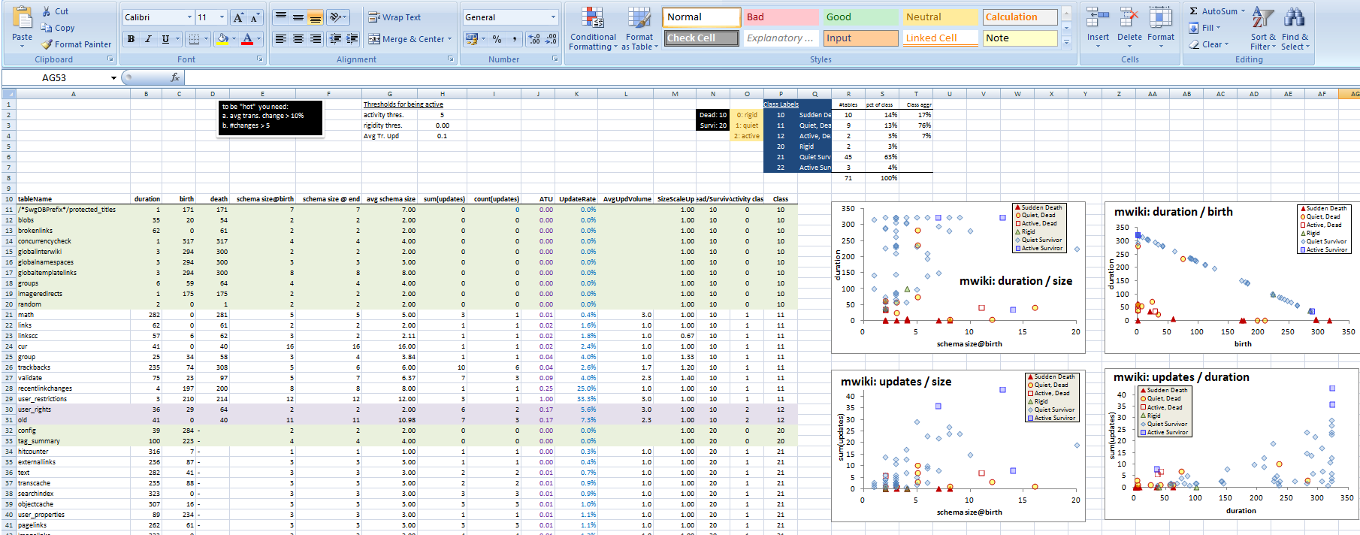
How does the schema size evolve?
Outline
Schema size evolution
Foreign Key Evolution
Table Evolution
Closing Remarks
Output: properties & patterns on the evolution of schema size (no. tables)
Not covered here:
  Growth patterns
  Lehman laws & schema evolution
Input: schema histories from github/sourceforge/…
For details:
- CAiSE 2014
- Inf. Systems 2015
http://www.cs.uoi.gr/~pvassil/publications/2014_CAiSE/

Slide 16
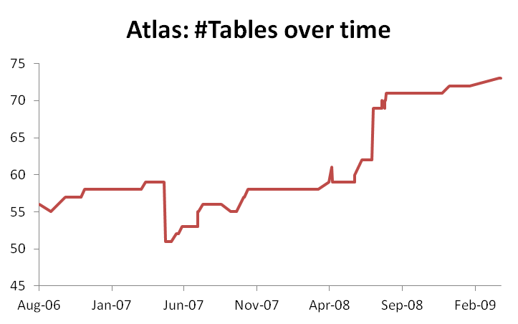
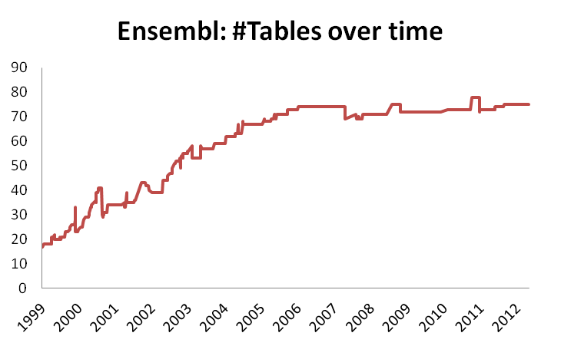
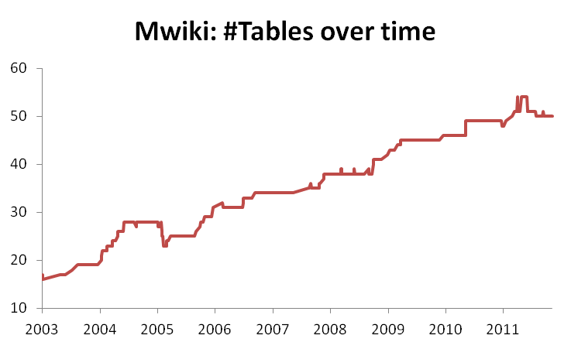
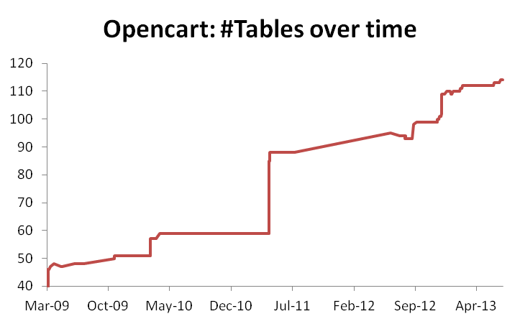
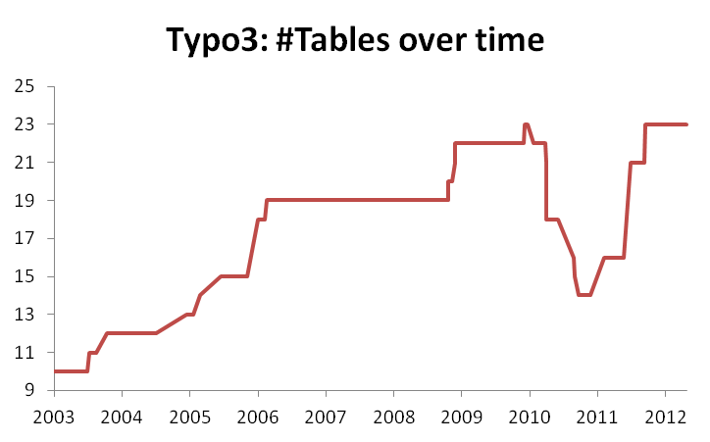
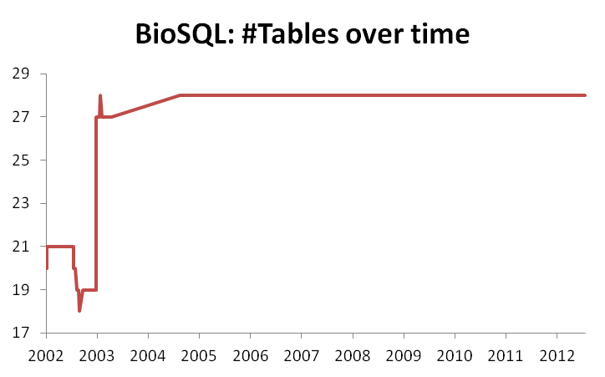
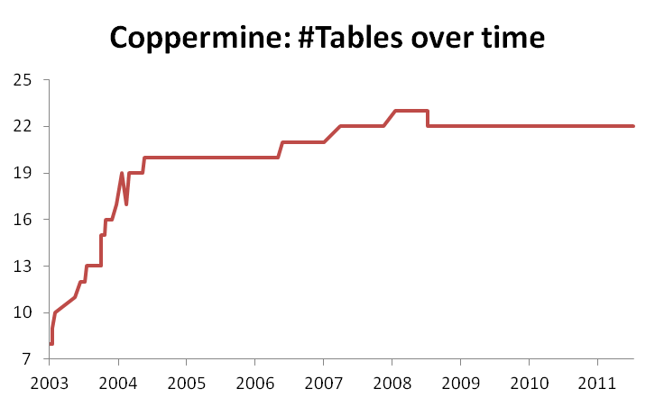
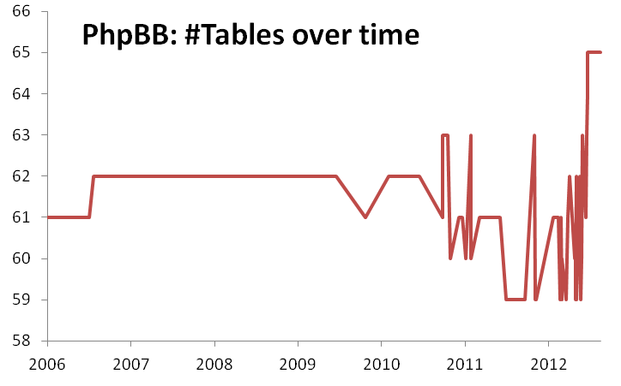
Schema Size (relations)

Slide 17
Highlights of Schema Size
Evolution
Overall increase in size
Periods of increase, esp. at beginning and after large drops
Drops: sudden and steep (in short duration)
Large periods of stability!
  Unlike traditional S/W, db’s are dependency magnets…

Slide 19
Growth over time
Calmness periods
Increase both slow (mostly) and abrupt
Occasional abrupt drops (maintenance)

Slide 20
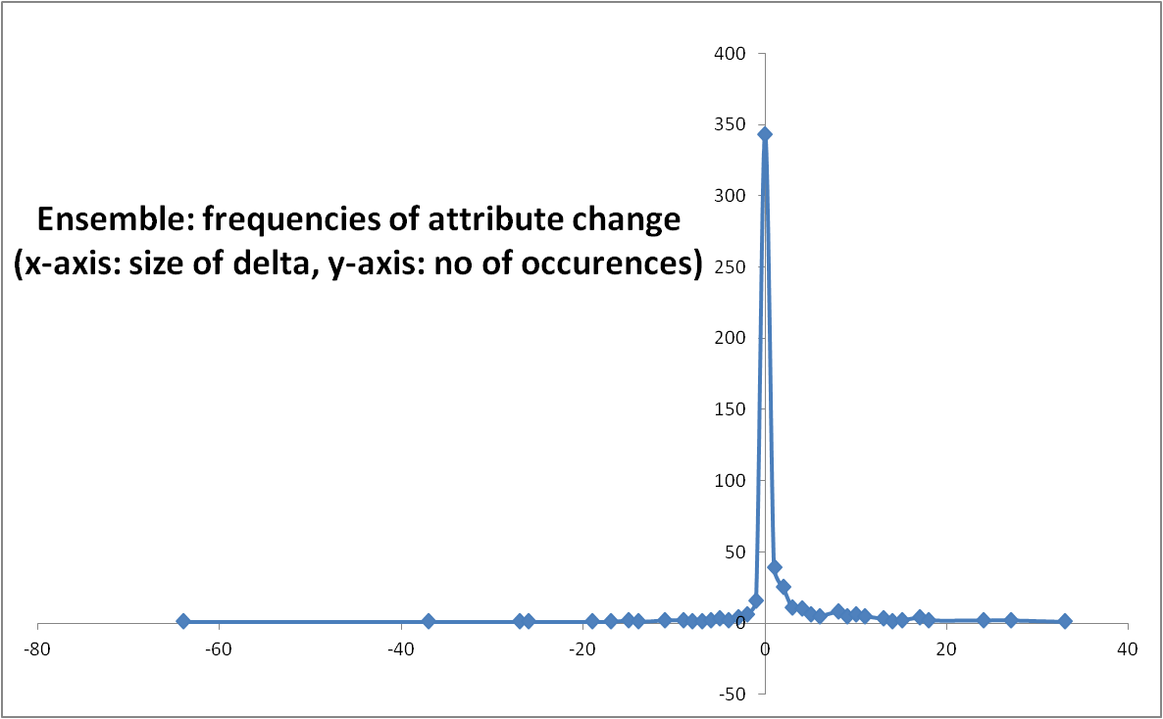
Zipfian model in the distribution of growth frequencies
Growth: delta in the schema size for two subsequent versions

Slide 21
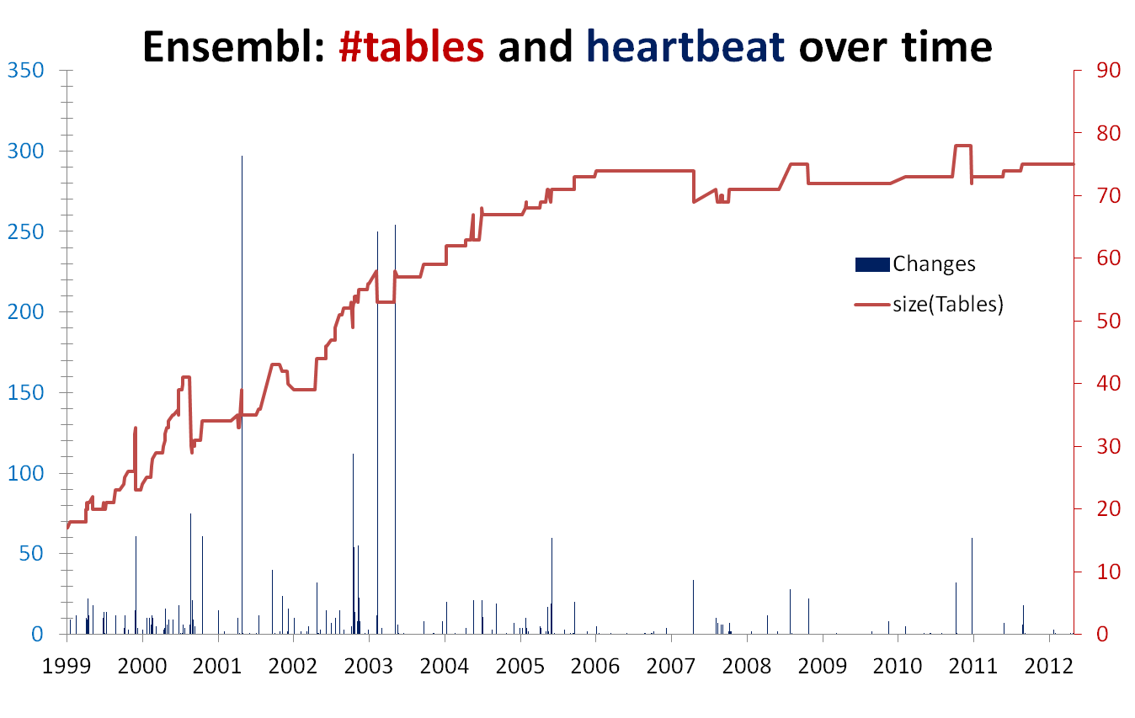
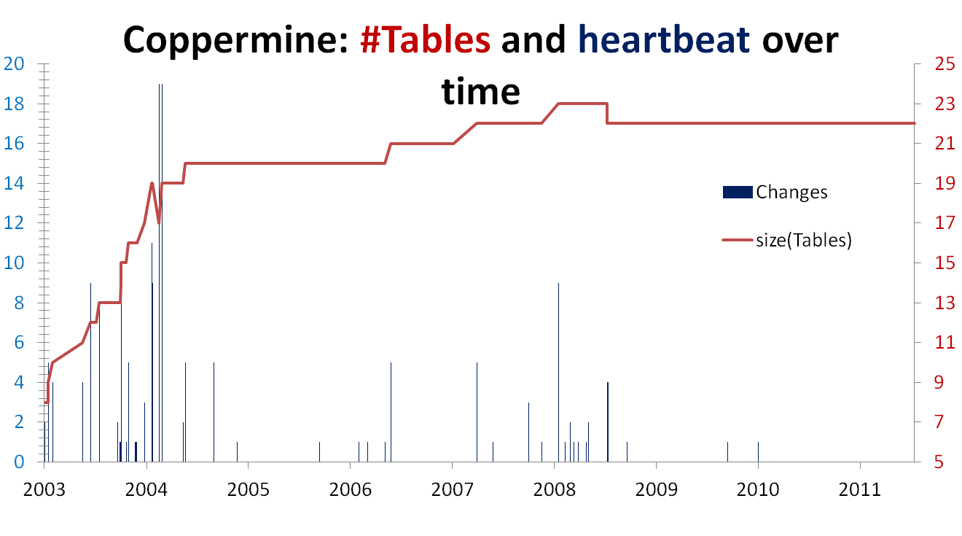
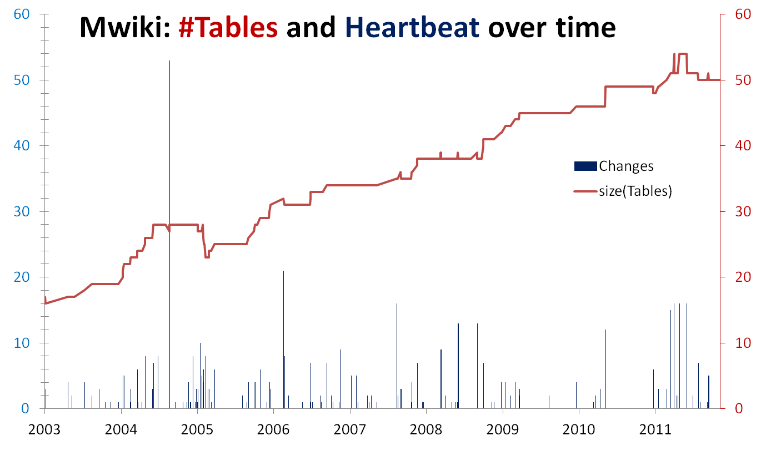
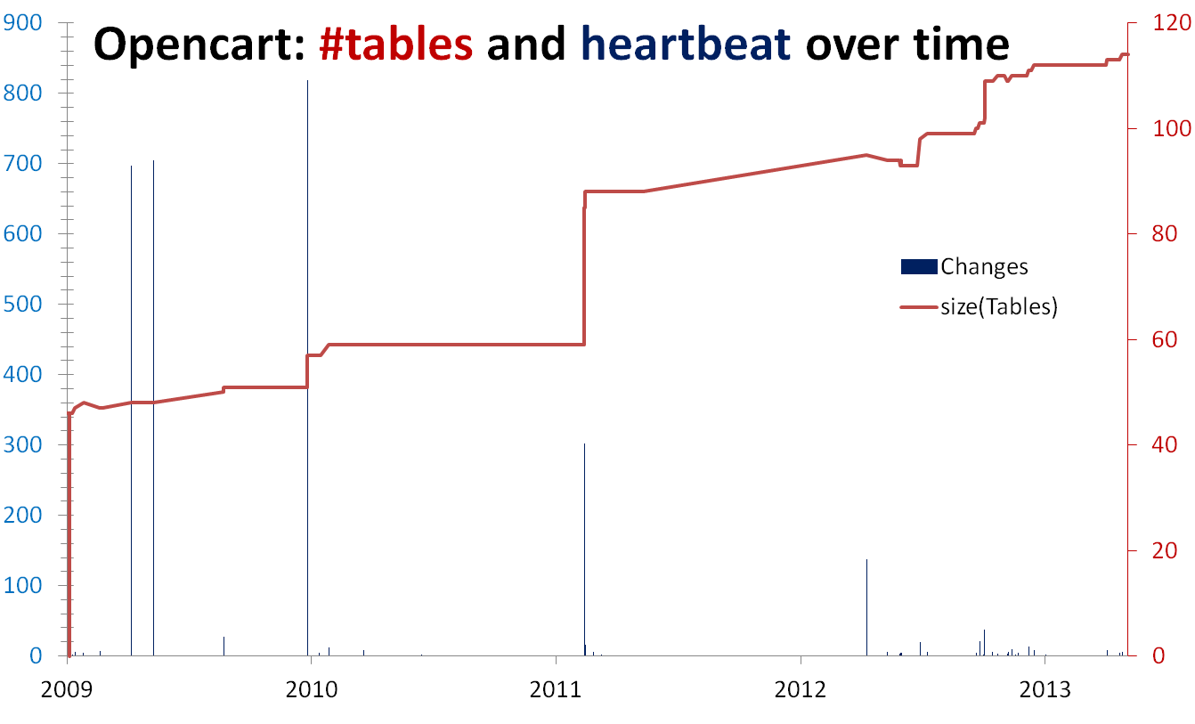
[With exceptions]
Density: focused maintenance effort
Progressive cooling : early –maintenance density >> later stages
Several spikes, many zero-change periods/versions

Slide 22
How do foreign keys evolve?
Outline
Schema size evolution
Foreign Key Evolution
Table Evolution
Closing Remarks
Output: properties & patterns on the evolution of foreign keys
Mainly patterns on:
  Size
  When FK Births & Deaths
  … unexpected results…
Input: schema histories from github/sourceforge/…
To appear in ER 2017
http://www.cs.uoi.gr/~pvassil/publications/2017_ER/

Slide 23
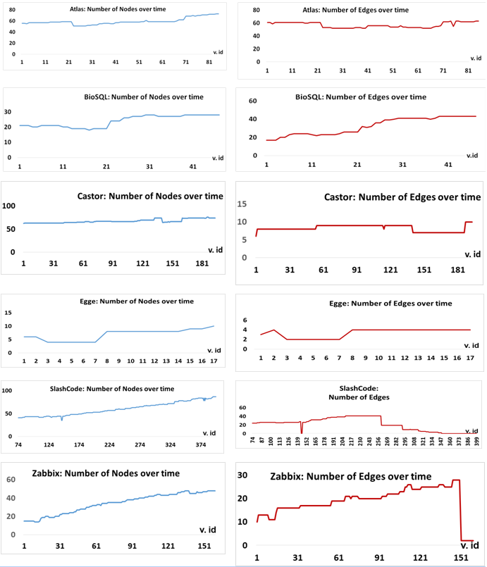
Evolution of
Tables & FK’s
Tables grow in all cases (known from previous research) with periods of slow growth, calmness, spikes of extension, and occasional cleanups
Foreign Keys are treated with different mentalities. 3 families:
  Scientific
  Comp. Toolkits
  CMS’s

Slide 24
Evolution of Tables & FK’s:
Scientific projects
Tables and FKS grow in synch, in both cases
Growth comes with expansion periods, shrinkage actions, and periods of calmness in terms of both tables and foreign keys.

Slide 25
Evolution of Tables & FK’s: Computational Resource Toolkits
Tables and FKS grow little and slowly; for Castor, not exactly in sync
Castor: observe how scarce FK’s are (too few tables come with FK’s, see vertical axis)

Slide 26
Evolution of Tables & FK’s:
Content Management Systems (CMS’s)
FK scarcity: really big at Slashcode, moderate at Zabbix
Slashcode started without foreign keys at all; 1st set of FK’s in v. 74. Zabbix seems to show a certain degree of syncronized growth
Yet, … both CMS's end up with no FK’s!! -> see next

Slide 27
What an unpleasant surprise: developers can resort in full removal of foreign keys!
Slashcode: there is a clear phase of progressive removal
Zabbix: abrupt removal of almost the entire set of foreign keys in a single transition. We have no knowledge on why this happened, & it is unexpected based on how FK’s had been treated till then…

Slide 28
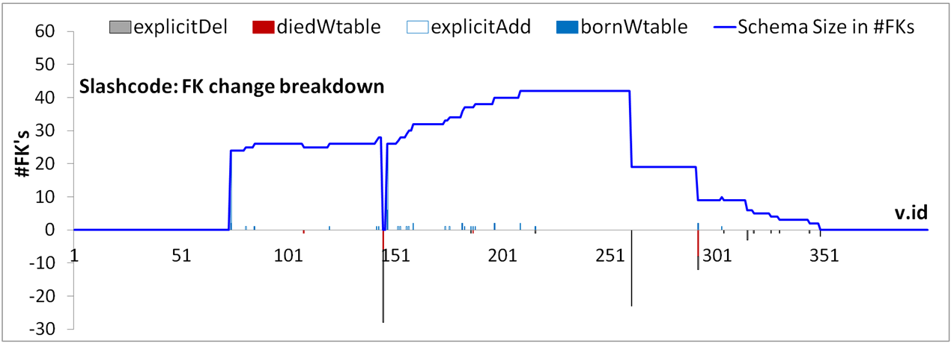
Slashcode: the disappearing FK’s
1st massive foreign key removal (rev 1.120),
22 FK’s deleted.
2nd massive deletion (rev 1.151), 10 FK's deleted
3rd deletion (rev 1.174), 3 FK's deleted
4th deletion (rev 1.189) 1 FK deleted
5th deletion (rev 1.201) 1 FK deleted

Slide 29
"Commented-out foreign keys are ones which currently cannot be used because they refer to a primary key which is NOT NULL AUTO INCREMENT and the child's key either has a default value which would be invalid for an auto increment field, typically NOT NULL DEFAULT '0'.
Or, in some cases, the primary key is e.g. VARCHAR(20) NOT NULL and the child's key will be VARCHAR(20). The possibility of NULLs negates the ability to add a foreign key. <= That's my current theory, but it doesn't explain why discussions.topic SMALLINT UNSIGNED NOT NULL DEFAULT '0' is able to be foreign-keyed to topics.tid SMALLINT UNSIGNED NOT NULL AUTO INCREMENT"
1st massive foreign key removal (rev 1.120),
22 FK’s deleted.
"Stories is now InnoDB and these other tables are still MyISAM, so no foreign keys between them."
2nd massive deletion (rev 1.151), 10 FK's deleted
"This doesn't work, makes createStory die. These don't work, should check why..."
3rd deletion (rev 1.174), 3 FK's deleted
"This doesn't work, since in the install pollquestions is populated before users, alphabetically"
4th deletion (rev 1.189) 1 FK deleted
"This doesn't work, since discussion may be 0."
5th deletion (rev 1.201) 1 FK deleted

Slide 30
Slashcode: what did the comments say?
The main problem seems to be the difficulty of developers with the tuning and handling of both foreign and primary keys.
Sometimes difficulties are hard -- e.g., different storage engines, typically due to performance reasons
Some difficulties are complicated due to technicalities like autonumbering
Sometimes fixes could be found with some effort (e.g., changing the order of table population, or using numeric data types for primary keys, or inserting some “goalkeeper” values at FK target table)

Slide 31
Scarcity of Foreign keys
A 2013 collection of schema histories, lists 21 data sets, -- some have more than one target DBMS variants.
How many data sets contain foreign keys?
Try this (also backed by manual sampling):
$ cd RESEARCH/Github/EvolutionDatasets
$ ls -d * */*
CERN CMS's/Coppermine CMS's/XOOPS Med
CERN/Atlas CMS's/DekiWiki CMS's/Zabbix Med/Ensembl
CERN/CASTOR CMS's/Joomla 1.5 CMS's/e107 Med/biosql
CERN/DQ2 CMS's/NucleusCMS CMS's/opencart README.md
CERN/DRAC CMS's/SlashCode CMS's/phpBB
CERN/EGEE CMS's/TikiWiki CMS's/phpwiki
CMS's CMS's/Typo3 CMS's/wikimedia
grep -rl "FOREIGN" . >> ALL-FKs-by-grep.ascii
awk '{split($0,a,"/"); print a[2],a[3]}' ALL-FKs-by-grep.ascii | uniq

Slide 32

Scarcity of Foreign keys
- How many data sets, out of the 21, contain foreign keys?
CERN Atlas
CERN CASTOR
CERN EGEE
CMS's SlashC
CMS's Zabbix
Med biosql
CERN DQ2
CERN DΙRAC
Med Ensembl
The 6 data sets reported here
+
DQ2 (only in the mySQL, not in the Oracle version): FK’s in 19 versions out of the 55. Starts with 2 FK's and ends with 1.
DΙRAC (not in the production folder, only at python+mysql).
9 tables at first version, 15 tables at last version
Starts with 10 FK's, ends with 8
Ensembl: not able to link FK DDL files to table evolution, yet
- 9 out of the 21 data sets do (including 3 that are really small for harnessing valuable results, spec., Egee, DQ2, DIRAC)
http://www.boldomatic.com/view/post/G_xPI

Slide 33
Foreign Key Evolution comes with different treatments:
Sometimes, FK’s are treated as an integral part of the system, and they are born and evicted along with table birth and eviction.
Other times, FK’s are treated as a disposable add-on: only a small subset of the tables involved in FK’s; birth and eviction of FK’s rarely performed in synch with their tables. If technical difficulties arise, it is possible to witness the complete removal of FK’s from the schema.
Another sign of concern is that in all the CMS’ we collected, FK’s are too scarce
More results in the paper: stats, threats to validity, and, the treatment of the evolving schema as an evolving graph
To appear in ER 2017
http://www.cs.uoi.gr/~pvassil/publications/2017_ER/

Slide 34
How do individual tables evolve?
Outline
Schema size evolution
Foreign Key Evolution
Table Evolution
Closing Remarks
Output: properties & patterns on table properties (birth, duration, amt of change, …)
Highlights
4 patterns of evolution,
here we focus on two of them
Input: schema histories from github/sourceforge/…

Slide 35
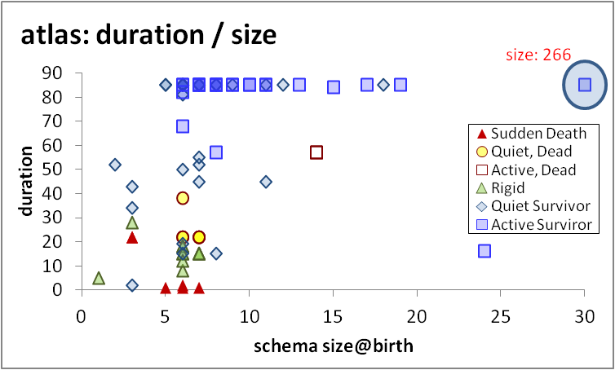

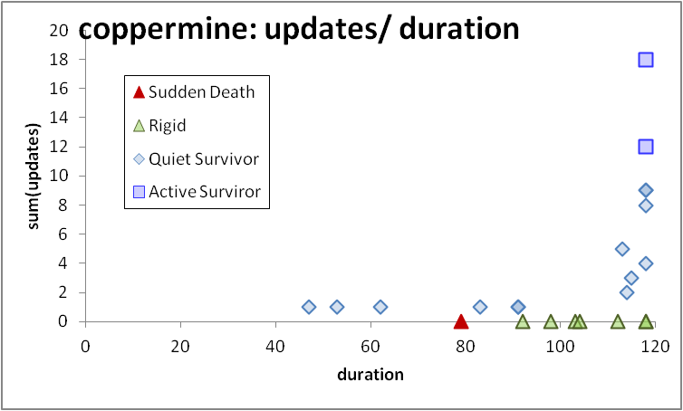
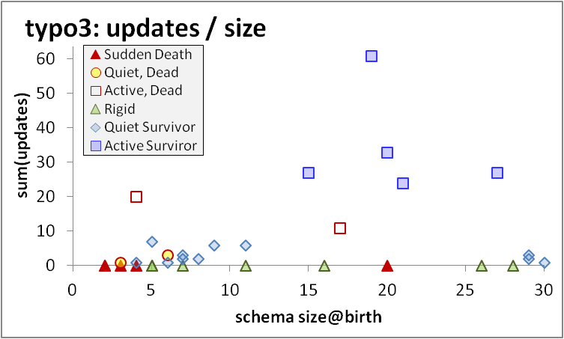
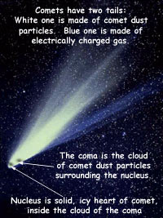
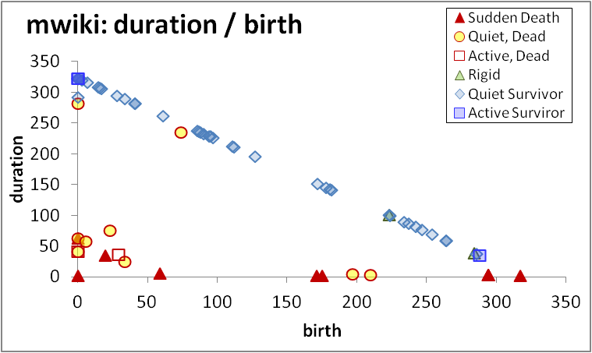
Regularities on table change do exist!
If you’re wide, you survive
Top-changers typically live long, are early born, survive …
… and they are not necessarily the widest ones in terms of schema size
Progressive cooling: most change activity lies at the beginning of the db history
Void triangle: The few dead tables are typically quiet, early born, short lived, and quite often all three of them
void
For details:
- ER 2015
- Inf. Sys. 2017
http://www.cs.uoi.gr/~pvassil/publications/2015_ER/

Slide 36
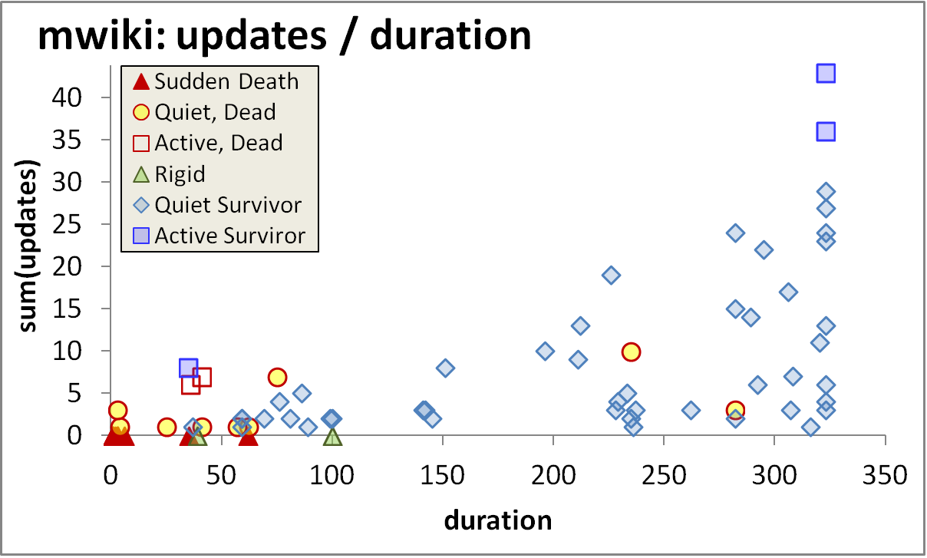
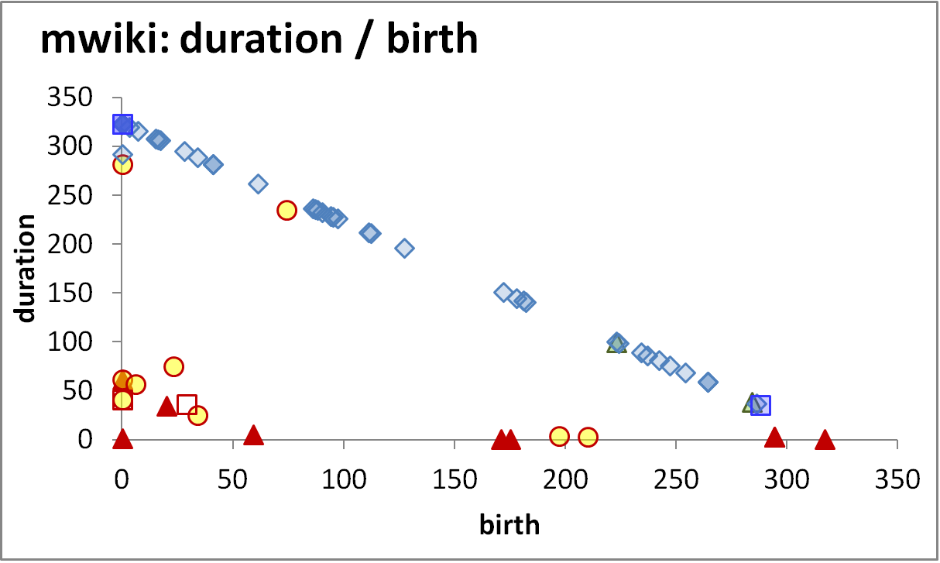
Longevity and update activity correlate !!
Top changers live long
Empty space: high change rates are only for early born & long lived
The few top-changers (in terms of avg trans. update – ATU)
are long lived,
typically come from the early versions of the database
due to the combination of high ATU and duration => they have high total amount of updates, and,
frequently survive!
Too many top changers are born early
void
Birth rate drops over time
Deleted tables are born early & last short

Slide 37
Die young
and suddenly
Empty space: high change rates are only for early born & long lived
There is a very large concentration of the deleted tables in a small range of newly born, quickly removed, with few or no updates…
…. resulting in very low numbers of removed tables with medium or long durations (empty triangle).
Deleted tables last short & do not change a lot
An empty triangle: no deleted tables with large or even modest durations
Deleted tables are born early & last short

Slide 38

Electrolysis pattern for table activities
For details:
- CAiSE 2017
http://www.cs.uoi.gr/~pvassil/publications/2017_CAiSE_Electrolysis

Slide 39
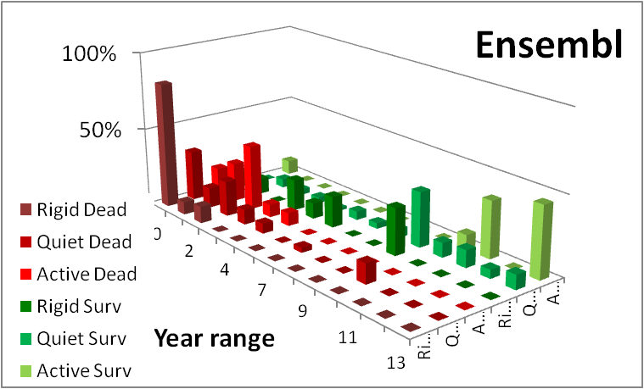
The electrolysis pattern
Dead tables demonstrate much shorter lifetimes than survivor ones,
can be located at short or medium durations, and practically never at high durations.
With few exceptions, the less active dead tables are, the higher the chance to reach shorter durations.
Survivors expose the inverse behavior, i.e., mostly located at medium or high durations.
The more active survivors are, the stronger they are attracted towards high durations, with a significant such inclination for the few active ones that cluster in very high durations.
Notes:
One could possibly argue that the observed clusterings and time spans are simply a matter of numbers: the more populated a class is, the broader its span is. To forestall any such criticism, this is simply not the case. We give the respective numbers in the sequel of this subsection; here, we proactively mention a few examples to address this concern. Rigid dead tables are the most populated group in the dead class, yet they have the shortest span of all. The rigid survivors, who are the 2nd most populated class of the entire population, exhibit all kind of behaviors; yet, in most of the cases, they are disproportionally clustered and not spread throughout the different categories. Active survivors are also disproportionately clustered at high durations. Overall, with the exception of the quiet survivors that indeed span a large variance of durations, in the rest of the categories, the time span is disproportionate to the size of the population (number of points in the scatter plot) of the respective class.

Slide 40
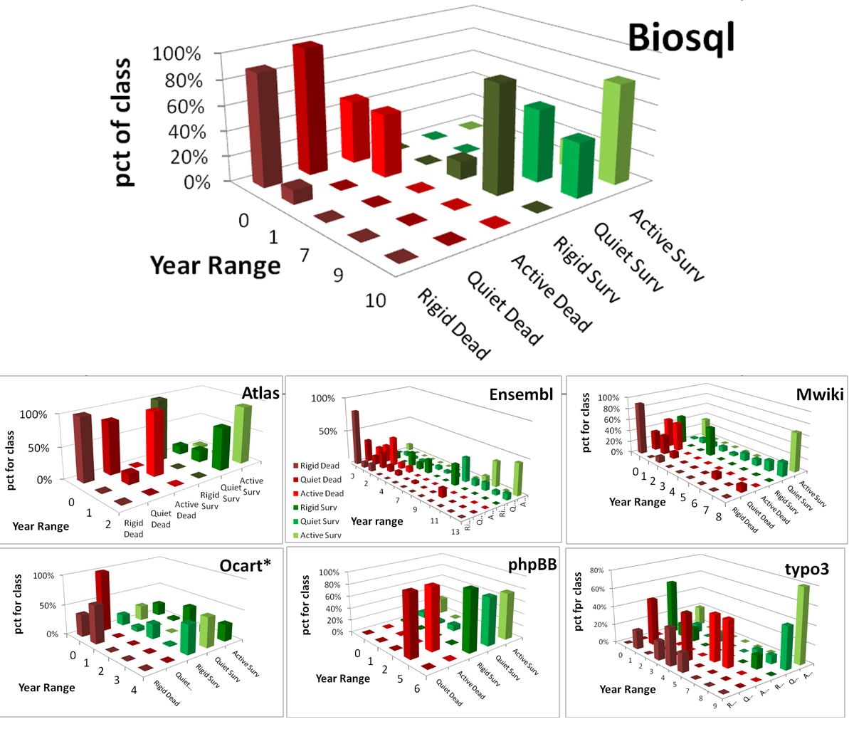
Attn: all pct’s are per class

Slide 41
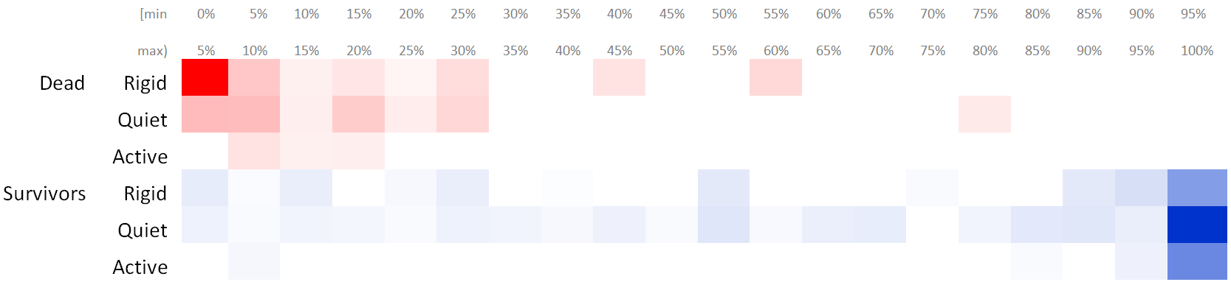
Electrolysis as a heatmap showing the extreme bias between dead and survivor tables
For each LifeAndDeath value, and for each duration range of 5% of the database lifetime, we computed the percentage of tables (over the total of the data set) whose duration falls within this range.
We removed cells that corresponded to only one data set
The resulting heatmap shows the polarization in colors: brighter color signifies higher percentage of the population

Slide 42
Gravitation to
Rigidity
Although the majority of survivor tables are in the quiet class, we can quite emphatically say that it is the absence of evolution that dominates!
  Survivors vastly outnumber removed tables.
  Similarly, rigid tables outnumber the active ones, both in the survival and, in particular, in the dead class.
  Schema size is rarely resized, and only in survivors (not in the paper).
  Active tables are few and do not seem to be born in other but early phases of the database lifetime.
Evidently, not only survival is also stronger than removal, but rigidity is also stronger a force than variability and the combination of the two forces further lowers the amount of change in the life of a database schema.

Slide 43
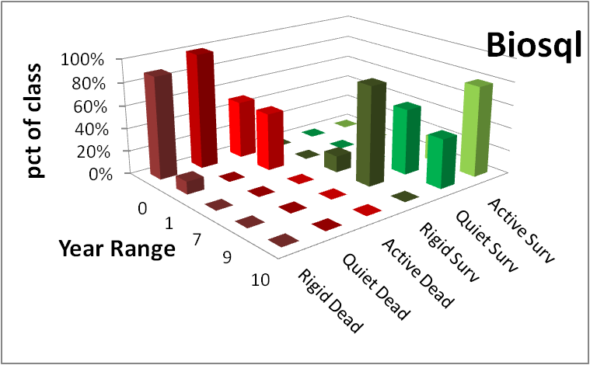
Summarizing…
Yes, we can indeed find patterns in the lives of tables, during schema evolution!
Survivors, mostly long-lived (esp. active ones) and quietly active are radically different than dead tables, being mostly short-lived and rigid!
Gravitation to rigidity rules: we see more absence than presence of schema evolution!
Also studied [not part of the paper]: year of birth, schema size, schema resizing
http://www.cs.uoi.gr/~pvassil/publications/2017_CAiSE_Electrolysis

Slide 44
Closing remarks
Outline
Schema size evolution
Foreign Key Evolution
Table Evolution
Closing Remarks
Where we stand
Open issues
… and discussions …

Slide 45
Where we stand
We have a first understanding of …
gravitation to rigidity, i.e., the mechanics of schema non-evolution for FoSS ecosystems
schemata growing, changed in focused periods of maintenance and progressively “cooling” down
patterns relating to how tables change, given their size, update behavior, time of birth, …
foreign key families of treatment, absence & removals
To probe further (code, data, details, presentations, …)
    http://www.cs.uoi.gr/~pvassil/projects/schemaBiographies/

Slide 46
Gravitation to rigidity:
Long calmness, low+focused growth
Empty triangle, inverse Gamma, electrolysis
More absence than presence of evo!
Individual Tables
Foreign Keys
Schema size
void

Slide 47
Where to go from here…
More studies, by more groups, on more data, to verify / disprove patterns & find new ones
More tools and techniques to fully automate processing
Weather Forecast: given the history and the state of a database, predict subsequent events
Engineer for evolution: To absorb change gracefully we can try to (i) alter db design and DDL; (ii) encapsulate the database via a “stable” API; …

Slide 48
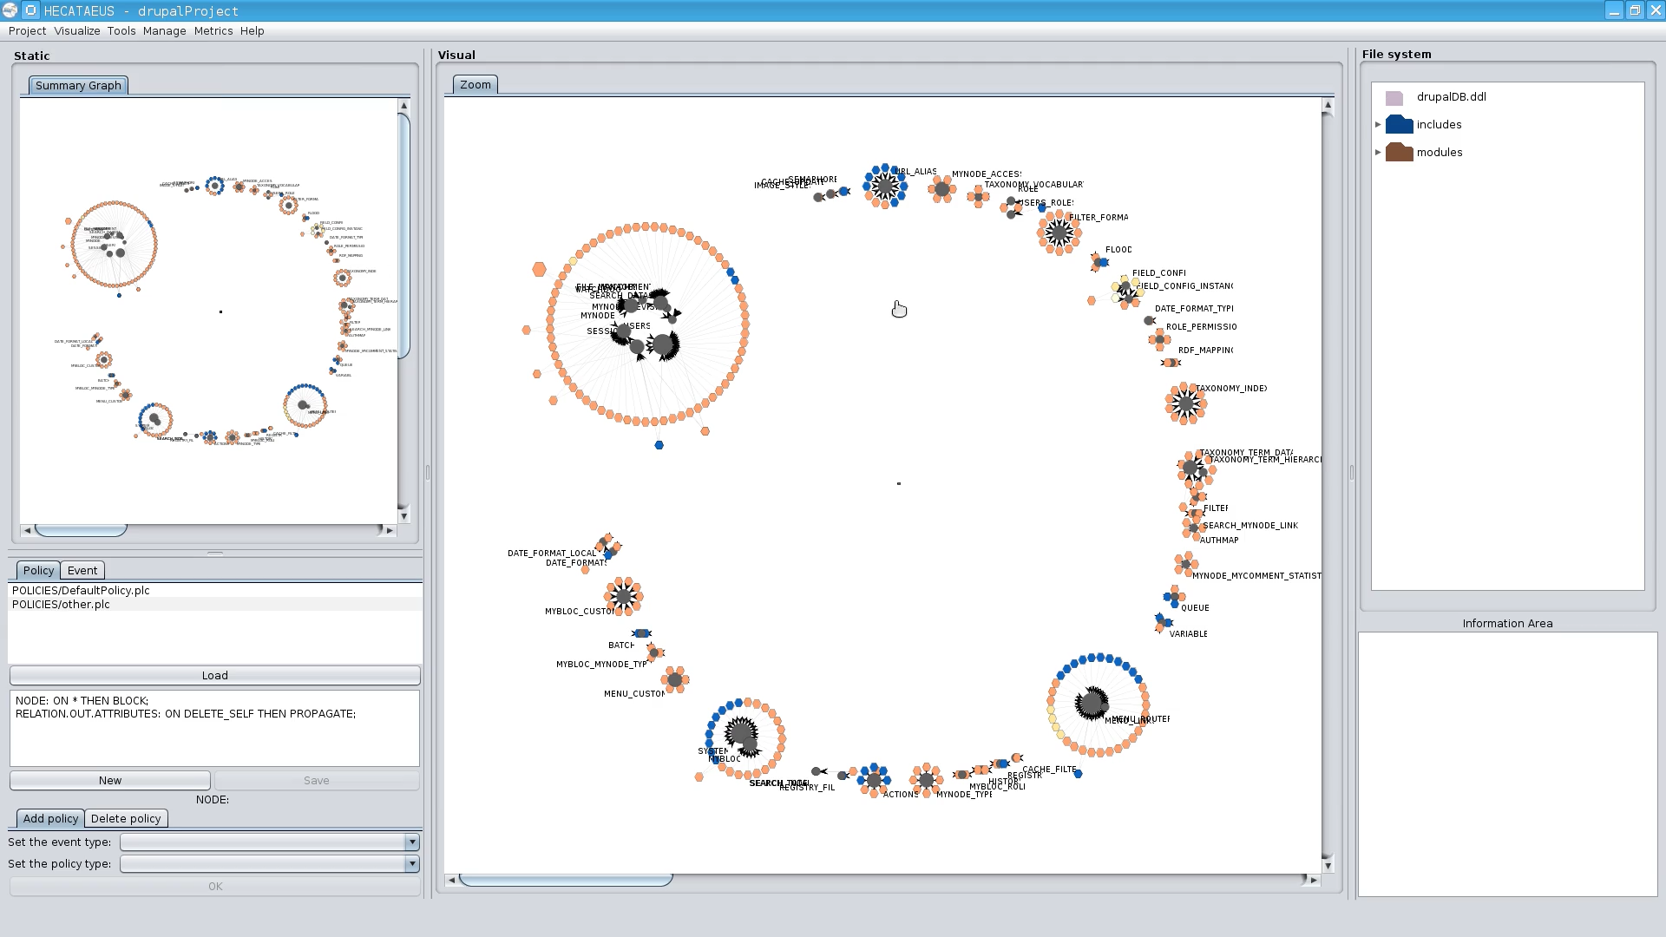
How does schema evolution relate to the surrounding software?
Which parts of the surrounding data-intensive software app’s are most sensitive to evolution?
  Metrics for sensitivity to evolution?
  Visualization of the architecture & evolution impact
Automation of the reaction to changes
  self-monitoring
  impact prediction
  auto-regulation (policy determination)
  self-repairing
http://www.cs.uoi.gr/~pvassil/projects/hecataeus/

Slide 49
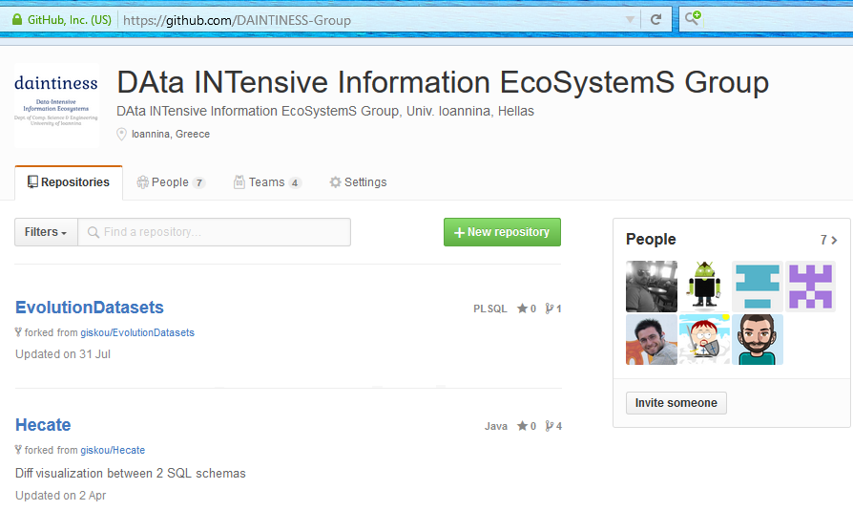
Everything HAS TO BE online!
We are happy to invite you to reuse / test / disprove /… all our code, data and results!
    https://github.com/DAINTINESS-Group
To probe further (code, data, details, presentations, …)
    http://www.cs.uoi.gr/~pvassil/projects/schemaBiographies/

Slide 50
Thank you!
Yes, we have the data and the tools to find patterns of schema evolution both for the entire schema and for individual parts of it!
Gravitation to rigidity rules: we see more absence than presence of schema evolution!
Many opportunities to exploit data, code and results for research on more studies, design and visualization of systems
To probe further (code, data, details, presentations, …)
    http://www.cs.uoi.gr/~pvassil/projects/schemaBiographies/

Slide 51
Auxiliary slides

Slide 52
Embedded queries in the past [Maule+08] …

Slide 53
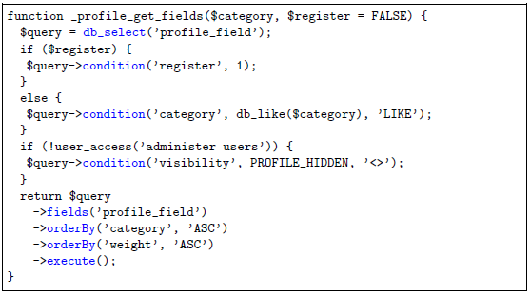
… nowadays, to be complemented with API-based db access (Drupal)

Slide 54
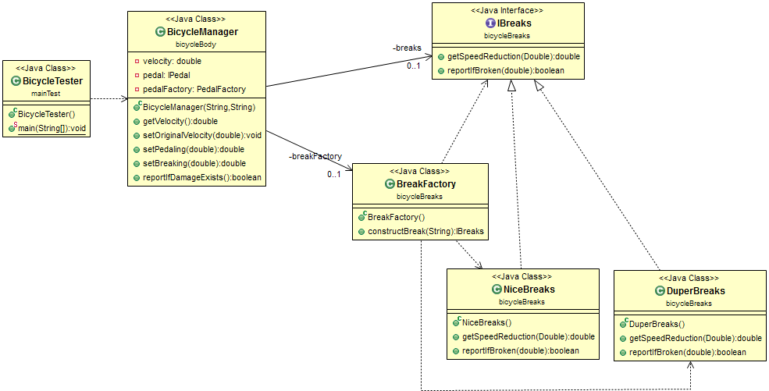
Abstract coupling example from my SW Dev course
Interface as a contract
Specification
≠
Implementation
Factory as a bridge
Client class
Service providers

Slide 55
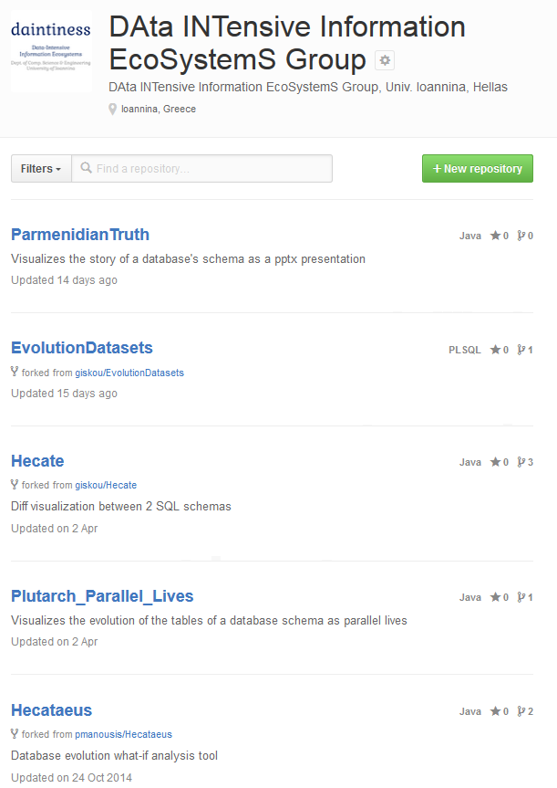
Put it all online!!
https://github.com/DAINTINESS-Group/
    My web page
    http://www.cs.uoi.gr/~pvassil/
has links to …
DB Schema Evolution
Papers, Data sets, Code, Results
projects/schemaBiographies/
… and to …
Tools for handling Evolution (Hecataeus)
projects/hecataeus/

Slide 56
Scope of the study && Validity considerations

Slide 57
Datasets
https://github.com/DAINTINESS-Group/EvolutionDatasets
Content management Systems
  MediaWiki, TYPO3, Coppermine, phpBB, OpenCart
Medical Databases
  Ensemble, BioSQL
Scientific
  ATLAS Trigger

Slide 58
Data sets
Dataset | Versions | Lifetime | Tables Start | Tables End | Attributes Start | Attributes End | Commits per Day | % commits with change | Repository URL
ATLAS Trigger | 84 | 2 Y, 7 M, 2 D | 56 | 73 | 709 | 858 | 0,089 | 82% | http://atdaq-sw.cern.ch/cgi-bin/viewcvs-atlas.cgi/offline/Trigger/TrigConfiguration/TrigDb/share/sql/combined_schema.sql
BioSQL | 46 | 10 Y, 6 M, 19 D | 21 | 28 | 74 | 129 | 0,012 | 63% | https://github.com/biosql/biosql/blob/master/sql/biosqldb-mysql.sql
Coppermine | 117 | 8 Y, 6 M, 2 D | 8 | 22 | 87 | 169 | 0,038 | 50% | http://sourceforge.net/p/coppermine/code/8581/tree/trunk/cpg1.5.x/sql/schema.sql
Ensembl | 528 | 13 Y, 3 M, 15 D | 17 | 75 | 75 | 486 | 0,109 | 60% | http://cvs.sanger.ac.uk/cgi-bin/viewvc.cgi/ensembl/sql/table.sql?root=ensembl&view=log
MediaWiki | 322 | 8 Y, 10 M, 6 D | 17 | 50 | 100 | 318 | 0,100 | 59% | https://svn.wikimedia.org/viewvc/mediawiki/trunk/phase3/maintenance/tables.sql?view=log
OpenCart | 164 | 4 Y, 4 M, 3 D | 46 | 114 | 292 | 731 | 0,104 | 47% | https://github.com/opencart/opencart/blob/master/upload/install/opencart.sql
phpBB | 133 | 6 Y, 7 M, 10 D | 61 | 65 | 611 | 565 | 0,055 | 82% | https://github.com/phpbb/phpbb3/blob/develop/phpBB/install/schemas/mysql_41_schema.sql
TYPO3 | 97 | 8 Y, 11 M, 0 D | 10 | 23 | 122 | 414 | 0,030 | 76% | https://git.typo3.org/Packages/TYPO3.CMS.git/history/TYPO3_6-0:/t3lib/stddb/tables.sql

Slide 59
Scope of the study
FoSS Dataset | Versions | Lifetime | Tables @ Start | Tables @ End
ATLAS Trigger [A] | 84 | 2 Y, 7 M, 2 D | 56 | 73
BioSQL [B] | 46 | 10 Y, 6 M, 19 D | 21 | 28
Coppermine [C] | 117 | 8 Y, 6 M, 2 D | 8 | 22
Ensembl [B] | 528 | 13 Y, 3 M, 15 D | 17 | 75
MediaWiki [C] | 322 | 8 Y, 10 M, 6 D | 17 | 50
OpenCart [C] | 164 | 4 Y, 4 M, 3 D | 46 | 114
phpBB [C] | 133 | 6 Y, 7 M, 10 D | 61 | 65
TYPO3 [C] | 97 | 8 Y, 11 M, 0 D | 10 | 23
Scope:
  databases being part of open-source software (and not proprietary ones)
  long history
  we work only with changes at the logical schema level (and ignore physical-level changes like index creation or change of storage engine)
  We encompass datasets with different domains ([A]: physics, [B]: biomedical, [C]: CMS’s), amount of growth (shade: high, med, low) & schema size
We should be very careful to not overgeneralize findings to proprietary databases or physical schemata!

Slide 60
Hecate: SQL schema diff extractor
Parses DDL files
Creates a model for the parsed SQL elements
Compares two versions of the same schema
Reports on the diff performed with a variety of metrics
Exports the transitions that occurred in XML format
  https://github.com/DAINTINESS-Group/Hecate

Slide 61
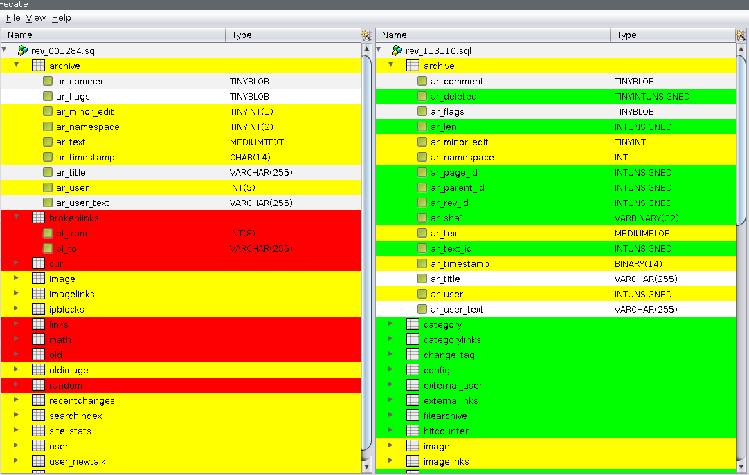
Hecate: SQL schema diff extractor
  https://github.com/DAINTINESS-Group/Hecate

Slide 62
External validity
Can we generalize out findings broadly?
We perform an exploratory study to observe frequently occurring phenomena within the scope of the aforementioned population
Are our data sets representative enough? Is it possible that the observed behaviors are caused by sui-generis characteristics of the studied data sets?
  Yes: we believe we have a good population definition & we abide by it
  Yes: we believe we have a large number of databases, from a variety of domains with different profiles, that seem to give fairly consistent answers to our research questions (behavior deviations are mostly related to the maturity of the database and not to its application area).
  Yes: we believe we have a good data extraction and measurement process without interference / selection / … of the input from our part
  Maybe: unclear when the number of studied databases is large enough to declare the general application of a pattern as “universal”.

Slide 63
External validity
Can we generalize out findings broadly?
Understanding the represented population
  Precision: all our data sets belong to the specified population
  Definition Completeness: no missing property that we knowledgably omit to report
  FoSS has an inherent way of maintenance and evolution
Representativeness of selected datasets
  Data sets come from 3 categories of FoSS (CMS / Biomedical / Physics)
  They have different size and growth volumes
  Results are fairly consistent both in our ER’15 and our CAiSE’14 papers
Treatment of data
  We have tested our “Delta Extractor”, Hecate, to parse the input correctly & adapted it during its development; the parser is not a full-blown SQL parser, but robust to ignore parts unknown to it
  A handful of cases where adapted in the Coppermine to avoid overcomplicating the parser; not a serious threat to validity ; other than that we have not interfered with the input
  Fully automated counting for the measures via Hecate

Slide 64
Internal validity
Can we confirm statements A=>B? No!
Are there any spurious relationships? Maybe!
Internal validity concerns the accuracy of cause-effect statements: “change in A => change in B”
We are very careful to avoid making strong causation statements!
  In some places, we just hint that we suspect the causes for a particular phenomenon, in some places in the text, but we have no data, yet, to verify our gut-feeling.
  And yes, it is quite possible that our correlations hide cofounding variables.

Slide 65
Is there a theory?
Our study should be regarded as a pattern observer, rather than as a collection of laws, coming with their internal mechanics and architecture.
It will take too many studies (to enlarge the representativeness even more) and more controlled experiments (in-depth excavation of cause-effect relationships) to produce a solid theory.
It would be highly desirable if a clear set of requirements on the population definition, the breadth of study and the experimental protocol could be solidified by the scientific community (like e.g., the TREC benchmarks)
… and of course, there might be other suggestions on how to proceed…

Slide 66
Related work

Slide 67
Timeline of empirical studies
Sjoberg
IST 93
Curino+
ICEIS08
Univ. Riverside
IWPSE09, ICDEW11
Qiu,Li,Su
FSE’13
Univ. Ioannina
CAiSE14, ER15
1993
2008
2009
2011
2013
2014
2015

Slide 68
Timeline of empirical studies
Sjoberg @ IST 93: 18 months study of a health system.
139% increase of #tables ; 274% increase of the #attributes
Changes in the code (on avg):
    relation addition: 19 changes ; attribute additions: 2 changes
    relation deletion : 59.5 changes; attribute deletions: 3.25 changes
An inflating period during construction where almost all changes were additions, and a subsequent period where additions and deletions where balanced.
Sjoberg
IST 93
Curino+
ICEIS08
Univ. Riverside
IWPSE09, ICDEW11
Qiu,Li,Su
FSE’13
Univ. Ioannina
CAiSE14, ER15
1993
2008
2009
2011
2013
2014
2015

Slide 69
Timeline of empirical studies
Curino+ @ ICEIS08: Mediawiki for 4.5 years
100% increase in the number of tables
142% in the number of attributes.
45% of changes do not affect the information capacity of the schema (but are rather index adjustments, documentation, etc)
Sjoberg
IST 93
Curino+
ICEIS08
Univ. Riverside
IWPSE09, ICDEW11
Qiu,Li,Su
FSE’13
Univ. Ioannina
CAiSE14, ER15
1993
2008
2009
2011
2013
2014
2015

Slide 70
Timeline of empirical studies
IWPSE09: Mozilla and Monotone (a version control system)
Many ways to be out of synch between code and evolving db schema
ICDEW11: Firefox, Monotone , Biblioteq (catalogue man.) , Vienna (RSS)
Similar pct of changes with previous work
Frequency and timing analysis: db schemata tend to stabilize over time, as there is more change at the beginning of their history, but seem to converge to a relatively fixed structure later
Sjoberg
IST 93
Curino+
ICEIS08
Univ. Riverside
IWPSE09, ICDEW11
Qiu,Li,Su
FSE’13
Univ. Ioannina
CAiSE14, ER15
1993
2008
2009
2011
2013
2014
2015

Slide 71
Timeline of empirical studies
Qiu,Li,Su@ FSE 2013: 10 (!) database schemata studied.
Change is focused both (a) with respect to time and (b) with respect to the tables who change.
Timing: 7 out of 10 databases reached 60% of their schema size within 20% of their early lifetime.
Change is frequent in the early stages of the databases, with inflationary characteristics; then, the schema evolution process calms down.
Tables that change: 40% of tables do not undergo any change at all, and 60%-90% of changes pertain to 20% of the tables (in other words, 80% of the tables live quiet lives). The most frequently modified tables attract 80% of the changes.
Sjoberg
IST 93
Curino+
ICEIS08
Univ. Riverside
IWPSE09, ICDEW11
Qiu,Li,Su
FSE’13
Univ. Ioannina
CAiSE14, ER15
1993
2008
2009
2011
2013
2014
2015

Slide 72
Timeline of empirical studies
Qiu,Li,Su@ FSE 2013: Code and db co-evolution, not always in synch.
Code and db changed in the same revision: 50.67% occasions
Code change was in a previous/subsequent version than the one where the database schema change: 16.22% of occasions
database changes not followed by code adaptation: 21.62% of occasions
11.49% of code changes were unrelated to the database evolution.
Each atomic change at the schema level is estimated to result in 10 -- 100 lines of application code been updated;
A valid db revision results in 100 -- 1000 lines of application code being updated
Sjoberg
IST 93
Curino+
ICEIS08
Univ. Riverside
IWPSE09, ICDEW11
Qiu,Li,Su
FSE’13
Univ. Ioannina
CAiSE14, ER15
1993
2008
2009
2011
2013
2014
2015

Slide 73
Timeline of empirical studies
CAiSE14: DB level
ER’15: Table level
Sjoberg
IST 93
Curino+
ICEIS08
Univ. Riverside
IWPSE09, ICDEW11
Qiu,Li,Su
FSE’13
Univ. Ioannina
CAiSE14, ER15
1993
2008
2009
2011
2013
2014
2015

Slide 74
Schema Evolution and Lehman laws
.. What do we see if we observe the evolution of the entire schema?
http://www.cs.uoi.gr/~pvassil/publications/2014_CAiSE/
Skoulis, Vassiliadis, Zarras. Open-Source Databases: Within, Outside, or Beyond Lehman's Laws of Software Evolution? CAiSE 2014
Growing up with stability: How open-source relational databases evolve. Information Systems, Volume 53, October–November 2015

Slide 75
Exploratory search of the schema histories for patterns
Input: schema histories from github/sourceforge/…
Raw material: details and stats on each table’s life, as produced by our diff extractor, for all the 8 datasets
Output: properties & patterns on schema properties (size, growth, changes, …) that occur frequently in our data sets
Highlights
Patterns on size and growth
Compliance to Lehman’s laws

Slide 76
Schema Size (relations)

Slide 77
Schema Size
Overall increase in size
Periods of increase, esp. at beginning and after large drops -> positive feedback
Drops: sudden and steep (in short duration) -> negative feedback
Large periods of stability!
  Unlike traditional S/W, db’s are dependency magnets…

Slide 79
Growth over time
Calmness periods
Increase both slow (mostly) and abrupt
Occasional abrupt drops (maintenance)

Slide 81
Schema Growth (diff in #tables)

Slide 82
Schema growth is small!
Growth is bounded in small values!
Zipfian distribution of growth values around 0
  Predominantly: occurrences of zero growth; almost all deltas are bounded between [-2..2] tables
  [0..2] tables slightly more popular => average value of growth slightly higher than 0
No periods of continuous change; small spikes instead
Due to perfective maintenance, we also have negative values of growth (less than the positive ones).
Oscillations exist too: positive growth is followed with immediate negative growth or stability

Slide 83
Zipfian model in the distribution of growth frequencies
Growth: delta in the schema size for two subsequent versions

Slide 84
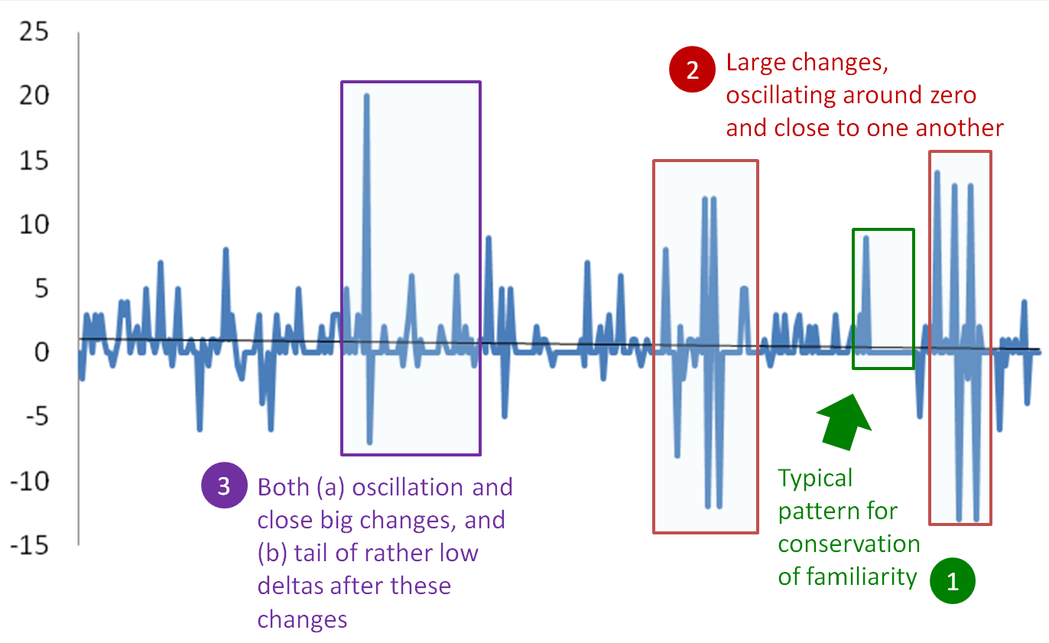
What happens after large changes?

Slide 85
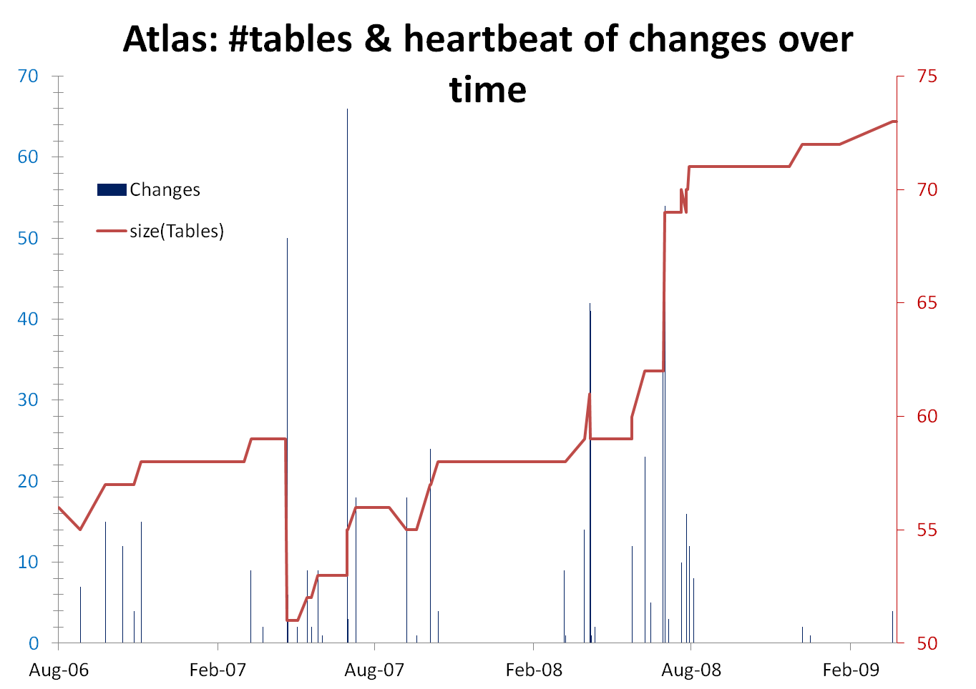
[With exceptions]
Density: focused maintenance effort
Progressive cooling : early –maintenance density >> later stages
Several spikes, many zero-change periods/versions

Slide 86
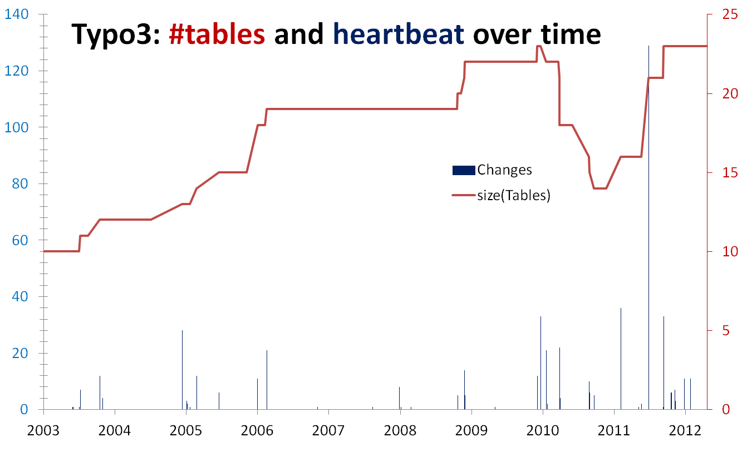
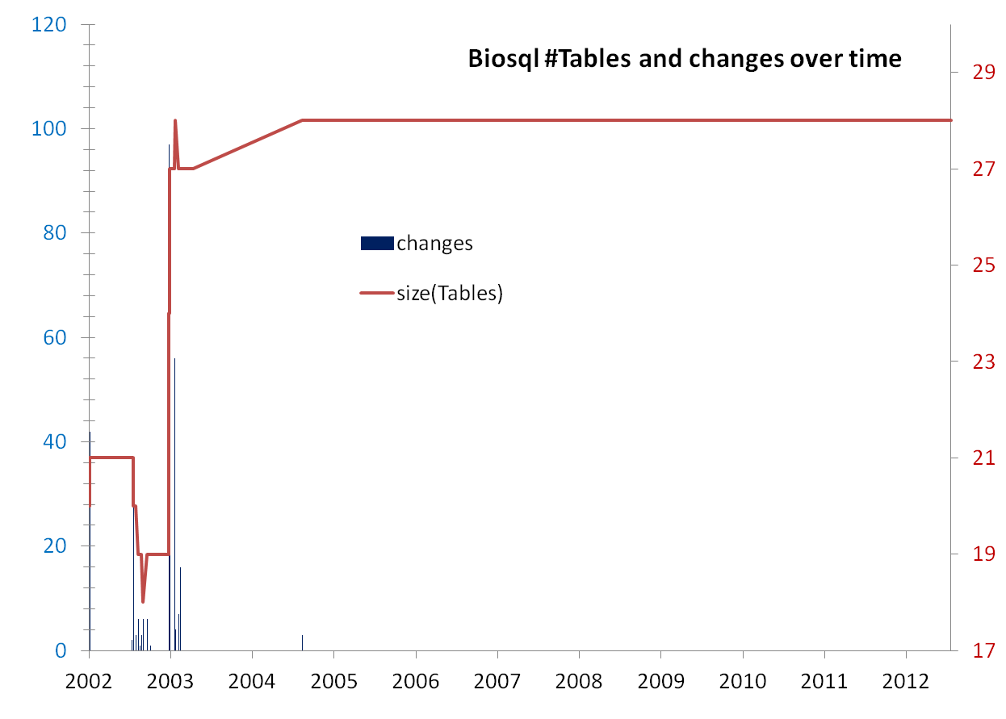
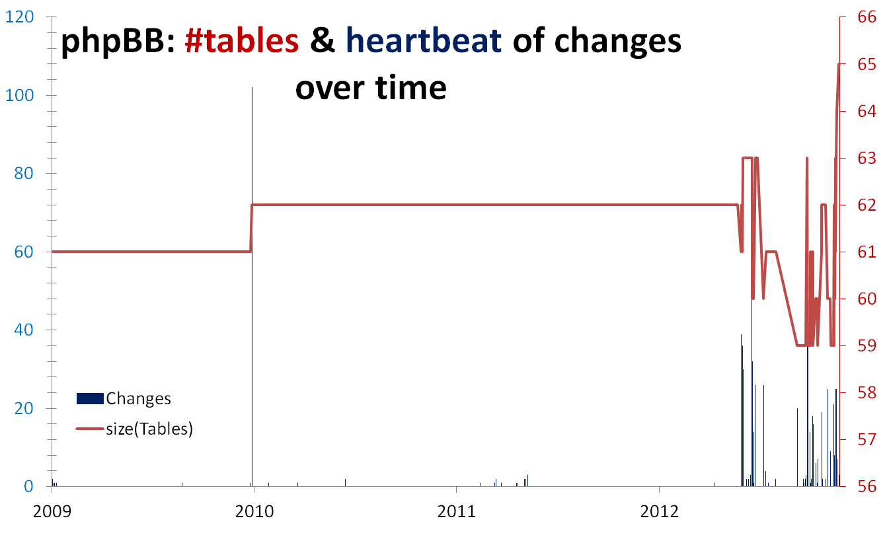
#tables & heartbeat of changes over time

Slide 87
How do schemata evolve?
Schema size (#tables – also: #attributes) supports the assumption of a feedback mechanism
Schema size grows over time; not continuously, but with bursts of concentrated effort
Drops in schema size signify the existence of perfective maintenance
Large periods of stability
Schema Growth (diff in size between subsequent versions) is small!!
Growth is small, smaller than in typical software
Average growth is close (slightly higher) to zero
Gravitation to rigidity:
Large periods of stability
Change frequency drops with time
For details:
- CAiSE 2014
- Inf. Systems 2015
Notes:
Divide findings in two categories:
-High Certainty
-need further work (grey)
We avoid the term law
– we don’t have unshakable evidence (too hard) or at least community consensus (different groups with different studies coinciding) of their existence,
– we don’t have clear understanding of mechanisms

Slide 88
The four patterns

Slide 89
void
To probe further (code, data, details, presentations, …)
    http://www.cs.uoi.gr/~pvassil/publications/2015_ER/

Slide 90
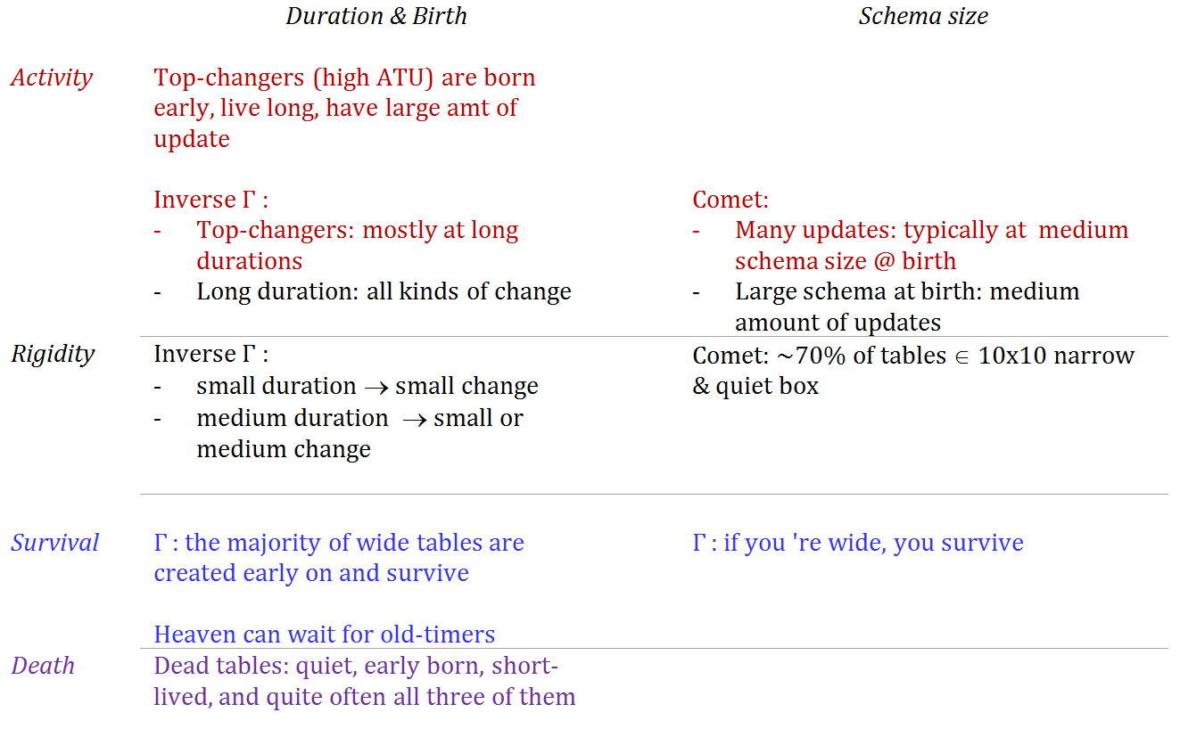

Slide 91
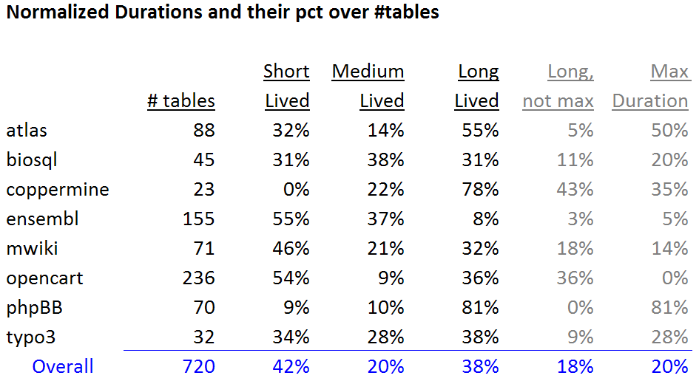
Statistical study of durations
Short and long lived tables are practically equally proportioned
Medium size durations are fewer than the rest!
Long lived tables are surprisingly too many
  in half the data sets they are the most populated group
  in all but one data set they exceed 30%
Way too many long-lived tables live throughout the entire lifespan (Max Duration) of the database

Slide 92
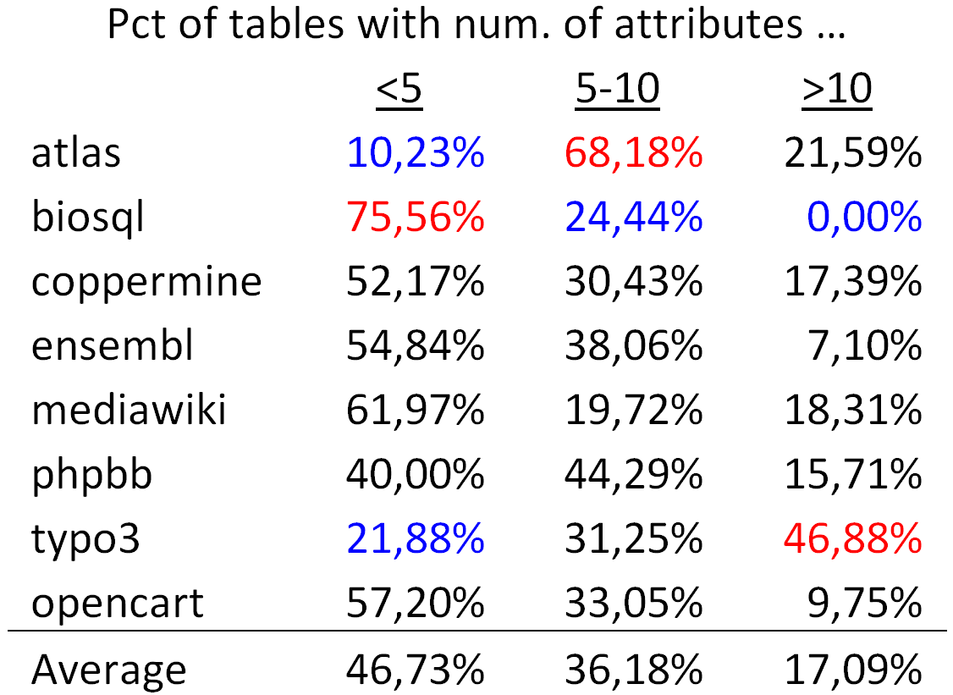
Tables are mostly thin
On average, half of the tables (approx. 47%) are thin tables with less than 5 attributes.
The tables with 5 to 10 attributes are approximately one third of the tables' population
The large tables with more than 10 attributes are approximately 17% of the tables.

Slide 93
The Gamma Pattern
Schema size @ birth / duration
If you ‘re wide, you survive
a.k.a (only the thin die young, all the wide ones seem to live forever)

Slide 94

The Gamma Pattern:
"if you 're wide, you survive"
The Gamma phenomenon:
  tables with small schema sizes can have arbitrary durations, //small size does not determine duration
  larger size tables last long
Observations:
  whenever a table exceeds the critical value of 10 attributes in its schema, its chances of surviving are high.
  in most cases, the large tables are created early on and are not deleted afterwards.

Slide 95
Exceptions
Biosql: nobody exceeds 10 attributes
Ensembl, mwiki: very few exceed 10 attributes, 3 of them died
typo: has many late born survivors

Slide 96
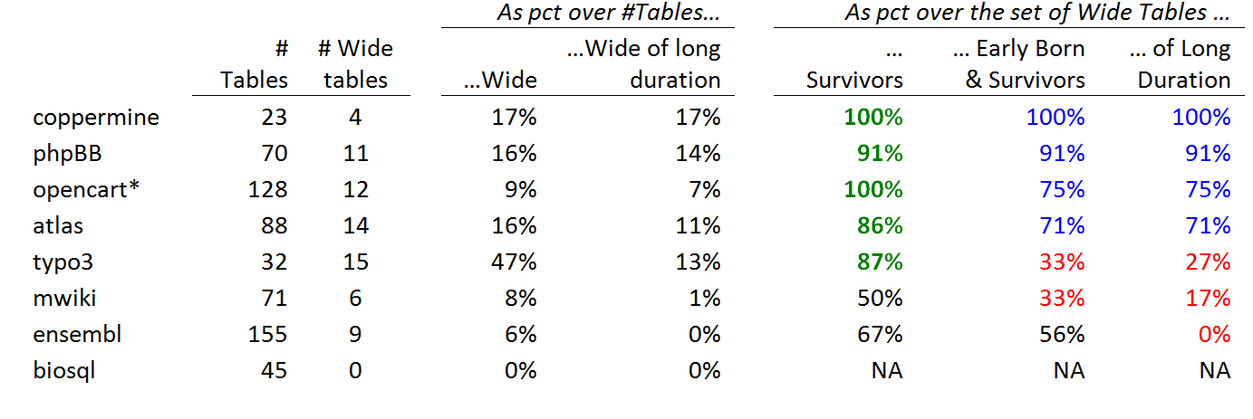
Stats on wide tables and their survival
Definitions:
Wide schema: strictly above 10 attributes.
The top band of durations (the upper part of the Gamma shape): the upper 10% of the values in the y-axis.
Early born table: ts birth version is in the lowest 33% of versions;
Late-comers: born after the 77% of the number of versions.

Slide 97
Whenever a table is wide, its chances of surviving are high
Apart from mwiki and ensembl, all the rest of the data sets confirm the hypothesis with a percentage higher than 85%. The two exceptions are as high as 50% for their support to the hypothesis.

Slide 98
Wide tables are frequently created early on and are not deleted afterwards
Early born, wide, survivor tables (as a percentage over the set of wide tables).
in half the data sets the percentage is above 70%
in two of them the percentage of these tables is one third of the wide tables.

Slide 99
Whenever a table is wide, its duration frequently lies within the top-band of durations (upper part of Gamma)
What is probability that a wide table belongs to the upper part of the Gamma?
there is a very strong correlation between the two last columns: the Pearson correlation is 88% overall; 100% for the datasets with high pct of early born wide tables.
Bipolarity on this pattern: half the cases support the pattern with support higher than 70%, whereas the rest of the cases clearly disprove it, with very low support values.

Slide 100
Long-lived & wide => early born and survivor
Subset
relationship
In all data sets, if a wide table has a long duration within the upper part of the Gamma, this deterministically (100% of all data sets) signifies that the table was also early born and survivor.
If a wide table is in the top of the Gamma line, it is deterministically an early born survivor.

Slide 101
The Comet Pattern
Schema size and updates

Slide 102
The Comet Pattern
“Comet “ for change over schema size with:
a large, dense, nucleus cluster close to the beginning of the axes, denoting small size and small amount of change,
medium schema size tables typically demonstrating medium to large change
  The tables with the largest amount of change are typically tables whose schema is on average one standard deviation above the mean
wide tables with large schema sizes demonstrating small to medium (typically around the middle of the y-axis) amount of change.

Slide 103
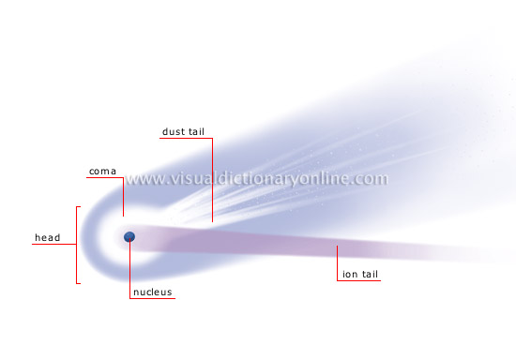
http://visual.merriam-webster.com/astronomy/celestial-bodies/comet.php
http://spaceplace.nasa.gov/comet-nucleus/en/

Slide 104
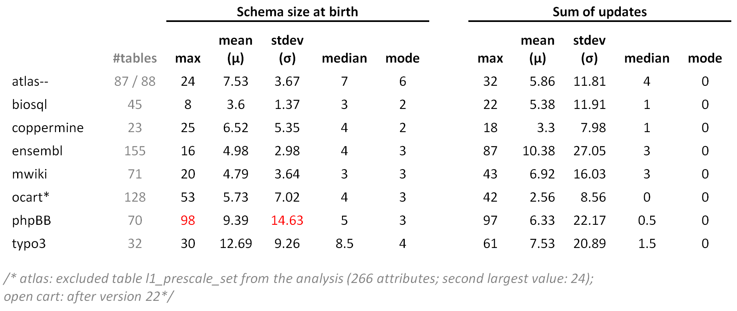
Statistics of schema size at birth and sum of updates

Slide 105
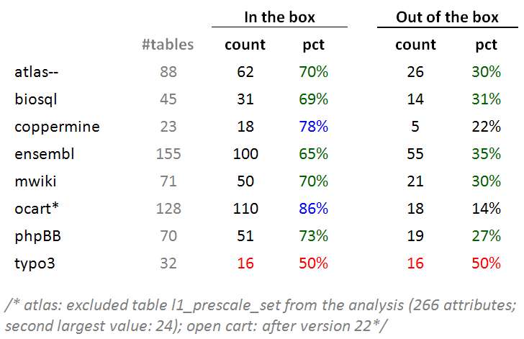
Typically: ~70% of tables inside the box
Typically, around 70% of the tables of a database is found within the 10x10 box of schemaSize@birth x sumOfUpdates (10 excluded in both axes).

Slide 106
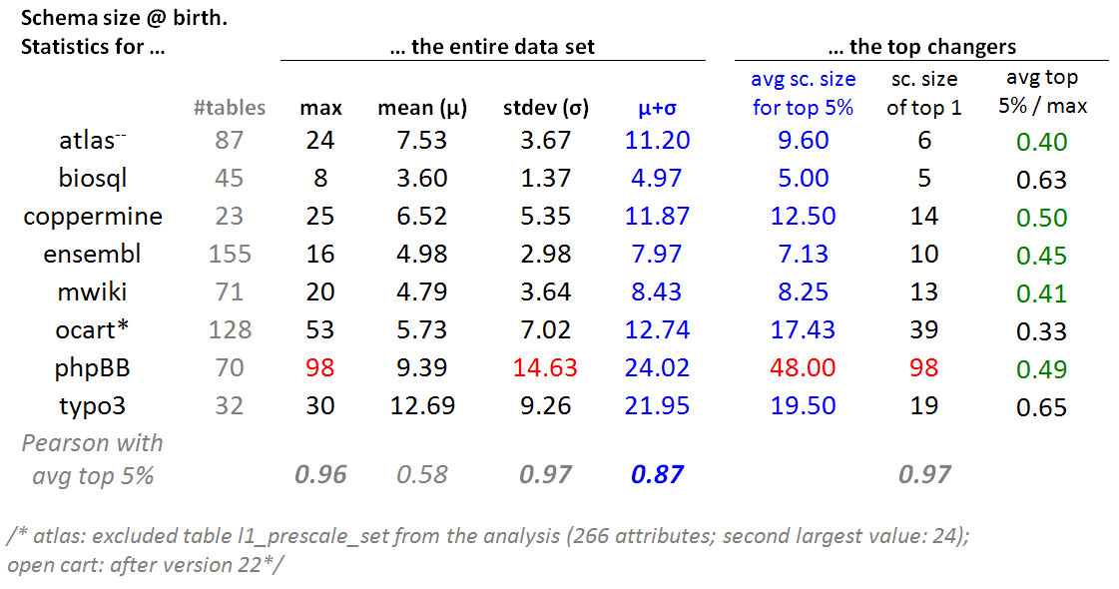
Top changers tend to have medium schema sizes
For every dataset: we selected the top 5% of tables in terms of this sum of updates and we averaged the schema size at birth of these top 5% tables.

Slide 107
Top changers tend to have medium schema sizes
The average schema size for the top 5% of tables in terms of their update behavior is close to one standard deviation up from the average value of the schema size at birth(i.e., very close to $mu$+$sigma$). //except phpBB

Slide 108
Top changers tend to have medium schema sizes
- In 5 out of 8 cases, the average schema size of top-changers within 0.4 and 0.5 of the maximum value (practically the middle of the domain) and never above 0.65 of it.
- Pearson: the maximum value, the standard deviation of the entire data set and the average of the top changers are very strongly correlated.

Slide 109
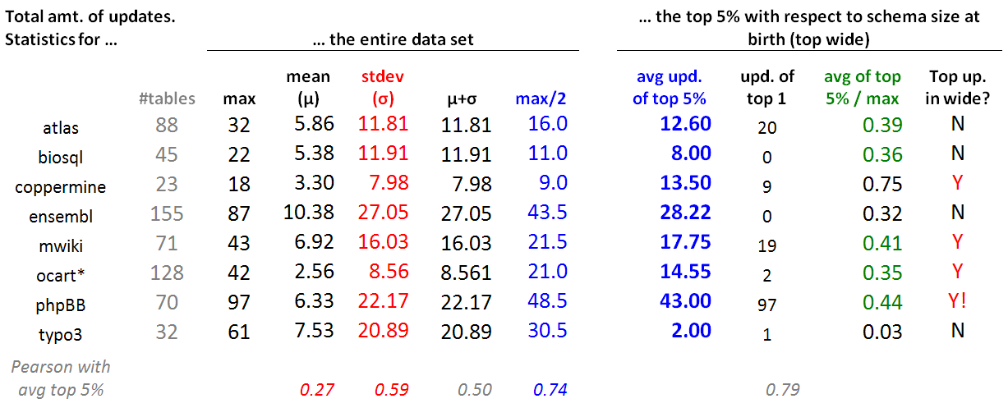
Wide tables have a medium number of updates
For each data set, we took the top 5% in terms of schema size at birth (top wide) and contrasted their update behavior wrt the update behavior of the entire data set.
Typically, the avg. number of updates of the top wide tables is close to the 38% of the domain of values for the sum of updates (i.e., the middle of the y-axis of the comet figure, measuring the sum of updates for each table).
This is mainly due to the (very) large standard deviation (twice the mean), rather than the --typically low -- mean value (due to the large part of the population living quiet lives).

Slide 110
Inverse Gamma

Slide 111
The inverse Gamma pattern
The correlation of change and duration is as follows:
  small durations come necessarily with small change,
  large durations come with all kinds of change activity and
  medium sized durations come mostly with small change activity (Inverse Gamma).

Slide 112


Slide 113

Skyline & Avg for Inverse
Gamma

Slide 114
The empty triangle pattern

Slide 115

Quiet tables rule, esp. for mature db’s
Non-survivors
Sudden deaths mostly
Quiet come ~ close
Too few active
Survivors
Quiet tables rule
Rigid and active then
Active mostly in “new” db’s
Mature DB’s: the pct of active tables drops significantly

Slide 116
Survive long enough &
you ‘re probably safe
Too rare to see deletions!
It is quite rare to see tables being removed at old age
Typically, the area of high duration is overwhelmingly inhabited by survivors (although each data set comes with a few such cases )!
High durations are overwhelmingly blue!
Only a couple of deletions are seen here!

Slide 117
Die young
and suddenly
[Early life of the db] There is a very large concentration of the deleted tables in a small range of newly born, quickly removed, with few or no updates, resulting in very low numbers of removed tables with medium or long durations.
[Mature db] After the early stages of the databases, we see the birth of tables who eventually get deleted, but they mostly come with very small durations and sudden deaths.
Deleted tables last short & do not change a lot
Few short lived tables are born and die in the mature life of the db
Deleted tables are born early & last short

Slide 118
void

Slide 119

Top changers: early born, survivors, often with long durations, and often all the above
In all data sets, active tables are born early with percentages that exceed 75%
With the exceptions of two data sets, they survive with percentage higher than 70%.
The probability of having a long duration is higher than 50% in 6 out of 8 data sets.
Interestingly, the two last lines are exactly the same sets of tables in all data sets!
  An active table with long duration has been born early and survived with prob. 100%
  An active, survivor table that has a long duration has been born early with prob. 100%

Slide 120

Dead are: quiet, early born, short lived, and quite often all three of them

Slide 121








Most births &deaths occur early (usually)

Slide 122
Longevity and update activity correlate !!
Top changers live long
Remember: top changers are defined as such wrt ATU (AvgTrxnUpdate), not wrt sum(changes)
Still, they dominate the sum(updates) too! (see top of inverse Γ)
See also upper right blue part of diagonal: too many of them are born early and survive => live long!
Too many top changers are born early
Birth rate drops over time
Deleted tables are born early & last short

Slide 123
All in one
Top changers live long
Empty space: high change rates are only for early born & long lived
Early stages of the database life are more "active" in terms of births, deaths and updates, and have higher chances of producing deleted tables.
After the first major restructuring, the database continues to grow; however, we see much less removals, and maintenance activity becomes more concentrated and focused.
Deleted tables last short & do not change a lot
Top changers are born early
An empty triangle: no deleted tables with large or even modest durations
Deleted tables are born early & last short
Birth rate drops over time

Slide 124
Survival in schema evolution: putting the lives of survivor and dead tables in counterpoint
… How do survivor tables differ from the dead ones (esp., wrt activity & duration)?
http://www.cs.uoi.gr/~pvassil/publications/2017_CAiSE_Electrolysis
Panos Vassiliadis, Apostolos Zarras. 29th International Conference on Advanced Information Systems Engineering , (CAiSE 2017), 12-16 June 2017, Essen, Germany.

Slide 125
Electrolysis pattern for table activities

Slide 126

Duration is related to the Life & Death Class of the tables!
DEAD
Low dur., rigidity
Rigid
Quiet
Active
SURVIVORS
High dur., quiet
Rigid
Quiet
Active
(a) Survival: DEAD vs SURVIVORS
(b) Activity: Rigid (no change) vs Active (change rate > 10%) vs Quiet (all in between)
(c) Life And Death (LAD) class: Survival x Activity

Slide 127
Attn: all pct’s are per class

Slide 128
The electrolysis pattern
Dead tables demonstrate much shorter lifetimes than survivor ones,
can be located at short or medium durations, and practically never at high durations.
With few exceptions, the less active dead tables are, the higher the chance to reach shorter durations.
Survivors expose the inverse behavior, i.e., mostly located at medium or high durations.
The more active survivors are, the stronger they are attracted towards high durations, with a significant such inclination for the few active ones that cluster in very high durations.
Notes:
One could possibly argue that the observed clusterings and time spans are simply a matter of numbers: the more populated a class is, the broader its span is. To forestall any such criticism, this is simply not the case. We give the respective numbers in the sequel of this subsection; here, we proactively mention a few examples to address this concern. Rigid dead tables are the most populated group in the dead class, yet they have the shortest span of all. The rigid survivors, who are the 2nd most populated class of the entire population, exhibit all kind of behaviors; yet, in most of the cases, they are disproportionally clustered and not spread throughout the different categories. Active survivors are also disproportionately clustered at high durations. Overall, with the exception of the quiet survivors that indeed span a large variance of durations, in the rest of the categories, the time span is disproportionate to the size of the population (number of points in the scatter plot) of the respective class.

Slide 129


The electrolysis pattern: survivors
The extreme clustering of active survivors to high durations
The wider spread of (quite numerous) quiet survivors to a large span of durations with long trails of points
The clustering of rigid survivors, albeit not just to one, but to all kinds of durations (frequently, not as high as quiet and active survivors)

Slide 130


The electrolysis pattern: dead
The total absence of dead tables from high durations
The clustering of rigid dead at low durations,
the spread of quiet dead tables to low or medium durations, and
the occasional presence of the few active dead, that are found also at low or medium durations, but in a clustered way

Slide 131
Electrolysis as a heatmap showing the extreme bias between dead and survivor tables
For each LifeAndDeath value, and for each duration range of 5% of the database lifetime, we computed the percentage of tables (over the total of the data set) whose duration falls within this range.
We removed cells that corresponded to only one data set
The resulting heatmap shows the polarization in colors: brighter color signifies higher percentage of the population

Slide 132
Gravitation to
Rigidity
Although the majority of survivor tables are in the quiet class, we can quite emphatically say that it is the absence of evolution that dominates!
  Survivors vastly outnumber removed tables.
  Similarly, rigid tables outnumber the active ones, both in the survival and, in particular, in the dead class.
  Schema size is rarely resized, and only in survivors (not in the paper).
  Active tables are few and do not seem to be born in other but early phases of the database lifetime.
Evidently, not only survival is also stronger than removal, but rigidity is also stronger a force than variability and the combination of the two forces further lowers the amount of change in the life of a database schema.

Slide 133
Electrolysis
Yes, we can indeed find patterns in the lives of tables, during schema evolution!
Survivors, mostly long-lived (esp. active ones) and quietly active are radically different than dead tables, being mostly short-lived and rigid!
Gravitation to rigidity rules: we see more absence than presence of schema evolution!
Also studied [not part of the paper]: year of birth, schema size, schema resizing

Slide 134
Schema Evolution and Foreign Keys: Birth, Eviction, Change and Absence
… How do foreign keys evolve?
http://www.cs.uoi.gr/~pvassil/publications/2017_ER
Panos Vassiliadis, Michail-Romanos Kolozoff*, Maria Zerva, Apostolos V. Zarras. 36th International Conference on Conceptual Modeling (ER 2017), Nov. 6th-9th, 2017, Valencia Spain

Slide 135
Research Questions
How do foreign keys evolve over time?
  Do tables and foreign keys evolve in sync?
  When & How do foreign keys germinate & die?
… as we will see, these questions led to unexpected results and more insights on how developers deal with foreign keys…

Slide 136
Evolution of
Tables & FK’s
Tables grow in all cases (known from previous research) with periods of slow growth, calmness, spikes of extension, and occasional cleanups
Foreign Keys are treated with different mentalities. 3 families:
  Scientific
  Comp. Toolkits
  CMS’s

Slide 137
Evolution of Tables & FK’s:
Scientific projects
Tables and FKS grow in synch, in both cases
Growth comes with expansion periods, shrinkage actions, and periods of calmness in terms of both tables and foreign keys.

Slide 138
Evolution of Tables & FK’s: Computational Resource Toolkits
Tables and FKS grow little and slowly; for Castor, not exactly in sync
Castor: observe how scarce FK’s are (too few tables come with FK’s, see vertical axis)

Slide 139
Evolution of Tables & FK’s:
Content Management Systems (CMS’s)
FK scarcity: really big at Slashcode, moderate at Zabbix
Slashcode started without foreign keys at all; 1st set of FK’s in v. 74. Zabbix seems to show a certain degree of syncronized growth
Yet, … both CMS's end up with no FK’s!! -> see next

Slide 140
What an unpleasant surprise: developers can resort in full removal of foreign keys!
Slashcode: there is a clear phase of progressive removal
Zabbix: abrupt removal of almost the entire set of foreign keys in a single transition. We have no knowledge on why this happened, & it is unexpected based on how FK’s had been treated till then…

Slide 141
How do FK’s germinate and die?
We classified FK’s births and deaths in 4 categories
Births
  Born with table: when either the source or the target table is born along with the foreign key,
  Explicit addition: when a foreign key is added to two existing tables.
Deletions
  Died with table: when either the source or the target table is removed along with the foreign key,
  Explicit deletion: when neither of the source or target tables gets deleted and only the foreign key is removed.

Slide 142

Stats on FK Change

Slide 143
Stats on FK Change
Atlas, Biosql and Egee (less) deal with FK’s as regular part of the schema
FK’s are, to a large extent …
Born with tables
Removed with tables

Slide 144
Stats on FK Change
Castor & Slashcode (both with a really small minority of FK’s) deal with FK’s as an ad-hoc add on: FK’s are mostly explicitly added/ removed
Zabbix has a mixed style: explicit del. and add. w. tables (& a sudden style change)

Slide 145

Families of developer profiles wrt the treatment of Foreign Keys
Integral part of schema: fairly large pct of tables involved in FKs, grow in sync with tables, germinate and die with them
Disposable Add-on: small pct of tables involved in FK’s, explicit additions and deletions, easy to remove them (in some cases, entirely!)
Mixed: can be with a change of style

Slide 146

Heartbeat of change
Birth & deaths are proportionally spread in time -- except Atlas.
The volume of change is typically low: most changes ~ 1 FK.
Exceptions:
(a) explicit mass add & del, (b) do-undo actions (Atlas, Slashcode and Castor), and,
(c) restructuring due to table renamings (4 in Biosql, 2 in Zabbix).

Slide 147

Percentage of transitions with FK change
Common theme in all the data sets: the consistent scarcity of FK changes
Scientific data sets: short active period + treatment of FK’s as an integral part of the schema (births and deaths of tables and FK’s in sync) => high pct of transitions with FK change
The rest: FK b&d are rare and explicit (w/o mass removals, would be even less)

Slide 148
Characteristics of the heartbeat of schemata wrt Foreign Keys
Scarcity of FK change: expectedly very few transitions come with FK change, except for idiosyncratic cases
Low volume: typically 1 FK change at a time, except for mass add/del
Birth & deaths are proportionally spread in time
Occasional do-undo and restructuring due to table renames

Slide 149
Slashcode: the disappearing FK’s
1st massive foreign key removal (rev 1.120),
22 FK’s deleted.
2nd massive deletion (rev 1.151), 10 FK's deleted
3rd deletion (rev 1.174), 3 FK's deleted
4th deletion (rev 1.189) 1 FK deleted
5th deletion (rev 1.201) 1 FK deleted

Slide 150
"Commented-out foreign keys are ones which currently cannot be used because they refer to a primary key which is NOT NULL AUTO INCREMENT and the child's key either has a default value which would be invalid for an auto increment field, typically NOT NULL DEFAULT '0'.
Or, in some cases, the primary key is e.g. VARCHAR(20) NOT NULL and the child's key will be VARCHAR(20). The possibility of NULLs negates the ability to add a foreign key. <= That's my current theory, but it doesn't explain why discussions.topic SMALLINT UNSIGNED NOT NULL DEFAULT '0' is able to be foreign-keyed to topics.tid SMALLINT UNSIGNED NOT NULL AUTO INCREMENT"
1st massive foreign key removal (rev 1.120),
22 FK’s deleted.
"Stories is now InnoDB and these other tables are still MyISAM, so no foreign keys between them."
2nd massive deletion (rev 1.151), 10 FK's deleted
"This doesn't work, makes createStory die. These don't work, should check why..."
3rd deletion (rev 1.174), 3 FK's deleted
"This doesn't work, since in the install pollquestions is populated before users, alphabetically"
4th deletion (rev 1.189) 1 FK deleted
"This doesn't work, since discussion may be 0."
5th deletion (rev 1.201) 1 FK deleted

Slide 151
Slashcode: what did the comments say?
The main problem seems to be the difficulty of developers with the tuning and handling of both foreign and primary keys.
Sometimes difficulties are hard -- e.g., different storage engines, typically due to performance reasons
Some difficulties are complicated due to technicalities like autonumbering
Sometimes fixes could be found with some effort (e.g., changing the order of table population, or using numeric data types for primary keys, or inserting some “goalkeeper” values at FK target table)

Slide 152
Scarcity of Foreign keys
A 2013 collection of schema histories, lists 21 data sets, -- some have more than one target DBMS variants.
How many data sets contain foreign keys?
Try this (also backed by manual sampling):
$ cd RESEARCH/Github/EvolutionDatasets
$ ls -d * */*
CERN CMS's/Coppermine CMS's/XOOPS Med
CERN/Atlas CMS's/DekiWiki CMS's/Zabbix Med/Ensembl
CERN/CASTOR CMS's/Joomla 1.5 CMS's/e107 Med/biosql
CERN/DQ2 CMS's/NucleusCMS CMS's/opencart README.md
CERN/DRAC CMS's/SlashCode CMS's/phpBB
CERN/EGEE CMS's/TikiWiki CMS's/phpwiki
CMS's CMS's/Typo3 CMS's/wikimedia
grep -rl "FOREIGN" . >> ALL-FKs-by-grep.ascii
awk '{split($0,a,"/"); print a[2],a[3]}' ALL-FKs-by-grep.ascii | uniq

Slide 153
Scarcity of Foreign keys
- How many data sets, out of the 21, contain foreign keys?
CERN Atlas
CERN CASTOR
CERN EGEE
CMS's SlashC
CMS's Zabbix
Med biosql
CERN DQ2
CERN DΙRAC
Med Ensembl
The 6 data sets reported here
+
DQ2 (only in the mySQL, not in the Oracle version): FK’s in 19 versions out of the 55. Starts with 2 FK's and ends with 1.
DΙRAC (not in the production folder, only at python+mysql).
9 tables at first version, 15 tables at last version
Starts with 10 FK's, ends with 8
Ensembl: not able to link FK DDL files to table evolution, yet
- 9 out of the 21 data sets do (including 3 that are really small for harnessing valuable results, spec., Egee, DQ2, DIRAC)
http://www.boldomatic.com/view/post/G_xPI

Slide 154
Heartbeat of change
Birth & deaths are proportionally spread in time -- except Atlas.
The volume of change is typically low: most changes ~ 1 FK.
Exceptions:
(a) explicit mass add & del, (b) do-undo actions (Atlas, Slashcode and Castor), and,
(c) restructuring due to table renamings (4 in Biosql, 2 in Zabbix).

Slide 155
Foreign Key Evolution comes with different treatments:
Sometimes, FK’s are treated as an integral part of the system, and they are born and evicted along with table birth and eviction.
Other times, FK’s are treated as a disposable add-on: only a small subset of the tables involved in FK’s; birth and eviction of FK’s rarely performed in synch with their tables. If technical difficulties arise, it is possible to witness the complete removal of FK’s from the schema.
Another sign of concern is that in all the CMS’ we collected, FK’s are too scarce
More results in the paper: stats, threats to validity, and, the treatment of the evolving schema as an evolving graph

Slide 156
Impact assessment
Roadmap
Evolution of views
Data warehouse Evolution
  A case study (if time)
Impact assessment in ecosystems
Empirical studies concerning database evolution
Open Issues and discussions
… and data intensive ecosystems…

Slide 157
Data intensive ecosystems
Ecosystems of applications, built on top of one or more databases and strongly dependent upon them
Like all software systems, they too change…

Slide 158
Evolving data-intensive ecosystem

Slide 159
Evolving data-intensive ecosystem
Remove CS.C_NAME
Syntactically invalid
Semantically unclear
Add exam year
The impact can be syntactical (causing crashes), semantic (causing info loss or inconsistencies) and related to the performance

Slide 160
The impact of changes & a wish-list
Syntactic: scripts & reports simply crash
Semantic: views and applications can become inconsistent or information losing
Performance: can vary a lot
We would like: evolution predictability
i.e., control of what will be affected
before changes happen
Learn what changes & how
Find ways to quarantine effects

Slide 161
The Hecataeus tool & method.
Here: a first map of Drupal
http://www.cs.uoi.gr/~pvassil/projects/hecataeus/

Slide 162

What happens if I modify table search_index? Who are the neighbors?

Slide 163

What happens if I modify table search_index? Who are the neighbors?
Tooltips with info on the script & query

Slide 164

In the file structure too…

Slide 165
How to handle evolution?
Architecture Graphs: graph with the data flow between modules (i.e., relations, views or queries) at the detailed (attribute) level; module internals are also modeled as subgraphs of the Architecture Graph
Policies, that annotate a module with a reaction for each possible event that it can withstand, in one of two possible modes:
  (a) block, to veto the event and demand that the module retains its previous structure and semantics, or,
  (b) propagate, to allow the event and adapt the module to a new internal structure.
Given a potential change in the ecosystem
  we identify which parts of the ecosystem are affected via a “change propagation” algorithm
  we rewrite the ecosystem to reflect the new version in the parts that are affected and do not veto the change via a rewriting algorithm
    Within this task, we resolve conflicts (different modules dictate conflicting reactions) via a conflict resolution algorithm

Slide 166

University E/S Architecture Graph
Notes:
Our ecosystem is described by the following image:
On the left we can see the Relations and their Attributes. On their right we see V_Course view where we use 3 of the relations. The V_Course view provides with Attributes the V_Tr view. The V_Tr view besides the V_Course view has as input the Transcript relation. Finally we can see on the upper most right part of the image the query that compares the grades of the students in DB_I & DB_II courses, and in the lower right part we see the query that gives the average grade of the students.
166

Slide 167

Architecture Graph
Modules and Module Encapsulation
Observe the input and output schemata!!
SELECT V.STUDENT_ID, S.STUDENT_NAME,
AVG(V.TGRADE) AS GPA
FROM V_TR V |><| STUDENT S ON STUDENT_ID
WHERE V.TGRADE > 4 / 10
GROUP BY V.STUDENT_ID, S.STUDENT_NAME
Notes:
167

Slide 168

Policies to predetermine reactions
RELATION.OUT.SELF: on ADD_ATTRIBUTE then PROPAGATE;
RELATION.OUT.SELF: on DELETE_SELF then PROPAGATE;
RELATION.OUT.SELF: on RENAME_SELF then PROPAGATE;
RELATION.OUT.ATTRIBUTES: on DELETE_SELF then PROPAGATE;
RELATION.OUT.ATTRIBUTES: on RENAME_SELF then PROPAGATE;
VIEW.OUT.SELF: on ADD_ATTRIBUTE then PROPAGATE;
VIEW.OUT.SELF: on ADD_ATTRIBUTE_PROVIDER then PROPAGATE;
VIEW.OUT.SELF: on DELETE_SELF then PROPAGATE;
VIEW.OUT.SELF: on RENAME_SELF then PROPAGATE;
VIEW.OUT.ATTRIBUTES: on DELETE_SELF then PROPAGATE;
VIEW.OUT.ATTRIBUTES: on RENAME_SELF then PROPAGATE;
VIEW.OUT.ATTRIBUTES: on DELETE_PROVIDER then PROPAGATE;
VIEW.OUT.ATTRIBUTES: on RENAME_PROVIDER then PROPAGATE;
VIEW.IN.SELF: on DELETE_PROVIDER then PROPAGATE;
VIEW.IN.SELF: on RENAME_PROVIDER then PROPAGATE;
VIEW.IN.SELF: on ADD_ATTRIBUTE_PROVIDER then PROPAGATE;
VIEW.IN.ATTRIBUTES: on DELETE_PROVIDER then PROPAGATE;
VIEW.IN.ATTRIBUTES: on RENAME_PROVIDER then PROPAGATE;
VIEW.SMTX.SELF: on ALTER_SEMANTICS then PROPAGATE;
QUERY.OUT.SELF: on ADD_ATTRIBUTE then PROPAGATE;
QUERY.OUT.SELF: on ADD_ATTRIBUTE_PROVIDER then PROPAGATE;
QUERY.OUT.SELF: on DELETE_SELF then PROPAGATE;
QUERY.OUT.SELF: on RENAME_SELF then PROPAGATE;
QUERY.OUT.ATTRIBUTES: on DELETE_SELF then PROPAGATE;
QUERY.OUT.ATTRIBUTES: on RENAME_SELF then PROPAGATE;
QUERY.OUT.ATTRIBUTES: on DELETE_PROVIDER then PROPAGATE;
QUERY.OUT.ATTRIBUTES: on RENAME_PROVIDER then PROPAGATE;
QUERY.IN.SELF: on DELETE_PROVIDER then PROPAGATE;
QUERY.IN.SELF: on RENAME_PROVIDER then PROPAGATE;
QUERY.IN.SELF: on ADD_ATTRIBUTE_PROVIDER then PROPAGATE;
QUERY.IN.ATTRIBUTES: on DELETE_PROVIDER then PROPAGATE;
QUERY.IN.ATTRIBUTES: on RENAME_PROVIDER then PROPAGATE;
QUERY.SMTX.SELF: on ALTER_SEMANTICS then PROPAGATE;
Remove CS.C_NAME
Allow deletion
Allow addition
Add exam year
Policies to predetermine the modules’ reaction to a hypothetical event?

Slide 169

How to handle evolution?
Remove CS.C_NAME

Slide 170
Internals of impact assess. & rewriting
Impact assessment. Given a potential event, a status determination algorithm makes sure that the nodes of the ecosystem are assigned a status concerning (a) whether they are affected by the event or not and (b) what their reaction to the event is (block or propagate).
Conflict resolution and calculation of variants. Algorithm that checks the affected parts of the graph in order to highlight affected nodes with whether they will adapt to a new version or retain both their old and new variants.
Module Rewriting. Our algorithm visits affected modules sequentially and performs the appropriate restructuring of nodes and edges.

Slide 171


Impact assessment & rewriting

Slide 172
Conflicts: what they are and how to handle them (more than flooding)
BEFORE
AFTER
R
R
View0
n
View0
View0
View1
View2
n
n
View1
View2
View2
Query1
Query2
n
Query1
Query2
View0 initiates a change
View1 and View 2 accept the change
Query2 rejects the change
Query1 accepts the change
The path to Query2 is left intact, so that it retains it semantics
View1 and Query1 are adapted
View0 and View2 are adapted too, however, we need two version for each: one to serve Query2 and another to serve View1 and Query1
Notes:
172

Slide 173

Played an impact analysis scenario: delete attr. ‘word’ from search_index
1. The table allowed the deletion, but…
2. Queries Q215 and Q216 vetoed

