Slide 1

Schema Evolution for Relational Databases
Panos Vassiliadis
joint work with: Apostolos Zarras, Ioannis Skoulis, Petros Manousis, Fanis Giahos, Michael Kolozoff, Athanasios Pappas, Maria Zerva
Department of Computer Science and Engineering
University of Ioannina, Hellas
http://www.cs.uoi.gr/~pvassil/projects/schemaBiographies/

Slide 2

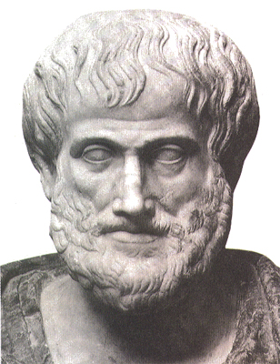
The nature that needs change is vicious; for it is not simple nor good…
Nicomachean Ethics, Book VII, Aristotle

Slide 3
SWEBOK Maintenance
 | Correction | Enhancement
Proactive | Preventive | Perfective
Reactive | Corrective | Adaptive
Corrective maintenance: reactive modification (or repairs) of a software product performed after delivery to correct discovered problems.
Adaptive maintenance: modification of a software product performed after delivery to keep a software product usable in a changed or changing environment.
Perfective maintenance: modification of a software product after delivery to provide enhancements for users, improvement of program documentation, and recoding to improve software performance, maintainability, or other software attributes.
Preventive maintenance: modification of a software product after delivery to detect and correct latent faults in the software product before they become operational faults.

Slide 4
Database Evolution: why and what
All software systems and, thus, both the databases themselves and applications built around databases are dynamic environments and can evolve due
  Changes of requirements
  Internal restructuring due to performance reasons
  migration to / integration with another system
  …
Database evolution further concerns
  changes in the operational environment of the database
  changes in the content (data) of the databases as time passes by
  changes in the internal structure, or schema, of the database

Slide 5
What evolves in DBMS...
Data
  UPDATE EMP
    SET SALARY = SALARY *1.10
    WHERE...
EMP_ID | SALARY
100 | 1500
EMP_ID | SALARY
100 | 1650
Metadata – Schemata – Models
    ALTER TABLE EMP
    ADD COLUMN PHONE VARCHAR ...
EMP_ID | SALARY
100 | 1500
EMP_ID | SALARY | PHONE
100 | 1500 | 210777777

Slide 6
Why is (schema) evolution so important?
Software and DB maintenance makes up for at least 50% of all resources spent in a project.
Changes are more frequent than you think
Databases are rarely stand-alone: typically, an entire ecosystem of applications is structured around them =>
Changes in the schema can impact a large (typically, not traced) number of surrounding app’s, without explicit identification of the impact

Slide 7
Embedded queries in the past [Maule+08] …

Slide 8
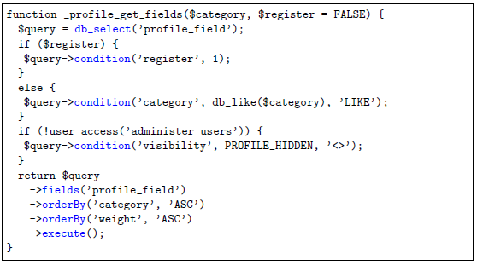
… nowadays, to be complemented with API-based db access (Drupal)

Slide 9
Evolution taxonomy
Schema evolution, itself, can be addressed at
  the conceptual level (req’s, goals, conc. models, …. evolve)
  the logical level, where the main constructs of the database structure evolve
    E.g.,: relations and views in the relational area, classes in the object-oriented database area, or (XML) elements in the XML/semi-structured area),
  the physical level, involving data placement and partitioning, indexing, compression, archiving etc.

Slide 10
Evolution taxonomy: areas
Relational databases
Object Oriented db’s
Conceptual models
XML
Ontologies
…
Special case of relational: data warehouses

Slide 11
… To probe further …
Michael Hartung, James F. Terwilliger, Erhard Rahm:
Recent Advances in Schema and Ontology Evolution. In Schema Matching and Mapping (Zohra Bellahsene, Angela Bonifati, Erhard Rahm), 149-190, Springer 2011, ISBN 978-3-642-16517-7
Matteo Golfarelli, Stefano Rizzi: A Survey on Temporal Data Warehousing. IJDWM 5(1): 1-17 (2009)
Robert Wrembel: A Survey of Managing the Evolution of Data Warehouses. IJDWM 5(2): 24-56 (2009)

Slide 12
Imagine if we could predict how a schema will evolve over time…
… we would be able to “design for evolution” and minimize the impact of evolution to the surrounding applications
  by applying design patterns
  by avoiding anti-patterns & complexity increase
  … in both the db and the code
… we would be able to plan administration and perfective maintenance tasks and resources, instead of responding to emergencies

Slide 13

What are the “laws” of database schema evolution?

Slide 14
Why aren’t we there yet?
Historically, nobody from the research community had access + the right to publish to version histories of database schemata
Open source tools internally hosting databases have changed this landscape &
We are now presented with the opportunity to study the version histories of such “open source databases”
Mind the gap!
(15 years)
Sjoberg
IST 93
Curino+
ICEIS08
Univ. Riverside
IWPSE09, ICDEW11
Qiu,Li,Su
FSE’13
Univ. Ioannina
CAiSE14, ER15
1993
2008
2009
2011
2013
2014
2015
Notes:
Sjoberg @ IST 93: 18 months study of a health system.
139% increase of #tables ; 274% increase of the #attributes
Changes in the code (on avg): (1) relation addition: 19 changes ; attribute additions: 2 changes, (2) relation deletion : 59.5 changes; attribute deletions: 3.25 changes
An inflating period during construction where almost all changes were additions, and a subsequent period where additions and deletions where balanced.
Curino+ @ ICEIS08: Mediawiki for 4.5 years
100% increase in the number of tables
142% in the number of attributes.
45% of changes do not affect the information capacity of the schema (but are rather index adjustments, documentation, etc)
IWPSE09: Mozilla and Monotone (a version control system). Many ways to be out of synch between code and evolving db schema
ICDEW11: Firefox, Monotone , Biblioteq (catalogue man.) , Vienna (RSS).Similar pct of changes with previous work
Frequency and timing analysis: db schemata tend to stabilize over time, as there is more change at the beginning of their history, but seem to converge to a relatively fixed structure later
Qiu,Li,Su@ FSE 2013: 10 (!) database schemata studied.
Change is focused both (a) with respect to time and (b) with respect to the tables who change.
Timing: 7 out of 10 databases reached 60% of their schema size within 20% of their early lifetime.
Change is frequent in the early stages of the databases, with inflationary characteristics; then, the schema evolution process calms down.
Tables that change: 40% of tables do not undergo any change at all, and 60%-90% of changes pertain to 20% of the tables (in other words, 80% of the tables live quiet lives). The most frequently modified tables attract 80% of the changes.
Code and db co-evolution, not always in synch.
Code and db changed in the same revision: 50.67% occasions
Code change was in a previous/subsequent version than the one where the database schema change: 16.22% of occasions
database changes not followed by code adaptation: 21.62% of occasions
11.49% of code changes were unrelated to the database evolution.
Each atomic change at the schema level is estimated to result in 10 -- 100 lines of application code been updated;
A valid db revision results in 100 -- 1000 lines of application code being updated

Slide 15

Our take on the problem
Collected version histories for the schemata of 8 open-source projects
  CMS’s: MediaWiki, TYPO3, Coppermine, phpBB, OpenCart
  Physics: ATLAS Trigger --- Bio: Ensemble, BioSQL
Preprocessed them to be parsable by our HECATE schema comparison tool and exported the transitions between each two subsequent versions and measures for them (size, growth, changes)
Exploratory search where we statistically studied / mined these measures, to extract patterns & regularities for the lives of tables
Web:
http://www.cs.uoi.gr/~pvassil/projects/schemaBiographies/
Data available at:
https://github.com/DAINTINESS-Group/EvolutionDatasets

Slide 16
Scope of the study
FoSS Dataset | Versions | Lifetime | Tables @ Start | Tables @ End
ATLAS Trigger [A] | 84 | 2 Y, 7 M, 2 D | 56 | 73
BioSQL [B] | 46 | 10 Y, 6 M, 19 D | 21 | 28
Coppermine [C] | 117 | 8 Y, 6 M, 2 D | 8 | 22
Ensembl [B] | 528 | 13 Y, 3 M, 15 D | 17 | 75
MediaWiki [C] | 322 | 8 Y, 10 M, 6 D | 17 | 50
OpenCart [C] | 164 | 4 Y, 4 M, 3 D | 46 | 114
phpBB [C] | 133 | 6 Y, 7 M, 10 D | 61 | 65
TYPO3 [C] | 97 | 8 Y, 11 M, 0 D | 10 | 23
Scope:
  databases being part of open-source software (and not proprietary ones)
  long history
  we work only with changes at the logical schema level (and ignore physical-level changes like index creation or change of storage engine)
  We encompass datasets with different domains ([A]: physics, [B]: biomedical, [C]: CMS’s), amount of growth (shade: high, med, low) & schema size
We should be very careful to not overgeneralize findings to proprietary databases or physical schemata!

Slide 17
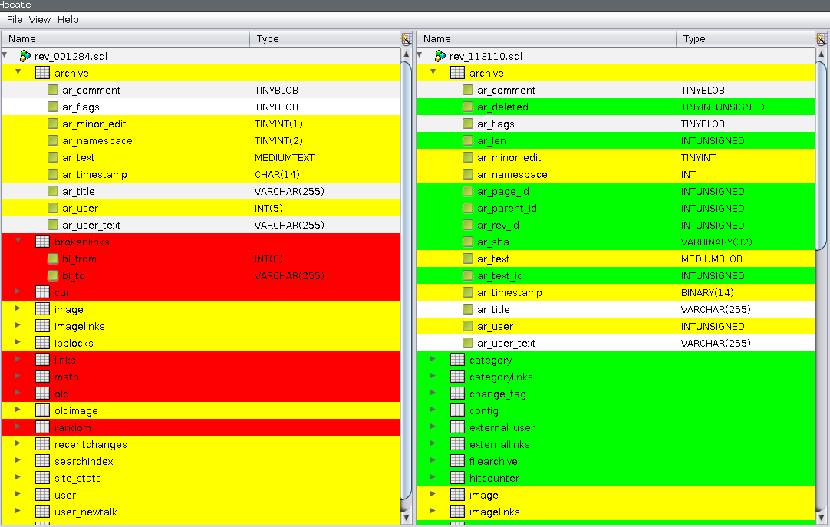
Hecate: SQL schema diff extractor
  https://github.com/DAINTINESS-Group/Hecate

Slide 18
Schema evolution for o/s db’s at the “macro” Level
.. What do we see if we observe the evolution of the entire schema?
http://www.cs.uoi.gr/~pvassil/publications/2014_CAiSE/
Skoulis, Vassiliadis, Zarras. Open-Source Databases: Within, Outside, or Beyond Lehman's Laws of Software Evolution? CAiSE 2014
Growing up with stability: How open-source relational databases evolve. Information Systems, Volume 53, October–November 2015

Slide 19
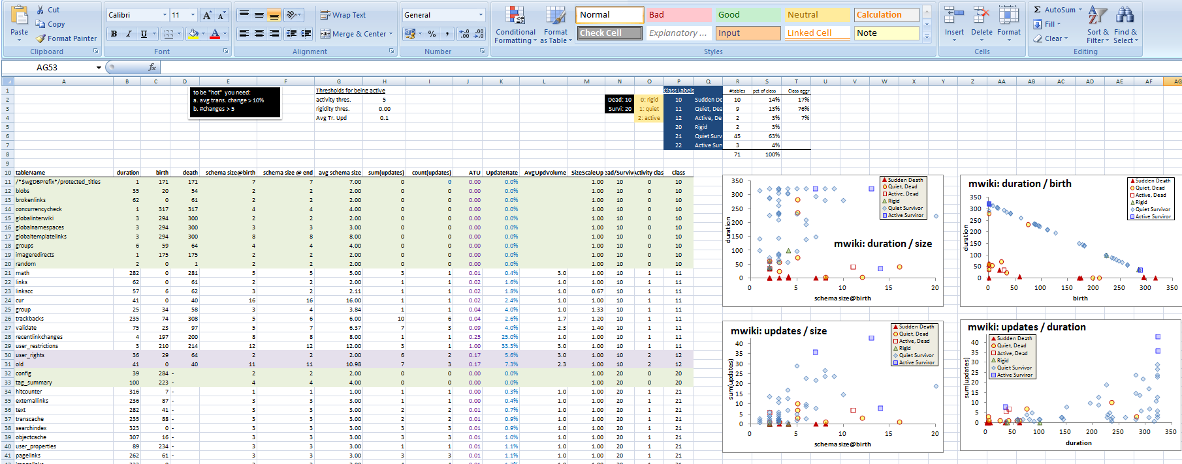
Exploratory search of the schema histories for patterns
Input: schema histories from github/sourceforge/…
Raw material: details and stats on each table’s life, as produced by our diff extractor, for all the 8 datasets
Output: properties & patterns on schema properties (size, growth, changes, …) that occur frequently in our data sets
Highlights
Patterns on size and growth
Compliance to Lehman’s laws

Slide 20
Schema Size (relations)

Slide 21
Schema Size
Overall increase in size
Periods of increase, esp. at beginning and after large drops -> positive feedback
Drops: sudden and steep (in short duration) -> negative feedback
Large periods of stability!
  Unlike traditional S/W, db’s are dependency magnets…

Slide 22
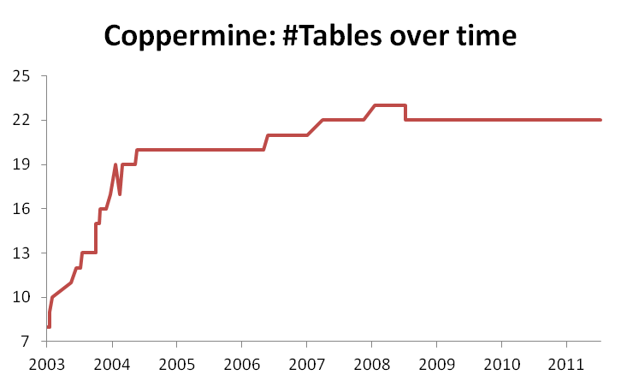
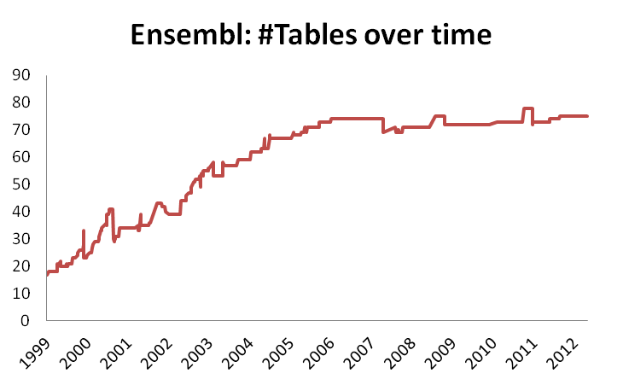
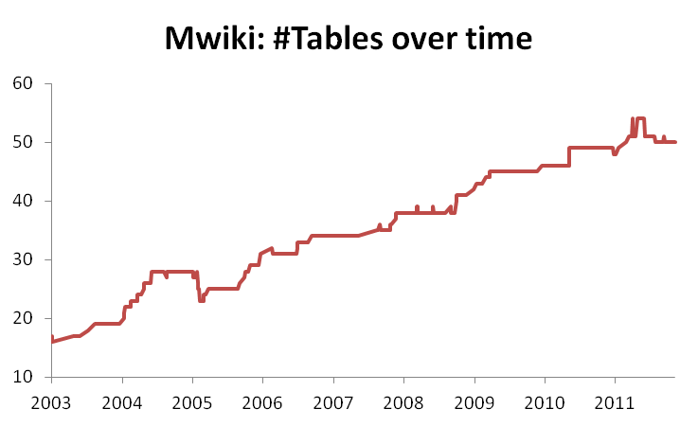
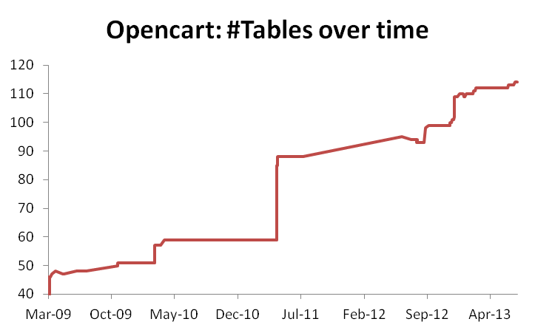

Slide 23
Growth over time
Calmness periods
Increase both slow (mostly) and abrupt
Occasional abrupt drops (maintenance)

Slide 24
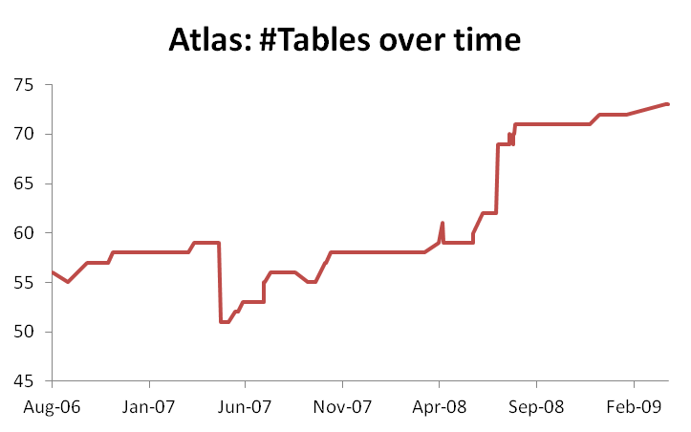
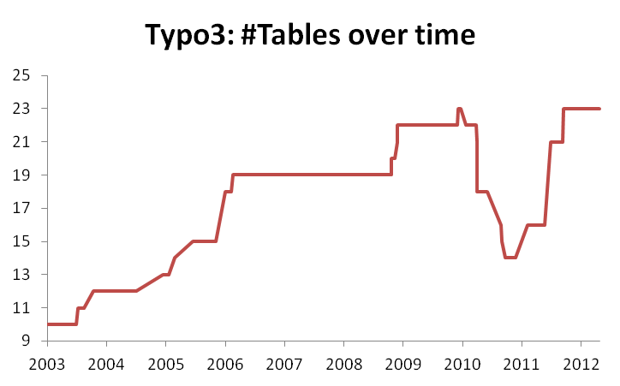
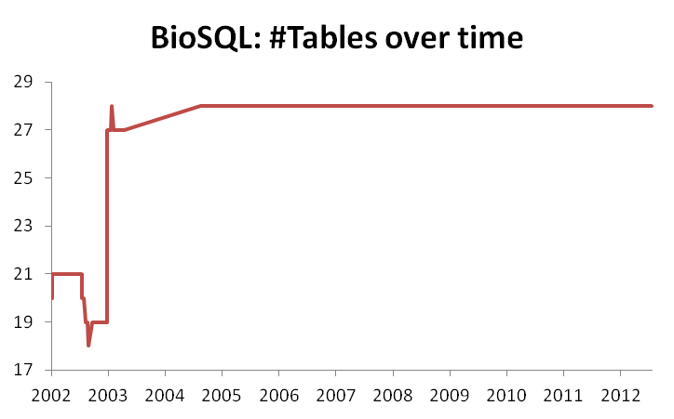
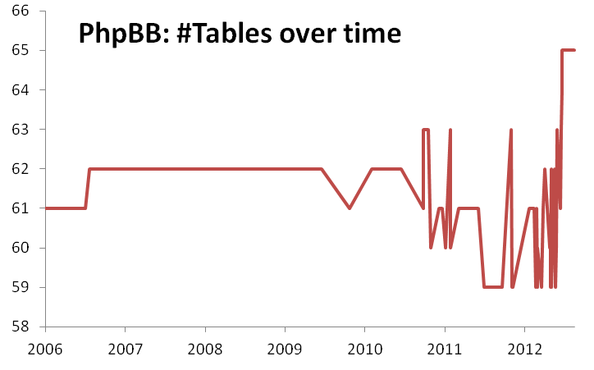

Slide 25
Schema Growth (diff in #tables)

Slide 26
Schema growth is small!
Growth is bounded in small values!
Zipfian distribution of growth values around 0
  Predominantly: occurrences of zero growth; almost all deltas are bounded between [-2..2] tables
  [0..2] tables slightly more popular => average value of growth slightly higher than 0
No periods of continuous change; small spikes instead
Due to perfective maintenance, we also have negative values of growth (less than the positive ones).
Oscillations exist too: positive growth is followed with immediate negative growth or stability

Slide 27
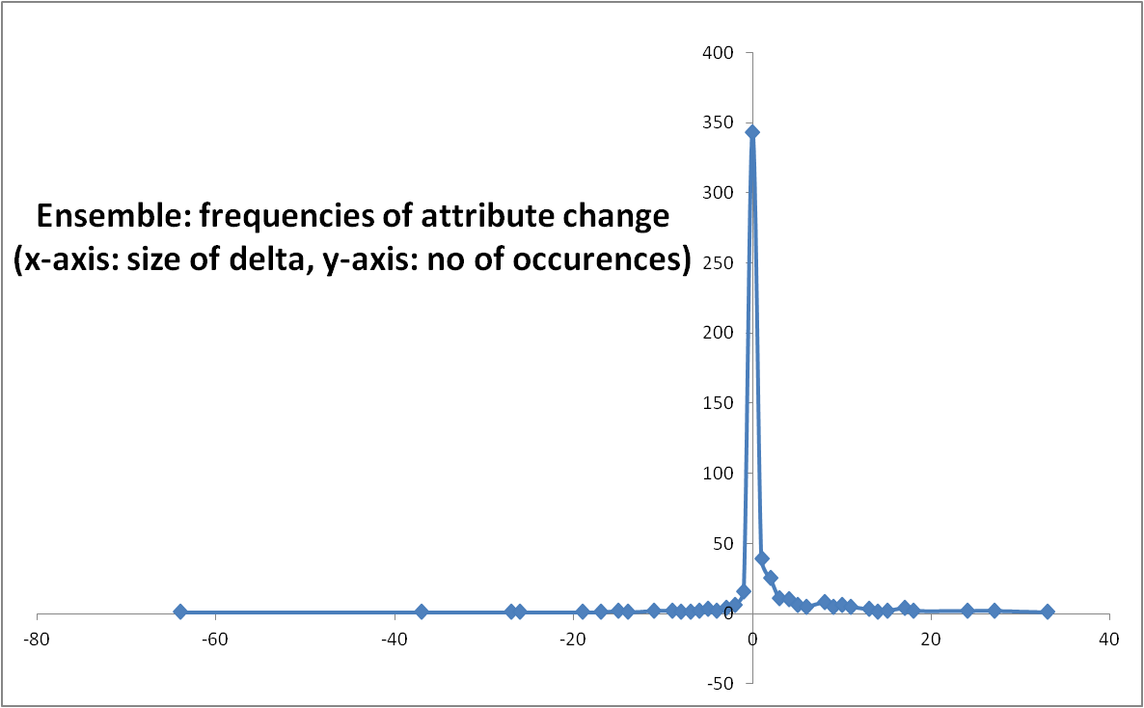
Zipfian model in the distribution of growth frequencies
Growth: delta in the schema size for two subsequent versions

Slide 28
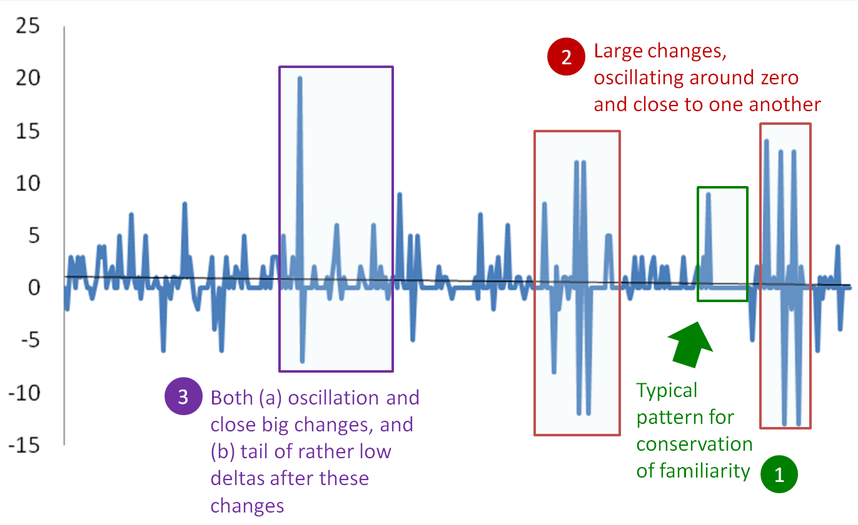
What happens after large changes?

Slide 29
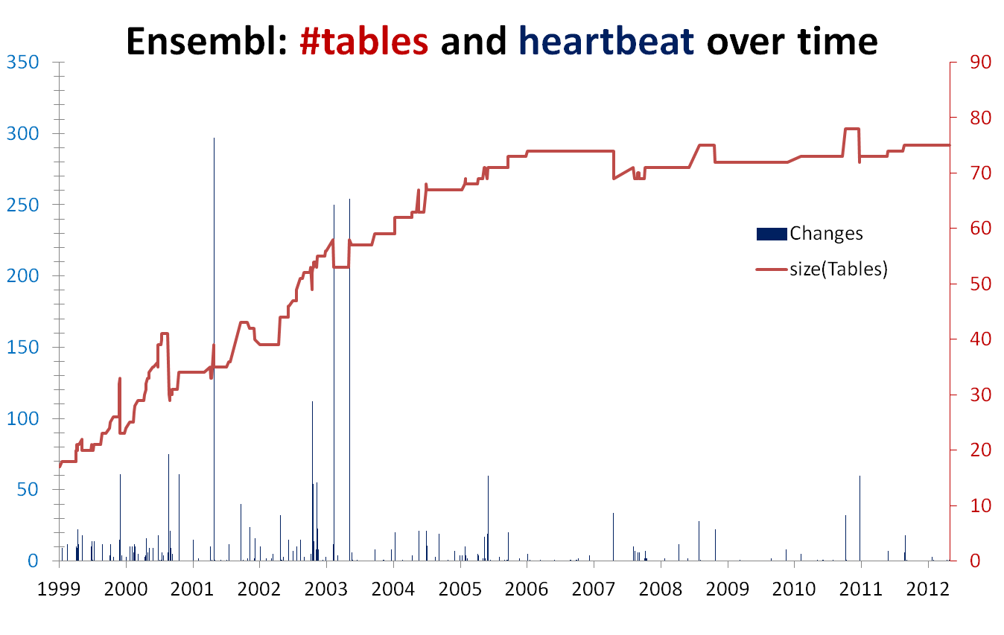
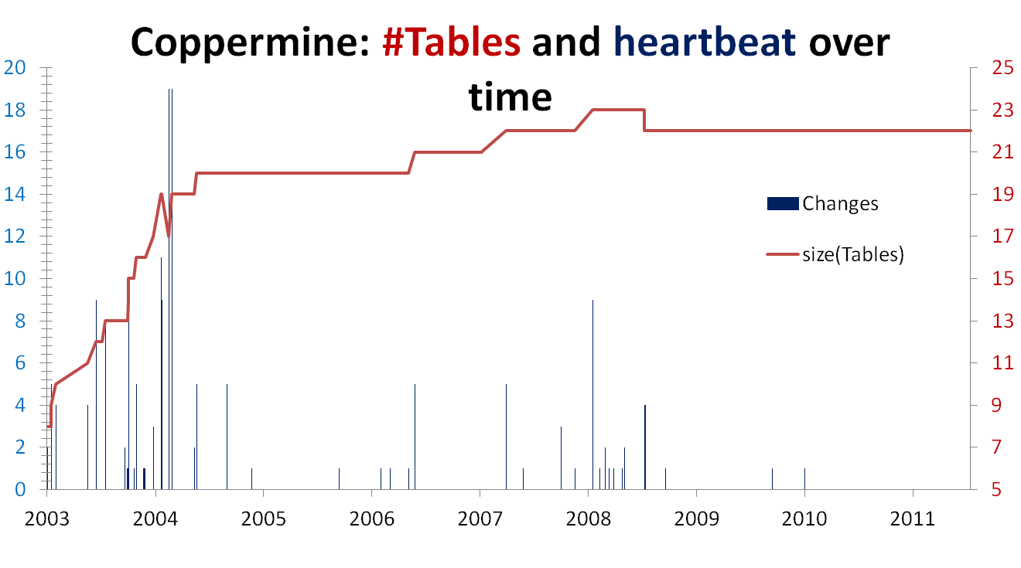
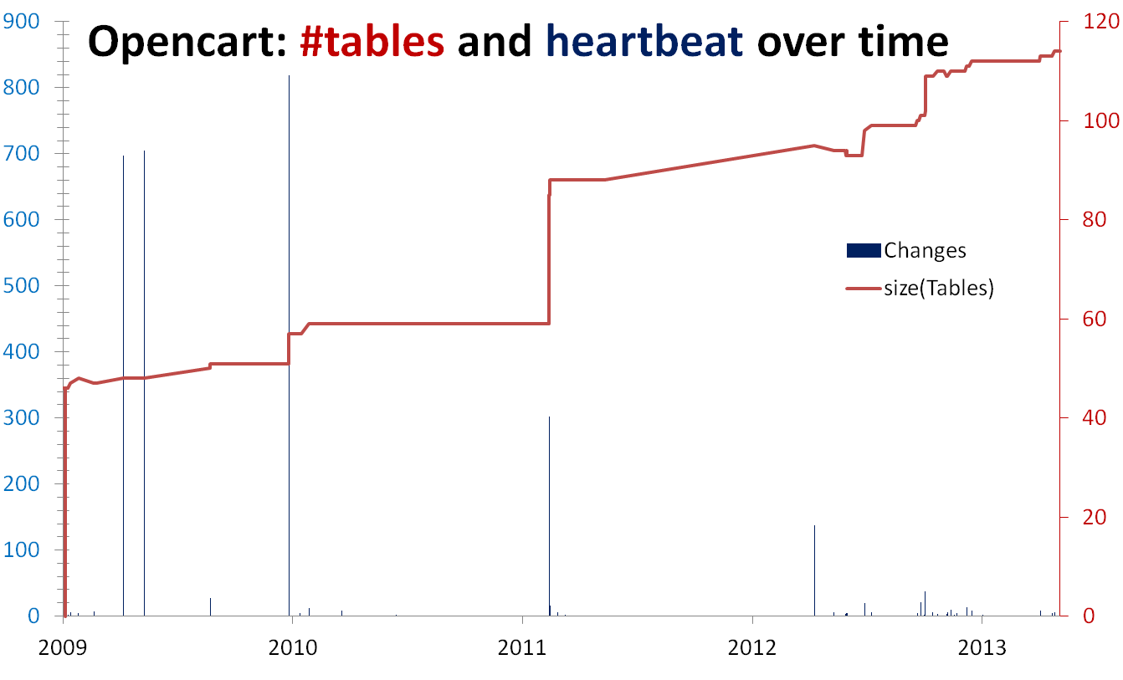
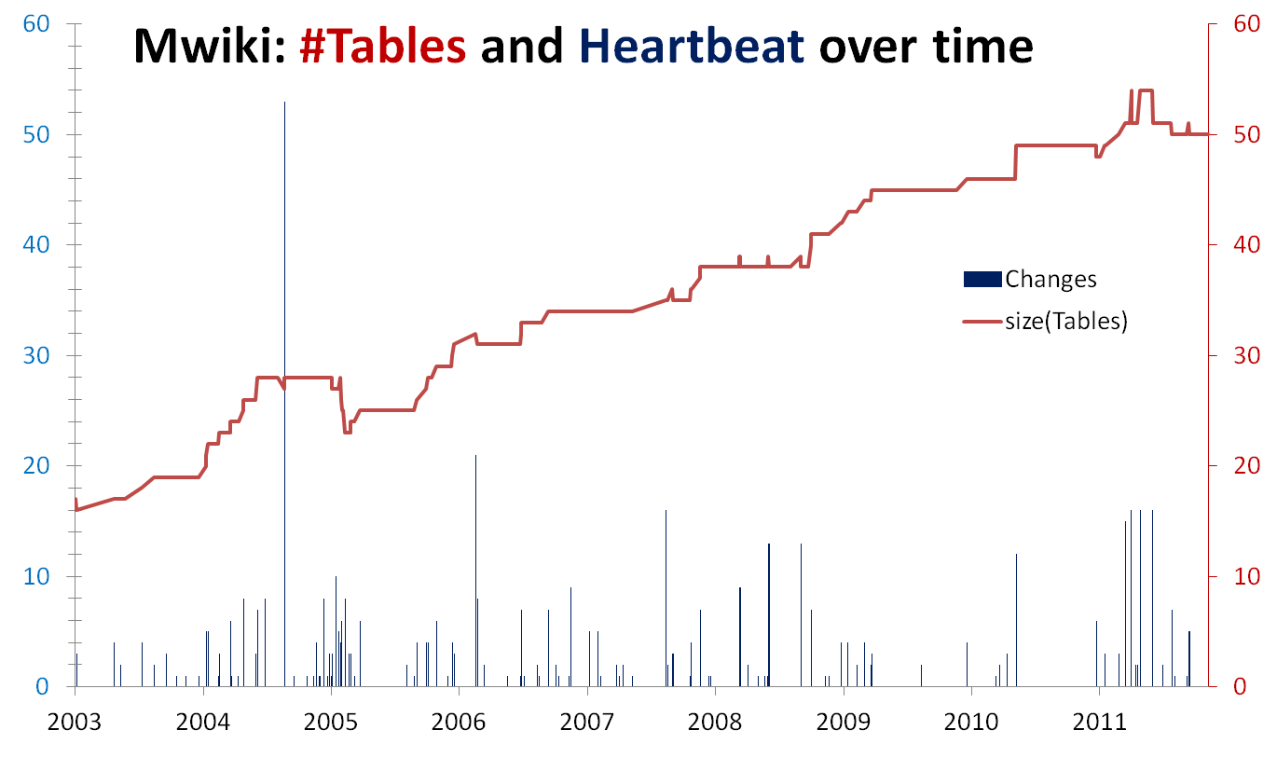
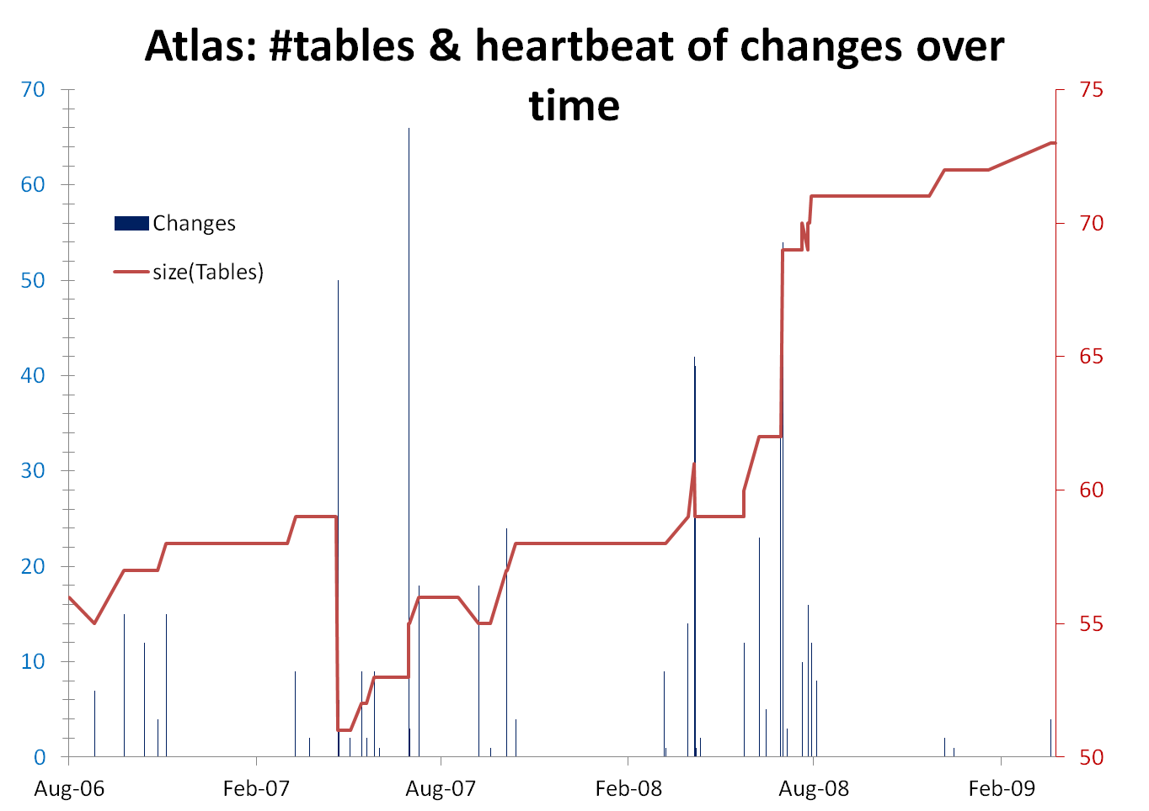
[With exceptions]
Density: focused maintenance effort
Progressive cooling : early –maintenance density >> later stages
Several spikes, many zero-change periods/versions

Slide 30
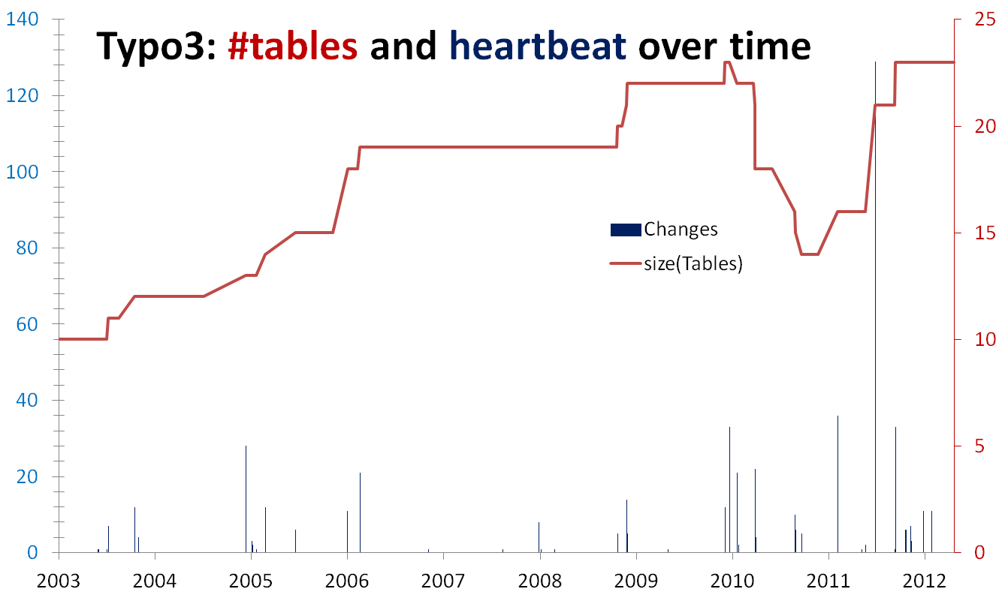
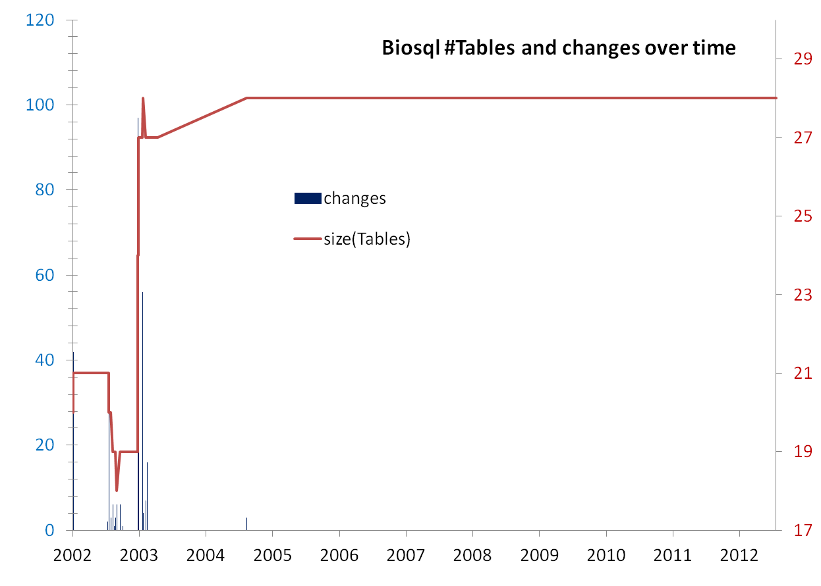
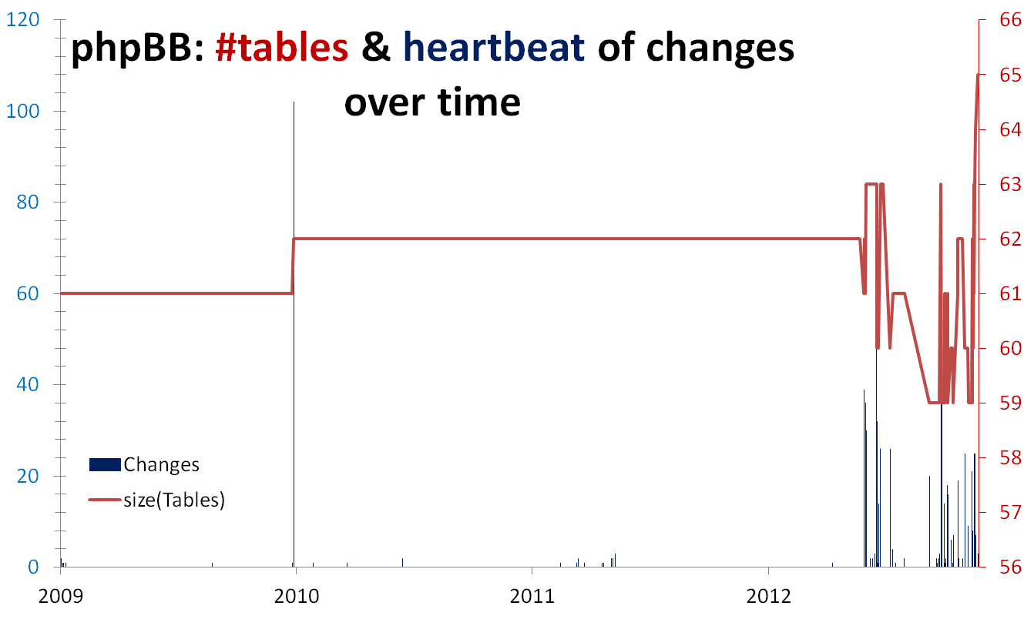
#tables & heartbeat of changes over time

Slide 31

Main results
Schema size (#tables, #attributes) supports the assumption of a feedback mechanism
Schema size grows over time; not continuously, but with bursts of concentrated effort
Drops in schema size signify the existence of perfective maintenance
Regressive formula for size estimation holds, with a quite short memory
Schema Growth (diff in size between subsequent versions) is small!!
Growth is small, smaller than in typical software
The number of changes for each evolution step follows Zipf’s law around zero
Average growth is close (slightly higher) to zero
Patterns of change: no consistently constant behavior
Changes reduce in density as databases age
Change follows three patterns: Stillness, Abrupt change (up or down), Smooth growth upwards
Change frequently follows spike patterns
Complexity does not increase with age
Grey for results requiring further search
Notes:
Divide findings in two categories:
-High Certainty
-need further work (grey)
We avoid the term law – don’t have unshakable evidence of their existence, we don’t have clear understanding of mechanisms

Slide 32
Observing the evolution of o/s db schemata at the micro level
.. What do we see if we observe the evolution of individual tables?
http://www.cs.uoi.gr/~pvassil/publications/2015_ER
P. Vassiliadis, A. Zarras, I. Skoulis. How is Life for a Table in an Evolving Relational Schema? Birth, Death & Everything in Between. ER 2015
Gravitating to rigidity: Patterns of schema evolution – and its absence – in the lives of tables. Accepted in Information Systems.

Slide 33
Exploratory search of the schema histories for patterns
Input: schema histories from github/sourceforge/…
Raw material: details and stats on each table’s life, as produced by our diff extractor, for all the 8 datasets
Output: properties & patterns on table properties (birth, duration, amt of change, …) that occur frequently in our data sets
Highlights
4 patterns of evolution

Slide 34
Schema size, change and duration
Statistical properties for schema size, change and duration of tables
How are these measures interrelated?

Slide 35

The Gamma Pattern:
"if you 're wide, you survive"
The Gamma phenomenon:
  tables with small schema sizes can have arbitrary durations, //small size does not determine duration
  larger size tables last long
Observations:
  whenever a table exceeds the critical value of 10 attributes in its schema, its chances of surviving are high.
  in most cases, the large tables are created early on and are not deleted afterwards.

Slide 36

Exceptions
Biosql: nobody exceeds 10 attributes
Ensembl, mwiki: very few exceed 10 attributes, 3 of them died
typo: has many late born survivors

Slide 37
The Comet Pattern
“Comet “ for change over schema size with:
a large, dense, nucleus cluster close to the beginning of the axes, denoting small size and small amount of change,
medium schema size tables typically demonstrating medium to large change
  The tables with the largest amount of change are typically tables whose schema is on average one standard deviation above the mean
wide tables with large schema sizes demonstrating small to medium (typically around the middle of the y-axis) amount of change.

Slide 38
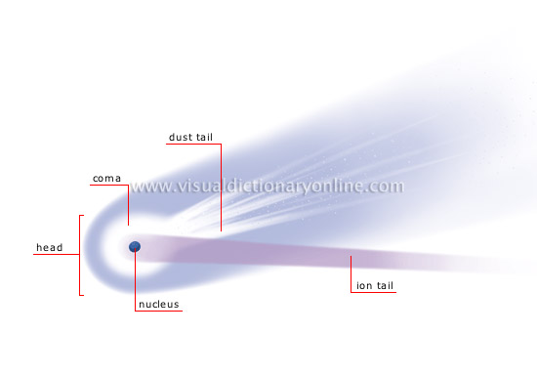
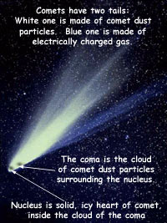
http://visual.merriam-webster.com/astronomy/celestial-bodies/comet.php
http://spaceplace.nasa.gov/comet-nucleus/en/

Slide 39
The inverse Gamma pattern
The correlation of change and duration is as follows:
  small durations come necessarily with small change,
  large durations come with all kinds of change activity and
  medium sized durations come mostly with small change activity (Inverse Gamma).

Slide 40
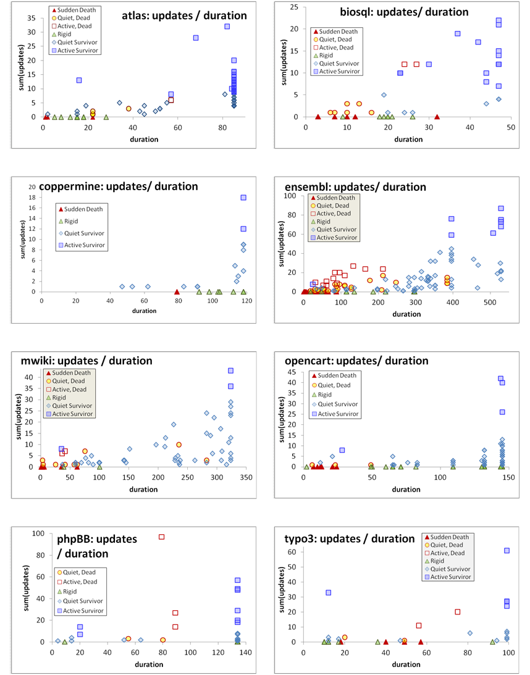

Slide 41
Birthday & schema size & matters of life and death
Who are the top changers?
Who are removed at some point of time?
How do removals take place?

Slide 42
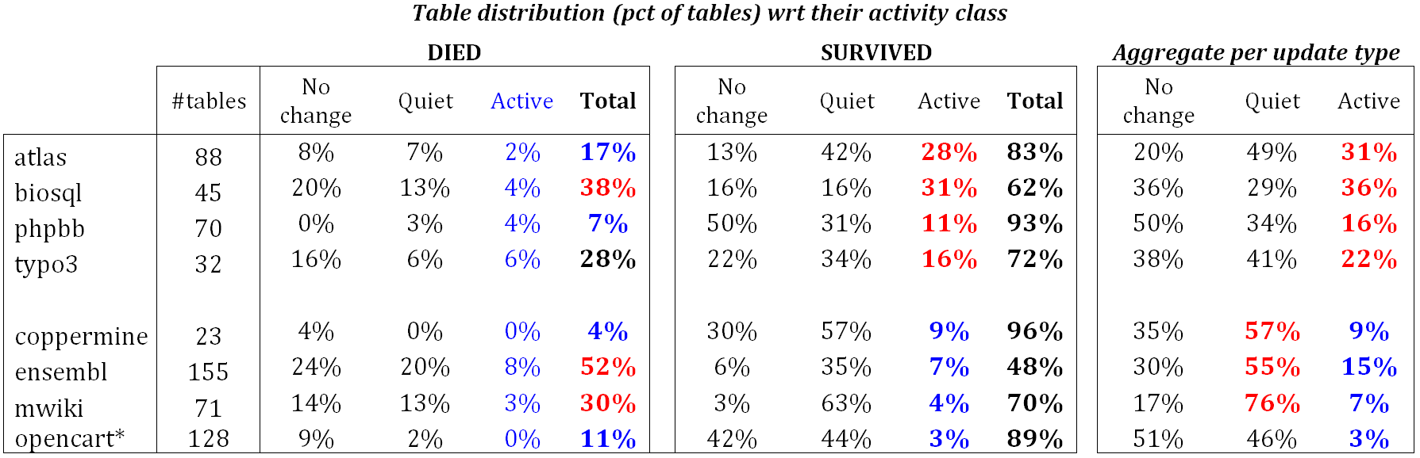
Quiet tables rule, esp. for mature db’s
Non-survivors
Sudden deaths mostly
Quiet come ~ close
Too few active
Survivors
Quiet tables rule
Rigid and active then
Active mostly in “new” db’s
Mature DB’s: the pct of active tables drops significantly

Slide 43
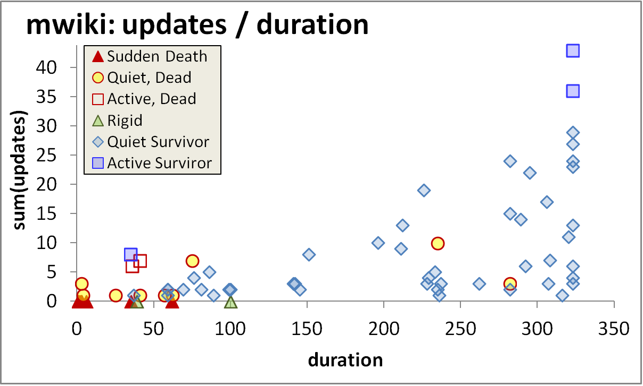
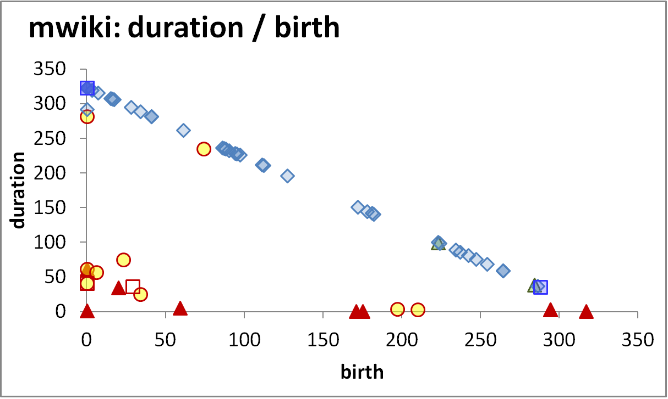
Longevity and update activity correlate !!
Top changers live long
Empty space: high change rates are only for early born & long lived
The few top-changers (in terms of avg trans. update – ATU)
are long lived,
typically come from the early versions of the database
due to the combination of high ATU and duration => they have high total amount of updates, and,
frequently survive!
Too many top changers are born early
Birth rate drops over time
Deleted tables are born early & last short

Slide 44
Die young
and suddenly
Empty space: high change rates are only for early born & long lived
There is a very large concentration of the deleted tables in a small range of newly born, quickly removed, with few or no updates…
…. resulting in very low numbers of removed tables with medium or long durations (empty triangle).
Deleted tables last short & do not change a lot
An empty triangle: no deleted tables with large or even modest durations
Deleted tables are born early & last short

Slide 45
Survive long enough &
you ‘re probably safe
Too rare to see deletions!
It is quite rare to see tables being removed at old age
Typically, the area of high duration is overwhelmingly inhabited by survivors (although each data set comes with a few such cases )!
High durations are overwhelmingly blue!
Only a couple of deletions are seen here!

Slide 46
Die young
and suddenly
[Early life of the db] There is a very large concentration of the deleted tables in a small range of newly born, quickly removed, with few or no updates, resulting in very low numbers of removed tables with medium or long durations.
[Mature db] After the early stages of the databases, we see the birth of tables who eventually get deleted, but they mostly come with very small durations and sudden deaths.
Deleted tables last short & do not change a lot
Few short lived tables are born and die in the mature life of the db
Deleted tables are born early & last short

Slide 47
void

Slide 48
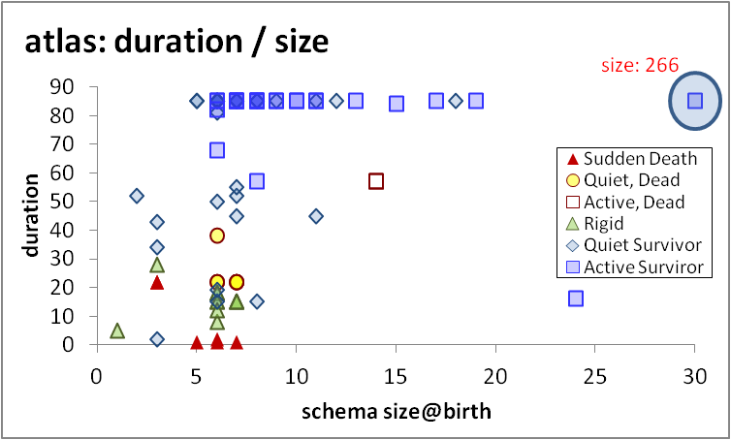
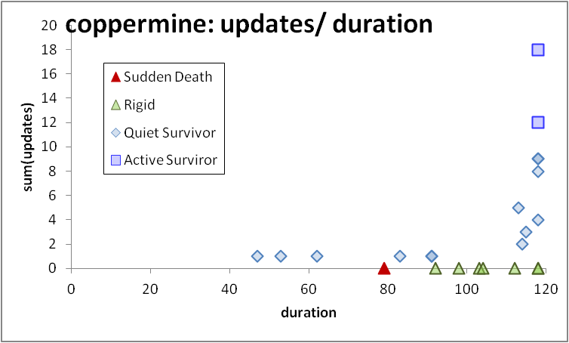
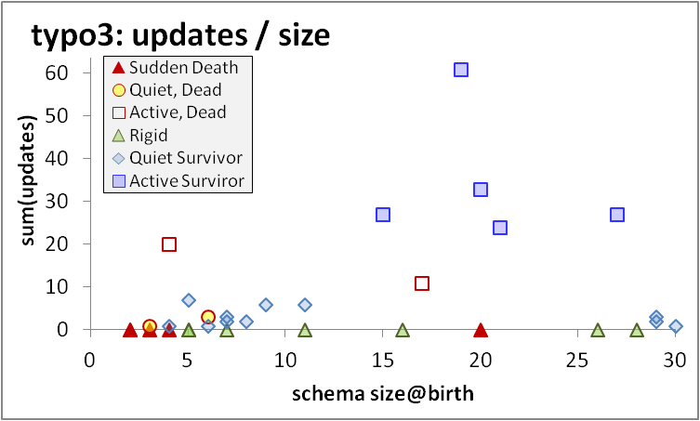
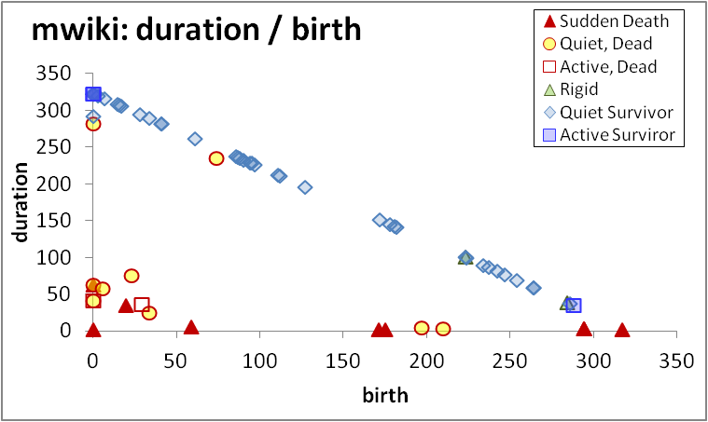
Regularities on table change do exist!
If you’re wide, you survive
Top-changers typically live long, are early born, survive …
… and they are not necessarily the widest ones in terms of schema size
Progressive cooling: most change activity lies at the beginning of the db history
Void triangle: The few dead tables are typically quiet, early born, short lived, and quite often all three of them
void

Slide 49
Open issues
Where we stand
Open issues
… and discussions …

Slide 50
Where we stand
We have a first glimpse of the mechanics of schema evolution for FoSS ecosystems
We have a first understanding of schemata growing, changed in focused periods of maintenance and progressively “cooling” down
We have a first understanding of patterns relating to how tables change, given their size, update behavior, time of birth, …
To probe further (code, data, details, presentations, …)
    http://www.cs.uoi.gr/~pvassil/projects/schemaBiographies/

Slide 51
Are there “laws” of schema evolution?
Collect more test cases
Tools for the automation of the process
  Extract changes & verify their correctness (what happened)
  Link changes to expressed user req’s / bugs / … (why it happened & by whom)
  Extract sub-histories of focused maintenance (how it happened & when)
  Co-change of schema and code (what is affected in the code)
  Visualization
Consolidate the fundamental laws that govern evolution && forecast it (what will change)

Slide 52
Unexplored research territory (risky but possibly rewarding)
Weather Forecast: given the history and the state of a database, predict subsequent events
  Risky: frequently, changes come due to an external, changing world and have “thematic” affinity.
  Big & small steps in many directions needed (more data sets, studies with high internal validity to find causations, more events to capture, …)
Engineer for evolution: To absorb change gracefully we can try to (i) alter db design and DDL; (ii) encapsulate the database via a “stable” API; …

Slide 53
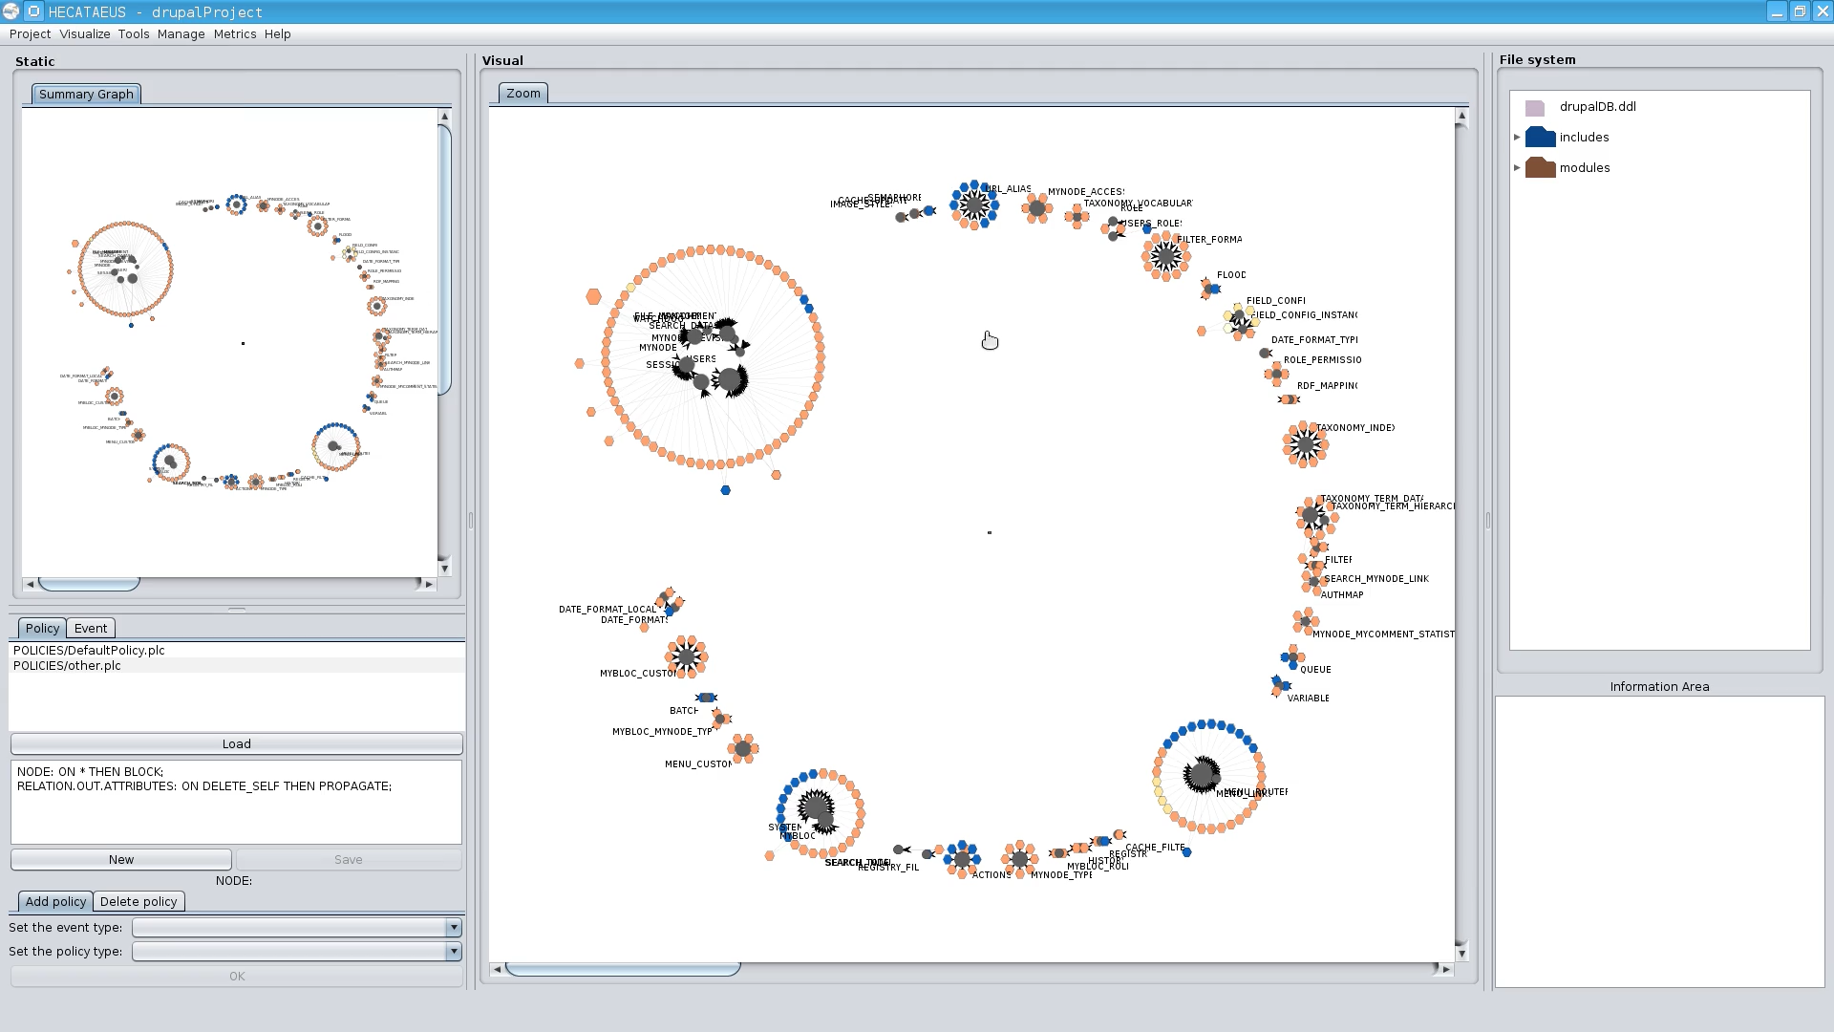
Management of ecosystems’ evolution
Can we find these constructs that are most sensitive to evolution?
  Metrics for sensitivity to evolution?
Automation of the reaction to changes
  self-monitoring
  impact prediction
  auto-regulation (policy determination)
  self-repairing
http://www.cs.uoi.gr/~pvassil/projects/hecataeus/

Slide 54
Take Away Message
Evolution is viciously omnipresent; due to its huge impact, it is leading to non-evolvable (rigid) data & software structures
Practically:
  Plan for evolution, well ahead of construction
  So far, our solutions and tools help only so much
  Industry not likely to help
This is why we can and have to do research
  We can do pure scientific research to find laws
  We can do practical work for tools and methods that reduce the pain

Slide 55
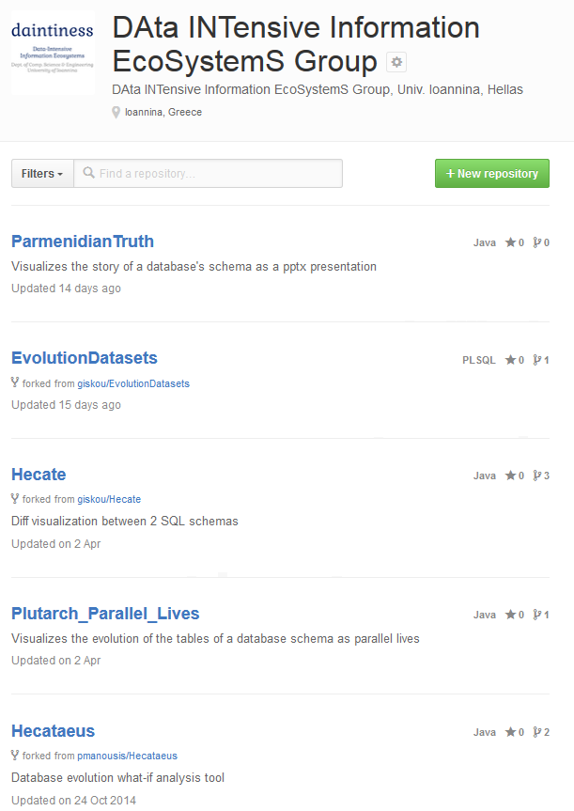
Thank you!
Q&A
https://github.com/DAINTINESS-Group/
    http://www.cs.uoi.gr/~pvassil/
DB Schema Evolution
Papers, Data sets, Code, Results
projects/schemaBiographies/
Architecture Graphs && Hecataeus
projects/hecataeus/

Slide 56
Auxiliary slides

Slide 57
What are the “laws” of database (schema) evolution?
How do databases change?
In particular, how does the schema of a database evolve over time?
Long term research goals:
  Are there any “invariant properties” (e.g., patterns of repeating behavior) on the way database (schemata) change?
  Is there a theory / model to explain them?
  Can we exploit findings to engineer data-intensive ecosystems that withstand change gracefully?

Slide 58
Why care for the “laws”/patterns of schema evolution?
Scientific curiosity!
Practical Impact: DB’s are dependency magnets. Applications have to conform to the structure of the db…
  typically, development waits till the “db backbone” is stable and applications are build on top of it
  slight changes to the structure of a db can cause several (parts of) different applications to crash, causing the need for emergency repairing

Slide 59
… nowadays, to be complemented with API-based db access (Drupal)

Slide 60
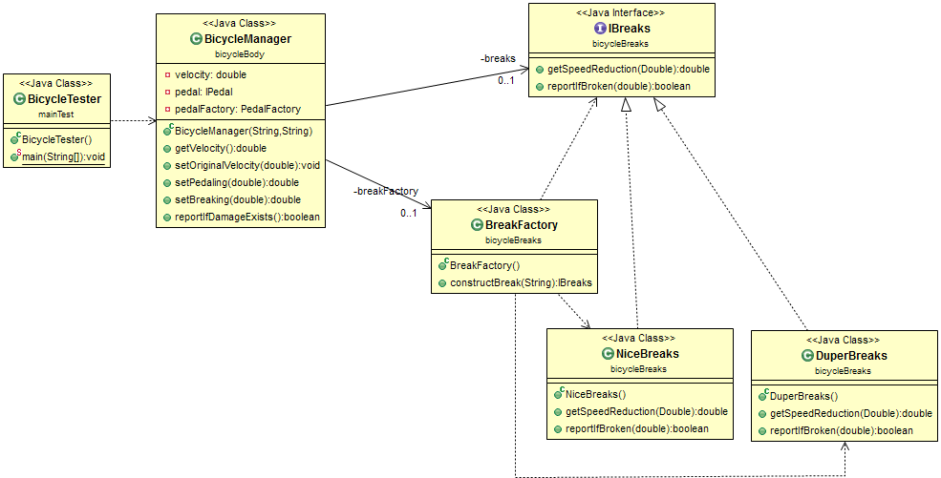
Abstract coupling example from my SW Dev course
Interface as a contract
Specification
≠
Implementation
Factory as a bridge
Client class
Service providers

Slide 61
Datasets
https://github.com/DAINTINESS-Group/EvolutionDatasets
Content management Systems
  MediaWiki, TYPO3, Coppermine, phpBB, OpenCart
Medical Databases
  Ensemble, BioSQL
Scientific
  ATLAS Trigger

Slide 62
Data sets
Dataset | Versions | Lifetime | Tables Start | Tables End | Attributes Start | Attributes End | Commits per Day | % commits with change | Repository URL
ATLAS Trigger | 84 | 2 Y, 7 M, 2 D | 56 | 73 | 709 | 858 | 0,089 | 82% | http://atdaq-sw.cern.ch/cgi-bin/viewcvs-atlas.cgi/offline/Trigger/TrigConfiguration/TrigDb/share/sql/combined_schema.sql
BioSQL | 46 | 10 Y, 6 M, 19 D | 21 | 28 | 74 | 129 | 0,012 | 63% | https://github.com/biosql/biosql/blob/master/sql/biosqldb-mysql.sql
Coppermine | 117 | 8 Y, 6 M, 2 D | 8 | 22 | 87 | 169 | 0,038 | 50% | http://sourceforge.net/p/coppermine/code/8581/tree/trunk/cpg1.5.x/sql/schema.sql
Ensembl | 528 | 13 Y, 3 M, 15 D | 17 | 75 | 75 | 486 | 0,109 | 60% | http://cvs.sanger.ac.uk/cgi-bin/viewvc.cgi/ensembl/sql/table.sql?root=ensembl&view=log
MediaWiki | 322 | 8 Y, 10 M, 6 D | 17 | 50 | 100 | 318 | 0,100 | 59% | https://svn.wikimedia.org/viewvc/mediawiki/trunk/phase3/maintenance/tables.sql?view=log
OpenCart | 164 | 4 Y, 4 M, 3 D | 46 | 114 | 292 | 731 | 0,104 | 47% | https://github.com/opencart/opencart/blob/master/upload/install/opencart.sql
phpBB | 133 | 6 Y, 7 M, 10 D | 61 | 65 | 611 | 565 | 0,055 | 82% | https://github.com/phpbb/phpbb3/blob/develop/phpBB/install/schemas/mysql_41_schema.sql
TYPO3 | 97 | 8 Y, 11 M, 0 D | 10 | 23 | 122 | 414 | 0,030 | 76% | https://git.typo3.org/Packages/TYPO3.CMS.git/history/TYPO3_6-0:/t3lib/stddb/tables.sql

Slide 63
Hecate: SQL schema diff extractor
Parses DDL files
Creates a model for the parsed SQL elements
Compares two versions of the same schema
Reports on the diff performed with a variety of metrics
Exports the transitions that occurred in XML format
  https://github.com/DAINTINESS-Group/Hecate

Slide 64
void
To probe further (code, data, details, presentations, …)
    http://www.cs.uoi.gr/~pvassil/publications/2015_ER/

Slide 65
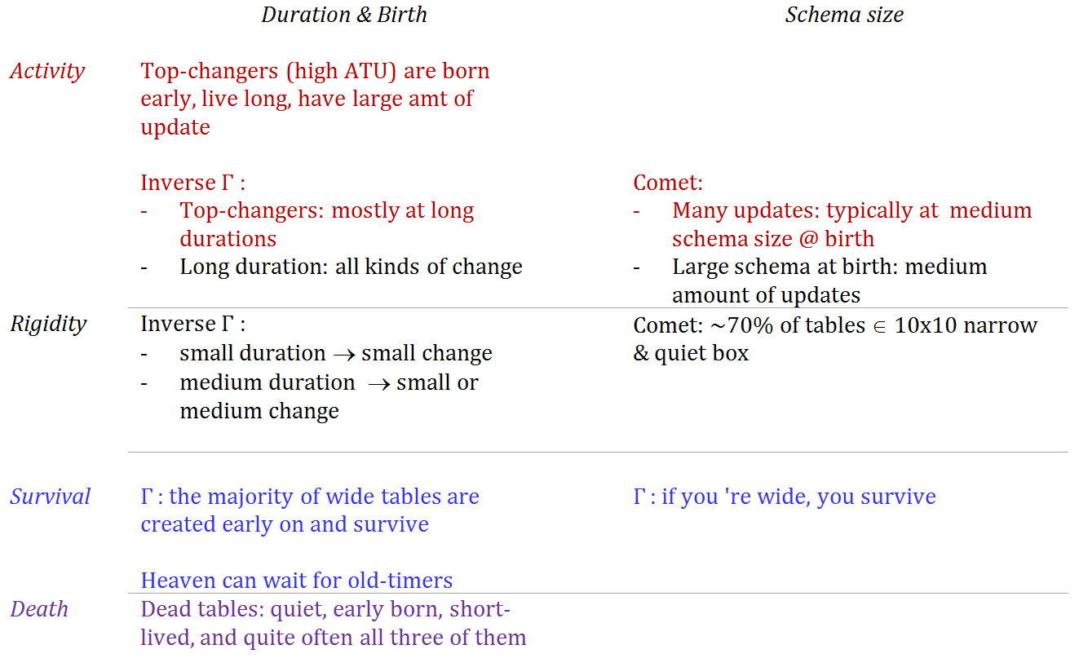

Slide 66
Scope of the study && Validity considerations

Slide 67
Data sets
Dataset | Versions | Lifetime | Tables Start | Tables End | Attributes Start | Attributes End | Commits per Day | % commits with change | Repository URL
ATLAS Trigger | 84 | 2 Y, 7 M, 2 D | 56 | 73 | 709 | 858 | 0,089 | 82% | http://atdaq-sw.cern.ch/cgi-bin/viewcvs-atlas.cgi/offline/Trigger/TrigConfiguration/TrigDb/share/sql/combined_schema.sql
BioSQL | 46 | 10 Y, 6 M, 19 D | 21 | 28 | 74 | 129 | 0,012 | 63% | https://github.com/biosql/biosql/blob/master/sql/biosqldb-mysql.sql
Coppermine | 117 | 8 Y, 6 M, 2 D | 8 | 22 | 87 | 169 | 0,038 | 50% | http://sourceforge.net/p/coppermine/code/8581/tree/trunk/cpg1.5.x/sql/schema.sql
Ensembl | 528 | 13 Y, 3 M, 15 D | 17 | 75 | 75 | 486 | 0,109 | 60% | http://cvs.sanger.ac.uk/cgi-bin/viewvc.cgi/ensembl/sql/table.sql?root=ensembl&view=log
MediaWiki | 322 | 8 Y, 10 M, 6 D | 17 | 50 | 100 | 318 | 0,100 | 59% | https://svn.wikimedia.org/viewvc/mediawiki/trunk/phase3/maintenance/tables.sql?view=log
OpenCart | 164 | 4 Y, 4 M, 3 D | 46 | 114 | 292 | 731 | 0,104 | 47% | https://github.com/opencart/opencart/blob/master/upload/install/opencart.sql
phpBB | 133 | 6 Y, 7 M, 10 D | 61 | 65 | 611 | 565 | 0,055 | 82% | https://github.com/phpbb/phpbb3/blob/develop/phpBB/install/schemas/mysql_41_schema.sql
TYPO3 | 97 | 8 Y, 11 M, 0 D | 10 | 23 | 122 | 414 | 0,030 | 76% | https://git.typo3.org/Packages/TYPO3.CMS.git/history/TYPO3_6-0:/t3lib/stddb/tables.sql

Slide 68
Scope of the study
FoSS Dataset | Versions | Lifetime | Tables @ Start | Tables @ End
ATLAS Trigger [A] | 84 | 2 Y, 7 M, 2 D | 56 | 73
BioSQL [B] | 46 | 10 Y, 6 M, 19 D | 21 | 28
Coppermine [C] | 117 | 8 Y, 6 M, 2 D | 8 | 22
Ensembl [B] | 528 | 13 Y, 3 M, 15 D | 17 | 75
MediaWiki [C] | 322 | 8 Y, 10 M, 6 D | 17 | 50
OpenCart [C] | 164 | 4 Y, 4 M, 3 D | 46 | 114
phpBB [C] | 133 | 6 Y, 7 M, 10 D | 61 | 65
TYPO3 [C] | 97 | 8 Y, 11 M, 0 D | 10 | 23
Scope:
  databases being part of open-source software (and not proprietary ones)
  long history
  we work only with changes at the logical schema level (and ignore physical-level changes like index creation or change of storage engine)
  We encompass datasets with different domains ([A]: physics, [B]: biomedical, [C]: CMS’s), amount of growth (shade: high, med, low) & schema size
We should be very careful to not overgeneralize findings to proprietary databases or physical schemata!

Slide 69
External validity
Can we generalize out findings broadly?
We perform an exploratory study to observe frequently occurring phenomena within the scope of the aforementioned population
Are our data sets representative enough? Is it possible that the observed behaviors are caused by sui-generis characteristics of the studied data sets?
  Yes: we believe we have a good population definition & we abide by it
  Yes: we believe we have a large number of databases, from a variety of domains with different profiles, that seem to give fairly consistent answers to our research questions (behavior deviations are mostly related to the maturity of the database and not to its application area).
  Yes: we believe we have a good data extraction and measurement process without interference / selection / … of the input from our part
  Maybe: unclear when the number of studied databases is large enough to declare the general application of a pattern as “universal”.

Slide 70
External validity
Can we generalize out findings broadly?
Understanding the represented population
  Precision: all our data sets belong to the specified population
  Definition Completeness: no missing property that we knowledgably omit to report
  FoSS has an inherent way of maintenance and evolution
Representativeness of selected datasets
  Data sets come from 3 categories of FoSS (CMS / Biomedical / Physics)
  They have different size and growth volumes
  Results are fairly consistent both in our ER’15 and our CAiSE’14 papers
Treatment of data
  We have tested our “Delta Extractor”, Hecate, to parse the input correctly & adapted it during its development; the parser is not a full-blown SQL parser, but robust to ignore parts unknown to it
  A handful of cases where adapted in the Coppermine to avoid overcomplicating the parser; not a serious threat to validity ; other than that we have not interfered with the input
  Fully automated counting for the measures via Hecate

Slide 71
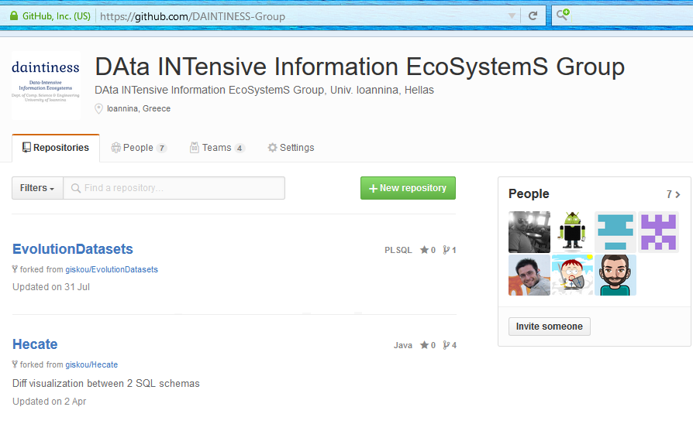
Most importantly: we are happy to invite you to reuse /test /assess /disprove /… all our code, data and results!
To probe further (code, data, results, …)
    http://www.cs.uoi.gr/~pvassil/publications/2015_ER/
    https://github.com/DAINTINESS-Group

Slide 72
Internal validity
Can we confirm statements A=>B? No!
Are there any spurious relationships? Maybe!
Internal validity concerns the accuracy of cause-effect statements: “change in A => change in B”
We are very careful to avoid making strong causation statements!
  In some places, we just hint that we suspect the causes for a particular phenomenon, in some places in the text, but we have no data, yet, to verify our gut-feeling.
  And yes, it is quite possible that our correlations hide cofounding variables.

Slide 73
Is there a theory?
Our study should be regarded as a pattern observer, rather than as a collection of laws, coming with their internal mechanics and architecture.
It will take too many studies (to enlarge the representativeness even more) and more controlled experiments (in-depth excavation of cause-effect relationships) to produce a solid theory.
It would be highly desirable if a clear set of requirements on the population definition, the breadth of study and the experimental protocol could be solidified by the scientific community (like e.g., the TREC benchmarks)
… and of course, there might be other suggestions on how to proceed…

Slide 74
Related work

Slide 75
Timeline of empirical studies
Sjoberg
IST 93
Curino+
ICEIS08
Univ. Riverside
IWPSE09, ICDEW11
Qiu,Li,Su
FSE’13
Univ. Ioannina
CAiSE14, ER15
1993
2008
2009
2011
2013
2014
2015

Slide 76
Timeline of empirical studies
Sjoberg @ IST 93: 18 months study of a health system.
139% increase of #tables ; 274% increase of the #attributes
Changes in the code (on avg):
    relation addition: 19 changes ; attribute additions: 2 changes
    relation deletion : 59.5 changes; attribute deletions: 3.25 changes
An inflating period during construction where almost all changes were additions, and a subsequent period where additions and deletions where balanced.
Sjoberg
IST 93
Curino+
ICEIS08
Univ. Riverside
IWPSE09, ICDEW11
Qiu,Li,Su
FSE’13
Univ. Ioannina
CAiSE14, ER15
1993
2008
2009
2011
2013
2014
2015

Slide 77
Timeline of empirical studies
Curino+ @ ICEIS08: Mediawiki for 4.5 years
100% increase in the number of tables
142% in the number of attributes.
45% of changes do not affect the information capacity of the schema (but are rather index adjustments, documentation, etc)
Sjoberg
IST 93
Curino+
ICEIS08
Univ. Riverside
IWPSE09, ICDEW11
Qiu,Li,Su
FSE’13
Univ. Ioannina
CAiSE14, ER15
1993
2008
2009
2011
2013
2014
2015

Slide 78
Timeline of empirical studies
IWPSE09: Mozilla and Monotone (a version control system)
Many ways to be out of synch between code and evolving db schema
ICDEW11: Firefox, Monotone , Biblioteq (catalogue man.) , Vienna (RSS)
Similar pct of changes with previous work
Frequency and timing analysis: db schemata tend to stabilize over time, as there is more change at the beginning of their history, but seem to converge to a relatively fixed structure later
Sjoberg
IST 93
Curino+
ICEIS08
Univ. Riverside
IWPSE09, ICDEW11
Qiu,Li,Su
FSE’13
Univ. Ioannina
CAiSE14, ER15
1993
2008
2009
2011
2013
2014
2015

Slide 79
Timeline of empirical studies
Qiu,Li,Su@ FSE 2013: 10 (!) database schemata studied.
Change is focused both (a) with respect to time and (b) with respect to the tables who change.
Timing: 7 out of 10 databases reached 60% of their schema size within 20% of their early lifetime.
Change is frequent in the early stages of the databases, with inflationary characteristics; then, the schema evolution process calms down.
Tables that change: 40% of tables do not undergo any change at all, and 60%-90% of changes pertain to 20% of the tables (in other words, 80% of the tables live quiet lives). The most frequently modified tables attract 80% of the changes.
Sjoberg
IST 93
Curino+
ICEIS08
Univ. Riverside
IWPSE09, ICDEW11
Qiu,Li,Su
FSE’13
Univ. Ioannina
CAiSE14, ER15
1993
2008
2009
2011
2013
2014
2015

Slide 80
Timeline of empirical studies
Qiu,Li,Su@ FSE 2013: Code and db co-evolution, not always in synch.
Code and db changed in the same revision: 50.67% occasions
Code change was in a previous/subsequent version than the one where the database schema change: 16.22% of occasions
database changes not followed by code adaptation: 21.62% of occasions
11.49% of code changes were unrelated to the database evolution.
Each atomic change at the schema level is estimated to result in 10 -- 100 lines of application code been updated;
A valid db revision results in 100 -- 1000 lines of application code being updated
Sjoberg
IST 93
Curino+
ICEIS08
Univ. Riverside
IWPSE09, ICDEW11
Qiu,Li,Su
FSE’13
Univ. Ioannina
CAiSE14, ER15
1993
2008
2009
2011
2013
2014
2015

Slide 81
Timeline of empirical studies
CAiSE14: DB level
ER’15: Table level
Sjoberg
IST 93
Curino+
ICEIS08
Univ. Riverside
IWPSE09, ICDEW11
Qiu,Li,Su
FSE’13
Univ. Ioannina
CAiSE14, ER15
1993
2008
2009
2011
2013
2014
2015

Slide 82
stats

Slide 83
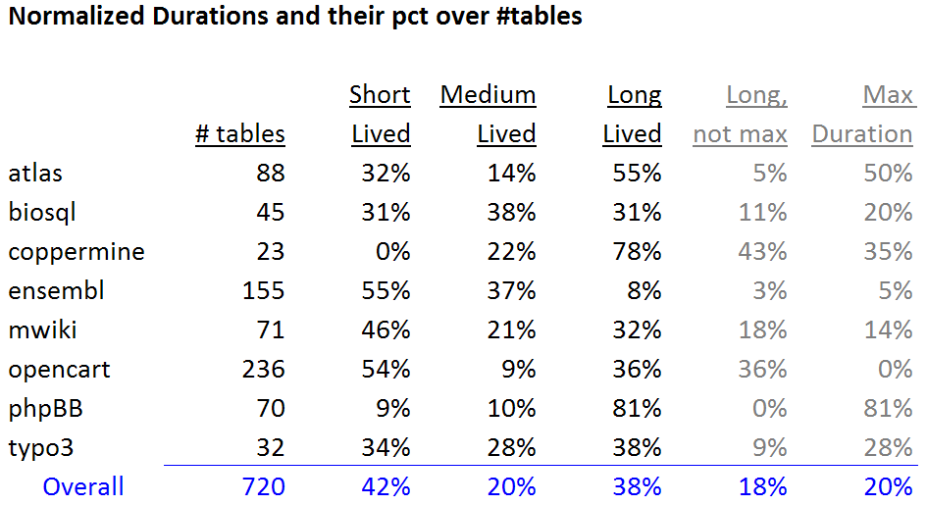
Statistical study of durations
Short and long lived tables are practically equally proportioned
Medium size durations are fewer than the rest!
Long lived tables are surprisingly too many
  in half the data sets they are the most populated group
  in all but one data set they exceed 30%
Way too many long-lived tables live throughout the entire lifespan (Max Duration) of the database

Slide 84
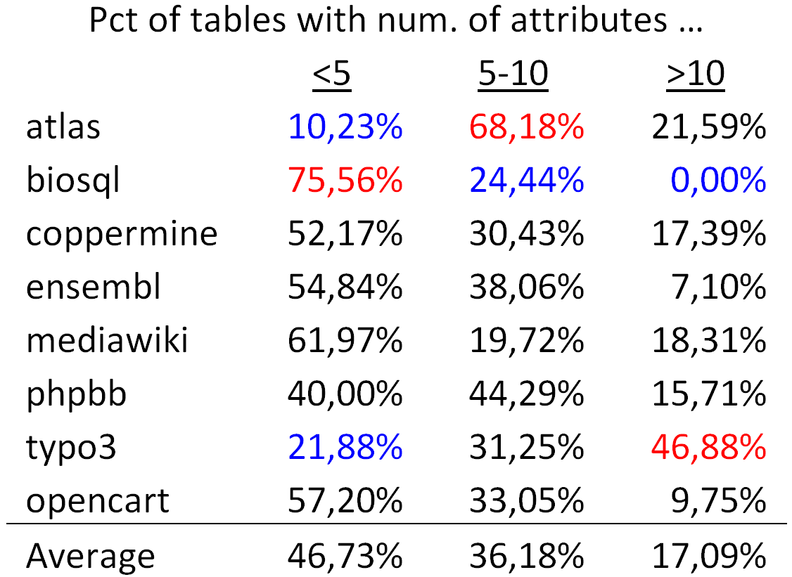
Tables are mostly thin
On average, half of the tables (approx. 47%) are thin tables with less than 5 attributes.
The tables with 5 to 10 attributes are approximately one third of the tables' population
The large tables with more than 10 attributes are approximately 17% of the tables.

Slide 85
The four patterns

Slide 86
The Gamma Pattern
Schema size @ birth / duration
If you ‘re wide, you survive
a.k.a (only the thin die young, all the wide ones seem to live forever)

Slide 87
Exceptions
Biosql: nobody exceeds 10 attributes
Ensembl, mwiki: very few exceed 10 attributes, 3 of them died
typo: has many late born survivors

Slide 88
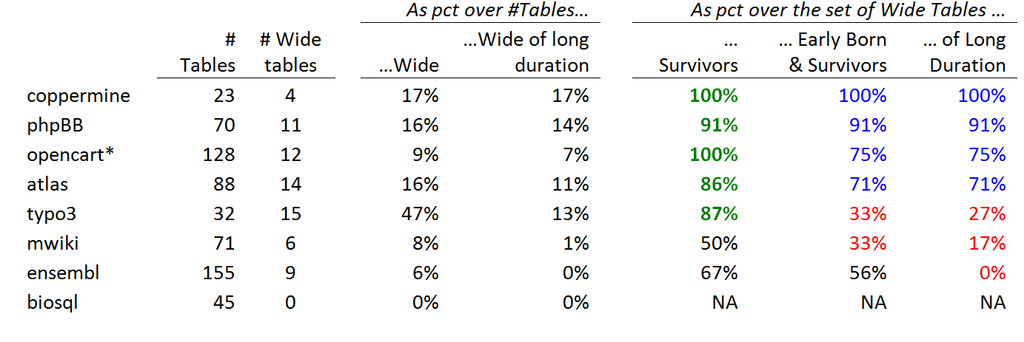
Stats on wide tables and their survival
Definitions:
Wide schema: strictly above 10 attributes.
The top band of durations (the upper part of the Gamma shape): the upper 10% of the values in the y-axis.
Early born table: ts birth version is in the lowest 33% of versions;
Late-comers: born after the 77% of the number of versions.

Slide 89
Whenever a table is wide, its chances of surviving are high
Apart from mwiki and ensembl, all the rest of the data sets confirm the hypothesis with a percentage higher than 85%. The two exceptions are as high as 50% for their support to the hypothesis.

Slide 90
Wide tables are frequently created early on and are not deleted afterwards
Early born, wide, survivor tables (as a percentage over the set of wide tables).
in half the data sets the percentage is above 70%
in two of them the percentage of these tables is one third of the wide tables.

Slide 91
Whenever a table is wide, its duration frequently lies within the top-band of durations (upper part of Gamma)
What is probability that a wide table belongs to the upper part of the Gamma?
there is a very strong correlation between the two last columns: the Pearson correlation is 88% overall; 100% for the datasets with high pct of early born wide tables.
Bipolarity on this pattern: half the cases support the pattern with support higher than 70%, whereas the rest of the cases clearly disprove it, with very low support values.

Slide 92
Long-lived & wide => early born and survivor
Subset
relationship
In all data sets, if a wide table has a long duration within the upper part of the Gamma, this deterministically (100% of all data sets) signifies that the table was also early born and survivor.
If a wide table is in the top of the Gamma line, it is deterministically an early born survivor.

Slide 93
The Comet Pattern
Schema size and updates

Slide 94
http://visual.merriam-webster.com/astronomy/celestial-bodies/comet.php
http://spaceplace.nasa.gov/comet-nucleus/en/

Slide 95
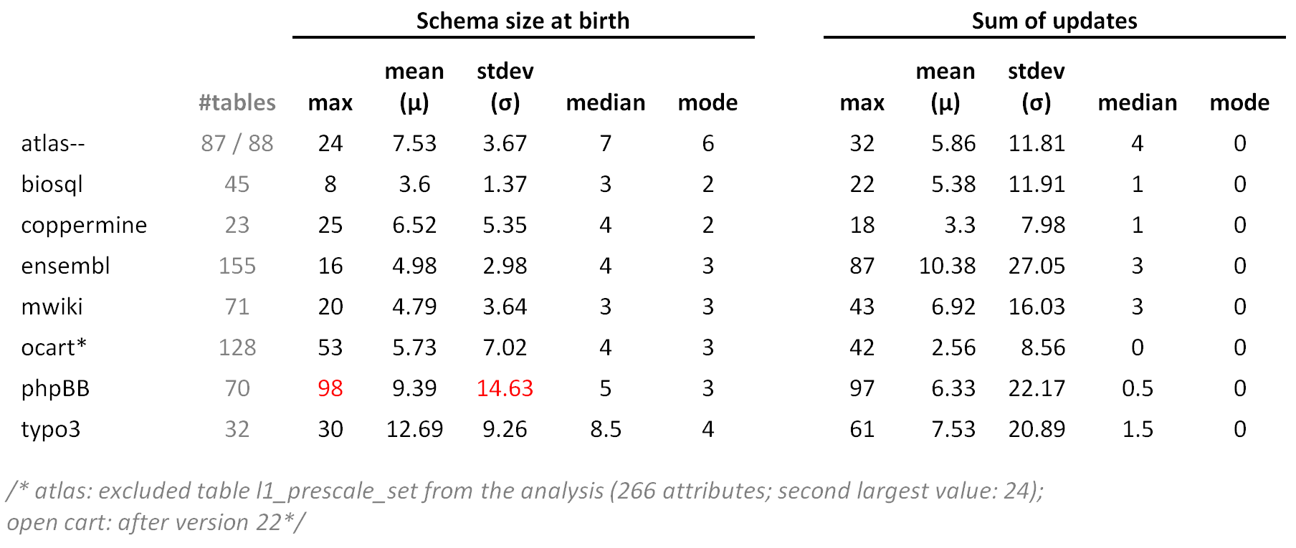
Statistics of schema size at birth and sum of updates

Slide 96
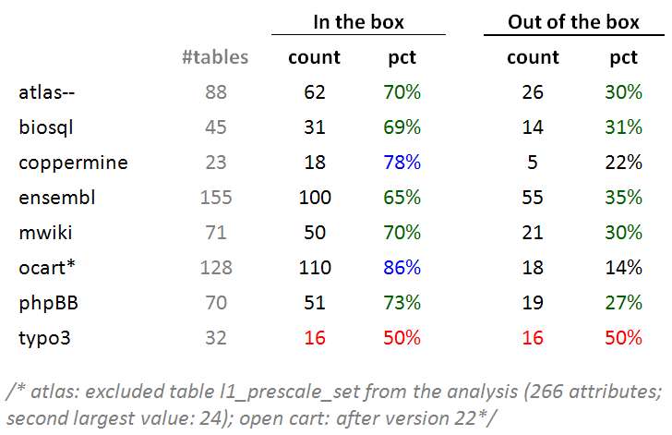
Typically: ~70% of tables inside the box
Typically, around 70% of the tables of a database is found within the 10x10 box of schemaSize@birth x sumOfUpdates (10 excluded in both axes).

Slide 97
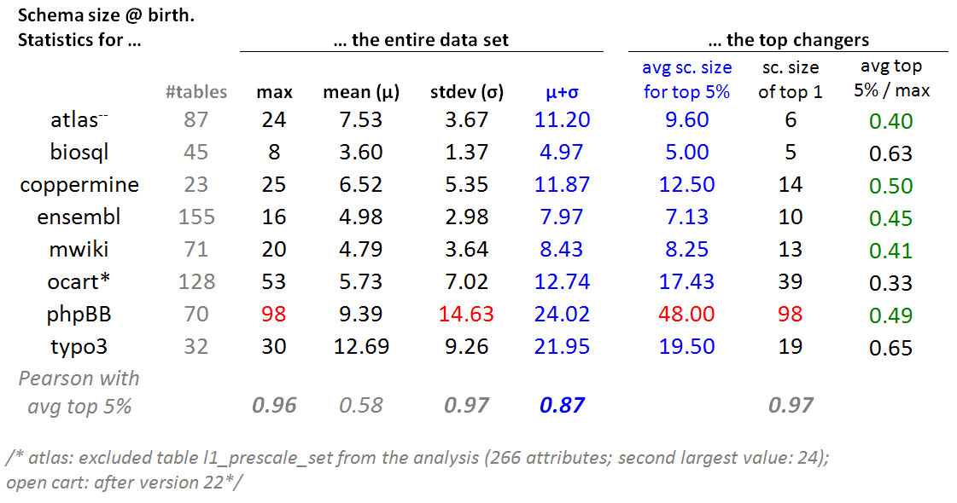
Top changers tend to have medium schema sizes
For every dataset: we selected the top 5% of tables in terms of this sum of updates and we averaged the schema size at birth of these top 5% tables.

Slide 98
Top changers tend to have medium schema sizes
The average schema size for the top 5% of tables in terms of their update behavior is close to one standard deviation up from the average value of the schema size at birth(i.e., very close to $mu$+$sigma$). //except phpBB

Slide 99
Top changers tend to have medium schema sizes
- In 5 out of 8 cases, the average schema size of top-changers within 0.4 and 0.5 of the maximum value (practically the middle of the domain) and never above 0.65 of it.
- Pearson: the maximum value, the standard deviation of the entire data set and the average of the top changers are very strongly correlated.

Slide 100
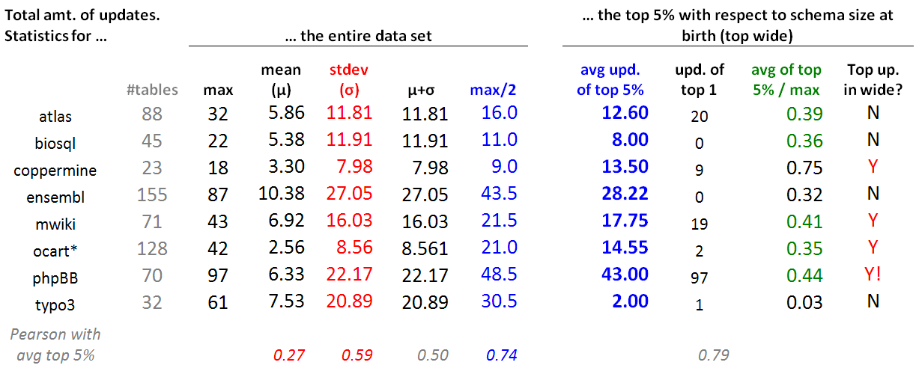
Wide tables have a medium number of updates
For each data set, we took the top 5% in terms of schema size at birth (top wide) and contrasted their update behavior wrt the update behavior of the entire data set.
Typically, the avg. number of updates of the top wide tables is close to the 50% of the domain of values for the sum of updates (i.e., the middle of the y-axis of the comet figure, measuring the sum of updates for each table).
This is mainly due to the (very) large standard deviation (twice the mean), rather than the --typically low -- mean value (due to the large part of the population living quiet lives).

Slide 101
Inverse Gamma

Slide 103
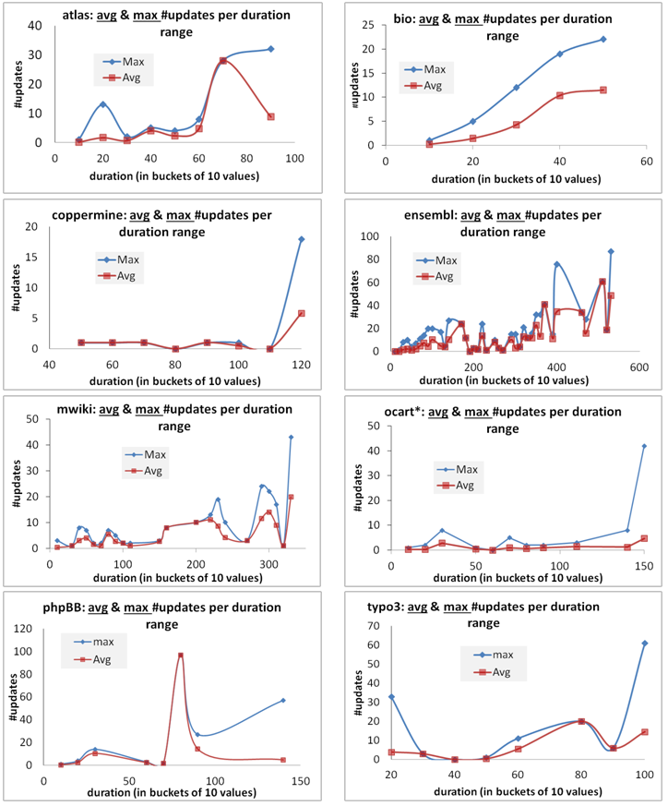
Skyline & Avg for Inverse
Gamma

Slide 104
The empty triangle pattern

Slide 105
void

Slide 106
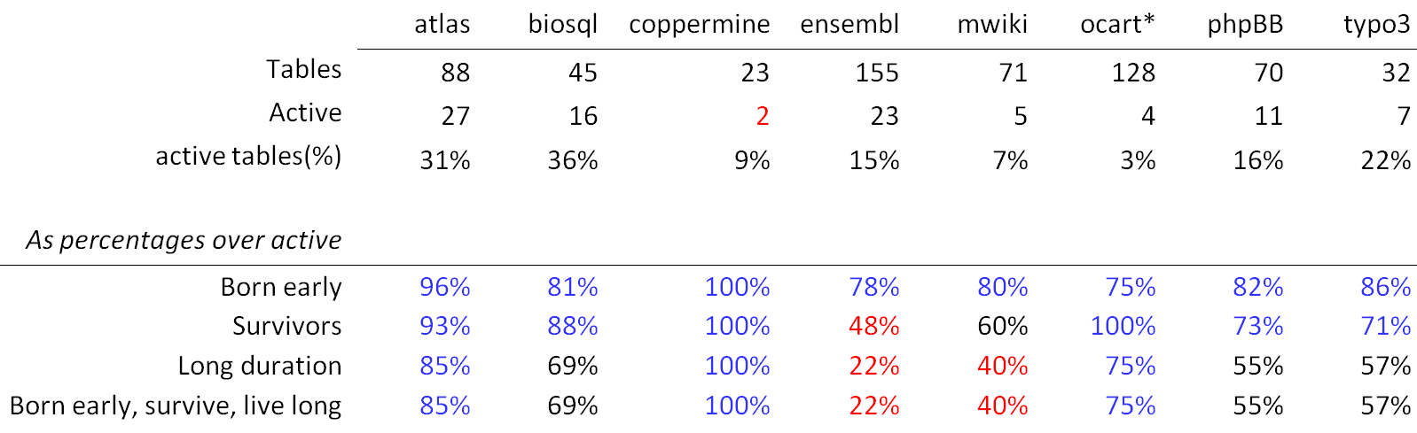
Top changers: early born, survivors, often with long durations, and often all the above
In all data sets, active tables are born early with percentages that exceed 75%
With the exceptions of two data sets, they survive with percentage higher than 70%.
The probability of having a long duration is higher than 50% in 6 out of 8 data sets.
Interestingly, the two last lines are exactly the same sets of tables in all data sets!
  An active table with long duration has been born early and survived with prob. 100%
  An active, survivor table that has a long duration has been born early with prob. 100%

Slide 107
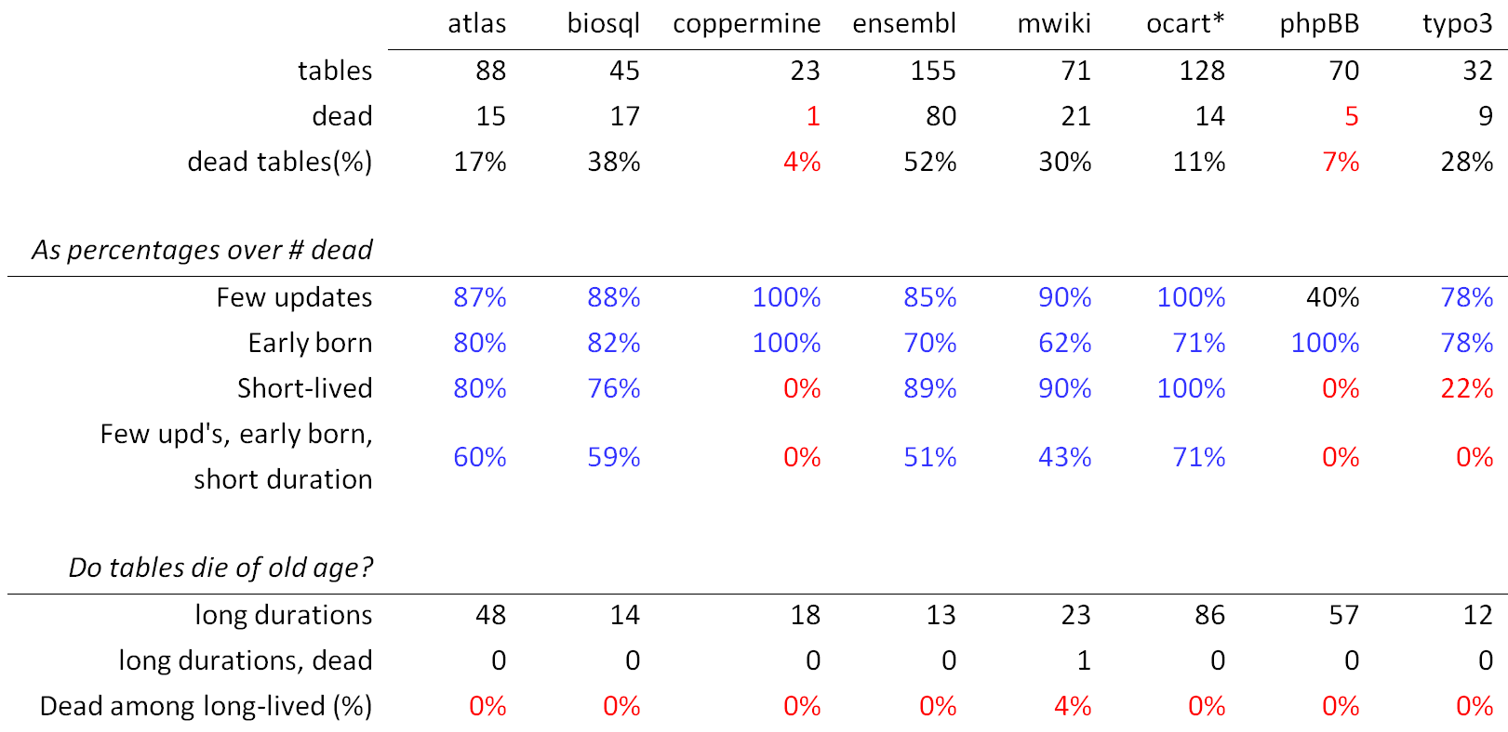
Dead are: quiet, early born, short lived, and quite often all three of them

Slide 108
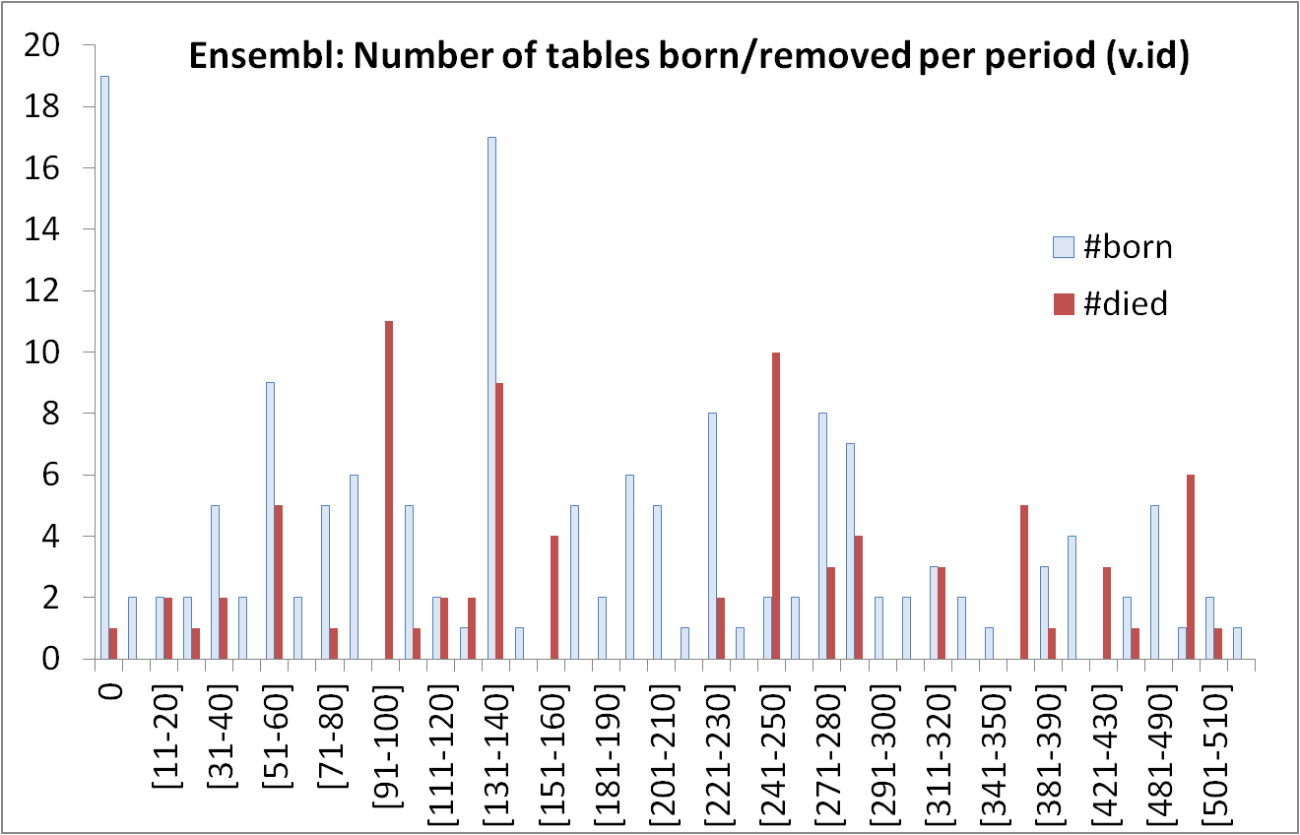
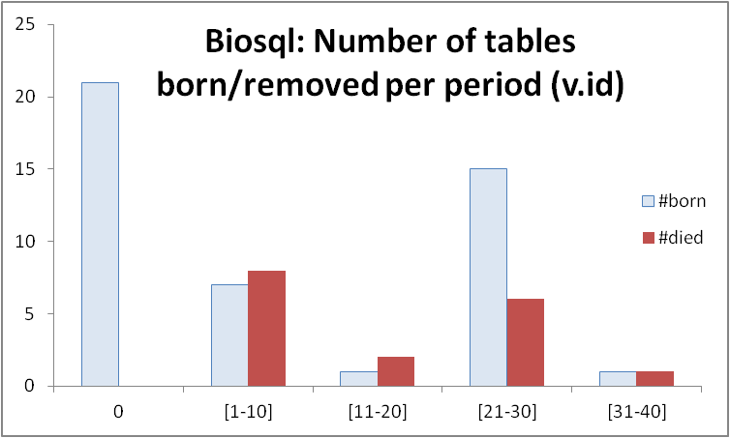
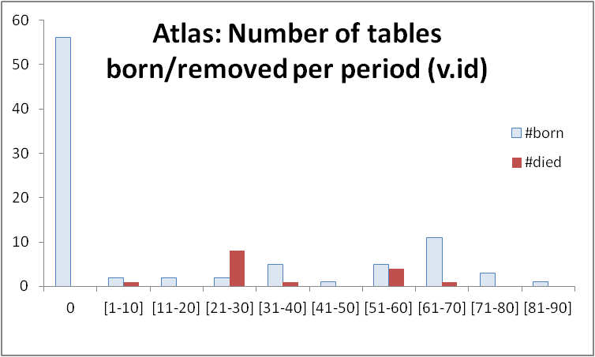





Most births &deaths occur early (usually)

Slide 109
Longevity and update activity correlate !!
Top changers live long
Remember: top changers are defined as such wrt ATU (AvgTrxnUpdate), not wrt sum(changes)
Still, they dominate the sum(updates) too! (see top of inverse Γ)
See also upper right blue part of diagonal: too many of them are born early and survive => live long!
Too many top changers are born early
Birth rate drops over time
Deleted tables are born early & last short

Slide 110
All in one
Top changers live long
Empty space: high change rates are only for early born & long lived
Early stages of the database life are more "active" in terms of births, deaths and updates, and have higher chances of producing deleted tables.
After the first major restructuring, the database continues to grow; however, we see much less removals, and maintenance activity becomes more concentrated and focused.
Deleted tables last short & do not change a lot
Top changers are born early
An empty triangle: no deleted tables with large or even modest durations
Deleted tables are born early & last short
Birth rate drops over time

Slide 111
Impact assessment
Roadmap
Evolution of views
Data warehouse Evolution
  A case study (if time)
Impact assessment in ecosystems
Empirical studies concerning database evolution
Open Issues and discussions
… and data intensive ecosystems…

Slide 112
Data intensive ecosystems
Ecosystems of applications, built on top of one or more databases and strongly dependent upon them
Like all software systems, they too change…

Slide 113

Evolving data-intensive ecosystem

Slide 114
Evolving data-intensive ecosystem
Remove CS.C_NAME
Syntactically invalid
Semantically unclear
Add exam year
The impact can be syntactical (causing crashes), semantic (causing info loss or inconsistencies) and related to the performance

Slide 115
The impact of changes & a wish-list
Syntactic: scripts & reports simply crash
Semantic: views and applications can become inconsistent or information losing
Performance: can vary a lot
We would like: evolution predictability
i.e., control of what will be affected
before changes happen
Learn what changes & how
Find ways to quarantine effects

Slide 116
The Hecataeus tool & method.
Here: a first map of Drupal
http://www.cs.uoi.gr/~pvassil/projects/hecataeus/

Slide 117

What happens if I modify table search_index? Who are the neighbors?

Slide 118

What happens if I modify table search_index? Who are the neighbors?
Tooltips with info on the script & query

Slide 119

In the file structure too…

Slide 120
How to handle evolution?
Architecture Graphs: graph with the data flow between modules (i.e., relations, views or queries) at the detailed (attribute) level; module internals are also modeled as subgraphs of the Architecture Graph
Policies, that annotate a module with a reaction for each possible event that it can withstand, in one of two possible modes:
  (a) block, to veto the event and demand that the module retains its previous structure and semantics, or,
  (b) propagate, to allow the event and adapt the module to a new internal structure.
Given a potential change in the ecosystem
  we identify which parts of the ecosystem are affected via a “change propagation” algorithm
  we rewrite the ecosystem to reflect the new version in the parts that are affected and do not veto the change via a rewriting algorithm
    Within this task, we resolve conflicts (different modules dictate conflicting reactions) via a conflict resolution algorithm

Slide 121

University E/S Architecture Graph
Notes:
Our ecosystem is described by the following image:
On the left we can see the Relations and their Attributes. On their right we see V_Course view where we use 3 of the relations. The V_Course view provides with Attributes the V_Tr view. The V_Tr view besides the V_Course view has as input the Transcript relation. Finally we can see on the upper most right part of the image the query that compares the grades of the students in DB_I & DB_II courses, and in the lower right part we see the query that gives the average grade of the students.
121

Slide 122

Architecture Graph
Modules and Module Encapsulation
Observe the input and output schemata!!
SELECT V.STUDENT_ID, S.STUDENT_NAME,
AVG(V.TGRADE) AS GPA
FROM V_TR V |><| STUDENT S ON STUDENT_ID
WHERE V.TGRADE > 4 / 10
GROUP BY V.STUDENT_ID, S.STUDENT_NAME
Notes:
122

Slide 123

Policies to predetermine reactions
RELATION.OUT.SELF: on ADD_ATTRIBUTE then PROPAGATE;
RELATION.OUT.SELF: on DELETE_SELF then PROPAGATE;
RELATION.OUT.SELF: on RENAME_SELF then PROPAGATE;
RELATION.OUT.ATTRIBUTES: on DELETE_SELF then PROPAGATE;
RELATION.OUT.ATTRIBUTES: on RENAME_SELF then PROPAGATE;
VIEW.OUT.SELF: on ADD_ATTRIBUTE then PROPAGATE;
VIEW.OUT.SELF: on ADD_ATTRIBUTE_PROVIDER then PROPAGATE;
VIEW.OUT.SELF: on DELETE_SELF then PROPAGATE;
VIEW.OUT.SELF: on RENAME_SELF then PROPAGATE;
VIEW.OUT.ATTRIBUTES: on DELETE_SELF then PROPAGATE;
VIEW.OUT.ATTRIBUTES: on RENAME_SELF then PROPAGATE;
VIEW.OUT.ATTRIBUTES: on DELETE_PROVIDER then PROPAGATE;
VIEW.OUT.ATTRIBUTES: on RENAME_PROVIDER then PROPAGATE;
VIEW.IN.SELF: on DELETE_PROVIDER then PROPAGATE;
VIEW.IN.SELF: on RENAME_PROVIDER then PROPAGATE;
VIEW.IN.SELF: on ADD_ATTRIBUTE_PROVIDER then PROPAGATE;
VIEW.IN.ATTRIBUTES: on DELETE_PROVIDER then PROPAGATE;
VIEW.IN.ATTRIBUTES: on RENAME_PROVIDER then PROPAGATE;
VIEW.SMTX.SELF: on ALTER_SEMANTICS then PROPAGATE;
QUERY.OUT.SELF: on ADD_ATTRIBUTE then PROPAGATE;
QUERY.OUT.SELF: on ADD_ATTRIBUTE_PROVIDER then PROPAGATE;
QUERY.OUT.SELF: on DELETE_SELF then PROPAGATE;
QUERY.OUT.SELF: on RENAME_SELF then PROPAGATE;
QUERY.OUT.ATTRIBUTES: on DELETE_SELF then PROPAGATE;
QUERY.OUT.ATTRIBUTES: on RENAME_SELF then PROPAGATE;
QUERY.OUT.ATTRIBUTES: on DELETE_PROVIDER then PROPAGATE;
QUERY.OUT.ATTRIBUTES: on RENAME_PROVIDER then PROPAGATE;
QUERY.IN.SELF: on DELETE_PROVIDER then PROPAGATE;
QUERY.IN.SELF: on RENAME_PROVIDER then PROPAGATE;
QUERY.IN.SELF: on ADD_ATTRIBUTE_PROVIDER then PROPAGATE;
QUERY.IN.ATTRIBUTES: on DELETE_PROVIDER then PROPAGATE;
QUERY.IN.ATTRIBUTES: on RENAME_PROVIDER then PROPAGATE;
QUERY.SMTX.SELF: on ALTER_SEMANTICS then PROPAGATE;
Remove CS.C_NAME
Allow deletion
Allow addition
Add exam year
Policies to predetermine the modules’ reaction to a hypothetical event?

Slide 124

How to handle evolution?
Remove CS.C_NAME

Slide 125
Internals of impact assess. & rewriting
Impact assessment. Given a potential event, a status determination algorithm makes sure that the nodes of the ecosystem are assigned a status concerning (a) whether they are affected by the event or not and (b) what their reaction to the event is (block or propagate).
Conflict resolution and calculation of variants. Algorithm that checks the affected parts of the graph in order to highlight affected nodes with whether they will adapt to a new version or retain both their old and new variants.
Module Rewriting. Our algorithm visits affected modules sequentially and performs the appropriate restructuring of nodes and edges.

Slide 126


Impact assessment & rewriting

Slide 127
Conflicts: what they are and how to handle them (more than flooding)
BEFORE
AFTER
R
R
View0
n
View0
View0
View1
View2
n
n
View1
View2
View2
Query1
Query2
n
Query1
Query2
View0 initiates a change
View1 and View 2 accept the change
Query2 rejects the change
Query1 accepts the change
The path to Query2 is left intact, so that it retains it semantics
View1 and Query1 are adapted
View0 and View2 are adapted too, however, we need two version for each: one to serve Query2 and another to serve View1 and Query1
Notes:
127

Slide 128

Played an impact analysis scenario: delete attr. ‘word’ from search_index
1. The table allowed the deletion, but…
2. Queries Q215 and Q216 vetoed

