Slide 1

Schema evolution for traditional databases and data warehouses
Panos Vassiliadis
also: Apostolos Zarras, Petros Manousis, Ioannis Skoulis, George Papastefanatos*
Department of Computer Science and Engineering
University of Ioannina, Hellas
* Research Center “Athena”, IMIS, Athens
Univ. of Ioannina

Slide 2

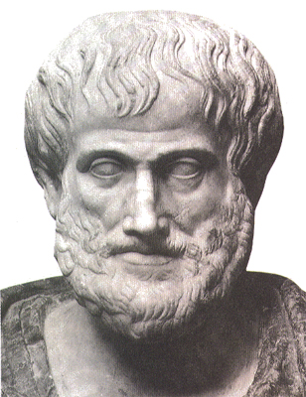
The nature that needs change is vicious; for it is not simple nor good…
Nicomachean Ethics, Book VII, Aristotle

Slide 3
SWEBOK Maintenance
 | Correction | Enhancement
Proactive | Preventive | Perfective
Reactive | Corrective | Adaptive
Corrective maintenance: reactive modification (or repairs) of a software product performed after delivery to correct discovered problems.
Adaptive maintenance: modification of a software product performed after delivery to keep a software product usable in a changed or changing environment.
Perfective maintenance: modification of a software product after delivery to provide enhancements for users, improvement of program documentation, and recoding to improve software performance, maintainability, or other software attributes.
Preventive maintenance: modification of a software product after delivery to detect and correct latent faults in the software product before they become operational faults.

Slide 4
Database Evolution: why and what
Software systems and, thus, databases are dynamic environments and can evolve due
  Changes of requirements
  Internal restructuring due to performance reasons
  migration / integration of data from another system
  …
Database evolution concerns
  changes in the content (data) of the databases as time passes by
  changes in the internal structure, or schema, of the database
  changes in the operational environment of the database

Slide 5
What evolves in DBMS...
Data
  UPDATE EMP
    SET SALARY = SALARY *1.10
    WHERE...
EMP_ID | SALARY
100 | 1500
EMP_ID | SALARY
100 | 1650
Metadata – Schemata – Models
    ALTER TABLE EMP
    ADD COLUMN PHONE VARCHAR ...
EMP_ID | SALARY
100 | 1500
EMP_ID | SALARY | PHONE
100 | 1650 | 210777777

Slide 6
Why is (schema) evolution so important?
Software and DB maintenance makes up for at least 50% of all resources spent in a project.
Changes are more frequent than you think
Databases are rarely stand-alone: typically, an entire ecosystem of applications is structured around them =>
Changes in the schema can impact a large (typically, not traced) number of surrounding app’s, without explicit identification of the impact

Slide 7
Some exemplary code [Maule+08]

Slide 8
Evolution taxonomy
Schema evolution, itself, can be addressed at
  the conceptual level (req’s, goals, conc. model, …. Evolve)
  the logical level, where the main constructs of the database structure evolve
    E.g.,: relations and views in the relational area, classes in the object-oriented database area, or (XML) elements in the XML/semi-structured area),
  the physical level, involving data placement and partitioning, indexing, compression, archiving etc.

Slide 9
Evolution taxonomy: areas
Relational databases
Object Oriented db’s
Conceptual models
XML
Ontologies
…
Special case of relational: data warehouses

Slide 10
… To probe further …
Michael Hartung, James F. Terwilliger, Erhard Rahm:
Recent Advances in Schema and Ontology Evolution. In Schema Matching and Mapping (Zohra Bellahsene, Angela Bonifati, Erhard Rahm), 149-190, Springer 2011, ISBN 978-3-642-16517-7
Matteo Golfarelli, Stefano Rizzi: A Survey on Temporal Data Warehousing. IJDWM 5(1): 1-17 (2009)
Robert Wrembel: A Survey of Managing the Evolution of Data Warehouses. IJDWM 5(2): 24-56 (2009)

Slide 11
Roadmap
Evolution of views
Data warehouse Evolution
  A case study if time
Impact assessment in ecosystems
Empirical studies for database evolution
Open Issues and discussions

Slide 12
View adaptation
Roadmap
Evolution of views
Data warehouse Evolution
  A case study (if time)
Impact assessment in ecosystems
Empirical studies concerning database evolution
Open Issues and discussions
What views and mat. views are
Traditional research problems related to views
View adaptation
Significant works

Slide 13
Views
Virtual views: macros that allow the developers to construct queries easier by using them as tables in subsequent queries
  CREATE VIEW sales_vv AS
  SELECT t.calendar_year, p.prod_id, SUM(s.amount_sold) AS sum_sales
  FROM times t, products p, sales s
  WHERE t.time_id = s.time_id AND p.prod_id = s.prod_id
  GROUP BY t.calendar_year, p.prod_id;
  Query:
  SELECT * FROM sales_vv WHERE calendar_year > 2012;

Slide 14
Views
http://docs.oracle.com/cd/B28359_01/server.111/b28286/statements_6002.htm#SQLRF01302
Materialized views are not macros, however, as they actually store (precompute) the result in persistent storage
  CREATE MATERIALIZED VIEW sales_mv
  BUILD IMMEDIATE
  REFRESH FAST ON COMMIT
  AS
  SELECT t.calendar_year, p.prod_id, SUM(s.amount_sold) AS sum_sales
  FROM times t, products p, sales s
  WHERE t.time_id = s.time_id AND p.prod_id = s.prod_id
  GROUP BY t.calendar_year, p.prod_id;

Slide 15
Traditional research problems with views
Query answering: how to integrate views (of all kinds) in the optimizer’s plan?
View selection: which views to materialized given query and update workloads?
View maintenance: how to update the stored extent of the mat. view when changes occur at the sources?
  For which views can I do it? (query class)
  How: Full or Incremental?
  When: On update? On demand? Periodically?
  Available info: deltas only? Int. constraints?

Slide 16
Oracle 11g and Materialized Views
CREATE MATERIALIZED VIEW view-name
BUILD [IMMEDIATE | DEFERRED]
  Compute extent at view definition or at query time
REFRESH [FAST | COMPLETE | FORCE ]
  FAST: incremental (needs log def. on source tables); COMPLETE: full; FORCE: if FAST fails, then COMPLETE
ON [COMMIT | DEMAND ]
  Trigger refresh when sources are updated, or on-demand
[[ENABLE | DISABLE] QUERY REWRITE]
  Used by the optimizer during Query Optimization
AS SELECT ... query definition …;
CREATE MATERIALIZED VIEW LOG ON times
WITH ROWID, SEQUENCE (time_id, calendar_year)
INCLUDING NEW VALUES;
CREATE MATERIALIZED VIEW LOG ON products
WITH ROWID, SEQUENCE (prod_id)
INCLUDING NEW VALUES;

Slide 17
View adaptation
What if there is a change in
  the view definition?
  the schema of the sources?
Can we maintain the view’s
  definition
  extent
correctly and efficiently?

Slide 18
Gupta et al @ Inf. Systems, 26(5), 2001
Assume the view definition changes
Given
  the old and the new view definition
  the existing data that are stored in the view
  the source tables
  (when needed: auxiliary information, like indexes on PK’s, aux. relations, …)
Produce the extent corresponding to the new view definition
Such that
  It is done incrementally rather than via a complete recomputation

Slide 19
A “taxonomy” of atomic changes to SPJ and SPJG+ views
Method: The authors assume a comprehensive set of potential atomic changes.
Addition or deletion of an attribute in the SELECT clause.
Addition, deletion, or modification of a predicate in the WHERE clause (with and without aggregation).
Addition or deletion of a join operand (in the FROM clause), with associated equijoin predicates and attributes in the SELECT clause.
Addition or deletion of an attribute from the GROUPBY list.
Addition or deletion of an aggregation function to a GROUPBY view.
Addition, deletion, or modification of a predicate in the HAVING clause. Addition of the first predicate or deletion of the last predicate corresponds to addition and deletion of the HAVING clause itself.
Addition or deletion of an operand to the UNION and EXCEPT operators.
Addition or deletion of the DISTINCT operator.
For each type of change the authors propose a set of steps required to maintain the view’s extent

Slide 20
Example: Adding an atomic selection to the WHERE clause
Assume we add a filter Q to a view V which becomes V’
  CREATE VIEW V’ AS
  SELECT A1, …, An
  FROM R1 & … & Rm
  WHERE Q AND C1 AND … AND Ck
We want to maintain V0 given its old extent and the source relations.
Algebraically: V’ = V - V⁻ U V⁺
where V+ are the tuples that should be inserted in the view and V⁻ are the tuples to be removed
  DELETE FROM V WHERE NOT Q //delete V⁻
  INSERT INTO V ( SELECT A1, …, An //add V⁺ (here: empty)
  FROM R1 & … & Rm
  WHERE Q1 AND NOT C1 AND … AND NOT Ck )

Slide 21
Important notes
Maintenance is incremental: you try to recompute V by checking out only the existing data
“Taxonomy” of atomic changes with locality principle: if you are given a complex redefinition, you can process it one change at a time (atomic changes are composable)

Slide 22
Nica et al., EDBT 1998
What if the schema in one of the relations participating to the view definition changes?
The method by Nica et al., proposes an algorithm (heavily oriented towards handling deletions) for rewritting the view to address the change
Two pillars:
  A Meta Knowledge Base keeping semantic properties of the database
  The annotation of views with directives on how to respond to changes

Slide 23
Meta Knowledge Base
Information on
  Available relations and views
  Implicit join conditions
  Semantic equivalences: which attribute/relation can be regarded as a potential replacement for another
For example:
  Join conditions:
    product.prod_id = sales.prod_id
  Equivalence assertions:
    sales.prod_id = product.prod_id
    times.calendar_year = year(sales.time_id)

Slide 24
View annotation
E-SQL: language to annotate parts of a view (exported attributes, underlying relations and filters) wrt:
  Dispensability: if the part can be removed from the view definition completely
  Replaceability with an another equivalent part.
  CREATE VIEW empProj_VV AS
  SELECT e.ΕΝame, e.Ephone (AD true, AR true) p.PName, w.PDuration
  FROM EMP e (RR true), PROJECT p, WORKS w
  WHERE (e.Εid = w.Eid) AND (p.Pid = w.Pid) AND (p.Plocation=Barcelona) (CD true)
  //assuming a relation EMP_ContactInfo duplicating id, name, phone of EMP’s, possibly with other contact info means
Notes:
AD : attribute dispensability
AR: attribute replaceability
…
Phone can be both removed and replaced
The filter on barcelona at the join condition can be dropped

Slide 25
Complex View Synchronization algorithm
Input : (0) an SPJ view V, (1) a change in a relation, (2) old MKB entities, and, (3) new MKB entities.
Output: view rewritings to adapt to new MKB providing the same result
Means: model that represents attributes as hyper-nodes and (i) relations, (ii) join cond., and (iii) equivalence assertions as hyper-edges
Steps:
  find all entities affected for Old MKB to become New MKB,
  for each one of these entities find a replacement from Old MKB,
  rewrite the view over these replacements.

Slide 26
Data warehouse evolution
Roadmap
Evolution of views
Data warehouse Evolution
  A case study (if time)
Impact assessment in ecosystems
Empirical studies concerning database evolution
Open Issues and discussions
DWs as Views
Evolving dimensions & SCD
Multiversion DWs & cross-version queries
Bonus: a case study, if time permits

Slide 27
Early days (late ‘90s)
Back then, people continued to think that DWs were collections of materialized views, defined over sources.
In this case, evolution is mostly an issue of adapting the views’ definitions whenever sources changes

Slide 28
DW = set of mat. views?
PKEY, DAY
MIN(COST)
S₁_PARTSUPP
DW.PARTSUPP
V1
Aggregate₁
U
DW.PARTSUPP.DATE,
DAY
PKEY, MONTH
AVG(COST)
S₂_PARTSUPP
TIME
V2

Aggregate₂
Sources
DW

Slide 29
NO!! DW ≠ Mat. views!
DS.PS_NEW₁
DS.PS_NEW₁.PKEY,
DS.PS_OLD₁.PKEY
DS.PS₁.PKEY, LOOKUP_PS.SKEY, SUPPKEY
SUPPKEY=1
COST
DATE
DS.PS₁
DS.PS_OLD₁
DIFF₁
Add_SPK₁
SK₁
$2€
A2EDate
U
rejected
rejected
rejected
Log
Log
Log
DS.PS_NEW₂
DS.PS_NEW₂.PKEY,
DS.PS_OLD₂.PKEY
DS.PS₂.PKEY, LOOKUP_PS.SKEY, SUPPKEY
SUPPKEY=2
COST
DATE=SYSDATE
QTY>0
DS.PS₂
DS.PS_OLD₂
DIFF₂
Add_SPK₂
SK₂
NotNULL
AddDate
CheckQTY
rejected
rejected
Log
Log
ETL
PKEY, DAY
MIN(COST)
S₁_PARTSUPP
DW.PARTSUPP
V1
FTP₁
Aggregate₁
DW.PARTSUPP.DATE,
DAY
PKEY, MONTH
AVG(COST)
S₂_PARTSUPP
TIME
V2
FTP₂

Aggregate₂
Sources
DW

Slide 30
Bellahsene (DEXA’98, KAIS02)
Annotate views with a HIDE clause that works oppositely to SELECT (i.e., you project all attributes except for the hidden ones)
Also: ADD ATTRIBUTE to equip views with attributes not present in the sources (e.g., timestamps, calculations)
What if sources change? The author considers attribute/relation addition & deletion and the impact it has to view rematerialization (how to recompute the materialized extent via SQL commands)
Cost model to estimate the cost of different options

Slide 31
Bellahsene (DEXA’98, KAIS02)
[Create] view <view name> As <query expression>;
[Add Attribute <attribute name>:<query expression>=<type>]
[Hide Attribute <attribute name>];
Used for schema evolution too. See how to change the type of an attribute
Create View V’ As Select From V;
Hide attribute A;
Add attribute A : T /* new type for A in V’ */
Drop view V;
Rename V’ as V;

Slide 32
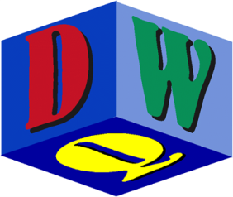
Quix @ DMDW ‘99
Context: DW schemata annotated with quality factors
Metadata that track the history of changes and provide a set of rules to enforce when a quality factor (completeness, consistency, correctness, …) has to be reevaluated.
Basic taxonomy of changes
 | Relation | View | Attribute | Constraint
Add | ✓ | ✓ | ✓ | ✓
Delete | ✓ | ✓ | ✓ | ✓
Rename | ✓ | ✓ | ✓
Redefine semantics |  | ✓

Slide 33
… and then came dimension buses and multidimensional models …
… which treat the DW as a collection of
  cubes, representing clean, undisputed facts that are to be loaded from the sources, cleaned and transformed, and eventually queried by the client applications
  defined over unambiguous, consolidated dimensions that uniquely and commonly define the context of the facts
… The idea of a central DW schema acting as reference for the back-stage loading and front-end querying completely changed the perspective of DW research …

Slide 34
Slowly Changing Dimensions
What you ‘ve probably heard for dimension updates is SCD’s
Type 0: no change allowed
Type 1: new value overwrites old
Type 2: new record; valid time timestamps + status columns indicate which row is current and what happened
  New Surrogate Key (so joins with facts work as if these are different dimension records)
  Same natural / detailed key (to be used in group by’s)
  Status attribute: Current vs Old (aka Type 6)
Type 3: add new column “PreviousValueForAttributeXXX” and update cells with new and old values respectively

Slide 35
Slowly Changing Dimensions
Type 4: definitions vary
  Split type 2 table in two tables subsets of the data set: the historical one and the current one (single row)
  Kimball’s: if some attributes of the dimension change frequently, export a new table (called “profile”) just for them; facts have two FK’s for the dimension, one for the dim table and another for the profile table

Slide 36
Quick guide to dimensional modeling
For each dimension:
Levels for “granularity degrees” of information
Each level L with a domain dom(L) (typically isom. to integers)
Can have attributes too
Typically form a lattice with
  a detailed level at bottom and
  A single-valued ‘ALL’ level at the top
Rollup functions between subsequent levels
Have to be fully defined at the domain level and consistent under composition
Drill-down relations (not functions): their inverse

Slide 37
Hurtado, Mendelzon and Vaisman @ DOLAP99, ICDE’99
Research issue:
What is the algebra of operators to change the dimensions of a DW?
What are the operators?
How do they affect the schema and data of dimensions and cubes?
[HuMN99a,b] Set of operators for evolving dimensions prescribing what should be done to have both a consistent schema and a consistent set of instances

Slide 38
Hurtado, Mendelzon and Vaisman @ DOLAP99, ICDE’99
Generalize | Adds a new level above a preexisting one, + a rollup function
Specialize | Adds a new level below the current bottom level + a rollup function
Relate | Adds a new edge, between two parallel levels. The associated roIlup function, if it exists, is determined automatically. If not possible to do so uniquely, the operator is not applicable.
Unrelate | Deletes an edge between two levels.
Delete Level | Deletes a level with the precondition that the new hierarchy must have a unique bottom level (ALL cannot be deleted).
Add Instance | Adds a value, say x, + a pair of the form (x,y) for each rollup function
Delete Instance | Deletes a value x from a level L + rollup functions
Reclassify | Update rollup-memberships (e.g., a brand moves to a new company)
Split & Merge | Czechoslovakia <-> Czechia & Slovakia + rollup functions
Update | Rename value without structural changes

Slide 39
Blaschka, Sapia and Höﬂing @DaWaK’99
Algebraic Operator
Insert level
Delete level
Insert Attribute
Delete Attribute
Connect attribute to dimension level
Disconnect attribute from dimension level
Connect attribute to fact
Disconnect attribute to fact
Insert classification relationship
Delete classification relationship
Insert fact
Delete fact
Insert dimension into fact
Delete Dimension
Data model + an evolution algebra :
  Evolution operators for multi-dimensional schemata and
  Spec. of their effects to both schema and instances.
Operators: atomic evolution operations,
that can be used for complex operations.

Slide 40
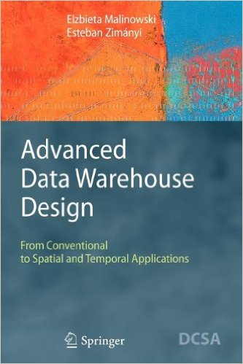
… and then came versioning…
After we had obtained a basic understanding of how multidimensional schemata are restructured, people thought:
“what if we keep track of the history of all the versions of a DW schema as it evolves?”
Then, we can ask a query that spans versions, and transform its results into a convenient schema to show to the users
Closely related to temporal management in DW’s
See later today presentation by Waqas Ahmed

Slide 41
Cross-Version Querying
Q
Schema
Data
t1
t2

Slide 42
Eder and Koncilia @ DaWaK 2001
Multidimensional data model that allows the registration of temporal versions of dimension data in data warehouses.
To navigate between temporal versions: mappings as transformation matrices. Each matrix is a mapping of data from structure Vi to V i+1 for a dimension D. For example, table T describes a split of value a into values a1 and a2 respectively. There is an mapping function that describes that the 30% of the fact –values for A should be placed to a1 and the remaining should be placed in a2 .
This mapping function is described in a transformation matrix T that says exactly that in order to go from A to A1 we need to take 30% of the tuples of table A and what remains goes to table A2.
Queries are posed over snapshots of the database. For each query the appropriate snapshots are computed.
T | A1 | A2
A | 30% | 70%

Slide 43
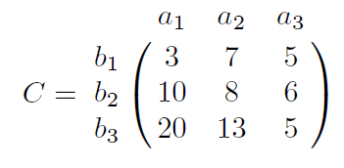
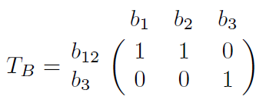
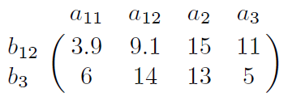
Eder and Koncilia @ DaWaK 2001
We can transform each cuboid C (with facts) over a set of dimensions from version Vi to version Vi+1, by sequentially transforming each of its dimensions one at a time.
Original cube (dimension values on the side)
Transformation matrices for dimensions
Final cube with the values of the original version over the “structure” of the new version
Photos stolen from the paper

Slide 44
Eder, Koncilia and Mitsche @ DaWaK’03, CAiSE’04
Making use of three basic operations (INSERT, UPDATE and DELETE), the authors are able to represent more complex operations on dimension values such as: SPLIT, MERGE, CHANGE, MOVE, NEW-MEMBER, and DELETE-MEMBER.
Also: data mining techniques for the detection of structural changes in data warehouses.

Slide 45
Golfarelli, Lechtenbörger, Rizzi and Vossen @ DKE 2006
How to facilitate cross-version queries?
A graph model for DW multidimensional schemata
Nodes : (i) fact tables and (ii) their attributes of fact tables (including properties and measures),
Edges: functional dependencies (aka dimension hierarchies) defined over the nodes

Slide 46
Golfarelli, Lechtenbörger, Rizzi and Vossen @ DKE 2006
Taxonomy of changes:
  Add / delete node (i.e., tables and attributes)
  Add / delete edge (i.e., restructure dimensions)
Transactions = sequences of atomic changes

Slide 47
Golfarelli, Lechtenbörger, Rizzi and Vossen @ DKE 2006
Augmented schema of a previous version
Assume a version S_{k}
Assume a set of changes M₁,…, M_{n}
Then you get to a version S_{k+n}
The augmented version of S_{k} wrt S_{k+n} is the schema and data of S_{k}, along with all the extra attributes and FD’s added at S_{k+n}
So basically, we are adapting the previous schema+data to the structure of the new version
This might require aggregations or disaggregations (and estimations of the necessary values), addition of default values, …

Slide 48
Golfarelli, Lechtenbörger, Rizzi and Vossen @ DKE 2006
Assume a fact
  SALES(ProdID, DayId, CustId, Price, Qty)
With a set of dimensions
  Product (Product, Type, Family)
  Customer(Customer, CustGroup)
  Time(Day, Month, Year)
and a set of changes
  Add attribute Salesman and a hierarchy Salesman -> Store
  Remove day from the time hierarchy and replace it with Month
  SumSales = Qty*Price
Then, the new fact is
SALES’(ProdID,MonthId,CustId,SalesmanId,Price,Qty,SumSales)

Slide 49
Golfarelli, Lechtenbörger, Rizzi and Vossen @ DKE 2006
SALES(ProdID, DayId, CustId, Price, Qty)
SALES’(ProdID,MonthId,CustId,SalesmanId,Price,Qty,SumSales)
We can compute the augmented version of the OLD schema
SALES^{Aug}(ProdID,DayId,MonthId,CustId,SalesmanId,Price,Qty,SumSales)
…that includes @ schema level
  The old attributes & FD’s
  The new attributes & FD’s added during evolution
  … hoping that all FD’s hold (otherwise there is no augmentation)
… and at data level: values of SALES (the old v.) with interpolation for the measures due to dimension addition

Slide 50
Golfarelli, Lechtenbörger, Rizzi and Vossen @ DKE 2006
History is a sequence of versions H = (v₁, …, v_{n}) . Each version has
  Its own schema
  The augmented schema wrt v_{n} //needs modification if v_{n+1} comes
  The timestamp of change
Why bother?
Because at query time, we can transform the old schema and data to the last one.
Then we can pose queries to the old data based on the structure of the new one and a get a uniform result under the last known schema.
If differences (e.g., because of attribute deletions), we retain the common set of attributes

Slide 51
Wrembel and Bebel @ JoDS’07
How to handle changes that come up on the external data sources (EDS) of a data warehouse?
Deal with it via a multiversion technique!
Everything has a version (each with a valid time):
  Dimensions, levels and hierarchies
  Facts
  Attributes
  Integrity constraints
Mappings are between versioned objects. E.g.,
  level versions are mapped to dimension versions
  Fact versions to level versions
  …
Both real and alternative (for simulation) versions are supported

Slide 52
Wrembel and Bebel @ JoDS’07
Photo stolen from the paper

Slide 53
Wrembel and Bebel @ JoDS’07
Schema Change Operations
  the addition / deletion of attribute @ dimension level table
  the creation of a new fact table + the association of a fact with a dimension
  the renaming of a table
  snowflake changes:
    the creation of a new dimension level table with a given structure
    the inclusion of a parent dimension level table into its child dimension level table,
    the creation of a parent dimension level table based on its child level table.
Instance change operations
  Add/del level instance
  Change parent of a level
  Merge many instances of a level into a single one / split(inverse)

Slide 54
Wrembel and Bebel @ JoDS’07
Querying multiple versions
Split original query to a set of single version queries
For each single version query, do a best-effort approach:
  if attributes are missing, omit them;
  use metadata for renames
  ignore v. if a grouping is impossible
  …
If possible, the collected results are integrated under the intersection of attributes common to all versions (if this is the case of the query);
Else they are presented as a set of results, each with its own metadata

Slide 55
Wrembel and Bebel @ JoDS’07
Metadata manager
Wrapper
Monitor
DW
Wrapper
Monitor
Refresher
…
…
…
Wrapper
Monitor
monitored External Data Sources

Slide 56
A case study Of
DW evolution
Roadmap
Evolution of views
Data warehouse Evolution
  A case study (if time)
Impact assessment in ecosystems
Empirical studies concerning database evolution
Open Issues and discussions
George Papastefanatos, Panos Vassiliadis, Alkis Simitsis, Yannis Vassiliou. Metrics for the Prediction of Evolution Impact in ETL Ecosystems: A Case Study. Journal on Data Semantics, August 2012, Volume 1, Issue 2, pp 75-97

Slide 57
Context of the Study
We have studied a data warehouse scenario from a Greek public sector’s data warehouse maintaining information for farming and agricultural statistics.
The warehouse maintains statistical information collected from surveys, held once per year via questionnaires.
Our study is based on the evolution of the source tables and their accompanying ETL flows, which has happened in the context of maintenance due to the change of requirements at the real world.
Practically this is due to the update of the questionnaires from year to year
Notes:
The survey data are primarily stored in 7 source tables and are subsequently processed so that they can be integrated in the organization’s warehouse and queried. Each survey varies its schema according to the different number and types of questions comprising the survey’s questionnaire; however, there are several common elements in all surveys.
One table (S1) holds information about the metadata of the survey (e.g., the year held, the sample size, etc.), which are rarely altered or renamed and mostly complemented or specialized yearly by adding new attributes in the survey’s metadata. All other source tables (S2-S7) retain the answers to the questionnaires, where most alterations occur every year.

Slide 58
Internals of the monitored scenario
The environment involves a set of 7 ETL workflows:
  7 source tables, (S1 to S7)
  3 lookup tables(L1 to L3),
  7 target tables, (T1 to T7), stored in the data warehouse.
  7 temporary tables (each target table has a temporary replica) for keeping data in the data staging area,
  58 ETL activities in total for all the 7 workflows.
Notes:
See next slides for details on the size of the schema of each table, in terms of number of attributes

Slide 59
PL/SQL to graph transformation
All ETL scenarios were source coded as PL\SQL stored procedures in the data warehouse.
  We extracted embedded SQL code (e.g., cursor definitions, DML statements, SQL queries) from activity stored procedures
  Each activity was represented in our graph model as a view defined over the previous activities
  Table definitions were represented as relation graphs.

Slide 60
Method of assessment
We have represented the ETL workflows in our graph model
We have recorded evolution events on the nodes of the source, lookup and temporary tables.
We have applied each event sequentially on the graph and monitored the impact of the change towards the rest of the graph by recording the times that a node has been affected by each change

Slide 61
Graph modeling of a data-intensive ecosystem
The entire data-intensive ecosystem, comprising databases and their internals, as well as applications and their data-intensive parts, is modeled via a graph that we call Architecture Graph
Why Graph modeling?
  Completeness: graphs can model everything
  Uniformity: we would like to module everything uniform manner
  Detail and Grand-View: we would like to capture parts and dependencies at the very finest level; at same time, we would like to have the ability to zoom-out at higher levels of abstraction
  Exploit graph management techniques and toolkits

Slide 62
Relations – Attributes - Constraints
CREATE TABLE EMP (EMP# INTEGER PRIMARY KEY,
NAME VARCHAR(25) NOT NULL,
TITLE VARCHAR(10),
SAL INTEGER NOT NULL);

Slide 63
Queries & Views
Q: SELECT EMP.Emp# as Emp#,
Sum(WORKS.Hours) as T_Hours
FROM EMP, WORKS
WHERE EMP.Emp# = WORKS.Emp#
AND EMP.SAL > 50K
GROUP BY EMP.Emp#

Slide 64
Modules: relations, queries, views

Slide 65
Zooming out to top-level nodes (modules)

Slide 66
Metrics: Node Degree
Simple metrics:
in-degree, out-degree, degree
EMP.Emp# is the most important attribute of EMP.SAL, if one considers how many nodes depend on it.
Edge direction: from dependant
to depended upon

Slide 67
Metrics: Transitive Node Degree
  Observe that there is both a view and a query with nodes dependent upon attribute EMP.Emp#.
Transitive Metrics:
in-degree, out-degree, degree

Slide 68
Strength: Zooming out to modules
Again, for modules, we can have both:
Simple strength
Transitive strength
A zoomed out graph highlights the dependence between modules (relations, queries, views), incorporating the detailed dependencies as the weight of the edges

Slide 69
Metrics: Node Entropy
The probability a node v being affected by an evolution event on node y_{i} :
Examples
P(Q|V) = 1/4,
P(Q|EMP) = 2/4,
P(V|WORKS) = 1/3
Entropy of a node v : How sensitive the node v is by an arbitrary event on the graph.
Notes:
Intuitively, entropy metrics:
-- are transitive-related metrics,
- take into account the #paths arriving to a node especially when more than one paths exist between two nodes in the graph (in contrast to the transitive degree that measures the max path)
- the #paths are quantified as probability and entropy measures how sensitive a node is by an arbitrary event on the graph (more paths arriving to a node, more dependent this node is).

Slide 70
Macroscopic view
ATTN: change of requirements at the real world determines pct breakdown!!
 | # tables affected | Occurrences | pct
Add Attribute | 8 | 122 | 29%
Add Constraint | 1 | 1 | 0%
Drop Attribute Count | 5 | 34 | 8%
Modify Attribute | 9 | 16 | 4%
Rename Attribute | 5 | 236 | 57%
Rename Table | 7 | 7 | 2%
 |  | 416

Slide 71
Workflow of the first ETL scenario, ETL1

Slide 72
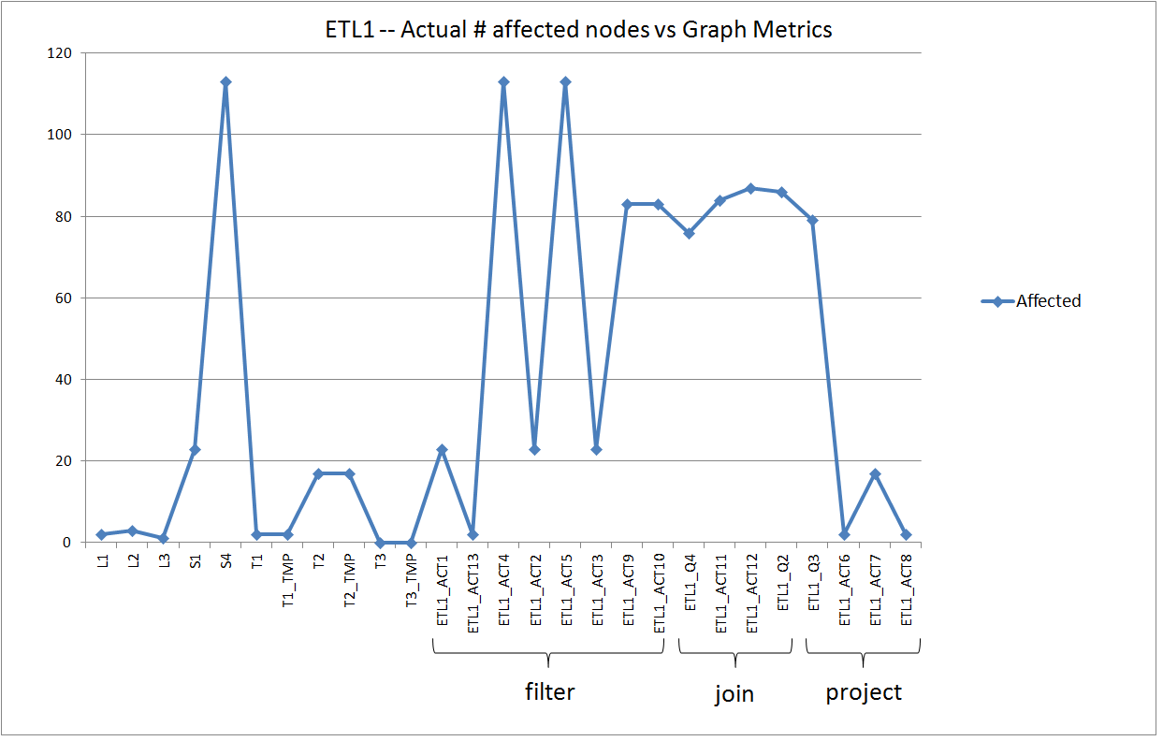

Slide 73
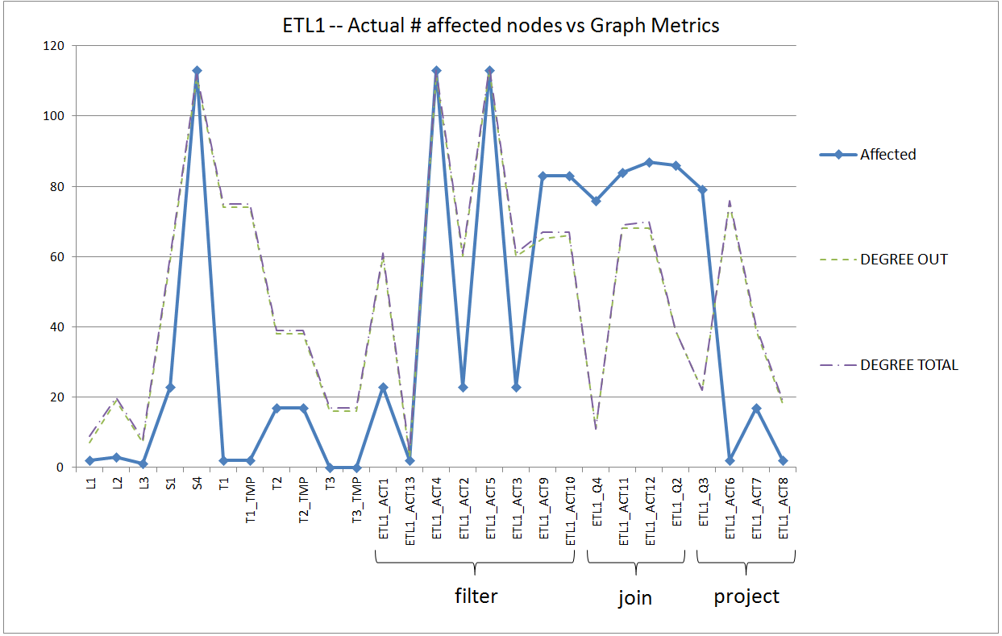
Out – degree
Schema size for tables
Output schema size for activities

Slide 74
Pretty good job for tables
Decent job for filters and joins
Not so good for projection activities

Slide 75
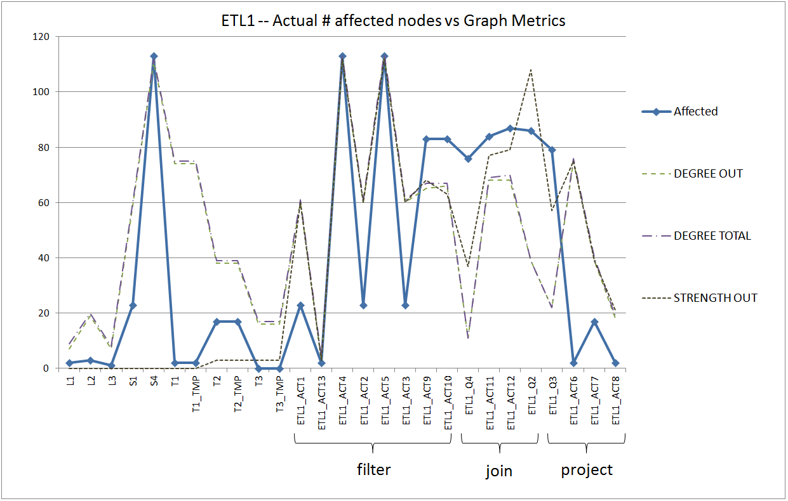
Strength out did not work so well -- esp. for tables, it is too bad

Slide 76
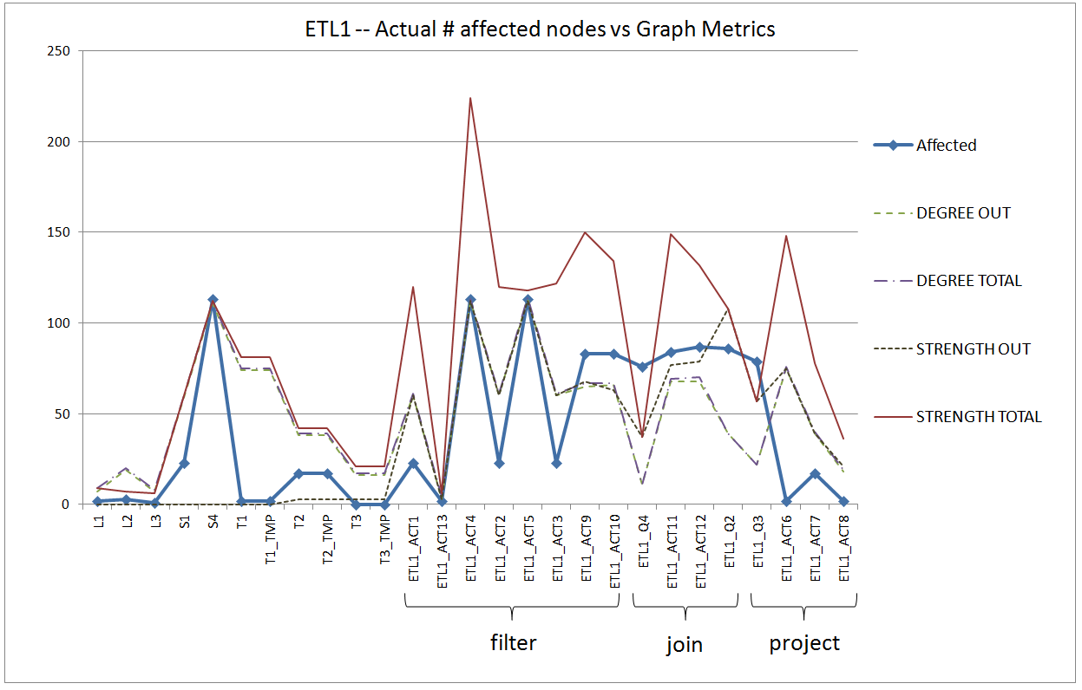
Strength-total works the other way around

Slide 77
Workflows of the second & third ETL scenarios, ETL2 – ETL3

Slide 78
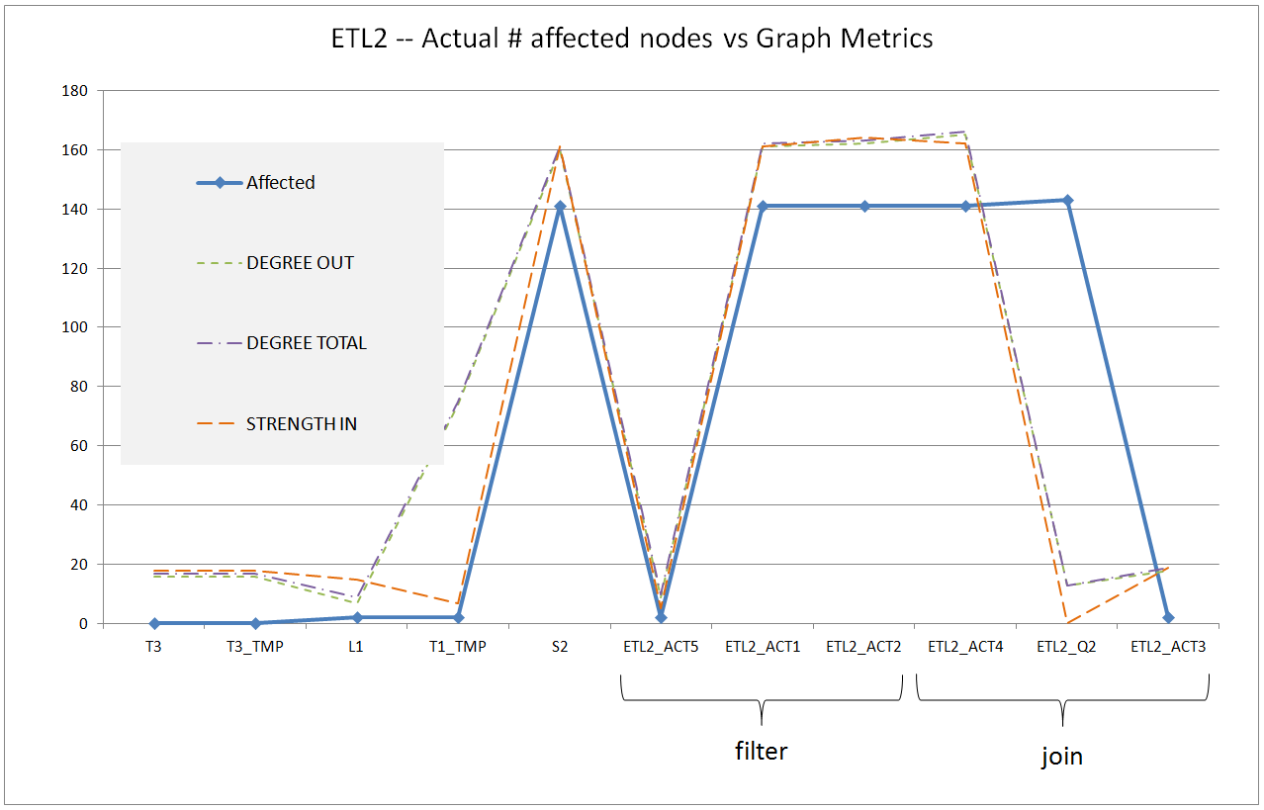

Slide 79
ETL 4

Slide 80
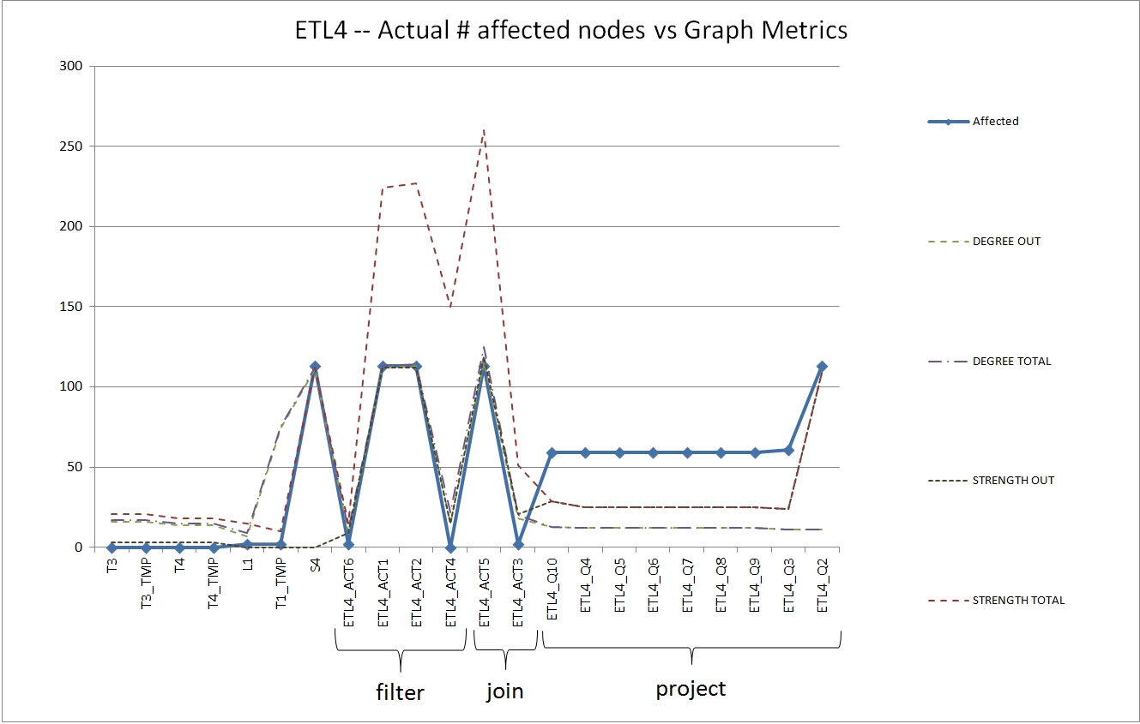
Suddenly everything is underestimated
Pretty good job in the left part

Slide 81
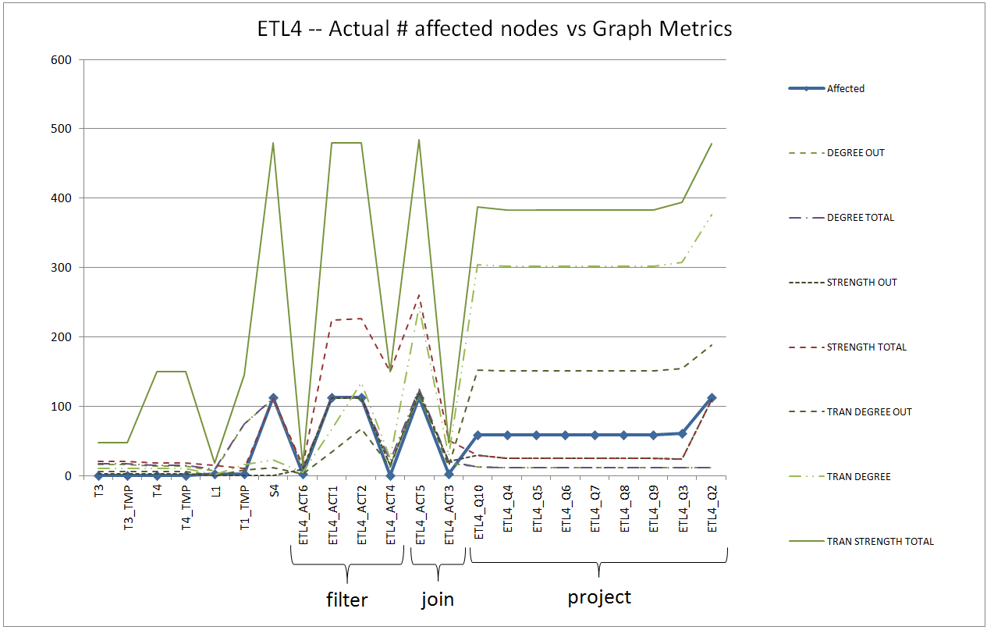
Transitive metrics to the rescue

Slide 82
ETL 5,6,7

Slide 83
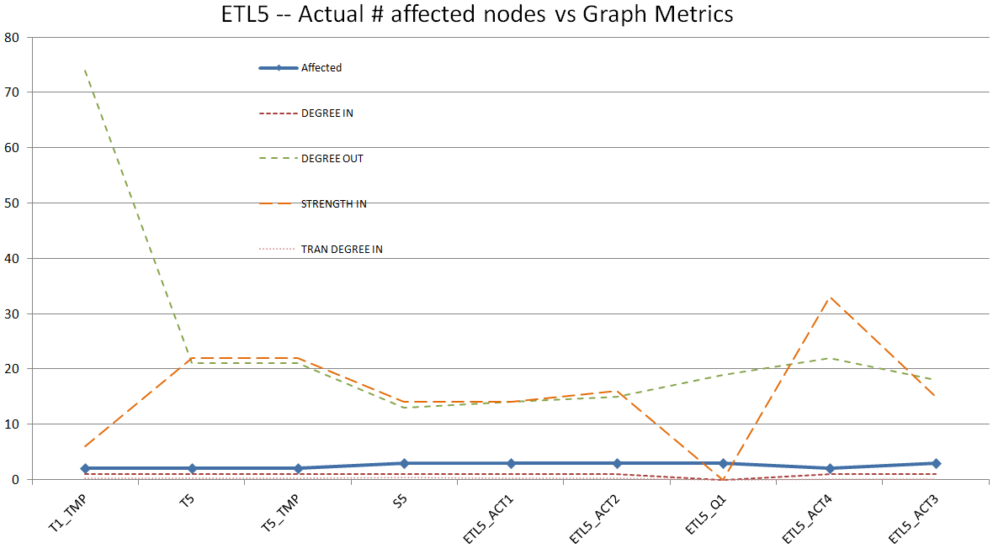

Slide 84
Schema size and module complexity as predictors for the vulnerability of a system
The size of the schemas involved in an ETL design significantly affects the design vulnerability to evolution events.
  For example, source or intermediate tables with many attributes are more vulnerable to changes at the attribute level.
  The out-degree captures the projected attributes by an activity, whereas the out-strength captures the total number of dependencies between an activity and its sources.
The internal structure of an ETL activity plays a significant role for the impact of evolution events on it.
  Activities with high out-degree and out-strengths tend to be more vulnerable to evolution
  Activities performing attribute reduction (e.g., through either a group-by or a projection operation) are in general, less vulnerable to evolution events.
  Transitive degree and entropy metrics capture the dependencies of a module with its various non-adjacent sources. Useful for activities which act as “hubs” of various different paths from sources in complex workflows.
The module-level design of an ETL flow also affects the overall evolution impact on the flow.
  For example, it might be worthy to place schema reduction activities early in an ETL flow to restrain the flooding of evolution events.

Slide 85
Summary & Guidelines
ETL Construct | Most suitable Metric | Heuristic
Source Tables | out-degree | Retain small schema size
Intermediate & Target Tables | out-degree | Retain small schema size in intermediate tables
Filtering activities | out-degree, out-strength | Retain small number of conditions
Join Activities | out-degree, out-strength, trans. out-degree, trans. out-strength, entropy | Move to early stages of the workflow
Project Activities | out-degree, out-strength, trans. out-degree, trans. out-strength, entropy | Move attribute reduction activities to early stages of the workflow and attribute increase activities to later stages

Slide 86
Impact assessment
Roadmap
Evolution of views
Data warehouse Evolution
  A case study (if time)
Impact assessment in ecosystems
Empirical studies concerning database evolution
Open Issues and discussions
… and data intensive ecosystems…

Slide 87
Data intensive ecosystems
Ecosystems of applications, built on top of one or more databases and strongly dependent upon them
Like all software systems, they too change…

Slide 88
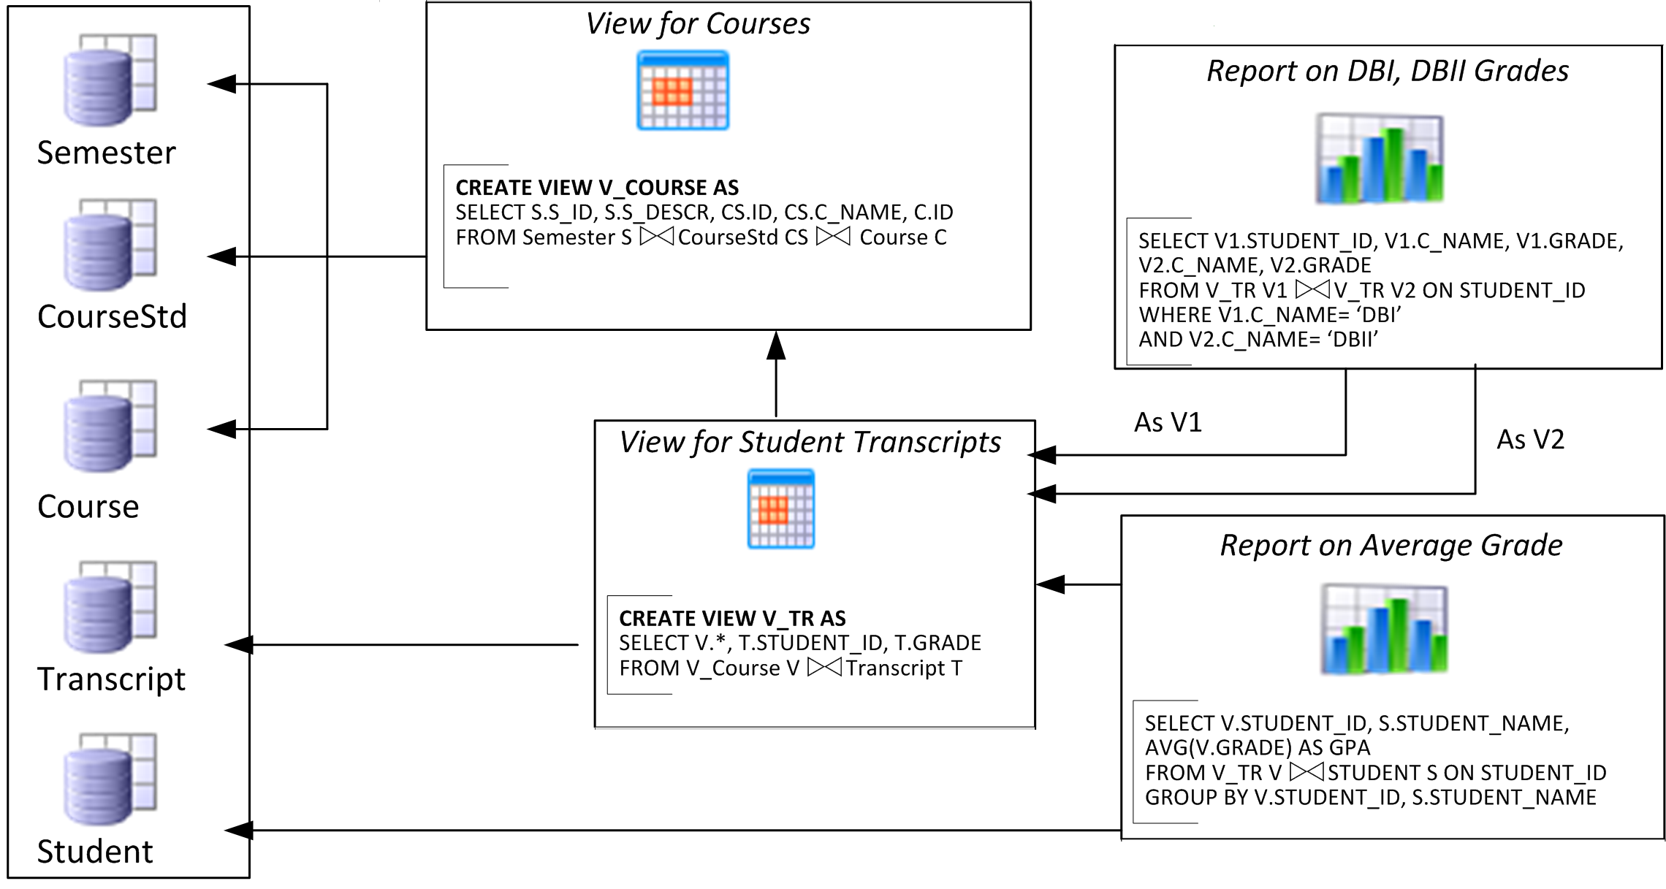
Evolving data-intensive ecosystem

Slide 89
Evolving data-intensive ecosystem
Remove CS.C_NAME
Syntactically invalid
Semantically unclear
Add exam year
The impact can be syntactical (causing crashes), semantic (causing info loss or inconsistencies) and related to the performance

Slide 90
The impact of changes & a wish-list
Syntactic: scripts & reports simply crash
Semantic: views and applications can become inconsistent or information losing
Performance: can vary a lot
We would like: evolution predictability
i.e., control of what will be affected
before changes happen
Learn what changes & how
Find ways to quarantine effects

Slide 91
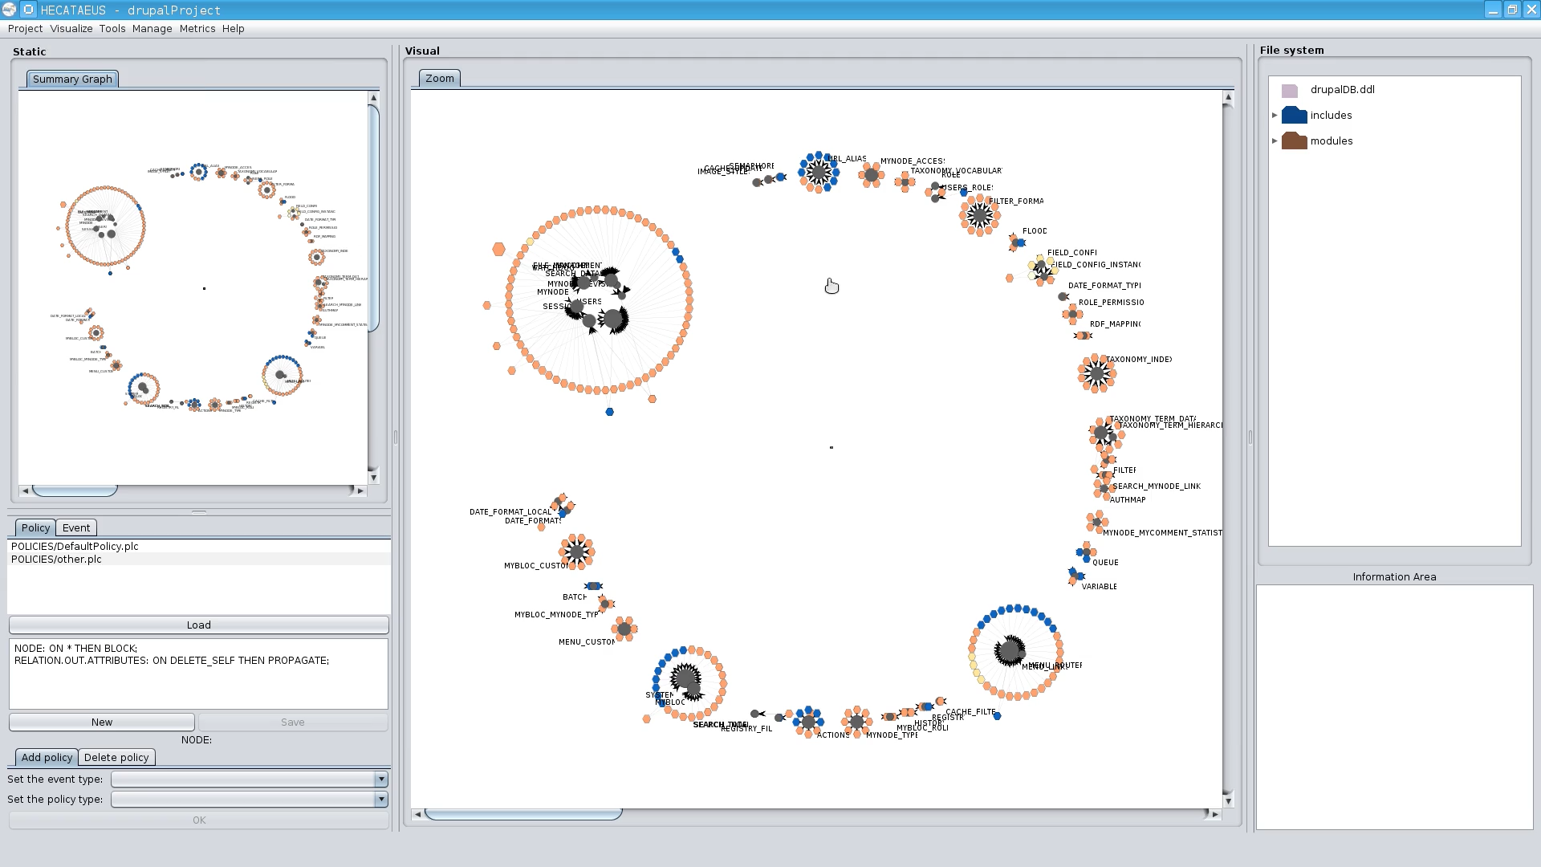
The Hecataeus tool & method.
Here: a first map of Drupal
http://www.cs.uoi.gr/~pvassil/projects/hecataeus/

Slide 92
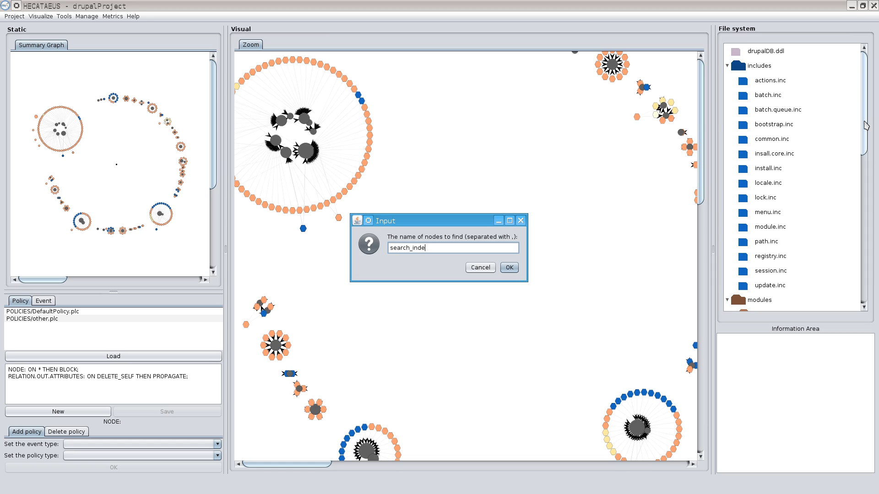
What happens if I modify table search_index? Who are the neighbors?

Slide 93
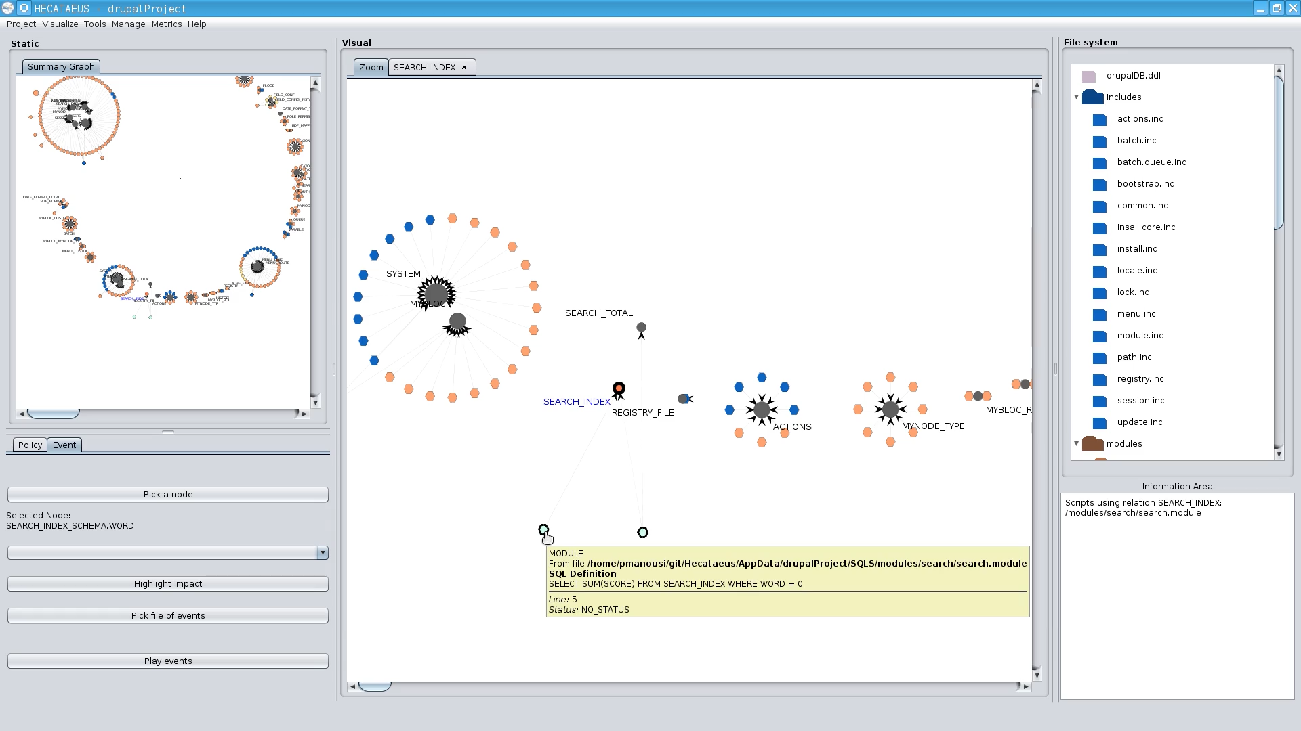
What happens if I modify table search_index? Who are the neighbors?
Tooltips with info on the script & query

Slide 94
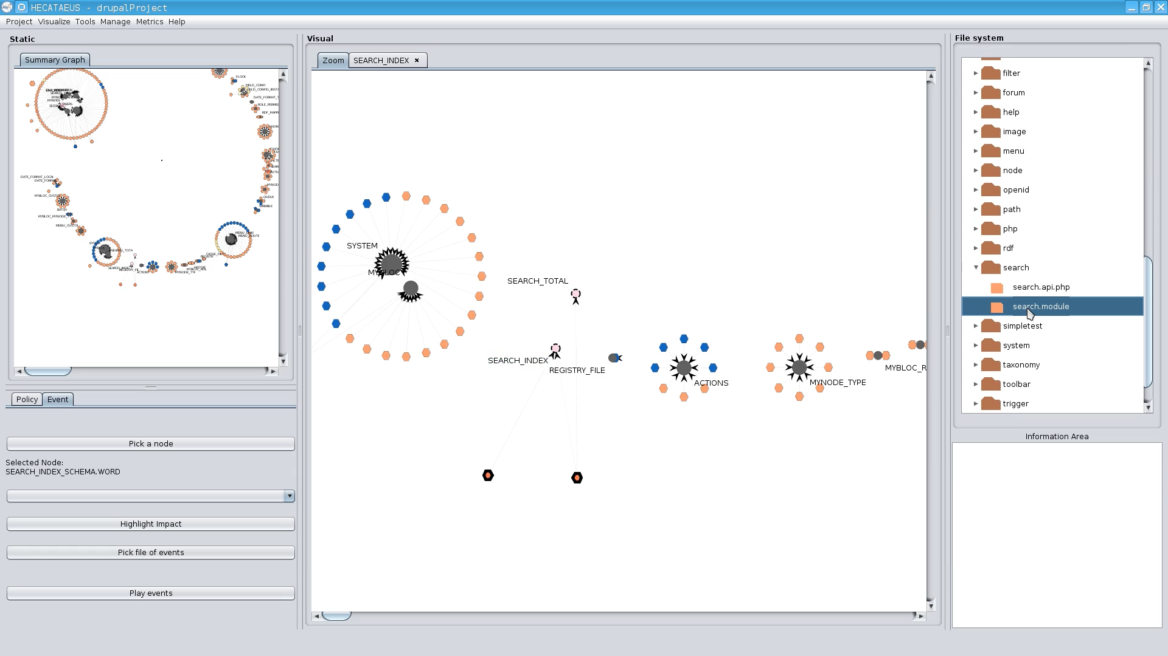
In the file structure too…

Slide 95
How to handle evolution?
Architecture Graphs: graph with the data flow between modules (i.e., relations, views or queries) at the detailed (attribute) level; module internals are also modeled as subgraphs of the Architecture Graph
Policies, that annotate a module with a reaction for each possible event that it can withstand, in one of two possible modes:
  (a) block, to veto the event and demand that the module retains its previous structure and semantics, or,
  (b) propagate, to allow the event and adapt the module to a new internal structure.
Given a potential change in the ecosystem
  we identify which parts of the ecosystem are affected via a “change propagation” algorithm
  we rewrite the ecosystem to reflect the new version in the parts that are affected and do not veto the change via a rewriting algorithm
    Within this task, we resolve conflicts (different modules dictate conflicting reactions) via a conflict resolution algorithm

Slide 96
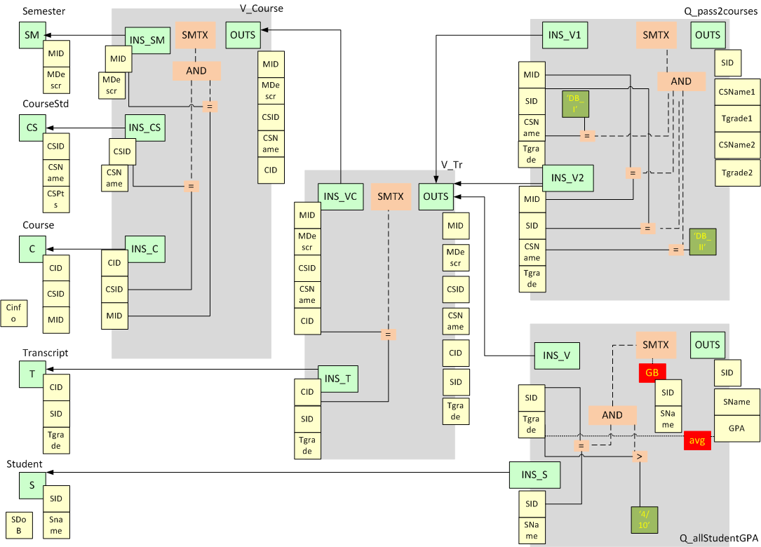
University E/S Architecture Graph
Notes:
Our ecosystem is described by the following image:
On the left we can see the Relations and their Attributes. On their right we see V_Course view where we use 3 of the relations. The V_Course view provides with Attributes the V_Tr view. The V_Tr view besides the V_Course view has as input the Transcript relation. Finally we can see on the upper most right part of the image the query that compares the grades of the students in DB_I & DB_II courses, and in the lower right part we see the query that gives the average grade of the students.
96

Slide 97
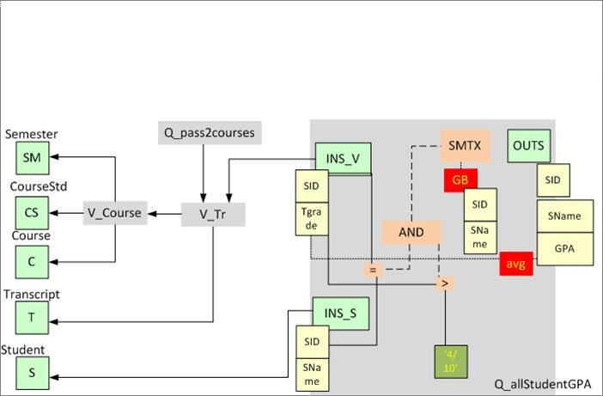
Architecture Graph
Modules and Module Encapsulation
Observe the input and output schemata!!
SELECT V.STUDENT_ID, S.STUDENT_NAME,
AVG(V.TGRADE) AS GPA
FROM V_TR V |><| STUDENT S ON STUDENT_ID
WHERE V.TGRADE > 4 / 10
GROUP BY V.STUDENT_ID, S.STUDENT_NAME
Notes:
A graph that describes the core parts of the ecosystem. We observe a query that gives the average grade of the courses that the students have attended and passed of our university ecosystem. The INS parts of the modules are the parts that are connected with provider modules. The OUTS part is the one that provides the answer to the users. Finally the SMTX part which represents the filters that the user wants to apply on the information (for example tgrade > 4/10).
97

Slide 98
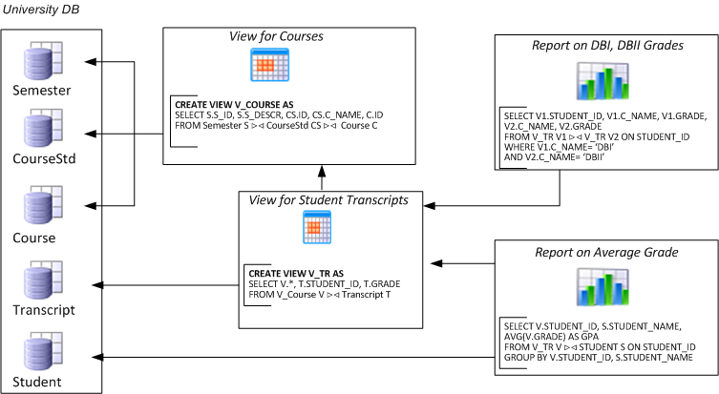
Policies to predetermine reactions
RELATION.OUT.SELF: on ADD_ATTRIBUTE then PROPAGATE;
RELATION.OUT.SELF: on DELETE_SELF then PROPAGATE;
RELATION.OUT.SELF: on RENAME_SELF then PROPAGATE;
RELATION.OUT.ATTRIBUTES: on DELETE_SELF then PROPAGATE;
RELATION.OUT.ATTRIBUTES: on RENAME_SELF then PROPAGATE;
VIEW.OUT.SELF: on ADD_ATTRIBUTE then PROPAGATE;
VIEW.OUT.SELF: on ADD_ATTRIBUTE_PROVIDER then PROPAGATE;
VIEW.OUT.SELF: on DELETE_SELF then PROPAGATE;
VIEW.OUT.SELF: on RENAME_SELF then PROPAGATE;
VIEW.OUT.ATTRIBUTES: on DELETE_SELF then PROPAGATE;
VIEW.OUT.ATTRIBUTES: on RENAME_SELF then PROPAGATE;
VIEW.OUT.ATTRIBUTES: on DELETE_PROVIDER then PROPAGATE;
VIEW.OUT.ATTRIBUTES: on RENAME_PROVIDER then PROPAGATE;
VIEW.IN.SELF: on DELETE_PROVIDER then PROPAGATE;
VIEW.IN.SELF: on RENAME_PROVIDER then PROPAGATE;
VIEW.IN.SELF: on ADD_ATTRIBUTE_PROVIDER then PROPAGATE;
VIEW.IN.ATTRIBUTES: on DELETE_PROVIDER then PROPAGATE;
VIEW.IN.ATTRIBUTES: on RENAME_PROVIDER then PROPAGATE;
VIEW.SMTX.SELF: on ALTER_SEMANTICS then PROPAGATE;
QUERY.OUT.SELF: on ADD_ATTRIBUTE then PROPAGATE;
QUERY.OUT.SELF: on ADD_ATTRIBUTE_PROVIDER then PROPAGATE;
QUERY.OUT.SELF: on DELETE_SELF then PROPAGATE;
QUERY.OUT.SELF: on RENAME_SELF then PROPAGATE;
QUERY.OUT.ATTRIBUTES: on DELETE_SELF then PROPAGATE;
QUERY.OUT.ATTRIBUTES: on RENAME_SELF then PROPAGATE;
QUERY.OUT.ATTRIBUTES: on DELETE_PROVIDER then PROPAGATE;
QUERY.OUT.ATTRIBUTES: on RENAME_PROVIDER then PROPAGATE;
QUERY.IN.SELF: on DELETE_PROVIDER then PROPAGATE;
QUERY.IN.SELF: on RENAME_PROVIDER then PROPAGATE;
QUERY.IN.SELF: on ADD_ATTRIBUTE_PROVIDER then PROPAGATE;
QUERY.IN.ATTRIBUTES: on DELETE_PROVIDER then PROPAGATE;
QUERY.IN.ATTRIBUTES: on RENAME_PROVIDER then PROPAGATE;
QUERY.SMTX.SELF: on ALTER_SEMANTICS then PROPAGATE;
Remove CS.C_NAME
Allow deletion
Allow addition
Add exam year
Policies to predetermine the modules’ reaction to a hypothetical event?

Slide 99
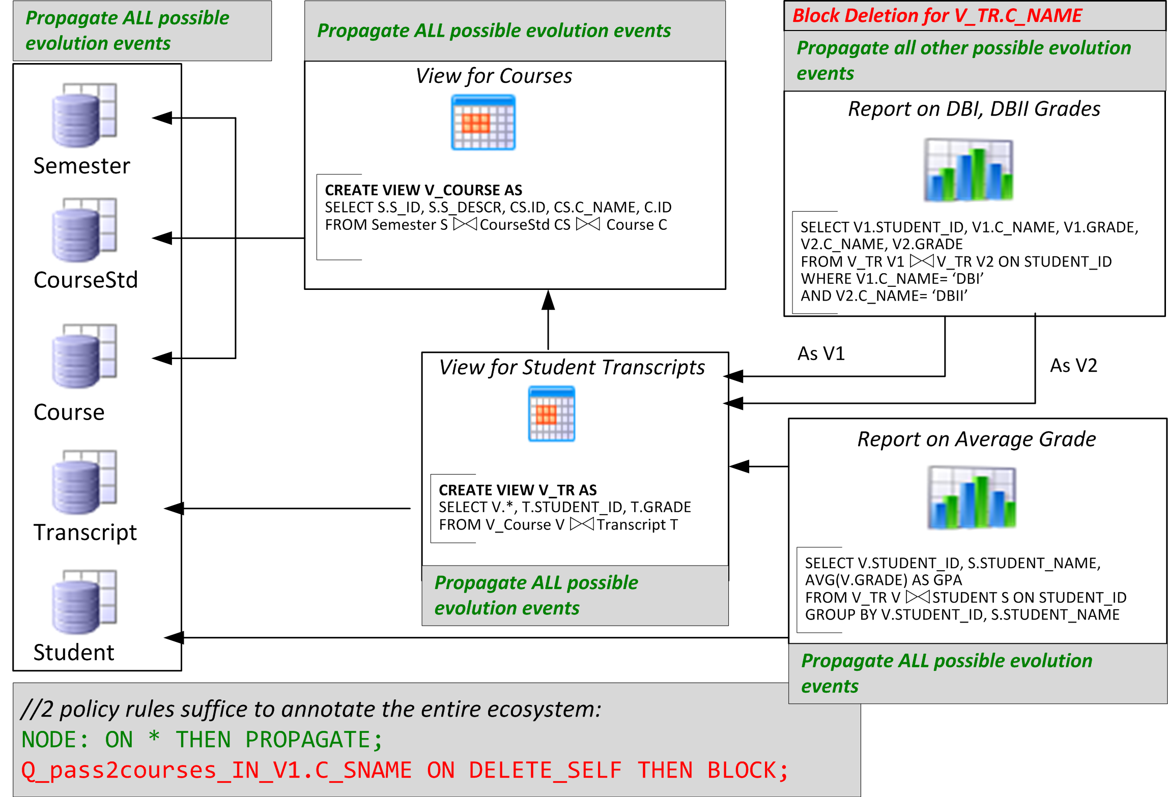
How to handle evolution?
Remove CS.C_NAME

Slide 100
Internals of impact assess. & rewriting
Impact assessment. Given a potential event, a status determination algorithm makes sure that the nodes of the ecosystem are assigned a status concerning (a) whether they are affected by the event or not and (b) what their reaction to the event is (block or propagate).
Conflict resolution and calculation of variants. Algorithm that checks the affected parts of the graph in order to highlight affected nodes with whether they will adapt to a new version or retain both their old and new variants.
Module Rewriting. Our algorithm visits affected modules sequentially and performs the appropriate restructuring of nodes and edges.
Notes:
Conflict resolution
Assume a view used by two queries is altered. Assume also that the first query vetoes the change and requires the structure and semantics of the old view to remain, whereas the second concedes to the change and states it will adapt to the new structure and semantics of the view. The co-existence of blocker and adapter data consumers of an affected module signifies the need to retain both the old and the new version of the module, whenever this is possible.
Rewritting
This is heavily dependent upon the nature of the event (obviously, a query adapts differently to the removal of an attribute and differently to the addition of an attribute, let alone changes in semantics).

Slide 101
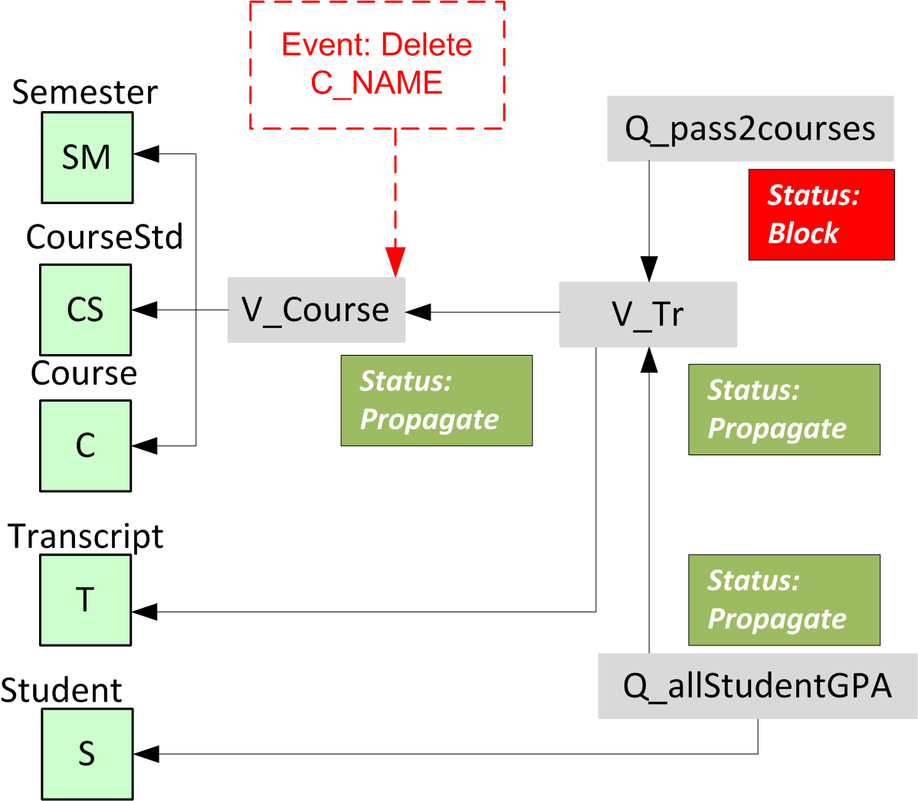
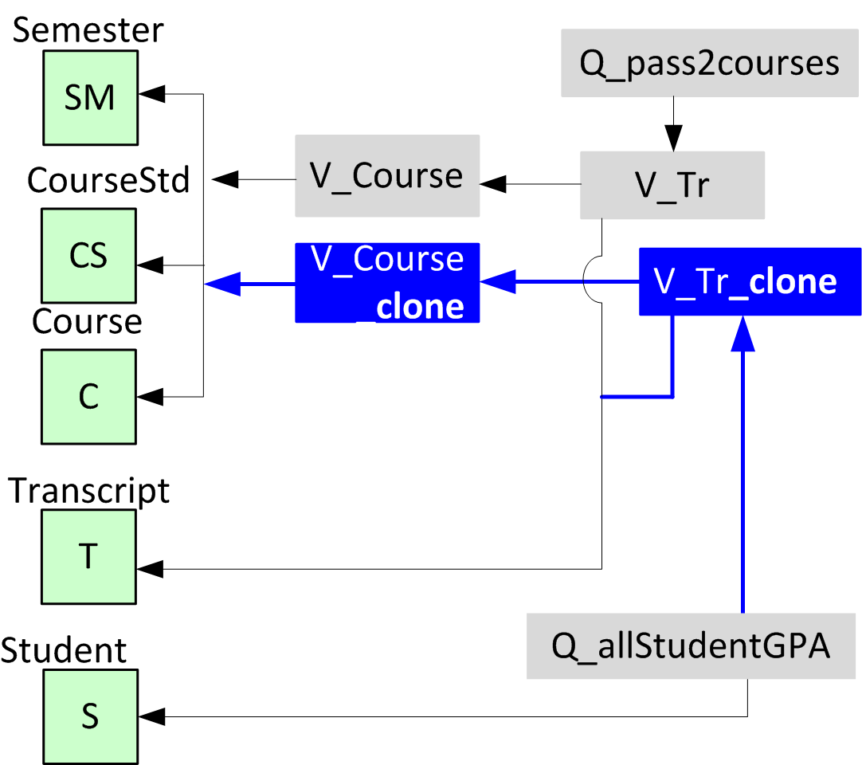
Impact assessment & rewriting

Slide 102
Conflicts: what they are and how to handle them (more than flooding)
BEFORE
AFTER
R
R
View0
n
View0
View0
View1
View2
n
n
View1
View2
View2
Query1
Query2
n
Query1
Query2
View0 initiates a change
View1 and View 2 accept the change
Query2 rejects the change
Query1 accepts the change
The path to Query2 is left intact, so that it retains it semantics
View1 and Query1 are adapted
View0 and View2 are adapted too, however, we need two version for each: one to serve Query2 and another to serve View1 and Query1
Notes:
102
Query 2 is a blocker while query1 accepts the change that was initiated by view0. Our issue is to satisfy both queries.

Slide 103
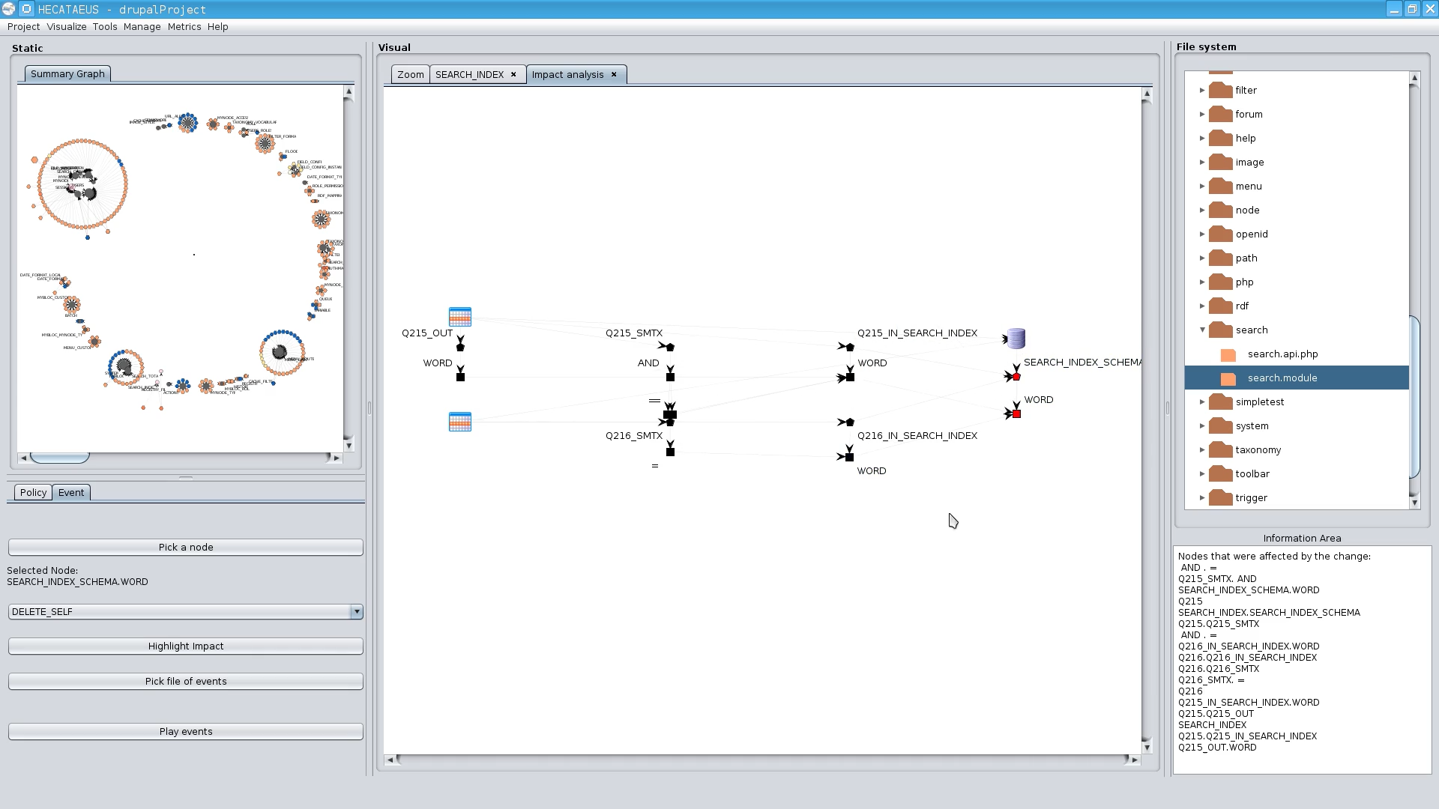
Played an impact analysis scenario: delete attr. ‘word’ from search_index
1. The table allowed the deletion, but…
2. Queries Q215 and Q216 vetoed

Slide 104
Other efforts
Maule et al @ ICSE 2008
The Prism/Prism++ line of research

Slide 105
Maule et al. @ ICSE’08
Given an OO app. built on top of a relational db schema and a change type
Produce the locations of the code that are affected
Method:
Slicing. A prototype slicing implementation to identify the database queries of the program.
A data-flow analysis algorithm to estimate all the possible runtime values for the parameters of the query.
Use an impact assessment tool, Crocopat, with a reasoning language (RML). Depending on the type of change, a different RML program that assesses impact over the stored data of the previous step is run: this isolates the lines of code affected by the change.

Slide 106
[On the side] code assumed to be of the form:

Slide 107
… whereas what you can get is …

Slide 108
Prism/Prism++
Series of works from the same authors
Carlo Curino, Hyun Jin Moon, Carlo Zaniolo. Graceful database schema evolution: the PRISM workbench. PVLDB 1(1): 761-772 (2008)
Carlo Curino, Hyun Jin Moon, Alin Deutsch, and Carlo Zaniolo. Update Rewriting and Integrity Constraint Maintenance in a Schema Evolution Support System: PRISM++. PVLDB, 4(2):117–128, 2010.
Carlo Curino, Hyun Jin Moon, Alin Deutsch, and Carlo Zaniolo. Automating the database schema evolution process. VLDB J., 22(1):73–98, 2013.

Slide 109
Prism/Prism++ motivation
Evolution happens all the time => can be viewed as a sequence of changes
Automatically migrate schema + data+ surrounding queries
Schema Modification Operators (SMO’s) are a principled set of operators to describe evolution steps, s.t.:
  The evolution DDL is implied by the SMO’s
  The DML for data migration can be automatically produced from the SMO’s
  The surrounding queries can be rewritten to the new schema
v1
v2
…
v_{n}

Slide 110
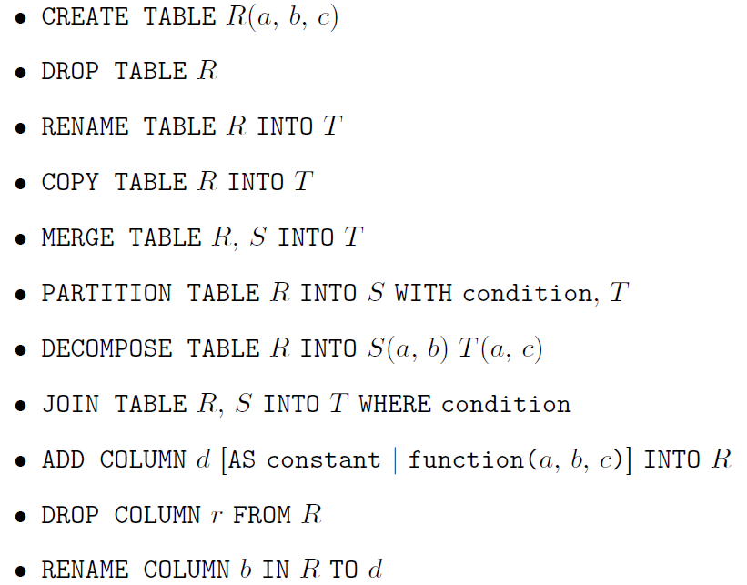
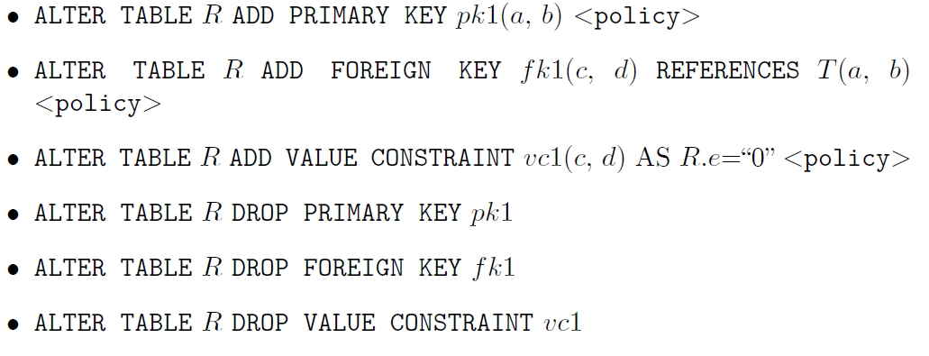
SMO’s and ICSMO’s
Automatic creation of
- DDL (schema evo)
- DML (data migration)
is feasible
ICSMO’s: the technique is extended to cover Integrity Constraints too.
<policy>
(i) CHECK if current
db satisfies the constraint, else ICMO is rolled back,
(ii) ENFORCE the removal of all data violating the constraint,
(iii) IGNORE violating tuples + informs the user about this.

Slide 111
Answering old queries to new schemata without user noticing it
q1
?
q1'
Assume we migrate the schema + data from v1 to v2
Can we rewrite the query q1 to q1’ s.t. we get the same result, as if we were still in v1?
v1
v2
SMO
SMO invertibility:
q1/v1 = q1 /SMO⁻¹(v2) = q1’ / v2
V1: R(…)
Q1: SELECT * FROM R
SMO: PARTITION R in S(…), T(…)
Q1’: SELECT * FROM S,T WHERE S.ID =T.ID

Slide 112
Empirical studies
Roadmap
Evolution of views
Data warehouse Evolution
  A case study (if time)
Impact assessment in ecosystems
Empirical studies concerning database evolution
Open Issues and discussions
A timeline of efforts concerning empirical studies
Results by Univ. Ioannina

Slide 113

What are the “laws” of database schema evolution?

Slide 114
What are the “laws” of database (schema) evolution?
How do databases change?
In particular, how does the schema of a database evolve over time?
Long term research goals:
  Are there any “invariant properties” (e.g., patterns of repeating behavior) on the way database (schemata) change?
  Is there a theory / model to explain them?

Slide 115
Why care for the “laws”/patterns of schema evolution?
Scientific curiosity!
Practical Impact: DB’s are dependency magnets. Applications have to conform to the structure of the db…
  typically, development waits till the “db backbone” is stable and applications are build on top of it
  slight changes to the structure of a db can cause several (parts of) different applications to crash, causing the need for emergency repairing

Slide 116
Imagine if we could predict how a schema will evolve over time…
… we would be able to “design for evolution” and minimize the impact of evolution to the surrounding applications
  by applying design patterns
  by avoiding anti-patterns & complexity increase
  … in both the db and the code
… we would be able to plan administration and perfective maintenance tasks and resources, instead of responding to emergencies
Notes:
Example for syntactic impact
relation removed causes direct failure in apps
Example for semantic impact
attribute insertion might add information that is not known and ignored by apps
Benefits by applying design patterns and by avoiding anti-patterns.
Anti patterns will lead to cumulative complexity for both db an applications that will eventually make the entire system decline and be replaced by other systems.
We can find out not only good ways to do stuff but we can see what is the matter with those that go bad and avoid it.

Slide 117
Why aren’t we there yet?
Historically, nobody from the research community had access + the right to publish to version histories of database schemata
Open source tools internally hosting databases have changed this landscape:
  not only is the code available, but also,
  public repositories (git, svn, …) keep the entire history of revisions
We are now presented with the opportunity to study the version histories of such “open source databases”

Slide 118
Timeline of empirical studies
Sjoberg
IST 93
Curino+
ICEIS08
Univ. Riverside
IWPSE09, ICDEW11
Qiu,Li,Su
FSE’13
Univ. Ioannina
CAiSE14, ER15
1993
2008
2009
2011
2013
2014
2015

Slide 119
Timeline of empirical studies
Sjoberg @ IST 93: 18 months study of a health system.
139% increase of #tables ; 274% increase of the #attributes
Changes in the code (on avg):
    relation addition: 19 changes ; attribute additions: 2 changes
    relation deletion : 59.5 changes; attribute deletions: 3.25 changes
An inflating period during construction where almost all changes were additions, and a subsequent period where additions and deletions where balanced.
Sjoberg
IST 93
Curino+
ICEIS08
Univ. Riverside
IWPSE09, ICDEW11
Qiu,Li,Su
FSE’13
Univ. Ioannina
CAiSE14, ER15
1993
2008
2009
2011
2013
2014
2015

Slide 120
Timeline of empirical studies
Curino+ @ ICEIS08: Mediawiki for 4.5 years
100% increase in the number of tables
142% in the number of attributes.
45% of changes do not affect the information capacity of the schema (but are rather index adjustments, documentation, etc)
Sjoberg
IST 93
Curino+
ICEIS08
Univ. Riverside
IWPSE09, ICDEW11
Qiu,Li,Su
FSE’13
Univ. Ioannina
CAiSE14, ER15
1993
2008
2009
2011
2013
2014
2015

Slide 121
Timeline of empirical studies
IWPSE09: Mozilla and Monotone (a version control system)
Many ways to be out of synch between code and evolving db schema
ICDEW11: Firefox, Monotone , Biblioteq (catalogue man.) , Vienna (RSS)
Similar pct of changes with previous work
Frequency and timing analysis: db schemata tend to stabilize over time, as there is more change at the beginning of their history, but seem to converge to a relatively fixed structure later
Sjoberg
IST 93
Curino+
ICEIS08
Univ. Riverside
IWPSE09, ICDEW11
Qiu,Li,Su
FSE’13
Univ. Ioannina
CAiSE14, ER15
1993
2008
2009
2011
2013
2014
2015

Slide 122
Timeline of empirical studies
Qiu,Li,Su@ FSE 2013: 10 (!) database schemata studied.
Change is focused both (a) with respect to time and (b) with respect to the tables who change.
Timing: 7 out of 10 databases reached 60% of their schema size within 20% of their early lifetime.
Change is frequent in the early stages of the databases, with inflationary characteristics; then, the schema evolution process calms down.
Tables that change: 40% of tables do not undergo any change at all, and 60%-90% of changes pertain to 20% of the tables (in other words, 80% of the tables live quiet lives). The most frequently modified tables attract 80% of the changes.
Sjoberg
IST 93
Curino+
ICEIS08
Univ. Riverside
IWPSE09, ICDEW11
Qiu,Li,Su
FSE’13
Univ. Ioannina
CAiSE14, ER15
1993
2008
2009
2011
2013
2014
2015

Slide 123
Timeline of empirical studies
Qiu,Li,Su@ FSE 2013: Code and db co-evolution, not always in synch.
Code and db changed in the same revision: 50.67% occasions
Code change was in a previous/subsequent version than the one where the database schema change: 16.22% of occasions
database changes not followed by code adaptation: 21.62% of occasions
11.49% of code changes were unrelated to the database evolution.
Each atomic change at the schema level is estimated to result in 10 -- 100 lines of application code been updated;
A valid db revision results in 100 -- 1000 lines of application code being updated
Sjoberg
IST 93
Curino+
ICEIS08
Univ. Riverside
IWPSE09, ICDEW11
Qiu,Li,Su
FSE’13
Univ. Ioannina
CAiSE14, ER15
1993
2008
2009
2011
2013
2014
2015

Slide 124
Timeline of empirical studies
To be detailed next.
CAiSE14: DB level
ER’15: Table level
Sjoberg
IST 93
Curino+
ICEIS08
Univ. Riverside
IWPSE09, ICDEW11
Qiu,Li,Su
FSE’13
Univ. Ioannina
CAiSE14, ER15
1993
2008
2009
2011
2013
2014
2015

Slide 125

Our take on the problem
Collected version histories for the schemata of 8 open-source projects
  CMS’s: MediaWiki, TYPO3, Coppermine, phpBB, OpenCart
  Physics: ATLAS Trigger --- Bio: Ensemble, BioSQL
Preprocessed them to be parsable by our HECATE schema comparison tool and exported the transitions between each two subsequent versions and measures for them (size, growth, changes)
Visualized the transitions in graphical representations and statistically studied the measures, both at the macro (database) and at the micro (table) level

Slide 126
Schema evolution for o/s db’s at the “macro” Level
.. What do we see if we observe the evolution of the entire schema?
http://www.cs.uoi.gr/~pvassil/publications/2014_CAiSE/
Skoulis, Vassiliadis, Zarras. Open-Source Databases: Within, Outside, or Beyond Lehman's Laws of Software Evolution? CAiSE 2014
Also: Growing up with stability: How open-source relational databases evolve. Information Systems, Volume 53, October–November 2015

Slide 127
Datasets
https://github.com/DAINTINESS-Group/EvolutionDatasets
Content management Systems
  MediaWiki, TYPO3, Coppermine, phpBB, OpenCart
Medical Databases
  Ensemble, BioSQL
Scientific
  ATLAS Trigger

Slide 128
Data sets
Dataset | Versions | Lifetime | Tables Start | Tables End | Attributes Start | Attributes End | Commits per Day | % commits with change | Repository URL
ATLAS Trigger | 84 | 2 Y, 7 M, 2 D | 56 | 73 | 709 | 858 | 0,089 | 82% | http://atdaq-sw.cern.ch/cgi-bin/viewcvs-atlas.cgi/offline/Trigger/TrigConfiguration/TrigDb/share/sql/combined_schema.sql
BioSQL | 46 | 10 Y, 6 M, 19 D | 21 | 28 | 74 | 129 | 0,012 | 63% | https://github.com/biosql/biosql/blob/master/sql/biosqldb-mysql.sql
Coppermine | 117 | 8 Y, 6 M, 2 D | 8 | 22 | 87 | 169 | 0,038 | 50% | http://sourceforge.net/p/coppermine/code/8581/tree/trunk/cpg1.5.x/sql/schema.sql
Ensembl | 528 | 13 Y, 3 M, 15 D | 17 | 75 | 75 | 486 | 0,109 | 60% | http://cvs.sanger.ac.uk/cgi-bin/viewvc.cgi/ensembl/sql/table.sql?root=ensembl&view=log
MediaWiki | 322 | 8 Y, 10 M, 6 D | 17 | 50 | 100 | 318 | 0,100 | 59% | https://svn.wikimedia.org/viewvc/mediawiki/trunk/phase3/maintenance/tables.sql?view=log
OpenCart | 164 | 4 Y, 4 M, 3 D | 46 | 114 | 292 | 731 | 0,104 | 47% | https://github.com/opencart/opencart/blob/master/upload/install/opencart.sql
phpBB | 133 | 6 Y, 7 M, 10 D | 61 | 65 | 611 | 565 | 0,055 | 82% | https://github.com/phpbb/phpbb3/blob/develop/phpBB/install/schemas/mysql_41_schema.sql
TYPO3 | 97 | 8 Y, 11 M, 0 D | 10 | 23 | 122 | 414 | 0,030 | 76% | https://git.typo3.org/Packages/TYPO3.CMS.git/history/TYPO3_6-0:/t3lib/stddb/tables.sql

Slide 129
Hecate: SQL schema diff viewer
Parses DDL files
Creates a model for the parsed SQL elements
Compares two versions of the same schema
Reports on the diff performed with a variety of metrics
Exports the transitions that occurred in XML format
  https://github.com/DAINTINESS-Group/Hecate

Slide 130
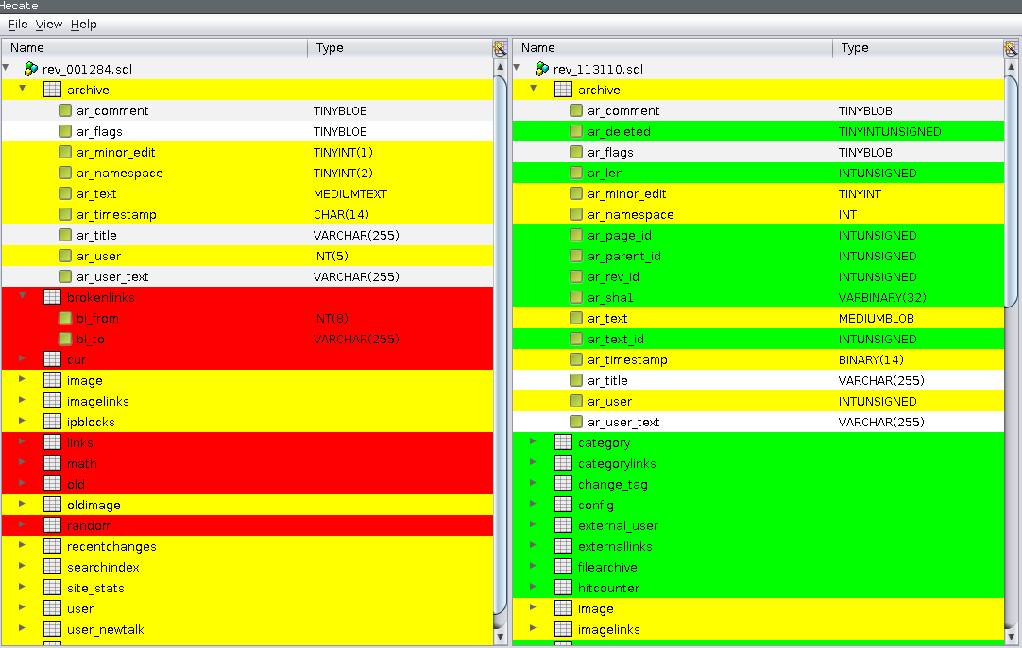
Hecate: SQL schema diff viewer

Slide 131
Schema Size (relations)

Slide 132
Schema Growth (diff in #tables)
Notes:
Small growth for relations
Too many occurrences of zero growth
no periods of continuous change but we have small spikes
Average value close to zero (++ zipfian model)
Immediate + delta is followed with immediate - delta
Oscillations do exist; still much more on + axis
we cannot see patterns of smooth growth interrupted by perfective maintenance

Slide 133
Change over time
Notes:
BioSQL (2nd row, last) is an exception to 1st law
Large gaps of stability (inactivity) in all datasets
Apart from phpBB (3rd row, 1st), age results in less activity; density of activity drops

Slide 134

Main results
Schema size (#tables, #attributes) supports the assumption of a feedback mechanism
Schema size grows over time; not continuously, but with bursts of concentrated effort
Drops in schema size signifies the existence of perfective maintenance
Regressive formula for size estimation holds, with a quite short memory
Schema Growth (diff in size between subsequent versions) is small!!
Growth is small, smaller than in typical software
The number of changes for each evolution step follows Zipf’s law around zero
Average growth is close (slightly higher) to zero
Patterns of change: no consistently constant behavior
Changes reduce in density as databases age
Change follows three patterns: Stillness, Abrupt change (up or down), Smooth growth upwards
Change frequently follows spike patterns
Complexity does not increase with age
Grey for results requiring further search
Notes:
Divide findings in two categories:
-High Certainty
-need further work (grey)
We avoid the term law – don’t have unshakable evidence of their existence, we don’t have clear understanding of mechanisms

Slide 135
Observing the evolution of o/s db schemata at the micro level
.. What do we see if we observe the evolution of individual tables?
http://www.cs.uoi.gr/~pvassil/publications/2015_ER
Vassiliadis, Zarras, Skoulis. How is Life for a Table in an Evolving Relational Schema? Birth, Death & Everything in Between.
To appear in ER 2015

Slide 136
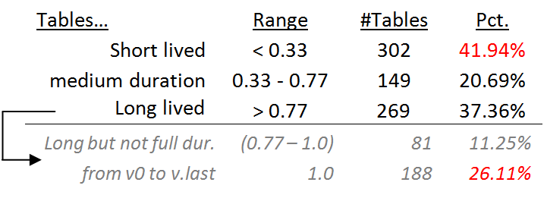
Statistical study of durations
Short and long lived tables are practically equally proportioned
Medium size durations are few!
Long lived tables are mostly survivors (see on the right)
One of the fascinating revelations of this measurement was that there is a 26.11% fraction of tables that appeared in the beginning of the database and survived until the end.
In fact, if a table is long-lived there is a 70% chance (188 over 269 occasions) that it has appeared in the beginning of the database.

Slide 137
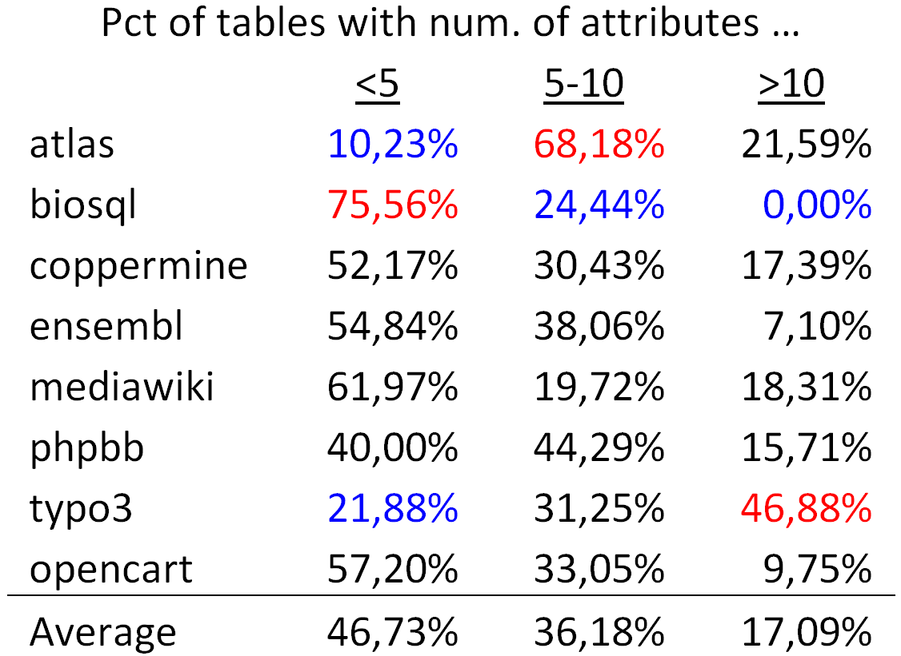
Tables are mostly thin
On average, half of the tables (approx. 47%) are thin tables with less than 5 attributes.
The tables with 5 to 10 attributes are approximately one third of the tables' population
The large tables with more than 10 attributes are approximately 17% of the tables.

Slide 138

The $Gamma$ Pattern:
"if you 're wide, you survive"
The $Gamma$ phenomenon:
  tables with small schema sizes can have arbitrary durations, //small size does not determine duration
  larger size tables last long
Observations:
  whenever a table exceeds the critical value of 10 attributes in its schema, its chances of surviving are high.
  in most cases, the large tables are created early on and are not deleted afterwards.
Notes:
- Small schema size does not determine duration;
- large schema sizes are very strongly related to survival and large durations (this is called a $Gamma$ pattern).

Slide 139
These exceptions are due to the fact that they do not exceed 10 attributes

Slide 140
The Comet Pattern
“Comet “ for change over schema size with:
a large, dense, nucleus cluster close to the beginning of the axes, denoting small size and small amount of change,
medium schema size tables typically demonstrating medium to large change
The tables with the largest amount of change are typically tables whose schema is on average one standard deviation above the mean
wide tables with large schema sizes demonstrating small to medium (typically around the middle of the y-axis) amount of change.
Notes:
"it is possible that a fact-carrying table of medium schema size, is augmented a lot to carry more information"

Slide 141
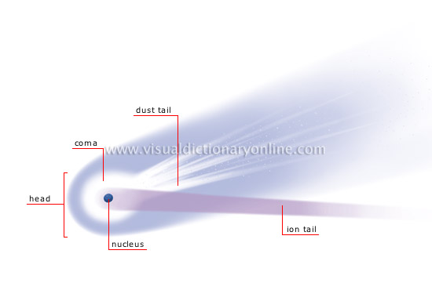
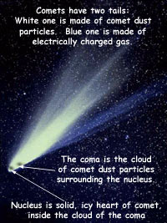
http://visual.merriam-webster.com/astronomy/celestial-bodies/comet.php
http://spaceplace.nasa.gov/comet-nucleus/en/

Slide 142
The inverse $Gamma$ pattern
The correlation of change and duration is as follows:
  small durations come necessarily with small change,
  large durations come with all kinds of change activity and
  medium sized durations come mostly with small change activity (inverse $Gamma$).
Notes:
The \emph{inverse} $Gamma$ phenomenon: tables with small duration undergo small change, tables with medium duration undergo small or medium change, and, long-lived tables demonstrate all kinds of change behavior.

Slide 144
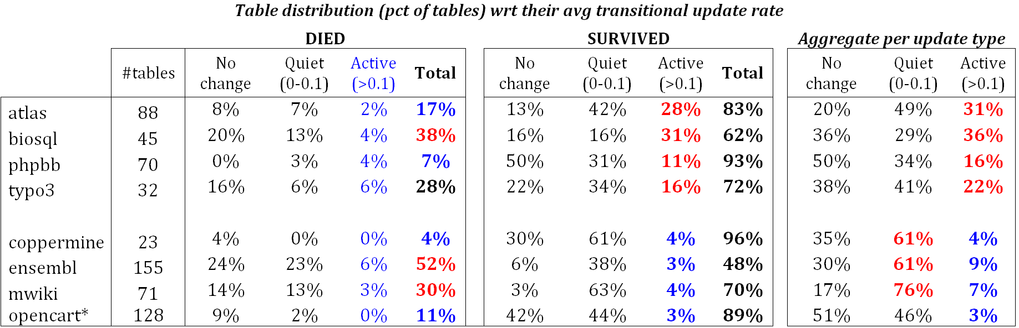
Quiet tables rule, esp. for mature db’s
Non-survivors
Sudden deaths mostly
Quiet come ~ close
Too few active
Survivors
Quiet tables rule
Rigid and active then
Active mostly in “new” db’s
Mature DB’s: the pct of active tables drops significantly

Slide 145
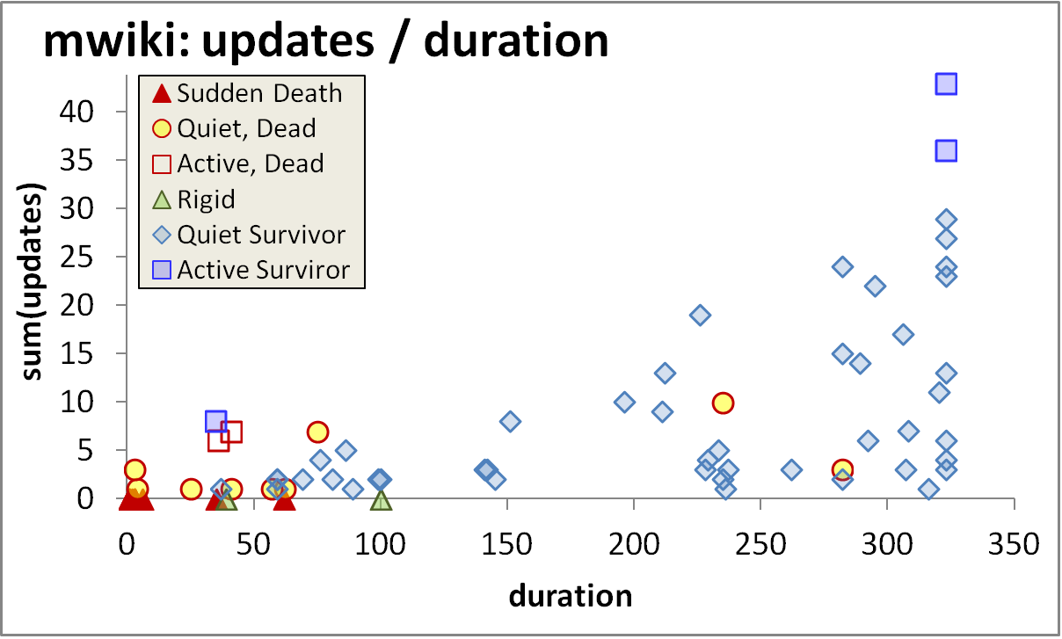
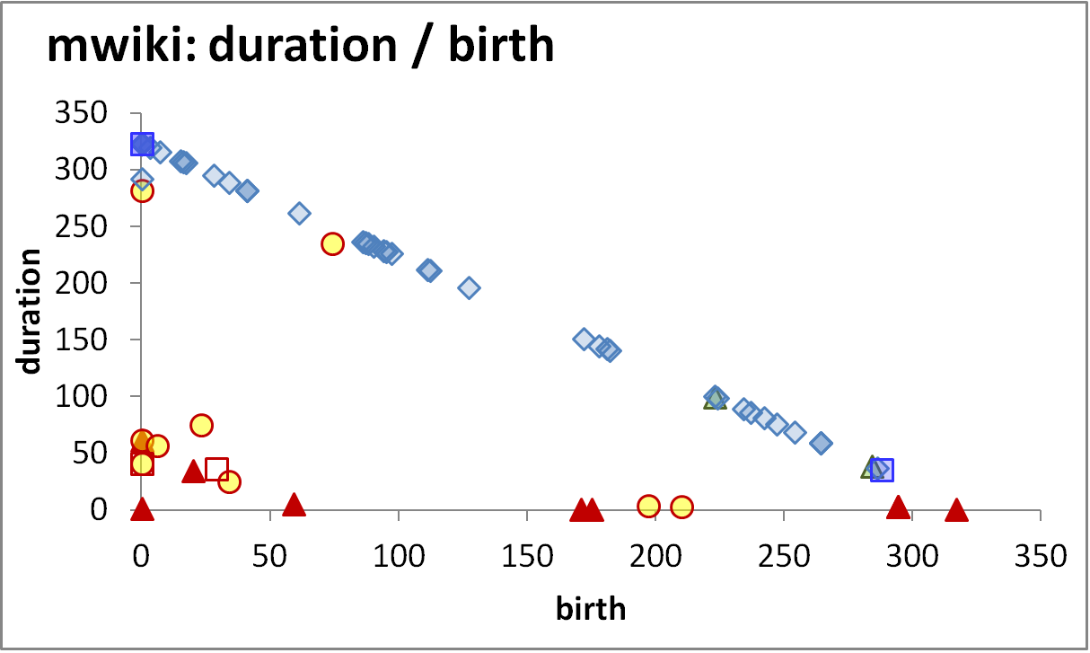
Longevity and update activity correlate !!
Top changers live long
Remember: top changers are defined as such wrt ATU (AvgTrxnUpdate), not wrt sum(changes)
Still, they dominate the sum(changes) too! (see top of inverse Γ)
See also upper right blue part of diagonal: too many of them are born early and survive => live long!
Too many top changers are born early
Birth rate drops over time
Deleted tables are born early & last short

Slide 146
Longevity and update activity correlate !!
Top changers live long
Empty space: high change rates are only for early born & long lived
The few top-changers (in terms of ATU) ….
are long lived,
typically come from the early versions of the database
due to the combination of high ATU and duration => they have high total amount of change, and,
frequently start with medium schema sizes (not shown here)
Too many top changers are born early
Birth rate drops over time
Deleted tables are born early & last short

Slide 147
Die young
and suddenly
Empty space: high change rates are only for early born & long lived
There is a very large concentration of the deleted tables in a small range of newly born, quickly removed, with few or no updates…
…. resulting in very low numbers of removed tables with medium or long durations (empty triangle).
Deleted tables last short & do not change a lot
An empty triangle: no deleted tables with large or even modest durations
Deleted tables are born early & last short

Slide 148
Die young
and suddenly
[Early life of the db] There is a very large concentration of the deleted tables in a small range of newly born, quickly removed, with few or no updates, resulting in very low numbers of removed tables with medium or long durations.
[Mature db] After the early stages of the databases, we see the birth of tables who eventually get deleted, but they mostly come with very small durations and sudden deaths.
Deleted tables last short & do not change a lot
Few short lived tables are born and die in the mature life of the db
Deleted tables are born early & last short

Slide 149
Survive long enough &
you ‘re probably safe
Too rare to see deletions!
It is quite rare to see tables being removed at old age
Typically, the area of high duration is overwhelmingly inhabited by survivors (although each data set comes with a few such cases )!
High durations are overwhelmingly blue!
Only a couple of deletions are seen here!

Slide 150
All in one
Top changers live long
Empty space: high change rates are only for early born & long lived
Early stages of the database life are more "active" in terms of births, deaths and updates, and have higher chances of producing deleted tables.
After the first major restructuring, the database continues to grow; however, we see much less removals, and maintenance activity becomes more concentrated and focused.
Deleted tables last short & do not change a lot
Top changers are born early
An empty triangle: no deleted tables with large or even modest durations
Deleted tables are born early & last short
Birth rate drops over time

Slide 152
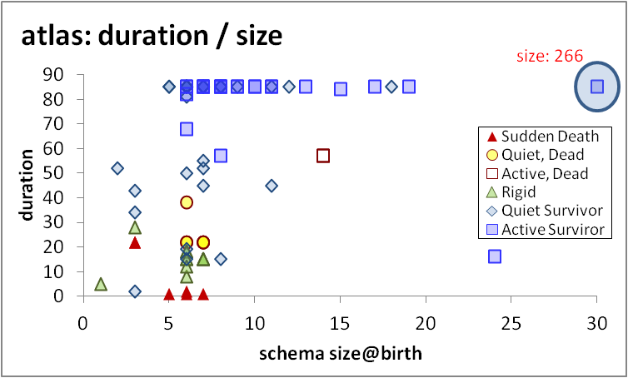
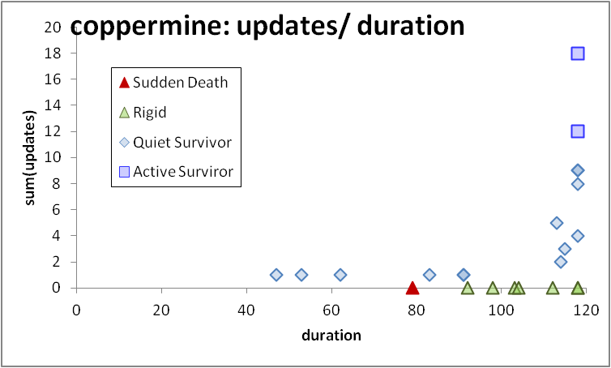
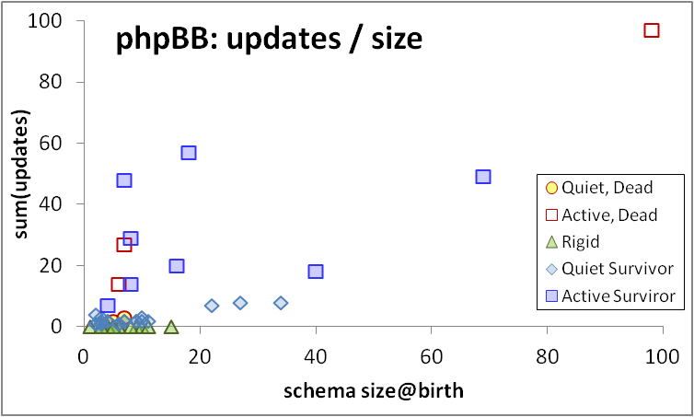
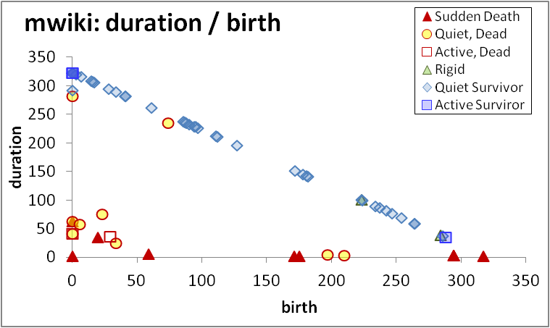
$Gamma$ Inv. $Gamma,
Comet Empty Triangle

Slide 153
Open issues
Roadmap
Evolution of views
Data warehouse Evolution
  A case study (if time)
Impact assessment in ecosystems
Empirical studies concerning database evolution
Open Issues and discussions
Where we stand
Open issues
… and discussions …

Slide 154
Where we stand
We know to handle evolving materialized views
And we also know to handle simple cases of DW evolution
We have started some work on handling evolving ecosystems
We have a first glimpse of the mechanics of database evolution

Slide 155
svn/git for db schemata
The versioning tale says: keep the history of previous schemata available, as this can allow the automation of query/application migration/forward-engineering and the translation of old data to a new structure.
When it comes to software, svn/git paradigm is the undisputed champion:
  You make branches for concurrent development
  Collisions are automatically detected
  Different versions can be merged
  You can refer to a particular version of the code easily
How does this apply to databases and application development for databases?
Is it really worth the trouble?

Slide 156
Schema curation and preservation
Data curation and preservation is a very large topic on its own
If we focus only at the schema part, and assuming we want to support history management for database schemata, how do we implement it?
SMO’s can be the key for altering a db schema in a way that history can be replayed backwards / forward
  Catch: meta information and functional dependencies are key to these methods. Need to pay the price for them.
But how can we handle the data efficiently then?

Slide 157
Are there “laws” of schema evolution?
Collect more test cases
Tools for the automation of the process
  Extract changes & verify their correctness (what happened)
  Link changes to expressed user req’s / bugs / … (why it happened & by whom)
  Extract sub-histories of focused maintenance (how it happened & when)
  Co-change of schema and code (what is affected in the code)
  Visualization
Consolidate the fundamental laws that govern evolution && forecast it (what will change)

Slide 158
Management of ecosystems’ evolution
Can we find these constructs that are most sensitive to evolution?
  Metrics for sensitivity to evolution?
Automation of the reaction to changes
  self-monitoring
  impact prediction
  auto-regulation (policy determination)
  self-repairing

Slide 159
Current trends in data management
How will the area of schema evolution be affected by the trends in the area of data management?
First, we need to agree on how the future will look like…
Open for discussion

Slide 160
What about DW evolution?
How do current trends in DW technology relate to schema evolution?
Largely depends on how different / unique DW’s will be contrasted to
  what they look like now
  what databases will be in the future
Open for discussion

Slide 161
Take Away Message
Evolution is viciously omnipresent; due to its huge impact, it is leading to non-evolvable (rigid) data & software structures
Practically:
  Plan for evolution, well ahead of construction
  So far, our solutions and tools help only so much
  Industry not likely to help
This is why we can and have to do research
  We can do pure scientific research to find laws
  We can do practical work for tools and methods that reduce the pain

Slide 162
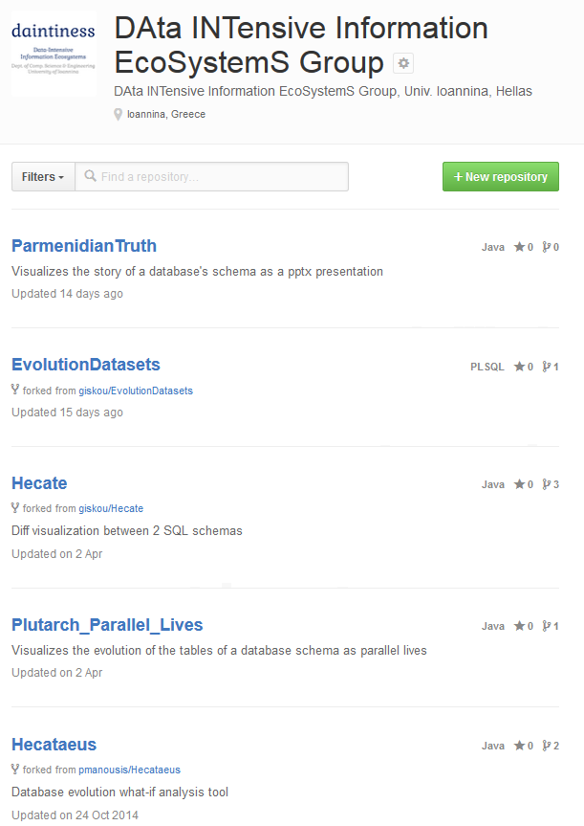
Thank you!
Q&A
https://github.com/DAINTINESS-Group/
http://www.cs.uoi.gr/~pvassil/
DB Schema Evolution
Data sets, Code, Results
publications/2014_CAiSE/
publications/2015_ER
Architecture Graphs && Hecataeus’
projects/hecataeus/

