Slide 1

A study on the effect of a table's involvement in foreign keys to its schema evolution
Konstantinos Dimolikas, Apostolos V. Zarras, Panos Vassiliadis
Department of Computer Science and Engineering
University of Ioannina, Hellas
39th International Conference on Conceptual Modeling (ER 2020), 3-6 Nov. 2020
http://www.cs.uoi.gr/~pvassil/publications/2020_ER_FK/
http://www.cs.uoi.gr/~pvassil/projects/schemaBiographies/

Slide 2
Body of Knowledge on Schema Evolution
The literature on Schema Evolution for the relational realm is limited, and mainly focused on the evolution of the entire schema in FoSS systems: schemata grow slowly over time, and, in fact with decreasing rate and alterations of change periods (mostly table insertions and updates) with long periods of calmness
For Foreign Keys and Evolution: we presented the first paper ever, in ER’17, showing that FK’s are not always welcome (frequently absent, even removed); there is also a relationship of higher activity for tables involved with many FK’s
http://www.cs.uoi.gr/~pvassil/projects/schemaBiographies/

Slide 3

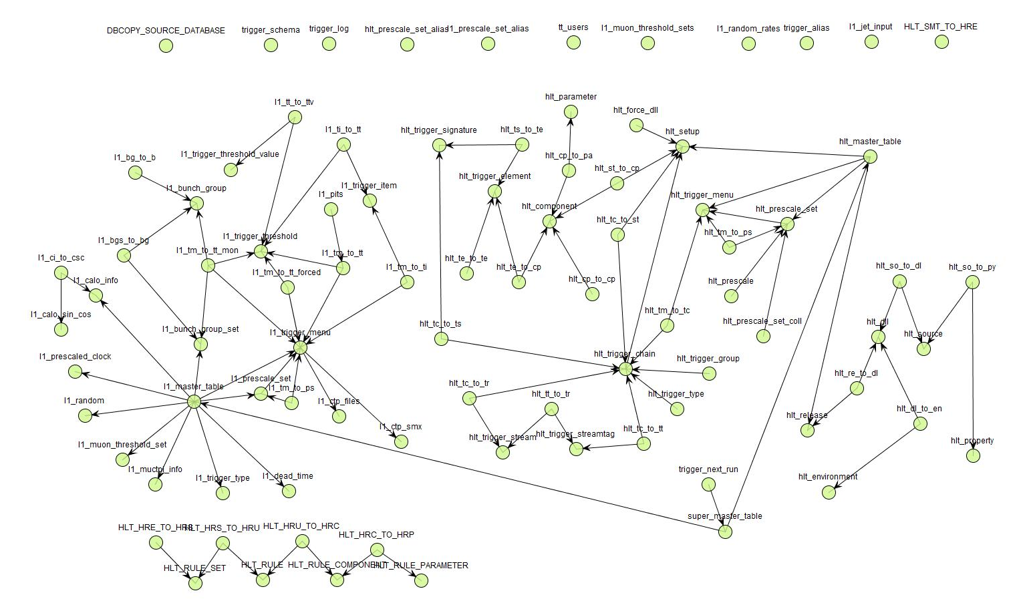
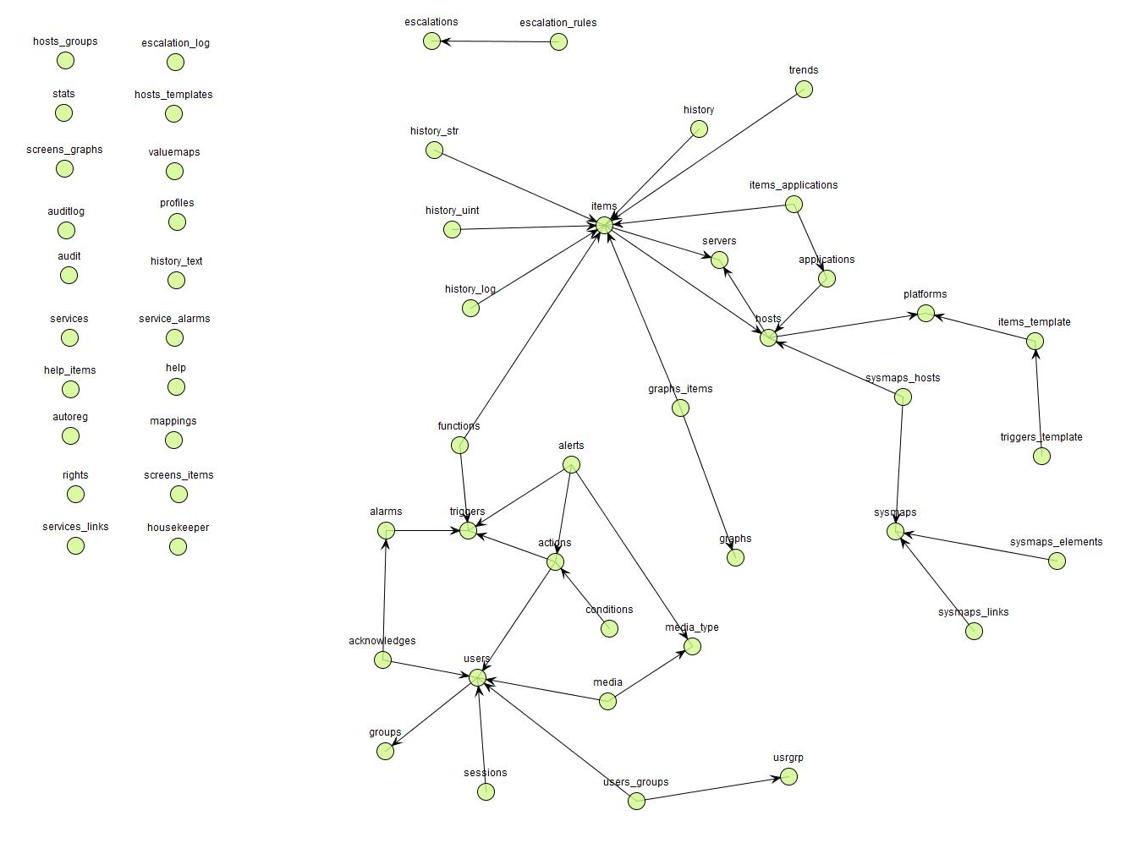
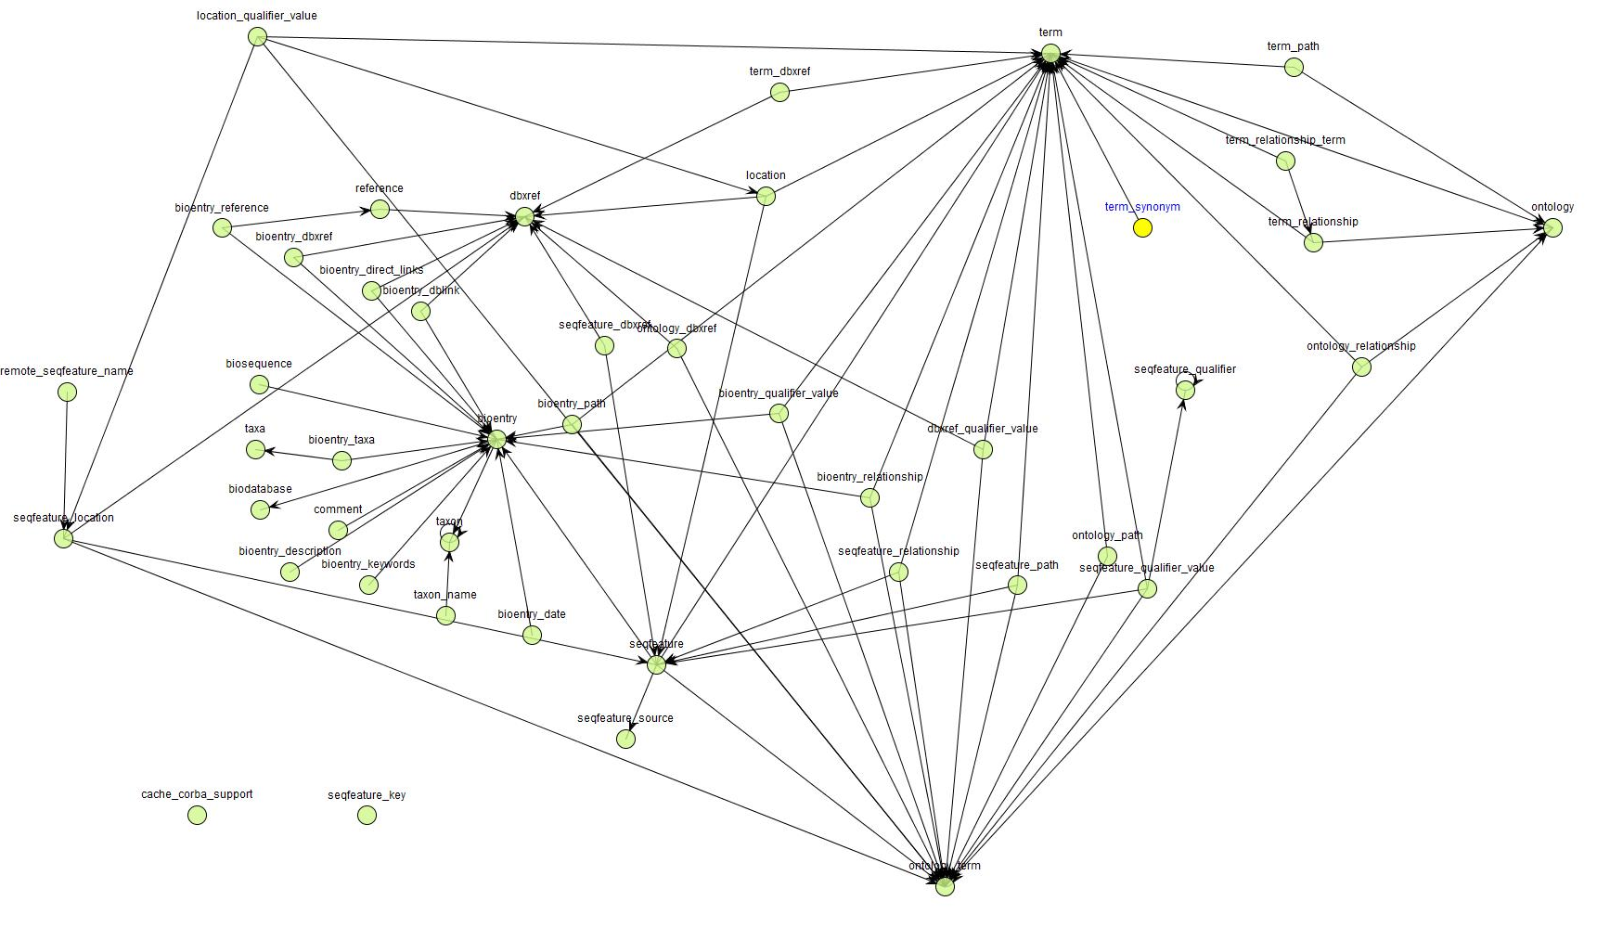
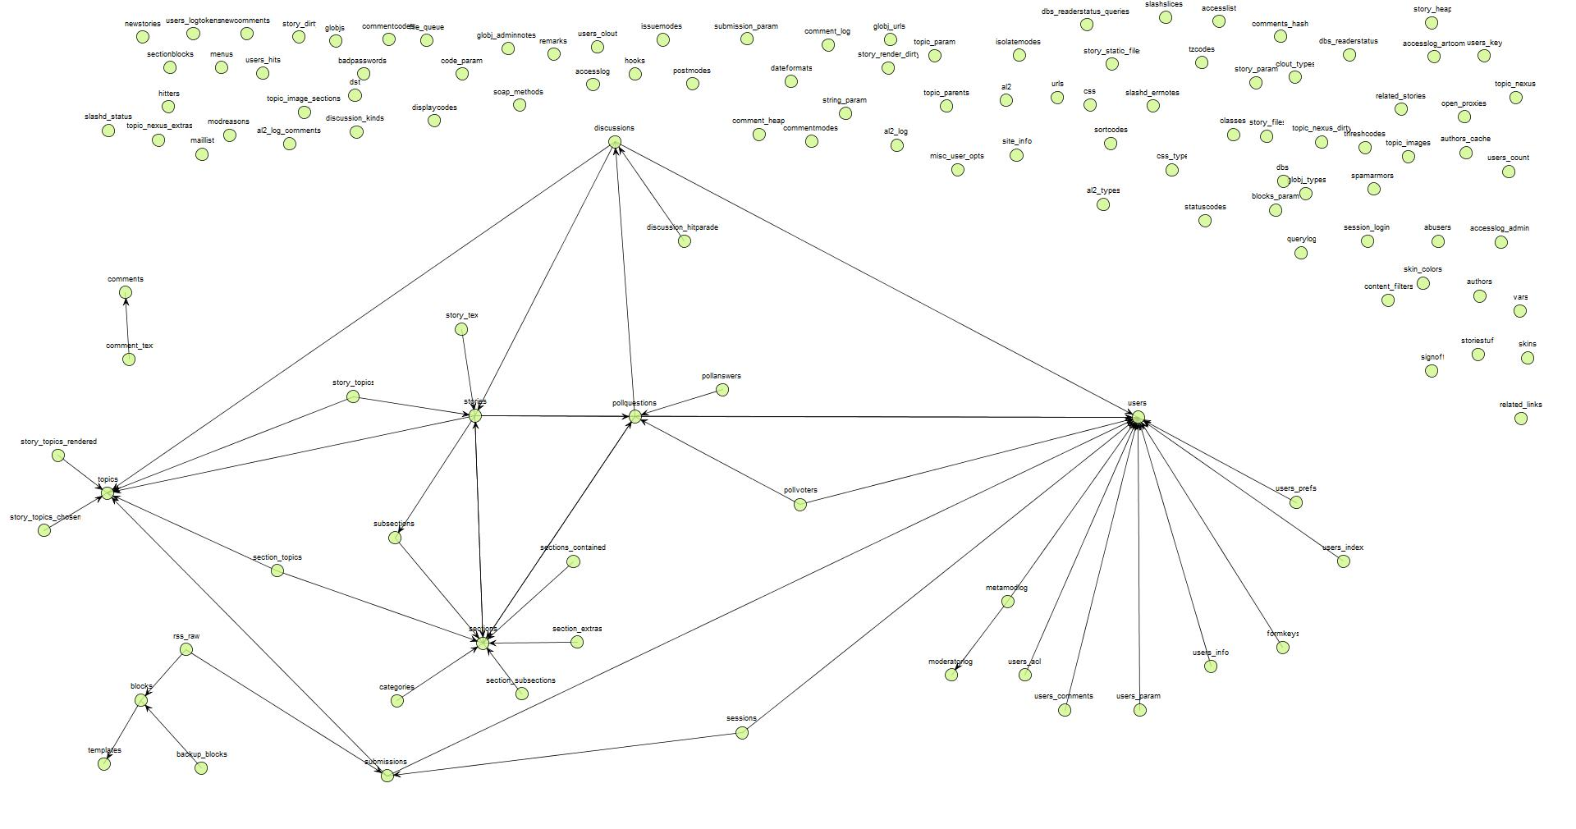
How is the structure of the foreign keys to which a table is related affecting its behavior during schema evolution?
Atlas
Zabbix
Biosql
SlashCode

Slide 4
Method overview
We study the histories of 6 relational schemata of significant durations and variable characteristics
We extract
  births and deaths of the tables,
  intra-table updates (attribute additions, deletions, data type and primary key updates)
  foreign keys and their changes
We model tables and foreign keys as nodes and edges on a graph
We relate the position of the tables in the graph to evolutionary characteristics

Slide 5
Results
We introduce a taxonomy of topological patterns with respect to how a table is positioned on the schema graph, with a direct relationship to how tables evolve
Our taxonomy practically introduces a spectrum of topological complexity & we show that evolutionary behavior is correlated with a hierarchy of topological complexity:
  Topologically complex tables appear to be fewer, active and born only early
  Tables with a simpler topology are more in numbers, less active and with higher chances to be born later in the life of the db

Slide 6
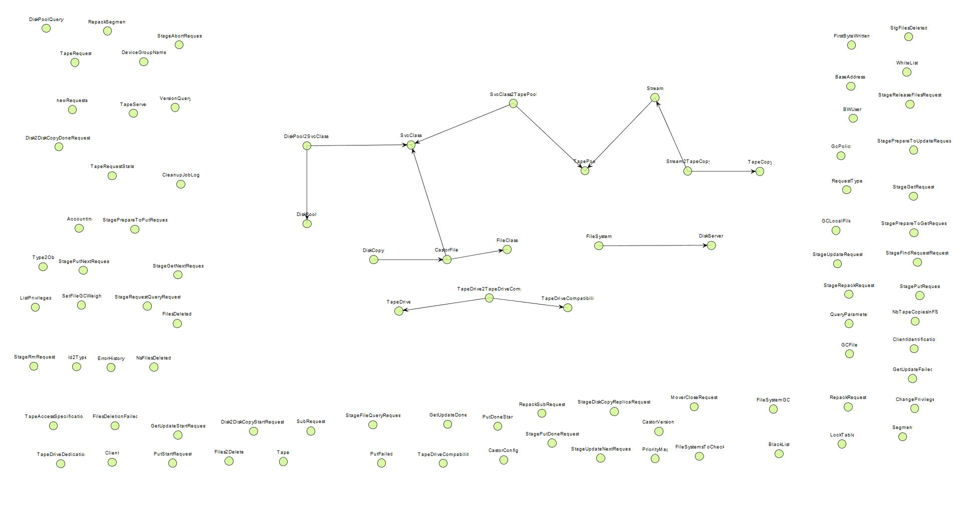
Study Setup
Atlas
Zabbix
Castor
Context and background
Study Setup
Topological Patterns
Topology and Evolution
Conclusions

Slide 7
Setup of our study
Scope & generalization:
  Collected histories (i.e., sequence of versions) of relational schemata being part of free open-source software (and not proprietary ones) coming with…
  … fairly long history
  … different domains, treatment of foreign keys, growth over time
  Domains
    Science (Atlas, BioSQL)
    Computational Resource Toolkits (Castor, Egee)
    CMS’s (Slashcode, Zabbix)
Changes extracted
  births and deaths of the tables,
  intra-table updates (attribute additions, deletions, data type and primary key updates)
  foreign keys and their changes
We should be very careful to not overgeneralize findings to proprietary databases!

Slide 8
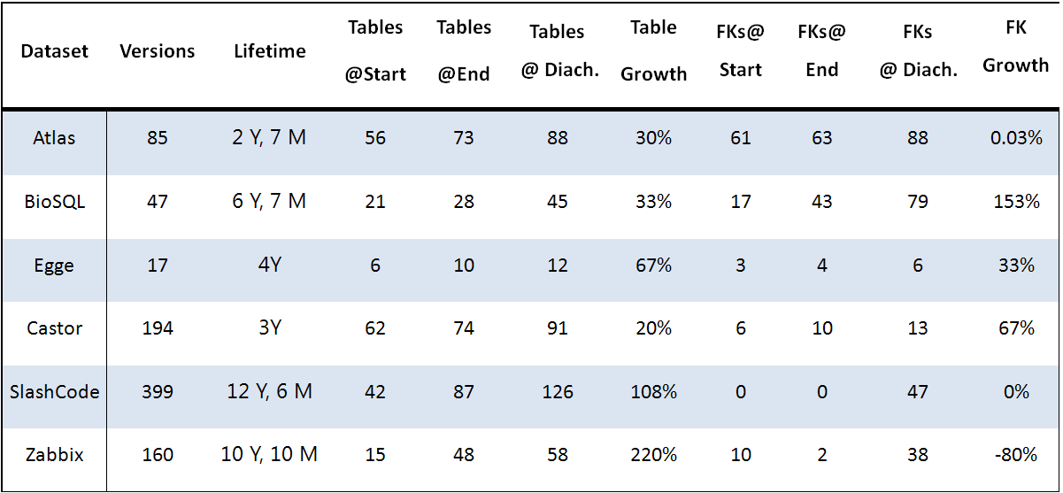
Datasets
Cover from 17 to 399 schema versions
Growth in number of tables from 19% to 220%
Growth in number of foreign keys with 2 exceptions

Slide 9
Toolset
  Some preprocessing was occasionally needed to allow the parsing of schema histories
Used out homegrown toolset to extract changes
  Hecate, a tool to extract the history of changes for tables
https://github.com/DAINTINESS-Group/Hecate
  Parmenidian Truth, a tool to extract the history of changes for foreign keys
https://github.com/DAINTINESS-Group/ParmenidianTruth
  Parmenidian Truth is also able to visualize the schema history as a PowerPoint/video file
All the data are available at:
https://github.com/DAINTINESS-Group/EvolutionDatasets

Slide 10
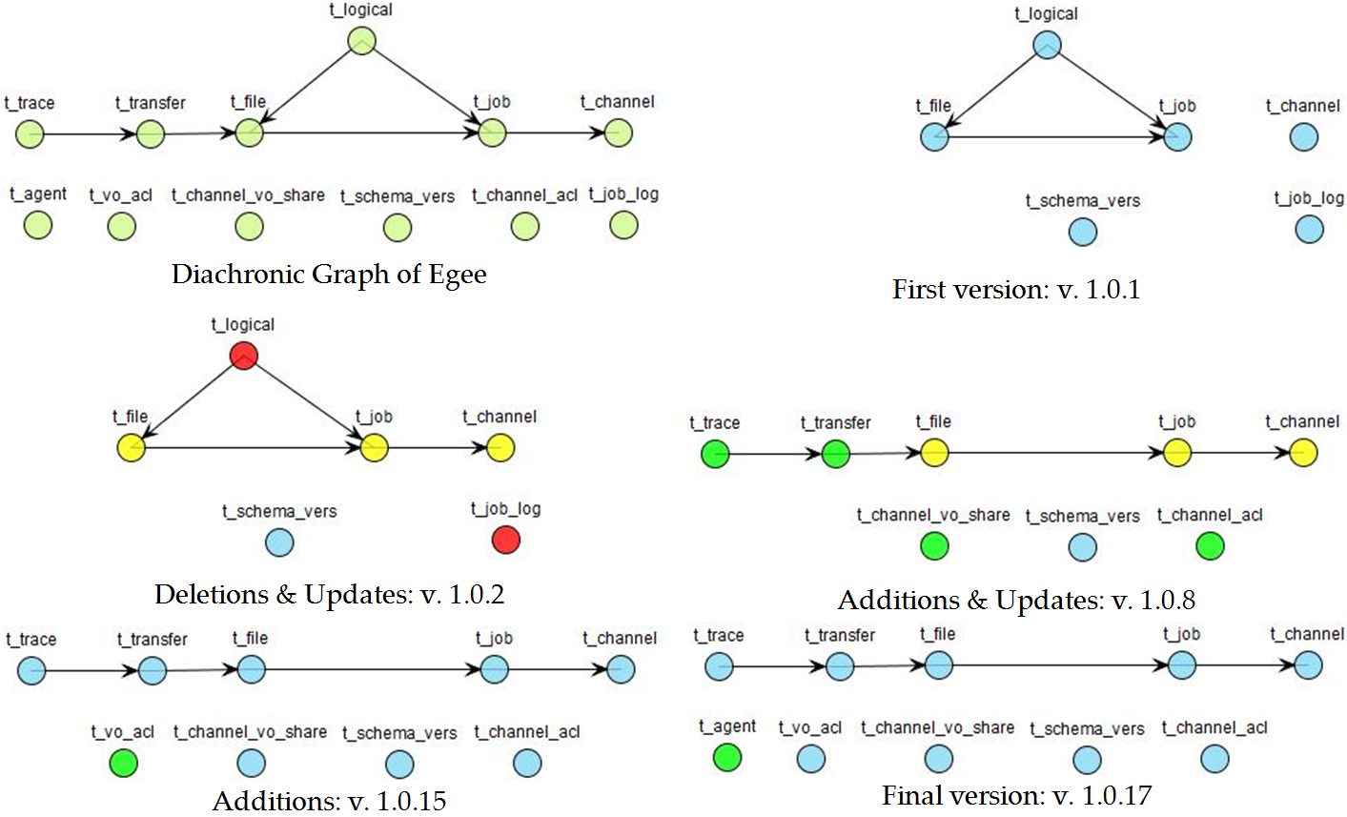
Graph modeling for evolving schemata with FK’s
(bonus: the story of Egee in one slide)

Slide 11
Topological
Patterns
Atlas
Zabbix
Castor
Context and background
Study Setup
Topological Patterns
Topology and Evolution
Conclusions

Slide 12
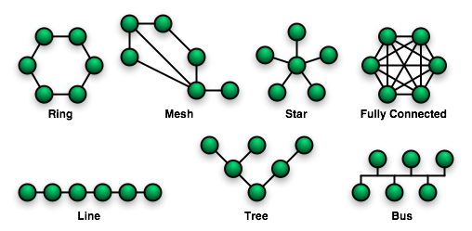
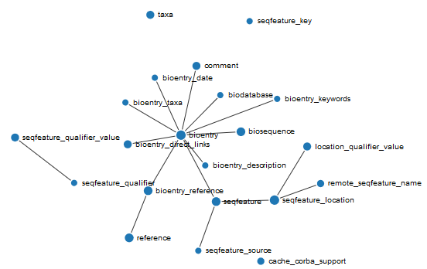
Definition of Topology
In network theory, topology is defined as the arrangement of a network’s nodes and links
In our work, a table’s (node’s) topology describes the pattern of edges (FKs) surrounding it
Source: https://commons.wikimedia.org/wiki/File:NetworkTopologies.png

Slide 13
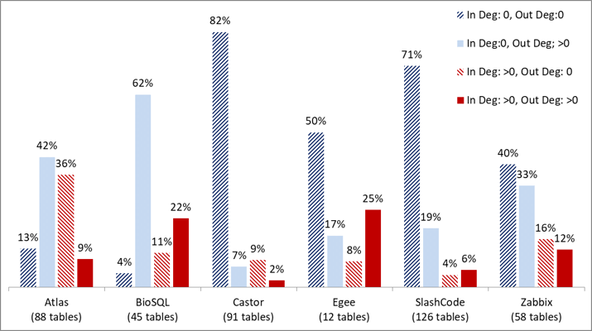

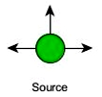
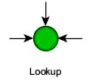
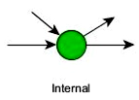
Table Topology
Defined 4 topological categories for the tables of a schema
  Isolated tables with no inciting edges
  Source tables with only outgoing edges
  Lookup tables with only incoming edges
  Internal with at least 1 incoming and 1 outgoing edges

Slide 14
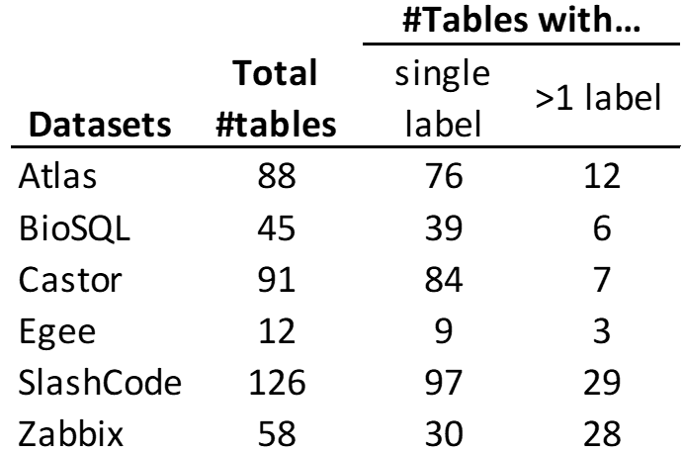
The problem of how to label tables with their topol. category
Given just a single graph as input, the labeling of the tables is straightforward with a single pass over the nodes, as the categories are disjoint and independent of a node's neighborhood.
Given a schema history, the labeling problem is different, as a table can change labels over time
Unexpectedly, this is rather rare
We have manually inspected all cases
& assigned a single label to each case
by exploiting the patterns of change

Slide 15
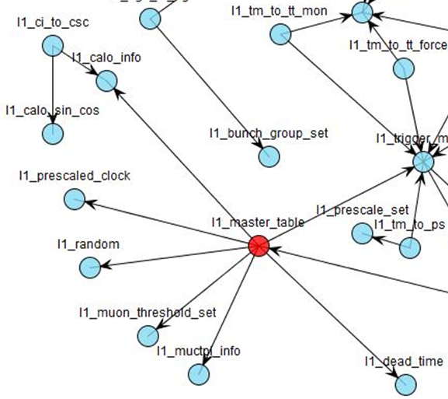
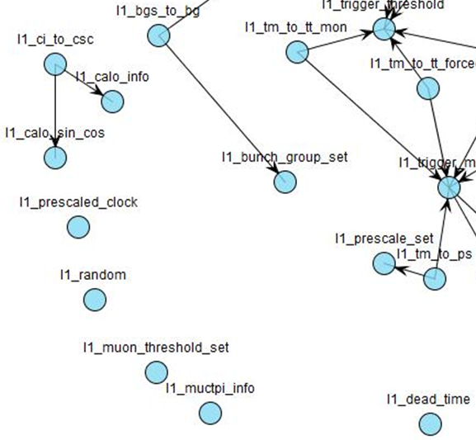
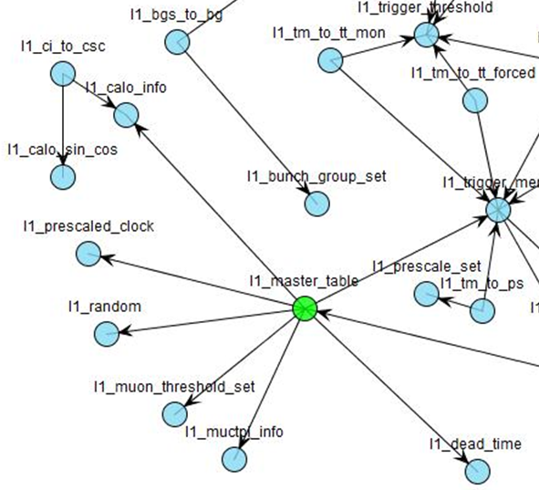
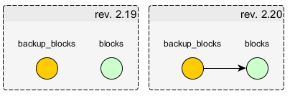
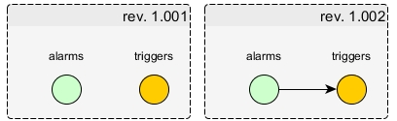
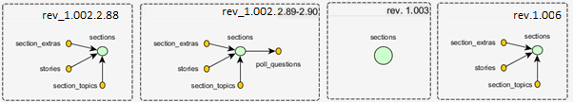
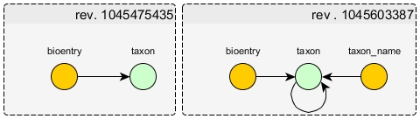
Multi-label Table-Changes
rev. 1.72
rev. 1.73
rev. 1.74
Ephemeral transition to a different category and return to the former one
Change from the isolated category to another category
Change of category soon after table’s birth
Changes leading to labels assigned for a short period
Changes caused by the presence of self-references

Slide 16
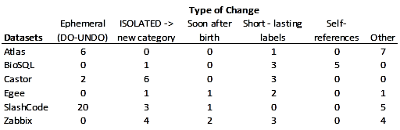
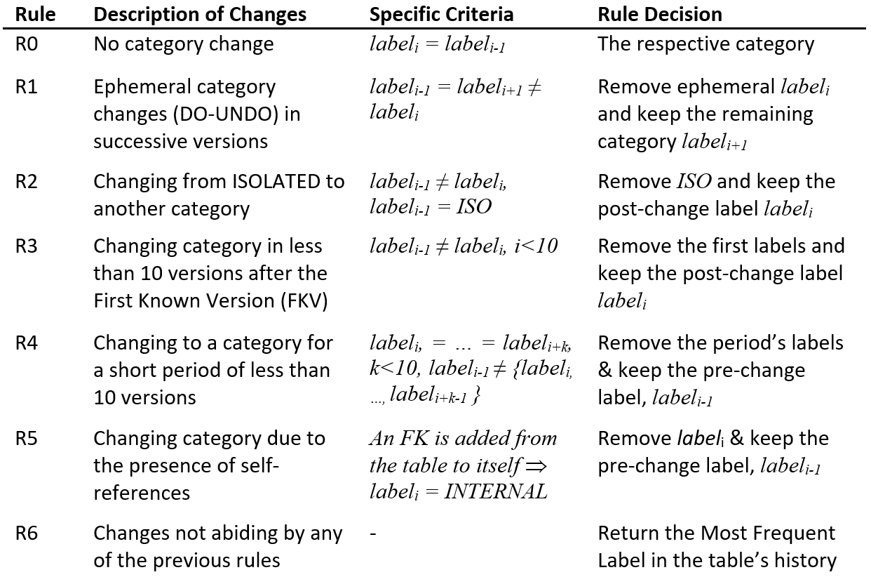
Simple resolution rule-set for assigning single-labels

Slide 17
Topology
& Evolution
Atlas
Zabbix
Castor
Context and background
Study Setup
Topological Patterns
Topology and Evolution
Conclusions

Slide 18
Is the evolution of a table related to its topology?
We present results on birth and activity related to topological patterns
… before proceeding, see also the stats
  … when isolated are included, and,
  … when excluded
Topological Category | %Table Population per Topological Pattern
 | Atlas | BioSQL | Castor | Egee | SlashCode | Zabbix
ISOLATED | 13% | 4% | 82% | 50% | 51% | 39%
SOURCE | 43% | 64% | 7% | 17% | 32% | 36%
LOOKUP | 36% | 18% | 10% | 8% | 10% | 20%
INTERNAL | 8% | 13% | 1% | 25% | 6% | 6%
Total | 88 | 45 | 91 | 12 | 68 | 56
Topological Category | %Table Population (without ISOLATED)
 | Atlas | BioSQL | Castor | Egee | SlashCode | Zabbix
SOURCE | 49% | 67% | 38% | 33% | 67% | 59%
LOOKUP | 42% | 19% | 56% | 17% | 21% | 32%
INTERNAL | 9% | 14% | 6% | 50% | 12% | 9%
Total | 77 | 43 | 16 | 6 | 33 | 34

Slide 19
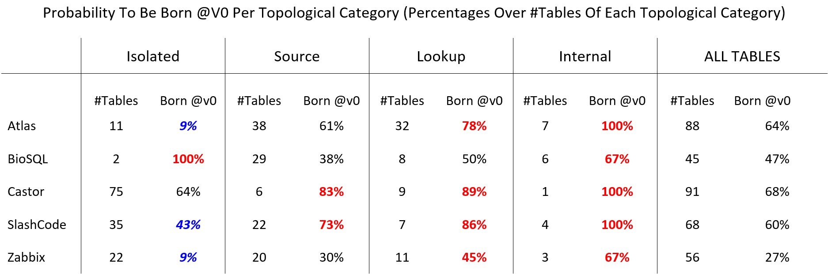
Research Question: how is the topological category of a table related to the probability of being born in the originating version of the schema history?
Internal & lookup: birth very likely at 1st version
  Internal: 100% for 3 of 5 data sets; lookup: in majority of cases for 4 of 5 data sets
  => UNLIKELY to be born later!!

Slide 20
Research Question: how is the topological category of a table related to the probability of being born in the originating version of the schema history?
Isolated and source have higher chances to appear in later versions compared to the previous two categories

Slide 21
Research Question: how is the topological category of a table related to the probability of being born in the originating version of the schema history?
Internal and lookup tables are more likely to be born in the originating version of their dataset's history, which, expressed in a different way, means that it is quite unlikely that they are " born" after this first version.
In contrast, source tables follow the trend of the general population and isolated tables are the ones with higher chances to be born in versions succeeding the originating one.

Slide 22
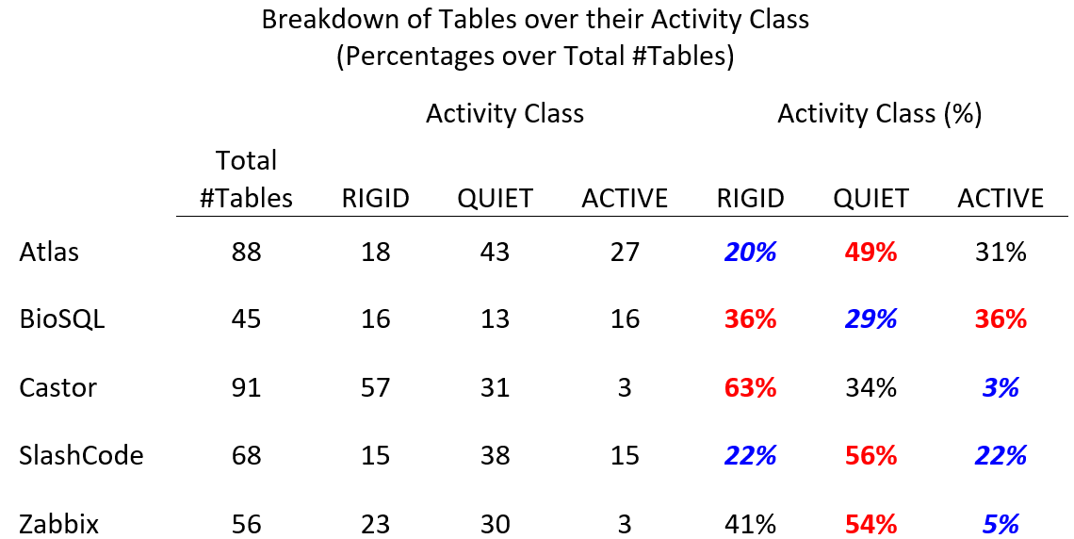
Research Question: is there a relationship between the topological category of a table and its update activity?
3 activity categories*
  Rigid
  Quiet
  Active
  *: P. Vassiliadis, A. Zarras, I. Skoulis , How is Life for a Table in an Evolving Relational Schema? Birth, Death and Everything in Between, ER 2015
Quiet tables are the largest group in 3/5 datasets; when not, rigid are the most populous

Slide 23
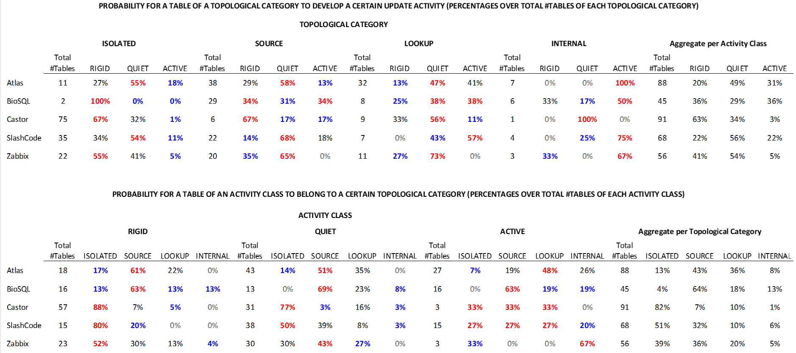
Research Question: is there a relationship between the topological category of a table and its update activity?
Isolated: mostly rigid and very rarely active!
Source: follow the overall pattern of their dataset (also due to population) => mostly quiet or rigid, and rarely active.
Lookup: more prone to changes wrt above ones, and wrt the overall dataset.
Internal: mostly active, with probability higher than in any other activity category!

Slide 24
Research Question: is there a relationship between the topological category of a table and its update activity?
Rigid tables: mostly isolated or source. The probability for a rigid table to be lookup very low and almost zero for internals.
Quiet tables distribution ~ aggregate distribution in all datasets. Closely follows the most populous category (source, isolated) too.
Active tables are strongly inclined towards higher topological complexity, esp. internals, much higher than their dataset’s distribution.

Slide 25
Research Question: is there a relationship between the topological category of a table and its update activity?
The topological category of a table is quite strongly related to its update activity. Isolated and source tables are inclined towards zero or few updates in their lifetime, lookup tables with few or many changes and internal tables with an inclination to active lives with many updates.

Slide 26
Analysis: Resize of table schemata
Table schema resize: ratio |#attr@last v.|/ |#attr@first v.| of the table
Overall, at least half the tables remain steady and 25%-47% increase their schema, 2% - 6% reduce their schema
Internal and lookup more prone to increase their size than the dataset’s avg., less prone to remain steady or reduce
Isolated and source have higher prob. to remain steady than the dataset’s avg., less prone to increase or reduce
PROBABILITY FOR A TABLE OF A TOPOLOGICAL CATEGORY TO HAVE CERTAIN SIZE SCALE (PERCENTAGES OVER TOTAL #TABLES OF EACH TOPOLOGICAL CATEGORY)
 | TOPOLOGICAL CATEGORY
 | ISOLATED |  |  |  | SOURCE |  |  |  | LOOKUP |  |  |  | INTERNAL |  |  |  | Aggregate per Size Scale Category
 | Total #Tables | <=0,99 | 1 | >1 | Total #Tables | <=0,99 | 1 | >1 | Total #Tables | <=0,99 | 1 | >1 | Total #Tables | <=0,99 | 1 | >1 | Total #Tables | <=0,99 | 1 | >1
Atlas | 11 | 9% | 73% | 18% | 38 | 5% | 82% | 13% | 32 | 3% | 59% | 38% | 7 | 14% | 43% | 43% | 88 | 6% | 69% | 25%
BioSQL | 2 | 0% | 100% | 0% | 29 | 10% | 62% | 28% | 8 | 0% | 25% | 75% | 6 | 0% | 33% | 67% | 45 | 7% | 53% | 40%
Castor | 75 | 1% | 72% | 27% | 6 | 0% | 67% | 33% | 9 | 22% | 33% | 44% | 1 | 0% | 0% | 100% | 91 | 3% | 67% | 30%
SlashCode | 35 | 3% | 69% | 29% | 22 | 5% | 41% | 55% | 7 | 0% | 14% | 86% | 4 | 0% | 0% | 100% | 68 | 3% | 50% | 47%
Zabbix | 22 | 5% | 68% | 27% | 20 | 0% | 55% | 45% | 11 | 0% | 36% | 64% | 3 | 0% | 33% | 67% | 56 | 2% | 55% | 43%

Slide 27
Conclusions
Atlas
Zabbix
Castor
Context and background
Study Setup
Topological Patterns
Topology and Evolution
Conclusions

Slide 28
A spectrum of (increasing) complexity
Similar to ISO
Typically resist change
Not unlikely to be born after @V0
Similar to INT
Prone to demonstrate change
Rarely born after @V0
Almost rigid
Frequently born after @V0
fewest of all
high activity
mostly born @V0
Most populous
Less active
Easier to add later
Less populous
Most active
Harder to add later
As time passes, people
are disinclined to add more complex structures to their database;
are more comfortable with adding new simple structures;
update complex structures with attribute injection when necessary.

Slide 29
Gravitation to rigidity explains why!
Gravitation to rigidity refers to the difficulty of altering the schema of a database when surrounding code is built upon it. See it working here:
  Topologically simple tables are much more populous and easy to create than complex and active ones;
  Very few tables change topological category, with most changes in the ephemeral or short-lasting categories of label-changes;
  Most of the activity of the high-end of the complexity spectrum is due to the addition of attributes to the existing tables, …
  … quite differently from the lower end of the spectrum, where administrators are more inclined towards building new tables.
Maintenance-by-addition, equiv., avoid-to-break-the-code principle: adding new info via (expendable) new tables, does not result in the necessity to update the surrounding code.
FOSS projects are built to be selected by other organizations. Upgrading the schema in the presence of existing data is a painful experience, and simple structures and maintenance-by-addition reduce this pain

Slide 30
Why bother?
Our empirical study on how schema evolution relates to foreign keys in FOSS projects …
  advances our knowledge with solid evidence,
  provides both maintenance clues to curators and evaluators of FOSS projects, and,
  provides insights to the research community on practical problems.
Project curators can expect that the schema in the future will expand in terms of (a) topologically simple structures and (b) complex topological structures. Enforcing maintenance-by-addition will allow lower impact to the surrounding code.
FOSS Evaluators, when selecting a software projects for adoption, will need to also assess the threats posed by the absence of (a) foreign keys and (b) maintenance actions from the side of the curators.
Researchers must understand that the nature of the situation boils down to the fundamentals of the relational model and how relational databases can be coupled to surrounding applications. Must also go for
  More flexible ways of building applications on top of databases
  Tools that accurately highlight the points of maintenance in the surrounding code, in the event of schema evolution.

Slide 31
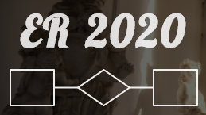

The more topologically complex tables are, the fewer, the more active (via attribute injection), and the harder to add as the schema ages!
Similar to ISO
Typically resist change
Not unlikely to be born after @V0
Similar to INT
Prone to demonstrate change
Rarely born after @V0
Almost rigid
Frequently born after @V0
fewest of all
high activity
mostly born @V0
Most populous
Less active
Easier to add later
Less populous
Most active
Harder to add later
To probe further (code, data, details, presentations, …)
    http://www.cs.uoi.gr/~pvassil/projects/schemaBiographies

