Slide 1

Schema Evolution and Foreign Keys: Birth, Eviction, Change and Absence
Panos Vassiliadis, Michail-Romanos Kolozoff*,
Maria Zerva, Apostolos V. Zarras
Department of Computer Science and Engineering
University of Ioannina, Hellas
* Currently @ Upcom, Hellas
http://www.cs.uoi.gr/~pvassil/projects/schemaBiographies/
http://www.cs.uoi.gr/~pvassil/publications/2017_ER/

Slide 2
Research Question
In the context of schema evolution,
how do foreign keys evolve over time?

Slide 3
Why is schema evolution so important?
Software and DB maintenance makes up for at least 50% of all resources spent in a project.
Databases are rarely stand-alone: typically, an entire ecosystem of applications is structured around them =>
Changes in the schema can impact a large (typically, not traced) number of surrounding app’s, without explicit identification of the impact.
  Is it possible to “design for evolution” and minimize the impact of evolution to the surrounding applications?
… But first, we need to know the “patterns of evolution” of relational schemata! …
Notes:
Example for syntactic impact
relation removed causes direct failure in apps
Example for semantic impact
attribute insertion might add information that is not known and ignored by apps
Benefits by applying design patterns and by avoiding anti-patterns.
Anti patterns will lead to cumulative complexity for both db an applications that will eventually make the entire system decline and be replaced by other systems.
We can find out not only good ways to do stuff but we can see what is the matter with those that go bad and avoid it.

Slide 4
Why aren’t we there yet?
Historically, nobody from the research community had access + the right to publish to version histories of database schemata
Open source tools internally hosting databases have changed this landscape &
We are now presented with the opportunity to study the version histories of such “open source databases”
Mind the gap!
(15 years)
Sjoberg
IST 93
Curino+
ICEIS08
Univ. Riverside
IWPSE09,
ICDEW11
Qiu,Li,Su
FSE13
Un. Ioannina
CAiSE14,
ER15
Cleve+
SCP15
Un. Ioannina
CAiSE17 ,
ER17
~ … ~
1993
2008
2009
2011
2013
2014
2015
2017
Notes:
Sjoberg @ IST 93: 18 months study of a health system.
139% increase of #tables ; 274% increase of the #attributes
Changes in the code (on avg): (1) relation addition: 19 changes ; attribute additions: 2 changes, (2) relation deletion : 59.5 changes; attribute deletions: 3.25 changes
An inflating period during construction where almost all changes were additions, and a subsequent period where additions and deletions where balanced.
Curino+ @ ICEIS08: Mediawiki for 4.5 years
100% increase in the number of tables
142% in the number of attributes.
45% of changes do not affect the information capacity of the schema (but are rather index adjustments, documentation, etc)
IWPSE09: Mozilla and Monotone (a version control system). Many ways to be out of synch between code and evolving db schema
ICDEW11: Firefox, Monotone , Biblioteq (catalogue man.) , Vienna (RSS).Similar pct of changes with previous work
Frequency and timing analysis: db schemata tend to stabilize over time, as there is more change at the beginning of their history, but seem to converge to a relatively fixed structure later
Qiu,Li,Su@ FSE 2013: 10 (!) database schemata studied.
Change is focused both (a) with respect to time and (b) with respect to the tables who change.
Timing: 7 out of 10 databases reached 60% of their schema size within 20% of their early lifetime.
Change is frequent in the early stages of the databases, with inflationary characteristics; then, the schema evolution process calms down.
Tables that change: 40% of tables do not undergo any change at all, and 60%-90% of changes pertain to 20% of the tables (in other words, 80% of the tables live quiet lives). The most frequently modified tables attract 80% of the changes.
Code and db co-evolution, not always in synch.
Code and db changed in the same revision: 50.67% occasions
Code change was in a previous/subsequent version than the one where the database schema change: 16.22% of occasions
database changes not followed by code adaptation: 21.62% of occasions
11.49% of code changes were unrelated to the database evolution.
Each atomic change at the schema level is estimated to result in 10 -- 100 lines of application code been updated;
A valid db revision results in 100 -- 1000 lines of application code being updated

Slide 5
Why aren’t we there yet?
In all previous attempts, the object of study was the schema size as well as the heartbeat of change,
Patterns on table behaviors have been studied only lately.
To the best of our knowledge, the current paper is the first comprehensive effort in the literature to study the evolution of foreign keys.
Mind the gap!
(15 years)
Sjoberg
IST 93
Curino+
ICEIS08
Univ. Riverside
IWPSE09,
ICDEW11
Qiu,Li,Su
FSE13
Un. Ioannina
CAiSE14,
ER15
Cleve+
SCP15
Un. Ioannina
CAiSE17 ,
ER17
~ … ~
1993
2008
2009
2011
2013
2014
2015
2017

Slide 6
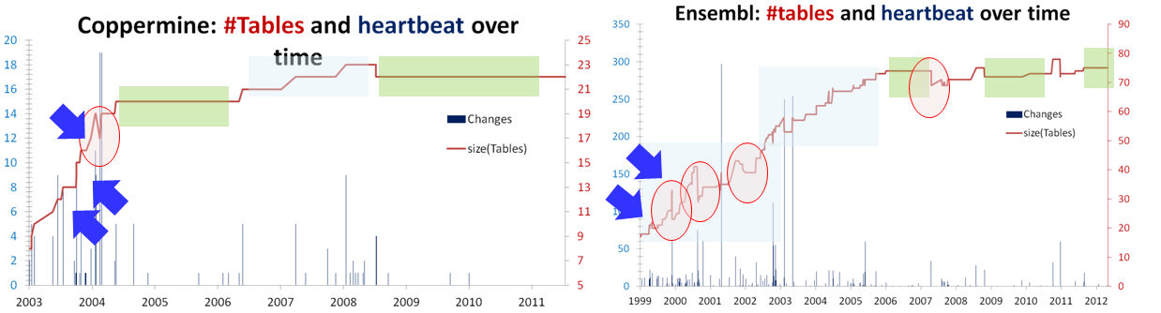
What we have found for schema evolution [CAiSE 14, IS 15]
Schema growth over time (red continuous line) along with the heartbeat of changes (spikes) for two of our datasets. Overlayed darker green rectangles highlight the calmness versions, and lighter blue rectangles highlight smooth expansions. Arrows point at periods of abrupt expansion and circles highlight drops in size. [IS15]
Notes:
Schemata grow over time in order to satisfy new requirements, albeit not in a continuous or linear fashion, but rather, with bursts of concentrated effort interrupting longer periods of calmness.
Growth is small, with average growth being close to zero.
Growth comes with drops in schema size that signify the existence of perfective maintenance.

Slide 7
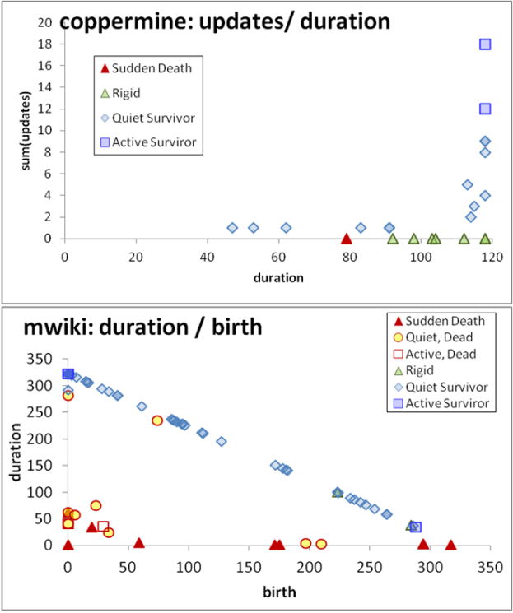
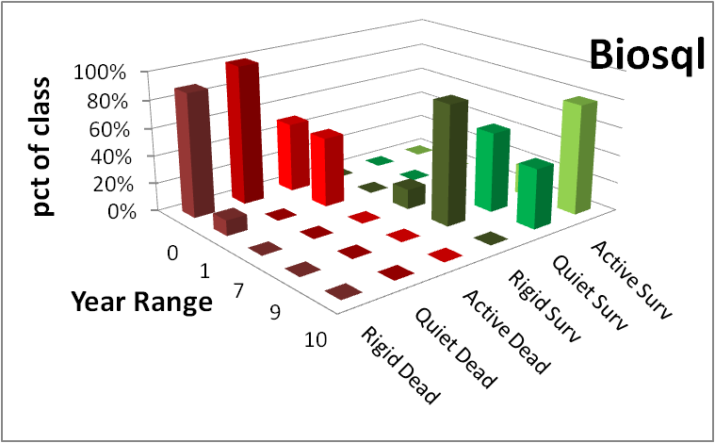
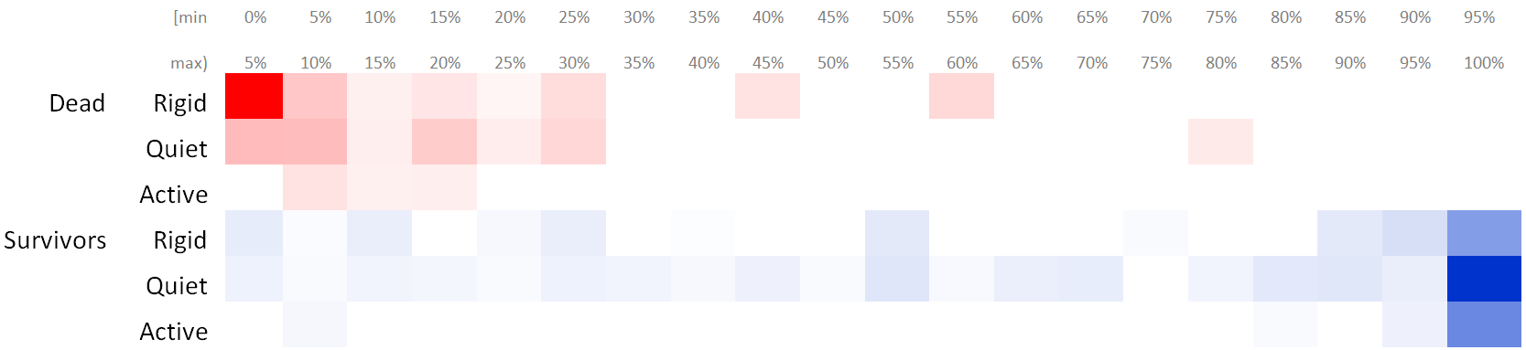
What we know so far for table evolution [ER 15, IS 17, CAiSE 17]
Notes:
The Γ pattern studies the interrelationship of the schema size of a table at its birth with its overall duration and indicates that tables with large schemata tend to have long durations and avoid removal;
The Comet pattern studies the interrelationship of the schema size of a table at its birth with its total amount of updates and indicates that the tables with most updates are frequently the ones with medium schema size;
The Inverse Γ pattern studies the interrelationship of the amount of updates in the life of a table with its duration and indicates that tables with medium or small durations produce amounts of updates lower than expected, whereas tables with long duration expose all sorts of update behavior.
The Empty Triangle pattern studies the interrelationship of a table’s version of birth with its overall duration and indicates a significant absence of tables of medium or long durations that were removed –thus, an empty triangle – signifying mainly short lives for deleted tables and low probability of deletion for old timers.
The Electrolysis Pattern: Survivors, mostly long-lived (esp. active ones) and quietly active are radically different than dead tables, being mostly short-lived and rigid!

Slide 8
Setup of our study
Scope & generalization:
  Collected histories (i.e., sequence of versions) of relational schemata being part of free open-source software (and not proprietary ones) coming with…
  … fairly long history
  … different domains, treatment of foreign keys, growth over time
  Domains
    Science (Atlas, BioSQL)
    Computational Resource Toolkits (Castor, Egee)
    CMS’s (Slashcode, Zabbix)
We should be very careful to not overgeneralize findings to proprietary databases!

Slide 9
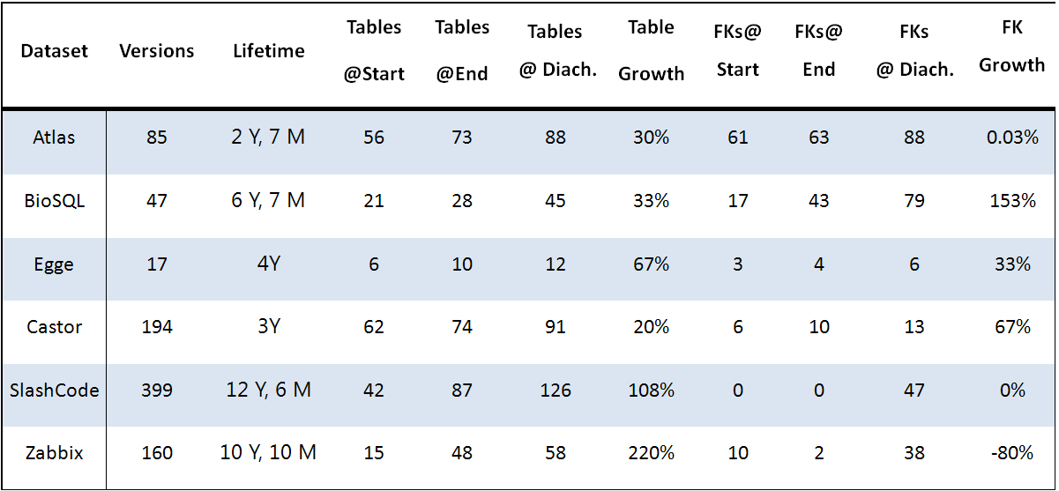
Characteristics of used datasets

Slide 10
Toolset
  Some preprocessing was occasionally needed to allow the parsing of schema histories
Used out homegrown toolset to extract changes
  Hecate, a tool to extract the history of changes for tables
https://github.com/DAINTINESS-Group/Hecate
  Parmenidian Truth, a tool to extract the history of changes for foreign keys
https://github.com/DAINTINESS-Group/ParmenidianTruth
  Parmenidian Truth is also able to visualize the schema history as a PowerPoint/video file
All the data are available at:
https://github.com/DAINTINESS-Group/EvolutionDatasets

Slide 11
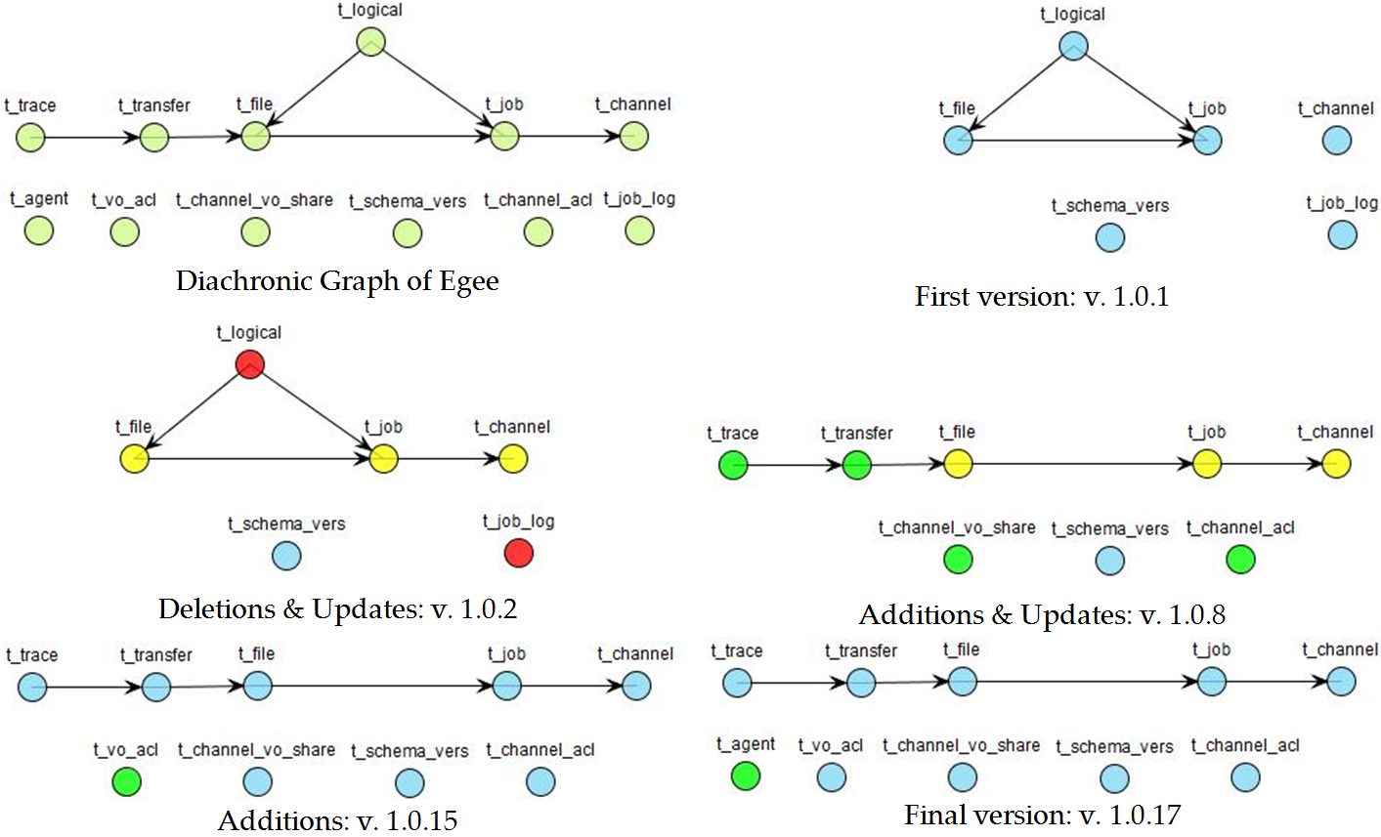
Using a graph metaphor for evolving schemata with FK’s
(bonus: the story of Egee in one slide)

Slide 12

What we don’t know yet…
How do FK’s evolve?
  Do tables and foreign keys evolve in sync?
  When & How do FK’s germinate & die?
… as we will see, these questions led to unexpected results and more insights on how developers deal with foreign keys…
Also studied [not part of the paper]: graph properties of tables and their relationship to evolution

Slide 13

Main Findings
Context and background
Setup of our study
Main findings
Strange things happening with FK’s
Lessons learned, open issues & why bother
Notes:
Mainly:
- (How) do tables and FK’s evolve? Do they evolve in sync?
- When & How do FK’s germinate & die?

Slide 14
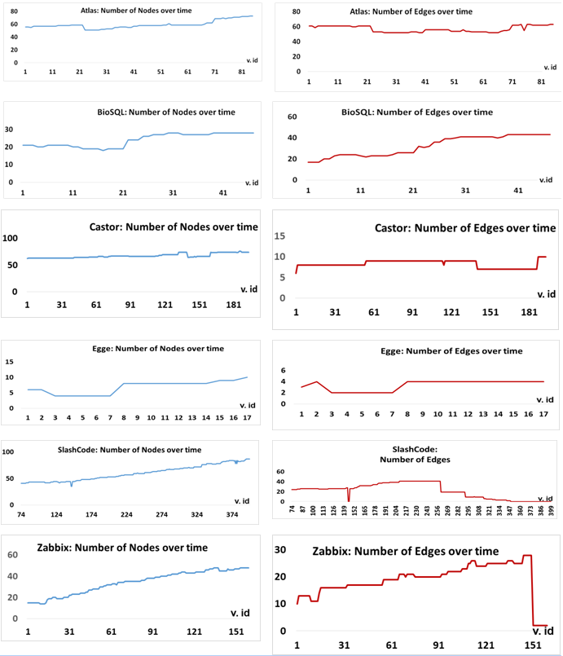
Evolution of
Tables & FK’s
Tables grow in all cases (known from previous research) with periods of slow growth, calmness, spikes of extension, and occasional cleanups
Foreign Keys are treated with different mentalities. 3 families:
  Scientific
  Comp. Toolkits
  CMS’s

Slide 15
Evolution of Tables & FK’s:
Scientific projects
Tables and FKS grow in synch, in both cases
Growth comes with expansion periods, shrinkage actions, and periods of calmness in terms of both tables and foreign keys.

Slide 16
Evolution of Tables & FK’s: Computational Resource Toolkits
Tables and FKS grow little and slowly; for Castor, not exactly in sync
Castor: observe how scarce FK’s are (too few tables come with FK’s, see vertical axis)

Slide 17
Evolution of Tables & FK’s:
Content Management Systems (CMS’s)
FK scarcity: really big at Slashcode, moderate at Zabbix
Slashcode started without foreign keys at all; 1st set of FK’s in v. 74. Zabbix seems to show a certain degree of syncronized growth
Yet, … both CMS's end up with no FK’s!! -> see next

Slide 18
What an unpleasant surprise: developers can resort in full removal of foreign keys!
Slashcode: there is a clear phase of progressive removal
Zabbix: abrupt removal of almost the entire set of foreign keys in a single transition (unexpected based on how FK’s had been treated till then)
We dedicate some explanations in the sequel…

Slide 19
How do FK’s germinate and die?
We classified FK’s births and deaths in 4 categories
Births
  Born with table: when either the source or the target table is born along with the foreign key,
  Explicit addition: when a foreign key is added to two existing tables.
Deletions
  Died with table: when either the source or the target table is removed along with the foreign key,
  Explicit deletion: when neither of the source or target tables gets deleted and only the foreign key is removed.

Slide 20
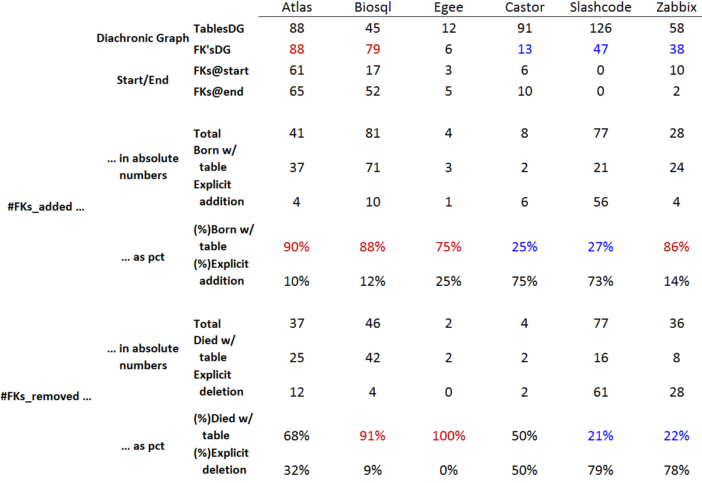
Stats on FK Change

Slide 21
Stats on FK Change
Atlas, Biosql and Egee (less) deal with FK’s as regular part of the schema
FK’s are, to a large extent …
Born with tables
Removed with tables

Slide 22
Stats on FK Change
Castor & Slashcode (both with a really small minority of FK’s) deal with FK’s as an ad-hoc add on: FK’s are mostly explicitly added/ removed
Zabbix has a mixed style: explicit del. and add. w. tables (& a sudden style change)

Slide 23


Families of developer profiles wrt the treatment of Foreign Keys
Integral part of schema: fairly large pct of tables involved in FKs, grow in sync with tables, germinate and die with them
Disposable Add-on: small pct of tables involved in FK’s, explicit additions and deletions, easy to remove them (in some cases, entirely!)
Mixed: can be with a change of style

Slide 24
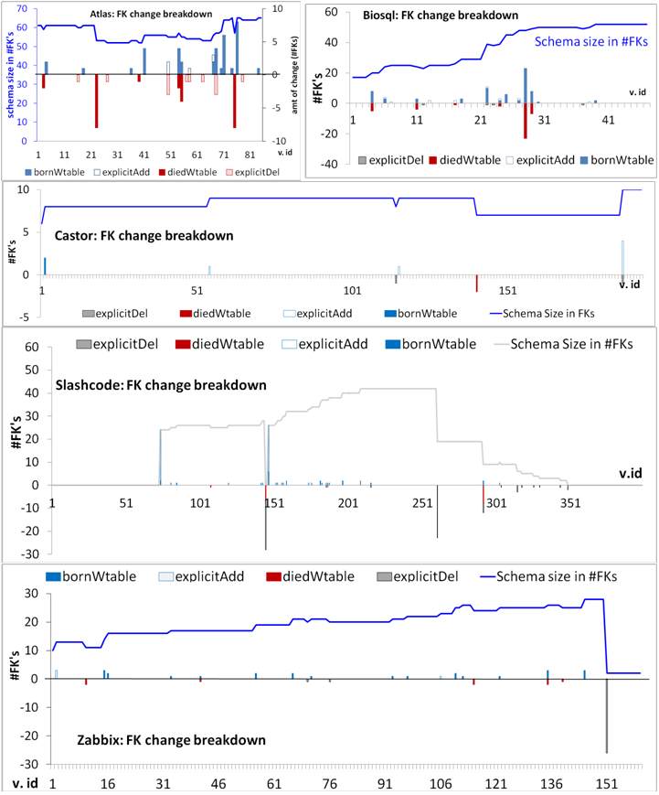
Heartbeat of change
Birth & deaths are proportionally spread in time -- except Atlas.
The volume of change is typically low: most changes ~ 1 FK.
Exceptions:
(a) explicit mass add & del, (b) do-undo actions (Atlas, Slashcode and Castor), and,
(c) restructuring due to table renamings (4 in Biosql, 2 in Zabbix).

Slide 25
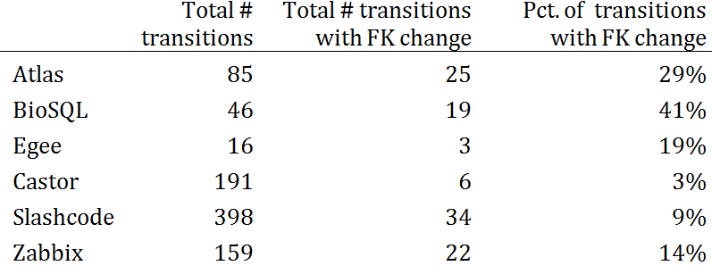
Percentage of transitions with FK change
Common theme in all the data sets: the consistent scarcity of FK changes
Scientific data sets: short active period + treatment of FK’s as an integral part of the schema (births and deaths of tables and FK’s in sync) => high pct of transitions with FK change
The rest: FK b&d are rare and explicit (w/o mass removals, would be even less)

Slide 26
Characteristics of the heartbeat of schemata wrt Foreign Keys
Scarcity of FK change: expectedly very few transitions come with FK change, except for idiosyncratic cases
Low volume: typically 1 FK change at a time, except for mass add/del
Birth & deaths are proportionally spread in time
Occasional do-undo and restructuring due to table renames

Slide 27
The mysterious case of the disappearing foreign keys
Context and background
Setup of our study
Main findings
Strange things happening with FK’s
Lessons learned, open issues & why bother

Slide 28
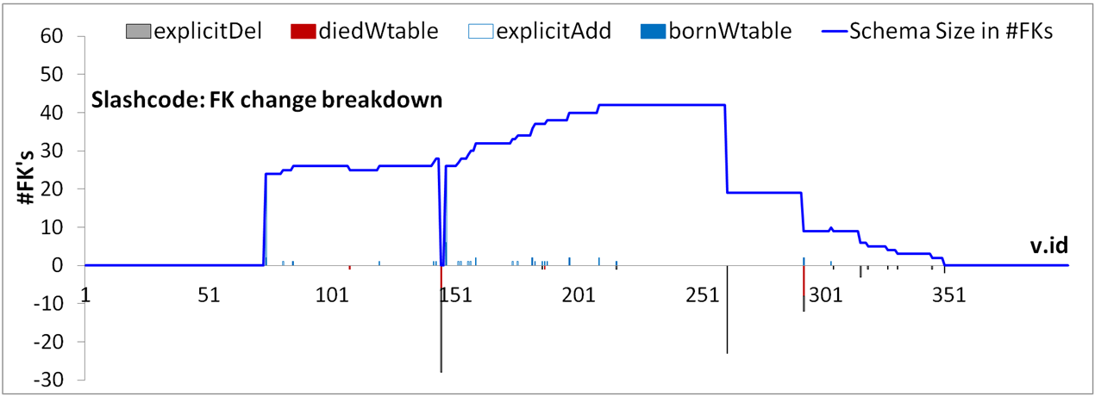
Heartbeat of change: CMS’s

Slide 29
Slashcode: the disappearing FK’s
At the end of its studied history, and via a progressive removal period, the schema is left with zero foreign keys.
Interestingly enough, the schema also contained zero foreign keys at its start.
Quite importantly, Slashcode's behavior holds both foreign key additions and deletions mostly happening explicitly (i.e., without the addition or removal of the involved tables).
In other words, it appears that foreign keys are treated as a disposable add-on that was removed when problems occurred.

Slide 30
Slashcode: the disappearing FK’s
1st massive foreign key removal (rev 1.120),
22 FK’s deleted.
2nd massive deletion (rev 1.151), 10 FK's deleted
3rd deletion (rev 1.174), 3 FK's deleted
4th deletion (rev 1.189) 1 FK deleted
5th deletion (rev 1.201) 1 FK deleted

Slide 31
"Commented-out foreign keys are ones which currently cannot be used because they refer to a primary key which is NOT NULL AUTO INCREMENT and the child's key either has a default value which would be invalid for an auto increment field, typically NOT NULL DEFAULT '0'.
Or, in some cases, the primary key is e.g. VARCHAR(20) NOT NULL and the child's key will be VARCHAR(20). The possibility of NULLs negates the ability to add a foreign key. <= That's my current theory, but it doesn't explain why discussions.topic SMALLINT UNSIGNED NOT NULL DEFAULT '0' is able to be foreign-keyed to topics.tid SMALLINT UNSIGNED NOT NULL AUTO INCREMENT"
1st massive foreign key removal (rev 1.120),
22 FK’s deleted.
"Stories is now InnoDB and these other tables are still MyISAM, so no foreign keys between them."
2nd massive deletion (rev 1.151), 10 FK's deleted
"This doesn't work, makes createStory die. These don't work, should check why..."
3rd deletion (rev 1.174), 3 FK's deleted
"This doesn't work, since in the install pollquestions is populated before users, alphabetically"
4th deletion (rev 1.189) 1 FK deleted
"This doesn't work, since discussion may be 0."
5th deletion (rev 1.201) 1 FK deleted

Slide 32
Slashcode: what did the comments say?
The main problem seems to be the difficulty of developers with the tuning and handling of both foreign and primary keys.
Sometimes difficulties are hard -- e.g., different storage engines, typically due to performance reasons
Some difficulties are complicated due to technicalities like autonumbering
Sometimes fixes could be found with some effort (e.g., changing the order of table population, or using numeric data types for primary keys, or inserting some “goalkeeper” values at FK target table)

Slide 33
Slashcode: what do we make out of this case?
The main problem seems to be the difficulty of developers with the tuning and handling of both foreign and primary keys.
Practically, it appears that the easiest way out of this kind of problems is to comment out the respective foreign key.
So, removals of foreign keys went on as a regular practice, instead of attempting to fix the problems.
This simply states that the essence of the contribution of foreign keys in the consistency of the schema does not seem to outweigh the need to quickly get things done.

Slide 34
Scarcity of Foreign keys
A 2013 collection of schema histories, lists 21 data sets, -- some have more than one target DBMS variants.
How many data sets contain foreign keys?
Try this (also backed by manual sampling):
$ cd RESEARCH/Github/EvolutionDatasets
$ ls -d * */*
CERN CMS's/Coppermine CMS's/XOOPS Med
CERN/Atlas CMS's/DekiWiki CMS's/Zabbix Med/Ensembl
CERN/CASTOR CMS's/Joomla 1.5 CMS's/e107 Med/biosql
CERN/DQ2 CMS's/NucleusCMS CMS's/opencart README.md
CERN/DRAC CMS's/SlashCode CMS's/phpBB
CERN/EGEE CMS's/TikiWiki CMS's/phpwiki
CMS's CMS's/Typo3 CMS's/wikimedia
grep -rl "FOREIGN" . >> ALL-FKs-by-grep.ascii
awk '{split($0,a,"/"); print a[2],a[3]}' ALL-FKs-by-grep.ascii | uniq

Slide 35

Scarcity of Foreign keys
- How many data sets, out of the 21, contain foreign keys?
CERN Atlas
CERN CASTOR
CERN EGEE
CMS's SlashC
CMS's Zabbix
Med biosql
CERN DQ2
CERN DΙRAC
Med Ensembl
The 6 data sets reported here
+
DQ2 (only in the mySQL, not in the Oracle version): FK’s in 19 versions out of the 55. Starts with 2 FK's and ends with 1.
DΙRAC (not in the production folder, only at python+mysql).
9 tables at first version, 15 tables at last version
Starts with 10 FK's, ends with 8
Ensembl: not able to link FK DDL files to table evolution, yet
- 9 out of the 21 data sets do (including 3 that are really small for harnessing valuable results, spec., Egee, DQ2, DIRAC)
http://www.boldomatic.com/view/post/G_xPI

Slide 36
Lessons Learned, things to do & Why all this matters
Context and background
Setup of our study
Main findings
Strange things happening with FK’s
Lessons learned, open issues & why bother

Slide 37
Main findings
Schemata grow in terms of tables, as time passes
Cases, mainly in projects of scientific nature, where FK’s are treated as an integral part of the system, and they are born and evicted along with table birth and eviction.
Cases where FK’s are treated as a disposable add-on: only a small subset of the tables involved in FK’s; birth and eviction of FK’s rarely performed in synch with their tables.
The heartbeat of FK change is mostly rare and small in volume, also with do-undo pairs of commits and occasionally massive removals).
Within all the CMS’s we collected, FK’s are too scarce. For the two CMSs that we studied, both ended-up with their complete removal, due to difficulty of managing technical issues related to FK’s.

Slide 38
Open research issues
More studies, by other groups, if we are to establish solid patterns and (who knows?) laws
More in-depth studies on the reasons of the observed phenomena
Mining patterns of graph evolution

Slide 39
Threats to validity
The scope, external validity & generalization of our study is restricted to databases that are part of FOSS projects (and not closed ones) and also pay the price for data consistency via foreign keys.
We have data sets from different domains (occasionally with domain-dependent) with adequately long stories and schema sizes. We make clear if patterns are omni-present or strictly characteristic to a domain can indeed be generalized.
Measurement validity: we have tested our tools with black box testing & fixed problems.
As this is the first -to our knowledge- study of its kind, it is strictly of exploratory nature & more studies are needed!.

Slide 40
Why does this matter?
We need to understand how schemata evolve over time and do it with solid evidence, because, …
  We are scientifically curious on how our discipline’s artifact evolve
  We will be able to design databases with a view to their evolution and minimize the impact of evolution to the surrounding applications
  We can plan to identify and avoid "design anti-patterns" leading to cumulative complexity for both the database and the surrounding applications,
  We can plan administration and maintenance tasks and resources, instead of just responding to emergencies.

Slide 41
Why does this matter?
… Yet , the study also reveals unexpected results: Although it is important not to over-generalize our findings outside the area of Free, Open Source Software, we have now significant evidence that, unless specifically curated, foreign keys in a FOSS database can potentially be unwelcome (and thus, rare) or even completely removed by the developers.
This is a clear warning that we, as a community, need to do better (a) in terms of making systems easier at handling foreign keys and their implications, especially at the deep technical details, as well as, (b) in terms of better educating developers on the benefits and necessities behind the usage of foreign keys in their databases.

Slide 42


Moltes gràcies! Muchas gracias!
Thank you!
Foreign Key Evolution comes with different treatments:
  Sometimes, FK’s are treated as an integral part of the system, and they are born and evicted along with table birth and eviction.
  Other times, FK’s are treated as a disposable add-on: only a small subset of the tables involved in FK’s; birth and eviction of FK’s rarely performed in synch with their tables.
Within all the CMS’ we collected, FK’s are too scarce & we even witnessed complete removal of FK’s from the schema --> we need to react as a community
Treating the evolving schema as an evolving graph comes with particular potential for deeper study.
To probe further (code, data, details, presentations, …)
    http://www.cs.uoi.gr/~pvassil/projects/schemaBiographies

Slide 43
Auxiliary material

Slide 44
The story of Egee in one slide

Slide 45
Heartbeat of change: Scientific projects

Slide 46
Heartbeat of change:
Computational Resource Toolkits

Slide 47
Heartbeat of change: Zabbix CMS

Slide 48
Heartbeat of change: Slashcode CMS

Slide 49
Einstein on curiosity
From: The ultimate quotable Einstein. Collected and edited by Alice Calaprice, Princeton Univ. Press
The important thing is not to stop questioning. Curiosity has its own reason for existing. One cannot help but be in awe when he contemplates the mysteries of eternity, of life, of the marvelous structure of reality. It is enough if one tries merely to comprehend a little of this mystery every day.
Memoirs of William Miller, editor, quoted in Life magazine, May 2, 1955
The main source of all technological achievements is the divine curiosity and playful drive of the tinkering and thoughtful researcher, as much as it is the creative imagination of the inventor
Speech on the occasion of the opening of the 7th German Radio and Audio Show in Berlin on August 22 in 1930

