Slide 1

Survival in schema evolution: putting the lives of survivor and dead tables in counterpoint
Panos Vassiliadis, Apostolos Zarras
Department of Computer Science and Engineering University of Ioannina, Hellas
http://www.cs.uoi.gr/~pvassil/projects/schemaBiographies/

Slide 2
Why is schema evolution so important?
Software and DB maintenance makes up for at least 50% of all resources spent in a project.
Databases are rarely stand-alone: typically, an entire ecosystem of applications is structured around them =>
Changes in the schema can impact a large (typically, not traced) number of surrounding app’s, without explicit identification of the impact.
Is it possible to “design for evolution” and minimize the impact of evolution to the surrounding applications?
… But first, we need to know the “patterns of evolution” of relational schemata! …
Notes:
Example for syntactic impact
relation removed causes direct failure in apps
Example for semantic impact
attribute insertion might add information that is not known and ignored by apps
Benefits by applying design patterns and by avoiding anti-patterns.
Anti patterns will lead to cumulative complexity for both db an applications that will eventually make the entire system decline and be replaced by other systems.
We can find out not only good ways to do stuff but we can see what is the matter with those that go bad and avoid it.

Slide 3
Why aren’t we there yet?
Historically, nobody from the research community had access + the right to publish to version histories of database schemata
Open source tools internally hosting databases have changed this landscape &
We are now presented with the opportunity to study the version histories of such “open source databases”
Mind the gap!
(15 years)
Sjoberg
IST 93
Curino+
ICEIS08
Univ. Riverside
IWPSE09,
ICDEW11
Qiu,Li,Su
FSE13
Un. Ioannina
CAiSE14,
ER15
Cleve+
SCP15
Un. Ioannina
CAiSE17
~ … ~
1993
2008
2009
2011
2013
2014
2015
2017
Notes:
Sjoberg @ IST 93: 18 months study of a health system.
139% increase of #tables ; 274% increase of the #attributes
Changes in the code (on avg): (1) relation addition: 19 changes ; attribute additions: 2 changes, (2) relation deletion : 59.5 changes; attribute deletions: 3.25 changes
An inflating period during construction where almost all changes were additions, and a subsequent period where additions and deletions where balanced.
Curino+ @ ICEIS08: Mediawiki for 4.5 years
100% increase in the number of tables
142% in the number of attributes.
45% of changes do not affect the information capacity of the schema (but are rather index adjustments, documentation, etc)
IWPSE09: Mozilla and Monotone (a version control system). Many ways to be out of synch between code and evolving db schema
ICDEW11: Firefox, Monotone , Biblioteq (catalogue man.) , Vienna (RSS).Similar pct of changes with previous work
Frequency and timing analysis: db schemata tend to stabilize over time, as there is more change at the beginning of their history, but seem to converge to a relatively fixed structure later
Qiu,Li,Su@ FSE 2013: 10 (!) database schemata studied.
Change is focused both (a) with respect to time and (b) with respect to the tables who change.
Timing: 7 out of 10 databases reached 60% of their schema size within 20% of their early lifetime.
Change is frequent in the early stages of the databases, with inflationary characteristics; then, the schema evolution process calms down.
Tables that change: 40% of tables do not undergo any change at all, and 60%-90% of changes pertain to 20% of the tables (in other words, 80% of the tables live quiet lives). The most frequently modified tables attract 80% of the changes.
Code and db co-evolution, not always in synch.
Code and db changed in the same revision: 50.67% occasions
Code change was in a previous/subsequent version than the one where the database schema change: 16.22% of occasions
database changes not followed by code adaptation: 21.62% of occasions
11.49% of code changes were unrelated to the database evolution.
Each atomic change at the schema level is estimated to result in 10 -- 100 lines of application code been updated;
A valid db revision results in 100 -- 1000 lines of application code being updated

Slide 4

Our take on the problem
To address the quest for finding patterns in the evolution of relational schemata, we have …
Collected version histories for the schemata of 8 open-source projects
CMS’s: MediaWiki, TYPO3, Coppermine, phpBB, OpenCart
Physics: ATLAS Trigger
Biomed: Ensemble, BioSQL
Preprocessed them to be parsable by our HECATE schema comparison tool and exported the transitions between each two subsequent versions and measures for them (size, growth, changes)
Performed exploratory research where we statistically study / mine these measures, to extract patterns & regularities for the lives of tables
Available at:
https://github.com/DAINTINESS-Group/EvolutionDatasets

Slide 5
Scope of our studies
FoSS Dataset | Versions | Lifetime | Tables @ Start | Tables @ End
ATLAS Trigger [A] | 84 | 2 Y, 7 M, 2 D | 56 | 73
BioSQL [B] | 46 | 10 Y, 6 M, 19 D | 21 | 28
Coppermine [C] | 117 | 8 Y, 6 M, 2 D | 8 | 22
Ensembl [B] | 528 | 13 Y, 3 M, 15 D | 17 | 75
MediaWiki [C] | 322 | 8 Y, 10 M, 6 D | 17 | 50
OpenCart [C] | 164 | 4 Y, 4 M, 3 D | 46 | 114
phpBB [C] | 133 | 6 Y, 7 M, 10 D | 61 | 65
TYPO3 [C] | 97 | 8 Y, 11 M, 0 D | 10 | 23
Scope:
databases being part of open-source software (and not proprietary ones)
long history
we work only with changes at the logical schema level (and ignore physical-level changes like index creation or change of storage engine)
We encompass datasets with different domains ([A]: physics, [B]: biomedical, [C]: CMS’s), amount of growth (shade: high, med, low) & schema size
We should be very careful to not overgeneralize findings to proprietary databases or physical schemata!

Slide 6
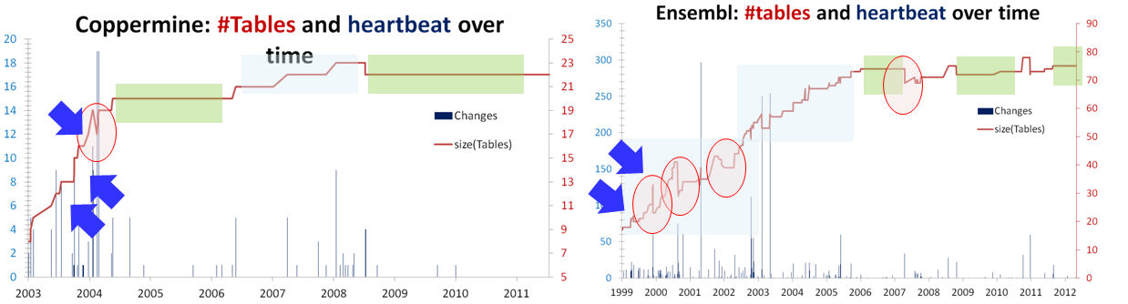
What we have found for schema evolution [CAiSE 14, IS 15]
Schema growth over time (red continuous line) along with the heartbeat of changes (spikes) for two of our datasets. Overlayed darker green rectangles highlight the calmness versions, and lighter blue rectangles highlight smooth expansions. Arrows point at periods of abrupt expansion and circles highlight drops in size. [IS15]
Notes:
Schemata grow over time in order to satisfy new requirements, albeit not in a continuous or linear fashion, but rather, with bursts of concentrated effort interrupting longer periods of calmness.
Growth is small, with average growth being close to zero.
Growth comes with drops in schema size that signify the existence of perfective maintenance.

Slide 7
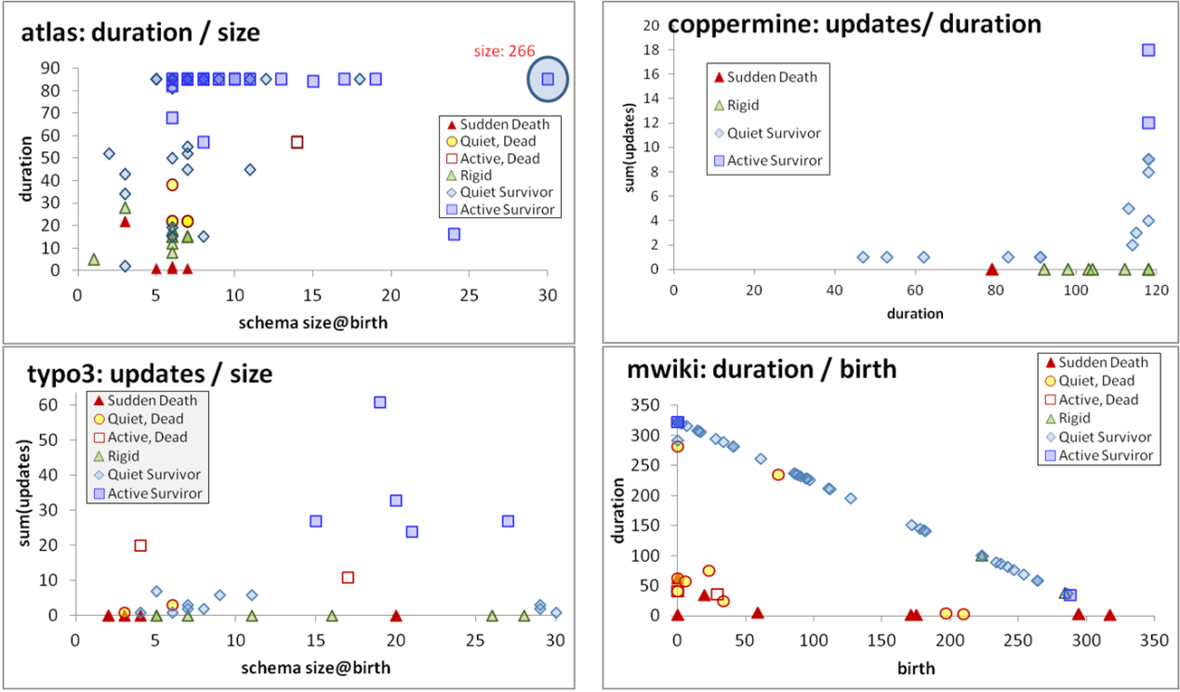
What we know so far for table evolution [ER 15, IS 17]
Notes:
The Γ pattern studies the interrelationship of the schema size of a table at its birth with its overall duration and indicates that tables with large schemata tend to have long durations and avoid removal;
The Comet pattern studies the interrelationship of the schema size of a table at its birth with its total amount of updates and indicates that the tables with most updates are frequently the ones with medium schema size;
The Inverse Γ pattern studies the interrelationship of the amount of updates in the life of a table with its duration and indicates that tables with medium or small durations produce amounts of updates lower than expected, whereas tables with long duration expose all sorts of update behavior.
The Empty Triangle pattern studies the interrelationship of a table’s version of birth with its overall duration and indicates a significant absence of tables of medium or long durations that were removed –thus, an empty triangle – signifying mainly short lives for deleted tables and low probability of deletion for old timers.

Slide 8

What we don’t know yet…
Although we have fused the discrimination of survivor vs. dead tables in the graphical representations, the 4 patterns do not tell us …
… how do survivors differ from dead tables with respect to the combination of duration and activity profile
Also studied [not part of the paper]: year of birth, schema size, schema resizing

Slide 9

Opposite skewed durations
Background
Durations’ study
Electrolysis
Discussion
Compute the histograms of durations for both dead and survivors, and you get …

Slide 10
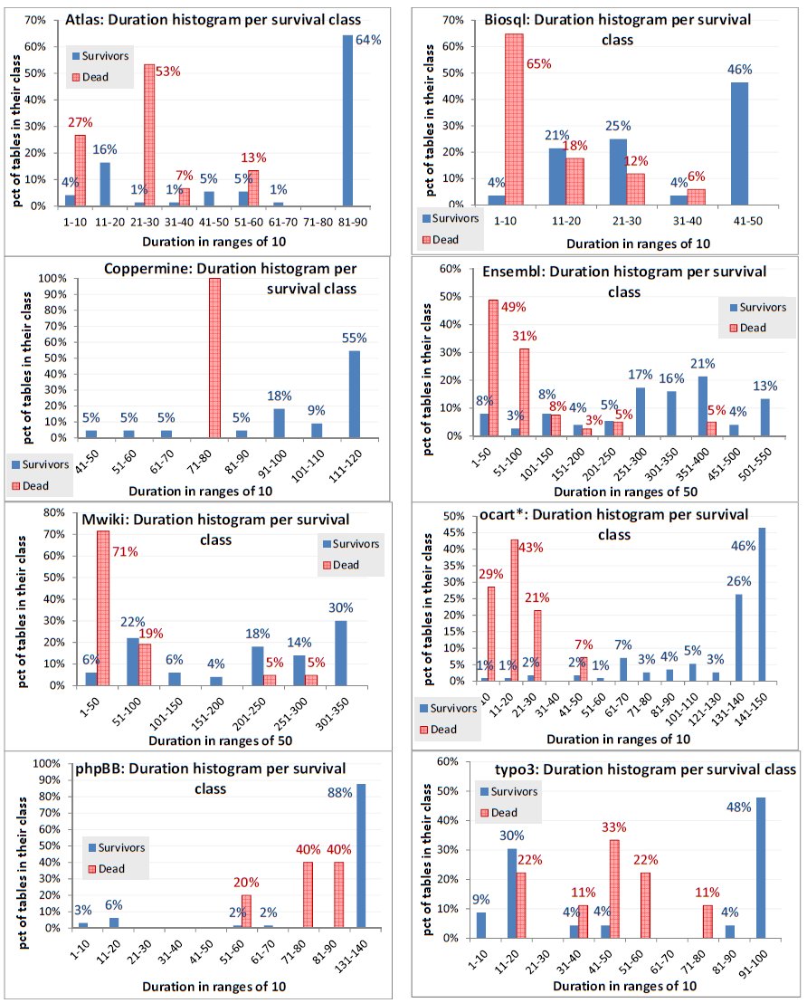
The oppositely skewed durations pattern
Histograms for the durations of dead vs. survivor tables
The dead tables are strongly biased towards short durations (positively skewed),
often with very large percentages of them being removed very shortly after birth.
Survivor tables are mostly heavy-tailed at the other end of the spectrum (negatively skewed), i.e., at high (frequently: max) durations.

Slide 11

Electrolysis pattern for table activities
Background
Durations’ study
Electrolysis
Discussion
Not only are the durations of dead vs survivors “opposite”, but also the activity profile is inverse, resulting in …

Slide 12

Electrolysis in chemistry
https://www.dreamstime.com/stock-illustration-electrolysis-experimental-set-up-electrolysis-process-passing-electric-current-cations-move-towards-cathode-get-image68978953 (C) Designua | Dreamstime.com

Slide 13
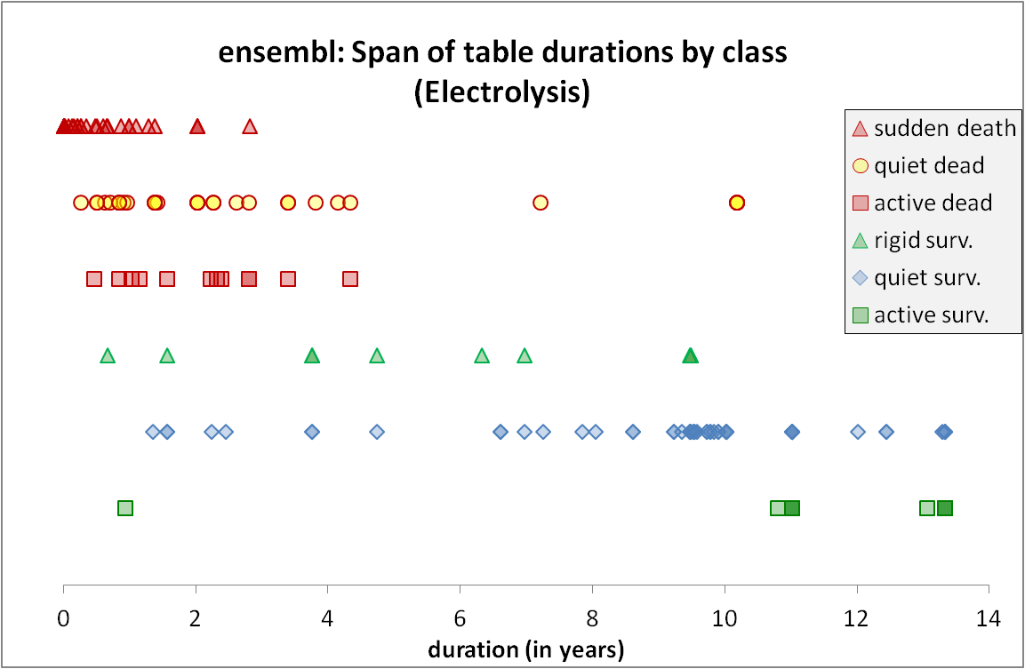
Duration is related to the Life & Death Class of the tables!
DEAD
Low dur., rigidity
Rigid
Quiet
Active
SURVIVORS
High dur., quiet
Rigid
Quiet
Active
(a) Survival: DEAD vs SURVIVORS
(b) Activity: Rigid (no change) vs Active (change rate > 10%) vs Quiet (all in between)
(c) Life And Death (LAD) class: Survival x Activity

Slide 14
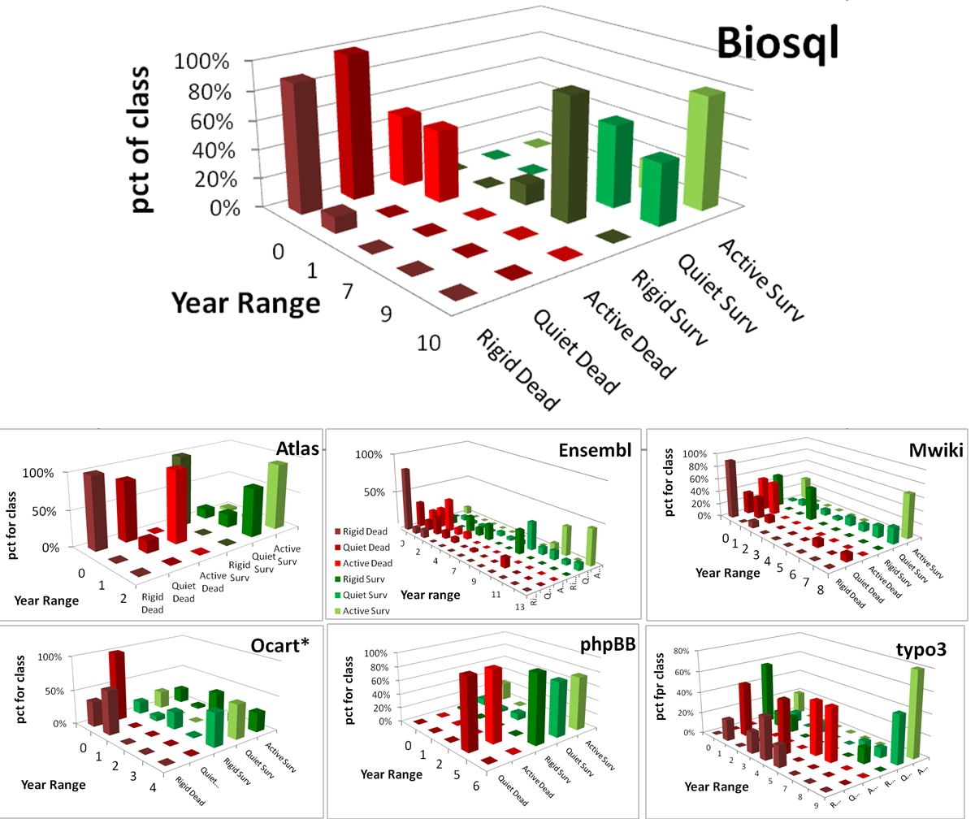
Attn: all pct’s are per class

Slide 15
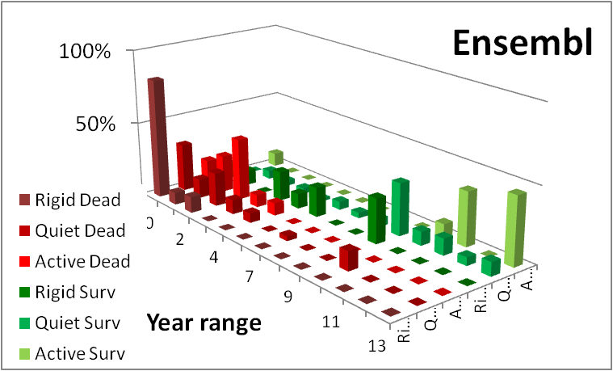
The electrolysis pattern
Dead tables demonstrate much shorter lifetimes than survivor ones,
can be located at short or medium durations, and practically never at high durations.
With few exceptions, the less active dead tables are, the higher the chance to reach shorter durations.
Survivors expose the inverse behavior, i.e., mostly located at medium or high durations.
The more active survivors are, the stronger they are attracted towards high durations, with a significant such inclination for the few active ones that cluster in very high durations.
Notes:
One could possibly argue that the observed clusterings and time spans are simply a matter of numbers: the more populated a class is, the broader its span is. To forestall any such criticism, this is simply not the case. We give the respective numbers in the sequel of this subsection; here, we proactively mention a few examples to address this concern. Rigid dead tables are the most populated group in the dead class, yet they have the shortest span of all. The rigid survivors, who are the 2nd most populated class of the entire population, exhibit all kind of behaviors; yet, in most of the cases, they are disproportionally clustered and not spread throughout the different categories. Active survivors are also disproportionately clustered at high durations. Overall, with the exception of the quiet survivors that indeed span a large variance of durations, in the rest of the categories, the time span is disproportionate to the size of the population (number of points in the scatter plot) of the respective class.

Slide 16
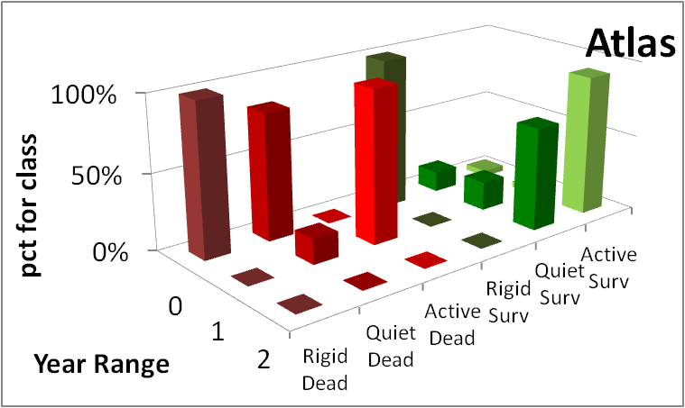
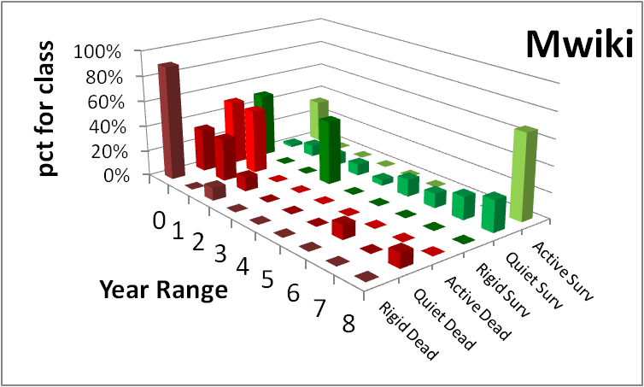
The electrolysis pattern: survivors
The extreme clustering of active survivors to high durations
The wider spread of (quite numerous) quiet survivors to a large span of durations with long trails of points
The clustering of rigid survivors, albeit not just to one, but to all kinds of durations (frequently, not as high as quiet and active survivors)

Slide 17
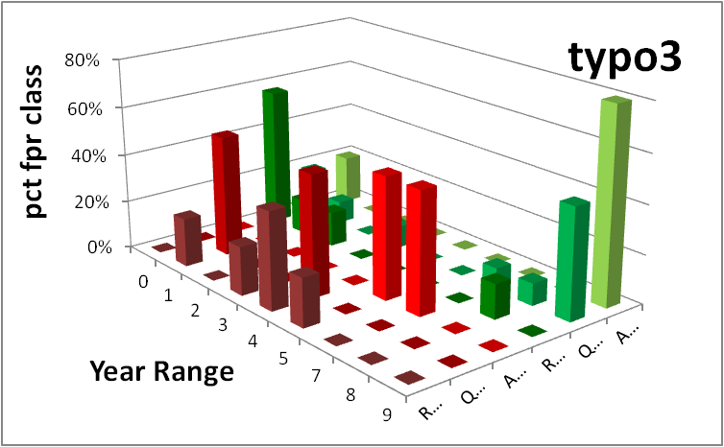
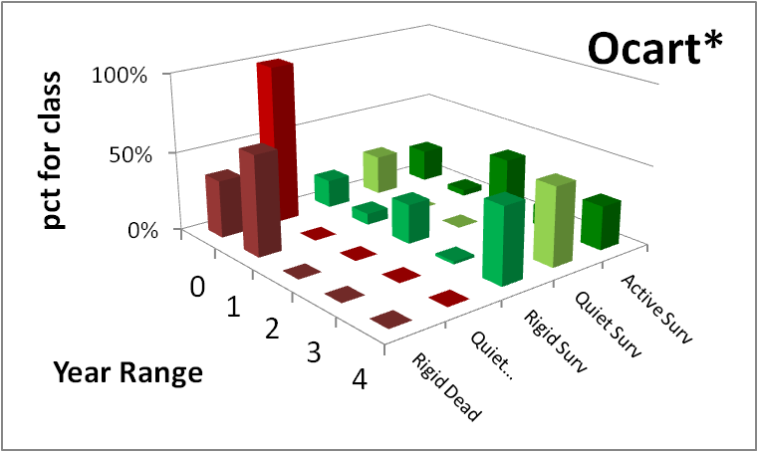
The electrolysis pattern: dead
The total absence of dead tables from high durations
The clustering of rigid dead at low durations,
the spread of quiet dead tables to low or medium durations, and
the occasional presence of the few active dead, that are found also at low or medium durations, but in a clustered way

Slide 18
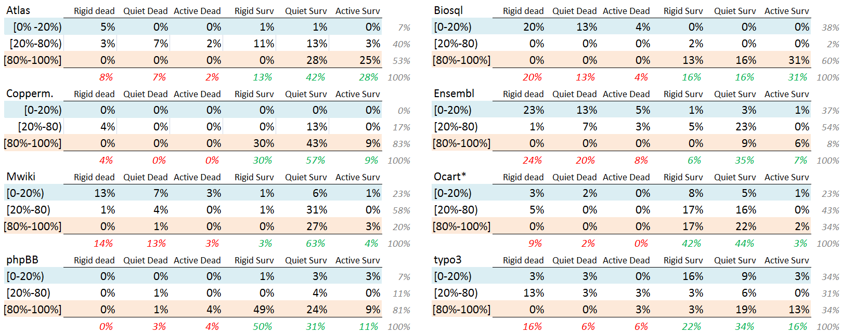
For each data set, for each LifeAndDeath class, percentage of tables per duration range over the total of the data set (for each data set, the sum of all cells adds up to 100%)
To probe further (code, data, details, presentations, …)
http://www.cs.uoi.gr/~pvassil/projects/schemaBiographies

Slide 19
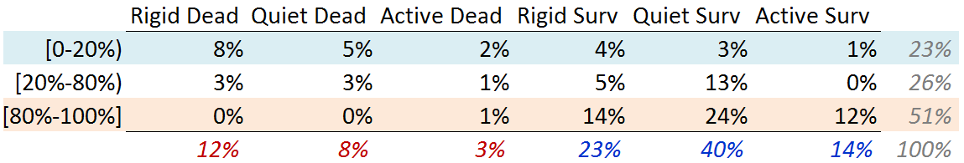
Indicative, average values over all datasets: for each LifeAndDeath class, percentage of tables per duration range over the total of the data set
An acute reader might express the concern whether it would be better to gather
all the tables in one single set and average over them. We disagree: each data set
comes with its own requirements, development style, and idiosyncrasy and putting
all tables in a single data set, not only scandalously favors large data sets, but
integrates different things. We average the behavior of schemata, not tables here.

Slide 20
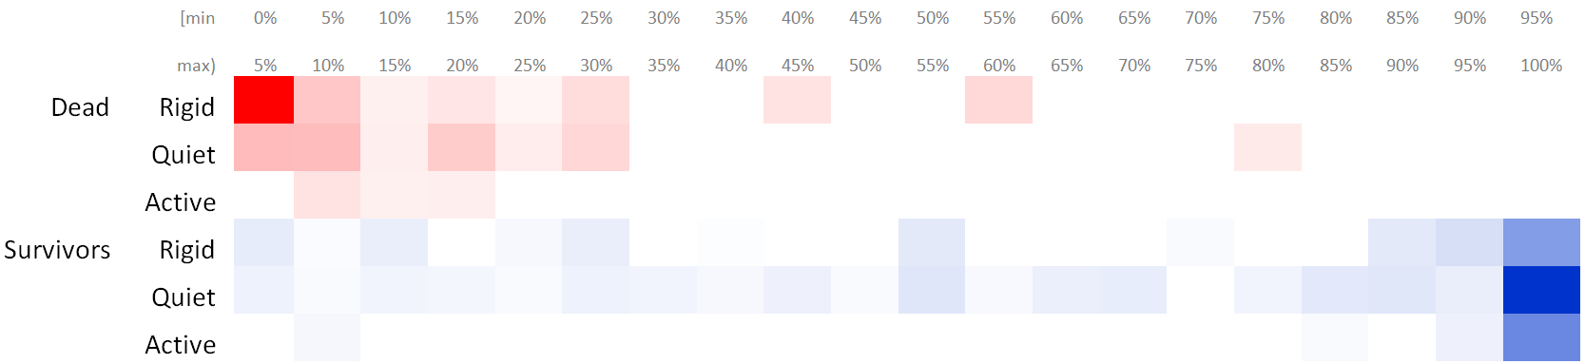
… electrolysis as a heatmap …
For each LifeAndDeath value, and for each duration range of 5% of the database lifetime, we computed the percentage of tables (over the total of the data set) whose duration falls within this range.
We removed cells that corresponded to only one data set
The resulting heatmap shows the polarization in colors: brighter color signifies higher percentage of the population

Slide 21
DISCUSSION & Open issues
Background
Durations’ study
Electrolysis
Discussion
Main Findings
Open Issues

Slide 22
Gravitation to Rigidity
Although the majority of survivor tables are in the quiet class, we can quite emphatically say that it is the absence of evolution that dominates!
Survivors vastly outnumber removed tables.
Similarly, rigid tables outnumber the active ones, both in the survival and, in particular, in the dead class.
Schema size is rarely resized, and only in survivors (not in the paper).
Active tables are few and do not seem to be born in other but early phases of the database lifetime.
Evidently, not only survival is also stronger than removal, but rigidity is also stronger a force than variability and the combination of the two forces further lowers the amount of change in the life of a database schema.

Slide 23
Gravitation to rigidity: death
Why dead tables have short durations and die mostly rigid?
We believe its due to the cost that deletions have for the maintenance of the software that surrounds the database.
The earlier a table is removed, the smaller the cost of maintaining the surrounding code is. If the table starts being used by queries spread in the code, the cost to to locate, maintain and test the application code that uses it is high.

Slide 24
Gravitation to rigidity: life
Who survives? Why do survivors last long?
Due to the reluctance for removals, it appears that after a certain period, practically within 10%-20% of the databases’ lifetime, tables begin to be “safe”…
… add to this that the starting versions of the database already include a large percentage of the overall population of tables …
… and you get a right-heavy, left-tailed, negatively skewed distribution of survivor tables (for 6 out of 8 data sets, survivor durations reaching the final bucket of the respective histogram exceed 45%).

Slide 25
Gravitation to rigidity: life
Tables with high durations that survive spend their lives mostly quietly (with the few occasional maintenance changes) – again minimizing the impact to the surrounding code.
The high concentration of the few active tables to very high durations and survival is related to the gravitation to rigidity:
… the early phases of the database lifetime typically include more table births
… after the development of a substantial amount of code, too high rate of updates becomes harder; this results in very low numbers of active tables being born later.
So, the pattern should not be read so much as “active tables are born early”, but rather as “we do not see so many active tables being born in late phases of the database life”.

Slide 26
Activity & Duration
Rigid tables find it hard to attain high durations (unless found in an environment of low change activity).
Shortly after there are born, they are in the high-risk group of being removed.
Rigid tables have the highest migration probability (a single upd => quiet).
Long duration and high activity are also correlated
Long duration is practically a pre-requisite of high activity (very rare exceptions)
Lack of late born active tables explains the long duration of the few active ones

Slide 27
Risks for developers
Young rigid tables are the high risk group for being removed
Tables mostly survive; when they don’t, tables typically die shortly after their birth and quite often, rigid
If a table surpasses infant mortality it will likely survive to live a rigid or, more commonly, a quiet live.
There is a small group of active tables, going through significant updates. Look for them in the early born, survivors.
Soon after a table is born, the development of code that depends on it should be kept as restrained as possible
After the period of infant mortality, it is fairly safe to say that (unless the table shows signs of significant update activity), gravitation to rigidity enters the stage and the table’s evolution will be low.
Notes:
Tables mostly survive; when they don’t, tables typically die shortly after their birth and quite often, rigid, i.e., without having experienced any update before. So, young rigid tables are the high risk group for being removed.
Typically, if a table surpasses infant mortality it will likely survive to live a rigid or, more commonly, a quiet live. There is a small group of active tables, going through significant updates. Look for them in the early born, survivors, as later phases of the database life do not seem to generate tables that are too active.
Overall, after a table is born, the development of code that depends on it should be kept as restrained as possible – preferably encapsulated via views that will hide the changes from the application code. After the period of infant mortality, it is fairly safe to say that unless the table shows signs of significant update activity, gravitation to rigidity enters the stage and the table’s evolution will be low.

Slide 28
Future work
Related literature suggests that database evolution cools down after the first versions. Is it true?
Collect posted comments and expressed user requirements at the public repositories and try to figure out why change is happening the way it does.
Automating this effort is a very ambitious goal in this context.
Finally, the validation of existing research results with more studies from other groups, different software tools, hopefully extending the set of studied data sets, is imperative to allow us progressively to move towards `laws' rather than `patterns‘ of change in the field of understanding schema evolution.

Slide 29
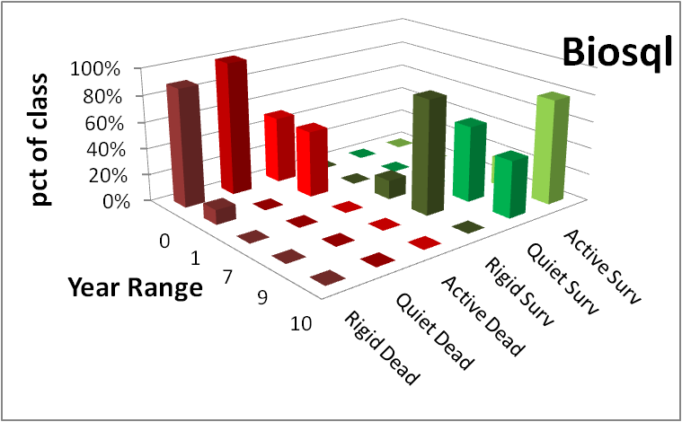


Danke schön! Thank you!
Yes, we can indeed find patterns in the lives of tables, during schema evolution!
Survivors, mostly long-lived (esp. active ones) and quietly active are radically different than dead tables, being mostly short-lived and rigid!
Gravitation to rigidity rules: we see more absence than presence of schema evolution!
To probe further (code, data, details, presentations, …)
http://www.cs.uoi.gr/~pvassil/projects/schemaBiographies

Slide 30
Auxiliary slides

Slide 31
What are the “laws” of database (schema) evolution?
How do databases change?
In particular, how does the schema of a database evolve over time?
Long term research goals:
Are there any “invariant properties” (e.g., patterns of repeating behavior) on the way database (schemata) change?
Is there a theory / model to explain them?
Can we exploit findings to engineer data-intensive ecosystems that withstand change gracefully?

Slide 32
Why care for the “laws”/patterns of schema evolution?
Scientific curiosity!
Practical Impact: DB’s are dependency magnets. Applications have to conform to the structure of the db…
typically, development waits till the “db backbone” is stable and applications are build on top of it
slight changes to the structure of a db can cause several (parts of) different applications to crash, causing the need for emergency repairing

Slide 33
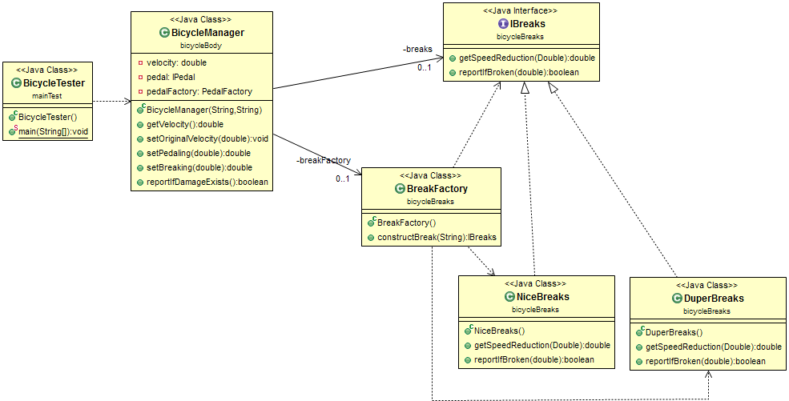
Abstract coupling example from my SW Dev course
Interface as a contract
Specification
≠
Implementation
Factory as a bridge
Client class
Service providers

Slide 34
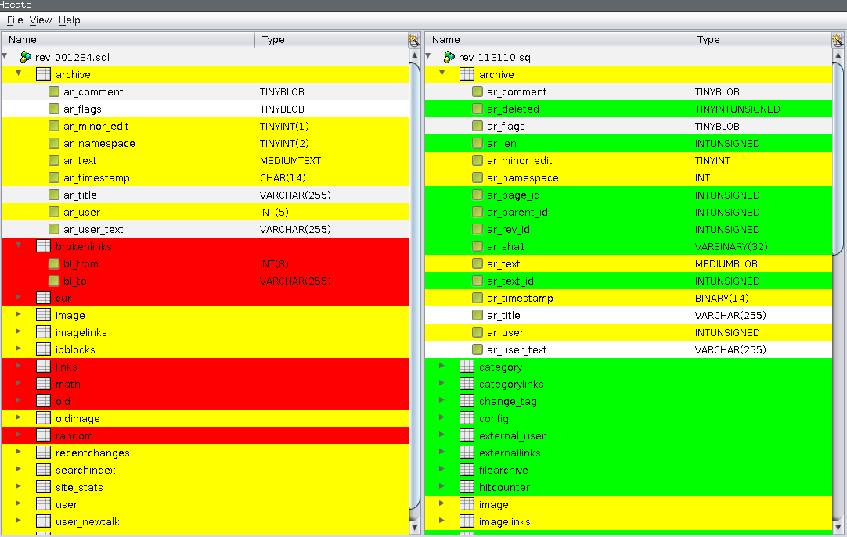
Hecate: SQL schema diff extractor
https://github.com/DAINTINESS-Group/Hecate

Slide 35
Hecate: SQL schema diff extractor
Parses DDL files
Creates a model for the parsed SQL elements
Compares two versions of the same schema
Reports on the diff performed with a variety of metrics
Exports the transitions that occurred in XML format
https://github.com/DAINTINESS-Group/Hecate

Slide 36
Scope of the study && Validity considerations

Slide 37
Data sets
Dataset | Versions | Lifetime | Tables Start | Tables End | Attributes Start | Attributes End | Commits per Day | % commits with change | Repository URL
ATLAS Trigger | 84 | 2 Y, 7 M, 2 D | 56 | 73 | 709 | 858 | 0,089 | 82% | http://atdaq-sw.cern.ch/cgi-bin/viewcvs-atlas.cgi/offline/Trigger/TrigConfiguration/TrigDb/share/sql/combined_schema.sql
BioSQL | 46 | 10 Y, 6 M, 19 D | 21 | 28 | 74 | 129 | 0,012 | 63% | https://github.com/biosql/biosql/blob/master/sql/biosqldb-mysql.sql
Coppermine | 117 | 8 Y, 6 M, 2 D | 8 | 22 | 87 | 169 | 0,038 | 50% | http://sourceforge.net/p/coppermine/code/8581/tree/trunk/cpg1.5.x/sql/schema.sql
Ensembl | 528 | 13 Y, 3 M, 15 D | 17 | 75 | 75 | 486 | 0,109 | 60% | http://cvs.sanger.ac.uk/cgi-bin/viewvc.cgi/ensembl/sql/table.sql?root=ensembl&view=log
MediaWiki | 322 | 8 Y, 10 M, 6 D | 17 | 50 | 100 | 318 | 0,100 | 59% | https://svn.wikimedia.org/viewvc/mediawiki/trunk/phase3/maintenance/tables.sql?view=log
OpenCart | 164 | 4 Y, 4 M, 3 D | 46 | 114 | 292 | 731 | 0,104 | 47% | https://github.com/opencart/opencart/blob/master/upload/install/opencart.sql
phpBB | 133 | 6 Y, 7 M, 10 D | 61 | 65 | 611 | 565 | 0,055 | 82% | https://github.com/phpbb/phpbb3/blob/develop/phpBB/install/schemas/mysql_41_schema.sql
TYPO3 | 97 | 8 Y, 11 M, 0 D | 10 | 23 | 122 | 414 | 0,030 | 76% | https://git.typo3.org/Packages/TYPO3.CMS.git/history/TYPO3_6-0:/t3lib/stddb/tables.sql

Slide 38
Scope of the study
FoSS Dataset | Versions | Lifetime | Tables @ Start | Tables @ End
ATLAS Trigger [A] | 84 | 2 Y, 7 M, 2 D | 56 | 73
BioSQL [B] | 46 | 10 Y, 6 M, 19 D | 21 | 28
Coppermine [C] | 117 | 8 Y, 6 M, 2 D | 8 | 22
Ensembl [B] | 528 | 13 Y, 3 M, 15 D | 17 | 75
MediaWiki [C] | 322 | 8 Y, 10 M, 6 D | 17 | 50
OpenCart [C] | 164 | 4 Y, 4 M, 3 D | 46 | 114
phpBB [C] | 133 | 6 Y, 7 M, 10 D | 61 | 65
TYPO3 [C] | 97 | 8 Y, 11 M, 0 D | 10 | 23
Scope:
databases being part of open-source software (and not proprietary ones)
long history
we work only with changes at the logical schema level (and ignore physical-level changes like index creation or change of storage engine)
We encompass datasets with different domains ([A]: physics, [B]: biomedical, [C]: CMS’s), amount of growth (shade: high, med, low) & schema size
We should be very careful to not overgeneralize findings to proprietary databases or physical schemata!

Slide 39
Measures and Terminology
SurvivalClass: this measure classifies a tables as (a) a survivor table (with the value of 20 in our data) if the table has survived (i.e., was present at the last known version of the database schema) or (b)a dead table (with the value of 10 in our data), if its last known version is prior to the last known version of the schema history.
ATU: Average Transitional amount of Updates is the ratio SumUpd / Duration
ActivityClass: characterization of how “active” a table is. Takes the value 0 for rigid tables that go through zero updates in their life, 2 for active tables, having ATU larger than 0.1 and sumUpd larger than 5 (see [ER 2015]), and 1 for the rest of the tables, characterized as quiet tables.
LifeAndDeath Class: the Cartesian product of the measures SurvivorClass and ActivityClass. The LifeAndDeath Class characterizes a table both with respect to its survival and to its update profile during its lifetime. The measure’s domain includes six values produced by the combination of {dead, survivor} x {rigid, quiet, active} (and conveniently computed as the sum SurvivorClass + ActivityClass in our data).

Slide 40
External validity
Can we generalize out findings broadly?
We perform an exploratory study to observe frequently occurring phenomena within the scope of the aforementioned population
Are our data sets representative enough? Is it possible that the observed behaviors are caused by sui-generis characteristics of the studied data sets?
Yes: we believe we have a good population definition & we abide by it
Yes: we believe we have a large number of databases, from a variety of domains with different profiles, that seem to give fairly consistent answers to our research questions (behavior deviations are mostly related to the maturity of the database and not to its application area).
Yes: we believe we have a good data extraction and measurement process without interference / selection / … of the input from our part
Maybe: unclear when the number of studied databases is large enough to declare the general application of a pattern as “universal”.

Slide 41
External validity
Can we generalize out findings broadly?
Understanding the represented population
Precision: all our data sets belong to the specified population
Definition Completeness: no missing property that we knowledgably omit to report
FoSS has an inherent way of maintenance and evolution
Representativeness of selected datasets
Data sets come from 3 categories of FoSS (CMS / Biomedical / Physics)
They have different size and growth volumes
Results are fairly consistent both in our ER’15 and our CAiSE’14 papers
Treatment of data
We have tested our “Delta Extractor”, Hecate, to parse the input correctly & adapted it during its development; the parser is not a full-blown SQL parser, but robust to ignore parts unknown to it
A handful of cases where adapted in the Coppermine to avoid overcomplicating the parser; not a serious threat to validity ; other than that we have not interfered with the input
Fully automated counting for the measures via Hecate

Slide 42
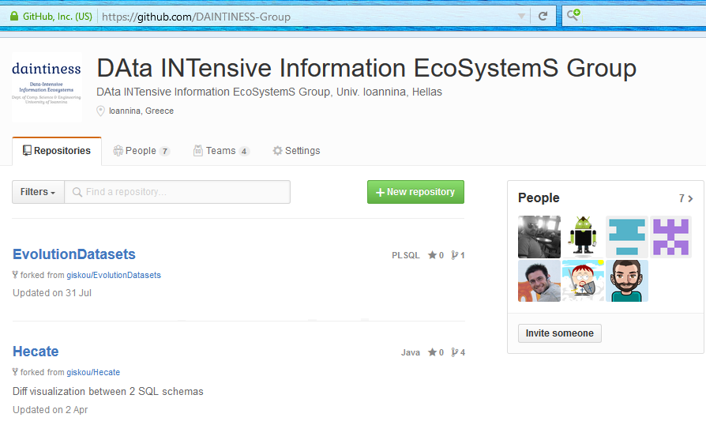
Most importantly: we are happy to invite you to reuse /test /assess /disprove /… all our code, data and results!
To probe further (code, data, results, …)
http://www.cs.uoi.gr/~pvassil/projects/schemaBiographies
https://github.com/DAINTINESS-Group

Slide 43
Internal validity
Can we confirm statements A=>B? No!
Are there any spurious relationships? Maybe!
Internal validity concerns the accuracy of cause-effect statements: “change in A => change in B”
We are very careful to avoid making strong causation statements!
In some places, we just hint that we suspect the causes for a particular phenomenon, in some places in the text, but we have no data, yet, to verify our gut-feeling.
And yes, it is quite possible that our correlations hide cofounding variables.

Slide 44
Is there a theory?
Our study should be regarded as a pattern observer, rather than as a collection of laws, coming with their internal mechanics and architecture.
It will take too many studies (to enlarge the representativeness even more) and more controlled experiments (in-depth excavation of cause-effect relationships) to produce a solid theory.
It would be highly desirable if a clear set of requirements on the population definition, the breadth of study and the experimental protocol could be solidified by the scientific community (like e.g., the TREC benchmarks)
… and of course, there might be other suggestions on how to proceed…

Slide 45
Related work

Slide 46
Why aren’t we there yet?
Historically, nobody from the research community had access + the right to publish to version histories of database schemata
Open source tools internally hosting databases have changed this landscape:
not only is the code available, but also,
public repositories (git, svn, …) keep the entire history of revisions
We are now presented with the opportunity to study the version histories of such “open source databases”

Slide 47
Timeline of empirical studies
Sjoberg
IST 93
Curino+
ICEIS08
Univ. Riverside
IWPSE09,
ICDEW11
Qiu,Li,Su
FSE13
Un. Ioannina
CAiSE14,
ER15
Cleve+
SCP15
Un. Ioannina
CAiSE17
~ … ~
1993
2008
2009
2011
2013
2014
2015
2017
Long v. IS’15
Long v. IS’17

Slide 48
Timeline of empirical studies
Sjoberg @ IST 93: 18 months study of a health system.
139% increase of #tables ; 274% increase of the #attributes
Changes in the code (on avg):
relation addition: 19 changes ; attribute additions: 2 changes
relation deletion : 59.5 changes; attribute deletions: 3.25 changes
An inflating period during construction where almost all changes were additions, and a subsequent period where additions and deletions where balanced.
Sjoberg
IST 93
Curino+
ICEIS08
Univ. Riverside
IWPSE09,
ICDEW11
Qiu,Li,Su
FSE13
Un. Ioannina
CAiSE14,
ER15
Cleve+
SCP15
Un. Ioannina
CAiSE17
~ … ~
1993
2008
2009
2011
2013
2014
2015
2017

Slide 49
Timeline of empirical studies
Curino+ @ ICEIS08: Mediawiki for 4.5 years
100% increase in the number of tables
142% in the number of attributes.
45% of changes do not affect the information capacity of the schema (but are rather index adjustments, documentation, etc)
Sjoberg
IST 93
Curino+
ICEIS08
Univ. Riverside
IWPSE09,
ICDEW11
Qiu,Li,Su
FSE13
Un. Ioannina
CAiSE14,
ER15
Cleve+
SCP15
Un. Ioannina
CAiSE17
~ … ~
1993
2008
2009
2011
2013
2014
2015
2017

Slide 50
Timeline of empirical studies
IWPSE09: Mozilla and Monotone (a version control system)
Many ways to be out of synch between code and evolving db schema
ICDEW11: Firefox, Monotone , Biblioteq (catalogue man.) , Vienna (RSS)
Similar pct of changes with previous work
Frequency and timing analysis: db schemata tend to stabilize over time, as there is more change at the beginning of their history, but seem to converge to a relatively fixed structure later
Sjoberg
IST 93
Curino+
ICEIS08
Univ. Riverside
IWPSE09,
ICDEW11
Qiu,Li,Su
FSE13
Un. Ioannina
CAiSE14,
ER15
Cleve+
SCP15
Un. Ioannina
CAiSE17
~ … ~
1993
2008
2009
2011
2013
2014
2015
2017

Slide 51
Timeline of empirical studies
Qiu,Li,Su@ FSE 2013: 10 (!) database schemata studied.
Change is focused both (a) with respect to time and (b) with respect to the tables who change.
Timing: 7 out of 10 databases reached 60% of their schema size within 20% of their early lifetime.
Change is frequent in the early stages of the databases, with inflationary characteristics; then, the schema evolution process calms down.
Tables that change: 40% of tables do not undergo any change at all, and 60%-90% of changes pertain to 20% of the tables (in other words, 80% of the tables live quiet lives). The most frequently modified tables attract 80% of the changes.
Sjoberg
IST 93
Curino+
ICEIS08
Univ. Riverside
IWPSE09,
ICDEW11
Qiu,Li,Su
FSE13
Un. Ioannina
CAiSE14,
ER15
Cleve+
SCP15
Un. Ioannina
CAiSE17
~ … ~
1993
2008
2009
2011
2013
2014
2015
2017

Slide 52
Timeline of empirical studies
Qiu,Li,Su@ FSE 2013: Code and db co-evolution, not always in synch.
Code and db changed in the same revision: 50.67% occasions
Code change was in a previous/subsequent version than the one where the database schema change: 16.22% of occasions
database changes not followed by code adaptation: 21.62% of occasions
11.49% of code changes were unrelated to the database evolution.
Each atomic change at the schema level is estimated to result in 10 -- 100 lines of application code been updated;
A valid db revision results in 100 -- 1000 lines of application code being updated
Sjoberg
IST 93
Curino+
ICEIS08
Univ. Riverside
IWPSE09,
ICDEW11
Qiu,Li,Su
FSE13
Un. Ioannina
CAiSE14,
ER15
Cleve+
SCP15
Un. Ioannina
CAiSE17
~ … ~
1993
2008
2009
2011
2013
2014
2015
2017

Slide 53
Timeline of empirical studies
CAiSE14: DB level
ER’15: Table level
Sjoberg
IST 93
Curino+
ICEIS08
Univ. Riverside
IWPSE09,
ICDEW11
Qiu,Li,Su
FSE13
Un. Ioannina
CAiSE14,
ER15
Cleve+
SCP15
Un. Ioannina
CAiSE17
~ … ~
1993
2008
2009
2011
2013
2014
2015
2017

Slide 54
Timeline of empirical studies
Cleve+ Science Comp. Progr. 2015: Oscar, an open source electronic medical record system
schema grows over time
deletions are rare
change is infrequent: most tables have less than 4 changes
Sjoberg
IST 93
Curino+
ICEIS08
Univ. Riverside
IWPSE09,
ICDEW11
Qiu,Li,Su
FSE13
Un. Ioannina
CAiSE14,
ER15
Cleve+
SCP15
Un. Ioannina
CAiSE17
~ … ~
1993
2008
2009
2011
2013
2014
2015
2017
Long v. IS’15
Long v. IS’17
Notes:
[Cleve et al., at Science of Comp. Programming 2015] discuss a study that verifies the observations of other works concerning the trend of increase in schema size and the reluctance in the deletion of tables.
The authors discuss a case study of the Oscar system, an open source electronic medical record (EMR) system whose evolution they study via a toolset they have built. The results verify previous studies in several ways. Concerning schema growth, the authors report that the schema grows over time, both in terms of tables and attributes. Concerning the heartbeat, the authors report that deletions are rare and the schema grows mostly via table additions. Large tables are mostly created early, although extremely large tables (with more than 200 attributes) are also created late in the project; the extreme schema size of these tables is due to a special utility of the Oscar systems that supports power users with specialized attribute. Early born table have –expectedly- more changes than the ones born later, although the most interesting finding is that most tables have less than 4 changes. The set of developers work with different tables – interestingly, even the most active developers do not touch more than 20% of the schema.

Slide 55
Caise 14 / Inf. Systems 15

Slide 56
Datasets
https://github.com/DAINTINESS-Group/EvolutionDatasets
Content management Systems
MediaWiki, TYPO3, Coppermine, phpBB, OpenCart
Medical Databases
Ensemble, BioSQL
Scientific
ATLAS Trigger

Slide 57
Schema Size (relations)

Slide 58
CaiSE’14: Main results
Schema size (#tables, #attributes) supports the assumption of a feedback mechanism
Schema size grows over time; not continuously, but with bursts of concentrated effort
Drops in schema size signifies the existence of perfective maintenance
Regressive formula for size estimation holds, with a quite short memory
Schema Growth (diff in size between subsequent versions) is small!!
Growth is small, smaller than in typical software
The number of changes for each evolution step follows Zipf’s law around zero
Average growth is close (slightly higher) to zero
Patterns of change: no consistently constant behavior
Changes reduce in density as databases age
Change follows three patterns: Stillness, Abrupt change (up or down), Smooth growth upwards
Change frequently follows spike patterns
Complexity does not increase with age
Grey for results requiring further search

Slide 59
What we have found for schema evolution [CAiSE 14, IS 15]
Schemata grow over time in order to satisfy new requirements, albeit not in a continuous or linear fashion, but rather, with bursts of concentrated effort interrupting longer periods of calmness.
Growth is small, with average growth being close to zero.
Growth comes with drops in schema size that signify the existence of perfective maintenance.

Slide 60
Schema Growth (diff in #tables)
Notes:
Small growth for relations
Too many occurrences of zero growth
no periods of continuous change but we have small spikes
Average value close to zero (++ zipfian model)
Immediate + delta is followed with immediate - delta
Oscillations do exist; still much more on + axis
we cannot see patterns of smooth growth interrupted by perfective maintenance

Slide 61
Change over time
Notes:
BioSQL (2nd row, last) is an exception to 1st law
Large gaps of stability (inactivity) in all datasets
Apart from phpBB (3rd row, 1st), age results in less activity; density of activity drops

Slide 62
ER 2015 / IS 2017

Slide 63
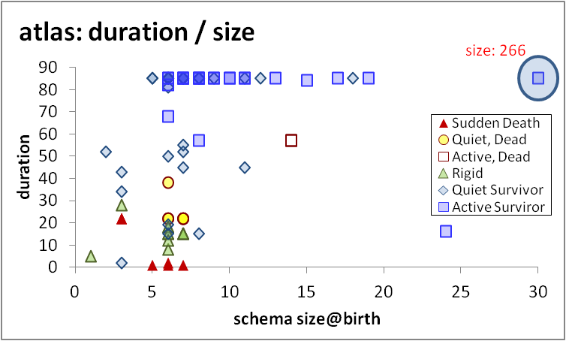
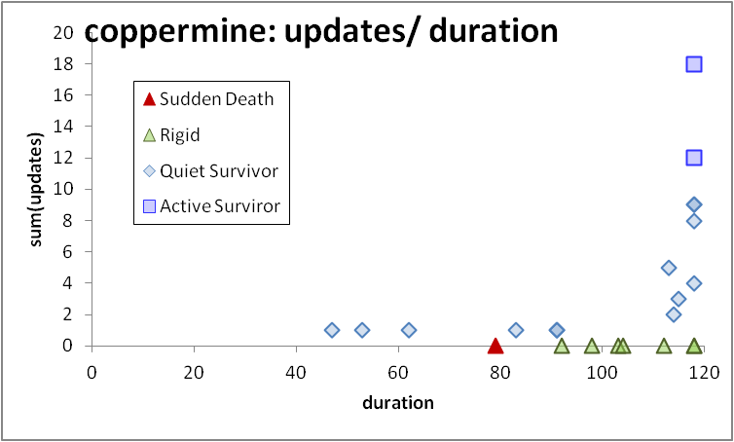

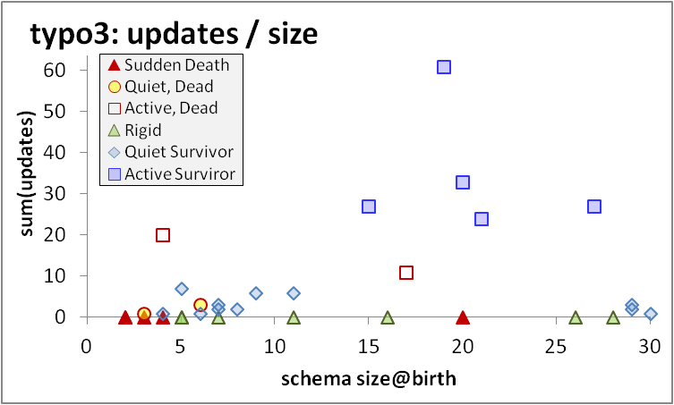
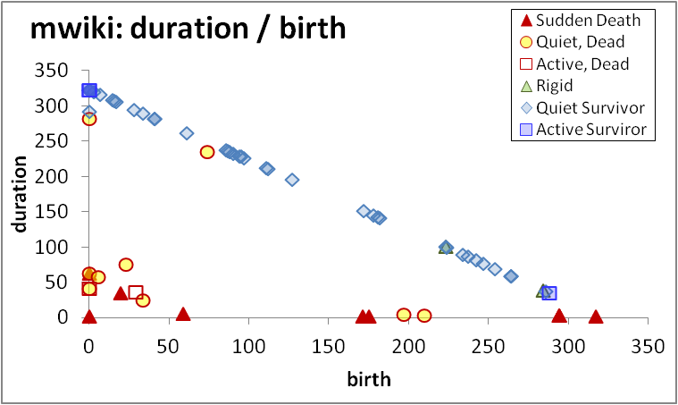
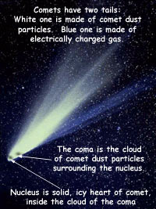
void
To probe further (code, data, details, presentations, …)
http://www.cs.uoi.gr/~pvassil/publications/2015_ER/

Slide 64
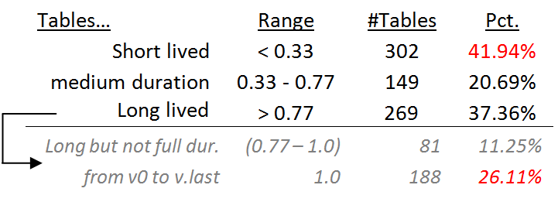
Statistical study of durations
Short and long lived tables are practically equally proportioned
Medium size durations are fewer than the rest!
Long lived tables are mostly survivors (see on the right)
One of the fascinating revelations of this measurement was that there is a 26.11% fraction of tables that appeared in the beginning of the database and survived until the end.
In fact, if a table is long-lived there is a 70% chance (188 over 269 occasions) that it has appeared in the beginning of the database.

Slide 65
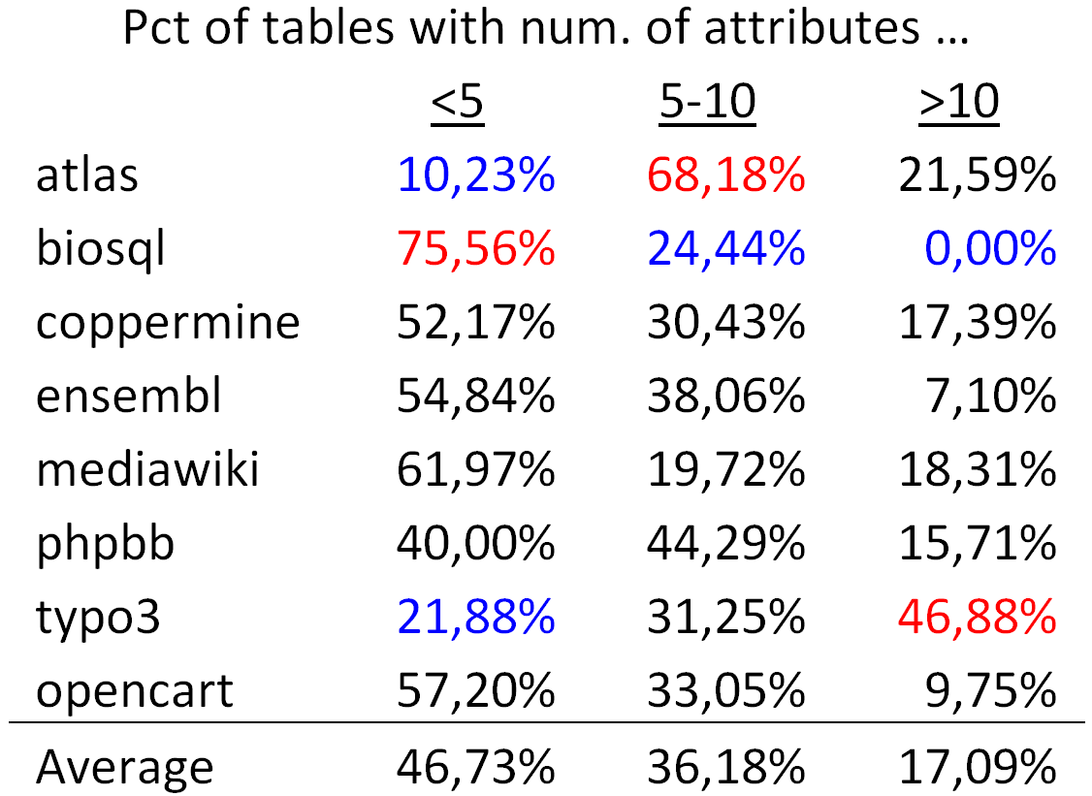
Tables are mostly thin
On average, half of the tables (approx. 47%) are thin tables with less than 5 attributes.
The tables with 5 to 10 attributes are approximately one third of the tables' population
The large tables with more than 10 attributes are approximately 17% of the tables.

Slide 66
The four patterns

Slide 67
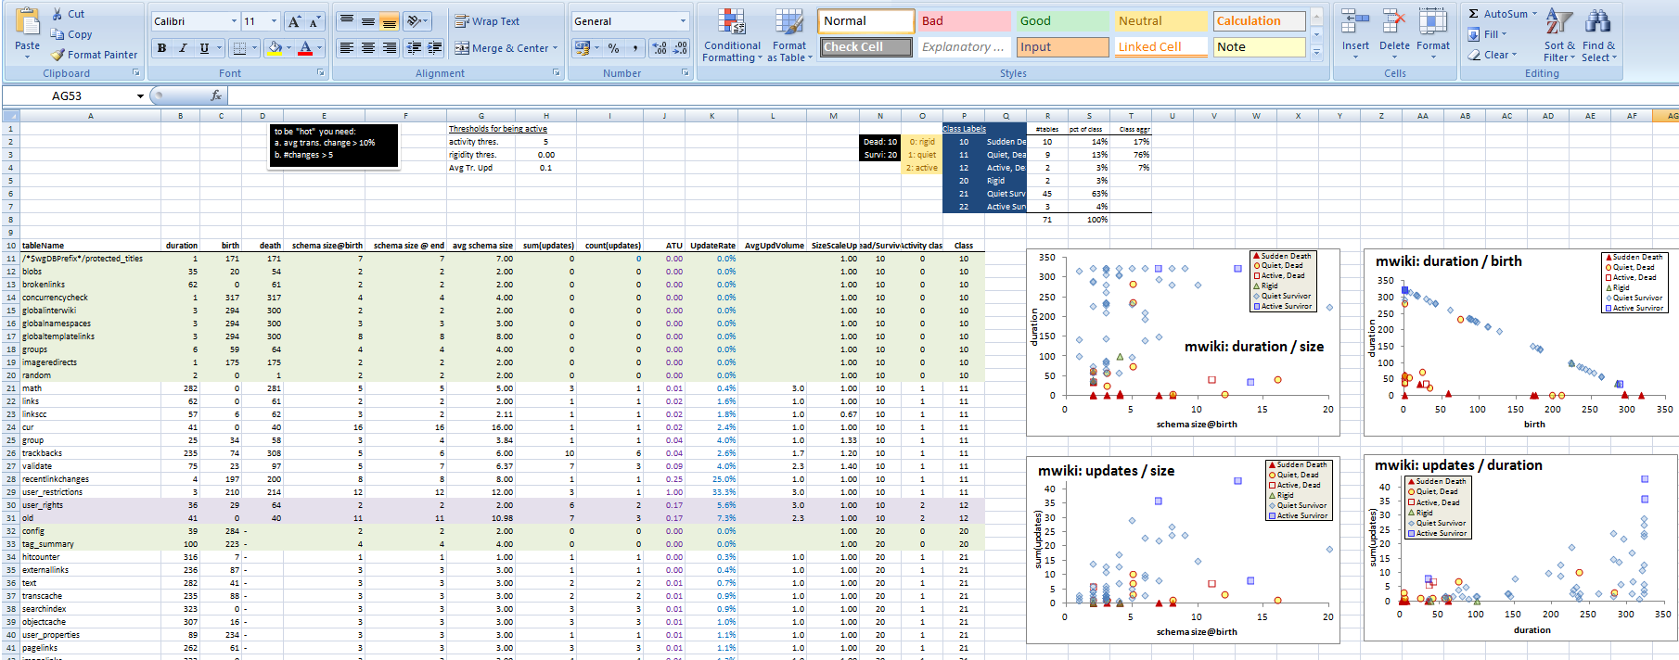
Exploratory search of the schema histories for patterns
Input: schema histories from github/sourceforge/…
Raw material: details and stats on each table’s life, as produced by our diff extractor, for all the 8 datasets
Output: properties & patterns on table properties (birth, duration, amt of change, …) that occur frequently in our data sets
Highlights
4 patterns of evolution

Slide 68
What we know so far for table evolution [ER 15, IS 17]
The Γ pattern indicates that tables with large schemata tend to have long durations and avoid removal;
The Comet pattern indicates that the tables with most updates are frequently the ones with medium schema size;
The Inverse Γ pattern indicates that tables with medium or small durations produce amounts of updates lower than expected, whereas tables with long duration expose all sorts of update behavior.
The Empty Triangle pattern indicates a significant absence of tables of medium or long durations that were removed –thus, an empty triangle – signifying mainly short lives for deleted tables and low probability of deletion for old timers.

Slide 69
Schema size, change and duration
Statistical properties for schema size, change and duration of tables
How are these measures interrelated?

Slide 70

The Gamma Pattern: "if you 're wide, you survive"
The Gamma phenomenon:
tables with small schema sizes can have arbitrary durations, //small size does not determine duration
larger size tables last long
Observations:
whenever a table exceeds the critical value of 10 attributes in its schema, its chances of surviving are high.
in most cases, the large tables are created early on and are not deleted afterwards.
Notes:
- Small schema size does not determine duration;
- large schema sizes are very strongly related to survival and large durations (this is called a $Gamma$ pattern).

Slide 71
Exceptions
Biosql: nobody exceeds 10 attributes
Ensembl, mwiki: very few exceed 10 attributes, 3 of them died
typo: has many late born survivors

Slide 72
The Comet Pattern
“Comet “ for change over schema size with:
a large, dense, nucleus cluster close to the beginning of the axes, denoting small size and small amount of change,
medium schema size tables typically demonstrating medium to large change
The tables with the largest amount of change are typically tables whose schema is on average one standard deviation above the mean
wide tables with large schema sizes demonstrating small to medium (typically around the middle of the y-axis) amount of change.
Notes:
"it is possible that a fact-carrying table of medium schema size, is augmented a lot to carry more information"

Slide 73
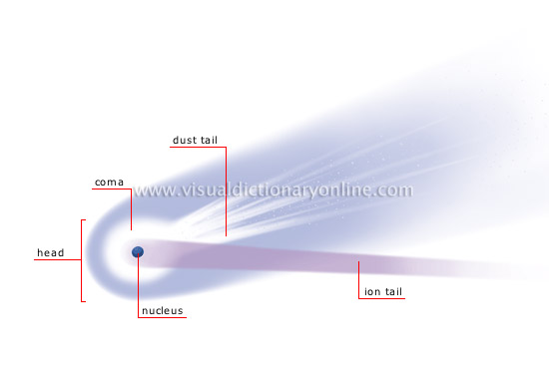
http://visual.merriam-webster.com/astronomy/celestial-bodies/comet.php
http://spaceplace.nasa.gov/comet-nucleus/en/

Slide 74
The inverse Gamma pattern
The correlation of change and duration is as follows:
small durations come necessarily with small change,
large durations come with all kinds of change activity and
medium sized durations come mostly with small change activity (Inverse Gamma).
Notes:
The \emph{inverse} $Gamma$ phenomenon: tables with small duration undergo small change, tables with medium duration undergo small or medium change, and, long-lived tables demonstrate all kinds of change behavior.

Slide 75
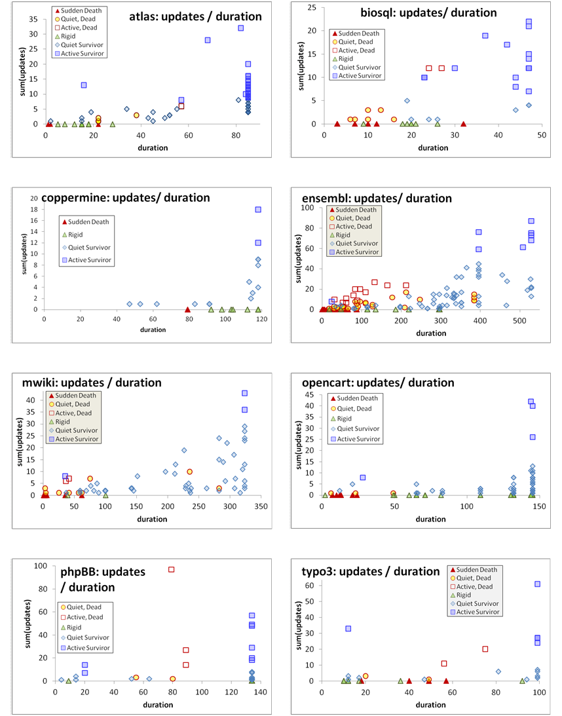

Slide 76
Birthday & schema size & matters of life and death
Who are the top changers?
Who are removed at some point of time?
How do removals take place?

Slide 77
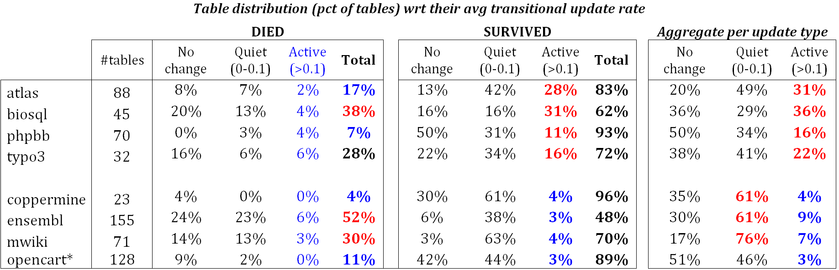
Quiet tables rule, esp. for mature db’s
Non-survivors
Sudden deaths mostly
Quiet come ~ close
Too few active
Survivors
Quiet tables rule
Rigid and active then
Active mostly in “new” db’s
Mature DB’s: the pct of active tables drops significantly

Slide 78
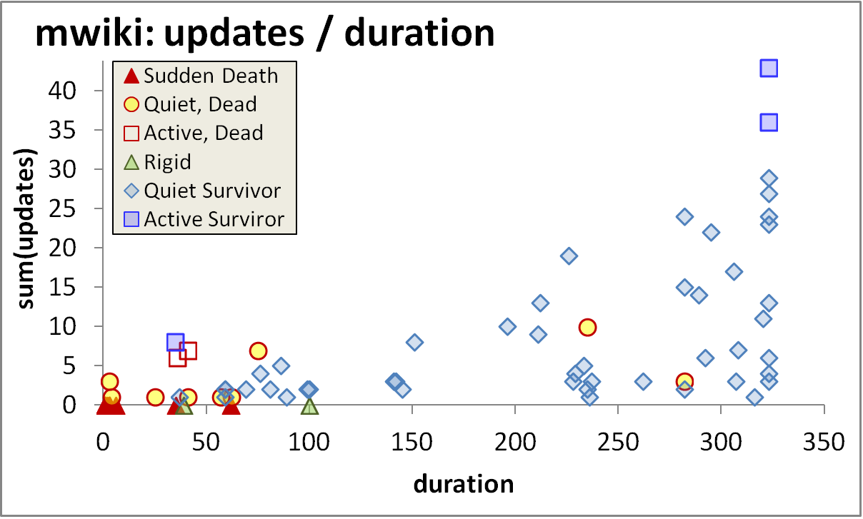
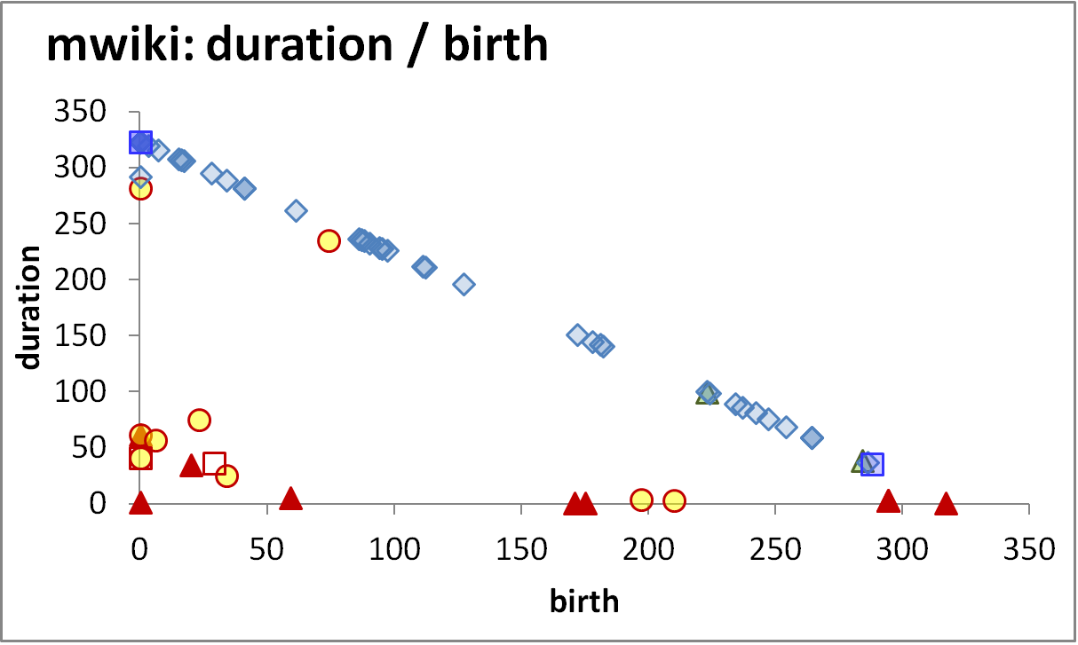
Longevity and update activity correlate !!
Top changers live long
Empty space: high change rates are only for early born & long lived
The few top-changers (in terms of avg trans. update – ATU)
are long lived,
typically come from the early versions of the database
due to the combination of high ATU and duration => they have high total amount of updates, and,
frequently survive!
Too many top changers are born early
Birth rate drops over time
Deleted tables are born early & last short

Slide 79
Die young
and suddenly
Empty space: high change rates are only for early born & long lived
There is a very large concentration of the deleted tables in a small range of newly born, quickly removed, with few or no updates…
…. resulting in very low numbers of removed tables with medium or long durations (empty triangle).
Deleted tables last short & do not change a lot
An empty triangle: no deleted tables with large or even modest durations
Deleted tables are born early & last short

Slide 80
Survive long enough &
you ‘re probably safe
Too rare to see deletions!
It is quite rare to see tables being removed at old age
Typically, the area of high duration is overwhelmingly inhabited by survivors (although each data set comes with a few such cases )!
High durations are overwhelmingly blue!
Only a couple of deletions are seen here!

Slide 81
Die young
and suddenly
[Early life of the db] There is a very large concentration of the deleted tables in a small range of newly born, quickly removed, with few or no updates, resulting in very low numbers of removed tables with medium or long durations.
[Mature db] After the early stages of the databases, we see the birth of tables who eventually get deleted, but they mostly come with very small durations and sudden deaths.
Deleted tables last short & do not change a lot
Few short lived tables are born and die in the mature life of the db
Deleted tables are born early & last short

Slide 82
void

Slide 83
The Gamma Pattern
Schema size @ birth / duration
Only the thin die young, all the wide ones seem to live forever

Slide 84
Exceptions
Biosql: nobody exceeds 10 attributes
Ensembl, mwiki: very few exceed 10 attributes, 3 of them died
typo: has many late born survivors

Slide 85
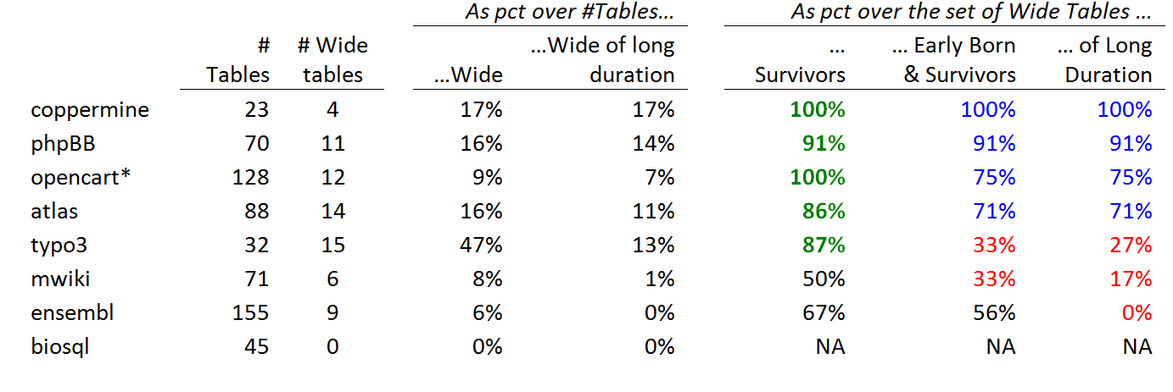
Stats on wide tables and their survival
Definitions:
Wide schema: strictly above 10 attributes.
The top band of durations (the upper part of the Gamma shape): the upper 10% of the values in the y-axis.
Early born table: ts birth version is in the lowest 33% of versions;
Late-comers: born after the 77% of the number of versions.

Slide 86
Whenever a table is wide, its chances of surviving are high
Apart from mwiki and ensembl, all the rest of the data sets confirm the hypothesis with a percentage higher than 85%. The two exceptions are as high as 50% for their support to the hypothesis.

Slide 87
Wide tables are frequently created early on and are not deleted afterwards
Early born, wide, survivor tables (as a percentage over the set of wide tables).
in half the data sets the percentage is above 70%
in two of them the percentage of these tables is one third of the wide tables.

Slide 88
Whenever a table is wide, its duration frequently lies within the top-band of durations (upper part of Gamma)
What is probability that a wide table belongs to the upper part of the Gamma?
there is a very strong correlation between the two last columns: the Pearson correlation is 88% overall; 100% for the datasets with high pct of early born wide tables.
Bipolarity on this pattern: half the cases support the pattern with support higher than 70%, whereas the rest of the cases clearly disprove it, with very low support values.

Slide 89
Long-lived & wide => early born and survivor
Subset
relationship
In all data sets, if a wide table has a long duration within the upper part of the Gamma, this deterministically (100% of all data sets) signifies that the table was also early born and survivor.
If a wide table is in the top of the Gamma line, it is deterministically an early born survivor.
Notes:
In other words, there is a subset relationship and all tables fulfilling the criteria for the last column of Figure XXX also fulfill the criteria for the penultimate one.

Slide 90
The Comet Pattern
Schema size and updates

Slide 91
http://visual.merriam-webster.com/astronomy/celestial-bodies/comet.php
http://spaceplace.nasa.gov/comet-nucleus/en/

Slide 92
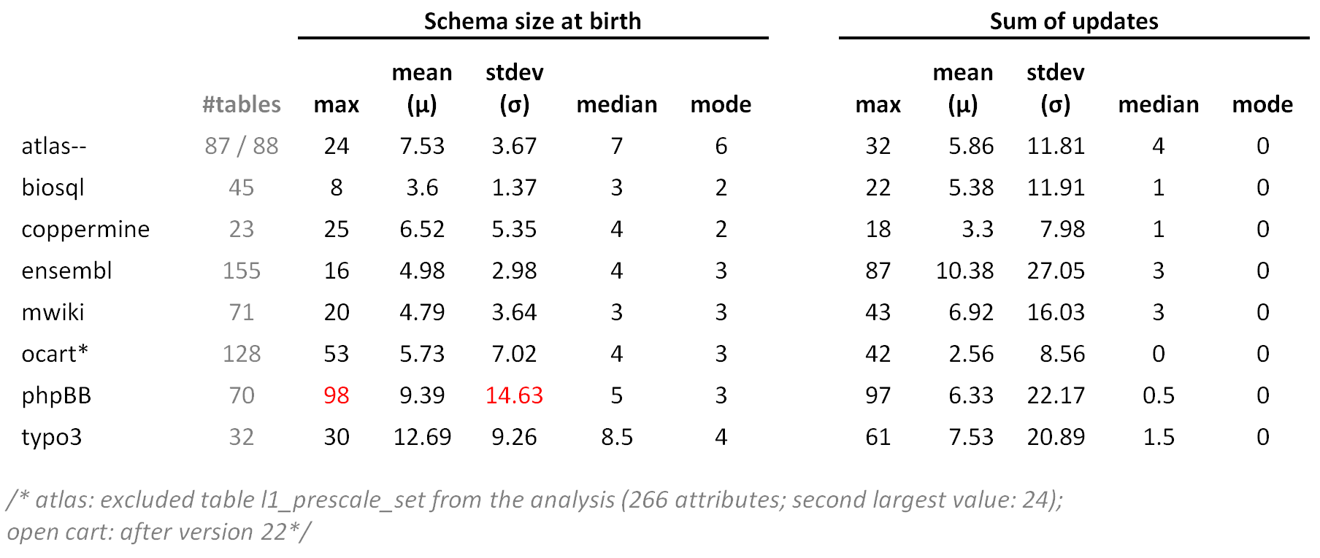
Statistics of schema size at birth and sum of updates

Slide 93
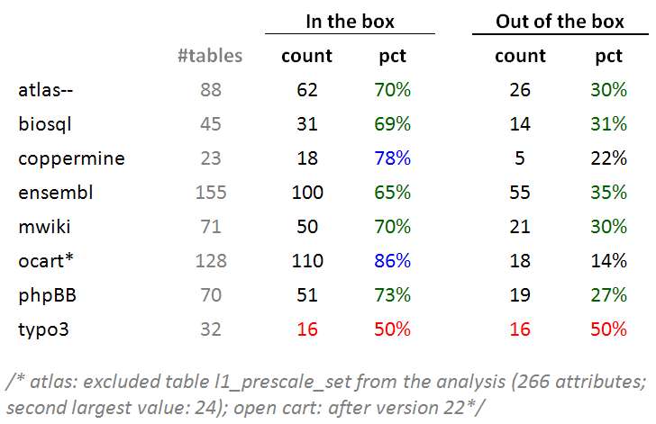
Typically: ~70% of tables inside the box
Typically, around 70% of the tables of a database is found within the 10x10 box of schemaSize@birth x sumOfUpdates (10 excluded in both axes).

Slide 94
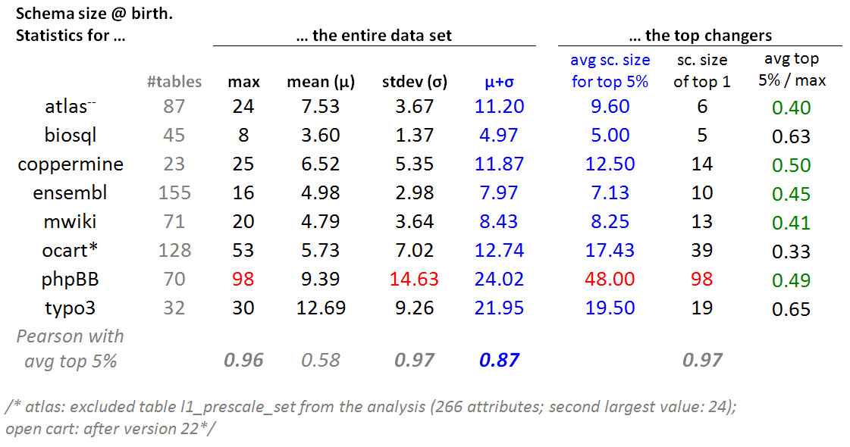
Top changers tend to have medium schema sizes
For every dataset: we selected the top 5% of tables in terms of this sum of updates and we averaged the schema size at birth of these top 5% tables.

Slide 95
Top changers tend to have medium schema sizes
The average schema size for the top 5% of tables in terms of their update behavior is close to one standard deviation up from the average value of the schema size at birth(i.e., very close to $mu$+$sigma$). //except phpBB

Slide 96
Top changers tend to have medium schema sizes
- In 5 out of 8 cases, the average schema size of top-changers within 0.4 and 0.5 of the maximum value (practically the middle of the domain) and never above 0.65 of it.
- Pearson: the maximum value, the standard deviation of the entire data set and the average of the top changers are very strongly correlated.

Slide 97
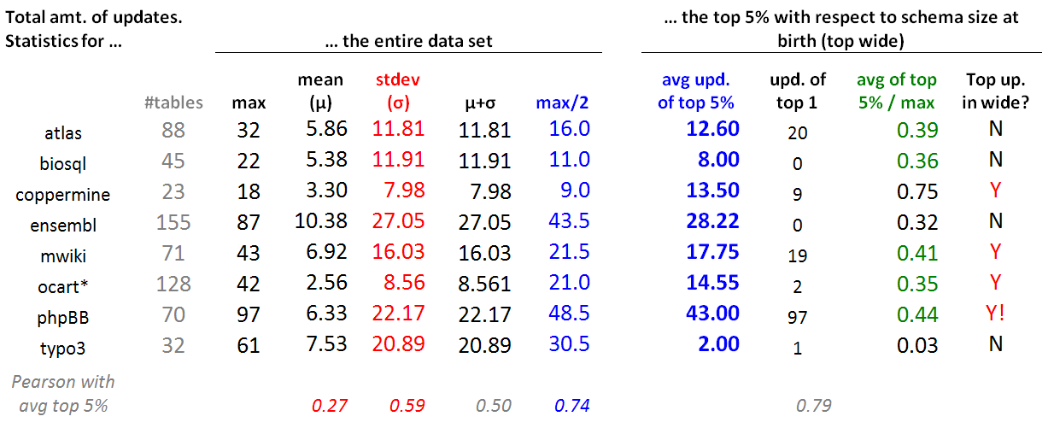
Wide tables have a medium number of updates
For each data set, we took the top 5% in terms of schema size at birth (top wide) and contrasted their update behavior wrt the update behavior of the entire data set.
Typically, the avg. number of updates of the top wide tables is close to the 50% of the domain of values for the sum of updates (i.e., the middle of the y-axis of the comet figure, measuring the sum of updates for each table).
This is mainly due to the (very) large standard deviation (twice the mean), rather than the --typically low -- mean value (due to the large part of the population living quiet lives).

Slide 98
Inverse Gamma

Slide 100
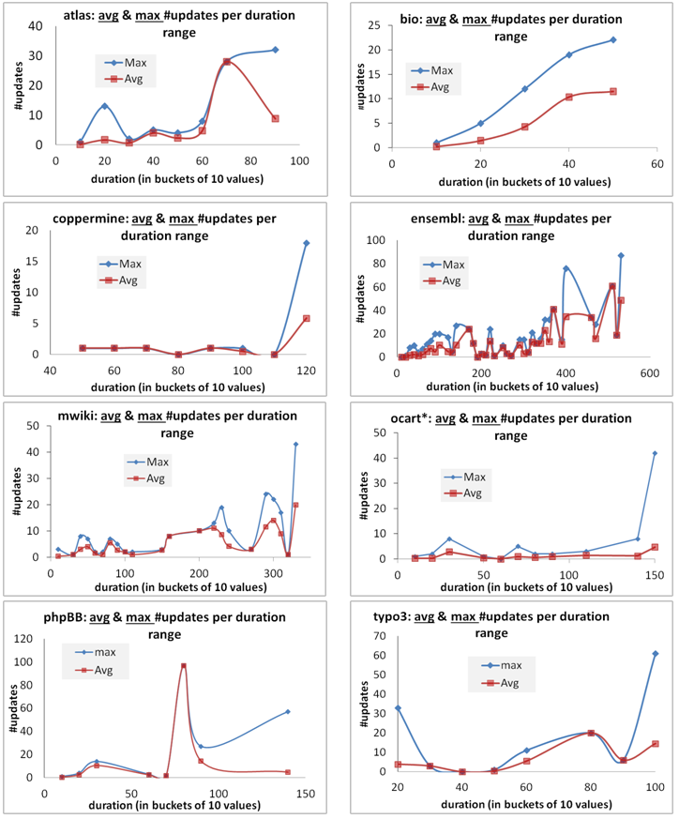
Skyline & Avg for Inverse Gamma

Slide 101
The empty triangle pattern

Slide 102
void

Slide 103
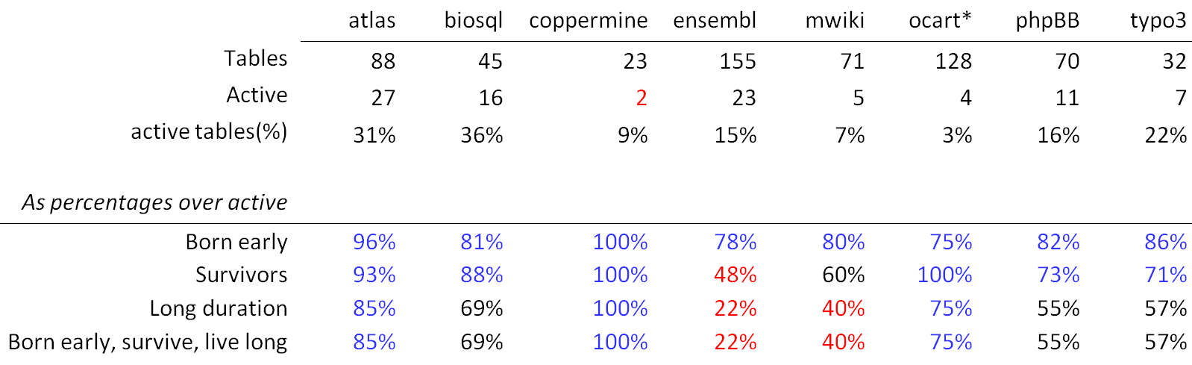
Top changers: early born, survivors, often with long durations, and often all the above
In all data sets, active tables are born early with percentages that exceed 75%
With the exceptions of two data sets, they survive with percentage higher than 70%.
The probability of having a long duration is higher than 50% in 6 out of 8 data sets.
Interestingly, the two last lines are exactly the same sets of tables in all data sets!
An active table with long duration has been born early and survived with prob. 100%
An active, survivor table that has a long duration has been born early with prob. 100%

Slide 104
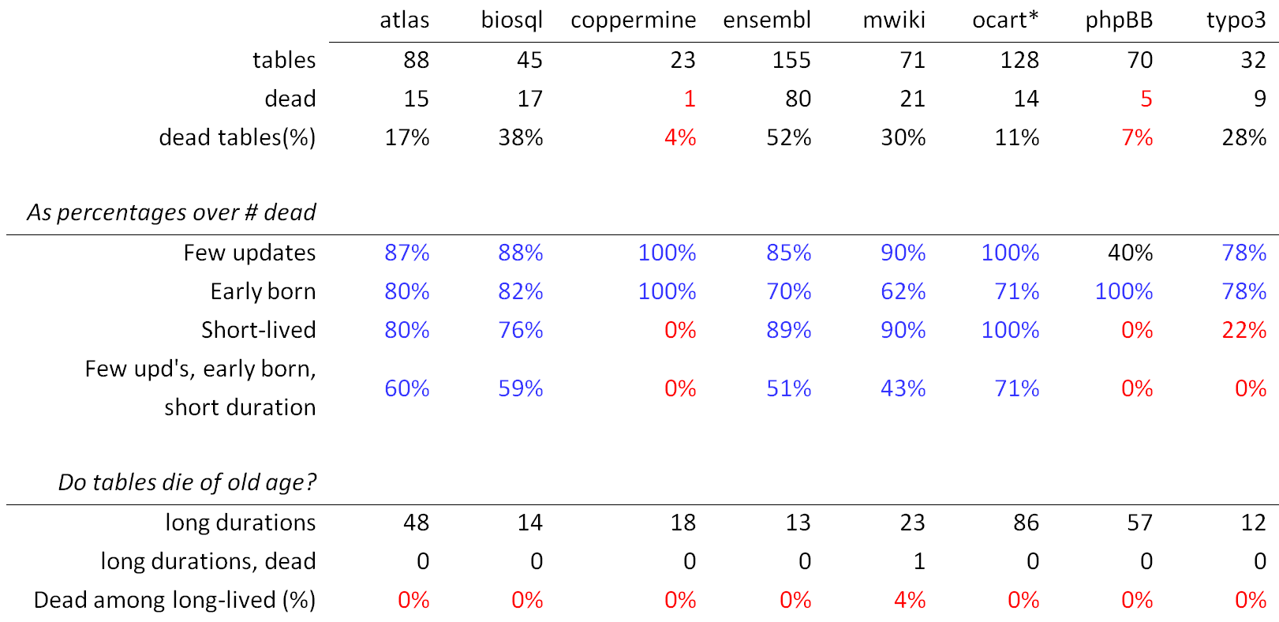
Dead are: quiet, early born, short lived, and quite often all three of them

Slide 105
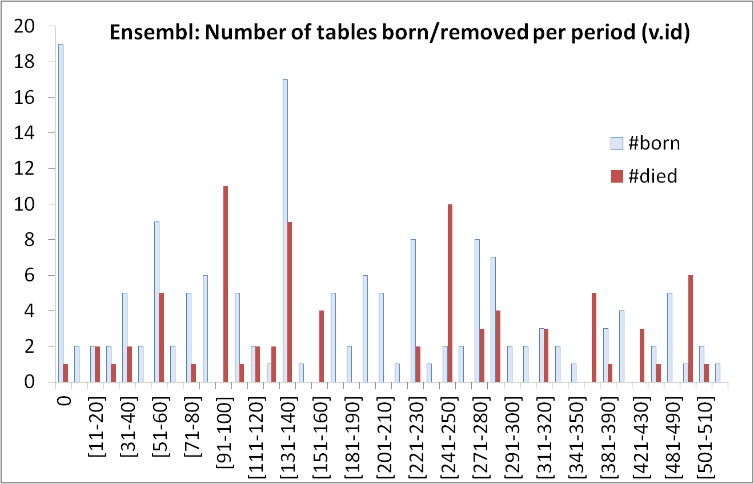
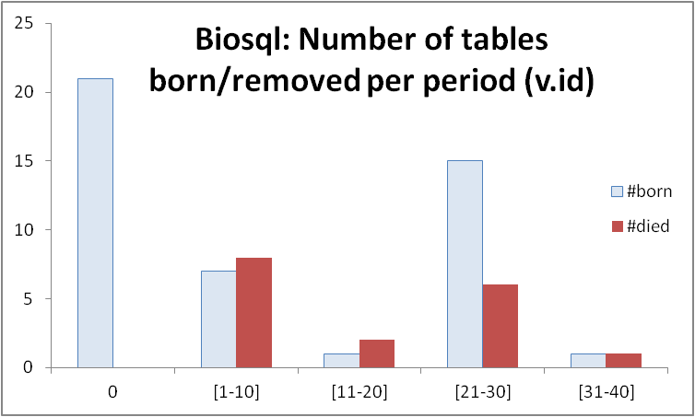
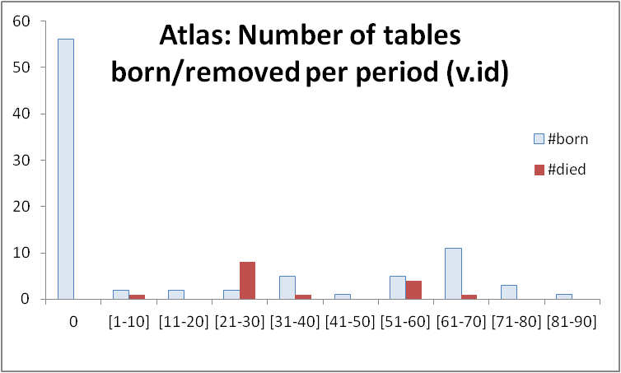
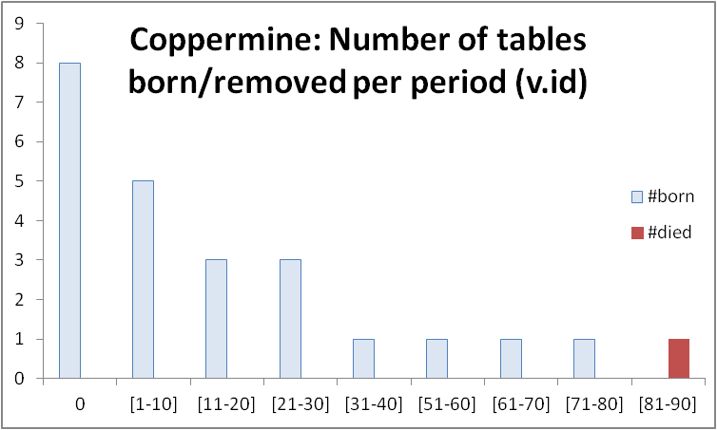
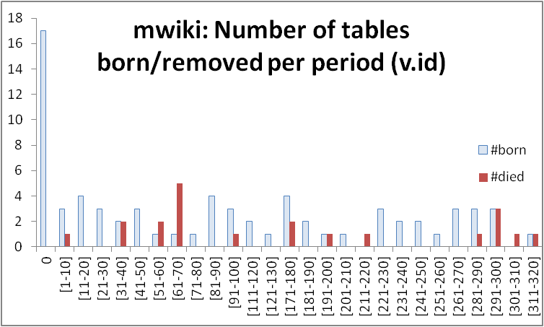
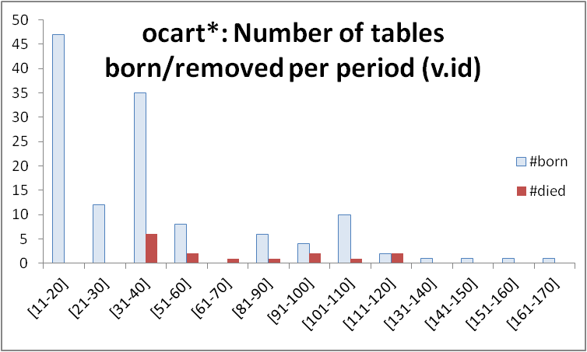
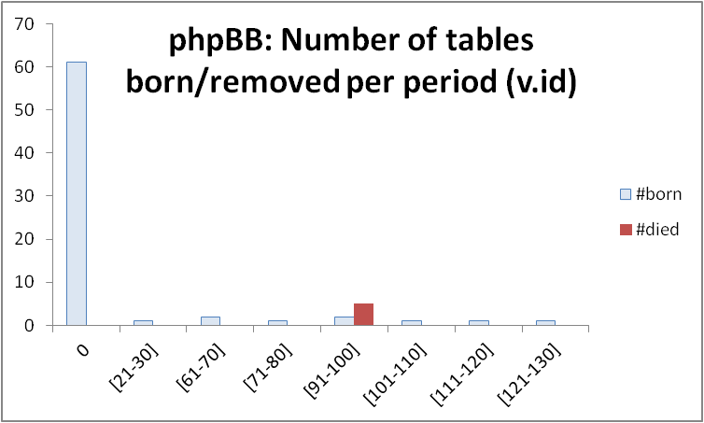
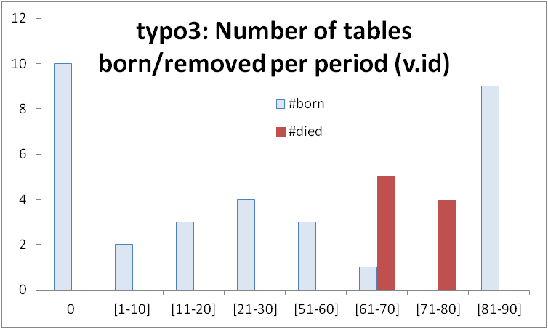
Most births &deaths occur early (usually)

Slide 106
Longevity and update activity correlate !!
Top changers live long
Remember: top changers are defined as such wrt ATU (AvgTrxnUpdate), not wrt sum(changes)
Still, they dominate the sum(updates) too! (see top of inverse Γ)
See also upper right blue part of diagonal: too many of them are born early and survive => live long!
Too many top changers are born early
Birth rate drops over time
Deleted tables are born early & last short

Slide 107
All in one
Top changers live long
Empty space: high change rates are only for early born & long lived
Early stages of the database life are more "active" in terms of births, deaths and updates, and have higher chances of producing deleted tables.
After the first major restructuring, the database continues to grow; however, we see much less removals, and maintenance activity becomes more concentrated and focused.
Deleted tables last short & do not change a lot
Top changers are born early
An empty triangle: no deleted tables with large or even modest durations
Deleted tables are born early & last short
Birth rate drops over time

Slide 108
Electrolysis @ CAiSe 2017

Slide 109
Why do we see what we see
We believe that this study strengthens our theory that schema evolution antagonizes a powerful gravitation to rigidity.
DB’s = “dependency magnets”
all the application code relies on them but not vice versa, =>
avoiding schema evolution reduces the need for adaptation and maintenance of application code

Slide 110


Slide 111
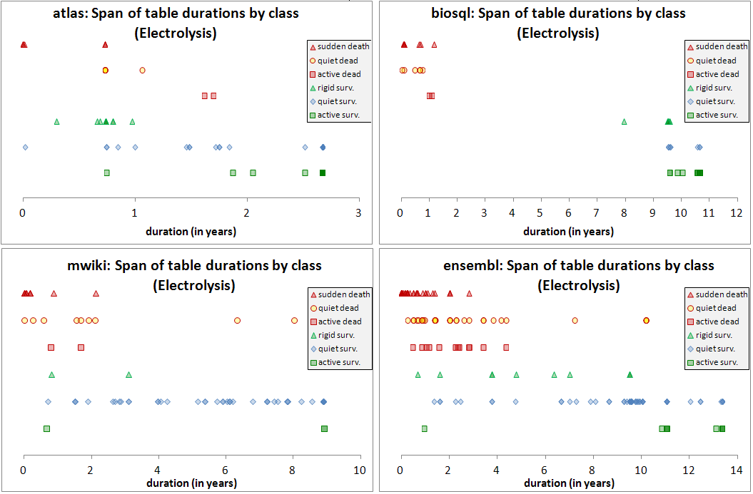

Slide 112
DEAD
Low dur., rigidity
Rigid
Quiet
Active
High dur., quiet
SURVIVORS
Rigid
Quiet
Active

Slide 113
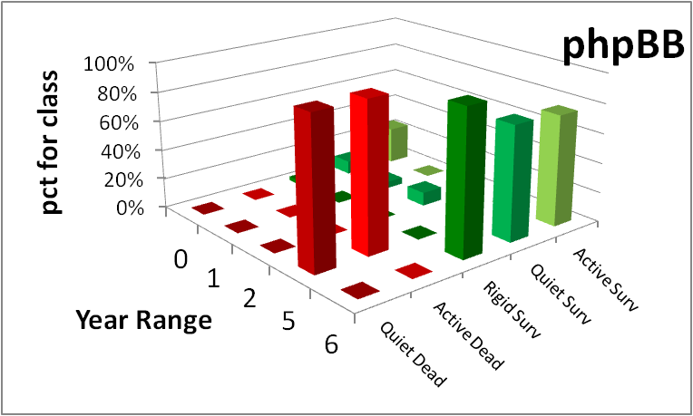

Slide 114
The data to support the pattern
We have performed an in-depth study of how tables are distributed in different durations. To group durations, we have split the duration of each schema lifetime into periods of 5%. Then, for each LifeAndDeath value, and for each duration range of 5% of the database lifetime, we computed the percentage of tables whose duration falls within this range.

Slide 115
… electrolysis as a heatmap …
For each LifeAndDeath value, and for each duration range of 5% of the database lifetime, we computed the percentage of tables (over the total of the data set) whose duration falls within this range.
We removed cells that corresponded to only one data set
The resulting heatmap shows the polarization in colors: brighter color signifies higher percentage of the population

Slide 116
For each data set, for each LifeAndDeath class, percentage of tables per duration range over the total of the data set (for each data set, the sum of all cells adds up to 100%)

Slide 117
Indicative, average values over all datasets: for each LifeAndDeath class, percentage of tables per duration range over the total of the data set
An acute reader might express the concern whether it would be better to gather
all the tables in one single set and average over them. We disagree: each data set
comes with its own requirements, development style, and idiosyncrasy and putting
all tables in a single data set, not only scandalously favors large data sets, but
integrates different things. We average the behavior of schemata, not tables here.

Slide 118
Do certain LifeAndDeath classes have high concentrations in particular data ranges?
The following tables are important. Many findings for survivor tables refer to it.

Slide 119
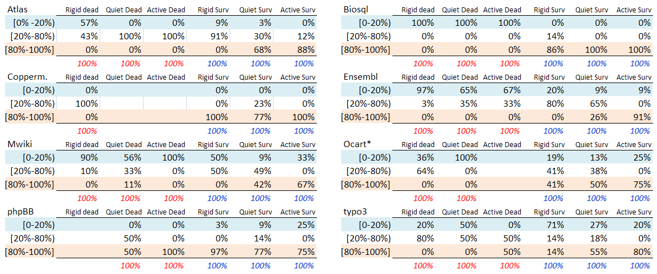
For each data set, for each LifeAndDeath class, percentage of tables per duration range over the total of their Life&Death class (for each data set, for each column, percentages add up to 100%)
Notes:
If one wants to measure of the percentage of tables for each value of the LifeAndDeath Class over each duration range, we need to calculate each cell as the percentage of the specific class (e.g., each cell in the rigid dead column should measure the fraction of rigid dead tables that belong to its particular duration range). The detailed data per data set, where the value of each cell is presented as percentage over its LifeAndDeath class are depicted in Fig. 5.D. In contrast to Fig. 5.G where percentages are computed over to the total number of tables of a schema, in Fig. 5.D, each cell of the Duration range x LifeAndDeath matrix expresses what is the percentage of tables of this particular LifeAndDeath class within this particular range (and this is why each column adds up to 100%). If we average the percentages for the respective cells of all the data sets, we end up with the distribution of values depicted in Fig. 5.E.

Slide 120
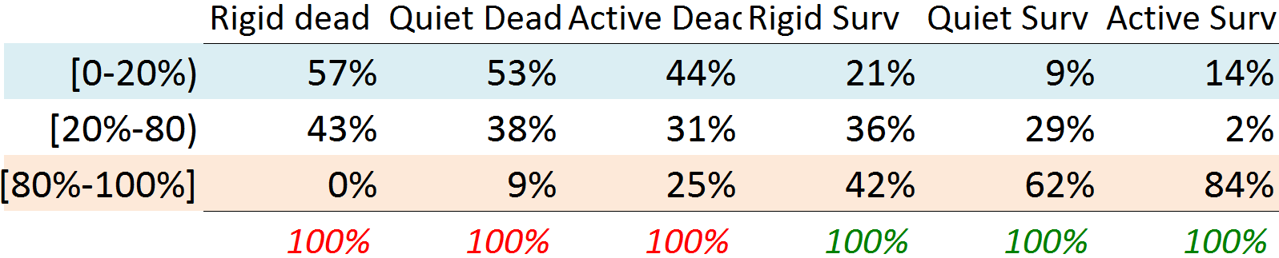
Average values over all datasets: for each LifeAndDeath class, percentage of tables per duration range over the total of their LifeAndDeath class (for each data set, for each column, percentages add up to 100%)
An acute reader might express the concern whether it would be better to gather
all the tables in one single set and average over them. We disagree: each data set
comes with its own requirements, development style, and idiosyncrasy and putting
all tables in a single data set, not only scandalously favors large data sets, but
integrates different things. We average the behavior of schemata, not tables here.

Slide 121
What is the distribution of tables per activity class for the dead tables that have durations less than the 20% of the database’s life? What is the distribution of tables per activity class for the survivor tables that have durations longer than the 80% of the database’s life?
The following table is important. Many findings for dead tables refer to it.

Slide 122

Zoom into low 20% of durations for the dead and upper 20% for the survivors
We count the number of tables, per LifeAndDeath class, for the respective critical duration range, and we compute the fraction of this value over the total number of tables pertaining to this LifeAndDeath class (columns Rigid, Quiet, Active). For the Dead and Surv columns, we divide the total number of dead/survivor tables belonging to the respective critical duration over the total number of dead/survivor tables overall.

Slide 123
In more than half of the cells of the table, the percentage reaches or exceeds 50%
We count the number of tables, per LifeAndDeath class, for the respective critical duration range, and we compute the fraction of this value over the total number of tables pertaining to this LifeAndDeath class (columns Rigid, Quiet, Active). For the Dead and Surv columns, we divide the total number of dead/survivor tables belonging to the respective critical duration over the total number of dead/survivor tables overall.

Slide 124
Dead Tables
All kinds of dead tables are strongly inclined (a) to rigidity, and (b) to small durations.
The less active tables are the more they are attracted to short durations.
The attraction of dead tables, especially rigid ones, to (primarily) low or, (secondarily) medium durations is significant and only few tables in the class of dead tables escape this rule.
Interestingly, in all our datasets, the only dead tables that escape the barrier of low and medium durations are a single table in mediawiki, another one in typo3, and the 4 of the 5 tables that are simultaneously deleted in phpBB.

Slide 125
Dead tables
Rigid dead tables, which is the most populated category of dead tables, strongly cluster in the area of low durations (lower than the 20% of the database lifetime) …
…with percentages of 90% – 100% in 3 of the 6 data sets
Quiet dead tables, which is a category including few tables, are mostly oriented towards low durations.
Specifically, there are 5 data sets with a high concentration of tables in the area of low durations; for the rest, the majority of quiet dead tables lie elsewhere
The very few active dead, have mixed behaviors.
Notes:
1. (Fig. 5.C). Atlas follows with a large percentage of 57% in this range. Two exceptions do exist: opencart and typo3, having most of their dead tables in the medium range. There are also two exceptions of minor importance: coppermine with a single deleted table and phpBB with a focused deletion of 5 tables at a single time point.
2. : atlas has 100% in the medium range and phpBB is split in half between medium and large durations.
3. which is a category where only six of the eight data sets have even a single table, there are two of them with 100% concentration and another one in 67% of its population in the low durations (Fig. 5.C). For the rest, atlas has 100% of its active dead in the medium range, phpBB 100% of the active dead in the long range (remember that phpBB has an exceptional behavior) and typo3 is split in half between low and medium durations (Fig. 5.D).

Slide 126
Survivor tables
It is extremely surprising that, the vast majority of active survivors exceed 80% of the database lifetime in all datasets.
With the exception of three data sets in the range of 67%-75%, the percentage of active survivors that exceeds 80% of the db lifetime exceeds 80%, and even attains totality in 2 cases.
Active survivor tables are not too many; however, it is amazing how long they live. If one looks into the detailed data and in synch with the empty triangle pattern of [IS16], the top changers are very often of maximum duration, i.e., early born and survivors.
This should be read as: no top-changer tables are born later!

Slide 127
Survivor tables
Rigid survivors demonstrate a large variety of behaviors.
Quiet survivors, being the (sometimes vast) majority of survivor tables, are mostly gravitated towards large durations, and secondarily to medium ones.
In 6 out of 8 data sets, the percentage of quiet survivors that exceeds 80% of db lifetime surpasses 50%.
In the two exceptions, medium durations is the largest subgroup of quiet survivors.
Still, quiet survivors also demonstrate short durations too, so overall, their span of possible durations is large.
Notably, in all data sets, there are quiet survivors reaching maximum duration.
Notes:
Rigid survivors are the second most populated category of tables after quiet survivors, and demonstrate too many profiles of clustering 1 data set comes with a low-heavy profile, another 3 with a high-heavy profile, another 2 with a medium-heavy profile, and there is one data set split in half between early and medium durations and another one with an orientation of medium-to-high durations.

Slide 128
Unexplored research territory (risky but possibly rewarding)
Weather Forecast: given the history and the state of a database, predict subsequent events
Risky: frequently, changes come due to an external, changing world and have “thematic” affinity.
Big & small steps in many directions needed (more data sets, studies with high internal validity to find causations, more events to capture, …)
Engineer for evolution: To absorb change gracefully we can try to (i) alter db design and DDL; (ii) encapsulate the database via a “stable” API; …
To probe further (code, data, details, presentations, …)
http://www.cs.uoi.gr/~pvassil/projects/schemaBiographies

Slide 129

Threats To Validity
With respect to the measurement validity of our work, we have tested (i) our automatic extraction tool, Hecate, for the accuracy of its automatic extraction of delta's and measures, and (ii) our human-made calculations.
The external validity of our study is supported by several strong statements: we have chosen data sets with
fairly long histories of versions,
a variety of domains (CMS's and scientific systems),
a variety in the number of their commits (from 46 to 528), and,
a variety of schema sizes (from 23 to 114 at the end of the study);
We have also been steadily attentive to work only with phenomena that are common to all the data sets.
Do not to interpret our findings as laws (that would need confirmation of our results by other research groups), but rather as patterns.

