Slide 1
Keep Calm & Wait for the Spike! Insights on the Evolution of Amazon Services
Apostolos Zarras | Panos Vassiliadis | Ioannis Dinos
Department of Computer Science &
Engineering
University of Ioannina - Greece
www.cs.uoi.gr
This work was supported from the European Community's
FP7/2007-2013 under grant agreement number 257178 (project CHOReOS).

Slide 2
Fundamental question
What are the patterns of
web service evolution
from the viewpoint of an
external observer?

Slide 3
Developer concerns
A developer of client applications of web services wants to know
should I use this service?
will the service evolve and how?
how will this impact my application?
// Create an Amazon SQS queue
CreateQueueRequest createQueueRequest = new CreateQueueRequest("MyQueue");
String myQueueUrl = sqs.createQueue(createQueueRequest).getQueueUrl();
...
//get all the msg's from the queue
ReceiveMessageRequest receiveMessageRequest = new ReceiveMessageRequest(myQueueUrl);
List<Message> messages = sqs.receiveMessage(receiveMessageRequest).getMessages();
...

Slide 4
Developer concerns
web service evolution
// Create an Amazon SQS queue
CreateQueueRequest createQueueRequest = new CreateQueueRequest("MyQueue");
String myQueueUrl = sqs.createQueue(createQueueRequest).getQueueUrl();
...
//get all the msg's from the queue
ReceiveMessageRequest receiveMessageRequest = new ReceiveMessageRequest(myQueueUrl);
List<Message> messages = sqs.receiveMessage(receiveMessageRequest).getMessages();
...
data type change?
signature change?
Deprecated operations?
New alternatives?
Renamings?

Slide 5
External observer
A developer of client applications of web services is not able to know the internals of the web service provider
The external observation of the history of changes is the only information she has…

Slide 6
Evolution of Dependency Magnets
Notes:
Why web services are unique?
Because they are dependency magnets on steroids! The amount of applications depending upon a popular web service is huge!
Thus, w/s evolution has its own unique characteristics due to vast amount of impacted app’s.

Slide 7
Contribution
We present patterns of web service evolution
from the viewpoint of an external observer
by studying the evolution of AWS services based on Lehman’s laws of software evolution
and discuss recommendations for assessing the future behavior of a w/s
Notes:
Web services are black box dependency magnets. Hence, studying how they evolve is both important and challenging. In this paper, we focus on one of the most successful stories of the service oriented paradigm in industry, i.e., the Amazon services. We perform a principled empirical study, that detects evolution patterns and regularities, based on Lehman's laws of software evolution.
Our findings indicate that service evolution comes with spikes of change, followed by calm periods where the service is internally enhanced. Although spikes come with unpredictable volume, developers can count in the near certainty of the calm periods following them to allow their absorption. As deletions rarely occur, both the complexity and the exported functionality of a service increase over time (in fact, predictably).
Based on the above findings, we provide recommendations that can be used by the developers of Web service applications for service selection and application maintenance.

Slide 8
Roadmap
- Method
- Laws
- Recommendations

Slide 9
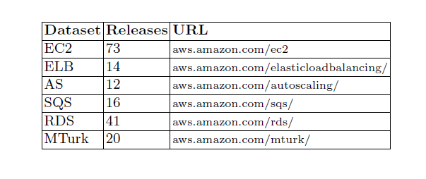
Setup & History Extraction
Membrane SOA Model: www.membrane-soa.org/
Notes:
Elastic Compute Cloud (EC2) allows to reuse computational resources, via the allocation and management of virtual servers, deployed on the AWS infrastructure.
Elastic Load Balancing (ELB) can be used together with EC2, to balance the load that is handled by a set of virtual servers, which have been allocated, via EC2.
Auto Scaling (AS) provides means for scaling up, or down, a set of virtual servers that have been allocated via EC2.
Simple Queue Service (SQS) allows message-based communication via queues.
Relational Database Service (RDS) provides means for managing and using relational databases, over the AWS infrastructure.
Mechanical Turk (MTurk) provides access to a scalable workforce, via an interface that offers operations for the creation of tasks, the qualification/selection of workers who are going to perform the tasks, the retrieval/approval of the work done, the payment of the workers, etc.

Slide 10
What did we measure
Service Evolution History:
Service Release:
Size: Number of Interfaces, Operations, XML Types
Change: Additions, Deletions, and Updates* of Operations between subsequent rel.
*Operation Updates: (a) changes in their own structure (e.g., attributes, annotations), or (b) updates in the structure of their constituents (e.g., messages, XML types).
Notes:
Size, is a tuple of basic size metrics that concern different parts of the WSDL specification of r^s_i . Specifically, Size[Interfaces], Size[Opers], Size[Types],
denote the number of interfaces, operations, and XML types, respectively.
Change, is a tuple of basic change metrics that concern the transition from R^s_{i-1} to r^s_i . In particular, Change[Adds], Change[Dels], and Change[Upds], denote the number of operation additions, removals, and updates, respectively.
For the purpose of our study, we consider operations as composite elements, whose updates involve (a) changes in their own structure (e.g.,
attributes, annotations), or (b) updates in the structure of their constituents (e.g., messages, XML types).

Slide 11
Roadmap
- Method
- Laws
- Recommendations

Slide 12
Lehman’s laws in a nutshell
An E-Type software system continuously changes over time (I) obeying a complex feedback-based evolution process (VIII) that prohibits the uncontrolled growth of the system (III).
Positive feedback: due to the need for growth and adaptation to user needs
evolution results in an increasing functional capacity of the system (VI),
produced by a growth ratio that is slowly declining in the long term (V),
with effort typically constant over phases (with the phases disrupted with bursts of effort from time to time (IV)).
Negative feedback: to regulate the ever-increasing growth and control both the overall quality of the system (VII), with particular emphasis to its internal quality (II).
Notes:
Functional capacity of the service that is perceived by the developers of Web service applications: (number of) operations of the service exported to them

Slide 13
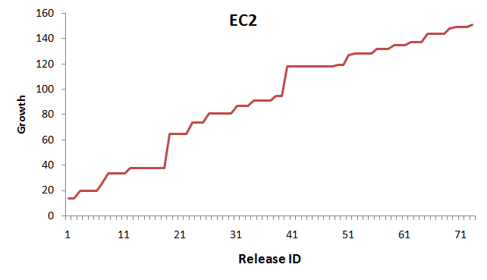
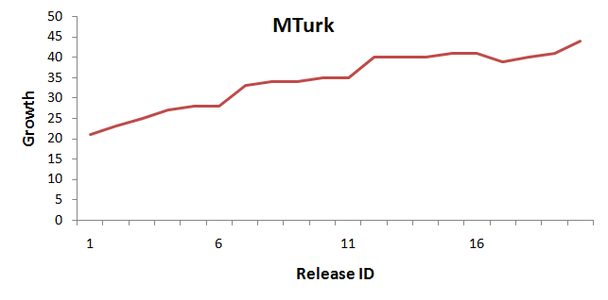
6th Law | The functional capability of E-type systems must be continually enhanced to maintain user satisfaction over system lifetime
Criteria | A continuous increasing trend in the growth of the system. We measure the growth of the service as the number of provided operations:
Validity | Holds
Properties | There is an increasing trend in the growth of the service operations However, the increase is not continuous
Notes:
As discussed in detail in \cite{LeRa06} the sixth law reflects the addition of new functionalities, while the first law generally concerns functional and behavioral changes.
Based on the exact wordings of the law, its validity for a particular system involves the existence of a continuous increasing trend in the growth of the system.
To assess the law in the case of Web services, we employ a metric typically used in the related literature \cite{LeRa06,XieCN09}, the functionality growth.
In our study, we measure the growth of the service as the number of operations provided by a particular service release. More formally, we employ the following metric.
Growth The growth of the operations for a service release rs is defined as the number of operations provided by rs
The case of Amazon services
In all of the Amazon services we observed \emph{an increasing trend in the growth of the service operations}. However, the periods of growth are interrupted by periods of calmness, consisting of subsequent service releases that offer the same number of operations (in Figure~\ref{is-model}, the solid lines depict the actual growth, while the dashed and the dotted lines give growth predictions, discussed later in law VIII).
Hence, \emph{the results that we obtained indicate that the sixth law holds}.
Nevertheless, the services do not grow exactly as originally stated in the law; their functional capacity increases, but the increase is not continuous.

Slide 14
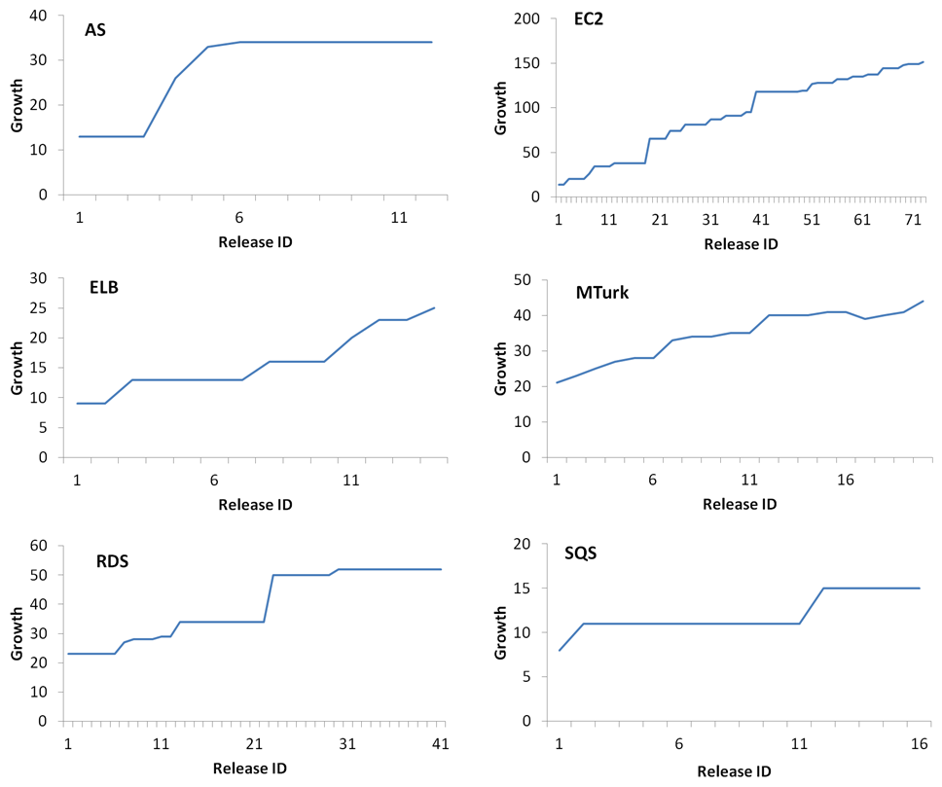
Growth

Slide 15
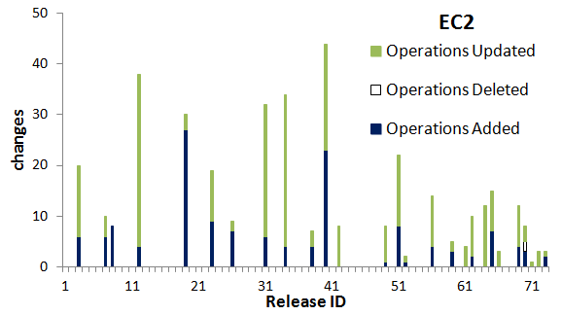
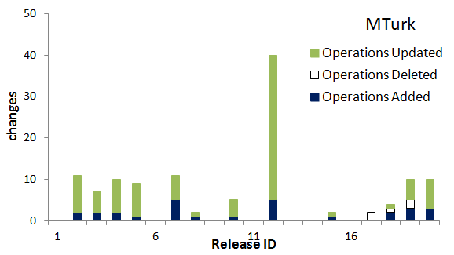
1st Law | An E-type system must be continually adapted, or else it becomes less satisfactory in use
Criteria | Heartbeat of changes during the service evolution history
Validity | Holds
Properties | Changes are mostly internal and involve the structure of the exported operations less frequently When they do, they involve mostly updates and additions
Notes:
The intuition behind the first law is that as time goes by, both the operational environment and the users' needs change, causing the need for the system to change too. In the service-oriented paradigm, as the services are publicly available through the Web, the number of the applications that depend upon them and their diversity is potentially unlimited. Hence, the potentials for the emergence of new requirements and the need for changing the services can be very high. In our study, we assess the first law based on \emph{the heartbeat of changes} that have been performed during the service evolution history.
The case of Amazon services
The study of the heartbeat of changes in the case of Amazon services reveals two main observations. The first one is that \emph{for a large number of service releases, the service interface remains unchanged}. According to the service release logs, in these releases most of the activity concerns bug fixing, documentation, security and performance improvements, deployment extensions, provision of client side APIs for specific programming languages and environments.
The second observation, which is inline with prior studies on the evolution of services \cite{Fokaefs11,RomanoP12}, is that \emph{the overwhelming majority of changes concern additions and updates}; there are very few cases of deletions.
Overall, \emph{the essence of the law holds} for the examined services. Notable properties are that \emph{changes are mostly internal and involve the structure of the exported operations less frequently; when they do, they involve mostly updates and additions}.

Slide 16
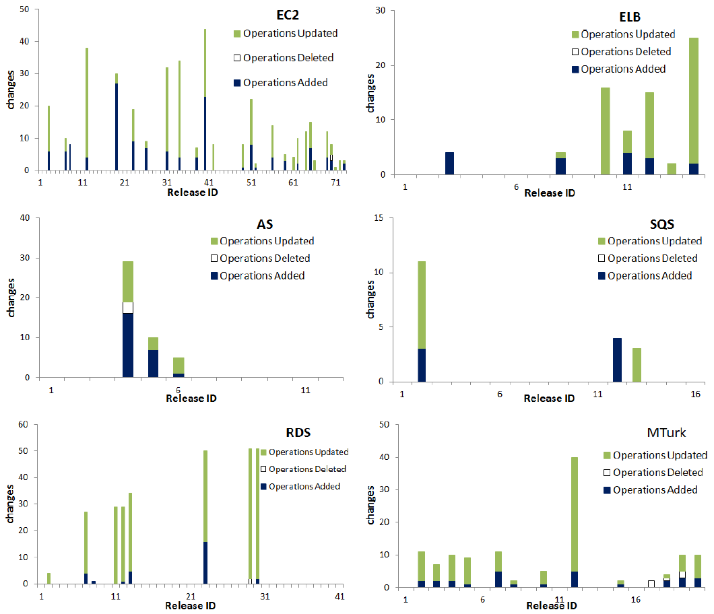
Heartbeat

Slide 17
4th Law | The work rate of an organization evolving an E-type system tends to be constant over the operational lifetime of that system, or phases of that lifetime
Criteria | Indicators like personnel time dedicated to software evolution is typically unavailable and inaccurate. An approximation suggested by Lehman et al. is number of changes performed per release
Validity | Inconclusive
Properties | The amount of changes is not invariant; also, it is not possible to speak about phases in which the amount of changes remains constant. On the other hand, it is not possible to know precisely the work done behind the scenes
Notes:
In practice, a constant work rate, along with the patterns that control the self-regulated evolution of the E-type system, facilitate the planning of resources that are needed for the E-type system's evolution activities. Unfortunately, though, the assessment of the law has been problematic early on (see e.g.,~\cite{LehmanRP98}~or~\cite{XieCN09}), as the available information on indicators like personnel time dedicated to software evolution is typically unavailable and inaccurate. An approximation suggested by Lehman et al.~\cite{LehmanRP98} involves measuring number of changes performed per release.
The case of Amazon services
In all cases we observed that the amount of changes is not invariant during the lifetime of the Amazon services; on the contrary, It may vary a lot (Figure1).
Also, it is not possible to speak about phases in which the amount of changes remains constant.
On the other hand, it is not possible to know precisely the work done behind the scenes (e.g., refactorings, repairs, etc.).
Therefore, based on our results we can not confirm or disprove the fourth law of software evolution.

Slide 18
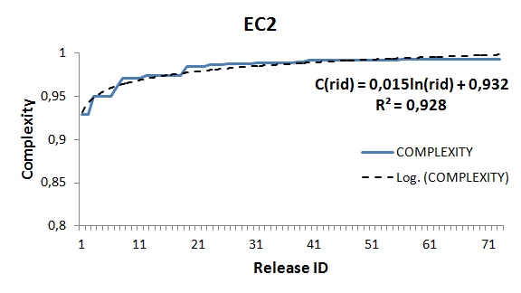
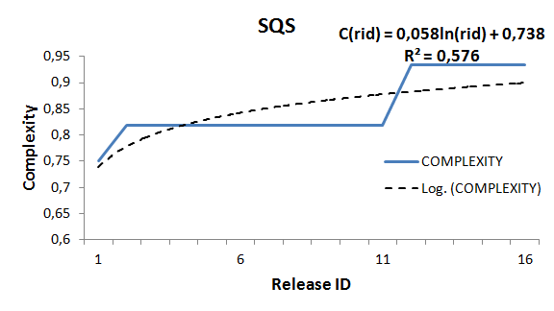
2nd Law | As an E-type system is changed its complexity increases and becomes more difficult to evolve, unless work is done to maintain or reduce the complexity
Criteria | Complement of the ratio of the provided interfaces to the operations:
Validity | Holds
Properties | Interface complexity, is high; it smoothly increases over time; usually the increase is logarithmic.
Notes:
The case of Amazon services
Regarding the second law, in all cases we observed that the value of $C(r_i^s)$ is generally high, which means that the interfaces of the examined services are composed of many operations (Figure~\ref{complexity}).
This holds, even for the initial releases of the services, where the value of $C(r_i^s)$ is typically higher than 0.9 for all datasets (except SQS). \emph{As time passes, the value of $C(r_i^s)$ increases smoothly with a slow logarithmic trend}. To further validate this observation we performed a logarithmic regression analysis. In all cases except for SQS (Figure~\ref{complexity}), the $R^2$ values that we obtained are high (from 0.576 to 0.928, 0.83 on average), indicating the logarithmic trend that we observed.
\emph{Notably, there is no evidence of the existence of a control mechanism for the aspect of complexity that we assess}.
As we discussed in the case of the first law, the deletions of operations are very rare. Interface decomposition would be another possible way to reduce complexity (e.g., \cite{azm15}).
Nevertheless, for the examined services the number of provided interfaces is typically constant during the evolution history of the services.
To sum up, \emph{we conclude that the second law holds}. Specifically, the results brought out the following properties: \emph{Interface complexity, measured in terms of the ratio of interfaces to operations, is high; it smoothly increases over time; usually the increase is logarithmic}.

Slide 19
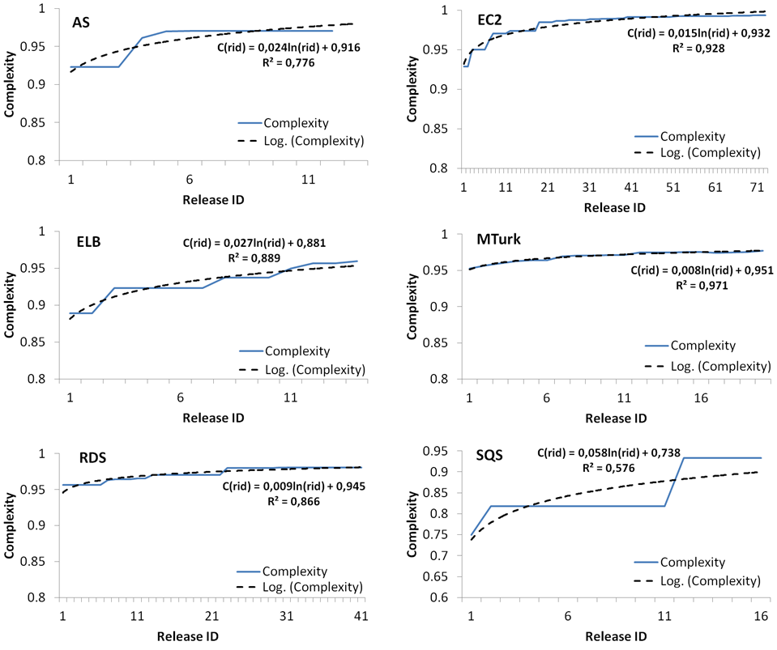
Complexity

Slide 20
7th Law | The quality of an E-type system will appear to be declining, unless rigorously maintained and adapted to operational environment changes
Criteria | The assessment is problematic because the required data are typically not publicly available . Lehman et al. discuss a more general strategy based on induction: quality decline, follows from functional growth and increasing complexity
Validity | Inconclusive
Properties | By following the general strategy suggested by Lehman et al. we have indications that the seventh law holds for the examined services. However, there are no concrete qualitative evaluations
Notes:
As discussed in \cite{LeRa06} this law is closely related with the first and the sixth law, in the sense that the system must be adapted and extended, with respect to the evolving operational environment. Otherwise, it is likely that the provided functionalities will not be satisfactory for the users and the overall perceived quality of the system will downgrade. Regarding the assessment of the seventh law, Lehman and his colleagues do not provide a concrete definition of quality. On the contrary, in \cite{LeRa06} they state that the quality of an E-type system is a function of many factors, whose definition, modeling, measurement and monitoring depend on several aspects, which may include organization, product, process properties and goals.
In the case of Web services, the main problem concerning the assessment of the seventh law is that the required data are typically not publicly available to the developer of Web service applications.
Nevertheless, in \cite{LehmanRP98} and \cite{LeRa06}, Lehman and his colleagues discuss a more general strategy to support the seventh law, which can be used in the case of Web services. Their strategy relies on logical induction, in the sense that the decline of the system quality, logically follows from the growth of the system's functional capacity (law VI), and from the increasing complexity that comes along with functionality growth (law II).
The case of Amazon services
So far, in our study we have evidence of the growing functional capacity of the examined services (Figure~\ref{is-model}) that confirm the validity of the sixth law (Section~\ref{law6}).
Moreover, we have some evidence of the increasing interface structural complexity of the examined services (Figure~\ref{complexity}) that support the validity of the second law (Section~\ref{law2}).
Therefore, by following the general strategy suggested by Lehman and his colleagues in \cite{LehmanRP98,LeRa06}, we have indications that the seventh law holds for the examined services.
However, given that the publicly available specifications of the examined services are not accompanied by concrete qualitative evaluations, \emph{we cannot confirm or disprove the law, based on indisputable objective measurements}.

Slide 21
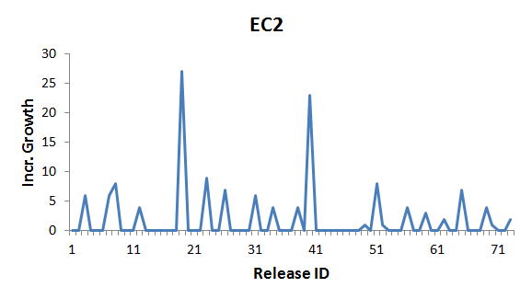
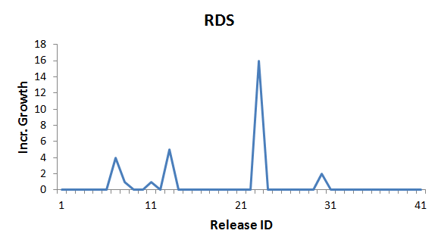
3nd Law | Global E-type system evolution is feedback regulated
Criteria | Demonstrated by patterns in the incremental growth:
Validity | Holds
Properties | Two patterns of incremental growth: spikes and calmness periods, which together indicate the existence of a stabilization mechanism. Calmness periods involve internal improvements on documentation, bug fixing, security patching and extension of programming facilities.
Notes:
The term regulation is used in the third law to emphasize that the system evolves in a controlled way, guided by (a) positive feedback activities that cause the system's functional capacity to grow, and, (b) negative feedback maintenance activities that resist to the unrestrained growth.
The validity of the third law is typically demonstrated by the existence of patterns in the incremental growth of a system \cite{LeRa06,XieCN09,SVZ14}.
Specifically, Lehman and his colleagues, observed ripples, which reflect the existence of a stabilization mechanism. Spikes indicate releases where the positive feedback activities that grow the functional capacity of the system dominate, while valleys indicate releases of small or even negative growth, where most of the effort is spent for negative feedback maintenance activities. Further studies report similar observations in open source software \cite{XieCN09} and database schemas \cite{SVZ14}. In the aforementioned studies, the incremental growth of the system is measured as the size difference between two subsequent releases. The size of the system is typically measured with respect to the system implementation (e.g, number of modules, number of schema tables).
To assess the third law, in the case of services we follow a similar track, by looking for patterns in the incremental growth of a service.
In our study, we measure the incremental growth of a service in terms of the difference in the number of operations provided by subsequent service releases, as this is the actual increase in the functional capacity of the service that is perceived by the developers of Web service applications.
The case of Amazon services:
As the case of typical E-type systems, \emph{in the incremental growth of Amazon services we also have spikes}. However, an interesting \emph{difference} is that the \emph{spikes} are usually sparse interrupted by \emph{periods of calmness}, where the functional capacity of the Web service does not grow.
MTurk appears to be an exception with consequent spikes, and only one short calmness period. In traditional E-type systems, negative feedback is concerned with correction actions, documentation improvement, dead code elimination, structural cleanups and restructurings, aiming to restrict uncontrolled change and its side effects. In the case of Amazon services, although we do not observe significant restructuring activities that are externally visible (resulting in an increased structural complexity -- Law II), we can however claim that the growth that results from the positive feedback is not uncontrolled or continuous: on the contrary, we frequently see occasions where documentation improvements, bug fixing, security patching and extension of programming facilities take place (see Law I).
In conclusion, \emph{there is evidence that the third law holds}. Although there are no visible restructurings and consolidations, we observe \emph{two patterns of incremental growth, specifically, spikes and calmness periods, which together indicate the existence of a stabilization mechanism}.

Slide 22
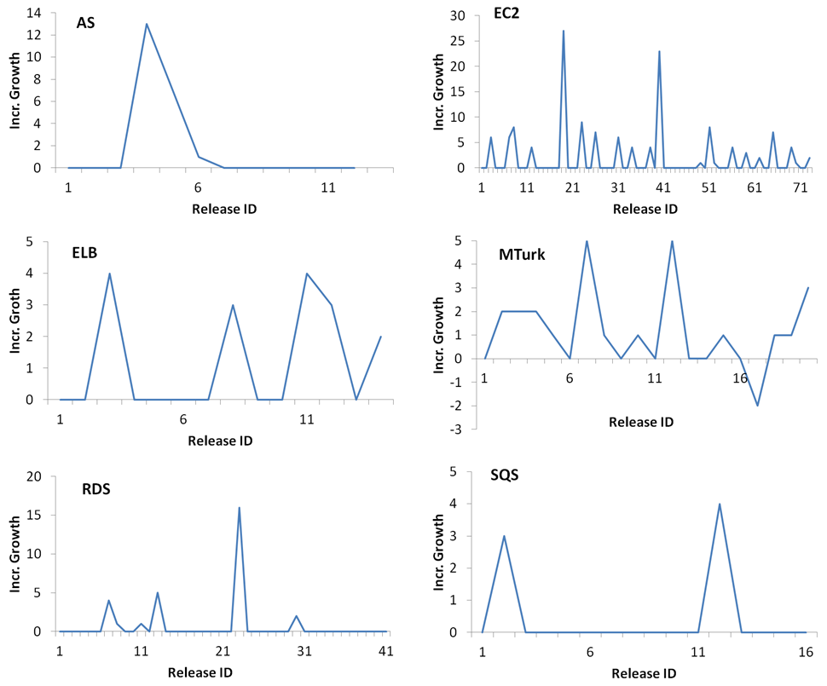
Incr. Growth

Slide 23
5th Law | The incremental growth of E-type systems is constrained by the need to maintain familiarity
Criteria | Releases characterized by high incremental growth, followed by releases with lower incremental growth Declining trend in the incremental growth of the system, due to the increasing complexity of the system
Validity | Holds
Properties | There is no clear declining trend in the incremental growth of the operations However, releases characterized by non-zero incremental growth, tend to be followed by releases of zero incremental growth.
Notes:
"The incremental growth of E-type systems is constrained by the need to maintain
Familiarity”. Based on the observations of Lehman and his colleagues \cite{LehmanRP98}, the validity of the law is demonstrated by two factors that relate with incremental growth.
The first one (which is more related to the wording of the law) is that releases characterized by high incremental growth are followed by releases with lower incremental growth, thus, smoothening the process of understanding and mastering the performed changes.
The second factor is that in the long term there is a declining trend in the incremental growth of the system, due to the increasing complexity of the system, which hardens the understanding of the changed context.
The case of Amazon services
We do not observe a clear declining trend in the incremental growth of the operations that are provided by the examined services (Figure~\ref{igrowth}).
However, as pointed out in the case of the third law (Section~\ref{law3}), spikes in the incremental growth of the operations are typically followed by calmness periods of zero growth.
Overall, we conclude that \emph{the essence of the fifth law holds}. Specifically, the property that comes out from the results is that \emph{releases characterized by non-zero incremental growth, tend to be followed by releases of zero incremental growth}.

Slide 24
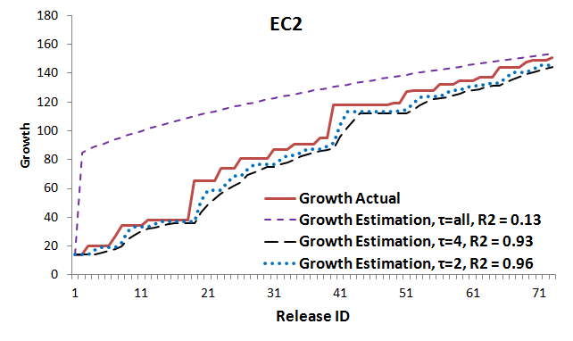
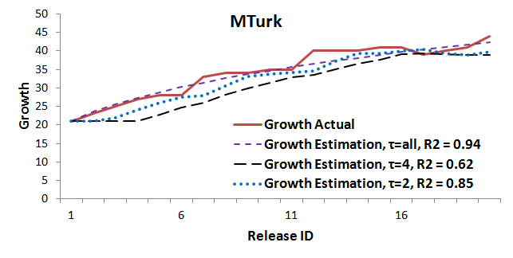
8th Law | E-type evolution processes are multi-level multi-loop, multi-agent feedback systems
Criteria | The actual growth of the system adheres to the inverse square (IS) model
Validity | Holds
Properties | The growth of the examined Web services can be accurately estimated via a feedback-based formula that exploits changes in previous service releases
Notes:
The case of Amazon services:
To assess the eighth law we calculated the estimated values of the operations' growth, with respect to the IS model, and compared them with the respective actual values, derived from the evolution histories of the Amazon services. Specifically, we considered 3 variants of the model.
The first variant, denoted by $\tau = all$, corresponds to the original IS model employed by Lehman in \cite{LehmanRP98}, where $\overline{E}$ is computed over the entire evolution history.
The other two variants (inspired from~\cite{SVZ14}), compute an average effort taking only the recent past into consideration. Specifically, in $\tau = 2$ and $\tau = 4$, $\overline{E}$ is computed for every release $r_i^s$, over the previous 2 and 4 releases, respectively.
To assess the quality of the estimated values, compared to the actual ones, we further calculated the values of the $R^2$ statistic for the IS model variants.
Based on the results, we observed that $\tau = 2$ gives quite good estimations ($R^2$ ranges from 0.60 to 0.96, 0.78 on average). In fact, $\tau = 2$ gives the best estimations in all cases, but MTurk where $\tau = all$ outperforms the other two variants (Figure~\ref{is-model}).
So, overall, \emph{we have evidence that the eighth law holds}; specifically, we can safely state that \emph{the growth of the examined Web services can be accurately estimated via a feedback-based formula that exploits changes in previous service releases}.

Slide 25
Roadmap
- Method
- Laws
- Recommendations

Slide 26
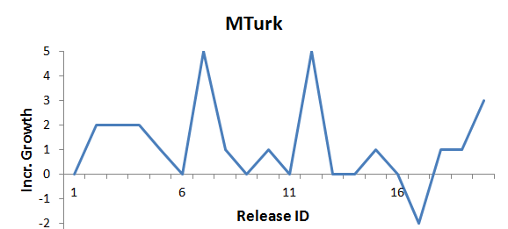
Is this service living a healthy life?
Normal life = calm lives with few excitement
(mostly) periods of calmness + add & update spikes
Checklist:
change heartbeat
incremental growth
of the service!
Notes:
Check the change heartbeat of the service!
During the calm periods, the service is typically enhanced in terms of correctness, documentation, security, performance and usability, showing that the service provider takes perfective maintenance seriously, performs bug fixing and improvements.
Check the incremental growth of the service!
again, the existence of spikes and calmness periods indicates that the service evolves normally, with respect to an underlying stabilization mechanism.

Slide 27
Will I have time to absorb changes?
Check the incremental growth of the service for a simple pattern:
releases with changes of the spec (non-zero incremental growth)
followed by
releases of zero incremental growth
If yes: there is time to absorb the changes.
Notes:
Check the incremental growth of the service; if you observe that releases of non-zero incremental growth, tend to be followed by releases of zero incremental growth, it means that there will be ample time to absorb the changes that take place.

Slide 28
Will I have time to absorb changes … … & learn about new functionalities?
Checklist:
Is growth increasing with discontinuations?
If you observe that the increase is not continuous: you can use the interval for the understanding of the new features.
Notes:
Check the growth of the service; typically there is an increasing trend in the growth of the service operations. If you observe that the increase is not continuous, you can count on the service expansion, and on the interval for the understanding of the new features.

Slide 29
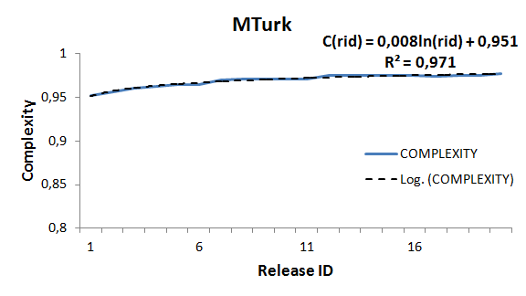
Will the complexity of the service be a problem for service usage?
Complexity assessment is complex!
More than one types of complexity: specification, architectural, structural, etc.
Focus on the one(s) you ‘re interested in!
Complexity is typically high with the tendency to increase
… but this can happen in a smooth way …
Neither panic (refrain from using an otherwise healthy service), nor relax
Notes:
Even for healthy services, complexity could be an issue. You have to assess the specific aspects of complexity that concern you (e.g., specification, architectural, structural, etc.). The complexity could be quite high and it may increase over time.
However, if the increase is smooth and predictable, you do not have to worry too much. In any case, you will have to anticipate the need to allocate time and resources for understanding and using the service.

Slide 30
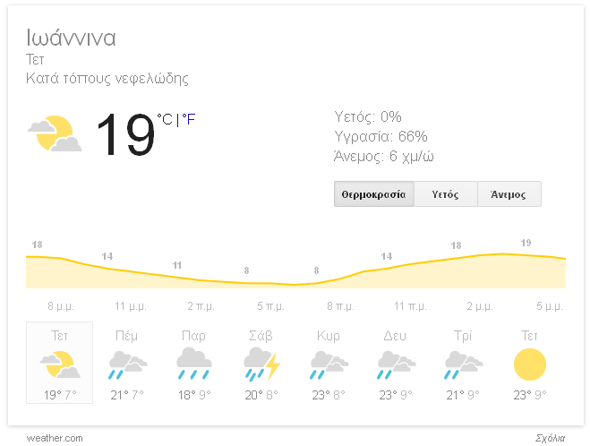
Can we forecast …
… the heartbeat of changes?
No!
Prepare (accommodate resources) for the worst.
… the quality of the service?
No!
Again: focus on the quality aspects that you’re interested in!
… the amount of new functionalities?
Coarsely, yes!
Notes:
Even for healthy services, it may not really be possible to forecast the heartbeat of changes that occur over time. Thus, you have to accommodate for resources for the worst case.
Most likely you wont be able to tell, based on available information; first you will have to determine the aspects of quality that concern you, then you will have to assess them by yourself. Anticipate the need to allocate time and resources for QoS evaluation.
It is likely that you could coarsely predict the expansion of the offered operations and plan accordingly; try to do this via a feedback-based regression formula that is based on Lehman's IS model.

Slide 31
In summary…
We can monitor web services as external observers and assess their evolution patterns
Normal life: spikes of increase between calmness
Few deletions, although a lot of internal maintenance
High complexity, but manageable
Plan for this in advance
There is time to absorb the changes
Can eventually deduce what part of the service is relevant
Notes:
Web services are black box dependency magnets. Hence, studying how they evolve is both important and challenging. In this paper, we focus on one of the most successful stories of the service-oriented paradigm in industry, i.e., the Amazon services. We perform a principled empirical study, that detects evolution patterns and regularities, based on Lehman's laws of software evolution.
Our findings indicate that service evolution comes with spikes of change, followed by calm periods where the service is internally enhanced. Although spikes come with unpredictable volume, developers can count in the near certainty of the calm periods following them to allow their absorption. As deletions rarely occur, both the complexity and the exported functionality of a service increase over time (in fact, predictably).
Based on the above findings, we provide recommendations that can be used by the developers of Web service applications for service selection and application maintenance.
Future directions in this line of research
Forecasting of service evolution
Study of the relationship between the evolution of services (e.g., number, size, frequency of spikes) and the applications that use them (e.g., number of clients, usage profile).
Metrics for service complexity and growth that account for more factors (e.g., input/output parameters)
Introduce a principled, patterns-based method that allows the developers of Web service applications to assess the healthiness of the Web services' that they use.

Slide 32
Keep Calm & Wait for the Spike!
Thank you!
Najlepša hvala!

Slide 33
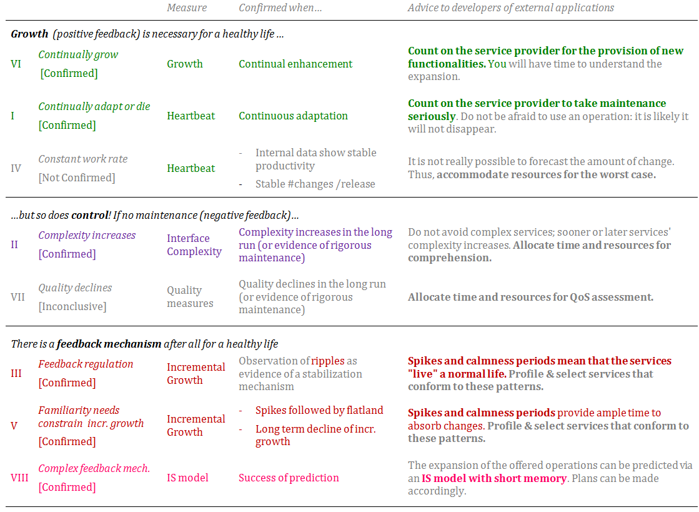

Slide 34
Keep Calm & Wait for the Spike!
Q & A
My answer to your question is:
YES, I think I can agree with that

Slide 35
Keep Calm & Wait for the Spike!
Q & A
My answer to your question is:
NO, I do not think I can agree

Slide 36
Keep Calm & Wait for the Spike!
Q & A
My answer to your question is:
It’s complicated, let me tell you what I think…

Slide 37
Keep Calm & Wait for the Spike!
Q & A
My answer to your question is:
I don’t know about that
…and the only thing I can add is …

Slide 38
Keep Calm & Wait for the Spike!
Auxiliary slides

Slide 39
Threats to validity
External Validity
DO NOT over-generalize the results to the overall population of existing Web services
The findings are representative of the overall population of Amazon services
The assessment approach is general and can be used to perform further similar studies.
The recommendations for service selection and usage are general
Construct Validity
Membrane SOA, for the accurate construction of evolution histories
Manual inspection of random samples of the collected data
Conclusion Validity
Validation of observed relations and trends with well-known statistic methods

Slide 40
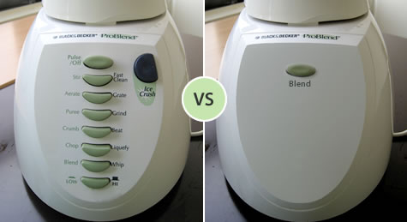
What did we measure
Interface Complexity:
Notes:
Interface Complexity For a service release $r_i^s$ that belongs to the evolution history, $H_s$, of a service, $s$, we assess interface complexity in terms of the complement of the ratio of the provided interfaces to the operations offered by these interfaces, i.e., $C(r_i^s) = 1 - \frac{r_i^s.Size[Interfaces]}{r_i^s.Size[Opers]}$.
Software complexity is a vast concept that involves several aspects (Lehman et al. \cite{LeRa06} refer to requirements and specification complexity, architecture complexity, design and implementation complexity, structural complexity, etc.) and metrics widely discussed in the literature (see e.g.,~\cite{XieCN09} for a large number of complexity metrics). Addressing all these aspects in one study is simply not possible.
Complexity from the viewpoint of the developers of Web service applications is mostly related to the effort required for (a) understanding, using and testing the functionalities of the interfaces exposed by the employed services \cite{PerepletchikovRT10}, and, (b) keeping the client applications up to date \cite{azm15}. Regarding these aspects of service complexity, in the empirical study that we performed in \cite{azm15}, we found that the developers of Web service applications suggest the decomposition of fat interfaces, as they find them hard to understand and use.
Based on this finding, in this paper we assess the second law with respect to the ratio of interfaces to operations. We consider that a particular service release is hard to understand, use and test if the provided interfaces consist of many operations. Following, we formally define the metric that we employ, with respect to the concept of service evolution history.
\textbf{Interface Complexity For a service release $r_i^s$ we assess interface complexity in terms of the complement of the ratio of the provided interfaces to the operations offered by these interfaces,
/* REMEMBER: INTERFACES = PORT TYPES*/
ZAS: As a reply to the criticism that metrics a re simple I would say that in the first place we like keeping the metrics simple because our vision for the approach is to be broadly used by simple developers who are not experts and also avoid the need for very sophisticated software tools for measuring quality
Of course looking at more sophisticated metrics would be interesting

Slide 41
What did we measure
Incremental Growth:
Growth:
Notes:
Growth The growth of the operations for a service release rs is defined as the number of operations provided by rs
Incremental growth or a pair of subsequent service releases $r_i^s$, $r_{i+1}^s$
the operations' incremental growth $IG_{op}(r_i^s, r_{i+1}^s)$ is the difference in the number of operations defined in the specification of $r_{i+1}^s$ and $r_i^s$,
In our study, we measure the incremental growth of a service in terms of the difference in the number of operations provided by subsequent service releases, as this is the actual increase in the functional capacity of the service that is perceived by the developers of Web service applications.
Incremental growth : For a pair of subsequent service releases $r_i^s$, $r_{i+1}^s$ that belong to the evolution history, $H_s$, of a service, $s$, the operations' incremental growth $IG_{op}(r_i^s, r_{i+1}^s)$ is the difference in the number of operations defined in the specification of $r_{i+1}^s$ and $r_i^s$, i.e., $IG_{op}(r_i^s, r_{i+1}^s) = r_{i+1}^s.Size[Opers]-r_i^s.Size[Opers]$.

Slide 42
What did we measure
Inverse Square Model:
Notes:
According to Lehman, the last law is a concise summary of the other seven.
In the literature, the main evidence for the validity of the law is to show that the actual growth of the system adheres to the inverse square (IS) model, which provides a \emph{feedback-based growth prediction formula} \cite{LeRa06,XieCN09,SVZ14}.
In our study we also rely on this strategy. Following, we adapt the IS growth prediction formula, with respect to the definition of growth that we provided in Section~\ref{law6}.
IS model for services
According to the IS model, the predicted operations' growth, $\widehat{G_{op}}(r_i^s)$, for a service release $r_i^s$ that belongs to the evolution history, $H_s$, of a service, $s$, is:
$\widehat{G_{op}}(r_i^s) = \widehat{G_{op}}(r_{i-1}^s) + \frac{\overline{E}}{\widehat{G_{op}}(r_{i-1}^s)^2}$, where
$\widehat{G_{op}}(r_{i-1}^s)$ is the estimated operations' growth for the previous service release, $r_{i-1}^s$, and
$\overline{E}$ estimates effort as the average of individual $E_j$,
$E_j$ is calculated for the service release history $H_s$, as follows: $E_j = (G_{op}(r_j^s) - G_{op}(r_{j-1}^s))*G_{op}(r_{j-1}^s)^2$, where
$G_{op}(r_j^s)$ refers to the actual operations' growth for a service release $r_j^s$, and
$G_{op}(r_{j-1}^s)$ refers to the actual operations' growth for the previous service release $r_{j-1}^s$.

Slide 43
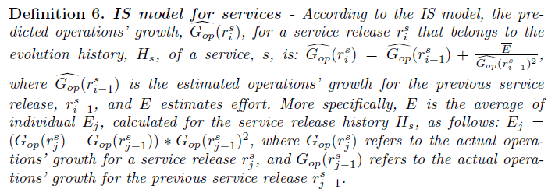
IS model

Slide 44
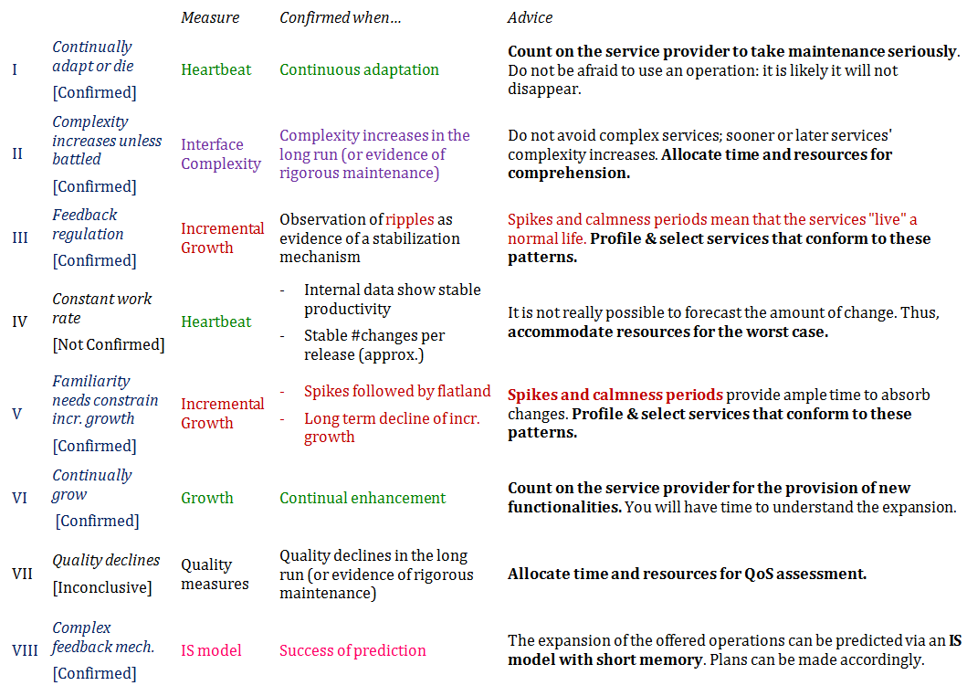
Keep Calm & Wait for the Spike!

Slide 45
Focaefs+ @ ICWS11
Present a tool, VTracker for detecting changes
Analyze AWS EC2, FedEx Rate, FedEx Movement Inf. Serv., Paypal, Bing Search
Findings include
Domination of operation additions in some WS
Domination of operation updates in some others + some specific versions of the former group
Absence of operation deletions
Taxonomy & discussion of data type changes

Slide 46
Romano & Pinzger @ ICWS12
Present a tool, WSDLDiff for detecting changes (more fine-grained than VTracker)
Analyze AWS EC2, FedEx Rate, FedEx Ship, FedEx Package Movement Inf. Serv.
Findings include:
Domination of operation additions @ AWS
Domination of operation updates @ Fedex
Absence of operation deletions
Too many data type updates in 3 out of 4 services
Each service comes with its own change profile, where some type of changes dominates (element additions for EC2, enumeration additions for Fedex.*)

Slide 47
Skoulis+ @ CAiSE’14: DB Schema evolution

Slide 48
Our goal…
We focus on
one of the most successful stories of the service-oriented paradigm in industry
We perform a principled empirical study that detects evolution patterns and regularities, based on Lehman's laws of software evolution

Slide 49
Laws on Software Evolution
A set of eight rules on the behavior of software as it evolves
Derived from a study, due to M. Lehman of proprietary software (OS/360)
Almost 40 years of reviewing and evaluation (first three laws published in 1976)
Have been recognized for their useful insights as to what and why evolves in the lifetime of a software system

Slide 50
Laws on Software Evolution
I. Continuing change
“An E-Type system must be continually adapted or else it becomes progressively less satisfactory.”
II. Increasing Complexity
“As an E-type system is changed its complexity increases and becomes more difficult to evolve unless work is done to maintain or reduce the complexity.”
III. Self Regulation
“Global E-type systems evolution is feedback regulated.”
IV. Conservation of Organizational Stability
“The work rate of an organization evolving an E-type software system tends to be constant over the operational lifetime of that system or phases of that lifetime.”

Slide 51
Laws on Software Evolution
V. Conservation of Familiarity
“In general, the incremental growth of E-type systems is constrained by the need to maintain familiarity.”
VI. Continuing Growth
“The functional capacity of E-type systems must be continually enhanced to maintain user satisfaction over system lifetime.”
VII. Declining Quality
“Unless rigorously adapted and evolved to take into account changes in the operational environment, the quality of an E-type system will appear to be declining.”
VIII. Feedback System
“E-type evolution process are multi-level, multi-loop, multi-agent feedback systems.”

Slide 52
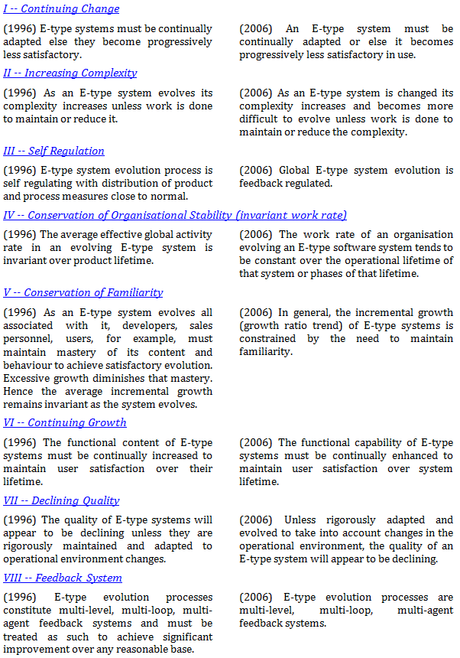
Evolution of the laws: 1996 vs 2006

Slide 53
Keep Calm & Wait for the Spike!

Slide 54
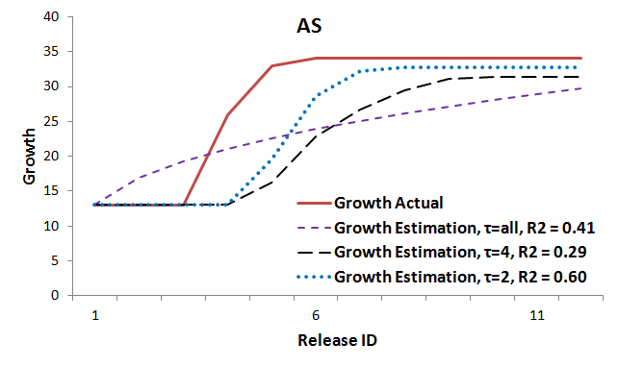
Is the amount of new functionalities predictable in some way?
You can coarsely predict the expansion of the offered operations and plan accordingly
Use the feedback-based regression formula with a short history horizon

