Slide 1

How is Life for a Table in an Evolving Relational Schema? Birth, Death & Everything in Between
This work was partially supported from the European Community's FP7/2007-2013 under grant agreement number 257178 (project CHOReOS).
Panos Vassiliadis, Apostolos Zarras, Ioannis Skoulis
Department of Computer Science and Engineering
University of Ioannina, Hellas
http://www.cs.uoi.gr/~pvassil/publications/2015_ER

Slide 2

What are the “laws” of database schema evolution?

Slide 3
Imagine if we could predict how a schema will evolve over time…
… we would be able to “design for evolution” and minimize the impact of evolution to the surrounding applications
  by applying design patterns
  by avoiding anti-patterns & complexity increase
  … in both the db and the code
… we would be able to plan administration and perfective maintenance tasks and resources, instead of responding to emergencies

Slide 4
Why aren’t we there yet?
Historically, nobody from the research community had access + the right to publish to version histories of database schemata
Open source tools internally hosting databases have changed this landscape:
  not only is the code available, but also,
  public repositories (git, svn, …) keep the entire history of revisions
We are now presented with the opportunity to study the version histories of such “open source databases”

Slide 5
Timeline of empirical studies
Mind the gap!
(15 years)
Sjoberg
IST 93
Curino+
ICEIS08
Univ. Riverside
IWPSE09, ICDEW11
Qiu,Li,Su
FSE’13
Univ. Ioannina
CAiSE14, ER15
1993
2008
2009
2011
2013
2014
2015

Slide 6

Our take on the problem
Collected version histories for the schemata of 8 open-source projects
  CMS’s: MediaWiki, TYPO3, Coppermine, phpBB, OpenCart
  Physics: ATLAS Trigger --- Bio: Ensemble, BioSQL
Preprocessed them to be parsable by our HECATE schema comparison tool and exported the transitions between each two subsequent versions and measures for them (size, growth, changes)
Exploratory search where we statistically studied / mined these measures, to extract patterns & regularities for the lives of tables
Available at:
https://github.com/DAINTINESS-Group/EvolutionDatasets

Slide 7
Scope of the study
FoSS Dataset | Versions | Lifetime | Tables @ Start | Tables @ End
ATLAS Trigger [A] | 84 | 2 Y, 7 M, 2 D | 56 | 73
BioSQL [B] | 46 | 10 Y, 6 M, 19 D | 21 | 28
Coppermine [C] | 117 | 8 Y, 6 M, 2 D | 8 | 22
Ensembl [B] | 528 | 13 Y, 3 M, 15 D | 17 | 75
MediaWiki [C] | 322 | 8 Y, 10 M, 6 D | 17 | 50
OpenCart [C] | 164 | 4 Y, 4 M, 3 D | 46 | 114
phpBB [C] | 133 | 6 Y, 7 M, 10 D | 61 | 65
TYPO3 [C] | 97 | 8 Y, 11 M, 0 D | 10 | 23
Scope:
  databases being part of open-source software (and not proprietary ones)
  long history
  we work only with changes at the logical schema level (and ignore physical-level changes like index creation or change of storage engine)
  We encompass datasets with different domains ([A]: physics, [B]: biomedical, [C]: CMS’s), amount of growth (shade: high, med, low) & schema size
We should be very careful to not overgeneralize findings to proprietary databases or physical schemata!

Slide 8
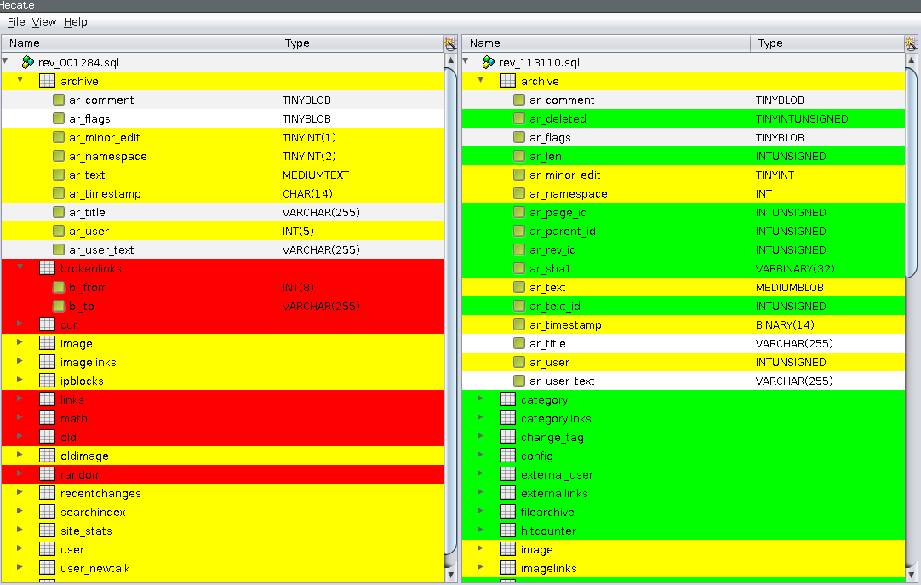
Hecate: SQL schema diff extractor
  https://github.com/DAINTINESS-Group/Hecate

Slide 9
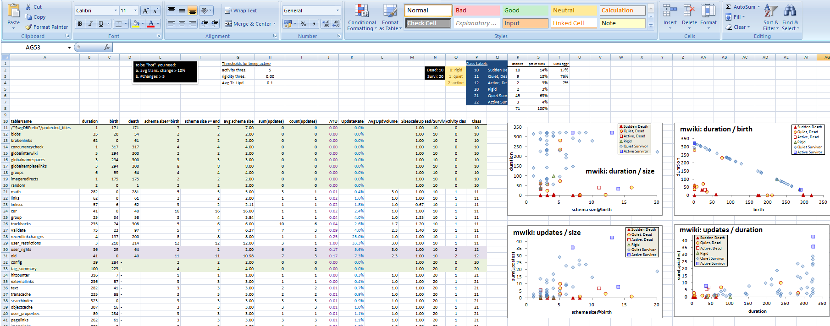
Exploratory search of the schema histories for patterns
Input: schema histories from github/sourceforge/…
Raw material: details and stats on each table’s life, as produced by our diff extractor, for all the 8 datasets
Output: properties & patterns on table properties (birth, duration, amt of change, …) that occur frequently in our data sets
Highlights
4 patterns of evolution

Slide 10
Schema size, change and duration
Statistical properties for schema size, change and duration of tables
How are these measures interrelated?

Slide 11

The Gamma Pattern:
"if you 're wide, you survive"
The Gamma phenomenon:
  tables with small schema sizes can have arbitrary durations, //small size does not determine duration
  larger size tables last long
Observations:
  whenever a table exceeds the critical value of 10 attributes in its schema, its chances of surviving are high.
  in most cases, the large tables are created early on and are not deleted afterwards.

Slide 12

Exceptions
Biosql: nobody exceeds 10 attributes
Ensembl, mwiki: very few exceed 10 attributes, 3 of them died
typo: has many late born survivors

Slide 13
The Comet Pattern
“Comet “ for change over schema size with:
a large, dense, nucleus cluster close to the beginning of the axes, denoting small size and small amount of change,
medium schema size tables typically demonstrating medium to large change
  The tables with the largest amount of change are typically tables whose schema is on average one standard deviation above the mean
wide tables with large schema sizes demonstrating small to medium (typically around the middle of the y-axis) amount of change.

Slide 14
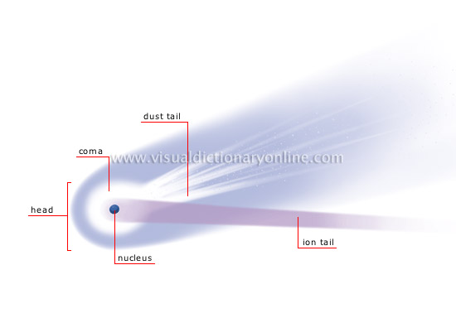
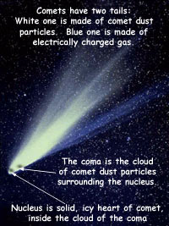
http://visual.merriam-webster.com/astronomy/celestial-bodies/comet.php
http://spaceplace.nasa.gov/comet-nucleus/en/

Slide 15
The inverse Gamma pattern
The correlation of change and duration is as follows:
  small durations come necessarily with small change,
  large durations come with all kinds of change activity and
  medium sized durations come mostly with small change activity (Inverse Gamma).

Slide 16
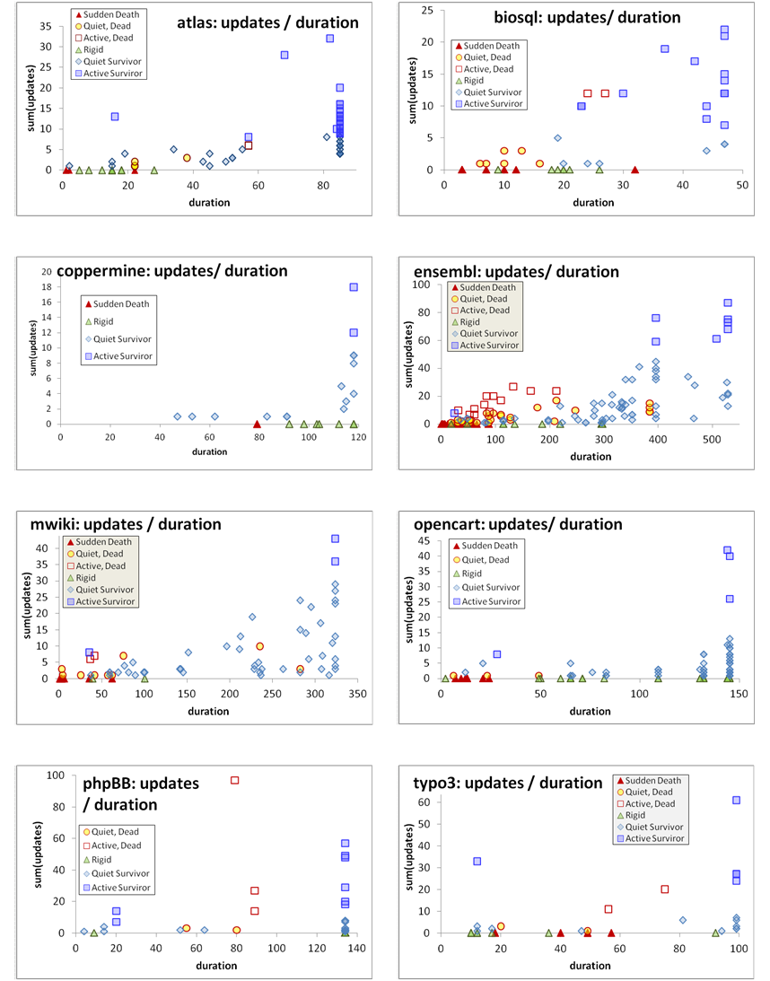

Slide 17
Birthday & schema size & matters of life and death
Who are the top changers?
Who are removed at some point of time?
How do removals take place?

Slide 18
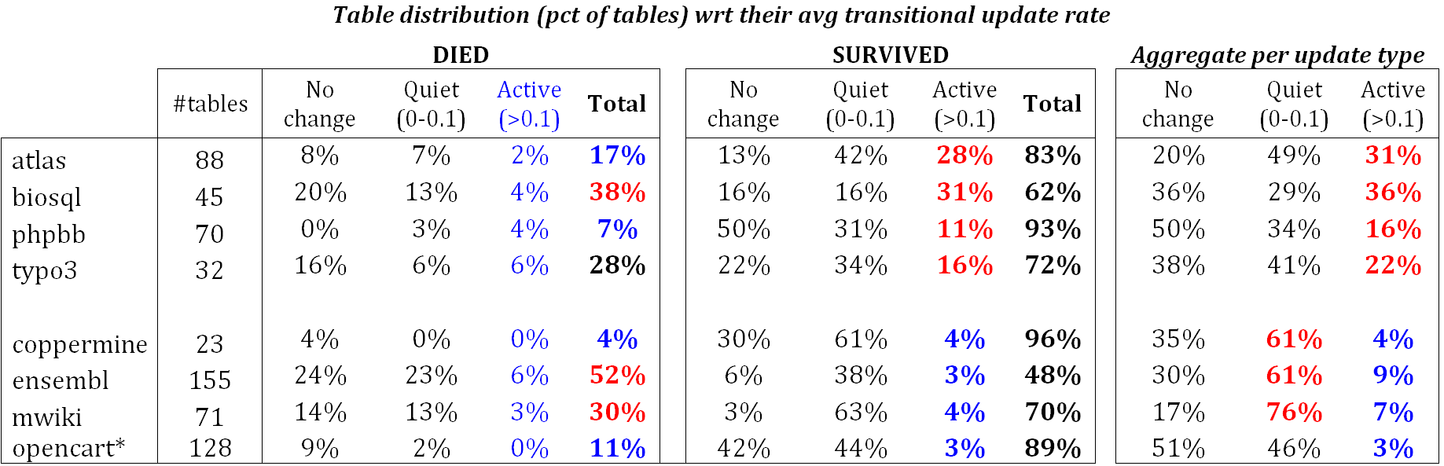
Quiet tables rule, esp. for mature db’s
Non-survivors
Sudden deaths mostly
Quiet come ~ close
Too few active
Survivors
Quiet tables rule
Rigid and active then
Active mostly in “new” db’s
Mature DB’s: the pct of active tables drops significantly

Slide 19
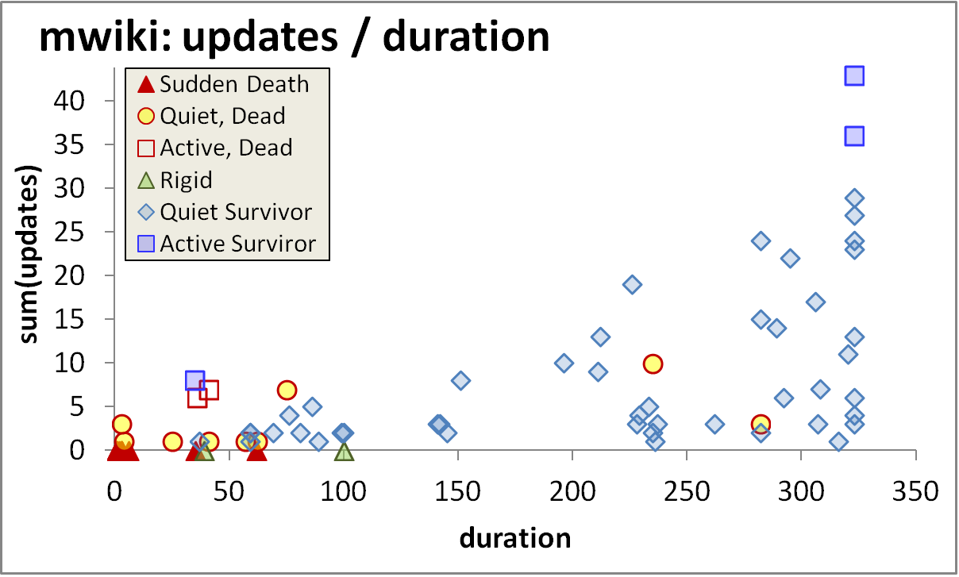
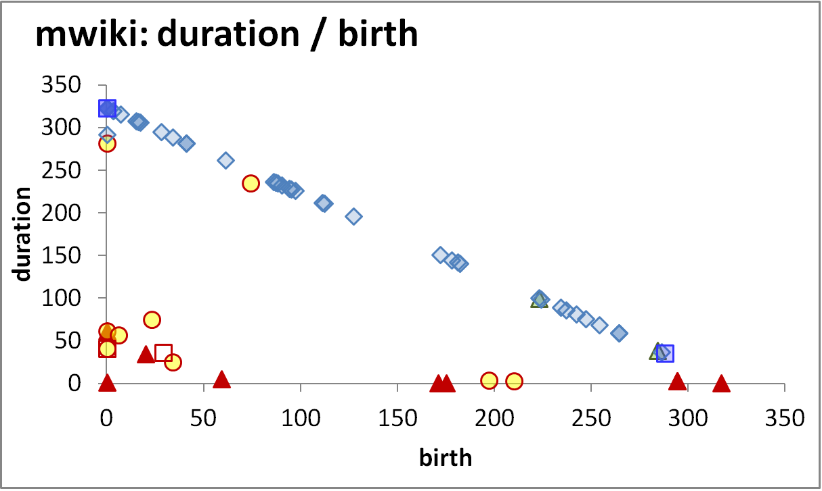
Longevity and update activity correlate !!
Top changers live long
Empty space: high change rates are only for early born & long lived
The few top-changers (in terms of avg trans. update – ATU)
are long lived,
typically come from the early versions of the database
due to the combination of high ATU and duration => they have high total amount of updates, and,
frequently survive!
Too many top changers are born early
Birth rate drops over time
Deleted tables are born early & last short

Slide 20
Die young
and suddenly
Empty space: high change rates are only for early born & long lived
There is a very large concentration of the deleted tables in a small range of newly born, quickly removed, with few or no updates…
…. resulting in very low numbers of removed tables with medium or long durations (empty triangle).
Deleted tables last short & do not change a lot
An empty triangle: no deleted tables with large or even modest durations
Deleted tables are born early & last short

Slide 21
Survive long enough &
you ‘re probably safe
Too rare to see deletions!
It is quite rare to see tables being removed at old age
Typically, the area of high duration is overwhelmingly inhabited by survivors (although each data set comes with a few such cases )!
High durations are overwhelmingly blue!
Only a couple of deletions are seen here!

Slide 22
Die young
and suddenly
[Early life of the db] There is a very large concentration of the deleted tables in a small range of newly born, quickly removed, with few or no updates, resulting in very low numbers of removed tables with medium or long durations.
[Mature db] After the early stages of the databases, we see the birth of tables who eventually get deleted, but they mostly come with very small durations and sudden deaths.
Deleted tables last short & do not change a lot
Few short lived tables are born and die in the mature life of the db
Deleted tables are born early & last short

Slide 23
void

Slide 24
Conclusions & Open issues
Main Findings
Open Issues

Slide 25
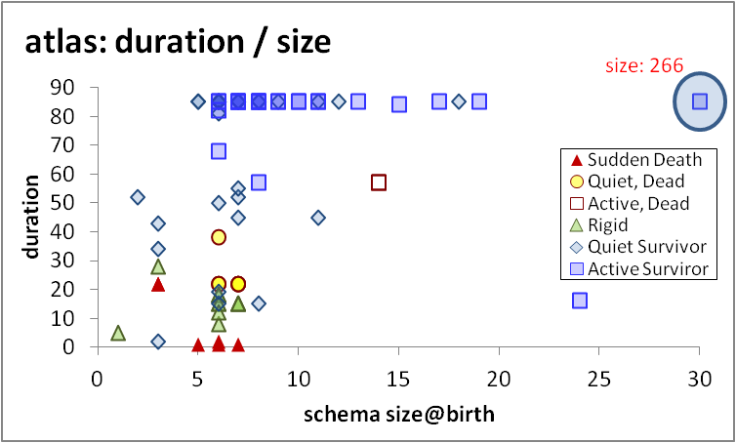
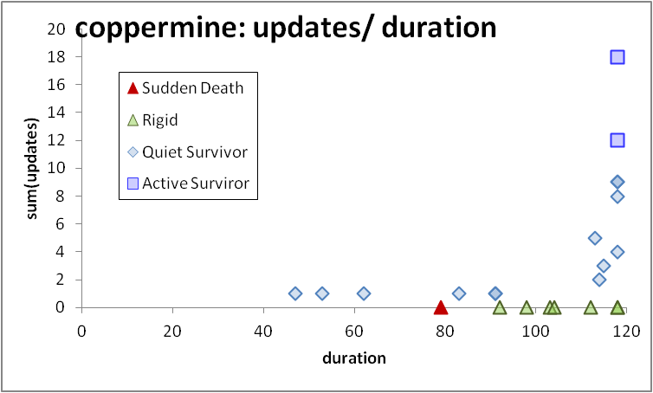
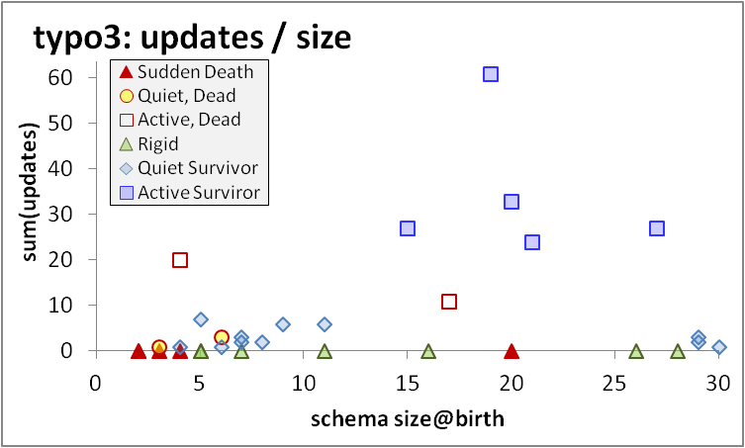
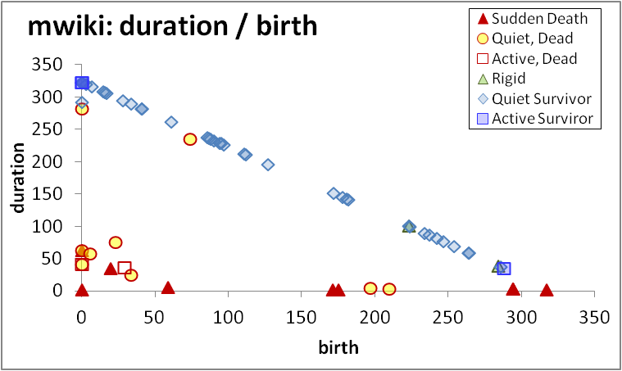
Regularities on table change do exist!
Only the thin die young, all the wide ones seem to live forever
Top-changers typically live long, are early born, survive …
… and they are not necessarily the widest ones in terms of schema size
Progressive cooling: most change activity lies at the beginning of the db history
Void triangle: The few dead tables are typically quiet, early born, short lived, and quite often all three of them
void

Slide 26
Unexplored research territory (risky but possibly rewarding)
Weather Forecast: given the history and the state of a database, predict subsequent events
  Risky: frequently, changes come due to an external, changing world and have “thematic” affinity.
  Big & small steps in many directions needed (more data sets, studies with high internal validity to find causations, more events to capture, …)
Engineer for evolution: To absorb change gracefully we can try to (i) alter db design and DDL; (ii) encapsulate the database via a “stable” API; …
To probe further (code, data, details, presentations, …)
    http://www.cs.uoi.gr/~pvassil/publications/2015_ER/

Slide 27



Q & A time…
Many thanks:
to our hosts for all their efforts to organize ER 2015!
to you for your attention!

Slide 28

Regularities on table change do exist!
Tack!
Ett varmt tack till våra värdar!
Only the thin die young, all the wide ones seem to live forever
Top-changers typically live long, are early born, survive …
… and they are not necessarily the widest ones in terms of schema size
Progressive cooling: most change activity lies at the beginning of the db history
Void triangle: The few dead tables are typically quiet, early born, short lived, and quite often all three of them
void

Slide 29
Auxiliary slides

Slide 30
What are the “laws” of database (schema) evolution?
How do databases change?
In particular, how does the schema of a database evolve over time?
Long term research goals:
  Are there any “invariant properties” (e.g., patterns of repeating behavior) on the way database (schemata) change?
  Is there a theory / model to explain them?
  Can we exploit findings to engineer data-intensive ecosystems that withstand change gracefully?

Slide 31
Why care for the “laws”/patterns of schema evolution?
Scientific curiosity!
Practical Impact: DB’s are dependency magnets. Applications have to conform to the structure of the db…
  typically, development waits till the “db backbone” is stable and applications are build on top of it
  slight changes to the structure of a db can cause several (parts of) different applications to crash, causing the need for emergency repairing

Slide 32
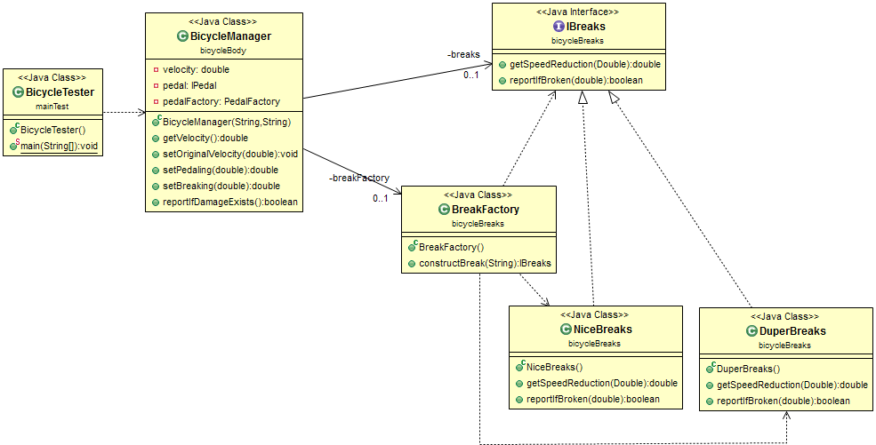
Abstract coupling example from my SW Dev course
Interface as a contract
Specification
≠
Implementation
Factory as a bridge
Client class
Service providers

Slide 33
Hecate: SQL schema diff extractor
Parses DDL files
Creates a model for the parsed SQL elements
Compares two versions of the same schema
Reports on the diff performed with a variety of metrics
Exports the transitions that occurred in XML format
  https://github.com/DAINTINESS-Group/Hecate

Slide 34
void
To probe further (code, data, details, presentations, …)
    http://www.cs.uoi.gr/~pvassil/publications/2015_ER/

Slide 35
Scope of the study && Validity considerations

Slide 36
Data sets
Dataset | Versions | Lifetime | Tables Start | Tables End | Attributes Start | Attributes End | Commits per Day | % commits with change | Repository URL
ATLAS Trigger | 84 | 2 Y, 7 M, 2 D | 56 | 73 | 709 | 858 | 0,089 | 82% | http://atdaq-sw.cern.ch/cgi-bin/viewcvs-atlas.cgi/offline/Trigger/TrigConfiguration/TrigDb/share/sql/combined_schema.sql
BioSQL | 46 | 10 Y, 6 M, 19 D | 21 | 28 | 74 | 129 | 0,012 | 63% | https://github.com/biosql/biosql/blob/master/sql/biosqldb-mysql.sql
Coppermine | 117 | 8 Y, 6 M, 2 D | 8 | 22 | 87 | 169 | 0,038 | 50% | http://sourceforge.net/p/coppermine/code/8581/tree/trunk/cpg1.5.x/sql/schema.sql
Ensembl | 528 | 13 Y, 3 M, 15 D | 17 | 75 | 75 | 486 | 0,109 | 60% | http://cvs.sanger.ac.uk/cgi-bin/viewvc.cgi/ensembl/sql/table.sql?root=ensembl&view=log
MediaWiki | 322 | 8 Y, 10 M, 6 D | 17 | 50 | 100 | 318 | 0,100 | 59% | https://svn.wikimedia.org/viewvc/mediawiki/trunk/phase3/maintenance/tables.sql?view=log
OpenCart | 164 | 4 Y, 4 M, 3 D | 46 | 114 | 292 | 731 | 0,104 | 47% | https://github.com/opencart/opencart/blob/master/upload/install/opencart.sql
phpBB | 133 | 6 Y, 7 M, 10 D | 61 | 65 | 611 | 565 | 0,055 | 82% | https://github.com/phpbb/phpbb3/blob/develop/phpBB/install/schemas/mysql_41_schema.sql
TYPO3 | 97 | 8 Y, 11 M, 0 D | 10 | 23 | 122 | 414 | 0,030 | 76% | https://git.typo3.org/Packages/TYPO3.CMS.git/history/TYPO3_6-0:/t3lib/stddb/tables.sql

Slide 37
Scope of the study
FoSS Dataset | Versions | Lifetime | Tables @ Start | Tables @ End
ATLAS Trigger [A] | 84 | 2 Y, 7 M, 2 D | 56 | 73
BioSQL [B] | 46 | 10 Y, 6 M, 19 D | 21 | 28
Coppermine [C] | 117 | 8 Y, 6 M, 2 D | 8 | 22
Ensembl [B] | 528 | 13 Y, 3 M, 15 D | 17 | 75
MediaWiki [C] | 322 | 8 Y, 10 M, 6 D | 17 | 50
OpenCart [C] | 164 | 4 Y, 4 M, 3 D | 46 | 114
phpBB [C] | 133 | 6 Y, 7 M, 10 D | 61 | 65
TYPO3 [C] | 97 | 8 Y, 11 M, 0 D | 10 | 23
Scope:
  databases being part of open-source software (and not proprietary ones)
  long history
  we work only with changes at the logical schema level (and ignore physical-level changes like index creation or change of storage engine)
  We encompass datasets with different domains ([A]: physics, [B]: biomedical, [C]: CMS’s), amount of growth (shade: high, med, low) & schema size
We should be very careful to not overgeneralize findings to proprietary databases or physical schemata!

Slide 38
External validity
Can we generalize out findings broadly?
We perform an exploratory study to observe frequently occurring phenomena within the scope of the aforementioned population
Are our data sets representative enough? Is it possible that the observed behaviors are caused by sui-generis characteristics of the studied data sets?
  Yes: we believe we have a good population definition & we abide by it
  Yes: we believe we have a large number of databases, from a variety of domains with different profiles, that seem to give fairly consistent answers to our research questions (behavior deviations are mostly related to the maturity of the database and not to its application area).
  Yes: we believe we have a good data extraction and measurement process without interference / selection / … of the input from our part
  Maybe: unclear when the number of studied databases is large enough to declare the general application of a pattern as “universal”.

Slide 39
External validity
Can we generalize out findings broadly?
Understanding the represented population
  Precision: all our data sets belong to the specified population
  Definition Completeness: no missing property that we knowledgably omit to report
  FoSS has an inherent way of maintenance and evolution
Representativeness of selected datasets
  Data sets come from 3 categories of FoSS (CMS / Biomedical / Physics)
  They have different size and growth volumes
  Results are fairly consistent both in our ER’15 and our CAiSE’14 papers
Treatment of data
  We have tested our “Delta Extractor”, Hecate, to parse the input correctly & adapted it during its development; the parser is not a full-blown SQL parser, but robust to ignore parts unknown to it
  A handful of cases where adapted in the Coppermine to avoid overcomplicating the parser; not a serious threat to validity ; other than that we have not interfered with the input
  Fully automated counting for the measures via Hecate

Slide 40
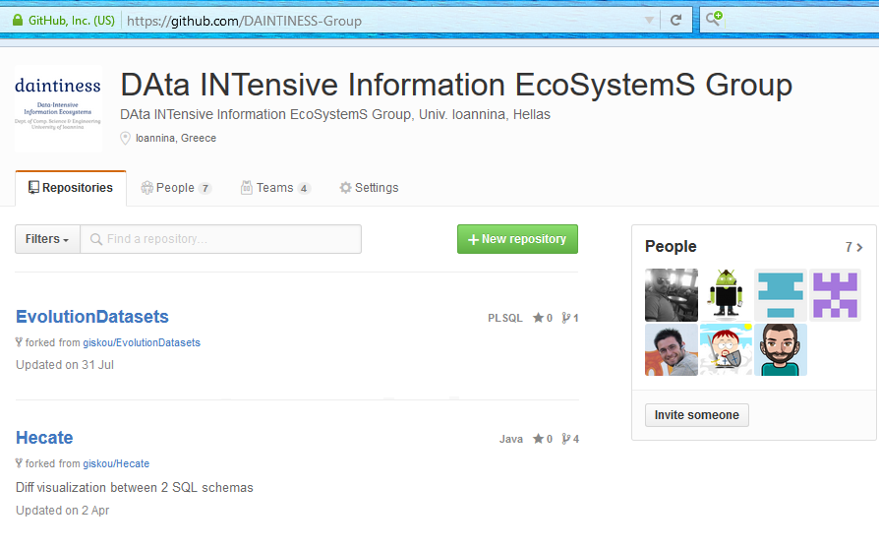
Most importantly: we are happy to invite you to reuse /test /assess /disprove /… all our code, data and results!
To probe further (code, data, results, …)
    http://www.cs.uoi.gr/~pvassil/publications/2015_ER/
    https://github.com/DAINTINESS-Group

Slide 41
Internal validity
Can we confirm statements A=>B? No!
Are there any spurious relationships? Maybe!
Internal validity concerns the accuracy of cause-effect statements: “change in A => change in B”
We are very careful to avoid making strong causation statements!
  In some places, we just hint that we suspect the causes for a particular phenomenon, in some places in the text, but we have no data, yet, to verify our gut-feeling.
  And yes, it is quite possible that our correlations hide cofounding variables.

Slide 42
Is there a theory?
Our study should be regarded as a pattern observer, rather than as a collection of laws, coming with their internal mechanics and architecture.
It will take too many studies (to enlarge the representativeness even more) and more controlled experiments (in-depth excavation of cause-effect relationships) to produce a solid theory.
It would be highly desirable if a clear set of requirements on the population definition, the breadth of study and the experimental protocol could be solidified by the scientific community (like e.g., the TREC benchmarks)
… and of course, there might be other suggestions on how to proceed…

Slide 43
Related work

Slide 44
Timeline of empirical studies
Sjoberg
IST 93
Curino+
ICEIS08
Univ. Riverside
IWPSE09, ICDEW11
Qiu,Li,Su
FSE’13
Univ. Ioannina
CAiSE14, ER15
1993
2008
2009
2011
2013
2014
2015

Slide 45
Timeline of empirical studies
Sjoberg @ IST 93: 18 months study of a health system.
139% increase of #tables ; 274% increase of the #attributes
Changes in the code (on avg):
    relation addition: 19 changes ; attribute additions: 2 changes
    relation deletion : 59.5 changes; attribute deletions: 3.25 changes
An inflating period during construction where almost all changes were additions, and a subsequent period where additions and deletions where balanced.
Sjoberg
IST 93
Curino+
ICEIS08
Univ. Riverside
IWPSE09, ICDEW11
Qiu,Li,Su
FSE’13
Univ. Ioannina
CAiSE14, ER15
1993
2008
2009
2011
2013
2014
2015

Slide 46
Timeline of empirical studies
Curino+ @ ICEIS08: Mediawiki for 4.5 years
100% increase in the number of tables
142% in the number of attributes.
45% of changes do not affect the information capacity of the schema (but are rather index adjustments, documentation, etc)
Sjoberg
IST 93
Curino+
ICEIS08
Univ. Riverside
IWPSE09, ICDEW11
Qiu,Li,Su
FSE’13
Univ. Ioannina
CAiSE14, ER15
1993
2008
2009
2011
2013
2014
2015

Slide 47
Timeline of empirical studies
IWPSE09: Mozilla and Monotone (a version control system)
Many ways to be out of synch between code and evolving db schema
ICDEW11: Firefox, Monotone , Biblioteq (catalogue man.) , Vienna (RSS)
Similar pct of changes with previous work
Frequency and timing analysis: db schemata tend to stabilize over time, as there is more change at the beginning of their history, but seem to converge to a relatively fixed structure later
Sjoberg
IST 93
Curino+
ICEIS08
Univ. Riverside
IWPSE09, ICDEW11
Qiu,Li,Su
FSE’13
Univ. Ioannina
CAiSE14, ER15
1993
2008
2009
2011
2013
2014
2015

Slide 48
Timeline of empirical studies
Qiu,Li,Su@ FSE 2013: 10 (!) database schemata studied.
Change is focused both (a) with respect to time and (b) with respect to the tables who change.
Timing: 7 out of 10 databases reached 60% of their schema size within 20% of their early lifetime.
Change is frequent in the early stages of the databases, with inflationary characteristics; then, the schema evolution process calms down.
Tables that change: 40% of tables do not undergo any change at all, and 60%-90% of changes pertain to 20% of the tables (in other words, 80% of the tables live quiet lives). The most frequently modified tables attract 80% of the changes.
Sjoberg
IST 93
Curino+
ICEIS08
Univ. Riverside
IWPSE09, ICDEW11
Qiu,Li,Su
FSE’13
Univ. Ioannina
CAiSE14, ER15
1993
2008
2009
2011
2013
2014
2015

Slide 49
Timeline of empirical studies
Qiu,Li,Su@ FSE 2013: Code and db co-evolution, not always in synch.
Code and db changed in the same revision: 50.67% occasions
Code change was in a previous/subsequent version than the one where the database schema change: 16.22% of occasions
database changes not followed by code adaptation: 21.62% of occasions
11.49% of code changes were unrelated to the database evolution.
Each atomic change at the schema level is estimated to result in 10 -- 100 lines of application code been updated;
A valid db revision results in 100 -- 1000 lines of application code being updated
Sjoberg
IST 93
Curino+
ICEIS08
Univ. Riverside
IWPSE09, ICDEW11
Qiu,Li,Su
FSE’13
Univ. Ioannina
CAiSE14, ER15
1993
2008
2009
2011
2013
2014
2015

Slide 50
Timeline of empirical studies
CAiSE14: DB level
ER’15: Table level
Sjoberg
IST 93
Curino+
ICEIS08
Univ. Riverside
IWPSE09, ICDEW11
Qiu,Li,Su
FSE’13
Univ. Ioannina
CAiSE14, ER15
1993
2008
2009
2011
2013
2014
2015

Slide 51
Caise 14 / Inf. Systems 15

Slide 52
Datasets
https://github.com/DAINTINESS-Group/EvolutionDatasets
Content management Systems
  MediaWiki, TYPO3, Coppermine, phpBB, OpenCart
Medical Databases
  Ensemble, BioSQL
Scientific
  ATLAS Trigger

Slide 53
Schema Size (relations)

Slide 54
CaiSE’14: Main results
Schema size (#tables, #attributes) supports the assumption of a feedback mechanism
Schema size grows over time; not continuously, but with bursts of concentrated effort
Drops in schema size signifies the existence of perfective maintenance
Regressive formula for size estimation holds, with a quite short memory
Schema Growth (diff in size between subsequent versions) is small!!
Growth is small, smaller than in typical software
The number of changes for each evolution step follows Zipf’s law around zero
Average growth is close (slightly higher) to zero
Patterns of change: no consistently constant behavior
Changes reduce in density as databases age
Change follows three patterns: Stillness, Abrupt change (up or down), Smooth growth upwards
Change frequently follows spike patterns
Complexity does not increase with age
Grey for results requiring further search

Slide 55
Schema Growth (diff in #tables)

Slide 56
Change over time

Slide 57
stats

Slide 58
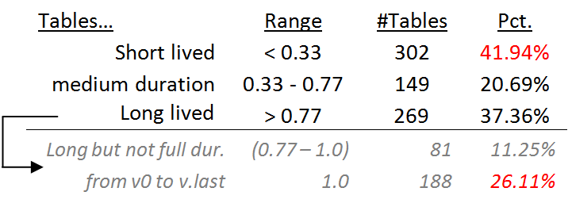
Statistical study of durations
Short and long lived tables are practically equally proportioned
Medium size durations are fewer than the rest!
Long lived tables are mostly survivors (see on the right)
One of the fascinating revelations of this measurement was that there is a 26.11% fraction of tables that appeared in the beginning of the database and survived until the end.
In fact, if a table is long-lived there is a 70% chance (188 over 269 occasions) that it has appeared in the beginning of the database.

Slide 59
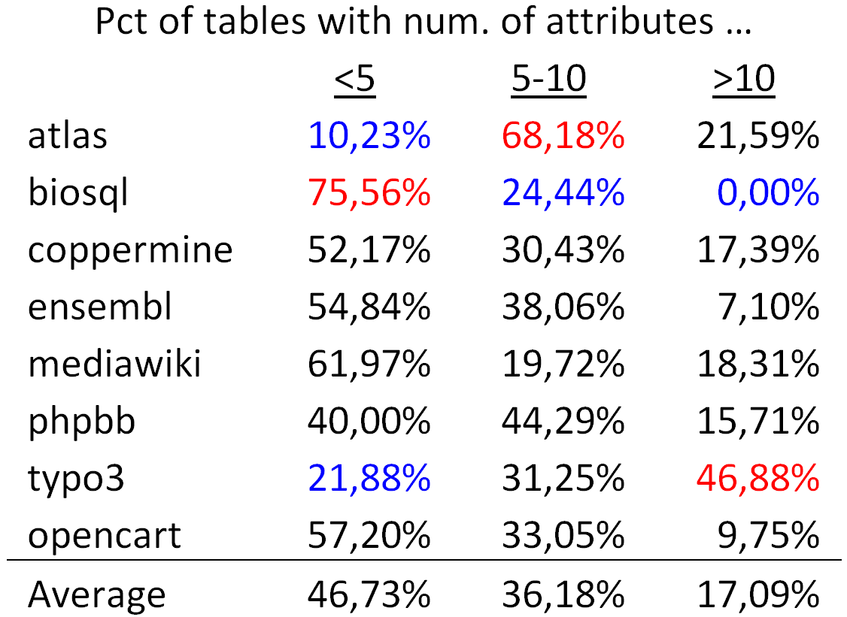
Tables are mostly thin
On average, half of the tables (approx. 47%) are thin tables with less than 5 attributes.
The tables with 5 to 10 attributes are approximately one third of the tables' population
The large tables with more than 10 attributes are approximately 17% of the tables.

Slide 60
The four patterns

Slide 61
The Gamma Pattern
Schema size @ birth / duration
Only the thin die young, all the wide ones seem to live forever

Slide 62
Exceptions
Biosql: nobody exceeds 10 attributes
Ensembl, mwiki: very few exceed 10 attributes, 3 of them died
typo: has many late born survivors

Slide 63
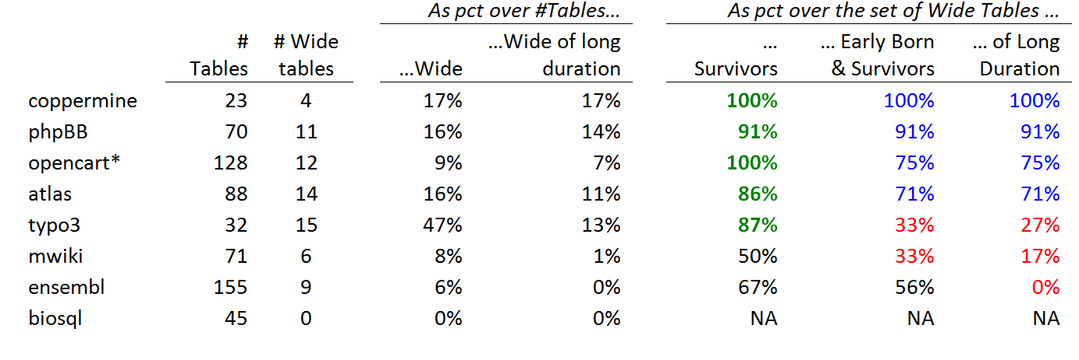
Stats on wide tables and their survival
Definitions:
Wide schema: strictly above 10 attributes.
The top band of durations (the upper part of the Gamma shape): the upper 10% of the values in the y-axis.
Early born table: ts birth version is in the lowest 33% of versions;
Late-comers: born after the 77% of the number of versions.

Slide 64
Whenever a table is wide, its chances of surviving are high
Apart from mwiki and ensembl, all the rest of the data sets confirm the hypothesis with a percentage higher than 85%. The two exceptions are as high as 50% for their support to the hypothesis.

Slide 65
Wide tables are frequently created early on and are not deleted afterwards
Early born, wide, survivor tables (as a percentage over the set of wide tables).
in half the data sets the percentage is above 70%
in two of them the percentage of these tables is one third of the wide tables.

Slide 66
Whenever a table is wide, its duration frequently lies within the top-band of durations (upper part of Gamma)
What is probability that a wide table belongs to the upper part of the Gamma?
there is a very strong correlation between the two last columns: the Pearson correlation is 88% overall; 100% for the datasets with high pct of early born wide tables.
Bipolarity on this pattern: half the cases support the pattern with support higher than 70%, whereas the rest of the cases clearly disprove it, with very low support values.

Slide 67
Long-lived & wide => early born and survivor
Subset
relationship
In all data sets, if a wide table has a long duration within the upper part of the Gamma, this deterministically (100% of all data sets) signifies that the table was also early born and survivor.
If a wide table is in the top of the Gamma line, it is deterministically an early born survivor.

Slide 68
The Comet Pattern
Schema size and updates

Slide 69
http://visual.merriam-webster.com/astronomy/celestial-bodies/comet.php
http://spaceplace.nasa.gov/comet-nucleus/en/

Slide 70
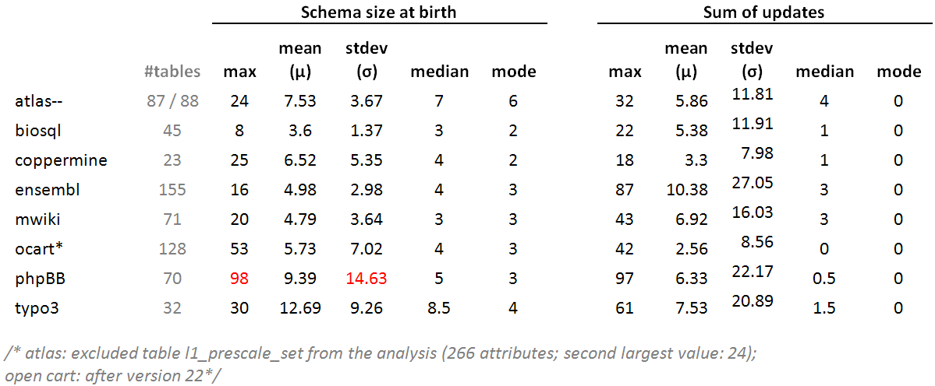
Statistics of schema size at birth and sum of updates

Slide 71
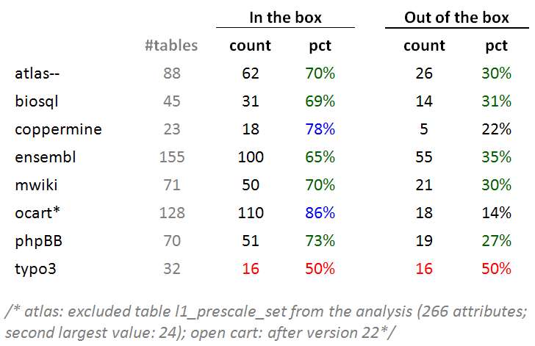
Typically: ~70% of tables inside the box
Typically, around 70% of the tables of a database is found within the 10x10 box of schemaSize@birth x sumOfUpdates (10 excluded in both axes).

Slide 72
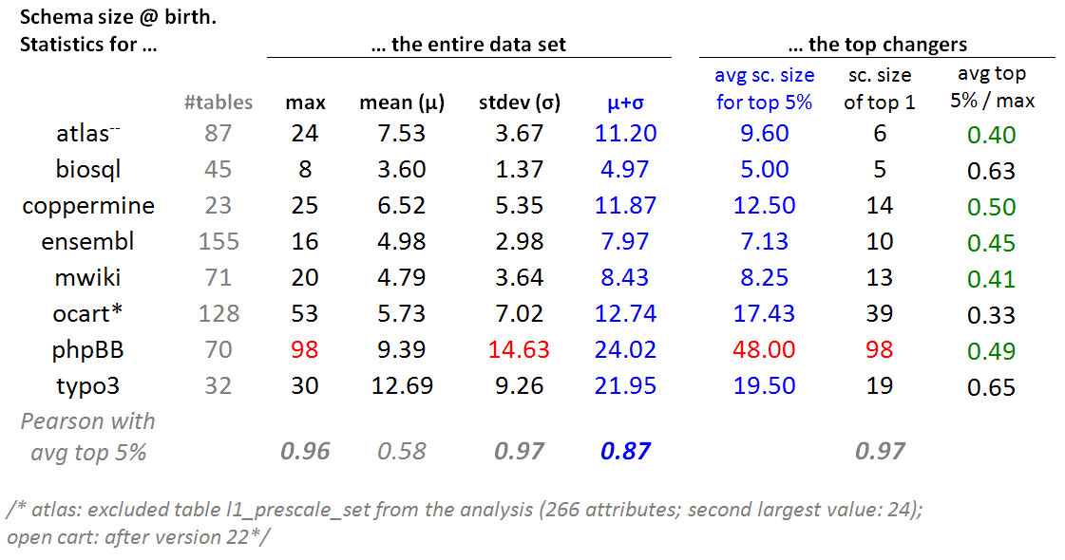
Top changers tend to have medium schema sizes
For every dataset: we selected the top 5% of tables in terms of this sum of updates and we averaged the schema size at birth of these top 5% tables.

Slide 73
Top changers tend to have medium schema sizes
The average schema size for the top 5% of tables in terms of their update behavior is close to one standard deviation up from the average value of the schema size at birth(i.e., very close to $mu$+$sigma$). //except phpBB

Slide 74
Top changers tend to have medium schema sizes
- In 5 out of 8 cases, the average schema size of top-changers within 0.4 and 0.5 of the maximum value (practically the middle of the domain) and never above 0.65 of it.
- Pearson: the maximum value, the standard deviation of the entire data set and the average of the top changers are very strongly correlated.

Slide 75
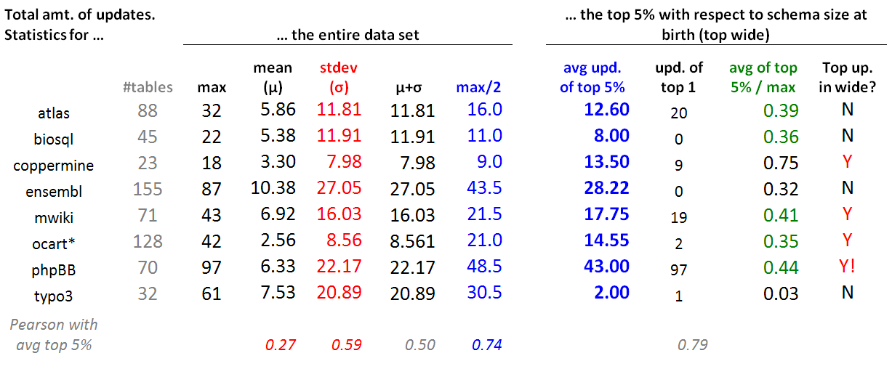
Wide tables have a medium number of updates
For each data set, we took the top 5% in terms of schema size at birth (top wide) and contrasted their update behavior wrt the update behavior of the entire data set.
Typically, the avg. number of updates of the top wide tables is close to the 50% of the domain of values for the sum of updates (i.e., the middle of the y-axis of the comet figure, measuring the sum of updates for each table).
This is mainly due to the (very) large standard deviation (twice the mean), rather than the --typically low -- mean value (due to the large part of the population living quiet lives).

Slide 76
Inverse Gamma

Slide 78
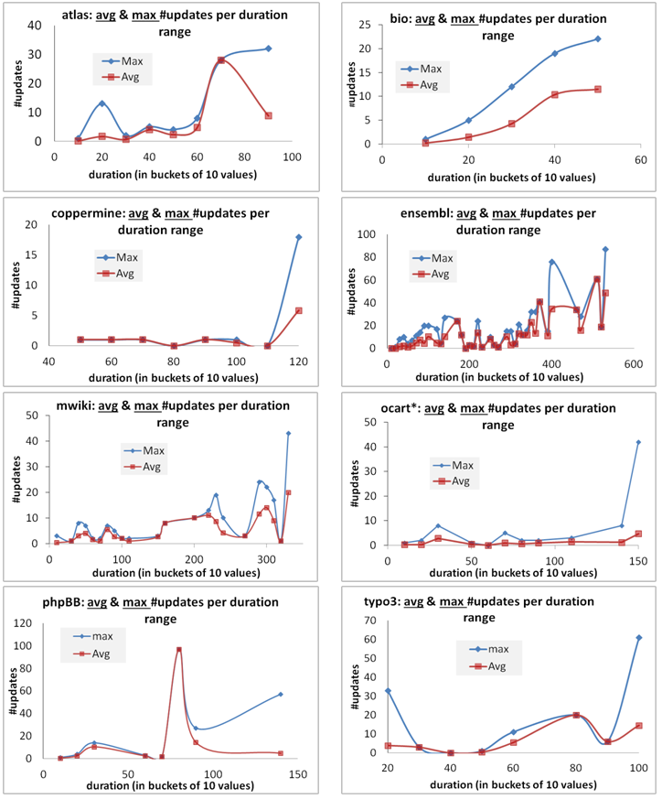
Skyline & Avg for Inverse
Gamma

Slide 79
The empty triangle pattern

Slide 80
void

Slide 81
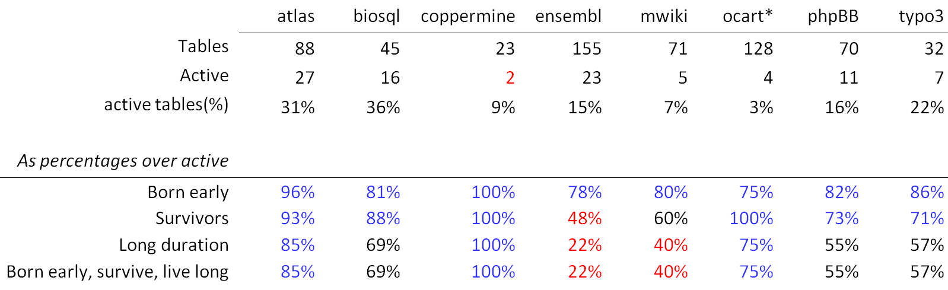
Top changers: early born, survivors, often with long durations, and often all the above
In all data sets, active tables are born early with percentages that exceed 75%
With the exceptions of two data sets, they survive with percentage higher than 70%.
The probability of having a long duration is higher than 50% in 6 out of 8 data sets.
Interestingly, the two last lines are exactly the same sets of tables in all data sets!
  An active table with long duration has been born early and survived with prob. 100%
  An active, survivor table that has a long duration has been born early with prob. 100%

Slide 82
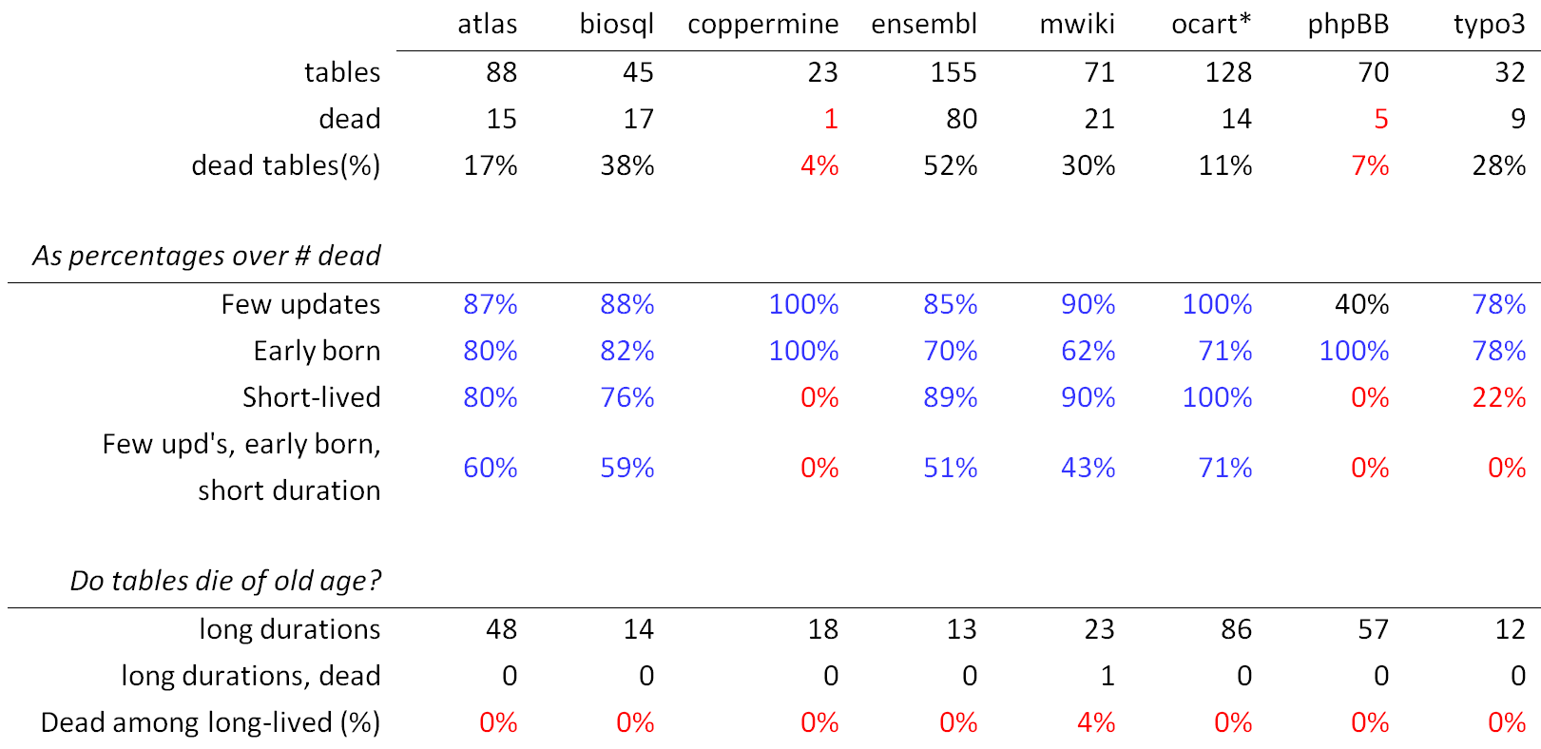
Dead are: quiet, early born, short lived, and quite often all three of them

Slide 83
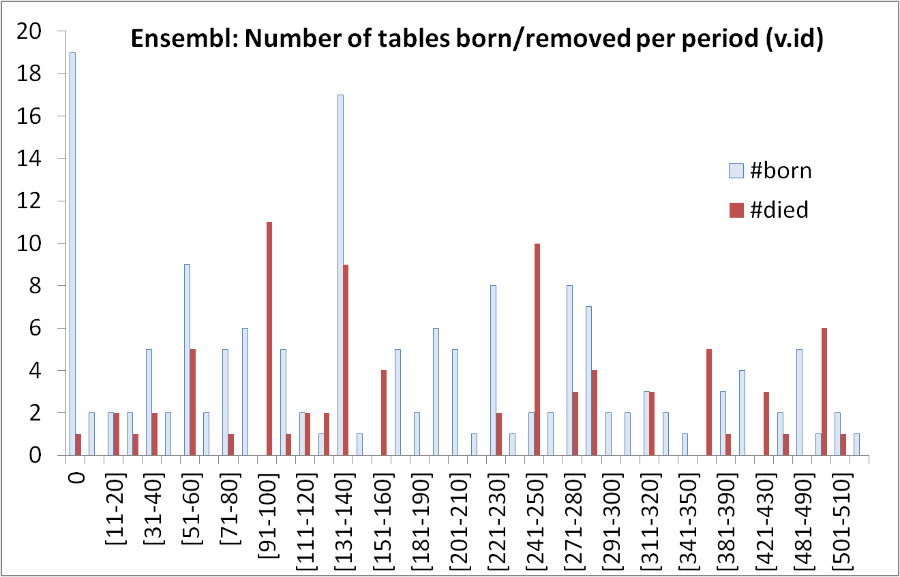
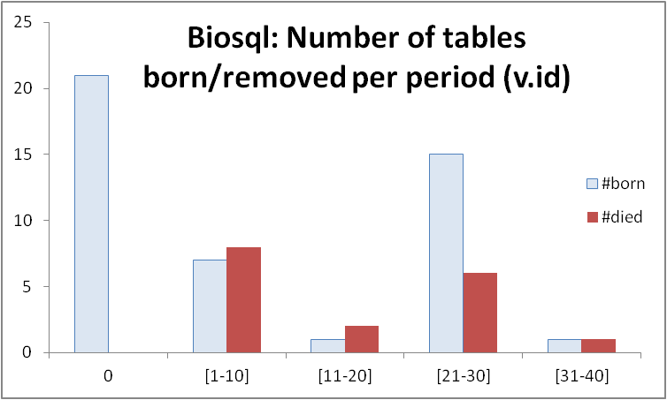
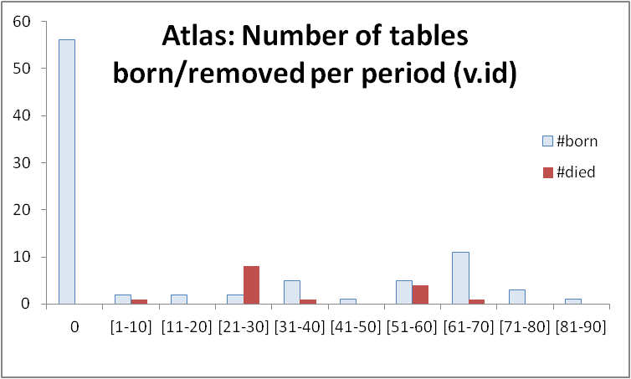
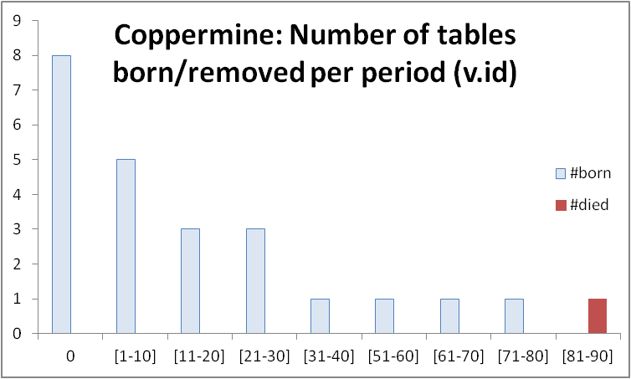
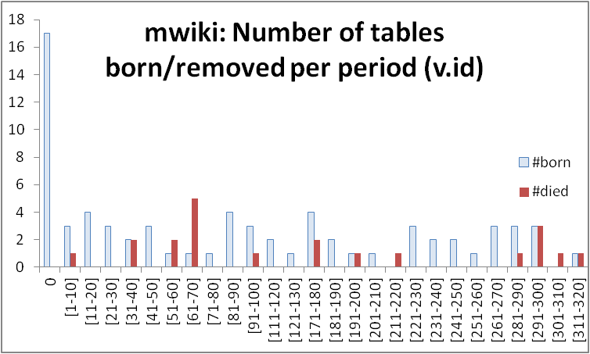
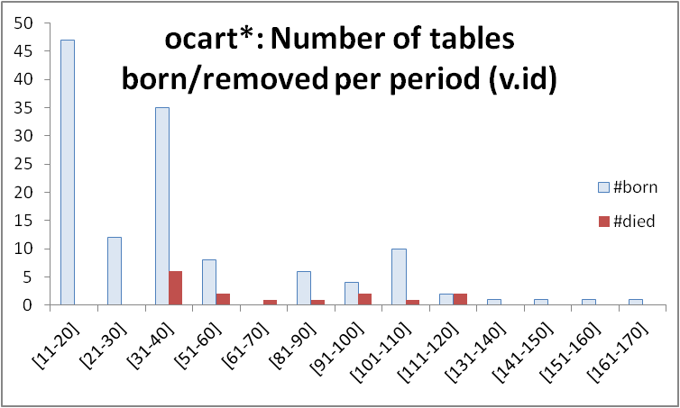
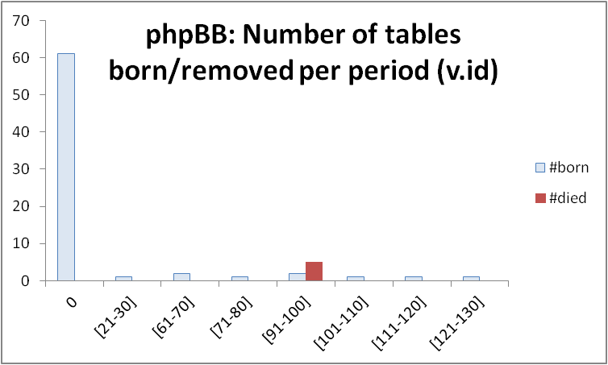
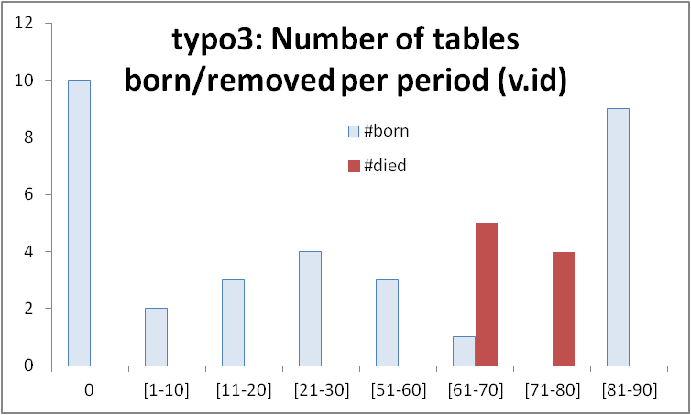
Most births &deaths occur early (usually)

Slide 84
Longevity and update activity correlate !!
Top changers live long
Remember: top changers are defined as such wrt ATU (AvgTrxnUpdate), not wrt sum(changes)
Still, they dominate the sum(updates) too! (see top of inverse Γ)
See also upper right blue part of diagonal: too many of them are born early and survive => live long!
Too many top changers are born early
Birth rate drops over time
Deleted tables are born early & last short

Slide 85
All in one
Top changers live long
Empty space: high change rates are only for early born & long lived
Early stages of the database life are more "active" in terms of births, deaths and updates, and have higher chances of producing deleted tables.
After the first major restructuring, the database continues to grow; however, we see much less removals, and maintenance activity becomes more concentrated and focused.
Deleted tables last short & do not change a lot
Top changers are born early
An empty triangle: no deleted tables with large or even modest durations
Deleted tables are born early & last short
Birth rate drops over time

