Slide 1
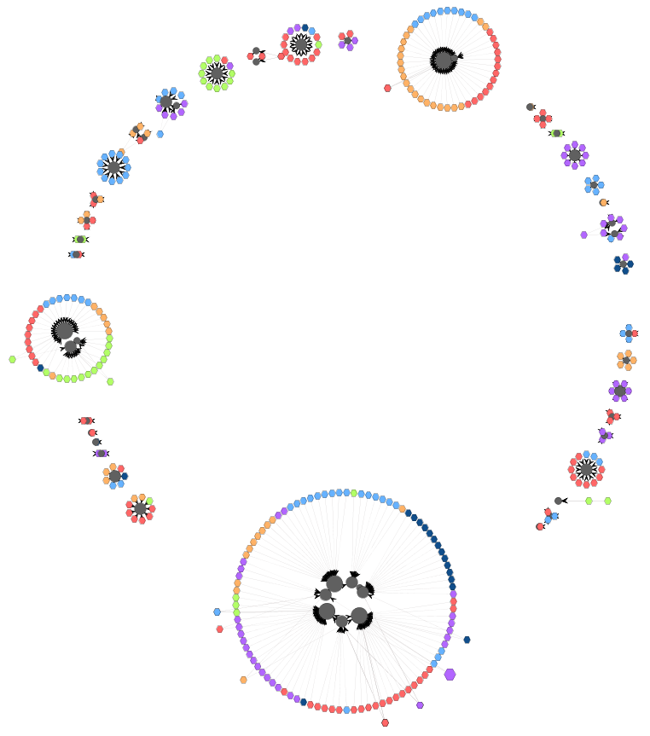
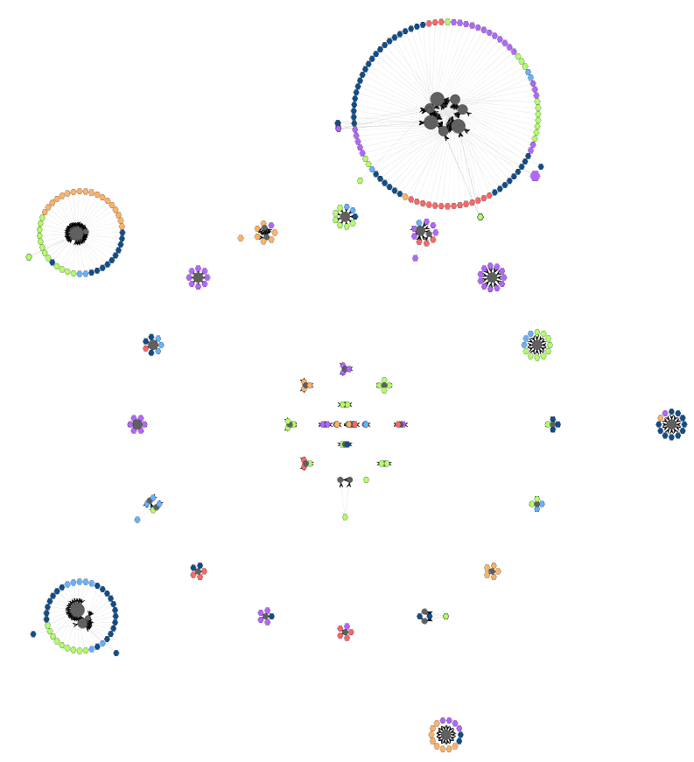
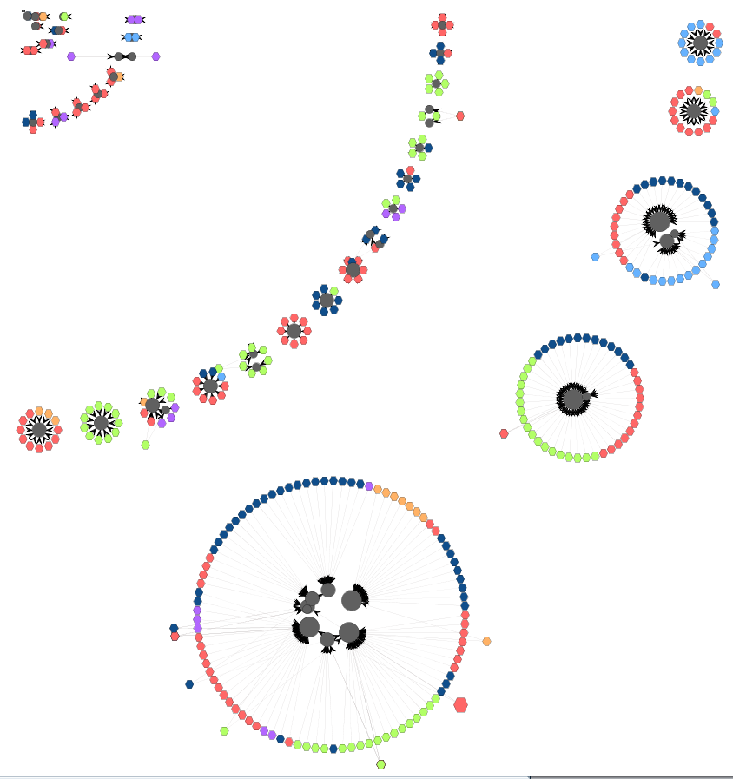

Visual Maps for Data-Intensive Ecosystems
Efthymia Kontogiannopoulou* | Petros Manousis, Panos Vassiliadis
Petroleum Geo-Services | Dept. of Computer Science & Engineering,
Oslo, Norway | Univ. Ioannina, Hellas
*work conducted while in the Univ. Ioannina
Univ. of Ioannina
This research has been co-financed by the European Union (European Social Fund - ESF) and Greek national funds through the Operational Program ”Education and Lifelong Learning” of the National Strategic Reference Framework (NSRF) - Research Funding Program: Thales. Investing in knowledge society through the European Social Fund.

Slide 2
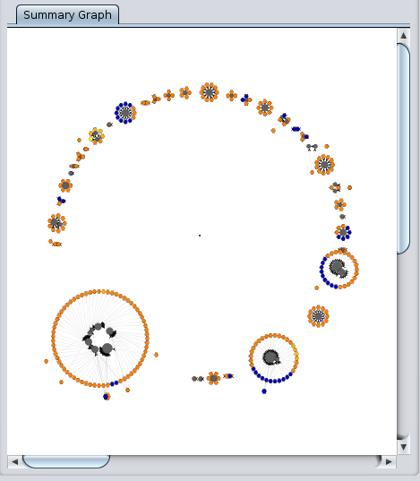
How do we make a map for a data-intensive software ecosystem? *
*Information system with applications
built around a central db and lots of
queries blended in their code, thus having
strong code-db dependencies

Slide 3
Why do we need these maps?
Documentation,
Program comprehension
impact analysis
“Programmers spend between 60-90% of their time reading and navigating code and other data sources ... Programmers form working sets of one or more fragments corresponding to places of interest …
Perhaps as a result, programmers may spend on average 35% of their time in IDEs actively navigating among working set fragments …, since they can only easily see one or two fragments at a time.”
Bragdon et al. Code bubbles: rethinking the user interface paradigm of integrated development environments. ICSE (1) 2010: 455-464.

Slide 4
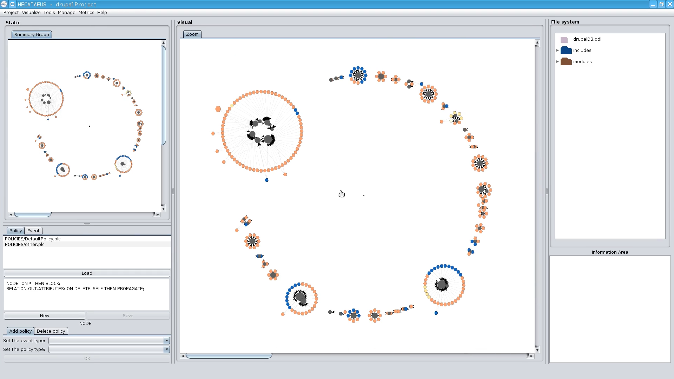
Circular placement for Drupal
Hecataeus tool: http://www.cs.uoi.gr/~pvassil/projects/hecataeus/

Slide 5
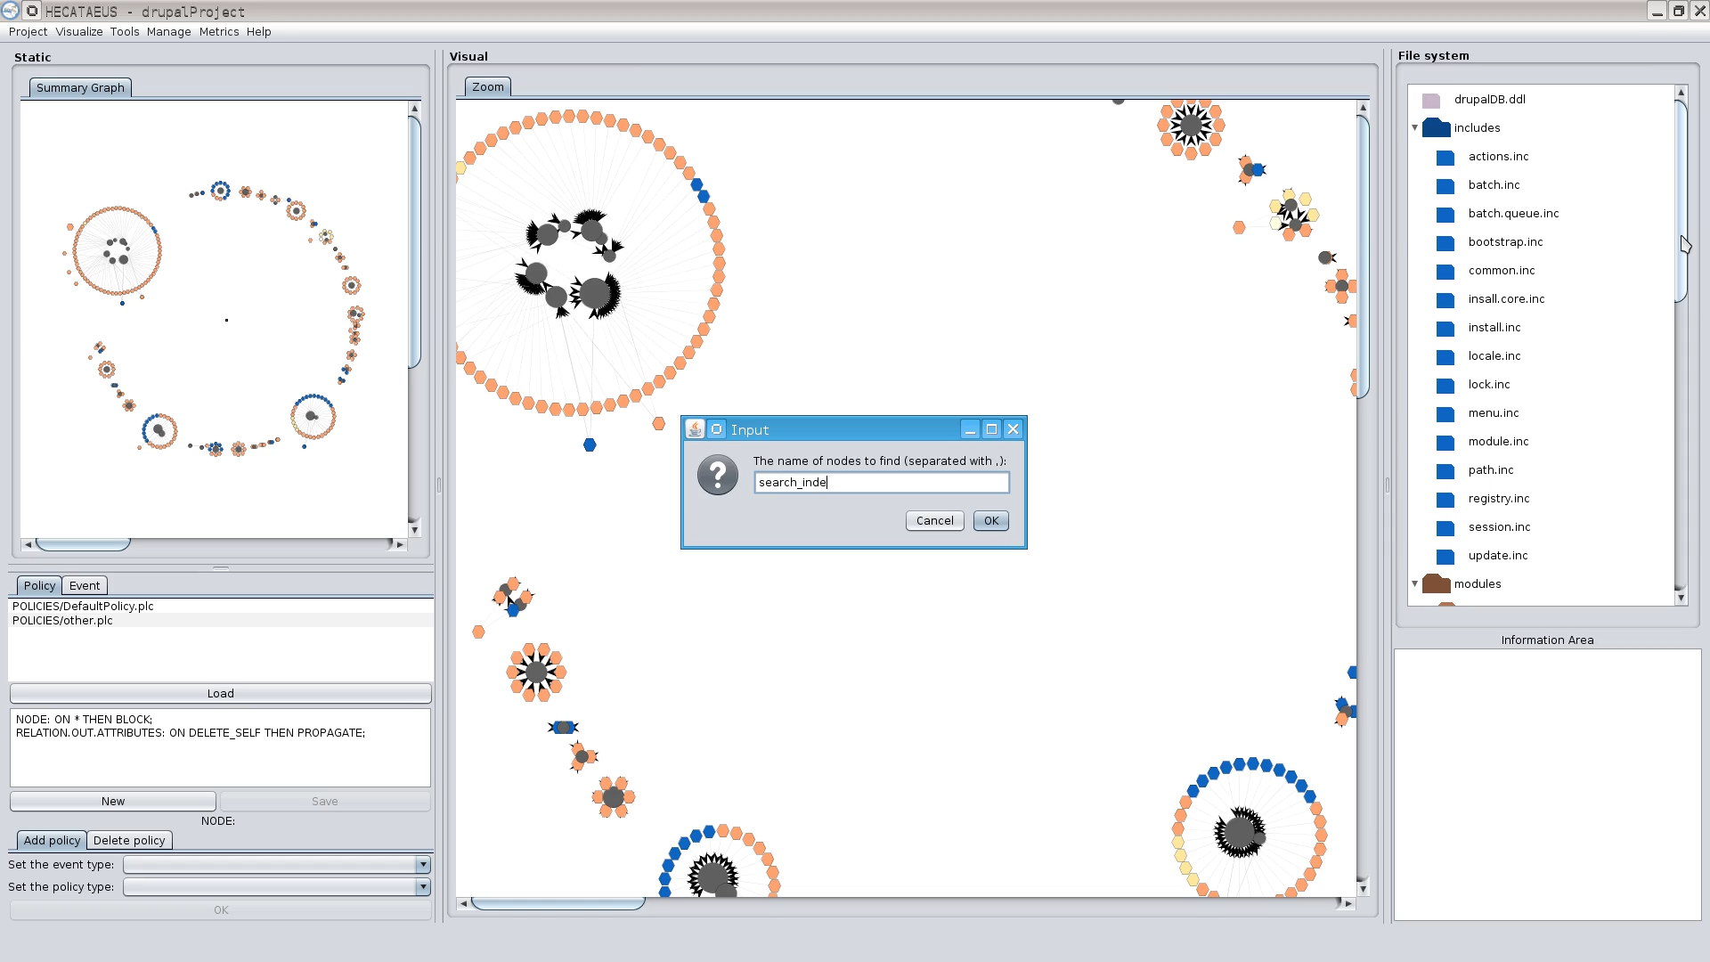
What happens if I modify table search_index? Who are the neighbors?
Can play with the file structure too
Hecataeus tool: http://www.cs.uoi.gr/~pvassil/projects/hecataeus/

Slide 6
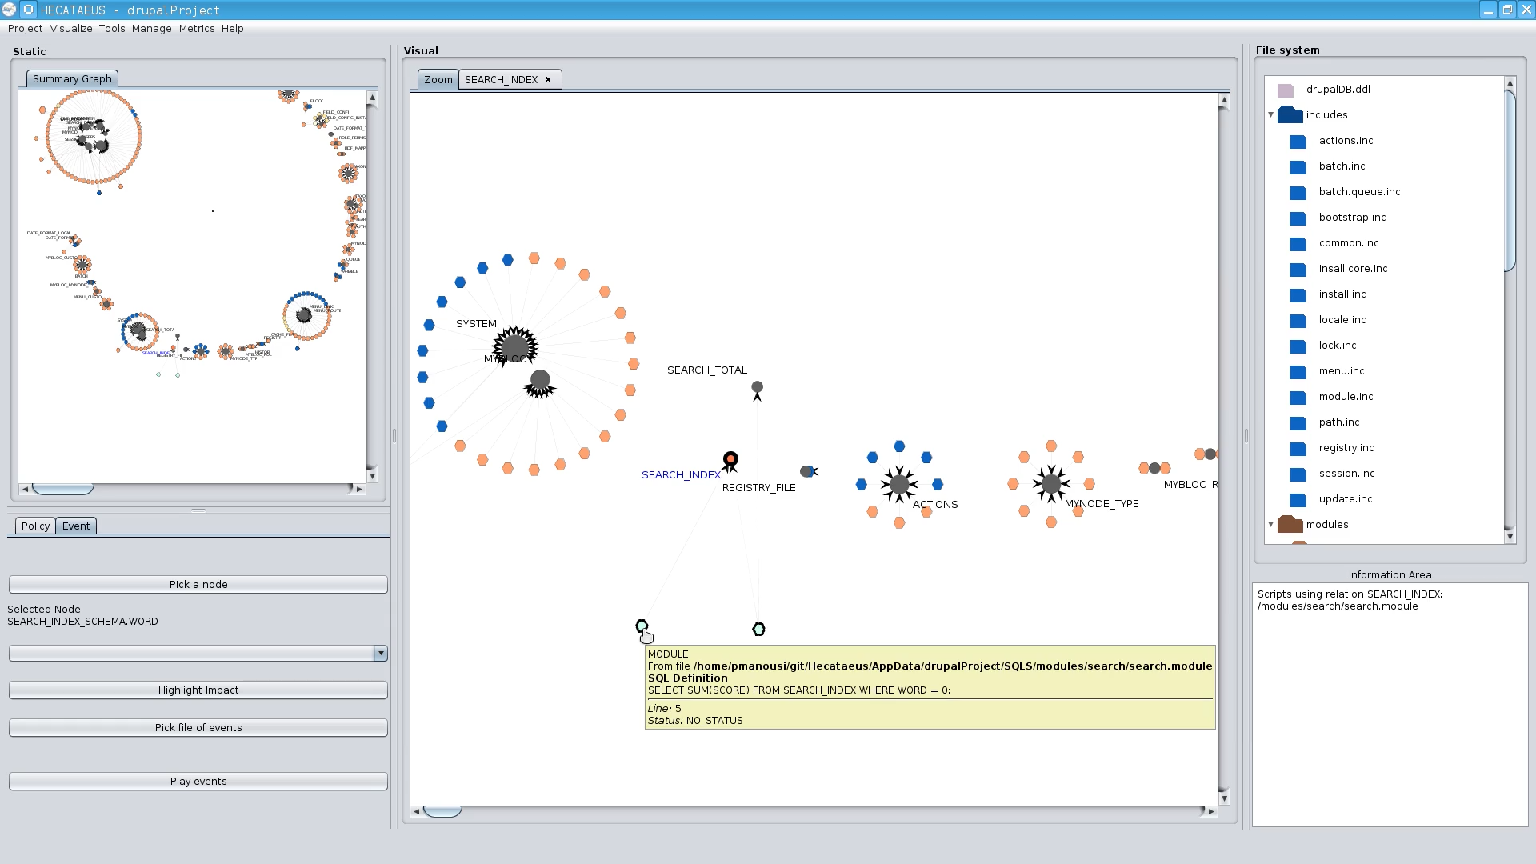
What happens if I modify table search_index? Who are the neighbors?
Tooltips with info on the script & query
+ reporting at the “information area”
Hecataeus tool: http://www.cs.uoi.gr/~pvassil/projects/hecataeus/

Slide 7
So, … how do we make a map for a data-intensive software ecosystem?

Slide 8
A charting method for data-intensive ecosystems, with a clear target to reduce visual clutter.
We exploit a rigorous, graph-based model on code-db dependencies
  modules (tables and queries embedded in the applications) as nodes and data provision relationships as edges
We cluster entities of the ecosystem in groups on the basis of their strong interrelationship
We chart the ecosystem via a set of radial methods and provide solutions for
  … cluster placement …
  … node placement within clusters …
  … tuning of visual representation details (shapes, colors, …) …
all with the goal of reducing visual clutter

Slide 9
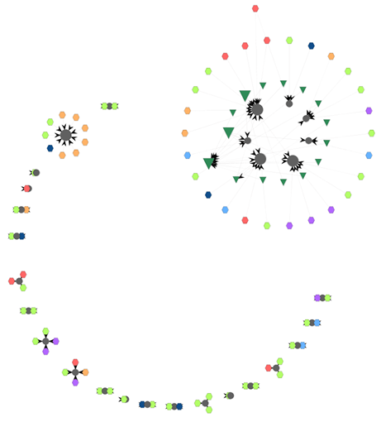
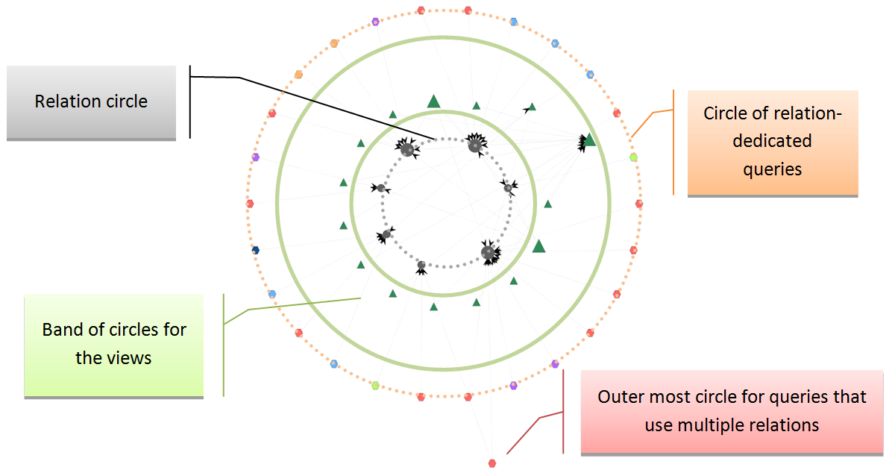
Graphical Notation
One (or more) embedding circle for cluster placement
Clusters are internally arranged over concentric circles, too
Node colors: acc. to script for queries; fixed for tables & views,
Node shape: relation / view / query
Node size: acc. to degree
The internal structure of a cluster
Clusters
…
bioSQL
Embedding circle
4 bands of circles, within a cluster:
1 circle for relations
As many as needed for views
2 circles for queries
Notes:
Fundamental modeling pillar: Architecture Graph G(V,E) of the data-intensive ecosystem. The Architecture Graph is a skeleton, in the form of graph, that traces the dependencies of the application code from the underlying database.
modules (relations, views and queries) as nodes and
edges denoting data provision relationships between them.
Visualization choices:
Circular layout. Circular layouts give:
better highlight of node similarity,
less line intersections, i.e., less clutter
Clustered graph drawing. We place clusters of objects in the periphery of an embedding circle or in the periphery of several concentric circles or arcs. Each cluster will again be displayed in terms of a set of concentric circles, thus producing a simple, familiar and repetitive pattern.

Slide 10
“Transparent” edges for less visual clutter
Edges are the main source of visual clutter!
So, we reduced the intensity of the edges’ presence of the visual map:
  we picked a light gray color for the edges and
  we made them very thin, in terms of weight (almost invisible).
To retain their info: every time a particular node is selected by the user its neighboring nodes are highlighted with a blue transparent color so, instead of emphasizing edges, we emphasize neighbors.

Slide 11
… and (finally) here is the method to construct the map:
Cluster similar nodes in groups (clusters)
  A cluster is a set of relations, views and queries
  Similarity is determined by the edges
Estimate the space required for each cluster
  … to avoid cluster overlaps later
3 alternative methods to place clusters on a 2D canvas
  Single circle
  Concentric Circles
  Concentric Arcs
Place the nodes of each cluster in concentric circles, internally in the cluster

Slide 12
Roadmap
1. Cluster similar nodes in groups (clusters)
2. Estimate the space required for each cluster
3. Three alternative methods to place clusters on a 2D canvas
  Single circle
  Concentric Circles
  Concentric Arcs
4. Place the nodes of each cluster in concentric circles, internally in the cluster
5. Summing up

Slide 13
Roadmap
1. Cluster similar nodes in groups (clusters)
2. Estimate the space required for each cluster
3. Three alternative methods to place clusters on a 2D canvas
  Single circle
  Concentric Circles
  Concentric Arcs
4. Place the nodes of each cluster in concentric circles, internally in the cluster
5. Summing up

Slide 14
Step 1: Clustering
We use agglomerative hierarchical clustering to group objects with similar semantics in advance of graph drawing.
Why? To reduce the amount of visible elements, visualization methods place them in groups, thus
  reducing visual clutter
  improving user understanding of the graph
Principle of proximity: similar nodes are placed next to each other

Slide 15
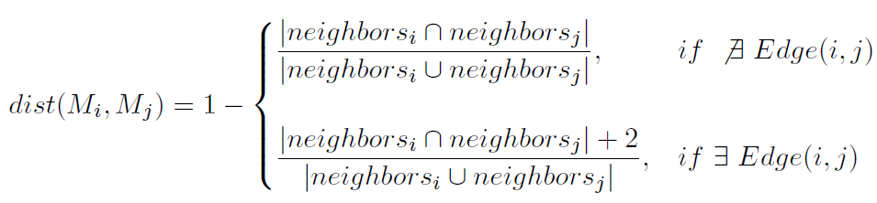
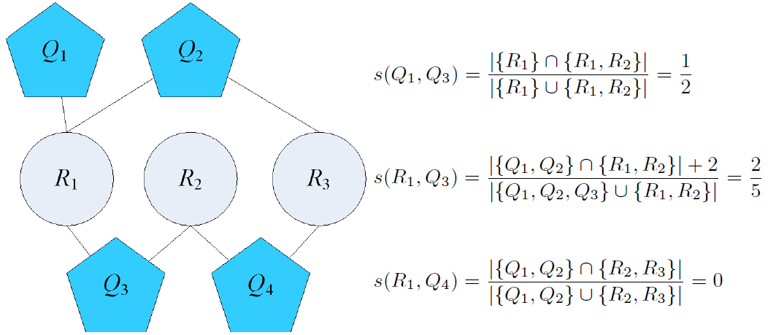
Step 1: Clustering
Notes:
The distance function used in our method evaluates node similarity on the grounds of common neighbors. So, for nodes of the same type (i.e., the similarity of two queries, or the similarity of two tables), similarity is computed via the Jaccard formula, i.e., the fraction of the number of common neighbors over the size of the union of the neighbors of the two modules. When it comes to assessing the similarity of nodes of different types (like, e.g., a query and a relation), we must take into account whether there is an edge among them. If this is the case, the numerator is increased by 2, accounting for the two participants.

Slide 16
Roadmap
✓
1. Cluster similar nodes in groups (clusters)
2. Estimate the space required for each cluster
3. Three alternative methods to place clusters on a 2D canvas
  Single circle
  Concentric Circles
  Concentric Arcs
4. Place the nodes of each cluster in concentric circles, internally in the cluster
5. Summing up

Slide 17
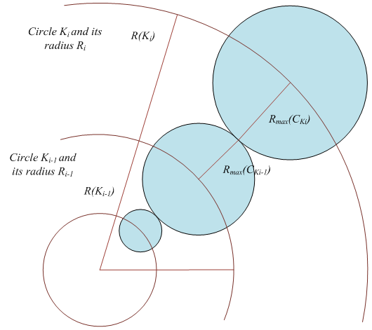
Step 2: Estimate the area of each cluster
Once the clusters have been computed, before placing them on the 2D canvas, the next step is to estimate the space required for each cluster
This step is crucial and necessary for the subsequent step of cluster placement, in order to be able to
  calculate the radius and area each cluster, and thus,
  arrange the clusters without overlaps

Slide 18
Step 2: Estimate the area of each cluster
Εach cluster includes 3 bands of concentric circles:
relations (1 circle), views, queries (2 circles)
A cluster’s internal layout from the Biosql ecosystem

Slide 19
Step 2: Estimate the area of each cluster
We determine the clusters’ circles and their nodes:
  We topologically sort cluster nodes in strata – each stratum becomes a circle
Then, we compute the radius for each circle:
R_{i} = 3 * log(nodes) + nodes
The outer circle gives us the radius of this cluster
A cluster’s internal layout from the Biosql ecosystem
Notes:
Rationale for the formula : we need a function that will increase rapidly for a small number of nodes and will not change that much when the number of the nodes gets bigger. This way we make sure that very small clusters will be placed on a visible circle and big clusters will not get enormous.
Because of that, we used the logarithmic function of the formula to which we intentionally added the number of nodes that belong to the circle of the cluster, to ensure that the circles with small number of nodes will obtain a visible area. The scale factor of 3 in the formula was empirically determined by working with the datasets that we have used in our experimentation

Slide 20
Roadmap
✓
1. Cluster similar nodes in groups (clusters)
2. Estimate the space required for each cluster
3. Three alternative methods to place clusters on a 2D canvas
  Single circle
  Concentric Circles
  Concentric Arcs
4. Place the nodes of each cluster in concentric circles, internally in the cluster
5. Summing up
✓

Slide 21
Step 3: Laying out the Clusters
3 alternative methods for placing the clusters on a 2D area
Circular placement
  all clusters on a single embedding circle
Concentric circles
  trying to reduce the intermediate empty space
Concentric arcs
  a combination of the previous two methods
Notes:
Circular: in contrast to existing techniques, we allocate different angles and sectors per cluster.
Drupal as an example

Slide 22
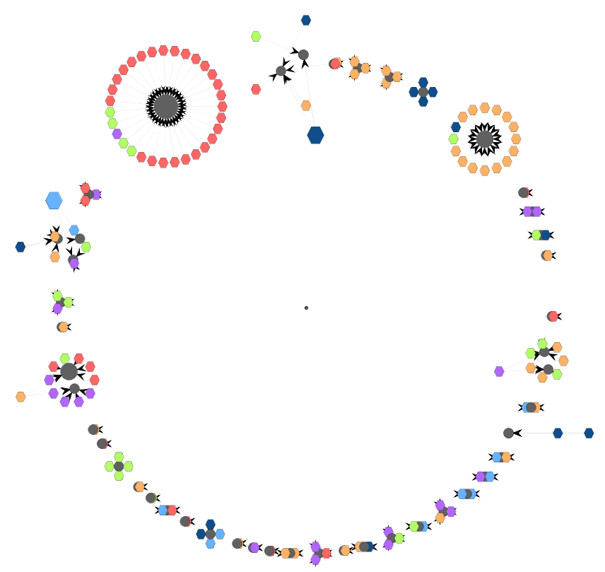
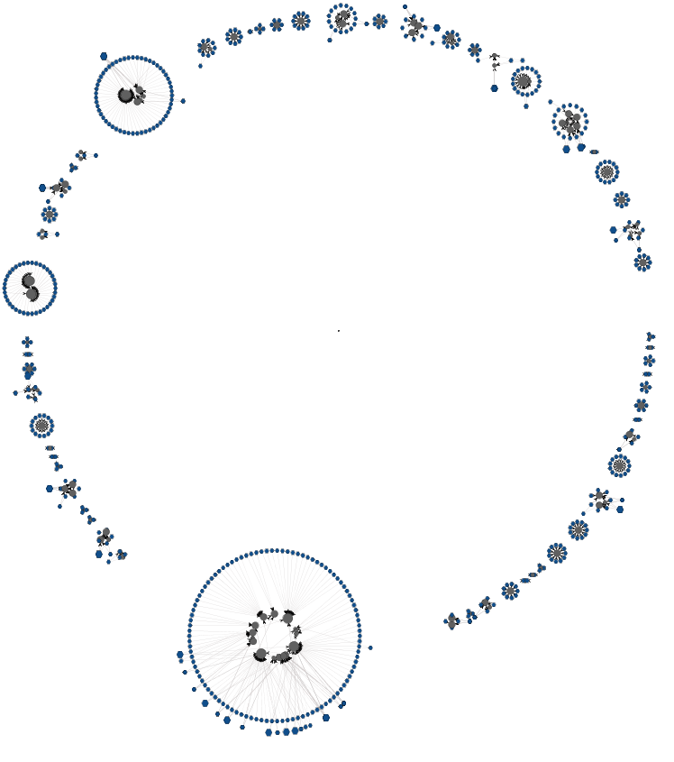
Circular Layout
Drupal
bioSQL
ZenCart
OpenCart
Notes:
4 data sets that we have used
3 CMS’s and 1 scientific ecosystem

Slide 23
Circular cluster layout
We use a single embedding circle to place the clusters.
One sector of the circle per cluster
  with its angle varying on the cluster’s size (#nodes)
  remember: each cluster is also a circle, approximated by its outermost constituent circle of nodes
Steps:
  Compute R, the radius of the embedding circle
  Compute φ_{i}, the angle of each cluster’s sector
  Add some extra whitespace
  Compute the coordinates of all clusters
Notes:
In contrast to the state of the art, we do not use fixed sizes for the sectors of the circle the clusters occupy, but rather, the part of the overall circle that is assigned to each cluster depends on its size (i.e., its number of nodes).

Slide 24
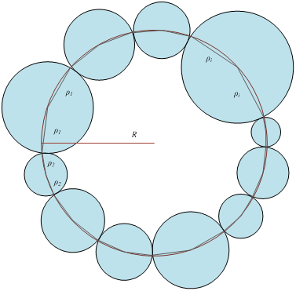
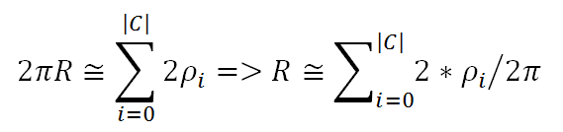
Circular Layout: Embedding
Circle determination
compute R;
compute φ_{i};
whitespace;
coordinates.
Given: the radius r_{i} of each cluster i Compute: R, the radius of the embedding circle.
Method:
approximate the circles periphery (2πR) by the sum of edges of the embedded polygon
divide this sum by 2π to calculate the radius R of the embedding circle
Notes:
We approximate the contour of the inscribed polygon of the circle, computed via the sum of twice the radius of the clusters and then we divide this sum by 2π to calculate the radius R of the embedding circle using equation (3). We approximate the circles periphery, equal to 2πR, by the sum of edges of the embedded polygon.

Slide 25
Circular layout: calculation of the angle for each of the segments
compute R;
compute φ_{i};
whitespace;
coordinates.
Goal: assign each cluster to a segment of the circle depending on the cluster’s radius (size).
Each these segments is defined by an angle φ over the embedding circle.
Not as obvious as it seems – we have to consider two cases:
  The radius ρ of the cluster we want to place is smaller or equal to the radius of the embedding circle R
  The radius ρ of the cluster we want to place is greater than the radius of the embedding circle R

Slide 26
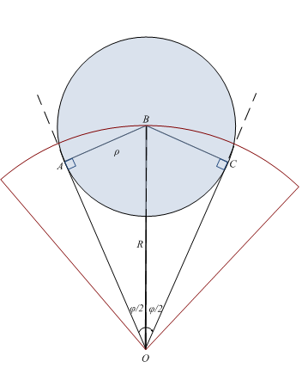

Circular layout: calculation of the angle for each of the segments
compute R;
compute φ_{i};
whitespace;
coordinates.
Typical case, where ρ ≤ R
Consider the left triangle ABO
Then:

Slide 27
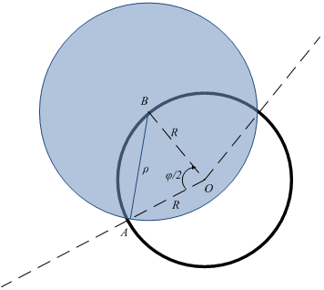
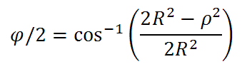

Circular layout: calculation of the angle for each of the segments
compute R;
compute φ_{i};
whitespace;
coordinates.
A large cluster occurs ρ > R
Assume the isosceles ABO, both AO,BO = R
Then:
due to
Note: cannot avoid to discriminate the two cases
Notes:
Assume the isosceles triangle ABO with O being the center of the circle and A, C the limits of the sector on the periphery of the circle. BO is the dichotomous of the angle of a sector AOC and also BO is equal to the radius of our circle, so we have constructed the isosceles triangle AOB and using the law of cosines (cosφ=(b^2+c^2-a^2)/2bc) with OA as c, OB as b and AB (which is equal to the radius of the cluster we wish to place) as a, we can calculate via the equation described above
It is noteworthy, that we cannot avoid discriminating the aforementioned two cases: when ρ < R, if we use the formula with the law of cosines, the line OA of Fig. 8 would not be a tangent line and would actually cut through the disk of the cluster. As already mentioned, in the case of ρ ≥ R, we cannot produce sin⁻¹ for values higher than 1.

Slide 28
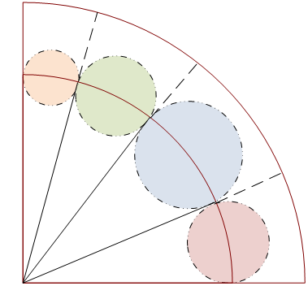
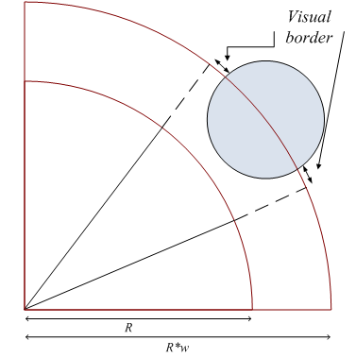
Circular layout: avoid cluster overlap!
compute R;
compute φ_{i};
whitespace;
coordinates.
original layout
We introduce a white space factor w that enlarges the radius R of the circle
Each cluster is approx. by a circle, with
  radius r (known from step #1)
  center [c_{x}, c_{y}] determined by φ, R, and w.
extra whitespace

Slide 29
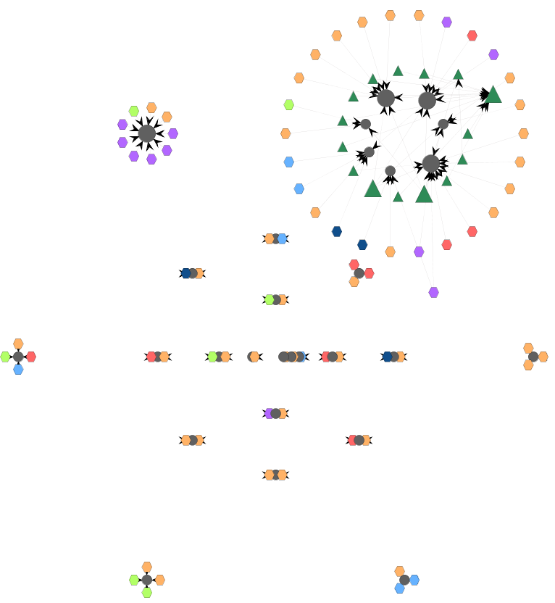
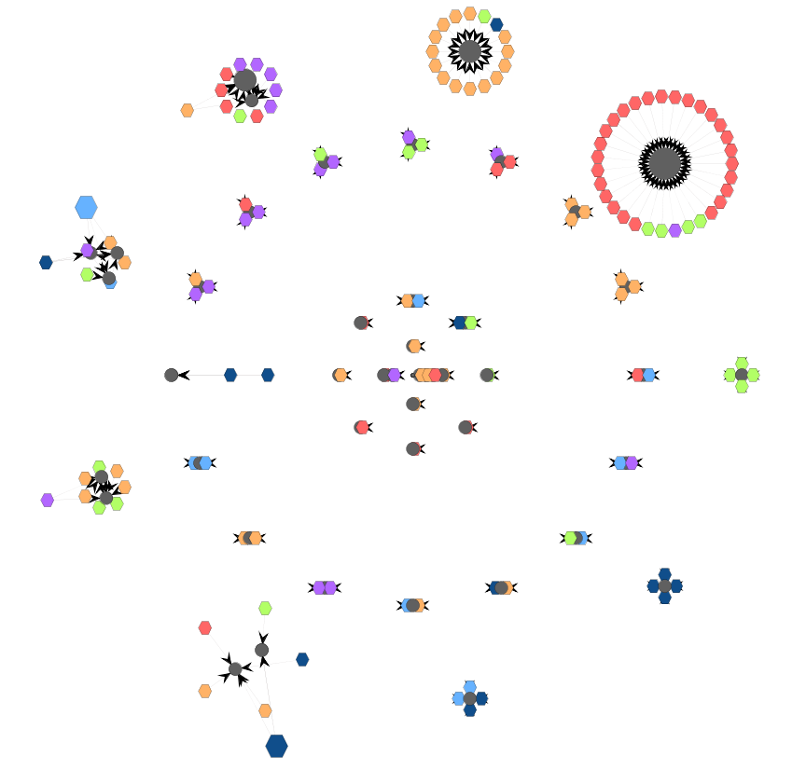
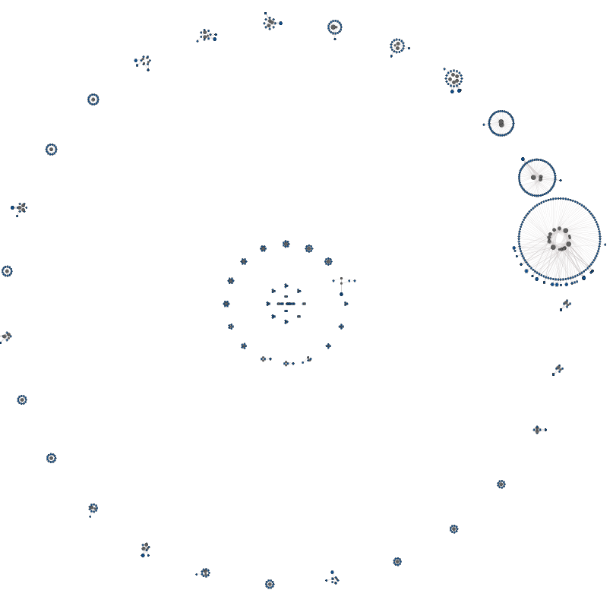
Concentric circles
Drupal
bioSQL
ZenCart
OpenCart

Slide 30
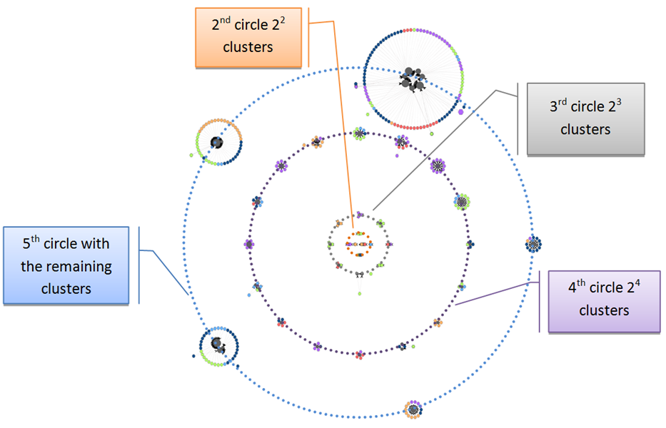
Concentric Circles Layout
Each circle is split in fragments of powers of 2
  as the order of the introduced circle increases, the number of fragments increases too (S = 2^{k}),
  with the exception of the outermost circle hosting the remaining clusters
This way, we can place
  the small clusters on the inner circles, and
  bigger clusters (occupying more space) on outer circles
Notes:
The k-th power of two was decided as a means to quickly enlarge the number of clusters per new circle

Slide 31
Concentric Circles Layout
Method:
Sort clusters by ascending size in a list L^{C}
While there are clusters not placed in circles
  Add a new circle and divide it in as many segments as S = 2^{k} with k being the order of the circle (i.e., the first circle has 2¹ segments, the second 2² and so on)
  Assign the next S fragments from the list L^{C} to the current circle and compute its radius according to this assignment
  Add the circle to a list L of circles
Draw the circles from the most inward (i.e., from the circle with the least segments) to the outermost by following the list L.
Main challenge

Slide 32
Concentric Circles: radius calculation
Instead of having to deal with just one circle, we need to compute the radius for each of the concentric circles, in a way that clusters do not overlap
Overlap can be the result of two problems:
  clusters of subsequent circles have radii big enough, so that they meet, or,
  clusters on the same circle are big enough to intersect.
R(K_{i}) = R(K_{i-1}) + R_{max}(C_{Ki-1})+R_{max}(C_{Ki})

Slide 33
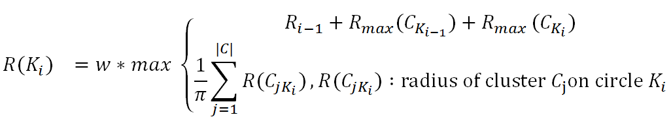

Concentric Circles: radius calculation for each circle
Finally, to calculate the radius of a circle:
  we take the maximum of the two values of the two aforementioned solutions and
  we use an additional whitespace factor w to enlarge it slightly (typically, we use a fixed value of 1.2 for w).
Clusters of the same circle have equal segments with an angle:
where n: the number of clusters on circle K_{i}
Notes:
To avoid the overlapping of clusters and to apply white space as visual border to distinguish clusters easily

Slide 34
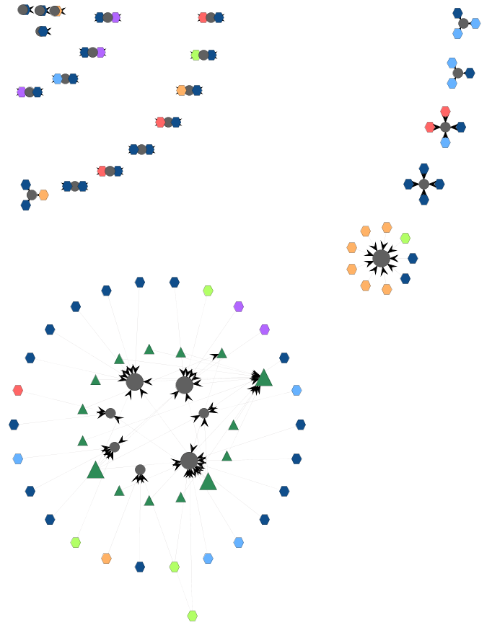
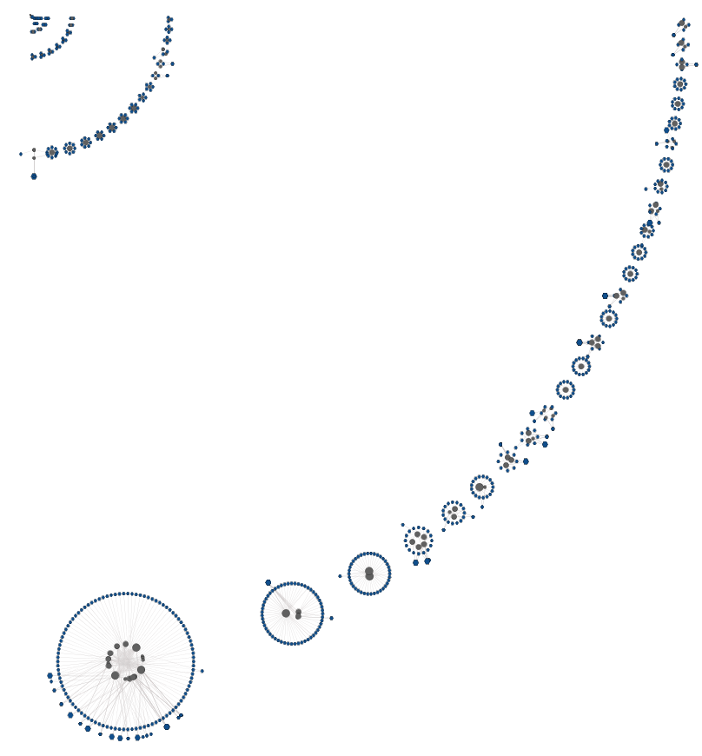
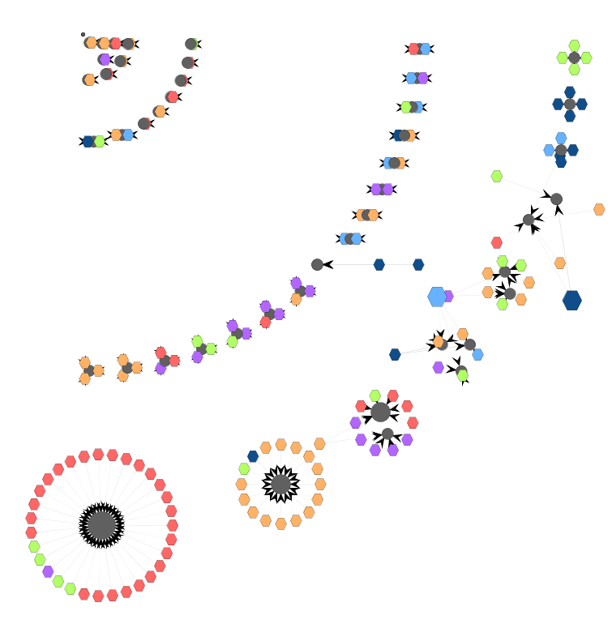
Concentric arcs
Drupal
bioSQL
ZenCart
OpenCart

Slide 35
Concentric Arcs Layout
To attain better space utilization
  small clusters placed in the upper left corner
  less whitespace to guard against cluster intersection
Just like concentric circles:
  we deploy the clusters on concentric arcs A_{i} of size π/2
  we place 2^{i} clusters on the i^{th} arc
  to avoid cluster overlaps, we use exactly the same radius optimization technique we used before.
Unlike the concentric circles,
  the partition assigned to each cluster is proportionate to its size (as in the case of the single circle), again taking care to avoid overlaps

Slide 36
Roadmap
✓
1. Cluster similar nodes in groups (clusters)
2. Estimate the space required for each cluster
3. Three alternative methods to place clusters on a 2D canvas
  Single circle
  Concentric Circles
  Concentric Arcs
4. Place the nodes of each cluster in concentric circles, internally in the cluster
5. Summing up
✓
✓

Slide 37
Step 4: arrangement of nodes within the circular clusters
Remember: 4 bands of circles to place nodes

Slide 38
Step 4: arrangement of nodes within the circular clusters
We want to follow a barycenter based method, which can work successfully for layered bipartite graphs
The standard barycenter method works with linear layers with the principle that once you have laid out layer i, you can lay out layer i+1 wrt the previous one
  … practically placing nodes in the barycenter of their neighbors in the previous layer i
Here, we have two challenges:
  adapt this to our radial, concentric circles
  decide the initial order of the process (here: relations in the inner circle)

Slide 39
Step 4: arrangement of nodes within the circular clusters
order R;
place R & Q_{R};
place V & Q-Q_{R}.
Order the relations
  Count the frequency of each combination of tables as hit by the queries
  Place tables in popular combinations sequentially
Decide the position of relations and relation-dedicated queries
  Locate relation dedicated queries, decide the arc they need and position them sequentially
  Place relation in the middle of this arc
Decide the position of the rest of the queries and the views
  Stratify views and queries – each stratum has a dedicated circle
  Place views and queries via a barycenter method on their angle
  Adjust overlapping nodes (e.g., queries hitting exactly the same tables)

Slide 40
Roadmap
✓
1. Cluster similar nodes in groups (clusters)
2. Estimate the space required for each cluster
3. Three alternative methods to place clusters on a 2D canvas
  Single circle
  Concentric Circles
  Concentric Arcs
4. Place the nodes of each cluster in concentric circles, internally in the cluster
5. Summing up
✓
✓
✓

Slide 41
Not covered in this talk / paper…
… failures & other tries ….
Algorithmic details and geometrical issues
  … esp., concerning the intra-cluster placement
Relationship to aesthetic principles
Experiments
To probe further (code, data, details, presentations, …)
    http://www.cs.uoi.gr/~pmanousi/publications/2014_ER/

Slide 42
We can tame code-db interdependence via rigorous modeling and visual methods
Visual methods to chart ecosystems explored on the grounds of:
  … radial deployment
  … grouping, coloring, placement
  … visual clutter reduction
  all aiming to better highlight code-db relationships
To probe further (code, data, details, presentations, …)
    http://www.cs.uoi.gr/~pmanousi/publications/2014_ER/

Slide 43
Auxiliary slides

Slide 44
Why bother?
The problem is …
  Important, as its implications relate to productivity and development effort
  Hard to solve, not solved by SotA, as standard graph drawing methods do not seem to work well
  Interesting, as it requires a large amount of technical solutions to visualization problems
… and, of course, we have not only solved it, but also, we have incorporated the solution to an actual system…

Slide 45
In a nutshell
Fundamental modeling pillar: Architecture Graph G(V,E) of the data-intensive ecosystem. The Architecture Graph is a skeleton, in the form of graph, that traces the dependencies of the application code from the underlying database.
  modules (relations, views and queries) as nodes and
  edges denoting data provision relationships between them.
Visualization choices:
Circular layout. Circular layouts give:
  better highlight of node similarity,
  less line intersections, i.e., less clutter
Clustered graph drawing. We place clusters of objects in the periphery of an embedding circle or in the periphery of several concentric circles or arcs. Each cluster will again be displayed in terms of a set of concentric circles, thus producing a simple, familiar and repetitive pattern.

Slide 46
Graphical Notation
One (or more) embedding circle for cluster placement
Clusters are internally arranged over concentric circles, too
Node colors: to which script queries belong
Node shape: relation / view / query
The internal structure of a cluster
Clusters
bioSQL
Embedding circle
4 bands of circles, within a cluster:
1 circle for relations
As many as needed for views
2 circles for queries

Slide 47
Aesthetics and design choices
Node shape: different shapes to visually distinguish the different type of nodes. Relation nodes have circular shape, view nodes have triangular shape and query nodes are depicted as hexagons.
Node size: scaled according to their node degree
  the most used modules are more conspicuous.
Node color: we distinguish node types with different colors.
  Relations are grey and views are dark green. (db’s are dark)
  Query nodes have different colors, depending on the folder their embedding script in the applications belongs.
  Thus, the difference in color provides another way of grouping queries.
Notes:
This way we can draw several conclusions like how likely is it for queries that belong to the same folder, to belong to the same cluster as well.

Slide 48
Visual clutter introduced by edges
Edges are the main source of visual clutter!
So, we reduced the intensity of the edges’ presence of the visual map:
  we picked a light gray color for the edges and
  we made them very thin, in terms of weight (almost invisible).
To retain their info: every time a particular node is selected by the user its neighboring nodes are highlighted with a blue transparent color so, instead of emphasizing edges, we emphasize neighbors.

Slide 49
Steps of the method
Our method for visualizing the ecosystem is based on the principle of clustered graph drawing and uses the following steps:
Cluster the queries, views and relations of the ecosystem, into clusters of related modules. Formally, this means that we partition the set of graph nodes V into a set of disjoint subsets, i.e., its clusters, C₁, C₂, . . . , C_{n}.
Estimate the necessary area for each cluster.
Position the clusters on a two-dimensional canvas in a way that minimizes visual clutter and highlights relationships and differences.
For each cluster, decide the positions of its nodes and visualize it.

Slide 50
Related Work

Slide 51
Gestalt principles
See for example C. Ware. “Information Visualization: perception for design”, Morgan Kaufmann, 2nd edn., 2004
Proximity - objects close to each other tend to be perceived as similar.
Similarity - objects of the same shape, color, orientation and size are perceived as similar by individuals.
Connectedness - to express semantic relationship among visually connected objects.
Closure - the eye tends to create perceptions of closed space, even if they do not exist -- best served when the depicted objects tend to create a “border” around similar objects along with blobs of whitespace.
Continuity - the eye tends to perceive as related objects that are aligned together intersections create the perception of single uninterrupted groups.
Symmetry - as a means to emphasize non-typical behavior or emphasis when symmetry is broken by an object. In principle asymmetry is used for emphasis while symmetry is used in cases where we do not want to target on something specific.
Contrast - creates emphasis in sharp antithesis to the similarity principle. Contrast can be achieved in terms of chromatic, size or shape choices.
Proportion - where an object placed in an area of the visualization is scaled according to its semantic significance, as the difference in proportion creates a visual attraction to the eye

Slide 52
Best practices
Clutter avoidance - the avoidance of noise on the diagram via uninterrupted areas of whitespace that act as separators of the groups of objects
Isolation - to promote emphasis for an object in sharp antithesis to the continuity of the vast majority of the “regular” objects
Visual hierarchy - to denote a semantic hierarchy in the depicted objects
Focal points to guide visual flow (i.e., objects that intentionally stand out in the representation and whose sequence guides the eye in the visual flow of exploring the diagram).
Jenifer Tidwell. “Designing interfaces - patterns for effective interaction design”, O'Reilly, 2006

Slide 53
The eyes have it
“Visual Information Seeking Mantra”: Overview first, zoom and filter, then details-on-demand
Overview: Gain an overview of the entire collection. Overview strategies include zoomed out views of each data type to see the entire collection plus an adjoining detail view.
Zoom : Zoom in on items of interest. Users typically have an interest in some portion of a collection, and they need tools to enable them to control the zoom focus and the zoom factor. Smooth zooming helps users preserve their sense of position and context. Zooming could be on one dimension at a time by moving the zoom bar controls or in two dimensions. A very satisfying way to zoom in is by pointing to a location and issuing a zooming command, usually by clicking on a mouse button for as long as the user wishes or clicking on a node or edge to view further details.
Filter: filter out uninteresting items.
Details-on-demand: Select an item or group and get details when needed. Once a collection has been trimmed to a few dozen items it should be easy to browse the details about the group or individual items. The usual approach is to simply click on an item to get a pop-up window with values of each of the attributes, also helpful to keep a history of user actions and support other actions the user may need like undo or replay.
Ben Shneiderman. “The Eyes Have It: A Task by Data Type Taxonomy for Information Visualizations”, Proc. of the 1996 IEEE Symposium on Visual Languages, pp 336-343, 1996

Slide 54
Code visualization
Brian Johnson and Ben Shneiderman. Tree-Maps: a space-filling approach to the visualization of hierarchical information structures. In Proceedings of the 2nd conference on Visualization '91 (VIS '91), pp. 284-291. 1991. IEEE Computer Society Press, Los Alamitos, CA, USA.
S.G. Eick, J. L. Steffen, E. E. Sumner Jr. Seesoft: a tool for visualizing line-oriented software statistics. IEEE Transactions on Software Engineering 18(11): pp. 957-968, 1992.
Andrew Bragdon, Robert C. Zeleznik, Steven P. Reiss, Suman Karumuri, William Cheung, Joshua Kaplan, Christopher Coleman, Ferdi Adeputra,Joseph J. LaViola Jr. “Code bubbles: a working set-based interface for code understanding and maintenance”, Proceedings of the 28th International Conference on Human Factors in Computing Systems (CHI 2010), pp 2503-2512, 2010
Robert DeLine, Kael Rowan. “Code canvas: zooming towards better development environments”, Proceedings of the 32nd ACM/IEEE International Conference on Software Engineering (ICSE 2010), pp 207-210, 2010
Pierre Caserta and Olivier Zendra. Visualization of the Static Aspects of Software: A Survey. IEEE Transactions on Visualization and Computer Graphics (TVCG), 17(7), July 2011

Slide 55
(Radial) graph drawing
Ivan Herman, Guy Melancon, and M. Scott Marshall. “Graph Visualization and Navigation in Information Visualization: A Survey”, IEEE Transactions on Visualization and Computer Graphics 6, pp 124-43. 2000
Takao Ito, Kazuo Misue, Jiro Tanaka. “Drawing Clustered Bipartite Graphs in Multi-circular Style”, 14th International Conference on Information Visualisation (IV 2010), pp 23-28, 2010
Kazuo Misue. “Drawing bipartite graphs as anchored maps”, Asia-Pacific Symposium on Information Visualisation (APVIS) pp 169-177, 2006

Slide 56
Method Internals

Slide 57
Bird’s eye view of the Method
Cluster similar nodes in groups (clusters)
  A cluster is a set of relations, views and queries
  Similarity is determined by the edges
Estimate the space required for each cluster
  … to avoid cluster overlaps later
3 alternative methods to place clusters on a 2D canvas
  Single circle
  Concentric Circles
  Concentric Arcs
Place the nodes of each cluster in concentric circles, internally in the cluster

Slide 58
Step 1: Clustering
To reduce the amount of visible elements, visualization methods place them in groups, thus
  reducing visual clutter
  improving user understanding of the graph
Principle of proximity: similar nodes are placed next to each other
Here: we use clustering to group objects with similar semantics in advance of graph drawing.

Slide 59
Step 1: Clustering
Average-link agglomerative clustering algorithm
First, we compute the distances for every pair of nodes in the graph.
Then, we iteratively perform cluster merging:
  find the minimum distance pair of clusters,
  merge the components of the pair into a new cluster, and,
  calculate the new distances.
This process starts with each node being a cluster on its own and stops when the minimum distance of all pairs of clusters is greater than a user-defined threshold of cluster distance.

Slide 61
Step 1: Clustering
Notes:
The distance function used in our method evaluates node similarity on the grounds of common neighbors. So, for nodes of the same type (i.e., the similarity of two queries, or the similarity of two tables), similarity is computed via the Jaccard formula, i.e., the fraction of the number of common neighbors over the size of the union of the neighbors of the two modules. When it comes to assessing the similarity of nodes of different types (like, e.g., a query and a relation), we must take into account whether there is an edge among them. If this is the case, the numerator is increased by 2, accounting for the two participants.

Slide 62
Step 2: Estimate the area of each cluster
Once the clusters have been computed, the next step is to estimate the space required for each cluster
This step is crucial and necessary for the subsequent step of cluster placement, in order to be able to
  calculate the total area of the overall graph and
  arrange the clusters without overlaps

Slide 63
Step 2: Estimate the area of each cluster
Εach cluster includes 3 bands of concentric circles:
  the innermost (single) circle for the relations,
  an intermediate band of circles for the views, and
  the outermost band of circles for the queries, organized as
    a circle of relation-dedicated queries (i.e., queries that hit a single relation) and
    an outer circle for the rest of the queries.
Notes:
Views: are stratified by definition, and can thus, be placed in strata
Queries: This heuristic is due to the fact that in all the studied datasets, there was a vast majority of relation-dedicated queries; thus, the heuristic allows a clearer visualization of how queries access relations and views.

Slide 64
Example: a cluster from BioSQL

Slide 65
Step 2: Estimate the area of each cluster
We need to:
  determine the circles of the drawing and the nodes that they contain, and
  compute the radius for each of these circles.
  Then, the outer of these circles gives us the area of this cluster

Slide 66
Step 2: Estimate the area of each cluster
To obtain the bands we topologically sort the nodes of the cluster and organize them in strata.
  Relations: the 0-th stratum (no dependencies whatsoever)
  Views: each stratum V_{i} defines an equivalence class in the graph with all the nodes of the graph that depend only from nodes in strata V_{j} previous to V_{i}, j < i.
  Queries: we heuristically split them in two pseudo-strata: (a) relation-dedicated queries and (b) all the rest of the queries.
For each stratum, we add a circle with radius
R_{i} = 3 * log(nodes) + nodes
Notes:
Rationale for the formula : we need a function that will increase rapidly for a small number of nodes and will not change that much when the number of the nodes gets bigger. This way we make sure that very small clusters will be placed on a visible circle and big clusters will not get enormous.
Because of that, we used the logarithmic function of the formula to which we intentionally added the number of nodes that belong to the circle of the cluster, to ensure that the circles with small number of nodes will obtain a visible area. The scale factor of 3 in the formula was empirically determined by working with the datasets that we have used in our experimentation

Slide 67
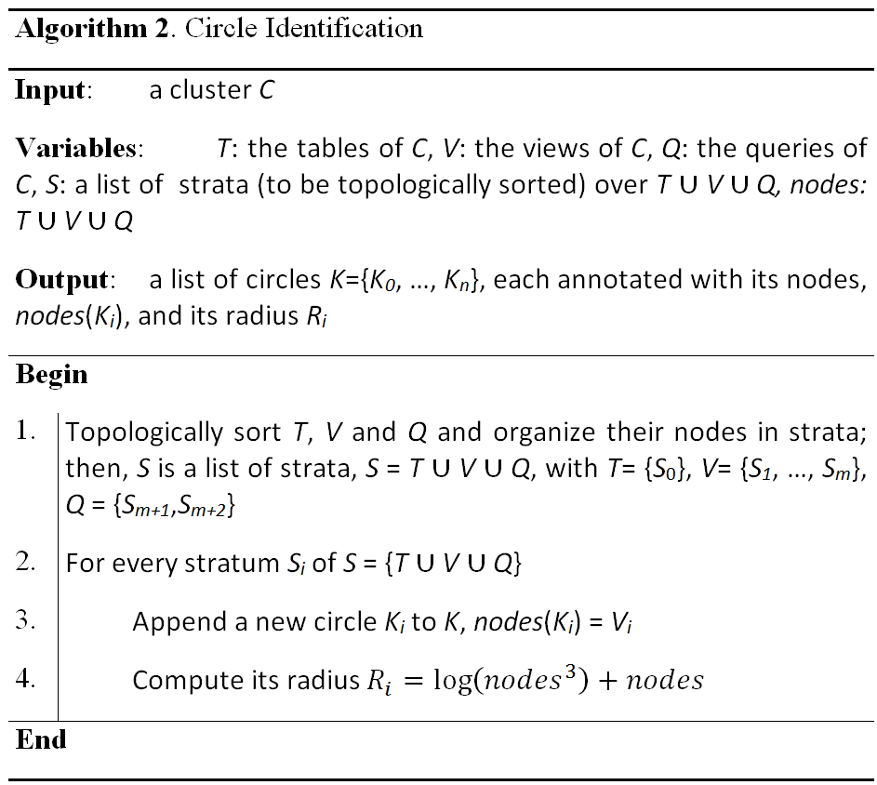
Step 2: Estimate the area of each cluster

Slide 68
Step 3: Laying out the Clusters
3 alternative methods for placing the clusters on a 2D area
Circular placement
  all clusters on a single circle
Concentric circles
  trying to reduce the intermediate empty space
Concentric arcs
  a combination of the previous two methods
Notes:
Circular: in contrast to existing techniques, we allocate different angles and sectors per cluster.
Drupal as an example

Slide 69
Circular cluster layout
We use a single embedding circle to place the clusters.
One sector of the circle per cluster
  with its angle varying on the cluster’s size (#nodes)
  remember: each cluster is also a circle, approximated by its outermost constituent circle of nodes
Steps:
  Compute R, the radius of the embedding circle
  Compute φ_{i}, the angle of each cluster’s sector
  Add some extra whitespace
  Compute the coordinates of all clusters
Notes:
In contrast to the state of the art, we do not use fixed sizes for the sectors of the circle the clusters occupy, but rather, the part of the overall circle that is assigned to each cluster depends on its size (i.e., its number of nodes).

Slide 70
Circular Layout: Embedding
Circle determination
compute R;
compute φ_{i};
whitespace;
coordinates.
Given: the radius r_{i} of each cluster i Compute: R, the radius of the embedding circle.
Method:
approximate the circles periphery (2πR) by the sum of edges of the embedded polygon
divide this sum by 2π to calculate the radius R of the embedding circle
Notes:
We approximate the contour of the inscribed polygon of the circle, computed via the sum of twice the radius of the clusters and then we divide this sum by 2π to calculate the radius R of the embedding circle using equation (3). We approximate the circles periphery, equal to 2πR, by the sum of edges of the embedded polygon.

Slide 71
Circular layout: calculation of the angle for each of the segments
compute R;
compute φ_{i};
whitespace;
coordinates.
Goal: assign each cluster to a segment of the circle depending on the cluster’s radius (size).
Each these segments is defined by an angle φ over the embedding circle.
Not as obvious as it seems – we have to consider two cases:
  The radius ρ of the cluster we want to place is smaller or equal to the radius of the embedding circle R
  The radius ρ of the cluster we want to place is greater than the radius of the embedding circle R

Slide 72
Circular layout: calculation of the angle for each of the segments
compute R;
compute φ_{i};
whitespace;
coordinates.
Typical case, where ρ ≤ R
Consider the left triangle ABO
Then:

Slide 73
In case you are wondering: is it possible that ρ > R ??
R = (1/π) * Σ(ρ_{i})
Assume ρ_{i} ∈ {250, 2, 3, 5} => R = 260 /3.14 = 82.80
Therefore, there is a cluster with larger radius than the surrounding circle…

Slide 74
Circular layout: calculation of the angle for each of the segments
compute R;
compute φ_{i};
whitespace;
coordinates.
A large cluster occurs ρ > R
Assume the isosceles ABO, both AO,BO = R
Then:
due to
Note: cannot avoid to discriminate the two cases
Notes:
Assume the isosceles triangle ABO with O being the center of the circle and A, C the limits of the sector on the periphery of the circle. BO is the dichotomous of the angle of a sector AOC and also BO is equal to the radius of our circle, so we have constructed the isosceles triangle AOB and using the law of cosines (cosφ=(b^2+c^2-a^2)/2bc) with OA as c, OB as b and AB (which is equal to the radius of the cluster we wish to place) as a, we can calculate via the equation described above
It is noteworthy, that we cannot avoid discriminating the aforementioned two cases: when ρ < R, if we use the formula with the law of cosines, the line OA of Fig. 8 would not be a tangent line and would actually cut through the disk of the cluster. As already mentioned, in the case of ρ ≥ R, we cannot produce sin⁻¹ for values higher than 1.

Slide 75
Circular layout: avoid cluster overlap!
compute R;
compute φ_{i};
whitespace;
coordinates.
original layout
We introduce a white space factor w that enlarges the radius R of the circle
Each cluster is approx. by a circle, with
  radius r (known from step #1)
  center [c_{x}, c_{y}] determined by φ, R, and w.
extra whitespace

Slide 76
Circular Layout
Drupal
bioSQL
ZenCart
OpenCart

Slide 77
Concentric Circles Layout
Each circle is split in fragments of powers of 2
  as the order of the introduced circle increases, the number of fragments increases too (S = 2^{k}),
  with the exception of the outermost circle hosting the remaining clusters
This way, we can place
  the small clusters on the inner circles, and
  bigger clusters (occupying more space) on outer circles

Slide 78
Concentric Circles Layout
Method:
Sort clusters by ascending size in a list L^{C}
While there are clusters not placed in circles
  Add a new circle and divide it in as many segments as S = 2^{k} with k being the order of the circle (i.e., the first circle has 2¹ segments, the second 2² and so on)
  Assign the next S fragments from the list L^{C} to the current circle and compute its radius according to this assignment
  Add the circle to a list L of circles
Draw the circles from the most inward (i.e., from the circle with the least segments) to the outermost by following the list L.

Slide 79
Concentric Circles Layout
Method:
Sort clusters by ascending size in a list L^{C}
While there are clusters not placed in circles
  Add a new circle and divide it in as many segments as S = 2^{k} with k being the order of the circle (i.e., the first circle has 2¹ segments, the second 2² and so on)
  Assign the next S fragments from the list L^{C} to the current circle and compute its radius according to this assignment
  Add the circle to a list L of circles
Draw the circles from the most inward (i.e., from the circle with the least segments) to the outermost by following the list L.
Main challenge

Slide 80
Concentric Circles: radius calculation
Instead of having to deal with just one circle, we need to compute the radius for each of the concentric circles, in a way that clusters do not overlap
Overlap can be the result of two problems:
  clusters of subsequent circles have radii big enough, so that they meet, or,
  clusters on the same circle are big enough to intersect.

Slide 81
Concentric Circles: radius calculation to avoid cluster overlap in subsequent circles
R(K_{i}) = R(K_{i-1}) + R_{max}(C_{Ki-1})+R_{max}(C_{Ki})
We need to make sure that the radius of a circle K_{i} is larger than the sum of
the radius of its previous circle K_{i-1},
the radius of its larger cluster R_{max}(C_{ki-1}) on the previous circle,
the radius of the larger cluster of the current circle R_{max}(C_{ki}).
Notes:
To avoid the overlap of clusters in subsequent circles (i.e., circles must have radii big enough), we need to make sure that the radius of a circle K_{i} is larger than the sum of (i) the radius of its previous circle K_{i-1}, (ii) the radius of its larger cluster R_{max}(C_{ki-1}) on the previous circle, and (iii) the radius of the larger cluster of the current circle R_{max}(C_{ki}).
In this figure, we depict the first condition we need to be satisfied (i.e. clusters of subsequent circles have radii big enough, so that they do not overlap). In this case we consider the worst scenario: We want to place on circle K_{i} a cluster C_{ki}, which happens to be the biggest cluster on K_{i} thus it’s radius is R_{max}(C_{ki}) and on the previous circle K_{i-1} in layer adjacent position, there is also the biggest cluster of circle K_{i-1} with radius R_{max}(C_{ki-1}). In this case to avoid overlaps we need to make sure that the radius R_{i} of circle K_{i} is not smaller than the sum of the radii R_{i-1} and R_{max}(C_{ki}) and R_{max}(C_{ki-1}).

Slide 82
Concentric Circles: radius calculation to avoid cluster overlap in the same circle
To avoid the overlap of clusters on the same circle, we compute R_{i} via the encompassing circle’s periphery (2πR_{i}) that can be approximated as the periphery of the inscribed polygon (sum of twice the radii of the circle’s clusters)

Slide 83
Concentric Circles: radius calculation for each circle
Finally, to calculate the radius of a circle:
  we take the maximum of the two values of the two aforementioned solutions and
  we use an additional whitespace factor w to enlarge it slightly (typically, we use a fixed value of 1.2 for w).
Clusters of the same circle have equal segments with an angle:
where n: the number of clusters on circle K_{i}
Notes:
To avoid the overlapping of clusters and to apply white space as visual border to distinguish clusters easily

Slide 84
Concentric circles
Drupal
bioSQL
ZenCart
OpenCart

Slide 85
Concentric Arcs Layout
To attain better space utilization, we can place the clusters in a set of concentric arcs, instead of concentric circles.
  the small clusters are placed in the upper left corner
  there is less whitespace devoted to guard against cluster intersection

Slide 86
Concentric Arcs Layout
Just like concentric circles:
  we deploy the clusters on concentric arcs A_{i} of size π/2
  we place 2^{i} clusters on the i^{th} arc
  to avoid cluster overlaps we use exactly the same radius optimization technique we used before.
Unlike the concentric circles,
  the partition assigned to each cluster is proportionate to its size (as in the case of the single circle), again taking care to avoid overlaps

Slide 87
Concentric arcs
Drupal
bioSQL
ZenCart
OpenCart

Slide 88
Step 4: arrangement of nodes within the circular clusters
Remember: 4 bands of circles to place nodes

Slide 89
Step 4: arrangement of nodes within the circular clusters
We want to follow a barycenter based method, which can work successfully for layered drawings
The standard barycenter method works with linear layers with the principle that once you have laid out layer i, you can lay out layer i+1 wrt the previous one
  … practically placing nodes in the barycenter of their neighbors in the previous layer i
Here, we have two challenges:
  adapt this to our radial, concentric circles
  decide the initial order of the process (here: relations in the inner circle)

Slide 90
Step 4: arrangement of nodes within the circular clusters
order R;
place R & Q_{R};
place V & Q-Q_{R}.
Order the relations
  Count the frequency of each combination of tables as hit by the queries
  Place tables in popular combinations sequentially
Decide the position of relations and relation-dedicated queries
  Locate relation dedicated queries, decide the arc they need and position them sequentially
  Place relation in the middle of this arc
Decide the position of the rest of the queries and the views
  Stratify views and queries – each stratum has a dedicated circle
  Place views and queries via a barycenter method on their angle
  Adjust overlapping nodes (e.g., queries hitting exactly the same tables)

Slide 91
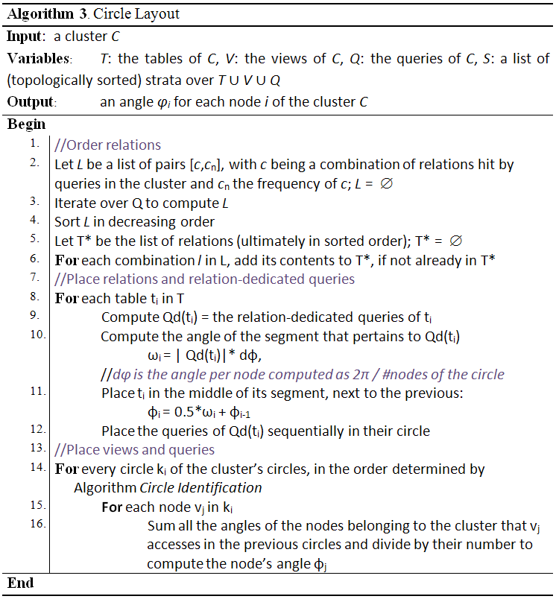

Slide 92
Step 4: arrangement of nodes within the circular clusters
order R;
place R & Q_{R};
place V & Q-Q_{R}.
Greedy arrangement that places sequentially tables in frequent combinations (as they appear in the FROM clause of queries)
Assume L= {{T4, T3}, {T1, T5}, {T1, T2, T3}} in decreasing order of frequency.
Then, the final order of the relations will be {T4, T3, T1, T5, T2}

Slide 93
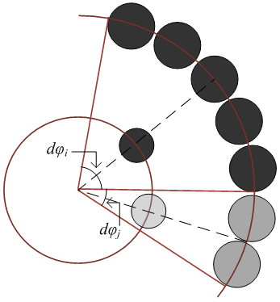
Step 4: arrangement of nodes within the circular clusters
order R;
place R & Q_{R};
place V & Q-Q_{R}.
Place relation-dedicated queries (accessing only one table) sequentially
The segment for each relation-dedicated query is the same, proportional to the #nodes of the circle (#relation-dedicated queries)
The relation is placed in the middle of the corresponding segment

Slide 94
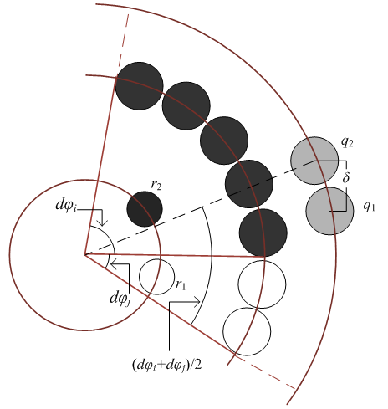
Step 4: arrangement of nodes within the circular clusters
order R;
place R & Q_{R};
place V & Q-Q_{R}.
We have stratified views and the rest of the queries in step 2.
Visit each circle (stratum) in turn: each node of circle k_{i} is defined over nodes in the previous circles
Traditional barycenter-based method: place the node in an angle = avg. value of the sum of the angles of the nodes it accessed
Rearrange nodes in occupied positions by a very small value δ (in our case δ=0.09 radians).
Notes:
we depict the following case: We need to place queries q₁ and q₂ and both of them reference the relation nodes r₁ and r₂. To decide their position we sum the angles dφ_{i} and dφ_{j}, r₁ and r₂ use and place q₁ on the corresponding circle with angle (dφ_{i} + dφ_{j}) / 2. Then we need to place query q₂ and since it is the second query that references both relations r₁ and r₂, we place it on the corresponding circle with angle (dφ_{i} + dφ_{j}) / 2 + δ to avoid overlap with query q₁.

Slide 95
Experiments and Results

Slide 96
Experimental method
4 data sets: well-known open source projects that contain database queries
The source code of the last version of each tool was downloaded. We retrieved the database definition from the source code.
We grepped the source code for the occurrences of SELECT and FROM terms in it, and out of the resulting text, we isolated lines actually encompassing queries.
The actual queries were automatically isolated via a dedicated java application we constructed for this purpose
Finally, they were post-processed in order to be parsable by our tool, Hecataeus that ultimately converts the ecosystem to an architecture graph and visualizes it for the user.

Slide 97
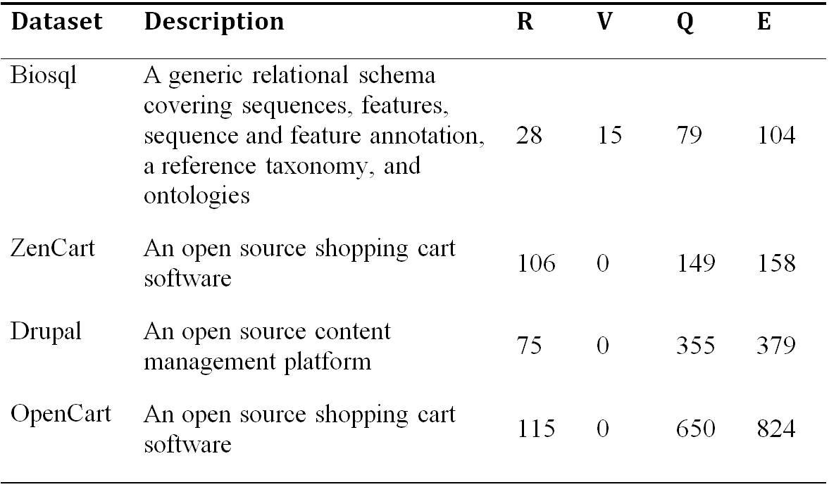
Data sets

Slide 98
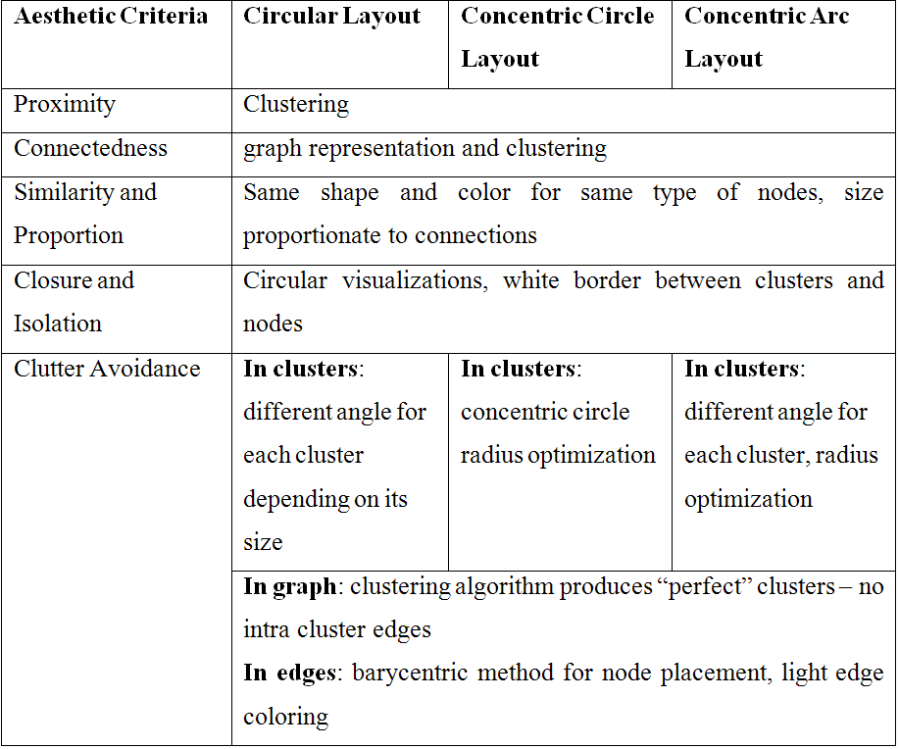
Compliance to aesthetic criteria

Slide 99
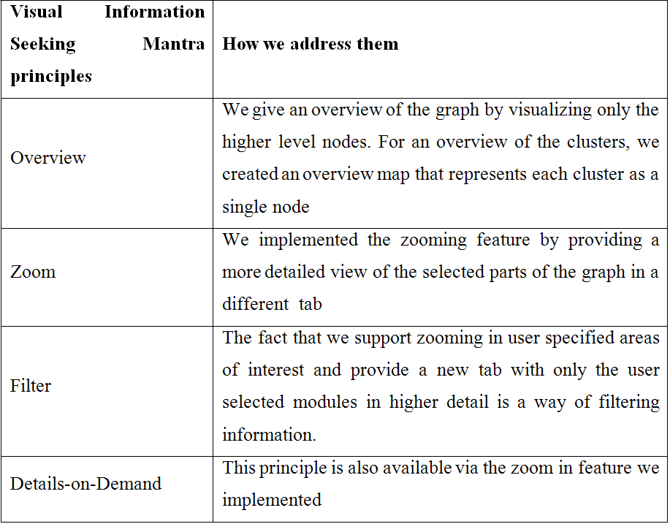
Compliance to the Visual Information Seeking Mantra

Slide 100
Clustering effectiveness
Clean separation of clusters in all cases!
However, this can be due to the nature of the ecosystems – must not hurry to generalize
In all cases, 20 – 60 clusters
  We find this reasonable for a 2D screen canvas
Data set | # clusters | # nodes | Avg nodes/cluster
BioSql | 22 | 112 | 5,55
ZenCart | 41 | 255 | 4,8
Drupal | 37 | 429 | 11
OpenCart | 59 | 765 | 12,9

Slide 101
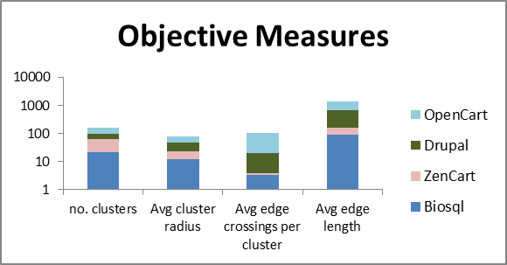
Method independent measures for all data sets

Slide 102
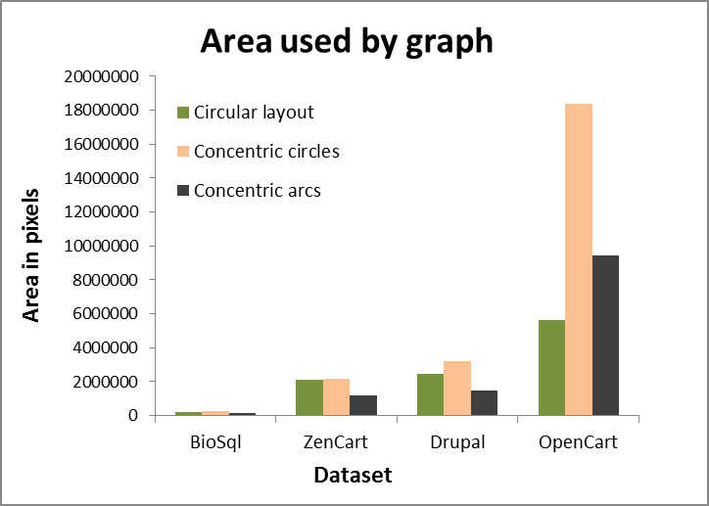
Area occupied by the graph: no clear winner

Slide 103
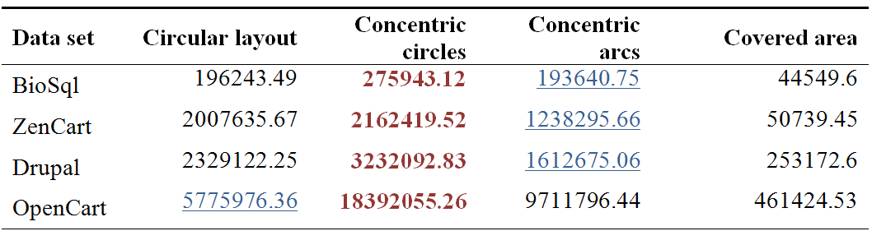
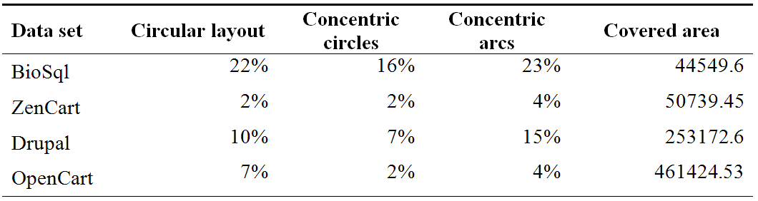
Area occupied by the produced graph (absolute and pct over MBR)

Slide 104
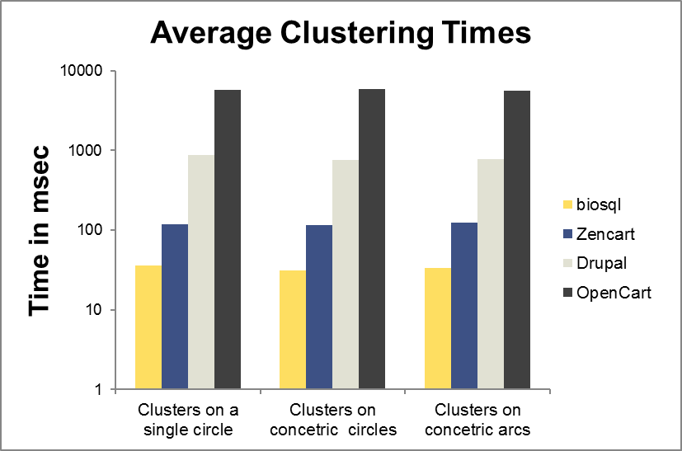
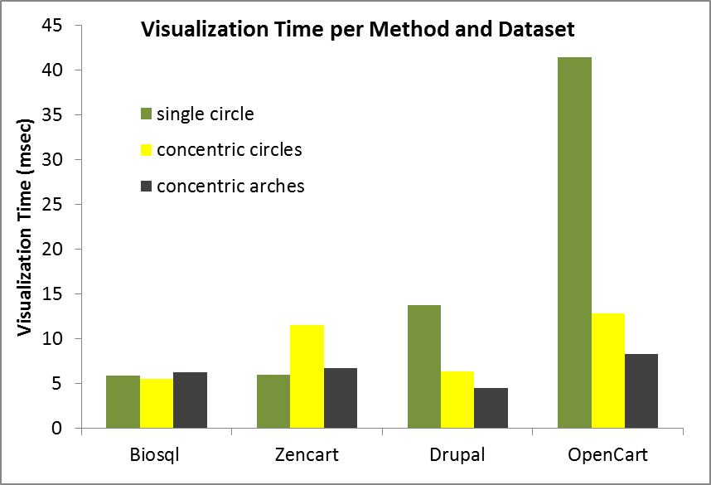
Time considerations

Slide 105
Any other useful slides

Slide 106
Future work
Ongoing:
  Still experimenting with coloring schemes
Open:
  Alternative visualization methods
  Other types/cases of ecosystems
  Forward engineering
  Incorporate full range of “entities” / “concepts” (actors, roles, …) to make it really an “ecosystem”…

Slide 107
Alternative methods provided by Jung
A simple Circular Layout that places vertices randomly on a circle
The Fruchterman-Reingold algorithm [FrRe91]
Meyer's "Self-Organizing Map" layout [Meye98]
The Kamada-Kawai algorithm [KaKa89]
A simple force-directed spring-embeder [dETT99]

Slide 108
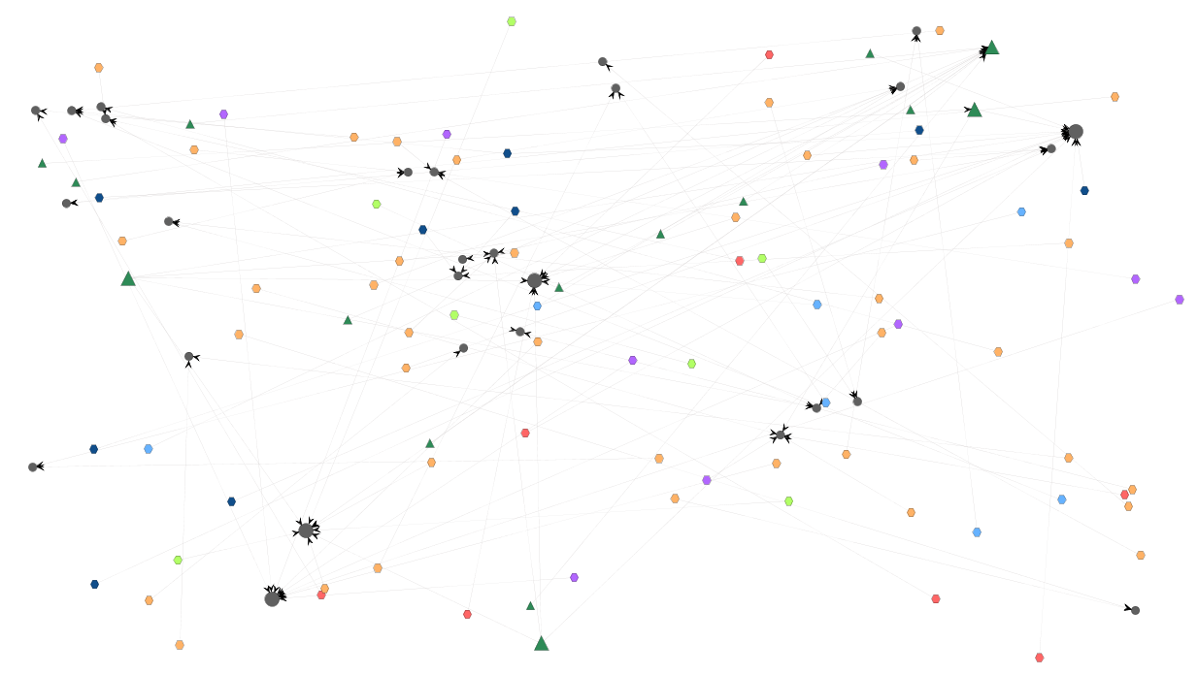
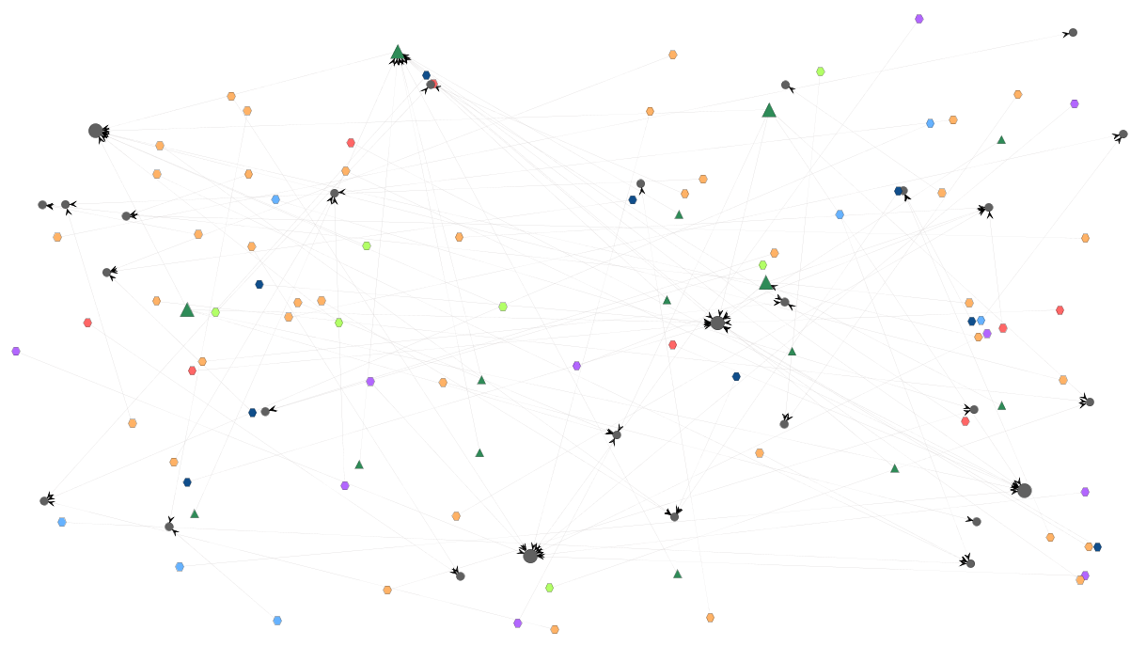
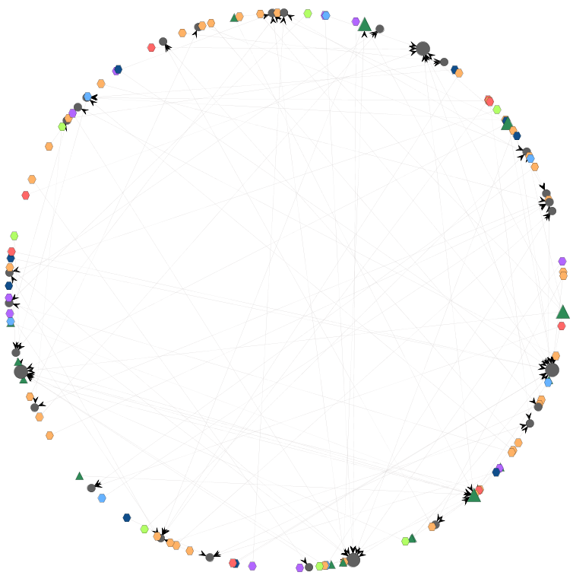
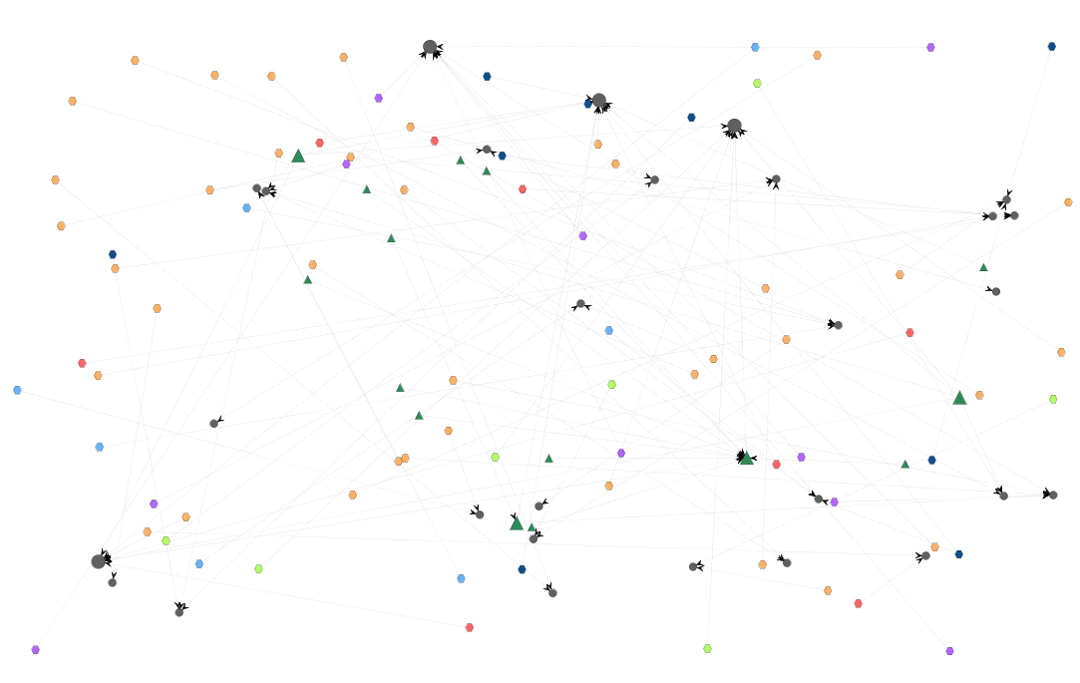
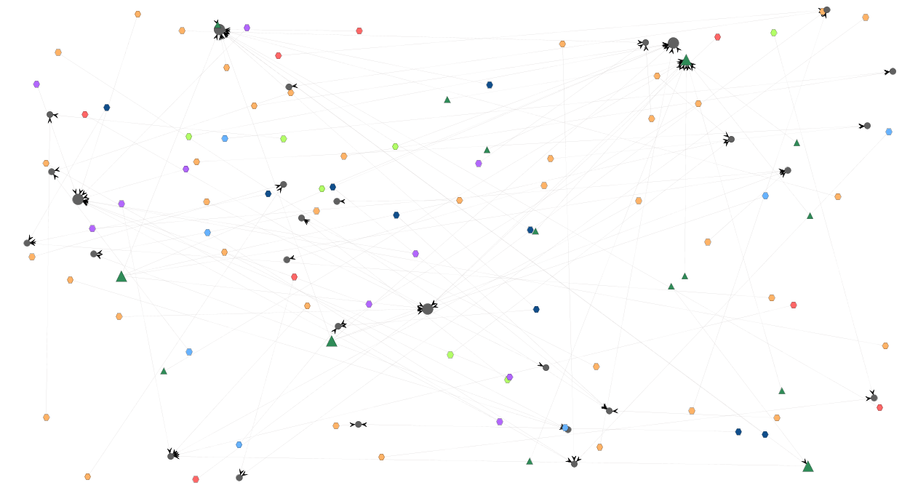
Alternative methods provided by Jung
Biosql visualized by Jung’s built –in’s
Fruchterman-Reingold
Meyer
Random Circular
Kamada-Kawai
Force-directed springs

Slide 109
Tales of glory
A short story executed over one of the latest v. of Hecataeus

Slide 110
Circular placement

Slide 111
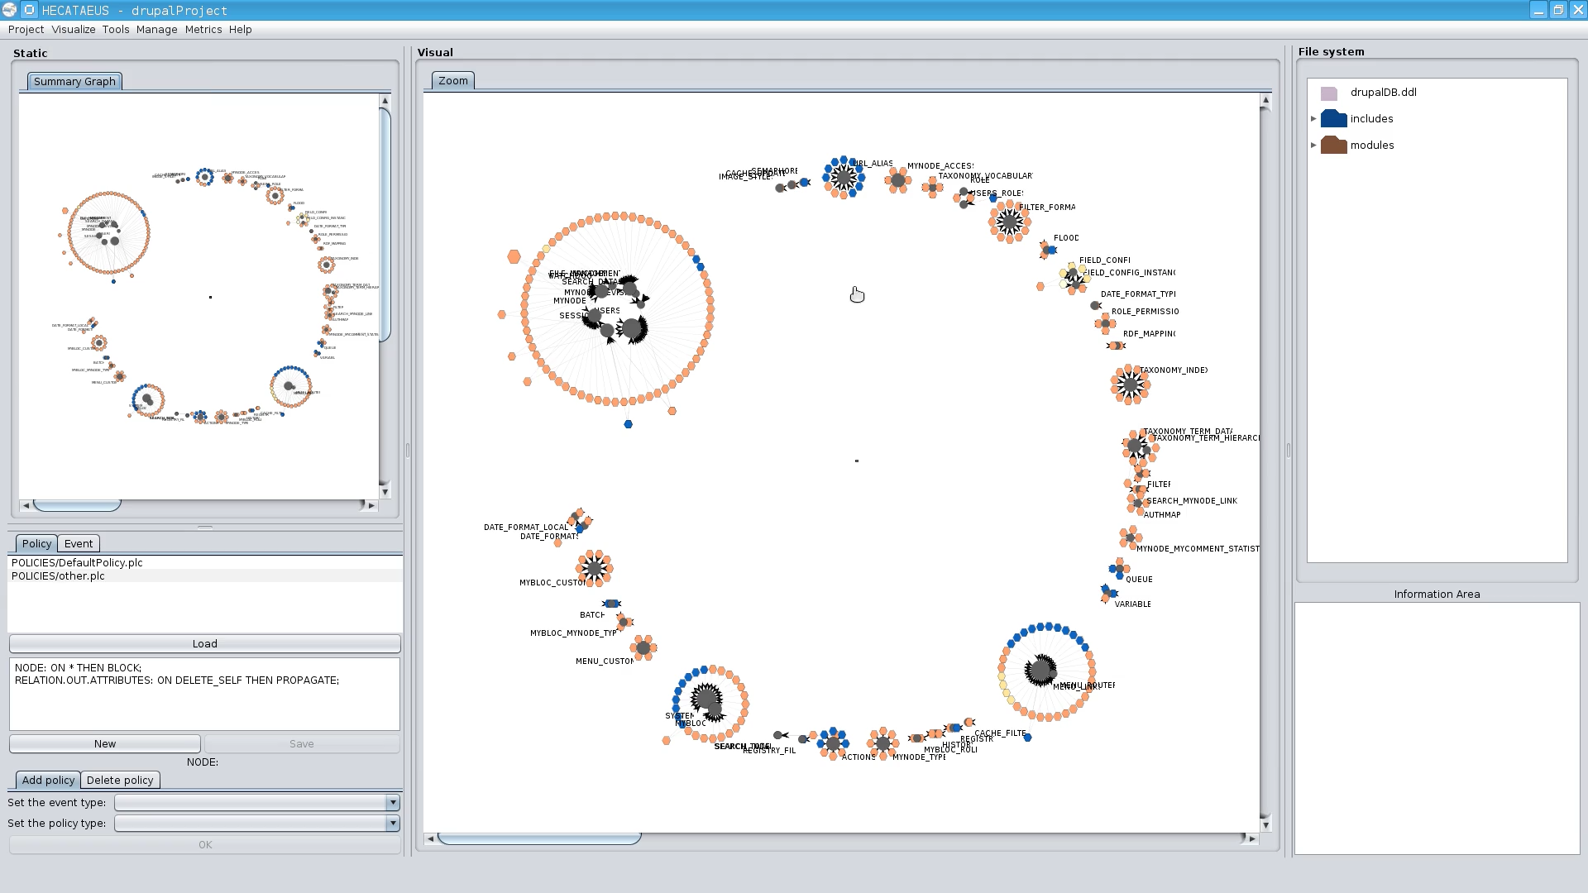
Labels on/off

Slide 112
What happens if I modify table search_index? Who are the neighbors?

Slide 113
What happens if I modify table search_index? Who are the neighbors?
Tooltips with info on the script & query

Slide 114
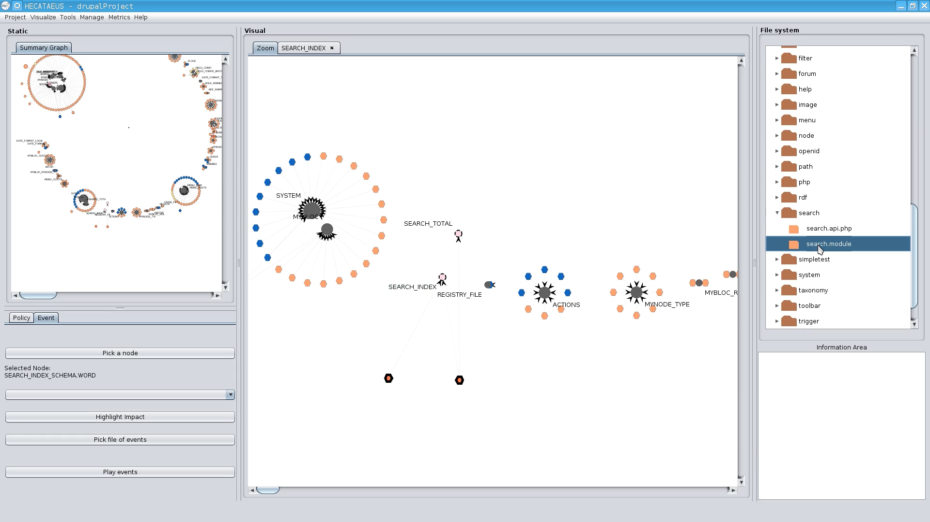
In the file structure too…

Slide 115
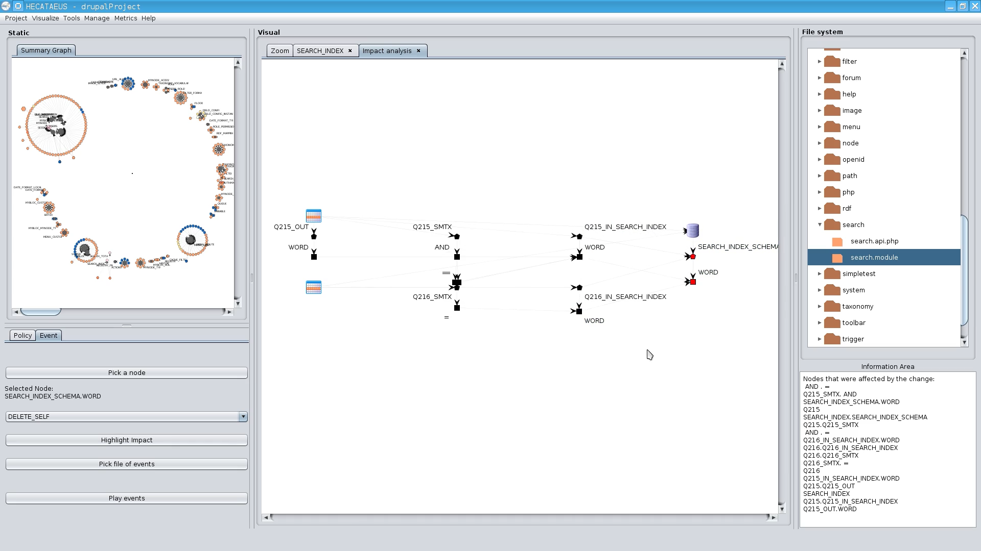
Played an impact analysis scenario: delete attr. ‘word’ from search_index
1. The table allowed the deletion, but…
2. Queries Q215 and Q216 vetoed
See the paper at ER 2013 for the details of impact analysis

Slide 116

… and the impact at the master graph…

Slide 117

Concentric circles

Slide 118

Concentric Arcs

Slide 119

Zooming into a cluster

