Slide 1

Analysis of Schema Evolution for Databases in Open-Source Software
MSc Thesis - Ioannis Skoulis
<iskoulis@cs.uoi.gr>
Department of Computer Science and Engineering
University of Ioannina, Greece
September 2013
Notes:
Τηα σισχετίσουμε τημ εξέλιξη σήματος βάσης με την εξέλιξη λογισμικού.

Slide 2
What is Software Evolution?
Software evolution:
The change of a software system, over the years and releases, from its initial formation to the point it is withdrawn (is no longer used or surpassed by competitive software)
E-type systems:
Software solving a problem or addressing an application in the real-world
Notes:
What is software evolution
What software do we target

Slide 3
What about Schema Evolution?
Databases also have users with requirements
Informational capacity must be raised to keep up with the real world
They are fairly independent from the rest of the software
Schema changes cause inconsistency in application (both syntactic and semantic)
Notes:
REVISIT
- in terms of informational capacity, thus resemble software
- evolutions comes directly from real world, rarely from changes to software around them.

Slide 4
What is the Status in Literature?
Software Evolution
  Theoretical level [Mens04]
  Case studies on proprietary software [LeBr85] (many in the seventies)
  Open Source made things easier [GoTu00], [XiSt05], [WeYL08], [XiCN09]
  Laws on Software Evolution [LeRa03]
Schema Evolution
  Three main case studies [Sjob93], [PVSV12], [CMDZ13]
Notes:
- Mens software refactoring – how we do it right
proprietary can not be confirmed
closed - monitoring
open source - more studies as data are available and can be studied after
kernel, jfreechart, eclipse, (samba, openssh, bind, sendmail, sqlite, vsftpd) < emph on the last
Health management system (closed) – monitored
Statistical information (closed) – authors note dificulty in collectin the data

Slide 5
What is the Problem?
We do not have any lead whatsoever as to why and how evolution takes place in a database
Notes:
Example for syntactic
relation removed causes direct failure in apps
Example for semantic
attribute insertion might add information that is not known and ignored by apps

Slide 6
What do we do about it?
We try to fill the gap in literature as there are no published works on whether the laws of software evolution can be applied on schema evolution.
Large scale study on schema evolution
Collected and processed eight schemas
Report on measures (size, growth, changes)
Study the applicability of the laws on DB
We use concrete measures to do so
Notes:
- open source, publicly available
- also cleansed CMS Med Scientific
- for both relations and attributes
- laws are abstract, we present in tuition on wording of the laws
we also restructure them for better understanding
- we avoid generalization

Slide 7
Roadmap
The Laws of Software Evolution
Experimental Setup
Adapting the Laws for Schema Evolution
Conclusion

Slide 8
Roadmap
The Laws of Software Evolution
Experimental Setup
Adapting the Laws for Schema Evolution
Conclusion

Slide 9
Laws on Software Evolution
Its a set of eight rules on the behavior of software as it evolves
Derived from a study, due to M. Lehman of proprietary software (OS/360)
Almost 40 years of reviewing and evaluation (first three published in 1976)
Have been recognized for their useful insights as to what and why evolves in the lifetime of a software system

Slide 10
Laws on Software Evolution
I. Continuing change
“An E-Type system must be continually adapted or else it becomes progressively less satisfactory.”
II. Increasing Complexity
“As an E-type system is changed its complexity increases and becomes more difficult to evolve unless work is done to maintain or reduce the complexity.”
III. Self Regulation
“Global E-type systems evolution is feedback regulated.”
IV. Conservation of Organizational Stability
“The work rate of an organization evolving an E-type software system tends to be constant over the operational lifetime of that system or phases of that lifetime.”
Notes:
world evolves so must software or it gets less satisfactorydev and maintenance take place
Like second law of thermodynamics (closed systems entropy increase to approach maximum at equilibrium)
2 ανταγωνιστικές διαδικασίες (Ι πρέπει να μεγαλώσει ΙΙ πρέπει να γίνει κάτο με το complexity)

Slide 11
Laws on Software Evolution
V. Conservation of Familiarity
“In general, the incremental growth of E-type systems is constrained by the need to maintain familiarity.”
VI. Continuing Growth
“The functional capacity of E-type systems must be continually enhanced to maintain user satisfaction over system lifetime.”
VII. Declining Quality
“Unless rigorously adapted and evolved to take into account changes in the operational environment, the quality of an E-type system will appear to be declining.”
VIII. Feedback System
“E-type evolution process are multi-level, multi-loop, multi-agent feedback systems.”
Notes:
VI time irrelevant

Slide 12
Roadmap
The Laws of Software Evolution
Experimental Setup
Adapting the Laws for Schema Evolution
Conclusion

Slide 13
Experimental Setup
For each dataset:
We gathered DDL files from public repos
We collected all commits of the database at the time of the trunk/master branch
We ignored all other branches
We ignored commits of other modules of the project
Focused on MySQL
Notes:
We are interested only on changes of the database part of the projects

Slide 14
Hecate: SQL schema diff viewer
Parses DDL files
Creates a model for the parsed SQL elements
Differentiates two version of the same schema
Reports on the diff performed with a variety of metrics
Exports the transitions that occurred in XML format

Slide 15
Datasets
Content management Systems
  MediaWiki, TYPO3, Coppermine, phpBB, OpenCart
Medical Databases
  Ensemble, BioSQL
Scientific
  ATLAS Trigger

Slide 16
Roadmap
The Laws of Software Evolution
Experimental Setup
Adapting the Laws for Schema Evolution
Conclusion

Slide 17
Laws for Schema Evolution
Three main groups for the Laws:
Feedback-based System
  I. Continuing change
  VIII. Feedback System
  III. Self Regulation
Positive feedback
  VI. Continuing Growth
  V. Conservation of Familiarity
  IV. Conservation of Organizational Stability
Negative feedback
  II. Increasing Complexity
  VII. Declining Quality
Notes:
A database schema continuously changes over time (I^{db})
emonstrating a behavior that appears to obey a complex feedback-based evolution process (VIII^{db})
αntagonism of positive feedback, requesting adaption and growth and negative feedback requesting control over change and code quality.
The process is typically guided by a pattern of growth that demonstrates its self-regulating nature, including a
smooth growth interrupted with versions dedicated to perfective maintenance (negative feedback)
-to calibrate the tendency for uncontrolled growth of the system’s size and complexity (III^{db}).
In the long term, we observe an increasing size (information capacity)-- in terms of relations and attributes-- of the database schema (VI^{db})
produced by a growth rate that is slowly declining (V^{db}).
The effort consumed for the above process is typically constant over phases, with the phases disrupted with burst of effort from time to time (IV^{db}).
To regulate the ever-increasing growth, there is negative feedback in the system controlling both the overall quality of the schema (VII^{db}), with particular emphasis to its internal quality (II^{db}).

Slide 18
I. Continuing change
“The database schema is continually adapted.”
Evaluation: The Database must shows signs of evolution as time passes
Metrics: heartbeat of changes over time and version
Notes:
I. world evolves so must software or it gets less satisfactory

Slide 19
Change over time
Notes:
Partialy holds

Slide 20
Change over version
Notes:
Partialy holds

Slide 21
I. Continuing change
Databases do change but not continuously
Notes:
I. world evolves so must software or it gets less satisfactory

Slide 22
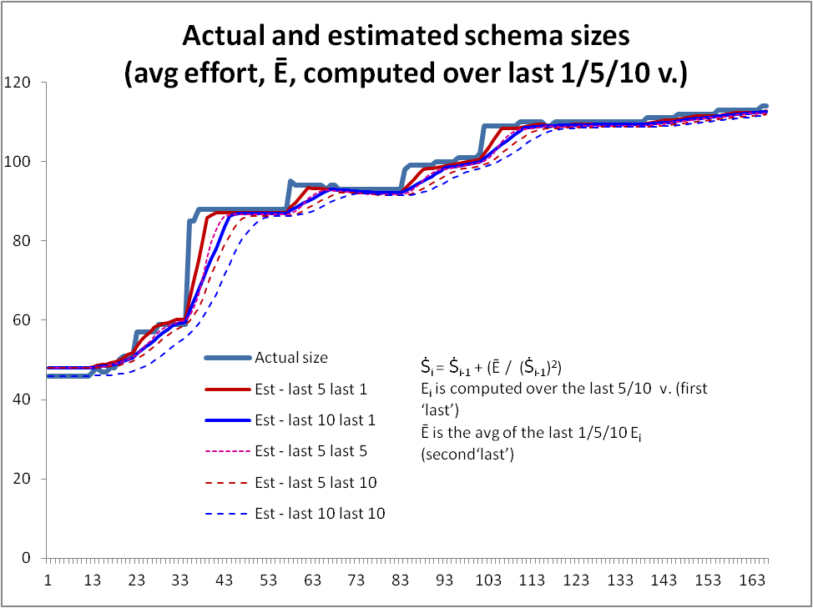
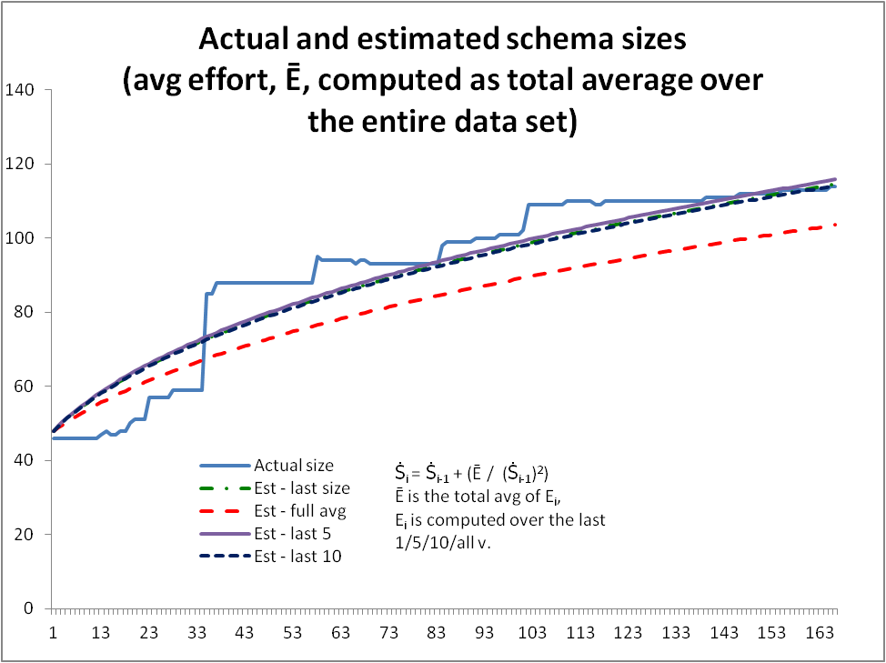
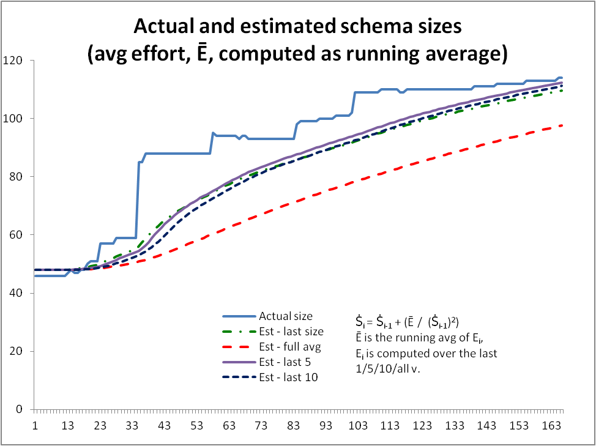
VIII. Feedback System
“Database schema evolution processes are multi-level, multi-loop, multi-agent feedback systems.”
Evaluation: Regression analysis to the estimate size of the database schemata
Metrics: estimated size , effort

Slide 23
Estimated Size
Notes:
Last 5 last 1
last 10 last 1

Slide 24
VIII. Feedback System
The regression formula for the estimation of size holds
Notes:
As far as the formula is concerned

Slide 25
III. Self Regulation
“Database schema evolution is feedback regulated.”
Evaluation: i) indication of patterns in size growth, ii) existence of negative feedback (drop in size and growth locally decreasing), iii) “ripples” in growth
Metrics: size over version, system growth
Notes:
Schema gwors in phases
Each with smooth growth
Each with shriking versions to calibrate long ones

Slide 26
Schema Size (relations)
Notes:
We see drops
sudden shift
take place in short periods
In all we see increase especially at the beginning or after large drops (positive feedback)
overall trend is increase
In all we have periods of stability

Slide 27
Schema Growth
Notes:
Small for relations
Too many occurrences of zero growth
no periods of continuous change but we have small spikes
Immediate + delta is followed with immediate - delta
Oscillations much more on + axis
we cannot see patterns of smooth growth interrupted by perfective maintenance

Slide 28
III. Self Regulation
We see sudden drops
In all we see increase especially at the beginning or after large drops (positive feedback)
Overall databases increase
In all we have periods of stability
Too many occurrences of zero growth
No periods of continuous change but we have small spikes
Immediate positive growth is followed with immediate negative growth or stability
Oscillations exist in growth
We cannot see patterns of smooth growth interrupted by perfective maintenance
Notes:
As far as the formula is concerned

Slide 29
Laws for Schema Evolution
Three main groups for the Laws:
Feedback-based System
  I. Continuing Change
  VIII. Feedback System
  III. Self Regulation
Positive feedback
  VI. Continuing Growth
  V. Conservation of Familiarity
  IV. Conservation of Organizational Stability
Negative feedback
  II. Increasing Complexity
  VII. Declining Quality

Slide 30
VI. Continuing Growth
“The informational capacity of databases must be continually enhanced to maintain user satisfaction over system lifetime.”
Evaluation: Overall expansion trend for the metrics involved
Metrics: number of relations, number of attributes
Notes:
Phases:
Stability (unique for databases Lehman never mentioned them)
smooth expansion
Abrupt change
We collect only schema related stuff
the other code is changes in the meantime
holds

Slide 31
VI. Continuing Growth
Phases:
Stability (unique for databases)
Smooth expansion
Abrupt change
Notes:
Phases:
Stability (unique for databases Lehman never mentioned them)
smooth expansion
Abrupt change
We collect only schema related stuff
the other code is changes in the meantime
holds

Slide 32
V. Conservation of Familiarity
“In general, the incremental growth of database schema is constrained by the need to maintain familiarity.”
Evaluation: i) growth is constant or declining, ii) version with significant change in size are followed by small growth
Metrics: schema growth, schema growth rate

Slide 33
Schema Growth
Notes:
No diminishing in values
reduction in density – drops the overall average value

Slide 34
Schema Size (relations)
Notes:
Change is frequent in the beginning
large changes and dense periods in any time
No expansion of growth
We covered intuitions but is this ok?
What about patterns

Slide 35
V. Conservation of Familiarity
No deminishing in growth trend
  Drop is due to density
Change is frequent in the beginning
Large changes and dense periods in any time
No expansion of growth
We covered intuitions but is this ok?

Slide 36
V. Conservation of Familiarity
The growth reacts as expected but is it because of the need to maintain familiarity?
In Databases there are other reason that might constrain growth:
Other modules are higly depentent on them
Effort might be taken to clean and organize a database

Slide 37
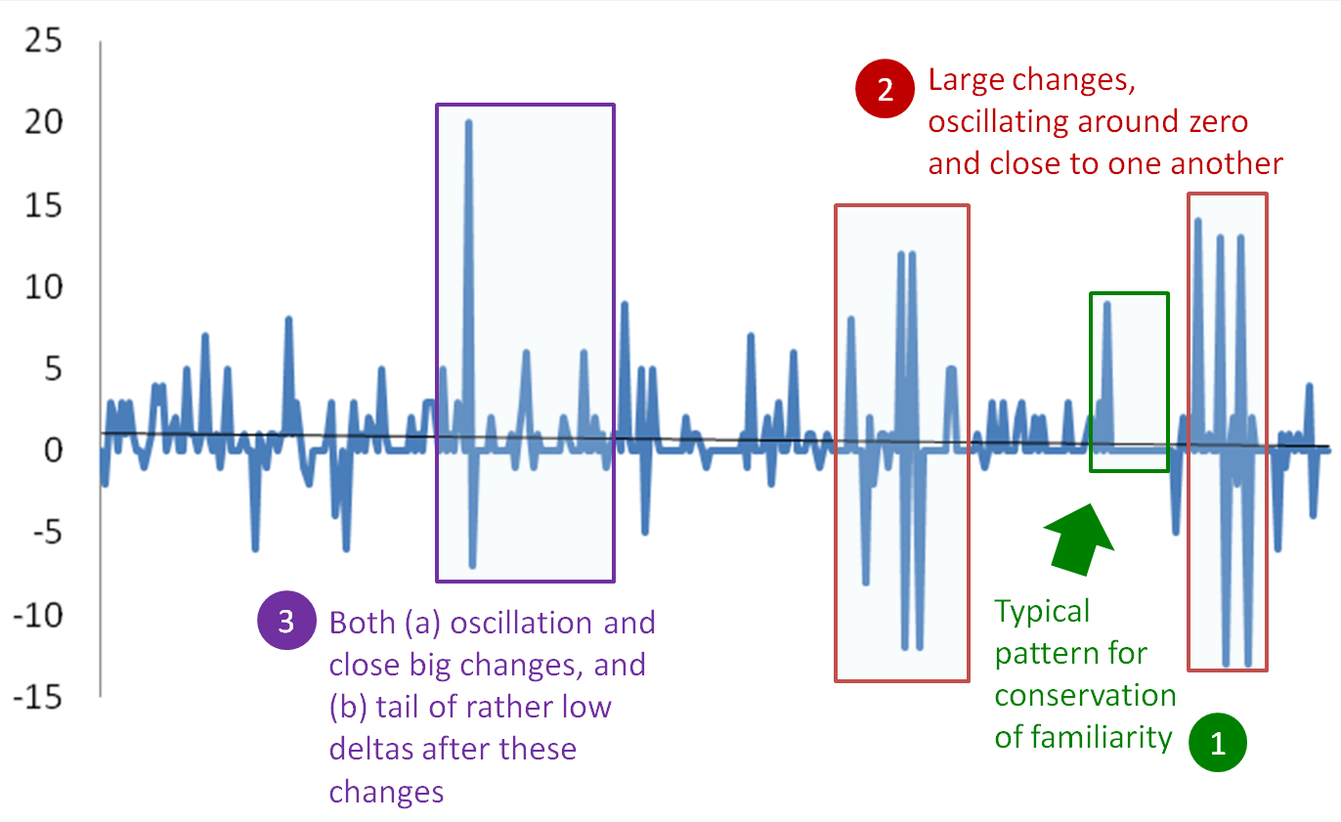
V. Conservation of Familiarity
Notes:
Patterns do exist so indicating the law

Slide 38
IV. Conservation of Organizational Stability
“The work rate of an organization evolving a database schema tends to be constant over the operational lifetime of that schema or phases of that lifetime.”
Evaluation: i) detect phases with constant growth, ii) those phases must be connected with abrupt changes
Metrics: schema growth
Notes:
Bounded in small values
Almost all numbers are between [-2,2] or [0,2]
Few changes

Slide 39
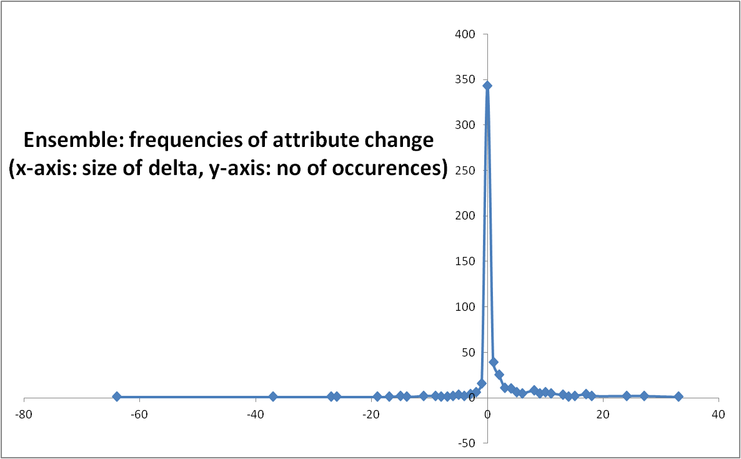
IV. Conservation of Organizational Stability

Slide 40
IV. Conservation of Organizational Stability
Growth is bounded in small values
Almost all numbers are between [-2,2] or [0,2]
Few changes
Overdominant zero values

Slide 41
Laws for Schema Evolution
Three main groups for the Laws:
Feedback-based System
  I. Continuing Change
  VIII. Feedback System
  III. Self Regulation
Positive feedback
  VI. Continuing Growth
  V. Conservation of Familiarity
  IV. Conservation of Organizational Stability
Negative feedback
  II. Increasing Complexity
  VII. Declining Quality

Slide 42
II. Increasing Complexity
“Efforts to maintain internal quality must be made.”
Evaluation: i) We must identify version with perfective maintenance, ii) the VIII law must hold, iii) the approximate complexity must increase
Metrics:
Notes:
Feedback holds so we expect perfective maintenance maintenace

Slide 43
Complexity
Notes:
It is dropping rather than rising
Changes also decline in density over time so complexity declines maintenance becomes easier
Confidence?
Complexity is estimates

Slide 44
Maintenance Rate

Slide 45
II. Increasing Complexity
Complexity is dropping rather than rising
Changes also decline in density over time so complexity declines
Maintenance becomes easier
Complexity is estimates

Slide 46
VII. Declining Quality
“Unless rigorously adapted and evolved to take into account changes in the operational environment, the quality of a database schema will appear to be declining.”
Evaluation: Hold by logical induction, if III, VIII, and II hold
Metrics: not possible to measure external quality
We are unsure of the behavior of internal quality so we are even more reluctant towards declaring external quality as improving.

Slide 47
Laws for Schema Evolution
Three main groups for the Laws:
Feedback-based System
  I. Continuing Change
  VIII. Feedback System
  III. Self Regulation
Positive feedback
  VI. Continuing Growth
  V. Conservation of Familiarity
  IV. Conservation of Organizational Stability
Negative feedback
  II. Increasing Complexity
  VII. Declining Quality
?

Slide 48
Roadmap
The Laws of Software Evolution
Experimental Setup
Adapting the Laws for Schema Evolution
Conclusion

Slide 49
Conclusions
High degree of certainty
    Databases do not grow continuously
    Changes reduce in density as databases age
    The size grows overall
    Regressive formula holds
    Growth is smaller than typical software
    Schema changes follows Zipf’s law
    Average growth is close to zero
Notes:
Divide findings in two categories
-High Certain
-need further work
We avoid the term law – don’t have unshakable evidence of their existence

Slide 50
Conclusions
Requiring further insight
    Change frequently follows spike patterns
    Change follows three patterns
      Stillness
      Abrupt change
      Smooth growth
    Large changes sequenced one after the other
    Age reduces complexity

Slide 51
Future Work
Time related measures
  We have occasions were effort is high or low
  We need better measures of change over time (patterns)
Detection of “abrupt change”
  Splitting of a lifetime in phases
  Compute running averages over fixed version
Identifying Perfecting Maintenance
  Capture renames
Notes:
-
And definition
-we automate stuff so we speculate
we only consider drops
uncertainty but much better

Slide 52
Future Work
Complexity
  We lack a representative set of metrics that measure the complexity of a database schema
  Structural complexity may involve:
    Number of foreign keys of the relational schema
    Number of relationships of the conceptual schema
  Measuring relations that are semantically related to each other
More datasets
Notes:
Don’t have data
Cms’s target speed

Slide 53
Reaching the End...
Questions ?

