Slide 1

Automating the adaptation of evolving data-intensive ecosystems
Petros Manousis, Panos Vassiliadis
University of Ioannina, Ioannina, Greece
George Papastefanatos
Research Center “Athena” \ IMIS, Athens, Greece
32nd International ER International Conference on Conceptual Modeling (ER 2013)
Hong Kong, 11-13, November, 2013.

Slide 2
Software Evolution and Data-intensive Ecosystems
Software evolution causes at least as much as 60% of the costs for the entire software lifecycle
Data-intensive ecosystems are no exception:
  DBA View: Databases change their internal structure, schema and semantics, due to changes on reqs.
  Application View: Users / Applications change their view on collected data (e.g., reports, workflows).
  DBA and development teams do not sync well all the time

Slide 3
Software Evolution and Data-intensive Ecosystems
Software evolution causes at least as much as 60% of the costs for the entire software lifecycle
Data-intensive ecosystems are no exception:
  DBA View: Databases change their internal structure, schema and semantics, due to changes on reqs.
  Application View: Users / Applications change their view on collected data (e.g., reports, workflows).
  DBA and development teams do not sync well all the time
Smooth evolution
Achieve ecosystem evolution without impacting the smooth operation or the semantic consistency of its components

Slide 4
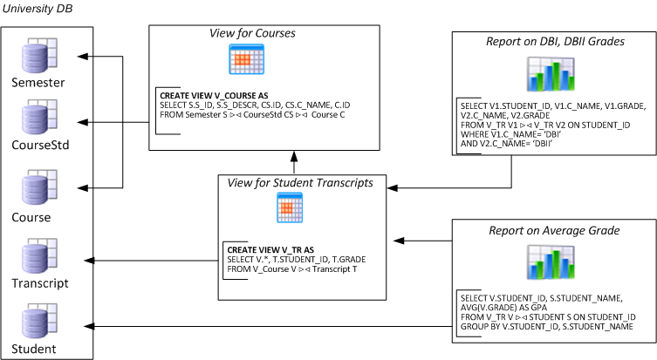
Evolving data-intensive ecosystem

Slide 5
Evolving data-intensive ecosystem
Remove CS.C_NAME
Add exam year

Slide 6
Evolving data-intensive ecosystem
Remove CS.C_NAME
Syntactically invalid
Add exam year
The impact can be syntactical (causing crashes)

Slide 7
Evolving data-intensive ecosystem
Remove CS.C_NAME
Syntactically invalid
Semantically unclear
Add exam year
The impact can be syntactical (causing crashes), semantic (causing info loss or inconsistencies) and related to the performance

Slide 8
Evolving data-intensive ecosystem
Remove CS.C_NAME
Add exam year
Which parts are affected and how?

Slide 9
Evolving data-intensive ecosystem
Remove CS.C_NAME
Block Deletion
Allow addition
Add exam year
Can we predetermine their reaction?

Slide 10
Overview of solution
Architecture Graphs: graph with the dependencies between data modules (i.e., relations, views or queries); module internals are also modeled as subgraphs of the Architecture Graph
Evolution Events: Changes on data modules definition
Policies: rules that annotate a module with a reaction for each possible event that it can withstand, in one of two possible modes:
  (a) block, to veto the event and demand that the module retains its previous structure and semantics, or,
  (b) propagate, to allow the event and adapt the module to a new internal structure.
Given a potential change in the ecosystem
  we identify which parts of the ecosystem are affected via a “change propagation” algorithm
  we rewrite the ecosystem to reflect the new version in the parts that are affected and do not veto the change via a rewriting algorithm
    we resolve conflicts (different modules dictate conflicting reactions) via a conflict resolution algorithm

Slide 11
Background
Ecosystem model, event propagation and policies

Slide 12
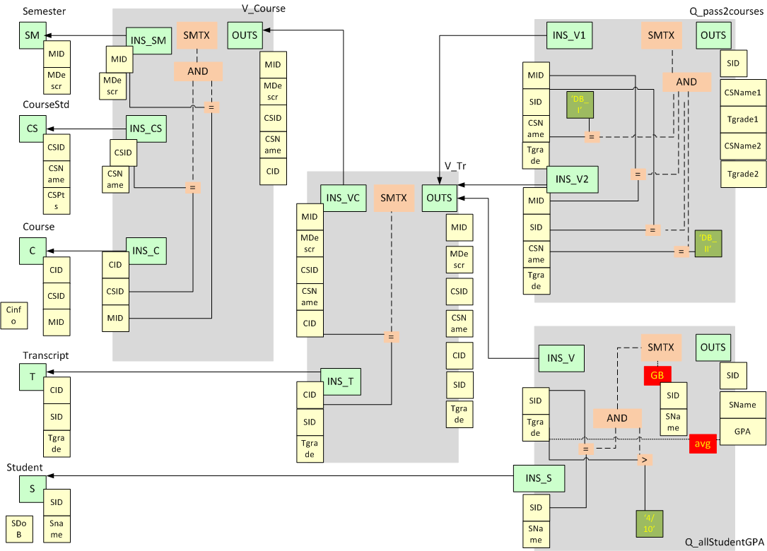
University E/S Architecture Graph
Notes:
Our ecosystem is described by the following image:
On the left we can see the Relations and their Attributes. On their right we see V_Course view where we use 3 of the relations. The V_Course view provides with Attributes the V_Tr view. The V_Tr view besides the V_Course view has as input the Transcript relation. Finally we can see on the upper most right part of the image the query that compares the grades of the students in DB_I & DB_II courses, and in the lower right part we see the query that gives the average grade of the students.
12

Slide 13
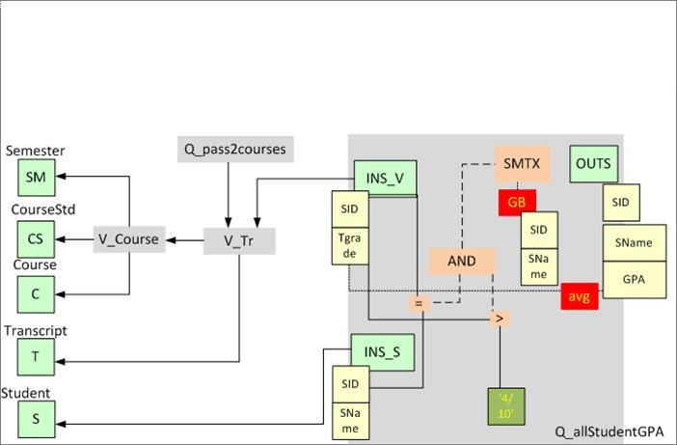
DB constructs→ Graph Modules
Modules and Module Encapsulation
Input part
Output part
Semantics part
SELECT V.STUDENT_ID, S.STUDENT_NAME,
AVG(V.TGRADE) AS GPA
FROM V_TR V |><| STUDENT S ON STUDENT_ID
WHERE V.TGRADE > 4 / 10
GROUP BY V.STUDENT_ID, S.STUDENT_NAME
Notes:
A graph that describes the core parts of the ecosystem. We observe a query that gives the average grade of the courses that the students have attended and passed of our university ecosystem. The INS parts of the modules are the parts that are connected with provider modules. The OUTS part is the one that provides the answer to the users. Finally the SMTX part which represents the filters that the user wants to apply on the information (for example tgrade > 4/10).
13

Slide 14
DB Changes → Graph events
Remove CS.C_NAME
Add exam year
Notes:
14

Slide 15
Annotation with Policies
On attribute deletion Then block
On attribute addition Then propagate
Notes:
One may see which modules and which internal parts of the modules will be affected by an imminent change. Those are the parts of the graph that policy regulations are needed.
15

Slide 16
Status Determination: who is affected and how
Background
Status Determination
Path check
Rewriting
Experiments and Results

Slide 17
Correctness of “event flooding”
How do we guarantee that when a change occurs at the nodes of the AG, this is correctly propagated to exactly the nodes of the graph that should learn about it?
  We notify exactly the nodes that should be notified
  The status of a node is determined independently of how messages arrive at the node
  Without infinite looping – i.e., termination
Q
V1
V2
R
Notes:
HotSWup11: theoretical framework
Manousis’ MSc: implementation and minor improvements

Slide 18
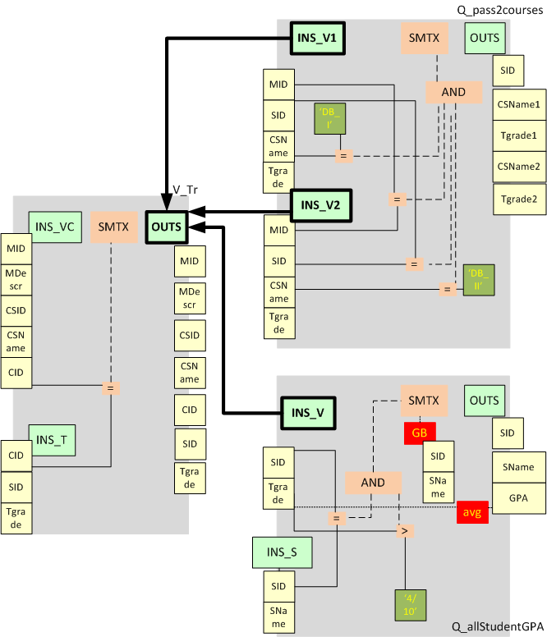
Propagation mechanism
Modules communicate with each other via a single means: the schema of a provider module notifies the input schema of a consumer module when this is necessary
Two levels of propagation:
    Inter-module level: At the module level, we need to determine the order and mechanism to visit each module
    Intra-module level: within each module, we need to determine the order and mechanism to visit the module’s components and decide who is affected and how it reacts + notify consumers
Notes:
If there is a change on a modules output attribute, but none of its consumers is related to that attribute, then no message is produced.
For example a change in the v_tr view saying thatn cid attribute will be deleted will produce no message since both queries make no use of cid attribute.
18

Slide 19
Method at a glance
Topologically sort the graph
Visit affected modules with its topological order and process its incoming messages for it.
Principle of locality: process locally the incoming messages and make sure that within each module
  Affected internal nodes are appropriately highlighted
  The reaction to the event is determined correctly
  If the final status is not a veto, notify appropriately the next modules
Notes:
For the propagation of messages we use a global queue in this level. Modules send messages one to another by inserting them to this global queue that any module can see.
19

Slide 20
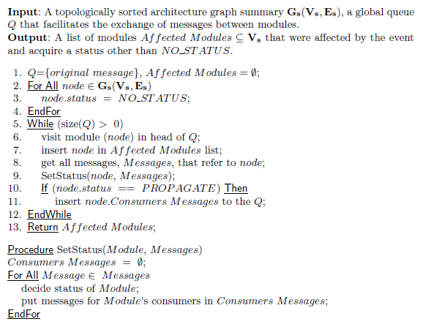
Status Determination
Notes:
All nodes are initially set to NO_STATUS status. Then while there are messages in the global queue, we get all the messages that are for the module that were in the head of the queue (the queue is topologically sorted). Then we visit that module and get a status decision. If the modules status is PROPAGATE we get all the messages that were produced by this module and insert them in the global queue, otherwise the module vetoed and no more message propagation from this module should be done. Finally we return all the modules we visited for later use in other algorithms.

Slide 21
Inter-Module Level Propagation
Add Exam Year
Notes:
Lets see what modules and nodes are affected by an insertion of a new attribute at Transcript table of our university ecosystem.
21

Slide 22
Inter-Module Level Propagation
1
Add Exam Year
Notes:
Since Transcript relations has only V_Tr view as consumer, V_Tr will receive a message saying its provider will add a new attribute, in its INS_T part.

Slide 23
Inter-Module Level Propagation
2
1
2
Add Exam Year
Notes:
The V_Tr provides the 2 queries with its output. The queries get the messages simultaneously (actually Q_Pass2courses gets 2 messages one for its INS_V1 and another for INS_V2 parts).
23

Slide 24
Intra-module processing
Message arrives at a module :
Input schema and its attributes if applicable, are probed.
If the parameter of the Message has any kind of connection with the semantics tree, then the Semantics schema is probed.
Likewise if the parameter of the Message has any kind of connection with the output schema, then the Output schema and its attributes (if applicable) is probed.
Finally, new Messages are produced for its consumers.
Notes:
We have a clear way of how the internal parts of a module will process a message. In the end a module will have the correct status, since we have rank the statuses in a way that the status will be correct (NO_STATUS < PROPAGATE < BLOCK, meaning that if a module is in BLOCK status, it can not get PROPAGATE or NO_STATUS statuses).

Slide 25
Path Check: handling policy conflicts
Background
Status Determination
Path check
Rewriting
Experiments and Results

Slide 26
Conflicts: what they are and how to handle them
BEFORE
AFTER
R
R
View0
n
View0
View0
View1
View2
n
n
View1
View2
View2
Query1
Query2
n
Query1
Query2
View0 initiates a change
View1 and View 2 accept the change
Query2 rejects the change
Query1 accepts the change
The path to Query2 is left intact, so that it retains it semantics
View1 and Query1 are adapted
View0 and View2 are adapted too, however, we need two version for each: one to serve Query2 and another to serve View1 and Query1
Notes:
26
Query 2 is a blocker while query1 accepts the change that was initiated by view0. Our issue is to satisfy both queries.

Slide 27
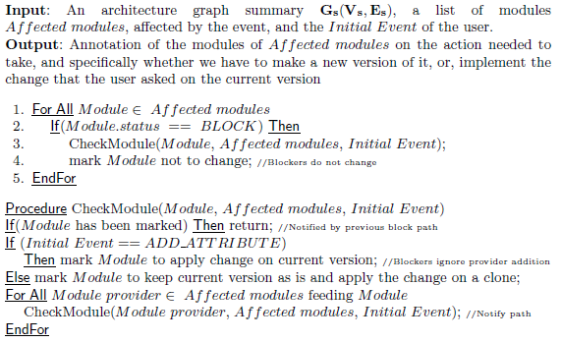
Path Check
Notes:
Using a recursive procedure we inform all modules starting from the blocker module to the module that initiated the change.
We know from previous algorithm (Status Determination) the modules that we visited, so in our recursive procedure we visit only those modules.
Finally (since we started from a veto module that we misinformed to keep two versions, the original for the blocker and another that accepts the change), we make sure that the blocker module will not change.

Slide 28
Path Check
If there exists any Block Module: we travel in reverse the Architecture Graph from blocker node to initiator of change
In each step, we inform the visited Module to keep current version and produce a new one adapting to the change
We inform the blocker node that it should not change at all.
Notes:
Exception is when any of the subsequent modules vetoed on an attribute addition. In that case when we get in the blocker we just ignore the new attribute that blockers provider has added in its output schema. Since we want to be as fast as we can we check if the module that we want to change has been notified about the number of versions it has to keep. If it has been notified, then the path from that module to the beginning is already informed.

Slide 29
Path Check
Relation R
View0
View1
View2
Query1
Query2
Notes:
Returning on our example: Query 2 (which is the blocker) is the start of the path check algorithm.
29

Slide 30
Path Check
Query2 starts Path Check algorithm
Searching which of his providers sent
him the message and notify him that
he does not want to change
Relation R
View0
View1
View2
Query1
Query2
Notes:
Query 2 searches its providers in order to inform them to keep their original form.
30

Slide 31
Path Check
View2 is notified
to keep current version for Query2 and
produce new version for Query1
Relation R
View0
View1
View2
Query1
Query2
Notes:
Query2 provider is View2 which gets notified and as query2 searches for its providers to inform them to keep their original form.
31

Slide 32
Path Check
View0 is notified
To keep current version for Query2 and
Produce new version for Query1
Relation R
View0
View1
View2
Query1
Query2
Notes:
Finally View0, where the initial message started about the change, is where path check algorithm finishes.
32

Slide 33
Path Check
We make sure that Query2 will not
change since it is the blocker
Relation R
View0
View1
View2
Query1
Query2
Notes:
Finally we make sure that the module that vetoed will not change at all.
33

Slide 34
Rewriting: once we identified affected parts and resolved conflicts, how will the ecosystem look like?
Background
Status Determination
Path check
Rewriting
Experiments and Results

Slide 35
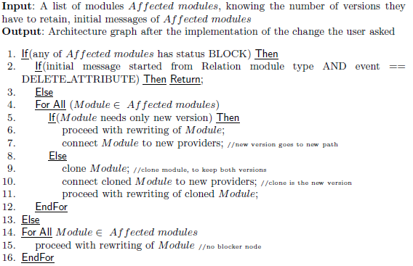
Rewriting
Notes:
Given the initial messages of the queue describing the imminent change (from status determination algorithm) and the information given to the modules of how many versions to keep (from path check algorithm) we are able to rewrite the modules that were affected. We make sure to connect the new modules to the new paths (if there exist, since the initial module has the same origins) while the modules that were unaffected or vetoed to the change stay as they are.

Slide 36
Rewriting
If there is Propagate, we perform the rewriting.
If there is Block
  We clone the Modules that are part of a block path and were informed by Path Check and we perform the rewrite on the clones
  We perform the rewrite on the Module if it is not part of a block path.
Notes:
Note: we perform no rewrite at all when someone vetoed on a change starting from a Relation module if the initial event is an attribute deletion (we do not provide multiple versions of tables data as we do on views, since views have no space cost –no materialized views).

Slide 37
Rewriting
Relation R
Keep current&
produce new
Relation R
View0
Keep current&
produce new
n
View0
View0
View1
View2
n
n
View1
View2
View2
Query1
Query2
n
Query1
Query2
Keep only
current
Notes:
Outcome: a Clone of view0 and a clone of view2 for the query 1 that accepted the change and view0, view2 and query2 as they were before the rewriting. Also since View1 accepted the change gets rewritten.
37

Slide 38
Experiments and results
Background
Status Determination
Path check
Rewriting
Experiments and Results

Slide 39
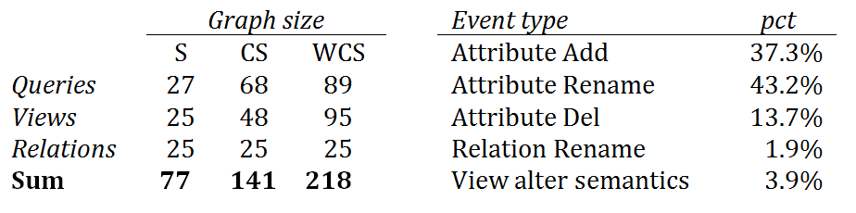
Experimental setup
TPC-DS ecosystem in 3 variants:
  a large ecosystem, WCS, with queries using all the available fact tables,(web, catalog, store tables)
  an ecosystem CS, where the queries to WEB SALES have been removed, and
  an ecosystem S, with queries using only the STORE SALES fact table.
Events Workload: taken by a real-world case study
Policies :
  MixtureDBA, consisting of 20% of the relation modules annotated with BLOCK policy and
  MixtureAD, consisting of 15% of the query modules annotated with BLOCK policy.
Notes:
The experiments were executed serially, making sure that one will not interfere with the ones that follow. There were 51 events and 3 graph sizes with 2 different policies in our experiments. From all experiments performed we excluded the 1st event, that we used in order to fill the cache of our pc. We performed each set of experiments 3 times and used the 2 best times (this is because we encountered measurements where one of the 3 was way to high –we assume that this was happening because the garbage collector of java was running that time).

Slide 40
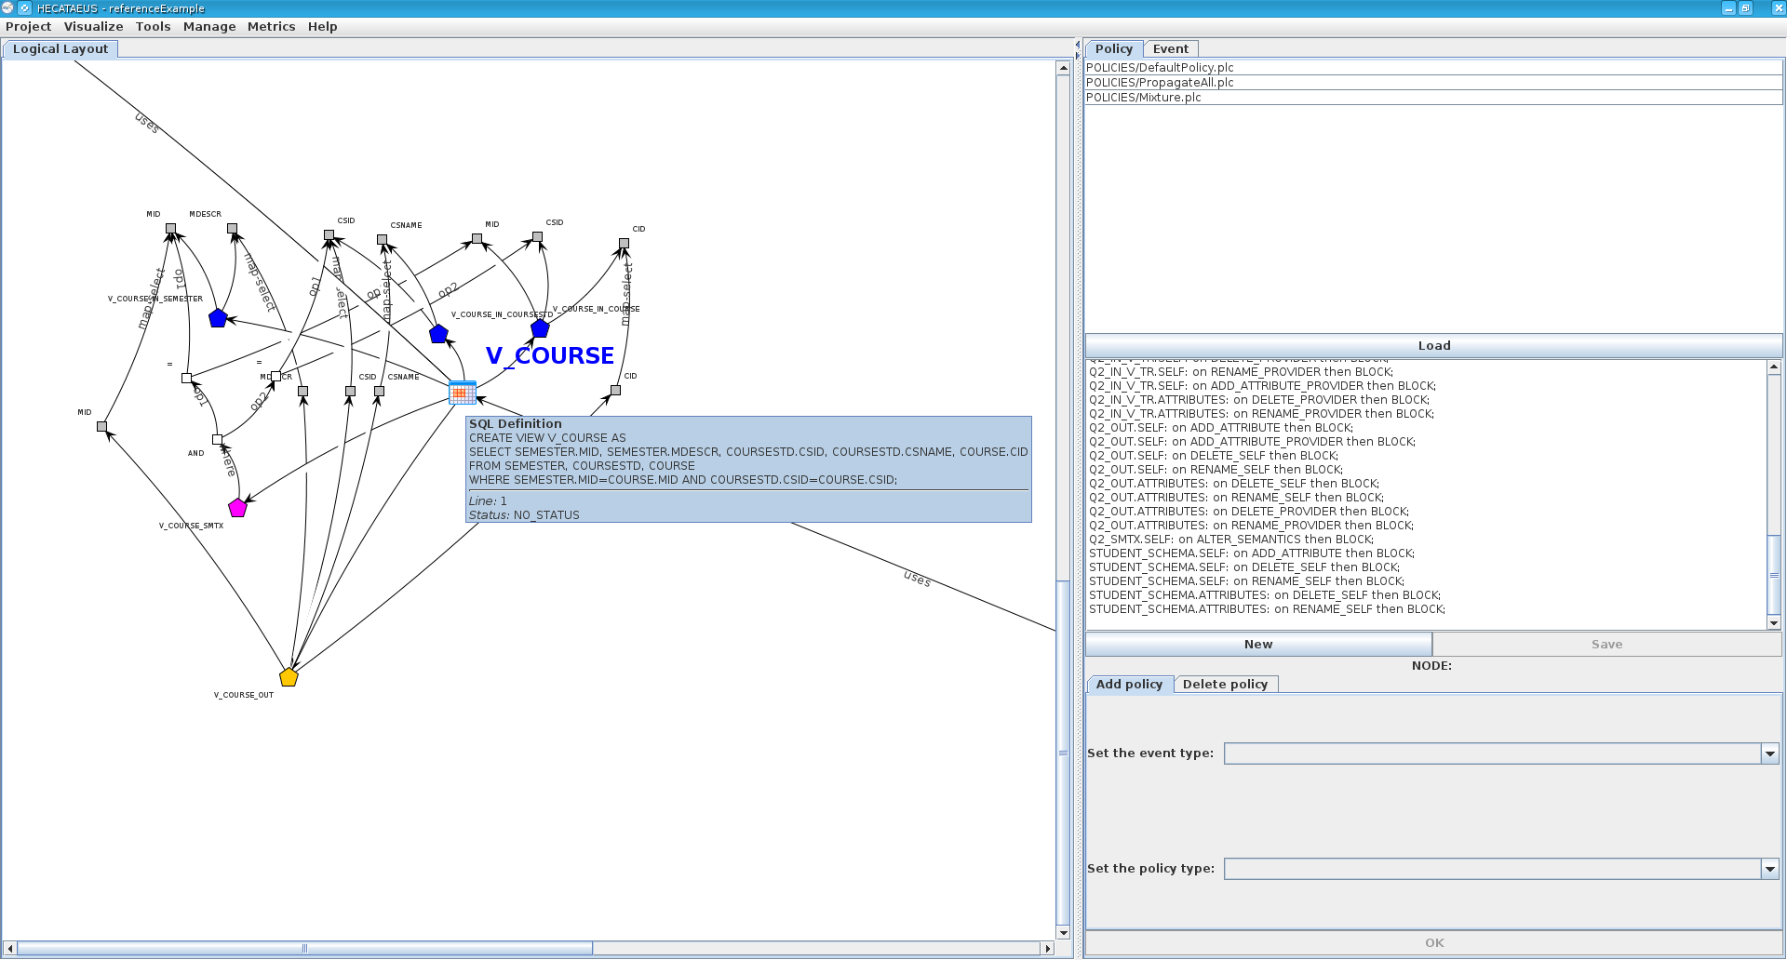
HECATAEUS
A tool for visualizing and performing what-if analysis for evolution scenarios

Slide 41
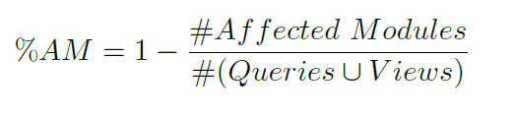
Effectiveness
How useful is our method for the application developers and the DBA's?
Assess the effort gain of a developer using the highlighting of affected modules of Hecataeus compared to the situation where he would have to perform all checks by hand
  We exclude the object that initiates the sequence of events from the computation, as it would be counted in both occasions.
%AM : the percentage of useless checks the user would have made

Slide 42
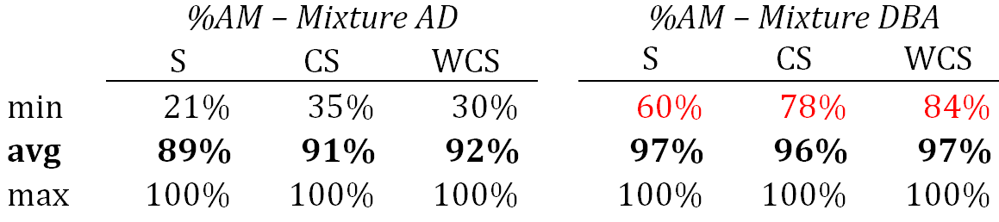
Effectiveness
On average, the effort gain is around 90% in the case of the AD mixture and 97% in the case of the DBA mixture.
As the graph size increases, the benefits from the highlighting of affected modules increase too.
DBA case (flooding of events is restricted early enough at the database's relations): the minimum benefit in all 51 events ranges between 60% - 84%.

Slide 43
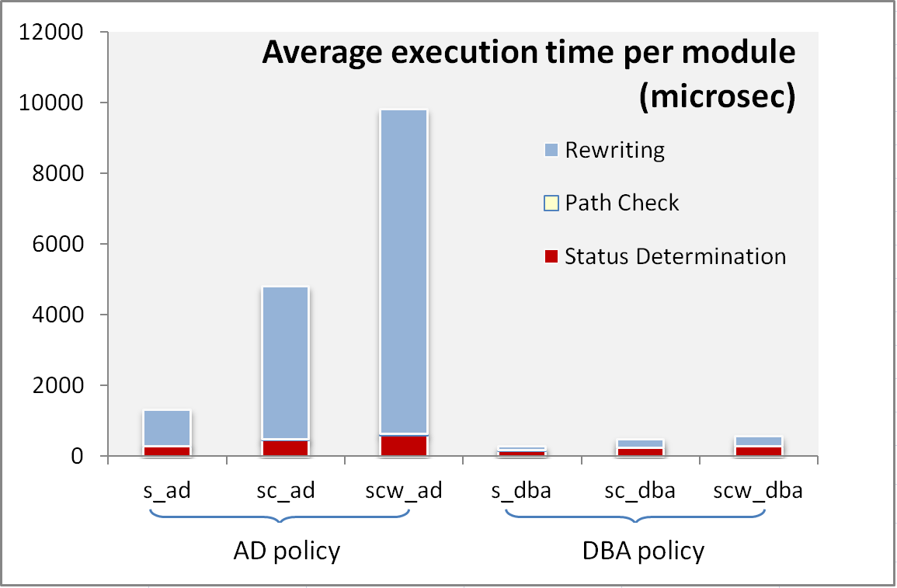
Efficiency

Slide 44
Lessons Learned
Effort gains are significant!
The annotation of few database relations significantly restricts the rewriting time (and consequently the overall execution time)
If the rewriting is not constrained early
enough, then the execution cost grows linearly with the size of the ecosystem.

Slide 45
Conclusions and future work
... and follow up’s not included in the paper

Slide 46
Managing the evolution of ecosystems is possible
We need to model the ecosystem and annotate it with evolution management techniques that dictate its reaction to future events
We can highlight what is impacted and if there is a veto or not.
We can handle conflicts, suggest automated rewritings and guarantee correctness
We can do it fast and gain effort for all involved stakeholders

Slide 47
With an Eye to the Future
Automatic policy suggestion
Visualization
Extend Hecataeus for other changes (create an index) that change the performance of DBMS.
Complex events (delete attr@tb1 & attr@tb2, etc).

Slide 48
Many thanks for your attention
http://www.cs.uoi.gr/~pvassil/projects/hecataeus/ http://www.cs.uoi.gr/~pmanousi/publications/2013_ER/

Slide 49
Auxiliary slides

Slide 50
The impact of changes & a wish-list
Syntactic: scripts & reports simply crash
Semantic: views and applications can become inconsistent or information losing
Performance: can vary a lot
We would like: evolution predictability, i.e., control of what will be affected, before changes happen s.t., we can find ways to quarantine effects

Slide 51
Problem definition
Changes on a database schema may cause syntactic or semantic inconsistency in its surrounding applications; is there a way to regulate the evolution of the database in a way that application needs are taken into account?
If there are conflicts between the applications’ needs on the acceptance or rejection of a change in the database, is there a possibility of satisfying all the different constraints?
If conflicts are eventually resolved and, for every affected module we know whether to accept or reject a change, how can we rewrite the ecosystem to reflect the new status?
Notes:
Changes on a database schema can affect the applications that are related to the database, in two ways (i) either the results of the query will be incorrect or (ii) the query will not be able to work at all.
Is there a way these changes to be done under the control of the db administrator?
If there is such a way, can the dba have those changes as soon as possible?
If there are conflicts concerning the acceptance or not of an imminent change, is there a way of satisfying all the involved applications?

Slide 52
Policies at various nodes
RELATION.OUT.SELF: on ADD_ATTRIBUTE then PROPAGATE;
RELATION.OUT.SELF: on DELETE_SELF then PROPAGATE;
RELATION.OUT.SELF: on RENAME_SELF then PROPAGATE;
RELATION.OUT.ATTRIBUTES: on DELETE_SELF then PROPAGATE;
RELATION.OUT.ATTRIBUTES: on RENAME_SELF then PROPAGATE;
VIEW.OUT.SELF: on ADD_ATTRIBUTE then PROPAGATE;
VIEW.OUT.SELF: on ADD_ATTRIBUTE_PROVIDER then PROPAGATE;
VIEW.OUT.SELF: on DELETE_SELF then PROPAGATE;
VIEW.OUT.SELF: on RENAME_SELF then PROPAGATE;
VIEW.OUT.ATTRIBUTES: on DELETE_SELF then PROPAGATE;
VIEW.OUT.ATTRIBUTES: on RENAME_SELF then PROPAGATE;
VIEW.OUT.ATTRIBUTES: on DELETE_PROVIDER then PROPAGATE;
VIEW.OUT.ATTRIBUTES: on RENAME_PROVIDER then PROPAGATE;
VIEW.IN.SELF: on DELETE_PROVIDER then PROPAGATE;
VIEW.IN.SELF: on RENAME_PROVIDER then PROPAGATE;
VIEW.IN.SELF: on ADD_ATTRIBUTE_PROVIDER then PROPAGATE;
VIEW.IN.ATTRIBUTES: on DELETE_PROVIDER then PROPAGATE;
VIEW.IN.ATTRIBUTES: on RENAME_PROVIDER then PROPAGATE;
VIEW.SMTX.SELF: on ALTER_SEMANTICS then PROPAGATE;
QUERY.OUT.SELF: on ADD_ATTRIBUTE then PROPAGATE;
QUERY.OUT.SELF: on ADD_ATTRIBUTE_PROVIDER then PROPAGATE;
QUERY.OUT.SELF: on DELETE_SELF then PROPAGATE;
QUERY.OUT.SELF: on RENAME_SELF then PROPAGATE;
QUERY.OUT.ATTRIBUTES: on DELETE_SELF then PROPAGATE;
QUERY.OUT.ATTRIBUTES: on RENAME_SELF then PROPAGATE;
QUERY.OUT.ATTRIBUTES: on DELETE_PROVIDER then PROPAGATE;
QUERY.OUT.ATTRIBUTES: on RENAME_PROVIDER then PROPAGATE;
QUERY.IN.SELF: on DELETE_PROVIDER then PROPAGATE;
QUERY.IN.SELF: on RENAME_PROVIDER then PROPAGATE;
QUERY.IN.SELF: on ADD_ATTRIBUTE_PROVIDER then PROPAGATE;
QUERY.IN.ATTRIBUTES: on DELETE_PROVIDER then PROPAGATE;
QUERY.IN.ATTRIBUTES: on RENAME_PROVIDER then PROPAGATE;
QUERY.SMTX.SELF: on ALTER_SEMANTICS then PROPAGATE;
Remove CS.C_NAME
Allow deletion
Allow addition
Add exam year
Policies to predetermine the modules’ reaction to a hypothetical event

Slide 53
Theoretical Guarantees
At the inter-module level
    Theorem 1 (termination). The message propagation at the inter-module level terminates.
    Theorem 2 (unique status). Each module in the graph will assume a unique status once the message propagation terminates.
    Theorem 3 (correctness). Messages are correctly propagated to the modules of the graph
At the intra-module level
    Theorem 4 (termination and correctness). The message propagation at the intra-module level terminates and each node assumes a status.
Notes:
Our architecture graph is acyclic and directed, therefore the 1st theorem is valid.
Our statuses are ranked (NO_STATUS<PROPAGATE<BLOCK), we are sure that no matter the sequence of the incoming messages, the final status of the module will be the correct one (a BLOCK status can not change to NO_STATUS or PROPAGATE status).
The topological sort we initially had makes the messages disseminate correctly.
As described earlier, in the intra-module propagation, the messages are propagated in a specific way which terminates and all the nodes that are affected, assume a status.
53

Slide 54
Message initiation
The Message is initiated in one of the following schemata:
  Output schema and its attributes if the user wants to change the output of a module (add / delete / rename attribute).
  Semantics schema if the user wants to change the semantics tree of the module.
Notes:
The user makes changes that have to do with the OUT schemas of the modules or with the Semantics tree. That message is inserted in the global queue and then the module takes the decision about its status. After that decision, new messages are produced for the modules consumers.

Slide 55
Efficiency: rewritings can cost a lot!
AD: as the events are allowed to flow within the ecosystem, the amount of rewriting increases with the size of the graph & dominates the overall execution (starts from a 24% - 74% for the small graph and ends to a 7% - 93% for the large graph).
DBA: the times are not only significantly smaller, but also equi-balanced: 57% - 42% for the small graph (Status Determination costs more in this case) and 49% - 50% for the two other graphs.

Slide 56
Efficiency as the graph size increases
DBA blocks early => orders of magnitude faster than AD
Scale up due to policy: status determination time is scaled up by 2; rewriting time is scaled up by a factor of 10, 20, and 30 for the small, medium and large graph respectively!
Rate of increase: linear increase for AD (both status determination and rewriting), very slow increase for DBA
Rewritings can cost a lot!

Slide 57
Rewriting
If there is Propagate, we perform the rewriting.
If there is Block
  If the change initiator is a relation we stop further processing.
  Otherwise:
    We clone the Modules that are part of a block path and were informed by Path Check and we perform the rewrite on the clones
    We perform the rewrite on the Module if it is not part of a block path.
Within each module, all its internals are appropriately adjusted (attribute / selection conditions / … additions and removals)
Notes:
Note: we perform no rewrite at all when someone vetoed on a change starting from a Relation module if the initial event is an attribute deletion (we do not provide multiple versions of tables data as we do on views, since views have no space cost –no materialized views).

