Slide 1
Macro-level Scheduling of ETL Workflows
Anastasios Karagiannis¹, Panos Vassiliadis¹, Alkis Simitsis²
¹ Univ. of Ioannina, Greece
² HP Labs, USA
alkis@hp.com

Slide 2
Outline
Motivation
Our Solution
  modeling
  algorithms
  system architecture
Evaluation
Conclusions

Slide 3
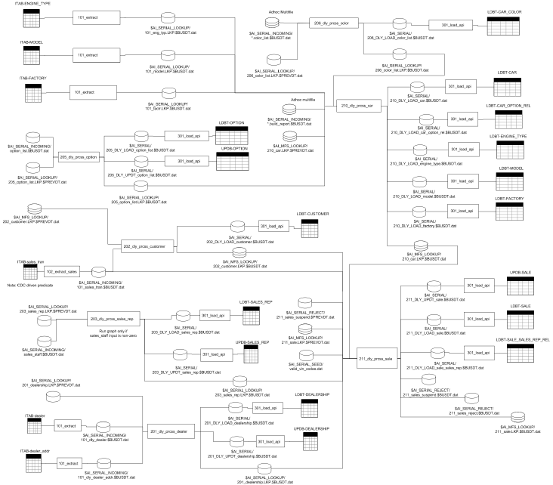
Example
Flow
s
Streaming Data Flow & Text Analytic Operators
information sources
e.g., database tables,
files, XML, sensors,
twitter, facebook,
web portals
Event
Stream
Sensor
data, external event
Streams
target results
e.g., warehouse tables,
OLAP/mining tools,
data marts, reports,
dashboards
Primitive Event
Detector
Complex Event
Detector
Filters
Primitive Event
Detector
Realtime
Correlation
Root Cause
Discovery
Multivariate
TS Predictor
Data Cleaning & Schema Modification Operators
Streaming Data Flow & Event Analytic Operators
© 2011 Hewlett-Packard Development Company, L.P.
The information contained herein is subject to change without notice

Slide 4
Background
Scheduling policies
  mostly in stream technology
    e.g., Aurora, Chain, Pipeline scheduling
  undisclosed policies used in commercial ETL tools
    round robin, OS takes over
  research on ETL has not dealt with scheduling
    efforts on efficient loading in real-time ETL workflows

Slide 5
Contribution
Study of scheduling processes for ETL workflows
  implementation of a simple, yet generic and extensible, ETL engine
  enforce scheduling policies in ETL execution
  use of template ETL workflows for experimentation
System characteristics
  pipelining
  zero data loss
  no deadlocks

Slide 6
Our solution

Slide 7
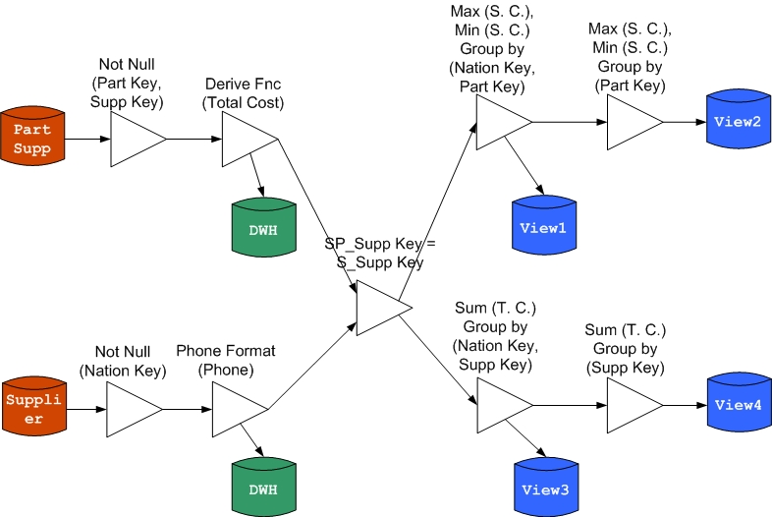
Modeling
v
…
…
v
in
out

Slide 8
Modeling
An ETL workflow is a DAG G(V,E)
An activity node v has
  consumption rate, selectivity,
  in-queues w/ total size queue(v)
A queue q has
  size(q) at time t, MaxMem(q)
v
…
…
v
in
out
Scheduler
  P policy and T = T₁ ∪…∪ T_{LAST}
  which operator to activate and for how long
  when an operator should stop
  when an operator finishes
  when flow execution ends
T_{i}
T_{i+1}
T₁
T_{LAST}
T_{i.f}
T_{i.l}
T_{i+1.f}
T_{i+1.l}

Slide 9
Modeling
Problem statement
  find a policy P for a workflow G(V,E), s.t.
    P creates a division of T into intervals T₁ ∪ T₂ ∪…∪ T_{LAST}
    ∀t∈T, v∈V, ∀q∈Q(v) size(q) ≤ MaxMem(q)
    minimize OF₁ and/or OF₂
      OF₁: minimize T_{LAST}
      OF₂: minimize max(Σ queue_{t}(v)) for t∈T and v∈V

Slide 10
Scheduling Algorithms
 | pick next operator
 | based on | when
Round Robin (RR) | operator id | input queue is exhausted
Minimum Cost (MC) | max size of input queue | input queue is exhausted
Minimum Memory (MM) | max memory benefit* | time slot
* MemB(v) = (In(v)-Out(v)) / ExecTime(v) x Queue(v)
Notes:
MM next: should consume the biggest data volume
data consumed is the data removed from memory, either by rejecting or writing tuples
Small selectivity / large processing rate / large input size help an operator to better exploit MM
- Small selectivity helps the operator to consume large portion of its input tuples
- Large input size helps the operator to process and possibly, reduce the in-memory data
- Finally, large processing rate fastens the data consumption.

Slide 11
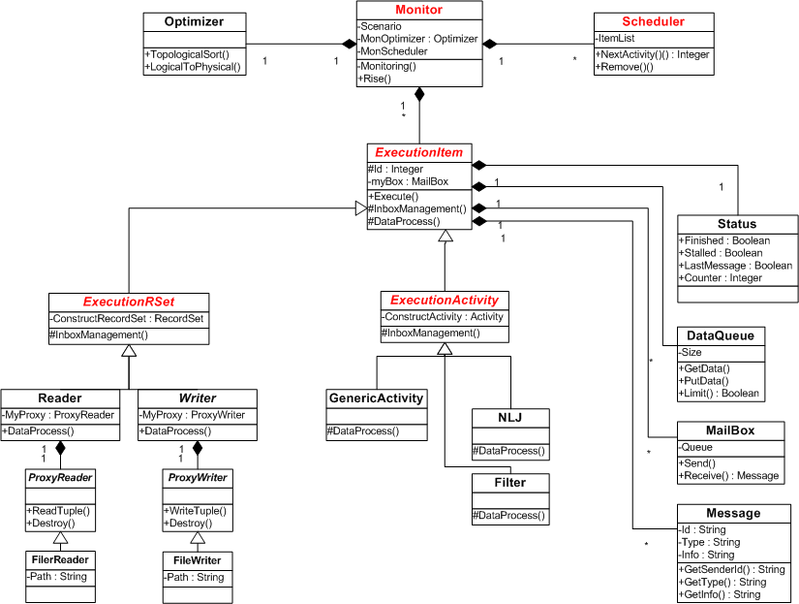
Software Architecture

Slide 12
Evaluation

Slide 13
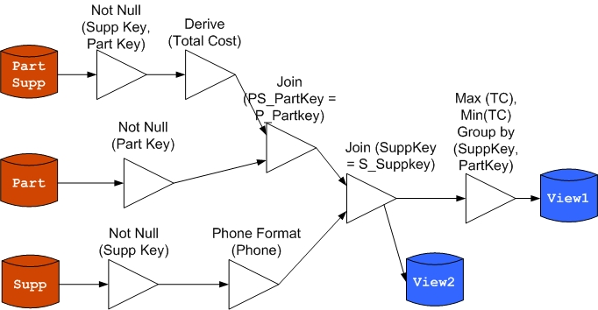
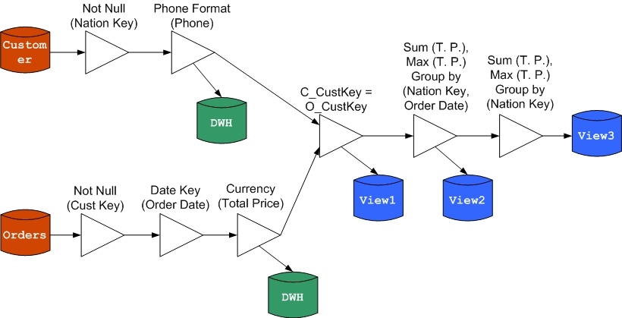
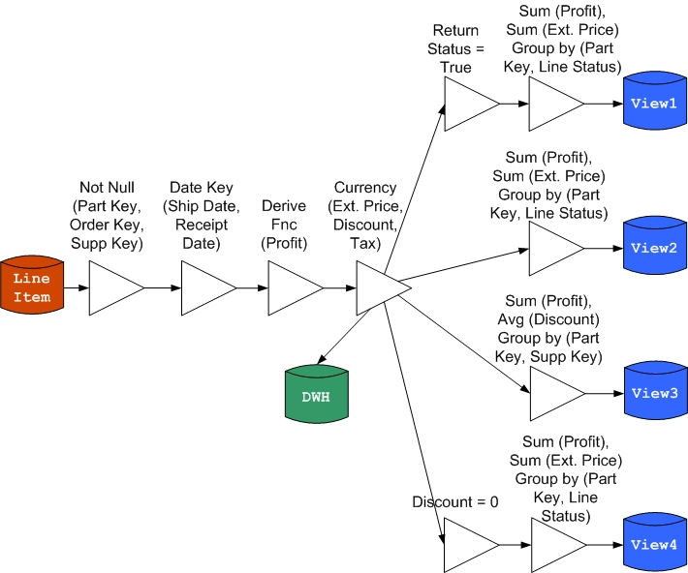
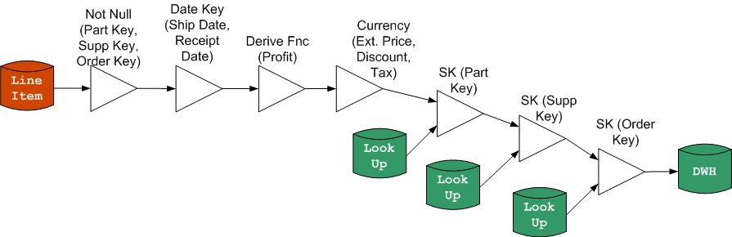
Template Workflows
tree
wishbone
fork
primary flow

Slide 14
Template Workflows
tree
wishbone
fork
primary flow

Slide 15
Experiments
Parameters
  workflow size, complexity, selectivity
  data size
Tuning
  stall time
  time slot
  data queue size
  row pack size
Dataset
  TPC-H data
Notes:
- stall time reasonably small, since makes system idle
using time slots for RR and MC increases communication and scheduling overhead => longer exec time
- used the stable version of each template

Slide 16
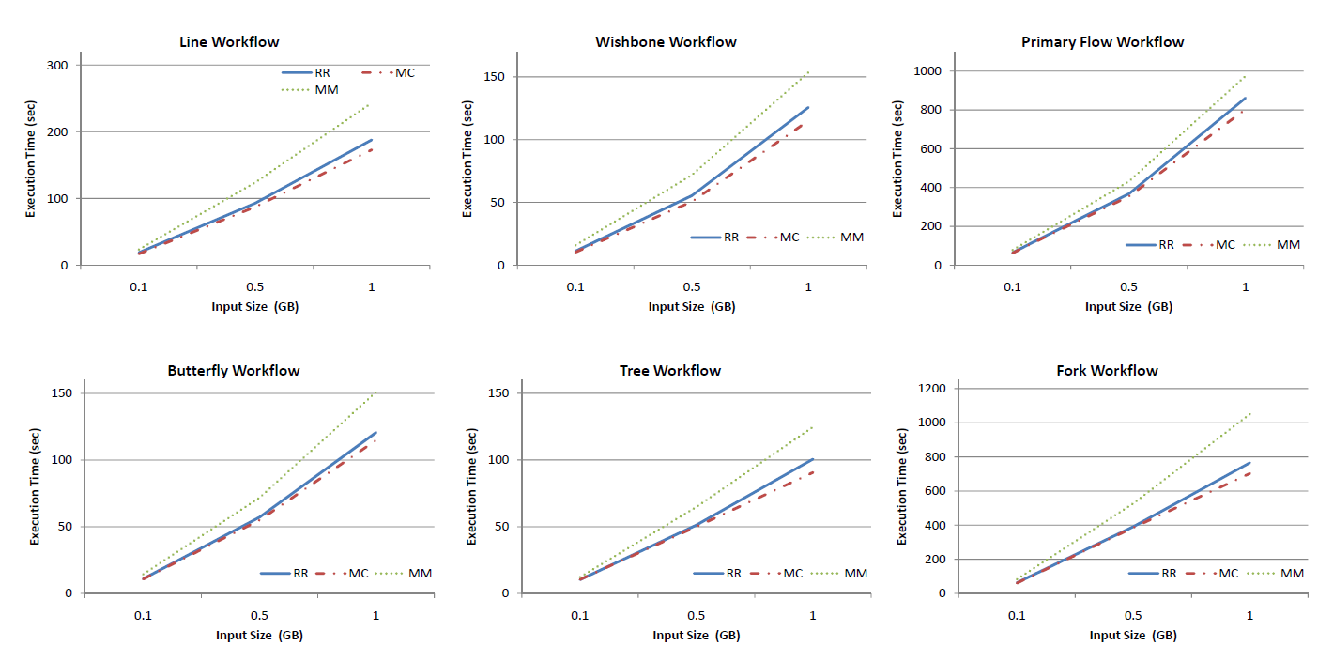
Experiments
data size and execution time

Slide 17
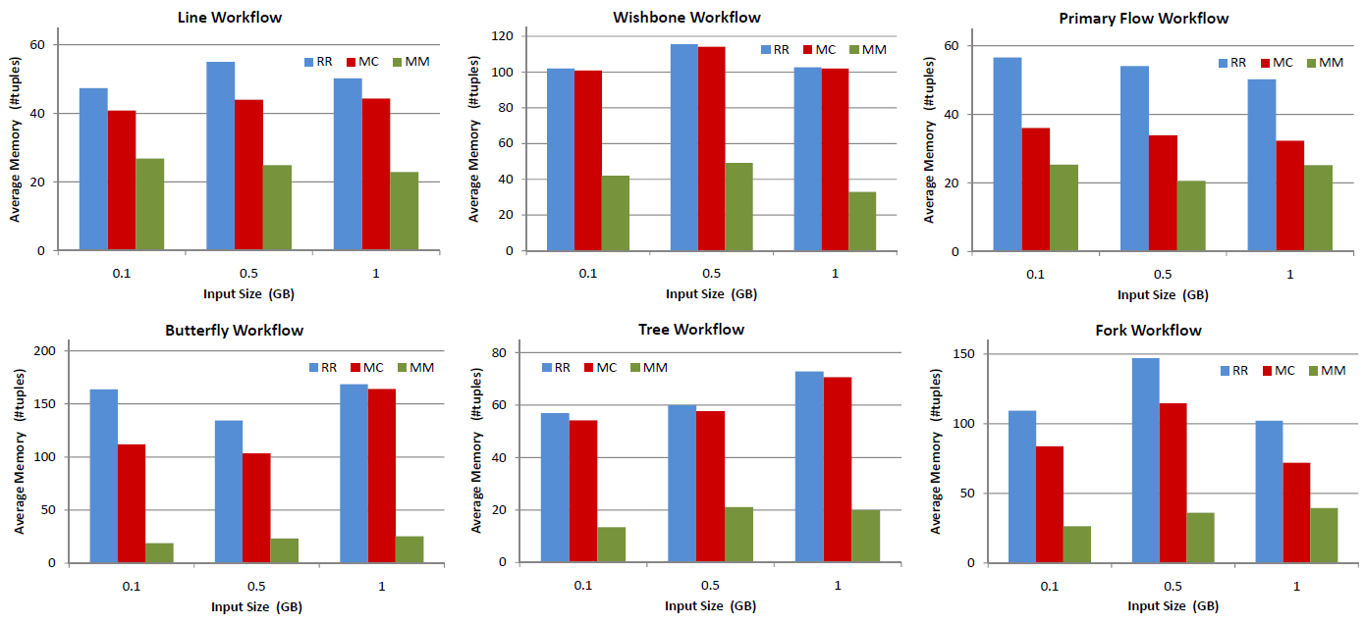
Experiments
data size and memory

Slide 18
Conclusions & On-going Work

Slide 19
Lessons Learned
RR is quite efficient in performance, but lags in memory consumption effectiveness
We can devise a scheduling policy (MC) with slightly better performance than RR and observable earnings in average memory consumption
A slower policy (MM) shows significant earnings in average memory consumption that range between 1/2 to 1/10 of the memory used by the other policies
Notes:
Winners
MC w.r.t. to execution time (RR is close though)
MM w.r.t. average memory requirements
suitable for concurrent operations when memory needed at peak times

Slide 20
Mixed Policy – sketch
Key idea
  split a workflow into subflows s.t.
    simple subflows can use a faster policy as MC
    complex subflows (w/ memory consuming tasks and blocking operators) can use MM for gaining in memory
  use the extra memory for boosting faster workflows with parallelization
  workflow segmentation (examples)
    parallelize subflows w/o dependencies on each other
    place pipeline activities into the same subflow
    blocking activities split the workflow into two parts that should be synchronized (allocate resources for the 2nd part only when the 1st finishes)
Notes:
the memory gained can be reused for boosting the faster workflows with parallelization

Slide 21
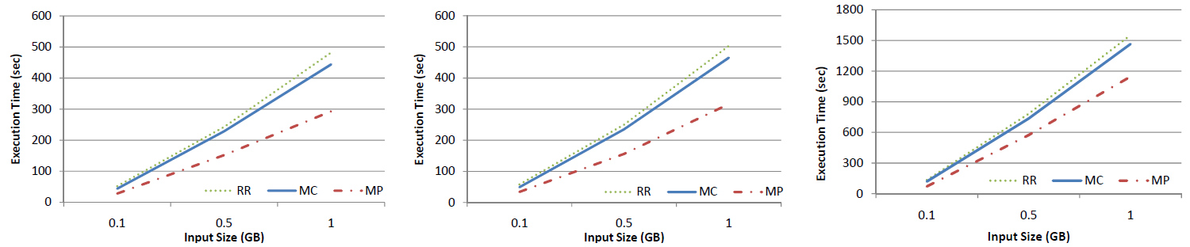
Mixed Policy – first results
Complex workflows based on tree, butterfly, and fork archetypes
tree
butterfly
fork

Slide 22
Conclusions
Summary
  Schedule ETL workflows for improving
    execution time
    memory consumption
  w/o data losses
  Home-grown implementation of an ETL engine
  Minimum Memory improves average memory consumption
  Minimum Cost improves execution time (RR is close)
Future work
  other prioritization schemes due to different SLAs
  scheduling for (near-)real-time ETL
Thank You!

Slide 23
Back-up slides

Slide 24
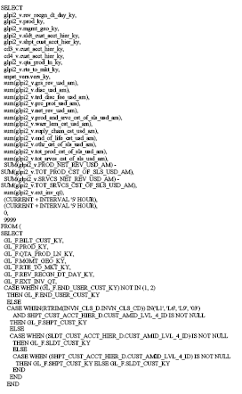
Example big query
© 2011 Hewlett-Packard Development Company, L.P.
The information contained herein is subject to change without notice

Slide 25
Example big query (cont.)
© 2011 Hewlett-Packard Development Company, L.P.
The information contained herein is subject to change without notice

Slide 26
Scheduling in RW (1)
Name | Source | Who Is Next | For How Long | Criterion | Decision
FIFO | [BBDM03], [UrFr01] | next token | until idle / time slot | Fairness | Local
Round Robin | [BBDM03], [UrFr01] | next ready token | until idle / time slot | Fairness | Local
Equal Time | [UrFr01] | least executed time | until idle / time slot | Fairness | Global
Cheapest First | [UrFr01] | least processing cost | until idle | response time | Local
Greedy Scheduling | [BBDM03] | least selectivity | time slot | memory consumption | Local

Slide 27
Scheduling in RW (2)
Name | Source | Who Is Next | For How Long | Criterion | Decision
Min Latency | [CCR+03] | largest output size | until idle | response time | Global
Rate Based | [UrFr01] | largest output size | until idle | response time | Global
Min Cost | [CCR+03] | largest input size | until idle | throughput | Local
Min Memory | [CCR+03] | largest data consumption | until idle | memory consumption | Local
Chain Scheduling | [BBDM03] | largest data consumption | time slot | memory consumption | Global

