Slide 1
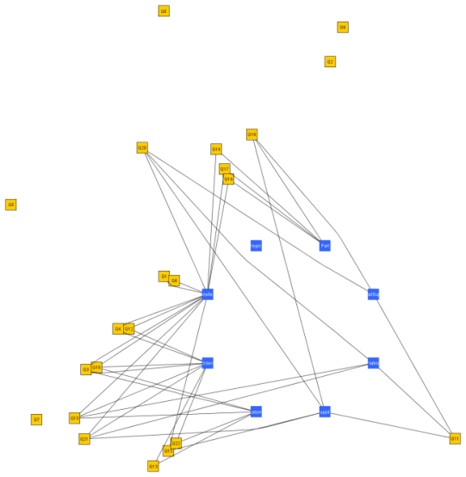
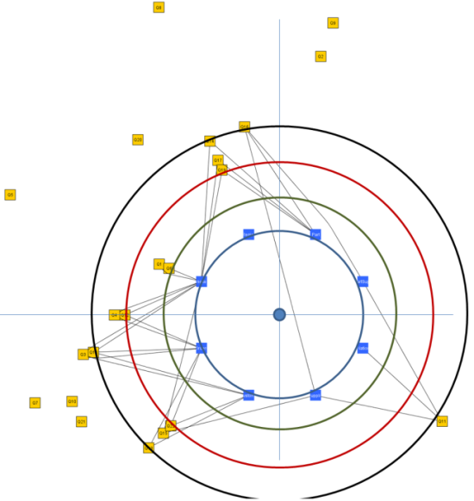
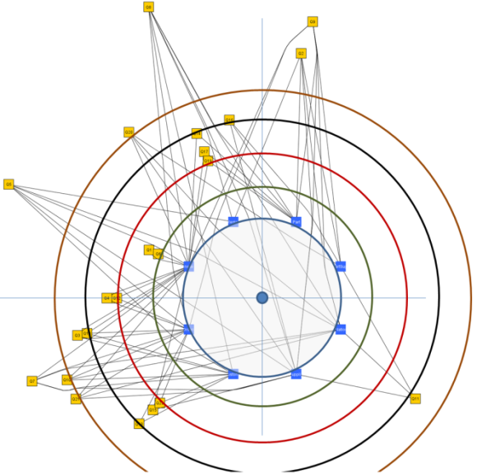

RADAR: Radial Applications’ Depiction Around Relations For Data-Centric Ecosystems
Panos Vassiliadis
Univ. of Ioannina

Slide 2
Roadmap
Motivation & Related Work
Problem Definition & Reference example
Barycenter Methods
Radial Methods
Conclusions & Thoughts for the future

Slide 3
Data centric ecosystems & the need for a map
Act3
Act4
Act2
WWW
Act5
Act1

Slide 4
Main drive
We would like the administrators of the database, as well as the developers of all the software modules of the ecosystem to be able to have a visual overview of the ecosystem and to be able to understand the interdependencies between its parts. In simple words, the question can be expressed as: “how do we visualize a data-centric ecosystem?”

Slide 5
Requirements and Challenges
Clear separation of relations and queries
Spatial memory
  placing graph’s nodes that have semantic relationships closely over the diagram
Simple representation

Slide 6
Problem definition

Slide 7
Graph model
The ecosystem is a bipartite graph G(V,E)
  Nodes: relations and queries
  Edges: query q uses a relation r in any way
Simplest possible model: we only care for the usage of a relation by a query
For the future
  Query semantics
  Views & constraints

Slide 8
Problem Definition
We need to lay the bipartite graph of the ecosystem on a 2D surface (the screen) such that
  Similar nodes are placed nearby (spatial memory)
    We need to measure similarity
  Dependency of queries over relations is easily traceable
    Place queries as close to their defining relations
  Clearly separate queries and relations

Slide 9
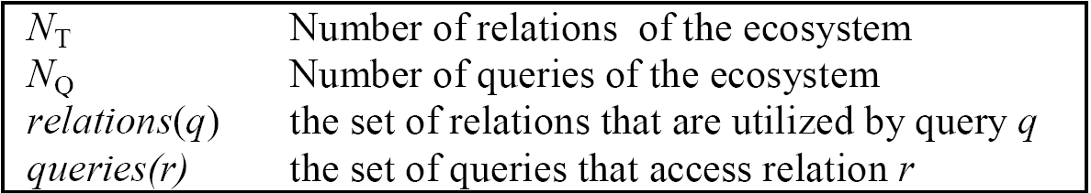
“Similar”? => Distance/Similarity function
Must precompute all possible distances between
  two queries
  two relations
We adopt a simple modeling and use Jaccard as the distance function

Slide 10
TPC-H as the reference example
 | Region | Nation | Supplier | Customer | Part | Partsupp | Lineitem | Orders
Q1 | 0 | 0 | 0 | 0 | 0 | 0 | 1 | 0
Q2 | 1 | 1 | 1 | 0 | 1 | 1 | 0 | 0
Q3 | 0 | 0 | 0 | 1 | 0 | 0 | 1 | 1
Q4 | 0 | 0 | 0 | 0 | 0 | 0 | 1 | 1
Q5 | 1 | 1 | 1 | 1 | 0 | 0 | 1 | 1
Q6 | 0 | 0 | 0 | 0 | 0 | 0 | 1 | 0
Q7 | 0 | 1 | 1 | 1 | 0 | 0 | 1 | 1
Q8 | 1 | 1 | 1 | 1 | 1 | 0 | 1 | 1
Q9 | 0 | 1 | 1 | 0 | 1 | 1 | 1 | 1
Q10 | 0 | 1 | 0 | 1 | 0 | 0 | 1 | 1
Q11 | 0 | 1 | 1 | 0 | 0 | 1 | 0 | 0
Q12 | 0 | 0 | 0 | 0 | 0 | 0 | 1 | 1
Q13 | 0 | 0 | 0 | 1 | 0 | 0 | 0 | 1
Q14 | 0 | 0 | 0 | 0 | 1 | 0 | 1 | 0
Q15 | 0 | 0 | 1 | 0 | 0 | 0 | 1 | 0
Q16 | 0 | 0 | 1 | 0 | 1 | 1 | 0 | 0
Q17 | 0 | 0 | 0 | 0 | 1 | 0 | 1 | 0
Q18 | 0 | 0 | 0 | 1 | 0 | 0 | 1 | 1
Q19 | 0 | 0 | 0 | 0 | 1 | 0 | 1 | 0
Q20 | 0 | 1 | 1 | 0 | 0 | 1 | 1 | 0
Q21 | 0 | 1 | 1 | 0 | 0 | 0 | 1 | 1
Q22 | 0 | 0 | 0 | 1 | 0 | 0 | 0 | 1

Slide 11
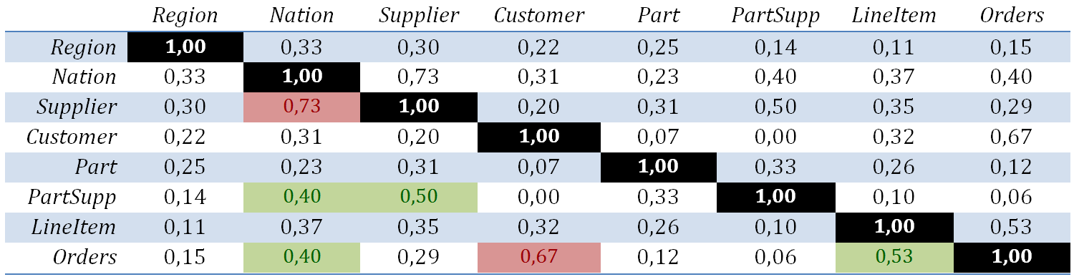
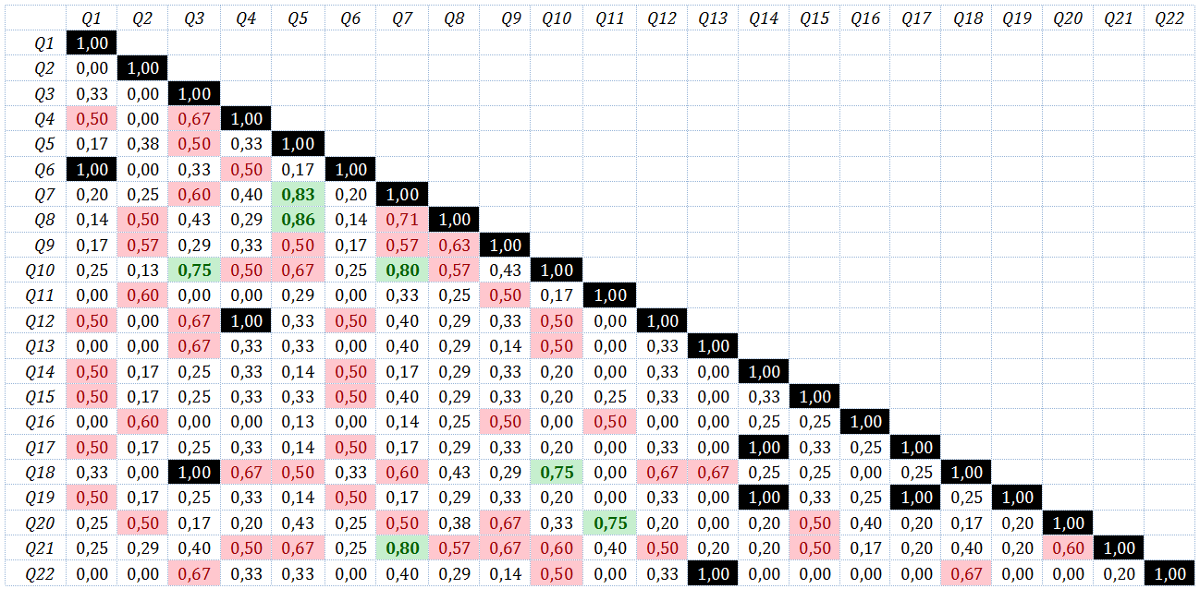

Slide 12
Barycenter Methods

Slide 13
Reference method for deploying bipartite graphs
Decide layers
Decide position of each node in its layer
  Such that the number of edge crossings is minimized
Assign coordinates in the 2D canvas

Slide 14
Reference method for deploying bipartite graphs
Decide layers
Decide position of each node in its layer
  Such that the number of edge crossings is minimized
Assign coordinates in the 2D canvas
In our case, steps 1 and 3 are easy; however step 2 is already NP-complete…

Slide 15
Barycenter methods
Recursive iterate the following over each layer of the bipartite graph
  Given two layers L and L’, where L’ has an ordering for its nodes
  Place each node of L as close as possible to the “middle” of the range of the nodes it accesses in layer L’,
  “middle” can be
    the median
    the average (barycenter) of their positions

Slide 16
In our case
2 layers: queries and relations
First align the relations by order of similarity
Then align the queries with respect to the placement of tables
We present only the sandwich extension: split the line of queries in two, surrounding the line of relations; place queries alternatively to the two lines

Slide 17
Align Tables as L1
Goal: place similar tables as close as possible
  “similar”: hit by as many as possible common queries
  Why? To reduce the span of these common queries

Slide 18
Align Tables as L1
While there exist relations not assigned to a position in the output list, the algorithm tries to find the two most similar relations out of the remaining ones, r_{i} and r_{j}, and once it finds them, it marks r_{i} as maxI and r_{j} as maxJ.
Then, it places relation maxI to the sorted list’s next free slot and adds right next to it all the relations whose similarity to maxI is larger than a user-defined threshold τ (which is given as input parameter to the algorithm).
Practically, the sorted list contains sub-lists of relations, each with decreasing maximum similarity among its members.

Slide 19
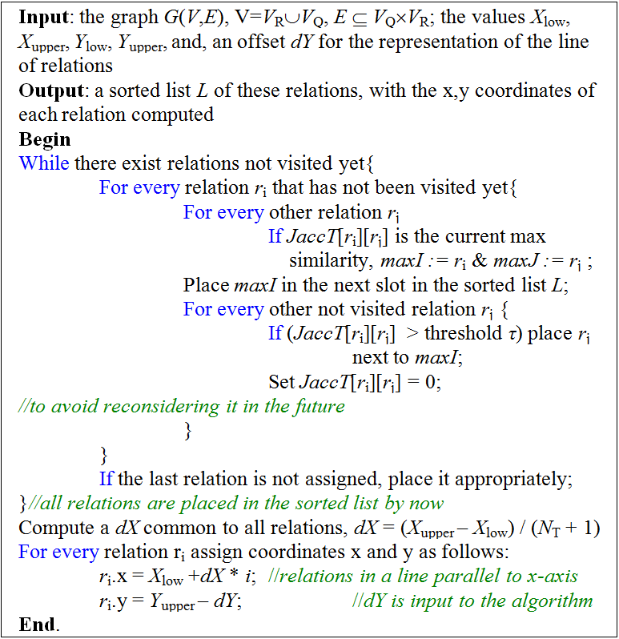
Align Tables as L1

Slide 20
Nation-Supplier & Customer-Orders
 | Region | Nation | Supplier | Customer | Part | Partsupp | Lineitem | Orders
Q1 | 0 | 0 | 0 | 0 | 0 | 0 | 1 | 0
Q2 | 1 | 1 | 1 | 0 | 1 | 1 | 0 | 0
Q3 | 0 | 0 | 0 | 1 | 0 | 0 | 1 | 1
Q4 | 0 | 0 | 0 | 0 | 0 | 0 | 1 | 1
Q5 | 1 | 1 | 1 | 1 | 0 | 0 | 1 | 1
Q6 | 0 | 0 | 0 | 0 | 0 | 0 | 1 | 0
Q7 | 0 | 1 | 1 | 1 | 0 | 0 | 1 | 1
Q8 | 1 | 1 | 1 | 1 | 1 | 0 | 1 | 1
Q9 | 0 | 1 | 1 | 0 | 1 | 1 | 1 | 1
Q10 | 0 | 1 | 0 | 1 | 0 | 0 | 1 | 1
Q11 | 0 | 1 | 1 | 0 | 0 | 1 | 0 | 0
Q12 | 0 | 0 | 0 | 0 | 0 | 0 | 1 | 1
Q13 | 0 | 0 | 0 | 1 | 0 | 0 | 0 | 1
Q14 | 0 | 0 | 0 | 0 | 1 | 0 | 1 | 0
Q15 | 0 | 0 | 1 | 0 | 0 | 0 | 1 | 0
Q16 | 0 | 0 | 1 | 0 | 1 | 1 | 0 | 0
Q17 | 0 | 0 | 0 | 0 | 1 | 0 | 1 | 0
Q18 | 0 | 0 | 0 | 1 | 0 | 0 | 1 | 1
Q19 | 0 | 0 | 0 | 0 | 1 | 0 | 1 | 0
Q20 | 0 | 1 | 1 | 0 | 0 | 1 | 1 | 0
Q21 | 0 | 1 | 1 | 0 | 0 | 0 | 1 | 1
Q22 | 0 | 0 | 0 | 1 | 0 | 0 | 0 | 1

Slide 21
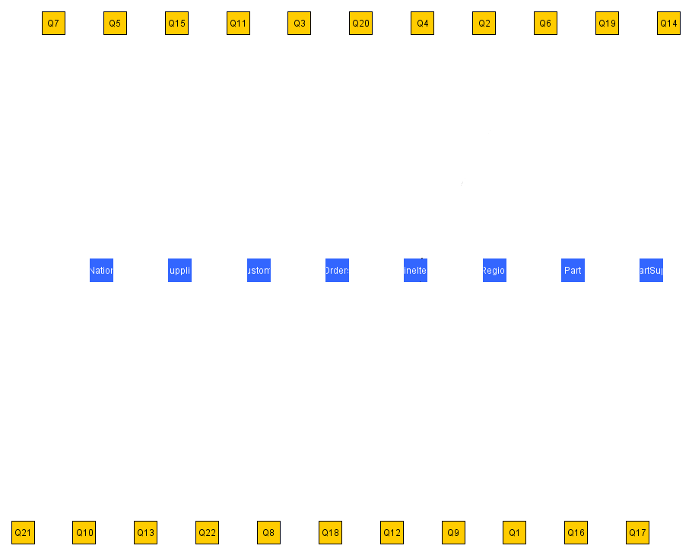

Slide 22
Coordinates
Once relations and queries are ordered, we give them coordinates
Y-coordinates fixed for both queries and relations
X-coordinates:
  Relations: each relation is placed in the next slot (computed as a dX step) in the x-axis
  Queries have a barycenter computation: we add the x coordinates of all the relations accessed by the query and we divide this sum by the out-degree of the query.

Slide 23
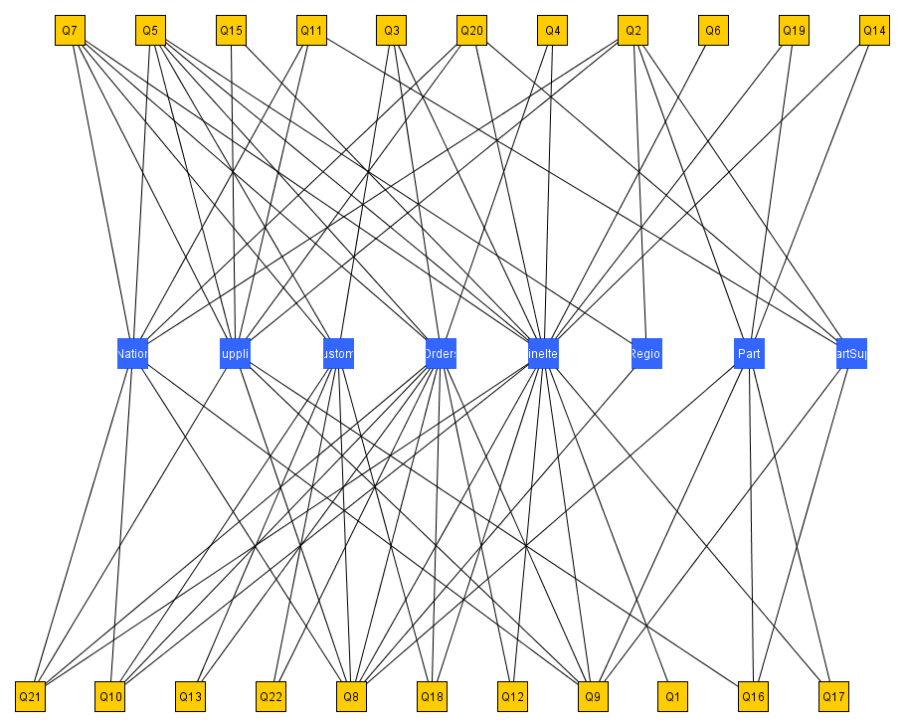

Slide 24
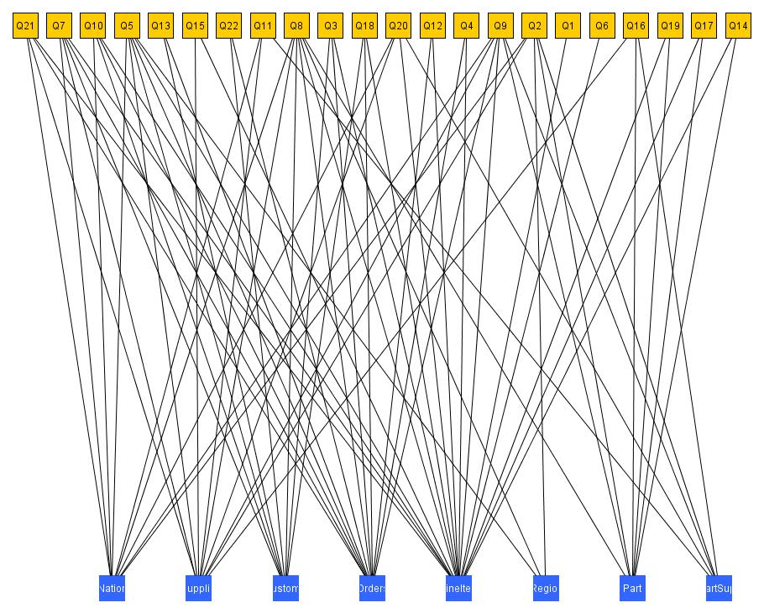

Slide 25
Radial layouts

Slide 26
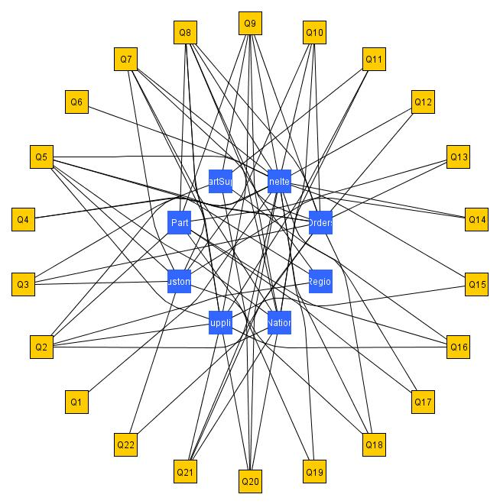
Basic idea
What if we bend the lines, to exploit the extra space?
Simple radial:
  Inner circle for relations
  Outer circle for queries
Simple Radial

Slide 27
Concentric circles
What –if, instead of 1 query circle, we have many concentric circles?
Keeps clear separation of queries and relations
Scales better
Adapts to different semantics
  One circle per query class
  … per source file / package / module
  … per developer
  …
  here: per query fan-out

Slide 28
Extra issues
Place each query as close to the relations if accesses
Handle gracefully the issue of large values for the range of accessed relations
Handle conflicts of nodes falling one on top of another

Slide 29
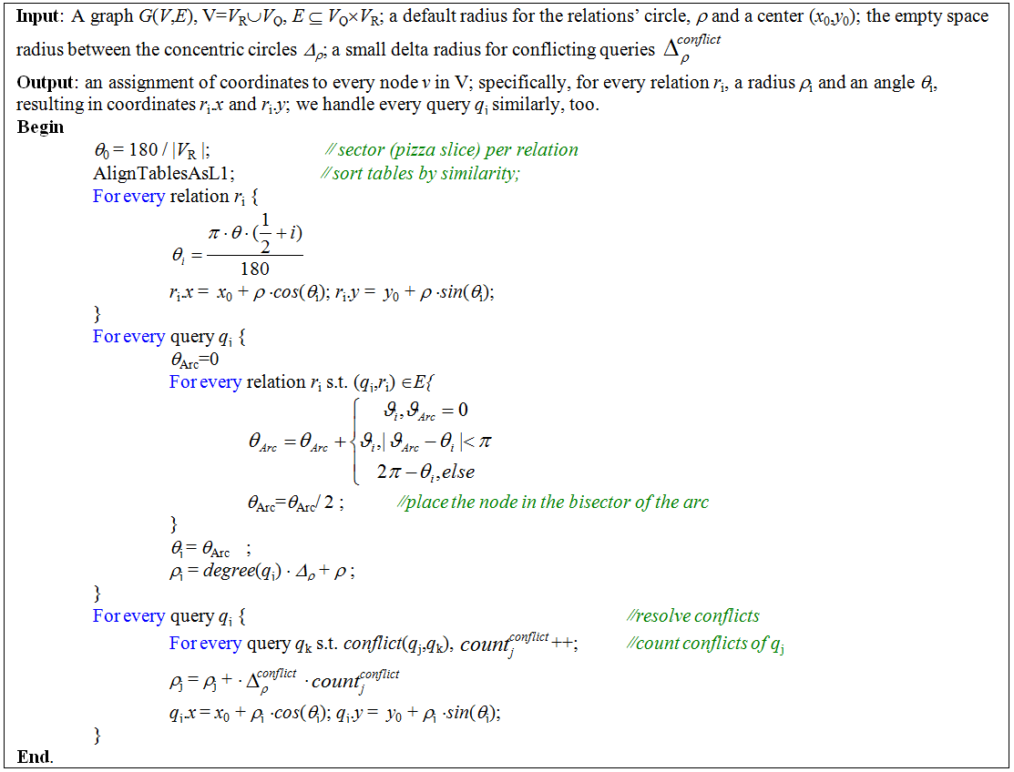
Algorithm Concentric Radial

Slide 30
Concentric Radial
We take as input
  the graph of the ecosystem
  the radius of the starting relations circle
  the empty space among circles
  a delta for conflicting queries
The output is a placement of queries and relations in a 2D canvas

Slide 31
Concentric Radial
First, Align Tables as L1, such that similar relations are placed one next to the other
Concert the relations’ line to circle, by computing the angle per relation
For each relation belonging to the next circle (here: depending on the fan-out), compute the arc of its accessing relations & place it in the bisector
  If some relations are further than 180º then, count the remainder angle
If there are conflicts, find the groups of conflicting nodes and push each of them by a small delta radius

Slide 32
…MOVIE with subtitles…
Surprisingly, the most interesting part is the “movie”

Slide 33
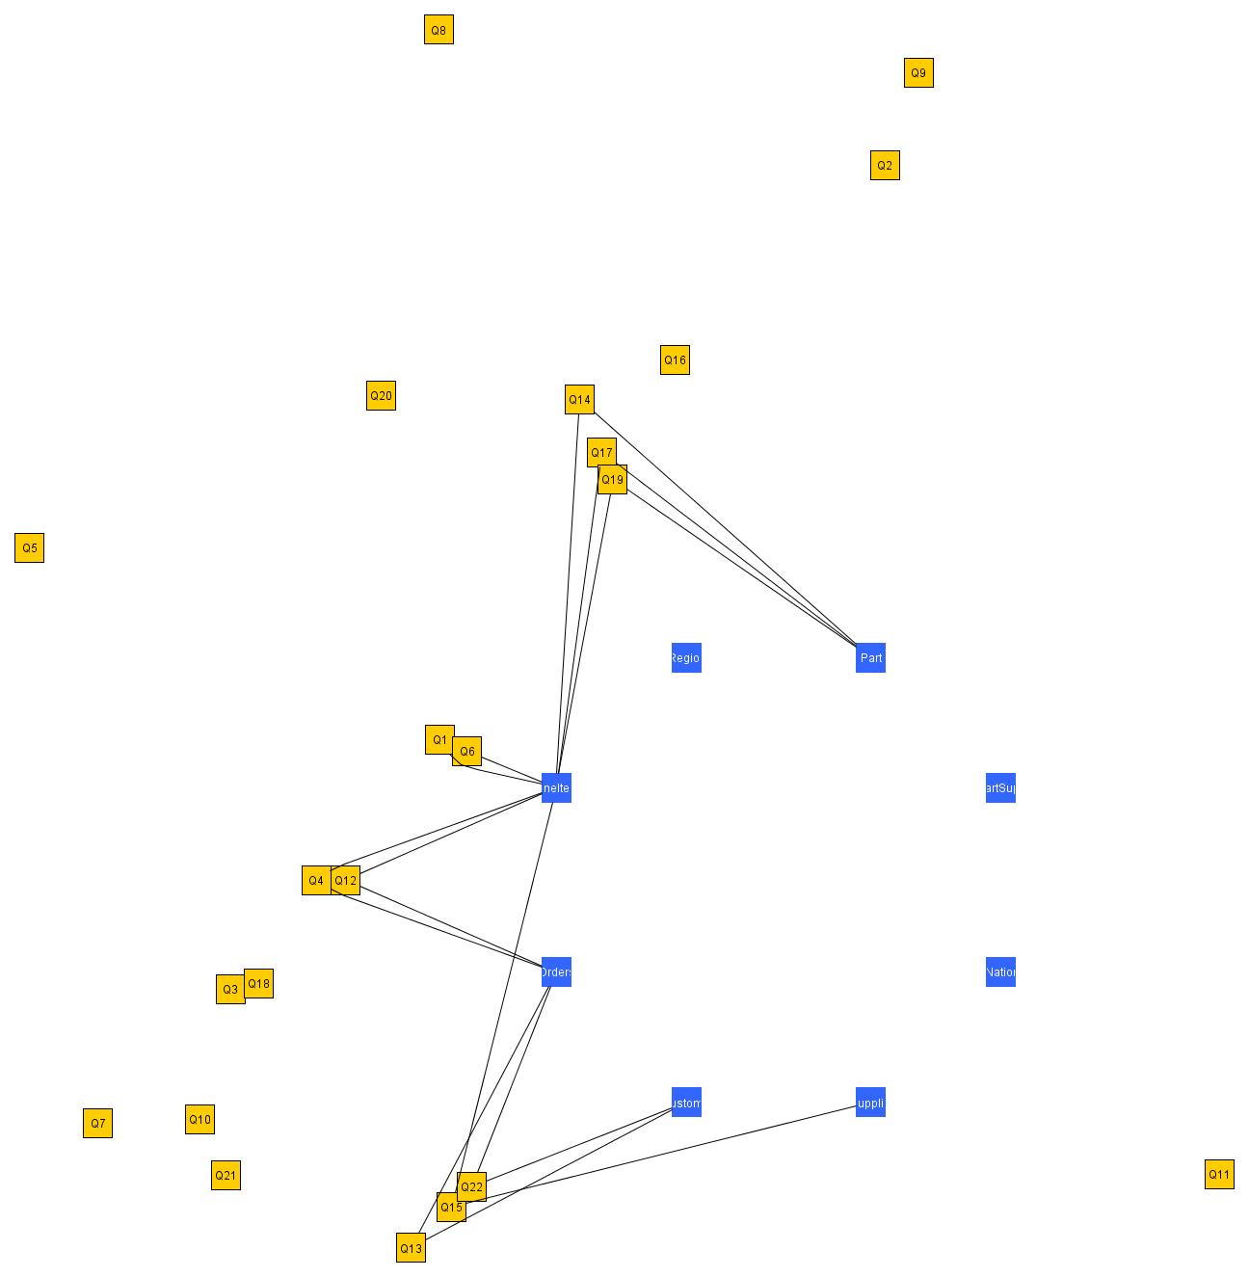
Fan-out = 1,2
Things are nice and calm in radar city
Observe the conflict resolution

Slide 34
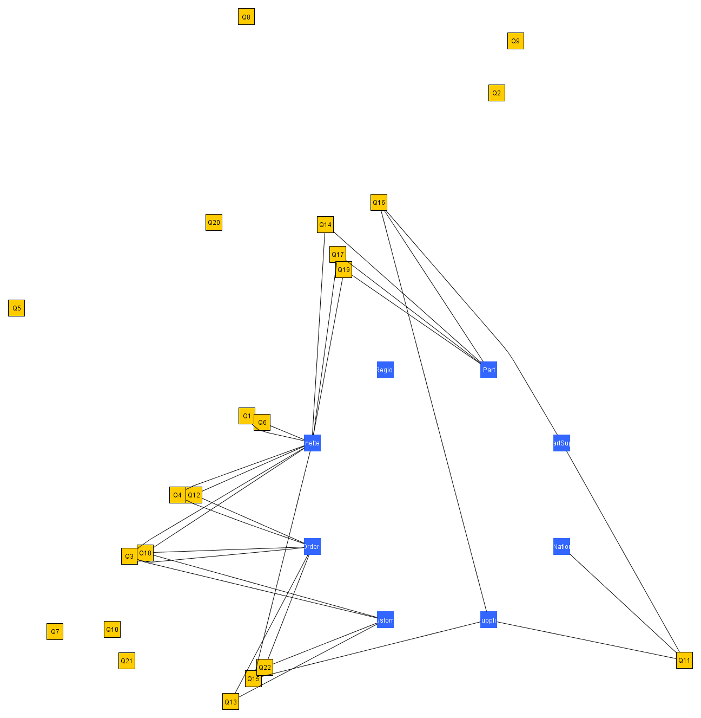
Observe the angle
Fan-out = 1,2,3

Slide 35

Fan-out = 1,2,3
See how the concentric circles work
It’s called RADAR, remember?

Slide 36

Observe the angle
Fan-out = 1,2,3,4
Interestingly, things are still quite clear with 17/22 queries

Slide 37
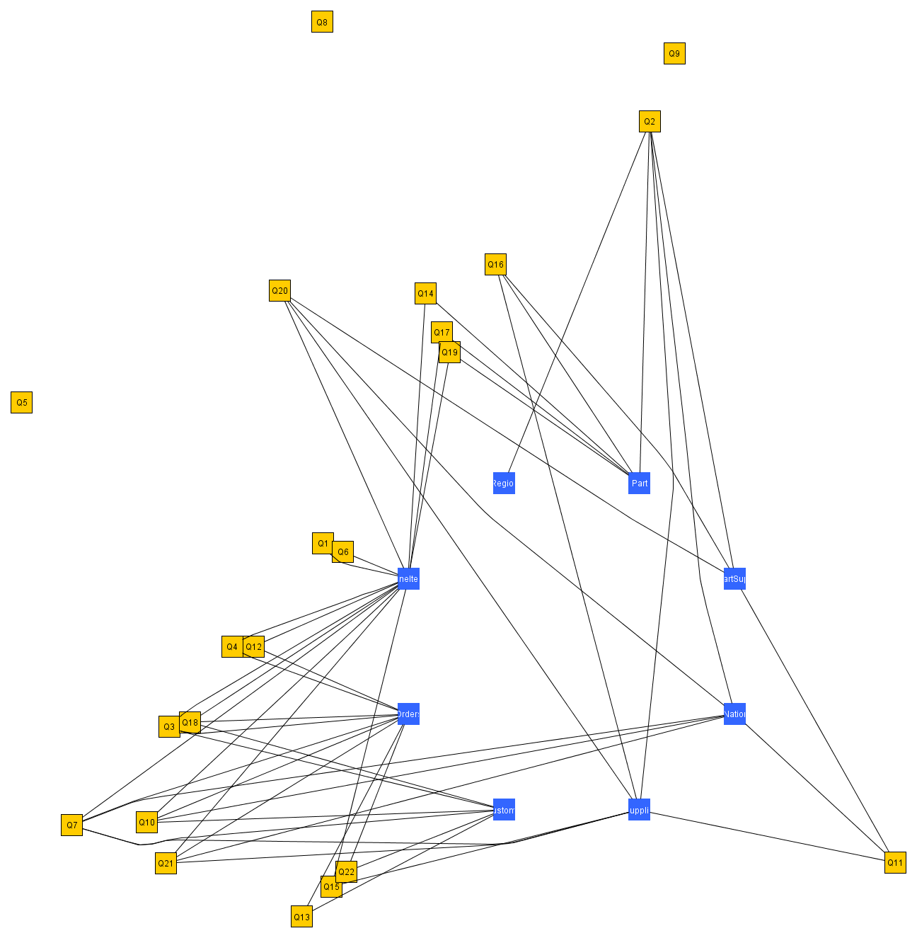
Fan-out = 1,2,3,4,5
Then, heavy hitters come…
A noisy guy

Slide 38
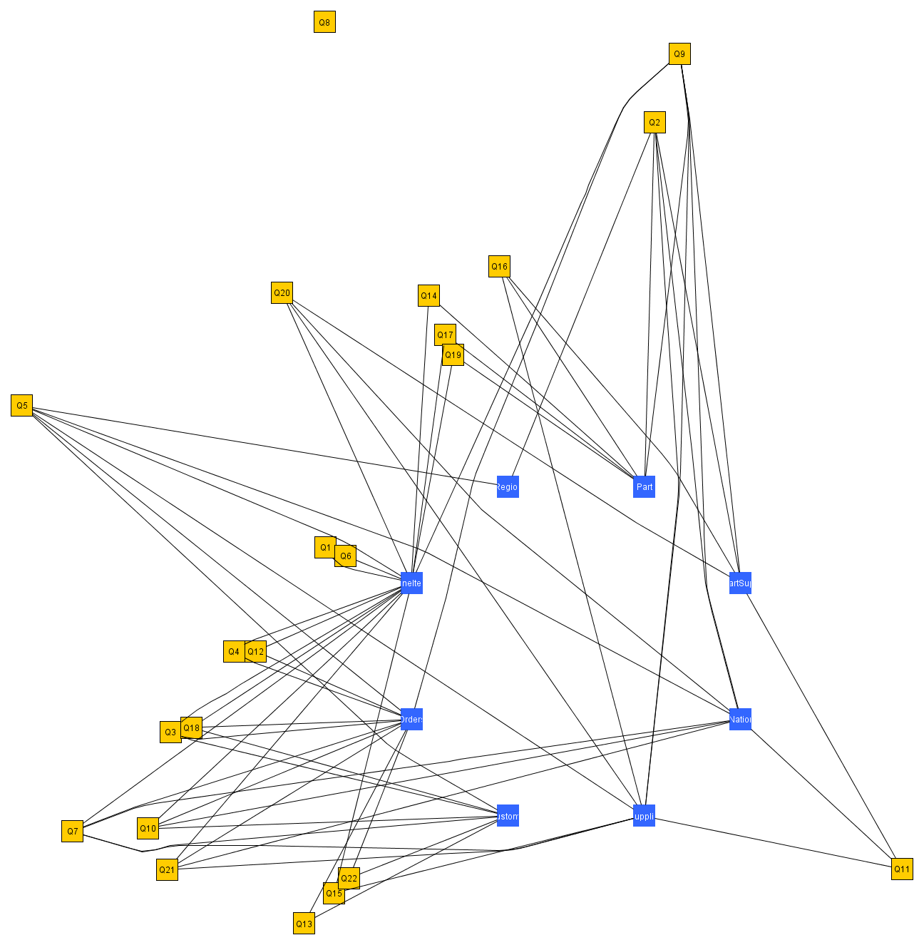
Fan-out = 1,2,3,4,5,6
… and edges become more of a noise …

Slide 39
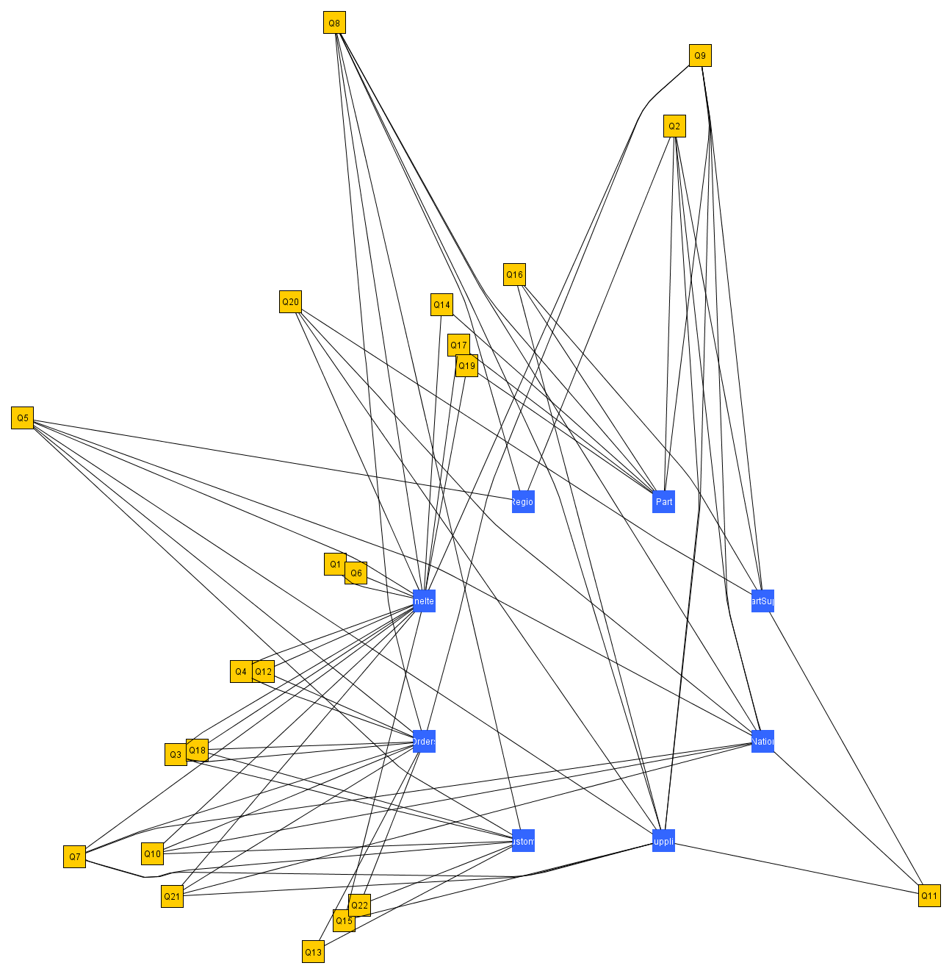
Done
… and edges become more and more of a noise …

Slide 40
What have we gained?
Clear diagram
  (to a large, but not full) extent
Less noise than barycenter
Scalability
… the movie … (!)
  try it backwards ☺
The visual clustering of queries (!)

Slide 41
Cluster: Q14, Q17, Q19

Slide 42
Conclusions and thoughts for the future

Slide 43
What we have done
Two methods for the visualization of data centric ecosystems, both with 2 variants
  barycentric (here shown only the sandwich variant)
  Radial – mainly interested to the concentric radial (or RADAR)
RADAR gives us better scalability, uses the empty space better, has multiple usages for its circles, clusters queries nicely and provides spatial memory

Slide 44
…but…
Heavy hitters make too much noise
  Possibly stop adding edges after a threshold circle (remember: here fan-out determines the circle)
  Unfortunately, agglomerative clustering of queries soon creates heavy hitters, too ☹
Need for many real world examples to test scalability
  Any input/suggestion/… is most welcome!!
Not yet incorporated in our impact analysis tool, HECATAEUS
  http://www.cs.uoi.gr/~pvassil/projects/hecataeus

Slide 45
…and…
More sophisticated modeling
  of the graph (e.g., with query semantics incorporated)
  of the distance function
  with views included
  of both the logical (current) graph with its physical counterparts (i.e., info on scripts, stored procedures, triggers, …)

Slide 46

Thank you!
Questions?
Many thanks go to our hosts and the W/S organizers

Slide 47
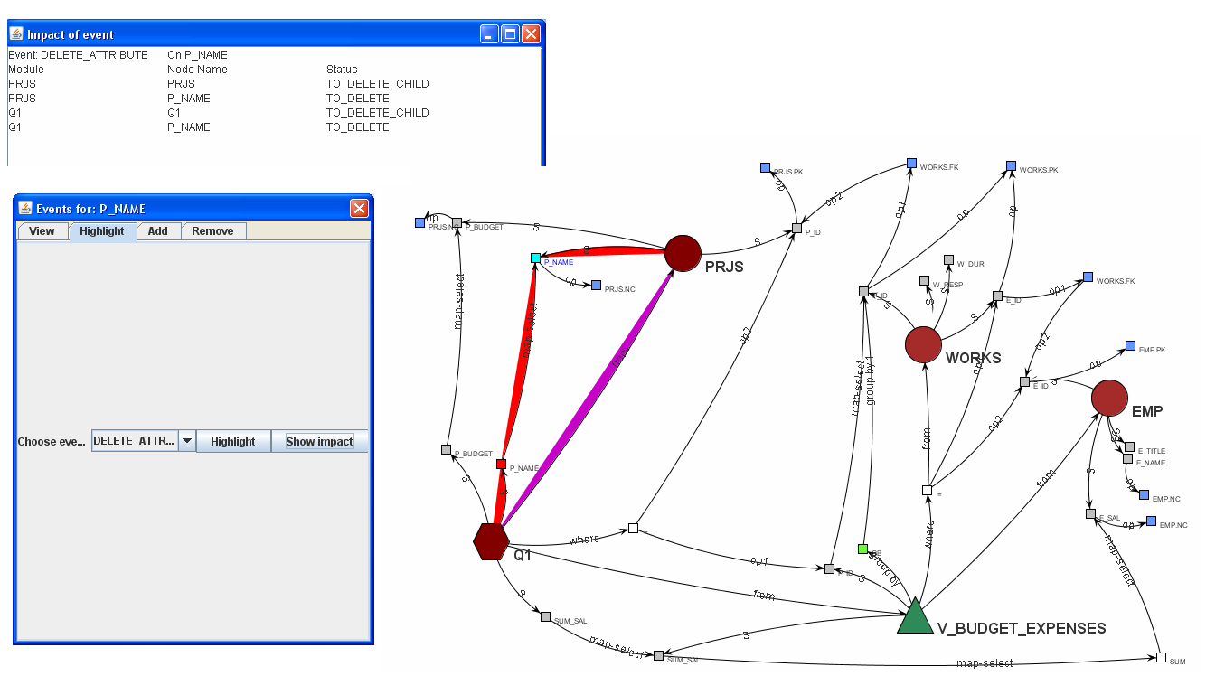
http://www.cs.uoi.gr/~pvassil/projects/hecataeus

