Slide 1
PHP, Javascript, SQL
By Petros Manousis, March 2015

Slide 2
A short example
A simple example with:
a postgres database back-end
a PHP page at the server
a javascript function that exchanges values via parameter passing with php
Runs at http://pc58.cs.uoi.gr/example/

Slide 3
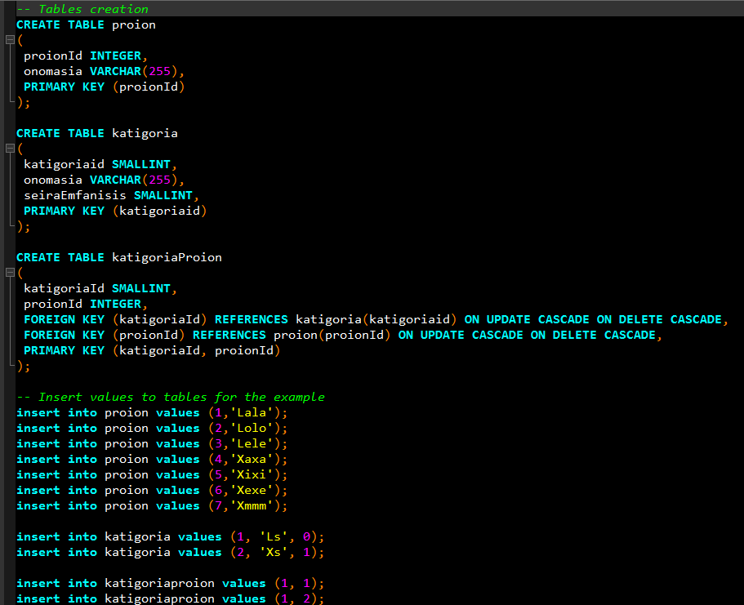

Slide 4
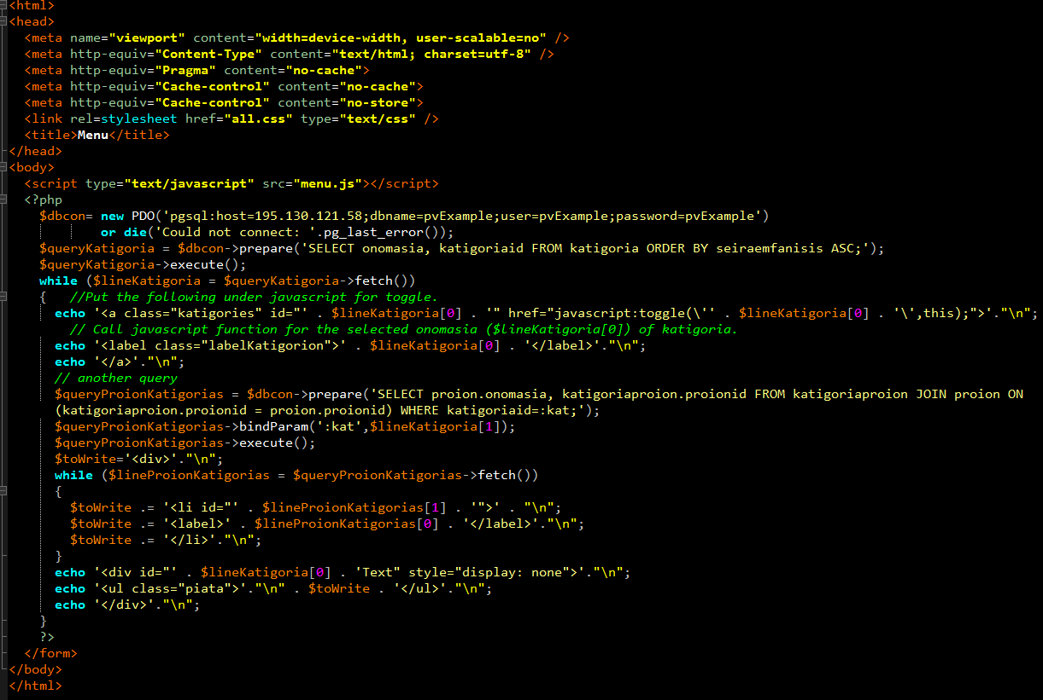
Menu.php

Slide 5
Menu.php

Slide 6
For mySQL: connection // see also http://php.net/manual/en/pdo.installation.php
<?php /* Connect to an ODBC database using driver invocation */ $dsn = 'mysql:dbname=testdb;host=127.0.0.1'; $user = 'dbuser'; $password = 'dbpass'; try { $dbh = new PDO($dsn, $user, $password); } catch (PDOException $e) { echo 'Connection failed: ' . $e->getMessage(); } ?>

