Slide 1
Privacy in Social Networks:
Introduction

Slide 2
Model: Social Graph
Social networks model social relationships by graph structures using vertices and edges.
Vertices model individual social actors in a network, while edges model relationships between social actors.
Labels (type of edges, vertices)
Directed/undirected
G = (V, E, L, L_{V}, L_{E}) V: set of vertices (nodes), E ⊆ V x V, set of edges, L set of labels, L_{V}: V → L, L_{E:} E → L
Bipartite graphs Tag – Document - Users

Slide 3
Privacy Preserving Publishing
1. User (participates in the network)
2. Attacker
3. Analyst
Given an input graph G of a social graph
Transform it so that
The attacked cannot disclose private information about the users (PRIVACY)
The analyst can still deduce useful information from the graph (UTILITY)

Slide 4
Privacy Preserving Publishing
Attacker
Background Knowledge
participation in many networks
or
Specific Attack
Types of Attacks
structural
examples:
          vertex refinement, subgraph, hub fingerprint
          degree
active vs passive
Quasi Identifiers
Analysts
Utility
Graph properties
      number of nodes/edges
      Experimentally, also:
      average path length, network diameter
      clustering coefficient
      average degree, degree distribution

Slide 5
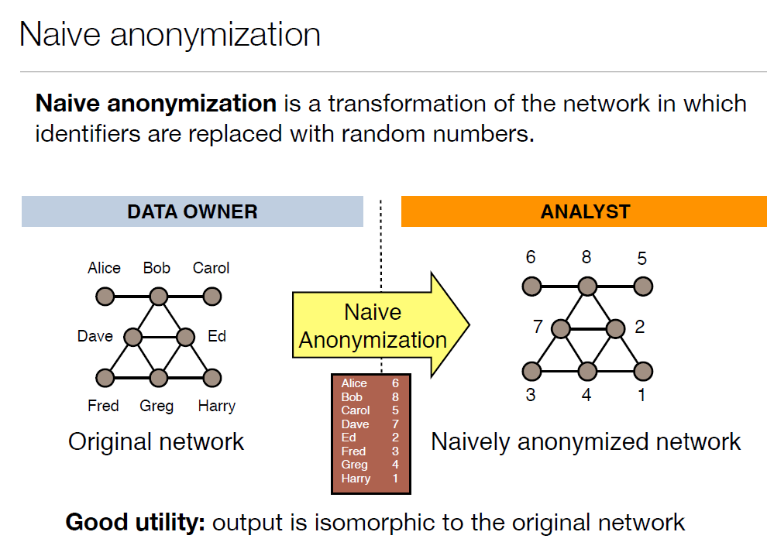
Privacy Preserving Publishing

Slide 6
Mappings that preserve the graph structure
A graph homomorphism f from a graph G = (V, E) to a graph G' = (V', E'), is a mapping f: G → G’, from the vertex set of G to the vertex set of G’ such that (u, u’) ∈ G ⇒ (f(u), f(u’)) ∈ G’
If the homomorphism is a bijection whose inverse function is also a graph homomorphism, then f is a graph isomorphism [(u, u’) ∈ G ⇔ (f(u), f(u’)) ∈ G’]

Slide 7
The general graph isomorphic problem which determines whether two graphs are isomorphic is NP-hard

Slide 8
Mappings that preserve the graph structure
A graph automorphism is a graph isomorphism with itself, i.e, a mapping from the vertices of the given graph G back to vertices of G such that the resulting graph is isomorphic with G. An automorphism f is non-trivial if it is not identity function.
A bijection, or a bijective function, is a function f from a set X to a set Y with the property that, for every y in Y, there is exactly one x in X such that f(x) = y.
Alternatively, f is bijective if it is a one-to-one correspondence between those sets; i.e., both one-to-one (injective) and onto (surjective)).

Slide 9
Privacy Models
Relational data: Identify (sensitive attribute of an individual)
Background knowledge and attack model: know the values of quasi identifiers and attacks come from identifying individuals from quasi identifiers
Social networks: Privacy classified into
Vertex existence
Identity disclosure
Link or edge disclosure
vertex (or link attribute) disclosure (sensitive or non-sensitive attributes)
content disclosure: the sensitive data associated with each vertex is compromised, for example, the email message sent and/or received by the individuals in an email communication network.
property disclosure

Slide 10
Anonymization Methods
Clustering-based or Generalization-based approaches: cluster vertices and edges into groups and replace a subgraph with a super-vertex
Graph Modification approaches: modifies (inserts or deletes) edges and vertices in the graph (Perturbations)
  randomized
  operations

Slide 11
Some Graph-Related Definitions
A subgraph H of a graph G is said to be induced if,
for any pair of vertices x and y of H, (x, y) is an edge of H if and only if (x, y) is an edge of G.
In other words, H is an induced subgraph of G if it has exactly the edges that appear in G over the same vertex set.
If the vertex set of H is the subset S of V(G), then H can be written as G[S] and is said to be induced by S.
Neighborhood

Slide 12
Active and Passive Attacks
Lars Backstrom, Cynthia Dwork and Jon Kleinberg,
Wherefore art thou r3579x?: anonymized social networks, hidden patterns, and structural steganography
Proceedings of the 16th international conference on World Wide Web, 2007 (WWW07)

Slide 13
k-anonymity in Graphs

Slide 14
Publishing Social Graphs
Methods based on k-anonymity
  k-candidate
  k-degree
  k-neighborhood
  k-automorphism

Slide 15
k-candidate Anonymity
automorphism, vertex refinement, subgraph and hub fingerprint queries
Michael Hay, Gerome Miklau, David Jensen, Donald F. Towsley, Philipp Weis: Resisting structural re-identification in anonymized social networks. PVLDB 1(1): 102-114 (2008)
Journal version with detailed clustering algorithm:
Michael Hay, Gerome Miklau, David Jensen, Donald F. Towsley, Chao Li: Resisting structural re-identification in anonymized social networks. VLDB J. 19(6): 797-823 (2010)

Slide 16
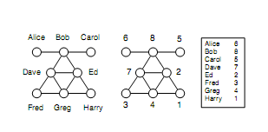
Main Points:
An individual x ∈ V called the target has a candidate set, denoted cand(x) which consists of the nodes of G_{a} that could possibly correspond to x
k is the size of the candidate set
An adversary has access to a source that provides answers to a restricted knowledge query Q evaluated for a single target node of the original graph G.
For target x, use Q(x) to refine the candidate set.
[CANDIDATE SET UNDER Q]. For a query Q over a graph, the candidate set of x w.r.t Q is cand_{Q}(x) = {y ∈V_{a} | Q(x) = Q(y)}.

Slide 17
Main Points:
Two important factors
descriptive power of the external information – background knowledge
structural similarity of nodes – graph properties
Closed-World vs Open-World Adversary
Assumption: External information sources are accurate, but not necessarily complete
  Closed-world: absent facts are false
  Open-world: absent facts are simply unknown

Slide 18
Main Points:
Introduces 3 models of external information
Evaluates the effectiveness of these attacks
  real networks
  random graphs
Proposes an anonymization algorithm based on clustering

Slide 19
Anonymity through Structural Similarity
Strongest notion of privacy
[automorphic equivalence]. Two nodes x, y ∈ V are automorphically equivalent (denoted x ≡ y) if there exists an isomorphism from the graph onto itself that maps x to y.
Example: Fred and Harry, but not Bob and Ed
Induces a partitioning on V into sets whose members have identical structural properties.
An adversary —even with exhaustive knowledge of the structural position of a target node — cannot identify an individual beyond the set of entities to which it is automorphically equivalent.
Some special graphs have large automorphic equivalence classes.
  E.g., complete graph, a ring

Slide 20
Adversary Knowledge
Vertex Refinement Queries
Subgraph Queries
Hub Fingerprint Queries

Slide 21

Vertex Refinement Queries
A class of queries of increasing power which report on the local structure of the graph around a node.
The weakest knowledge query, H₀, simply returns the label of the node.
H₁(x) returns the degree of x,
H₂(x) returns the multiset of each neighbors’ degree,
H_{i}(x) returns the multiset of values which are the result of evaluating H_{i-1} on the nodes adjacent to x

Slide 22
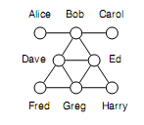
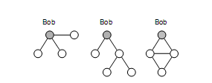
Subgraph Queries
Subgraph queries: class of queries about the existence of a subgraph around the target node.
Measure their descriptive power by counting edge facts (# edges in the subgraph)
may correspond to different strategies
may be incomplete (open-world)

Slide 23
Hub Fingeprint Queries
A hub is a node with high degree and high betweenness centrality (the proportion of shortest paths in the network that include the node)
A hub fingerprint for a target node x is a description of the connections of x (distance) to a set of designated hubs in the network.
F_{i}(x) hub fingerprint of x to a set of designated hubs, where i limit on the maximum distance

Slide 24
Disclosure in Real Networks
For each data set, consider each node in turn as a target.
Assume the adversary computes a vertex refinement query, a subgraph query, or a hub fingerprint query on that node, and then compute the corresponding candidate set for that node.
Report the distribution of candidate set sizes across the population of nodes to characterize how many nodes are protected and how many are identifiable.

Slide 25
Synthetic Datasets
Random Graphs (Erdos-Reiny (ER) Graphs)
Power Law Graphs

Slide 26

Anonymization Algorithms
Partition/Cluster the nodes of Ga into disjoint sets
In the generalized graph,
  supernodes: subsets of Va
  edges with labels that report the density
Partitions of size at least k

Slide 27
Anonymization Algorithms
For any generalization G of Ga, W(G) the set of possible worlds (graphs over Va) that are consistent with G.
Intuitively, this set of graphs is generated by
considering each supernode X and choosing exactly d(X, X) edges between its elements, then
considering each pair of supernodes (X, Y ) and choosing exactly d(X, Y ) edges between elements of X and elements of Y .
The size of W(G) is a measure of the accuracy of G as a summary of Ga.
Extreme cases:
a singe super-node with self-loop, Ga -> size of W(G)?
each partition a single node -> size of W(G)?
Again: Privacy vs Utility
Analyst: samples a random graph from this set

Slide 28

Anonymization Algorithms
Require that each partition has at least size k => cand_{Q}(x) ≥ k
Find a partition that best fits the input graph
Estimate fitness via a maximum likelihood approach
Uniform probability distribution over all possible worlds

Slide 29
Anonymization Algorithms
Searches all possible partitions using simulated annealing
Each valid partitions (minimum partition of at least k nodes) is a valid state
Starting with a single partition with all nodes, propose a change of state:
split a partition
merge two partitions, or
move a node to a different partition
Proposal always accepted if it improves the likelihood, accepted with some probability if it decreases the likelihood
Stop when fewer than 10% of the proposals are accepted

Slide 30
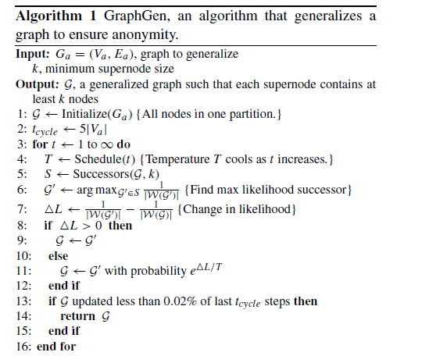
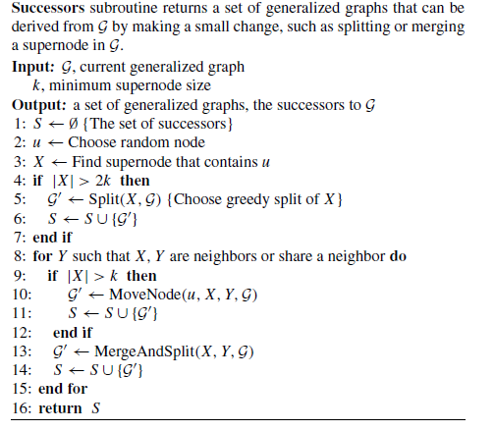
Anonymization Algorithms

Slide 31
Anonymization Algorithms
Utility Measures
Degree: distribution of the degrees of all vertices in the graph.
Path length: distribution of the lengths of the shortest paths between 500 randomly sampled pairs of vertices in the graph.
Transitivity (a.k.a. clustering coefficient): distribution of values where, for each vertex, we find the proportion of all possible neighbor pairs that are connected.
Network resilience is measured by plotting the number of vertices in the largest connected component of the graph as nodes are removed in decreasing order of degree.
Infectiousness is measured by plotting the proportion of vertices infected by a hypothetical disease, which is simulated by first infecting a randomly chosen node and then transmitting the disease to each neighbor with the specified infection rate

Slide 32
k-degree Anonymity
K. Liu and E. Terzi, Towards Identity Anonymization on Graphs, SIGMOD 2008

Slide 33
Privacy model
k-degree anonymity A graph G(V, E) is k-degree anonymous if every node in V has the same degree as k-1 other nodes in V.
A (2)
A (2)
B (1)
E (1)
B (2)
E (2)
anonymization
C (1)
D (1)
C (1)
D (1)

Slide 34
Degree-sequence anonymization
[k-anonymous sequence] A sequence of integers d is k-anonymous if every distinct element value in d appears at least k times.
[100,100, 100, 98, 98,15,15,15]
A graph G(V, E) is k-degree anonymous if its degree sequence is k-anonymous

Slide 35
Problem Definition
Given a graph G(V, E) and an integer k, modify G via a set of edge addition or deletion operations to construct a new graph k-degree anonymous graph G’ in which every node u has the same degree with at least k-1 other nodes

Slide 36
Problem Definition
Given a graph G(V, E) and an integer k, modify G via a minimal set of edge addition or deletion operations to construct a new graph G’(V’, E’) such that
1) G’ is k-degree anonymous;
2) V’ = V;
3) The symmetric difference of G and G’ is as small as possible
Symmetric difference between graphs G(V,E) and G’(V,E’) :
Assumption: G: undirected, unlabeled, no self-loops or multiple-edges
Only edge additions -- SymDiff(G’, G) = |E’| - |E|
There is always a feasible solution (ποια;)

Slide 37
Degree-sequence anonymization
Increase/decrease of degrees correspond to additions/deletions of edges
[degree-sequence anonymization] Given degree sequence d, and integer k, construct k-anonymous sequence d’ such that ||d’-d|| (i.e., L₁(d’ – d)) is minimized
|E’| - |E| = ½ L₁(d’ – d)
Relax graph anonymization: E’ not a supergraph of E

Slide 38
Με λίγα λόγια …
Σε 2 βήματα
Step 1: Given d -> construct d’ (anonymized)
Step 2: Given d’ -> construct a graph with d’
Step 1:
Naïve
Greedy
Dynamic Programming solution
Step 2:
Start from G
Start from d’
Hybrid

Slide 39
Graph Anonymization algorithm
Two steps
Input: Graph G with degree sequence d, integer k Output: k-degree anonymous graph G’
[STEP 1: Degree Sequence Anonymization]: Construct an (optimal) k-anonymous degree sequence d’ from the original degree sequence d [STEP 2: Graph Construction]: [Construct]: Given degree sequence d', construct a new graph G⁰(V, E⁰) such that the degree sequence of G⁰ is d‘ .

Slide 40
degree-sequence anonymization
Greedy
Form a group with the first k, for the k+1, consider
C_{merge} = (d(1) – d(k+1)) + I(k+2, 2k+1) – C_{new}(k+1, 2k)

Slide 41
DP for degree-sequence anonymization
DA(1, j): the optimal degree anonymization of subsequence d(1, j)
DA(1, n): the optimal degree-sequence anonymization cost
I(i, j): anonymization cost when all nodes i, i+1, …, j are put in the same anonymized group
For i < 2k (impossible to construct 2 different groups of size k)
For i ≥ 2k

Slide 42
DP for degree-sequence anonymization
Can be improved, no anonymous groups should be of size larger than 2k-1
We do not have to consider all the combinations of I(i, j) pairs, but for every i, only j’s such that k ≤ j – i + 1 ≤ 2k-1
O(n²) -> (Onk)
Additional bookkeeping -> Dynamic Programming with O(nk)

Slide 43
Με λίγα λόγια …
Σε 2 βήματα
Step 1: Given d -> construct d’ (anonymized)
Step 2: Given d’ -> construct a graph with d’
Step 1:
Naïve
Greedy
Dynamic Programming solution
Step 2:
Start from G
Start from d’
Hybrid

Slide 44
Are all degree sequences realizable?
A degree sequence d is realizable if there exists a simple undirected graph with nodes having degree sequence d.
Not all vectors of integers are realizable degree sequences
  d = {4,2,2,2,1} ?
How can we decide?

Slide 45
Realizability of degree sequences
[Erdös and Gallai] A degree sequence d with d(1) ≥ d(2) ≥… ≥ d(i) ≥… ≥ d(n) and Σd(i) even, is realizable if and only if
For each subset of the l highest degree nodes, the degrees of these nodes can be “absorbed” within the nodes and the outside degrees

Slide 46
Realizability of degree sequences
Input: Degree sequence d’
Output: Graph G⁰(V, E⁰) with degree sequence d’ or NO!
General algorithm, create a graph with degree sequence d’
In each iteration,
pick an arbitrary node u
add edges from u to d(u) nodes of highest residual degree, where d(u) is the residual degree of u
Is an oracle
Instead of arbitrary
higher (dense)
lower (sparse)

Slide 47
Realizability of degree sequences
We also need G’ such that E’ ⊇ E
Algorithm 1
we start with the edges of E already in
Is not an oracle

Slide 48
Realizability of degree sequences
Input: Degree sequence d’
Output: Graph G⁰(V, E⁰) with degree sequence d’ or NO!
→If the degree sequence d’ is NOT realizable?
  Convert it into a realizable and k-anonymous degree sequence
Slightly increase some of the entries in d via the addition of uniform noise
in real graph, few high degree nodes – rarely any two of these exactly the same degree
examine the nodes in increasing order of their degrees, and slightly increase the degrees of a single node at each iteration
Slightly increasing the degree of small-degree nodes in d

Slide 49
GraphAnonymization algorithm (relaxed)
Input: Graph G with degree sequence d, integer k Output: k-degree anonymous graph G’
[Degree Sequence Anonymization]: Contruct an anonymized degree sequence d’ from the original degree sequence d [Graph Construction]: [Construct]: Given degree sequence d', construct a new graph G⁰(V, E⁰) such that the degree sequence of G⁰ is d‘ [Transform]: Transform G⁰(V, E⁰) to G’(V, E’) so that SymDiff(G’,G) is minimized.

Slide 50
Graph-transformation algorithm
GreedySwap transforms G⁰ = (V, E⁰) into G’(V, E’) with the same degree sequence d’, and min symmetric difference SymDiff(G’,G) .
GreedySwap is a greedy heuristic with several iterations.
At each step, GreedySwap swaps a pair of edges to make the graph more similar to the original graph G, while leaving the nodes’ degrees intact.
Notes:
50
Overall process dp-erdosgallai-transform the graph into something close to the original graph

Slide 51
Valid swappable pairs of edges
A swap is valid if the resulting graph is simple

Slide 52
GreedySwap algorithm
Input: A pliable graph G⁰(V, E⁰) , fixed graph G(V,E) Output: Graph G’(V, E’) with the same degree sequence as G⁰(V,E⁰)
i=0 Repeat find the valid swap in G^{i} that most reduces its symmetric difference with G , and form graph G^{i+1} i++

Slide 53
Experiments
Datasets:
  Co-authors (7995 authors of papers in db and theory conference),
  Enron emails (151 users, edge if at least 5 times),
  powergrid (generators, transformers and substations in a powergrid network, edges represent high-voltage transmission lines between them),
  Erdos-Renyi (random graphs with nodes randomly connected to each other with probability p),
  small-world large clustering coefficient (average fraction of pair of neighbors of a node that are also neighbors) and small average path length (average length of the shortest path between all pairs of reachable nodes),
  power-law or scale graphs (the probability that a node has degree d is proportional to d^{-γ}, γ = 2, 3)
Goal (Utility): degree-anonymization does not destroy the structure of the graph
  Average path length
  Clustering coefficient
  Exponent of power-law distribution

Slide 54
Experiments: Clustering coefficient and Avg Path Length
Co-author dataset
APL and CC do not change dramatically even for large values of k

Slide 55
Experiments: Edge intersections
Edge intersection achieved by the GreedySwap algorithm for different datasets (average over various k).
Parenthesis value indicates the original value of edge intersection before Greedy Swap
Synthetic datasets
Small world graphs* | 0.99 (0.01)
Random graphs | 0.99 (0.01)
Power law graphs** | 0.93 (0.04)
Real datasets
Enron | 0.95 (0.16)
Powergrid | 0.97 (0.01)
Co-authors | 0.91(0.01)
(*) L. Barabasi and R. Albert: Emergence of scaling in random networks. Science 1999.
(**) Watts, D. J. Networks, dynamics, and the small-world phenomenon. American Journal of Sociology 1999

Slide 56
Experiments: Exponent of power law distributions
Original | 2.07
k=10 | 2.45
k=15 | 2.33
k=20 | 2.28
k=25 | 2.25
k=50 | 2.05
k=100 | 1.92
Co-author dataset
Exponent of the power-law distribution as a function of k

Slide 57
k-neighborhood Anonymity
B. Zhou and J. Pei, Preserving Privacy in Social Networks Against Neighborhood Attacks, ICDE 2008

Slide 58
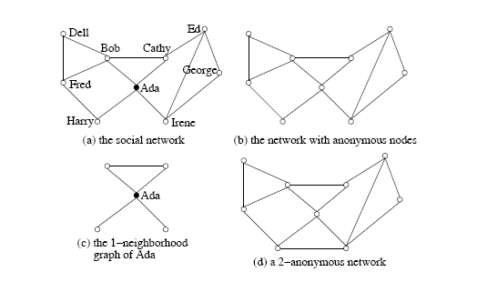
Motivation
An adversary knows that:
Ada has two friends who know each other, and has another two friends who do not know each other (1-neighborhood graph)
Similarly, Bob can be identified if the adversary knows its 1-neighborhood graph

Slide 59
1-neighborhood attacks
The neighborhood of u ∈ V(G) is the induced subgraph of the neighbors of u, denoted by Neighbor_{G}(U) = G(N_{u}) where N_{u} = {v | (u,v) ∈ E(G)}.

Slide 60
Graph Model
Graph G= (V, E, L, F),
V is a set of vertices,
E ⊆ VxV is a set of edges,
L is a set of labels, and
F a labeling function F: V → L assigns each vertex a label
edges do not carry labels
Items in L form a hierarchy
E.g., if L occupations, L contains not only the specific occupations [such as dentist, general physician, optometrist, high school teacher, primary school teacher, etc] but also general categories [such as, medical doctor, teacher, and professional}.
* ∈ L -> most general category generalizing all labels
Partial order
Διαφορά από τα προηγούμενα: οι κόμβοι έχουν labels

Slide 61
Graph Model
Given a graph = (V_{H}, E_{H}, L, F ) and a social network G = (V, E, L, L), an instance of H in G is a tuple (H', f) where H' = (V_{H’} ,E_{H’} ,L, F) is a subgraph in G and f: V_{H} →V_{H’}, is a bijection function such that
(1) for any u ∈ V_{H}, F(f(u)) ≤ F(u), /* the corresponding labels in H’ are more general */ and
(2) (u, v) ∈ E_{H} if and only if (f (u), f(v)) ∈ E_{H’}.
Naïve anonymization + labels (labels can be replaced by more general ones)

Slide 62
G -> G’ through a bijection (isomorphism) A
No edge deletion and V’ = V
[k-neighborhood anonymity] A vertex u ∈ V (G), u is k anonymous in G’ if there are at least (k − 1) other vertices u₁, . . . , u_{k−1} ∈ V (G) such that Neighbor_{G′}(A(u)), Neighbor_{G′}(A(u₁)), . . ., Neighbor_{G′}(A(u_{k−1})) are isomorphic.
G′ is k-anonymous if every vertex in G′ is k-anonymous.
Property 1 (k-anonymity) Let G be a social network and G′ an anonymization of G.
If G′ is k-anonymous, then with the neighborhood background knowledge, any vertex in G cannot be re-identified in G′ with confidence larger than 1/k .

Slide 63
Given a social network G, the k-anonymity problem is to compute an anonymization G′ such that
(1) G′ is k-anonymous;
(2) each vertex in G is anonymized to a vertex in G′ and G′ does not contain any fake vertex; (no node addition/deletion)
(3) every edge in G is retained in G′; and (no edge deletion)
(4) the number of edges to be added is minimized.

Slide 64
Utility
Aggregate queries:
compute the aggregate on some paths or subsgraphs satisfying some given conditions
E.g., Average distance from a medical doctor to a teacher
Heuristically, when the number of edges added is as small as possible, G′ can be used to answer aggregate network queries accurately

Slide 65
Anonymization Method
Two steps:
STEP 1
Extract the neighborhoods of all vertices in the network
Encode the neighborhood of each vertex (to facilitate the comparison between neigborhoods)
STEP 2
Greedily, organize vertices into groups and anonymize the neighborhoods of vertices in the same group

Slide 66
Step 1: Neighborhood Extraction and Coding
General problem of determining whether two graphs are isomorphic is NP-complete
Goal: Find a coding technique for neighborhood subgraphs so that whether two neighborhoods are isomorphic can be determined by the corresponding encodings

Slide 67
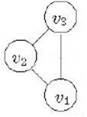
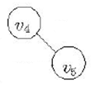

Step 1: Neighborhood Extraction and Coding
A subgraph C of G is a neighborhood component of u ∈ V (G), if C is a maximal connected subgraph in Neighbor_{G}(u).
Neighborhood components of u
Divide the neighborhood of v into neighborhood components
To code the whole neighborhood, first code each component

Slide 68
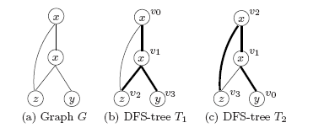
Step 1: Neighborhood Extraction and Coding
Encode the edges and vertices in a graph based on its depth-first search tree (DFS-tree).
All the vertices in G can be encoded in the pre-order of T .
Thick edges are those in the DFS-trees (forward edges),
Thin edges are those not in the DFS-trees (backward edges)
vertices encoded u0 to u3 according to the pre-order of the corresponding DFS-trees.
The DFS-tree is generally not unique for a graph -> minimum DFS code (based on an ordering of edges) – select the lexically minimum DFS code – DFS(G)
Two graphs G and G’ are isomorphic, if and only if, DFS(G) = DFS(G’)
Note: Codes include the labels

Slide 69
Step 1: Neighborhood Extraction and Coding
Combine the code of each component to produce a single code for the neighborhood
The neighborhood component code of NeighborG(u) is a vector NCC(u) = (DFS(C₁)).... DFS(C_{m}))
where C₁,...,C_{m} are the neighborhood components of NeighborG(U), where components are ordered
Theorem (Neighborhood component code): For two vertices u, v ∈ V(G) where G is a social network, Neighbor_{G}(u) and Neighbor_{G}(v) are isomorphic if and only if NCC(u) = NCC(v).

Slide 70
Step 2: Social Network Anonymization
Each vertex must be grouped with a least (k-1) other vertices such their anonymized neighborhoods are isomorphic
For a group S with the same neighborhoods, all vertices in S have the same degree
Vary few nodes have high degrees, process them first to keep information loss for them low
Many vertices of low degree, easier to anonymize
1. Define Quality Measures
2. Anonymize Two Neighborhoods
3. Anonymize a Social Network

Slide 71
Step 2: Quality Measures
Generalize vertex labels
l₁ (leaf level)-> more general l₂ (penalty or loss as
in relational) size(*)= #leafs size(l2) leafs at l2-subtree
Add Edges
Total number of edges added +
Number of vertices that are not in the neighborhood of the target vertex and are linked for anonymization

Slide 72
Step 2: Anonymizing 2 neighborhoods
1. First, find all perfect matches of neighborhood components (perfectly match=same minimum DFS code)
2. For unmatched, try to pair “similar” components and anonymize them
How: greedily, starting with two vertices with the same degree and label in the two components to be matched (if ties, start from the one with the highest degree, if there are no such vertices: choose the one with minimum cost
Then a BFS to match vertices one by one, if we need to add a vertex, consider vertices in V(G)

Slide 73
Step 2: Social Network Anonymization
Maintain a list VertexList of unanonymized vertices in descending order of neighborhood size

Slide 74
Co-authorship data from KDD Cup 2003 (from arXiv, high-energy physics)
Edge – co-authored at least one paper in the data set.
57,448 vertices
120,640 edges
average number of vertex degrees about 4.

Slide 75
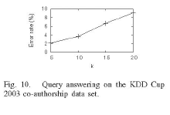
3-level anonymization, author, affiliations-countries, *
Anonymized for different k
Aggregate queries: the average distance from vertex with level l1 to each nearest neighbor with label l2
For 10 random label pairs

Slide 76
k-Automorphism
L. Zhu, L. Chen and M. Tamer Ozsu, k-automorphism: a general framework for privacy preserving network publication, PVLDB 2009

Slide 77
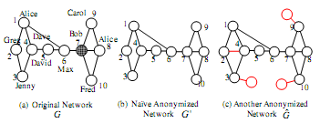
K-Automorphism
Considers any subgraph query - any structural attack
At least k symmetric vertices no structural differences

Slide 78
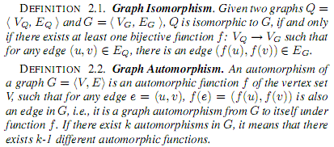

K-Automorphism
map each node of graph G to (another) node of graph G

Slide 79

K-Automorphism
any k-1 automorphic functions?

Slide 80
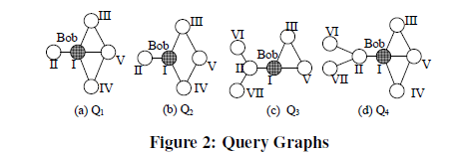
K-Automorphism
Take query Q3 in (b)

Slide 81
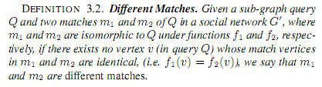

K-Automorphism

Slide 82

K-Automorphism: Cost

Slide 83
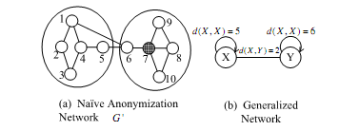
K-Automorphism: Algorithm
compare with Hay et al

Slide 84
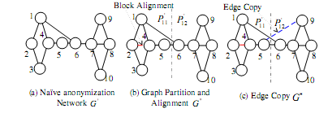
K-Match (KM) Algorithm
Step 1: Partition the original network into blocks
Step 2: Align the blocks to attain isomorphic blocks (add edge (2,4))
Step 3: Apply the "edge-copy" technique to handle matches that cross the two blocks

Slide 85
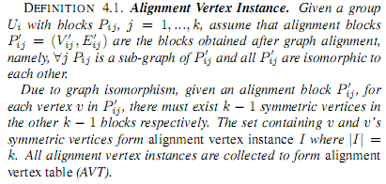
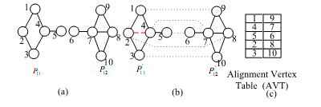
K-Match (KM) Algorithm: Alignment

Slide 86
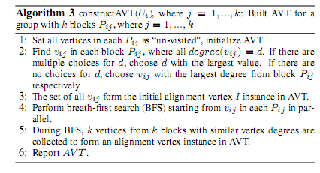
K-Match (KM) Algorithm: Alignment
Heuristic for finding a good alignment
Find k vertices with the same vertex degree d
If many choices for d, start with those with high degree (largest d)
If none, choose the one with the largest degree
This set -> initial alignment
BFS in each block in parallel,
pairing nodes with similar degree (if there is no corresponding vertex, introduce dummy with the same label as the corresponding)

Slide 87

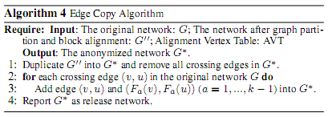
K-Match (KM) Algorithm: Edge Copy
Duplicate all crossing edges using the AVT

Slide 88

K-Match (KM) Algorithm: Graph Partitioning
How many blocks to add a small number of edges?
Few -> fewer crossing edges, but larger groups (more edges for aligning)
NP complete -> heuristics

Slide 89
K-Match (KM) Algorithm: Graph Partitioning

Slide 90
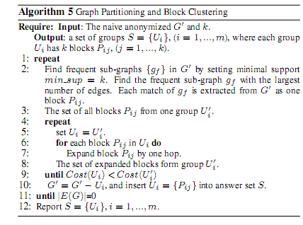
K-Match (KM) Algorithm: Graph Partitioning
Find all frequent subgraphs (first group!)
Try to expand them until the cost becomes worst, in which case start a new group

Slide 91
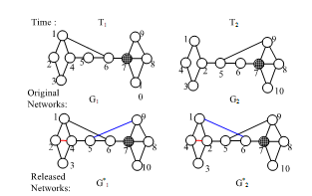

Dynamic Releases
Example: G1* and G2*
Individually satisfy 2-automorphism
Assume that an adversary knows that sub-graph Q4 exists around target Bob at both time T1 and T2.
At time T1, an adversary knows that there are two candidates vertices (2, 7)
Similarly, at time T2, there are still two candidates (4, 7)
Since Bob exists at both T1 and T2, vertex 7 corresponds to Bob
Why not remove all vertex IDs, or permute vertex IDs randomly (so, a given vertexID does not correspond to the same entity in different publications)?
Impossible to conduct proper data analysis

Slide 92
Dynamic Releases
vertex ID generalization
For simplicity, no vertex insertions or deletions in different releases (set of all vertex IDs remains unchanged)

Slide 93

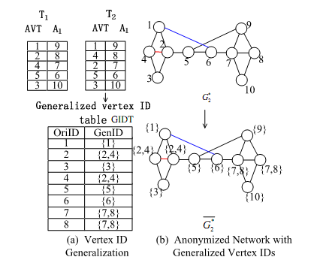
Vertex ID Generalization
Given a series of s publications, vertex v cannot be identified with a probability higher than 1/k if:

Slide 94
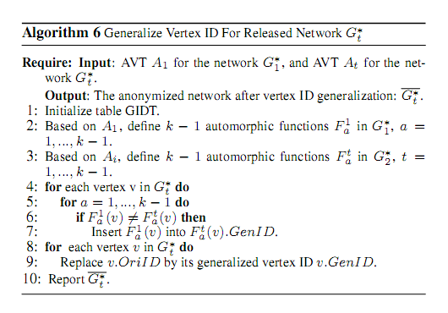
Vertex ID Generalization: Algorithm

Slide 95
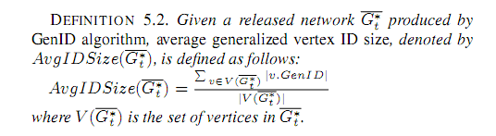
Vertex ID Generalization: Cost

Slide 96
Vertex Insertion and Deletion
(Deletion) There is a vertex ID v that exists in G'₁ but not in G'_{t}
Find an arbitrary vertex ID u that exists in both
Insert v in the generalized vertex ID of u
(Insertion) There is a vertex ID v that exists in G'_{t} but not in G'₁
Assume that instance I contains v in AVT A_{t}
For each vertex u in I, insert v in the generalized vertex ID of u

Slide 97
Evaluation
Prefuse (129 nodes, 161 edges)
Co-author graph (7995 authors in database and theory, 10055 edges)
Synthetic
Erdos Renyi 1000 nodes
Scale free, 2 < γ < 3
All k = 10 degree anonymous, but no sub-graph anonymous

Slide 98
Questions?

