Slide 1
k-anonymity in Graphs

Slide 2
Publishing Social Graphs
Methods based on k-anonymity
  k-candidate
  k-degree
  k-neighborhood
  k-automorphism

Slide 3
k-candidate Anonymity
M Hay et al, Resisting Structural Re-identification in Anonymized Social Networks VLDB 2008

Slide 4
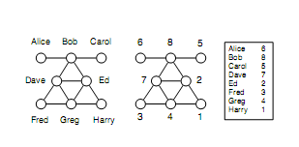
G_{a} the naive anonymization of G - an isomorphic graph defined by a random bijection f (aka anonymization mapping or random secret mapping) V-> V_{a}
An individual x ∈ V called the target has a candidate set, denoted cand(x) which consists of the nodes of G_{a} that could possibly correspond to x
Size of candidate set
Given an uninformed adversary, f random => each target x the same risk of re-identification, cand(x) = V_{a}
In practice, background knowledge
Bob has three or more neighbors, cand(Bob) =?
Greg is connected to at least two nodes, each with degree 2, cand(Greg) =?

Slide 5
In this paper:
(background knowledge) = structural re-identification (information of the adversary is about graph structure)
(utility) analysis about structural properties: finding communities, fitting power-law graph models, enumerating motifs, measuring diffusion, accessing resiliency
Two factors
descriptive power of the external information – background knowledge
structural similarity of nodes – graph properties

Slide 6
Introduces 3 models of external information
Evaluates the effectiveness of these attacks
  real networks
  random graphs
Proposes an anonymization algorithm based on clustering

Slide 7
Knowledge Acquisition in Practice
External information may be acquired through
  malicious actions by the adversary (active attacks) or
  through public information sources
An adversary may be a participant in the network with some innate knowledge of entities and their relationships
Radius - neighborhood
(locality) Adversary knowledge about a targeted individual tends to be local to the targeted nodes
For the participant adversary there is a horizon of awareness of about distance two around most individuals

Slide 8
Knowledge Acquisition in Practice
Closed-World vs Open-World Adversary
Assumption: External information sources are accurate, but not necessarily complete
  Closed-world: absent facts are false
  Open-world: absent facts are simply unknown
Adversary knows that Bob has 2 neighbors (closed vs open)

Slide 9
Anonymity through Structural Similarity
Strongest notion of privacy
[automorphic equivalence]. Two nodes x, y ∈ V are automorphically equivalent (denoted x ≡ y) if there exists an isomorphism from the graph onto itself that maps x to y.
Example: Fred and Harry, but not Bob and Ed
Induces a partitioning on V into sets whose members have identical structural properties.
An adversary —even with exhaustive knowledge of the structural position of a target node — cannot identify an individual beyond the set of entities to which it is automorphically equivalent.
Some special graphs have large automorphic equivalence classes.
  E.g., complete graph, a ring

Slide 10
Adversary Knowledge (model)
An adversary has access to a source that provides answers to a restricted knowledge query Q evaluated for a single target node of the original graph G.
knowledge gathered by the adversary is accurate.
For target x, use Q(x) to refine the candidate set.
[CANDIDATE SET UNDER Q]. For a query Q over a graph, the candidate set of x w.r.t Q is cand_{Q}(x) = {y ∈V_{a} | Q(x) = Q(y)}.

Slide 11
Adversary Knowledge
Vertex Refinement Queries
Subgraph Queries
Hub Fingerprint Queries

Slide 12

Vertex Refinement Queries
A class of queries of increasing power which report on the local structure of the graph around a node.
The weakest knowledge query, H₀, simply returns the label of the node.
H₁(x) returns the degree of x,
H₂(x) returns the multiset of each neighbors’ degree,
H_{i}(x) returns the multiset of values which are the result of evaluating H_{i-1} on the nodes adjacent to x

Slide 13
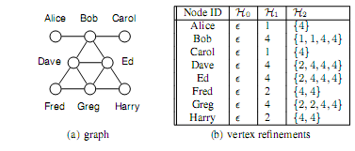
Vertex Refinement Queries II

Slide 14
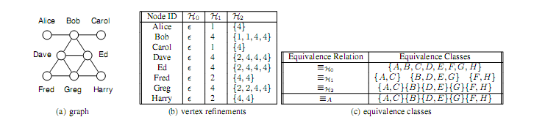
Vertex Refinement Queries III
DEFINITION 2 (RELATIVE EQUIVALENCE). Two nodes x, y in a graph are equivalent relative to H_{i}, denoted x ≡ _{Hi} y, if and only if H_{i}(x) = H_{i}(y).
Proposition: Let x, x' ∈ V, if x ≡ _{Hi} x', then cand_{Hi}(x) = cand_{Hi}(x')
H* Iterative computation of H until no new vertices are distinguished.
Basis of graph isomorphism algorithms (equivalence with H* likely to coincide with automorphism equivalence)

Slide 15
Subgraph Queries
Limitation of vertex refinement:
complete information about the nodes adjacent to the target (closed-world).
arbitrarily large subgraphs around a node if that node is highly connected
E.g., if H₁(x) = 100 vs H₁(y) = 2
Subgraph queries: class of queries about the existence of a subgraph around the target node.
Measure their descriptive power by counting edge facts (# edges in the subgraph)

Slide 16
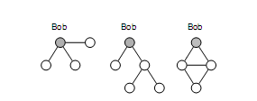
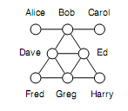
Subgraph Queries
Example: Three subgraph queries centered around Bob.
may correspond to different strategies of knowledge acquisition by the adversary.
including breadth-first exploration, induced subgraphs of radius 1 and 2. etc -- For a given number of edge facts, some queries are more effective at distinguishing individuals.
may be incomplete (open-world)

Slide 17
Hub Fingeprint Queries
A hub is a node with high degree and high betweenness centrality (the proportion of shortest paths in the network that include the node)
Difficult to protect their identity
A hub fingerprint for a target node x is a description of the connections of x (distance) to a set of designated hubs in the network.
F_{i}(x) hub fingerprint of x to a set of designated hubs, where i limit on the maximum distance

Slide 18
Hub Fingeprint Queries
both an open and a closed world.
Hubs: Dave and Ed
F₁(Fred) = (1; 0)
F₂(Fred) = (1; 2)
Example:
open world, if the adversary knows F₁(Fred) = (1; 0) then nodes in the anonymized graph with F₁ ﬁngerprints of (1; 0) or (1; 1) are both candidates for Fred.

Slide 19
Comparison of the Knowledge Models
Expressiveness:
Vertex refinement queries provide complete information about node degree.
A subgraph query can never express H_{i} because subgraph queries are existential and cannot assert exact degree constraints or the absence of edges in a graph.
Complexity Computing:
H* is linear in the number of edges,
Subgraph queries can be NP-hard in the number of edge facts, (requires finding all isomorphic subgraphs in the input graph)
Both have well-studied logical foundations:
H_{i} knowledge corresponds to first order logic with counting quantiﬁers, restricted to i variables.
Subgraph queries can be expressed as conjunctive queries with inequalities. The number of edge facts corresponds to the number of subgoals in the query

Slide 20
Disclosure in Real Networks
Study three networked data sets, drawn from diverse domains.
For each data set, consider each node in turn as a target.
Assume the adversary computes a vertex refinement query, a subgraph query, or a hub fingerprint query on that node, and then compute the corresponding candidate set for that node.
Report the distribution of candidate set sizes across the population of nodes to characterize how many nodes are protected and how many are identifiable.

Slide 21
Disclosure in Real Networks
Hep-Th database: papers and authors in theoretical high-energy physics, from the arXiv archive, linked if at least two papers together.
Enron dataset: from a corpus of email sent to and from managers at Enron Corporation -- Two individuals connected if they corresponded at least 5 times.
Net-trace dataset: from an IP-level network trace collected at a major university. monitors traffic at the gateway; a bipartite graph between IP addresses internal to the institution, and external IP addresses.
187 internal addresses from a single campus department and the 4026 external addresses to which at least 20 packets were sent on port 80 (http traffic).
undirected edges, self-loops removed, eliminated a small percentage of disconnected nodes.

Slide 22
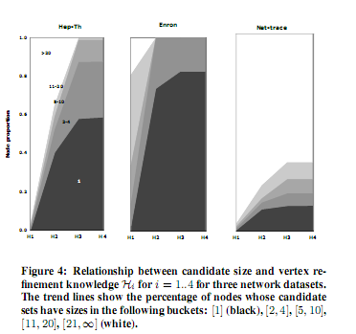
Reidentification: Vertex Refinement I

Slide 23
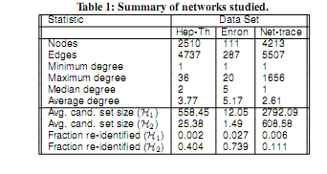

Slide 24
Reidentification: Vertex Refinement
very low percentage of high-risk nodes under a reasonable assumption about adversary knowledge.
Two datasets meet that requirement for H1 (Hep-Th and Net-trace), but no datasets meet that requirement for H2.
signiﬁcant variance across different datasets in their vulnerability to different adversary knowledge.
the most signiﬁcant change in re-identiﬁcation is from H1 to H2,
Re-identiﬁcation tends to stabilize after H3 — more information in the form of H4 does not lead to an observable increase in re-identiﬁcation
a substantial number of nodes are not uniquely identiﬁed even with H4

Slide 25
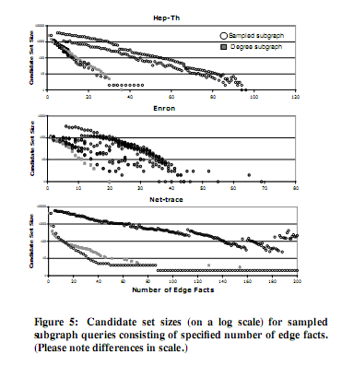
Reidentification: Subgraph Queries I
x -> #edge facts
y -> candidate set size (log scale)
Each point -> a subgraph query of a speciﬁed size
For a ﬁxed number of edge facts, many possible subgraph queries.
Degree subgraphs: breadth-ﬁrst exploration (
Sampled subgraphs: random subgraphs, induced subgraphs of radius 1 and 2, and small dense structures

Slide 26
Reidentification: Subgraph Queries
disclosure is substantially lower than for vertex reﬁnement queries.
To select candidate sets of size less than 10 requires a subgraph query of size 24 for Hep-Th, size 12 for Enron, and size 32 for Net-trace.
The smallest subgraph query resulting in a unique disclosure was size 36 for Hep-Th and 20 for Enron. The smallest candidate set witnessed for Net-trace was size 2, which resulted from a query consisting of 88 edge facts.
Breadth-ﬁrst exploration led to selective queries across all three datasets.
asserts lower bounds on the degree of nodes.
In Enron, the most selective subgraph queries witnessed;
for Hep-Th and Net-trace, the more selective subgraph queries asserted the existence of two nodes with a large set of common neighbors.
an interesting open question is to determine, given a graph, and a fixed number of edge facts, the subgraph query that will result in the smallest candidate set.

Slide 27
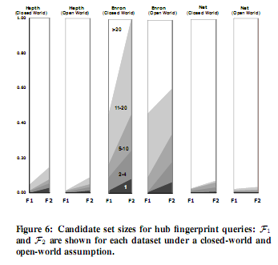
Reidentification: Hub Fingerprints I
Candidate set sizes for hub fingerprints F1 and F2,
choosing the 5 highest degree nodes as hubs for Enron, and the 10 highest degree nodes for both Hepth and Net-trace.
The choice of #hubs based on whether the degree of the node was distinguishable in the degree distribution
both the closed-world iand the open-world interpretation.

Slide 28
Reidentification: Hub Fingerprints
disclosure is low using hub fingerprints.
At distance 1, 54% of the nodes in Enron were not connected to any hub and therefore hub fingerprints provide no information.
This was 90% for Hepth and 28% for Net-trace.
connectivity to hubs was fairly uniform across individuals.
For example, the space of possible fingerprints at distance 1 for Hepth and Net-trace is 2¹⁰= 1024.
Of these, only 23 distinct fingerprints were observed for Hepth and only 46 for Net-trace.
hubs themselves stand out, but have high-degrees, thus connections to a hub are shared by many.

Slide 29
Synthetic Datasets
Random Graphs (Erdos-Reiny (ER) Graphs)
Power Law Graphs
Small World Graphs

Slide 30
Random Graphs
Erdos-Renyi (RE) random graphs
Construction:
G(n, p) Generate a graph with n nodes by sampling each edge independently with probability p
Other interpretation: G(N, M) any graph with M edges is equally probable

Slide 31
Power Law or Scale Free Graphs
The probability that a node has degree d is proportional to d^{-γ}
Barabasi and Albert (preferential attachment) Algorithm
Nodes are inserted sequentially
Each node is initially connected to l already existing nodes with probability proportional to their degree
Start with a small number (m0) of vertices
Αt every step, add a new vertex with m (≤ m0) edges that link the new vertex to m different vertices already present in the system.
To incorporate preferential attachment, the probability that a new vertex will be connected to vertex i depends on the connectivity k_{i} of that vertex, such that (k_{i}) = k_{i}/Σ_{j} k_{j} .

Slide 32
Power Law or Scale Free Graphs
The probability that a node has degree d is proportional to d^{-γ}
PLRG (Power-Law Random Graph) Algorithm
The graph is constructed by first assigning a degree to each node, where the degree is sampled form a power law distribution
Edges are inserted by randomly choosing endpoints until every node has as many edges as its specified degree
This can result in self-loops or multiple edges

Slide 33
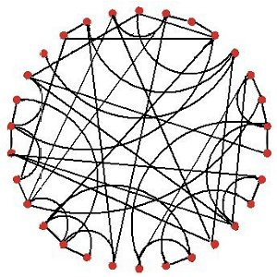
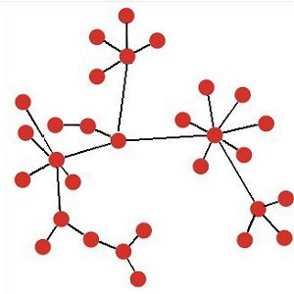

Slide 34
Small World Graphs
Large clustering coefficient (the average fraction of pairs of neighbors of a node that are also connected to each other)
Small average path length (the averare length of the shortest path between all pairs of reachable nodes)

Slide 35


Small World Graphs
Watts-Strogatz graph
Given the desired number of nodes N, the mean degree K (an even integer), and a special parameter β,
The model constructs undirected graph with N nodes and edges
Construct a regular ring lattice, a graph with N nodes each connected to K neighbors, K/2 on each side.
That is, if the nodes are labeled n₀...n_{N − 1}, there is an edge (n_{i},n_{j}) if and only if
for some

Slide 36
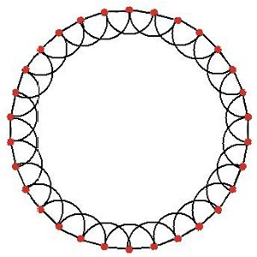
Step 1

Slide 37
Small World Graphs
Watts-Strogatz graph
For every node
take every edge (n_{i},n_{j}) with i < j, and rewire it with probability β.
Rewiring is done by replacing (n_{i},n_{j}) with (n_{i},n_{k}) where k is chosen with uniform probability from all possible values that avoid loops and link duplication (there is no edge (n_{i},n_{k'}) with k' = k at this point in the algorithm).

Slide 38
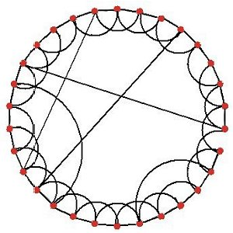
Step 1
Step 2

Slide 39
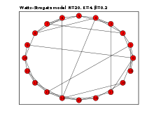

Slide 40
Anonymization in Random Graphs (Vertex Refinement)
Erdos-Renyi (RE) random graphs
Generate a graph with n nodes by sampling each edge independently with probability p
sparce p = c/n,
dense = c logn/n,
super-dense p = c (c is a constant)
c>1,
include a giant connected component of size Θ(n), and a collection of smaller components (sparse)
completed connected (dense)

Slide 41

Anonymization in Random Graphs (Vertex Refinement)
The graph lacks sufficient density to create diversity
The expected degree goes to c as n goes to infinity

Slide 42

Anonymization in Random Graphs (Vertex Refinement)
For dense, nodes cannot be identified for H₁ for any c>0, but all nodes are re-identifiable for H₂ for any c>1

Slide 43
Anonymization in Power-Law Graphs (Vertex Refinement)
THEOREM 3 (POWER-LAW RANDOM GRAPHS). Let G be a
PLRG on n nodes. With probability going to one, the expected sizes of the equivalence classes induced by H_{i} is Θ(n), for any i ≥ 0.

Slide 44

Reindification in Random Graphs (Subgraph Queries)
ω(G) the number of nodes in the largest clique
Any subgraph query matching fewer than ω(G) nodes, will match any node in the clique (open world)

Slide 45
What about attributes?
Label alphabet A
Extend vertex refinement
Correlated with structural information?

Slide 46
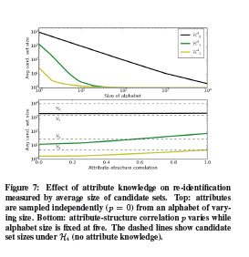

Slide 47

Anonymization Algorithms
Partition/Cluster the nodes of Ga into disjoint sets
In the generalized graph,
supernodes: subsets of Va
edges with labels that report the density
Partitions of size at least k
Extreme cases: a singe super-node with self-loop, Ga
Again: Privacy vs Utility

Slide 48

Anonymization Algorithms
Find a partition that best fits the input graph
Estimate fitness via a maximum likelihood approach
Uniform probability distribution over all possible worlds

Slide 49
Anonymization Algorithms
Searches all possible partitions using simulated annealing
Each valid partitions (minimum partition of at least k nodes) is a valid state
Starting with a single partition with all nodes, propose a change of state:
split a partition
merge two partitions, or
move a node to a different partition
Stop when fewer than 10% of the proposals are accepted

Slide 50
Anonymization Algorithms
3 concrete examples:
Know the degree, and
Neighborhood,
Any structural query

Slide 52
k-degree Anonymity
K. Liu and E. Terzi, Towards Identity Anonymization on Graphs, SIGMOD 2008

Slide 53
Identity anonymization on graphs
Question
  How to share a network in a manner that permits useful analysis without disclosing the identity of the individuals involved?
Observations
  Simply removing the identifying information of the nodes before publishing the actual graph does not guarantee identity anonymization.
  L. Backstrom, C. Dwork, and J. Kleinberg, “Wherefore art thou R3579X?: Anonymized social netwoks, hidden patterns, and structural steganography,” In WWW 2007.
  J. Kleinberg, “Challenges in Social Network Data: Processes, Privacy and Paradoxes, ” KDD 2007 Keynote Talk.
Can we borrow ideas from k-anonymity?
Notes:
53

Slide 54
What if you want to prevent the following from happening
Assume that adversary A knows that B has 327 connections in a social network!
If the graph is released by removing the identity of the nodes
  A can find all nodes that have degree 327
  If there is only one node with degree 327, A can identify this node as being B.

Slide 55
Privacy model
k-degree anonymity A graph G(V, E) is k-degree anonymous if every node in V has the same degree as k-1 other nodes in V.
A (2)
A (2)
B (1)
E (1)
B (2)
E (2)
anonymization
C (1)
D (1)
C (1)
D (1)
  [Properties] It prevents the re-identification of individuals by adversaries with a priori knowledge of the degree of certain nodes.

Slide 56
Degree-sequence anonymization
[k-anonymous sequence] A sequence of integers d is k-anonymous if every distinct element value in d appears at least k times.
[100,100, 100, 98, 98,15,15,15]
A graph G(V, E) is k-degree anonymous if its degree sequence is k-anonymous

Slide 57
Problem Definition
Given a graph G(V, E) and an integer k, modify G via a set of edge addition or deletion operations to construct a new graph k-degree anonymous graph G’ in which every node u has the same degree with at least k-1 other nodes
Why not simply transform G to the complete graph?
Prop 1: If G is k1-degree anonymous, then it is also k2-degree anonymous, for every k2 ≤ k1

Slide 58
Problem Definition
Given a graph G(V, E) and an integer k, modify G via a minimal set of edge addition or deletion operations to construct a new graph G’(V’, E’) such that
1) G’ is k-degree anonymous;
2) V’ = V;
3) The symmetric difference of G and G’ is as small as possible
Symmetric difference between graphs G(V,E) and G’(V,E’) :
Assumption: G: undirected, unlabeled, no self-loops or multiple-edges
Only edge additions -- SymDiff(G’, G) = |E’| - |E|
There is always a feasible solution (ποια;)

Slide 59
Degree-sequence anonymization
Increase/decrease of degrees correspond to additions/deletions of edges
[degree-sequence anonymization] Given degree sequence d, and integer k, construct k-anonymous sequence d’ such that ||d’-d|| (i.e., L₁(d’ – d)) is minimized
|E’| - |E| = ½ L₁(d’ – d)
Relax graph anonymization: E’ not a supergraph of E

Slide 60
Graph Anonymization algorithm
Two steps
Input: Graph G with degree sequence d, integer k Output: k-degree anonymous graph G’
[STEP 1: Degree Sequence Anonymization]: Construct an (optimal) k-anonymous degree sequence d’ from the original degree sequence d [STEP 2: Graph Construction]: [Construct]: Given degree sequence d', construct a new graph G⁰(V, E⁰) such that the degree sequence of G⁰ is d‘ [Transform]: Transform G⁰(V, E⁰) to G’(V, E’) so that SymDiff(G’,G) is minimized.

Slide 61
DP for degree-sequence anonymization
d (1) ≥ d (2) ≥… ≥ d (i) ≥… ≥ d (n) : original degree sequence.
d’ (1) ≥ d’ (2) ≥…≥ d’ (i) ≥…≥ d’ (n) : k-anonymized degree sequence.
If we only add edges, d’(i) ≥ d(i)
Observation 1, if d’(i) = d’(j) with i < j, then d’(i) = d’(i+1) = .. . d’(j-1) = d(j)
I(i, j): anonymization cost when all nodes i, i+1, …, j are put in the same anonymized group

Slide 62
Algorithm for degree-sequence anonymization
Original degree sequence
k=4
k=2

Slide 63
DP for degree-sequence anonymization
DA(1, j): the optimal degree anonymization of subsequence d(1, j)
DA(1, n): the optimal degree-sequence anonymization cost
I(i, j): anonymization cost when all nodes i, i+1, …, j are put in the same anonymized group
For i < 2k (impossible to construct 2 different groups of size k)
For i ≥ 2k

Slide 64
DP for degree-sequence anonymization
Can be improved, no anonymous groups should be of size larger than 2k-1
We do not have to consider all the combinations of I(i, j) pairs, but for every i, only j’s such that k ≤ j – i + 1 ≤ 2k-1
O(n²) -> (Onk)
Additional bookkeeping -> Dynamic Programming with O(nk)
Greedy
Form a group with the first k, for the k+1, consider
C_{merge} = (d(1) – d(k+1)) + I(k+2, 2k+1) – C_{new}(k+1, 2k)

Slide 65
GraphAnonymization algorithm
Input: Graph G with degree sequence d, integer k Output: k-degree anonymous graph G’
[Degree Sequence Anonymization]: Contruct an anonymized degree sequence d’ from the original degree sequence d [Graph Construction]: [Construct]: Given degree sequence d', construct a new graph G⁰(V, E⁰) such that the degree sequence of G⁰ is d‘ [Transform]: Transform G⁰(V, E⁰) to G’(V, E’) so that SymDiff(G’,G) is minimized.

Slide 66
Are all degree sequences realizable?
A degree sequence d is realizable if there exists a simple undirected graph with nodes having degree sequence d.
Not all vectors of integers are realizable degree sequences
  d = {4,2,2,2,1} ?
How can we decide?

Slide 67
Realizability of degree sequences
[Erdös and Gallai] A degree sequence d with d(1) ≥ d(2) ≥… ≥ d(i) ≥… ≥ d(n) and Σd(i) even, is realizable if and only if
For each subset of the l highest degree nodes, the degrees of these nodes can be “absorbed” within the nodes and the outside degrees

Slide 68
Realizability of degree sequences
Input: Degree sequence d’
Output: Graph G⁰(V, E⁰) with degree sequence d’ or NO!
General algorithm, create a graph with degree sequence d’
In each iteration,
pick an arbitrary node u
add edges from u to d(u) nodes of highest residual degree, where d(u) is the residual degree of u
Is an oracle
We also need G’ such that E’ ⊇ E
Thus, we start with the edges of E already in
Is not an oracle

Slide 69
Realizability of degree sequences
Input: Degree sequence d’
Output: Graph G⁰(V, E⁰) with degree sequence d’ or NO!
→If the degree sequence d’ is NOT realizable?
  Convert it into a realizable and k-anonymous degree sequence
Slightly increase some of the entries in d via the addition of uniform noise
in real graph, few high degree nodes – rarely any two of these exactly the same degree
examine the nodes in increasing order of their degrees, and slightly increase the degrees of a single node at each iteration
Slightly increasing the degree of small-degree nodes in d

Slide 70
GraphAnonymization algorithm (relaxed)
Input: Graph G with degree sequence d, integer k Output: k-degree anonymous graph G’
[Degree Sequence Anonymization]: Contruct an anonymized degree sequence d’ from the original degree sequence d [Graph Construction]: [Construct]: Given degree sequence d', construct a new graph G⁰(V, E⁰) such that the degree sequence of G⁰ is d‘ [Transform]: Transform G⁰(V, E⁰) to G’(V, E’) so that SymDiff(G’,G) is minimized.

Slide 71
Graph-transformation algorithm
GreedySwap transforms G⁰ = (V, E⁰) into G’(V, E’) with the same degree sequence d’, and min symmetric difference SymDiff(G’,G) .
GreedySwap is a greedy heuristic with several iterations.
At each step, GreedySwap swaps a pair of edges to make the graph more similar to the original graph G, while leaving the nodes’ degrees intact.
Notes:
71
Overall process dp-erdosgallai-transform the graph into something close to the original graph

Slide 72
Valid swappable pairs of edges
A swap is valid if the resulting graph is simple

Slide 73
GreedySwap algorithm
Input: A pliable graph G⁰(V, E⁰) , fixed graph G(V,E) Output: Graph G’(V, E’) with the same degree sequence as G⁰(V,E⁰)
i=0 Repeat find the valid swap in G^{i} that most reduces its symmetric difference with G , and form graph G^{i+1} i++

Slide 74
Experiments
Datasets:
  Co-authors (7995 authors of papers in db and theory conference),
  Enron emails (151 users, edge if at least 5 times),
  powergrid (generators, transformers and substations in a powergrid network, edges represent high-voltage transmission lines between them),
  Erdos-Renyi (random graphs with nodes randomly connected to each other with probability p),
  small-world large clustering coefficient (average fraction of pair of neighbors of a node that are also neighbors) and small average path length (average length of the shortest path between all pairs of reachable nodes),
  power-law or scale graphs (the probability that a node has degree d is proportional to d^{-γ}, γ = 2, 3)
Goal (Utility): degree-anonymization does not destroy the structure of the graph
  Average path length
  Clustering coefficient
  Exponent of power-law distribution

Slide 75
Experiments: Clustering coefficient and Avg Path Length
Co-author dataset
APL and CC do not change dramatically even for large values of k

Slide 76
Experiments: Edge intersections
Edge intersection achieved by the GreedySwap algorithm for different datasets (average over various k).
Parenthesis value indicates the original value of edge intersection before Greedy Swap
Synthetic datasets
Small world graphs* | 0.99 (0.01)
Random graphs | 0.99 (0.01)
Power law graphs** | 0.93 (0.04)
Real datasets
Enron | 0.95 (0.16)
Powergrid | 0.97 (0.01)
Co-authors | 0.91(0.01)
(*) L. Barabasi and R. Albert: Emergence of scaling in random networks. Science 1999.
(**) Watts, D. J. Networks, dynamics, and the small-world phenomenon. American Journal of Sociology 1999

Slide 77
Experiments: Exponent of power law distributions
Original | 2.07
k=10 | 2.45
k=15 | 2.33
k=20 | 2.28
k=25 | 2.25
k=50 | 2.05
k=100 | 1.92
Co-author dataset
Exponent of the power-law distribution as a function of k

Slide 79
k-neighborhood Anonymity
B. Zhou and J. Pei, Preserving Privacy in Social Networks Against Neighborhood Attacks, ICDE 2008

Slide 80
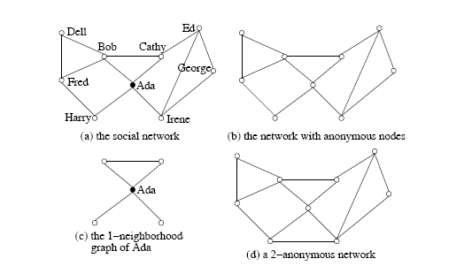
Motivation
An adversary knows that:
Ada has two friends who know each other, and has another two friends who do not know each other (1-neighborhood graph)
Similarly, Bob can be identified if the adversary knows its 1-neighborhood graph

Slide 81
1-neighborhood attacks
The neighborhood of u ∈ V(G) is the induced subgraph of the neighbors of u, denoted by Neighbor_{G}(U) = G(N_{u}) where N_{u} = {v | (u,v) ∈ E(G)}.

Slide 82
Graph Model
Graph G= (V, E, L, F),
V is a set of vertices,
E ⊆ VxV is a set of edges,
L is a set of labels, and
F a labeling function F: V →L assigns each vertex a label.
edges do not carry labels
Items in L form a hierarchy.
E.g., if occupations are used as labels of vertices, L contains not only the specific occupations [such as dentist, general physician, optometrist, high school teacher, primary school teacher, etc] but also general categories [such as, medical doctor, teacher, and professional}.
* ∈ L -> most general category generalizing all labels.

Slide 83
Graph Model
Given a graph = (V_{H}, E_{H}, L, F ) and a social network G = (V, E, L, L), an instance of H in G is a tuple (H', f) where H' = (V_{H’} ,E_{H’} ,L, F) is a subgraph in G and f: V_{H} →V_{H’}, is a bijection function such that
(1) for any u ∈ V_{H}, F(f(u)) ≤ F(u), /* the corresponding labels in H’ are more general */ and
(2) (u, v) ∈ E_{H} if and only if (f (u), f(v)) ∈ E_{H’}.
Naïve anonymization + labels (labels can be replaced by more general ones)

Slide 84
G -> G’ through a bijection (isomorphism) A
[k-neighborhood anonymity] A vertex u ∈ V (G), u is k anonymous in G’ if there are at least (k − 1) other vertices u₁, . . . , u_{k−1} ∈ V (G) such that Neighbor_{G′}(A(u)), Neighbor_{G′}(A(u₁)), . . ., Neighbor_{G′}(A(u_{k−1})) are isomorphic.
G′ is k-anonymous if every vertex in G′ is k-anonymous.
Property 1 (k-anonymity) Let G be a social network and G′ an anonymization of G.
If G′ is k-anonymous, then with the neighborhood background knowledge, any vertex in G cannot be re-identified in G′ with confidence larger than 1/k .

Slide 85
Given a social network G, the k-anonymity problem is to compute an anonymization G′ such that
(1) G′ is k-anonymous;
(2) each vertex in G is anonymized to a vertex in G′ and G′ does not contain any fake vertex; (no node addition)
(3) every edge in G is retained in G′; and (no node deletion)
(4) the number of edges to be added is minimized.

Slide 86
Utility
Aggregate queries:
compute the aggregate on some paths or subsgraphs satisfying some given conditions
E.g., Average distance from a medical doctor to a teacher
Heuristically, when the number of edges added is as small as possible, G′ can be used to answer aggregate network queries accurately

Slide 87
Anonymization Method
Two steps:
STEP 1
Extract the neighborhoods of all vertices in the network
Encode the neighborhood of each node (to facilitate the comparison between neigborhoods)
STEP 2
Greedily, organize vertices into groups and anonymize the neighborhoods of vertices in the same group

Slide 88
Step 1: Neighborhood Extraction and Coding
General problem of determining whether two graphs are isomorphic is NP-complete
Goal: Find a coding technique for neighborhood subgraphs so that whether two neighborhoods are isomorphic can be determined by the corresponding encodings

Slide 89
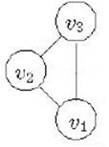
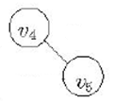

Step 1: Neighborhood Extraction and Coding
A subgraph C of G is a neighborhood component of u ∈ V (G), if C is a maximal connected subgraph in Neighbor_{G}(u).
Neighborhood components of u
Divide the neighborhood of v into neighborhood components
To code the whole neighborhood, first code each component.

Slide 90
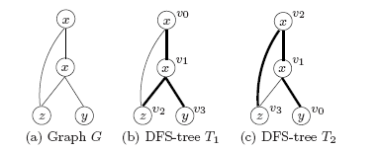
Step 1: Neighborhood Extraction and Coding
Encode the edges and vertices in a graph based on its depth-first search tree (DFS-tree).
All the vertices in G can be encoded in the pre-order of T .
Thick edges are those in the DFS-trees (forward edges),
Thin edges are those not in the DFS-trees (backward edges)
vertices encoded u0 to u3 according to the pre-order of the corresponding DFS-trees.
The DFS-tree is generally not unique for a graph -> minimum DFS code (based on an ordering of edges) – select the lexically minimum DFS code – DFS(G)
Two graphs G and G’ are isomorphic, if and only if, DFS(G) = DFS(G’)
Note: Codes include the labels

Slide 91
Step 1: Neighborhood Extraction and Coding
Combine the code of each component to produce a single code for the neighborhood
The neighborhood component code of NeighborG(u) is a vector NCC(u) = (DFS(C₁)).... DFS(C_{m})) where C₁,...,C_{m}
are the neighborhood components of NeighborG(U), where components are ordered
Theorem (Neighborhood component code): For two vertices u, v ∈ V(G) where G is a social network, Neighbor_{G}(u) and Neighbor_{G}(v) are isomorphic if and only if NCC(u) = NCC(v).

Slide 92
Step 2: Social Network Anonymization
Each vertex must be grouped with a least (k-1) other vertices such their anonymized neighborhoods are isomorphic
For a group S with the same neighborhoods, all vertices in S have the same degree
Vary few nodes have high degrees, process them first to keep information loss for them low
Many vertices of low degree, easier to anonymize
1. Define Quality Measures
2. Anonymize Two Neighborhoods
3. Anonymize a Social Network

Slide 93
Step 2: Quality Measures
Generalize vertex labels
l₁ (leaf level)-> more general l₂ (penalty or loss as
in relational) size(*)= #leafs
Add Edges
Total number of edges added +
Number of vertices that are not in the neighborhood of the target vertex and are linked for anonymization

Slide 94
Step 2: Anonymizing 2 neighborhoods
1. First, find all perfect matches of neighborhood components (perfectly match=same minimum DFS code)
2. For unmatched, try to pair “similar” components and anonymize them
How: greedily, starting with two vertices with the same degree and label in the two components to be matched (if ties, start from the one with the highest degree, if there are no such vertices: choose the one with minimum cost
Then a BFS to match vertices one by one, if we need to add a vertex, consider vertices in V(G)

Slide 95
Step 2: Social Network Anonymization
Maintain a list VertexList of unanonymized vertices in descending order of neighborhood size

Slide 96
Co-authorship data from KDD Cup 2003 (from arXiv, high-energy physics)
Edge – co-authored at least one paper in the data set.
57,448 vertices
120,640 edges
average number of vertex degrees about 4.

Slide 97
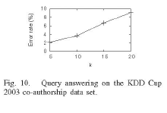
3-level anonymization, author, affiliations-countries, *
Anonymized for different k
Aggregate queries: the average distance from vertex with level l1 to each nearest neighbor with label l2
For 10 random label pairs

Slide 98
k-Automorphism
L. Zhu, L. Chen and M. Tamer Ozsu, k-automorphism: a general framework for privacy preserving network publication, PVLDB 2009

Slide 99
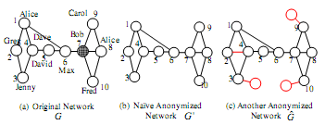
K-Automorphism
Considers any subgraph query - any structural attack
At least k symmetric vertices no structural differences

Slide 100
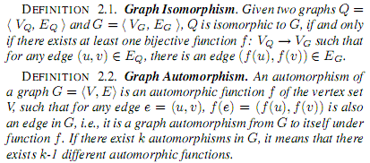

K-Automorphism
map each node of graph G to (another) node of graph G

Slide 101

K-Automorphism
any k-1 automorphic functions?

Slide 102
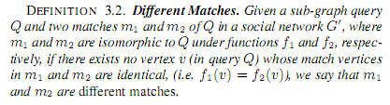

K-Automorphism

Slide 103

K-Automorphism: Cost

Slide 104
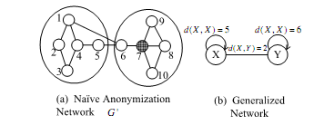
K-Automorphism: Algorithm
compare with Hay et al

Slide 105
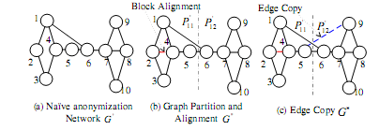
K-Match (KM) Algorithm
Step 1: Partition the original network into blocks
Step 2: Align the blocks to attain isomorphic blocks (add edge (2,4))
Step 3: Apply the "edge-copy" technique to handle matches that cross the two blocks

Slide 106
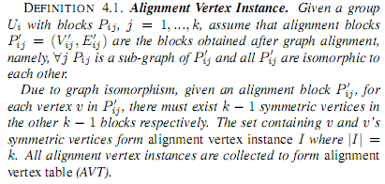
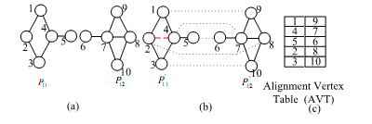
K-Match (KM) Algorithm: Alignment

Slide 107
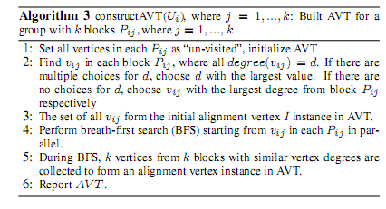
K-Match (KM) Algorithm: Alignment
Heuristic for finding a good alignment
Find k vertices with the same vertex degree
If many, start with those with high degree
If none, choose the one with the largest degree
This set -> initial alignment
BFS in each block in parallel,
pairing nodes with similar degree (if there is no corresponding vertex, introduce dummy with the same label as the corresponding)

Slide 108

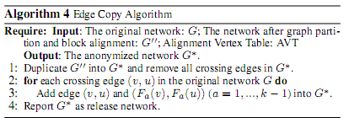
K-Match (KM) Algorithm: Edge Copy
Duplicate all crossing edges using the AVT

Slide 109

K-Match (KM) Algorithm: Graph Partitioning
How many blocks to add a small number of edges?
Few -> fewer crossing edges, but larger groups (more edges for aligning)
NP complete -> heuristics

Slide 110
K-Match (KM) Algorithm: Graph Partitioning

Slide 111
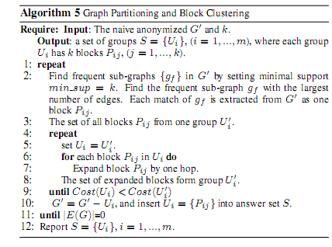
K-Match (KM) Algorithm: Graph Partitioning
Find all frequent subgraphs (first group!)
Try to expand them until the cost becomes worst, in which case start a new group

Slide 112
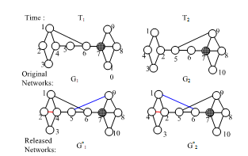

Dynamic Releases
Example:
Individually satisfy 2-automorphism
Assume that an adversary knows that sub-graph Q4 exists around target Bob at both time T1 and T2.
At time T1, an adversary knows that there are two candidates vertices (2, 7)
Similarly, at time T2, there are still two candidates (4, 7)
Since Bob exists at both T1 and T2, vertex 7 corresponds to Bob

Slide 113
Dynamic Releases
Remove all vertex IDs, or permute vertex IDs randomly (so, a given vertexID does not correspond to the same entity in different publications).
Impossible to conduct proper data analysis.
Instead, vertex ID generalization
For simplicity, no vertex insertions or deletions in different releases (set of all vertex IDs remains unchanged)

Slide 114

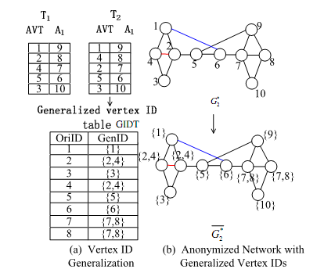
Vertex ID Generalization
Given a series of s publications, vertex v cannot be identified with a probability higher than 1/k if:

Slide 115
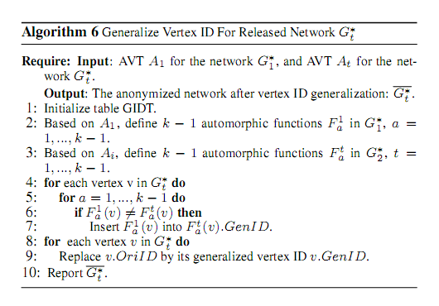
Vertex ID Generalization: Algorithm

Slide 116
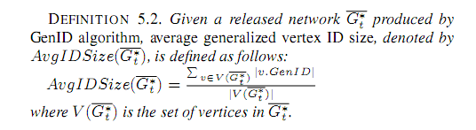
Vertex ID Generalization: Cost

Slide 117
Vertex Insertion and Deletion
(Deletion) There is a vertex ID v that exists in G'₁ but not in G'_{t}
Find an arbitrary vertex ID u that exists in both
Insert v in the generalized vertex ID of u
(Insertion) There is a vertex ID v that exists in G'_{t} but not in G'₁
Assume that instance I contains v in AVT A_{t}
For each vertex u in I, insert v in the generalized vertex ID of u

Slide 118
Evaluation
Prefuse (129 nodes, 161 edges)
Co-author graph (7995 authors in database and theory, 10055 edges)
Synthetic
Erdos Renyi 1000 nodes
Scale free, 2 < γ < 3
All k = 10 degree anonymous, but no sub-graph anonymous

Slide 119
Questions?

