Slide 1
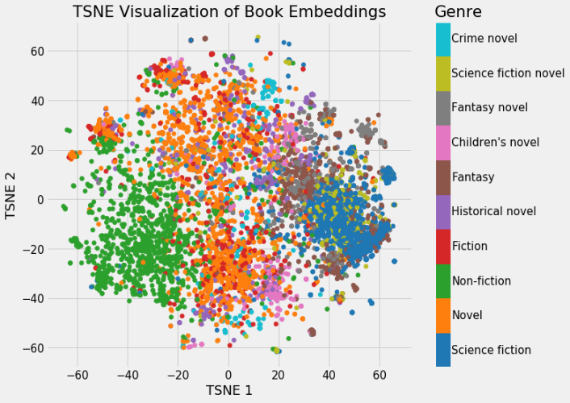
Τι θα δούμε σήμερα
Διανυσματική αναπαράσταση λέξεων (word embeddings)
Μερικές πληροφορίες για την εργασία
Books on Wikipedia colored by genre in two dimensions. Source: Koehrsen 2018

Slide 2
Word embeddings

Slide 3
Πρόβλημα: Διανυσματική αναπαράσταση (representation) όρων
embedding
όρος
διάνυσμα
Στόχος: Όμοιοι όροι -> όμοια διανύσματα

Slide 4
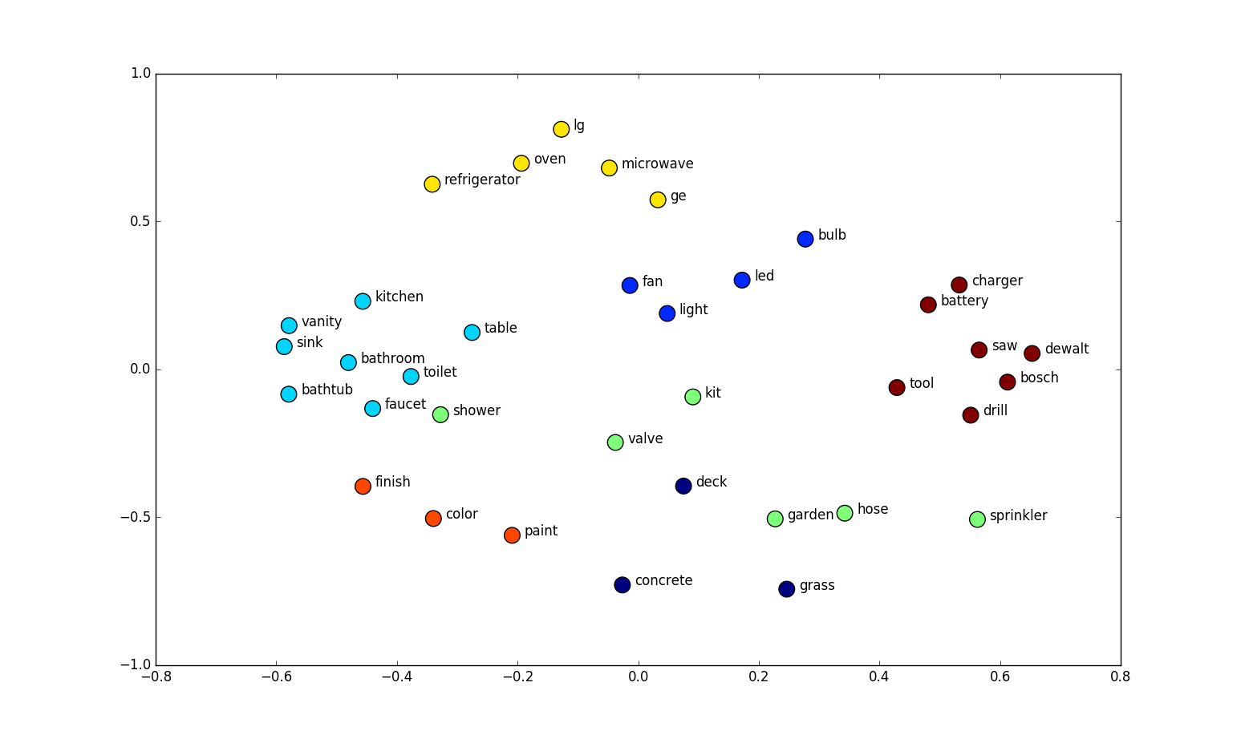
Παράδειγμα: 2-διάστατα embeddings
http://suriyadeepan.github.io
Notes:
t-SNE plot
a nonlinear dimensionality reduction technique well-suited for embedding high-dimensional data for visualization in a low-dimensional space of two or three dimensions. Specifically, it models each high-dimensional object by a two- or three-dimensional point in such a way that similar objects are modeled by nearby points and dissimilar objects are modeled by distant points with high probability.

Slide 5
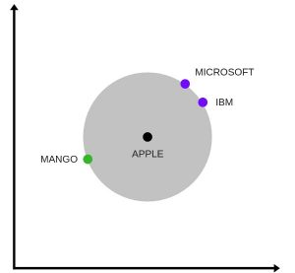
Apple: φρούτο και εταιρεία
https://www.analyticsvidhya.com/blog/2017/06/word-embeddings-count-word2veec/

Slide 6
Embeddings: why?
Machine learning lifecycle
Raw Data
Structured Data
Learning Algorithm
Model
Feature Engineering
Downstream
prediction task
For words: document occurrences, k-grams. etc
Classification
Learning to rank
Clustering
For documents: length, words, etc
For graphs: degree, PageRank, motifs, degrees of neighbors, Pagerank of neighbors, etc

Slide 7
Embeddings: why?
Machine learning lifecycle
Raw Data
Structured Data
Learning Algorithm
Model
Feature Engineering
Downstream
prediction task
For words: document occurrences, k-grams. etc
For documents: length, words, etc
Automatically learn the features (embeddings)
For graphs: degree, PageRank, motifs, degrees of neighbors, Pagerank of neighbors, etc

Slide 8

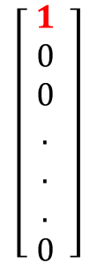
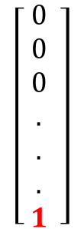
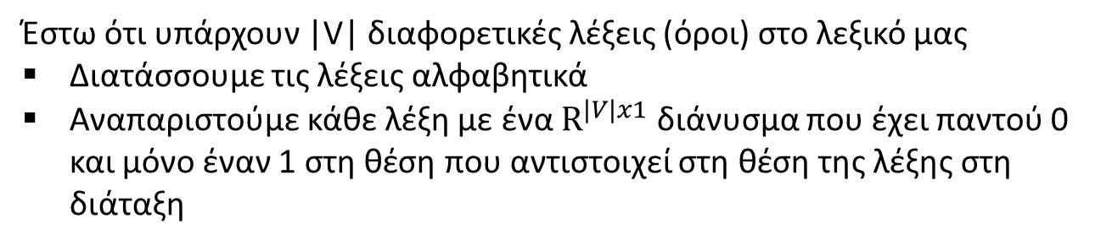

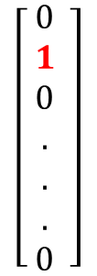


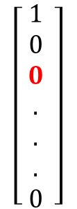
One-hot vectors
Έστω ότι υπάρχουν |V| διαφορετικές λέξεις (όροι) στο λεξικό μας
Διατάσσουμε τις λέξεις αλφαβητικά
Αναπαριστούμε κάθε λέξη με ένα $R^{|V|x1}$ διάνυσμα που έχει παντού 0 και μόνο έναν 1 στη θέση που αντιστοιχεί στη θέση της λέξης στη διάταξη
$$\left[\begin{aligned} 1 \\ 0 \\ 0 \\ . \\ . \\ . \\ 0\end{aligned} \right]$$
$$\left[\begin{aligned} 0 \\ 1 \\ 0 \\ . \\ . \\ . \\ 0\end{aligned} \right]$$
$$\left[\begin{aligned} 1 \\ 0 \\ 0 \\ . \\ . \\ . \\ 0\end{aligned} \right]$$
$$\left[\begin{aligned} 0 \\ 0 \\ 0 \\ . \\ . \\ . \\ 1\end{aligned} \right]$$
.. .
$w^{aardvark}$ =
$w^{a}$ =
$w^{at}$ =
$w^{zerba}$ =
Καμία πληροφορία για ομοιότητα
Πολλές διαστάσεις

Slide 9
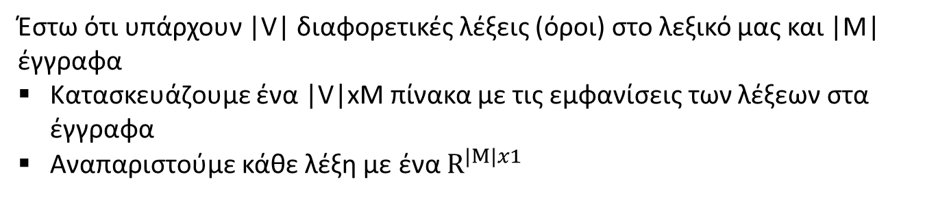
Term-Document co-occurrence matrix
Έστω ότι υπάρχουν |V| διαφορετικές λέξεις (όροι) στο λεξικό μας και |Μ| έγγραφα
Κατασκευάζουμε ένα |V|xM πίνακα με τις εμφανίσεις των λέξεων στα έγγραφα
Αναπαριστούμε κάθε λέξη με ένα $R^{|Μ|x1}$
 | d1 | d2 | d3 | d4 | d5
a | 1 | 1 | 1 | 1 | 1
b | 1 | 1 | 0 | 1 | 1
c | 1 | 0 | 1 | 0 | 1
d | 0 | 1 | 1 | 0 | 1
e | 0 | 0 | 1 | 1 | 0
f | 0 | 0 | 1 | 0 | 0
Παράδειγμα:
d1: a b c
d2: a d a b
d3: a c d e c a f
d4: b e a b
d5: a b d c a
Word vector for c
|V| = 6, |Μ| =5

Slide 10
Term-Document co-occurrence matrix
Μπορούμε αντί για 0-1 να έχουμε το tf ή και το tf-idf βάρος
Παράδειγμα:
 | d1 | d2 | d3 | d4 | d5
a | 1 | 2 | 2 | 1 | 2
b | 1 | 1 | 0 | 2 | 1
c | 1 | 0 | 2 | 0 | 1
d | 0 | 1 | 1 | 0 | 1
e | 0 | 0 | 1 | 1 | 0
f | 0 | 0 | 1 | 0 | 0
d1: a b c
d2: a d a b
d3: a c d e c a f
d4: b e a b
d5: a b d c a
Word vector for c
Πολλές διαστάσεις
Πρόβλημα κλιμάκωσης με τον αριθμό των εγγράφων

Slide 11
Window-based co-occurrence matrix
Κατασκευάζουμε ένα |V|x|V| affinity-matrix για τις λέξεις: για δύο λέξεις, μετράμε τον αριθμό των φορών που αυτές δύο λέξεις εμφανίζονται μαζί σε έγγραφα
Συγκεκριμένα, μετράνε τον αριθμό των φορών που κάθε λέξη εμφανίζεται μέσα σε ένα παράθυρο συγκεκριμένου μεγέθους γύρω από τη λέξη ενδιαφέροντος
Παράδειγμα:
 | a | b | c | d | e | f
a | 0 | 4 | 3 | 1 | 1 | 1
b | 4 | 0 | 1 | 1 | 1 | 0
c | 3 | 1 | 0 | 2 | 1 | 0
d | 1 | 1 | 2 | 0 | 1 | 0
e | 1 | 1 | 1 | 1 | 0 | 0
f | 1 | 0 | 0 | 0 | 0 | 0
d1: a b c
d2: a d a b
d3: a c d e c a f
d4: b e a b
d5: a b d c a
W = 1 (σε απόσταση 1)

Slide 12
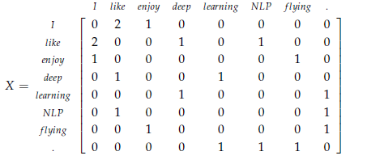
Window-based co-occurrence matrix
Κατασκευάζουμε ένα |V|x|V| affinity-matrix για τις λέξεις: μετράμε τον αριθμό των φορών που δυο λέξεις εμφανίζονται μέσα σε ένα παράθυρο συγκεκριμένου μεγέθους
Λέξεις όπως apple, orange, mango, κλπ μαζί με λέξεις όπως eat, grow, cultivate, slice, κλπ και το ανάποδο
Παράδειγμα:
d1: I enjoy flying.
d2: I like NLP.
d3: I like deep learning.
W = 1
Πολλές διαστάσεις

Slide 13
Θα μπορούσαμε να χρησιμοποιήσουμε μια τεχνική για να μειώσουμε τις διαστάσεις (dimensionality reduction) (πχ PCA analysis)

Slide 14
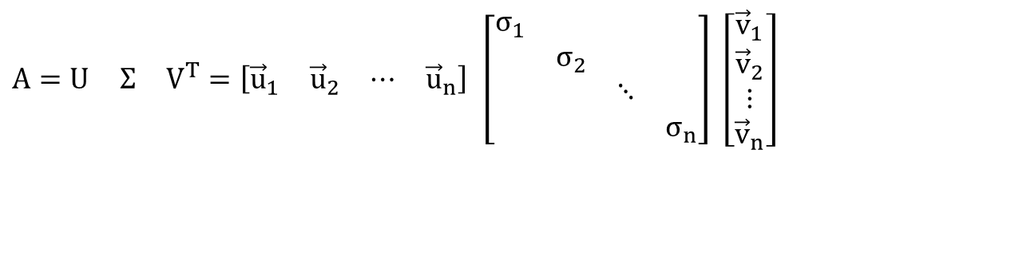


Singular Value Decomposition
From dimension d to dimension r
$$A=U Σ V^{T}=\left[\begin{matrix}{\vec{u}}_{1} & {\vec{u}}_{2} & ⋯ & {\vec{u}}_{n}\end{matrix}\right] \left[\begin{matrix}σ_{1} & & & \\ & σ_{2} & & \\ & & ⋱ & \\ & & & σ_{n}\end{matrix}\right] \left[\begin{matrix}{\vec{v}}_{1} \\ {\vec{v}}_{2} \\ ⋮ \\ {\vec{v}}_{n}\end{matrix}\right]$$
σ₁≥ σ₂≥ … ≥σ_{n} : singular values (square roots of eigenvals AA^{T}, A^{T}A)
: left singular vectors (eigenvectors of AA^{T})
: right singular vectors (eigenvectors of A^{T}A)
[n×n]
[n×n]
[×n]
$${\vec{u}}_{1}\text{,}{\vec{\text{u}}}_{2},⋯\text{,}{\vec{\text{u}}}_{n}$$
$${\vec{v}}_{1}\text{,}{\vec{\text{v}}}_{2},⋯\text{,}{\vec{\text{v}}}_{n}$$
Cut the singular values at some index r (get the largest r such values)
Get the first r columns of U to get the r-dimensional vectors

Slide 15
Singular Value Decomposition
Ar best approximation of A (Frobernius norm)
r : rank of matrix A
σ₁≥ σ₂≥ … ≥σ_{r} : singular values (square roots of eigenvals AA^{T}, A^{T}A)
: left singular vectors (eigenvectors of AA^{T})
: right singular vectors (eigenvectors of A^{T}A)
[n×r]
[r×r]
[r×n]

Slide 16
Αλλά
Δύσκολο να ενημερώσουμε, πχ, αλλάζουν οι διαστάσεις συχνά
Αραιός πίνακας
Πολύ μεγάλες διαστάσεις
Θα δούμε μια τεχνική που βασίζεται σε επαναληπτικές μεθόδους

Slide 17
word2vec

Slide 18
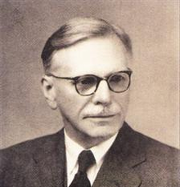
Basic Idea
You can get a lot of value by representing a word by means of its neighbors
“You shall know a word by the company it keeps”
(J. R. Firth 1957: 11)
One of the most successful ideas of modern statistical NLP
  government debt problems turning into banking crises as has happened in
  saying that Europe needs unified banking regulation to replace the hodgepodge
   These words will represent banking 

Slide 19
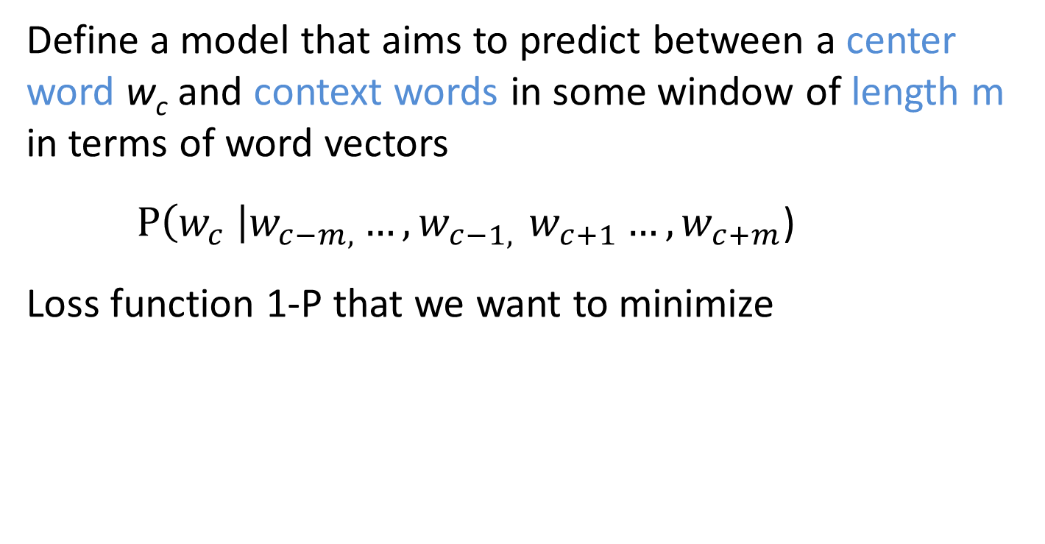
Basic idea
Define a model that aims to predict between a center word w_{c} and context words in some window of length m in terms of word vectors
$P\left(w_{c} \right|w_{c−m, }{…, w}_{c−1, }w_{c+1}…, w_{c+m}$)
Loss function 1-P that we want to minimize
Notes:
The central new idea is that you change the word representation, as well as the other parameters of the model.
I’m going to directly and concretely build one, concrete prediction models. You may already know of some other things you might do, and we’ll come back to other possibilities next week, but this way of doing it is one of the best ways known.

Slide 20
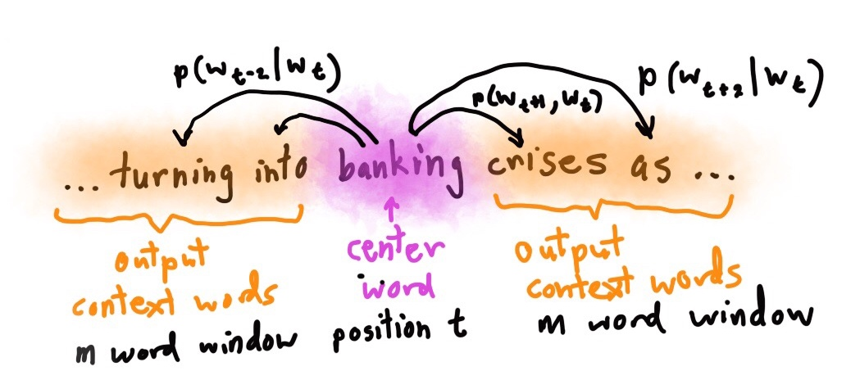

Slide 21
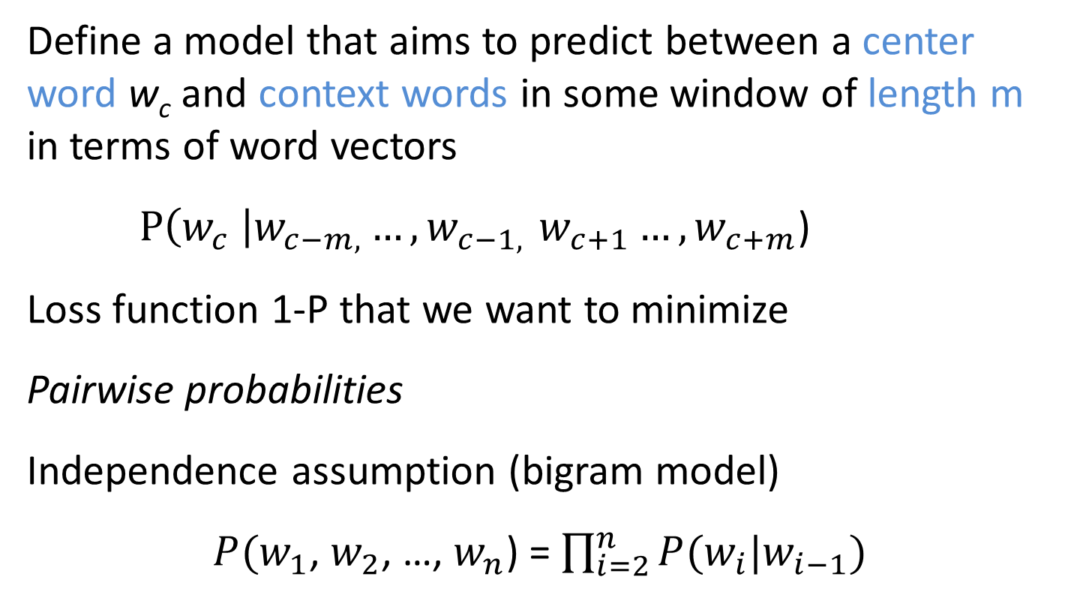
Basic idea
Define a model that aims to predict between a center word w_{c} and context words in some window of length m in terms of word vectors
$P\left(w_{c} \right|w_{c−m, }{…, w}_{c−1, }w_{c+1}…, w_{c+m}$)
Loss function 1-P that we want to minimize
Pairwise probabilities
Independence assumption (bigram model)
$P(w_{1}$, $w_{2}$, …, $w_{n}$) = $\prod_{i=2}^{n}{P(w_{i}|w_{i−1})}$
Notes:
The central new idea is that you change the word representation, as well as the other parameters of the model.
I’m going to directly and concretely build one, concrete prediction models. You may already know of some other things you might do, and we’ll come back to other possibilities next week, but this way of doing it is one of the best ways known.

Slide 22
Word2Vec
  Predict between every word and its context words
Two algorithms
  Skip-grams (SG)
    Predict context words given the center word
  Continuous Bag of Words (CBOW)
    Predict center word from a bag-of-words context
    Position independent (do not account for distance from center)
Two training methods
  Hierarchical softmax
  Negative sampling
Tomas Mikolov, Ilya Sutskever, Kai Chen, Gregory S. Corrado, Jeffrey Dean: Distributed Representations of Words and Phrases and their Compositionality. NIPS 2013: 3111-3119

Slide 23

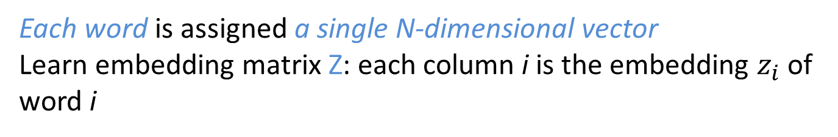
Note
  |V| number of words
  N size of embedding
  m size of the window (context)
Each word is assigned a single N-dimensional vector
Learn embedding matrix Z: each column i is the embedding $z_{i}$ of word i
|V|
Z
i
Dimension/size of the embedding
N
$$z_{i}$$

Slide 24


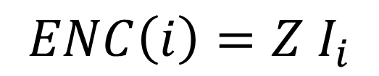
Note
Encoder is an embedding lookup
$$ENC\left(i\right)=Z I_{i}$$
Z
i
$${One hot vector I}_{i}$$
i
0
0
1
0
One-hot or indicator vector, all 0s but position i
$$z_{i}$$

Slide 25
CBOW
  |V| number of words
  N size of embedding
  m size of the window (context)
Use a window of context words to predict the center word
Input: 2m context words
Output: center word
each represented as a one-hot vector

Slide 26
CBOW
  Use a window of context words to predict the center word
Learns two matrices (two embeddings per word, one when context, one when center)
W
Embedding of the i-th word when center word
N
W’
i
i
Embedding of the i-th word when context word
N
|V|
|V|
N x |V| center embeddings
when output
|V| x N context embeddings
when input

Slide 27
CBOW
Use a window of context words to predict the center word
Intuition
The W’-embedding of the center word should be similar to the W-embeddings of its context words
For similarity, we will use cosine (dot product)
We will take the average of the W-embeddings of the context word
We want similarity close to one for the center word and close to 0 for all other words

Slide 28
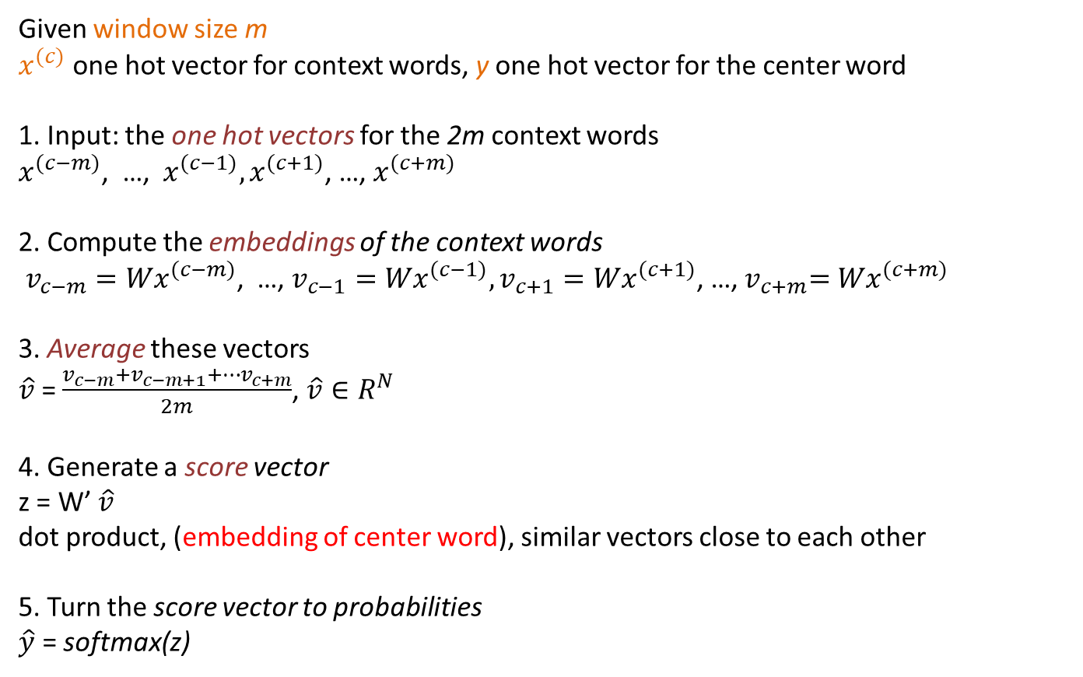
CBOW
Given window size m
$x^{(c)}$ one hot vector for context words, y one hot vector for the center word
1. Input: the one hot vectors for the 2m context words
$x^{(c−m)}$, …, $x^{(c−1)},x^{(c+1)}$, …, $x^{(c+m)}$
2. Compute the embeddings of the context words
$v_{c−m}{=Wx}^{(c−m)}$, …, $v_{c−1}{=Wx}^{(c−1)},v_{c+1}{=Wx}^{(c+1)}$, …,${ v}_{c+m}{=Wx}^{(c+m)}$
3. Average these vectors
$\hat{v}$ = $\frac{v_{c−m}+v_{c−m+1}+…v_{c+m}}{2m}$, $\hat{v}∈R^{N}$
4. Generate a score vector
z = W’ $\hat{v}$
dot product, (embedding of center word), similar vectors close to each other
5. Turn the score vector to probabilities
$\hat{y}$ = softmax(z)
We want this to be close to 1 for the center word

Slide 29
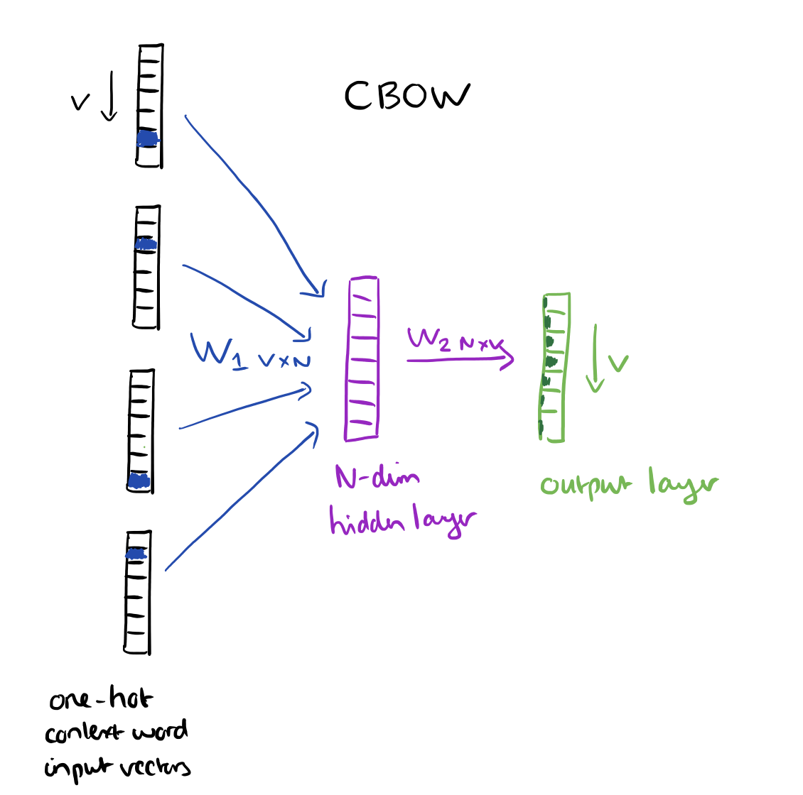

Slide 30
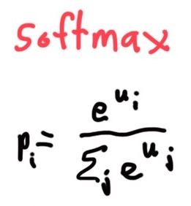
Exponentiate to
make positive
Normalize to
give probability

Slide 31
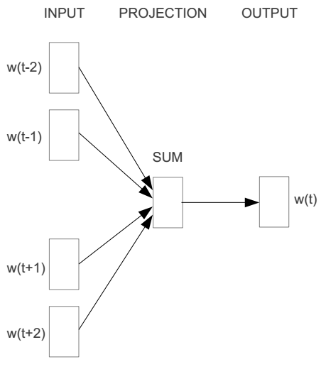
E.g. “The cat sat on floor”
  Window size = 2
the
cat
sat
on
floor

Slide 32
Input layer
Index of cat in vocabulary
0
1
0
cat
0
Hidden layer
Output layer
0
0
0
0
0
0
…
0
one-hot
vector
0
0
one-hot
vector
0
sat
0
0
0
0
1
0
…
1
0
on
0
0
0
0
…
0

Slide 33



We must learn W and W’
Input layer
0
1
0
cat
0
$$W_{V×N}$$
Hidden layer
Output layer
0
0
0
0
0
0
V-dim
…
0
0
$${W′}_{N×V}$$
0
0
sat
0
0
0
0
1
0
$$W_{V×N}$$
N-dim
…
V-dim
1
0
on
0
0
0
0
V-dim
…
N will be the size of word vector
0

Slide 34
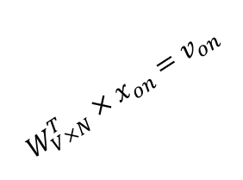

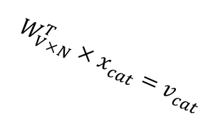



$$W_{V×N}^{T} ×x_{cat}=v_{cat}$$
Input layer
0.1 | 2.4 | 1.6 | 1.8 | 0.5 | 0.9 | … | … | … | 3.2
0.5 | 2.6 | 1.4 | 2.9 | 1.5 | 3.6 | … | … | … | 6.1
… | … | … | … | … | … | … | … | … | …
… | … | … | … | … | … | … | … | … | …
0.6 | 1.8 | 2.7 | 1.9 | 2.4 | 2.0 | … | … | … | 1.2
0
2.4
2.6
…
…
1.8
1
0
$$×$$
0
$$=$$
1
0
0
0
0
0
x_{cat}
0
0
Output layer
0
0
0
$$W_{V×N}^{T}×x_{cat}=v_{cat}$$
…
0
0
0
0
V-dim
…
0
0
$$\hat{v}=\frac{v_{cat}+v_{on}}{2}$$
0
+
0
sat
0
0
0
0
$$W_{V×N}^{T}×x_{on}=v_{on}$$
1
0
…
V-dim
1
Hidden layer
0
x_{on}
0
0
N-dim
0
0
V-dim
…
0

Slide 35

$$W_{V×N}^{T} ×x_{on}=v_{on}$$
Input layer
0.1 | 2.4 | 1.6 | 1.8 | 0.5 | 0.9 | … | … | … | 3.2
0.5 | 2.6 | 1.4 | 2.9 | 1.5 | 3.6 | … | … | … | 6.1
… | … | … | … | … | … | … | … | … | …
… | … | … | … | … | … | … | … | … | …
0.6 | 1.8 | 2.7 | 1.9 | 2.4 | 2.0 | … | … | … | 1.2
0
1.8
2.9
…
…
1.9
0
0
$$×$$
0
$$=$$
1
1
0
0
0
0
x_{cat}
0
0
Output layer
0
0
0
$$W_{V×N}^{T}×x_{cat}=v_{cat}$$
…
0
0
0
0
V-dim
…
0
0
$$\hat{v}=\frac{v_{cat}+v_{on}}{2}$$
0
+
0
sat
0
0
0
0
$$W_{V×N}^{T}×x_{on}=v_{on}$$
1
0
…
V-dim
1
Hidden layer
0
x_{on}
0
0
N-dim
0
0
V-dim
…
0

Slide 36






Input layer
0
1
0
cat
0
$$W_{V×N}$$
Hidden layer
Output layer
0
0
0
0
0
0
V-dim
…
0
0
$$W_{V×N}^{′}×\hat{v}=z$$
0
$$\hat{y}=softmax(z)$$
0
0
0
0
0
$$\hat{v}$$
1
0
$$W_{V×N}$$
…
1
N-dim
0
on
0
${\hat{y}}_{sat}$
0
0
V-dim
0
V-dim
…
N will be the size of word vector
0

Slide 37


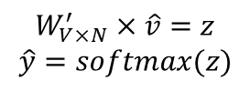
Input layer
0
We would prefer $\hat{y}$ close to ${\hat{y}}_{sat}$
1
0
cat
0
$$W_{V×N}$$
Hidden layer
Output layer
0
0
0.01
0.02
0.00
0.02
0.01
0.02
0.01
0.7
…
0.00
0
0
0
0
V-dim
…
0
0
0
$$W_{V×N}^{′}×\hat{v}=z$$
$$\hat{y}=softmax(z)$$
0
0
0
0
0
$$\hat{v}$$
1
0
$$W_{V×N}$$
…
1
N-dim
0
on
0
${\hat{y}}_{sat}$
0
0
V-dim
0
V-dim
…
N will be the size of word vector
$\hat{y}$
0

Slide 38




$$W_{V×N}^{T}$$
Input layer
0.1 | 2.4 | 1.6 | 1.8 | 0.5 | 0.9 | … | … | … | 3.2
0.5 | 2.6 | 1.4 | 2.9 | 1.5 | 3.6 | … | … | … | 6.1
… | … | … | … | … | … | … | … | … | …
… | … | … | … | … | … | … | … | … | …
0.6 | 1.8 | 2.7 | 1.9 | 2.4 | 2.0 | … | … | … | 1.2
Contain word’s vectors
0
1
0
x_{cat}
0
Output layer
0
0
$$W_{V×N}^{}$$
0
0
0
0
V-dim
…
0
0
$$W_{V×N}^{′}$$
0
0
sat
0
0
0
0
$$W_{V×N}^{}$$
1
0
…
V-dim
1
Hidden layer
0
x_{on}
0
0
N-dim
0
0
V-dim
…
0
We can consider either W (context) or W’ (center) as the word’s representation.
Or even take the average.
Notes:
W contains input word vectors.
W’ contains output word vectors.
We can consider either W or W’ as the word’s representation. Or even take the average.

Slide 39
Skipgram
Given the center word, predict (or, generate) the context words
Input: center word
Output: 2m context word
each represented as a one-hot vectors
Learn two matrices
W: N x |V|, input matrix, word representation as center word
W’: |V| x N, output matrix, word representation as context word

Slide 40
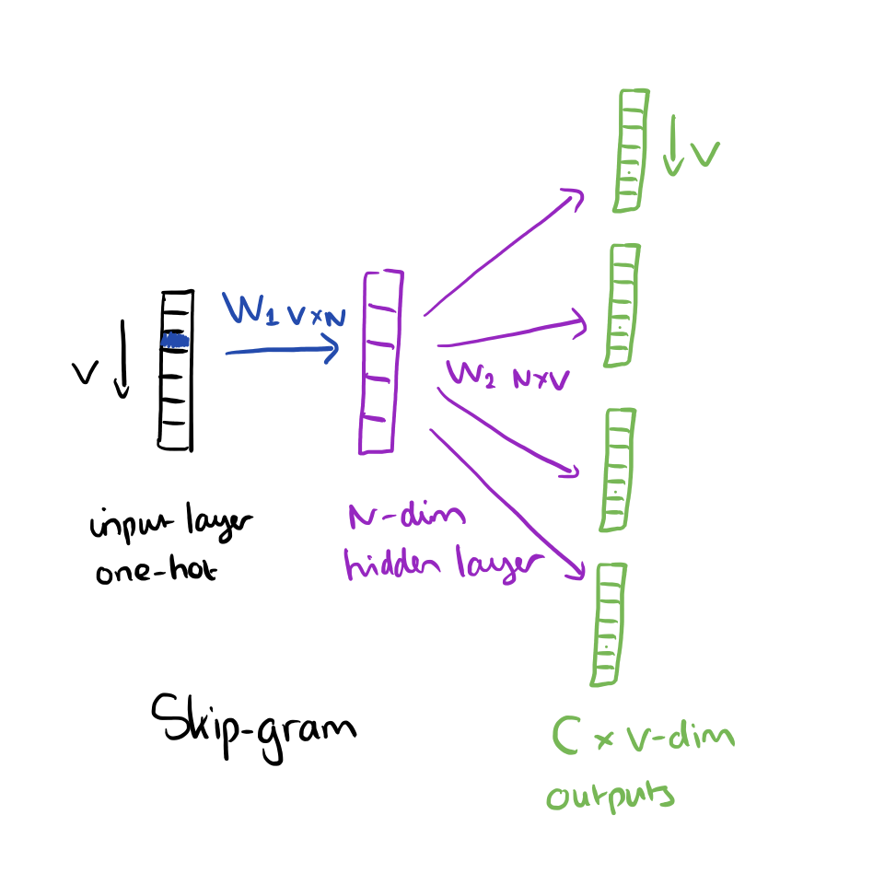

Slide 41
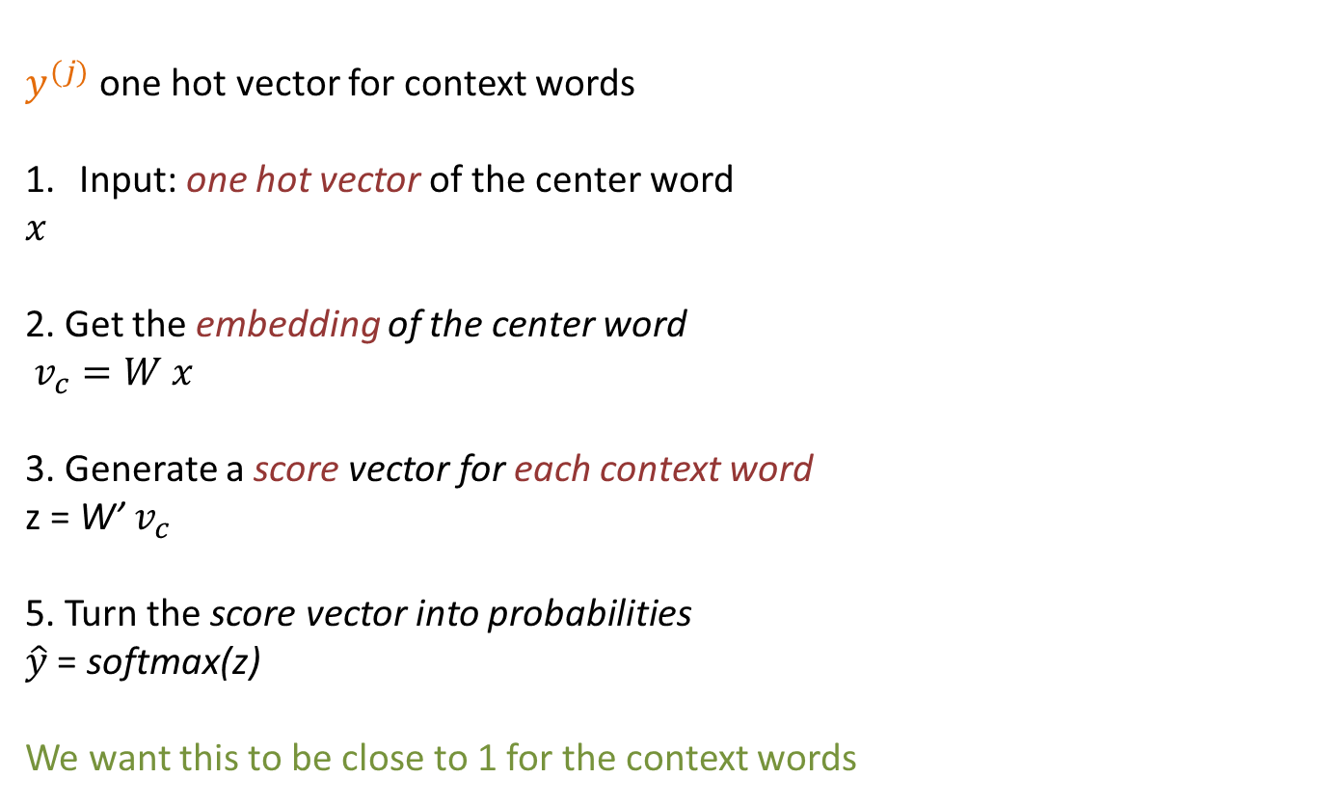
Skipgram
Given the center word, predict (or, generate) the context words
$y^{(j)}$ one hot vector for context words
Input: one hot vector of the center word
$$x$$
2. Get the embedding of the center word
$v_{c}=W x$
3. Generate a score vector for each context word
z = W’ $v_{c}$
5. Turn the score vector into probabilities
$\hat{y}$ = softmax(z)
We want this to be close to 1 for the context words

Slide 42
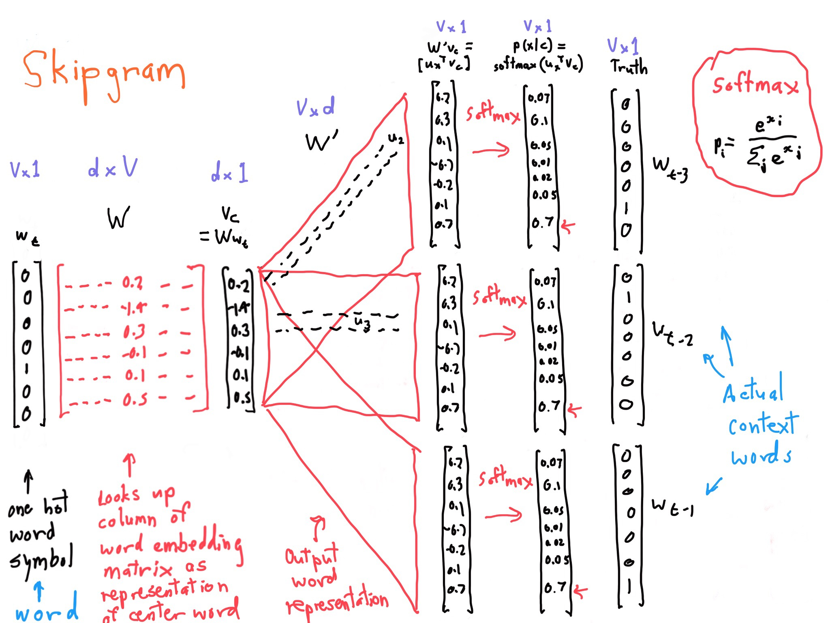

Slide 43
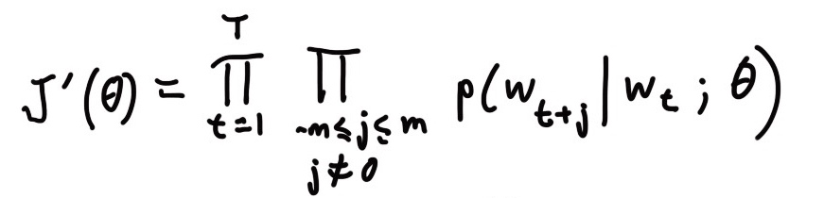
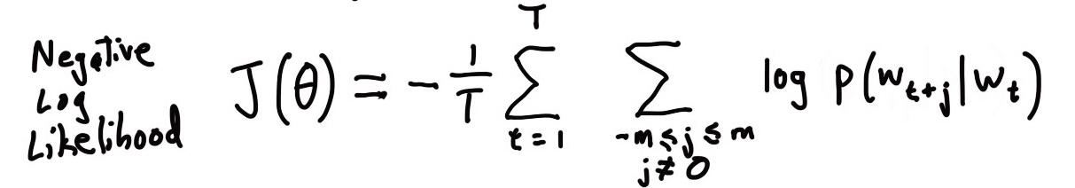
Skipgram
For each word t = 1 … T, predict surrounding words in a window of “radius” m of every word.
Objective function: Maximize the probability of any context word given the current center word:
where θ represents all variables we will optimize

Slide 44
An example

Slide 45
Word2Vec
  Predict between every word and its context words
Two algorithms
  Skip-grams (SG)
    Predict context words given the center word
  Continuous Bag of Words (CBOW)
    Predict center word from a bag-of-words context
    Position independent (do not account for distance from center)
Two training methods
  Hierarchical softmax
  Negative sampling
Tomas Mikolov, Ilya Sutskever, Kai Chen, Gregory S. Corrado, Jeffrey Dean: Distributed Representations of Words and Phrases and their Compositionality. NIPS 2013: 3111-3119

Slide 46
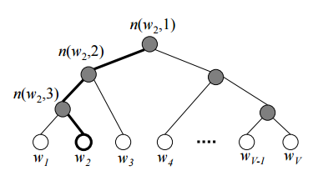
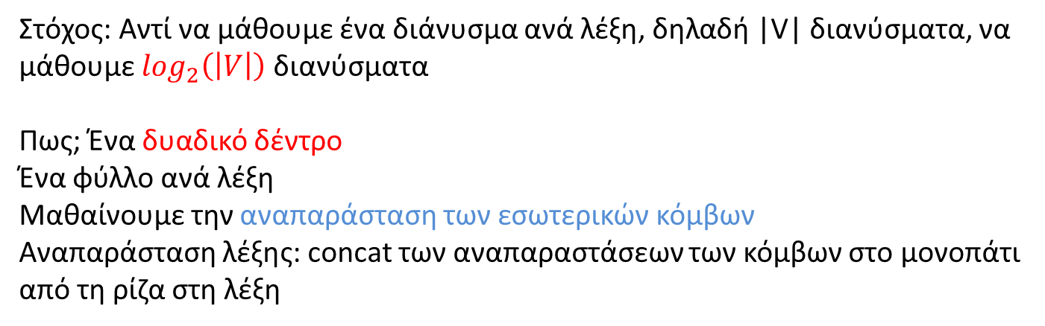
Training methods: hierarchical softmax
Στόχος: Αντί να μάθουμε ένα διάνυσμα ανά λέξη, δηλαδή |V| διανύσματα, να μάθουμε $\log_{2}\left(\left|V\right|\right)$ διανύσματα
Πως; Ένα δυαδικό δέντρο
Ένα φύλλο ανά λέξη
Μαθαίνουμε την αναπαράσταση των εσωτερικών κόμβων
Αναπαράσταση λέξης: concat των αναπαραστάσεων των κόμβων στο μονοπάτι από τη ρίζα στη λέξη

Slide 47
Training methods: negative sampling
Στόχος: Να βελτιώσουμε την ποιότητα των αναπαραστάσεων με χρήση αρνητικών δειγμάτων
Για κάθε ένα θετικό, Κ αρνητικά δείγματα
Χρήση unigram μοντέλου για να τα κατασκευάσουμε

Slide 48
These representations are very good at encoding similarity and dimensions of similarity!
Analogies testing dimensions of similarity can be solved quite well just by doing vector subtraction in the embedding space
  Syntactically
  x_{apple} − x_{apples} ≈ x_{car} − x_{cars} ≈ x_{family} − x_{families}
  Similarly for verb and adjective morphological forms
  Semantically
  x_{shirt} − x_{clothing} ≈ x_{chair} − x_{furniture}
  x_{king} − x_{man} ≈ x_{queen} − x_{woman}

Slide 49
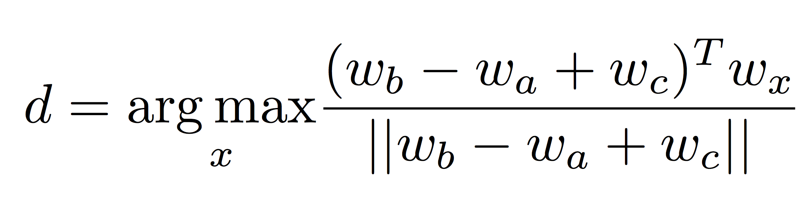
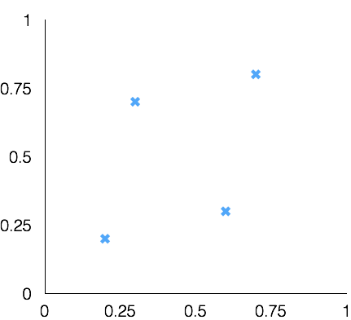
Test for linear relationships, examined by Mikolov et al.
a:b :: c:?
man:woman :: king:?
+
king
[ 0.30 0.70 ]
king
−
man
[ 0.20 0.20 ]
+
woman
[ 0.60 0.30 ]
woman
queen
[ 0.70 0.80 ]
man

Slide 50
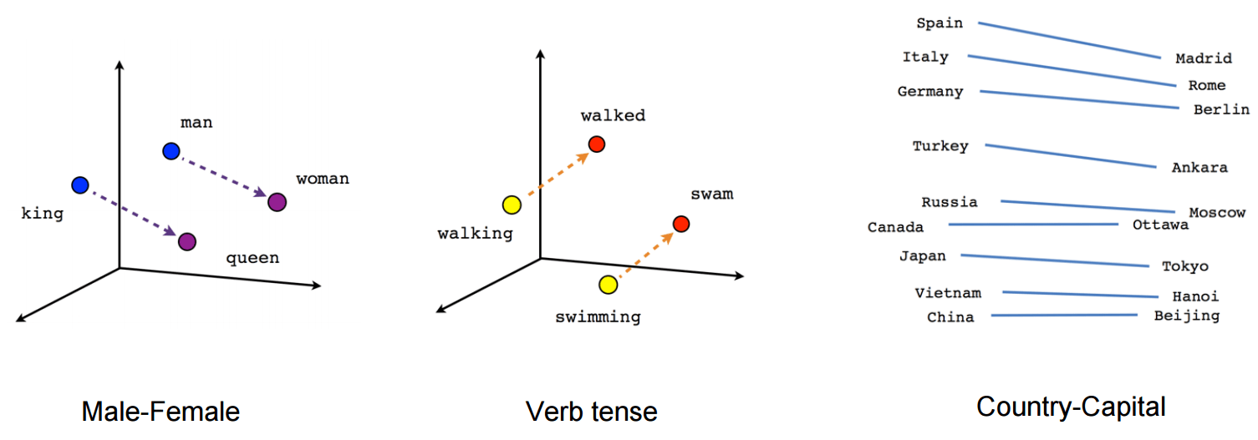

Slide 51
Στην εργασία, σας ζητείτε να χρησιμοποιείστε word embeddings
  Πρέπει να επιλέξετε πως
  Θα αξιολογηθεί και η καταλληλότητα/πρωτοτυπία/χρησιμότητα
  Στη συνέχεις θα δούμε
    pretrained embeddings
    μερικές εφαρμογές

Slide 52
Σύντομη περιγραφή της εργασίας
1. Θα συλλέξετε έναν αριθμό από Wikipedia άρθρα
Αυτή θα είναι η συλλογή σας.
2. Θα υλοποιήσετε ένα σύστημα αναζήτησης (ΣΑΠ) αυτών των άρθρων:
Ο χρήστης θα δίνει μία ή περισσότερες λέξεις κλειδιά και το σύστημα θα επιστρέφει τα πιο συναφή άρθρα σε διάταξη με βάση τη συνάφεια τους στην ερώτηση
Για να υλοποιήσετε το σύστημα θα χρησιμοποιείστε τη Lucene. Περισσότερα την επόμενη ώρα.

Slide 53
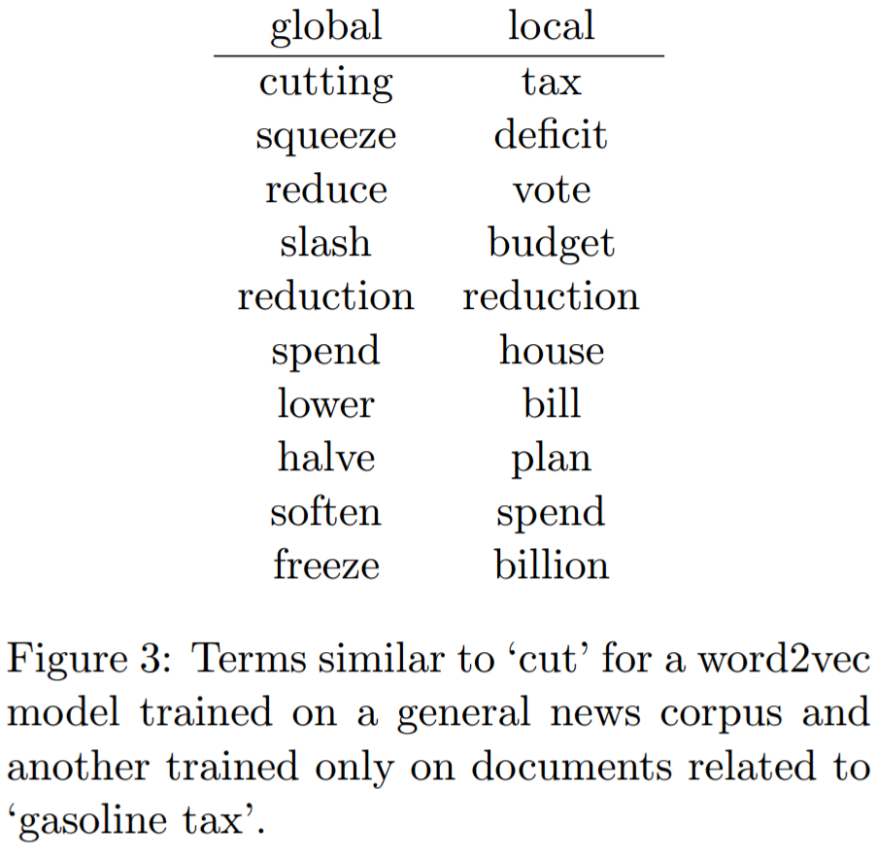
Global vs. local embedding
Πάνω σε ποια συλλογή (corpus) φτιάχνουμε τα embeddings;
Προτάσεις από ποια κείμενα θα χρησιμοποιήσουμε;
[Diaz 2016]

Slide 54
Train and create embeddings based on a local collection
Python implementation in gensim
https://radimrehurek.com/gensim/models/word2vec.html
Tensorflow
https://www.tensorflow.org/tutorials/text/word_embeddings
2. Use pretrained embeddings
Pretrained embeddings for 157 languages
https://fasttext.cc/docs/en/crawl-vectors.html
Google
https://code.google.com/archive/p/word2vec/

Slide 55
Finding the degree of similarity between two words.
model.similarity('woman','man')
0.73723527
Finding odd one out.
model.doesnt_match('breakfast cereal dinner lunch';.split())
'cereal'
Amazing things like woman+king-man =queen
model.most_similar(positive=['woman','king'],negative=['man'],topn=1)
queen: 0.508
Probability of a text under the model
model.score(['The fox jumped over the lazy dog'.split()])
0.21
ανεκτική ανάκτηση: (1) επέκταση ερωτήματος ή/και (2) context-dependent διόρθωση λάθους, όπου θα μπορούσαμε να χρησιμοποιήσουμε και το query log και γενικά query suggestions

Slide 56
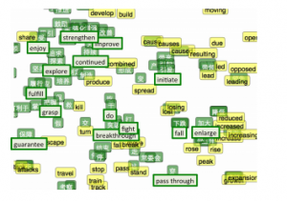
Improve language translation
bilingual embedding with chinese in green and english in yellow
By aligning the word embeddings for the two languages

Slide 57

Χρήση στη διάταξη των εγγράφων του αποτελέσματος μιας ερώτησης
Είδαμε διάταξη με $q^{T}d$
Μπορούμε να χρησιμοποιήσουμε embeddings;
Πολλές εναλλακτικές, για παράδειγμα (aboutness)
$$\sum_{w∈q}{wd′}$$
Όπου w το embedding των λέξεων της ερώτησης και d’ το embedding του εγγράφου (π.χ., το μέσο των embedding των λέξεων του εγγράφου)
Στόχος: Σχέση ερώτησης με το όλο το περιεχόμενο του εγγράφου
Input (center word) embedding ή output (context) word embedding; in-query, out-document
Σε συνδυασμό με άλλα κριτήρια

Slide 58
End of lecture
Χρησιμοποιήθηκε υλικό από
CS276: Information Retrieval and Web Search, Christopher Manning and Pandu Nayak, Lecture 14: Distributed Word Representations for Information Retrieval
https://www.analyticsvidhya.com/blog/2017/06/word-embeddings-count-word2veec/
Μια περιγραφή του skipgram:
Chris McCormick
http://mccormickml.com/2016/04/19/word2vec-tutorial-the-skip-gram-model/
Δείτε και το
https://www.analyticsvidhya.com/blog/2017/06/word-embeddings-count-word2veec/

Slide 59
Extra slides
Hierarchical softmax and negative sampling

Slide 60
Hierarchical softmax
Instead of learning O(|V|) vectors, learn O(log(|V|) vectors
How?
Build a binary tree with leaves the words, and learn one vector for each internal node.
The value for each word w is the product of the values of the internal nodes in the path from the root to w.

Slide 61

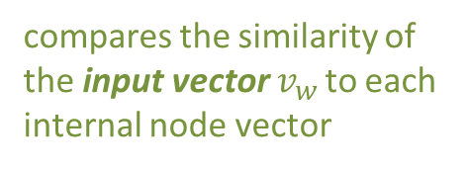

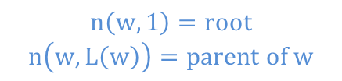
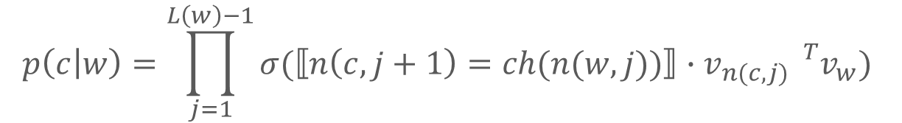
The probability of a word being the context word is defined as:
where:
  $n\left(w,j\right)$– is the j-th node on the path from the root to w.
  $L\left(w\right)$ – is the length of the path from root to w.
  $ch(n$) – is the left child of node n.
  $⟦x⟧=\{\begin{matrix}1 if x is true \\ −1 otherwise\end{matrix}$
  $σ\left(x\right)=\frac{1}{1+e^{−x}}$
compares the similarity of the input vector $v_{w }$to each internal node vector
$$p\left(c | w\right)=\prod_{j=1}^{L\left(w\right)−1}{σ(⟦n\left(c,j+1\right)=ch(n(w,j))⟧∙v_{n(c,j) }{}_{}^{T}{v_{w}}})$$
returns 1 if the path goes left,
- 1 if it goes right
$$n\left(w,1\right)=root$$
$$n\left(w,L\left(w\right)\right)=parent of w$$
$$L\left(w2\right)=3$$

Slide 62
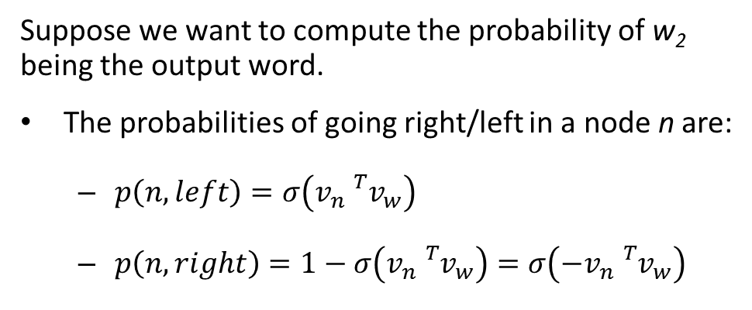
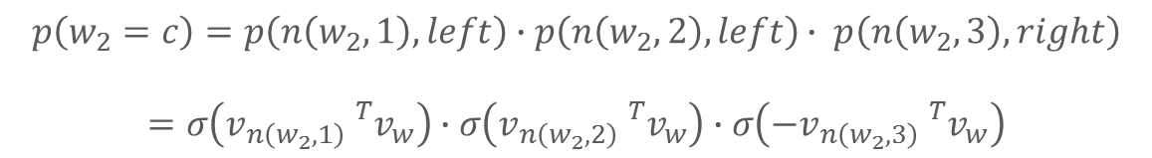
Suppose we want to compute the probability of w₂ being the output word.
The probabilities of going right/left in a node n are:
  $p\left(n,left\right)=σ\left(v_{n}{}_{}^{T}{v_{w}}\right)$
  $p\left(n,right\right)=1−σ\left(v_{n}{}_{}^{T}{v_{w}}\right)=σ\left(−v_{n}{}_{}^{T}{v_{w}}\right)$
$$p\left(w_{2}=c\right)=p\left(n\left(w_{2},1\right),left\right)∙p\left(n\left(w_{2},2\right),left\right)∙ p\left(n\left(w_{2},3\right),right\right)$$
$$=σ\left(v_{n\left(w_{2},1\right)}{}_{}^{T}{v_{w}}\right)∙σ\left(v_{n\left(w_{2},2\right)}{}_{}^{T}{v_{w}}\right)∙σ\left(−v_{n\left(w_{2},3\right)}{}_{}^{T}{v_{w}}\right)$$
Complexity improved even further using a Huffman tree:
Designed to compress binary code of a given text.
A full binary suffix tree that guarantees a minimal average weighted path length when some words are frequently used.

Slide 63
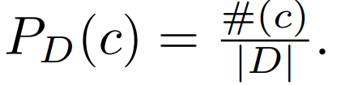
Negative Sampling
For each positive example we draw K negative examples.
The negative examples are drawn according to the unigram distribution of the data

Slide 64
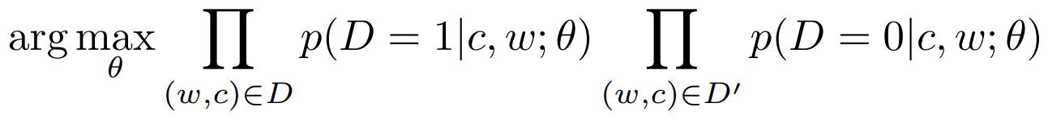
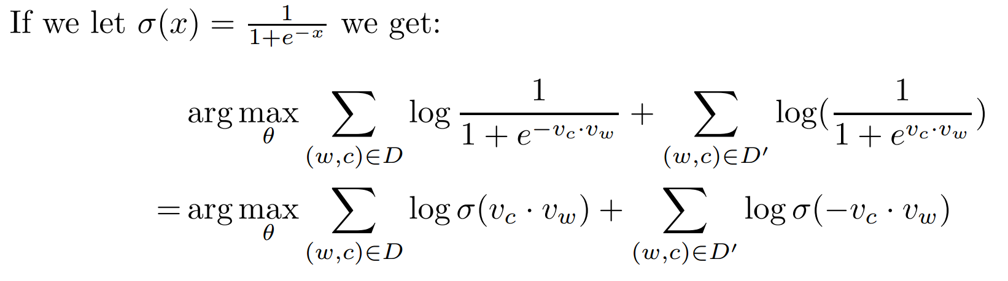
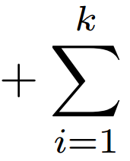
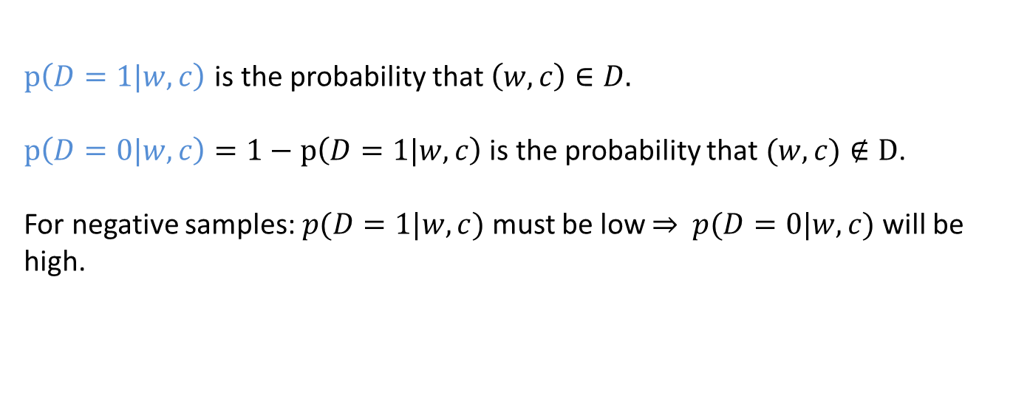
$p\left(D=1|w,c\right)$ is the probability that $\left(w,c\right)∈D.$
$p\left(D=0|w,c\right)=1−p\left(D=1|w,c\right)$ is the probability that $(w,c)∉D$.
For negative samples: $p(D=1|w,c)$ must be low ⇒ $p(D=0|w,c)$ will be high.
For one sample:

Slide 65
Extra slides
Neural nets (from our graduate class with P. Tsaparas)

Slide 66
Introduction to Neural Networks
(Thanks to Philipp Koehn for the material borrowed from his slides)

Slide 67
Classification
Classification is the task of learning a target function f that maps attribute set x to one of the predefined class labels y
categorical
categorical
continuous
class
One of the attributes is the class attribute
In this case: Cheat
Two class labels (or classes): Yes (1), No (0)

Slide 68
Illustrating Classification Task

Slide 69
Example of a Model
categorical
categorical
continuous
class
Refund
Yes
No
NO
MarSt
Single, Divorced
Married
TaxInc
NO
< 80K
> 80K
NO
YES
Training Data
Model: Decision Tree

Slide 70
Classification in Networks
There are various problems in network analysis that can be mapped to a classification problem:
  Link prediction: Predict 0/1 for missing edges, whether they will appear or not in the future.
  Node classification: Classify nodes as democrat-republican/spammers-legitimate/other categories
    Use node features but also neighborhood and structural features
    Label propagation
  Edge classification: Classify edges according to type (professional/family relationships), or according to strength.
  More…
Recently all of this is done using Neural Networks.

Slide 71
Linear Classification
A simple model for classification is to take a linear combination of the feature values and compute a score.
Input: Feature vector $x=(x_{1},…,x_{n})$
Model: Weights $w=(w_{1},…, w_{n})$
Output: $score\left(w,x\right)=\sum_{i}{w_{i}x_{i}}$
Make a decision depending on the output score.
  E.g.: Decide “Yes” if $score\left(w,x\right)>0$ and “No” if $score\left(w,x\right)<0$

Slide 72
Linear Classification
We can represent this as a network
Edges correspond to weights
$$x_{1}$$
$$w_{1}$$
Input nodes correspond to features
$$x_{2}$$
$$w_{2}$$
$$x_{3}$$
$$w_{3}$$
$$score(w,x)$$
$$x_{4}$$
$$w_{4}$$
$$w_{5}$$
“Output” node with incoming edges computes the score
$$x_{5}$$

Slide 73
Linear models
Linear models partition the space according to a hyperplane
But they cannot model everything

Slide 74
Multiple layers
We can add more layers:
  Each arrow has a weight
  Nodes compute scores from incoming edges and give input to outgoing edges
Did we gain anything?

Slide 75
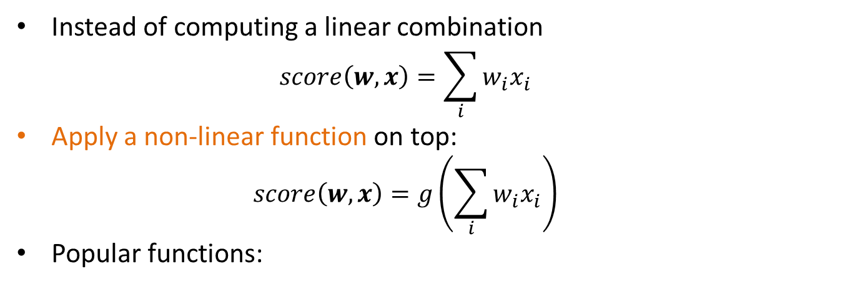
Non-linearity
Instead of computing a linear combination
  $$score\left(w,x\right)=\sum_{i}{w_{i}x_{i}}$$
Apply a non-linear function on top:
  $$score\left(w,x\right)=g\left(\sum_{i}{w_{i}x_{i}}\right)$$
Popular functions:
These functions play the role of a soft “switch” (threshold function)

Slide 76
Side note
Logistic regression classifier:
  Single layer with a logistic function

Slide 77
Deep learning
Networks with multiple layers
Each layer can be thought of as a processing step
Multiple layers allow for the computation of more complex functions

Slide 78
Example
A network that implements XOR
Hidden node $h_{0}$ is OR
Output node $h_{1}−h_{0}$
Hidden node $h_{1}$ is AND
Bias term

Slide 79
Error
The computed value is 0.76 but the correct value is 1
  There is an error in the computation
  How do we set the weights so as to minimize this error?

Slide 80
Gradient Descent
The error is a function of the weights
We want to find the weights that minimize the error
Compute gradient: gives the direction to the minimum
Adjust weights, moving at the direction of the gradient.

Slide 81
Gradient Descent

Slide 82
Gradient Descent

Slide 83
Backpropagation
How can we compute the gradients? Backpropagation!
Main idea:
  Start from the final layer: compute the gradients for the weights of the final layer.
  Use these gradients to compute the gradients of previous layers using the chain rule
  Propagate the error backwards
Backpropagation essentially is an application of the chain rule for differentiation.

Slide 84
$$x_{1}$$
$$a_{11}$$
$$h_{1}$$
$$b_{11}$$
$$y_{1}$$
Error: $E={\left\|y−t\right\|}^{2}={\left(y_{1}−t_{1}\right)}^{2}+{\left(y_{2}−t_{2}\right)}^{2}$
$$a_{12}$$
$$b_{12}$$
$$\frac{∂E}{∂b_{11}}=\frac{∂E}{∂s_{y_{1}}}\frac{∂s_{y_{1}}}{∂b_{11}}=δ_{y_{1}}h_{1}$$
$$a_{21}$$
$$b_{21}$$
$$x_{2}$$
$$a_{22}$$
$$h_{2}$$
$$y_{2}$$
$$b_{22}$$
$δ_{y_{1}}$= $\frac{∂E}{∂s_{y_{1}}}$= $\frac{∂E}{∂y_{1}}\frac{∂y_{1}}{∂s_{y_{1}}}=2\left(y_{1}−t_{1}\right)g′(s_{y_{1}})$
Notation:
Activation function: $g$
$s_{y_{1}}=b_{11}h_{1}+b_{12}h_{2}$ , $y_{1}=g\left(s_{y_{1}}\right)$
$s_{y_{2}}=b_{21}h_{1}+b_{22}h_{2}$ , $y_{2}=g(s_{y_{2}})$
$s_{h_{1}}=a_{11}x_{1}+a_{12}x_{2}$ , $h_{1}=g(s_{h_{1}})$
$s_{h_{2}}=a_{21}x_{1}+a_{22}x_{2}$ , $h_{2}=g(s_{h_{2}})$
$$\frac{∂E}{∂b_{21}}=δ_{y_{2}}h_{1}$$
$δ_{y_{2}}$= $\frac{∂E}{∂s_{y_{2}} }$= $2\left(y_{2}−t_{2}\right)g′(s_{y_{2}})$
$$\frac{∂E}{∂b_{12}}=δ_{y_{1}}h_{2}$$
$$\frac{∂E}{∂b_{22}}=δ_{y_{2}}h_{2}$$
$$\frac{∂E}{∂a_{11}}=\frac{∂E}{∂s_{h_{1}}}\frac{∂s_{h_{1}}}{∂a_{11}}=δ_{h_{1}}x_{1}$$
$$\frac{∂E}{∂a_{22}}=\frac{∂E}{∂s_{h_{2}}}\frac{∂s_{h_{2}}}{∂a_{22}}=δ_{h_{2}}x_{2}$$
$$\frac{∂E}{∂a_{21}}=δ_{h_{1}}x_{2}$$
$$\frac{∂E}{∂a_{12}}=δ_{h_{2}}x_{1}$$
$$δ_{h_{1}}=\frac{∂E}{∂s_{h_{1}}}=\frac{∂E}{∂h_{1}}\frac{∂h_{1}}{∂s_{h_{1}}}=\left(\frac{∂E}{∂s_{y_{1}}}\frac{∂s_{y_{1}}}{∂h_{1}}+\frac{∂E}{∂s_{y_{2}}}\frac{∂s_{y_{2}}}{∂h_{1}}\right)g^{′}\left(s_{h_{1}}\right)=\left(δ_{y_{1}}b_{11}+δ_{y_{2}}b_{21}\right)g′(s_{h_{1}})$$
$$δ_{h_{2}}=\left(δ_{y_{1}}b_{12}+δ_{y_{2}}b_{22}\right)g′(s_{h_{2}})$$

Slide 85
Backpropagation
$$δ_{y_{1}}=\frac{∂E}{∂s_{y_{1}}}$$
$$δ_{y_{k}}=\frac{∂E}{∂s_{y_{k}}}$$
$$δ_{y_{n}}=\frac{∂E}{∂s_{y_{n}}}$$
$$y_{1}$$
$$y_{k}$$
$$y_{n}$$
$$\frac{∂E}{∂a_{ij}}=\sum_{k=1}^{n}{δ_{y_{k}}b_{ki}}g^{′}\left(s_{h_{i}}\right)x_{j}$$
$$s_{y_{1}}$$
$$s_{y_{k}}$$
$$s_{y_{n}}$$
$$b_{1i}$$
$$b_{ki}$$
$$b_{ni}$$
For the sigmoid function:
$$g\left(x\right)= \frac{1}{1+e^{−x}}$$
The derivative is:
$$g^{′}\left(x\right)=g(x)(1−g\left(x\right))$$
This makes it easy to compute it. We have:
$$g^{′}\left(s_{h_{i}}\right)=h_{i}(1−h_{i})$$
$$h_{i}$$
$$s_{h_{i}}$$
$$a_{ij}$$
$$x_{j}$$

Slide 86
Stochastic gradient descent
Ideally the loss should be the average loss over all training data.
We would need to compute the loss for all training data every time we update the gradients.
  However, this is expensive.
Stochastic gradient descent: Consider one input point at the time. Each point is considered only once.
Intermediate solution: Use mini-batches of data points.

Slide 87
End of extra slides

