Slide 1

DisC Diversity: Result Diversification based on Dissimilarity and Coverage
Marina Drosou, Evaggelia Pitoura
Computer Science Department
University of Ioannina, Greece
http://dmod.cs.uoi.gr

Slide 2
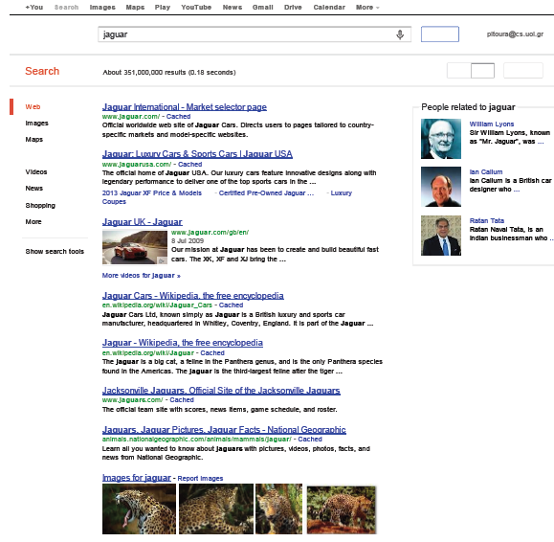
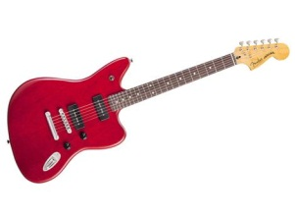

Why diversify?
Car
Animal
Sports Team
“Mr. Jaguar’’
Notes:
An example of diversity in the vase of web search

Slide 3
What it means
Given a set P of query results we want to select a representative diverse subset S of P
What diverse means^{[1]}?
  Coverage: different aspects, perspectives, concepts
    as in the example of web search
  Dissimilarity: non-similar items
    e.g., a number of characteristics in recommendations
  Novelty: items not seen in the past
[1] | Marina Drosou, Evaggelia Pitoura: Search result diversification. SIGMOD Record 39(1): 41-47 (2010)
Notes:
cover

Slide 4
Shortcomings of previous approaches
Most previous work views as a top-k problem
Given a set P of items and a number k, select a subset S* of P with the k most diverse items of P.
where
P = {p₁, …, p_{n}}
k ≤ n
d: a distance metric
f: a diversity function
Find:

Slide 5

Our approach - DisC Diversity
What is the right size for the diverse subset S?
What is a good k?
What if… instead of k, a radius r?
Given a result set P and a radius r, we select a representative subset S ⊆ P such that:
  For each item in P, there is at least one similar item in S (coverage)
  No two items in S are similar with each other (dissimilarity)

Slide 6
r-DisC set: r-Dissimilar and Covering set
Zoom-in
Zoom-out
Local zoom
Small r: more and less dissimilar points (zoom in)
Large r: less and more dissimilar points (zoom out)
Local zooming at specific points by adjusting the radius around them

Slide 7
Talk Overview
Formal definition and algorithms
Comparison
Adaptive Diversification
Implementation using M-trees
Evaluation

Slide 8
Our approach - DisC Diversity
Since a DisC set for a set P is not unique
We seek a concise representation → the minimum DisC set
Formal definition:
Let P be a set of objects and r, r ≥ 0, a real number. A subset S ⊆ P is an r-Dissimilar-and-Covering diverse subset, or r-DisC diverse subset, of P, if the following two conditions hold:
(coverage condition) ∀p_{i} ∈ P, ∃p_{j} ∈ N⁺_{r} (p_{i}), such that p_{j} ∈ S and
(dissimilarity condition) ∀ p_{i}, p_{j} ∈ S with p_{i} ≠ p_{j} , it holds that d(p_{i}, p_{j}) > r

Slide 9
Graph model
We use a graph to model the problem:
  Each item is a vertex
  There exists an edge between two vertices, if their distance is less than r
r

Slide 10
Graph model
Solving the minimum r-DisC Diverse Subset Problem for a set P is equivalent to finding a minimum Independent Dominating set of the graph.
  Independent: no edge between any two vertices in the set
  Dominating: all vertices outside connected with at least one inside
NP-hard
✗
Dominating, not independent
Dominating and independent

Slide 11
Computing DisC subsets

Slide 12
How smaller is the minimum set?
The size of any r-DisC diverse subset S of P is ≤ B times the size of any minimum r-DisC diverse subset S∗
where B the maximum number of independent neighbors of any item in P
      i.e., each item has at most B neighbors that are independent from each other.
  B depends on the distance metric and data cardinality
  We have proved that:
  for the Euclidean distance in the 2D plane: B = 5
  for the Manhattan distance in the 2D plane: B = 7
  for the Euclidean distance in the 3D plane: B = 24
  (proofs in the paper)

Slide 13
Bounding the size of DisC subsets
Raising the dissimilarity condition:
Let Δ be the maximum number of neighbors of any item in P. The size of any covering (but not dissimilar) diverse subset S of P is at most lnΔ times larger than any minimum covering subset S∗
(proof in the paper)

Slide 14
Talk Overview
Formal definition and algorithms
Comparison
Adaptive Diversification
Implementation using M-trees
Evaluation

Slide 15
Comparison with other models
Two widespread options for f:

Slide 16
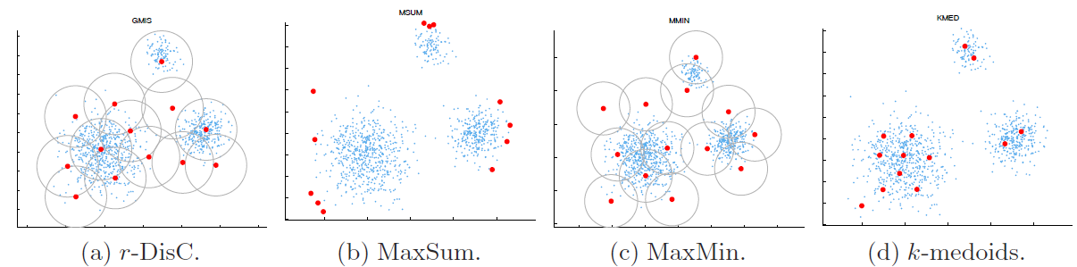
Comparison with other models

Slide 17
Comparison with other models
  Let S be an r-DisC set and S* be an optimal MaxMin set. Let λ and λ* be the MaxMin distances of the two sets. Then, λ* ≤ 3λ.
(proof in the paper)

Slide 18
Talk Overview
Formal definition and Algorithms
Comparison
Adaptive Diversification
Implementation using M-trees
Evaluation

Slide 19
Zooming
We want to change the radius r to r’ interactively and compute a new diverse set
  r’ < r zoom in, r’ > r, zoom out
Two requirements:
  Support an incremental mode of operation:
    the new set S^{r’} should be as close as possible to the already seen result S^{r}. Ideally, S^{r’} ⊇ S^{r} for r’ < r and S^{r’} ⊆ S^{r} for r’ > r
  The size of S^{r’} should be as close as possible to the size of the minimum r’-DisC diverse subset
  There is no monotonic property among the r-DisC diverse and the r’-DisC diverse subsets of a set of objects P (the two sets may be completely different)

Slide 20
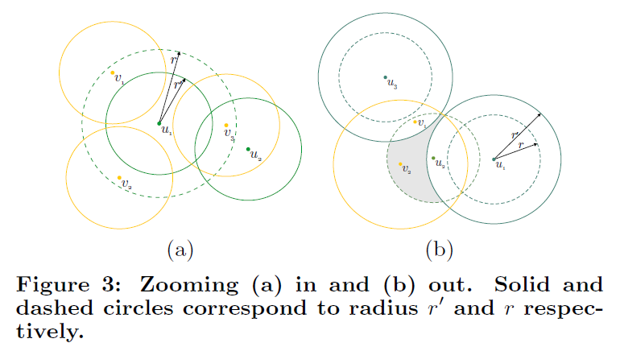

Size when moving from r -> r’
$$N{}_{r_{1}{,r}_{2}}^{I}{(p_{i})}$$
The change in size of the diverse set when moving from r to r’ depends on the number of independent neighbors (for r’) in the “ring” around an object between the two radii.

Slide 21



Zooming
  Again, $|N{}_{r_{1}{,r}_{2}}^{I}{\left(p_{i}\right)|}$ depends on the distance metric and data cardinality
    2D Euclidean
    2D Manhattan
(proofs in the paper)

Slide 22
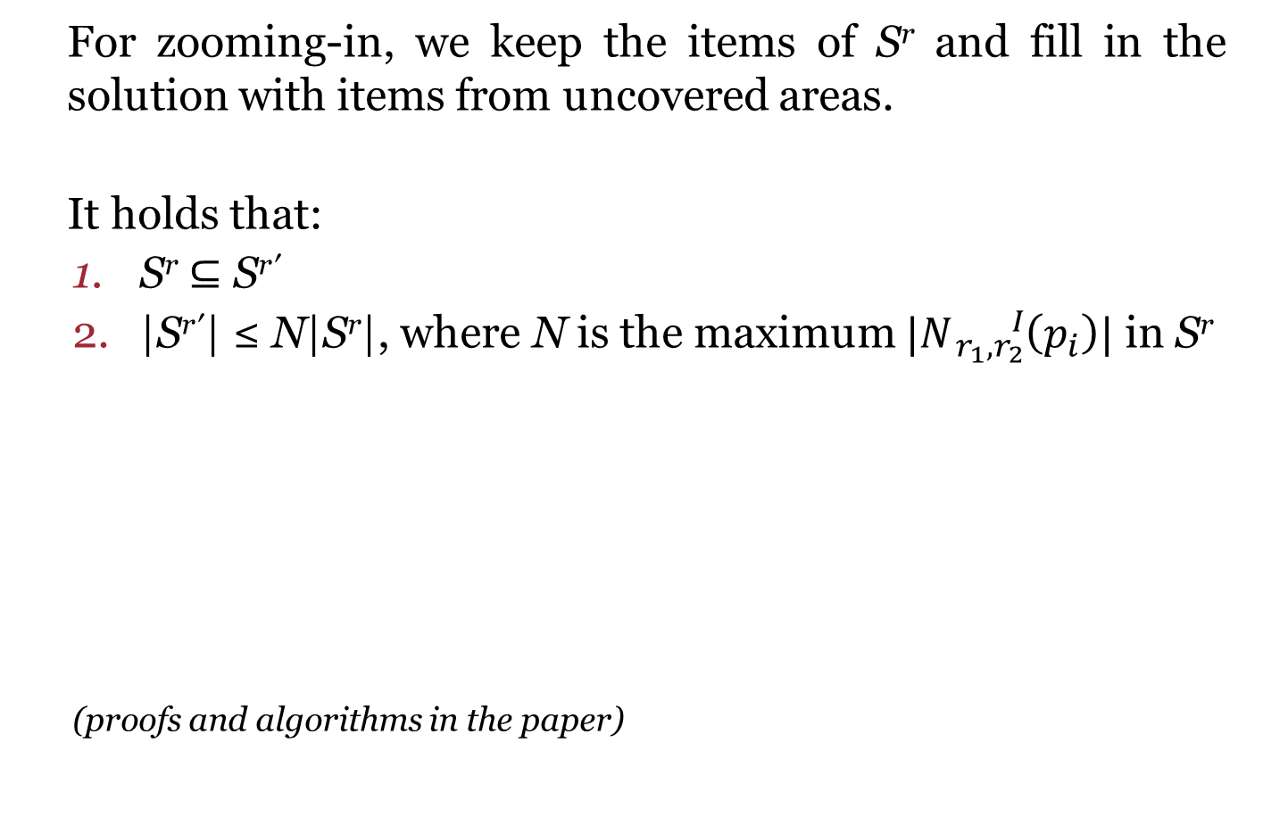
Zooming-In
For zooming-in, we keep the items of S^{r} and fill in the solution with items from uncovered areas.
It holds that:
  S^{r} ⊆ S^{r′}
  |S^{r′}| ≤ N|S^{r}|, where N is the maximum $|N{}_{r_{1}{,r}_{2}}^{I}{\left(p_{i}\right)|}$ in S^{r}
  (proofs and algorithms in the paper)
  (proof and various algorithms for
  keeping the size small in the paper)

Slide 23
Zooming-Out
For zooming-out, we keep the independent items of S^{r} and fill in the solution with items from uncovered areas.
It holds that:
  There are at most N items in S^{r}\S^{r’}
  For each item in S^{r}\S^{r’}, at most (B-1) items are added to S^{r’}
  (proof and various algorithms for
  keeping the size small in the paper)

Slide 24
Talk Overview
Formal definition and Algorithms
Comparison
Adaptive Diversification
Implementation using M-trees
Evaluation

Slide 25
Implementation
We base our implementation on a spatial data structure (central operation: compute neighbors)
  We use an M-tree
    We link together all leaf nodes (we visit items in a single left-to-right traversal of the leaf level to exploit locality)
    We build trees using splitting policies that minimize overlap

Slide 26
Implementation
Pruning Rule:
A leaf node that contains no white objects is colored grey. When all its children become grey, an internal node is colored grey and becomes inactive. We prune subtrees with only “grey nodes”.
  Lazy variations for updating neigborhoods
  Our code is available on-line:
    www.dbxr.org (VLDB 2013 Reproducible label)

Slide 27
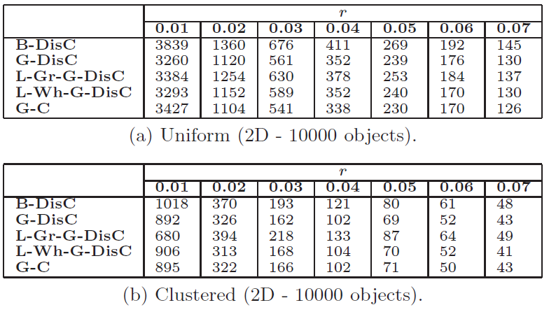
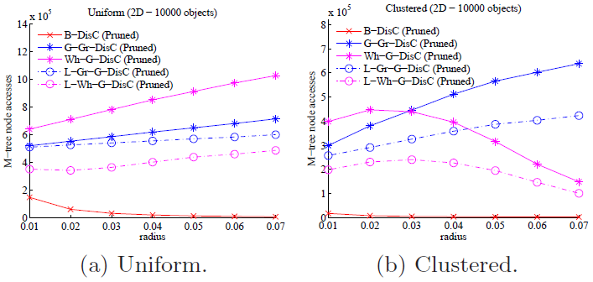
Performance
Many real and synthetic datasets
General trade-off:
Larger r → Smaller diverse set → higher cost
Lazy variations of our algorithms further reduce computational cost
The cost also depends on the characteristics of the M-tree (fat-factor)
Smaller sizes for clustered data
Solution size
Cost

Slide 28
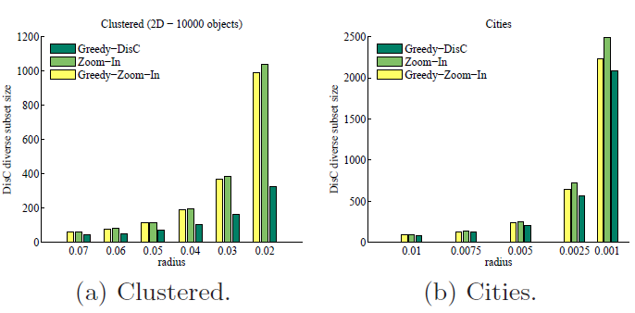
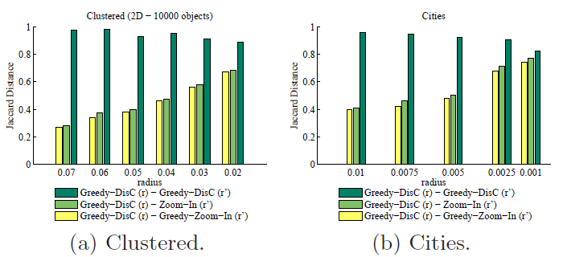
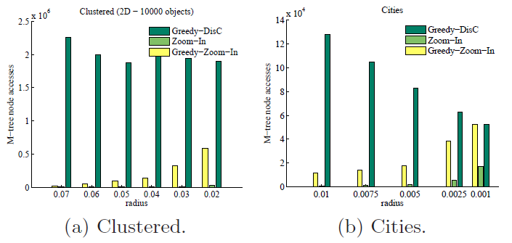
Zooming performance
Solution size
Both requirements:
incremental (much smaller cost) and
small size (relative to computing it from scratch)
Jaccard distance among solutions
Cost
Larger overlap among S^{r} and S^{r’}

Slide 29
On-going and future work
Incorporate relevance:
  instead of locating the smaller set, locating the “most relevant” set
Use multiple radii:
  emphasize specific areas of the dataset
  emphasize specific items, e.g., most relevant
Streaming (publish/subscribe) systems: also “novelty”
Many other – other forms of indexing, integrating the notion of diversity with database query processing, etc .

Slide 30

Thank you!
See DisC and other models in action in our demo!
Poikilo @ Group D

Slide 31
Computing DisC subsets
Let us call black the objects of P that are in S, grey the objects covered by S and white the objects that are neither black nor grey.
Initially, S is empty and all objects are white.
  until there are no more white objects.
    select an arbitrary white object p_{i}
    color p_{i} black
    and colors all objects in the neighborhood of p_{i} grey.
Greedy variation:
  At each step, we select the white object with the largest number of white neighbors.

