Slide 1
Preferential Publish/Subscribe
Marina Drosou
Department of Computer Science
University of Ioannina, Greece
Joint work with Evaggelia Pitoura and Kostas Stefanidis
http://dmod.cs.uoi.gr

Slide 2
Publish/Subscribe Systems
Publish/Subscribe is an alternative to typical searching
Users do not need to repeatedly search for new interesting data
They specify their interests once and the system automatically notifies them whenever relevant data is made available
Example:
Google Alerts

Slide 3
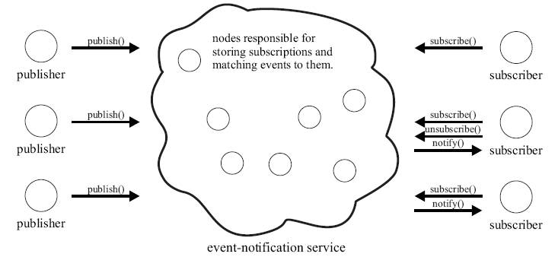
Publish/Subscribe Systems
Parts of a Publish/Subscribe system:
Subscribers: consumers of events
Publishers: generators of events
Event-notification service:
Store subscriptions (user interests)
Match events to subscriptions
Deliver event notifications

Slide 4
Publish/Subscribe Example
Published events
title = The Godfather
genre = drama
showing time = 21:10
Matching events
title = The Godfather
genre = drama
showing time = 21:10
title = Ratatouille
genre = comedy
showing time = 21:15
User subscriptions
genre = drama
title = Fight Club
genre = drama
showing time = 23:00
title = Fight Club
genre = drama
showing time = 23:00
genre = horror
title = Casablanca
genre = drama
showing time = 23:10
title = Casablanca
genre = drama
showing time = 23:10
title = Vertigo
genre = drama
showing time = 23:20
title = Vertigo
genre = drama
showing time = 23:20

Slide 5
Motivation
Typically, all subscriptions are considered equally important
Users may receive overwhelming amounts of notifications
In such cases, users would like to receive only a fraction of those notifications, the most interesting ones
Say John is more interested in horror movies than comedies
John would like to receive notifications about comedies only if there are no (or just a few) notifications about horror movies
Current publish/subscribe systems do not allow John to express this different degree of interest

Slide 6
Motivation
To express some form of ranking among subscriptions, we define priorities among them
To do this, we use preferences among subscriptions (preferential subscriptions)
Based on preferential subscriptions, we deliver to users only the k most interesting events

Slide 7
Outline
Publish/Subscribe Preliminaries
Preferential Subscriptions & Time-Valid Notifications
Ranking in Publish/Subscribe
Evaluation
Summary

Slide 8
Outline
Publish/Subscribe Preliminaries
Preferential Subscriptions & Time-Valid Notifications
Ranking in Publish/Subscribe
Evaluation
Summary

Slide 9
Publish/Subscribe Variations
There are two kind of used schemes for specifying interesting events:
Topic-based
Each event belongs to a number of topics (e.g. “music”, “sport”)
Users subscribe to topics and receive all relevant events
Content-based
Users subscribe to the actual content of the events
More expressive
In this work we use the content-based scheme

Slide 10
Notifications
A notification is a set of typed attributes consisting of:
A type
A name
A value
string title = LOTR: The Return of the King
string director = Peter Jackson
time release date = 1 Dec 2003
string genre = fantasy
integer oscars = 11

Slide 11
Subscriptions
A subscription is a set of typed attribute constraints consisting of:
A type
A name
A binary operator
A value
string director = Peter Jackson
time release date > 1 Jan 2003

Slide 12
Cover Relation
Given a notification n and a subscription s, s covers n (or n matches s) if and only if every attribute constraint of s is satisfied by some attribute of n
Subscriptions
Event notification
string director = Peter Jackson
time release date > 1 Jan 2003
string title = LOTR: The Return of the King
string director = Peter Jackson
time release date = 1 Dec 2003
string genre = fantasy
integer oscars = 11
string director = Steven Spielberg
string genre = fantasy
string release date > 1 Jan 2003

Slide 13
Outline
Publish/Subscribe Preliminaries
Preferential Subscriptions & Time-Valid Notifications
Ranking in Publish/Subscribe
Evaluation
Summary

Slide 14
Preferential Subscriptions
To define priorities among subscriptions: add preferences
Two ways to express preferences:
Quantitative approach
Preferences are expressed by using scoring functions
Qualitative approach
Preferences are expressed by using preference relations between pairs of subscriptions
genre = drama
genre = horror
0.9
0.7
genre = drama
≻
genre = horror

Slide 15
Preferential Subscriptions
A preferential subscription is a subscription enhanced with a numeric score within the range [0, 1]
preferential subscription = subscription + score
string director = Peter Jackson
time release date > 1 Jan 2003
0.9

Slide 16
Notification Score
Given a set of user preferential subscriptions and a published notification
Find out how important the notification is to the user
How?
The notification score is computed based on the scores of the matching subscriptions
In the case of one matching subscription:
Notification score = subscription score

Slide 17
Notification Score
For user X, a notification n has score:
sc(n, X) = max {score₁, …, score_{m}}
where score₁, …, score_{m} are the scores of X’s preferential subscriptions that cover n
genre = adventure
string title = King Kong
string director = Peter Jackson
time release date = 14 Dec 2005
string genre = adventure
0.9
0.9
director = Peter Jackson
0.7

Slide 18
Top-k Notifications
Based on the user’s preferential subscriptions, we rank published notifications and deliver only the top-k, i.e. the notifications with the k highest scores
Publication of events is continuous
A newly published notification n is delivered to a user X, if and only if:
It is covered by some subscription s issued by X and
X has not already received k notifications more preferable to n

Slide 19
Stale Notifications
New notifications are constantly produced
It is possible for very old but highly preferable notifications to prevent newer ones from reaching the user

Slide 20
Example
Published events
title = The Apartment
genre = comedy
showing time = 21:00
20:00
0.9
User subscriptions
Top-2 events
title = The Godfather
genre = drama
showing time = 21:10
title = The Apartment
genre = comedy
showing time = 21:00
20:10
0.8
genre = comedy
0.9
title = Ratatouille
genre = comedy
showing time = 21:15
20:15
0.9
genre = drama
title = The Godfather
genre = drama
showing time = 21:10
0.8
title = Fight Club
genre = drama
showing time = 21:20
20:20
0.8
title = Ratatouille
genre = comedy
showing time = 21:15
title = Casablanca
genre = drama
showing time = 21:25
20:25
0.8
title = Vertigo
genre = drama
showing time = 23:20
22:20
0.8

Slide 21
Time-Valid Notifications
Old but highly preferable notifications may prevent newer notifications from reaching the user
To overcome this problem, we use the notion of time validity:
Notifications are associated with an expiration time
Only valid notifications can prevent others from reaching the user
A newly published notification n is delivered to a user X, if and only if:
It is covered by some subscription s issued by X and
X’s top-k results do not contain k valid notifications more preferable to n

Slide 22
Example
Published events
Notifications expire
at their showing time
title = The Apartment
genre = comedy
showing time = 21:00
20:00
0.9
Top-2 events
User subscriptions
title = The Apartment
genre = comedy
showing time = 21:00
title = The Godfather
genre = drama
showing time = 21:10
20:10
0.8
genre = comedy
0.9
title = Ratatouille
genre = comedy
showing time = 21:15
title = The Godfather
genre = drama
showing time = 21:10
20:15
0.9
genre = drama
0.8
title = Fight Club
genre = drama
showing time = 21:20
title = Ratatouille
genre = comedy
showing time = 21:15
20:20
0.8
title = Casablanca
genre = drama
showing time = 21:25
title = Vertigo
genre = drama
showing time = 23:20
20:25
0.8
title = Vertigo
genre = drama
showing time = 23:20
22:20
0.8

Slide 23
Outline
Publish/Subscribe Preliminaries
Preferential Subscriptions & Time-Valid Notifications
Ranking in Publish/Subscribe
Preferential Subscription Graph
Forwarding Notifications
Evaluation
Summary

Slide 24
Match Notifications to Subscriptions
Whenever a new notification n is published:
Locate users with matching subscriptions
Check whether n belongs to their top-k valid results
If so, forward n

Slide 25
Match Notifications to Subscriptions
How does the event-notification service carry out the matching process?
Notifications need to be checked against user subscriptions
All of them?
Exploit cover relations between subscriptions
string genre = fantasy
string director = Peter Jackson
string genre = fantasy

Slide 26
Preferential Subscription Graph
We organize preferential subscriptions using a directed acyclic graph
Preferential subscription graph (PSG):
Nodes correspond to subscriptions
Edges correspond to cover relations between subscriptions
A score set is assigned to each subscription
Pairs of the form (user, score)

Slide 27
Preferential Subscription Graph
Preferential subscription graph (PSG):
Nodes correspond to subscriptions
Edges correspond to cover relations between subscriptions
A score set is assigned to each subscription
Pairs of the form (user, score)
genre = drama
Anna, 0.5
cinema = ster
genre = drama
showing time > 21:00
John, 0.5
John, 0.7
cinema = ster
genre = drama
showing time > 21:00
John, 0.9
Anna, 0.6

Slide 28
Outline
Publish/Subscribe Preliminaries
Preferential Subscriptions & Time-Valid Notifications
Ranking in Publish/Subscribe
Preferential Subscription Graph
Forwarding Notifications
Evaluation
Summary

Slide 29
Forwarding Notifications
A server maintains:
A Preferential Subscription Graph
A list of k elements of the form (score, expiration) for each user j (list^{j})
Each such element represents a notification previously forwarded to the user:
score is the notification’s score
expiration is the notification’s expiration time

Slide 30
Forwarding Notifications
Initially, all lists are empty
Upon receiving a notification n
Walk through PSG and locate all subscriptions that cover n
For each user j associated with at least one such subscription
Compute n’s notification score sc(n,j) for j
Remove expired elements from list^{j}
If | list^{j} | < k or sc(n,j) > minimum score in list^{j}
Add (sc(n,j) , n.expiration) to list^{j}
Forward n to j

Slide 31
Forwarding Notifications
Top-2 lists
genre = drama
John
0.9 | 10:00
0.5 | 11:00
Anna
0.7 | 11:00
0.7 | 12:00
Anna, 0.5
0.7
21:10
genre = drama
showing time > 21:00
cinema = ster
John, 0.7
Anna, 0.6
John, 0.5
cinema = ster
genre = drama
showing time > 21:00
John, 0.9
Anna, 0.7
Current time: 08:00
Published notification n:
title = The Godfather
genre = drama
cinema = odeon
showing time = 21:10
expiration
21:10
sc(n, John) = 0.7
sc(n, Anna) = 0.6

Slide 32
Preferential Subscriptions
Up to now, we have used the quantitative approach to express preferences
Subscriptions augmented with interest scores
The qualitative approach can also be used
Expressing priorities through preference relations
genre = drama
genre = horror
0.9
0.7
genre = drama
≻
genre = horror

Slide 33
Qualitative Approach
Assume a set of priority conditions among a user’s subscriptions
We use the winnow operator to extract the most preferable subscriptions, i.e. the subscriptions that are not covered by any other subscription
genre = drama
≻
genre = horror
genre = drama
genre = comedy
genre = comedy
≻
genre = romance
genre = romance
≻
genre = action
genre = horror
genre = romance
genre = action

Slide 34
Qualitative Approach
Instead of a score, each subscription is now associated with a rank
genre = drama
genre = comedy
rank = 1
genre = horror
genre = romance
rank = 2
genre = action
rank = 3

Slide 35
Qualitative Approach
In this case, subscriptions are augmented with a rank instead of a numeric score
genre = drama
Anna, 3
cinema = ster
genre = drama
showing time > 21:00
John, 3
John, 2
Anna, 2
cinema = ster
genre = drama
showing time > 21:00
John, 1
Anna, 1
The maintained lists now contain elements of the form (rank, expiration)
rank(n, X) = min{rank₁, …, rank_{m}}

Slide 36
Outline
Publish/Subscribe Preliminaries
Preferential Subscriptions & Time-Valid Notifications
Ranking in Publish/Subscribe
Evaluation
Summary

Slide 37
Evaluation
We have fully implemented our approach
PrefSIENA: http://www.cs.uoi.gr/~mdrosou/PrefSIENA
PrefSIENA is an extension of SIENA, a multi-threaded, distributed publish/subscribe system

Slide 38
Experimental Setup
Real movie dataset, derived from IMDB. Data about 58788 movies:
Title, year, budget, length, rating, MPAA, genre
We measure the number of notifications delivered to the users:
Out goal is to deliver a portion of the matching notifications, the most interesting for each user
This number depends on k, the expiration time and the order of the published events

Slide 39
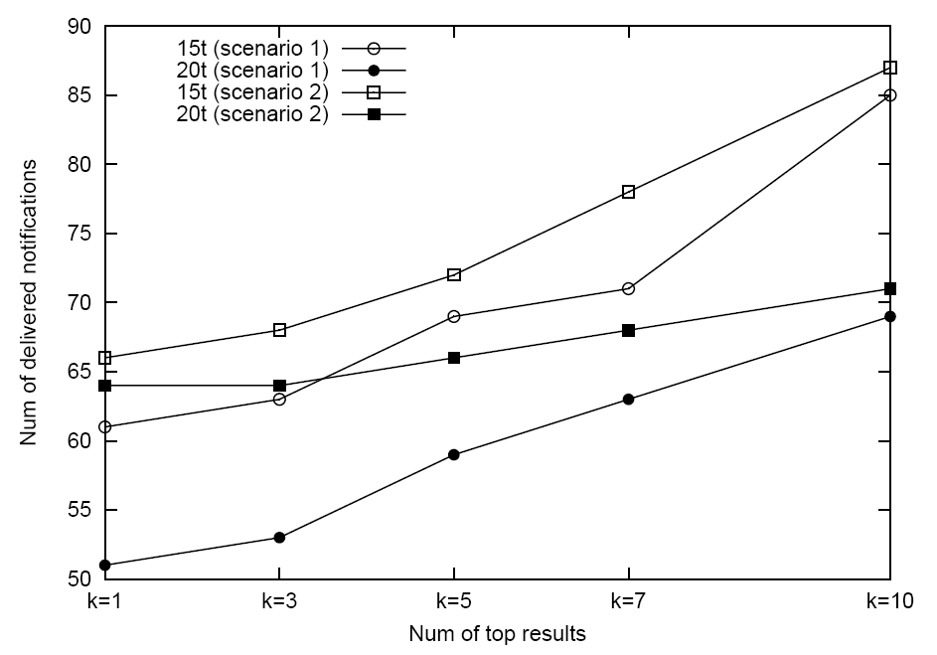
Notifications forwarded to a specific user
100 matching notifications
scenario 1: highly preferable notifications first
scenario 2: highly preferable notifications last
τ as a function of the time length t = 500ms between publications
Scenario 1 and larger expiration time result in more pruning

Slide 40
Outline
Publish/Subscribe Preliminaries
Preferential Subscriptions & Time-Valid Notifications
Ranking in Publish/Subscribe
Evaluation
Summary

Slide 41
Summary
We extend publish/subscribe systems to incorporate ranking capabilities
Notifications are ranked based on preferential subscriptions
To maintain the freshness of data, we associate expiration times with notifications
Preferential subscriptions are organized in a graph which is utilized to forward notifications to the users
We have fully implemented our approach (PrefSIENA)

Slide 42
Future work
Other ways of computing notification scores:
Mean, minimum, weighted sum
Using the scores of the most specific preferential subscriptions
Alternatives to expiration time
genre = adventure
string title = King Kong
string director = Peter Jackson
time release date = 14 Dec 2005
string genre = adventure
0.9
0.7
director = Peter Jackson
genre = adventure
0.7

Slide 43
Related Work
Kresimir Pripuzic, Ivana Podnar Zarko, Karl Aberer
“Top-k/w Publish/Subscribe: Finding k Most Relevant Publications in Sliding Time Window w”
2nd International Conference on Distributed Event-Based Systems, Rome, July 1-4, 2008
Ashwin Machanavajjhala, Erik Vee, Minos Garofalakis, Jayavel Shanmugasundaram
“Scalable Ranked Publish/Subscribe”
34th International Conference on Very Large Data Bases, Auckland, August 23-28, 2008
Christian Zimmer, Christos Tryfonopoulos, Klaus Berberich, Gerhard Weikum, Manolis Koubarakis
“Node Behavior Prediction for LargeScale Approximate Information Filtering”
1st Workshop on Large-Scale Distributed Systems for Information Retrieval, Amsterdam, July 27, 2007

Slide 44
Thank you!

Slide 45
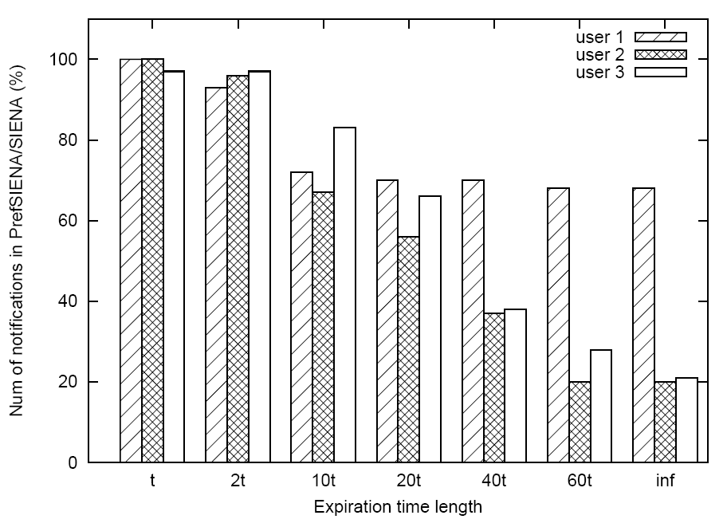
Number of forwarded notifications
Matching notifications:
User 1: 51%
User 2: 27%
User 3: 15%
k = 1
t = 500ms
Larger expiration times result in more pruning for all users

