Slide 1
Preference-Aware Publish/Subscribe Delivery with Diversity
Marina Drosou
Master Thesis
Supervisor: Evaggelia Pitoura

Slide 2
Publish/Subscribe Systems
Publish/Subscribe is an alternative to typical searching
Users do not need to repeatedly search for new interesting data
They specify their interests once and the system automatically notifies them whenever relevant data is made available
Example:
Google Alerts (Google)
Herald (Microsoft)

Slide 3
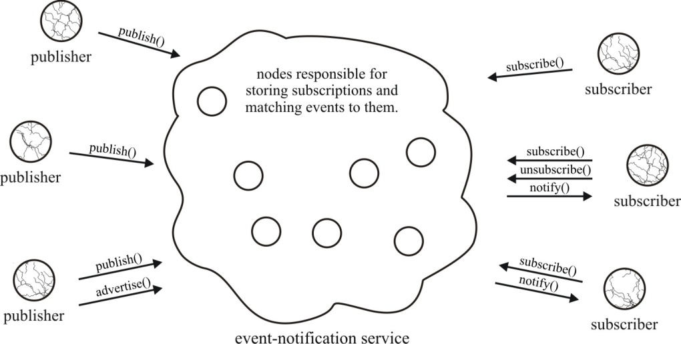
Publish/Subscribe Systems
Parts of a Publish/Subscribe system:
Subscribers: consumers of events
Publishers: generators of events
Event-notification service:
Store subscriptions (user interests)
Match events to subscriptions
Deliver event notifications

Slide 4
Typical Publish/Subscribe Example
Published events
title = The Godfather
genre = drama
showing time = 21:10
Matching events
title = The Godfather
genre = drama
showing time = 21:10
title = Ratatouille
genre = comedy
showing time = 21:15
User subscriptions
genre = drama
title = Fight Club
genre = drama
showing time = 23:00
title = Fight Club
genre = drama
showing time = 23:00
genre = horror
title = Casablanca
genre = drama
showing time = 23:10
title = Casablanca
genre = drama
showing time = 23:10
title = Vertigo
genre = horror
showing time = 23:20
title = Vertigo
genre = horror
showing time = 23:20

Slide 5
Motivation
Typically, all subscriptions are considered equally important
Users may receive overwhelming amounts of notifications
In such cases, users would like to receive only a fraction of those notifications, the most interesting ones
Say John is more interested in horror movies than dramas
John would like to receive notifications about horror only if there are no (or just a few) notifications about drama movies
Current publish/subscribe systems do not allow John to express this different degree of interest

Slide 6
Motivation
To express some form of ranking among subscriptions, we define priorities among them
To do this, we use preferences among subscriptions (preferential subscriptions)
Based on preferential subscriptions, we deliver to users only the k most interesting events
We also take into account the diversity of delivered events
John probably wants to receive some horror movies once in a while and not just dramas

Slide 7
Outline
Publish/Subscribe Preliminaries
Preference Model
Timing Policies
Event Diversity
Ranking in Publish/Subscribe
Evaluation
Summary

Slide 8
Outline
Publish/Subscribe Preliminaries
Preference Model
Timing Policies
Event Diversity
Ranking in Publish/Subscribe
Evaluation
Summary

Slide 9
Flavors of Publish/Subscribe
There are two kind of schemes for specifying interesting events:
Topic-based
Each event belongs to a number of topics (e.g. “music”, “sport”)
Users subscribe to topics and receive all relevant events
Content-based
Users subscribe to the actual content of the events
More expressive
In this work we use the content-based scheme

Slide 10
Events & Subscriptions
An event is a set of typed attributes consisting of:
A type
A name
A value
string title = The Return of the King
string director = Peter Jackson
time release date = 1 Dec 2003
string genre = fantasy
integer oscars = 11
A subscription is a set of typed attribute constraints consisting of:
A type
A name
A binary operator
A value
string director = Peter Jackson
time release date > 1 Jan 2003

Slide 11
Cover Relation
Given an event e and a subscription s, s covers e (or e matches s) if and only if every attribute constraint of s is satisfied by some attribute of e
Subscriptions
Published Event
string director = Peter Jackson
time release date > 1 Jan 2003
string title = The Return of the King
string director = Peter Jackson
time release date = 1 Dec 2003
string genre = fantasy
integer oscars = 11
string director = Steven Spielberg
string genre = fantasy
string release date > 1 Jan 2003

Slide 12
Outline
Publish/Subscribe Preliminaries
Preference Model
Preferential Subscriptions
Computing Event Ranks
Timing Policies
Event Diversity
Ranking in Publish/Subscribe
Evaluation
Summary

Slide 13
Preferential Subscriptions
To define priorities among subscriptions: add preferences
Two ways to express preferences:
Quantitative approach
Preferences are expressed by using scoring functions
Qualitative approach
Preferences are expressed by using preference relations between pairs of subscriptions
genre = drama
genre = horror
0.9
0.7
genre = drama
≻
genre = horror

Slide 14
Preferential Subscriptions
A preferential subscription is a subscription enhanced with a degree of interest, called prefrank, which is a real number within the range [0, 1]
ps_{i}^{X} = (s_{i}, prefrank_{i}^{X})
Higher preference ranks denote more important subscriptions

Slide 15
Extracting Preference Ranks
Quantitative approach:
Preference rank equal to user assigned score
Qualitative approach:
We assume that priorities follow a strict partial order
We use a multilevel variation of the winnow operator to extract the most preferable subscriptions

Slide 16
Extracting Preference Ranks
User preferences
genre = drama
≻
genre = comedy
genre = horror
≻
genre = romance
genre = romance
≻
genre = action
Extracted preference ranks
genre = drama
genre = horror
prefrank = 1
genre = comedy
genre = romance
prefrank = 1/2
genre = action
prefrank = 1/3

Slide 17
Computing Event Ranks
To measure the importance (or relevance) of a published event e for a user X, we define the event’s rank as a function ℱ of the preference ranks of the subscriptions that cover it
rank(e, X) = ℱ(prefrank₁^{X}, …, prefrank_{m}^{X})
genre = adventure
string title = King Kong
string director = Peter Jackson
time release date = 14 Dec 2005
string genre = adventure
0.9
ℱ = max
0.9
director = Peter Jackson
0.7

Slide 18
Outline
Publish/Subscribe Preliminaries
Preference Model
Timing Policies
Continuous
Periodic
Sliding Window
Event Diversity
Ranking in Publish/Subscribe
Evaluation
Summary

Slide 19
Top-k results
Our goal is to deliver only the k highest-ranked events to each subscriber
Since events are continuously published, we need to specify the timing period over which the top-k events are computed
We examine three timing policies
Continuous
Periodic
Sliding Window
The three policies differ in the number and freshness of delivered events

Slide 20
Continuous Timing Policy
A newly published event e is delivered to a user X, if and only if:
It is covered by some subscription s issued by X and
X has not already received k events more preferable to e
Drawback: It is possible for very old but highly preferable event notifications to prevent newer ones from reaching the user
Users end up with highly-ranked but stale information

Slide 21
Stale Information Example
Published events
title = The Apartment
genre = comedy
showing time = 22:15
20:00
0.9
title = The Godfather
genre = drama
showing time = 21:10
User preferential subscriptions
Top-2 events
20:10
0.8
title = The Apartment
genre = comedy
showing time = 22:15
genre = comedy
0.9
title = Ratatouille
genre = comedy
showing time = 22:40
20:15
0.9
genre = drama
title = The Godfather
genre = drama
showing time = 21:10
0.8
title = Fight Club
genre = drama
showing time = 23:00
22:00
0.8
genre = horror
0.5
title = Ratatouille
genre = comedy
showing time = 22:40
title = Vertigo
genre = horror
showing time = 23:20
22:10
0.5
title = Casablanca
genre = drama
showing time = 23:10
22:25
0.8

Slide 22
Time-Valid Events
Old but highly preferable events may prevent newer ones from reaching the user
To overcome this problem, we use the notion of time validity:
Events are associated with an expiration time e.exp
Only valid events can prevent others from reaching the user
A newly published event e is delivered to a user X, if and only if:
It is covered by some subscription s issued by X and
X’s top-k results do not contain k valid events more preferable to e

Slide 23
Expiration Example
Published events
Event notifications expire
at the showing time
title = The Apartment
genre = comedy
showing time = 22:15
20:00
0.9
Top-2 events
title = The Apartment
genre = comedy
showing time = 22:15
title = The Godfather
genre = drama
showing time = 21:10
User preferential subscriptions
20:10
0.8
genre = comedy
0.9
title = Ratatouille
genre = comedy
showing time = 22:40
title = The Godfather
genre = drama
showing time = 21:10
20:15
0.9
genre = drama
0.8
title = Fight Club
genre = drama
showing time = 23:00
title = Ratatouille
genre = comedy
showing time = 22:40
22:00
0.8
genre = horror
0.5
title = Vertigo
genre = horror
showing time = 23:20
title = Casablanca
genre = drama
showing time = 23:10
22:10
0.5
title = Casablanca
genre = drama
showing time = 23:10
22:25
0.8

Slide 24
Continuous Timing Policy
Events are immediately forwarded to the users
The number of delivered events depends on the relative order of their publication
e.g. if they are published in ascending order in regard to their rank, all of them will be delivered
Events are either forwarded or not at the time of their publication

Slide 25
Periodic Timing Policy
Time is divided into periods of duration T
Top-k events are computed at the end of each period
Ties are resolved by picking the most recently published events
The number of delivered events is bounded
For a time interval c, the number of delivered events is k⋅ ⌊c/T ⌋
The order of the published events within each period does not affect the results
But, high-ranked events appearing in periods with a many other high-ranked ones may fail to be delivered

Slide 26
Periodic Sliding Policy
Published events
title = The Apartment
genre = comedy
showing time = 21:10
20:00
0.9
title = Seven
genre = horror
showing time = 21:00
title = The Apartment
genre = comedy
showing time = 21:10
20:20
0.5
title = The Godfather
genre = drama
showing time = 21:25
20:25
0.8
title = Jaws
genre = horror
showing time = 21:30
20:30
0.5
title = Vertigo
genre = horror
showing time = 21:45
title = Psycho
genre = horror
showing time = 21:50
20:45
0.5
title = Psycho
genre = horror
showing time = 21:50
20:50
0.5

Slide 27
Sliding Window Timing Policy
Top-k events are computed over the events of sliding event-windows of length w
An event remains in the window until w newer events arrive
If at any time it belongs to the top-k results, it is forwarded to the user
Between two consequent windows, at most one event is forwarded
The number of delivered events depends on the order of their publication, as in the continuous timing policy

Slide 28
Sliding Window Timing Policy
Published events
title = The Apartment
genre = comedy
showing time = 21:10
20:00
0.9
Top-1
title = Seven
genre = horror
showing time = 21:00
title = The Apartment
genre = comedy
showing time = 21:10
20:20
0.5
title = The Godfather
genre = drama
showing time = 21:25
20:25
0.8
title = The Godfather
genre = drama
showing time = 21:25
title = Jaws
genre = horror
showing time = 21:30
20:30
0.5
title = Vertigo
genre = horror
showing time = 21:45
title = Psycho
genre = horror
showing time = 21:50
20:45
0.5
title = Psycho
genre = horror
showing time = 21:50
20:50
0.5

Slide 29
Outline
Publish/Subscribe Preliminaries
Preference Model
Timing Policies
Event Diversity
Event Distance
Diverse top-k results
Ranking in Publish/Subscribe
Evaluation
Summary

Slide 30
Diversity
Top-k results are often very similar to each other
Goal: Increase user satisfaction by diversifying forwarded events
Published events
title = The Godfather
genre = drama
showing time = 21:25
title = Pulp Fiction
genre = drama
showing time = 21:50
title = Vertigo
genre = horror
showing time = 21:45
title = Goodfellas
genre = drama
showing time = 21:20
0.8
0.8
0.5
0.8

Slide 31
Event Distance
We measure the distance of two events based on the number of their common attributes:
Then, the diversity of a list L of m events is given as:

Slide 32
Choosing Diverse Events
To identify the k most diverse ones out of a set of q events
Find all combinations of k events
Measure their diversity
Choose the one with the larger diversity
This method has a high complexity, which makes it impractical to use
We use a heuristic to lower the complexity of locating diverse events

Slide 33
Heuristic
Given a set of events {e₁, …, e_{q}), we aim to produce a list of k diverse ones, q > k
We use the Event-List Distance:
First, we choose a random event to be added to L
Then, until we have added k events
We measure the Event-List Distances of all candidate events
We add to L the event with the maximum one

Slide 34
Heuristic Evaluation
To compare the quality of our heuristic to the optimal case, we generate sets of q random numbers in [0, 100] and select k of them using
The optimal method
The heuristic
A random choice
q | k | Random | Heuristic | Optimal
20 | 2 | 35.76 | 71.88 | 90.45
 | 4 | 193.23 | 330.69 | 349.27
 | 8 | 938.72 | 1302.50 | 1314.64
40 | 2 | 34.14 | 74.86 | 95.86
 | 4 | 200.35 | 353.78 | 375.84
 | 8 | 944.63 | 1427.09 | 1447.93

Slide 35
Diverse Top-k Events
We aim to deliver diverse top-k results, i.e. events that are both:
Highly-ranked
Diverse
We modify our heuristic to choose events based on a combination of rank and distance from other chosen events:
First, we choose the highest-ranked event to be added to L
Then, until we have added k events
We measure the Event-List Distances of all candidate events
We add to L the event with the maximum value of divrank

Slide 36
Outline
Publish/Subscribe Preliminaries
Preference Model
Timing Policies
Event Diversity
Ranking in Publish/Subscribe
Preferential Subscription Graph
Forwarding events
Evaluation
Summary

Slide 37
Matching Events to Subscriptions
Whenever a new event e is published:
Locate users with matching subscriptions
Check whether e belongs to their top-k valid results
Events need to be checked against user subscriptions
Exploit cover relations between subscriptions
string genre = fantasy
string director = Peter Jackson
string genre = fantasy

Slide 38
Preferential Subscription Graph
We organize preferential subscriptions using a directed acyclic graph
Preferential subscription graph (PSG):
Nodes correspond to subscriptions
Edges correspond to cover relations between subscriptions
A PrefRank Set is assigned to each subscription
Pairs of the form (user, prefrank)
genre = drama
Anna, 0.5
cinema = ster
genre = drama
showing time > 21:00
John, 0.5
John, 0.7
cinema = ster
genre = drama
showing time > 21:00
John, 0.9
Anna, 0.6

Slide 39
Forwarding Events (Continuous Timing Policy)
A server maintains:
A Preferential Subscription Graph
A list of k elements of the form (rank, expiration) for each user X (list^{X})
Each such element represents an event previously forwarded to the user:
rank is the event’s rank
expiration is the event’s expiration time

Slide 40
Forwarding Events (Continuous Timing Policy)
Initially, all lists are empty
Upon receiving an event e
Walk through PSG and locate all subscriptions that cover e
For each user X associated with at least one such subscription
Compute e’s event rank rank(e,X) for X
Remove expired elements from list^{X}
If | list^{X} | < k or rank(e,X) > minimum rank in list^{X}
Add (rank(e,X) , e.exp) to list^{X}
Forward e to X

Slide 41
Forwarding Events (Continuous Timing Policy)
Top-2 lists
John
rank | exp
0.9 | 10:00
0.5 | 11:00
Anna
rank | exp
0.7 | 11:00
0.7 | 12:00
genre = drama
Anna, 0.5
genre = drama
showing time > 21:00
cinema = ster
John, 0.7
Anna, 0.6
0.7
21:10
John, 0.5
cinema = ster
genre = drama
showing time > 21:00
John, 0.9
Anna, 0.7
Current time: 08:00
Published event e:
rank(e, John) = 0.7
rank(e, Anna) = 0.6
title = The Godfather
genre = drama
cinema = odeon
showing time = 21:10
expiration
21:10

Slide 42
Forwarding Events (Periodic & Sliding Window)
In the Periodic Timing Policy a server maintains:
A Preferential Subscription Graph
A buffer of matching events published in the current period
At the end of the period, we compute the top-k events for each user and forward them
In the Sliding Window Timing Policy a server maintains:
A Preferential Subscription Graph
A buffer of matching events per subscriber
Whenever a window slides, we compute the top-k events for the corresponding user and forward any of those that have not been forwarded before

Slide 43
Applying Diversity
In the continuous policy, we do not maintain any information about the content of past event, therefore no diversity is applied
In the periodic and sliding window policies, whenever we compute top-k results, we choose events based on their divranks

Slide 44
Topology of Servers
The event-notification service can be implemented over a network of servers
Servers are organized in a hierarchy
Each server sends to its parent the subscriptions in the top level of its PSG
Only events matching those need to be propagated to the server
To reduce the number of those subscriptions, clients are not connected to a random server, but instead probe a number of servers during bootstraping and choose one based on
The number of new nodes that will be created in the top level of the PSG
The total number of nodes in the PSG (load balance)

Slide 45
Outline
Publish/Subscribe Preliminaries
Preference Model
Timing Policies
Event Diversity
Ranking in Publish/Subscribe
Evaluation
Summary

Slide 46
Dataset
We have fully implemented our approach as an extension of SIENA, a multi-threaded, distributed publish/subscribe system (PrefSIENA)
We use a real movie dataset, derived from IMDB. Data about 58788 movies:
Title, year, budget, length, rating, MPAA-rating, genre
Publishers generate events by randomly selecting movies.
Subscriptions are generated by choosing a random number of attributes and attribute values based on a zipf distribution

Slide 47
Experiments
We perform three sets of experiments:
Number of delivered events
Quality of delivered events
Average rank
Diversity
Freshness
Overhead evaluation
Time
We examine a number of publication scenarios:
Best-First
Best-Last
Burst
Random

Slide 48
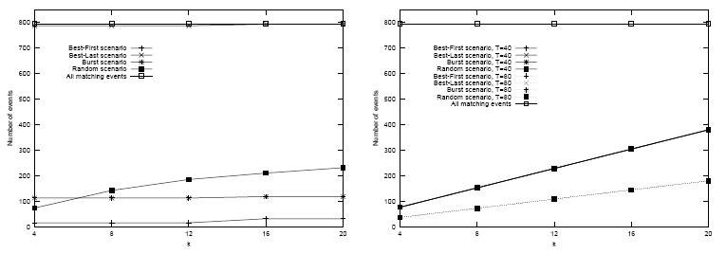
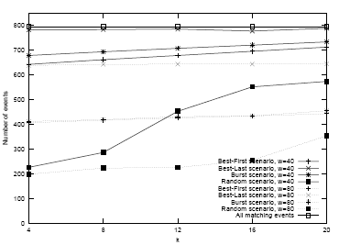
Number of Delivered Events
Continuous Timing Policy
Periodic Timing Policy
Matching/Published events: 800/2500
Continuous: e.g. Random: 9%-29%
Periodic: 7% - 35%
Sliding: e.g. Random: 25%
Larger period/window: fewer delivered events
Sliding Window Timing Policy

Slide 49
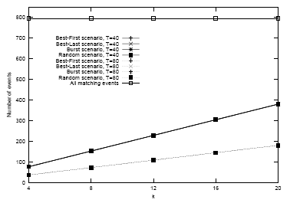
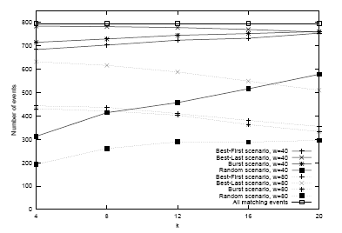
Number of Delivered Events (Diversity)
Periodic
Same number (bounded by k)
Sliding
Number of delivered notifications increases slightly
more than one event may be delivered at each window
Periodic Timing Policy
Sliding Window Timing Policy

Slide 50
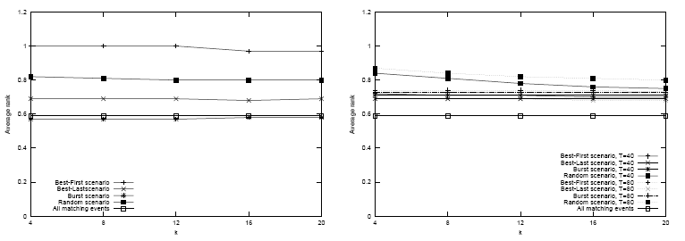
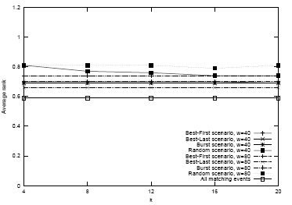
Quality of Delivered Events (Average Rank)
Continuous Timing Policy
Periodic Timing Policy
Average rank of all matching events: 0.59
The average rank increases in all cases, even though in the presence of many high-ranked events some may be dismissed.
When diversifying, average rank decreases slightly.
Sliding Window Timing Policy

Slide 51
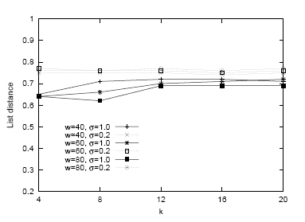
Quality of Delivered Events (Diversity)
List-Distance of delivered events
σ = 1
σ = 0.2
List-Distance indeed increases with our diversity heuristic
Sliding Window Timing Policy
Random Scenario

Slide 52
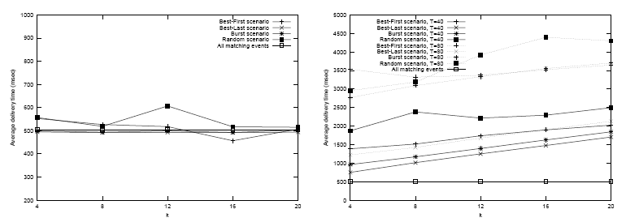
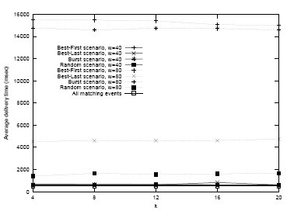
Quality of Delivered Events (Freshness)
Continuous Timing Policy
Periodic Timing Policy
Freshness: Time between publication and delivery
Continuous: independent from scenario
Periodic: depends on scenario and T
Sliding: depends on w
Sliding Window Timing Policy

Slide 53
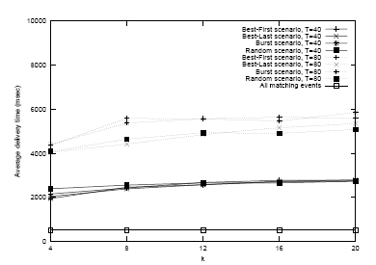
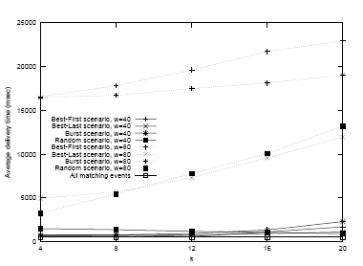
Quality of Delivered Events (Freshness)
When diversity is applied, freshness is reduced
extra time needed for top-k computation
Periodic Timing Policy
Sliding Window Timing Policy

Slide 54
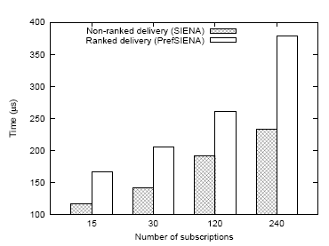
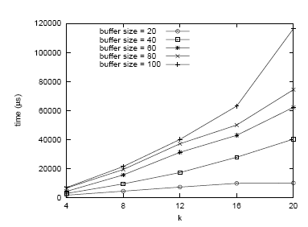
Performance
Two substantial overheads:
To compute event relevance we have to locate all matching subscriptions instead of just one
On average, we have to check twice as many nodes of the PSG
Maintaining state and perform top-k computations, esp. when diversifying
Depends on buffer size and k
Matching Time (Per Event)
Diversification Time (Per Window)

Slide 55
Outline
Publish/Subscribe Preliminaries
Preference Model
Timing Policies
Event Diversity
Ranking in Publish/Subscribe
Evaluation
Summary

Slide 56
Summary
We extend publish/subscribe systems to incorporate ranking
Increase quality of delivered events
Events are ranked based on preferential subscriptions
Diversity of delivered events is also taken into account
We examine different timing policies for top-k computation
We have fully implemented our approach (PrefSIENA)

Slide 57
Related Work
Ranking in Publish/Subscribe:
Ashwin Machanavajjhala, Erik Vee, Minos Garofalakis, Jayavel Shanmugasundaram
“Scalable Ranked Publish/Subscribe”
34th International Conference on Very Large Data Bases (VLDB), Auckland, August 23-28, 2008
Kresimir Pripuzic, Ivana Podnar Zarko, Karl Aberer
“Top-k/w Publish/Subscribe: Finding k Most Relevant Publications in Sliding Time Window w”
2nd International Conference on Distributed Event-Based Systems, (DEBS) Rome, July 1-4, 2008
Christian Zimmer, Christos Tryfonopoulos, Klaus Berberich, Gerhard Weikum, Manolis Koubarakis
“Node Behavior Prediction for LargeScale Approximate Information Filtering”
1st Workshop on Large-Scale Distributed Systems for Information Retrieval, Amsterdam, July 27, 2007
Diversity:
Cai-Nicolas Ziegler, Sean M. McNee, Joseph A. Konstan, Georg Lausen
“Improving Recommendation Lists Through Topic Diversification”
14th International World Wide Web Conference (WWW), Chiba, Japan, May 10-14, 2005
Erik Vee, Utkarsh Srivastava, Jayavel Shanmugasundaram, , Prashant Bhat, Sihem Amer Yahia
“Efficient Computation of Diverse Query Results”
IEEE 24th International Conference on Data Engineering (ICDE), Cancun, Mexico, , 7-12 April 2008

Slide 58
Thank you!

Slide 59
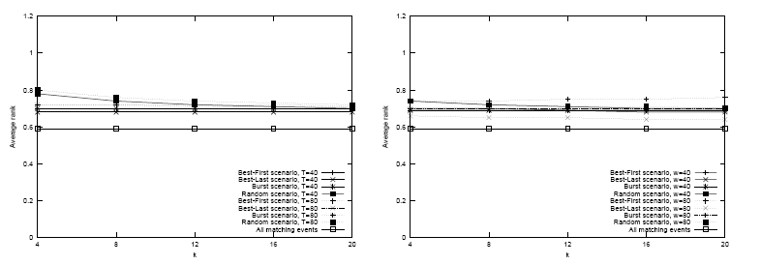
Average Rank (+ Diversity)
Average rank of events when diversity is used
Average rank drops slightly, as diversity increases
Periodic Timing Policy
Sliding Window Timing Policy

Slide 60
Complexities (required DIS(e₁,e₂) operations)
Optimal:
Heuristic:

