Slide 1
Perk: Personalized Keyword Search in Relational Databases through Preferences
Marina Drosou
Computer Science Department
University of Ioannina, Greece
Joint work with Kostas Stefanidis* and Evaggelia Pitoura
http://dmod.cs.uoi.gr
* Now at the Chinese University of Hong Kong

Slide 2
Introduction
Keyword-based search is very popular:
It allows users to discover information without knowing
the structure of data or
any query language
Basic idea:
Locate tuples in the database that contain query keywords and can be
joined together

Slide 3
Keyword Search in Relational Databases
Q = {thriller, B. Pitt}
Movies
m2, Twelve Monkeys, thriller, 1996, T. Gilliam
idm | title | genre | year | director
m1 | Dracula | thriller | 1992 | F. F. Coppola
m2 | Twelve Monkeys | thriller | 1996 | T. Gilliam
m3 | Seven | thriller | 1996 | D. Fincher
m4 | Schindler’s List | drama | 1993 | S. Spielberg
m5 | Picking up the Pieces | comedy | 2000 | A. Arau
a2, B. Pitt, male, 1963
m2, a2
m3, Seven, thriller, 1996, D. Fincher
Play
Actors
a2, B. Pitt, male, 1963
m3, a2
idm | ida
m1 | a1
m2 | a2
m3 | a2
m4 | a3
m5 | a4
ida | name | gender | dob
a1 | G. Oldman | male | 1958
a2 | B. Pitt | male | 1963
a3 | L. Neeson | male | 1952
a4 | W. Allen | male | 1935
query result:
joining trees of tuples (JTTs)
total
minimal

Slide 4
Motivation
Given the abundance of available information, exploring the contents of a database is a complex procedure
A huge volume of data may be returned
Results may be vague
The need to rank results arises

Slide 5
Ranking Results of Keyword Search
Previous approaches ranking JTTs based on their relevance to the query
Relevance based on the JTT size (e.g. Hristidis et al. [VLDB2002], Agrawal et al. [ICDE 2002])
The smaller the size of JTT, the smaller the number of joins, thus the largest its relevance
Relevance based on the importance of its tuples
e.g. assign scores to JTTs based on the prestige of their tuples (Bhalotia et al. [ICDE 2002]) or adapt IR-style document relevance ranking (Hristidis et al. [VLDB 2003] )
Our approach:
Personalized Keyword Search: exploit user preferences in ranking keyword results

Slide 6
Talk Outline
6
Model
Contextual Keyword Preferences
Dominance among JTTs
Top-k personalized results
Problem definition
Algorithms
Evaluation
EDBT 2010 @ Lausanne, Switzerland

Slide 7
Keyword Preference Model
Preferences express a user choice that holds under a specific context, where both context and choice are specified through keywords
A contextual keyword preference is a pair (context, w_{i} ≻ w_{j}), where w_{i}, w_{j} are keywords and context is a set of keywords
e.g. ({thriller}, G. Oldman ≻ W. Allen)
({comedy}, W. Allen ≻ G. Oldman)
({}, R. De Niro ≻ A. Paccino) (empty context)
Given a set of preferences, personalize a keyword query Q by ranking its results in an order compatible with the order expressed in the user choices for context Q
The query is the context

Slide 8
Direct Dominance between JTTs
Given a keyword query Q and a set of preferences P_{Q} with context Q, let T_{i}, T_{j} be two JTTs that are total for Q
We say that:
T_{i} directly dominates T_{j} under P_{Q}, T_{i} ≻ T_{j},
if and only if, ∃w_{i} in T_{i}, such that, ∄w_{j} in T_{j} with w_{j} ≻ w_{i}

Slide 9
Direct Dominance between JTTs example
Direct Dominance: order JTTs that contain choice keywords
e.g.
Q = {thriller} and P_{Q} = ({thriller}, F. F. Coppola ≻ T. Gilliam)
T₁
T₂
Both of them dominate
T₃
Movies
idm | title | genre | year | director
m1 | Dracula | thriller | 1992 | F. F. Coppola
m2 | Twelve Monkeys | thriller | 1996 | T. Gilliam
m3 | Seven | thriller | 1996 | D. Fincher
m4 | Schindler’s List | drama | 1993 | S. Spielberg
m5 | Picking up the Pieces | comedy | 2000 | A. Arau
m1, Dracula, thriller, 1992, F. F. Coppola
≻
Play
Actors
m2, Twelve Monkeys, thriller, 1996, T. Gilliam
idm | ida
m1 | a1
m2 | a2
m3 | a2
m4 | a3
m5 | a4
ida | name | gender | dob
a1 | G. Oldman | male | 1958
a2 | B. Pitt | male | 1963
a3 | L. Neeson | male | 1952
a4 | W. Allen | male | 1935
m3, Seven, thriller, 1996, D. Fincher

Slide 10
Keyword Search in Relational Databases example
10
Q = {thriller, male}
P_{Q} = ({thriller, male}, T. Gilliam ≻ D. Fincher)
({thriller , male}, D. Fincher ≻ B. Pitt)
Movies
idm | title | genre | year | director
m1 | Dracula | thriller | 1992 | F. F. Coppola
m2 | Twelve Monkeys | thriller | 1996 | T. Gilliam
m3 | Seven | thriller | 1996 | D. Fincher
m4 | Schindler’s List | drama | 1993 | S. Spielberg
m5 | Picking up the Pieces | comedy | 2000 | A. Arau
m2, Twelve Monkeys, thriller, 1996, T. Gilliam
a2, B. Pitt, male, 1963
m2, a2
Play
≻
Actors
idm | ida
m1 | a1
m2 | a2
m3 | a2
m4 | a3
m5 | a4
ida | name | gender | dob
a1 | G. Oldman | male | 1958
a2 | B. Pitt | male | 1963
a3 | L. Neeson | male | 1952
a4 | W. Allen | male | 1935
m3, Seven, thriller, 1996, D. Fincher
a2, B. Pitt, male, 1963
m3, a2
EDBT 2010 @ Lausanne, Switzerland

Slide 11
Direct Dominance between JTTs
What if:
Neither T₁ ≻ T₂ nor T₂ ≻ T₁ holds (none of the JTTs contain any choice keyword)
Such JTTs are incomparable
But, in some cases, we should be able to compare them ..

Slide 12
Extending Dominance
Q= {thriller} and
P_{Q} = ({thriller}, G. Oldman ≻ B. Pitt)
T₁
T₂
Movies
idm | title | genre | year | director
m1 | Dracula | thriller | 1992 | F. F. Coppola
m2 | Twelve Monkeys | thriller | 1996 | T. Gilliam
m3 | Seven | thriller | 1996 | D. Fincher
m4 | Schindler’s List | drama | 1993 | S. Spielberg
m5 | Picking up the Pieces | comedy | 2000 | A. Arau
m1, Dracula, thriller, 1992, F. F. Coppola
?
m2, Twelve Monkeys, thriller, 1996, T. Gilliam
Play
Actors
idm | ida
m1 | a1
m2 | a2
m3 | a2
m4 | a3
m5 | a4
ida | name | gender | dob
a1 | G. Oldman | male | 1958
a2 | B. Pitt | male | 1963
a3 | L. Neeson | male | 1952
a4 | W. Allen | male | 1935
T₁ and T₂ are incomparable, whereas T₁ should be preferred over T₂ since it is a thriller movie related to G. Oldman, while T₂ is related to B. Pitt…
We cannot order results that may contain choice keywords indirectly through joins…

Slide 13
Extending Dominance
Movies
Q = {thriller} and P_{Q} = ({thriller}, G. Oldman ≻ B. Pitt)
idm | title | genre | year | director
m1 | Dracula | thriller | 1992 | F. F. Coppola
m2 | Twelve Monkeys | thriller | 1996 | T. Gilliam
m3 | Seven | thriller | 1996 | D. Fincher
m4 | Schindler’s List | drama | 1993 | S. Spielberg
m5 | Picking up the Pieces | comedy | 2000 | A. Arau
Play
Actors
idm | ida
m1 | a1
m2 | a2
m3 | a2
m4 | a3
m5 | a4
ida | name | gender | dob
a1 | G. Oldman | male | 1958
a2 | B. Pitt | male | 1963
a3 | L. Neeson | male | 1952
a4 | W. Allen | male | 1935
T₃
m1, Dracula, thriller, 1992, F. F. Coppola
m1, a1
a1, G. Oldman, male, 1958
≻
T₄
m2, Twelve Monkeys, thriller, 1996, T. Gilliam
m2, a2
a2, B. Pitt, male, 1963

Slide 14
Indirect Dominance Example
Q = {thriller} and
P_{Q} = ({thriller}, G. Oldman ≻ B. Pitt)
Direct domination:
T₃
m1, Dracula, thriller, 1992, F. F. Coppola
m1, a1
a1, G. Oldman, male, 1958
≻
T₄
m2, Twelve Monkeys, thriller, 1996, T. Gilliam
m2, a2
a2, B. Pitt, male, 1963
Indirect domination:
T₁
m1, Dracula, thriller, 1992, F. F. Coppola
≻≻
T₂
m2, Twelve Monkeys, thriller, 1996, T. Gilliam

Slide 15
Indirect Dominance
Projected JTT:
T_{j} is a projected JTT of T_{i} for a query Q, if and only if, T_{j} is a subtree of T_{i} that is total and minimal for Q, that is, T_{j} ∈ Res(Q)
The set of the projected JTTs of T_{i} for Q is denoted by project_{Q}(T_{i})
e.g. for Q = {thriller}, the JTT
is a projected JTT of
T₁
m1, Dracula, thriller, 1992, F. F. Coppola
T₃
m1, Dracula, thriller, 1992, F. F. Coppola
m1, a1
a1, G. Oldman, male, 1958

Slide 16
Indirect Dominance
Indirect Preferential Domination:
Given a keyword query Q and a set of preferences P_{Q} with context Q, let T_{i}, T_{j} be two JTTs total for Q:
T_{i} indirectly dominates T_{j} under P_{Q}, T_{i} ≻≻ T_{j}, if there is a JTT T_{i}’ ∈ PRes(Q, P_{Q}), such that, T_{i} ∈ project_{Q}(T_{i}’) and there is no JTT T_{j}’ ∈ PRes(Q, P_{Q}), such that, T_{j} ∈ project_{Q}(T_{j}’) and T_{j}’ ≻ T_{i}’
PRes(Q, P_{Q}) is the set of all JTTs that are both total and minimal for at least one of the queries Q ∪ {w_{i}}, where w_{i} belongs to the set of keywords that appear in the choices of P_{Q}

Slide 17
Processing Dominance
Observation:
If w_{i} ≻ w_{j} , then the trees in the result of Q ∪ {w_{i}} directly dominate the trees in the result of Q ∪ {w_{j}},
That is, the order for generating the results should follow the order among the choice keywords
Graph of choices for a specific context:
R. De Niro
A. Pacino
R. Williams
Extract from the graph the most preferred keywords, in rounds (or levels):
W(1) = {R. De Niro, A. Pacino, R. Williams}
W(2) = {A. Garcia, A. Hopkins, R. Gere}
(topological sort)
A. Garcia
A. Hopkins
R. Gere

Slide 18
Talk Outline
18
Model
Contextual Keyword Preferences
Dominance among JTTs
Top-k personalized results
Problem definition
Algorithms
Evaluation
EDBT 2010 @ Lausanne, Switzerland

Slide 19
Top-k Personalized Results
We exploit user preferences to rank results
However, besides preferences (i.e. dominance among JTTs) there are also other desired properties:
relevance
coverage
diversity

Slide 20
Coverage
Given a set of preferences for our movies example, assume that F.F.Copolla and T. Gilliam are equally preferred and also their corresponding JTTs have the same relevance:
We would expect that a good result does not only include JTTs (i.e. movies) for F.F.Copolla but also JTTs for T. Gilliam (and perhaps other choices as well)
To capture this requirement, we define the coverage of a set S of JTTs for a query Q as the percentage of choice keywords that appear in S:
Q = {thriller} and
P_{Q} = ({thriller}, F. F. Coppola ≻ S. Spielberg)
({thriller}, T. Gilliam ≻ S. Spielberg)
m1, Dracula, thriller, 1992, F. F. Coppola
m2, Twelve Monkeys, thriller, 1996, T. Gilliam

Slide 21
Diversity
High coverage ensures that user will find many interesting results
However, two JTTs may contain very similar information, even if they are computed for different choice keywords
For quantifying the overlap between two JTTs, we use a Jaccard-based definition of distance, which measures dissimilarity between the tuples that form these trees
Given two JTTs T_{i}, T_{j} consisting of the sets of tuples A_{i}, A_{j} respectively, the distance between T_{i} and T_{j} is:

Slide 22
Top-k Result Selection Problem
Given a restriction k on the size of the result, provide users with k
preferable and
relevant results
that also as a whole (set)
cover many of their choices and
exhibit low redundancy (i.e. have high diversity)
This is a multi-criteria optimization problem

Slide 23
Top-k Result Selection Problem
Top-k JTTs:
Given a keyword query Q, the set of preferences P_{Q}, a relevance threshold s and the sets of results {Z¹, …, Z^{l}}, the top-k JTTs is the set S* for which:
such that, Z^{i} contributes F(i) JTTs to S* which are uniformly distributed among the keywords of level i and F is a monotonically decreasing function with
Z^{i}: the JTTs with relevance greater than s
computed using the keywords W(i).
Graph of choices for a specific context:
R. De Niro
A. Pacino
R. Williams
A. Garcia
A. Hopkins
R. Gere

Slide 24
Top-k Result Selection
We use a heuristic to capture the desired properties of the result:
Preferential dominance: the more preferred keywords contribute more trees to the top-k results
The number of trees offered by each level i is captured by a monotonically decreasing function F with
Relevance: the selected JTTs have relevance greater than a threshold s

Slide 25
Top-k Result Selection
We use a heuristic to capture the desired properties of the result:
Coverage: the contributed JTTs are uniformly distributed among the keywords of each level
Diversity: among the combinations of k trees that satisfy the constraints, choose the one with the highest set diversity

Slide 26
Tuning Parameters: Function F, Threshold s
Dominance, coverage and relevance depend on how quickly F decreases
A high decrease rate leads to keywords from fewer levels contributing to the final result
Coverage decreases, average dominance increases
A low decrease rate of F means that less trees will be retrieved from each level, so relevance increases
Relevance is calibrated through the selection of the threshold s
A large value for s with an appropriate F, results in k JTTs with the largest relevance
Diversity is calibrated through s that determines the number of candidate JTTs out of which to select the k most diverse ones

Slide 27
Talk Outline
27
Model
Contextual Keyword Preferences
Dominance among JTTs
Top-k personalized results
Problem definition
Algorithms
Evaluation
EDBT 2010 @ Lausanne, Switzerland

Slide 28
Next, we focus on:
How to compute preferential query results?
We use a database schema based approach to retrieve JTTs that answer a query

Slide 29
Keyword Query Processing
Movies
Q = {thriller, B. Pitt}
Results:
idm | title | genre | year | director
m1 | Dracula | thriller | 1992 | F. F. Coppola
m2 | Twelve Monkeys | thriller | 1996 | T. Gilliam
m3 | Seven | thriller | 1996 | D. Fincher
m4 | Schindler’s List | drama | 1993 | S. Spielberg
m5 | Picking up the Pieces | comedy | 2000 | A. Arau
m2, Twelve Monkeys, thriller, 1996, T. Gilliam
a2, B. Pitt, male, 1963
m2, a2
Play
Actors
idm | ida
m1 | a1
m2 | a2
m3 | a2
m4 | a3
m5 | a4
ida | name | gender | dob
a1 | G. Oldman | male | 1958
a2 | B. Pitt | male | 1963
a3 | L. Neeson | male | 1952
a4 | W. Allen | male | 1935
m3, Seven, thriller, 1996, D. Fincher
a2, B. Pitt, male, 1963
m3, a2
These JTTs are produced using the schema level tree: Movies^{{thriller}} – Play{} – Actors^{{B. Pitt}}
Such trees are called joining trees of tuple sets (JTSs)
Construct JTSs as an intermediate
step of the computation of JTTs

Slide 30
Algorithm Sketch
Hristidis et al. [VLDB 2002]
Given a query Q, the algorithm constructs the JTSs with size up to s
Compute all possible tuple sets R_{i}^{X}
R_{i}^{X}= {t | t ∈ R_{i} and ∀w_{x} ∈ X, t contains w_{x} and ∀w_{y} ∈ Q\X, t does not contain w_{y}}
Select randomly a query keyword w_{z}
Locate all tuple sets R_{i}^{X}, for which w_{z} ∈ X
These are the initial JTSs with only one node
Expand trees either by adding a tuple set that contains at least another query keyword or a tuple set for which X = {} (free tuple set)
These trees can be further expanded
JTSs that contain all query keywords are returned
JTSs of the form R_{i}^{X} – R_{j}{} – R_{i}^{Y}, where an edge (R_{j} → R_{i}) exists in the schema graph, are pruned
JTTs produced by them have more than one occurrence of the same tuple for every instance of the database
Movies^{{thriller}}
- Play {}
- Actors^{{B. Pitt}}

Slide 31
Preferential Keyword Query Processing
Baseline JTS Algorithm: construct at levels the set of JTSs for the queries
Q ∪ {w_{t}} for all choice keywords w_{t}, starting from the level with the most preferred keywords
Observation:
JTSs constructed for Q may already contain the additional keyword w_{t}
Employ JTSs for Q to construct JTSs for Q ∪ {w_{t}}
How?

Slide 32
Sharing Results Algorithm
Construct the JTSs for Q ∪ {w_{t}}, using the tuple sets R_{i}^{X} for Q
For each Q ∪ {w_{t}}, re-compute its tuple sets
Partition R_{i}^{X} for Q into two tuple sets for Q ∪ {w_{t}}:
R_{i}^{X} that contains the tuples with only the keywords X
R_{i}^{X∪ {wt}} that contains the tuples with keywords X ∪ {w_{t}}

Slide 33
Sharing Results Algorithm
Using the JTSs for Q and the tuple sets for Q ∪ {w_{t}} produce all combinations of trees of tuple sets that will be used next to construct the final JTSs for Q ∪ {w_{t}}
e.g., for R_{i}^{X} – R_{j}^{Y} for Q, we construct for Q ∪ {w_{t}} the JTSs:
R_{i}^{X} – R_{j}^{Y}
R_{i}^{X∪ {wt}} – R_{j}^{Y}
R_{i}^{X} – R_{j}^{Y ∪ {wt}}
R_{i}^{X ∪ {wt}} – R_{j}^{Y ∪ {wt}}
Expand JTSs as before
But, have we finished with the construction of all JTSs for Q ∪ {w_{t}}?

Slide 34
Sharing Results Algorithm
The initial algorithm does not construct for Q JTSs of the form:
R_{i}^{{wz}} – R_{j}^{{wz}}
This way, the above procedure does not construct for Q ∪ {w_{t}} JTSs of the form
R_{i}^{{wz}} – R_{j}^{{wz,wt}}
The same holds for the JTSs that connect R_{i}^{{wz}}, R_{j}^{{wz,wt}} via free tuple sets
We need to construct all such trees from scratch and then expand them as before
Completeness:
Every JTT of size s that belongs to the preferential query result of a keyword query Q is produced by a JTS of size s that is constructed by the Sharing Result Algorithm

Slide 35
Top-k Query Processing
We use the following heuristic:
Consider an empty set S
Add to S the two furthest apart JTTs of Z¹
Z¹ consists of the JTTs constructed for keywords of the first level
Incrementally construct S by adding to it the JTT of Z¹\S with the maximum distance from the JTTs already in S
When F(1)/|W(1)| trees have been added to S for a keyword in W(1), exclude JTTs computed for that keyword from Z¹
Proceed by selecting trees from Z²\S until another F(2) trees have been added to S, and so on

Slide 36
Talk Outline
36
Model
Contextual Keyword Preferences
Dominance among JTTs
Top-k personalized results
Problem definition
Algorithms
Evaluation
EDBT 2010 @ Lausanne, Switzerland

Slide 37
Evaluation
We compare the efficiency of the Sharing Results Algorithm vs. the Baseline alternative
We demonstrate the effectiveness of the properties used in top-k computation
We measure the impact of query personalization in keyword search in terms of
Result pruning
Time overhead
We perform a usability evaluation

Slide 38
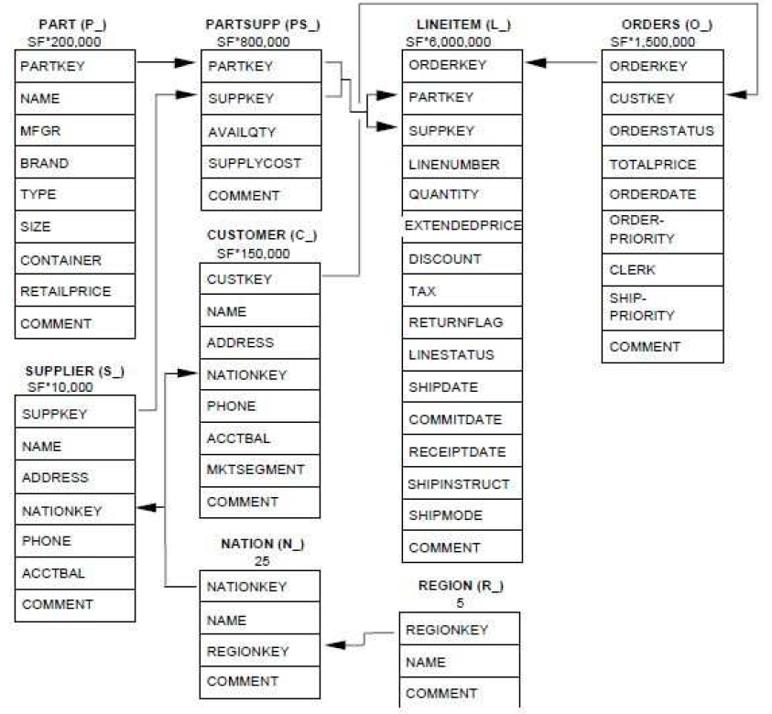
Datasets
MOVIES schema
(Stanford Movies Dataset)
TPC-H schema

Slide 39
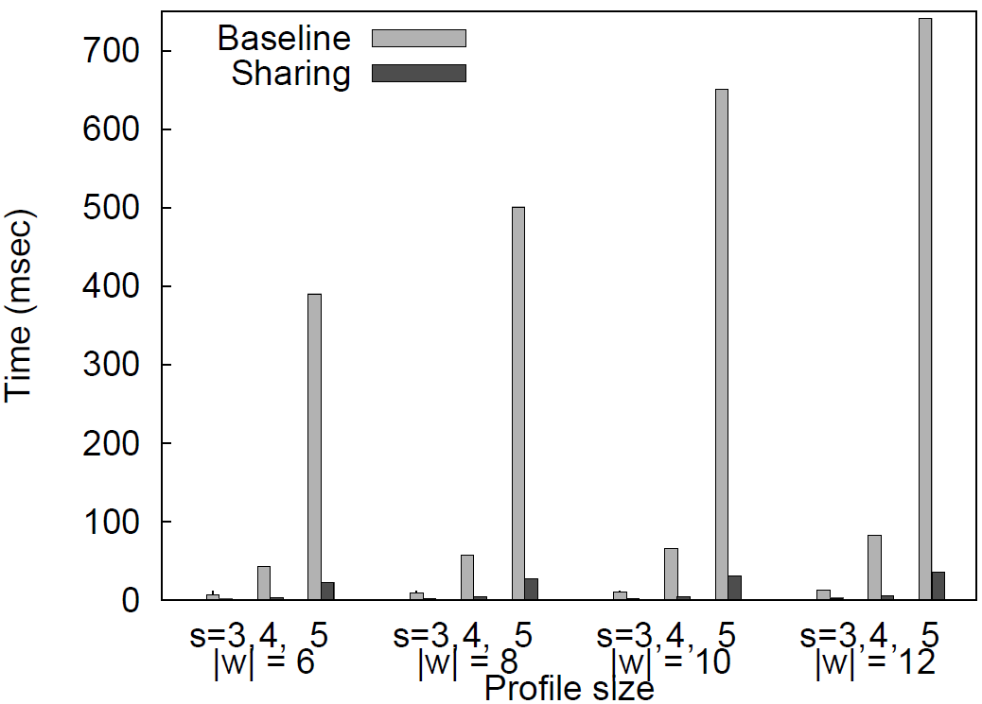
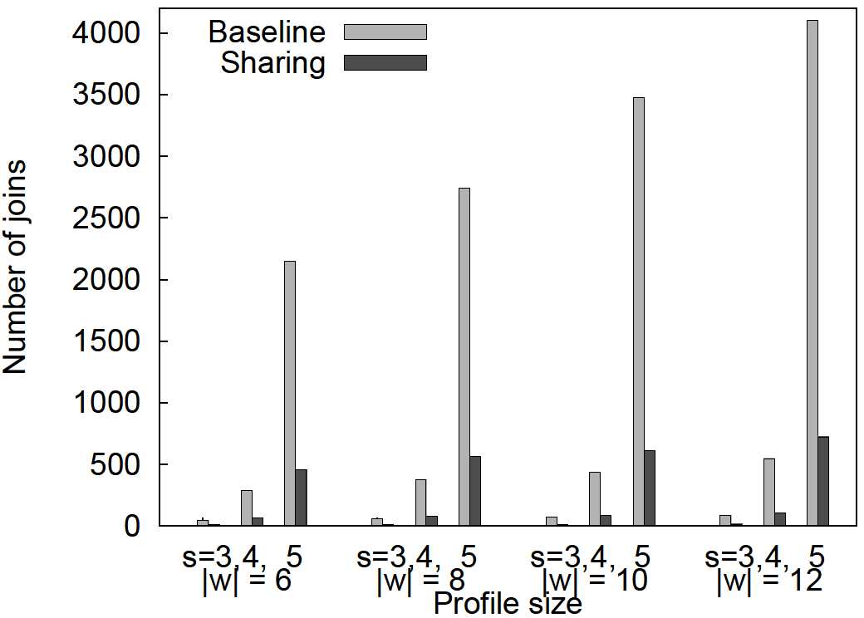
Sharing vs. Baseline Algorithm
TPC-H
The probability of a keyword appearing in the largest relation (LINEITEM) is 10%
For the smallest relation (REGION), this probability is around 1%
Query keywords = 3
The Sharing algorithm is more efficient
Performs only a small fraction of the join operations performed by the Baseline one, thus, requires much less time
As s increases, the reduction becomes more evident
The larger the size is, the more the computational steps that are shared

Slide 40
Sharing vs. Baseline Algorithm
Similar observations for the MOVIES database
The Sharing algorithm requires around 10% of the time required by the Baseline algorithm
The reduction of join operations during the expansion phase depends on the number of query keywords and varies from 90% to 50%

Slide 41
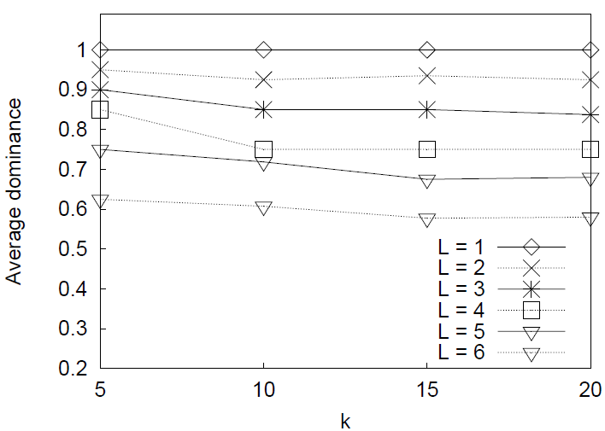
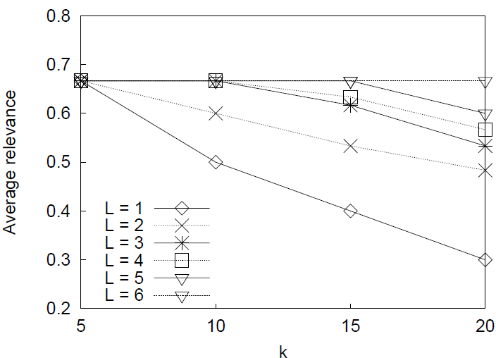
Top-k Query Processing: Dominance & Relevance
Tune the trade-off between dominance and relevance through F:
L is the lowest level from which choice keywords are retrieved
As L increases:
The average dominance decreases
Less preferable choice keywords are employed
The average relevance increases
Highly relevant JTTs from the lower levels enter the top-k results

Slide 42
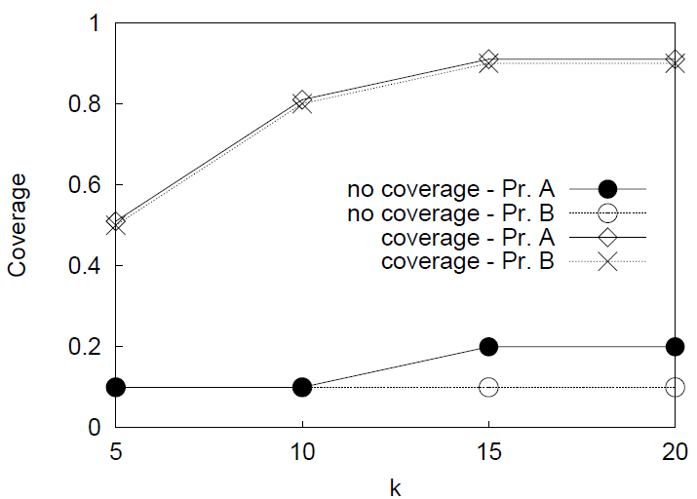
Top-k Query Processing: Coverage
42
Skewed selectivity among the choice keywords
Average coverage for two profiles
Pr. A contains keywords with similar selectivities
Pr. B contains keywords of different popularity, i.e., some keywords produce more results
Coverage is greatly improved in both cases
More keywords from all levels contribute to the result
The improvement is more evident for Pr. B, as expected
EDBT 2010 @ Lausanne, Switzerland

Slide 43
Diversity
43
High coverage does not ensured that results are not similar with each other
e.g. Q = {drama}
The most preferable choice keywords are: Greek and Italian
Locate the top-4 JTTs (for simplicity, we use only the JTSs: Movies^{{drama}} − Directors^{{Greek}} and Movies^{{drama}} − Directors^{{Italian}})
When only coverage is applied:
(Tan21, Eternity and a Day, 1998, Th. Angelopoulos, Drama) − (Th. Angelopoulos, 1935, Greek)
(FF50, Intervista, 1992, F. Fellini, Drama) − (F. Fellini, 1920, Italian)
(Tan12, Landscape in Fog, 1988, Th. Angelopoulos, Drama) − (Th. Angelopoulos, 1935, Greek)
(GT01, Cinema Paradiso, 1989, G. Tornatore, Drama) − (G. Tornatore, 1955, Italian)
When diversity is also considered, the third of these results is replaced by:
(PvG02, Brides, 2004, P. Voulgaris, Drama) − (P. Voulgaris, 1940, Greek)
Coverage remains the same, however, with diversity, one more director can be found in the results
EDBT 2010 @ Lausanne, Switzerland

Slide 44
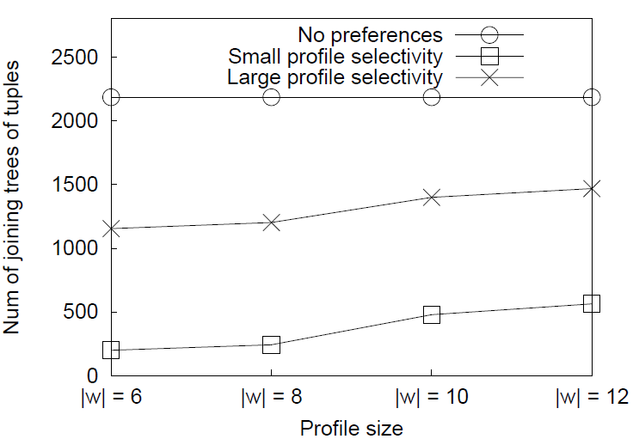
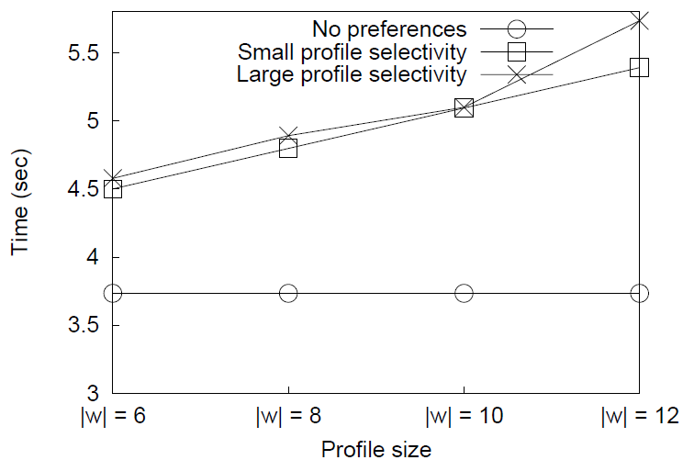
Result Pruning and Time Overhead
Overall impact of query personalization in keyword search
Number of returned results
Time overhead
3 cases: (i) No preferences, preferences with (ii) small and (iii) large selectivity
Query personalization results in high pruning:
Preferences with large selectivity prune more than 33% of the initial results (s = 4)
Small selectivity prunes 74%
Time overhead to generate the JTSs
For large selectivity, the time overhead is 35%
For small selectivity, the time overhead is 32%

Slide 45
Usability evaluation
 | precision@10 | degree of satisfaction
No preferences | 0.09 | 1.9
Empty-Context Keyword Preferences | 0.21 | 2.7
Relaxed Context | 0.87 | 7.4
Contextual Keyword Preferences
Dominance-Relevance | 0.89 | 7.9
Dominance-Relevance-Coverage-Diversity | 0.94 | 8.7
Most users defined short graph of choices → many ties according to dominance
Coverage and diversity improve user satisfaction considerably

Slide 46
Summary
We introduced the problem of personalized keyword search via the use of preferences in relational databases
We modeled contextual keyword preferences and defined dominance among Joining Trees of Tuples
We computed top-k results for users based on dominance, relevance, coverage and diversity
We proposed an algorithm that locates top-k results efficiently
We evaluated our approach in terms of efficiency of our algorithm and effectiveness

Slide 47
Thank you!

Slide 48
Back-up slides

Slide 49
Keyword Search in Relational Databases
49
Given a database with n relations R₁, …, R_{n}, the schema graph G is an undirected graph capturing the foreign key relationships in the schema
Joining tree of tuples (JTT):
A tree T of tuples, such that, for each pair of adjacent tuples t_{i}, t_{j} in T, t_{i} ∈ R_{i}, t_{j} ∈ R_{j}, there is an edge (R_{i}, R_{j}) ∈ G and it holds that (t_{i} ⊳⊲ t_{j}) ∈ (R_{i} ⊳⊲ R_{j})
Total JTT:
A JTT T is total for a keyword query Q, if and only if, every keyword of Q is contained in at least one tuple of T
Minimal JTT:
A JTT T that is total for a keyword query Q is also minimal for Q, if and only if, we cannot remove a tuple from T and get a total JTT for Q
Query result: Given a keyword query Q, the result Res(Q) of Q is the set of all JTTs that are both total and minimal for Q
EDBT 2010 @ Lausanne, Switzerland

Slide 50
Direct Dominance between JTTs
Movies
idm | title | genre | year | director
m1 | Dracula | thriller | 1992 | F. F. Coppola
m2 | Twelve Monkeys | thriller | 1996 | T. Gilliam
m3 | Seven | thriller | 1996 | D. Fincher
m4 | Schindler’s List | drama | 1993 | S. Spielberg
m5 | Picking up the Pieces | comedy | 2000 | A. Arau
Direct Dominance: order JTTs that contain choice keywords
e.g.
Q = {thriller} and P_{Q} = ({thriller}, F. F. Coppola ≻ T. Gilliam)
T₁
T₂
Play
Actors
idm | ida
m1 | a1
m2 | a2
m3 | a2
m4 | a3
m5 | a4
ida | name | gender | dob
a1 | G. Oldman | male | 1958
a2 | B. Pitt | male | 1963
a3 | L. Neeson | male | 1952
a4 | W. Allen | male | 1935
m1, Dracula, thriller, 1992, F. F. Coppola
≻
m2, Twelve Monkeys, thriller, 1996, T. Gilliam

Slide 51
Top-k Personalized Results
two types of properties that affect the goodness of the result:
Properties that refer to each individual JTT in the result
Preferential dominance
Relevance (based on some properties, e.g. size)
Properties that refer to the result as a whole
Coverage of user interests
Diversity, i.e. avoiding redundant information

Slide 52
Diversity Heuristic Performance
n | k | Heuristic |  | Brute-force
 |  | Set Diversity | Time (ms) | Set Diversity | Time (ms)
10 | 4 | 0.97 | 7 | 0.98 | 33
 | 8 | 0.92 | 11 | 0.92 | 38
20 | 4 | 0.97 | 16 | 0.99 | 623
 | 8 | 0.93 | 21 | 0.94 | 71,194
 | 12 | 0.86 | 30 | 0.86 | 171,315
 | 16 | 0.80 | 43 | 0.81 | 11,730
30 | 4 | 0.99 | 21 | 1.000 | 3,190
 | 8 | 0.98 | 30 | 0.98 | 3,041,457
 | 12 | 0.95 | 43 | 0.96 | 105,035,021
 | 16 | 0.93 | 61 | 0.94 | 300,561,487
 | 20 | 0.90 | 79 | 0.91 | 102,214,544
The time complexity of the brute-force method makes it non-applicable for real-time systems
Marginal reduction in set diversity when we use the heuristic (< 1%)

