Slide 1
Ranked Publish/Subscribe Delivery
Marina Drosou
Department of Computer Science
University of Ioannina, Greece
Thesis Advisor: Evaggelia Pitoura
http://dmod.cs.uoi.gr

Slide 2
Introduction
Publish/Subscribe is an attractive alternative to typical searching
Users do not need to repeatedly search for new interesting data
They specify their interests once and the system automatically notifies them whenever relevant data is made available

Slide 3
Motivation
Typically, all subscriptions are considered equally important
Users may receive:
overwhelming amounts of notifications
too much overlapping information
In such cases, users would like to receive only a fraction of notifications, the most interesting ones:
Say Addison is more interested in horror movies than comedies
Addison would like to receive notifications about (various) comedies only if there are no (or just a few) notifications about horror movies
Current publish/subscribe systems do not allow Addison to express this different degree of interest

Slide 4
Purpose
This PhD thesis aims at increasing user satisfaction by the received results by proposing methods that will control the number of results delivered to users, mainly through ranking them according to their importance.
Importance can be described by
Relevance to user interests (or preferences)
Diversity
Freshness

Slide 5
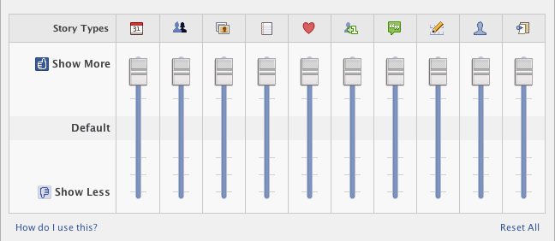
Applications
Social networks
Lots of notifications
Friends’ news, friends’ actions, games, quizzes etc.

Slide 6
Outline
Challenges
Preferences
Diversity
Freshness
Combining Criteria
DiveR

Slide 7
Outline
Challenges
Preferences
Diversity
Freshness
Combining Criteria
DiveR

Slide 8
Model
We consider a content-based pub/sub system
Greater expressiveness
Most content methods rely on a description of the content
string title = LOTR: The Return of the King
string director = Peter Jackson
time release date = 1 Dec 2003
string genre = fantasy
integer oscars = 11
string director = Peter Jackson
time release date > 1 Jan 2003
Notification example
Subscription example

Slide 9
Timing
A major issue is the continuous flow of information
Most important (or top-k) notifications over which?
Events are associated with a number of time instants:
Publication time
Matching time
Forwarding time
Delivery time
Pub/sub systems are usually best-effort
Arbitrary delays, different for each event

Slide 10
Timing
We consider time-partitioning methods:
Periodic
Window-based
Time-based
Event-based

Slide 11
Users
Another major issue is that users are independent
Their interests may vary a lot
There are no globally top-ranked notifications
A possible solution is clustering

Slide 12
Outline
Challenges
Preferences
Diversity
Freshness
Combining Criteria
DiveR

Slide 13
Expressing preferences
Preferences are associated with subscriptions
Different degrees of granularity
Subscription-based preferences
Attribute-based preferences
genre = drama
director = T. Burton
≻
genre = horror
director = S. Spielberg
director = T. Burton
≻
director = S. Spielberg
genre = drama
≻
genre = horror

Slide 14
Ordering Subscriptions
To order user subscriptions we use the winnow operator, applying it on various levels
per subscription or per attribute
User preferences
Preference graph
genre = drama
≻
genre = drama
genre = horror
genre = horror
genre = drama
genre = comedy
≻
genre = romance
genre = comedy
genre = romance
genre = comedy
≻
genre = action
genre = horror
genre = romance
genre = romance
genre = action
genre = romance
genre = comedy
≻
genre = horror
genre = action

Slide 15
Extracting preference ranks
We perform a topological sort to compute winnow levels. The subscriptions of level i are associated with a preference rank 𝒢(i):
𝒢 is a monotonically decreasing function with 𝒢 → [0, 1]
e.g. for 𝒢 = (D +1 – (l -1)) / (D +1)
Preference graph
genre = drama
genre = comedy
Preference rank = 1
genre = horror
genre = romance
Preference rank = 2/3
genre = action
Preference rank = 1/3

Slide 16
Event ranks
Generally, to compute the importance of an event, we consider only the matching subscriptions
Furthermore, we can consider only the most specific among them
string title = King Kong
string director = Peter Jackson
time release date = 14 Dec 2005
string genre = adventure
User subscriptions
string title = King Kong
string director = Peter Jackson
time release date = 14 Dec 2005
string genre = adventure
genre = adventure
0.9
0.9
director = Peter Jackson
0.7
ℱ = max

Slide 17
Outline
Challenges
Preferences
Diversity
Freshness
Combining Criteria
DiveR

Slide 18
Motivation
User subscriptions
Published events
genre = drama
title = The Godfather
genre = drama
showing time = 21:10
0.9
genre = comedy
title = Ratatouille
genre = comedy
showing time = 21:15
0.8
title = Fight Club
genre = drama
showing time = 23:00
title = Casablanca
genre = drama
showing time = 23:10
title = Vertigo
genre = drama
showing time = 23:20
The most highly ranked events may
be very similar to each other…

Slide 19
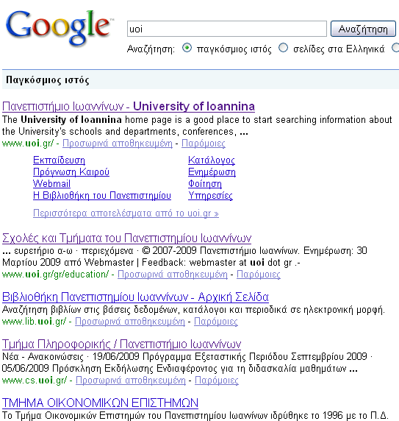
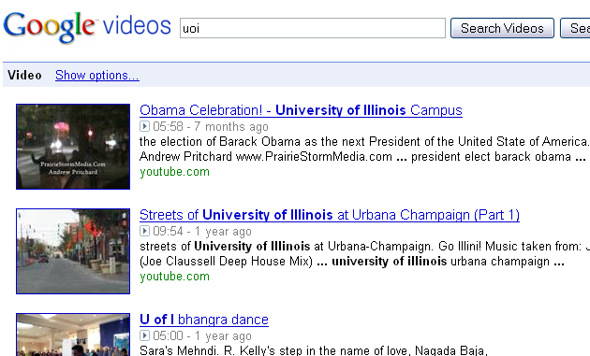
Motivation

Slide 20
Diversity
We wish to retrieve results on a broader variety of user interests
Two different perspectives on achieving diversity:
Avoid overlap: choose notifications that are dissimilar to each other
Increase coverage: choose notifications that cover as many user interests as possible
How to measure diversity?
Many alternative ways
Common ground: measure similarity/distance among the selected items

Slide 21
Problem Definition & Complexity
Diversify(k) problem:
Generally, the problem of choosing diverse results is NP-hard ¹
Intuitively:
To find the most diverse subset S* of all results M we have to compute all possible combinations of k items out of |M| and keep the one with the maximum diversity
Select the k out of all results that exhibit the maximum diversity
¹ Erhan Erkut, “The discrete p-dispersion problem”, European Journal of Operational Research vol. 46, nº1 1990

Slide 22
Solutions
To solve the problem, heuristics are employed
Greedy heuristics:
Selecting items one by one until we have k of them
Interchange heuristics:
Start with a random solution and interchange items that improve the objective function
Neighborhood heuristics:
Disqualify items close to the ones already selected
Simulated Annealing:
Apply simulated annealing to avoid local maxima
General difficulty: Diversify(k-1) ⊄ Diversify(k)

Slide 23
Outline
Challenges
Preferences
Diversity
Freshness
Combining Criteria
DiveR

Slide 24
Freshness
Continuous flow of information
Also, system overheads, network latency…
Need for fresh information
We consider a model in which a notification’s importance decreases along with time
e ‘s publication time
Maximum time that e is considered important

Slide 25
Outline
Challenges
Preferences
Diversity
Freshness
Combining Criteria
DiveR

Slide 26
Combining criteria
Various alternatives
still in search for the best one ☺
Relevance + Freshness
Relevance + Freshness + Diversity
event rank for user X
𝜎 ∈ [0, 1]
set diversity

Slide 27
Outline
Challenges
Preferences
Diversity
Freshness
Combining Criteria
DiveR

Slide 28
Implementation
We have initially implemented our ideas in SIENA
However, this implementation is not optimized for distributed environments, since the focus was on exploring ranking methods
We are in the process of designing a new implementation (DiveR) that can efficiently support ranked pub/sub delivery

Slide 29
DiveR

Slide 30
Summary
Our goal is to increase the quality of notifications delivered in pub/sub systems
Three main factors
Relevance to user preferences
Diversity
Freshness
Up to now, we have mainly focused in our model for information ranking
Our future plans are to develop ranking methods that can be efficiently applied in a distributed environment

Slide 31
Thank you!

