Slide 1
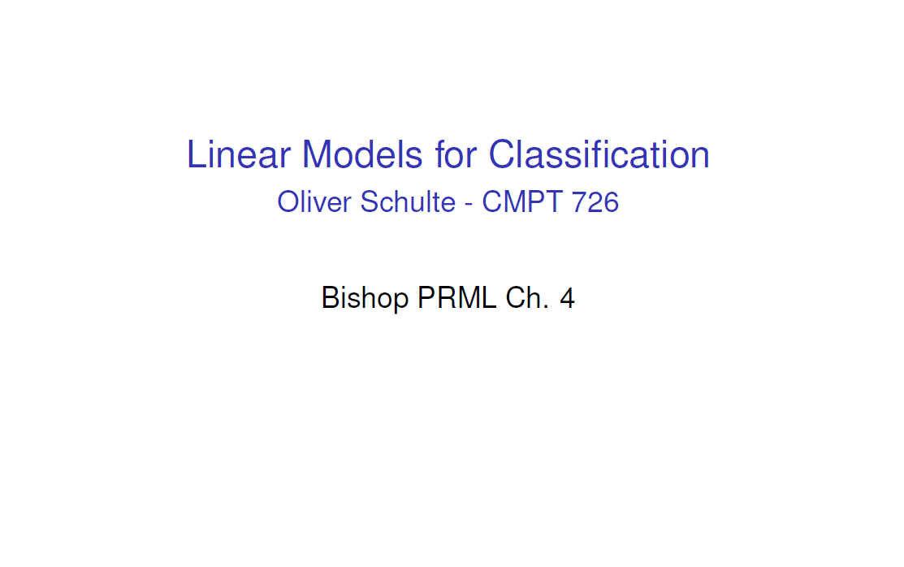

Slide 15
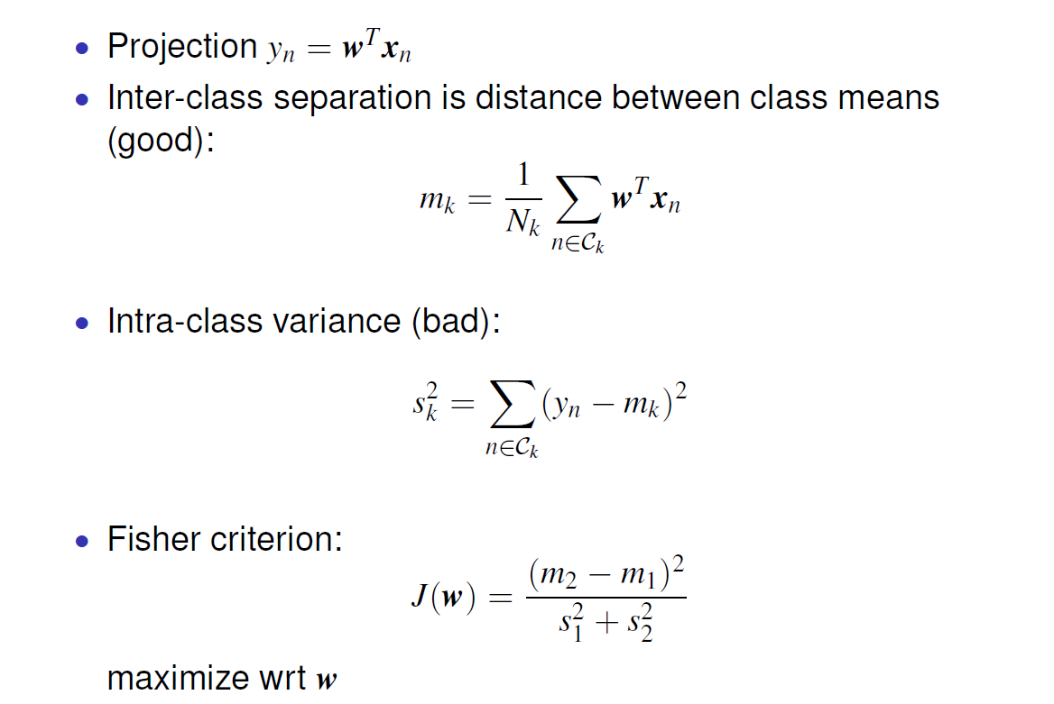

Slide 16
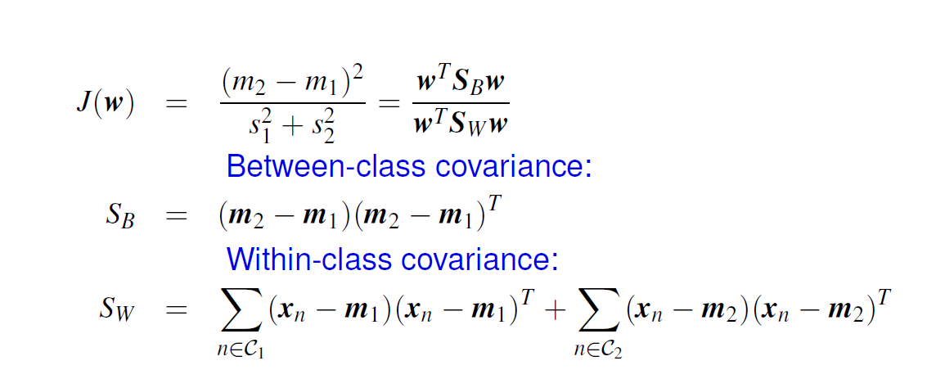

Slide 24
Training phase:
We model the probability density p(x|C_{k}) of each class C_{k} using density estimation (e.g. Gaussians) methods applied to the data of class C_{k}
We define the class priors P(C_{k}) (either uniform or N_{k}/N)
To classify a point x:
We compute P(x|C _{k}) for each k.
We compute P(C_{k}|x) for each k.
We assign x to the class with maximum P(C_{k}|x) (Bayes rule for classification)

Slide 29
(Cross-entropy)

Slide 30
No closed form solution (contrary to Least Squares)
Train using gradient descent (or Iterative Reweighted Least Squares)

Slide 31
z_{i} = w^{T}_{i} x
(Cross-entropy)

Slide 32
Multiclass Classification
Gradient of cross-entropy with softmax activation has the same form as the gradient of squared error with linear activation!
However, when the activation is linear, the outputs y_{i} do not form a probability vector (wrong approach)
The above also hold for the two-class case (where we have one output)

Slide 33
Least Squares
Logistic Regression

