Slide 1
Deep Learning Overview
Train networks with many layers (vs. shallow nets with just a couple of layers)
Multiple layers work to build an improved feature space
First layer learns 1st order features (e.g. edges…)
2nd layer learns higher order features (combinations of first layer features, combinations of edges, etc.)
Several models learn intermediate layers in an unsupervised mode and discover general features of the input space
Final layer of features are fed into supervised layer(s)
Entire network is often subsequently tuned using supervised training of the entire net

Slide 2
Deep Net Feature Transformation
Supervised
Learning
ML Model
New Feature Space
Supervised
or
Unsupervised
Learning
Original Features

Slide 3
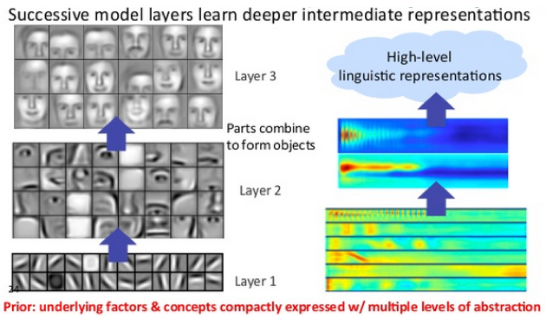
Face Recognition Example

Slide 4
Why Deep Learning
Biological Plausibility – e.g. Visual Cortex
Highly varying functions can be efficiently represented with deep architectures
Less weights/parameters to update than a less efficient shallow representation (weight sharing)
Sub-features created in deep architecture can potentially be shared between multiple tasks:
Transfer or Multi-task learning

Slide 5
Deep Training Difficulties
Vanishing Gradient – error attenuates as it propagates to earlier layers (f '(net)*(t-y))
Leads to very slow training (especially at early layers)
Need a way for early layers to do effective work
Instability of gradient in deep networks: Vanishing or exploding gradient
Product of many terms, which unless “balanced” just right, is unstable
Either early or late layers stuck while “opposite” layers are learning
Long training times
Many Local Minima of error function
Advanced computing infrastructure is needed

Slide 6
Unsupervised Pre-Training
The first Deep-Learning approach (Deep Belief Networks 2006)
Unsupervised Pre-Training uses unsupervised learning in the deep layers to transform the inputs into features that are easier to learn by a final supervised model
Often not a lot of labeled data available while there may be lots of unlabeled data.
Unsupervised Pre-Training can take advantage of unlabeled data. Can be a huge issue for some tasks.

Slide 7
Greedy Layer-Wise Training
Train first layer using your data without the labels (unsupervised)
Then freeze the first layer parameters and start training the second layer using the output of the first layer as the unsupervised input to the second layer
Repeat this for as many layers as desired
This builds the set of robust features
Use the outputs of the final layer as inputs to a supervised layer/model and train the last supervised layer(s) (leave early weights frozen)
Unfreeze all weights and fine tune the full network by training with a supervised approach, given the pre-training weight settings (optional)

Slide 8
Deep Net with Greedy Layer Wise Training
Supervised
Learning
ML Model
New Feature Space
Unsupervised
Learning
Original Inputs

Slide 9
Greedy Layer-Wise Training
Greedy layer-wise training avoids many of the problems of trying to train a deep net in a supervised fashion
Each layer gets full learning focus in its turn since it is the only current "top" layer (no unstable gradient issues, etc.)
Can take advantage of unlabeled data
When you finally tune the entire network with supervised training the network weights have already been adjusted so that you are in a good error basin and just need fine tuning. This helps with problems of
Ineffective early layer learning
Deep network local minima
Two landmark approaches
Deep Belief Networks (2006)
Stacked Auto-Encoders (2007)

Slide 10
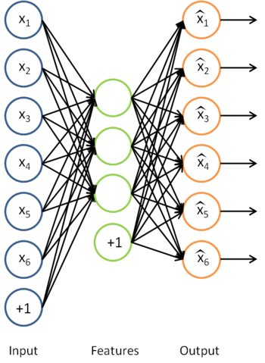
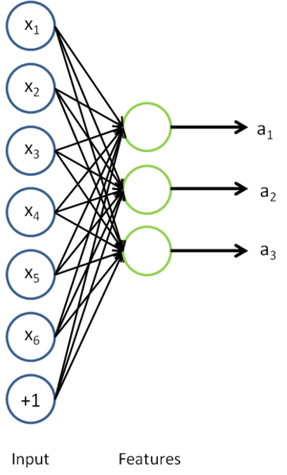
Auto-Encoders
A type of unsupervised learning which discovers generic features of the data (self-supervised learning)
Learn identity function by learning important sub-features
Compression, etc. – Undercomplete |h| < |x|
For |h| ≥ |x| (Overcomplete case more common in deep nets) use regularized autoencoding

Slide 11
Sparse Auto-Encoders
Use more hidden nodes in the encoder
Use regularization techniques which encourage sparseness (e.g. a significant portion of nodes have zero output for any given input)
Penalty in the learning function for non-zero nodes
Weight decay
De-noising Auto-Encoder
Stochastically corrupt training instance each time, but still train auto-encoder to decode the uncorrupted instance
Improved empirical results

Slide 12
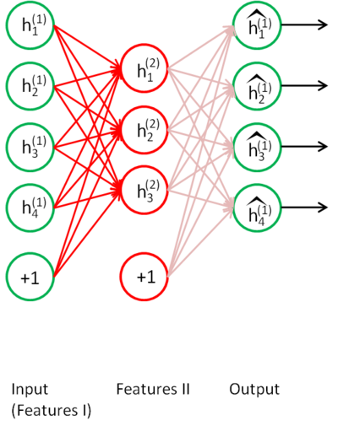
Stacked Auto-Encoders
Bengio (2007) – After Deep Belief Networks (2006)
Stack many (sparse) auto-encoders in succession and train them using greedy layer-wise training
Drop the decode output layer each time

Slide 13
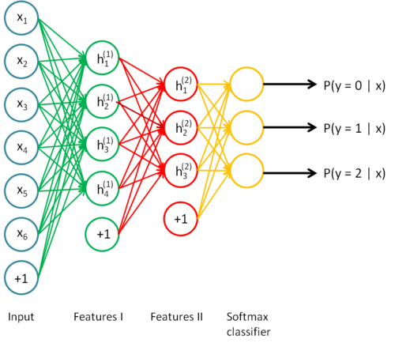
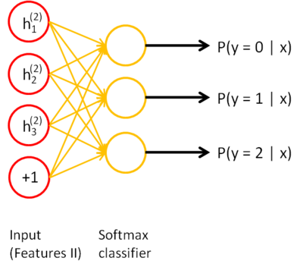
Stacked Auto-Encoders
Do supervised training (can now only used labeled examples) on the last layer using final features
Then do supervised training on the entire network to fine- tune all weights (optional)

Slide 14
Deep Belief Networks (DBN)
Beginning of Deep Learning hype (2006) – outperformed kernel methods (SVMs) on MNIST – Also generative
Uses Greedy layer-wise training but each layer is an RBM (Restricted Boltzmann Machine)
RBM is a constrained
Boltzmann machine with
No lateral connections between
hidden (h) and visible (x) nodes
Symmetric weights, different biases
Typically uses probabilistic logistic node, but other activations possible

Slide 15
RBM Sampling and Training
Initial state typically set to a training
example x (can be real valued)
Sample in an iterative back and forth process
P(h_{i} = 1|x) = sigmoid(W_{i}x + c_{i}) = 1/(1+e^{-net(hi)}) // c_{i} is hidden node bias
P(x_{i} = 1|h) = sigmoid(W'_{i}h + b_{i}) = 1/(1+e^{-net(xi)}) // b_{i} is visible node bias
Contrastive Divergence (CD-k): the difference from the original training example to the relaxed version after k relaxation steps
Then update weights to decrease the divergence
Typically just do CD-1 (Good empirical results)

Slide 17
Deep Belief Network Training
Greedy layer-wise approach
First train lowest RBM (h⁰ – h¹) using RBM update algorithm (note h⁰ is x)
Freeze weights and train subsequent RBM layers
Then connect final outputs to a supervised model and train that model
Finally, unfreeze all weights, and fine tune as an MLP using the initial weights found by DBN training
Can do execution as just the tuned MLP

Slide 18
Fully Supervised Deep Learning
Much recent success in doing fully supervised deep learning with extensions which diminish the effect of early learning difficulties (unstable gradient, etc.)
Patience (now that we know it may be worth it), faster computers, use of GPUs
More efficient activation functions (e.g. ReLUs) in terms of both computation and avoiding f '(net) saturation
Put some effort on weight initialization
Use Dropout during training
Training using variations of Scaled Conjugate Gradient (SGD) that speed-up learning + Train in mini-batches
Batch normalization in hidden nodes: for every hidden node input (k):

Slide 19
Speed up variations of SGD
Adaptive learning rate (LR) approaches:
Standard Momentum
Nesterov Momentum – Calculate point you would go to if using normal momentum. Then, compute gradient at that point. Do normal update using that gradient and momentum.
Rprop – Resilient BackProp, if gradient sign inverts, decrease it’s individual LR, else increase it – common goal is faster in the flats, there are variants that backtrack a step, etc.
Adagrad – Scale LRs inversely proportional to the sum of past values – LRs with smaller derivatives are decreased less
RMSprop – Adagrad but uses exponentially weighted moving average, older updates basically forgotten
Adam (Adaptive moments) – Momentum terms on both gradient and squared gradient

Slide 20
Convolutional Neural Networks
Networks built specifically for problems with low dimensional grid-like local structure (e.g. images)
Inspired from biological computations in visual cortex (visual pyramid)
Neighboring pixels will have high correlations and local features (edges, corners, etc.), while distant pixels are un-correlated
Natural images have the property of being stationary, meaning that the statistics of one part of the image are the same as any other part
CNNs enforce that a node receives only a small set of features which are spatially or temporally close to each other called receptive fields from one layer to the next (e.g. 3x3, 5x5), thus enforcing ability to handle local 2-D structure.
Good for problems with local grid structure, but inappropriate for general learning with abstract features having no prescribed feature ordering or locality

Slide 21
Convolutional Neural Networks
Typical MLPs: fully connectivity between layers
Convolutional nets (sparse connectivity + weight sharing):
Nodes still do a scalar dot product (convolution) from the previous layer, but with only a small portion (receptive field) of the nodes in the previous layer – Sparse connectivity
Every node has the exact same weight values from the preceding layer – Shared parameters, tied weights, a LOT less unique weight values (regularization)
Each node has it’s shared weight convolution computed on a receptive field slightly shifted, from that of it’s neighbor, in the previous layer – Translation invariance.
Each node’s convolution scalar is then passed through a non-linear activation function (ReLU, tanh, etc.)
Convolution is a simple weighted sum

Slide 22
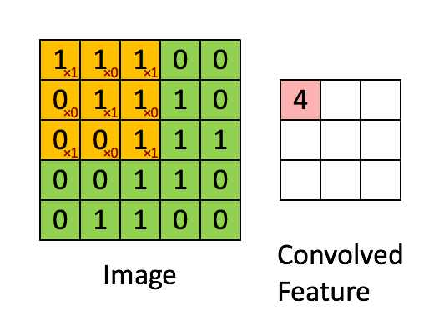
Convolution Example

Slide 23
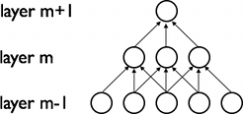
Convolution layers
The 2-d layers (grids) of nodes (or their outputs) in a CNN are called feature maps
Each node in a feature map has the same weights, and each node connects to a different overlapping receptive field of the previous layer (stride parameter determines overlapping)
Each feature map ‘scans’ previous layer to see where its feature occurs
Later layers could concern themselves with higher order combinations of features

Slide 24
Convolutional Neural Networks
C layers are convolutions, S layers pool/sample
Often starts with fairly raw features at initial input and lets CNN discover improved feature layer for final supervised learner – eg. MLP/BP

Slide 25
CNN Structure
Each node in convolution layer is calculated for each receptive field in the previous layer
During training the corresponding weights are always tied to be the same
Thus a relatively small number of unique weight parameters to learn, although they are replicated many times in the feature map
Each node output in CNN is f(Σxw + b) (ReLU, tanh etc.)
Multiple feature maps in each layer
Each feature map should learn a different feature

Slide 26
Convolution layers
The 2-d layers (grids) of nodes (or their outputs) in a CNN are called feature maps
Each node in a feature map has the same weights, and each node connects to a different overlapping receptive field of the previous layer (stride parameter determines overlapping)
Each feature map ‘scans’ previous layer to see where its feature occurs
Later layers could concern themselves with higher order combinations of features

Slide 27
Sub-Sampling (Pooling)
Sub-sampling (Pooling) allows number of features to be diminished, and to pool information
Pooling replaces the network output at a certain point with a summary statistic of nearby outputs
Max-Pooling common, also average pooling, stochastic pooling etc.
Pooling smooths the data and reduces spatial resolution
2x2 pooling would do 4:1 compression, 3x3 9:1, etc
Convolution layer (C) followed by sub-sampling layer (S) and so on
A fully connected MLP is added on the top of the final S layer.

Slide 28
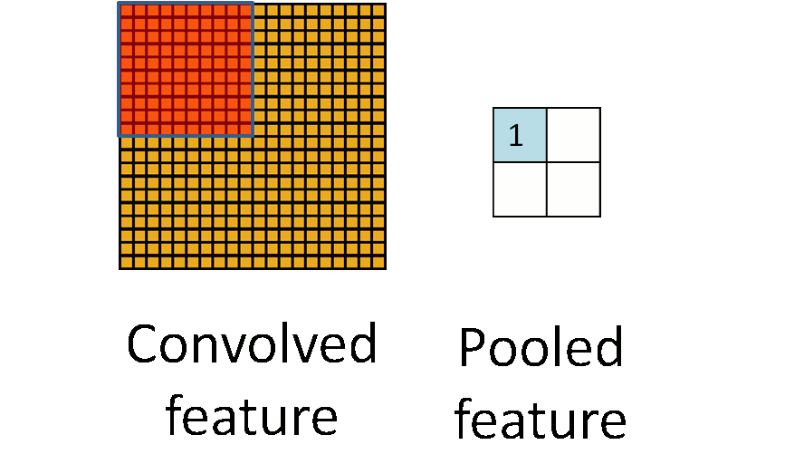
Pooling Example (Summing or averaging)

Slide 29
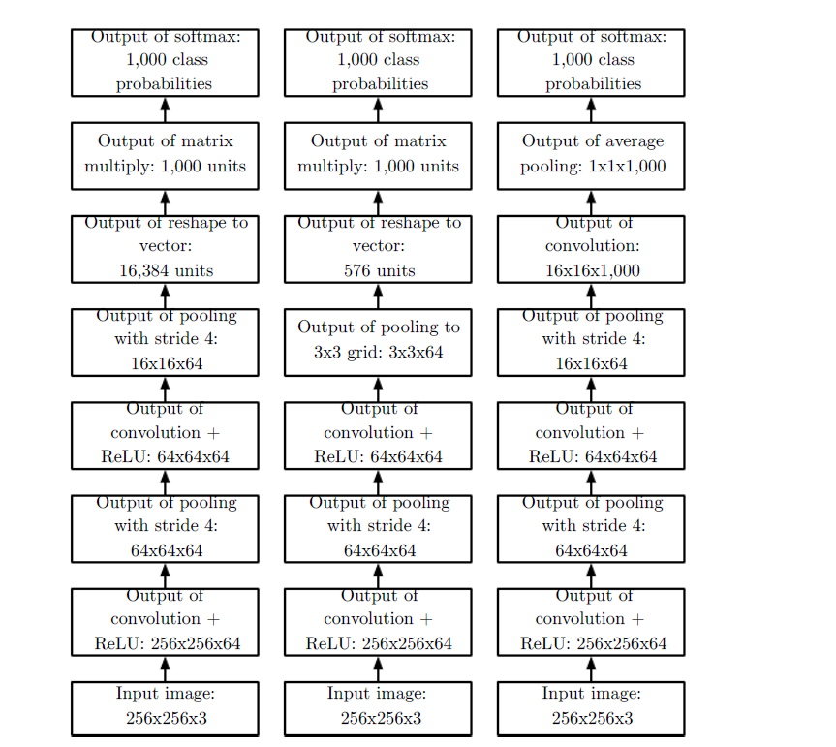
CNN Examples

Slide 30
CNN weight sparsity
Convolution layer
Each feature map has one weight for each input and one bias
A feature map with a 5x5 receptive field (filter) would have a total of 26 weights, which are the same coming into each node of the feature map
If a convolution layer had 10 feature maps, then only a total of 260 unique weights to be trained in that layer
Sub-Sampling (Pooling) Layer
All elements of receptive field max’d, averaged, summed, etc.
Result multiplied by one trainable weight and a bias added, then passed through non-linear function (e.g. ReLU) for each pooling node
If a layer had 10 pooling feature maps, then 20 unique weights to be trained

Slide 31
CNN Training
CNNs trained with gradient-based methods (e.g. SGD) and cross-entropy loss function but with weight sharing in each feature map
Gradients computed using back-propagation
Add (or average) the weight updates over the shared weights in feature map layers
Mini-batch training
Randomized initial weights through entire network

Slide 32
CNN Hyperparameters
The structure of the CNN is currently usually hand crafted with trial and error (cross-validation or simple validation error)
Parameters to be determined:
Number of layers
Size of filters (receptive field)
Receptive field overlapping (stride)
Number of feature maps in convolution layers
Connectivity between layers
Activation functions
Size of pooling layers
Type of pooling
Final supervised layers etc

Slide 33
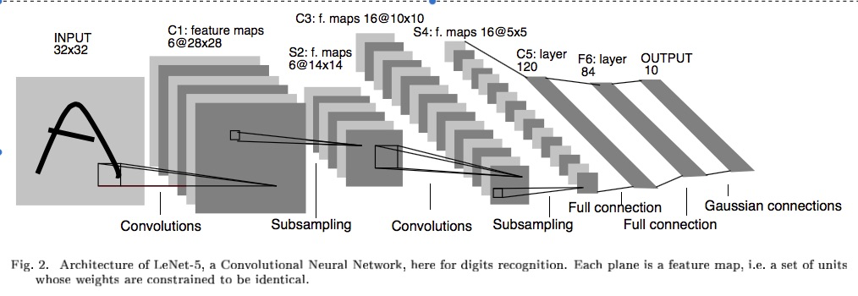
Example – LeNet-5 – MNIST Classification (the first CNN)

Slide 34
ILSVRC Image net Large Scale Vision Recognition Competition

Slide 35
Example CNNs Structures ILSVRC winners
Note Pooling considered part of the layer
96 convolution kernels, then 256, then 384
Stride of 4 for first convolution kernel, 1 for the rest
Pooling layers with 3x3 receptive fields and stride of 2 throughout
Finishes with fully connected (fc) MLP with 2 hidden layers and 1000 output nodes for classes

Slide 36
Example CNNs Structures ILSVRC winners

Slide 37
CNN Summary
Special purpose deep neural net
Inappropriate for general datasets
High accuracy for image applications – Breaking all records and doing it using just using just raw pixel features (no image preprocessing)!
CNNs are effective when inputs are structured (grid-like)
Tedius of hand-crafting and hyperparameter tuning
Long training times (large computing infrastructure necessary)
Pretrained networks (e.g VGG, ResNet) can be used as backbone and easily fine tuned to solve specific tasks (transfer learning).

Slide 38
Transformers
Very successful on sequential data (e.g. Natural Language Processing Applications)
Feedforward neural networks
Found to be superior to Recurrent Neural Networks (LSTMs, GRUs) that have been used for training using sequential data.
Transform a sequence to another sequence (e.g. language translation)
Based on the idea of self-attention
Include an encoder part and a decoder part

Slide 39
Transformers
The encoder part
takes as input a sequence of vectors (e.g word embeddings)
Encodes its position (positional encoding)
produces an efficient internal representation of the sequence using: self-attention modules + MLPs
This representation is passed to the decoder that generates the ‘translated’ sequence.
The self-attention module is based on the Query-Key-Value idea.

Slide 40
Transformers
In several applications the encoder part (self-attention + MLP) can also be trained solely (without the decoder) in a self-supervised manner.
The encoder self-pretrained on huge datasets can be used as a backbone (eg. BERT, GPT) for several applications: just add and train a classification layer on top of the backbone to solve a specific problem (transfer learning)

Slide 41
Synthetic Data Generation
Given a set of data object (eg. face images), generate synthetic samples that are ‘similar’ to the original ones (e.g. synthetic faces)
Most popular approaches
Generative Adversarial Networks (GANs)
Generator : takes input noise (sampled from the normal distribution) and generates synthetic data
Discriminator: classifier that learns to discriminate between real and synthetic data
Objective: generator tries to ‘fool’ the discriminator
Variational Autoencoders (VAEs): autoencoders trained so that the ‘code vectors’ follow the Normal Distribution.

