Slide 1
Supervised Feature Selection & Unsupervised Dimensionality Reduction

Slide 2
Feature Subset Selection
Supervised: class labels are given
Select a subset of the problem features
Why?
Redundant features
much or all of the information contained in one or more other features
Example: purchase price of a product and the amount of sales tax
Irrelevant features
contain no information that is useful for the data mining task at hand
Example: students' ID is often irrelevant to the task of predicting students' GPA
Data mining may become easier
The selected features may convey important information (e.g. gene selection)

Slide 3
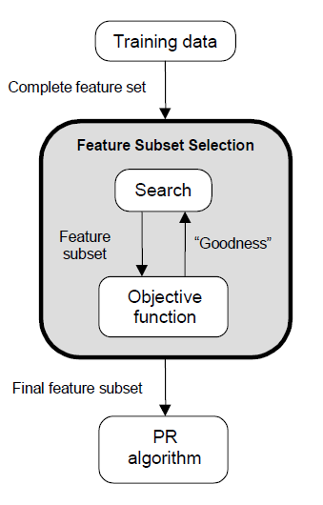
Feature Selection Steps
Feature selection is an optimization problem.
Step 1: Search the space of possible feature subsets.
Step 2: Pick the subset that is optimal or near-optimal with respect to some criterion

Slide 4
Feature Selection Steps (cont’d)
Search strategies
Exhaustive
Heuristic
Evaluation Criterion
Filter methods
Wrapper methods
Embedded methods

Slide 5
Search Strategies
Assuming d features, an exhaustive search would require:
Examining all possible subsets of size m.
Selecting the subset that performs the best according to the criterion.
Exhaustive search is usually impractical.
In practice, heuristics are used to speed-up search but they cannot guarantee optimality.

Slide 6
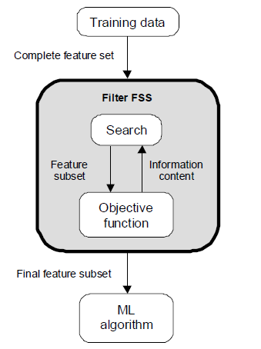
Evaluation Strategies
Filter Methods
Evaluation is independent of the classification method.
The criterion evaluates feature subsets based on their class discrimination ability (feature relevance):
Mutual information or correlation between the feature values and the class labels

Slide 7
Filter Criterion – Inf. Theory
Information Theoretic Criteria
Most approaches use (empirical estimates of) mutual information between features and the target:
Case of discrete variables:
(probabilities are estimated from frequency counts)

Slide 8
Filter Criterion - SVC
Single Variable Classifiers
Idea: Select variables according to their individual predictive power
criterion: Performance of a classifier built with 1 variable
e.g. the value of the variable itself (decision stump)
(set threshold on the value of the variable)
predictive power is usually measured in terms of error rate (or criteria using presicion, recall, F1)

Slide 9
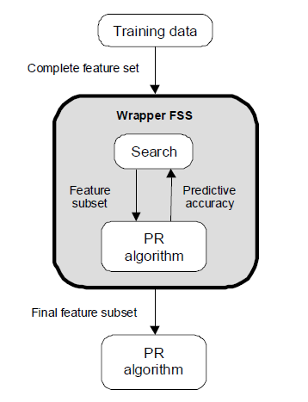
Evaluation Strategies
Wrapper Methods
Evaluation uses criteria related to the classification algorithm.
To compute the objective function, a classifier is built for each tested feature subset and its generalization accuracy is estimated (eg. cross-validation).

Slide 10
Feature Ranking
Evaluate all d features individually using the criterion
Select the top m features from this list.
Disadvantage
Correlation among features is not considered

Slide 11
Sequential forward selection (SFS) (heuristic search)
First, the best single feature is selected (i.e., using some criterion).
Then, pairs of features are formed using one of the remaining features and this best feature, and the best pair is selected.
Next, triplets of features are formed using one of the remaining features and these two best features, and the best triplet is selected.
This procedure continues until a predefined number of features are selected.
Wrapper methods (e.g. decision trees, linear classifiers) or Filter methods (e.g. mRMR) could be used

Slide 12
Example
features added at
each iteration
Results of sequential forward feature selection for classification of a satellite image using 28 features. x-axis shows the classification accuracy (%) and y-axis shows the features added at each iteration (the first iteration is at the bottom). The highest accuracy value is shown with a star.

Slide 13
Sequential backward selection (SBS) (heuristic search)
First, the criterion is computed for all n features.
Then, each feature is deleted one at a time, the criterion function is computed for all subsets with n-1 features, and the worst feature is discarded.
Next, each feature among the remaining n-1 is deleted one at a time, and the worst feature is discarded to form a subset with n-2 features.
This procedure continues until a predefined number of features are left.
Wrapper or filter methods could be used.

Slide 14
Example
features removed at
each iteration
Results of sequential backward feature selection for classification of a satellite image using 28 features. x-axis shows the classification accuracy (%) and y-axis shows the features removed at each iteration (the first iteration is at the top). The highest accuracy value is shown with a star.

Slide 15
Limitations of SFS and SBS
The main limitation of SFS is that it is unable to remove features that become redundant after the addition of other features.
The main limitation of SBS is its inability to reevaluate the usefulness of a feature after it has been discarded.

Slide 16
Embedded Methods
Tailored to a specific classifier
RFE-SVM:
RFE: Recursive Feature Elimination
Iteratively train a linear SVM and remove features with the smallest weights at each iteration
Has been successfully used for gene selection in bioinformatics
Decision Trees or Random Forest: evaluate every feature by computing average reduction in impurity for the tree nodes containing this feature
Random Forest: determine the importance of a feature by measuring how the out-of-bag error of the classifier will be increased, if the values of this feature in the out-of-bag samples are randomly permuted
Relief (based on k-NN): the weight of any given feature decreases if its value differs in nearby instances of the same class more than it differs in nearby instances of the other class (and increases in the opposite case).

Slide 17
Unsupervised Dimensionality Reduction
Feature Extraction: new features are created by combining the original features
The new features are usually fewer than the original
No class labels available (unsupervised)
Purpose:
Avoid curse of dimensionality
Reduce amount of time and memory required by data mining algorithms
Allow data to be more easily visualized
May help to eliminate irrelevant features or reduce noise
Techniques
Principal Component Analysis (optimal linear approach)
Non-linear approaches

Slide 18
PCA: The Principal Components
Vectors originating from the center of the dataset (data centering: use (x-m) instead of x, m=mean(X))
Principal component #1 points in the direction of the largest variance.
Each subsequent principal component…
is orthogonal to the previous ones, and
points in the directions of the largest variance of the residual subspace

Slide 19
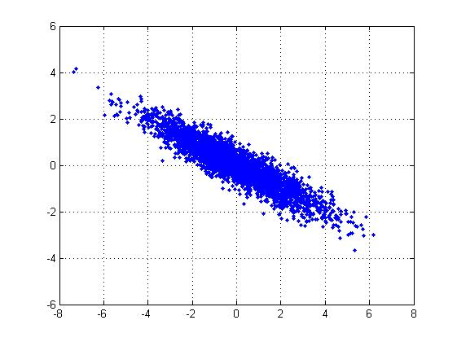
PCA: 2D Gaussian dataset

Slide 20
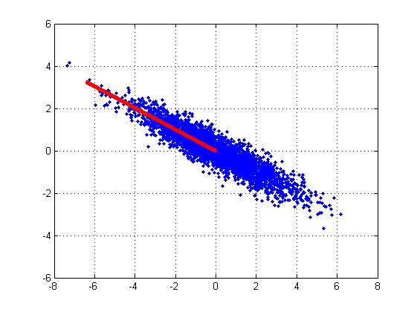
1st PCA axis

Slide 21
2nd PCA axis

Slide 22
PCA algorithm
Given data {x₁, …, x_{n}}, compute covariance matrix Σ:
PCA basis vectors = the eigenvectors of Σ (dxd)
{ λ_{i}, u_{i} }_{i=1..N} = eigenvectors/eigenvalues of Σ
λ₁ ≥ λ₂ ≥ … ≥ λ_{n} (eigenvalue ordering)
Select { λ_{i}, u_{i} }_{i=1..k} (top k principal components)
Usually few λ_{i} are large and the remaining quite small
Larger eigenvalue ⇒ more important eigenvectors

Slide 23
PCA algorithm
W=[u₁ u₂ … u_{k} ]^{T} (kxd projection matrix)
Z=X*W^{T} (nxk data projections)
Xrec=Z*W (nxd reconstructions of X from Z)
PCA is optimal Linear Projection: minimizes the reconstruction error:

Slide 24
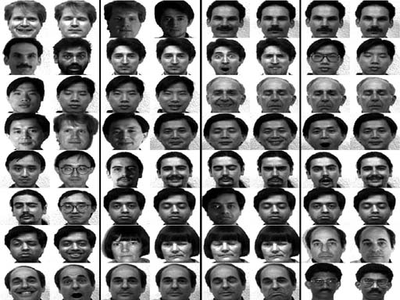
PCA example: face analysis
Original dataset: images 256x256

Slide 25
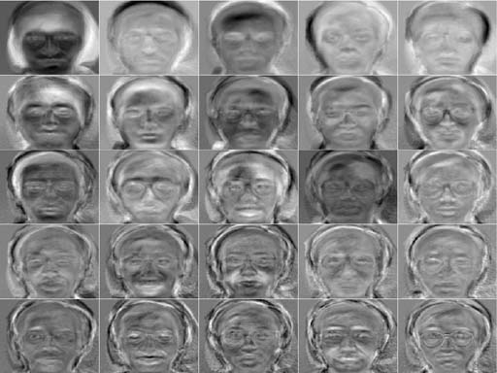
PCA example: face analysis
Principal components: 25 top eigenfaces

Slide 26
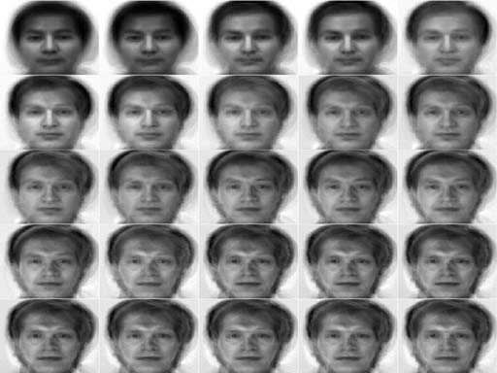
PCA example: face analysis
Reconstruction examples

Slide 27
Non-Linear Dim Reduction
rerwerwer

Slide 28
Non-Linear Dim Reduction

Slide 29
Non-Linear Dim Reduction

Slide 30
Non-Linear Dim Reduction
Kernel PCA
Locally Linear Embedding (LLE)
Isomap
Laplacian EigenMaps
AutoEncoders (neural networks)
t-SNE

Slide 31
Kernel PCA

Slide 32
Kernel PCA

Slide 33
Kernel PCA

Slide 34
Kernel PCA

Slide 35
Kernel PCA

Slide 36
Locally Linear Embedding (LLE)

Slide 37
Locally Linear Embedding

Slide 38
Locally Linear Embedding

Slide 39
Isomap (Isometric Feature Mapping)

Slide 40
Isomap (Isometric Feature Mapping)

Slide 41
Isomap (Isometric Feature Mapping)

Slide 42
Isomap (Isometric Feature Mapping)

Slide 43
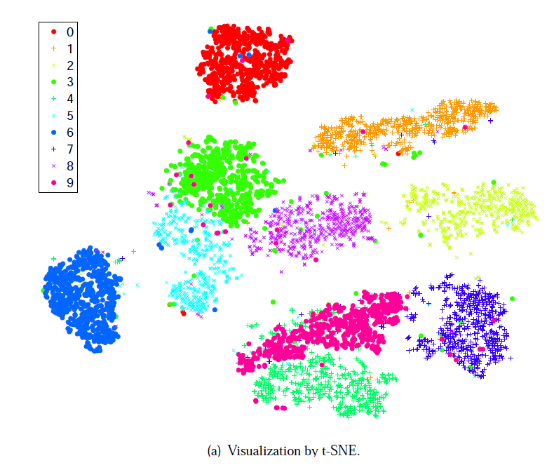
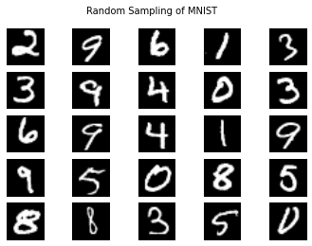
Visualizing Data using t-SNE
Laurens van der Maaten, and Geoffrey Hinton
Tilburg University. The Netherlands
University of Toronto. Canada
Journal of Machine Learning Research (2008)
slides from→ http://kawahara.ca/visualizing-data-using-t-sne-slides/

Slide 44
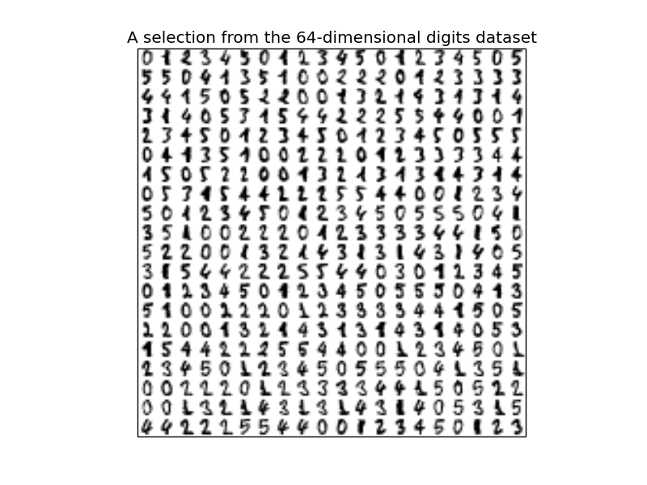
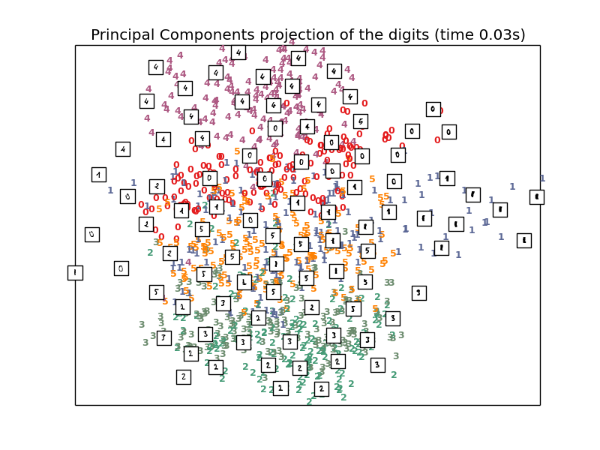
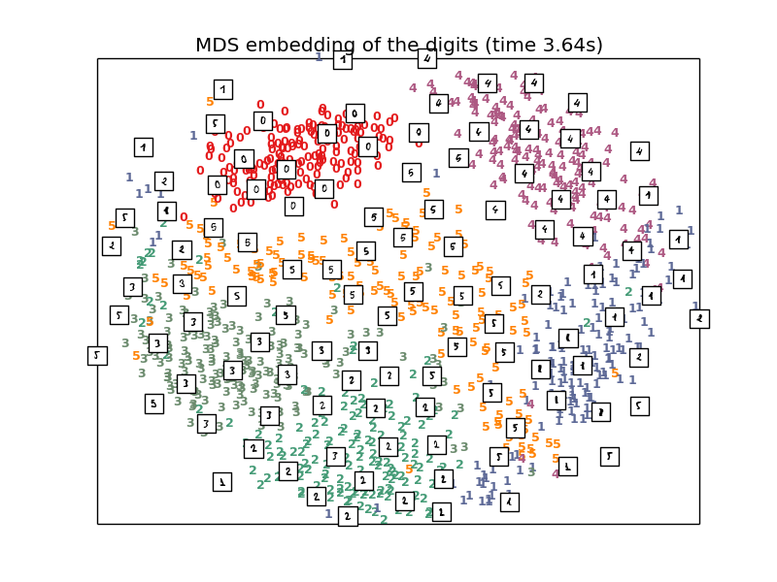
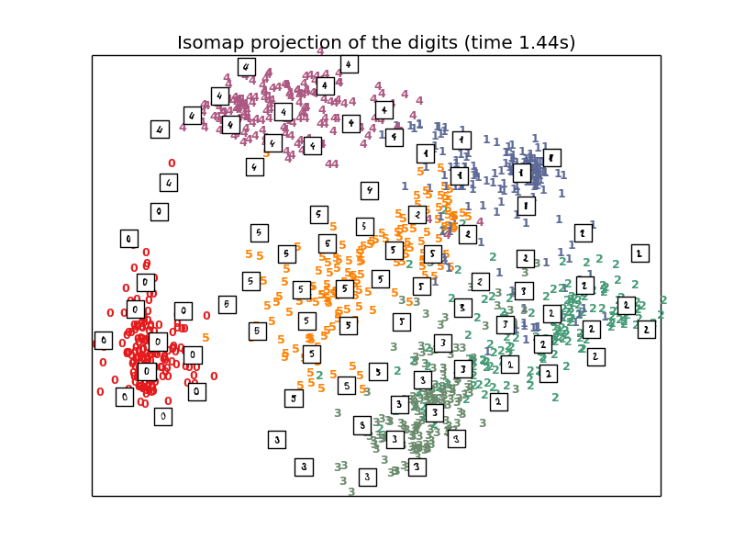
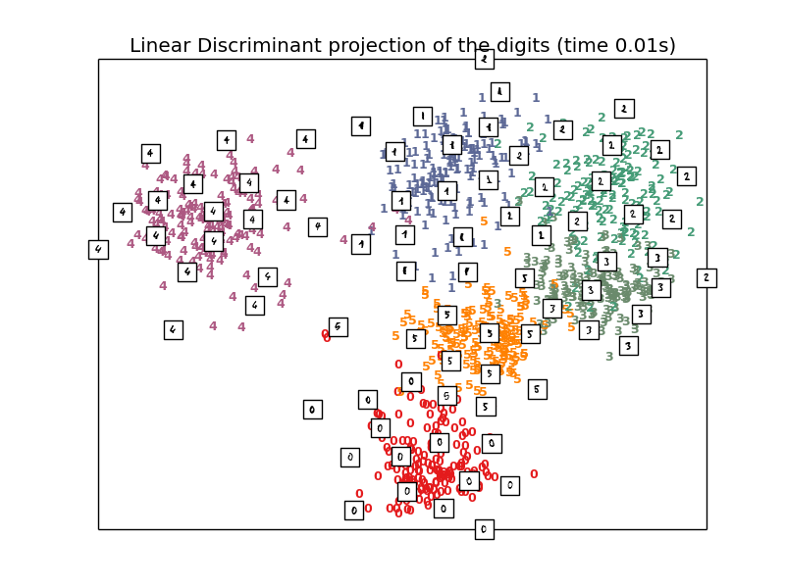
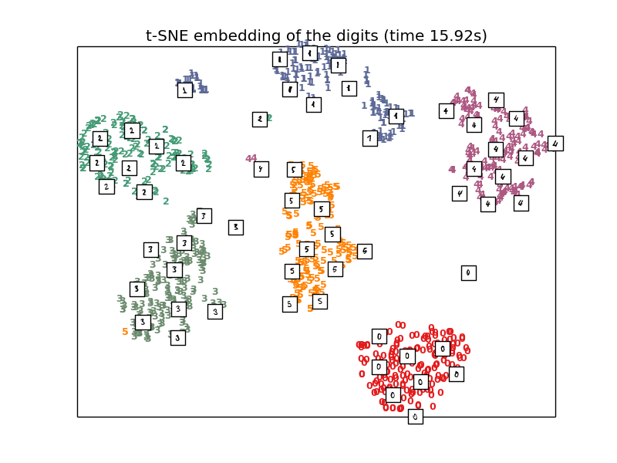
http://scikit-learn.org/stable/auto_examples/manifold/plot_lle_digits.html

Slide 45
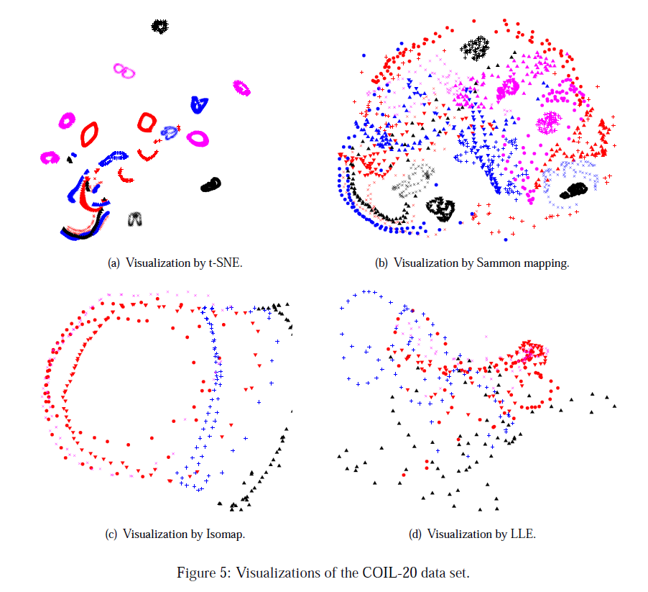

Slide 46
What is t-SNE?
t-Distributed Stochastic Neighbor Embedding (t-SNE)
Unsupervised (does not use class labels)
Models the probabilities that high-d points xi,xj are neighbors
Models the probabilities the corresponding low-d
points yi,yj are neighbors
Finds a low-d representation that is faithful to the high-d model

Slide 47
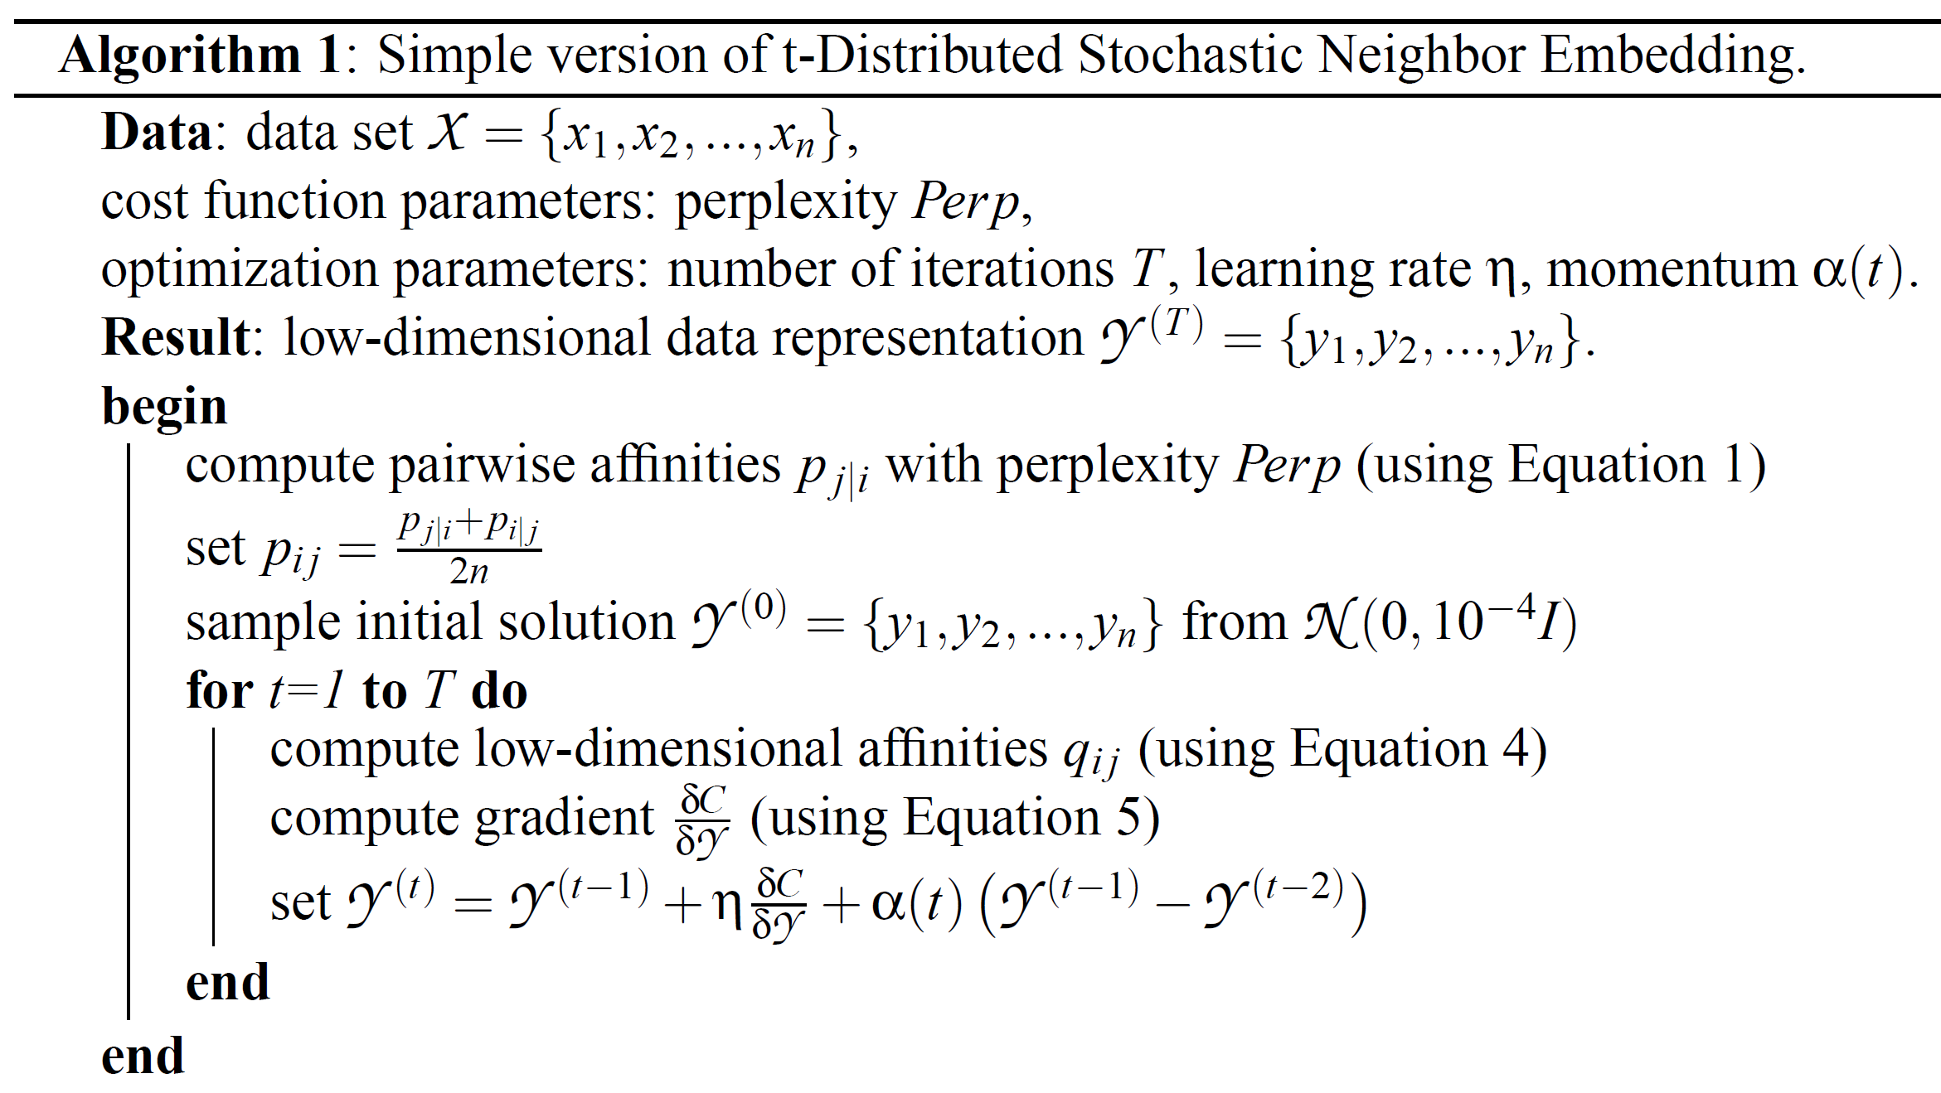
The basic algorithm …

Slide 50
Compute probabilities P that xi
and xj are neighbors
(based on Euclidian distance in high-d space)

Slide 51
Compute probabilities Q that yi and yj are neighbors (corresponding to xi, xj)
(based on Euclidian distance in low-d space)

Slide 52
Key assumption is that the high-d P and the low-d Q probability distributions should be close

Slide 53
Find a low-d map that minimizes the difference between the P (high-d) and Q (low-d) distributions
(if xi,xj has high probability of being neighbors in high-d, then yi,yj should have high probability in low-d)

Slide 54
We will minimize the difference between the high-d and low-d maps using gradient descent

Slide 55
User specifies a perplexity value
(a number usually between 5 and 50)

Slide 56
Set optimization parameters for gradient descent

Slide 57
The probability that xi would choose xj as its neighbor
σ_i is determined through binary search based on the perplexity value

Slide 58
Initialize a solution
(Randomly sample points in the low-d space near the origin)

Slide 59
In the low-d space, probability that yi and yj choose each other as neighbors
Modeled as a Student t-distribution

Slide 60
In the low-d space, probability that yi and yj choose each other as neighbors
Modeled as a Student t-distribution

Slide 61
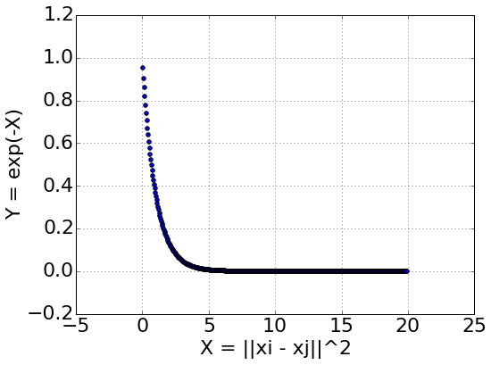
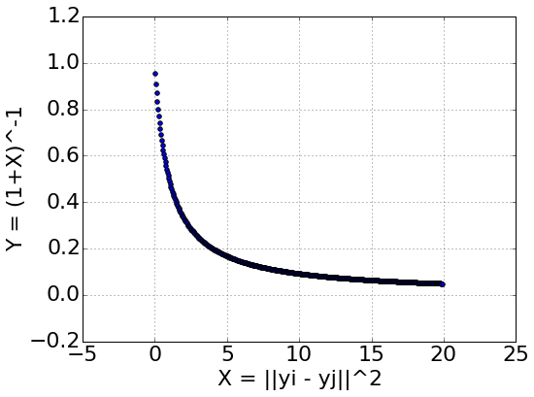
In the low-d space, probability that yi and yj choose each other as neighbors
Modeled as a Student t-distribution

Slide 62
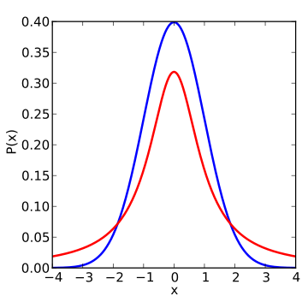
Student's has longer tails… gives higher probabilities to points that are further away
In the low-d space, probability that yi and yj choose each other as neighbors
Modeled as a Student t-distribution
Blue = Gaussian
Red = Student's T
Desirable as, we have limited low-d space and want to focus on modelling the close high-d points.
Want to have moderately far high-d points further apart in the low-d space
(avoids crowding)
http://en.wikipedia.org/wiki/Student%27s_t-distribution#/media/File:T_distribution_1df_enhanced.svg

Slide 63
In the low-d space, probability Q that yi and yj choose each other as neighbors
Modeled as a Student t-distribution
In the high-d space, probability P that xi and xj would choose each other as neighbor

Slide 64
In the low-d space, probability Q that yi and yj choose each other as neighbors
Modeled as a Student t-distribution
In the high-d space, probability P that xi and xj would choose each other as neighbor
Minimize the Kullback-Leibler divergence between P and Q
if p = q then log(1) = 0
Penalize when p != q

Slide 65
The derivative has a relatively simple form: (derivation in the paper)
Gradient of C with respect to yi

Slide 66
The weighted gradient
The solution (i.e. low-d map) at time t
The previous solution
Weighted momentum of the previous solutions

