Slide 1
Machine Learning Categories
Supervised Learning
  Teacher guides learner providing correct answers
  Answer:
    class label (classification)
    real numbers (regression)
Unsupervised Learning
  Learner discovers on its own (no information from a teacher)
Reinforcement Learning
  Teacher provides hints (reinforcement signal) to the learner

Slide 2
Regression
Input: Set of N tuples:
  is the sample
  t_{i} ∈ R prediction or a value of an unknown function over the features of x_{i}
Supervised technique
Goal: create a function y :
  in one dimension
  in d dimensions
θ is the (unknown) set of parameters

Slide 3
Graphical Example of Regression
?

Slide 4
Graphical Example of Regression

Slide 5
Graphical Example of Regression
Notes:
Different styles of regression learn different functions.

Slide 6
Linear regression:
The case of 1-dimensional data
40
Input dataset
Target t
20
(one feature)
0
0
10
Input x
20

Slide 7
Linear regression:
The case of 1-dimensional data
Predictor: Evaluate line
40
Input dataset
Target t
20
(one feature)
0
0
10
Input x
20
Machine Learning 2017 – Computer Science & Engineering, University of Ioannina – ML1 ( 7 )

Slide 8
Linear regression:
The case of 1-dimensional data
so as
40
Input dataset
Target t
20
Learning: Estimating the regression
coefficients {w₀ , w₁} which are the
weights of the linear equation
0
0
10
Input x
20

Slide 9
Least squares linear fit to data
Most popular estimation method is least squares.
Determine linear weights w that minimize the sum of squared loss (SSL):
Use standard differential calculus:
  differentiate SSL with respect to w₀ , w₁
  find zeros of each partial differential equation
  solve for w₀ , w₁

Slide 10
Derivatives of parameters:

Slide 11
More dimensions (d>1)
26
26
t
24
t
24
22
22
20
20
30
30
40
40
20
30
20
30
x₁
20
x₁
20
10
10
x₂
10
10
x₂
0
0
0
0
Input x has d features:
There are d+1 linear weights for describing the regression function

Slide 12
Linear regression model
Alternative representation
where

Slide 13
Sum of Squared Error (SSE)
How can we quantify the error?

Slide 14

Sum of Squared Error (SSE)
Observation
Error or “residual”
Prediction
0
0
20

Slide 15
How can we quantify the error?

Slide 16

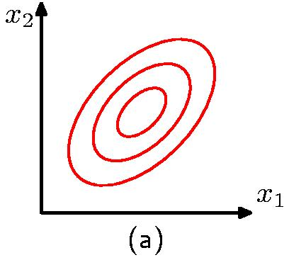

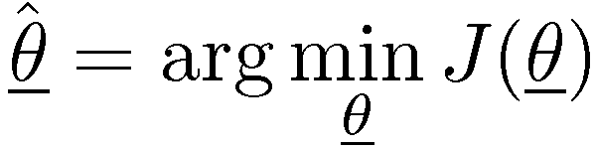

Finding good parameters
Want to find parameters w which minimize the error
Think of a cost “surface”: error residual for that w…

Slide 17
The general case
Reordering, we take
Least Squares estimator
(X^{T} X)⁻¹X^{T} is called the “pseudo-inverse”
If X^{T} is square and independent, this is the inverse X⁻¹

Slide 18
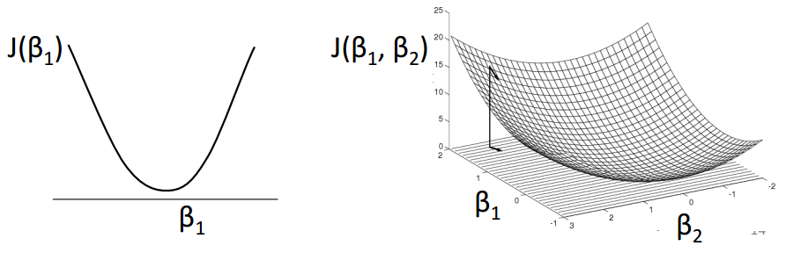
Minimization of SSE
Even when (X^{T} X) is invertible, might be computationally expensive if X is huge.
Treat as an optimization problem:
How to find an estimator?
J(w) is convex in w
J(w₁)
J(w₁,w₂)
w₁
w₁
w₂

Slide 19
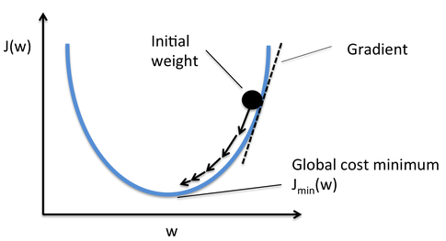
Gradient Descent Optimization
Steepest Descent
η: learning rate
(or step-size)
Function decreases most quickly in the direction of the negative gradient.
J(w)
J_{min}(w)

Slide 20
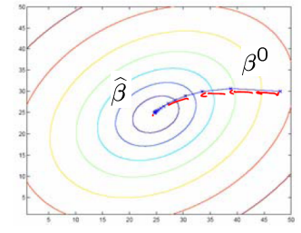
Gradient descent
Move along negative of gradient
Initialize: (t=0)
Update rule:
Stop: when some criterion is met (e.g. fixed # iterations) or when

Slide 21
Non-linear Regression
Consider non-linear regression
  Ex: higher-order polynomials

Slide 22
Classification
Training set:
  x_{i} : input data sample
  y_{i} ∈ {1, …, K}: class or label of input
Target: Construct function
Prediction of class for any unknown input

Slide 23
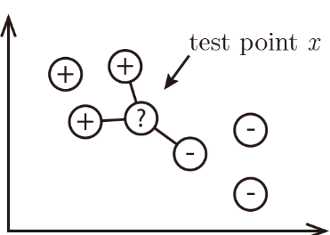
Nearest Neighbor classifier
The simplest classification method
Assumption: data belongs to the same category are neighbors
Classification rule: Classify according to the neighbor(s)

Slide 24
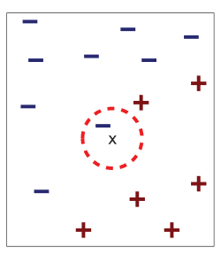
Nearest Neighbor Classifier
Classification
Find the nearest neighbor
(according to a distance function)
Class of unknown is similar to its neighbor

Slide 25
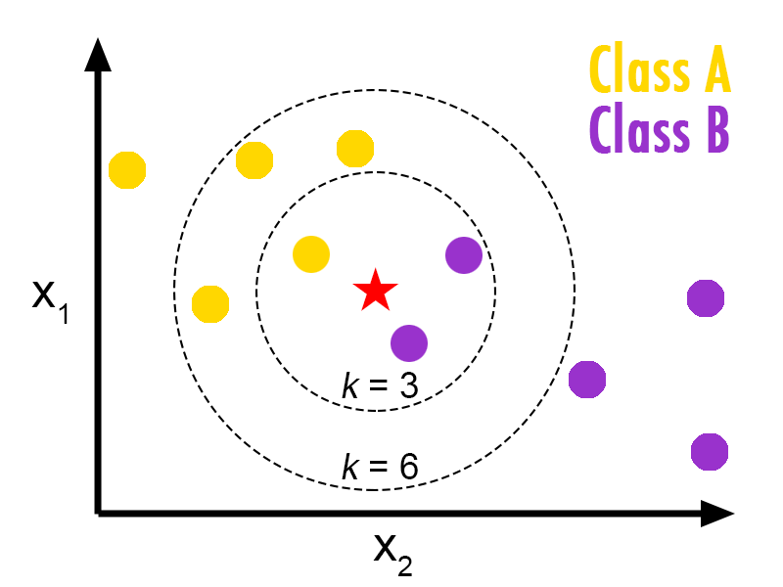
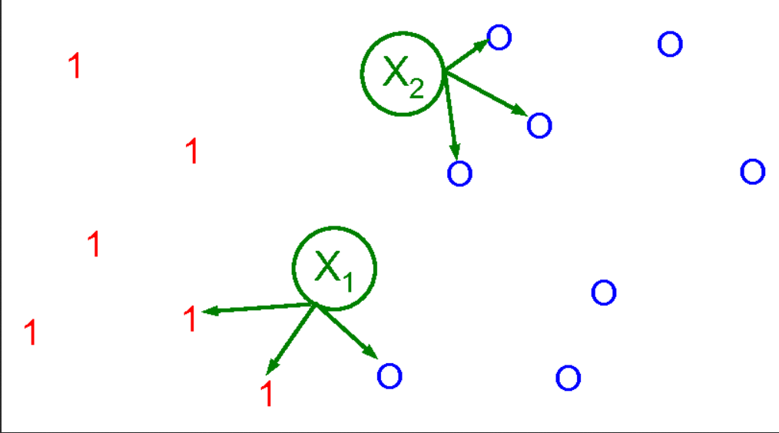
Extension to k-NN
Find k>1 neighbors
Classify according to the class majority

Slide 26
Linear Classifiers
Κ=2 classes C₁ , C₂
Target: Construction of a hyperplane f(x,w) between data of 2 classes
Decision boundaries:
w are the parameters to be learnt

Slide 27
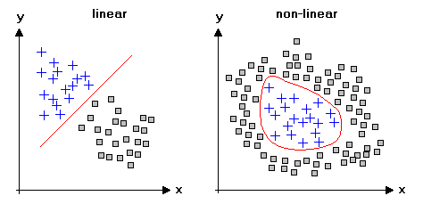
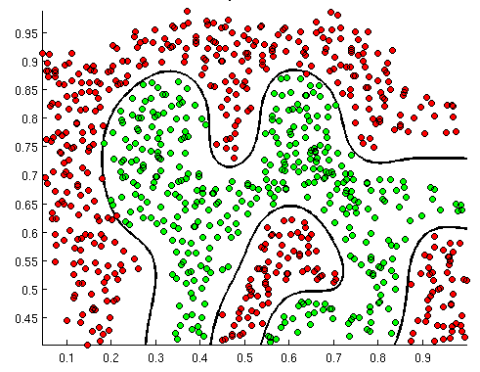
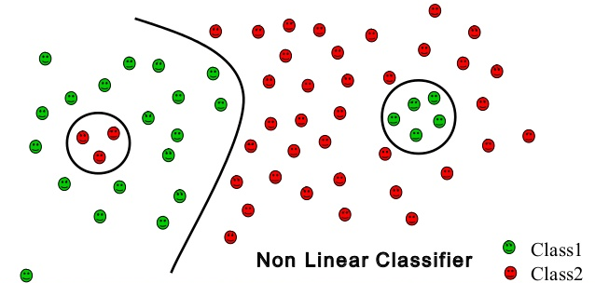
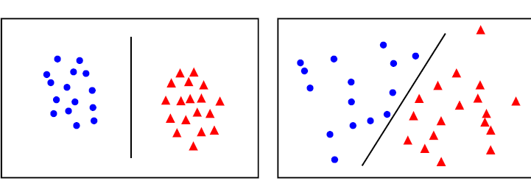
linear classification nonlinear classification

Slide 28
Training Set
x₂
w^{T} x + w₀ > 0
f(x) linear function:
w^{T} x + w₀ = 0
w
Define a separating hyperplane between two classes
w^{T} x + w₀ < 0
x₁

Slide 29
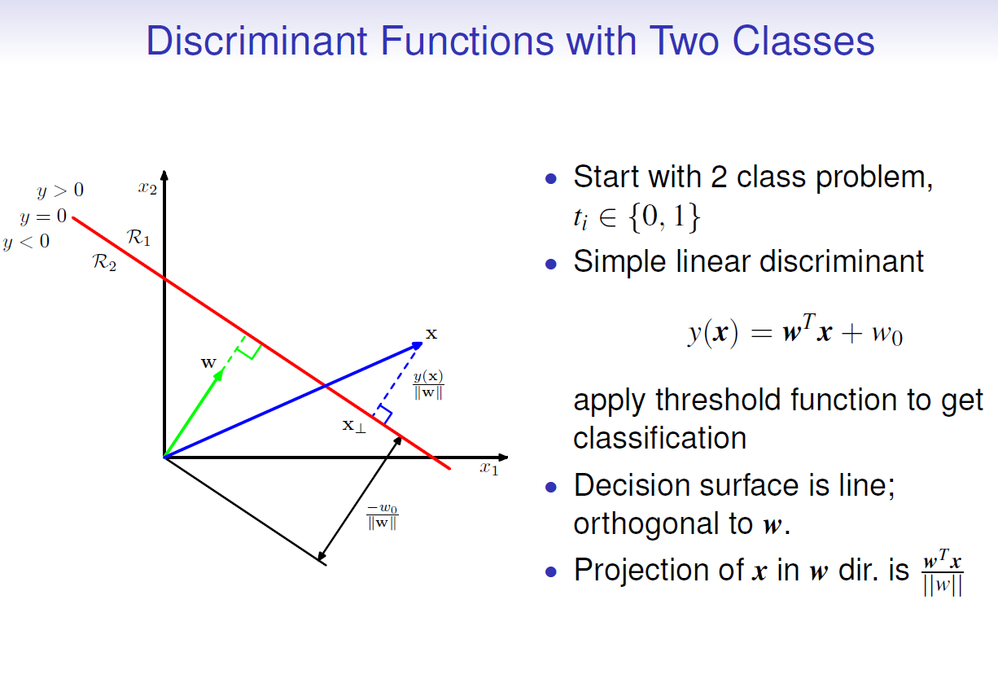
Linear Models for Classification

Slide 30
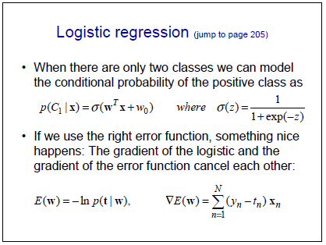
Linear Models for Classification

Slide 31
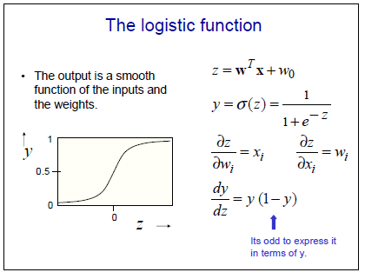

Slide 32
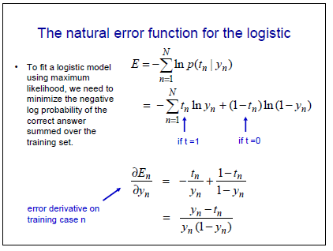
(Cross-entropy)

Slide 33
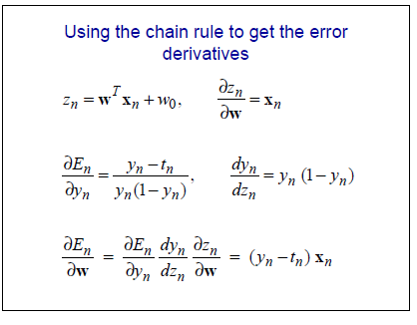
No closed form solution (contrary to Least Squares)
Train using gradient descent (or Iterative Reweighted Least Squares)

Slide 34
Support Vector Machines for Classification
Find a linear hyperplane (decision boundary) that will separate the data

Slide 35
One Possible Solution

Slide 36
Other possible solutions

Slide 37
Support Vector Machines
Find hyperplane maximizes the margin => B1 is better than B2

Slide 38
Linear Support Vector Machines

Slide 39
Trainining Linear SVM
Objective is to maximize:
  Which is equivalent to minimizing:
  Subject to the constraints:
  This is a convex constrained optimization problem
      Solve it using Lagrange multipliers method
      Unique global minimum (w*, b*)

Slide 40
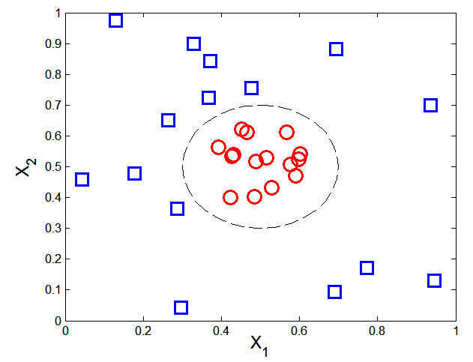

Nonlinear Support Vector Machines
What if decision boundary is not linear?

Slide 41
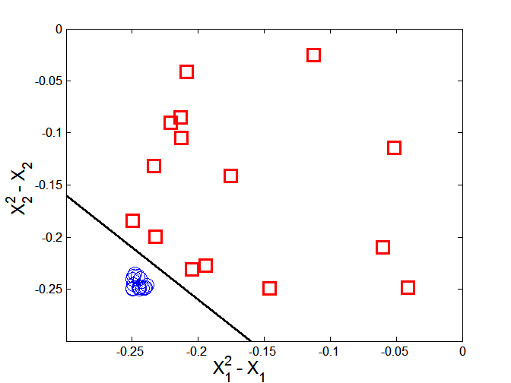
Nonlinear Support Vector Machines
Kernel Trick: Map each data point x into higher dimensional space φ(x) where the decision boundary is expected to be linear.
Train a linear SVM using φ(x_{i} ) instead of x_{i}
Linear Decision boundary for
φ(x₁,x₂)=(x₁² -x₁ , x₂² - x₂)

Slide 42
Decision Trees for Classification
categorical
categorical
continuous
class
Single, Divorced
MarSt
Married
NO
Home Owner
Yes
No
NO
Income
< 80K
> 80K
NO
YES
There could be more than one tree that fits the same data!

Slide 43
Apply Model to Test Data
Test Data
Start from the root of tree.
Home Owner
Yes
No
NO
MarSt
Single, Divorced
Married
Income
NO
< 80K
> 80K
NO
YES

Slide 44
Apply Model to Test Data
Test Data
Home Owner
Yes
No
NO
MarSt
Single, Divorced
Married
Income
NO
< 80K
> 80K
NO
YES

Slide 45
Apply Model to Test Data
Test Data
Home Owner
Yes
No
NO
MarSt
Single, Divorced
Married
Income
NO
< 80K
> 80K
NO
YES

Slide 46
Apply Model to Test Data
Test Data
Home Owner
Yes
No
NO
MarSt
Single, Divorced
Married
Assign Defaulted to “No”
Income
NO
< 80K
> 80K
NO
YES

Slide 47
Decision Tree Induction
Many Algorithms:
  Hunt’s Algorithm (one of the earliest)
  CART
  ID3, C4.5
  SLIQ,SPRINT

Slide 48
General Structure of Hunt’s Algorithm
Let D_{t} be the set of training records that reach a node t
General Procedure:
  If D_{t} contains records that belong the same class y_{t}, then t is a leaf node labeled as y_{t}
  If D_{t} contains records that belong to more than one class, use an attribute test to split the data into smaller subsets. Recursively apply the procedure to each subset.
D_{t}
?

Slide 49
Hunt’s Algorithm
(7,3)
(3,0)
(4,3)
(3,0)
(3,0)
(3,0)
(1,3)
(3,0)
(1,0)
(0,3)

Slide 50
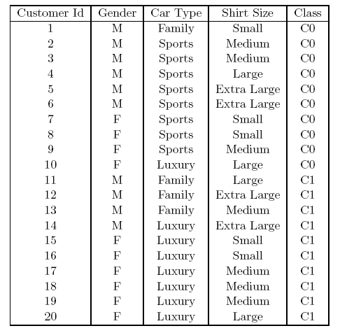
How to determine the Best Split
Before Splitting: 10 records of class 0,
10 records of class 1
Which test condition is the best?

Slide 51
How to determine the Best Split
Greedy approach:
  Nodes with purer class distribution are preferred
Need a measure of node impurity:
High degree of impurity
Low degree of impurity

Slide 52
Measures of Node Impurity
Gini Index
Entropy
Misclassification error

Slide 53
Finding the Best Split
- Compute impurity measure (M) after splitting
    Compute impurity measure of each child node
    M is the weighted impurity of children
- Choose the attribute test condition that produces lowest impurity measure after splitting

Slide 54
Neural Networks

Slide 55
Artificial Neuron
(generalized linear model)
x₁
x₀=1
activation function
x₂
w₁
w₀
w₂
u
g(u)
o (output)
w_{d}
x_{d}
d inputs,
input signal x_{i} (i=1,…,d)
connection weights w_{i}, (i=1,…,d)
bias (w₀ ) → weight of a connection whose input is 1

Slide 56
Artificial Neuron
Two stage computation:
  Compute activation (total input):
  Compute output o(x) using activation function
  o(x)=g(u)
  inner–product unit
  u(x)=w^{T}x +w₀

Slide 57
Logistic Sigmoid function
  σ(x)=1/(1+exp(-ax))
  (a: slope, usually a=1)
  gives values in (0,1)
  σ’(x)=σ(x)(1-σ(x))
Σχήμα 2.5: Η συνάρτηση υπερβολικής εφαπτομένης.

Slide 58
MultiLayer Perceptron (MLP)
Layered feedforward neural network.
Inner-product units
Non-linear activation (e.g. logistic sigmoid) in hidden units
ο
input
ο
2
hidden
output
1
hidden
layer
layer
layer
layer

Slide 59
MultiLayer Perceptron (MLP)
Notation : neuron i in layer
: total input
: output
: error
: bias (or )
: activation function in
layer
: number of neurons in layer
: weight of connection from neuron to neuron

Slide 60
MultiLayer Perceptron(MLP)
Consider MLP with d inputs, p outpus and Η hidden layers. Input layer is zero, output layer is Η+1. (d₀ = d, d_{H+1} = p)
Forward pass (given input vector compute output vector):
Input layer: ,
For h=1,…,H+1
Output vector:

Slide 61
MLP training
Data set D={(x^{n},t^{n})}, n=1,…,N.
x^{n}=(x_{n1,…,}x_{nd})^{T} , t^{n}=(t_{n1,…,}t_{np})^{T} (regression problem).
MLP with d inputs and p outputs.
User should define the network architecture: number of hidden layers, hidden units per layer, type of activation functions.
ο(x^{n}; w): the MLP ouput vector with input x^{n}, and w=(w₁,w₂,…,w_{L})^{T} the vector of weights and biases.
Training: specify w.

Slide 62
MLP training
Ε(w): error (loss) function to be minimized wrt to w (sum of squared errors for regression).
Typically gradient descent approaches are used.
The partial derivatives of Ε^{n} wrt to w_{i} is needed:
error backpropagation
Given a training example (x,t), error backpropagation computes the partial derivatives of the loss (error) function for this training example wrt to the weights, in a feedforward neural network with inner-product units and differentiable activation functions (e.g. MLP).

Slide 63
MLP Computational Capabilities
MLP implements a mapping from input space to output space.
The desired mapping is determined by training examples.
Universal approximation property: an MLP with at least one hidden layer with non-linear hidden units is able to implement any mapping with arbitrary accuracy if the number of hidden units becomes arbitrarily large.
Not useful in practice.
Determining the number of hidden units is a model selection problem.

Slide 64
MLP computational capabilities
The use of non-linear hidden units provides increased computational capabilities.
MLP can solve non-linear separable problems.
Decision regions are defined as intersections among hyperplanes.
Usually 1 or 2 hidden layers are used. Recently there is increased interest in deep neural networks (more than two hidden layers).

Slide 65
Unsupervised Learning
PCA for Dimensionality Reduction
Feature Extraction: new features are created by combining the original features
The new features are usually fewer than the original
No class labels available (unsupervised)
Purpose:
  Avoid curse of dimensionality
  Reduce amount of time and memory required by data mining algorithms
  Allow data to be more easily visualized
  May help to eliminate irrelevant features or reduce noise
Techniques
  Principal Component Analysis (optimal linear approach)
  Non-linear approaches (e.g. autoencoders, Kernel PCA)

Slide 66
PCA: Principal Component Analysis
Principal components:
Vectors originating from the center of the dataset (data centering: use (x-m) instead of x, m=mean(X))
Principal component #1 points
in the direction of the largest variance.
Each subsequent principal component
  is orthogonal to the previous ones, and
  points in the directions of the largest variance of the residual subspace

Slide 67
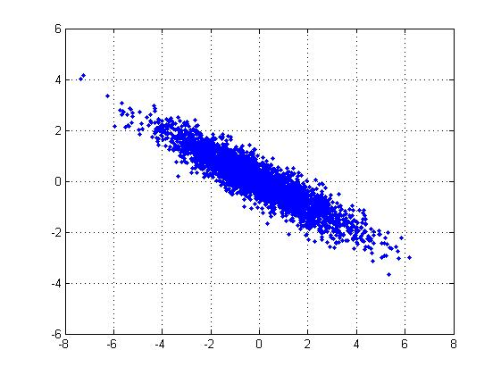
PCA: 2D Gaussian dataset

Slide 68
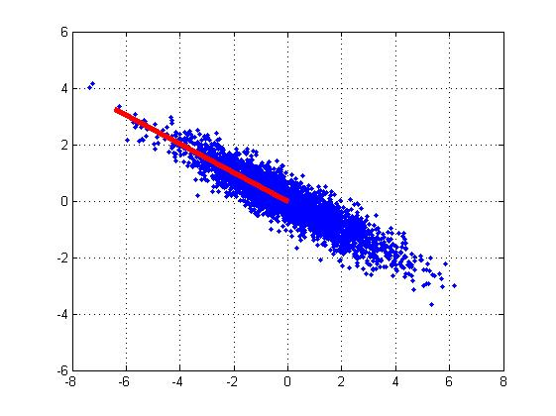
1st PCA axis

Slide 69

2nd PCA axis

Slide 70
PCA algorithm
Given data {x₁, …, x_{n}}, compute covariance matrix Σ:
PCA basis vectors = the eigenvectors of Σ (dxd)
{ λ_{i}, u_{i} }_{i=1..d} = eigenvectors/eigenvalues of Σ
λ₁ ≥ λ₂ ≥ … ≥ λ_{d} (eigenvalue ordering)
Select { λ_{i}, u_{i} }_{i=1..q} (top q principal components)
Usually few λ_{i} are large and the remaining quite small
Larger eigenvalue ⇒ more important eigenvectors

Slide 71
PCA algorithm
W=[u₁ u₂ … u_{q} ]^{T} (kxd projection matrix)
Z=X*W^{T} (nxq data projections)
Xrec=Z*W (nxd reconstructions of X from Z)
PCA is optimal Linear Projection: minimizes the reconstruction error:
In autoencoders we also minimize the same criterion, but the model is non-linear.

Slide 72
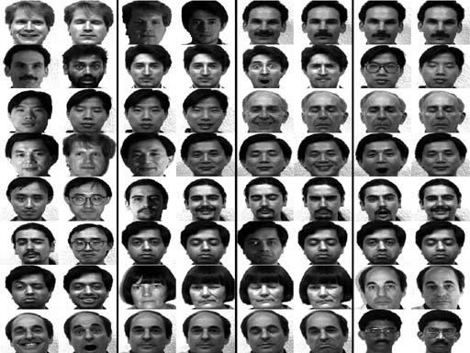
PCA example: face analysis
Original dataset: images 256x256

Slide 73
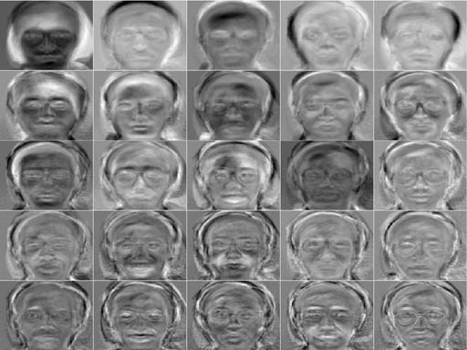
PCA example: face analysis
Principal components: 25 top eigenfaces

Slide 74
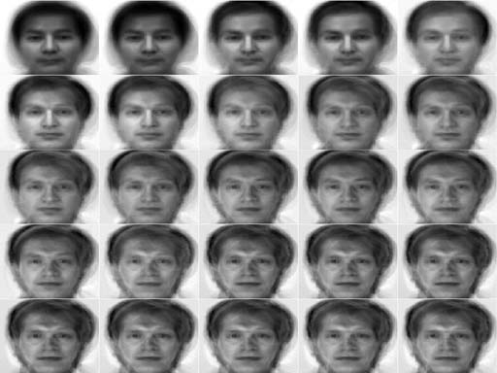
PCA example: face analysis
Reconstruction examples

Slide 75
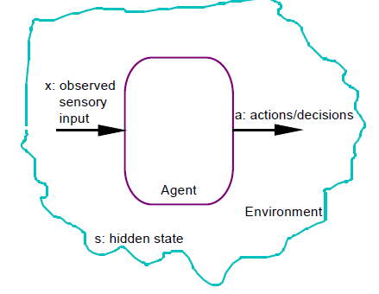
Reinforcement Learning
Agent receives sensory input and takes actions
The agent occasionally receives reinforcement signal (reward or penalty)
The goal is to take actions that maximize the reinforcement it receives

Slide 76
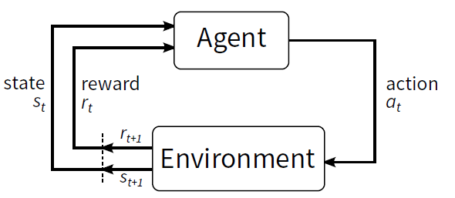
The Agent-Environment Interface
. . .
r
t +1
r
t +2
r
. . .
s
s
t +1
s
t +2
t +3
s
t +3
t
a
a
t +1
a
t +2
a
t
t +3

Slide 77
Policy (π)
It is a “program”, a decision mechanism
It contains a map from states (or situations) to actions that could be taken
A probability distribution π(s,a)
  If in a state s, then with probability π(s, a) take the action a

Slide 78
Reward (r)
Rewards specify what the agent needs to achieve, not HOW to achieve it
The goal of an MDP is not to maximize immediate rewards but to maximize long term accumulated rewards.
Average future return:
  This assumes that a reward into the future is as
  valuable as a reward now (all have the same weight)
Discounted future return (γ: discount factor)

Slide 79
Value Functions
State value function: Used to determine how good is it for the agent to be in a given state,
State-action value function: how good is it to perform an action from a given state and then follow policy
This are defined with respect to a specific policy, π(s,a)

Slide 80
Optimal Policies and Values
Optimal Policy:
Possibly more than one optimal policy. Always there is at least one optimal policy
Optimal state value function:
If policy π is such that in each state s it selects an action that maximizes value, then π is an optimal policy

Slide 81
Optimal Policies and Values
Optimal state-action value function

Slide 82
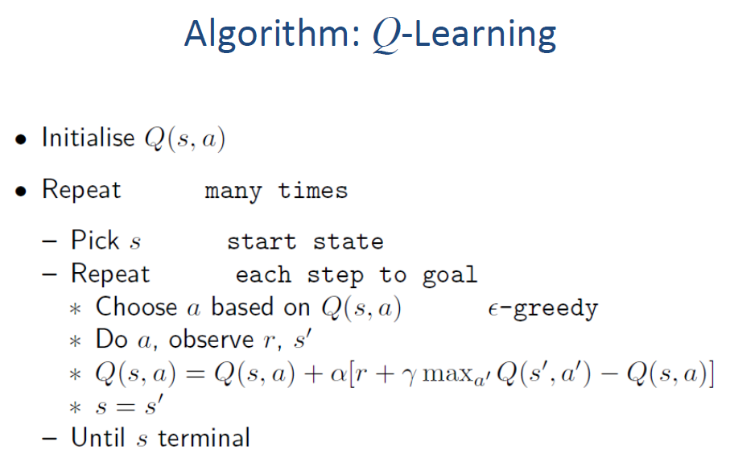

Slide 83
Exploration vs. Exploitation
Can’t always choose the action with highest Q-value
  The Q-function is initially unreliable
  Need to explore until it is optimal
A trade-off is needed between exploration and exploitation
Exploitation
To make the best decision given current information
Exploration
To Gather more information to make a better decision

Slide 84
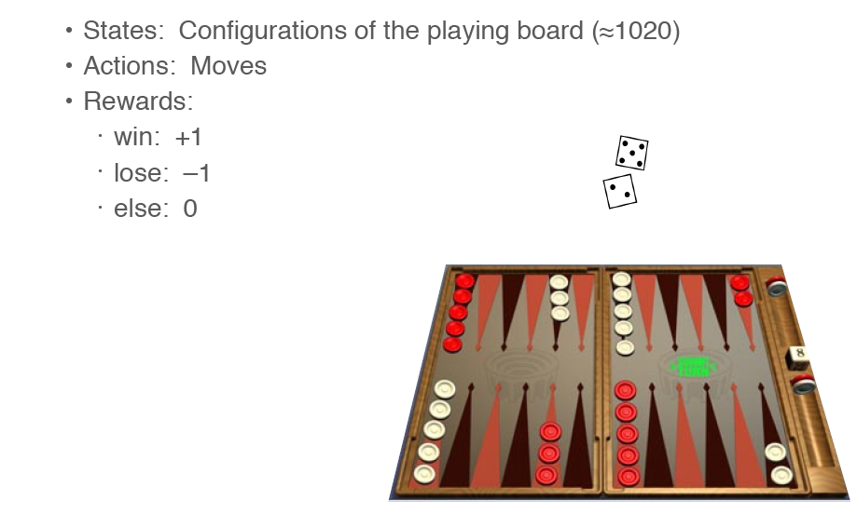
Reinforcement Learning in Board Games
Backgammon

Slide 85
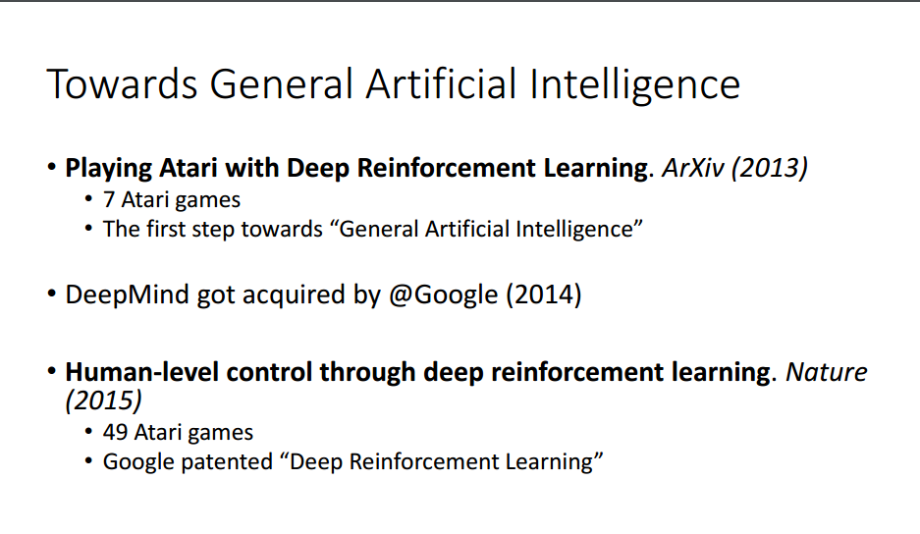
Deep Reinforcement Learning
(Deep Mind Tech., Google - 2015)

Slide 86
