Slide 1
A Crash COURSE on PROBABILITY THEORY
Discrete and Continuous Probabilities

Slide 2
DISCRETE PROBABILITY THEORY

Slide 3
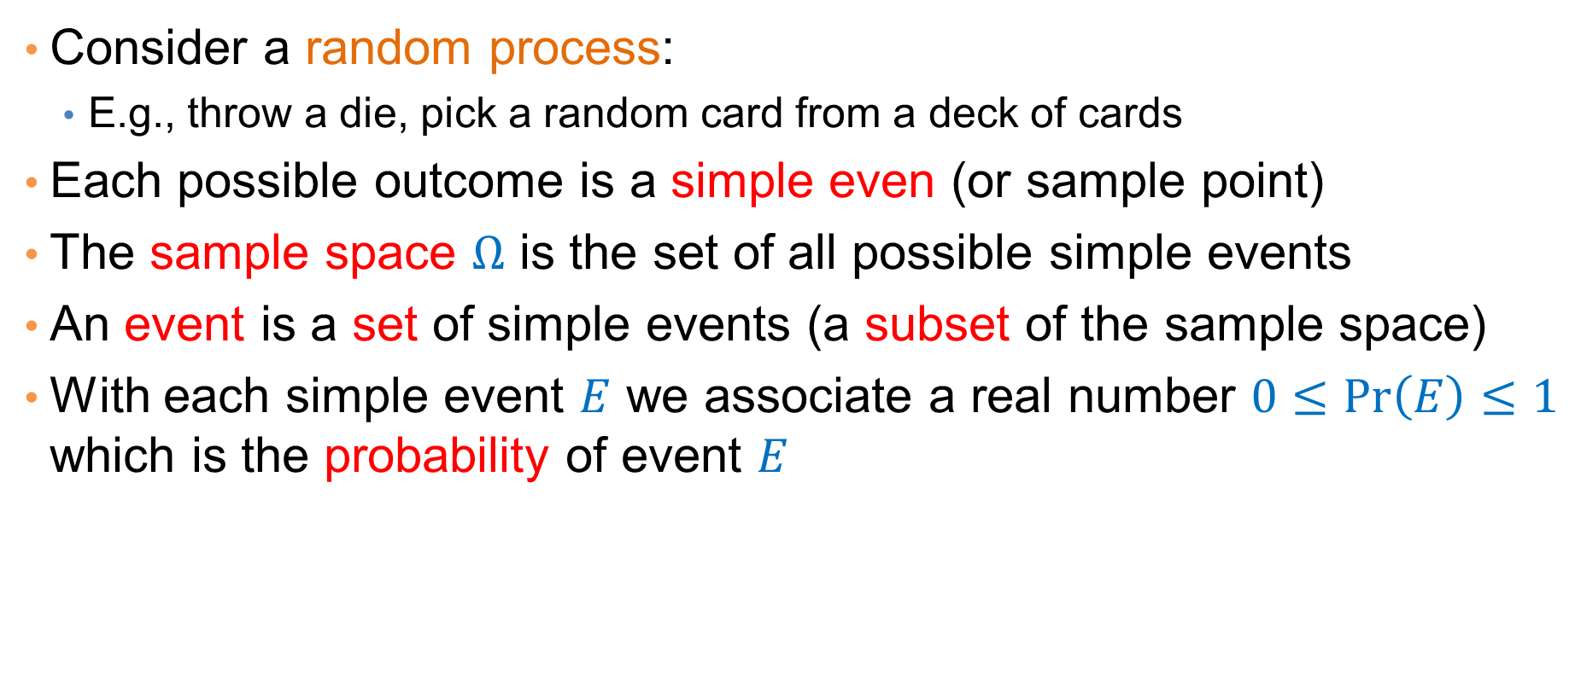
Events and Probabilities
Consider a random process:
  E.g., throw a die, pick a random card from a deck of cards
Each possible outcome is a simple even (or sample point)
The sample space $Ω$ is the set of all possible simple events
An event is a set of simple events (a subset of the sample space)
With each simple event $E$ we associate a real number $0≤\operatorname{Pr}\left(E\right)≤1$ which is the probability of event $E$

Slide 4
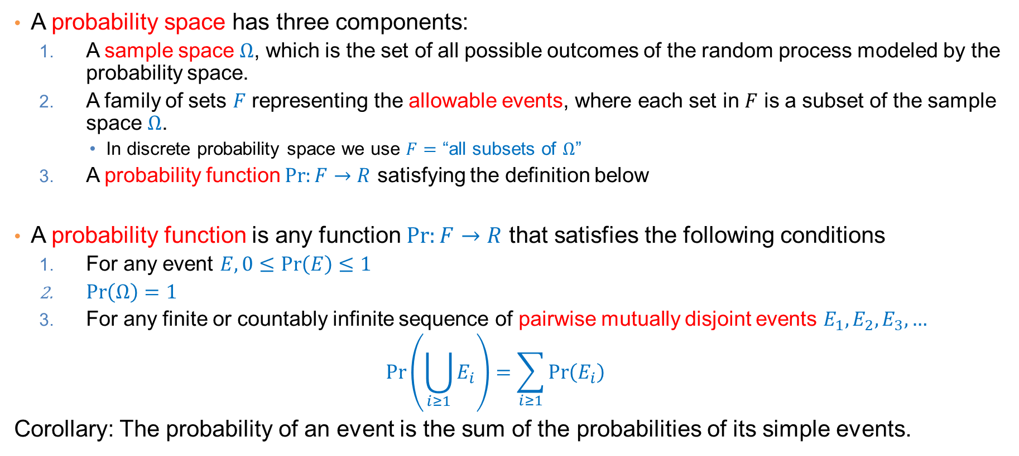
Probability Space – Definition
A probability space has three components:
  A sample space $Ω$, which is the set of all possible outcomes of the random process modeled by the probability space.
  A family of sets $F$ representing the allowable events, where each set in $F$ is a subset of the sample space $Ω$.
      In discrete probability space we use $F=$ “all subsets of $Ω$”
  A probability function $\operatorname{Pr}{:F→R}$ satisfying the definition below
A probability function is any function $\operatorname{Pr}{:F→R}$ that satisfies the following conditions
  For any event $E, 0≤\operatorname{Pr}\left(E\right)≤1$
  $\operatorname{Pr}\left(Ω\right)=1$
  For any finite or countably infinite sequence of pairwise mutually disjoint events $E_{1},E_{2},E_{3},…$
  $$\operatorname{Pr}\left(\bigcup_{i≥1}{E_{i}}\right)=\sum_{i≥1}{\operatorname{Pr}\left(E_{i}\right)}$$
Corollary: The probability of an event is the sum of the probabilities of its simple events.

Slide 5
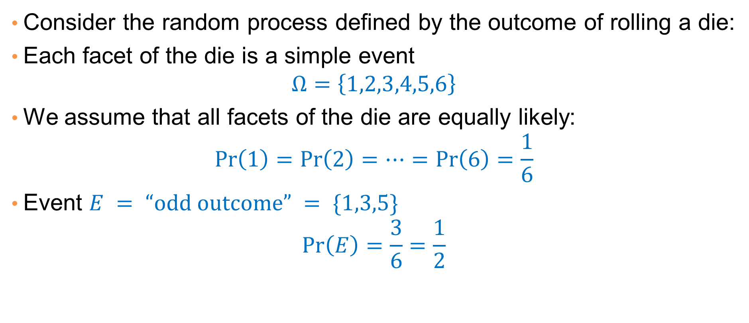
Example
Consider the random process defined by the outcome of rolling a die:
Each facet of the die is a simple event
$$Ω=\left\{1,2,3,4,5,6\right\}$$
We assume that all facets of the die are equally likely:
$$\operatorname{Pr}\left(1\right)=\operatorname{Pr}\left(2\right)=⋯=\operatorname{Pr}\left(6\right)=\frac{1}{6}$$
Event $E = “odd outcome” = \{1,3,5\}$
$$\operatorname{Pr}\left(E\right)=\frac{3}{6}=\frac{1}{2}$$

Slide 6
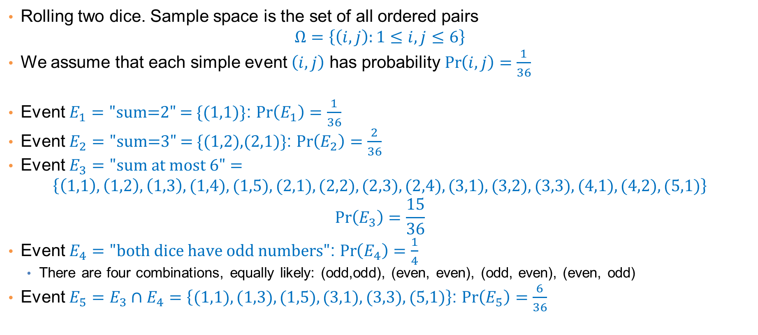
Example
Rolling two dice. Sample space is the set of all ordered pairs
$$Ω=\left\{\left(i,j\right):1≤i,j≤6\right\}$$
We assume that each simple event $\left(i,j\right)$ has probability $\operatorname{Pr}\left(i,j\right)=\frac{1}{36}$
Event $E_{1}=\text{"}\text{sum}\text{=2" = \{(1,1)\}}$: $\operatorname{Pr}\left(E_{1}\right)=\frac{1}{36}$
Event $E_{2}=\text{"}\text{sum}\text{=3" = \{(1,2),(2,1)\}}$: $\operatorname{Pr}\left(E_{2}\right)=\frac{2}{36}$
Event $E_{3}=\text{"}\text{sum} \text{at} \text{most}\text{ 6}"=$
$$\left\{\left(1,1\right),\left(1,2\right),\left(1,3\right),(1,4),(1,5),(2,1),(2,2),(2,3),(2,4), (3,1),(3,2),(3,3),(4,1),(4,2),(5,1)\right\}$$
$$\operatorname{Pr}\left(E_{3}\right)=\frac{15}{36}$$
Event $E_{4}=\text{"}\text{both} \text{dice} \text{have} \text{odd} \text{numbers}"$: $\operatorname{Pr}\left(E_{4}\right)=\frac{1}{4}$
  There are four combinations, equally likely: (odd,odd), (even, even), (odd, even), (even, odd)
Event $E_{5}=E_{3}∩E_{4}=\left\{(1,1),(1,3),(1,5),(3,1),(3,3),(5,1)\right\}$: $\operatorname{Pr}\left(E_{5}\right)=\frac{6}{36}$

Slide 7
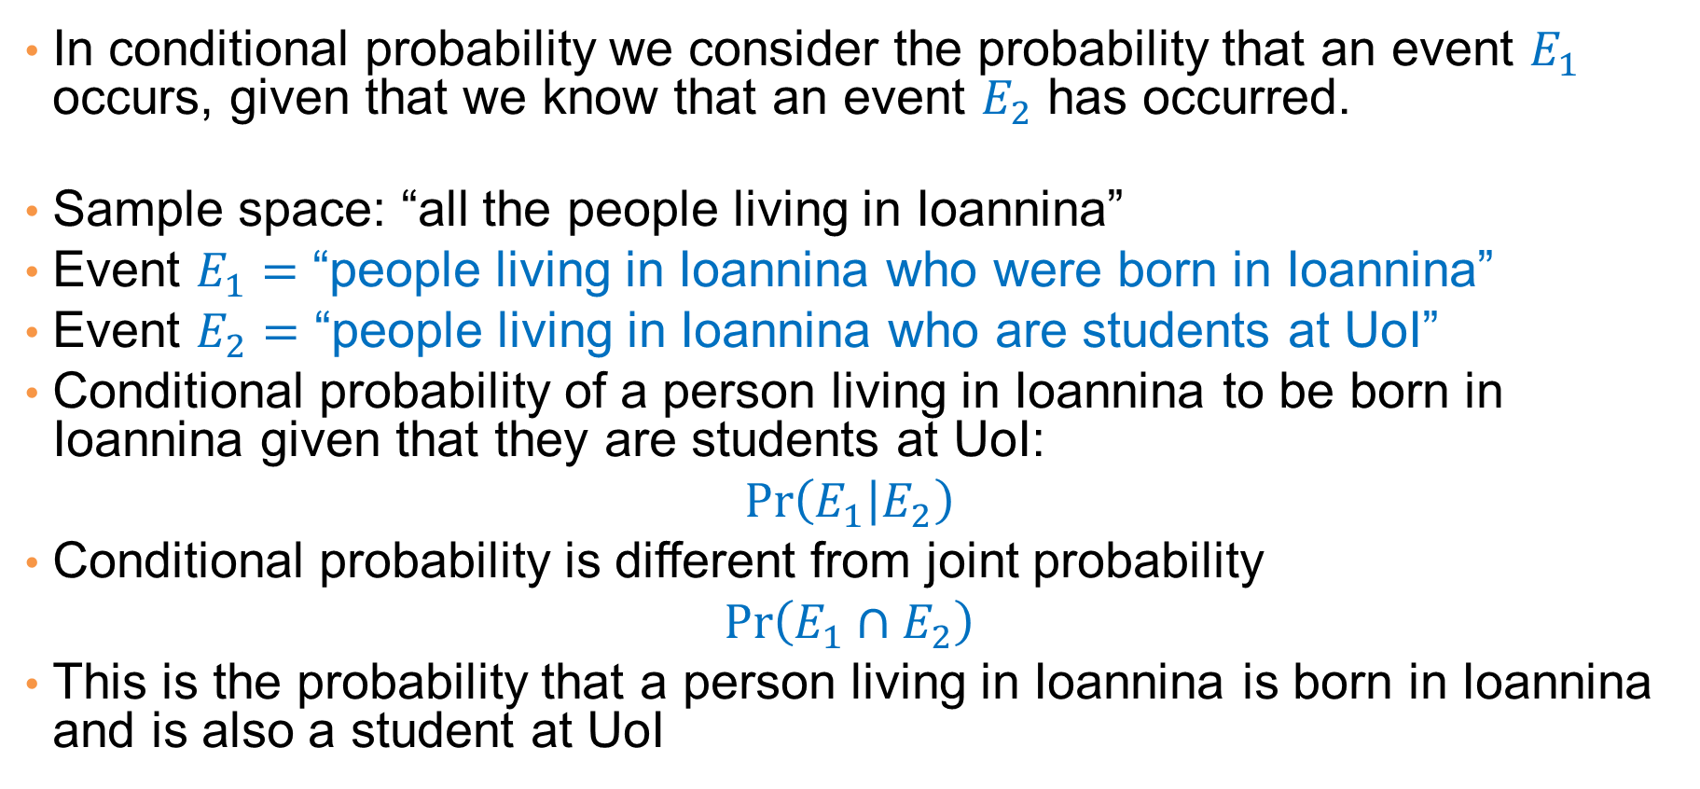
Conditional Probability
In conditional probability we consider the probability that an event $E_{1}$ occurs, given that we know that an event $E_{2}$ has occurred.
Sample space: “all the people living in Ioannina”
Event $E_{1}=$ “people living in Ioannina who were born in Ioannina”
Event $E_{2}=$ “people living in Ioannina who are students at UoI”
Conditional probability of a person living in Ioannina to be born in Ioannina given that they are students at UoI:
$$\operatorname{Pr}\left(E_{1} | E_{2}\right)$$
Conditional probability is different from joint probability
$$\operatorname{Pr}\left(E_{1}∩E_{2}\right)$$
This is the probability that a person living in Ioannina is born in Ioannina and is also a student at UoI

Slide 8
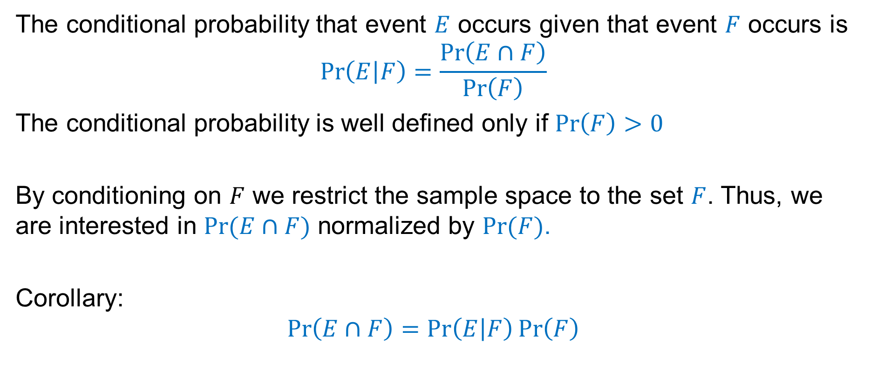
Computing Conditional Probability
The conditional probability that event $E$ occurs given that event $F$ occurs is
$$\operatorname{Pr}\left(E | F\right)=\frac{\operatorname{Pr}\left(E∩F\right)}{\operatorname{Pr}\left(F\right)}$$
The conditional probability is well defined only if $\operatorname{Pr}\left(F\right)>0$
By conditioning on $F$ we restrict the sample space to the set $F$. Thus, we are interested in $Pr⁡(E∩F)$ normalized by $Pr⁡(F)$.
Corollary:
$$\operatorname{Pr}\left(E∩F\right)=\operatorname{Pr}\left(E | F\right)\operatorname{Pr}\left(F\right)$$

Slide 9
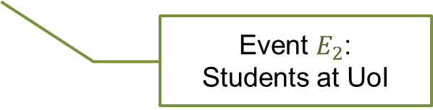
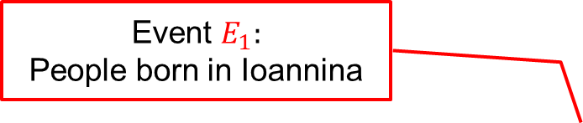


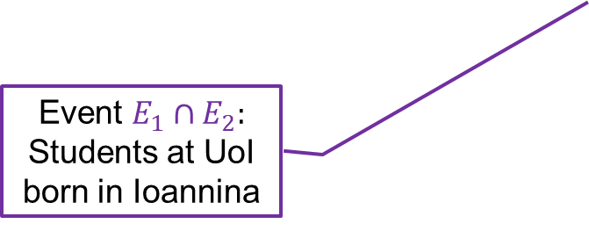
Venn Diagrams
We can represent events using Venn Diagrams
Sample space:
All people living in Ioannina
Event $E_{1}:$
People born in Ioannina
$$\operatorname{Pr}\left(E_{1}∩Ε_{2}\right)= \frac{purple}{blue}$$
The probability that a randomly selected person living in Ioannina is a student at UoI, born in Ioannina
$$\operatorname{Pr}\left(E_{1}|Ε_{2}\right)= \frac{purple}{green}$$
The probability that a randomly selected student at UoI is born in Ioannina
Event $E_{1}∩E_{2}:$
Students at UoI born in Ioannina
Event $E_{2}$:
Students at UoI

Slide 10

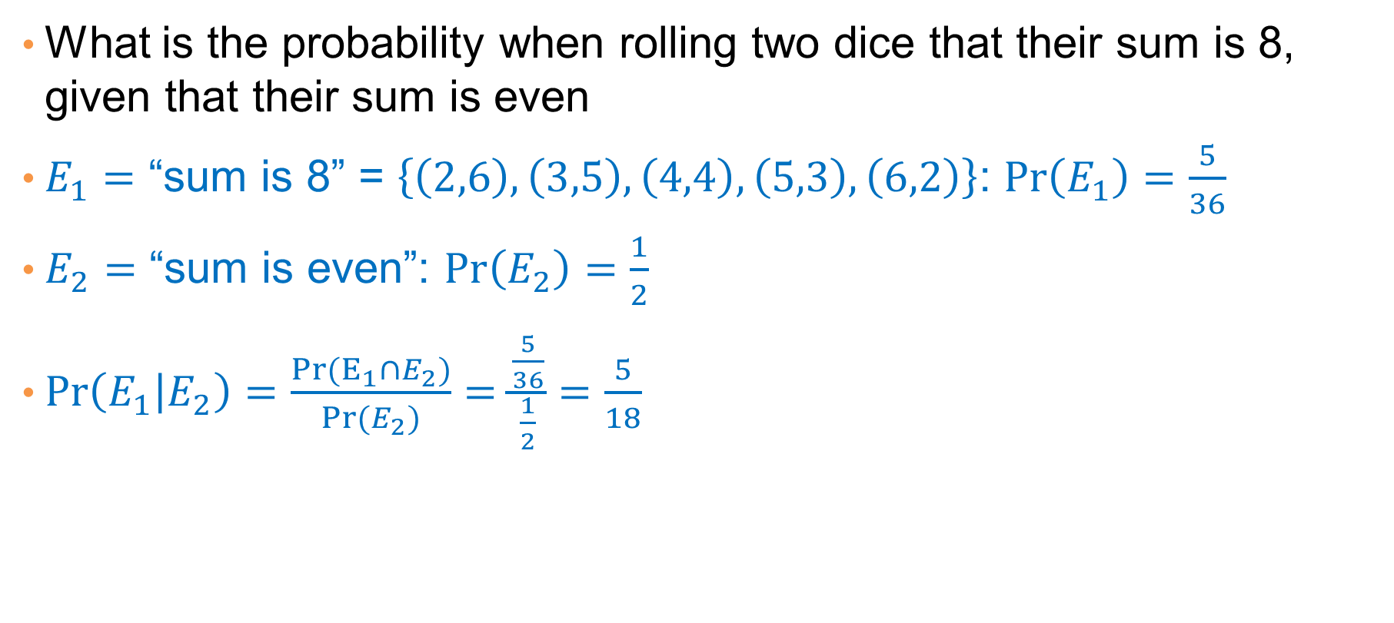
Example
What is the probability when rolling two dice that their sum is 8, given that their sum is even
$E_{1}=$ “sum is 8” = $\left\{\left(2,6\right),\left(3,5\right),\left(4,4\right),\left(5,3\right),\left(6,2\right)\right\}$: $\operatorname{Pr}\left(E_{1}\right)=\frac{5}{36}$
$E_{2}=$ “sum is even”: $\operatorname{Pr}\left(E_{2}\right)=\frac{1}{2}$
$\operatorname{Pr}\left(E_{1} | E_{2}\right)=\frac{Pr(E_{1}∩E_{2})}{Pr⁡(E_{2})}=\frac{\frac{5}{36}}{\frac{1}{2}}=\frac{5}{18}$
$$\operatorname{Pr}{(E_{1}∩E_{2})}=\operatorname{Pr}\left(E_{1}\right)$$
$E_{1}⊆E_{2}$: When the sum is 8 then it is even.

Slide 11

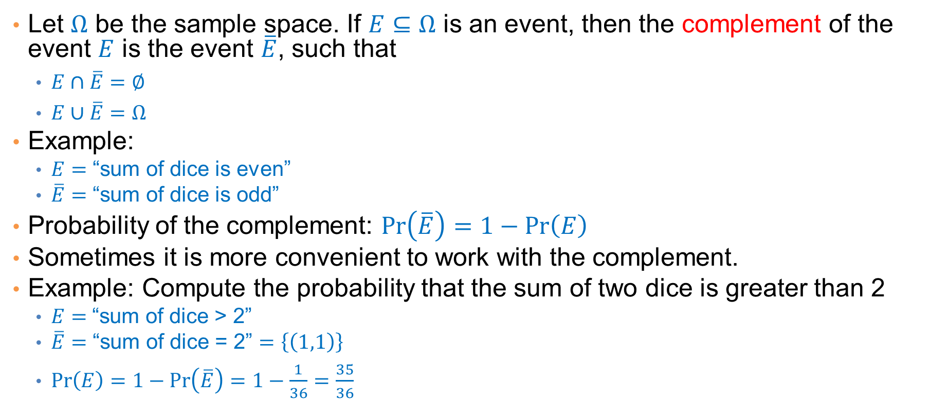

Complement
Let $Ω$ be the sample space. If $E⊆Ω$ is an event, then the complement of the event $E$ is the event $\overline{E}$, such that
  $E∩\overline{E}=∅$
  $E∪\overline{E}=Ω$
Example:
  $E=$ “sum of dice is even”
  $\overline{E}=$ “sum of dice is odd”
Probability of the complement: $\operatorname{Pr}\left(\overline{E}\right)=1−\operatorname{Pr}\left(E\right)$
Sometimes it is more convenient to work with the complement.
Example: Compute the probability that the sum of two dice is greater than 2
  $E=$“sum of dice > 2”
  $\overline{E}=$ “sum of dice = 2” $=\left\{\left(1,1\right)\right\}$
  $\operatorname{Pr}\left(E\right)=1−\operatorname{Pr}\left(\overline{E}\right)=1−\frac{1}{36}=\frac{35}{36}$
$$\overline{E}$$
$$Ε$$

Slide 12



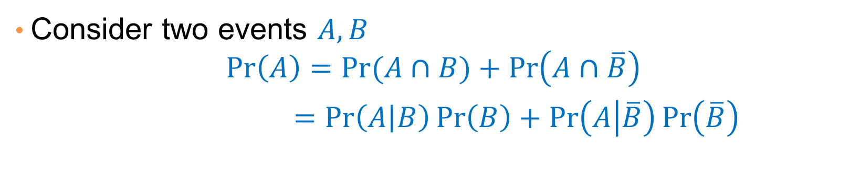



A Useful Identity
Consider two events $A,B$
$$\operatorname{Pr}\left(A\right)=\operatorname{Pr}{(A∩B)}+\operatorname{Pr}\left(A∩\overline{B}\right)$$
$=\operatorname{Pr}\left(A | B\right)\operatorname{Pr}\left(B\right)+\operatorname{Pr}\left(A | \overline{B}\right)\operatorname{Pr}\left(\overline{B}\right)$
$A∩B$ and $A∩\overline{B}$ are disjoint
Recall that $\operatorname{Pr}\left(A∩B\right)=\operatorname{Pr}\left(A | B\right)\operatorname{Pr}\left(B\right)$
$$A$$
$$B$$
$$\overline{B}$$

Slide 13
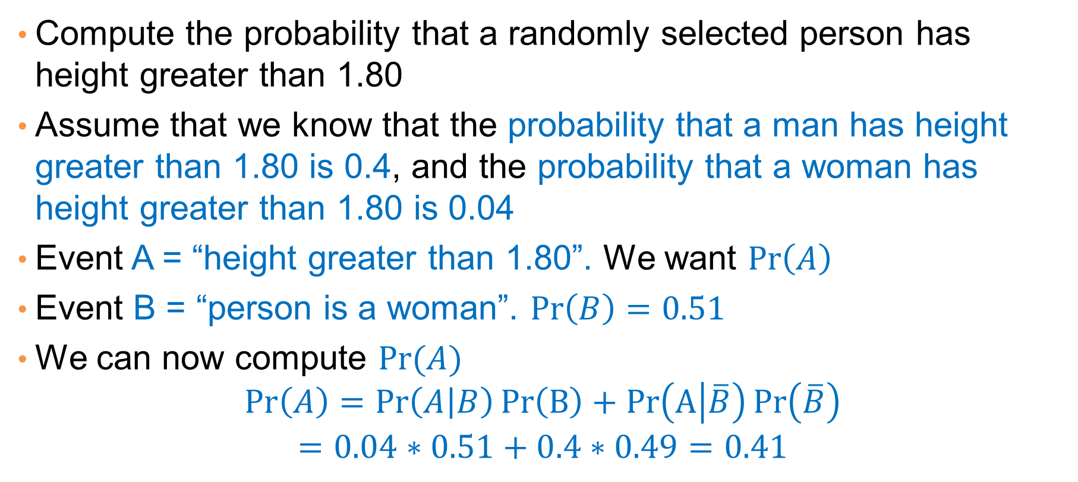
Application
Compute the probability that a randomly selected person has height greater than 1.80
Assume that we know that the probability that a man has height greater than 1.80 is 0.4, and the probability that a woman has height greater than 1.80 is 0.04
Event A = “height greater than 1.80”. We want $\operatorname{Pr}\left(A\right)$
Event B = “person is a woman”. $\operatorname{Pr}\left(B\right)=0.51$
We can now compute $\operatorname{Pr}{(A)}$
$$\operatorname{Pr}\left(A\right)=\operatorname{Pr}\left(A | B\right)Pr\left(B\right)+Pr\left(A | \overline{B}\right)\operatorname{Pr}\left(\overline{B}\right)$$
$$=0.04∗0.51+0.4∗0.49=0.41$$

Slide 14
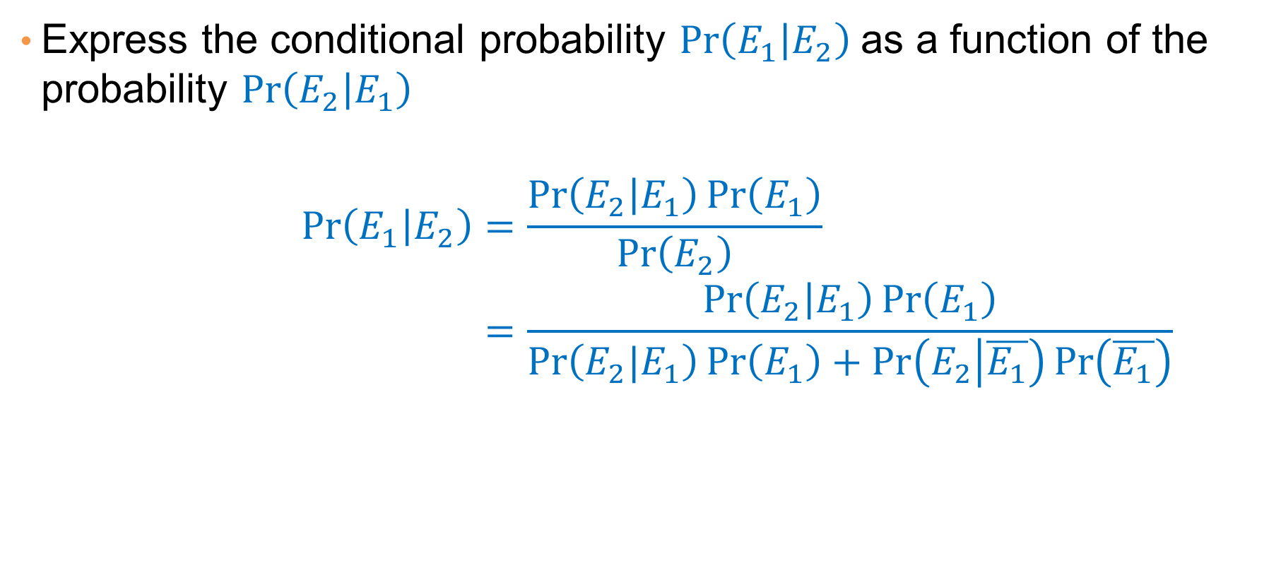
Bayes Rule
Express the conditional probability $\operatorname{Pr}\left(E_{1} | E_{2}\right)$ as a function of the probability $\operatorname{Pr}\left(E_{2} | E_{1}\right)$
$$\operatorname{Pr}\left(E_{1} | E_{2}\right)=\frac{\operatorname{Pr}\left(E_{2} | E_{1}\right)\operatorname{Pr}\left(E_{1}\right)}{\operatorname{Pr}\left(E_{2}\right)} \\ =\frac{\operatorname{Pr}\left(E_{2} | E_{1}\right)\operatorname{Pr}\left(E_{1}\right)}{\operatorname{Pr}\left(E_{2}|E_{1}\right)\operatorname{Pr}\left(E_{1}\right)+\operatorname{Pr}\left(E_{2} | \overline{E_{1}}\right)\operatorname{Pr}\left(\overline{E_{1}}\right)}$$

Slide 15
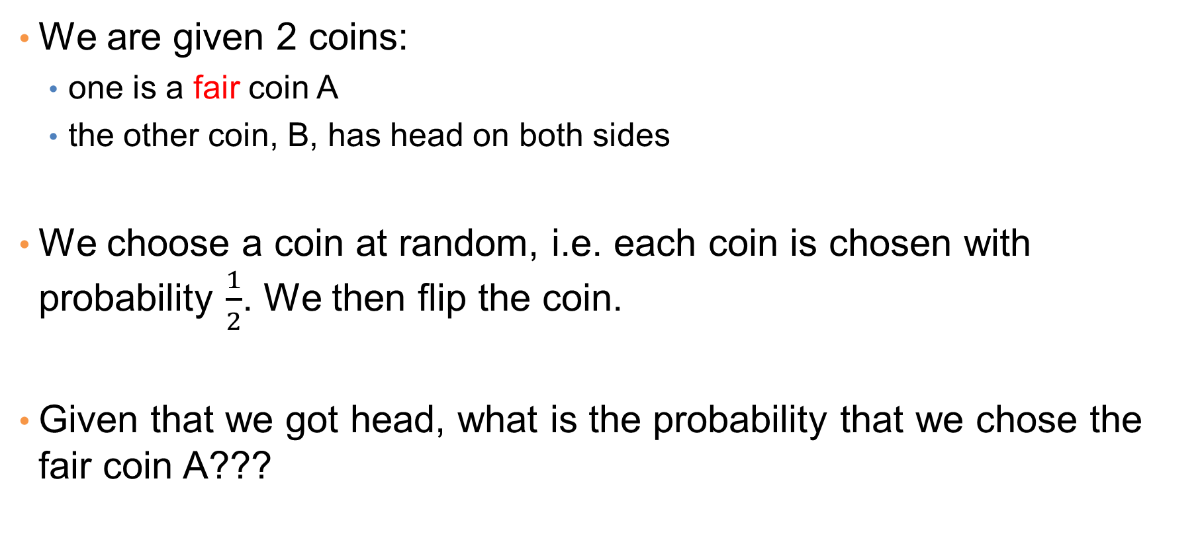
Example: A-posteriori probability
We are given 2 coins:
  one is a fair coin A
  the other coin, B, has head on both sides
We choose a coin at random, i.e. each coin is chosen with probability $\frac{1}{2}$. We then flip the coin.
Given that we got head, what is the probability that we chose the fair coin A???

Slide 16
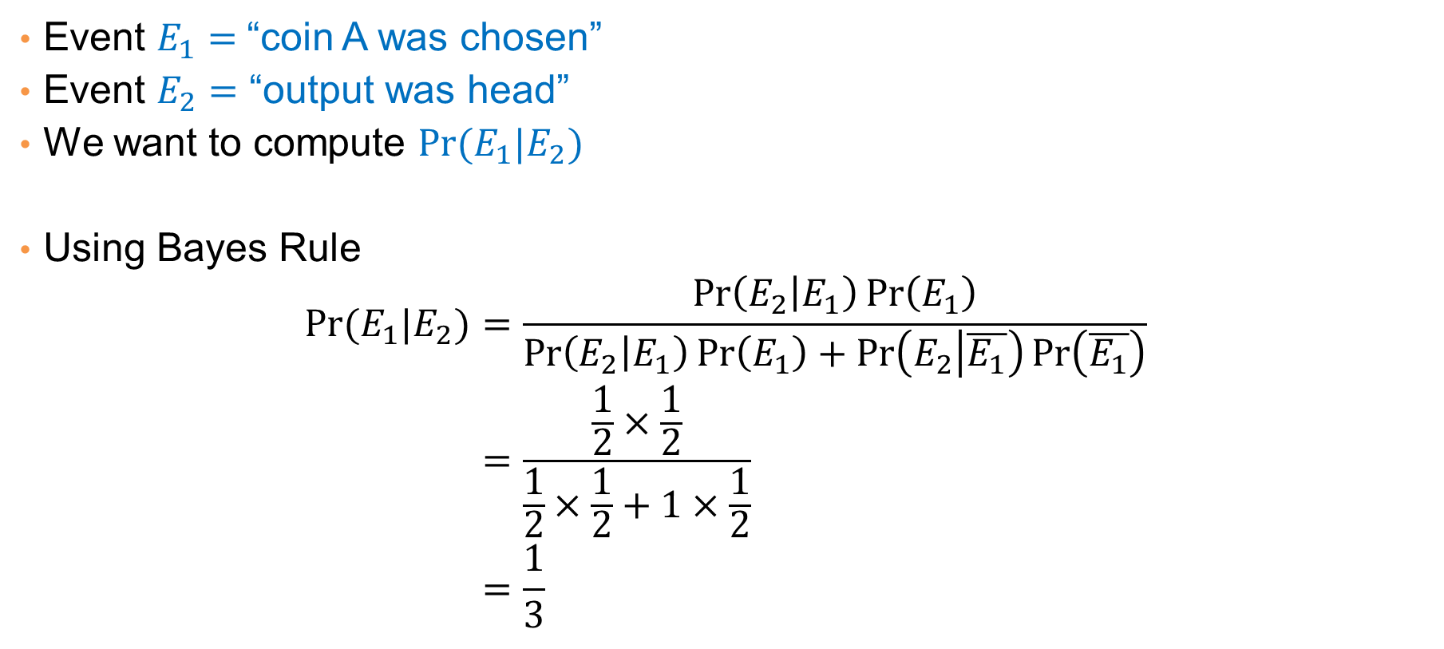
Example: A-posteriori probability
Event $E_{1}=$“coin A was chosen”
Event $E_{2}=$ “output was head”
We want to compute $\operatorname{Pr}{(E_{1}|E_{2})}$
Using Bayes Rule
$$\operatorname{Pr}{(E_{1}|E_{2})}=\frac{\operatorname{Pr}\left(E_{2} | E_{1}\right)\operatorname{Pr}\left(E_{1}\right)}{\operatorname{Pr}\left(E_{2} | E_{1}\right)\operatorname{Pr}\left(E_{1}\right)+\operatorname{Pr}\left(E_{2} | \overline{E_{1}}\right)\operatorname{Pr}\left(\overline{E_{1}}\right)} \\ =\frac{\frac{1}{2}×\frac{1}{2}}{\frac{1}{2}×\frac{1}{2}+1×\frac{1}{2}} \\ =\frac{1}{3}$$

Slide 17
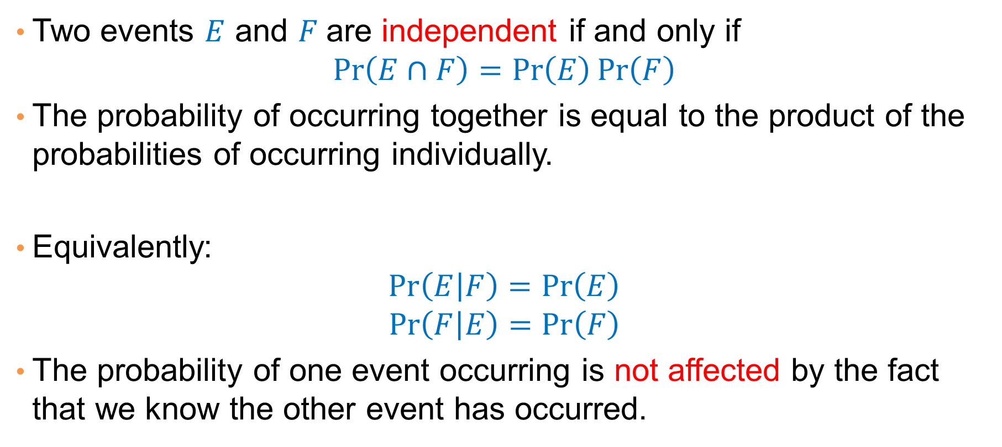
Independent Events
Two events $E$ and $F$are independent if and only if
$$\operatorname{Pr}\left(E∩F\right)=\operatorname{Pr}\left(E\right)\operatorname{Pr}\left(F\right)$$
The probability of occurring together is equal to the product of the probabilities of occurring individually.
Equivalently:
$$\operatorname{Pr}\left(E | F\right)=\operatorname{Pr}\left(E\right)$$
$$\operatorname{Pr}\left(F | E\right)=\operatorname{Pr}\left(F\right)$$
The probability of one event occurring is not affected by the fact that we know the other event has occurred.

Slide 18


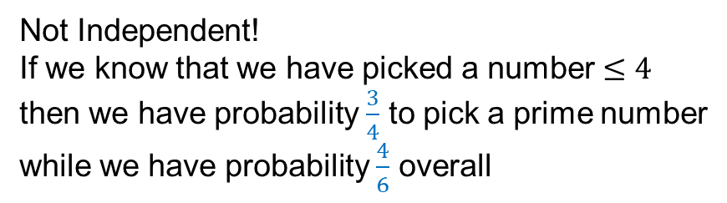
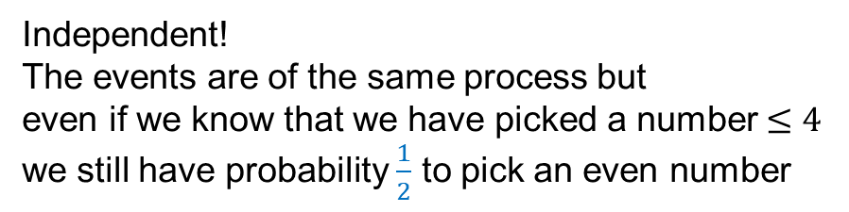
Examples
Pick a random card from a deck:
  $E=$“ace was picked”
  $F=$“heart was picked”
Roll a die:
  $E=$“even number” $=\left\{2,4,6\right\}$
  $F=$“number $≤4$” $=\{1,2,3,4\}$
Roll a die:
  $E=$“prime number” $=\left\{1,2,3,5\right\}$
  $F=$“number $≤4$” $=\{1,2,3,4\}$
Independent!
Even if we know that we have picked a heart
we still have probability $\frac{1}{13}$ to pick an ace
Two independent processes
Independent!
The events are of the same process but
even if we know that we have picked a number $≤4$
we still have probability $\frac{1}{2}$ to pick an even number
Not Independent!
If we know that we have picked a number $≤4$
then we have probability $\frac{3}{4}$ to pick a prime number
while we have probability $\frac{4}{6}$ overall

Slide 19
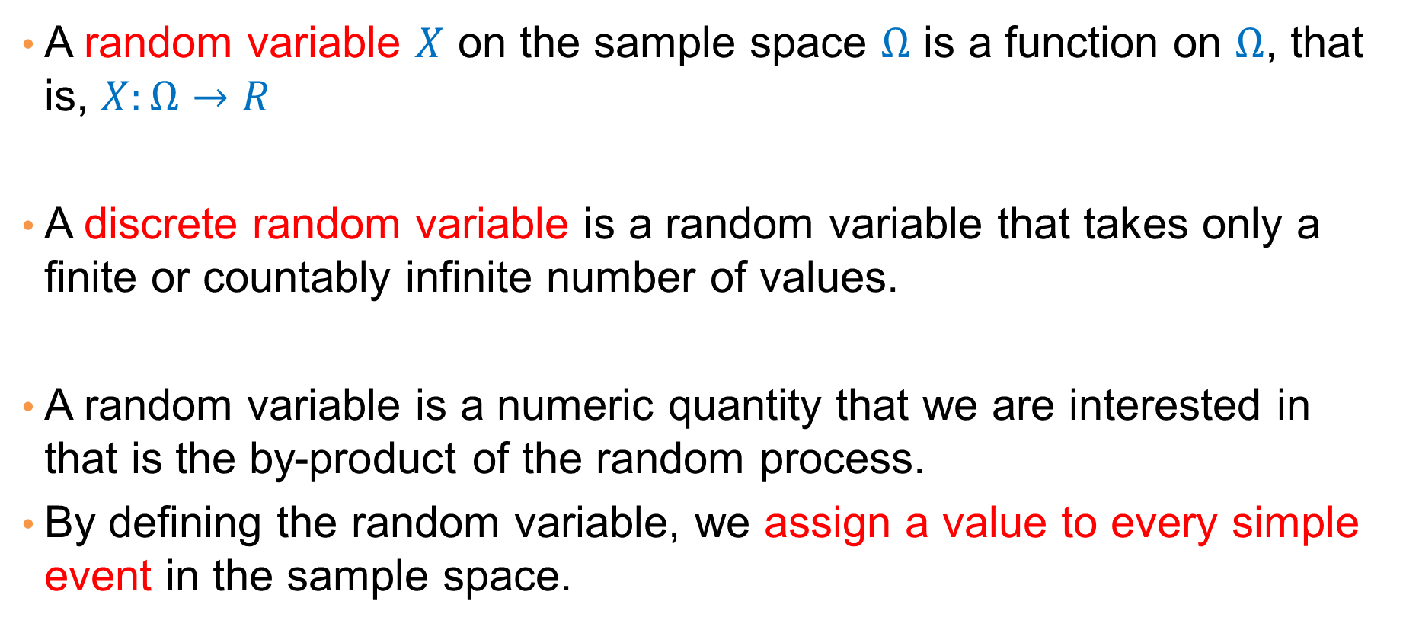
Random Variables
A random variable $X$ on the sample space $Ω$ is a function on $Ω$, that is, $X:Ω→R$
A discrete random variable is a random variable that takes only a finite or countably infinite number of values.
A random variable is a numeric quantity that we are interested in that is the by-product of the random process.
By defining the random variable, we assign a value to every simple event in the sample space.

Slide 20
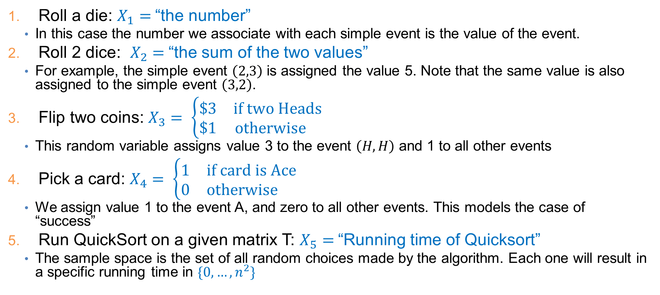
Examples
Roll a die: $X_{1}=$“the number”
  In this case the number we associate with each simple event is the value of the event.
Roll 2 dice: $X_{2}=$“the sum of the two values”
  For example, the simple event $\left(2,3\right)$ is assigned the value 5. Note that the same value is also assigned to the simple event $\left(3,2\right)$.
Flip two coins: $X_{3}= \left\{\begin{matrix}\$3 & \text{if} \text{two} \text{Heads} \\ \$1 & \text{otherwise} \end{matrix}\right.$
  This random variable assigns value 3 to the event $\left(H,H\right)$ and 1 to all other events
Pick a card: $X_{4}= \left\{\begin{matrix}1 & \text{if} \text{card} \text{is} \text{Ace} \\ 0 & \text{otherwise} \end{matrix}\right.$
  We assign value 1 to the event A, and zero to all other events. This models the case of “success”
Run QuickSort on a given matrix T: $X_{5}=$“Running time of Quicksort”
  The sample space is the set of all random choices made by the algorithm. Each one will result in a specific running time in $\{0,…,n^{2}\}$

Slide 21
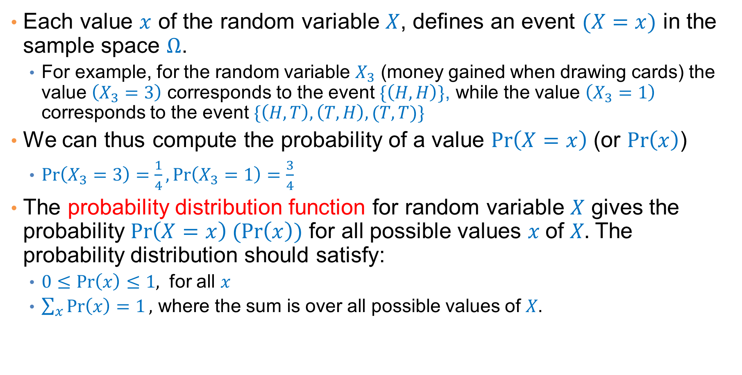
Probability Distribution
Each value $x$ of the random variable $X$, defines an event $(X=x)$ in the sample space $Ω$.
  For example, for the random variable $X_{3}$ (money gained when drawing cards) the value $\left(X_{3}=3\right)$ corresponds to the event $\{\left(H,H\right)\}$, while the value $\left(X_{3}=1\right)$ corresponds to the event $\{\left(H,T\right),\left(T,H\right),(T,T)\}$
We can thus compute the probability of a value $\operatorname{Pr}\left(X=x\right)$ (or $\operatorname{Pr}\left(x\right)$)
  $\operatorname{Pr}\left(X_{3}=3\right)=\frac{1}{4},\operatorname{Pr}\left(X_{3}=1\right)=\frac{3}{4}$
The probability distribution function for random variable $X$ gives the probability $\operatorname{Pr}\left(X=x\right) (\operatorname{Pr}\left(x\right))$ for all possible values $x$of $X.$ The probability distribution should satisfy:
  $0≤\operatorname{Pr}\left(x\right)≤1,$ for all $x$
  $\sum_{x}{\operatorname{Pr}\left(x\right)=1},$ where the sum is over all possible values of $X.$

Slide 22
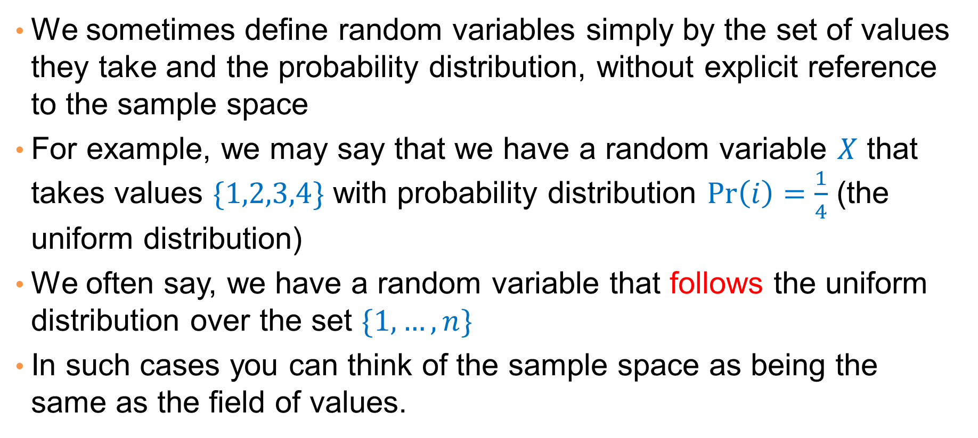
Random variables and Probability Distribution
We sometimes define random variables simply by the set of values they take and the probability distribution, without explicit reference to the sample space
For example, we may say that we have a random variable $X$ that takes values $\{1,2,3,4\}$ with probability distribution $\operatorname{Pr}\left(i\right)=\frac{1}{4}$ (the uniform distribution)
We often say, we have a random variable that follows the uniform distribution over the set $\{1,…,n\}$
In such cases you can think of the sample space as being the same as the field of values.

Slide 23
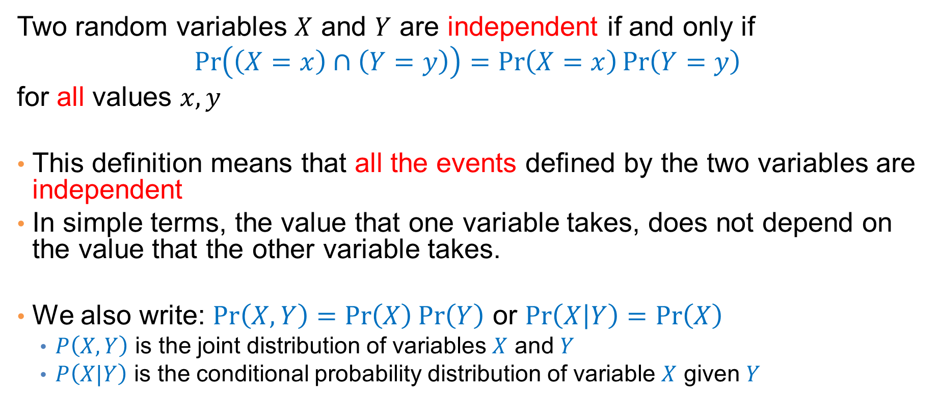
Independent Random Variables
Two random variables $X$ and $Y$ are independent if and only if
$$\operatorname{Pr}\left(\left(X=x\right)∩\left(Y=y\right)\right)=\operatorname{Pr}\left(X=x\right)\operatorname{Pr}\left(Y=y\right)$$
for all values $x,y$
This definition means that all the events defined by the two variables are independent
In simple terms, the value that one variable takes, does not depend on the value that the other variable takes.
We also write: $\operatorname{Pr}\left(X,Y\right)=\operatorname{Pr}\left(X\right)\operatorname{Pr}\left(Y\right)$ or $\operatorname{Pr}\left(X | Y\right)=\operatorname{Pr}\left(X\right)$
  $P\left(X,Y\right)$ is the joint distribution of variables $X$ and $Y$
  $P\left(X|Y\right)$ is the conditional probability distribution of variable $X$ given $Y$

Slide 24
Example
Rolling 5 dice:
  The outcome of each roll is independent of the outcome of the other rolls
  The sum of the first three rolls is independent of the sum of the last two rolls
Drawing 3 cards:
  The number of Aces we have is independent of the number of Hearts we get
General rule: When repeating the same experiment multiple times, we assume that each trial is independent of the rest

Slide 25
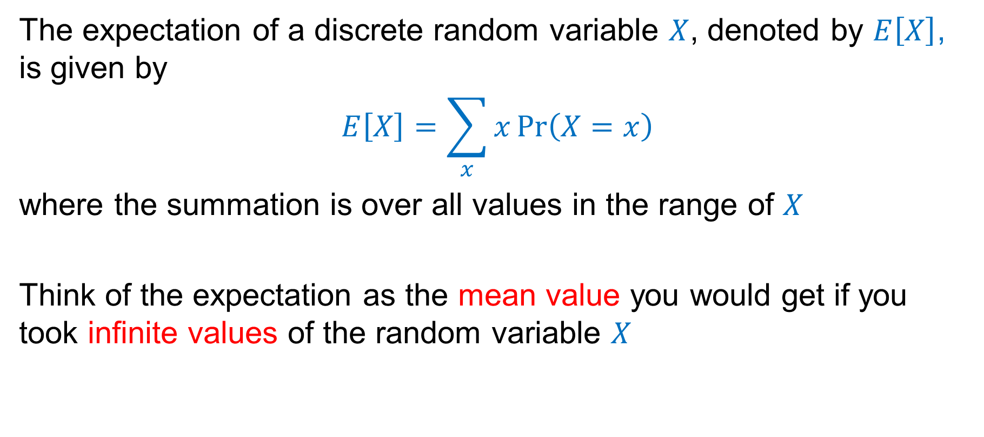
Expectation
The expectation of a discrete random variable $X$, denoted by $E\left[X\right]$, is given by
$$E\left[X\right]=\sum_{x}{x\operatorname{Pr}\left(X=x\right)}$$
where the summation is over all values in the range of $X$
Think of the expectation as the mean value you would get if you took infinite values of the random variable $X$

Slide 26
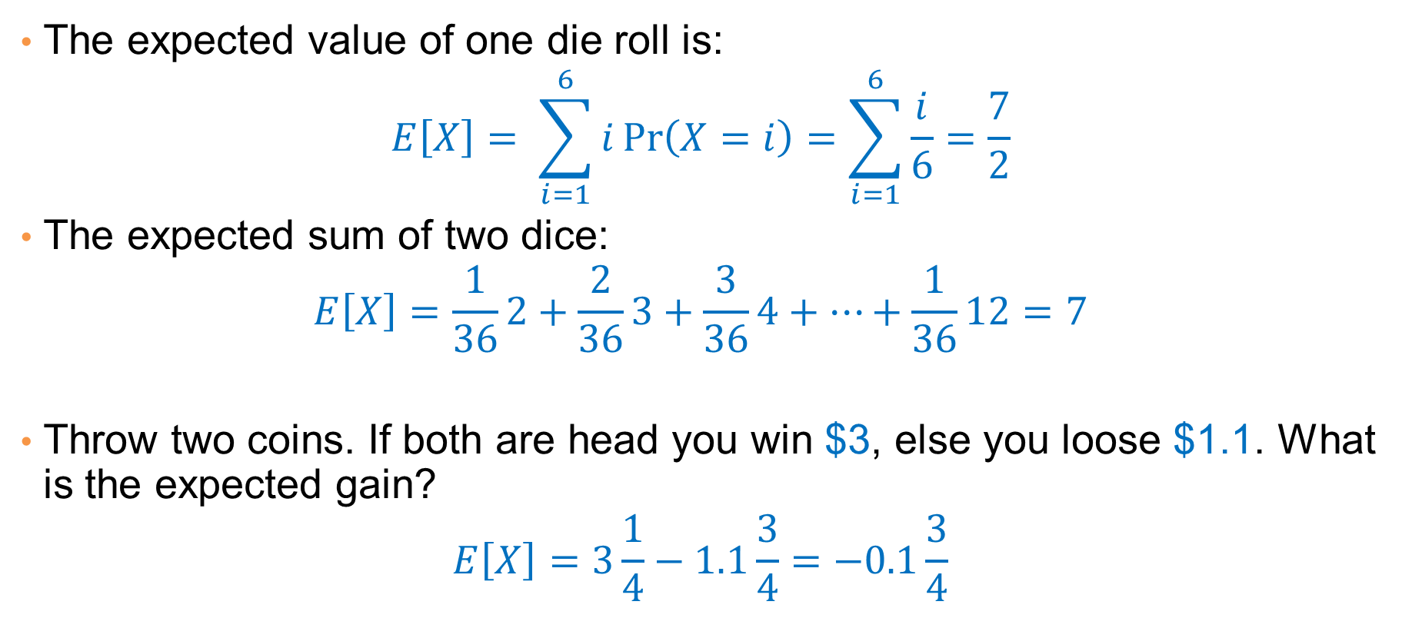
Examples
The expected value of one die roll is:
$$E\left[X\right]= \sum_{i=1}^{6}{i\operatorname{Pr}\left(X=i\right)}=\sum_{i=1}^{6}{\frac{i}{6}}=\frac{7}{2}$$
The expected sum of two dice:
$$E\left[X\right]=\frac{1}{36}2+\frac{2}{36}3+\frac{3}{36}4+…+\frac{1}{36}12=7$$
Throw two coins. If both are head you win $3, else you loose $1.1. What is the expected gain?
$$E\left[X\right]=3\frac{1}{4}−1.1\frac{3}{4}=−0.1\frac{3}{4}$$

Slide 27
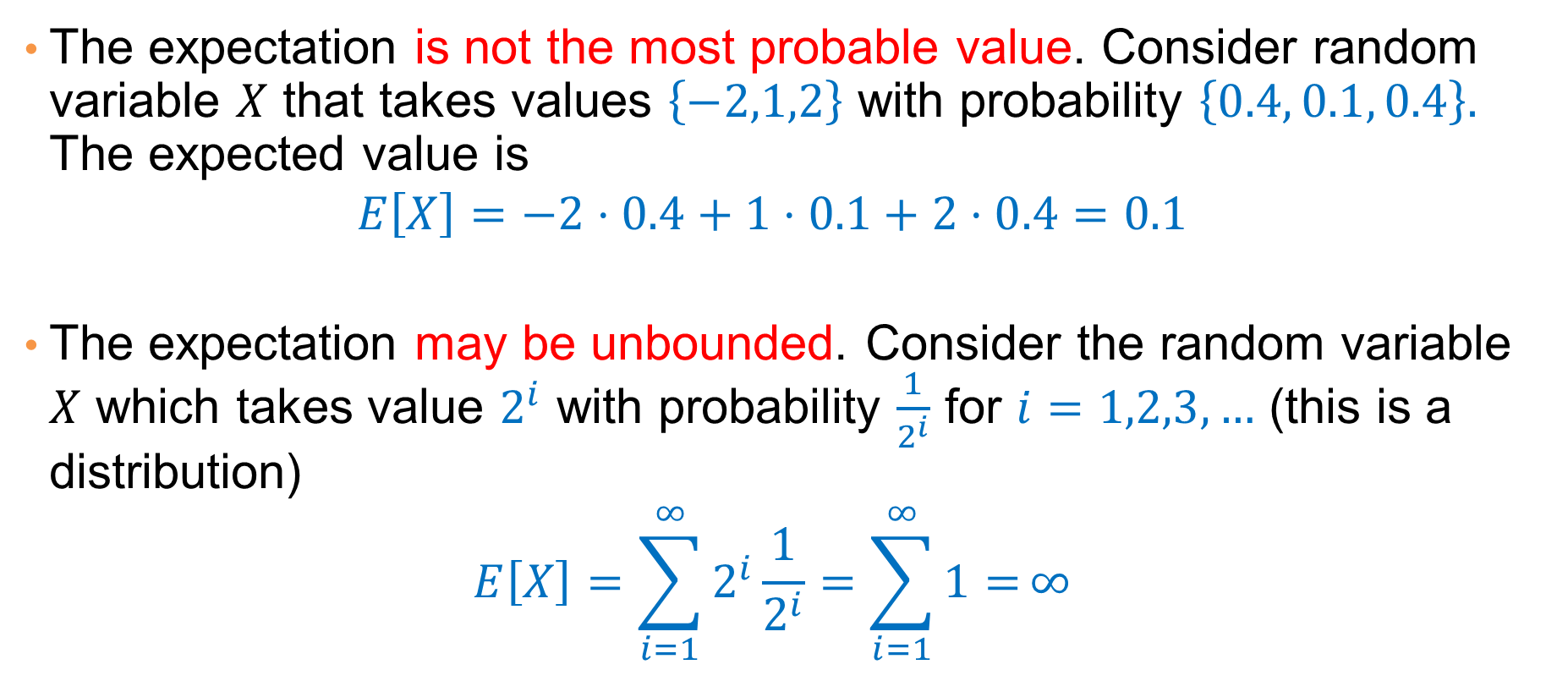
Examples
The expectation is not the most probable value. Consider random variable $X$ that takes values $\left\{−2,1,2\right\}$ with probability $\left\{0.4, 0.1, 0.4\right\}.$ The expected value is
$$E\left[X\right]=−2⋅0.4+1⋅0.1+2⋅0.4=0.1$$
The expectation may be unbounded. Consider the random variable $X$ which takes value $2^{i}$ with probability $\frac{1}{2^{i}}$ for $i=1,2,3,…$ (this is a distribution)
$$E\left[X\right]=\sum_{i=1}^{∞}{2^{i}\frac{1}{2^{i}}=\sum_{i=1}^{∞}{1=}}∞$$

Slide 28
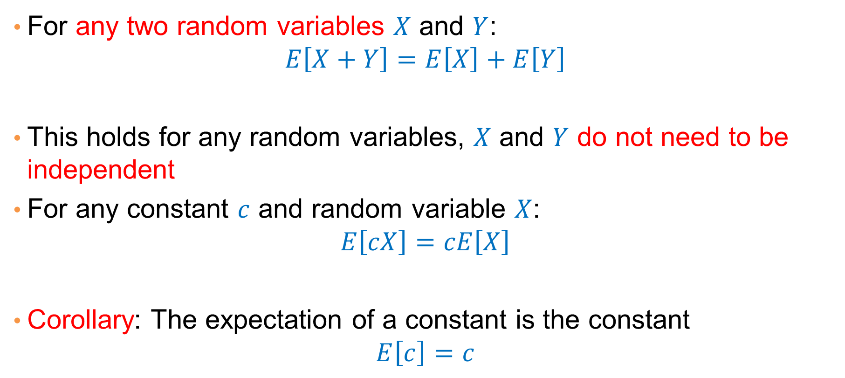
Linearity of Expectation
For any two random variables $X$ and $Y$:
$$E\left[X+Y\right]=E\left[X\right]+E\left[Y\right]$$
This holds for any random variables, $X$ and $Y$ do not need to be independent
For any constant $c$ and random variable $X$:
$$E\left[cX\right]=cE\left[X\right]$$
Corollary: The expectation of a constant is the constant
$$E\left[c\right]=c$$

Slide 29
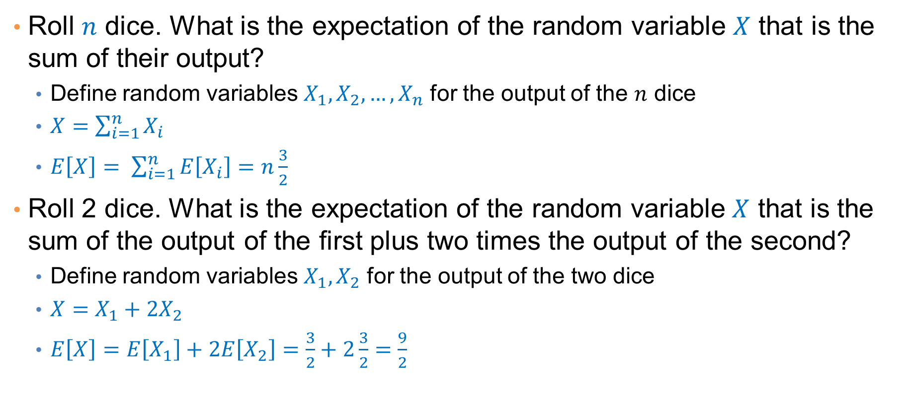
Examples
Roll $n$ dice. What is the expectation of the random variable $X$ that is the sum of their output?
  Define random variables $X_{1},X_{2},…,X_{n}$ for the output of the $n$ dice
  $X=\sum_{i=1}^{n}{X_{i}}$
  $E\left[X\right]= \sum_{i=1}^{n}{E\left[X_{i}\right]}=n\frac{3}{2}$
Roll 2 dice. What is the expectation of the random variable $X$ that is the sum of the output of the first plus two times the output of the second?
  Define random variables $X_{1},X_{2}$ for the output of the two dice
  $X=X_{1}+2X_{2}$
  $E\left[X\right]=E\left[X_{1}\right]+2E\left[X_{2}\right]=\frac{3}{2}+2\frac{3}{2}=\frac{9}{2}$

Slide 30
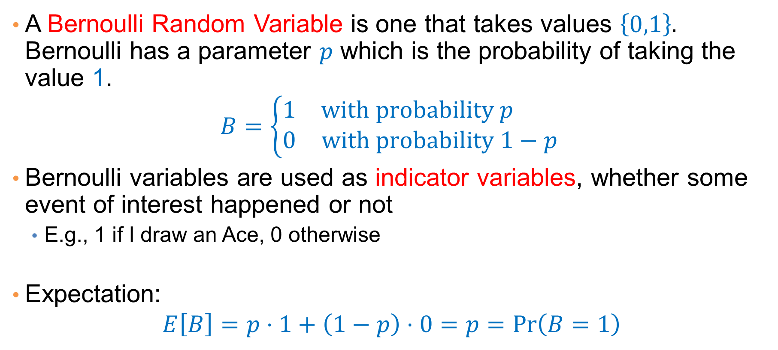
Bernoulli Random Variable
A Bernoulli Random Variable is one that takes values $\left\{0,1\right\}.$ Bernoulli has a parameter $p$ which is the probability of taking the value 1.
$$B=\left\{\begin{matrix}1 & \text{with} \text{probability} p \\ 0 & \text{with} \text{probability} 1−p \end{matrix}\right.$$
Bernoulli variables are used as indicator variables, whether some event of interest happened or not
  E.g., 1 if I draw an Ace, 0 otherwise
Expectation:
$$E\left[B\right]=p⋅1+\left(1−p\right)⋅0=p=\operatorname{Pr}\left(B=1\right)$$

Slide 31
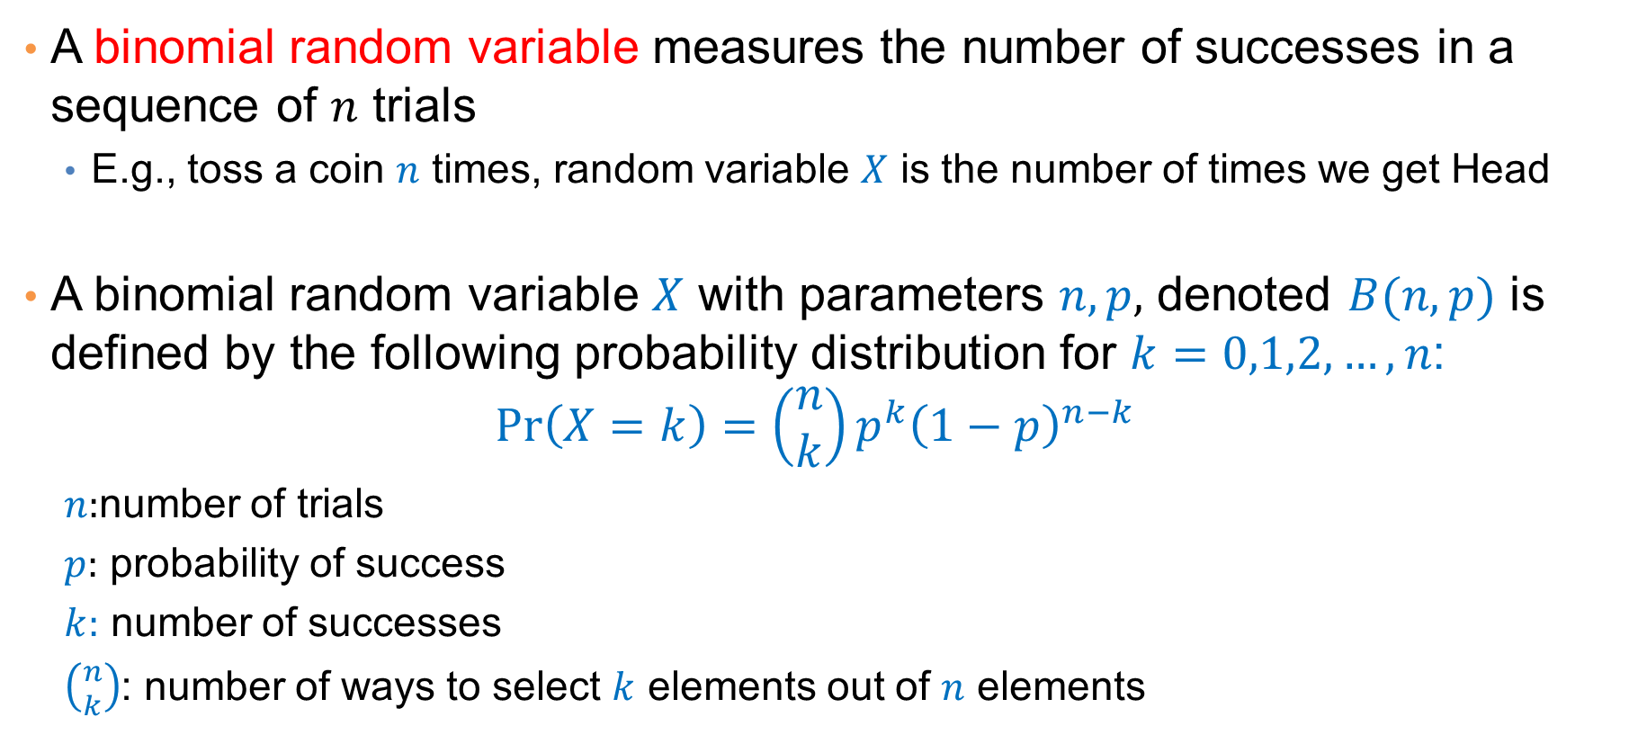
Binomial Random Variable
A binomial random variable measures the number of successes in a sequence of $n$ trials
  E.g., toss a coin $n$ times, random variable $X$ is the number of times we get Head
A binomial random variable $X$ with parameters $n,p,$ denoted $B(n,p)$ is defined by the following probability distribution for $k=0,1,2,…,n$:
$$\operatorname{Pr}\left(X=k\right)=\left(\begin{matrix}n \\ k\end{matrix}\right)p^{k}{\left(1−p\right)}^{n−k }$$
  $n:$number of trials
  $p:$ probability of success
  $k:$ number of successes
  $\left({n \atop k}\right)$: number of ways to select $k$ elements out of $n$ elements

Slide 32
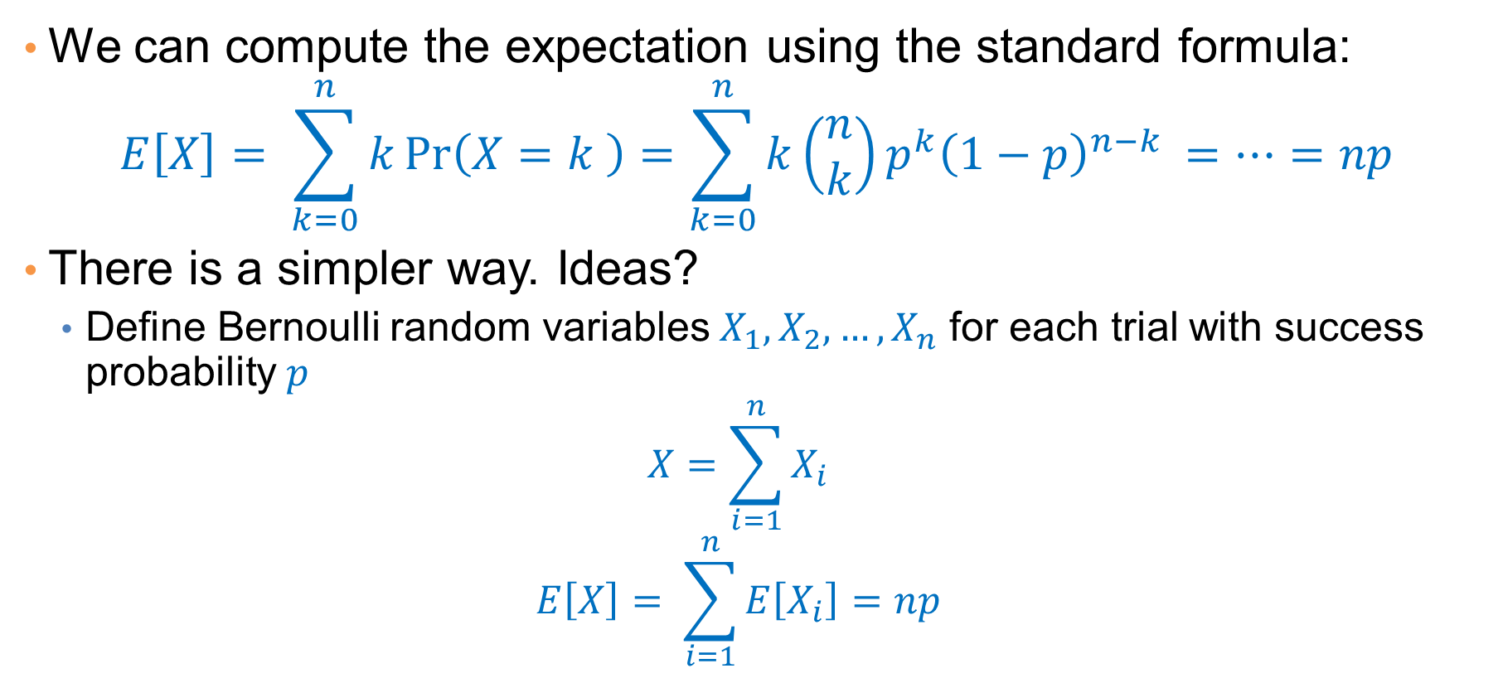
Expectation of a Binomial Random Variable
We can compute the expectation using the standard formula:
$$E\left[X\right]= \sum_{k=0}^{n}{k\operatorname{Pr}\left(X=k \right)=\sum_{k=0}^{n}{k\left(\begin{matrix}n \\ k\end{matrix}\right)p^{k}{\left(1−p\right)}^{n−k }}=…=np}$$
There is a simpler way. Ideas?
  Define Bernoulli random variables $X_{1},X_{2},…,X_{n}$ for each trial with success probability $p$
  $$X=\sum_{i=1}^{n}{X_{i}}$$
  $$E\left[X\right]= \sum_{i=1}^{n}{E\left[X_{i}\right]}=np$$

Slide 33
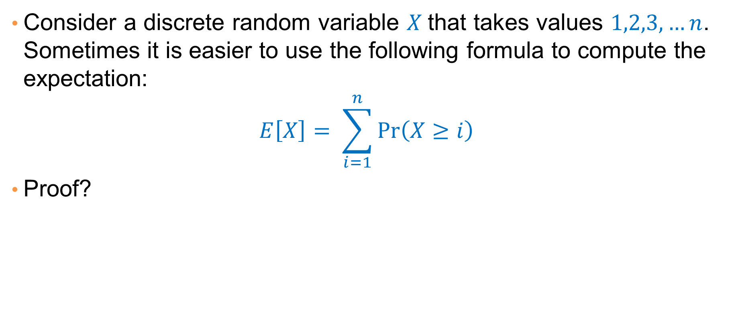
A useful formula
Consider a discrete random variable $X$that takes values $1,2,3,…n$. Sometimes it is easier to use the following formula to compute the expectation:
$$E\left[X\right]= \sum_{i=1}^{n}{\operatorname{Pr}\left(X≥i\right)}$$
Proof?

Slide 34

Expectation is not everything
Consider the following two jobs:
  One job gives salary $1000$ euros per month
  The other job gives salary $1$ euro per month, plus a bonus of $1,000,000$ with probability $\frac{1}{1000}$
Which job would you pick?

Slide 35
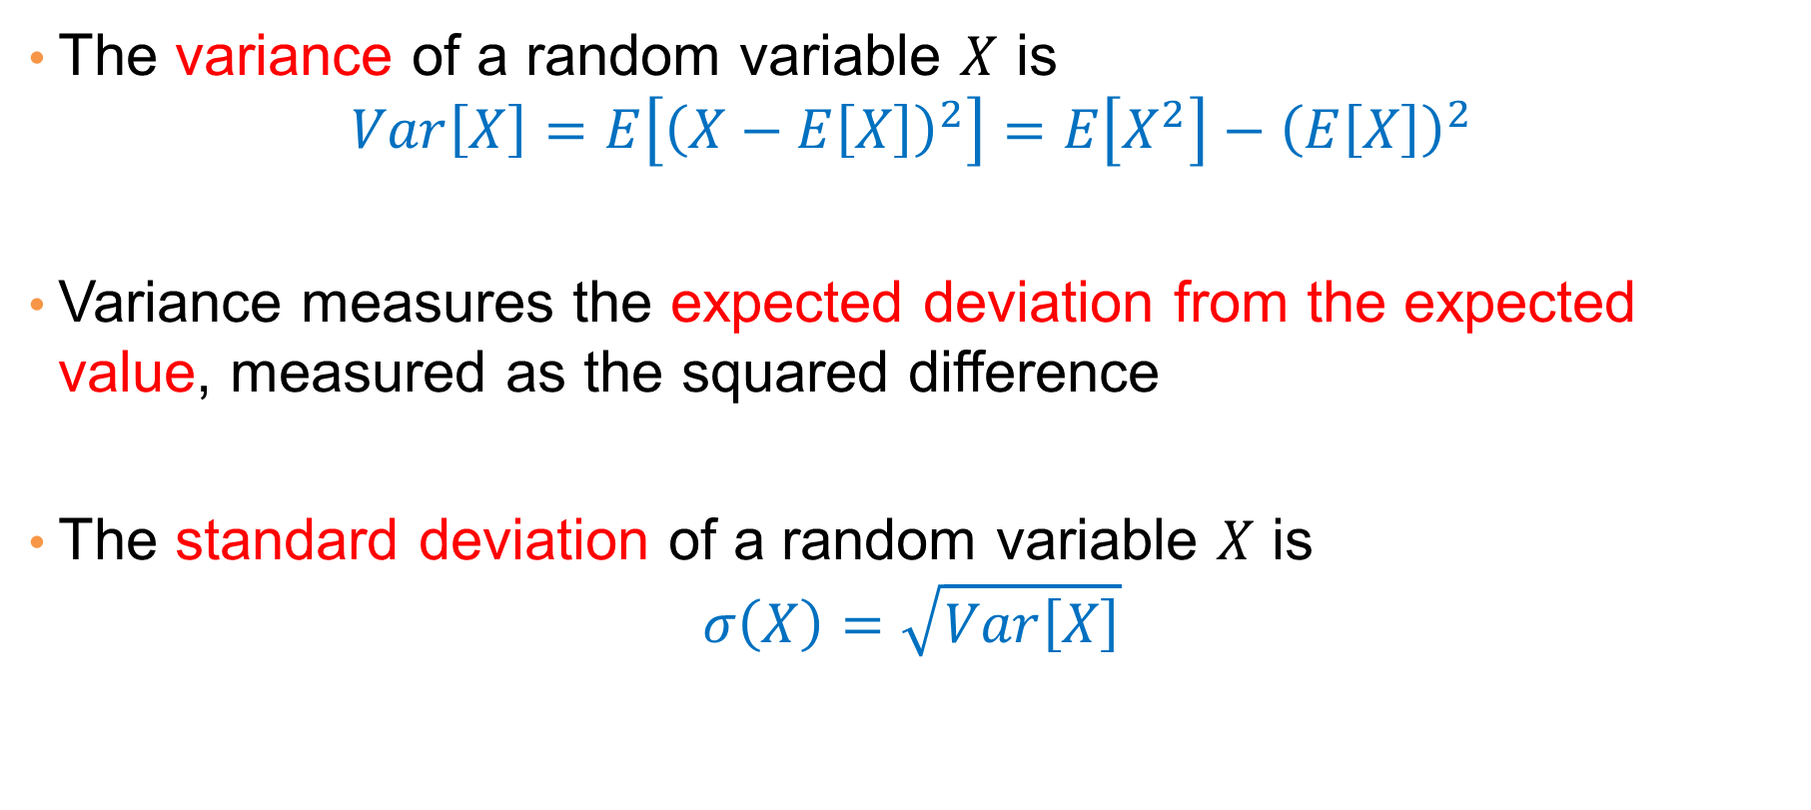
Variance
The variance of a random variable $X$ is
$$Var\left[X\right]=E\left[{\left(X−E\left[X\right]\right)}^{2}\right]=E\left[X^{2}\right]−{\left(E\left[X\right]\right)}^{2}$$
Variance measures the expected deviation from the expected value, measured as the squared difference
The standard deviation of a random variable $X$ is
$$σ\left(X\right)=\sqrt{Var\left[X\right]}$$

Slide 36
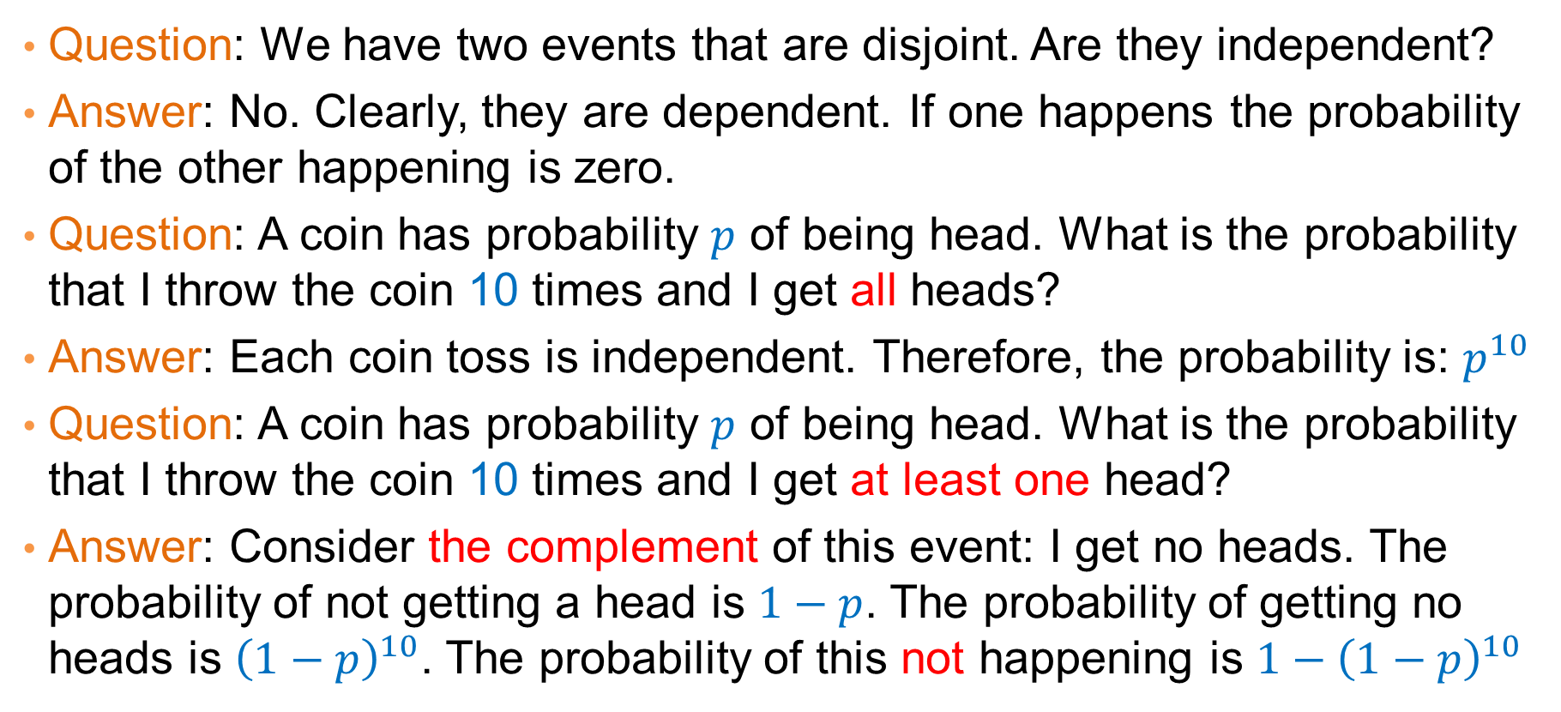
Quiz
Question: We have two events that are disjoint. Are they independent?
Answer: No. Clearly, they are dependent. If one happens the probability of the other happening is zero.
Question: A coin has probability $p$ of being head. What is the probability that I throw the coin 10 times and I get all heads?
Answer: Each coin toss is independent. Therefore, the probability is: $p^{10}$
Question: A coin has probability $p$ of being head. What is the probability that I throw the coin 10 times and I get at least one head?
Answer: Consider the complement of this event: I get no heads. The probability of not getting a head is $1−p$. The probability of getting no heads is ${\left(1−p\right)}^{10}$. The probability of this not happening is $1−{\left(1−p\right)}^{10}$

Slide 37
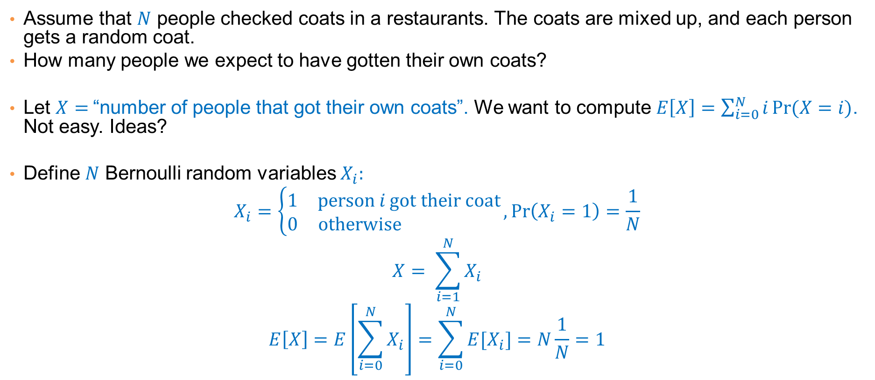
Exercise
Assume that $N$ people checked coats in a restaurants. The coats are mixed up, and each person gets a random coat.
How many people we expect to have gotten their own coats?
Let $X=$“number of people that got their own coats”. We want to compute $E\left[X\right]=\sum_{i=0}^{N}{i\operatorname{Pr}{(X=i)}}$. Not easy. Ideas?
Define $N$ Bernoulli random variables $X_{i}:$
$$X_{i}=\left\{\begin{matrix}1 & \text{person} i \text{got} \text{their} \text{coat} \\ 0 & \text{otherwise} \end{matrix}\right.,\operatorname{Pr}\left(X_{i}=1\right)=\frac{1}{N}$$
$$X= \sum_{i=1}^{N}{X_{i}}$$
$$E\left[X\right]=E\left[\sum_{i=0}^{N}{X_{i}}\right]=\sum_{i=0}^{N}{{E[X}_{i}]=N\frac{1}{N}=1}$$

Slide 38
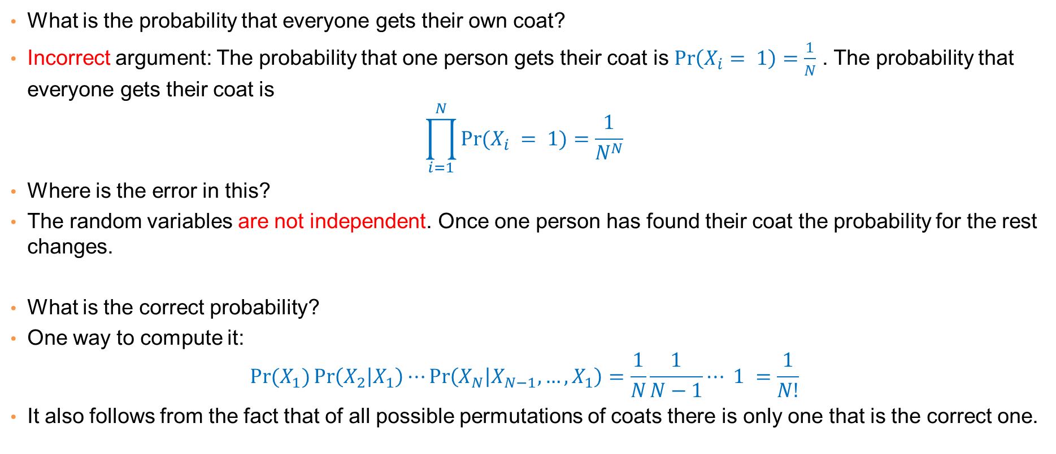
Exercise
What is the probability that everyone gets their own coat?
Incorrect argument: The probability that one person gets their coat is $\operatorname{Pr}\left(X_{i}= 1\right)=\frac{1}{N}$ . The probability that everyone gets their coat is
$$\prod_{i=1}^{N}{\operatorname{Pr}{(X_{i} = 1)}}=\frac{1}{N^{N}}$$
Where is the error in this?
The random variables are not independent. Once one person has found their coat the probability for the rest changes.
What is the correct probability?
One way to compute it:
$$\operatorname{Pr}{(X_{1})}\operatorname{Pr}\left(X_{2} | X_{1}\right)⋯\operatorname{Pr}\left(X_{N} | X_{N−1},…,X_{1}\right)=\frac{1}{N}\frac{1}{N−1}⋯ 1 =\frac{1}{N!}$$
It also follows from the fact that of all possible permutations of coats there is only one that is the correct one.

Slide 39
CONTINUOUS RANDOM VARIABLES

Slide 40
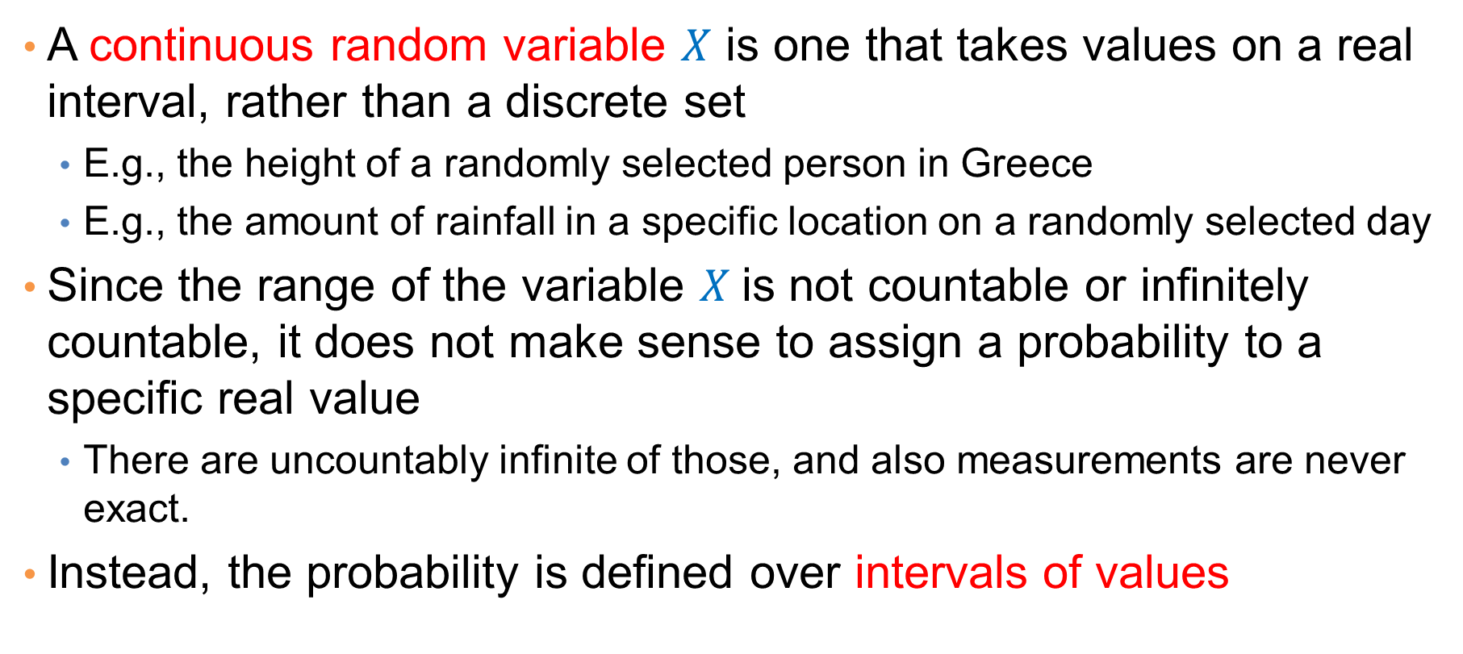
Continuous Random Variables
A continuous random variable $X$ is one that takes values on a real interval, rather than a discrete set
  E.g., the height of a randomly selected person in Greece
  E.g., the amount of rainfall in a specific location on a randomly selected day
Since the range of the variable $X$is not countable or infinitely countable, it does not make sense to assign a probability to a specific real value
  There are uncountably infinite of those, and also measurements are never exact.
Instead, the probability is defined over intervals of values

Slide 41
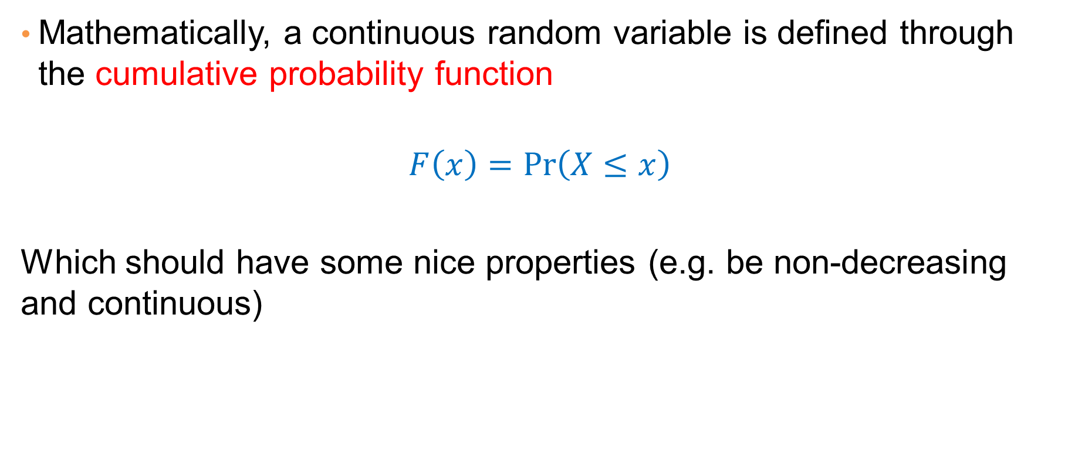
Cumulative Probability Function
Mathematically, a continuous random variable is defined through the cumulative probability function
$$F\left(x\right)=\operatorname{Pr}\left(X≤x\right)$$
Which should have some nice properties (e.g. be non-decreasing and continuous)

Slide 42
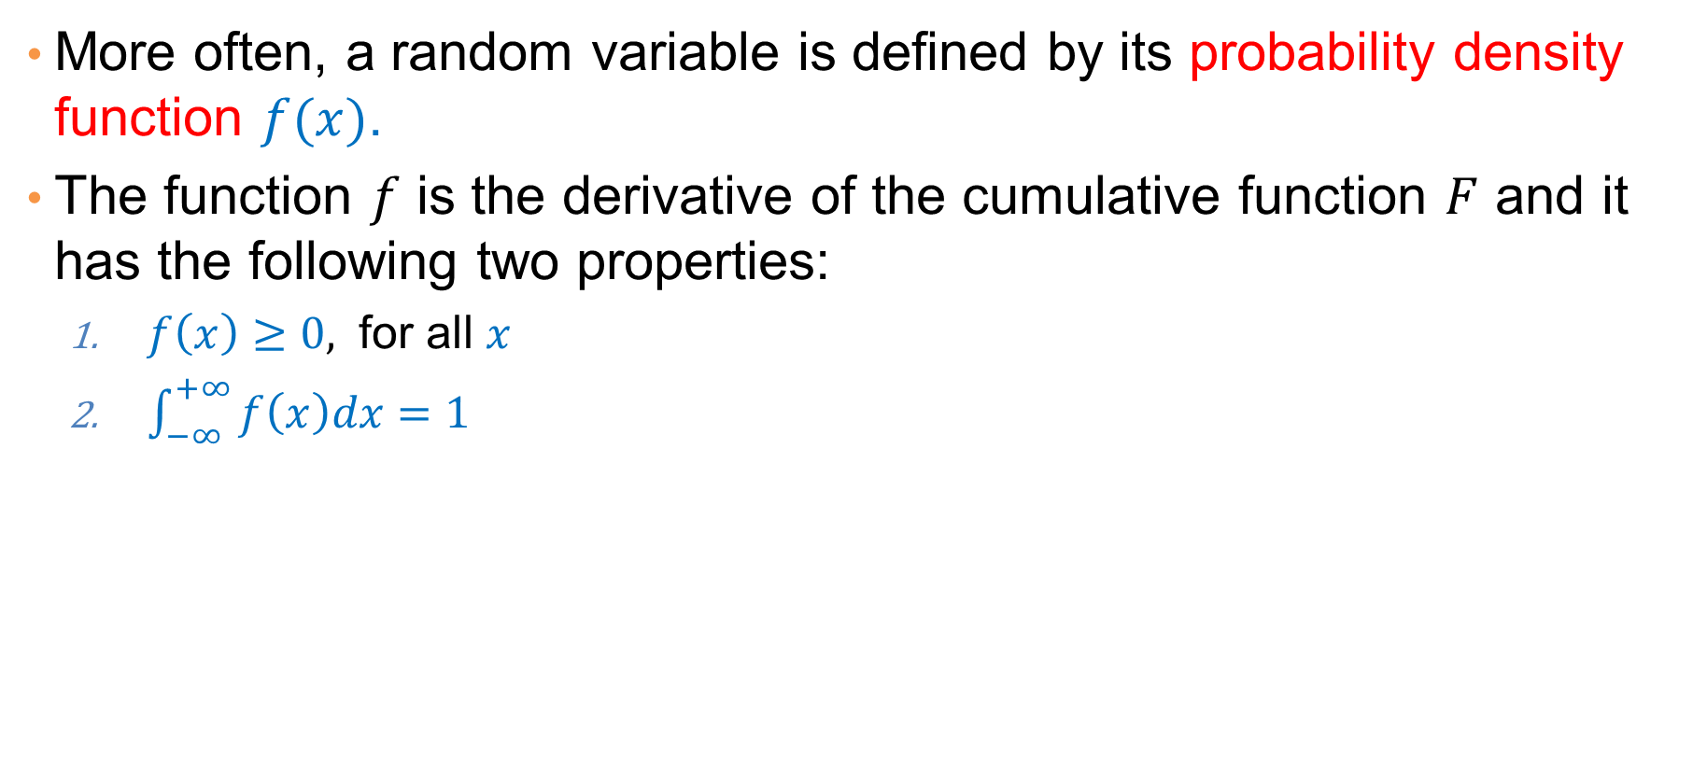
Probability Density Function
More often, a random variable is defined by its probability density function $f(x)$.
The function $f$ is the derivative of the cumulative function $F$ and it has the following two properties:
  $f\left(x\right)≥0,$ for all $x$
  $\int_{−∞}^{+∞}{f\left(x\right)dx=1}$

Slide 43
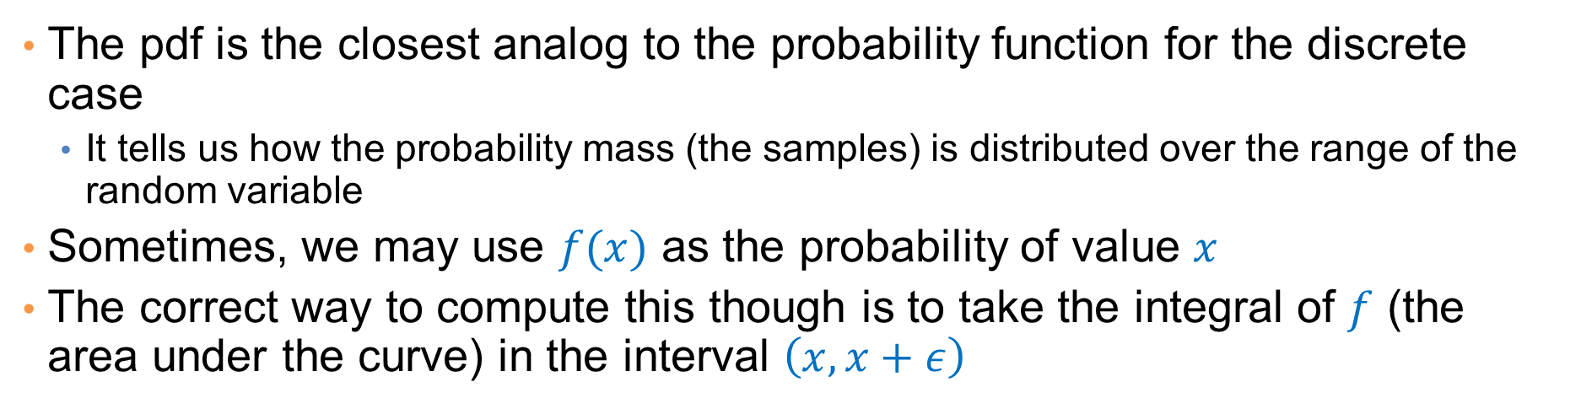


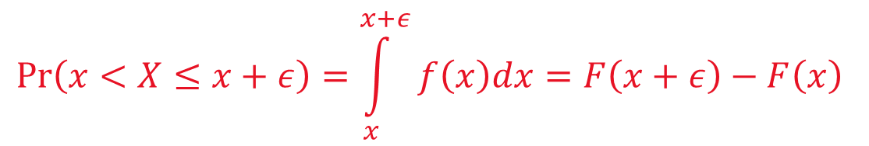
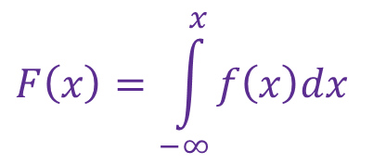
Probability Density Function
The pdf is the closest analog to the probability function for the discrete case
  It tells us how the probability mass (the samples) is distributed over the range of the random variable
Sometimes, we may use $f(x)$ as the probability of value $x$
The correct way to compute this though is to take the integral of $f$ (the area under the curve) in the interval $\left(x,x+ε\right)$
$$\operatorname{Pr}\left(x<X≤x+ε\right)=\int_{x}^{x+ε}{f\left(x\right)dx}=F\left(x+ε\right)−F\left(x\right)$$
$$F\left(x\right)=\int_{−∞}^{x}{f\left(x\right)dx}$$

Slide 44

Expectation and Indepedence
The expectation is defined by taking the integral
$$E\left[X\right]= \int_{−∞}^{+∞}{xf\left(x\right)dx}$$
Same properties hold for linearity of expectation
Independence is defined using the cumulative or density function
$$F\left(x,y\right)=F\left(x\right)F\left(y\right)$$
$$f\left(x,y\right)=f\left(x\right)f(y)$$

Slide 45



Important continuous distributions
Uniform distribution: The probability of any interval $(a,b)$ is proportional to its length $b−a$.
  The pdf is a flat line: equal mass everywhere.
Gaussian/Normal distribution. Probability density function:
$$φ\left(x\right)= \frac{1}{σ\sqrt{2π}}e^{\frac{1}{2}{\left(\frac{x−μ}{σ}\right)}^{2}}$$
It is fully characterized by the mean $μ$ and the standard deviation $σ$

Slide 46

Central Limit Theorem
Let $Y_{1},Y_{2},…,Y_{n}$ be independent identically distributed random variables with mean $μ$ and variance $σ^{2}$
  For example, $n$height measurements from a broader population
Let $\overline{Y}=\frac{1}{n}\sum_{i}{Y_{i}}$be the mean value of the $n$ random variables
  Taking the mean height
When $n$ is large the random variable $\overline{Y}$ converges to a normal distribution with mean $μ$ and variance $\frac{σ^{2}}{n}$
  This means that if we repeat the height measurements multiple times, the distribution of the mean height will follow a gaussian distribution.

