Slide 1
DATA MINING
Dimensionality Reduction
SVD – PCA
Model-based recommendation systems
(Thanks to Jure Leskovec, Evimaria Terzi)

Slide 2
The curse of dimensionality
Real data usually have thousands, or millions of dimensions
  E.g., web documents, where the dimensionality is the vocabulary of words
  Facebook graph, where the dimensionality is the number of users
Huge number of dimensions causes problems
  Data becomes very sparse, some algorithms become meaningless (e.g., density-based clustering)
  The complexity of several algorithms depends on the dimensionality, and they become infeasible (e.g., nearest neighbor search).

Slide 3
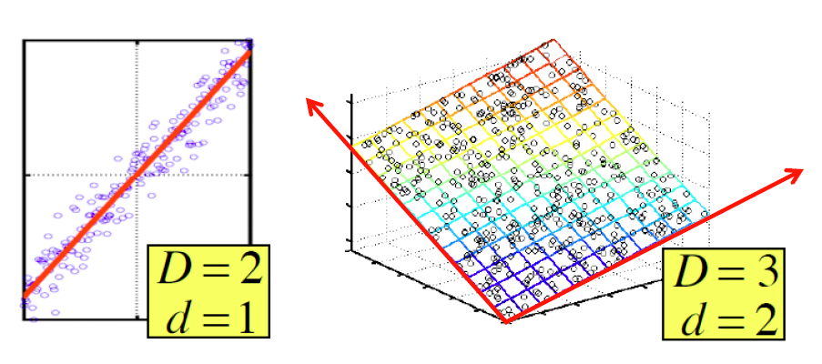
Dimensionality Reduction
Usually, the data can be described with fewer dimensions, without losing much of the information in the data.
  The data reside in a space of lower dimensionality

Slide 4
Example
In this data matrix the dimension is essentially 3
  There are three types of products and three types of users

Slide 5

Example
Cloud of points 3D space:
  Think of point positions
  as a matrix:
We can rewrite coordinates more efficiently!
  Old basis vectors: [1 0 0] [0 1 0] [0 0 1]
  New basis vectors: [1 2 1] [-2 -3 1]
  Then A has new coordinates: [1 0]. B: [0 1], C: [1 -1]
    Notice: We reduced the number of coordinates!
A
B
C
A
1 row per point:
Notes:
Write each row as a linear combination of the two new basis vectors

Slide 6
Dimensionality Reduction
Find the “true dimension” of the data
  In reality, things are never as clear and simple as in this example, but we can still reduce the dimension.
Essentially, we assume that some of the data is useful signal, and some data is noise, and that we can approximate the useful part with a lower dimensionality space.
  Dimensionality reduction does not just reduce the amount of data, it often brings out the useful part of the data

Slide 7
Dimensionality Reduction
Goal of dimensionality reduction is to discover the axis of data!
Rather than representing every point with 2 coordinates we represent each point with 1 coordinate (corresponding to
the position of the point on the red line).
By doing this we incur a bit of error as the points do not
exactly lie on the line
We assume that the line has the useful information, while the errors are noise
Notes:
If I have the equation y = ax+b, then given the point x I can compute the value y

Slide 8
Why Reduce Dimensions?
Discover hidden correlations/topics
  E.g., in documents, words that occur commonly together
Remove redundant and noisy features
  E.g., in documents, not all words are useful
Interpretation and visualization
Easier storage and processing of the data

Slide 9
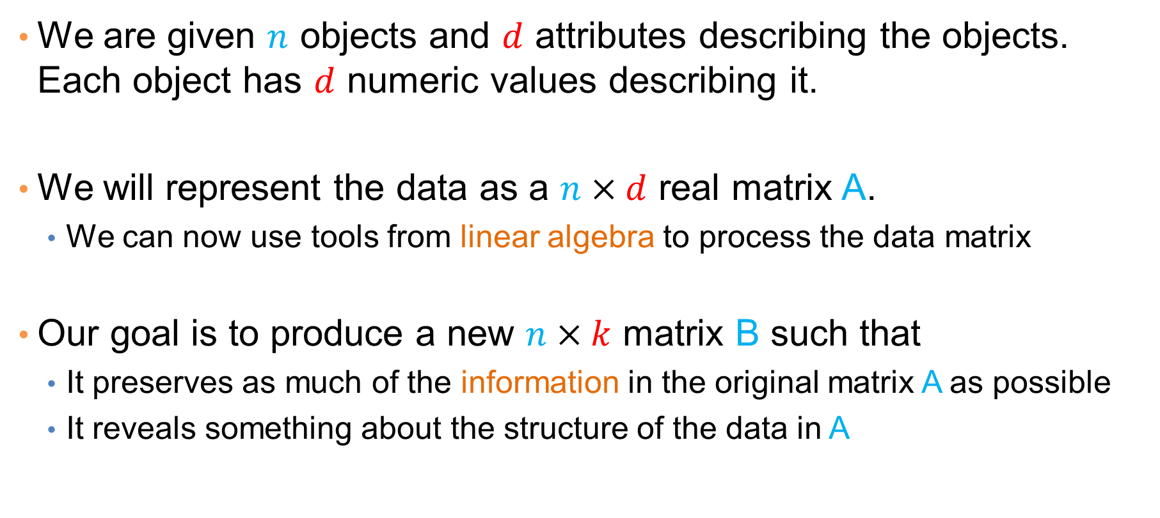
Data in the form of a matrix
We are given $n$ objects and $d$ attributes describing the objects. Each object has $d$ numeric values describing it.
We will represent the data as a $n×d$ real matrix A.
  We can now use tools from linear algebra to process the data matrix
Our goal is to produce a new $n×k$ matrix B such that
  It preserves as much of the information in the original matrix A as possible
  It reveals something about the structure of the data in A

Slide 10
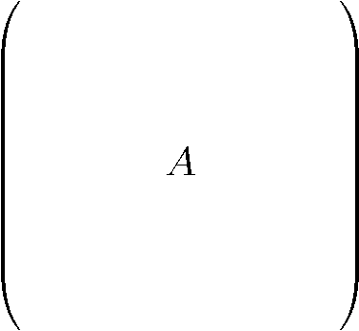
Example: Document matrices
d terms
(e.g., theorem, proof, etc.)
n documents
A_{ij} = frequency of the j-th term in the i-th document
Find subsets of terms that bring documents together

Slide 11
Example: Recommendation systems
d movies
n customers
A_{ij} = rating of j-th product by the i-th customer
Find subsets of movies that capture the behavior or the customers

Slide 12

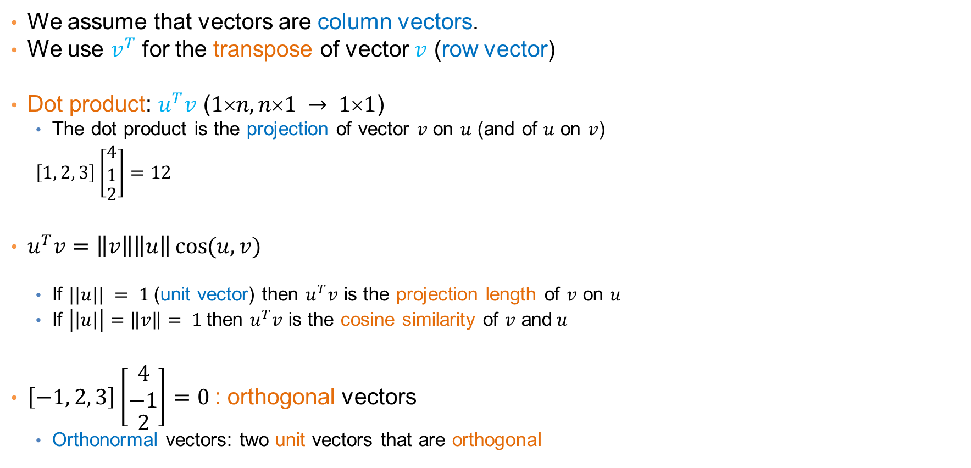

Linear algebra
We assume that vectors are column vectors.
We use $v^{T}$ for the transpose of vector $v$ (row vector)
Dot product: $u^{T}v$ ($1n, n1 → 11$)
  The dot product is the projection of vector $v$ on $u$ (and of $u$ on $v$)
  $\left[1, 2, 3\right]\left[\begin{matrix}\begin{matrix}4 \\ 1\end{matrix} \\ 2\end{matrix}\right]=12$
$u^{T}v=\left\|v\right\|\left\|u\right\|\cos{(u,v)}$
  If $||u|| = 1$(unit vector) then $u^{T}v$ is the projection length of $v$ on $u$
  If $\left|\left|u\right|\right|=\left\|v\right\|= 1$then $u^{T}v$ is the cosine similarity of $v$ and$u$
$\left[−1, 2, 3\right]\left[\begin{matrix}\begin{matrix}4 \\ −1\end{matrix} \\ 2\end{matrix}\right]=0$: orthogonal vectors
  Orthonormal vectors: two unit vectors that are orthogonal
$$v$$
$$u$$

Slide 13
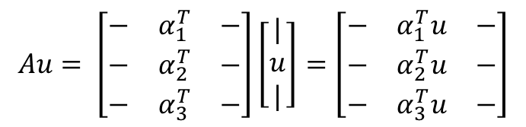
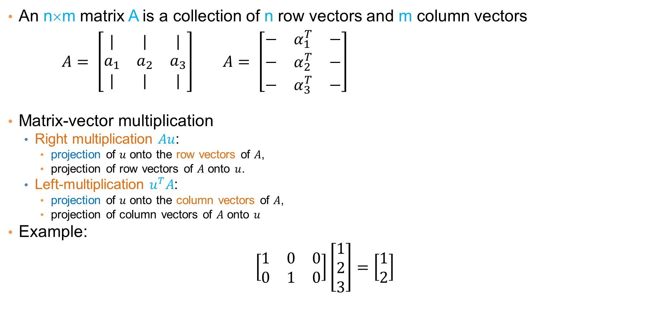
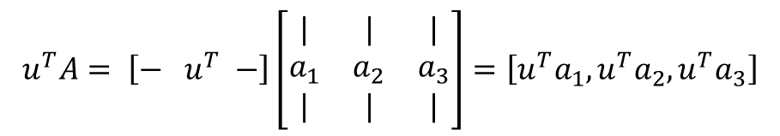
Matrices
An n×m matrix A is a collection of n row vectors and m column vectors
$A= \left[\begin{matrix}| & | & | \\ a_{1} & a_{2} & a_{3} \\ | & | & |\end{matrix}\right]$ $A= \left[\begin{matrix}− & α_{1}^{T} & − \\ − & α_{2}^{T} & − \\ − & α_{3}^{T} & −\end{matrix}\right]$
Matrix-vector multiplication
  Right multiplication $Au$:
    projection of $u$ onto the row vectors of $A$,
    projection of row vectors of $A$ onto $u$.
  Left-multiplication $u^{T}A$:
    projection of $u$ onto the column vectors of $A$,
    projection of column vectors of $A$ onto $u$
Example:
$$\left[\begin{matrix}1 & 0 & 0 \\ 0 & 1 & 0\end{matrix}\right]\left[\begin{matrix}1 \\ 2 \\ 3\end{matrix}\right]=\left[\begin{matrix}1 \\ 2\end{matrix}\right]$$
$$Au= \left[\begin{matrix}− & α_{1}^{T} & − \\ − & α_{2}^{T} & − \\ − & α_{3}^{T} & −\end{matrix}\right]\left[\begin{aligned}| \\ u \\ |\end{aligned}\right]=\left[\begin{matrix}− & α_{1}^{T}u & − \\ − & α_{2}^{T}u & − \\ − & α_{3}^{T}u & −\end{matrix}\right]$$
$$u^{T}A= \left[− u^{T} −\right]\left[\begin{matrix}| & | & | \\ a_{1} & a_{2} & a_{3} \\ | & | & |\end{matrix}\right]=\left[u^{T}a_{1},u^{T}a_{2}, u^{T}a_{3}\right]$$

Slide 14
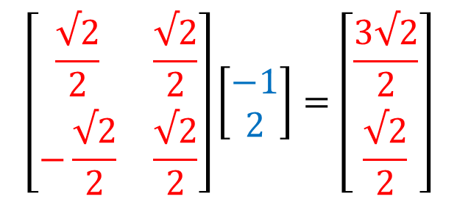
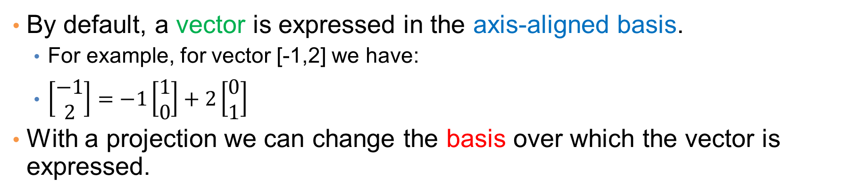
Change of basis
By default, a vector is expressed in the axis-aligned basis.
  For example, for vector [-1,2] we have:
  $\left[\begin{matrix}−1 \\ 2\end{matrix}\right]=−1\left[\begin{matrix}1 \\ 0\end{matrix}\right]+2\left[\begin{matrix}0 \\ 1\end{matrix}\right]$
With a projection we can change the basis over which the vector is expressed.
$$\left[\begin{matrix}\frac{√2}{2} & \frac{√2}{2} \\ −\frac{√2}{2} & \frac{√2}{2}\end{matrix}\right]\left[\begin{matrix}−1 \\ 2\end{matrix}\right]=\left[\begin{matrix}\frac{3√2}{2} \\ \frac{√2}{2}\end{matrix}\right]$$
The rows of the matrix are the new basis vectors

Slide 15
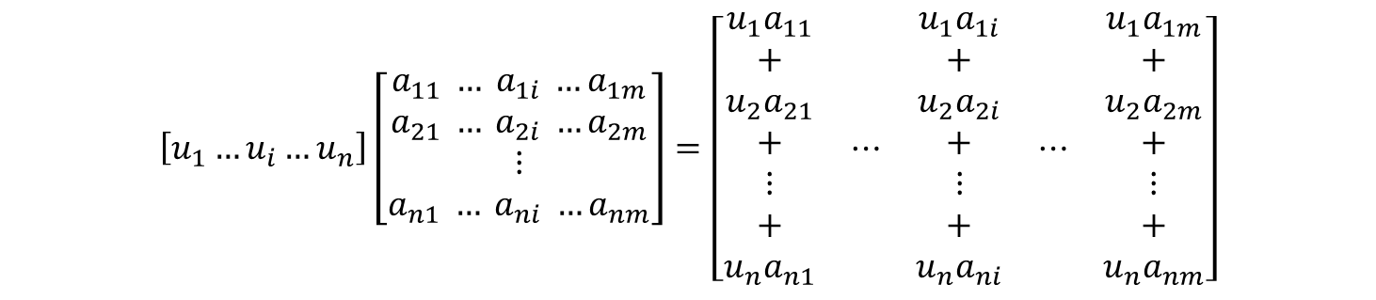


Row and Column space
Row space of A: The set of vectors that can be written as a linear combination of the rows of A
  All vectors of the form $v=u^{T}A$
  the coordinates of $u$ are the coefficients of the linear combination
Column space of A: The set of vectors that can be written as a linear combination of the columns of A
  All vectors of the form $v=Au.$
  the coordinates of $u$ are the coefficients of the linear combination
$$=\begin{matrix}\begin{aligned}u_{1}a_{1}^{T} \\ +\end{aligned} \\ \begin{aligned}u_{2}a_{2}^{T} \\ + \\ ⋮\end{aligned} \\ \begin{aligned}+ \\ u_{n}a_{n}^{T}\end{aligned}\end{matrix}$$
$$\left[u_{1}…u_{i}…u_{n}\right]\left[\begin{aligned}a_{11} … a_{1i} …a_{1m} \\ a_{21} … a_{2i} …a_{2m} \\ ⋮ \\ a_{n1} … a_{ni} …a_{nm}\end{aligned}\right]=\left[\begin{matrix}\begin{aligned}u_{1}a_{11} \\ + \\ u_{2}a_{21} \\ + \\ ⋮ \\ + \\ u_{n}a_{n1}\end{aligned} & \begin{matrix}⋯ & \begin{aligned}u_{1}a_{1i} \\ + \\ u_{2}a_{2i} \\ + \\ ⋮ \\ + \\ u_{n}a_{ni}\end{aligned} & ⋯\end{matrix} & \begin{aligned}u_{1}a_{1m} \\ + \\ u_{2}a_{2m} \\ + \\ ⋮ \\ + \\ u_{n}a_{nm}\end{aligned}\end{matrix}\right]$$

Slide 16
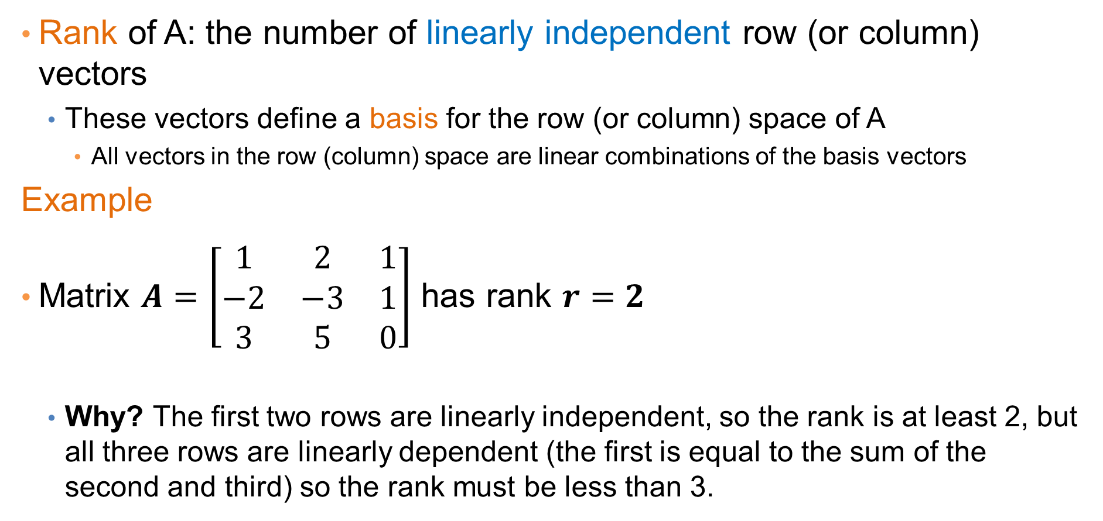
Rank
Rank of A: the number of linearly independent row (or column) vectors
  These vectors define a basis for the row (or column) space of A
    All vectors in the row (column) space are linear combinations of the basis vectors
Example
Matrix $A=\left[\begin{matrix}1 & 2 & 1 \\ −2 & −3 & 1 \\ 3 & 5 & 0\end{matrix}\right]$ has rank $r=2$
  Why? The first two rows are linearly independent, so the rank is at least 2, but all three rows are linearly dependent (the first is equal to the sum of the second and third) so the rank must be less than 3.
Notes:
For the columns -5*first + 3*second = third

Slide 17
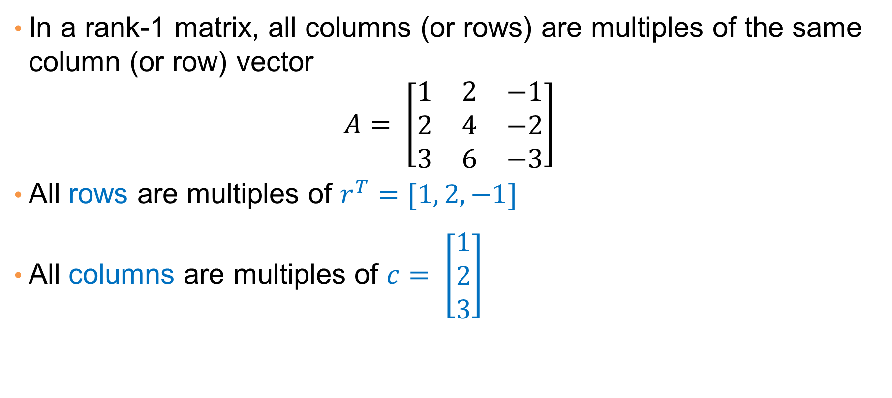
Rank-1 matrices
In a rank-1 matrix, all columns (or rows) are multiples of the same column (or row) vector
$$A= \left[\begin{matrix}1 & 2 & −1 \\ 2 & 4 & −2 \\ 3 & 6 & −3\end{matrix}\right]$$
All rows are multiples of $r^{T}=[1, 2,−1]$
All columns are multiples of $c= \left[\begin{matrix}1 \\ 2 \\ 3\end{matrix}\right]$

Slide 18
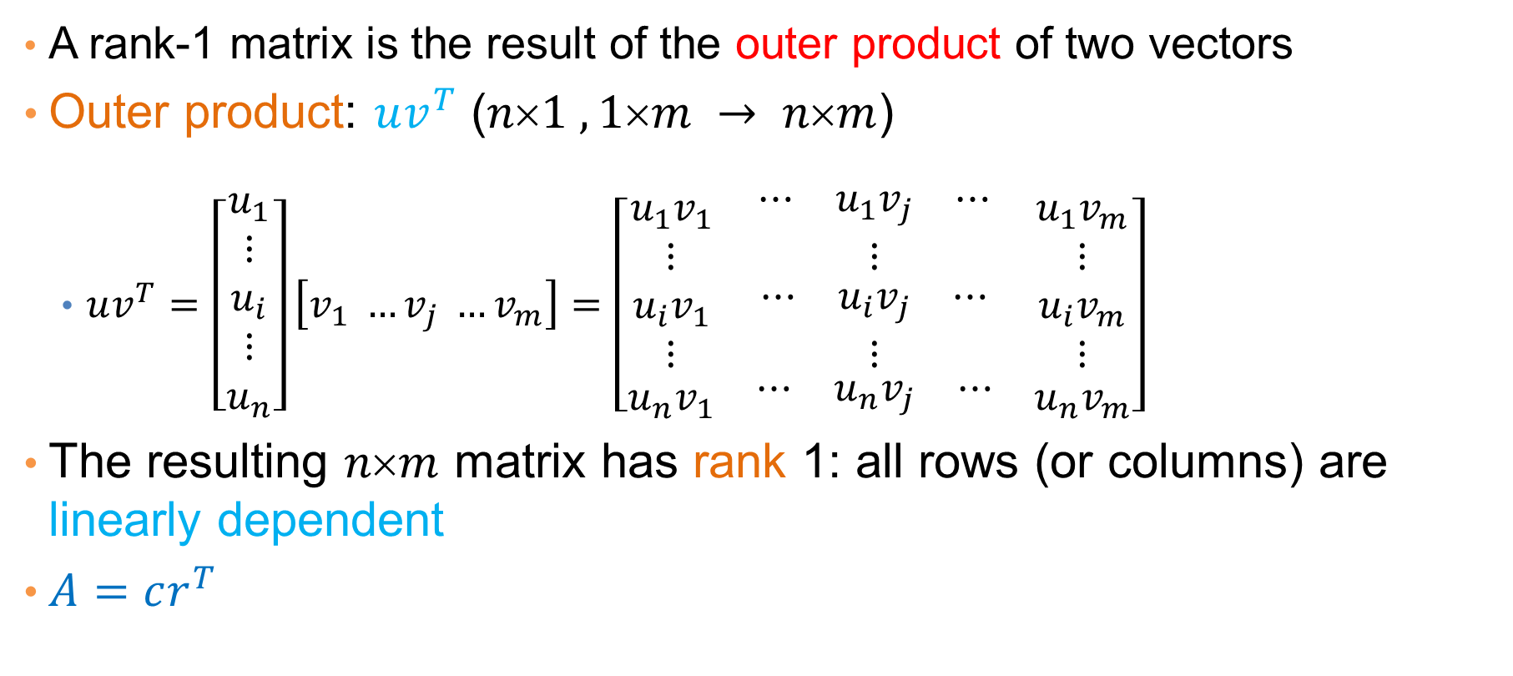
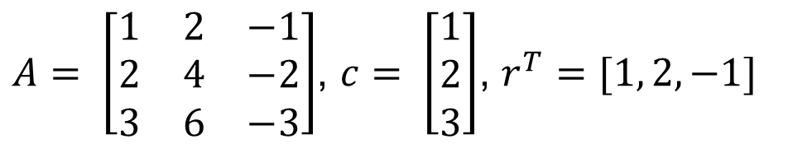
Rank-1 matrices
A rank-1 matrix is the result of the outer product of two vectors
Outer product: $uv^{T}$ ($n1 ,1m → nm$)
  $uv^{T}=\left[\begin{aligned}u_{1} \\ ⋮ \\ u_{i} \\ ⋮ \\ u_{n}\end{aligned}\right]\left[v_{1} …v_{j} …v_{m}\right]=\left[\begin{matrix}u_{1}v_{1} & \begin{matrix}⋯ & u_{1}v_{j} & ⋯\end{matrix} & u_{1}v_{m} \\ \begin{matrix}⋮ \\ u_{i}v_{1} \\ ⋮\end{matrix} & \begin{matrix}⋮ \\ \begin{matrix}⋯ & u_{i}v_{j} & ⋯\end{matrix} \\ ⋮\end{matrix} & \begin{matrix}⋮ \\ u_{i}v_{m} \\ ⋮\end{matrix} \\ u_{n}v_{1} & \begin{matrix}⋯ & u_{n}v_{j} & ⋯\end{matrix} & u_{n}v_{m}\end{matrix}\right]$
The resulting $nm$ matrix has rank 1: all rows (or columns) are linearly dependent
$A=cr^{T}$
$A= \left[\begin{matrix}1 & 2 & −1 \\ 2 & 4 & −2 \\ 3 & 6 & −3\end{matrix}\right]$, $c= \left[\begin{matrix}1 \\ 2 \\ 3\end{matrix}\right]$, $r^{T}=[1, 2,−1]$

Slide 19

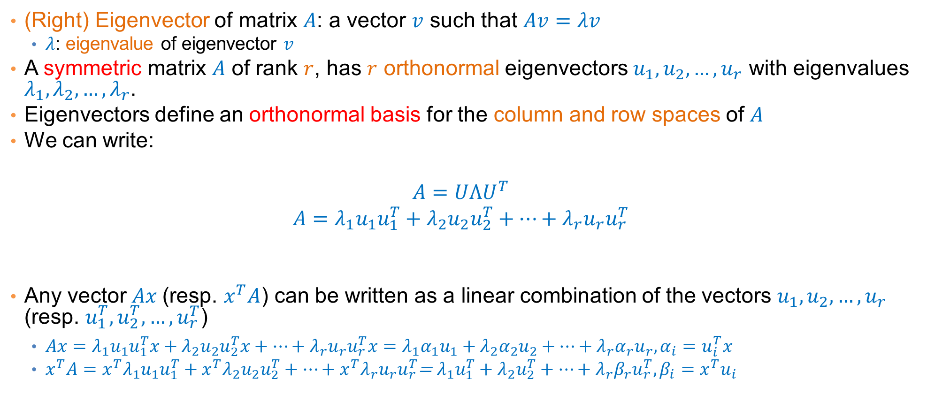

Eigenvectors
(Right) Eigenvector of matrix $A$: a vector $v$ such that $Av=λv$
  $λ$: eigenvalue of eigenvector $v$
A symmetric matrix $A$ of rank $r$, has $r$ orthonormal eigenvectors $u_{1},u_{2},…,u_{r}$ with eigenvalues $λ_{1},λ_{2},…,λ_{r}$.
Eigenvectors define an orthonormal basis for the column and row spaces of $A$
We can write:
$$A=UΛU^{T}$$
$$A=λ_{1}u_{1}u_{1}^{T}+λ_{2}u_{2}u_{2}^{T}+⋯+λ_{r}u_{r}u_{r}^{T}$$
Any vector $Ax$(resp. $x^{T}A$) can be written as a linear combination of the vectors $u_{1},u_{2},…,u_{r}$ (resp. $u_{1}^{T},u_{2}^{T},…,u_{r}^{T}$)
  $Ax=λ_{1}u_{1}u_{1}^{T}x+λ_{2}u_{2}u_{2}^{T}x+⋯+λ_{r}u_{r}u_{r}^{T}x=λ_{1}{α_{1}u}_{1}+λ_{2}{α_{2}u}_{2}+⋯+λ_{r}α_{r}u_{r}, α_{i}=u_{i}^{T}x$
  $x^{T}A={x^{T}λ}_{1}u_{1}u_{1}^{T}+{x^{T}λ}_{2}u_{2}u_{2}^{T}+⋯+x^{T}λ_{r}u_{r}u_{r}^{T}$= $λ_{1}u_{1}^{T}+λ_{2}u_{2}^{T}+⋯+λ_{r}β_{r}u_{r}^{T}, β_{i}=x^{T}u_{i}$
$$U=\left[\begin{matrix}\begin{aligned}| \\ u_{1} \\ |\end{aligned} & \begin{matrix}\begin{aligned}| \\ u_{2} \\ |\end{aligned} & ⋯\end{matrix} & \begin{aligned}| \\ u_{r} \\ |\end{aligned}\end{matrix}\right]$$
$$Λ=\left[\begin{matrix}\begin{matrix}λ_{1} & \\ & λ_{2}\end{matrix} & 0 \\ 0 & \begin{matrix}⋱ & \\ & λ_{r}\end{matrix}\end{matrix}\right]$$

Slide 20
SINGULAR VALUE DECOMPOSITION (SVD)

Slide 21

Singular Value Decomposition (SVD)
$$A=U Σ{ V}^{T}= \left[u_{1}, u_{2}, ⋯,u_{r}\right]\left[\begin{matrix}\begin{matrix}σ_{1} & \\ & σ_{2}\end{matrix} & 0 \\ 0 & \begin{matrix}⋱ & \\ & σ_{r}\end{matrix}\end{matrix}\right]\left[\begin{matrix}\begin{matrix}v_{1}^{T} \\ v_{2}^{T}\end{matrix} \\ ⋮ \\ v_{r}^{T}\end{matrix}\right]$$
$σ_{1},≥σ_{2}≥…≥σ_{r}$: singular values of matrix $A$
$u_{1},u_{2},…,u_{r}$: left singular vectors of $A$
$v_{1},v_{2},…,v_{r}$: right singular vectors of $A$
$$A=σ_{1}u_{1}v_{1}^{T}+σ_{2}u_{2}v_{2}^{T}+⋯+σ_{r}u_{r}v_{r}^{T}$$
[n×m] =
[n×r]
[r×r]
[r×m]
r: rank of matrix A
SVD can be computed for any matrix (not necessarily symmetric or square)

Slide 22
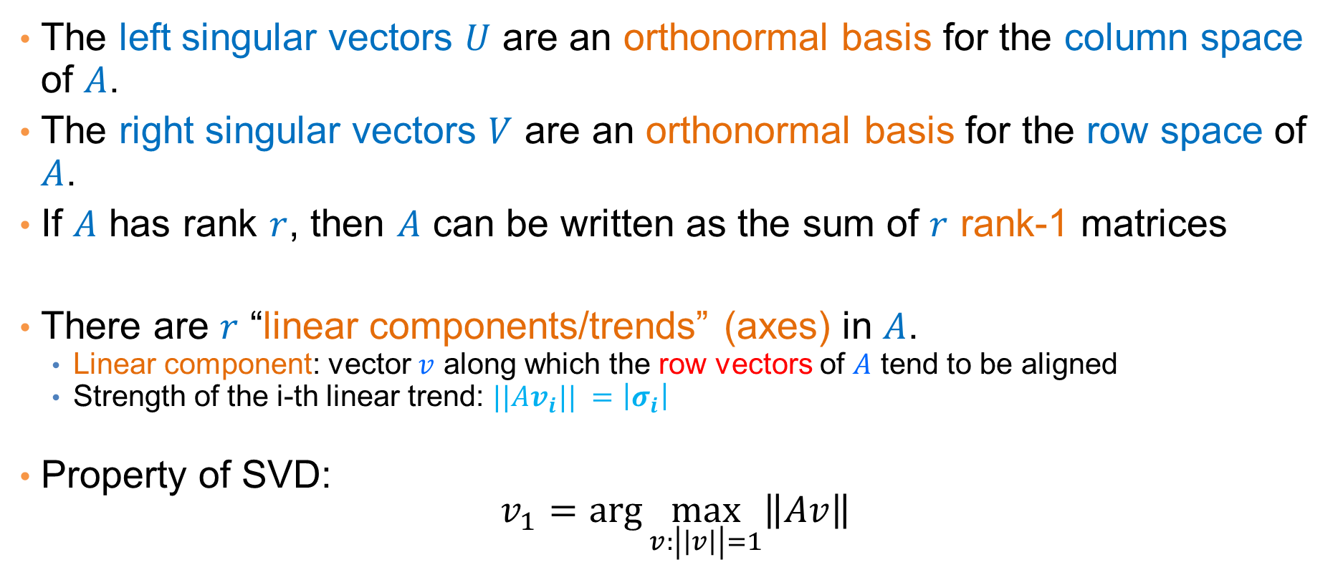
Singular Value Decomposition
The left singular vectors $U$ are an orthonormal basis for the column space of $A$.
The right singular vectors $V$ are an orthonormal basis for the row space of $A$.
If $A$ has rank $r$, then $A$ can be written as the sum of $r$ rank-1 matrices
There are $r$ “linear components/trends” (axes) in $A$.
  Linear component: vector $v$ along which the row vectors of $A$ tend to be aligned
  Strength of the i-th linear trend: $||Av_{i}|| =\left|σ_{i}\right|$
Property of SVD:
$$v_{1}=\arg{\max_{v:\left|\left|v\right|\right|=1}\left\|Av\right\|}$$

Slide 23
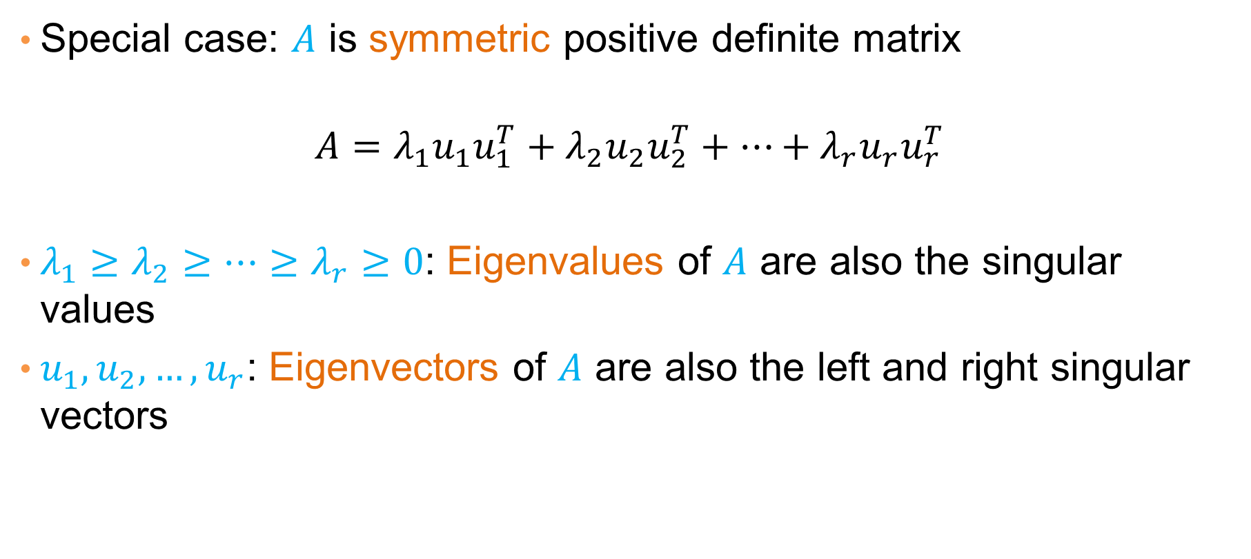
Symmetric matrices
Special case: $A$ is symmetric positive definite matrix
$$A=λ_{1}u_{1}u_{1}^{T}+λ_{2}u_{2}u_{2}^{T}+⋯+λ_{r}u_{r}u_{r}^{T}$$
$λ_{1}≥λ_{2}≥⋯≥λ_{r}≥0$: Eigenvalues of $A$ are also the singular values
$u_{1},u_{2},…, u_{r}$: Eigenvectors of $A$ are also the left and right singular vectors

Slide 24
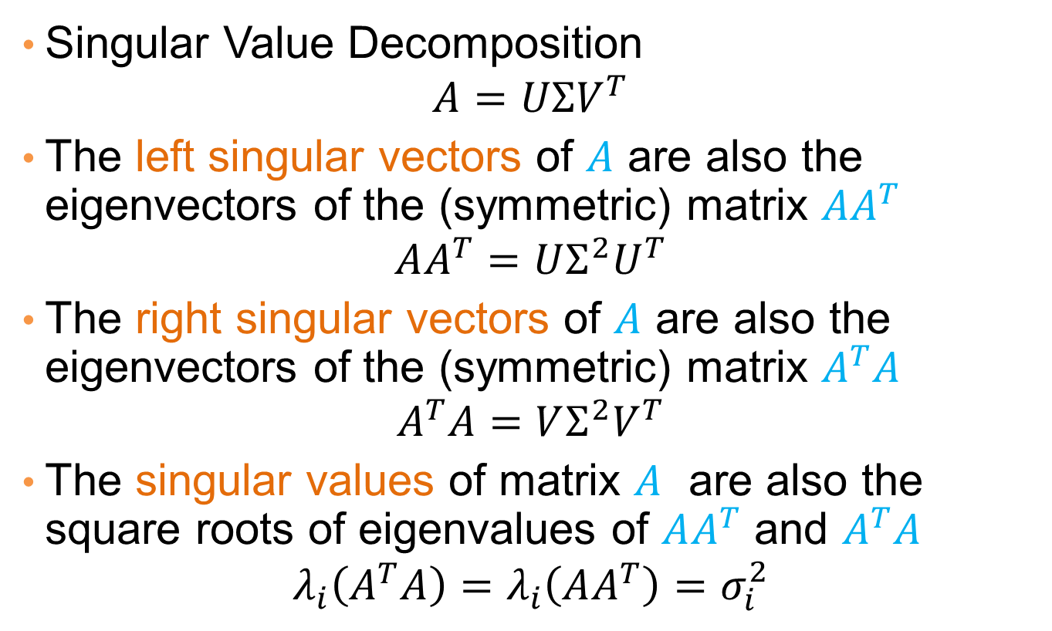
Singular Values and Eigenvalues
Singular Value Decomposition
$$A=UΣV^{T}$$
The left singular vectors of $A$ are also the eigenvectors of the (symmetric) matrix $AA^{T}$
$$AA^{T}=UΣ^{2}U^{T}$$
The right singular vectors of $A$ are also the eigenvectors of the (symmetric) matrix $A^{T}A$
$$A^{T}A=VΣ^{2}V^{T}$$
The singular values of matrix $A$ are also the square roots of eigenvalues of $AA^{T}$ and $A^{T}A$
$$λ_{i}\left(A^{T}A\right)=λ_{i}\left(AA^{T}\right)=σ_{i}^{2}$$

Slide 25
SVD properties
Singular Value Decomposition has three useful properties that we will study now:
  It provides the important (principal) directions (dimensions) in the data – Principal Component Analysis
  It provides the best low rank approximation for our matrix
  It minimizes the reconstruction error (squared distance between real data points and their estimates)

Slide 26
PRINCIPAL COMPONENT ANALYSIS (PCA)

Slide 27
Principal Component Analysis
Goal: reduce the dimensionality while preserving the “information in the data”.
In the new space we want to:
  Maximize the amount of information
  Minimize redundancy – remove the redundant dimensions
  Minimize the noise in the data.

Slide 28
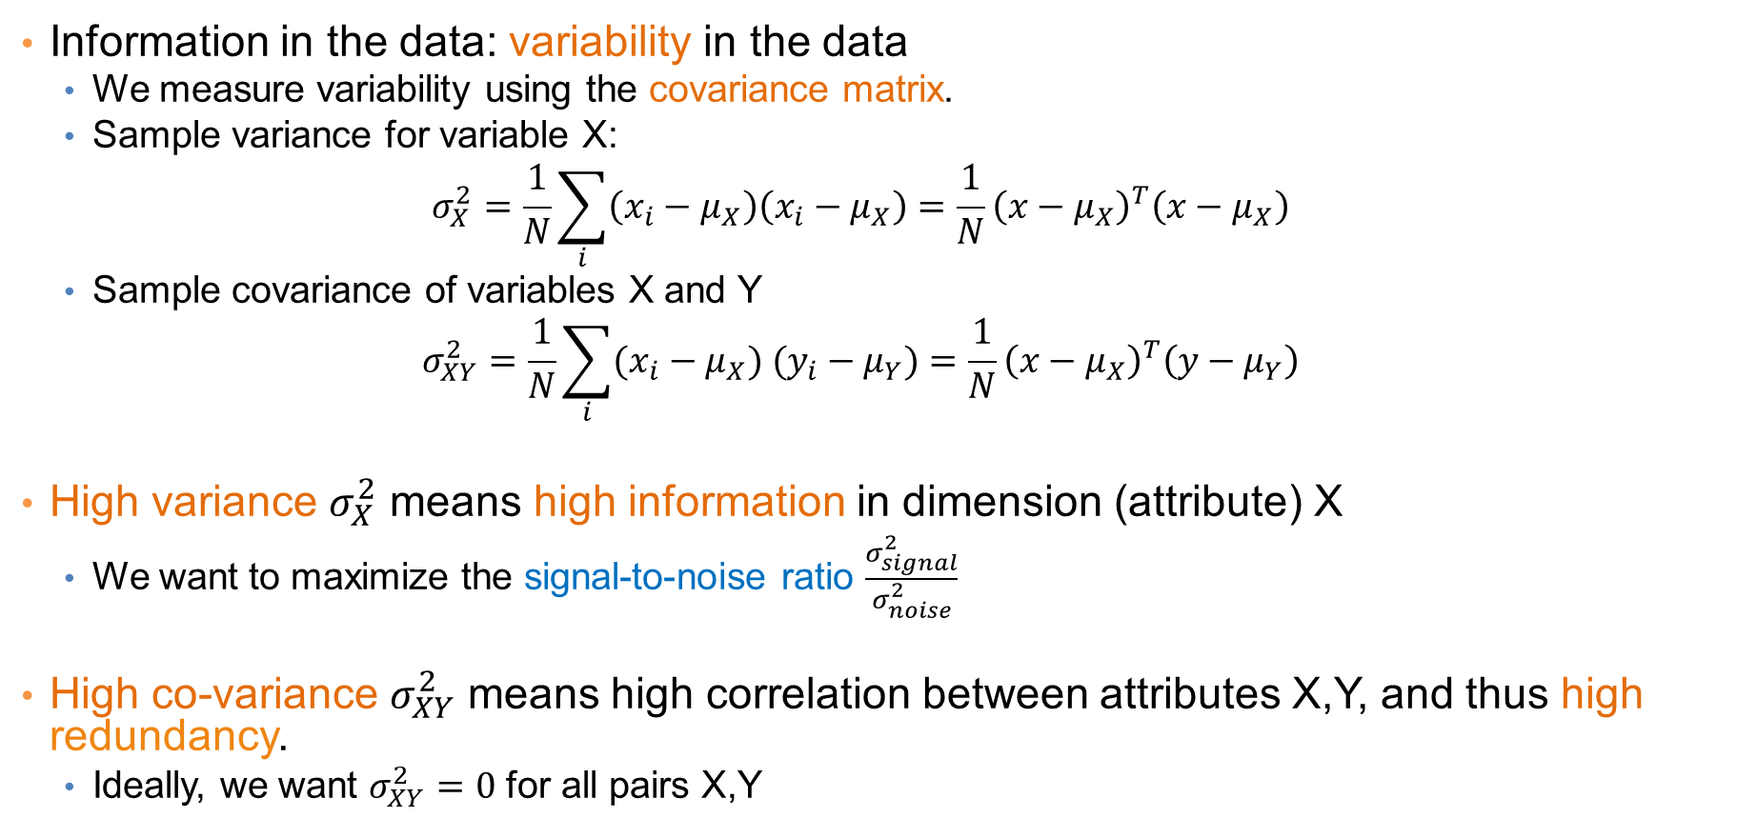
Variability
Information in the data: variability in the data
  We measure variability using the covariance matrix.
  Sample variance for variable X:
  $$σ_{X}^{2}=\frac{1}{N}\sum_{i}{\left(x_{i}−μ_{X}\right)\left(x_{i}−μ_{X}\right)}={\frac{1}{N}\left(x−μ_{X}\right)}^{T}\left(x−μ_{X}\right)$$
  Sample covariance of variables X and Y
  $$σ_{XY}^{2}=\frac{1}{N}\sum_{i}{(x_{i}−μ_{X}) (y_{i}−μ_{Y})}={\frac{1}{N}\left(x−μ_{X}\right)}^{T}\left(y−μ_{Y}\right)$$
High variance $σ_{X}^{2}$ means high information in dimension (attribute) X
  We want to maximize the signal-to-noise ratio $\frac{σ_{signal}^{2}}{σ_{noise}^{2}}$
High co-variance $σ_{XY}^{2}$ means high correlation between attributes X,Y, and thus high redundancy.
  Ideally, we want $σ_{XY}^{2}=0$ for all pairs X,Y

Slide 29
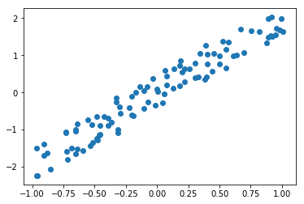


Example
In the data below the data are essentially one-dimensional, but what is the axis we should use?
  The direction in which the variance is maximized.
The variance along the direction orthogonal to the main direction is small and captures the noise in the data
$$σ_{noise}^{2}$$
$$σ_{signal}^{2}$$

Slide 30
Example
Which direction is best to project?

Slide 31
Example
Which direction is best to project?

Slide 32
Example
Which direction is best to project?

Slide 33
Example
Which direction is best to project?

Slide 34
Example
Which direction is best to project?
Note that in the case of blue and green directions we have points that are falling on each other.
The red maximizes the variance, which gives more information

Slide 35
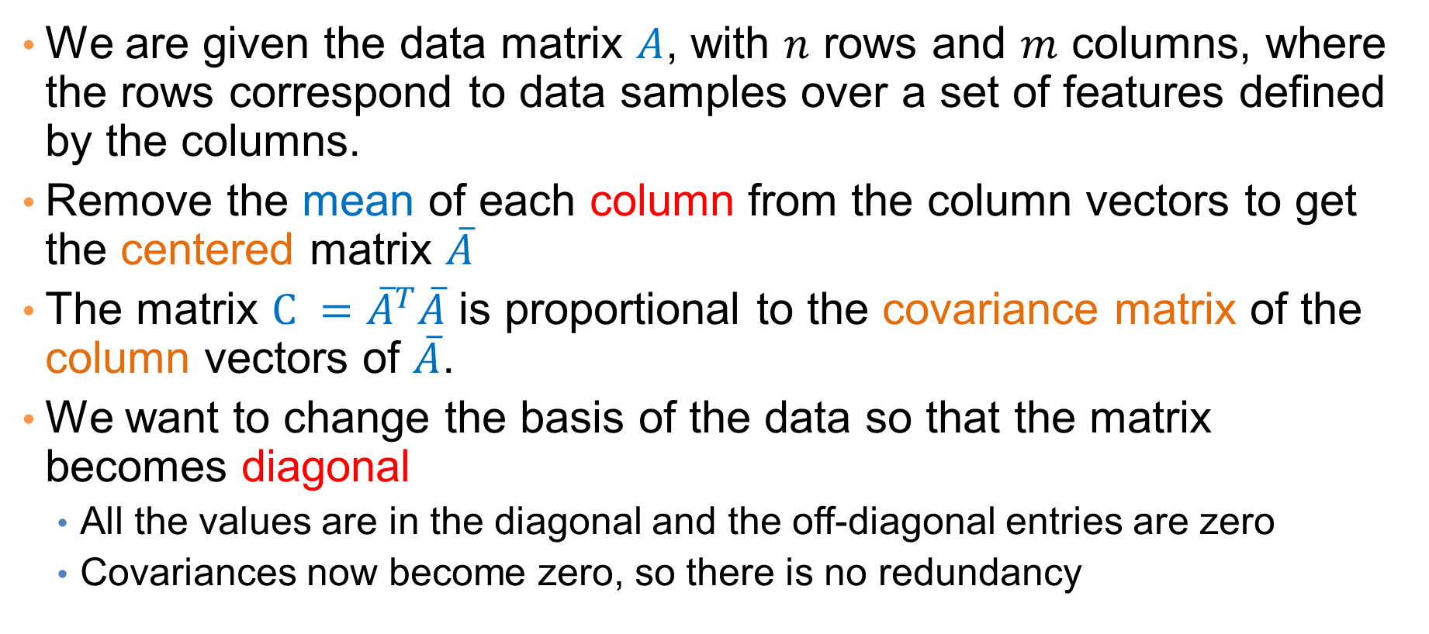
Covariance matrix
We are given the data matrix $A$, with $n$ rows and $m$ columns, where the rows correspond to data samples over a set of features defined by the columns.
Remove the mean of each column from the column vectors to get the centered matrix $\overline{A}$
The matrix $C ={\overline{A}}^{T}\overline{A}$ is proportional to the covariance matrix of the column vectors of $\overline{A}$.
We want to change the basis of the data so that the matrix becomes diagonal
  All the values are in the diagonal and the off-diagonal entries are zero
  Covariances now become zero, so there is no redundancy

Slide 36
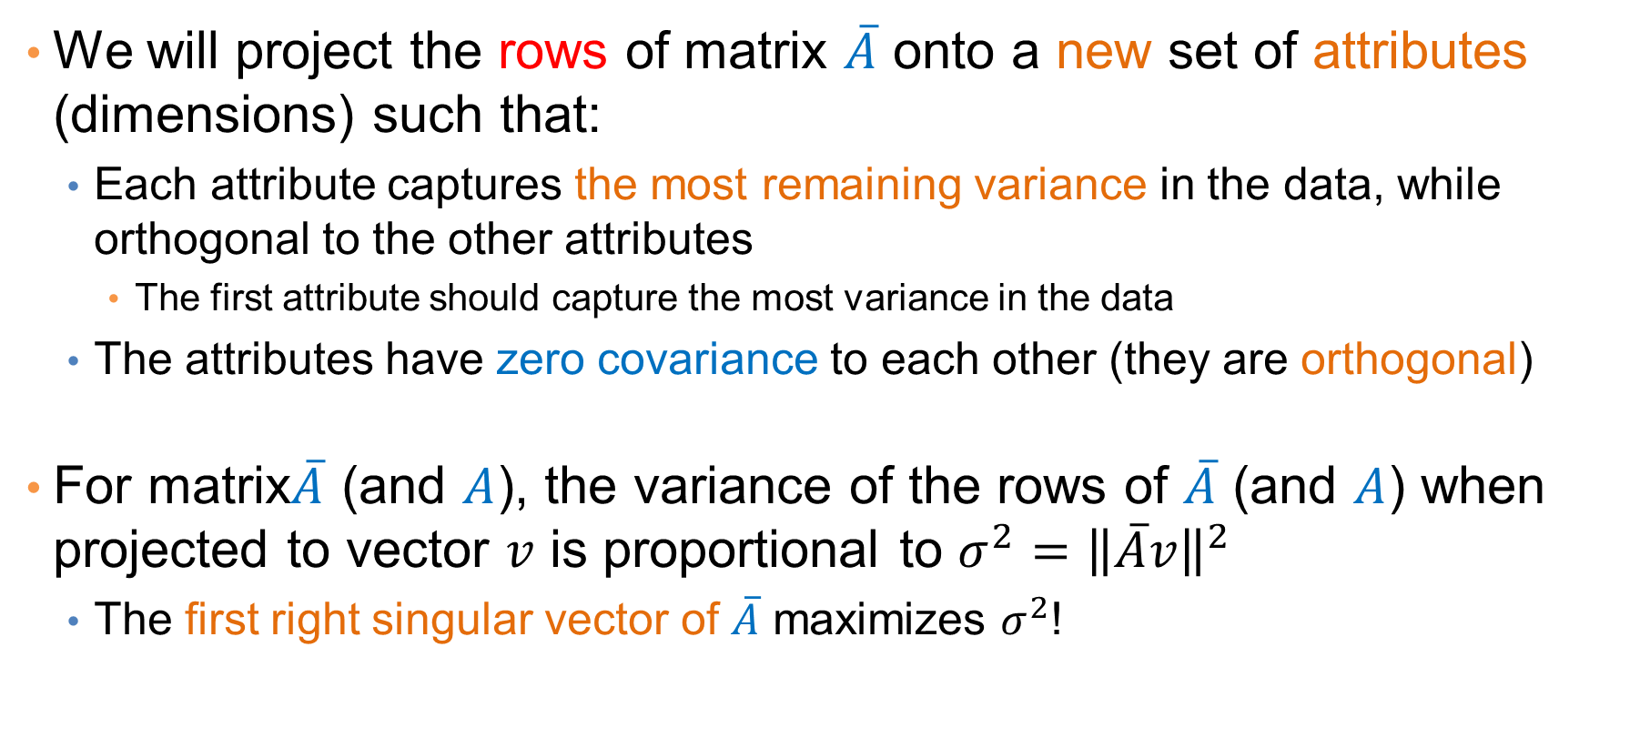
PCA: Principal Component Analysis
We will project the rows of matrix $\overline{A}$ onto a new set of attributes (dimensions) such that:
  Each attribute captures the most remaining variance in the data, while orthogonal to the other attributes
    The first attribute should capture the most variance in the data
  The attributes have zero covariance to each other (they are orthogonal)
For matrix$\overline{A}$ (and $A$), the variance of the rows of $\overline{A}$ (and $A$) when projected to vector $v$ is proportional to $σ^{2}={\left\|\overline{A}v\right\|}^{2}$
  The first right singular vector of $\overline{A}$ maximizes $σ^{2}$!

Slide 37
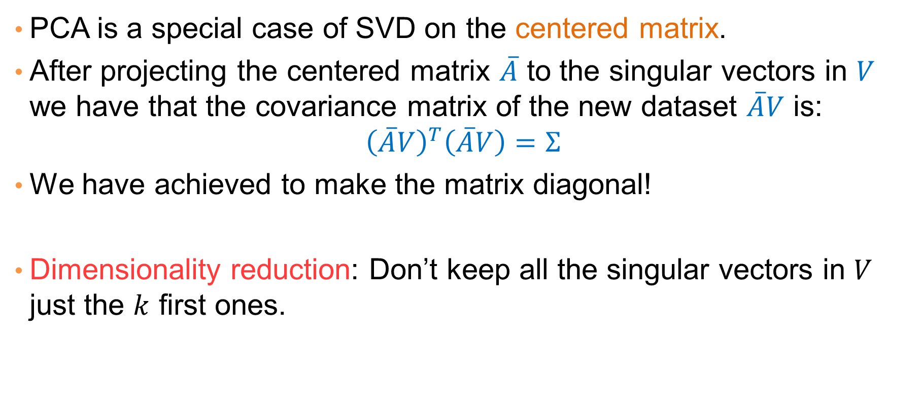
PCA and SVD
PCA is a special case of SVD on the centered matrix.
After projecting the centered matrix $\overline{A}$ to the singular vectors in $V$ we have that the covariance matrix of the new dataset $\overline{A}V$ is:
$${\left(\overline{A}V\right)}^{T}\left(\overline{A}V\right)=Σ$$
We have achieved to make the matrix diagonal!
Dimensionality reduction: Don’t keep all the singular vectors in $V$ just the $k$ first ones.

Slide 38
PCA
Input: 2-d dimensional points
Output:
2nd (right) singular vector
1st (right) singular vector:
direction of maximal variance,
2nd (right) singular vector:
direction of maximal variance, after removing the projection of the data along the first singular vector.
1st (right) singular vector
Notes:
The key observation is that the mean of a column after the projection of the centered matrix remains zero.

Slide 39
Singular values
2nd (right) singular vector
σ₁: measures data variance along the first singular vector.
σ₂: measures how much of the data variance is explained by the second singular vector.
σ₁
1st (right) singular vector

Slide 40
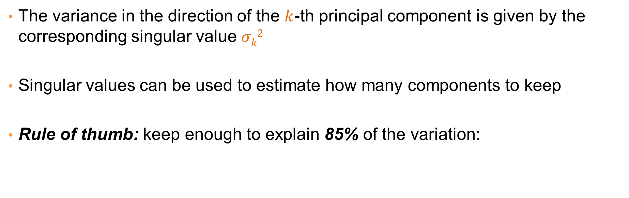
Singular values tell us something about the variance
The variance in the direction of the $k$-th principal component is given by the corresponding singular value $σk2$
Singular values can be used to estimate how many components to keep
Rule of thumb: keep enough to explain 85% of the variation:

Slide 41

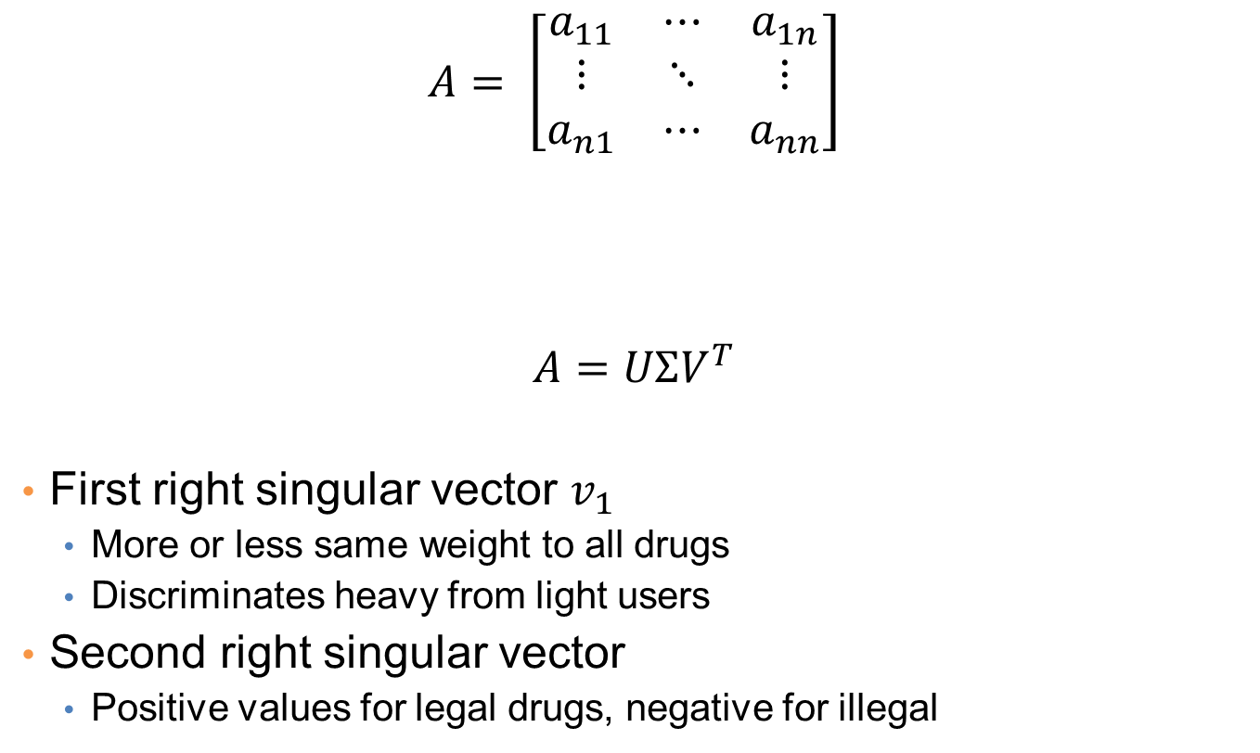
Example
drugs
$$A= \left[\begin{matrix}a_{11} & ⋯ & a_{1n} \\ ⋮ & ⋱ & ⋮ \\ a_{n1} & ⋯ & a_{nn}\end{matrix}\right]$$
$$A=UΣV^{T}$$
First right singular vector $v_{1}$
  More or less same weight to all drugs
  Discriminates heavy from light users
Second right singular vector
  Positive values for legal drugs, negative for illegal
students
legal
illegal
$a_{ij}$: usage of student i of drug j
Drug 1
Drug 2

Slide 42
LOW-RANK APPROXIMATION

Slide 43

SVD and Rank-k approximations
A
=
U
Σ
V^{T}
features
sig.
significant
=
noise
noise
significant
noise
objects
We keep the k most important singular vectors
The matrix $U_{k}Σ_{k}V_{k}^{T}$ is a rank-k approximation of A
The idea is that this is the part that has the useful information and noise is removed
This is also the best rank-k approximation (closest to the original A)

Slide 44
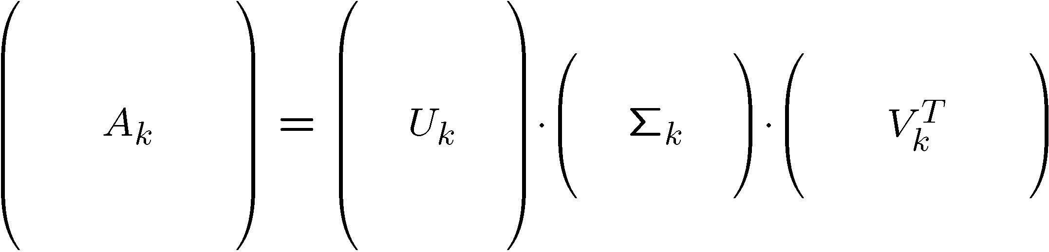
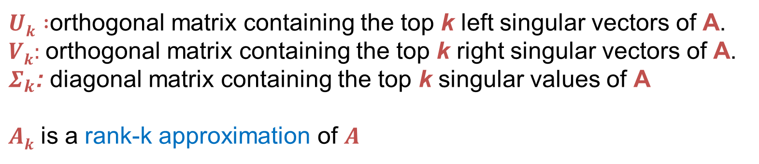

Rank-k approximations (A_{k})
n x d
n x k
k x k
k x d
$Uk :$orthogonal matrix containing the top k left singular vectors of A.
$Vk:$orthogonal matrix containing the top k right singular vectors of A.
$Σ_{k}$: diagonal matrix containing the top k singular values of A
$Ak$ is a rank-k approximation of $A$
$Ak$ is the best approximation of $A$

Slide 45
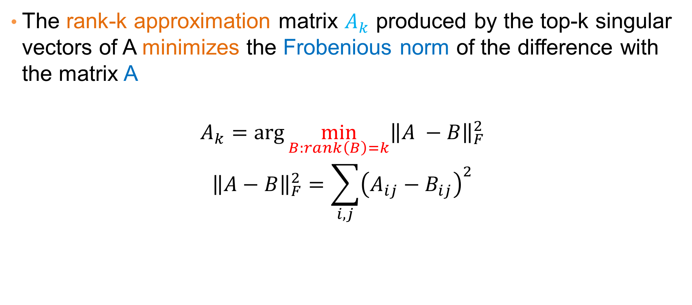
SVD as an optimization
The rank-k approximation matrix $A_{k}$ produced by the top-k singular vectors of A minimizes the Frobenious norm of the difference with the matrix A
$$A_{k}=\arg{\min_{B:rank\left(B\right)=k}{{\left\|A −B\right\|}_{F}^{2}}}$$
$${\left\|A−B\right\|}_{F}^{2}=\sum_{i,j}{{\left(A_{ij}−B_{ij}\right)}^{2}}$$
Explanation: The $(i,j)$ cell in $A_{k}$ is close on average with the $\left(i,j\right)$cell of $A$

Slide 46
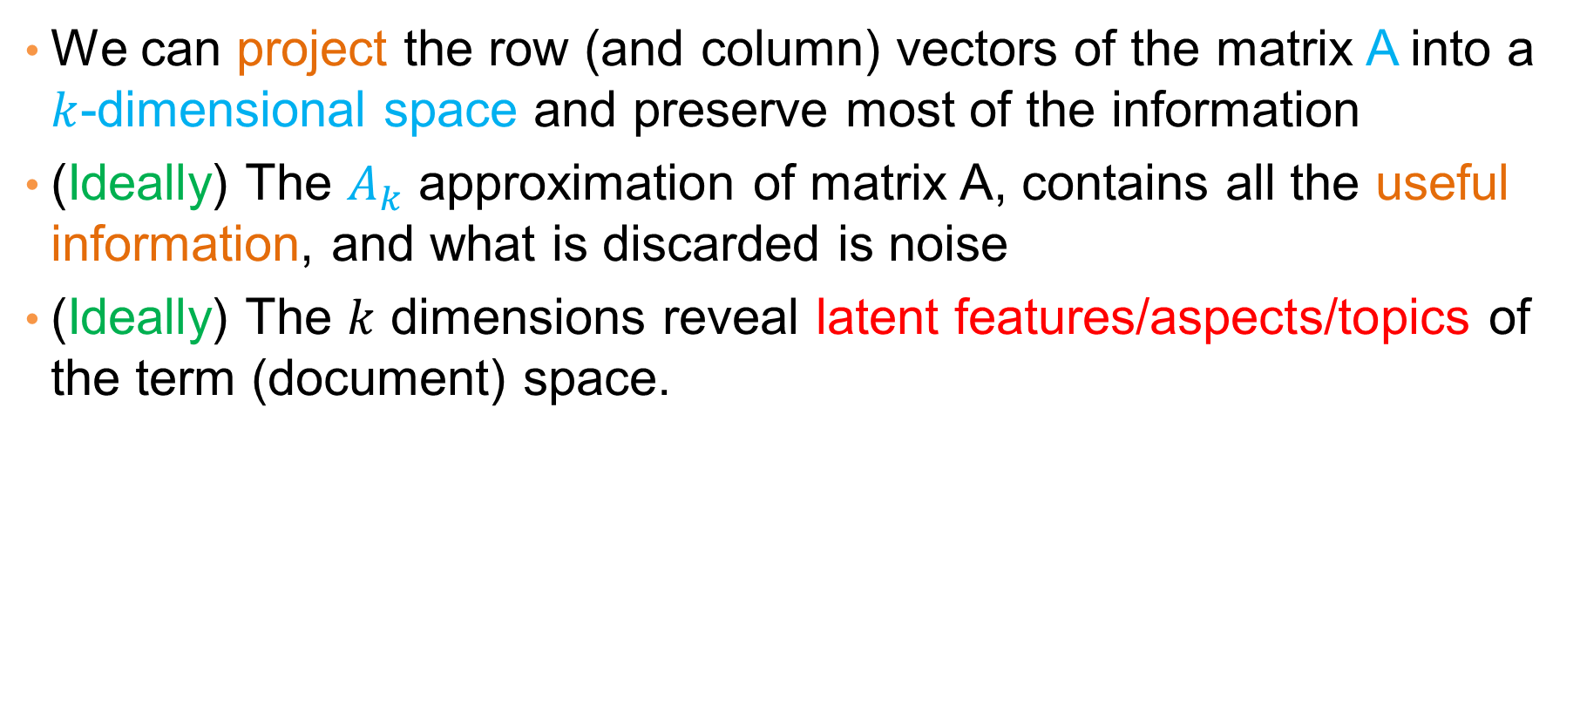
What does this mean?
We can project the row (and column) vectors of the matrix A into a $k$-dimensional space and preserve most of the information
(Ideally) The $A_{k}$ approximation of matrix A, contains all the useful information, and what is discarded is noise
(Ideally) The $k$ dimensions reveal latent features/aspects/topics of the term (document) space.

Slide 47
LATENT FACTOR MODELS AND RECOMMENDATION SYSTEMS

Slide 48
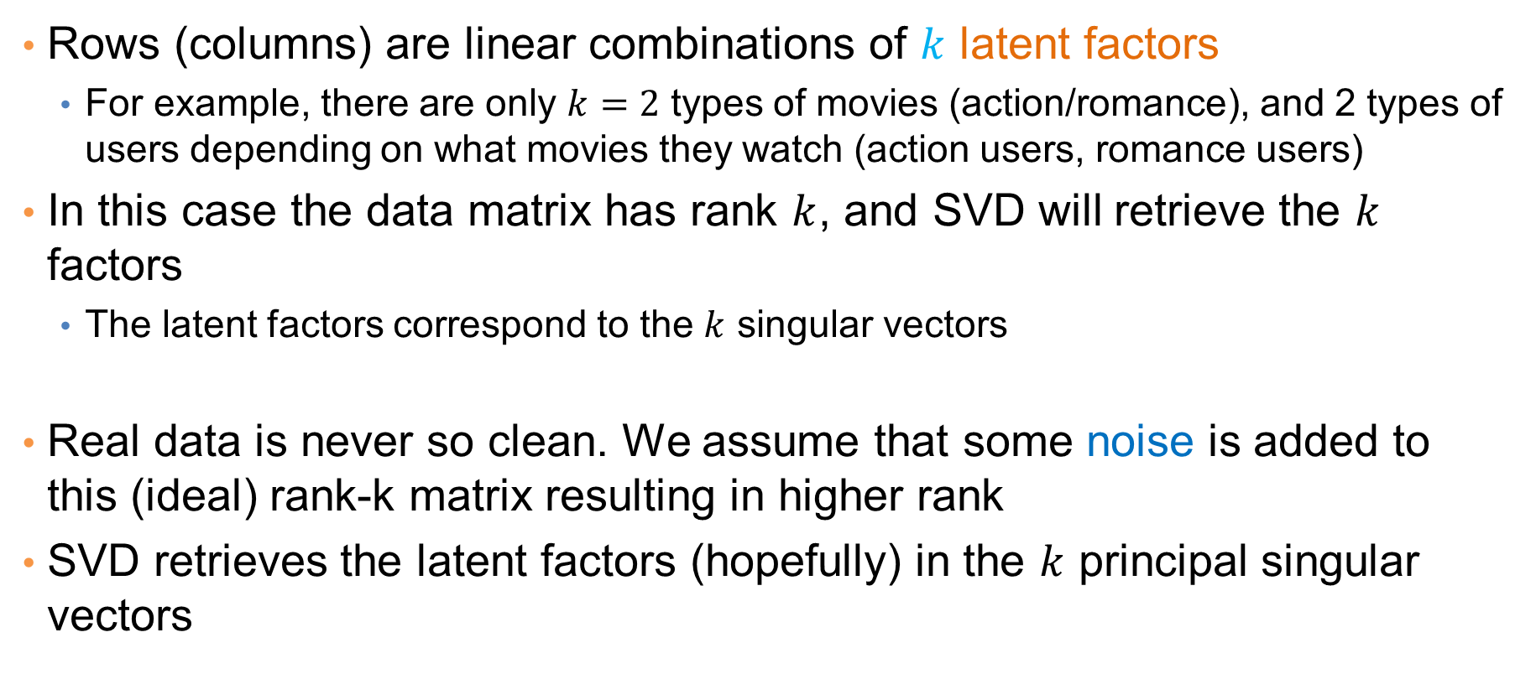
Latent factor model
Rows (columns) are linear combinations of $k$ latent factors
  For example, there are only $k=2$ types of movies (action/romance), and 2 types of users depending on what movies they watch (action users, romance users)
In this case the data matrix has rank $k$, and SVD will retrieve the $k$ factors
  The latent factors correspond to the $k$ singular vectors
Real data is never so clean. We assume that some noise is added to this (ideal) rank-k matrix resulting in higher rank
SVD retrieves the latent factors (hopefully) in the $k$ principal singular vectors

Slide 49
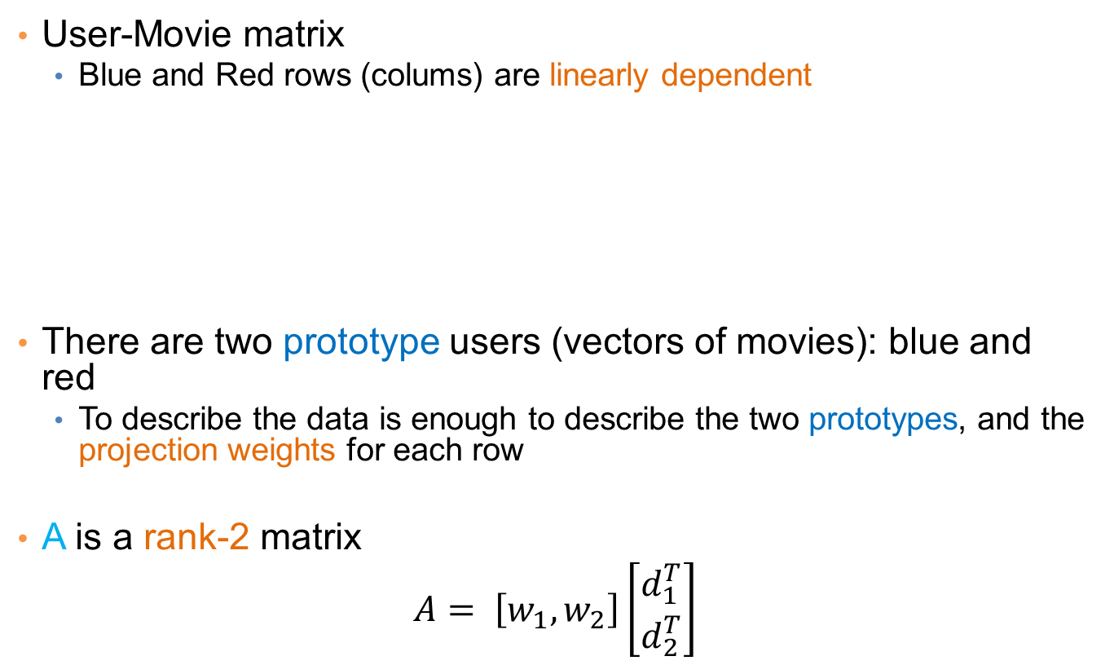
An ideal example
User-Movie matrix
  Blue and Red rows (colums) are linearly dependent
There are two prototype users (vectors of movies): blue and red
  To describe the data is enough to describe the two prototypes, and the projection weights for each row
A is a rank-2 matrix
$$A= \left[w_{1},w_{2}\right]\left[\begin{matrix}d_{1}^{T} \\ d_{2}^{T}\end{matrix}\right]$$
A =

Slide 50
SVD – Example: Users-to-Movies
A = U Σ V^{T} - example: Users to Movies
Matrix
Alien
Serenity
Casablanca
Amelie
n
1 1 1 0 0
3 3 3 0 0
4 4 4 0 0
5 5 5 0 0
0 0 0 4 4
0 0 0 5 5
0 0 0 2 2
SciFi
Σ
V^{T}
=
m
Romance
U
“Concepts”
AKA Latent dimensions
AKA Latent factors

Slide 51
SVD – Example: Users-to-Movies
A = U Σ V^{T} - example: Users to Movies
Matrix
Alien
Serenity
Casablanca
Amelie
SciFi-concept
Romance-concept
1 1 1 0 0
3 3 3 0 0
4 4 4 0 0
5 5 5 0 0
0 0 0 4 4
0 0 0 5 5
0 0 0 2 2
0.14 0.00
0.42 0.00
0.56 0.00
0.70 0.00
0.00 0.60
0.00 0.75
0.00 0.30
SciFi
=
x
12.4 0
0 9.5
x
Romance
0.58 0.58 0.58 0.00 0.00
0.00 0.00 0.00 0.71 0.71
Notes:
Explain what are the values in the columns and the rows of the new matrices, and what are the values in the Sigma matrix

Slide 52
SVD – Example: Users-to-Movies
A = U Σ V^{T} - example: Users to Movies
Matrix
Alien
Serenity
Casablanca
Amelie
SciFi-concept
Romance-concept
U is “user-to-concept”
similarity (or importance) matrix
1 1 1 0 0
3 3 3 0 0
4 4 4 0 0
5 5 5 0 0
0 0 0 4 4
0 0 0 5 5
0 0 0 2 2
0.14 0.00
0.42 0.00
0.56 0.00
0.70 0.00
0.00 0.60
0.00 0.75
0.00 0.30
SciFi
=
x
12.4 0
0 9.5
x
Romance
0.58 0.58 0.58 0.00 0.00
0.00 0.00 0.00 0.71 0.71

Slide 53
SVD – Example: Users-to-Movies
A = U Σ V^{T} - example: Users to Movies
Matrix
Alien
Serenity
Casablanca
Amelie
SciFi-concept
Romance-concept
V is “movie to concept” similarity (or importance) matrix
1 1 1 0 0
3 3 3 0 0
4 4 4 0 0
5 5 5 0 0
0 0 0 4 4
0 0 0 5 5
0 0 0 2 2
0.14 0.00
0.42 0.00
0.56 0.00
0.70 0.00
0.00 0.60
0.00 0.75
0.00 0.30
SciFi
=
x
12.4 0
0 9.5
x
Romance
0.58 0.58 0.58 0.00 0.00
0.00 0.00 0.00 0.71 0.71

Slide 54
SVD – Example: Users-to-Movies
A = U Σ V^{T} - example: Users to Movies
Matrix
Alien
Serenity
Casablanca
Amelie
SciFi-concept
Romance-concept
Σ is the “concept strength” matrix
1 1 1 0 0
3 3 3 0 0
4 4 4 0 0
5 5 5 0 0
0 0 0 4 4
0 0 0 5 5
0 0 0 2 2
0.14 0.00
0.42 0.00
0.56 0.00
0.70 0.00
0.00 0.60
0.00 0.75
0.00 0.30
SciFi
=
x
12.4 0
0 9.5
x
Romance
0.58 0.58 0.58 0.00 0.00
0.00 0.00 0.00 0.71 0.71

Slide 55
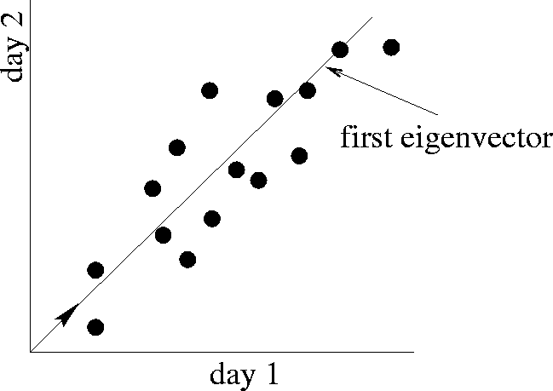
SVD – Example: Users-to-Movies
A = U Σ V^{T} - example: Users to Movies
Matrix
Alien
Serenity
Casablanca
Amelie
Movie 2
1st singular vector
1 1 1 0 0
3 3 3 0 0
4 4 4 0 0
5 5 5 0 0
0 0 0 4 4
0 0 0 5 5
0 0 0 2 2
0.14 0.00
0.42 0.00
0.56 0.00
0.70 0.00
0.00 0.60
0.00 0.75
0.00 0.30
SciFi
Movie 1
=
x
12.4 0
0 9.5
x
Σ is the “spread (variance)” matrix
Romance
0.58 0.58 0.58 0.00 0.00
0.00 0.00 0.00 0.71 0.71

Slide 56

SVD – Example: Users-to-Movies
The axes on which we project the users (rows) are defined by the movies-to-concepts matrix $V$
Similarly for movies the axes are defined by matrix $U$
Matrix
Alien
Serenity
Casablanca
Amelie
1 1 1 0 0
3 3 3 0 0
4 4 4 0 0
5 5 5 0 0
0 0 0 4 4
0 0 0 5 5
0 0 0 2 2
0.14 0.00
0.42 0.00
0.56 0.00
0.70 0.00
0.00 0.60
0.00 0.75
0.00 0.30
0.58 0.00
0.58 0.00
0.58 0.00
0.00 0.71
0.00 0.71
SciFi
x
=
x
12.4 0
0 9.5
Romance

Slide 57
A more realistic example
User-Movie matrix
There are two prototypes of users and movies, but they are noisy
  Missing ratings
  Ratings “out of character”
This is the usual case for real data (lots of missing entries)
A =

Slide 58
SVD – Example: Users-to-Movies
A = U Σ V^{T} - example: Users to Movies
Matrix
Alien
Serenity
Casablanca
Amelie
n
1 1 1 0 0
3 3 3 0 0
4 4 4 0 0
5 5 5 0 0
0 2 0 4 4
0 0 0 5 5
0 1 0 2 2
SciFi
Σ
V^{T}
=
m
Romance
U
“Concepts”
AKA Latent dimensions
AKA Latent factors

Slide 59
SVD – Example: Users-to-Movies
A = U Σ V^{T} - example: Users to Movies
Matrix
Alien
Serenity
Casablanca
Amelie
1 1 1 0 0
3 3 3 0 0
4 4 4 0 0
5 5 5 0 0
0 2 0 4 4
0 0 0 5 5
0 1 0 2 2
0.13 -0.02 -0.01
0.41 -0.07 -0.03
0.55 -0.09 -0.04
0.68 -0.11 -0.05
0.15 0.59 0.65
0.07 0.73 -0.67
0.07 0.29 0.32
SciFi
12.4 0 0
0 9.5 0
0 0 1.3
=
x
x
Romance
0.56 0.59 0.56 0.09 0.09
-0.12 0.02 -0.12 0.69 0.69
0.40 -0.80 0.40 0.09 0.09

Slide 60
SVD – Example: Users-to-Movies
A = U Σ V^{T} - example: Users to Movies
Matrix
Alien
Serenity
Casablanca
Amelie
SciFi-concept
Romance-concept
The first two vectors are more or less unchanged
1 1 1 0 0
3 3 3 0 0
4 4 4 0 0
5 5 5 0 0
0 2 0 4 4
0 0 0 5 5
0 1 0 2 2
0.13 -0.02 -0.01
0.41 -0.07 -0.03
0.55 -0.09 -0.04
0.68 -0.11 -0.05
0.15 0.59 0.65
0.07 0.73 -0.67
0.07 0.29 0.32
SciFi
12.4 0 0
0 9.5 0
0 0 1.3
=
x
x
Rom
0.56 0.59 0.56 0.09 0.09
-0.12 0.02 -0.12 0.69 0.69
0.40 -0.80 0.40 0.09 0.09

Slide 61
SVD – Example: Users-to-Movies
A = U Σ V^{T} - example: Users to Movies
Matrix
Alien
Serenity
Casablanca
Amelie
The third vector has a very low singular value
1 1 1 0 0
3 3 3 0 0
4 4 4 0 0
5 5 5 0 0
0 2 0 4 4
0 0 0 5 5
0 1 0 2 2
0.13 -0.02 -0.01
0.41 -0.07 -0.03
0.55 -0.09 -0.04
0.68 -0.11 -0.05
0.15 0.59 0.65
0.07 0.73 -0.67
0.07 0.29 0.32
SciFi
12.4 0 0
0 9.5 0
0 0 1.3
=
x
x
Rom
0.56 0.59 0.56 0.09 0.09
-0.12 0.02 -0.12 0.69 0.69
0.40 -0.80 0.40 0.09 0.09

Slide 62
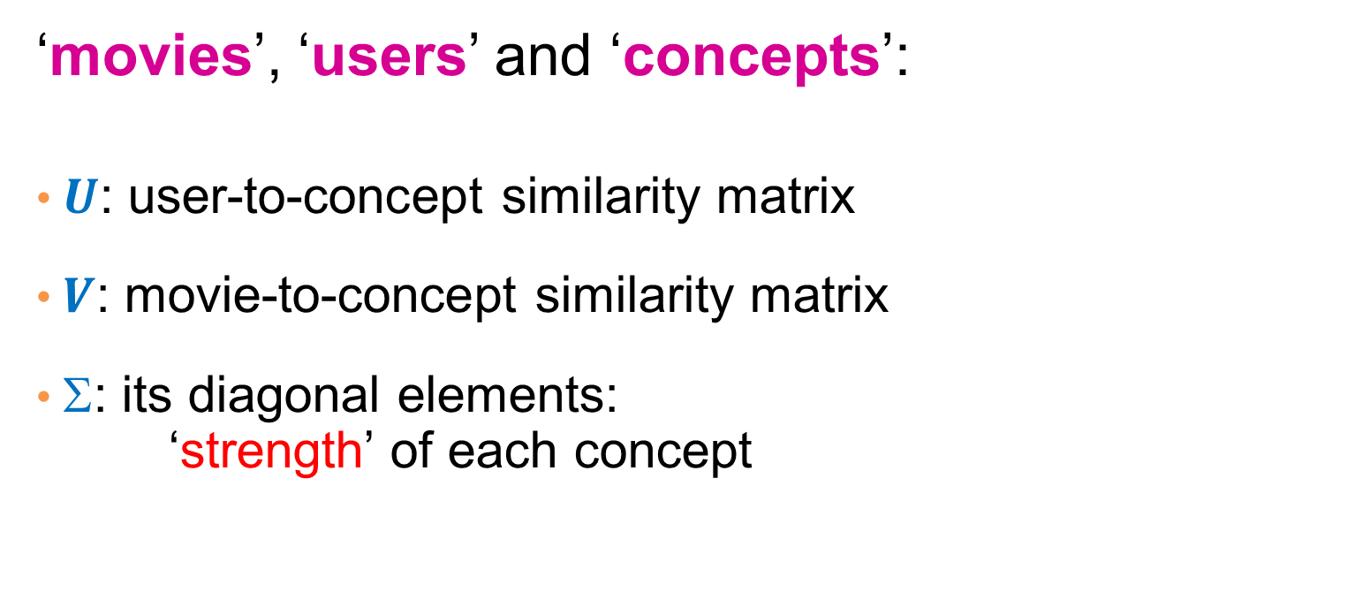
SVD - Interpretation
‘movies’, ‘users’ and ‘concepts’:
$U$: user-to-concept similarity matrix
$V$: movie-to-concept similarity matrix
$$: its diagonal elements:
‘strength’ of each concept

Slide 63
Rank-k approximation
In this User-Movie matrix
We have more than two singular vectors, but the strongest ones are still about the two types.
  The third models the noise in the data
By keeping the two strongest singular vectors we obtain most of the information in the data.
  This is the rank-2 approximation of the matrix A
A =

Slide 64
SVD for matrix reconstruction
We will now see how we can use the fact that SVD gives the best rank-k approximation for a data matrix A.
The idea is that we assume that the “true” matrix is rank-k, and rank is increased due to noise
We use SVD to find the best rank-k approximation for A, and thus the best approximation of the “true” matrix

Slide 65
Example
More details
Q: How exactly is dim. reduction done?
A: Compute SVD
1 1 1 0 0
3 3 3 0 0
4 4 4 0 0
5 5 5 0 0
0 2 0 4 4
0 0 0 5 5
0 1 0 2 2
0.13 -0.02 -0.01
0.41 -0.07 -0.03
0.55 -0.09 -0.04
0.68 -0.11 -0.05
0.15 0.59 0.65
0.07 0.73 -0.67
0.07 0.29 0.32
12.4 0 0
0 9.5 0
0 0 1.3
=
x
x
0.56 0.59 0.56 0.09 0.09
-0.12 0.02 -0.12 0.69 0.69
0.40 -0.80 0.40 0.09 0.09

Slide 66
Example
More details
Q: How exactly is dim. reduction done?
A: Set smallest singular values to zero
1 1 1 0 0
3 3 3 0 0
4 4 4 0 0
5 5 5 0 0
0 2 0 4 4
0 0 0 5 5
0 1 0 2 2
0.13 -0.02 -0.01
0.41 -0.07 -0.03
0.55 -0.09 -0.04
0.68 -0.11 -0.05
0.15 0.59 0.65
0.07 0.73 -0.67
0.07 0.29 0.32
12.4 0 0
0 9.5 0
0 0 1.3
≈
x
x
0.56 0.59 0.56 0.09 0.09
-0.12 0.02 -0.12 0.69 0.69
0.40 -0.80 0.40 0.09 0.09

Slide 67
Example
More details
Q: How exactly is dim. reduction done?
A: Set smallest singular values to zero
1 1 1 0 0
3 3 3 0 0
4 4 4 0 0
5 5 5 0 0
0 2 0 4 4
0 0 0 5 5
0 1 0 2 2
0.13 -0.02 -0.01
0.41 -0.07 -0.03
0.55 -0.09 -0.04
0.68 -0.11 -0.05
0.15 0.59 0.65
0.07 0.73 -0.67
0.07 0.29 0.32
12.4 0 0
0 9.5 0
0 0 1.3
≈
x
x
0.56 0.59 0.56 0.09 0.09
-0.12 0.02 -0.12 0.69 0.69
0.40 -0.80 0.40 0.09 0.09

Slide 68
Example
More details
Q: How exactly is dim. reduction done?
A: Keep the new representation of the users-movies
1 1 1 0 0
3 3 3 0 0
4 4 4 0 0
5 5 5 0 0
0 2 0 4 4
0 0 0 5 5
0 1 0 2 2
0.13 -0.02
0.41 -0.07
0.55 -0.09
0.68 -0.11
0.15 0.59
0.07 0.73
0.07 0.29
12.4 0
0 9.5
≈
x
x
0.56 0.59 0.56 0.09 0.09
-0.12 0.02 -0.12 0.69 0.69

Slide 69
Example
More details
Q: How exactly is dim. reduction done?
A: Compute new matrix that approximates the original (w/o noise)
1 1 1 0 0
3 3 3 0 0
4 4 4 0 0
5 5 5 0 0
0 2 0 4 4
0 0 0 5 5
0 1 0 2 2
0.92 0.95 0.92 0.01 0.01
2.91 3.01 2.91 -0.01 -0.01
3.90 4.04 3.90 0.01 0.01
4.82 5.00 4.82 0.03 0.03
0.70 0.53 0.70 4.11 4.11
-0.69 1.34 -0.69 4.78 4.78
0.32 0.23 0.32 2.01 2.01
≈
Frobenius norm:
ǁMǁ_{F} = √Σ_{ij} M_{ij}²
ǁA-Bǁ_{F} = √ Σ_{ij} (A_{ij}-B_{ij})²
^{is “small”}

Slide 70
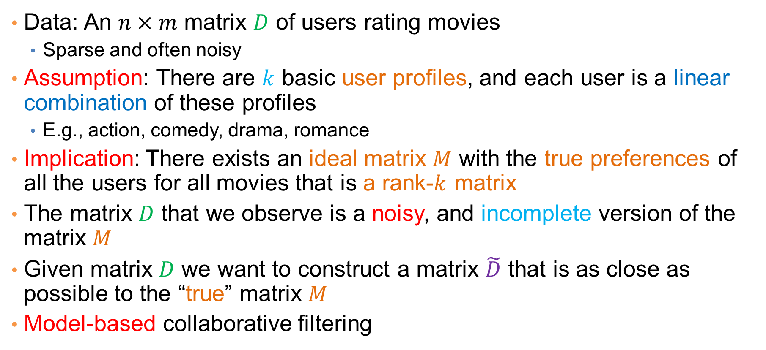
Model-based Recommendation Systems
Data: An $n×m$ matrix $D$ of users rating movies
  Sparse and often noisy
Assumption: There are $k$ basic user profiles, and each user is a linear combination of these profiles
  E.g., action, comedy, drama, romance
Implication: There exists an ideal matrix $M$ with the true preferences of all the users for all movies that is a rank-$k$ matrix
The matrix $D$ that we observe is a noisy, and incomplete version of the matrix $M$
Given matrix $D$ we want to construct a matrix $\tilde{D}$ that is as close as possible to the “true” matrix $M$
Model-based collaborative filtering

Slide 71
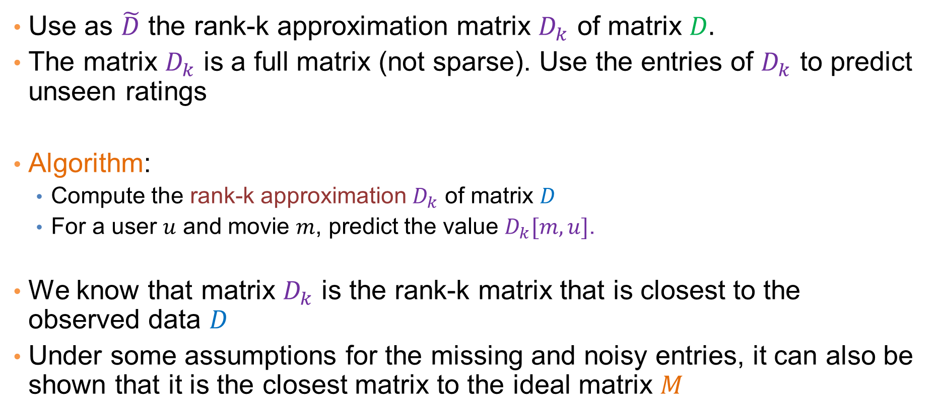
Model-based Recommendation Systems
Use as $\tilde{D}$ the rank-k approximation matrix $D_{k}$ of matrix $D.$
The matrix $D_{k}$ is a full matrix (not sparse). Use the entries of $D_{k}$ to predict unseen ratings
Algorithm:
  Compute the rank-k approximation $D_{k}$ of matrix $D$
  For a user $u$ and movie $m$, predict the value $D_{k}[m,u]$.
We know that matrix $D_{k}$ is the rank-k matrix that is closest to the observed data $D$
Under some assumptions for the missing and noisy entries, it can also be shown that it is the closest matrix to the ideal matrix $M$

Slide 72
Example
Missing ratings and noise
1 1 1 0 0
0 3 3 0 0
4 4 0 0 0
5 5 5 0 0
0 2 0 4 4
0 0 0 5 5
0 1 0 2 2
0.14 -0.06 -0.04
0.30 -0.11 -0.61
0.43 -0.16 0.76
0.74 -0.31 -0.18
0.15 0.53 0.02
0.07 0.70 -0.03
0.07 0.27 0.01
12.4 0 0
0 9.5 0
0 0 1.3
=
x
x
0.51 0.66 0.44 0.23 0.23
-0.24 -0.13 -0.21 0.66 0.66
0.59 0.08 -0.80 0.01 0.01

Slide 73
Example
Missing ratings and noise
1 1 1 0 0
0 3 3 0 0
4 4 0 0 0
5 5 5 0 0
0 2 0 4 4
0 0 0 5 5
0 1 0 2 2
0.14 -0.06 -0.04
0.30 -0.11 -0.61
0.43 -0.16 0.76
0.74 -0.31 -0.18
0.15 0.53 0.02
0.07 0.70 -0.03
0.07 0.27 0.01
12.4 0 0
0 9.5 0
0 0 1.3
=
x
x
0.51 0.66 0.44 0.23 0.23
-0.24 -0.13 -0.21 0.66 0.66
0.59 0.08 -0.80 0.01 0.01

Slide 74
Example
Reconstruction of missing ratings
This is the rank-2 approximation of the input matrix
0.96 1.14 0.82 -0.01 -0.01
1.94 2.32 1.66 0.07 0.07
2.77 3.32 2.37 0.08 0.08
4.84 5.74 4.14 -0.08 0.08
0.40 1.42 0.33 4.06 4.06
-0.42 0.63 -0.38 4.92 4.92
0.20 0.71 0.16 2.03 2.03

Slide 75

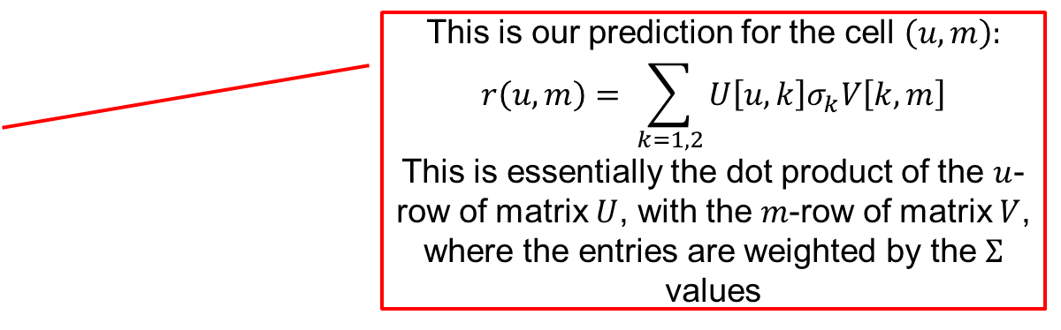

Example
Reconstruction of missing ratings
This is the rank-2 approximation of the input matrix
$$m$$
0.96 1.14 0.82 -0.01 -0.01
1.94 2.32 1.66 0.07 0.07
2.77 3.32 2.37 0.08 0.08
4.84 5.74 4.14 -0.08 0.08
0.40 1.42 0.33 4.06 4.06
-0.42 0.63 -0.38 4.92 4.92
0.20 0.71 0.16 2.03 2.03
This is our prediction for the cell $\left(u,m\right):$
$$r\left(u,m\right)= \sum_{k=1,2}{U\left[u,k\right]σ_{k}V\left[k,m\right]}$$
This is essentially the dot product of the $u$-row of matrix $U$, with the $m$-row of matrix $V$, where the entries are weighted by the $Σ$ values
$$u$$

Slide 76

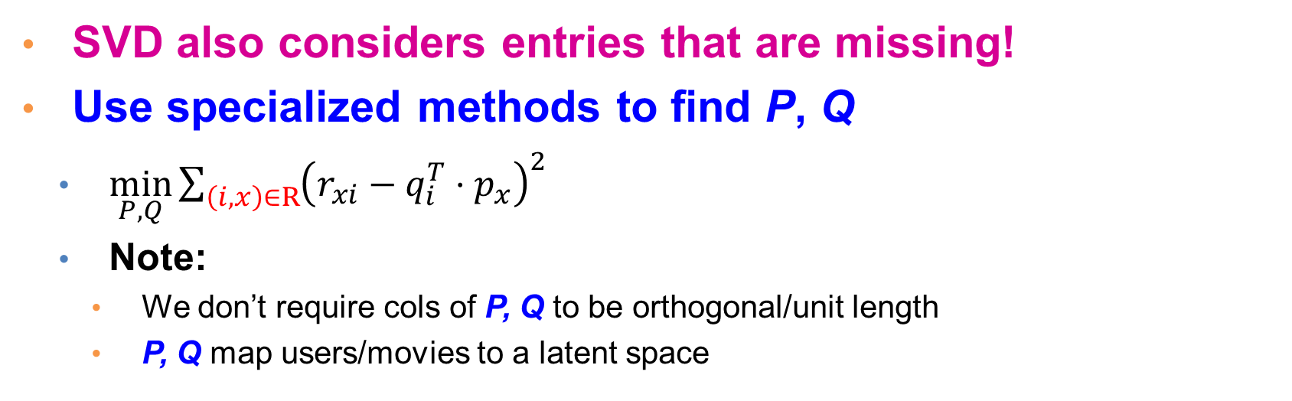

Latent Factor Models
In SVD, for the user-item matrix $D$:
$$D=UΣV$$
$$Q=VΣ^{\frac{1}{2}}$$
$$P=UΣ^{\frac{1}{2}}$$
users
factors
 | 4 |  | 5 |  |  | 5 |  |  | 3 |  | 1
3 | 1 | 2 |  |  | 4 |  |  | 4 | 5
 | 5 | 3 | 4 |  | 3 |  | 2 | 1 |  | 4 | 2
 | 2 |  |  | 4 |  |  | 5 |  | 4 | 2
5 | 2 |  |  |  |  | 2 | 4 | 3 | 4
 | 4 |  |  | 2 |  |  | 3 |  | 3 |  | 1
.2 | -.4 | .1
.5 | .6 | -.5
.5 | .3 | -.2
.3 | 2.1 | 1.1
-2 | 2.1 | -.7
.3 | .7 | -1
users
items
≈
-.9 | 2.4 | 1.4 | .3 | -.4 | .8 | -.5 | -2 | .5 | .3 | -.2 | 1.1
1.3 | -.1 | 1.2 | -.7 | 2.9 | 1.4 | -1 | .3 | 1.4 | .5 | .7 | -.8
.1 | -.6 | .7 | .8 | .4 | -.3 | .9 | 2.4 | 1.7 | .6 | -.4 | 2.1
factors
items
P^{T}
Q
SVD also considers entries that are missing!
Use specialized methods to find P, Q
  $\min_{P,Q}\sum_{\left(i,x\right)∈R}{{\left(r_{xi}−q_{i}^{T}⋅p_{x}\right)}^{2}}$
  Note:
    We don’t require cols of P, Q to be orthogonal/unit length
    P, Q map users/movies to a latent space
$${\hat{r}}_{xi}=q_{i}^{T}⋅p_{x}$$

Slide 77
Latent factors
We can define latent factor models that apply the same idea in different ways
  Probabilistic/Generative models.
These models are also described as Matrix Factorization techniques
The latent factor methods work well in practice, and they are employed by most sophisticated recommendation systems
Today there is also a lot of deep learning involved

Slide 78
OTHER PROPERTIES OF SVD

Slide 79
Another property of PCA/SVD
The chosen vectors are such that minimize the sum of square differences between the data vectors and the low-dimensional projections
1st (right) singular vector

Slide 80
Another Application
Latent Semantic Indexing (LSI):
  Apply PCA on the document-term matrix, and index the k-dimensional vectors
  When a query comes, project it onto the k-dimensional space and compute cosine similarity in this space
  Principal components capture main topics, and enrich the document representation

Slide 81
SVD is “the Rolls-Royce and the Swiss Army Knife of Numerical Linear Algebra.”*
*Dianne O’Leary, MMDS ’06

Slide 82
Other dimensionality reduction techniques
Multidimensional Scaling
  You are given pairwise distances between objects
  Find a low-dimensional representation of the objects (2D for visualization) such that you approximate the distances as well as possible
(Deep) Neural Network Embeddings:
  Use a very simplistic, high-dimensional representation of the data (e.g., one-hot encoding)
  Consider a prediction problem (e.g., predict the context words) and pass the data through a multi-layer neural network.
  Use the input of the last layer as the representation

Slide 83
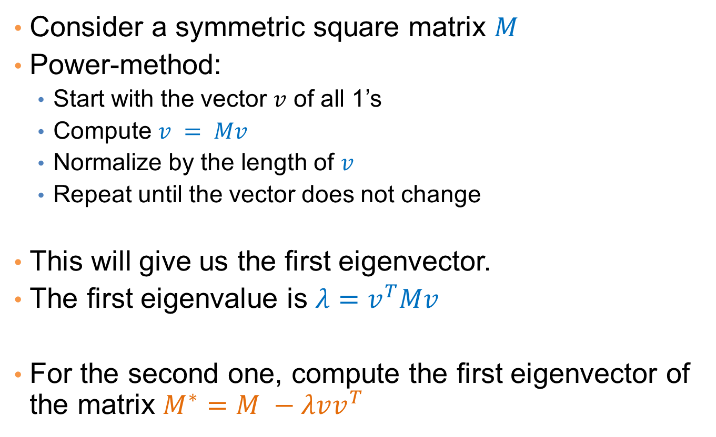
Computation of eigenvectors
Consider a symmetric square matrix $M$
Power-method:
  Start with the vector $v$ of all 1’s
  Compute $v = Mv$
  Normalize by the length of $v$
  Repeat until the vector does not change
This will give us the first eigenvector.
The first eigenvalue is $λ=v^{T}Mv$
For the second one, compute the first eigenvector of the matrix $M^{∗}=M −λvv^{T}$

Slide 84
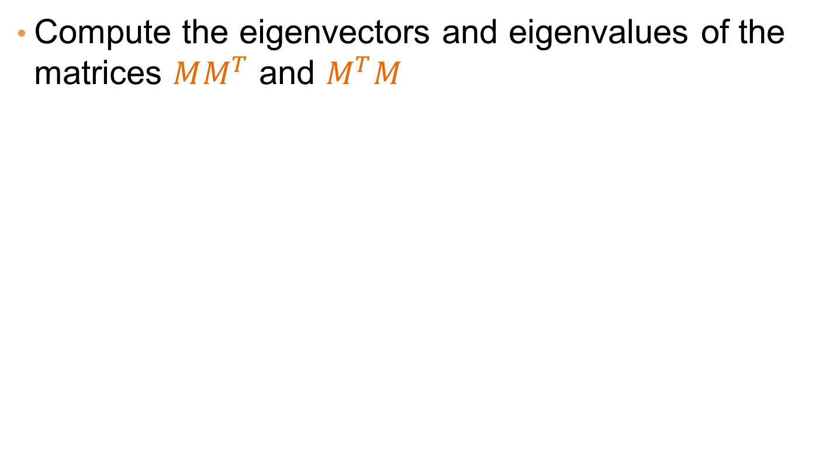
Computing singular vectors
Compute the eigenvectors and eigenvalues of the matrices $MM^{T}$ and $M^{T}M$

