Slide 1


The road to highlights is paved with good intentions: envisioning a paradigm shift in OLAP modeling
Panos Vassiliadis | Patrick Marcel
University of Ioannina, Hellas | University of Tours, France

Slide 2
Why the need for a paradigm shift?
After many years of research on efficiency, ETL, highly distr. progr., …, we have neglected what kind of analysis we offer to end-users
Unless we provide a principled way to handle end-user operations, the industry will do it before us (again) and in ad-hoc manner (again)
We envision a paradigm shift for OLAP, meaning that we need to ….
… Re-invent / Revive / Redefine OLAP with
A new model of what a query is
A new model of what a query answer is

Slide 3
The intentional analytics model
Redefining what a query is

Slide 4
Intentional Analytics model
SQL aggregate queries
Direct implementation in SQL at the db level
At the beginning:
Reporting, but the “kid-who-knows-programming”
Focused on
HOW TO GIVE THE BOSS WHAT I THINK HE NEEDS

Slide 5
Intentional Analytics model
OLAP: Roll-Up, Drill-Down, Drill-Across, Slice
Manipulation at the cube level
On-line processing, by the user himself, focused on
WHAT DATA I NEED
SQL aggregate queries
Direct implementation in SQL at the db level
At the beginning:
Reporting, but the “kid-who-knows-programming”
Focused on
HOW TO GIVE THE BOSS WHAT I THINK HE NEEDS

Slide 6
Intentional Analytics model
OLAP: Explain, Predict, Focus, …
“I want the tool, to explain to me, why sales are dropping”
Manipulation at the INTENTION level
On-line processing, mostly by the tool, focused on
WHAT IS THE GOAL OF MY ANALYSIS
(data is for the db,
Info is for the user)
OLAP: Roll-Up, Drill-Down, Drill-Across, Slice
Manipulation at the cube level
On-line processing, by the user himself, focused on
WHAT DATA I NEED
SQL aggregate queries
Direct implementation in SQL at the db level
At the beginning:
Reporting, but the “kid-who-knows-programming”
Focused on
HOW TO GIVE THE BOSS WHAT I THINK HE NEEDS

Slide 7
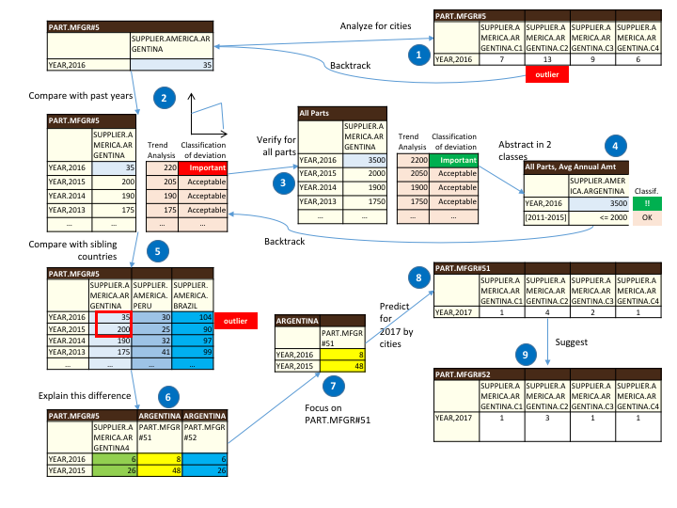

Slide 8
Operator: Analyze
Analyze: I want details on the data you present
Implemented via one drill down or all possible (Cinecubes’ ‘detail’ operator)

Slide 9
Operator: Compare
Compare: contrast a cube/cell with its peer, “similar” cubes/cells
Implemented via drill across or Cinecubes’ ‘put-in-context’ operator

Slide 10
Operator: Verify
Verify: check if a pattern you observe happens also at a broader context
Implemented via Relax operator (observe that the specific part on the left is generalized to all parts at the right)

Slide 11
Operator: Abstract
Abstract: show me less details and a broader context
Implemented via Rollup, clustering, shrink, etc (here: abstract the year dimension)

Slide 12
Operator: Explain
Explain: show me what makes a difference
Implemented via the Diff operator (here in the Fig.) or outlier detection, etc

Slide 13
Operator: FocusOn
Focus On: constrain the scope of analysis
Implemented via sliceNDice, skyline, winnow (top-k), etc.

Slide 14
Operator: Predict
Predict: forecast future values
Implemented via typical timeseries analysis methods (regression, ARIMA, …) as well as classification methods

Slide 15
Operator: Suggest
Suggest: any hint on what should I ask now?
Implemented via query recommendation techniques, or via operators like Inform

Slide 16
How do we change querying?
Focus on the actual goal of the analyst and NOT on the data she wants to get
Let the system decide which data to fetch
OPEN ISSUE: instead of executing EVERY single OLAP operator that corresponds to an intentional operator can we AUTOMATICALLY optimize (a) what we execute and (b) what we show (see next too)
Also in the paper: vision of a language for composing operators
On-Going work: further reduce the set of operators, by abstracting even more!

Slide 17
…Redefine what the answer to an OLAP query is
OK, we redefined what an OLAP query is, but this is not enough. We also suggest that we urgently need to …

Slide 18

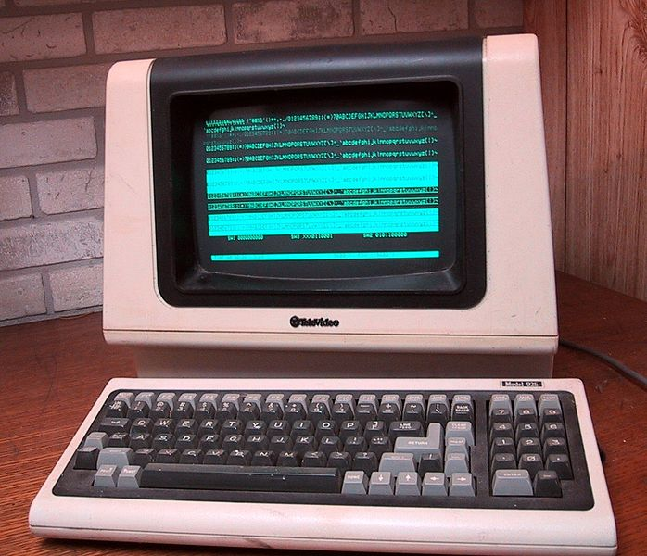
Caught somewhere in time
Query result = (just) a set of tuples
No difference from the 70’s when this assumption was established and tailored for
what people had available then
… a green/orange monochrome screen
… a dot-matrix(?) printer
… nothing else
users being programmers
Photos copied from http://en.wikipedia.org/
Notes:
So far, database systems assume their work is done once results are produced, effectively prohibiting even well-educated end-users to work with them.

Slide 19
The answer to a query can be …
… a set of tuples (traditionally)
… a data movie that includes a set of complementary queries supporting a data story, whose results are properly visualized, enriched with textual comments, and vocally enriched (DOLAP13 Cinecubes for reporting)

Slide 20
The answer to a query can be …
… a set of tuples (traditionally)
… a data movie that includes a set of complementary queries supporting a data story, whose results are properly visualized, enriched with textual comments, and vocally enriched (DOLAP13 Cinecubes for reporting)
… a dashboard that apart from data, also comes with (i) the automatic mining of models and patterns, and (ii) the extraction of “jewels” hidden in the result, which we call highlights, plus, the aforementioned (iii) visuals and generated text (for OLAP)

Slide 21
Data analysis and models
We consider the plugging of data analysis algorithms in the back-stage of a dashboard as an indispensable part of OLAP.
These algorithms can range …
… from very simple ones (e.g., finding the top values of a cuboid, or detecting whether a dimension value is systematically related to top or bottom sales)
…to very complicated ones (like, classification, outlier detection, dimensionality reduction, etc).
The findings of these automatically invoked and executed data analysis algorithms will be the models of the data

Slide 22
Data analysis and models
The findings of automatically invoked and executed data analysis algorithms will be the models of the data
Due to the vastness of the possible models, we need to automatically assess them on their significance for the user and retain the most important ones, which we call highlights

Slide 23
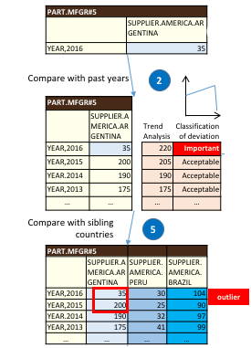
…and what are models and highlights?
Models: concise information-rich abstractions that “mine” relationships and properties from data
Here: (@2) a trend analysis of past sales produces a list of “expected” values + a classification of deviation of achieved sales compared to the actual, labels the result; (@5) an outlier analysis identifies points with high outlierness

Slide 24
…and what are models and highlights?
Highlights: “important” parts of models, linked to data
Here: (@2) sales = 35 having a large deviation from expected and classified as “important” is an important part of the model; similarly, (@5) the outlier is important too

Slide 25
Model components, data and highlights
Models have model components, that can link to source data e.g.,
Α time series model splits a time series measure to trend, seasonality and noise => the source measure is annotated with them
A cluster model = a set of clusters => the source cells can be annotated with the id of the cluster to which they belong.
A classification model groups source data by the label of the class to which they belong.
A model of top-k values of a measure labels source cells with their rank.
Components are linked to their respective data:
A notable property of our modeling is that we require model components to be directly mapped and linked to their generating data in a bidirectional mapping, so that the end-user can navigate back and forth between cube cells and their models.
Highlights are produced by identifying components with “interesting” information, according to the user’s intention

Slide 26
Important questions & challenges
Stay tuned for the long version of the paper for …
… sketch of solutions for:
How do we select which algorithms to execute, how to fine-tune them, and how do we do it in real time?
How do we select highlights out of the vast number of models generated?
Must investigate interestingness wrt intention
… solutions for:
How do we handle the heterogeneity of models?
How do we put data and highlights to work together?
… open for the future:
How do we plug in (a) visualizations and (b) storytelling?

Slide 27
Concluding, we …
… redefine what an OLAP query must be & propose…
Intention queries via intentional operators, that the user can use instead of R-UP’s, DD’s with more ease
Compare, Analyze, Explain, Predict, Verify, Focus, Abstract, …
… redefine what the answer to an OLAP query must be = a dashboard with …
Data from several data cubes
Models with information-rich properties/relationships
Highlights with interesting pointsOfFocus
Visuals and Generated Text
… encourage & invite the community to actively pursue this research avenue now!
Thank you!

