Slide 1
Λ14 Διαδικτυακά Κοινωνικά Δίκτυα και Μέσα
Link Analysis and Web Search
Chapter 14, from D. Easley and J. Kleinberg
Jure Leskovez slides CS224W course

Slide 2
Topics
Web Search
HITS
PageRank

Slide 3
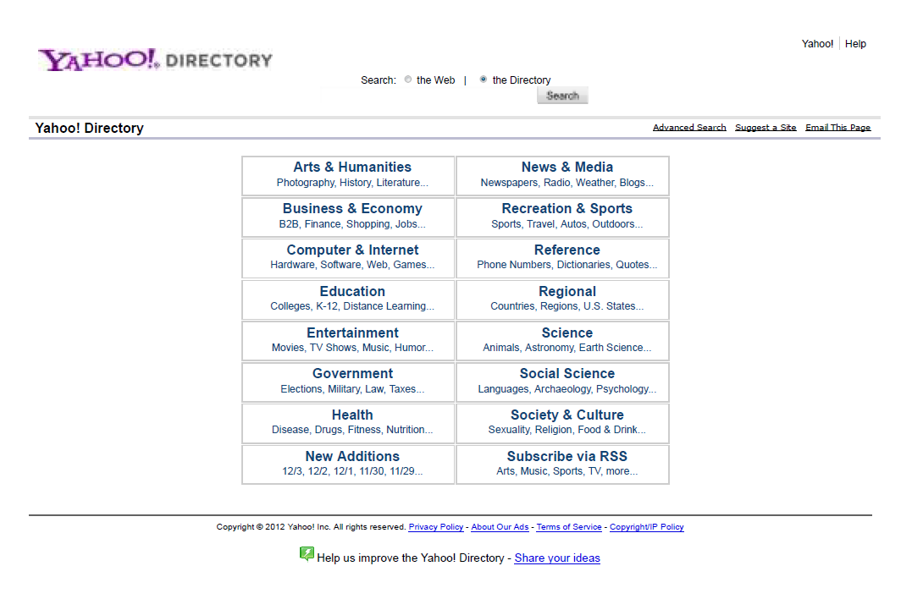
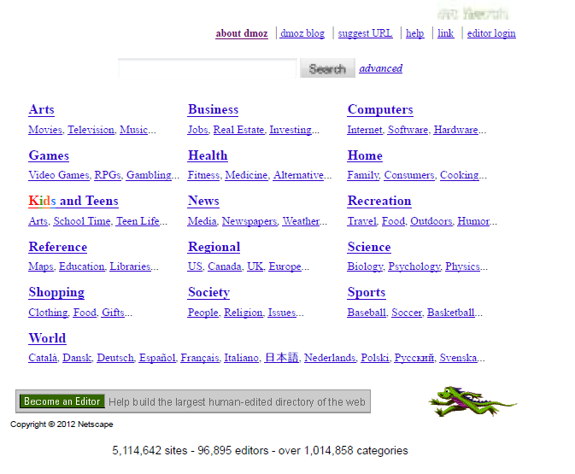
How to Organize the Web
First try: Human curated Web directories
Yahoo, DMOZ, LookSmart

Slide 4
How to Organize the Web
Second try: Web Search
Information Retrieval investigates:
Find relevant docs in a small and trusted set e.g., Newspaper articles, Patents, etc. (“needle-in-a-haystack”)
Limitation of keywords (synonyms, polysemy, etc)
But: Web is huge, full of untrusted documents, random things, web spam, etc.
Everyone can create a web page of high production value
Rich diversity of people issuing queries
Dynamic and constantly-changing nature of web content

Slide 5
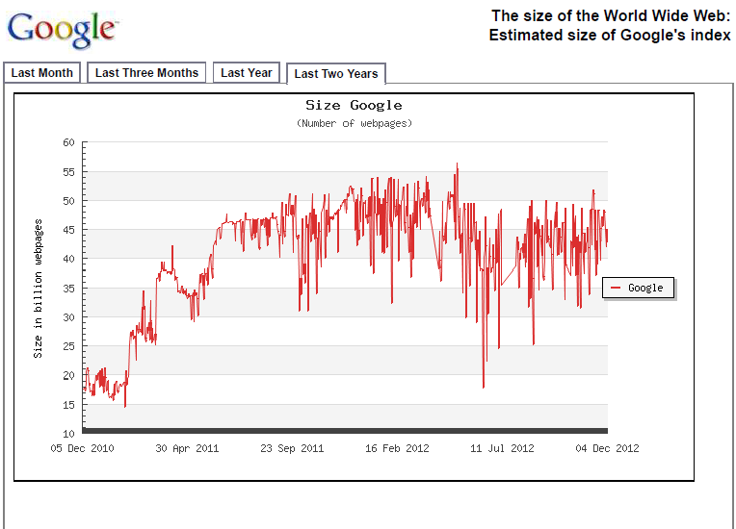
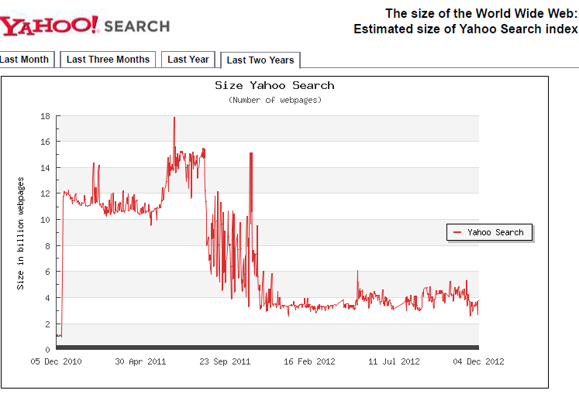
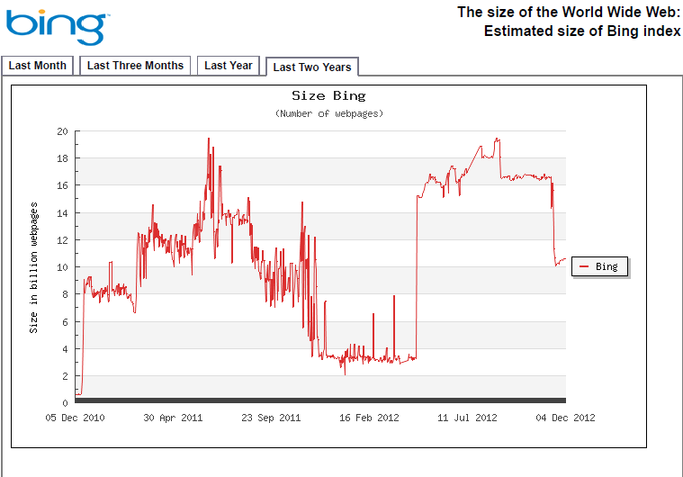
Size of the Search Index
http://www.worldwidewebsize.com/

Slide 6
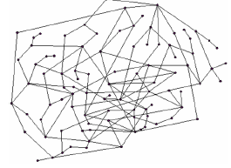
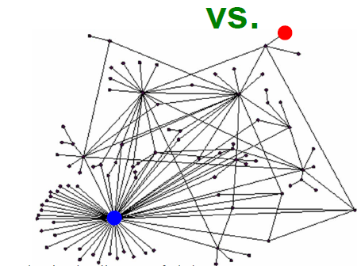
Link Analysis
Not all web pages are equal

Slide 7
Link Analysis Using Hubs and Authorities
Assume you search for “newspaper”
First collect a large number of pages that are relevant to the topic (e.g., using text-only IR)
Note that the pages may not be actual web sites of a “newspaper” but we can use them to access the “authority” of a page on the topic
How?
Relevant pages “vote” through their links
Authority = #in-links from relevant pages

Slide 8
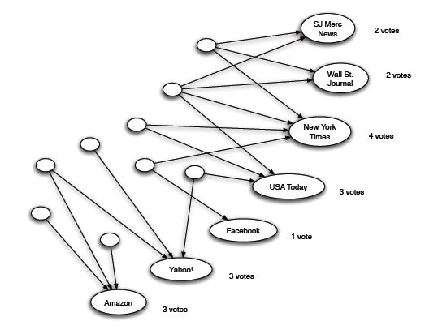
Link Analysis Using Hubs and Authorities
Relevant pages
“quality” of relevant pages?
Best – pages that compile lists of resources relevant to the topic (hubs)

Slide 9
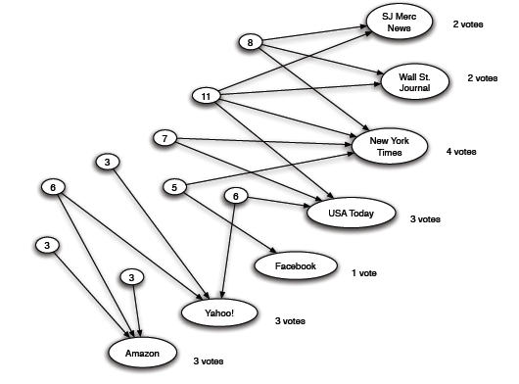
Link Analysis Using Hubs and Authorities
Hubs:
Voted for many of the pages
value of a hub = sum of the votes received by all pages it voted for

Slide 10
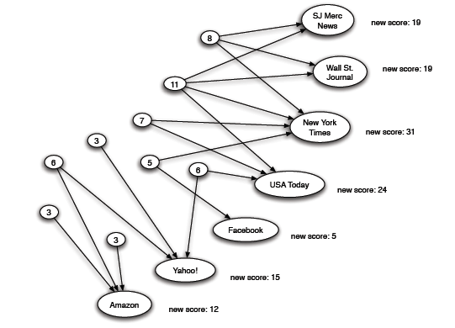
Link Analysis Using Hubs and Authorities: the principle of repeated improvement
Vote (link) from a good “hub” should count more!
Think about restaurant recommendations!!

Slide 11
Link Analysis Using Hubs and Authorities: the principle of repeated improvement
Why stop here?
Recompute the score of the hubs using the improved scores of the authorities!
Repeat .. Recompute the score of the authories using the improved scores of the hubs!
…

Slide 12
Link Analysis Using Hubs and Authorities
Interesting pages fall into two classes:
Authorities are pages containing useful information (the prominent, highly endorsed answers to the queries)
Newspaper home pages
Course home pages
Home pages of auto manufacturers
Hubs are pages that link to authorities (highly value lists)
List of newspapers
Course bulletin
List of US auto manufacturers
A good hub links to many good authorities
A good authority is linked from many good hubs

Slide 13
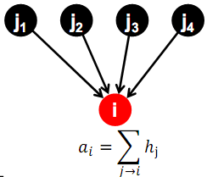
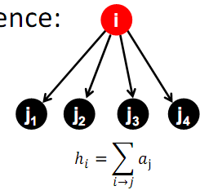
Link Analysis Using Hubs and Authorities: HITS algorithm
Each page p, has two scores
A hub score (h) quality as an expert
Total sum of votes of pages pointed to
An authority score (a) quality as content
Total sum of votes of experts
Authority Update Rule: For each page i, update a(i) to be the sum of the hub scores of all pages that point to it.
Hub Update Rule: For each page i, update h(i) to be the sum of the authority scores of all pages that it points to.
A good hub links to many good authorities
A good authority is linked from many good hubs

Slide 14
Link Analysis Using Hubs and Authorities: HITS algorithm
HITS Algorithm
Start with all hub scores and all authority scores equal to 1.
Choose a number of steps k.
Perform a sequence of k hub-authority updates. For each node:
- First, apply the Authority Update Rule to the current set of scores.
- Then, apply the Hub Update Rule to the resulting set of scores.
At the end, hub and authority scores may be very large.
Normalize: divide each authority score by the sum of all authority scores, and each hub score by the sum of all hub scores.

Slide 15
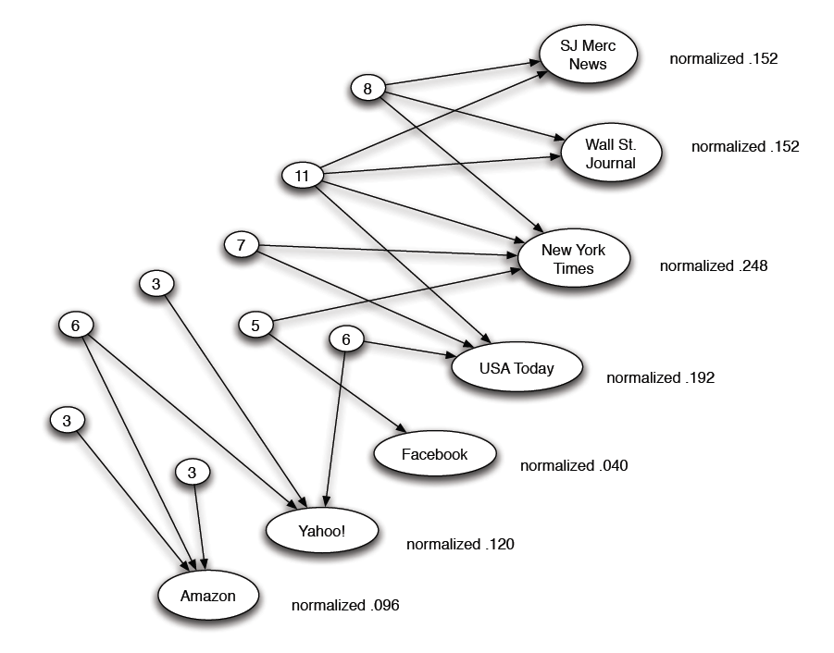
Link Analysis Using Hubs and Authorities: HITS algorithm

Slide 16
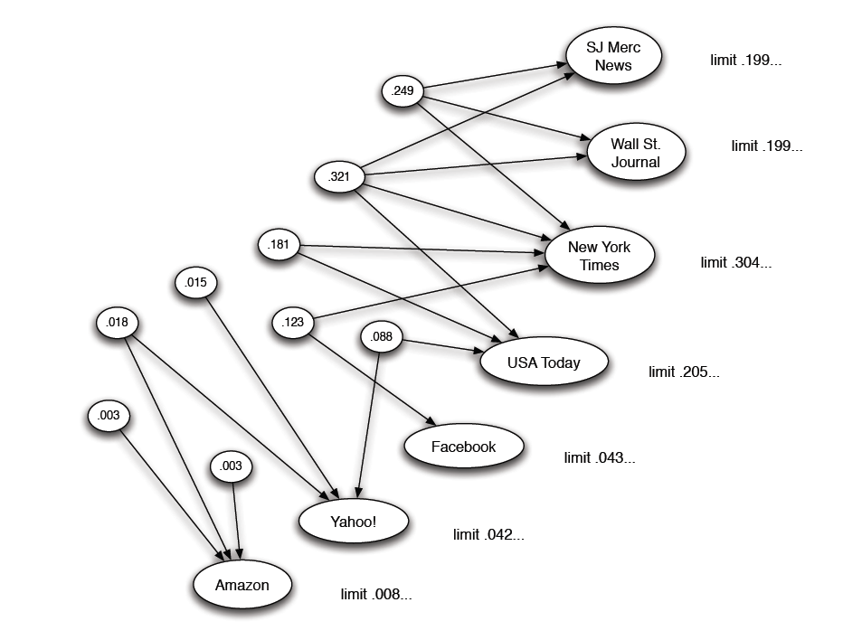
Link Analysis Using Hubs and Authorities: HITS algorithm
Converges?

Slide 17
Hubs and Authorities: Spectral Analysis
Vector representation

Slide 18
Hubs and Authorities: Spectral Analysis

Slide 19
Hubs and Authorities: Spectral Analysis

Slide 20
Hubs and Authorities: Spectral Analysis

Slide 21
PageRank

Slide 22
PageRank
A page is important if it has many links (in-going? outgoing?)
Are all links equal important?
A page is important if it is cited by other important pages

Slide 23
PageRank: flow equations

Slide 24
PageRank: Algorithm
In a network with n nodes, assign all nodes the same initial PageRank = 1/n.
Choose a number of steps k.
Perform a sequence of k updates to the PageRank values, using the following rule:
Basic PageRank Update Rule:
Each page divides its current PageRank equally across its out-going links, and passes these equal shares to the pages it points to.
(If a page has no out-going links, it passes all its current PageRank to itself.)
Each page updates its new PageRank to be the sum of the shares it receives.

Slide 25
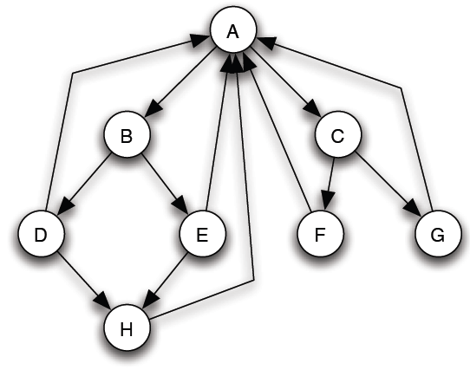
PageRank
Initially, all nodes PageRank 1/8
As a kind of “fluid” that circulates through the network
The total PageRank in the network remains constant (no need to normalize)

Slide 26
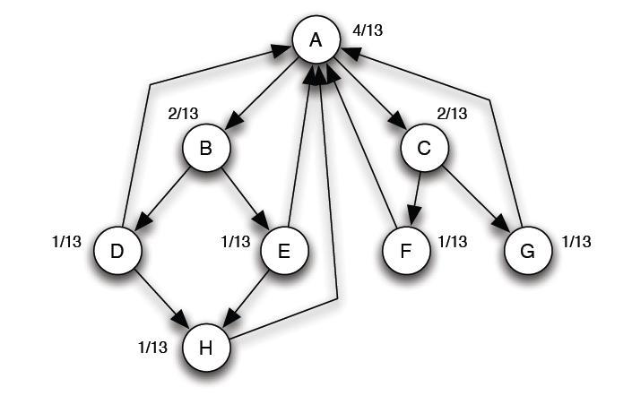
PageRank: equilibrium
A simple way to check whether an assignment of numbers s forms an equilibrium set of PageRank values: check that they sum to 1, and check that when apply the Basic PageRank Update Rule, we get the same values back.
If the network is strongly connected then there is a unique set of equilibrium values.

Slide 27
PageRank: Algorithm

Slide 28
PageRank: analysis
Vector representation

Slide 29
PageRank: flow equations

Slide 30
PageRank: flow equations

Slide 31
PageRank: Random walks
Random walk interpretation
Someone randomly browse a network of Web pages.
Starts by choosing a page at random, picking each page with equal probability.
Then follows links for a sequence of k steps: each step, picking a random out-going link from the current page, and follow it to where it leads.
Claim: The probability of being at a page X after k steps of this random walk is precisely the PageRank of X after k applications of the Basic PageRank Update Rule.

Slide 32
PageRank:extensions

Slide 33
PageRank: Spider Trap

Slide 34
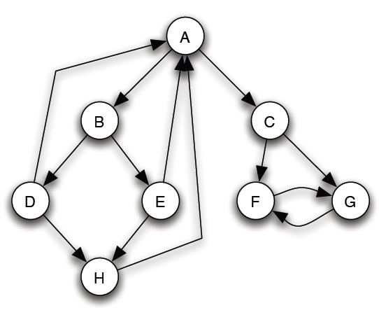
PageRank: Spider Trap
Scaled PageRank Update Rule: First apply the Basic PageRank Update Rule. Then scale down all PageRank values by a factor of s. This means that the total PageRank in the network has shrunk from 1 to s. We divide the residual 1 − s units of PageRank equally over all nodes, giving (1 − s)/n to each.
In practice, s between 0.8 and 0.9

Slide 35
PageRank: Spider Trap

Slide 36
PageRank: Random walks
Random walk with jumps
With probability s, the walker follows a random edge as before; and with probability 1 − s, the walker jumps to a random page anywhere in the network, choosing each node with equal probability

Slide 37
PageRank: Dead End

Slide 38
PageRank: Dead End

Slide 39
PageRank: Dead End

Slide 40
PageRank: Spectral Analysis

Slide 41
PageRank: Algorithm

Slide 42
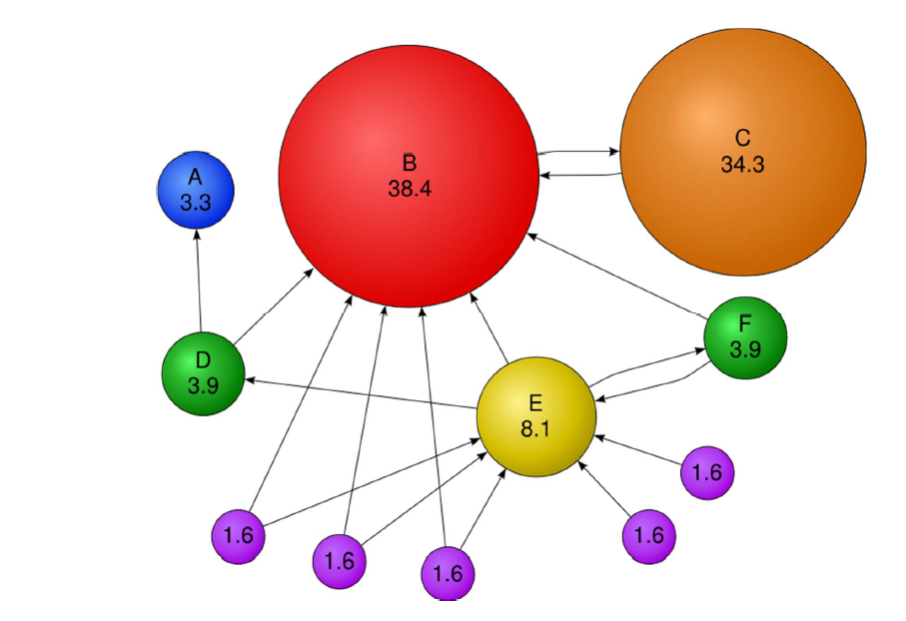
PageRank: Example

Slide 43
PageRank: Personalized Page Rank

Slide 44
Other Issues
Analysis of anchor text
e.g., weight links by a factor indicating the quality of the associated anchor text
User Feedback
click or not on a result
Attempts to score highly in search engine rankings
a search engine optimization (SEO) industry (perfect ranking a moving target + secretive)

Slide 45
PageRank: Trust Rank

Slide 47
Size of the Search Index
a method that combines word frequencies obtained in a large offline text collection (corpus), and search counts returned by the engines. Each day 50 words are sent to all four search engines. The number of webpages found for these words are recorded; with their relative frequencies in the background corpus, multiple extrapolated estimations are made of the size of the engine's index, which are subsequently averaged. The 50 words have been selected evenly across logarithmic frequency intervals (see Zipf's Law). The background corpus contains more than 1 million webpages from DMOZ, and can be considered a representative sample of the World Wide Web. When you know, for example, that the word 'the' is present in 67,61% of all documents within the corpus, you can extrapolate the total size of the engine's index by the document count it reports for 'the'. If Google says that it found 'the' in 14.100.000.000 webpages, an estimated size of the Google's total index would be 23.633.010.000.
http://www.worldwidewebsize.com/

Slide 48
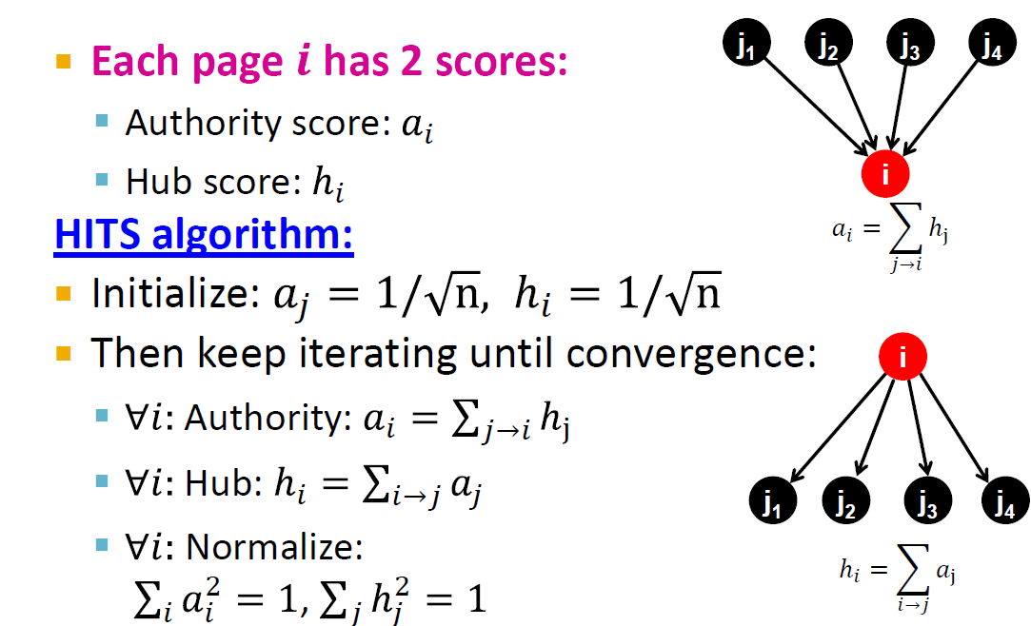
Link Analysis Using Hubs and Authorities: HITS algorithm (again)

Slide 49
PageRank: random web surfer

Slide 50
PageRank: random web surfer

