Slide 1
Αλγοριθμική Θεωρία Γραφημάτων
Διάλεξη 4
Permutation Graphs
Split Graphs
Cographs, Threshold Graphs

Slide 2
Algorithmic Graph Theory
Permutation Graphs
Permutation Labeling

Slide 3
Permutation Graphs
Let π be a permutation on N_{n}= {1, 2,…, n}
Let us think of π as a sequence [π₁, π₂, …, π_{n}] so, for example, the permutation
π = [4, 3, 6, 1, 5, 2]
has π₁= 4, π₂ = 3, etc.

Slide 4
Permutation Graphs
The permutation
π = [4, 3, 6, 1, 5, 2]
has π₁= 4, π₂ = 3, etc.
π_{i}⁻¹ is the position in the sequence where the number i can be found;
in our example π₄⁻¹ =1, π₃⁻¹ =2, etc.

Slide 5
Permutation Graphs
We define the inversion Graph G[π]=(V,E) of π as follows: V = {1, 2, …, n}
(i,j) ∈ E ⬄ (i-j) (π_{i}⁻¹ - π_{j}⁻¹ ) < 0
In our example, π = [4, 3, 6, 1, 5, 2]
both 4 and 3 are connected to 1, whereas neither 5 nor 2 is connected to 1.
1 2 3 4 5 6

Slide 6
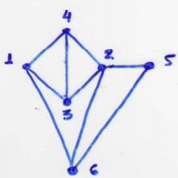
Permutation Graphs
Definition: An undirected graph G is called a permutation graph if there exists a permutation π on N_{n} such that G ≅ G[π].
The graph G[4, 3, 6, 1, 5, 2]

Slide 7
Permutation Graphs
Notice what happens when we reverse the sequence π. - the permutation graph we obtain is the complement of G[π] ; π^{r} = [2,5,1,6,3,4]
- G[π^{r} ]= G [π]
This shows that the complement of a permutation graph is also a permutation graph.

Slide 8
Permutation Graphs
Theorem: An undirected graph G is a permutation graph iff G and Ğ are comparability graphs.
Let (V, F₁) and (V, F₂) be transitive orientations
of G = (V, E) and Ğ = (V, Ē), respectively.
Then, (i) (V, F₁+F₂) is acyclic (ii) (V, F₁⁻¹+F₂) is acyclic.
Pls, prove (i) and (ii).

Slide 9
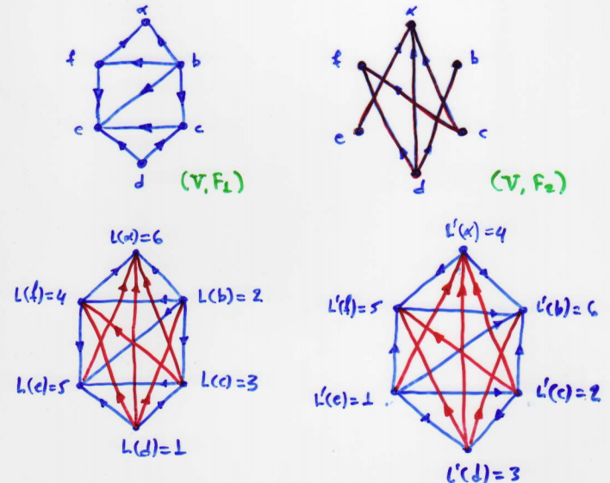
Permutation Graphs
For each vertex x,
if L(x) = i, then π_{i}⁻¹ = L΄(x).
1, 2, 3, 4, 5, 6
π = [5, 3, 1, 6, 4, 2]

Slide 10
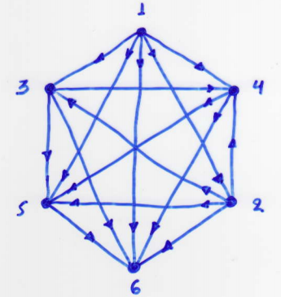
Construction of a π: G ≅ G[π]
The following figure shows a transitive orientation and the linear ordering of its vertices.

Slide 11
Construction of a π: G ≅ G[π]
Procedure:
Step I. Label the vertices according to the order determined by F₁+F₂; namely, if in-degree(x) = i-1 then L(x) = i.
Step II. Label the vertices according to the order determined by F₁⁻¹+F₂; namely, if in-degree(x) = i-1 then L΄(x) = i

Slide 12
Construction of a π: G ≅ G[π]
Notice that
xy∈ E ⬄ [L(x)-L(y)][L΄(x)-L΄(y)] < 0 (1)
since it is the edges of E which have their orientations reversed between steps I and II.
Step III. Define π as follows: For each vertex x, if L(x) = i, then π_{i}⁻¹ = L΄(x).

Slide 13
Construction of a π: G ≅ G[π]
(V, F₁+F₂) (V, F₁⁻¹+F₂)
π = [5, 3, 1, 6, 4, 2] (see Step III)

Slide 14
Construction of a π: G ≅ G[π]
We have shown that G is a permutation graph if and only if G and Ğ are comparability graphs.
This result suggests an algorithm for recognizing permutation graphs:
Applying the transitive orientation algorithm to the graph G and to its complement Ğ.
If we succeed in finding transitive orientations, then the graph is a permutation graph.

Slide 15
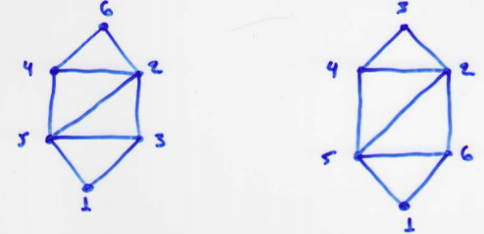
Permutation Labeling
The following figure shows two labelings of the same graph
This labeling is a permutation labeling
{5,3} - (1) - {2,4,6}
This labeling is not a permutation labeling
{5,6} - (1) - {2,3,4}

Slide 16
Permutation Labeling
Theorem: Let G be a graph. A bijection
L : V→ {1, 2, ….., n}
is a permutation labeling of G iff the napping F: x → L(x) - d⁻(x) + d⁺(x) (x∈Γ)
is a injection, where
d⁻(x) = | {y∈N(x) | L(y) < L(x)} |
and d⁺(x) = | {y∈N(x) | L(y) > L(x)} |

Slide 17
Algorithmic Graph Theory
Sorting a Permutation
Minimum Clique Cover

Slide 18
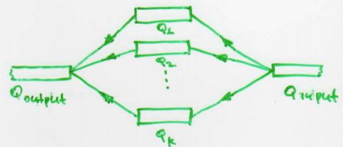
Sorting a Permutation using Queues
Let us consider the problem of sorting a permutation π of {1, 2, …., n} using a network of K queues arranged in parallel.
Given a permutation π; how many queues will we need?

Slide 19
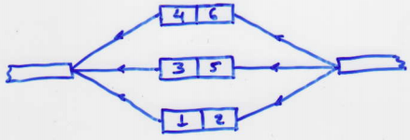
Sorting a Permutation using Queues
Example: Π = [4,3,6,1,5,2]
What is it that forces two numbers to go into different queues?

Slide 20
Sorting a Permutation using Queues
Thus, if i and j are adjacent in G[π], then they must go through different queues.
Proposition: Let π = [π₁,π₂,…,π_{n}] be a permutation on N_{n}. There is a one-to-one correspondence between the proper k-colorings of G[π] and the successful sorting strategies for π in a network of k parallel queues.

Slide 21
Sorting a Permutation using Queues
Corollary: Let π be a permutation on N_{n}. The following numbers are equal:
(i) the chromatic number of G[π]
(ii) the min number of queues required to sort π
(iii) the length of a longest decreasing subsequence of π
The canonical sorting stratege for π places each number in the first available queue.
From this strategy, we obtain the canonical coloring of G[π].

Slide 22
Coloring a Permutation Graph
Algorithm Canonical Coloring
input: A permutation π on N_{n};
output: A coloring of the vertices of G[π] and χ(G[π]);
Method
During the jth interation, π_{j} is transferred onto the queue Q_{i} having the smallest index i satisfying
π_{j} ≥ last entry of Q_{i.}

Slide 23
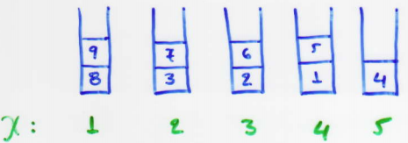
Coloring a Permutation Graph
Example: Π = [8, 3, 2, 7, 1, 9, 6, 5, 4]
Theorem: Let π be a permutation on N_{n}. The canonical coloring of G[π], as produced by Algorithm canonical coloring, is a minimum coloring.

Slide 24
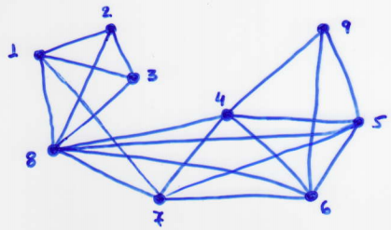
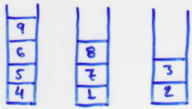
Minimum Clique Cover
Remark: To find a minimum clique cover of G[π], apply Algorithm canonical coloring to the reversal π^{r} of π.
π^{r} = [4, 5, 6, 9, 1, 7, 2, 3, 8]

Slide 25
Coloring a Permutation Graph
The algorithm canonical coloring runs in O(nlogn) time provided we have the permutation π and the isomorphism G → G[π]
If we do not have π, then we would revert to the coloring algorithm for comparability graphs.

Slide 26
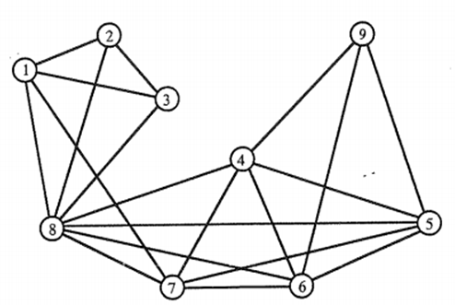
Coloring a Permutation Graph
χ(G[π]) = The length of a longest decreasing subsequence of π

Slide 27
Coloring a Permutation Graph
χ(G[π]) = The length of a longest decreasing subsequence of π

Slide 28
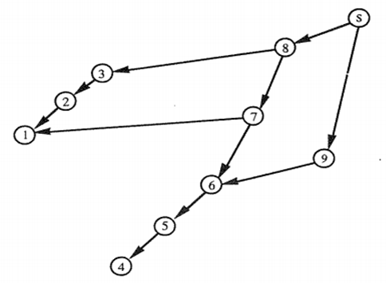
Coloring a Permutation Graph

Slide 29
Permutation- directed acyclic Graph
Συνάρτηση Ύψους
6
5
3
2
4
1
4
3
2
1

Slide 30
Basic Properties of Permutations
Permutations may be represented in many ways.
The most straightforward is a rearrangement of the numbers 1, 2, …, n, as in the following example:
index | 1 | 2 | 3 | 4 | 5 | 6 | 7 | 8 | 9 | 10 | 11 | 12 | 13 | 14 | 15
permutation | 9 | 14 | 4 | 1 | 12 | 2 | 10 | 13 | 5 | 6 | 11 | 3 | 8 | 15 | 7

Slide 31
Basic Properties of Permutations
An inversion is a pair i < j with π_{i} > π_{j.}
If q_{j} is the number of i < j with π_{i} > π_{j ,} then q₁q₂….q_{n} is called the inversion table of π.
The sample permutation given above has 49 inversions.
permutation | 9 | 14 | 4 | 1 | 12 | 2 | 10 | 13 | 5 | 6 | 11 | 3 | 8 | 15 | 7
inversion table | 0 | 0 | 2 | 3 | 1 | 4 | 2 | 1 | 5 | 5 | 3 | 9 | 6 | 0 | 8

Slide 32
Basic Properties of Permutations
A cycle is an index sequence i₁i₂ …. i_{t} with π_{i1} =i₂, π_{i2} =i₃, ….., π_{it} =i₁.
We use the notation (i₁ i₂ …. i_{t}) to specify a cycle
index | 1 | 2 | 3 | 4 | 5 | 6 | 7 | 8 | 9 | 10 | 11 | 12 | 13 | 14 | 15
permutation | 9 | 14 | 4 | 1 | 12 | 2 | 10 | 13 | 5 | 6 | 11 | 3 | 8 | 15 | 7
cycles | (1 9 5 12 3 4) |  |  |  |  |  | (2 14 15 7 10 6) |  |  |  |  |  | (8 13) |  | (11)

Slide 33
Cycle Representation
The fundamental correspondence between a permutation and the canonical form of its cycle structure representation defines a “representation” of permutations.
 | 1 | 2 | 3 | 4 | 5 | 6 | 7 | 8 | 9 | 10 | 11 | 12 | 13 | 14 | 15
permutation | 9 | 14 | 4 | 1 | 12 | 2 | 10 | 13 | 5 | 6 | 11 | 3 | 8 | 15 | 7
cycle form | 11 | 12 | 3 | 4 | 1 | 9 | 5 | 13 | 8 | 15 | 7 | 10 | 6 | 2 | 14

Slide 34
Lattice Representation
The following figure shows a two-dimentional representation that is useful for studing a number of properties of permutations.
index | 1 | 2 | 3 | 4 | 5 | 6 | 7 | 8 | 9 | 10 | 11 | 12 | 13 | 14 | 15
permutation | 9 | 14 | 4 | 1 | 12 | 2 | 10 | 13 | 5 | 6 | 11 | 3 | 8 | 15 | 7

Slide 35
Lattice Representation
The permutation π is represented by labelling the cell at row π_{i} and column i with the number π_{i} for every i.

Slide 36
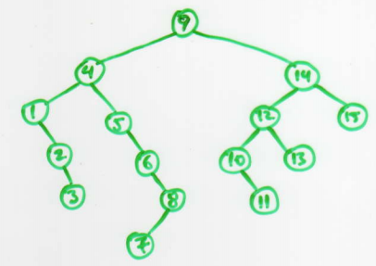
Binary Search Trees
A direct relationship between permutations and BST is shown in the following figure:

Slide 37
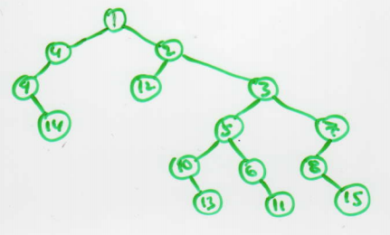
Heap- ordered Trees
A tree can also be built from the lattice representation in a similar maner as illustrated in the next figure:

Slide 38
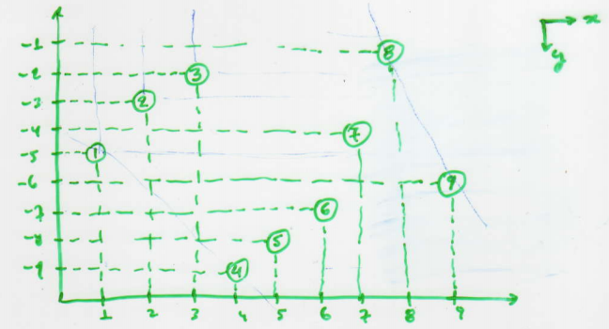
Euclidean plane transformation
2D Representation
Let π=[8, 3, 2, 7, 1, 9, 6, 5, 4] be a permutation of l = 9; then, x(i) = i and y(i) = -π⁻¹(i)

Slide 39
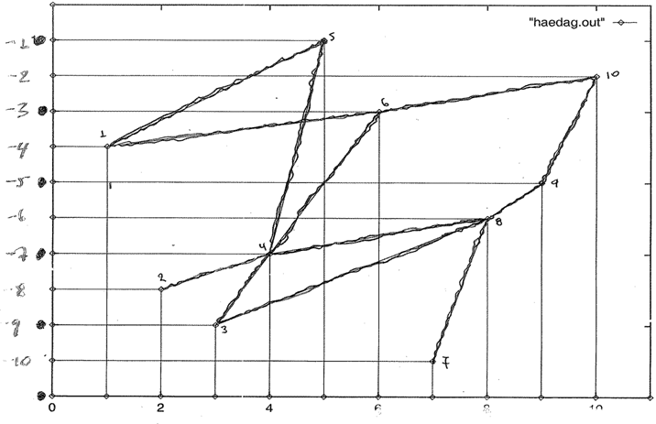
Permutation
2D Representation…
5
10
6
1
9
8
4
2
3
7

Slide 40
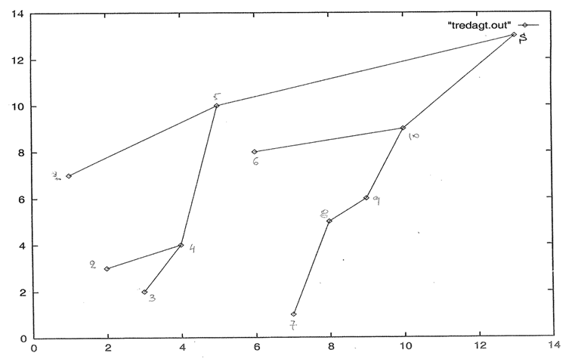
Permutation
2D Representation…
s
5
10
6
1
9
8
4
2
3
7

Slide 41
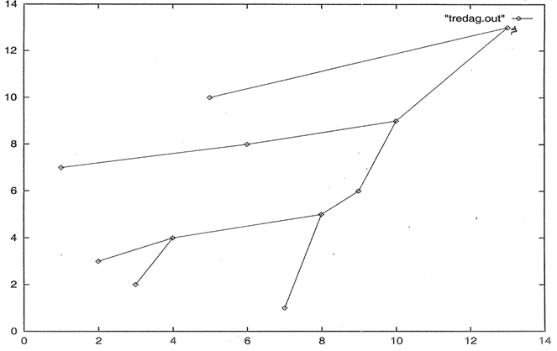
Permutation
2D Representation…
s
5
10
6
1
9
8
4
2
3
7

Slide 42
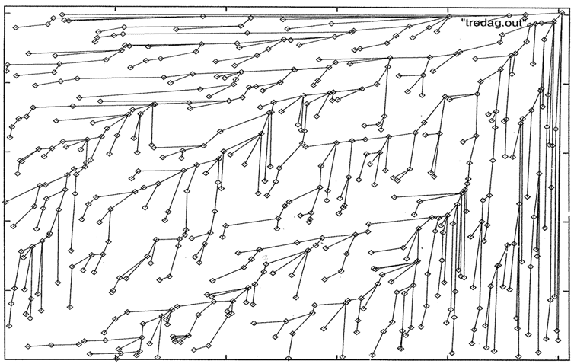
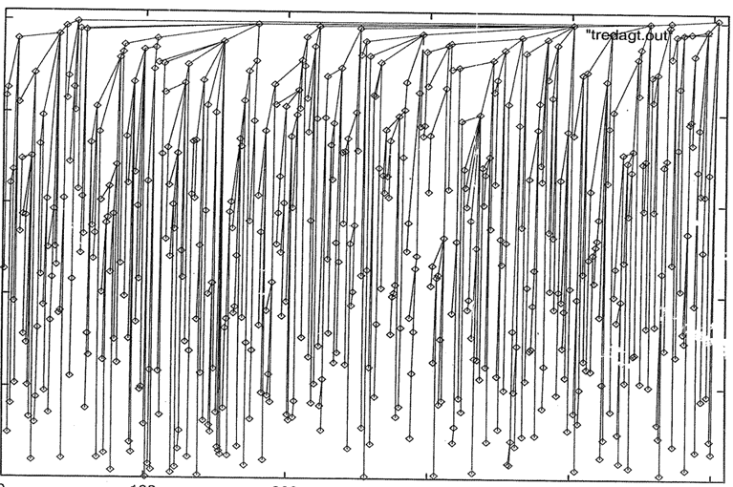
Permutation
2D Representation…

Slide 43
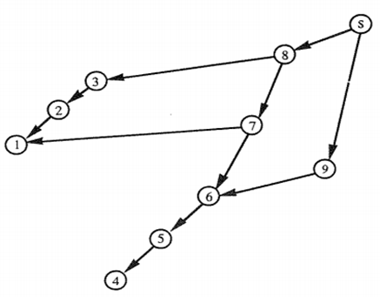
Permutation and its Permutation Graph
DAG Representation

Slide 44
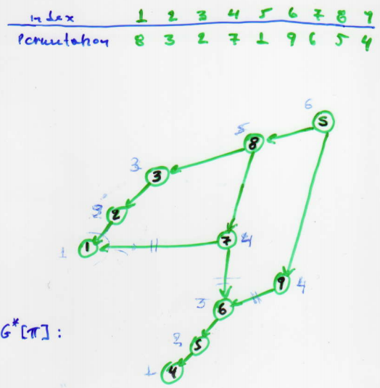
DAG representation
We show that there is an 1-1 correspondence between the length of the longest path from s to a vertex v in G*[π] and the color of the vertex v.
Lemma: Let π be a permutation of length n. The following numbers are equal: (i) χ(G[π]); (ii) the length of the longest decreasing subsequence of π; (iii) the length of the longest path in G*[π];

Slide 45
BFS Tree
Let π = [8, 3, 2, 7, 1, 9, 6, 5, 4] be permutation.
We define two sequences: -R = (r₁, r₂, …, r_{p}): the first increasing subseq. going
from left to right;
-S = (s₁, s₂, …, s_{p}): the first decreasing subseq. going from right to left;
R[π] = [8,9] and S[π] = [1,4]

Slide 46
BFS Tree
We construct the following sequence: r₁,s₂,r_{i ,}…, r_{p}
In general: t1,t2,…,tn

Slide 47
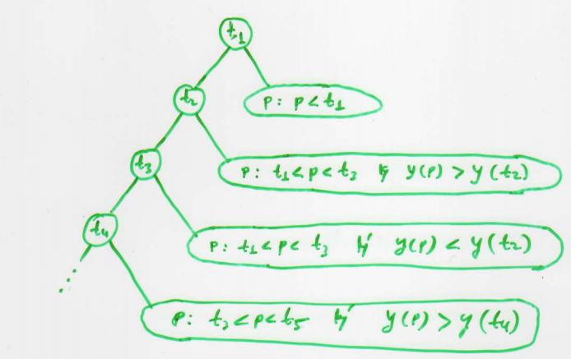
BFS Tree
The BFS tree of the graph G[π] has the following structure:

Slide 48
DFS Tree
We show that the DFS tree problem can be solved efficiently for permutation graphs.
Consider the Euclidean plane transformation (2D representation) of a permutation graph G.

Slide 49
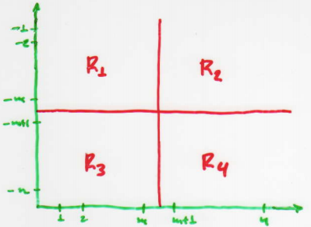
DFS Tree
Let m = ⎣n/2⎦
Draw a horizontal line with y-coordinate -m + 0.5 and a vertical line with x-coordinate m + 0.5

Slide 50
DFS Tree
Let n_{i} (1 ≤ i ≤ 4) be the # of vertices in R_{i}
Observe that n₁+n₃ = n₁+n₂ = m
This implies n₂ = n₃
Since each vertex in R₂ is adjacent to every vertex in R₃, we can construct a path P consisting of all vertices in R₂ and R_{3,} where the vertices of P alternate between R₂ and R_{3.}

Slide 51
DFS Tree
P = {P₁, P₂, …., P_{t}} starting at r = P₁
If P is removed from G the graph G[R1 ∪ R4] becomes disconnected and each connected component has at most n/2 vertices.

Slide 52
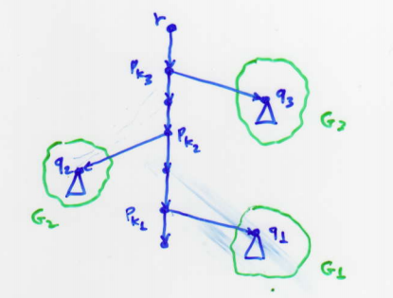
DFS Tree
Algorithm DFST
Construct the path P = {P₁, P₂, …, P_{t}} where P₁ = r = root.
Let G΄= G - P.
Compute the connected components G₁, G₂, …., G_{s} of G΄.

Slide 53
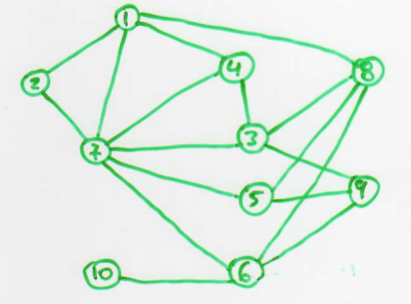
Maximum Independent Set
Hamilton path? Hamilton cycle?
Maximum independent set
π = [7, 2, 4, 8, 1, 9, 3, 5, 10, 6]

Slide 54
Maximum Independent Set
Maximum independent set
π = [7, 2, 4, 8, 1, 9, 3, 5, 10, 6]

Slide 55
Maximum Independent Set
Maximum – weight indipendent set
π = [7, 2, 4, 8, 1, 9, 3, 5, 10, 6]
w = [4, 6, 7, 5, 3, 10, 8, 1, 2, 9]
First we have π₁=7, hence the MWIS containing vertex 7 in sequence [π₁]=[7] is I₇={7} and W₇=4.

Slide 56
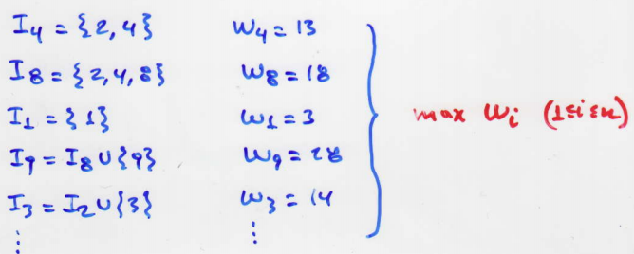
Maximum Independent Set
Secondly we have π₂=2 in [π₁, π₂]=[7,2] is an MWIS containing vertex 2. That is, I₂ ={2} and W₂=6.
continuing in this way we have:

Slide 57
Algorithmic Graph Theory
Split Graphs
Properties

Slide 58
Split Graphs
An undirected graph G = (V, E) is defined to be split if there is a partition V = S + K of its vertex set: S = stable set and K = complete set
In general, the partition V = S + K of a split graph will not be unique.
S will not necessarily be a maximal stable set. K will not necessarily be a maximal clique.

Slide 59
Split Graphs
Their Structure

Slide 60
Split Graphs
Since a stable set of G is a complete set of Ğ and vice versa, we have an immediate result.
Theorem: G is a split graph iff Ğ is a split graph.
The next theorem follows from the work of Hammer and Simeone [1977].

Slide 61
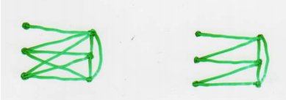
Split Graphs
Theorem: Let G be a split graph and V=S+K. Exactly one of the following conditions holds:
|S| = L(G) and |K|=W(G)
|S| = L(G) and |K|=W(G) -1
|S| = L(G)-1 and |K|=W(G)

Slide 62
Split Graphs
Theorem (Földes and Hammer [1977]) Let G be an undirected graph. The following conditions are equivalent:
G is a split graph
G and Ğ are triangulated graphs;
G contains no induced subgraph ≅ 2K₂, C₄, C₅
A characterazation of when a split graph is also a comparability graph is given by the following theorem:

Slide 63
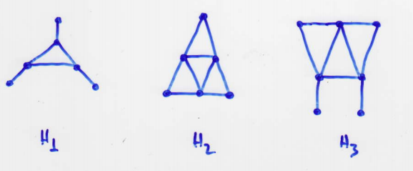
Split Graphs
Theorem: If G is a split graph, then G is a comparability graph iff G contains no induced subgraph isomorhic to H₁, H₂ or H₃

Slide 64
Algorithmic Graph Theory
Cographs
Properties

Slide 65
Cographs (complement reducible graphs)
Cographs are defined as the class of graphs formed from a single vertex under the closure of the operations of union and complement.
More precisely, the class of cographs can be defined recursivly as follows:
(i) a single-vertex graph is a cograph;
(ii) the disjoint union of a cograph is a cograph;
(iii) the complement of a cograph is a cograph;

Slide 66
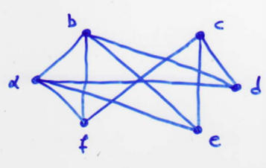
Cographs (complement reducible graphs)
Construction of the following cograph:

Slide 67
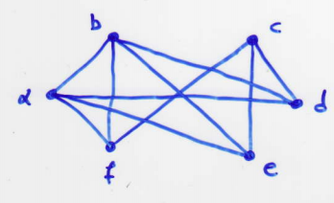
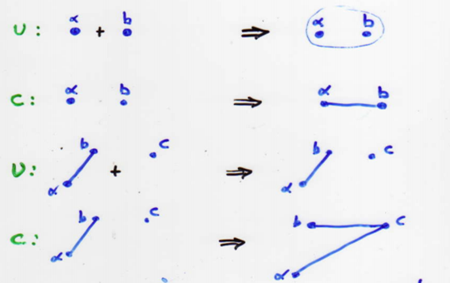
Cographs (complement reducible graphs)
Construction of the following cograph:

Slide 68
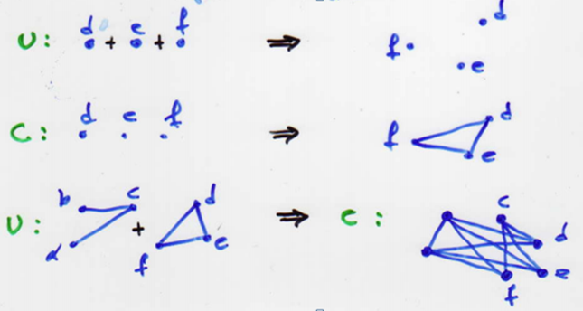
Cographs (complement reducible graphs)
Construction of the following cograph:

Slide 69
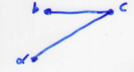
Cographs (complement reducible graphs)
Cograph were introduced in the early 1970s by Lerchs.
Lerchs has shown, among other properties, the following two very nice algorithmic properties:
(P1) cographs are exactly the P4 restricted graphs (P2) cographs have a unique tree representation called cotree.

Slide 70
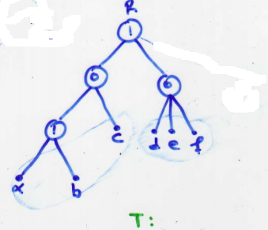
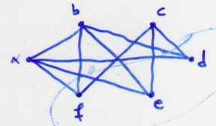
Cographs (complement reducible graphs)
A cograph and its cotree:
The root R will have only one (o) node child iff the represented cograph is disconnected.
1
a,b,c d,e,f
G:

Slide 71
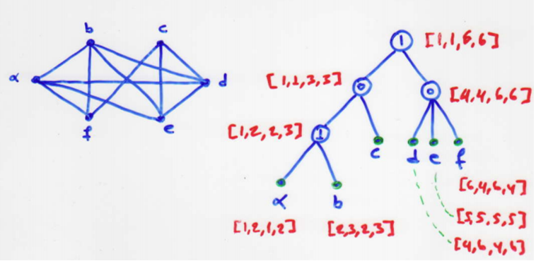
Permutation Representation Cographs
Example:

Slide 72
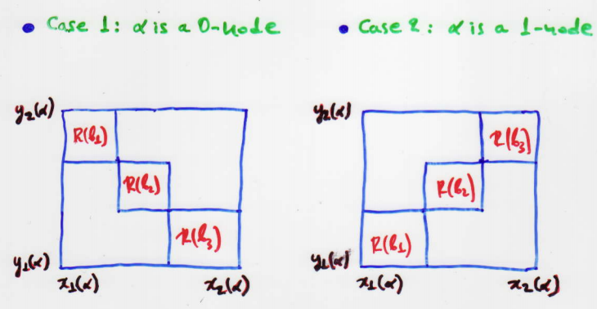
Permutation Representation Cographs
Suppose R(a) = [x₁(a), y₁(a), x₂(a), y₂(a)] has been computed, we describe how to compute R(β_{i}) = [x₁(β_{i}), y₁(β_{i}), x₂(β_{i}), y₂(β_{i})] for each 1 ≤ i ≤ k.

Slide 73
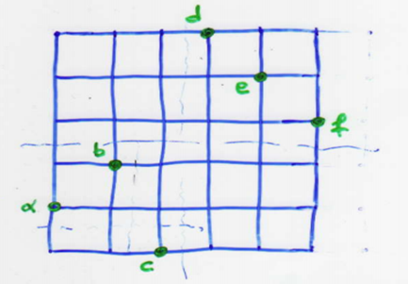
Permutation Representation Cographs
Example:
(6,6)
(1,1)

Slide 74
Permutation Representation Cographs
Example:
(6,6)
(3,3)
(4,4)
(1,1)

Slide 75
Recognition Properties of Cographs
Theorem: Let G be a graph. The following statements are equivalent: (i) G is a cograph; (ii) G does not contain P₄ as a subgraph;
Example:

Slide 76
Recognition Properties of Cographs
For every actual edge (x,y)∈AE we define: AV^{x}_{(x,y)} ={z ∈V| (x,z)∈E and (y,z)∉E} AV^{y}_{(x,y)} ={z ∈V| (x,z)∉E and (y,z)∈E}
For every pair x,y ∈V:( x,y) ∉E we define: FV_{{x,y}} ={z ∈V| (x,z) ∈ E and (y,z)∈E}
Theorem: Let G = (V, E) be an A-free graph. Then, G is a cograph.

Slide 77
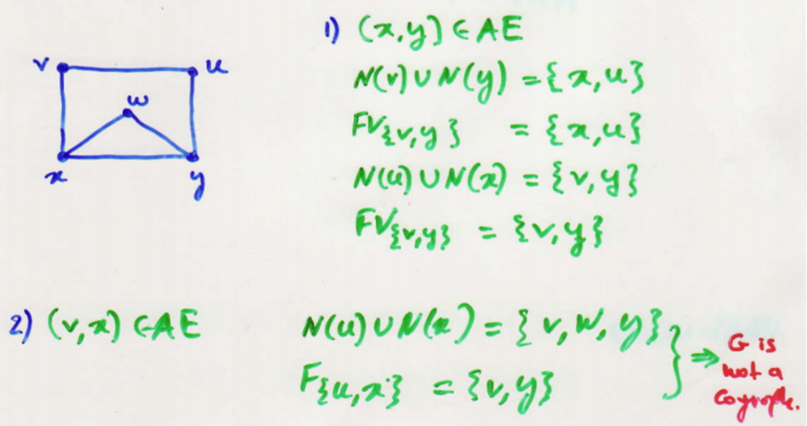
Recognition Properties of Cographs
Example:

Slide 78
Algorithmic Graph Theory
Threshold Graphs
Quazi-threshold Graphs

Slide 79
Threshold Graphs
Chvátal and Hammer have proved the following result:
Theorem: Let G = (V,E) be a graph. The following statements are equivalent: (i) G is a threshold graph; (ii) G has no induced subgraphs ≅ to P₄,C₄ or 2K₂
There exist an O(n)-time sequential algorithm for recognizing threshold graphs.
The algorithm is based on the degree partition.

Slide 80
Threshold Graphs
Define: δ_{o} =0 and δ_{k+1} = |V|-1
The degree partition of V is given by
V=D₀+D₁+….+D_{K} where D_{i} = set of all vertices of degree δ_{i}

Slide 81
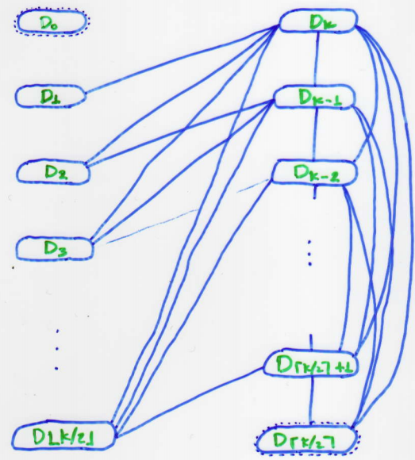
Threshold Graphs
The typical structure of a threshold graph:

Slide 82
Quazi-threshold Graphs (A-free)
A graph G = (V, E) is called an A-free graph if every edge of G is either free or semi-free.
We define
cent(G)={x∈V| N[x]=V}
Theorem: Let G be a graph. Then the following statements are equivalent: (i) G is a A-free graph; (ii) G has no induced subgraph ≅ to P₄ or C₄; (iii) Every connected induced subgraph G[S], S⊆V, satisfies cent(G[S]) ≠Ø.

Slide 83
Quazi-threshold Graphs (A-free)
Lemma: The following two statement hold: (i) G is an A-free iff G-cent(G) is an A-free; (ii) If G-cent(G) ≠Ø, then G-cent (G) contains at least two components.
Let G be an A-free graph. Then, V₁=cent(G).
Set G₁= G G-V₁=G₂ ∪ G₃ ∪ … ∪ G_{r} where
G_{i} is a component of G-V₁, r ≥ 2

Slide 84
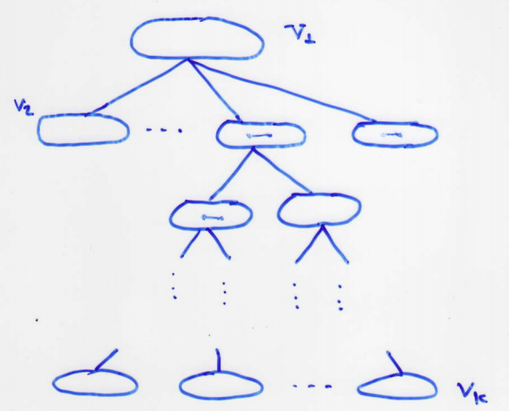
Quazi-threshold Graphs (A-free)
Then, G_{i} is an A-free graph, and so V_{i} = cent(G_{i}) ≠ Ø
We finally obtain the following partition of V: V=V₁+V₂+…..+V_{K} where V_{i}=cent(G_{i})
The typical structure of an A-free graph:

Slide 85
Quazi-threshold Graphs (A-free)
Moreover we can define a partial order ≤ on {V₁,V₂,…..,V_{K} } as follows: V_{i} ≤ V_{j} if V_{i} = cent (G_{i}) and V_{j} ⊆ V(G_{i})
Let G be a connected A-free graph, and let V(G)=V₁+V₂+…..+V_{K}
Then this partition and the partially ordered set ({Vi}, ≤) have the following properties:

Slide 86
Quazi-threshold Graphs (A-free)
(P1) If V_{i} ≤ V_{j} then every vertex of V_{i} and every vertex of V_{j} are joined by an edge.
(P2) For every V_{i}, cent (G[{∪ V_{i} | V_{i} ≤ V_{j} }])= V_{i}
(P3) For every two V_{s} and V_{t} : V_{s} ≤ V_{t,}
G[{∪ V_{i} | V_{s} ≤ V_{i} ≤ V_{t}}] is a complet graph.
Moreover, for every maximal element V_{t} of ({V_{i} }, ≤), G[{∪ V_{i} | V₁ ≤ V_{i} ≤ V_{t}}] is a maximal complete subgraph of G.
(P4) Every edge (x,y): x,y ∈V_{i}, (x,y) ∈FE;
Every edge (x,y): x∈V_{i} , y∈V_{j} , V_{i} ≠ V_{j} , (x,y) ∈SE

Slide 87
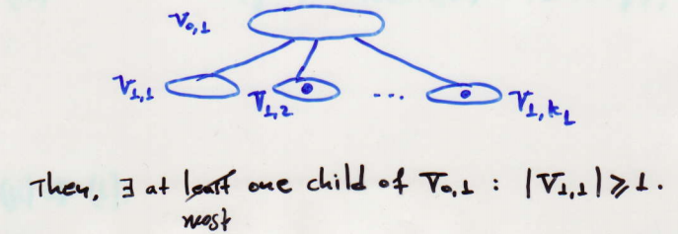
Quazi-threshold Graphs (A-free)
G is a threshold graph iff G has no induced subgraphs isomorphic to C₄ , P₄ or 2K₂
Theorem: Let G be an A-free graph. The following statements are equivalent: (i) G contains no 2K₂ ; (ii) Ğ is an A-free graph;
Proof. (i) ⇒ (ii): Let Tc(G) be the cent –tree of G and let V_{i,1},V_{1,2},…..,V _{1,k1} be the children of the node V_{0,1} = cent (G);

Slide 88
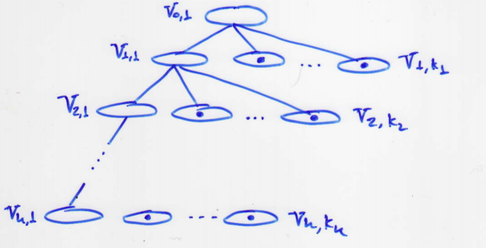
Quazi-threshold Graphs (A-free)
We can prove that the typical structure of an A-free graph which contains no induced subgraph ≅ to 2K₂ is the following:

