Slide 1
Αλγοριθμική Θεωρία Γραφημάτων
Διάλεξη 3
Τριγωνικά Γραφήματα
Μεταβατικά Γραφήματα

Slide 2
Algorithmic Graph Theory
Triangulated Graphs
Perfect Elimination Ordering

Slide 3
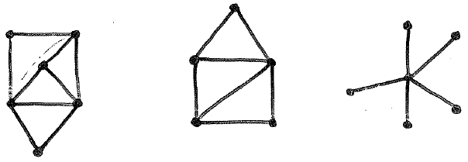
Triangulated Graphs
G triangulated ⬄ G has the triangulated graph property
Every simple cycle of length l > 3 possesses a chord.
Triangulated graphs, or
Chordal graphs, or
Perfect Elimination Graphs

Slide 4
Triangulated Graphs
c
a
b
c
d
c
b
d
e
f
b
d
g
f
e
a
a
e
G
G
G
1
2
3

Slide 5
Triangulated Graphs
Dirac (1961) and later Lekkerkerker and Boland (1962) proved that:
A triangulated graph always has a simplicial node, a node all of whose neighbors form a clique.
a
a, c, f simplicial nodes
b, d, e non siplicial
b
e
c
d
f
Fulkerson and Gross [1965] (also Rose) gave useful algorithmic characterization.

Slide 6
Triangulated Graphs
It follows easily from the triangulated property that:
deleting nodes of a triangulated graph yields another triangulated graph.
a
a
a
b
e
b
b
e
⇒
d
d
d
f
c
f
c
f

Slide 7
Triangulated Graphs
Recognition Algorithm
This observation leads to the following easy and simple recognition algorithm:
Find a simplicial node of G;
Delete it from G, resulting G’;
Recourse on the resulting graph G’, until no node remain.

Slide 8
Triangulated Graphs
If G contains a C_{k}, k ≥ 4, no node in that cycle will ever become simplicial.
Triangulated
Non-triangulated

Slide 9
Triangulated Graphs
The algorithm provides us with all the maximal cliques.
Let C(v_{i}) = {v_{i}} ∪ {v_{j} : v_{j} higher neighbor of v_{i}}. Then, C(v_{i}) = clique
The set of cliques C(v_{i}), 1 ≤ i ≤ n ,
includes all the maximal cliques.
C(a) = {a, b, e}
C(b) = {b, c, d, e}
C(c) = {c, d, e}
C(d) = {d, e, f}
C(e) = {e, f}
C(f) = {f}
a
b
e
f
c
d

Slide 10
Triangulated Graphs
Note that some cliques C(v_{i}) are not maximal.
a
C(a) = {a, b, e}
C(b) = {b, c, d, e}
C(c) = {c, d, e}
C(d) = {d, e, f}
C(e) = {e, f}
C(f) = {f}
b
e
f
c
d

Slide 11
Triangulated Graphs
Theorem. There are at most n maximal cliques in a chordal graph on n nodes.
The node-ordering provided by the algorithm has many other uses.
Max cliques 7
Number of nods 6
a
b
e
(a, c, b, e, d) (c, d, e, a, b) (c, a, b, d, e) …
c
d

Slide 12
Triangulated Graphs
Node-ordering : perfect elimination ordering, or perfect elimination scheme
Rose establishes a connection between triangulated graphs and symmetric linear systems
a
b
e
(a, c, b, e, d) (c, d, e, a, b) (c, a, b, d, e) …
c
d

Slide 13
Triangulated Graphs
Let σ = [v₁,v₂, ...,v_{n}] be an ordering of the vertices of a graph G = (V, E)
σ is a peo, if each v_{i} is a simplicial node to graph G[{v_{i},v_{i+1}, …,v_{n}}]
a
a
b
e
e
b
σ = (c, d, e, a, b)
c
d
d

Slide 14
Triangulated Graphs
σ is a peo if each v_{i} is a simplicial node to graph G[{v_{i},v_{i+1}, …,v_{n}}]. That is,
X_{i}= {v_{j} ∈ ad_{j} (v_{i}) | i < j} is complete.
σ =[1, 7, 2, 6, 3, 5, 4] no simplicial vertex
G₁ has 96 different peo.
a
b
c
d
c
G
2
b
e
f
G
d
1
g
f
e
a

Slide 15
Algorithmic Graph Theory
Algorithm LexBFS
Algorithm MCS

Slide 16
Computing PEO - LexBFS
Algorithm LexBFS
1. for all v∈V do label(v) : = () ;
2. for i : = |V| down to 1 do
2.1 choose v∈V with lexmax label (v);
2.1 σ (i) ← v;
2.3 for all u ∈V ∩N(v) do
label (u) ← label (u) || i
2.4 V ← V \ {v};
end

Slide 17
Computing PEO - LexBFS
c
Algorithm LexBFS
(An example)
b
d
a
e

Slide 18
Computing PEO - LexBFS
c
c
c
c
c
1
b
d
b
4
d
b
4
3
d
b
4
3
d
b
4
3
d
5
5
5
5
2
5
2
a
e
a
e
a
e
a
e
a
e
σ = [a]
L(b) = (4)
L(c) = ()
L(d) = (4)
L(e) = (4)
σ = [b, a]
L(c) = (3)
L(d) = (43)
L(e) = (43)
σ = [d, b, a]
L(c) = (32)
L(e) = (432)
σ = [e, d, b, a]
L(c) = (321)
σ = [c, e, d, b, a]

Slide 19
Algorithms for Computing PEO
Algorithm MCS
1. for i : = |V| down to 1 do
1.1 choose v∈V with max number of
numbered neighbours;
1.2 number v by i;
1.3 σ (i) ← v;
1.4 V ← V \ {v};
end

Slide 20
Computing PEO - MCS
c
Algorithm MCS
(An example)
b
d
a
e

Slide 21
Computing PEO - MCS
c
c
c
c
c
2
2
b
d
b
4
d
b
4
3
d
b
4
3
d
b
4
3
d
5
5
5
e
5
5
1
a
e
a
e
a
a
e
a
e
σ = [a]
σ = [b, a]
σ = [d, b, a]
σ = [e, d, b, a]
σ = [c, e, d, b, a]

Slide 22
Computing PEO - Complexity
Algorithms LexBFS & MCS

Slide 23
Algorithmic Graph Theory
Algorithm PERFECT
Correctness & Complexity

Slide 24
Testing a PEO – Algorithm PERFECT
Naive Algorithm O(n³)
This Algorithm O(n+m)
Algorithm PERFECT
for all vertices u do A(u) ← Ø;
for i ← 1 to n-1 do
v ← σ(i);
X_{v} ← {x ∈ adj(v) | σ⁻¹(v) < σ⁻¹(x) } ;
if X_{v} = Ø then goto 8
u ← σ (min { σ⁻¹(x) | x∈X_{v} });
A(u) ← A(u) || X_{v}-{u}
if A(v) - adj (v) ≠ Ø then return (“false”)
end
return (“true”)
A(v) ⊆ adj(v) ⇒ true

Slide 25
Testing a PEO – Algorithm PERFECT
Όταν επεξεργαζόμαστε τον v
A(u) = {x, y}
Όταν επεξεργαζόμαστε τον u
A(u) - adj(u) ≠ Ø
Initially: A(a) = A(e) = A(b) = … = Ø
v = a X_{v} = {e, b} u = e A(e)={b} A(a) - adj(a) = Ø
v = e X_{v} = {b, d} u = b A(b) = {d} A(e) - adj(e) = Ø
…
v u x y
v u x y
A(u) - adj(u) = Ø
A(u) ← {x,y}
c
b
d
a
e
σ = [a,e,b,d,c]

Slide 26
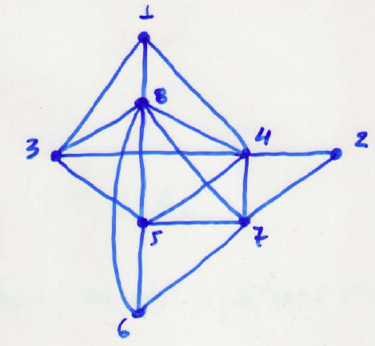
Testing a PEO – Algorithm PERFECT
Example (a):
σ = [1, 2, 3, 4, 5, 6, 7, 8]
v = 1: X_{v}={3,4,8} u = 3 A(3)={4,8} A(1) - adj(1)
v = 2: X_{v}={4,7} u = 4 A(4)={7} A(2) - adj(2)
v = 3: X_{v}={4,5,8} u = 4 A(4)={7,5,8} A(3) - adj(3)
v = 4: X_{v}={5,7,8} u = 5 A(5)={7,8} A(4) - adj(4)
v = 5: X_{v}={6,7,8} u = 6 A(6)={7,8} A(5) - adj(5)
v = 6: X_{v}={7,8} u = 7 A(7)={8} A(6) - adj(6)

Slide 27
Correctness of Algorithm PERFECT
Theorem: The algorithm PERFECT returns TRUE
iff σ is a peo
Proof :
(⇐) Suppose that the algorithm returns FALSE during the σ⁻¹(u)-th iteration. This may happen only if in line 8:
A(u) - adj(u) ≠ ∅
Thus, ∃ w ∈ A(u) such that w∉ adj(u)

Slide 28
Correctness of Algorithm PERFECT
A(u) - adj(u) ≠ ∅ ⇒ w ∈ A(u) and w ∉ adj(u)
The algorithm returns FALSE if and only if
∃ vertices v, u, w : σ⁻¹(v) < σ⁻¹(u) < σ⁻¹(w),
where u is define in line 6 during the σ⁻¹(v)-th iteration, and
u, w ∈ Adj(v) but w ∉ adj(u)
Clearly, since (u,w) ∉ E ⇒ σ is not peo.
v u x w

Slide 29
Correctness of Algorithm PERFECT
(⇒) Suppose σ is not a peo and the Algo PERFECT returns TRUE.
Let v be a vertex with max index in σ, such that
X_{v}={w | w ∈ adj(v) and σ⁻¹(v) < σ⁻¹(w)}
is not complete
σ = [………v,….….....…..]
max
i.e., v is the first vertex from right to left in σ s.t X_{v} does not induce a clique

Slide 30
Correctness of Algorithm PERFECT
Let u be a vertex of set X_{v}
defined during the σ⁻¹(v)-th iteration (in line 6),
after which (in line 7)
X_{v}-{u} is added to A(u)
1st neighbor
σ = [………v,…..,u,……..]

Slide 31
Correctness of Algorithm PERFECT
σ = (……, v, …, u, ……..)
X - {u}
A(u)
v
max
v
u
Since the Algorithm PERFECT returns TRUE ⇒
A(u) - adj(u) = ∅ (in line 8) ⇒
X_{v}-{u} ⊆ adj (u)
x
X - {u}
v
Thus, (i) every x ∈ X_{v} -{u} is adjacent to u.

Slide 32
Correctness of Algorithm PERFECT
σ = (……, v, …, u, ……..)
X - {u}
A(u)
v
max
v
u
(i) every x ∈ X_{v} -{u} is adjacent to u.
and
(ii) every x, y ∈ X_{v} -{u} is adjacent.
x
y
X - {u}
v
Statement (ii) follows since v is the vertex with max index in σ such that X_{v} is not complete
Thus, X_{v} is complete, a contradiction!

Slide 33
Algorithmic Graph Theory
Chromatic Number
Clique Number - Max Clique
Stability Number α(G)

Slide 34
X and Maximal Cliques
Fulkerson and Gross (1965) pointed out that:
Every maximal clique of a triangulated graph G is of the form {u} ∪ X_{u} where X_{u} = { x ∈ adj(u) | σ⁻¹(u) < σ⁻¹(x) }
Proposition (Fulkerson and Gross, 1965):
A triangulated graph on n nodes has at most n maximal cliques, with equality iff the graph has no edges.

Slide 35
X and Maximal Cliques
Algorithm Maximalcliques
Some of {u}∪X_{u} will not be maximal clique;
{u}∪X_{u} is not maximal clique if and only if
for some i, in line 7 of Algorithm PERFECT,
X_{u} = X_{v}-{u} is concatenated to A(u);
{u}∪X_{u}
1, 2, …, i, …
X_{u}
v
u
7. A(u) ← A(u) || X_{v}-{u}

Slide 36
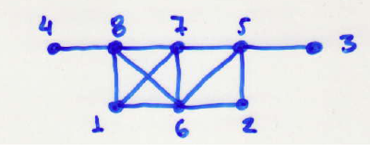
X and Maximal Cliques
Example (a):
{1}∪X₁ ={1,6,7,8}
{2}∪X₂ ={2,5,6}
{3}∪X₃ ={3,5} {6}∪X₆ ={6,7,8}
{4}∪X₄ ={4,8} {7}∪X₇ ={7,8}
{5}∪X₅ ={5,6,7} {8}∪X₈={8}
maximal non maximal
σ = [1, 2, 3, 4, 5, 6, 7, 8]

Slide 37
X and Maximal Cliques
Example (b):
{6}∪ X₆={6,7,8} is not maximal clique, since X₆ is concatenated to A(6)
X₆={7,8}
There exists vertex v = 1, such that:
(lines 3-6) v = 1, X₁={6,7,8} and u = 6
(line 7) X₁-{6} is concatenated to A(u)
X₁-{6} = {7,8} = X₆ is concatenated to A(6)
σ = [1, 2, 3, 4, 5, 6, 7, 8]

Slide 38
X and Maximal Cliques
Example (c):
{7}∪X₇ ={7,8} is not maximal clique, since X₇ is concatenated to A(7)
X₇={8}
There exists vertex v = 6, such that:
(lines 3-6) v = 6, X₆={7,8} and u = 7
(line 7) X₆-{7} is concatenated to A(u)
X₆-{7} = {8} = X₇ is concatenated to A(7)
σ = [1, 2, 3, 4, 5, 6, 7, 8]

Slide 39
Algorithm X and Maximal Clique
S(v) indicates the size of the largest set that would have been concatenated to A(v) in Algorithm PERFECT.
clique(σ)
X ←1; S(v) ← 0 ∀ v∈V;
1. for i ← 1 to n do
2. v ← σ(i)
3. X_{v} ←{x∈adj(v) | σ⁻¹(v) < σ⁻¹(x) }
4. if adj(v) = Ø then print {v};
5. u ← σ (min { σ⁻¹(x) | x∈X_{v} });
6. if X_{v} = Ø then goto 9
7. S(u) ← max{S(u), |X_{v}|-1}
8. if S(v) < |X_{v}| then do : print {v}∪X_{v}
9. end X = max {X, 1+ | X_{v}| }
return X

Slide 40
Coloring Chordal Graphs
Gavril (1972) gives a coloring algorithm, based on a greedy approach.
We use positive integers as colors.
Method:
Start at the last node v_{n} of the peo;
Work backwards, assign to each v_{i} in turn the minimum color not assigned to its higher neighbors.

Slide 41
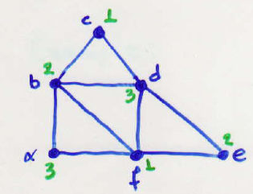
Coloring Chordal Graphs
Example:
σ = [a, c, b, d, e, f]
3 1 2 3 2 1
ω(G) = χ(G)

Slide 42
Finding the Stability Number α(G)
Gavril (1972) gives the following solution:
Method:
Let σ be a peo of a chordal graph G;
Define inductively a sequence of vertices v₁, v₂, …, v_{t} as follows:
v₁ = σ(1);
v_{i} is the first vertex in σ which
(i) follows v_{i-1} and (ii) is not in Xv₁ ∪ Xv₂∪ … ∪ Xv_{i-1};
Recall that, all vertices following v_{t} are in Xv₁∪ Xv₂∪ … ∪Xv_{t}

Slide 43
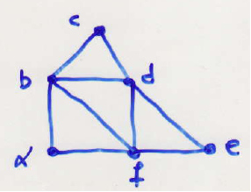
Finding the Stability Number α(G)
Example:
σ = [a, c, b, d, e, f]
v₁
v₂
v₃
Xv₁= {b, f}
Xv₂= {d}
Xv₃= {}

Slide 44
Finding the Stability Number α(G)
Theorem: The set {v₁, v₂, …, v_{t}} is a maximum stable set of G, and the collection of sets
Y_{i} = {v_{i}} ∪ Xv_{i,} 1≤ i ≤ t,
comprises a minimum clique cover of G.
Proof.
The set {v₁, v₂, …, v_{t} } is stable since
if (v_{j}, v_{i}) ∈ E for j < i, then v_{i} ∈ Xv_{j} which cannot be.
Thus, α(G) ≥ t.

Slide 45
Finding the Stability Number α(G)
On the other hand, each of the sets Y_{i} = {v_{i}} ∪ Xv_{i}
is a clique, and so {Y₁, …, Y_{t}} is a clique cover of G. Thus, α(G) = κ(G) = t.
We have produced the desired
maximum stable set and minimum clique cover.

Slide 46
Algorithmic Graph Theory
Vertex Separators
Characterizations

Slide 47
Characterizing Triangulated Graphs
Definition: A subset S of vertices is called a
Vertex Separator for nonadjacent vertices a, b
or, equivalently, a-b separator,
if in graph G_{V-S} vertices a and b are in different connected components.
If no proper subset of S in an a-b separator, S is called
Minimal Vertex Separator.

Slide 48
Characterizing Triangulated Graphs
Example 1:
The set {y, z} is a minimal vertex separator for
p and q.
p
x
q
z
y
r

Slide 49
Characterizing Triangulated Graphs
Example 2:
The set {x, y, z} is a minimal vertex separator for
p and r (p-r separator).
.
p
x
q
z
y
r

Slide 50
Characterizing Triangulated Graphs
Theorem (Dirac 1961, Fulkerson and Gross 1965)
G is triangulated.
G has a peo; moreover, any simplicial vertex can start a perfect order.
Every minimal vertex separator induces a complete subgraph of G.
Proof:
(1) ⇒ (3)
G_{A} S G_{B}
a_{r}
y
b₁
a
b
x
b_{k}
a₁

Slide 51
Characterizing Triangulated Graphs
G_{A} S G_{B}
Let S be an a-b separator.
We will denote G_{A}, G_{B}
the connected components of G_{V-S} containing a, b.
a_{r}
y
b₁
a
b
x
b_{k}
a₁
Since S is minimal, every vertex x∈S is a neighbor of a vertex in A and a vertex in B.
For any x,y ∈S , ∃ minimal paths
[x,a₁,…,a_{r},y] (a_{i} ∈A) and [x,b_{k},….,b₁,y] (b_{i} ∈B)

Slide 52
Characterizing Triangulated Graphs
G_{A} S G_{B}
Since
[x, a₁, …a_{r}, y, b₁, …., b_{k}, x]
is a simple cycle of length
l ≥ 4, ⇒ it contains a chord.
a_{r}
y
b₁
a
b
x
b_{k}
a₁
For every i, j a_{i}b_{j}∉E, (S is a-b separate)
and also a_{i}a_{j}∉E, b_{i}b_{j}∉E (by the minimality of
the paths)
Thus, x y ∈E.

Slide 53
Characterizing Triangulated Graphs
(3) ⇒ (1) Suppose every minimal separator S is a clique
Let [v₁,v₂,….,v_{k},v₁] be a chordless cycle.
v₁ and v₃ are nonadjacent.
Any minimal v₁-v₃ separator S_{1,3}
contains v₂ and at least one of v₄,v₅,……,v_{k}.
But vertices v₂,v_{i} (i = 4, 5, …, k) are nonadjacent
⇒ S_{1,3} does not induce a clique.
v
v
2
1
v
3
v
v
k
4
v
5

Slide 54
A characterization of Chordal Graphs
The chordal graphs are exactly the intersection graphs of subtrees of trees.
That is, for a tree T and subtrees T₁, T₂, …, T_{n}
of T there is a graph G:
- its nodes correspond to subtrees T₁, T₂, …, T_{n}, and
- two nodes are adjacent if the corresponding subtrees share a node of T.

Slide 55
A characterization of Chordal Graphs
Example:
E
G
B
H
G
H
E
D
C
D
F
F
C
A
A
B

Slide 56
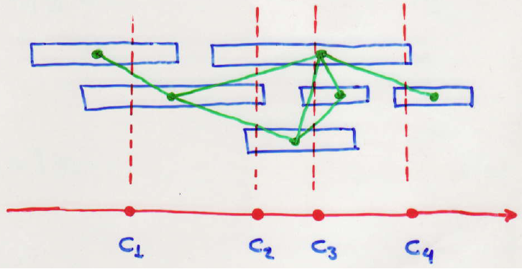
A characterization of Chordal Graphs
The graphs arising in this way are exactly the chordal graphs, and interval graphs arise when the tree T happens to be a simple path.

Slide 57
Interval Graphs
Theorem: Let G be a graph. The following statements are equivalent.
(i) G is an interval graph.
(ii) G contains no C₄ and Ğ is a comparability graph.
(iii) The maximal cliques of G can be linearly ordered
such that, for every vertex x of G the maximal
cliques containing vertex x occur consecutively.

Slide 58
Simple Elimination Scheme
We have showed two main graph properties:
Chordal: if every cycle of length l > 3 has a chord.
Comparability: if we can assign directions to
edges of G so that the resulting
digraph G΄ is transitive.

Slide 59
Simple Elimination Scheme
Simple Elimination Scheme (SES):
A permutation σ = (v₁, v₂,…., v_{n}) such that each
v_{i} is simplicial in G - {v₁, …, v_{i-1}}, and
the neighborhoods of the vertices adjacent to v_{i}
in G - {v₁, …, v_{i-1}} form a total order with respect to set containment.
or, Simple Elimination Ordering (SEO)

Slide 60
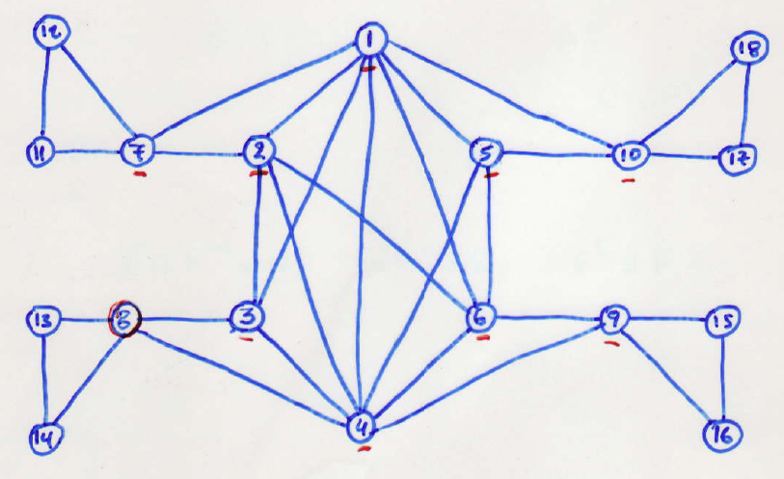
Simple Elimination Scheme
Example:
σ = (13,14,15,16,17,18,11,12,8,9,10,7,5,3,6,2,4,1)

Slide 61
Simple Elimination Scheme
If G is a chordal comparability graph, we will show that the following algorithm (Cardinality LexBFS) constructs a SEO.
The Cardinality LexBFS or CLexBFS is a modification of LexBFS that always prefers a vertex with largest possible degree.
We note that the reason we need CLexBFS is that it guarantees that if N(v) is proper subset of N(w), vertex v comes before w in the scheme.

Slide 62
Simple Elimination Scheme
Algorithm CLexBFS
1. for each vertex x in V(G) do
Compute the deg(x);
Initialize label(x) ← (); position(x) ← undefined;
2. for k ← n down to 1 do
Let S be the set of unpositioned vertices with largest labels;
Let x be a vertex in S with largest degree;
Set σ(k) ← x; set label(x) ← k;
For each unpositioned vertex y∈adj(x) do
append k to the label of y;

Slide 63
Simple Elimination Scheme
Example:
σ = (13,14,15,16,17,18,11,12,8,9,10,7,5,3,6,2,4,1)

Slide 64
Simple Elimination Scheme
Theorem: Given a chordal comparability graph, the CLBFS algorithm constructs a SES (or, SEO).
See: Borie, Spinrad, “Construction of a simple elimination scheme for a chordal comparability graph in linear time”, DAM 91(1999) 287-292.

Slide 65
Algorithmic Graph Theory
Comparability Graphs
Properties & Algorithms

Slide 66
Comparability Graphs
A graph G = (V, E) is a comparability graph if there exists an orientation (V, F) of G satisfying
F ∩ F⁻¹ = Ø, F + F⁻¹ = E, F² ⊆ F
where F² = {ac | ab, bc ∈ F for some vertex b}

Slide 67
Comparability Graphs
Define the binary relation Γ on the edges of an undirected graph G = (V, E) as follows:
ab Γ a’ b’ iff either a = a’ and b b’ ∉ E
or b = b’ and a a’ ∉ E.
Edges ab, cd are in the same implication class
iff there exists a Γ-chain from ab to cd; ab Γ* cd,
that is
ab = a₀b₀ Γ a₁b₁ Γ … Γ a_{k}b_{k} = cd

Slide 68
Comparability Graphs
Example:
A = {ab, cb, cd, cf, ef, bf, A₁={ab} ba, bc, dc, fc, fe, fb} A₂={cd}
A₃={ac, ad, ae}
A₄={bc, bd, be}
A = Â = A∪A⁻¹ A ∩ A⁻¹ = Ø

Slide 69
Comparability Graphs
The next theorem is of major importance since it legitimizes the use of G-decomposition as a tool for recognizing comparability graph.
A partition of is called G-decomposition
of E if is an implication class of

Slide 70
Comparability Graphs
Algorithm: Decomposition_Algorithm
Initialize: i ← 1; E_{i} ← E; F ← Ø;
Arbitrarily pick an edge x_{i}y_{i} ∈ E_{i} ;
Enumerate the implication class B_{i} of E; if B_{i}∩B_{i}⁻¹ = Ø then add B_{i} to F; else “G is not comparability graph”; STOP;
Define: E_{i+1} ← E_{i} - ;
if E_{i+1}= Ø then k ← i; output F; STOP;
else i ← i+1; goto 2;
∧
∧
∧
∧

Slide 71
Comparability Graphs
Moreover, when these conditions hold, B₁ + B₂ + … + B_{k} is a transitive orientation of E.
Decomposition scheme [ac, bc, dc]

Slide 72
Comparability Graphs
Theorem(TRO): Let be a
G-decomposition of G = (V, E). The following statements are equivalent:
(i) G = (V, E) is a comparability graph;
(ii) A ∩ A⁻¹ = Ø for all implication classes A of E;
(iii) B_{i} ∩ B_{i}⁻¹ = Ø for i =1, 2, ……, k;
(iv) every “circuit” of edges v₁v₂, v₂v₃,…, v_{q}v₁ ∈E, such that v_{q-1}v₁, v_{q}v₂, v_{i-1}v_{i+1} ∉ E
(for i = 2, 3,…., q-1) has even length.

Slide 73
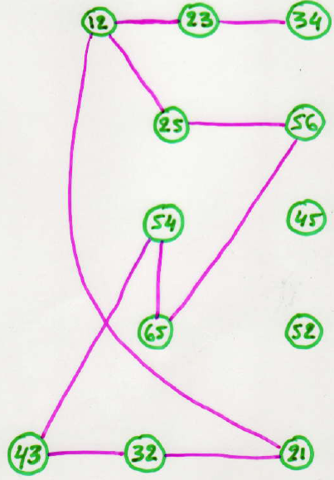
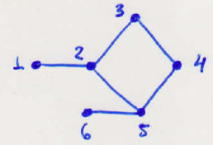
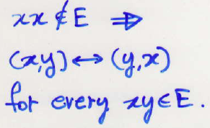
Comparability Graphs
Definition: Given an undirected graph G = (V,E) we
define a graph G΄=(V΄,E΄) in the following
manner.
V΄= {(i,j), (j,i) | i, j ∈ V}
E΄= {(x,y) ↔ (y,z) | xz ∉ E}
Example:

Slide 74
Comparability Graphs
Theorem: (Ghouilla-Houri, 1962) The following
claims are equivalent:
The graph G is a comparability graph
The graph G΄ is bipartite
Proof: We will use GH characterization (Any odd
cycle contains a short-chord).
The vertices of a cycle in G΄correspond to adjacent
edges in G (with common vertex), which induce a
cycle in G with no chords.
Thus, G΄ is bipartite ↔ G is a comparability graph.

Slide 75
Algorithmic Graph Theory
Coloring
Maximum Weighted Clique

Slide 76
Coloring Comparability Graphs
Let F be an acyclic orientation (not necessarily transitive) of an undirected graph G.
A height function h can be placed on V(G) as follows:
h(v) =
The height function can be assigned in linear time using DFS.
1+ max{ h(w) | vw∈F };
0 if v is a sink ;

Slide 77
Coloring Comparability Graphs
The function h is always a proper vertex coloring of G, but it is not necessarily a minimum coloring.
#colors = #vertices in the longest path of F = 1+ max {h(v) | v∈V}
The function h is a minimum coloring if F happens to be transitive.

Slide 78
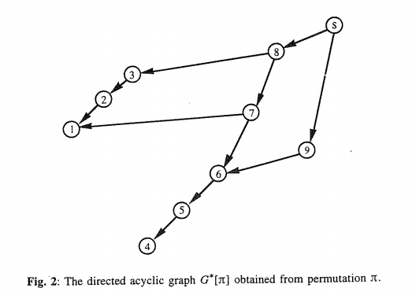
Coloring Comparability Graphs
The function h is a minimum coloring if F happens to be transitive
6
5
3
2
4
1
4
3
2
1

Slide 79
Coloring Comparability Graphs
Suppose that G is a comparability graph, and let F be a transitive orientation of G.

Slide 80
Coloring Comparability Graphs
In such a case, every path in F corresponds to a clique of G because of transitivity.

Slide 81
Coloring Comparability Graphs
Thus, the height function will yield a coloring of G which uses exactly ω(G) colors, which is the best possible.
6
5
3
2
4
1
4
3
2
1

Slide 82
Coloring Comparability Graphs
Moreover, since being a comparability graph is a hereditary property, we find that ω(G_{A}) = χ(G_{A}) for all induced subgraphs G_{A} of G.
This proves: Every comparability graph is a
perfect graph.

Slide 83
Maximum Weighted clique
In general the maximum weighted clique problem is NP-complete, but when restricted to comparability graphs it becomes tractable.
Algorithm MWClique
Input: A transitive orientation F of a comparability graph G = (V, E) and a weight function w defined on V.
Output: A clique C of G whose weight is max.

Slide 84
Maximum Weighted clique
Method: We use a modification of the height calculation technique (DFS).
To each vertex v we associate its cumulative weight W(v) = the weight of the heaviest path from v to some sink.
A pointer is assigned to v designating its successor on that heaviest path.

