Slide 1
Αλγοριθμική Θεωρία Γραφημάτων
Διάλεξη 2
Βασικές Έννοιες
Τέλεια Γραφήματα
Πολυπλοκότητα Αλγορίθμων

Slide 2
Αλγόριθμοι Θεωρίας Γραφημάτων
Πολυωνυμικοί Αλγόριθμοι… (Γραμμικοί)
Προβλήματα: NP-Πλήρη
Επιλογές Προσέγγιση Λύσης
Περιορισμοί Ιδιοτήτων
Τέλεια Γραφήματα, …

Slide 3
Classes of Perfect Graphs

Slide 4
Algorithmic Graph Theory
Notations - Terminology
Graph Theoretic Foundations

Slide 5
Graph Theoretic Foundations
Graph G = (V, E)
B
C_{n} Άχορδος κύκλος με n κόμβους
K_{n} Πλήρες γράφημα με n κόμβους
P_{n} Άχορδη διαδρομή με n κόμβους

Slide 6
Graph Theoretic Foundations
Regular Graphs:
Κυκλικό γράφημα (C_{n}): όλοι οι κόμβοι d(v)=2 (κυβικός k = 3)

Slide 7
Graph Theoretic Foundations
Induced Subgraphs
Let A ⊆ V. We define the subgraph induced by A to be G_{A} = (A, E_{A}), where E_{A} = {(x, y) ∈ E_{A} | x ∈ A and y ∈ A}
Not every subgraph G_{A} of G is
an induced subgraph of G.
1
1
2
3
3
4
4
5
6
6

Slide 8
Graph Theoretic Foundations
Induced Subgraphs
1
1
1
2
3
2
3
2
3
3
4
5
4
4
5
4
5
6
6
6
6
G = (V, E) V’= {1, 3, 4, 6} V’ V’
G [V’] ? ?

Slide 9
Graph Theoretic Foundations
Isomorphic Graphs
G = (V, E) and G′ = (V′, E′) are isomorphic, denoted G G′, if ∃ a bijection f: V→ V′:
(x, y) ∈ E ⇔ (f(x), f(y)) ∈E′ ∀x, y ∈V
1, 2, 3, 4, 5, 6
1, 5, 4, 3, 6, 2
(2,6) ∈ E ⇔ (5, 6) ∈ E’

Slide 10
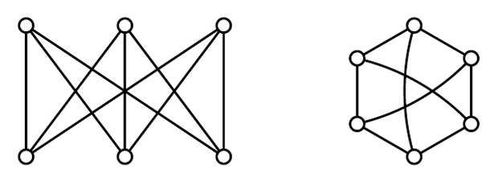
Graph Theoretic Foundations
Isomorphic Graphs

Slide 11
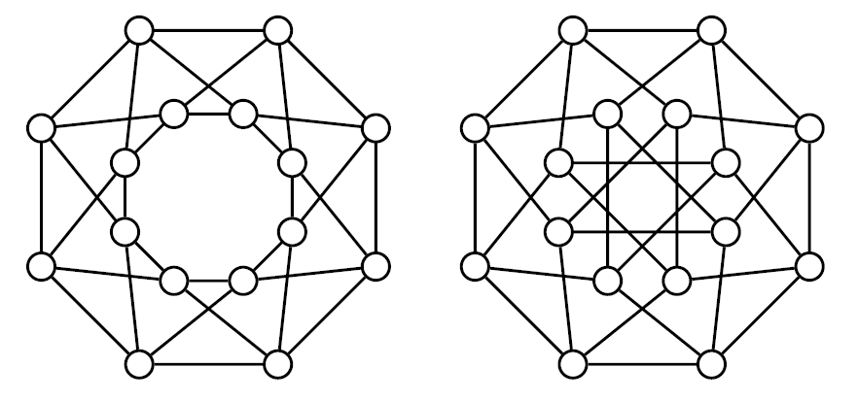
Graph Theoretic Foundations
Isomorphic Graphs

Slide 12
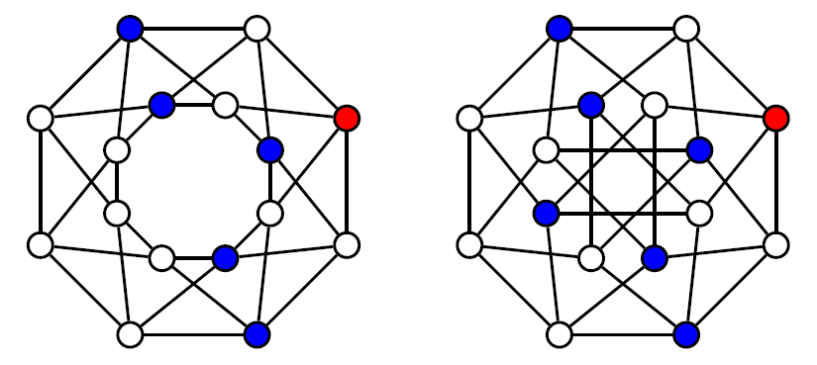
Graph Theoretic Foundations
Isomorphic Graphs

Slide 13
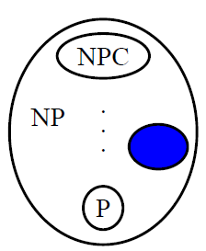
Graph Theoretic Foundations
Isomorphic Graphs

Slide 14
Graph Theoretic Foundations
Operations ∪ ∩ ⊕
2
2
6
1
3
1
3
G₁
G₂
5
4
4
2
6
2
2
6
1
3
1
3
1
3
5
4
4
5
4
G₁
∪
G₂
G₁
∩
G₂
G₁
⊕
G₂

Slide 15
Graph Theoretic Foundations
Operation +
+
⇒
Κ₂ Κ₃ Κ₅ (complete graph)
+
⇒
Κ₁ (N₁) C_{n-1} W_{n} (wheel graph)

Slide 16
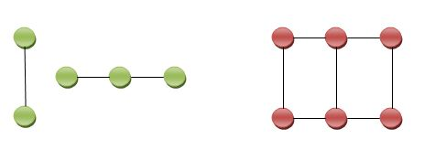
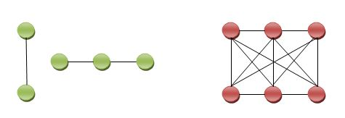
Graph Theoretic Foundations
Cartesian Product G1 × G2
Lexicographic Product G1[G2]
?
G₁
G₂
× G₂
× G₁
G₁
G₂
?
G₁
G₂
G₁[G₂]
G₂[G₁]

Slide 17
Algorithmic Graph Theory
Intersection Graphs
Object – Graph
Graph Properties

Slide 18
Intersection Graphs
Let F be a family of nonempty sets.
The intersection graph of F is obtained be representing each set in F by a vertex:
x → y ⇔ S_{X} ∩ S_{Y} ≠ ∅

Slide 19
Intersection Graphs (Interval)
The intersection graph of a family of intervals on a linearly ordered set (like the real line) is called an interval graph
I₁ I₃ I₅
I₂ I₄ I₆
I₇
Unit & Proper internal graph
No internal property contains another
2
1
3
6
7
4
5

Slide 20
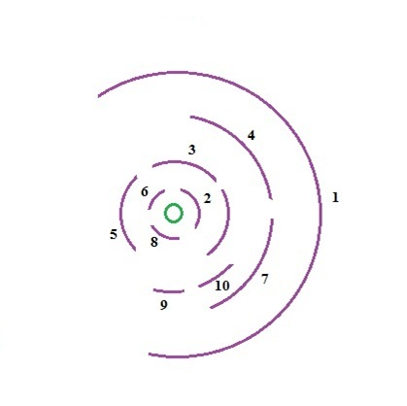
Intersection Graphs (Circular-arc)
Circular-arc graphs properly contain the internal graphs.
proper circular - arc graphs
5
8
6
9
1
4
1
7
3
2

Slide 21
Intersection Graphs (Permutation)
A permutation diagram consists of n points on each of two parallel lines and n straight line segments matching the points.
π = [4,1, 3, 2]
1
2
3
4
4
1
3
2
1
2
G[π]
4
3

Slide 22
Intersection Graphs (Chords-of-circle)
Intersecting chords of a circle
3
2
4
2
1
3
4
4
3
2
1
1

Slide 23
Intersection Graphs (cont…)
Propositinon 1.1. An induced subgraph of an interval graph is an interval graph.
In general…
Hamiltonian
non-Hamiltonian

Slide 24
Intersection Graphs (cont…)
Propositinon 1.1. An induced subgraph of an interval graph is an interval graph.
Proof ?
G
Interval

Slide 25
Intersection Graphs (cont…)
Propositinon 1.1. An induced subgraph of an interval graph is an interval graph.
Proof ?
G
Interval
G’
G’

Slide 26
Intersection Graphs (cont…)
Propositinon 1.1. An induced subgraph of an interval graph is an interval graph.
Proof.
If [I_{V}], v ∈V, is an interval representation of a graph G = (V, E). Then
[I_{V}], v∈X, is an interval representation of the induced subgraph G_{X} = (X, E_{X}).

Slide 27
Algorithmic Graph Theory
Objects
Transformations

Slide 28
Objects - Transformations
w
π = [π , π , …, π ]
1
2
n
G

Slide 29
Algorithmic Graph Theory
Triangulated Property
Transitive Orientation Property

Slide 30
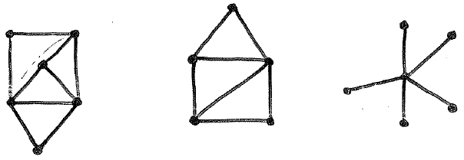
Triangulated Property
Triangulated Graph Property Every simple cycle of length l > 3 possesses a chord.
Triangulated graphs (or chord graphs)

Slide 31
Transitive Orientation Property
Transitive Orientation Property Each edge can be assigned a one-way direction in such a way that the resulting oriented graph (V, F):
ab ∈ F and bc ∈ F ⇒ ac ∈ F (∀ a, b, c ∈V)
Comparability graphs

Slide 32
Intersection Graph Properties (1)
Proposition 1.2. An interval graph satisfies the triangulated graph property.
Proof.
Suppose G contains a cordless cycle [v₀,v₁,….,v_{l-1},v₀] with l > 3. Let I_{K}→ v_{K} .
For i =1, 2,…, l-1, choose a point P_{i}∈ I_{i-1} ∩ I_{i} .
Since I_{i-1} and I_{i+1} do not overlap, the points P_{i} constitute a strictly increasing or decreasing sequence.
Therefore, it is impossible for the intervals I₀ and I_{l-1} to intersect, contradicting the criterion that v₀v_{l-1} is an edge of G.

Slide 33
Intersection Graph Properties (2)
Proposition 1.3. The complement of an internal graph satisfies the transitive orientation property.
Proof (1).
G
Interval

Slide 34
Intersection Graph Properties (3)
Proposition 1.3. The complement of an internal graph satisfies the transitive orientation property.
Proof (1).
_
G
Interval

Slide 35
Intersection Graph Properties (4)
Proposition 1.3. The complement of an internal graph satisfies the transitive orientation property.
Proofv (2).
Let {I_{v}} v ∈V be the interval representation for G = (V, E).
Define an orientation F of Ğ = (V, Ē) as follows:
xy∈F ⇔ I_{X} < I_{Y} (∀xy ∈Ē).
Here, I_{X} < I_{Y} means that I_{X} lies entirely to the left of I_{Y.} Clearly the top is satisfied, since I_{X} < I_{Y} < I_{Z} ⇒ I_{X} < I_{Z.} Thus F is a transitive orientation of Ğ.

Slide 36
Intersection Graph Properties (5)
Theorem 1.4. An undirected graph G is an interval graph if and only if (iff)
G is triangulated graph, and
its complement Ğ is a comparability graph.
Proof… M. Golumbic, pp. 172.

Slide 37
Algorithmic Graph Theory
Numbers ω(G)
Numbers α(G)
Numbers k(G)
Numbers x(G)

Slide 38
Graph Theoretic Foundations (2)
Clique number ω(G) the number of vertices in a maximum clique of G
Stability number α(G) the number of vertices in a stable set of max cardinality
Max κλίκα του G
ω(G) = 4
Max stable set of G
α(G) = 3
a
b
e
a
b
e
⇒
c
d
c
f
d
f
c

Slide 39
Graph Theoretic Foundations (3)
A clique cover of size k is a partition
V = C₁ + C₂ +…+ C_{k}
such that C_{i} is a clique.
A proper coloring of size c (proper c-coloring) is a partition
V = X₁ + X₂ +…+ X_{c}
such that X_{i} is a stable set.

Slide 40
Graph Theoretic Foundations (4)
Clique cover number κ(G) the size of the smallest possible clique cover of G
Chromatic number χ(G) the smallest possible c for which there exists a proper c-coloring of G.
χ(G) = 2 κ(G) = 3
clique cover V={2,5}+{3,4}+{1} c-coloring V={1,3,5}+{2,4}
ω(G)=2 α(G)=3
4
3
5
1
2

Slide 41
Graph Theoretic Foundations (1)
Observation...
Each of the graphs can be colored using 3 colors and each contains a triangle. Therefore, χ(G) = ω(G)

Slide 42
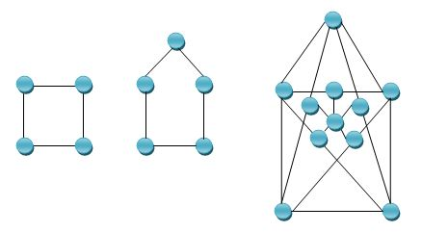
Graph Theoretic Foundations (5)
For any graph G: ω(G) ≤ χ(G) α(G) ≤ κ(G)
Obviously: α(G) = ω(Ğ) and κ(G) = χ(Ğ)

Slide 43
Algorithmic Graph Theory
χ-Perfect property
α-Perfect property
Perfect Graphs

Slide 44
Perfect Graphs - Properties
χ-Perfect property
For each induced subgraph G_{A} of a graph G
χ(G_{A}) = ω(G_{A})
α-Perfect property
For each induced subgraph G_{A} of a graph G
α(G_{A}) = κ(G_{A})

Slide 45
Perfect Graphs - Definition
Let G = (V, E) be an undirected graph:
(P₁) ω(G_{A}) = χ(G_{A})
(P₂) α(G_{A}) = κ(G_{A})
for all A ⊆ V
for all A ⊆ V
For each induced subgraph G_{A} of a graph G !!!
G is called…
Perfect Graph

Slide 46
The Perfect Graph Theorem
Lovasz (1972):
For an undirected graph G = (V, E), the following statements are equivalent:
(P₁) ω(G_{A}) = χ(G_{A}) for all A ⊆ V
(P₂) α(G_{A}) = κ(G_{A}) for all A ⊆ V
(P₃) ω(G_{A})α(G_{A}) ≥ |Α| for all A ⊆ V

Slide 47
The Strong Perfect Graph Conjecture
Claude Berge (1960):
SPGC1: An undirected graph G is Perfect iff contains no induced subgraph isomorphic to C_{2k+1} or co-C_{2k+1} (for k ≥ 2).
SPGC2: An undirected graph G is Perfect iff in G and in co-G every odd cycle of length l ≥ 5 has a chord.

Slide 48
The Strong Perfect Graph Conjecture
Maria Chudnovsky, Neil Robertson, Paul Seymour, Robin Thomas (2002):
SPGT: G is Perfect iff it contains
neither odd holes nor odd antiholes.
The strong perfect graph theorem is a forbidden graph characterization of the perfect graphs as being exactly the graphs that have neither odd holes (odd-length induced cycles) nor odd antiholes (complements of odd holes).
Classroom Project

Slide 49
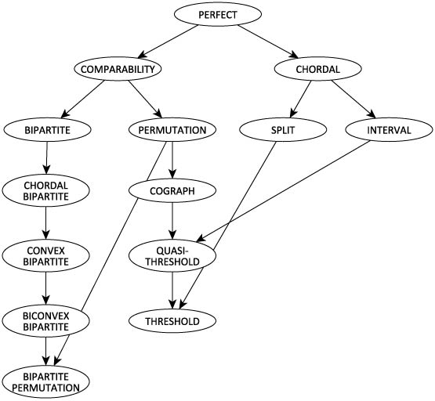
Classes of Perfect Graphs

Slide 50
Algorithmic Graph Theory
Algorithms
Graph Theory

Slide 51
The Design of Efficient Algorithms
Computability – computational complexity
Computability addresses itself mostly to questions of existence:
Is there an algorithm which solves problem Π?
An algorithm for Π is a step-by-step procedure which when applied to any instance of Π produces a solution.

Slide 52
The Design of Efficient Algorithms
Rewrite an optimization problem as a decision problem
Graph Coloring | Graph Coloring
Instance: A graph G | Instance: G and k∈ Z₊
Question: What is the smallest number of colors needed for a proper coloring of G? | Question: Does there exist a proper k coloring of G?

Slide 53
The Design of Efficient Algorithms
Determining the complexity of a problem Π requires a two-sided attack:
The upper bound – the minimum complexity of all known algorithms solving Π.
The lower bound – the largest function f for which it has been proved (mathematically) that all possible algorithms solving Π are required to have complexity at least as high as f.
Gap between (1) - (2) ⇒ research

Slide 54
The Design of Efficient Algorithms
Example: matrix multiplication - Strassen [1969] - Pan [1979]
The lower bound known to date for this problem is only O(n²)
[Aho, Hoproft, Ullman, 1994, pp 438]
O(n^{2.81})
O(n^{2.78})
O(n^{2.6054}) n >>

Slide 55
The Design of Efficient Algorithms
The biggest open question involving the gap between upper and lower complexity bounds involves the so called NP-complet problems.
Π ∈ NP-complete ⇒ only exponential-time algorithms are known,
yet the best lower bounds proven so far are polynomial functions.

Slide 56
The Design of Efficient Algorithms
Π ∈ P if there exists a “deterministic”
polynomial-time algorithm which solves Π
A nondeterministic algorithm is one for which a state may determine many next states and which follows up on each of the next states simultaneously.
Π ∈ NP if there exists a “nonderminitic”
polynonial-time algorithm which solves Π.

Slide 57
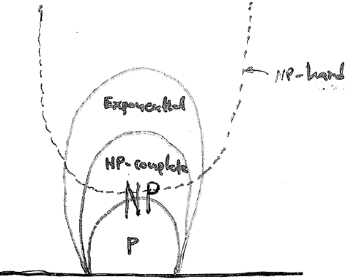
The Design of Efficient Algorithms
Clearly, P ⊆ NP
Open question is whether the containment of P in NP is proper
is P ≠ NP ?

Slide 58
The Design of Efficient Algorithms
Π∈NP – complete if Π∈NP and Π∈NP-hard
Repeat the following instructions:
1. Find a candidate Π which might be NP-complete
2. Select Π΄ from the bag of NP-complete problems
3. Show that Π∈NP and Π΄≤ Π
4. Add Π to the bag

Slide 59
The Design of Efficient Algorithms
Theorem (Poljak (1974)): STABLE SET ≤ STABLE SET ON TRIANGLE-FREE GRAPHS
Proof Let G be a graph on n vertices and m edges. We construct from G a triangle-tree graph H with the properly that :
Knowing α(H) will immediately give us α(G)
G

Slide 60
The Design of Efficient Algorithms
Subdivide each edge of G into a path of length 3
H is triangle-free with
n+2m vertices, and 3m edges
Also, H can be constructed from G in Ο(n+m)
Finally, since α(H) = α(G) + m, a deterministic
polynomial time algorithm which solves for α(H)
yields a solution to α(G).
H

Slide 61
The Design of Efficient Algorithms
Since it is well known that STABLE SET is ` NP-complete, we obtain the following lesser known result.
Corollary:
STABLE SET ON TRIANGLE-FREE GRAPHS is NP-complete.
Theorem (Poljak(1974)):
STABLE SET ≤ GRAPH COLORING

Slide 62
The Design of Efficient Algorithms
Some NP-complete Problems
Graph coloring instance: G question: What is χ(G)?
Clique instance : G question: What is ω(G)?
Perfect graphs ⇒ Optimization Problems?
Stable set instance : G question: What is α(G)?
Clique cover instance : G question: What is κ(G)?

Slide 63
Algorithmic Graph Theory
Classes of Perfect Graphs
Optimization Problems

Slide 64
Perfect Graphs – Optimization Problems
Πολυωνυμικοί Αλγόριθμοι Προβλημάτων
Αναγνώρισης
Βελτιστοποίησης
Triangulated
Comparability
Interval
Permutation
Split
Cographs
Threshold graphs
QT graphs
…
Coloring
Max Clique
Max Stable Set
Clique Cover
Matching
Hamiltonian Path
Hamiltonian Cycle
…

