Slide 1
Dynamic Diversification of Continuous Data
Marina Drosou and Evaggelia Pitoura
Computer Science Department
University of Ioannina, Greece
http://dmod.cs.uoi.gr

Slide 2
Motivation
The abundance of available information online creates the need for selecting and presenting to users representative results.
Result diversification can be applied in multiple domains:
Exploratory or ambiguous queries
Recommenders

Slide 3
Result Diversification
Problem definition:
Given a set P of items and a number k, we seek to select a subset S* of P with the k most dissimilar items of P.
Let P = {p₁, …, p_{n}}, k ≤ n, d be a distance measure and f be a function measuring the diversity of items as indicated by d. Then:

Slide 4
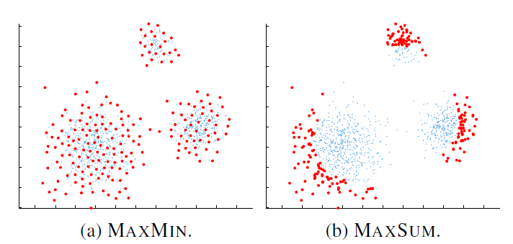
Diversity Functions
Two widespread options for f:

Slide 5
Contribution
We study the dynamic/streaming diversification problem:
New items (books, movies etc.) are added to a recommender system.
News articles are published while old ones are not important anymore.
Microblogging applications (e.g., twitter)
We introduce continuity requirements that need to be satisfied in streaming environments:
The order in which diverse items are delivered to the users must follow the order of their generation.
Items must not appear, disappear and then re-appear again to the users.

Slide 6
Contribution
We propose an efficient indexing approach based on Cover Trees.
We provide approximation bounds for the accuracy of the achieved solutions.
We conduct an experimental study of the efficiency and effectiveness of our approach using both real and synthetic datasets.

Slide 7
Outline
Diversification Model
Diversification framework
Continuous k-diversity problem
Cover Tree
Structure
Algorithms
Evaluation

Slide 8
Outline
Diversification Model
Diversification framework
Continuous k-diversity problem
Cover Tree
Structure
Algorithms
Evaluation

Slide 9
Diversification Framework
We consider a streaming scenario, where new items arrive and older items expire.
We want to provide users with a continuously updated subset of the top-k most diverse recent items in the stream.
We focus on the MaxMin diversification problem.

Slide 10
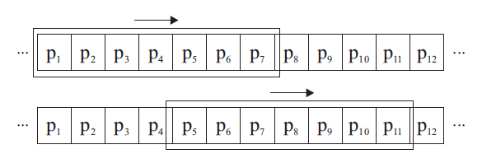
Jumping Windows
We consider a sliding-window model where the k most diverse items are computed over windows of length w in the streaming input data.
We allow windows not only to slide but also to jump.
This corresponds to the view of the users between consequent logins to their notification service.
Window P_{i-1}
Window P_{i}
jump step
w

Slide 11
Constrained Continuous k-Diversity Problem
Let P_{i-1}, P_{i} be two consequent jumping windows.
For each P_{i}, we seek to select a diverse subset S_{i}, where the additional two constraints hold:
Durability: ∀ p_{j} ∈ (S_{i-1} ∩ P_{i}) ⇒ p_{j} ∈ S_{i}
Once selected as diverse, an item remains as such until it expires.
Freshness: Let p_{l} be the newest item in S_{i-1.} Then, ∄p_{j} ∈P_{i}\S_{i-1} with j < l, such that, p_{j} ∈S_{i}
Items are selected in the same order they are produced.

Slide 12
Widespread approaches
The diversification problem is NP-hard.
Most current solutions to the (static) diversification problem are either:
Greedy Heuristics
Select one item at a time.
Interchange Heuristics
Start with a random solution and try to improve it.
Other approaches include the definition of optimization problems, probabilistic selection etc.

Slide 13
Greedy Heuristic
One of the most widely spread and best performing heuristics^{1,2}.
Algorithm (applied after each window jump):
Add first into S the two most dissimilar items of P.
Continue by adding one item at a time, until k items are selected. Add the item p with the largest distance from S:
The greedy heuristic provides a ½-approximation of the optimal solution.
M. Vieira, H. Razente, M. Barioni, M. Hadjieleftheriou, D. Srivastava, C. Traina Jr., V. Tsotras: On query result diversification. ICDE, 2011
M.Drosou, E.Pitoura: Search result diversification. SIGMOD Record 39(1), 2010

Slide 14
Outline
Diversification Model
Diversification framework
Continuous k-diversity problem
Cover Tree
Structure
Algorithms
Evaluation

Slide 15
The Cover Tree
A leveled tree where each level is a “cover” for all levels beneath it.
Items at higher levels are farther apart from each other than items at lower levels.
level C_{l}
level C_{l-1}
level C_{l-2}

Slide 16
Cover Tree Invariants - Nesting
Nesting: C_{l} ⊂ C_{l-1}, i.e., once an item p appears at some level, then every lower level has a node associated with p.
p₂
level C_{l}
p₁
p₂
p₃
level C_{l-1}
p₃
p₁
p₂
level C_{l-2}

Slide 17
Cover Tree Invariants - Covering
Covering: For every p_{i} ∈ C_{l-1}, there exists a p_{j} ∈ C_{l}, such that d(p_{i},p_{j}) ≤ b^{l} and the node associated with p_{j} is the parent of the node associated with p_{i}.
p₂
level C_{l}
≤ b^{l-1}
p₁
p₂
p₃
level C_{l-1}
p₃
p₁
p₂
level C_{l-2}
b: the “base” of the tree l: the level of p_{i}

Slide 18
Cover Tree Invariants - Separation
Separation: For all distinct p_{i}, p_{j} ∈ C_{l}, it holds that d(p_{i}, p_{j}) > b^{l}.
p₂
level C_{l}
≤ b^{l-1}
p₁
p₂
p₃
level C_{l-1}
p₃
p₁
p₂
level C_{l-2}
> b^{l-2}

Slide 19
Cover Tree Representations
After an item p appears in some level l of the tree, then p is a child of itself at all levels below l.
Implicit Representation
Explicit Representation
p₂
p₂
p₁
p₁
p₂
p₃
p₃
p₁
p₂
p₃
space depending on P
O(n) space

Slide 20
Computing Diverse Subsets
Basic idea:
Let T be a cover tree for P. Select k distinct items that appear at the highest levels of the tree.
l ← +∞
while |T.C_{l-1}| ≤ k do
l ← l-1
end while
S ← T.C_{l}
candidates ← T.C_{l-1}
while |S| < k do
p* ← argmax_{p ∈ candidates} d(p,S)
S ← S ∪ {p*}
candidates ← candidates\{p*}
end while
return S

Slide 21
Example of Diverse Subsets
Diverse subsets (items in red) for different values of k from the same Cover Tree.

Slide 22
Continuity Requirements
Items in the tree are marked as valid or invalid:
Freshness: non-diverse items that are older than the newest diverse item from the previous window are marked as invalid in the cover tree and are not further considered.
Durability: Let r be the number of diverse items from previous windows that have not yet expired. We select k-r new valid diverse items from the new window.

Slide 23
Dynamic Construction
Items can be inserted and deleted from a Cover Tree in a dynamic fashion.
Insertion:
Starting from the root, descend towards the candidate nodes that can cover the new item p.
Continue until we reach a level C_{l} where p is separated from all other items.
Select as parent the candidate node of C_{l+1} that is closest to p.
Deletion:
Descend the tree looking for p, keeping note of candidate nodes that can cover the children of p.
Remove p and reassign its children to the candidate nodes.

Slide 24
Insertion
We traverse the tree until we find a level in which the new item is separated from the rest
p₂
p₁
p₂
p₃
p₁
p₂
p₃
p₂
p₁
p₂
p₃
p₁
p₂
p₃
p₂
p₁
p₂
p₃
p₁
p₂
p₃
The new item is assigned to the closest candidate parent
(according to the covering invariant)

Slide 25
Deletion
p₂
p₁
p₂
p₃
p₁
p₂
p₃
p₂
p₃ is deleted
p₁
p₂
p₁
p₂
p₂
This child is assigned to p₂ since it can be covered by it
p₁
p₄
p₂
p₁
p₄
A new item is promoted to the upper level and covers the other children
p₂

Slide 26
Approximation Bound
Let P be a set of items, k ≥ 2, d^{OPT}(P,k) the optimal minimum distance for the MaxMin problem and d^{CT}(P,k) be the minimum distance of the diverse set computed by the Cover Tree algorithm. It holds that:
d^{CT}(P,k) ≥ α ⋅ d^{OPT}(P,k), where α = (b-1)/(2b²)
Proved by exploiting the covering invariant of the tree to bound the level where the least common ancestor of any two items of the optimal solution appears in the tree.

Slide 27
Batch Construction
If all items of P are available, we can perform a batch construction of the Cover Tree
We call the trees thus constructed Batch Cover Trees (BCTs).
Algorithm:
The leaf level C_{l} contains all items in P
We greedily select items from C_{l} with distance larger than b^{l+1} and promote them to C_{l+1}
The rest of the items in C_{l} are distributed as children among the new nodes of C_{l+1}
Continue until we reach the root level
We have proved that computing diverse subsets from a BCT results in solutions identical to those produced by the Greedy Heuristic, i.e., ½-approximations of the optimal solution.

Slide 28
Changing k
The Cover Tree can support a zooming functionality from k to k’ items.
Let l be the lowest level from which the k diverse items were selected. We can exploit the nesting invariant:
For k’ > k (zoom in), we select items from level l or lower.
For k’ < k (zoom out), we select items that appear in levels higher than l.

Slide 29
Outline
Diversification Model
Diversification framework
Continuous k-diversity problem
Cover Tree
Structure
Algorithms
Evaluation

Slide 30
Setup
Dataset |  | Cardinality | Dimensions | Distance metric
Synthetic | Uniform | 10000 | 2 | Euclidean
 | Clustered | 10000 | 2 | Euclidean
Real | Cities | 5922 | 2 | Euclidean
 | Forest | 5000 | 10 | Cosine
 | Faces | 300 | 256 | Cosine
 | Flickr | 18245 | - | Jaccard
GR: Greedy Heuristic
BCT: Batch Cover Tree
ICT: Incremental Cover Tree (dynamic insertions and deletions)
RA: Random selection

Slide 31
Building Batch Cover Trees
We measure the extra cost of building a BCT as compared to executing GR for k = n.
This extra cost corresponds to assigning nodes to suitable parents to form the tree levels.
 | Clustered |  | Faces
b | non-np | np | non-np | np
1.3 | 0.42% | 0.58% | 1.49% | 1.94%
1.5 | 0.42% | 0.56% | 1.47% | 1.92%
1.7 | 0.41% | 0.55% | 1.47% | 1.91%
Extra Cost
np – nearest parent heuristic (choose closest candidate parent).
The quality of the solution is the same for BCT and GR.

Slide 32
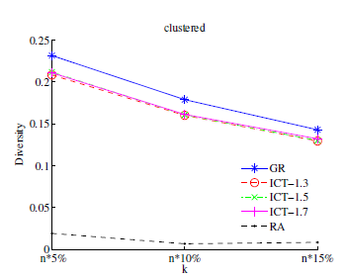
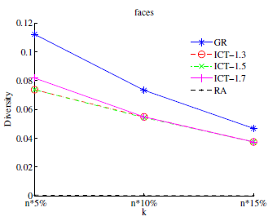
Building Incremental Cover Trees
Building ICTs requires a small fraction of the cost required for the corresponding BCTs.
However, the quality of the solutions provided by ICTs is comparable to that of BCTs (and, thus, GR).
b | Clustered | Faces
1.3 | 0.16% | 0.79%
1.5 | 0.08% | 0.41%
1.7 | 0.06% | 0.28%
Extra Cost
For trees with 10,ooo items:
Insertion cost: ~2.6 msec
Deletion cost: ~10 msec
Inserting/Removing items after a window jump depends on the size of the window and the jump step but is much faster than re-building a BCT for the new set of items.

Slide 33
Streaming Data
We compare ICTs against SGR, a streaming version of GR:
After each window jump, we initialize the solution for the new window with the remaining diverse items from the previous window (durability) and let GR select items from the new window satisfying freshness.
To simulate the order in which data arrives, we used the photo upload time for the Flickr dataset. For the rest of the datasets, we permuted the items so that they enter the stream in a random order.

Slide 34
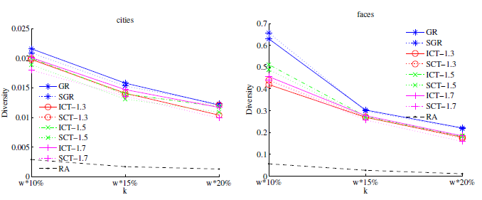
Streaming Data
Comparable achieved diversity, while ICTs are much faster.
Retrieving the top-100 items from an ICT with 1,000-10,000 items requires ~1.5 msec.
Executing SGR requires 3.2 sec for 5,000 items and more than 15 sec for 10,000 items.

Slide 35
Summary
We studied the diversification problem in a dynamic setting, where items change over time.
We defined continuity requirements that the diversified items must satisfy.
We proposed an indexed-based approach based on Cover Trees for providing efficient solutions for continuous diversification.
We provided theoretical and experimental results for the quality of our approach.

Slide 36
Thank you!

