Slide 1
Online Social Networks and Media
Network models

Slide 2
What is a network model?
Informally, a network model is a process (radomized or deterministic) for generating a graph
Models of static graphs
  input: a set of parameters Π, and the size of the graph n
  output: a graph G(Π,n)
Models of evolving graphs
  input: a set of parameters Π, and an initial graph G₀
  output: a graph G_{t} for each time t

Slide 3
Families of random graphs
A deterministic model D defines a single graph for each value of n (or t)
A randomized model R defines a probability space ‹G_{n},P› where G_{n} is the set of all graphs of size n, and P a probability distribution over the set G_{n} (similarly for t)
  we call this a family of random graphs R, or a random graph R

Slide 4
Why do we care?
Creating models for real-life graphs is important for several reasons
  Create data for simulations of processes on networks
  Identify the underlying mechanisms that govern the network generation
  Predict the evolution of networks

Slide 5
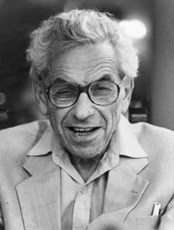
Erdös-Renyi Random graphs
Paul Erdös (1913-1996)
Notes:
Biographic information for Erdos, mostly from wikipedia

Slide 6
Erdös-Renyi Random Graphs
The G_{n,p} model
  input: the number of vertices n, and a parameter p, 0 ≤ p ≤ 1
  process: for each pair (i,j), generate the edge (i,j) independently with probability p
Related, but not identical: The G_{n,m} model
  process: select m edges uniformly at random

Slide 7
Graph properties
A property P holds almost surely (a.s.) (or for almost every graph), if
Evolution of the graph: which properties hold as the probability p increases?
  different from the evolving graphs over time that we saw before
Threshold phenomena: Many properties appear suddenly. That is, there exist a probability p_{c} such that for p<p_{c} the property does not hold a.s. and for p>p_{c} the property holds a.s.

Slide 8
The giant component
Let z=np be the average degree
If z < 1, then almost surely, the largest component has size at most O(ln n)
if z > 1, then almost surely, the largest component has size Θ(n). The second largest component has size O(ln n)
if z =ω(ln n), then the graph is almost surely connected.

Slide 9
The phase transition
When z=1, there is a phase transition
  The largest component is O(n^{2/3})
  The sizes of the components follow a power-law distribution.

Slide 10
Random graphs degree distributions
The degree distribution follows a binomial
Assuming z=np is fixed, as n→∞, B(n,k,p) is approximated by a Poisson distribution
Highly concentrated around the mean, with a tail that drops exponentially

Slide 11
Other properties
Clustering coefficient
  C = z/n
Diameter (maximum path)
  L = log n / log z

Slide 12
Phase transitions
Phase transitions (a.k.a. Threshold Phenomena, Critical phenomena) are observed in a variety of natural or human processes, and they have been studied extensively by Physicists and Mathematicians
  Also, in popular science: “The tipping point”
Examples
  Water becoming ice
  Percolation
  Giant components in graphs
In all of these examples, the transition from one state to another (e.g., from water to ice) happens almost instantaneously when a parameter crosses a threshold
At the threshold value we have critical phenomena, and the appearance of Power Laws
  There is no characteristic scale.

Slide 13
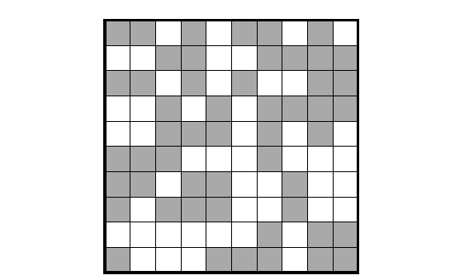
Percolation on a square lattice
Each cell is occupied with probability p
What is the mean cluster size?

Slide 14
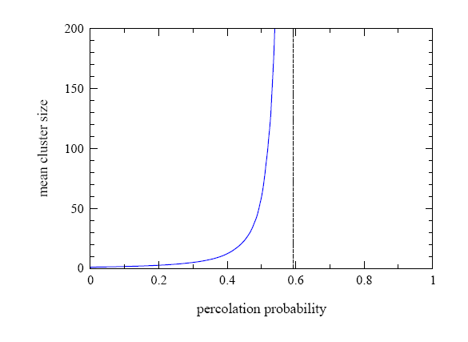
Critical phenomena and power laws
p_{c} = 0.5927462…
For p < p_{c} mean size is independent of the lattice size
For p > p_{c} mean size diverges (proportional to the lattice size - percolation)
For p = p_{c} we obtain a power law distribution on the cluster sizes

Slide 15
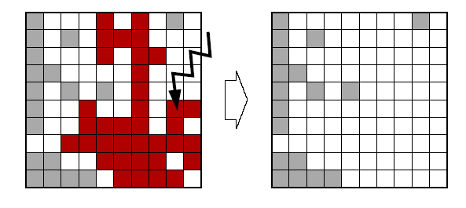
Self Organized Criticality
Consider a dynamical system where trees appear in randomly at a constant rate, and fires strike cells randomly
The system eventually stabilizes at the critical point, resulting in power-law distribution of cluster (and fire) sizes

Slide 16
The idea behind self-organized criticality (more or less)
There are two contradicting processes
  e.g., planting process and fire process
For some choice of parameters the system stabilizes to a state that no process is a clear winner
  results in power-law distributions
The parameters may be tunable so as to improve the chances of the process to survive
  e.g., customer’s buying propensity, and product quality.
Could we apply this idea to graphs?
Notes:
I do not remember where I read about this. Actually as it is right now it does not make a lot of sense to me.

Slide 17
Random graphs and real life
A beautiful and elegant theory studied exhaustively
Random graphs had been used as idealized network models
Unfortunately, they don’t capture reality…

Slide 18
Departing from the ER model
We need models that better capture the characteristics of real graphs
  degree sequences
  clustering coefficient
  short paths

Slide 19
Graphs with given degree sequences
The configuration model
  input: the degree sequence [d₁,d₂,…,d_{n}]
  process:
    Create d_{i} copies of node i
    Take a random matching (pairing) of the copies
      self-loops and multiple edges are allowed
Uniform distribution over the graphs with the given degree sequence

Slide 20
Example
Suppose that the degree sequence is
Create multiple copies of the nodes
Pair the nodes uniformly at random
Generate the resulting network
4
1
3
2

Slide 21
Other properties
The giant component phase transition for this model happens when
The clustering coefficient is given by
The diameter is logarithmic
p_{k}: fraction of nodes with degree k

Slide 22
Power-law graphs
The critical value for the exponent α is
The clustering coefficient is
When α<7/3 the clustering coefficient increases with n

Slide 23
Graphs with given expected degree sequences
Input: the degree sequence [d₁, d₂, … ,d_{n}]
m = total number of edges
Process: generate edge (i,j) with probability d_{i}d_{j}/m
  preserves the expected degrees
  easier to analyze

Slide 24
However…
The problem is that these models are too contrived
It would be more interesting if the network structure emerged as a side product of a stochastic process rather than fixing its properties in advance.

Slide 25
Preferential Attachment in Networks
First considered by [Price 65] as a model for citation networks (directed)
  each new paper is generated with m citations (mean)
  new papers cite previous papers with probability proportional to their indegree (citations)
  what about papers without any citations?
    each paper is considered to have a “default” a citations
    probability of citing a paper with degree k, proportional to k+a
Power law with exponent α = 2+a/m

Slide 26
Practical Issues
The model is equivalent to the following:
  With probability m/(m+a) link to a node with probability proportional to the degree.
  With probability a/(m+a) link to a node selected uniformly at random.
How do we select a node with probability proportional to the degree?
  Select a node and pick on of the nodes it points to.
  In practice:
    Maintain a list with the endpoints of all the edges seen so far, and select a node from this list uniformly at random
    Append the list each time new edges are created.

Slide 27
Barabasi-Albert model
The BA model (undirected graph)
  input: some initial subgraph G₀, and m the number of edges per new node
  the process:
    nodes arrive one at the time
    each node connects to m other nodes selecting them with probability proportional to their degree
    if [d₁,…,d_{t}] is the degree sequence at time t, the node t+1 links to node i with probability
Results in power-law with exponent α = 3

Slide 28
The mathematicians point of view [Bollobas-Riordan]
Self loops and multiple edges are allowed
For the single edge problem:
  At time t, a new vertex v, connects to an existing vertex u with probability
  it creates a self-loop with probability
If m edges, then they are inserted sequentially, as if inserting m nodes
  the problem reduces to studying the single edge problem.
Notes:
From Bollobas paper that we have on the web page of the course. The idea: how to simulate the preferential attachment process on a static graph. Useful for the analysis of the model. Interesting as a construction.

Slide 29
The Linearized Chord Diagram (LCD) model
Consider 2n nodes labeled {1,2,…,2n} placed on a line in order.

Slide 30
Linearized Chord Diagram
Generate a random matching of the nodes.

Slide 31
Linearized Chord Diagram
Starting from left to right identify all endpoints until the first right endpoint. This is node 1. Then identify all endpoints until the second right endpoint to obtain node 2, and so on.

Slide 32
Linearized Chord Diagram
Uniform distribution over matchings gives uniform distribution over all graphs in the preferential attachment model

Slide 33
Linearized Chord Diagram
Create a random matching with 2(n+1) nodes by adding to a matching with 2n nodes a new cord with the right endpoint being in the rightmost position and the left being placed uniformly

Slide 34
Linearized Chord Diagram
A new right endpoint creates a new graph node

Slide 35
Linearized Chord Diagram
The left endpoint may be placed within any of the existing “supernodes”

Slide 36
Linearized Chord Diagram
The number of free positions within a supernode is equal to the number of pairing nodes it contains
This is also equal to the degree

Slide 37
Linearized Chord Diagram
For example, the probability that the black graph node links to the blue node is 4/11
  d_{i} = 4, t = 6, d_{i}/(2t-1) = 4/11

Slide 38
Preferential attachment graphs
Expected diameter
  if m = 1, the diameter is Θ(log n)
  if m > 1, the diameter is Θ(log n/loglog n)
Expected clustering coefficient

Slide 39
Weaknesses of the BA model
Technical issues:
  It is not directed (not good as a model for the Web) and when directed it gives acyclic graphs
  It focuses mainly on the (in-) degree and does not take into account other parameters (out-degree distribution, components, clustering coefficient)
  It correlates age with degree which is not always the case
Academic issues
  the model rediscovers the wheel
  preferential attachment is not the answer to every power-law
  what does “scale-free” mean exactly?
Yet, it was a breakthrough in the network research, that popularized the area

Slide 40
Variations of the BA model
Many variations have been considered some in order to address the problems with the vanilla BA model
  edge rewiring, appearance and disappearance
  fitness parameters
  variable mean degree
  non-linear preferential attachment
    surprisingly, only linear preferential attachment yields power-law graphs

Slide 41
Empirical observations for the Web graph
In a large scale experimental study by
Kumar et al, they observed that the
Web contains a large number of
small bipartite cliques (cores)
  the topical structure of the Web
a K_{3,2} clique
Such subgraphs are highly unlikely in random graphs
They are also unlikely in the BA model
Can we create a model that will have high concentration of small cliques?

Slide 42
Copying model
Input:
  the out-degree d (constant) of each node
  a parameter α
The process:
  Nodes arrive one at the time
  A new node selects uniformly one of the existing nodes as a prototype
  The new node creates d outgoing links. For the i^{th} link
    with probability α it copies the i-th link of the prototype node
    with probability 1- α it selects the target of the link uniformly at random

Slide 43


An example
d = 3

Slide 44
Copying model properties
Power law degree distribution with exponent β = (2-α)/(1- α)
Number of bipartite cliques of size i x d is ne^{-i}
The model has also found applications in biological networks
  copying mechanism in gene mutations

Slide 45
Other graph models
Cooper Frieze model
  multiple parameters that allow for adding vertices, edges, preferential attachment, uniform linking
Directed graphs [Bollobas et al]
  allow for preferential selection of both the source and the destination
  allow for edges from both new and old vertices

Slide 46
Small world Phenomena
So far we focused on obtaining graphs with power-law distributions on the degrees. What about other properties?
  Clustering coefficient: real-life networks tend to have high clustering coefficient
  Short paths: real-life networks are “small worlds”
    this property is easy to generate
  Can we combine these two properties?

Slide 47
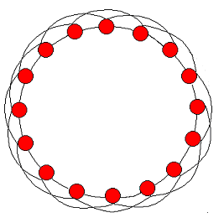
Clustering Coefficient
How can you create a graph with high clustering coefficient?
High clustering coefficient but long paths

Slide 48
Small-world Graphs
According to Watts [W99]
  Large networks (n >> 1)
  Sparse connectivity (avg degree z << n)
  No central node (k_{max} << n)
  Large clustering coefficient (larger than in random graphs of same size)
  Short average paths (~log n, close to those of random graphs of the same size)

Slide 49
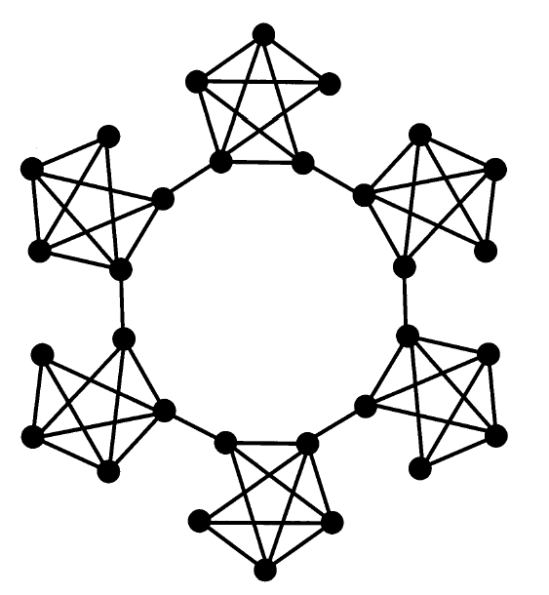
The Caveman Model [W99]
The random graph
  edges are generated completely at random
  low avg. path length L ≤ logn/logz
  low clustering coefficient C ~ z/n
The Caveman model
  edges follow a structure
  high avg. path length L ~ n/z
  high clustering coefficient C ~ 1-O(1/z)
Can we interpolate between the two?
Notes:
From the paper of Watts (by himself)

Slide 50
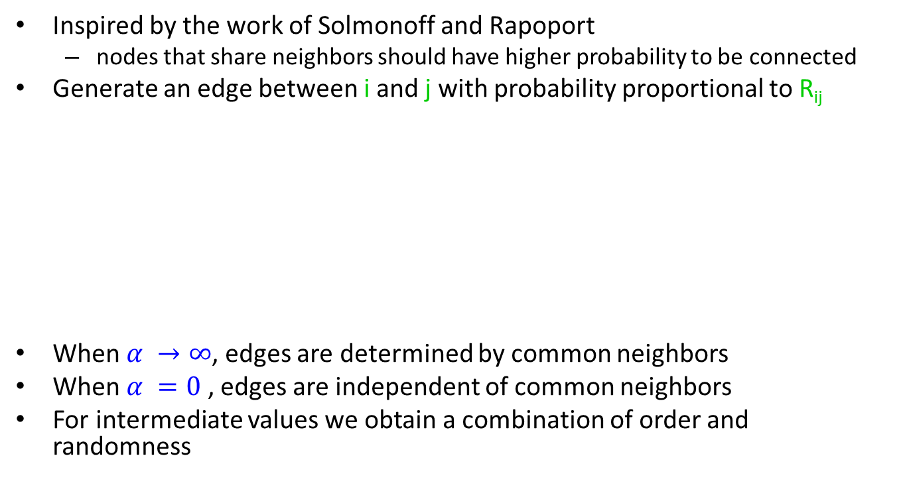
Mixing order with randomness
Inspired by the work of Solmonoff and Rapoport
  nodes that share neighbors should have higher probability to be connected
Generate an edge between i and j with probability proportional to R_{ij}
When $α →∞$, edges are determined by common neighbors
When $α =0$ , edges are independent of common neighbors
For intermediate values we obtain a combination of order and randomness
m_{ij} = number of common
neighbors of i and j
p = very small probability

Slide 51
Algorithm
Start with a ring
For i = 1 … n
  Select a vertex j with probability proportional to R_{ij} and generate an edge (i,j)
Repeat until z edges are added to each vertex

Slide 52
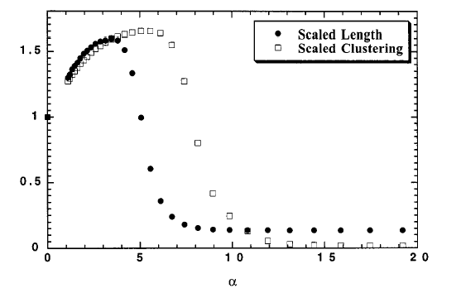
Clustering coefficient – Avg path length
small world graphs

Slide 53
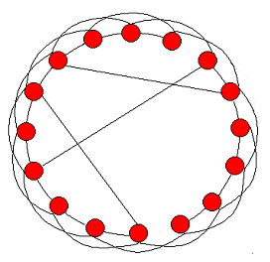
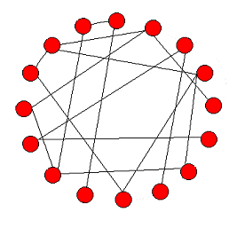
Watts and Strogatz model [WS98]
Start with a ring, where every node is connected to the next z nodes
With probability p, rewire every edge (or, add a shortcut) to a uniformly chosen destination.
  Granovetter, “The strength of weak ties”
order
randomness
p = 0
0 < p < 1
p = 1
Notes:
From the paper of Watts and Strogatz

Slide 54
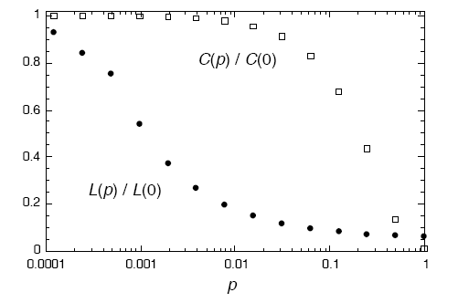
Clustering Coefficient – Characteristic Path Length
log-scale in p
When p = 0, C = 3(k-2)/4(k-1) ~ ¾
L = n/k
For small p, C ~ ¾
L ~ logn

Slide 55
Graph Theory Results
Graph theorist failed to be impressed. Most of these results were known.

Slide 56

Optimized graphs
Suppose you are building an airline network, how would you set up the routes?
Optimization criteria
  Minimize the cost of routes
  Minimize the travel time of passengers
    Distance travelled
    Number of hops
  Take city populations into account.
Use $δ$to control the tradeoff between the two

Slide 57
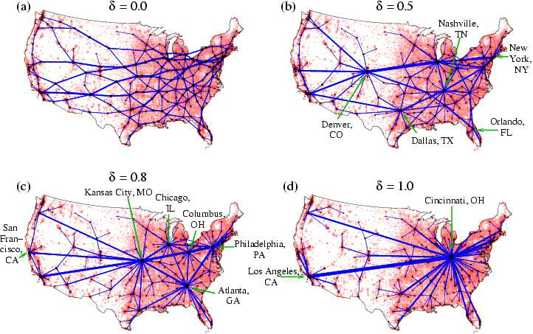
Experiment with US flights

Slide 58
Evolution of graphs
So far we looked at the properties of graph snapshots. What if we have the history of a graph?
  e.g., citation networks, internet graphs

Slide 59
Measuring preferential attachment
Is it the case that the rich get richer?
Look at the network for an interval [t,t+dt]
For node i, present at time t, we compute
  dk_{i} = increase in the degree
  dk = number of edges added
Fraction of edges added to nodes of degree k
Cumulative: fraction of edges added to nodes of degree at most k

Slide 60
Measuring preferential attachment
Linear preferential attachment
We plot F(k) as a function of k. If preferential attachment exists we expect that F(k) ~ k^{b}
  actually, it has to be b ~ 1
No preferential attachment
citation network
Internet
scientific collaboration network
actor collaboration network

Slide 61
Network models and temporal evolution
For most of the existing models it is assumed that
  number of edges grows linearly with the number of nodes
  the diameter grows at rate logn, or loglogn
What about real graphs?
  Leskovec, Kleinberg, Faloutsos 2005

Slide 62

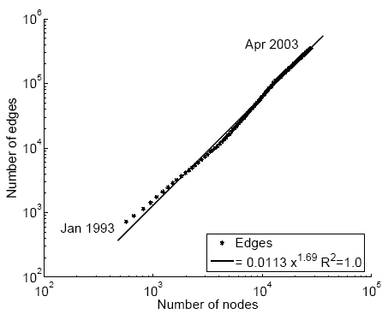
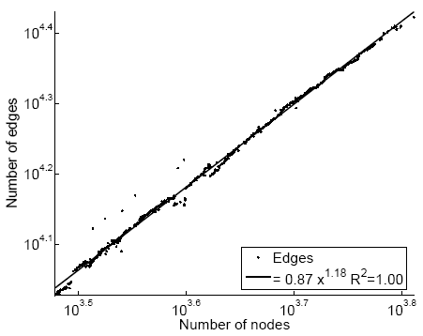
Densification laws
In real-life networks the average degree increases! – networks become denser!
α = densification exponent
E(t)
E(t)
1.69
1.18
scientific
citation network
Internet
N(t)
N(t)
Notes:
From Leskovek, Kleinberg, Faloutsos the remaining

Slide 63
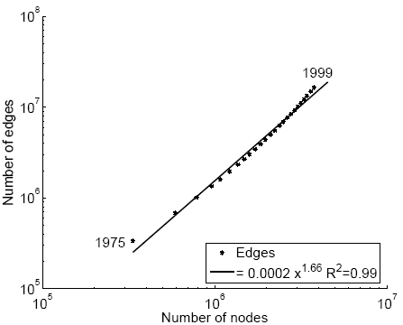
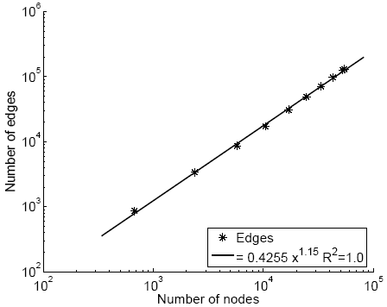
More examples
The densification exponent 1≤α≤2
  α = 1: linear growth – constant out degree
  α = 2: quadratic growth - clique
E(t)
patent citation network
movies affiliation network
E(t)
1.66
1.15
N(t)
N(t)

Slide 64
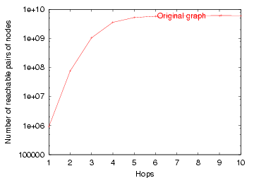
What about diameter?
Effective diameter: the interpolated value where 90% of node pairs are reachable
# reachable pairs
Effective Diameter
hops

Slide 65
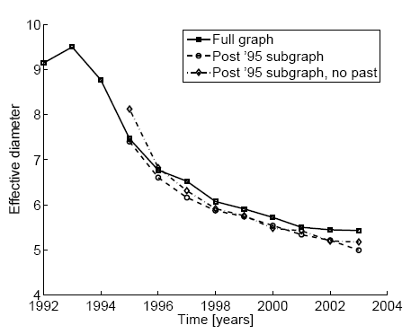
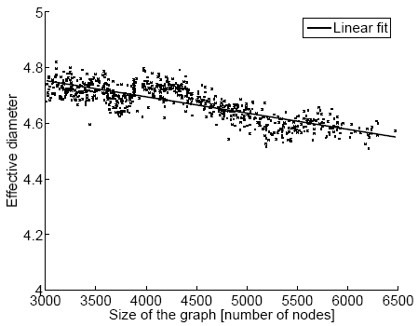
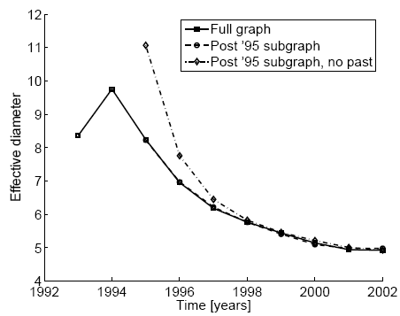
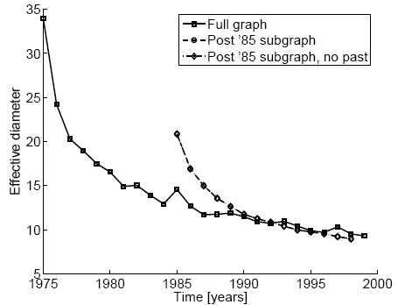
Diameter shrinks
scientific
citation network
Internet
affiliation network
patent citation network

Slide 66
Densification – Possible Explanation
Existing graph generation models do not capture the Densification Power Law and Shrinking diameters
Can we find a simple model of local behavior, which naturally leads to observed phenomena?
Two proposed models
  Community Guided Attachment – obeys Densification
  Forest Fire model – obeys Densification, Shrinking diameter (and Power Law degree distribution)

Slide 67
Community structure
Let’s assume the community structure
One expects many within-group friendships and fewer cross-group ones
How hard is it to cross communities?
University
Science
Arts
CS
Math
Drama
Music
Self-similar university
community structure
Notes:
Animation: first faces, then comminities, then edges

Slide 68

Fundamental Assumption
If the cross-community linking probability of nodes at tree-distance h is scale-free
We propose cross-community linking probability:
where: c ≥ 1 … the Difficulty constant
h … tree-distance
Notes:
Animation with communities: f(1), f(2), … f(h)

Slide 69

Densification Power Law
Theorem: The Community Guided Attachment leads to Densification Power Law with exponent
α … densification exponent
b … community structure branching factor
c … difficulty constant
Notes:
Animation for a,b,c

Slide 70
Difficulty Constant
Theorem:
Gives any non-integer Densification exponent
If c = 1: easy to cross communities
  Then: α = 2, quadratic growth of edges – near clique
If c = b: hard to cross communities
  Then: α = 1, linear growth of edges – constant out-degree

Slide 71
Room for Improvement
Community Guided Attachment explains Densification Power Law
Issues:
  Requires explicit Community structure
  Does not obey Shrinking Diameters
The ”Forrest Fire” model

Slide 72
“Forest Fire” model – Wish List
We want:
  no explicit Community structure
  Shrinking diameters
  and:
    “Rich get richer” attachment process, to get heavy-tailed in-degrees
    “Copying” model, to lead to communities
    Community Guided Attachment, to produce Densification Power Law
Notes:
Animation with people connected
New person
Add hierarchy
Connect
Remove hierarchy

Slide 73
“Forest Fire” model – Intuition
How do authors identify references?
  Find first paper and cite it
  Follow a few citations, make citations
  Continue recursively
  From time to time use bibliographic tools (e.g. CiteSeer) and chase back-links

Slide 74
“Forest Fire” model – Intuition
How do people make friends in a new environment?
  Find first a person and make friends
  From time to time get introduced to his friends
  Continue recursively
Forest Fire model imitates exactly this process

Slide 75
“Forest Fire” – the Model
A node arrives
Randomly chooses an “ambassador”
Starts burning nodes (with probability p) and adds links to burned nodes
“Fire” spreads recursively
Notes:
End the red line

Slide 76
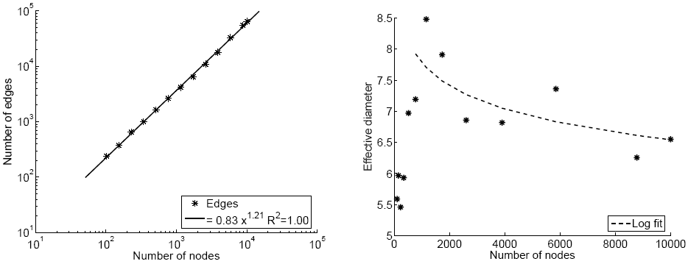
Forest Fire in Action (1)
Forest Fire generates graphs that Densify and have Shrinking Diameter
E(t)
densification
diameter
1.21
diameter
N(t)
N(t)

Slide 77
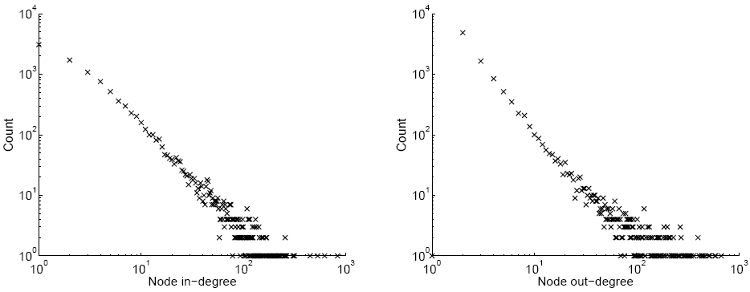
Forest Fire in Action (2)
Forest Fire also generates graphs with heavy-tailed degree distribution
in-degree
out-degree
count vs. in-degree
count vs. out-degree
Notes:
Label the axis

Slide 78
Forest Fire model – Justification
Densification Power Law:
  Similar to Community Guided Attachment
  The probability of linking decays exponentially with the distance – Densification Power Law
Power law out-degrees:
  From time to time we get large fires
Power law in-degrees:
  The fire is more likely to reach hubs

Slide 79
Forest Fire model – Justification
Communities:
  Newcomer copies neighbors’ links
Shrinking diameter

Slide 80
Acknowledgements
Many thanks to Jure Leskovec for his slides from the KDD 2005 paper.

Slide 81
References
M. E. J. Newman, The structure and function of complex networks, SIAM Reviews, 45(2): 167-256, 2003
R. Albert and L.A. Barabasi, Statistical Mechanics of Complex Networks, Rev. Mod. Phys. 74, 47-97 (2002).
B. Bollobas, Mathematical Results in Scale-Free random Graphs
D.J. Watts. Networks, Dynamics and Small-World Phenomenon, American Journal of Sociology, Vol. 105, Number 2, 493-527, 1999
Watts, D. J. and S. H. Strogatz. Collective dynamics of 'small-world' networks. Nature 393:440-42, 1998
Michael T. Gastner and M. E. J. Newman, Optimal design of spatial distribution networks, Phys. Rev. E 74, 016117 (2006).J.
Leskovec, J. Kleinberg, C. Faloutsos. Graphs over Time: Densification Laws, Shrinking Diameters and Possible Explanations. Proc. 11th ACM SIGKDD Intl. Conf. on Knowledge Discovery and Data Mining, 2005.

Slide 82
Assignment
In teams of 2
Pick a scale free or a small world model
  Scale free: Preferential Attachment, Copying model
  Small world: Caveman model, ring rewiring
Create different networks for different parameters
Use Gephi to visualize the graphs, plot degree distributions, and compute clustering coefficient

